Slide 1
CMSC 28100 Introduction to Complexity Theory Winter 2024 Instructor: William Hoza
7 |  |  |  |  |  |  | 5 | 3
 |  |  |  |  |  |  |  | 4
 | 4 | 8 |  | 3 |  | 1 | 2
8 |  | 1 | 3 |  |  | 2 | 7 | 5
 | 9 |  | 1 |  |  |  | 4
 | 5 |  |  |  |  | 3
2 |  | 5 |  | 8 | 4
1 | 3 | 4 |  | 5

Slide 2
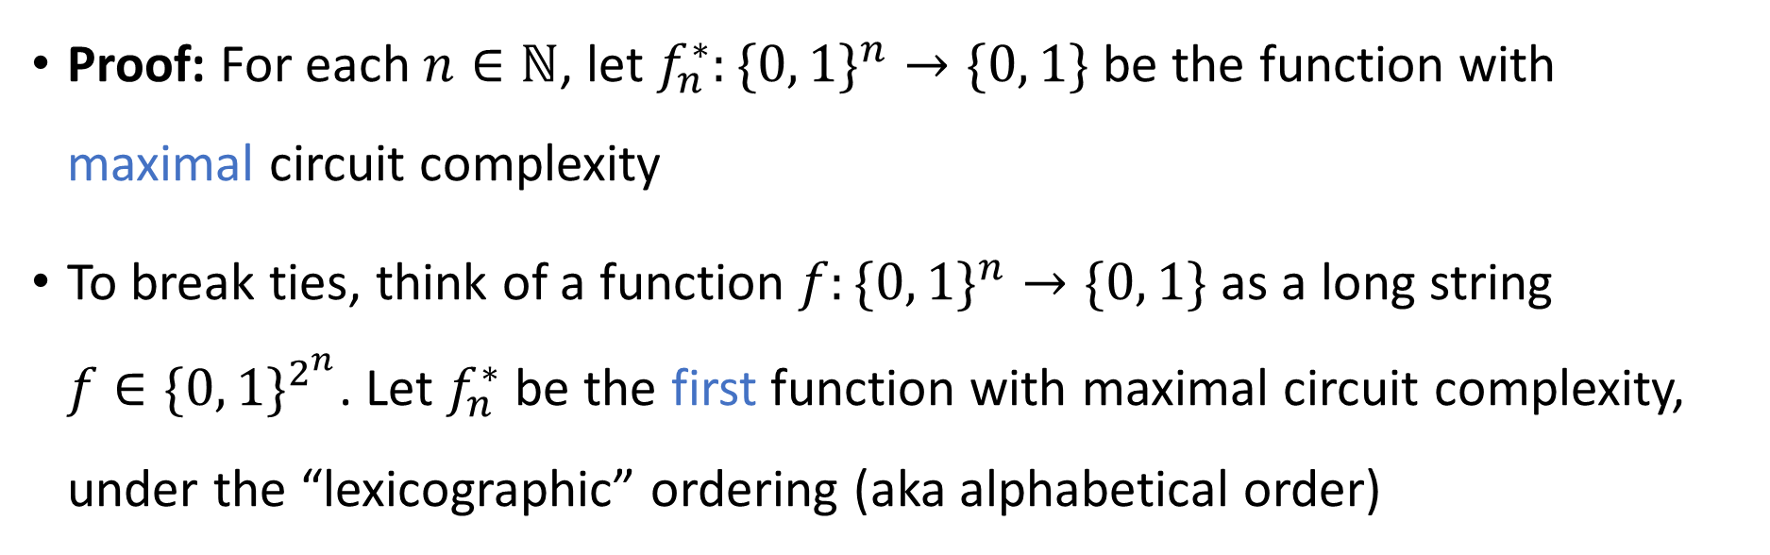
Decidable but not tractable
Theorem: There exists a decidable language $L$ such that $L∉\text{P}$.
Proof: For each $n∈ℕ$, let $f_{n}^{∗}:\{0, 1\}^{n}→\{0, 1\}$ be the function with maximal circuit complexity
To break ties, think of a function $f:\{0, 1\}^{n}→\{0, 1\}$ as a long string $f∈\{0, 1\}^{2^{n}}$. Let $f_{n}^{∗}$ be the first function with maximal circuit complexity, under the “lexicographic” ordering (aka alphabetical order)

Slide 3
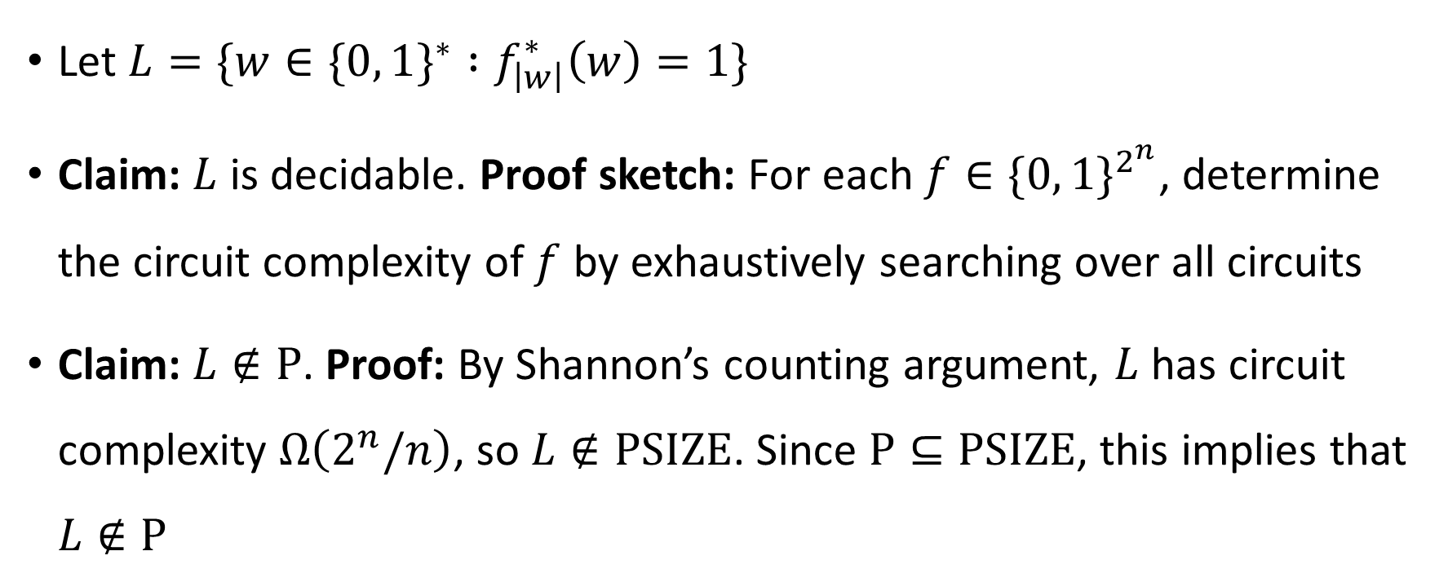
Decidable but not tractable
Let $L=\{w∈\{0, 1\}^{∗} :f_{\left|w\right|}^{∗}\left(w\right)=1\}$
Claim: $L$ is decidable. Proof sketch: For each $f∈\{0, 1\}^{2^{n}}$, determine the circuit complexity of $f$ by exhaustively searching over all circuits
Claim: $L∉\text{P}$. Proof: By Shannon’s counting argument, $L$ has circuit complexity $Ω\left(2^{n}/n\right)$, so $L∉\text{PSIZE}$. Since $\text{P}⊆\text{PSIZE}$, this implies that $L∉\text{P}$

Slide 4





Intractability vs. undecidability
All languages
$$\text{HALT}$$
$$\{\left\langle M\right\rangle :M \text{halts} \text{on} \left\langle M\right\rangle \text{within} 2^{\left|\left\langle M\right\rangle \right|} \text{steps}\}$$
Decidable languages
$$\{w :f_{\left|w\right|}^{∗}\left(w\right)=1\}$$
$$\text{P}$$
$$\text{LIS}$$

Slide 5

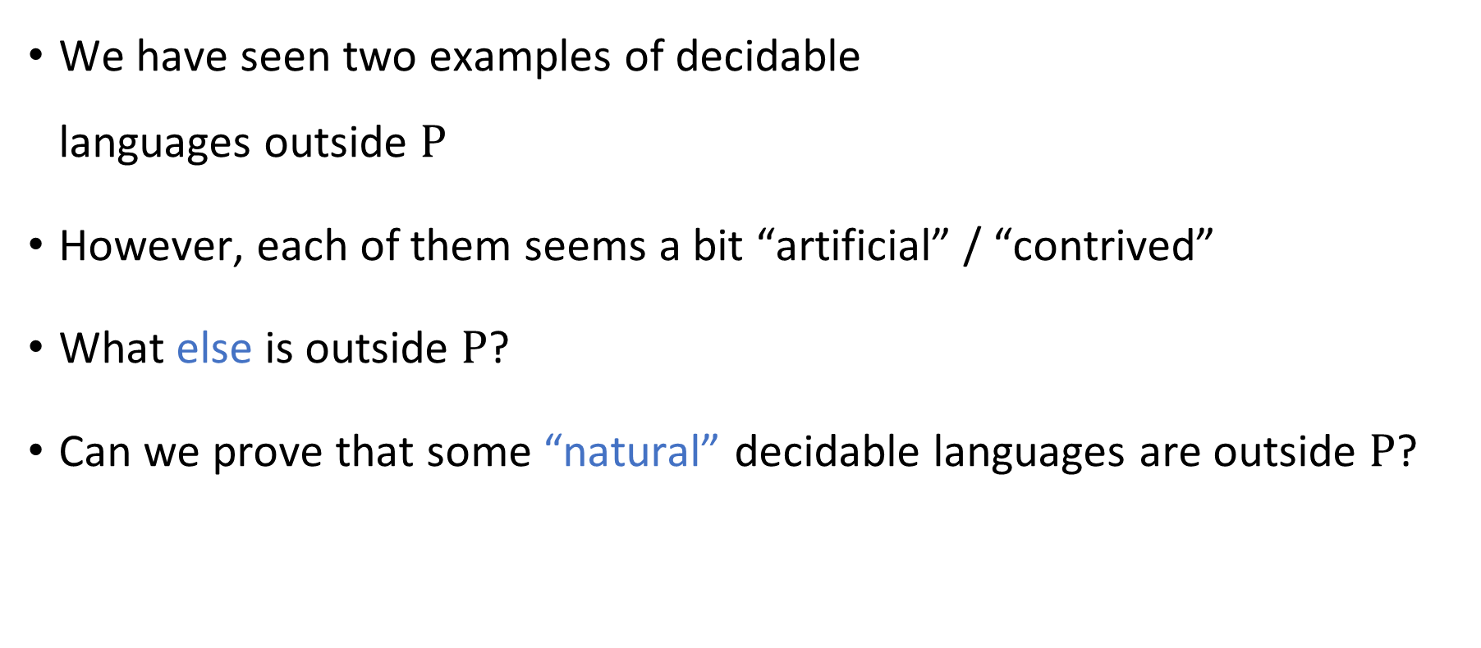

“Natural” languages outside $\text{P}$
We have seen two examples of decidable languages outside $\text{P}$
However, each of them seems a bit “artificial” / “contrived”
What else is outside $\text{P}$?
Can we prove that some “natural” decidable languages are outside $\text{P}$?

Slide 6
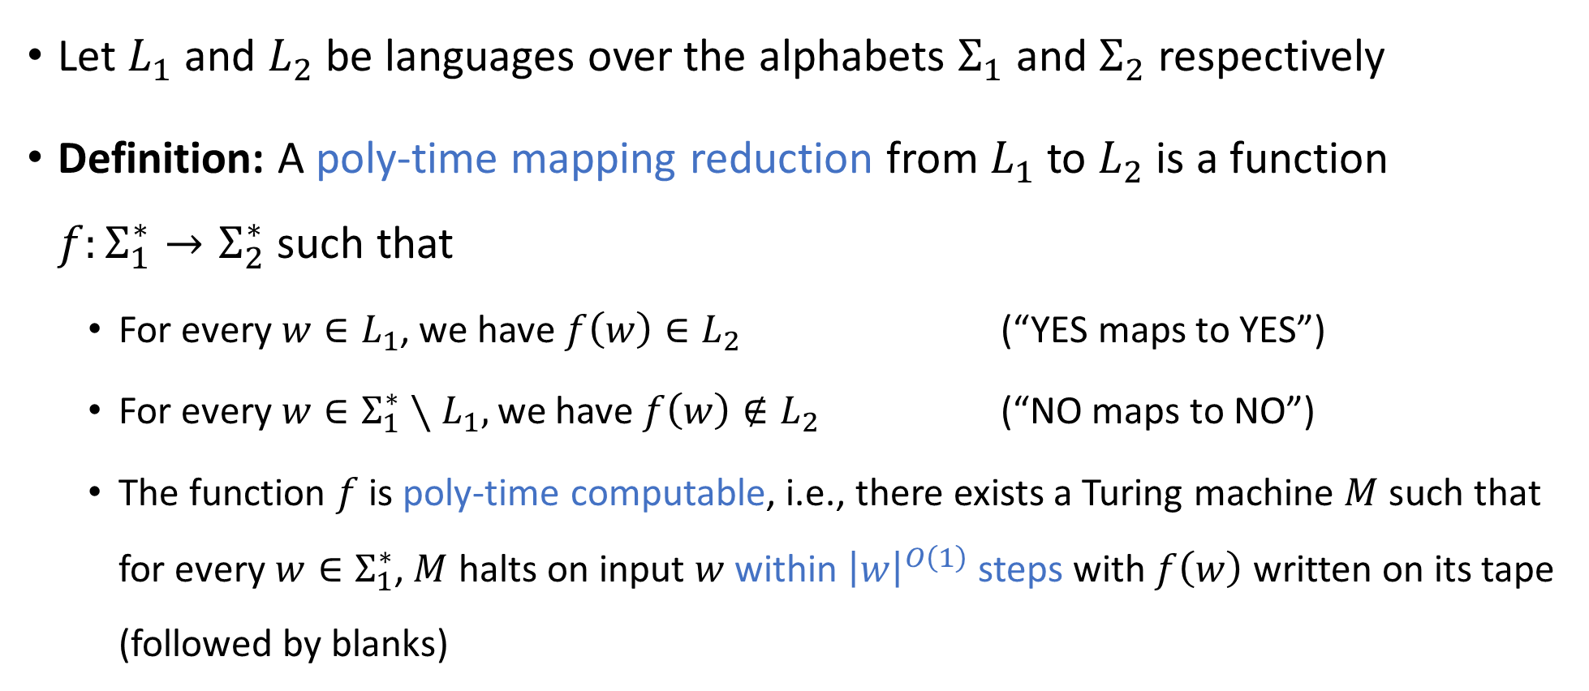
Polynomial-time reductions
Let $L_{1}$ and $L_{2}$ be languages over the alphabets $Σ_{1}$ and $Σ_{2}$ respectively
Definition: A poly-time mapping reduction from $L_{1}$ to $L_{2}$ is a function $f:Σ_{1}^{∗}→Σ_{2}^{∗}$ such that
For every $w∈L_{1}$, we have $f\left(w\right)∈L_{2}$ (“YES maps to YES”)
For every $w∈Σ_{1}^{∗}∖L_{1},$ we have $f\left(w\right)∉L_{2}$ (“NO maps to NO”)
The function $f$ is poly-time computable, i.e., there exists a Turing machine $M$ such that for every $w∈Σ_{1}^{∗}$, $M$ halts on input $w$ within ${\left|w\right|}^{O\left(1\right)}$ steps with $f\left(w\right)$ written on its tape (followed by blanks)

Slide 7

Polynomial-time reductions
A poly-time mapping reduction from $L_{1}$ to $L_{2}$ is a way of efficiently converting instances of $L_{1}$ into equivalent instances of $L_{2}$
$$L_{2}$$
$$L_{1}$$
$$Σ_{1}^{∗}$$
$$Σ_{2}^{∗}$$

Slide 8
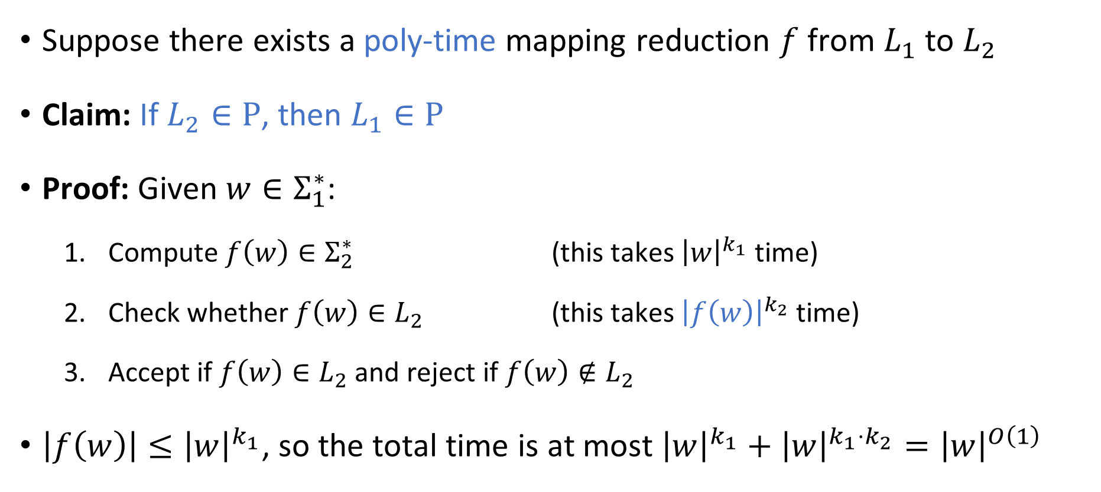

Reductions: Proving that a language is in $\text{P}$
Suppose there exists a poly-time mapping reduction $f$ from $L_{1}$ to $L_{2}$
Claim: If $L_{2}∈\text{P}$, then $L_{1}∈\text{P}$
Proof: Given $w∈Σ_{1}^{∗}$:
Compute $f\left(w\right)∈Σ_{2}^{∗}$ (this takes ${\left|w\right|}^{k_{1}}$ time)
Check whether $f\left(w\right)∈L_{2}$ (this takes ${\left|f\left(w\right)\right|}^{k_{2}}$ time)
Accept if $f\left(w\right)∈L_{2}$ and reject if $f\left(w\right)∉L_{2}$
$\left|f\left(w\right)\right|≤{\left|w\right|}^{k_{1}}$, so the total time is at most ${\left|w\right|}^{k_{1}}+{\left|w\right|}^{k_{1}⋅k_{2}}={\left|w\right|}^{O\left(1\right)}$

Slide 9


Reductions: Proving that a language is not in $\text{P}$
Suppose there exists a poly-time mapping reduction $f$ from $L_{1}$ to $L_{2}$
Claim: If $L_{1}∉\text{P}$, then $L_{2}∉\text{P}$
Proof: This is the contrapositive of the previous claim

Slide 10
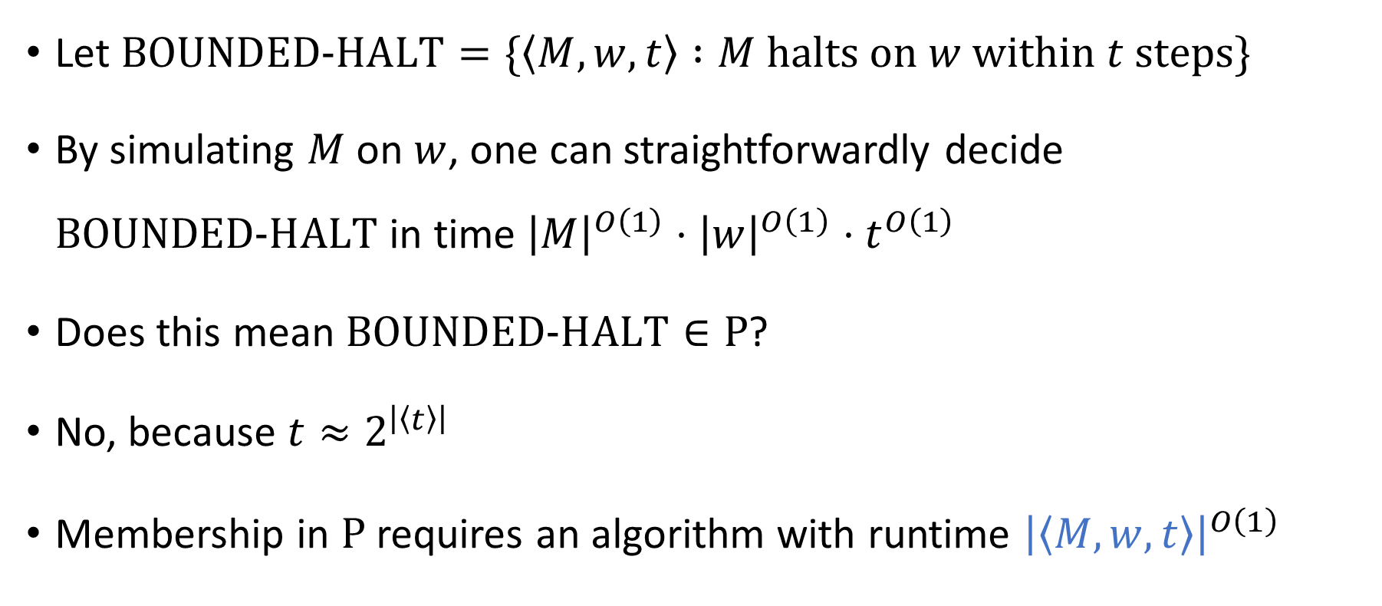
Time-bounded halting problem
Let $\text{BOUNDED}\text{‑}\text{HALT}=\{\left\langle M, w, t\right\rangle :M \text{halts} \text{on} w \text{within} t \text{steps}\}$
By simulating $M$ on $w$, one can straightforwardly decide $\text{BOUNDED}\text{‑}\text{HALT}$ in time ${\left|M\right|}^{O\left(1\right)}⋅{\left|w\right|}^{O\left(1\right)}⋅t^{O\left(1\right)}$
Does this mean $\text{BOUNDED}\text{‑}\text{HALT}∈\text{P}$?
No, because $t≈2^{\left|\left\langle t\right\rangle \right|}$
Membership in $\text{P}$ requires an algorithm with runtime ${\left|\left\langle M,w,t\right\rangle \right|}^{O\left(1\right)}$

Slide 11
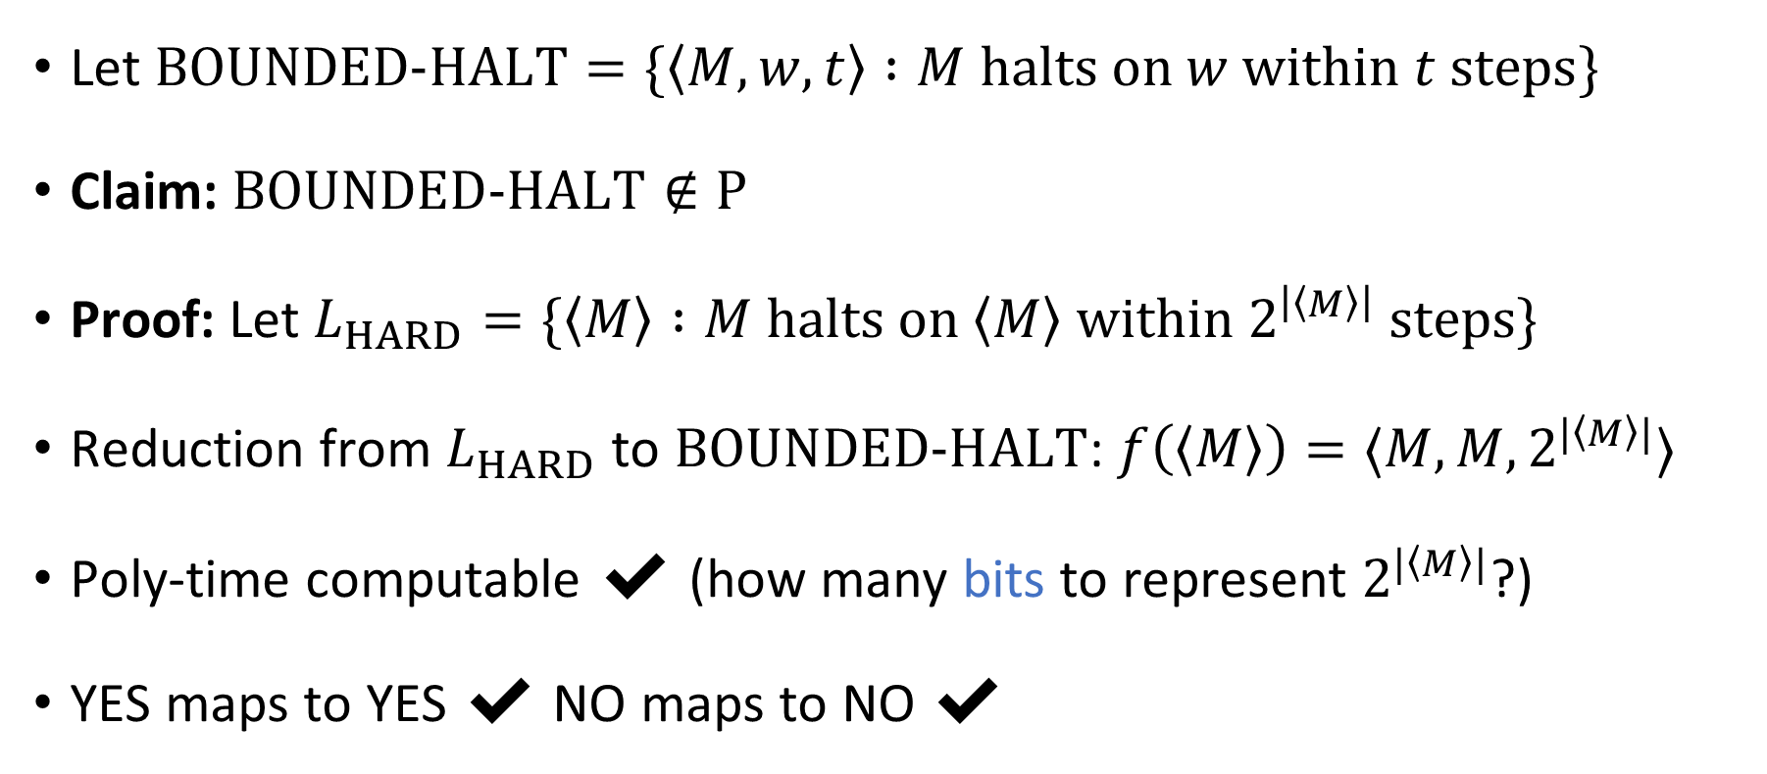
Time-bounded halting problem
Let $\text{BOUNDED}\text{‑}\text{HALT}=\{\left\langle M, w, t\right\rangle :M \text{halts} \text{on} w \text{within} t \text{steps}\}$
Claim: $\text{BOUNDED}\text{‑}\text{HALT}∉\text{P}$
Proof: Let $L_{HARD}=\{\left\langle M\right\rangle :M \text{halts} \text{on} \left\langle M\right\rangle \text{within} 2^{\left|\left\langle M\right\rangle \right|} \text{steps}\}$
Reduction from $L_{HARD}$ to $\text{BOUNDED}\text{‑}\text{HALT}$: $f\left(\left\langle M\right\rangle \right)=⟨M,M,2^{|\left\langle M\right\rangle |}⟩$
Poly-time computable ✔️ (how many bits to represent $2^{|\left\langle M\right\rangle |}$?)
YES maps to YES ✔️ NO maps to NO ✔️

Slide 12

How hard is hard?
We can actually say more than just “$\text{BOUNDED}\text{‑}\text{HALT}∉\text{P}$”
We can more precisely characterize the complexity of $\text{BOUNDED}\text{‑}\text{HALT}$

Slide 13
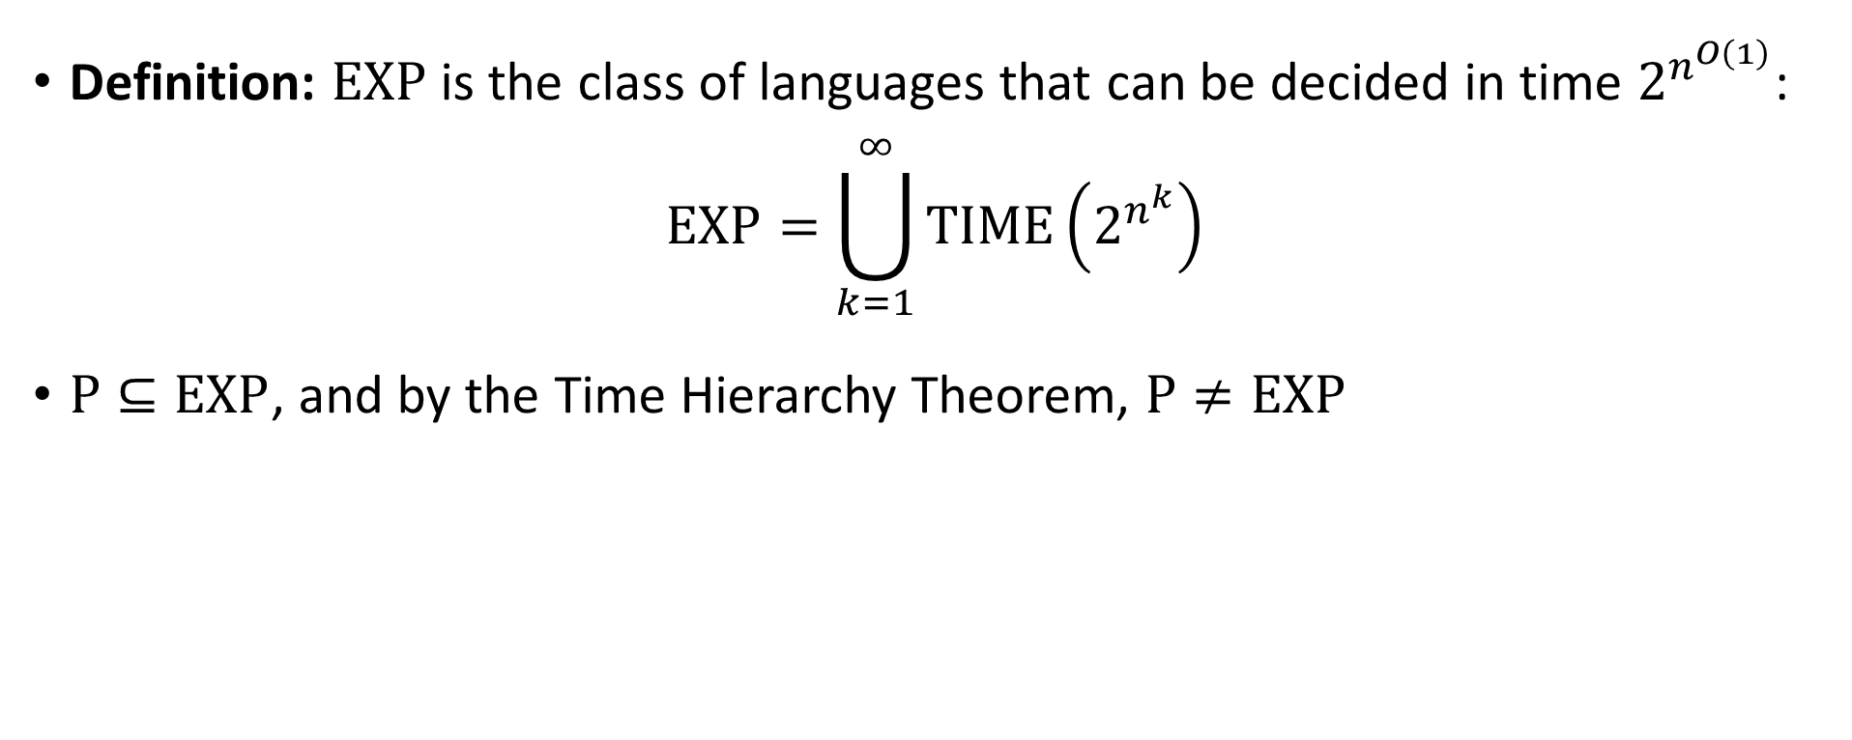

The class $\text{EXP}$
Definition: $\text{EXP}$ is the class of languages that can be decided in time $2^{n^{O\left(1\right)}}$:
$$\text{EXP}=\bigcup_{k=1}^{∞}{\text{TIME}\left(2^{n^{k}}\right)}$$
$\text{P}⊆\text{EXP}$, and by the Time Hierarchy Theorem, $\text{P}≠\text{EXP}$

Slide 14


The class $\text{EXP}$
All languages
Decidable languages
$$\text{EXP}$$
$$\text{P}$$

Slide 15
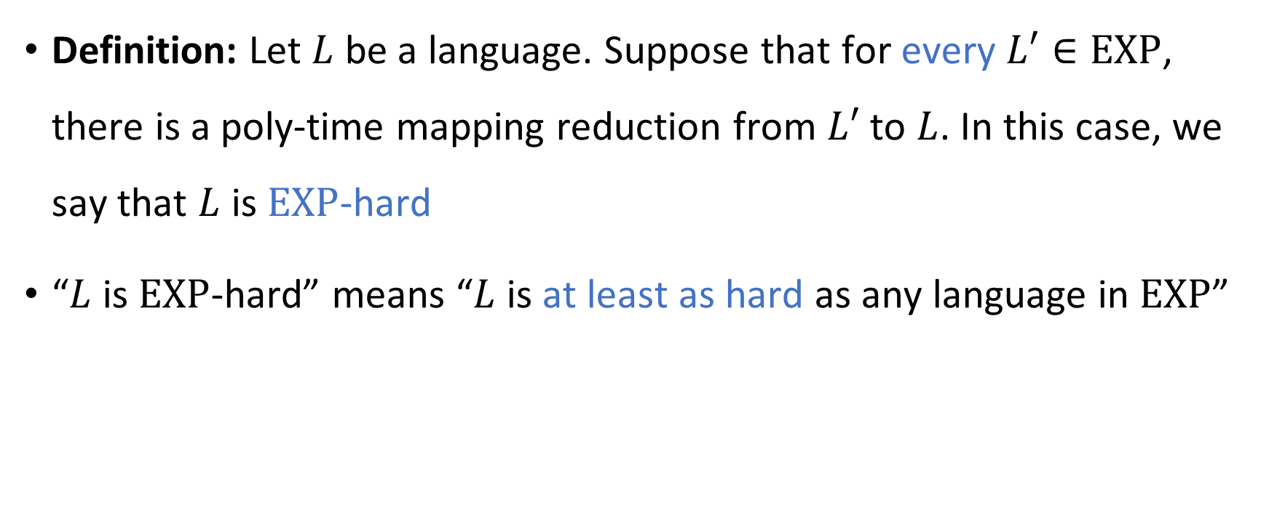
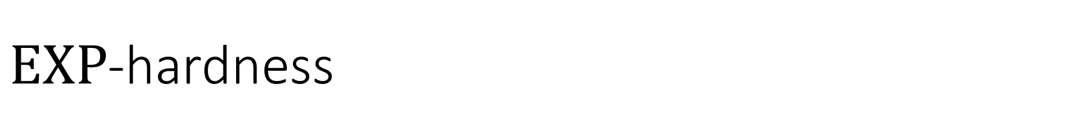
$\text{EXP}$-hardness
Definition: Let $L$ be a language. Suppose that for every $L′∈\text{EXP}$, there is a poly-time mapping reduction from $L′$ to $L$. In this case, we say that $L$ is $\text{EXP}$-hard
“$L$ is $\text{EXP}$-hard” means “$L$ is at least as hard as any language in $\text{EXP}$”

Slide 16
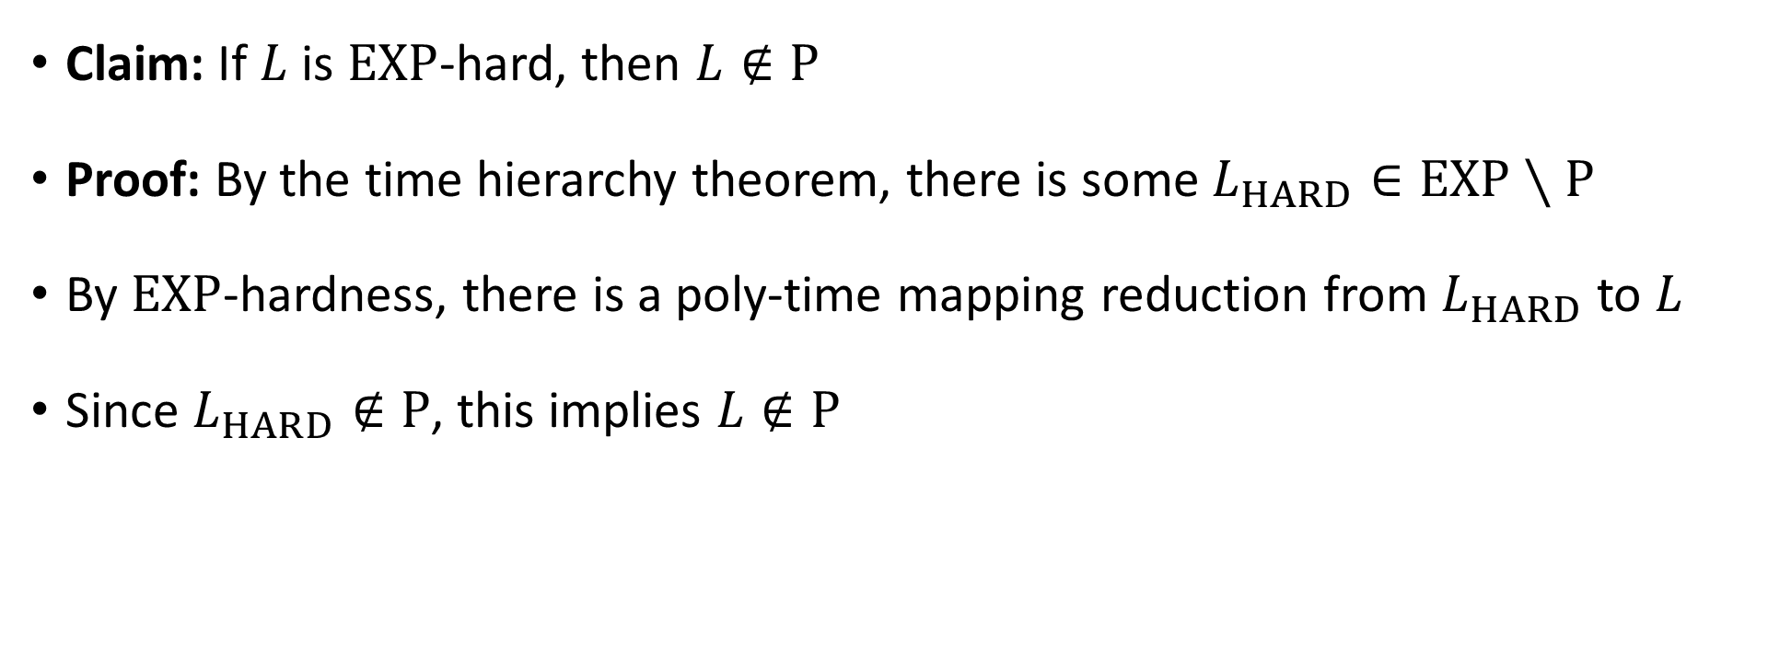
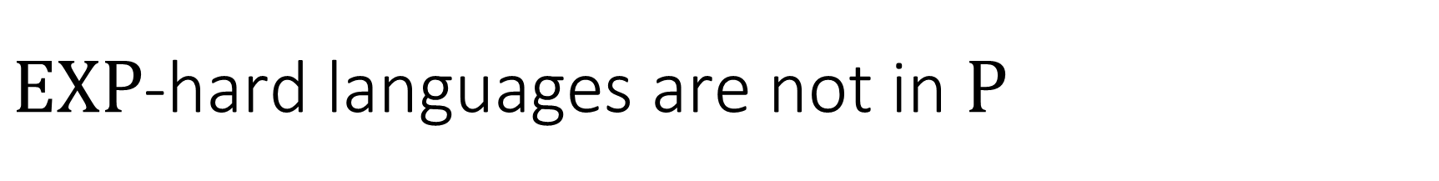
$\text{EXP}$-hard languages are not in $\text{P}$
Claim: If $L$ is $\text{EXP}$-hard, then $L∉\text{P}$
Proof: By the time hierarchy theorem, there is some $L_{HARD}∈\text{EXP}∖\text{P}$
By $\text{EXP}$-hardness, there is a poly-time mapping reduction from $L_{HARD}$ to $L$
Since $L_{HARD}∉\text{P}$, this implies $L∉\text{P}$

Slide 17
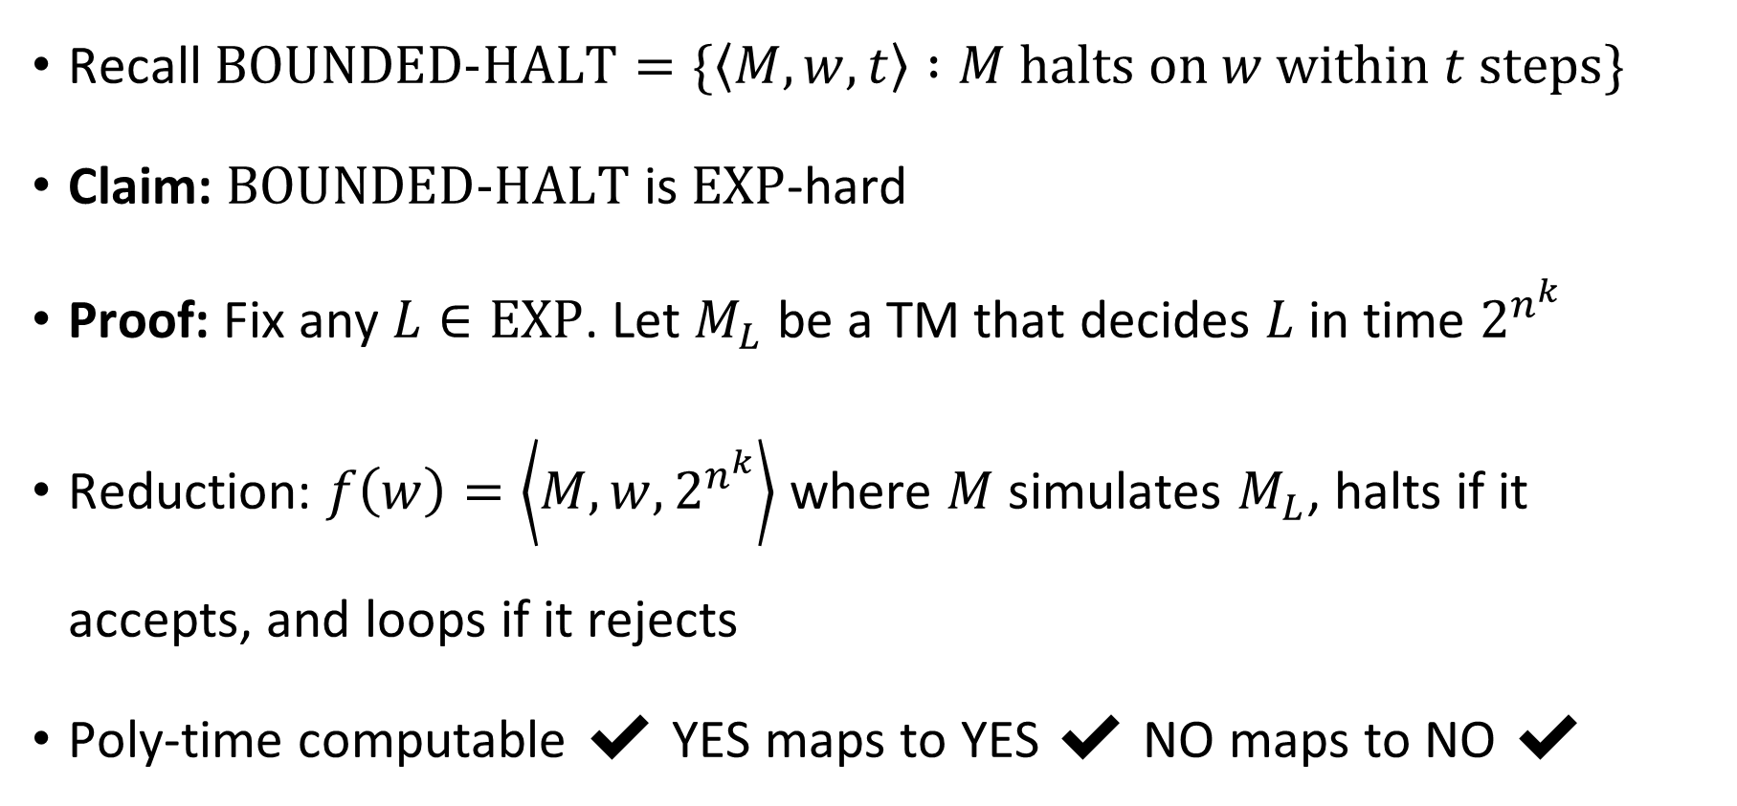

$\text{BOUNDED}\text{‑}\text{HALT}$ is $\text{EXP}$-hard
Recall $\text{BOUNDED}\text{‑}\text{HALT}=\{\left\langle M,w,t\right\rangle :M \text{halts} \text{on} w \text{within} t \text{steps}\}$
Claim: $\text{BOUNDED}\text{‑}\text{HALT}$ is $\text{EXP}$-hard
Proof: Fix any $L∈\text{EXP}$. Let $M_{L}$ be a TM that decides $L$ in time $2^{n^{k}}$
Reduction: $f\left(w\right)=\left\langle M,w,2^{n^{k}}\right\rangle$ where $M$ simulates $M_{L}$, halts if it accepts, and loops if it rejects
Poly-time computable ✔️ YES maps to YES ✔️ NO maps to NO ✔️

