Slide 1
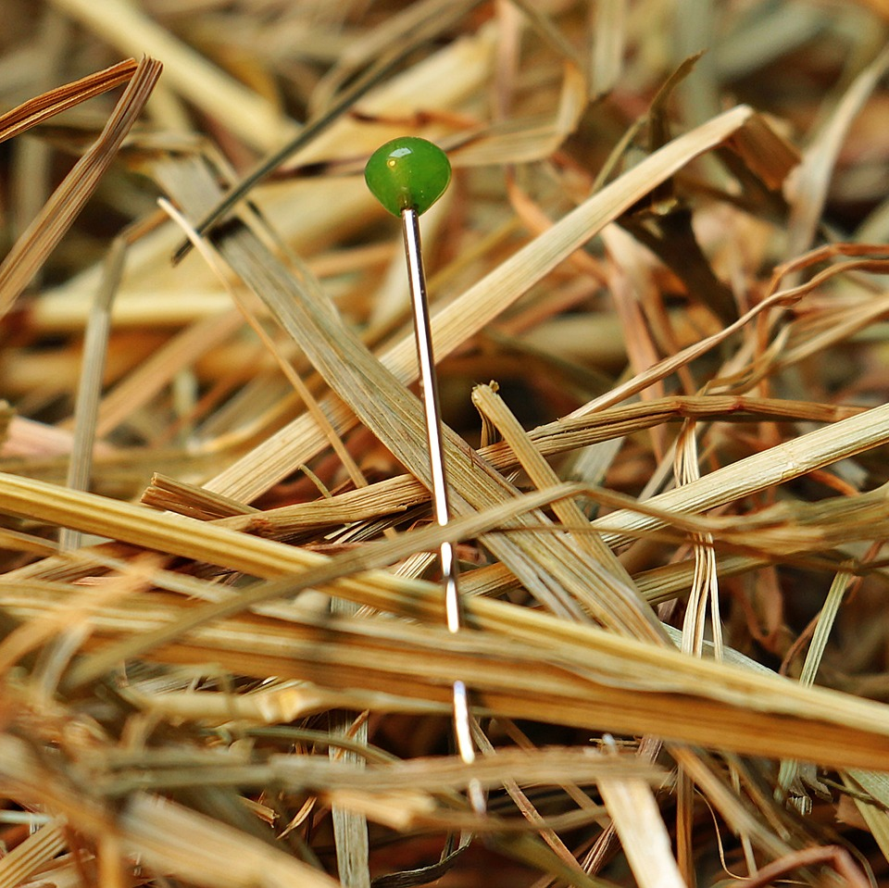
CMSC 28100 Introduction to Complexity Theory Spring 2024 Instructor: William Hoza

Slide 2
Midterm exam
Midterm exam will be in class on Wednesday, April 17
To prepare for the midterm, you only need to study the material up to this point
The midterm will be about decidability and undecidability

Slide 3
Which problems can be solved through computation?

Slide 4
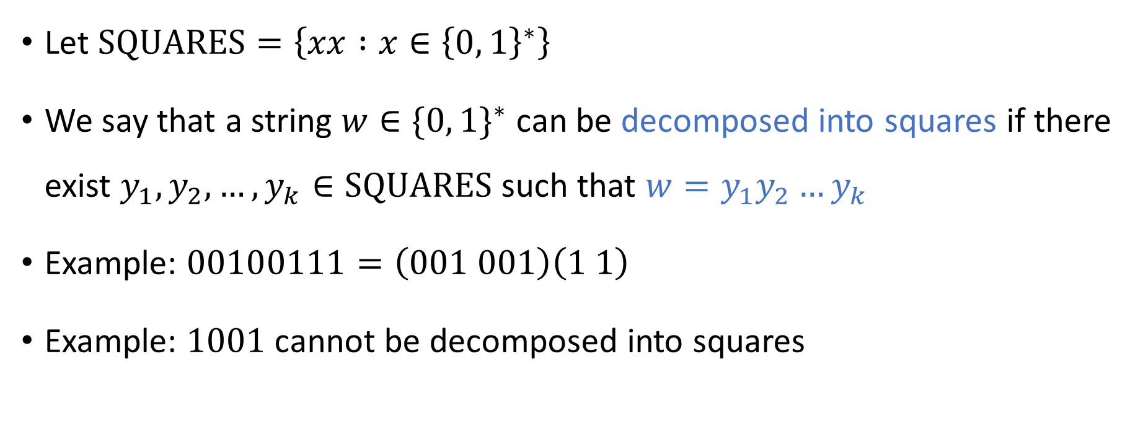
Decompositions into squares
Let $\text{SQUARES}=\left\{xx :x∈{\left\{0, 1\right\}}^{∗}\right\}$
We say that a string $w∈\{0, 1\}^{∗}$ can be decomposed into squares if there exist $y_{1},y_{2},…, y_{k}∈\text{SQUARES}$ such that $w=y_{1}y_{2}…y_{k}$
Example: $00100111=\left(001 001\right)\left(1 1\right)$
Example: $1001$ cannot be decomposed into squares

Slide 5

Decompositions into squares
Let $\text{DECOMPOSABLE}\text{‑}\text{INTO}\text{‑}\text{SQUARES}=\left\{w∈{\left\{0, 1\right\}}^{∗} :w \text{can} \text{be} \text{decomposed} \text{into} \text{squares}\right\}$
Is $\text{DECOMPOSABLE}\text{‑}\text{INTO}\text{‑}\text{SQUARES}$ decidable?
A: Yes
B: No
C: It depends on the encoding
D: It’s not a language, so the question doesn’t make sense
Respond at PollEv.com/whoza or text “whoza” to 22333

Slide 6
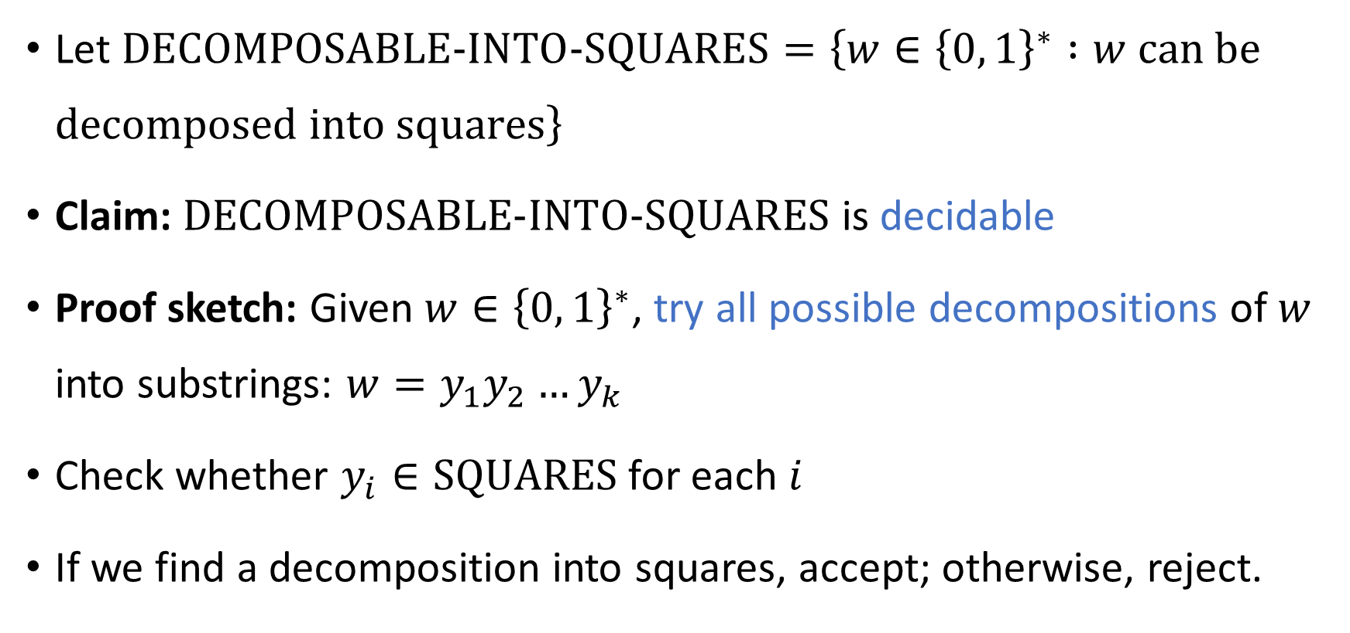
Decompositions into squares
Let $\text{DECOMPOSABLE}\text{‑}\text{INTO}\text{‑}\text{SQUARES}=\left\{w∈{\left\{0, 1\right\}}^{∗} :w \text{can} \text{be} \text{decomposed} \text{into} \text{squares}\right\}$
Claim: $\text{DECOMPOSABLE}\text{‑}\text{INTO}\text{‑}\text{SQUARES}$ is decidable
Proof sketch: Given $w∈{\left\{0, 1\right\}}^{∗}$, try all possible decompositions of $w$ into substrings: $w=y_{1}y_{2}…y_{k}$
Check whether $y_{i}∈\text{SQUARES}$ for each $i$
If we find a decomposition into squares, accept; otherwise, reject.

Slide 7

Decompositions into squares
$\text{DECOMPOSABLE}\text{‑}\text{INTO}\text{‑}\text{SQUARES}$ is decidable
So… Can we actually decide it?

Slide 8
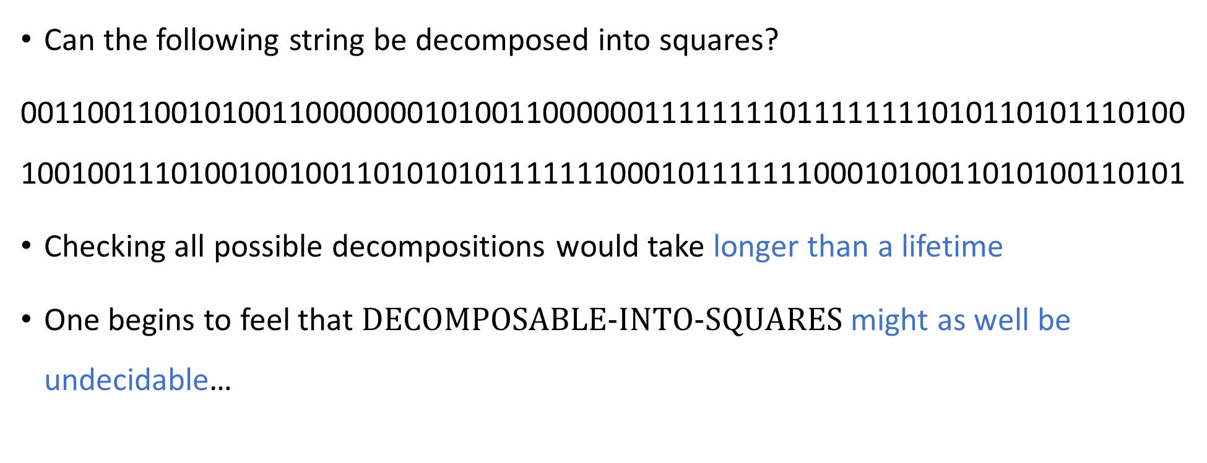
Our algorithm is so slow that it’s worthless
Can the following string be decomposed into squares?
001100110010100110000000101001100000011111111011111111010110101110100100100111010010010011010101011111110001011111110001010011010100110101
Checking all possible decompositions would take longer than a lifetime
One begins to feel that $\text{DECOMPOSABLE}\text{‑}\text{INTO}\text{‑}\text{SQUARES}$ might as well be undecidable…

Slide 9
Which problems can be solved through computation?

Slide 10

Refining our model
The mathematical model we have studied so far: Decidable vs. undecidable
Now we will refine our model to take into account the fact that in real life, we only have a limited amount of time (and other resources)
“Complexity theory”

Slide 11

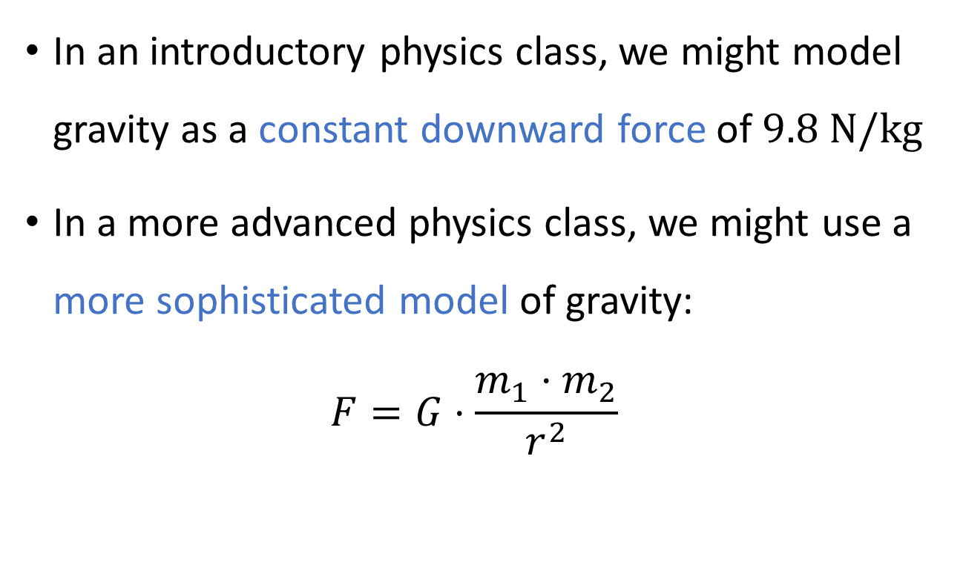
Analogy: Gravity
In an introductory physics class, we might model gravity as a constant downward force of $9.8 \text{N}/\text{kg}$
In a more advanced physics class, we might use a more sophisticated model of gravity: $F=G⋅\frac{m_{1}⋅m_{2}}{r^{2}}$

Slide 12
Theory vs. practice
Disclaimer: Our theoretical model will still not be perfectly accurate!
Sometimes, we might categorize a problem as “tractable” even though it is not actually “solvable in practice”
Other times, we might categorize a problem as “intractable” even though it is actually “solvable in practice”

Slide 13
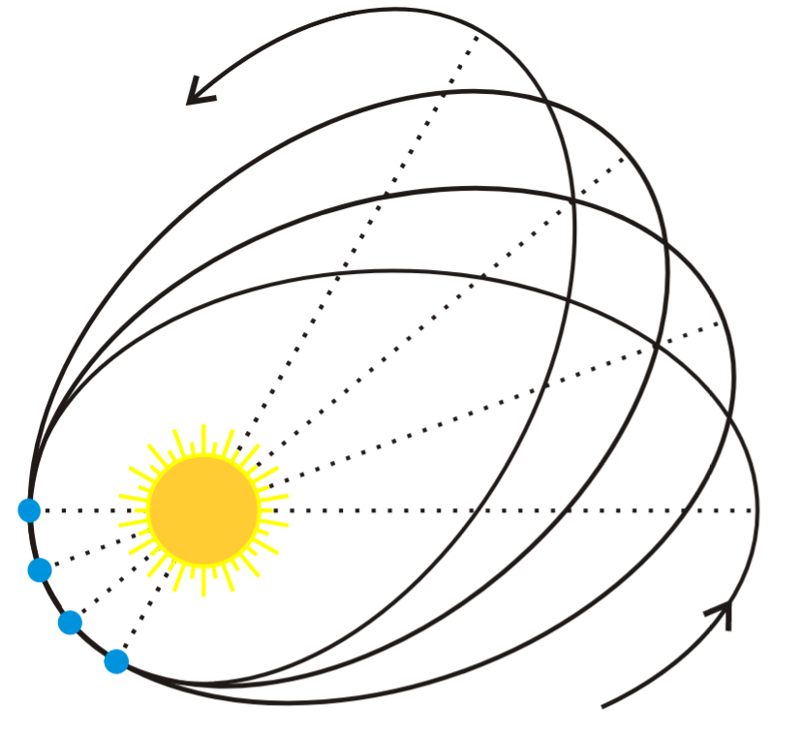
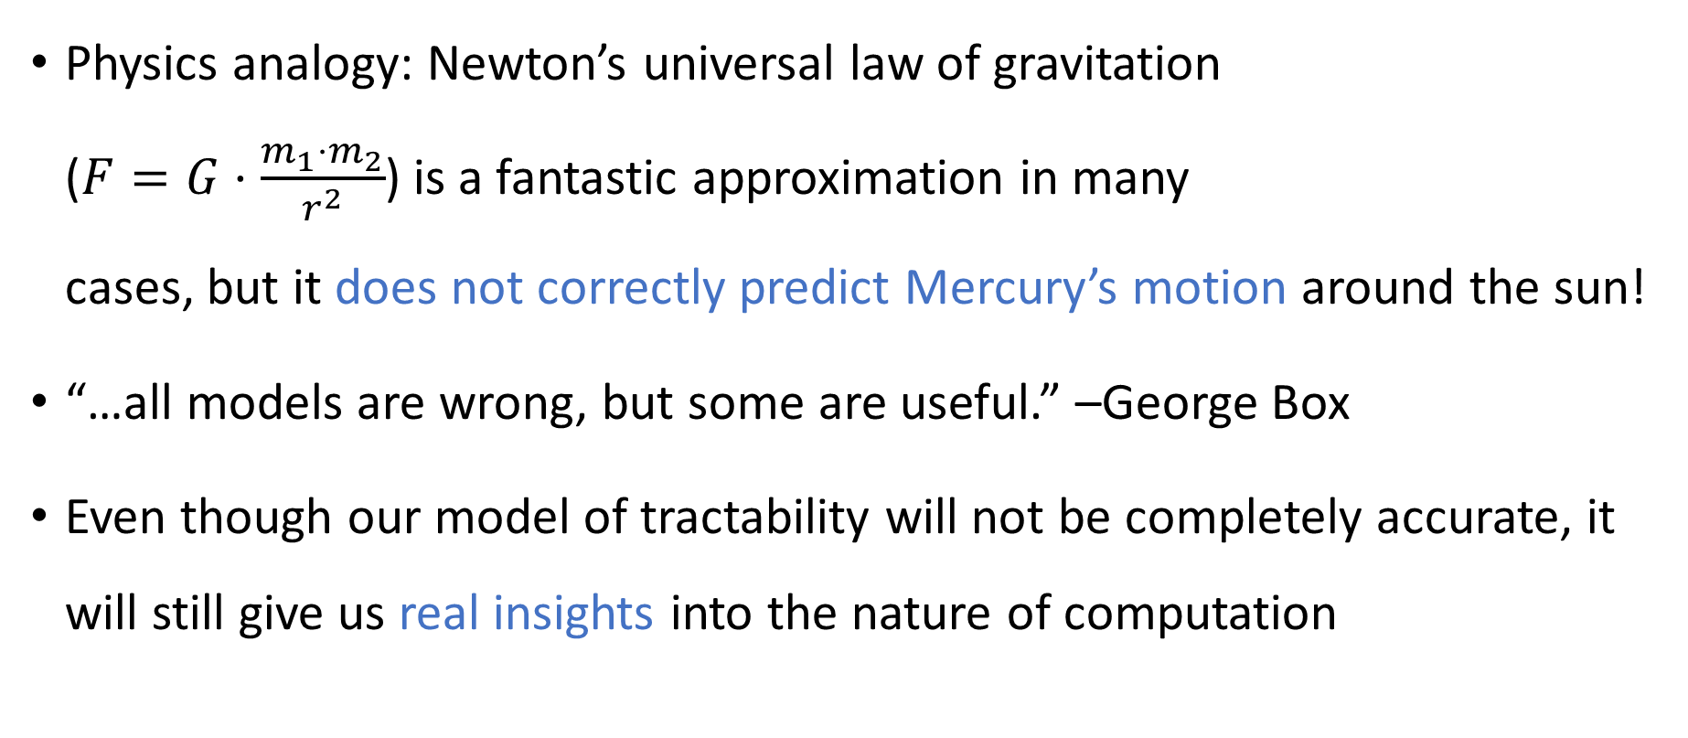
Theory vs. practice
Physics analogy: Newton’s universal law of gravitation ($F=G⋅\frac{m_{1}⋅m_{2}}{r^{2}}$) is a fantastic approximation in many cases, but it does not correctly predict Mercury’s motion around the sun!
“…all models are wrong, but some are useful.” –George Box
Even though our model of tractability will not be completely accurate, it will still give us real insights into the nature of computation

Slide 14
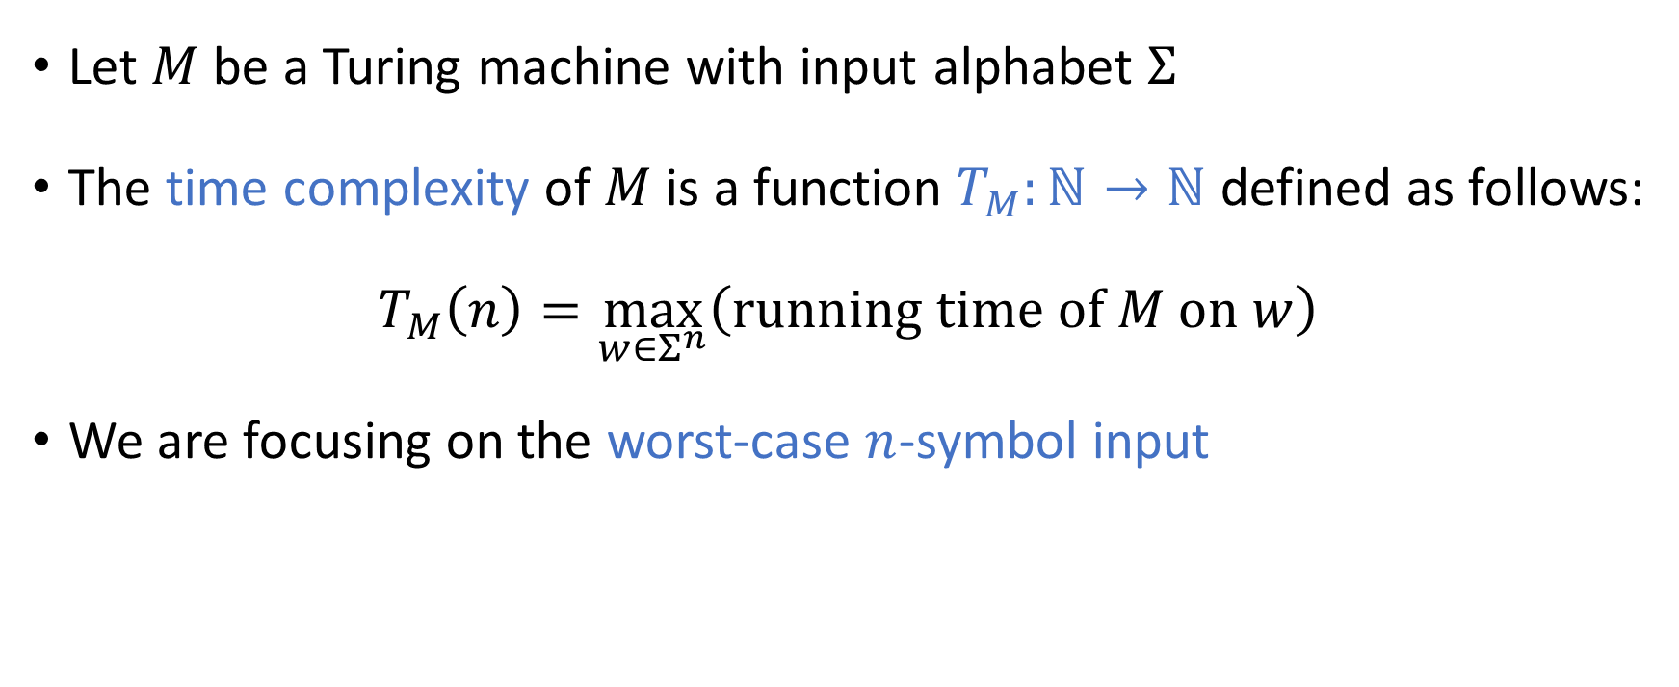
Time complexity
Let $M$ be a Turing machine with input alphabet $Σ$
The time complexity of $M$ is a function $T_{M}:ℕ→ℕ$ defined as follows:
$$T_{M}\left(n\right)=\max_{w∈Σ^{n}}\left(\text{running} \text{time} \text{of} M \text{on} w\right)$$
We are focusing on the worst-case $n$-symbol input

Slide 15
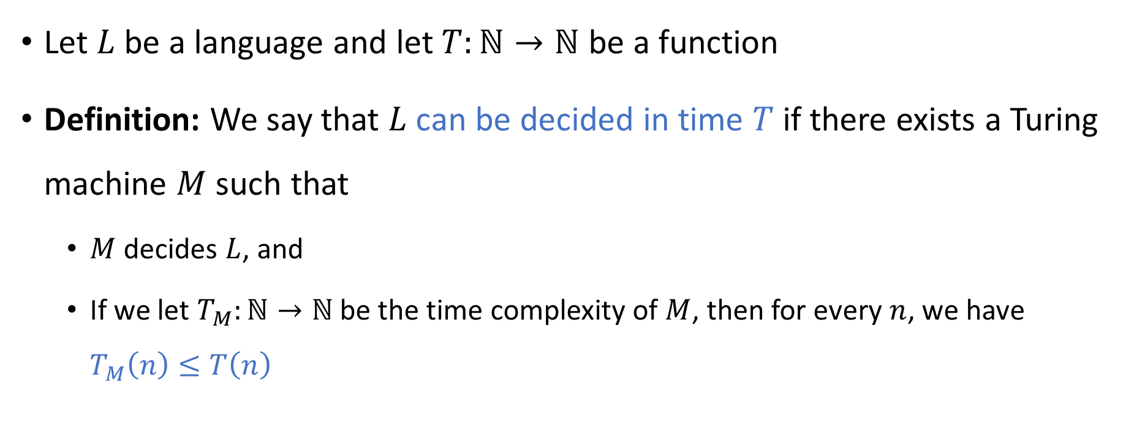

Deciding a language in time $T$
Let $L$ be a language and let $T:ℕ→ℕ$ be a function
Definition: We say that $L$ can be decided in time $T$ if there exists a Turing machine $M$ such that
$M$ decides $L$, and
If we let $T_{M}:ℕ→ℕ$ be the time complexity of $M$, then for every $n$, we have $T_{M}\left(n\right)≤T\left(n\right)$

Slide 16

Scaling behavior
We will mainly focus on the limiting behavior of $T\left(n\right)$ as $n→∞$
How “quickly” does the time complexity $T\left(n\right)$ increase when we increase the input length $n$?

Slide 17
Asymptotic analysis

Slide 18
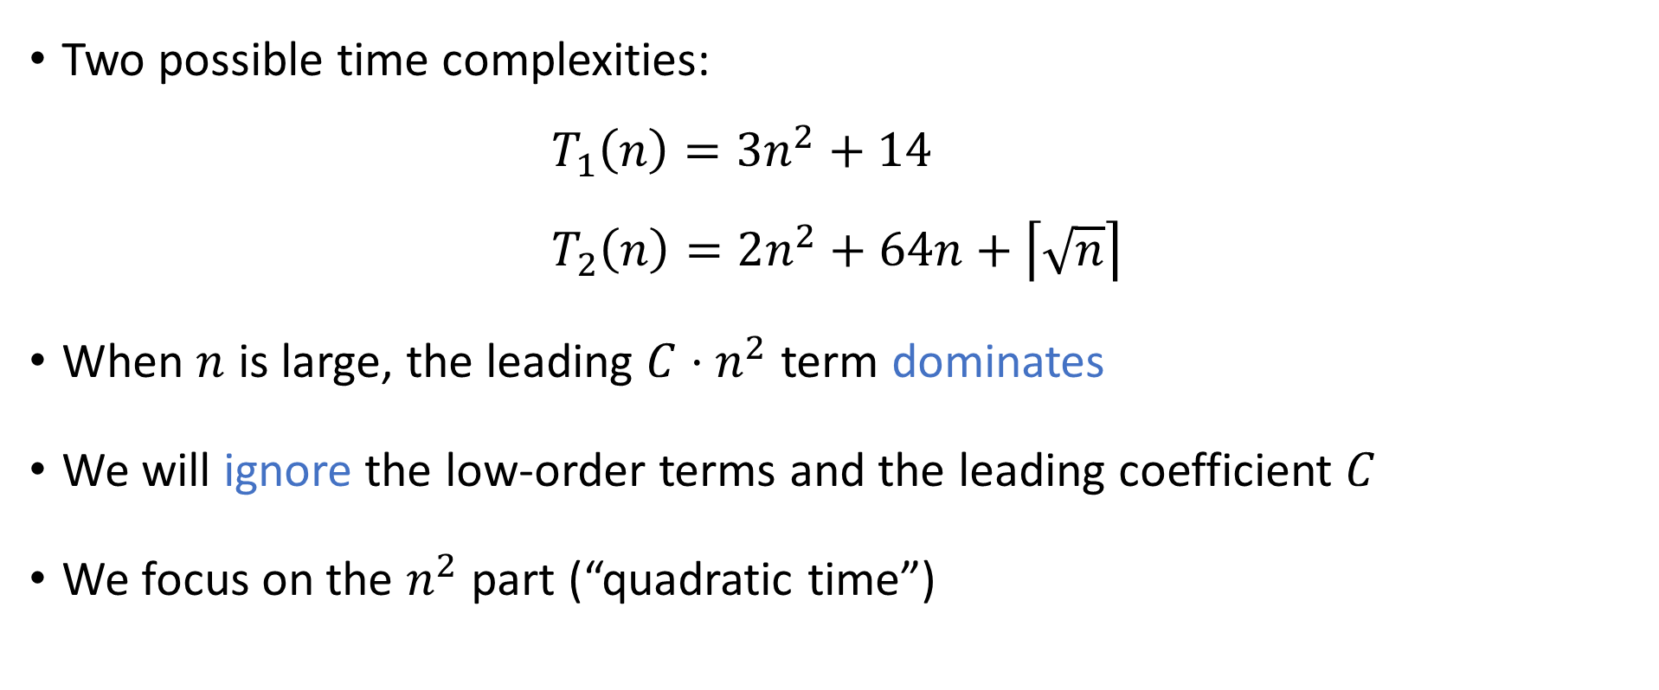
Asymptotic analysis
Two possible time complexities:
$$T_{1}\left(n\right)=3n^{2}+14 \\ T_{2}\left(n\right)=2n^{2}+64n+\left\lceil \sqrt{n}\right\rceil$$
When $n$ is large, the leading ${C⋅n}^{2}$ term dominates
We will ignore the low-order terms and the leading coefficient $C$
We focus on the $n^{2}$ part (“quadratic time”)

Slide 19
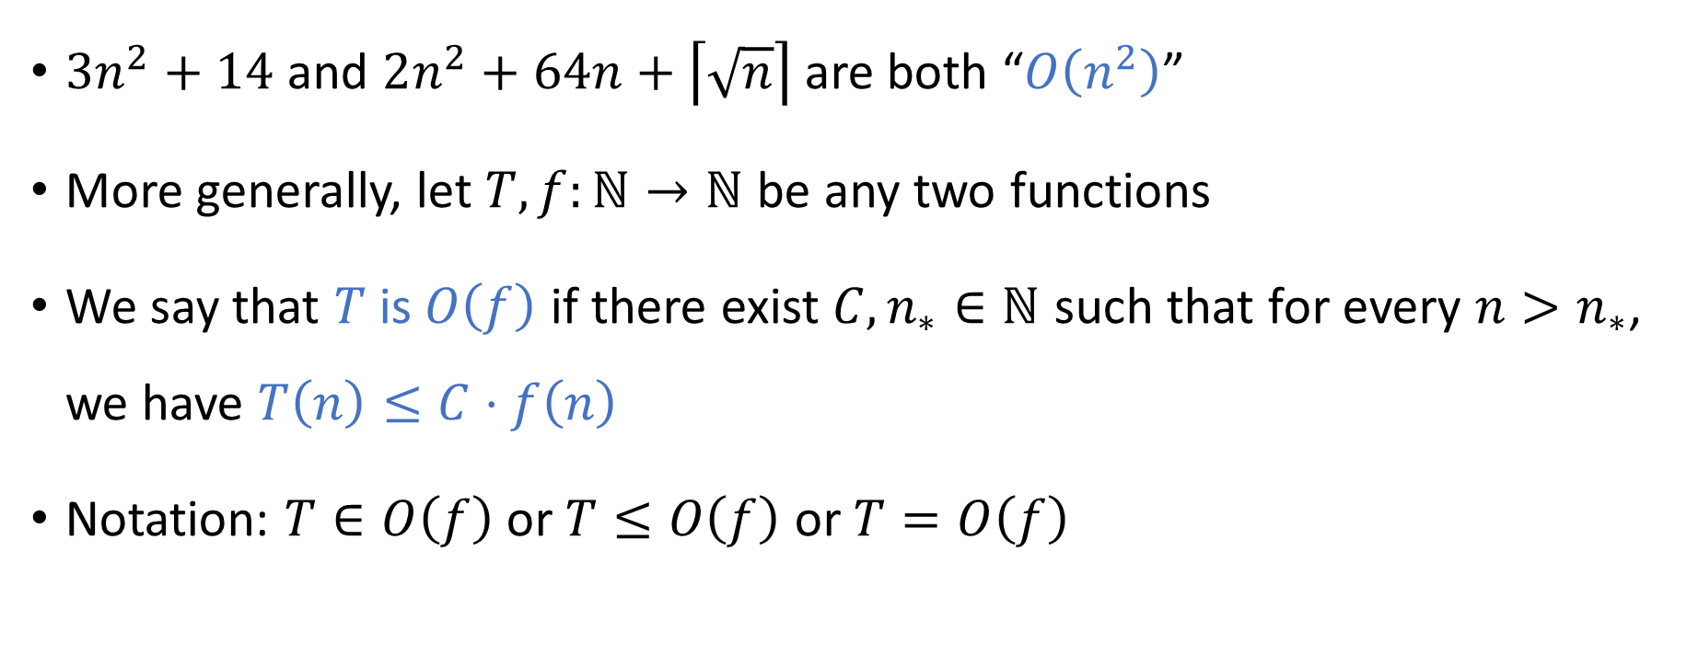
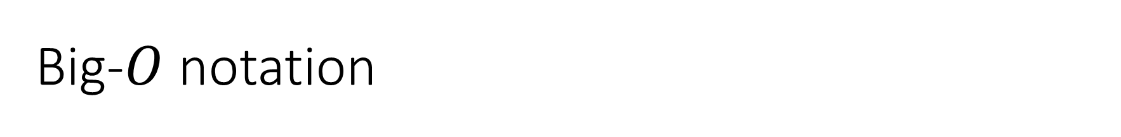
Big-$O$ notation
$3n^{2}+14$ and $2n^{2}+64n+\left\lceil \sqrt{n}\right\rceil$are both “$O\left(n^{2}\right)$”
More generally, let $T,f:ℕ→ℕ$ be any two functions
We say that $T$ is $O\left(f\right)$ if there exist ${C,n}_{∗}∈ℕ$ such that for every $n>n_{∗}$, we have $T\left(n\right)≤C⋅f\left(n\right)$
Notation: $T∈O\left(f\right)$ or $T≤O\left(f\right)$ or $T=O\left(f\right)$

Slide 20

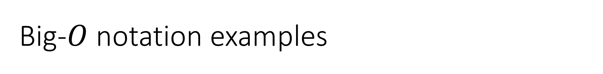
Big-$O$ notation examples
$3n^{2}+14$ is $O\left(n^{2}\right)$
$3n^{2}+14$ is $O\left(n^{2}+n\right)$
$3n^{2}+14$ is $O\left(n^{3}\right)$
$3n^{2}+14$ is not $O\left(n^{1.9}\right)$

Slide 21
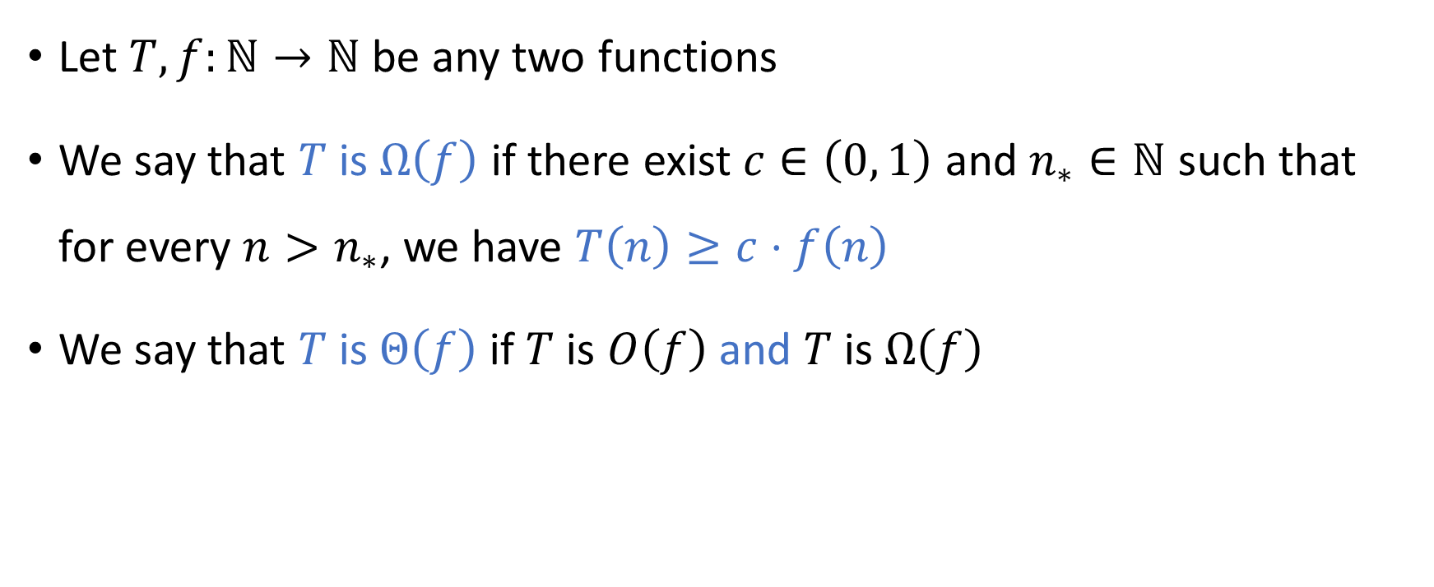
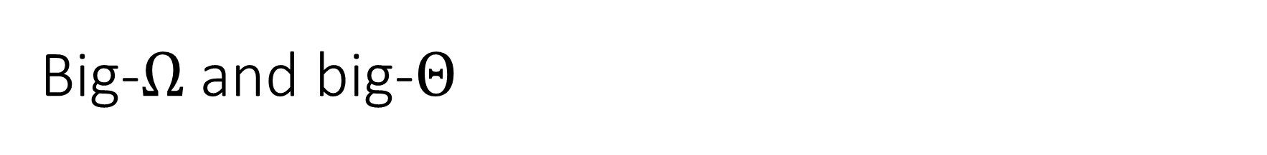
Big-$Ω$ and big-$Θ$
Let $T,f:ℕ→ℕ$ be any two functions
We say that $T$ is $Ω\left(f\right)$ if there exist $c∈\left(0, 1\right)$ and $n_{∗}∈ℕ$ such that for every $n>n_{∗}$, we have $T\left(n\right)≥c⋅f\left(n\right)$
We say that $T$ is $Θ\left(f\right)$ if $T$ is $O\left(f\right)$ and $T$ is $Ω\left(f\right)$

Slide 22
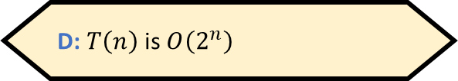

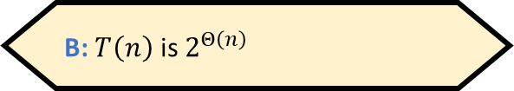
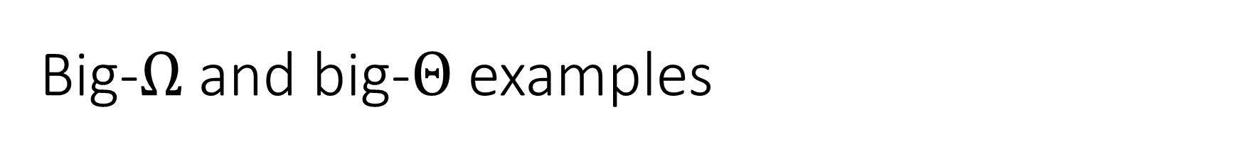
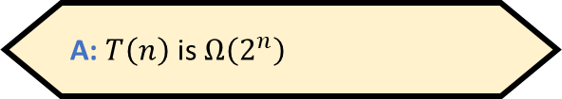
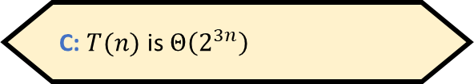
Big-$Ω$ and big-$Θ$ examples
$0.1n^{2}+14$ is $Ω\left(n^{2}\right)$ and $Ω\left(n\right)$, but not $Ω\left(n^{3}\right)$
$0.1n^{2}+14$ is $Θ\left(n^{2}\right)$ and $Θ\left(n^{2}+2n^{1.4}\right)$, but not $Θ\left(n\right)$
Let $T\left(n\right)=2^{3n+4}$. Which of the following statements is false?
A: $T\left(n\right)$ is $Ω\left(2^{n}\right)$
B: $T\left(n\right)$ is $2^{Θ\left(n\right)}$
C: $T(n)$ is $Θ\left(2^{3n}\right)$
D: $T\left(n\right)$ is $O\left(2^{n}\right)$
Respond at PollEv.com/whoza or text “whoza” to 22333

