Slide 1
CMSC 28100 Introduction to Complexity Theory Winter 2024 Instructor: William Hoza
7 |  |  |  |  |  |  | 5 | 3
 |  |  |  |  |  |  |  | 4
 | 4 | 8 |  | 3 |  | 1 | 2
8 |  | 1 | 3 |  |  | 2 | 7 | 5
 | 9 |  | 1 |  |  |  | 4
 | 5 |  |  |  |  | 3
2 |  | 5 |  | 8 | 4
1 | 3 | 4 |  | 5

Slide 2
Course Review

Slide 3
Which problems can be solved through computation?

Slide 4
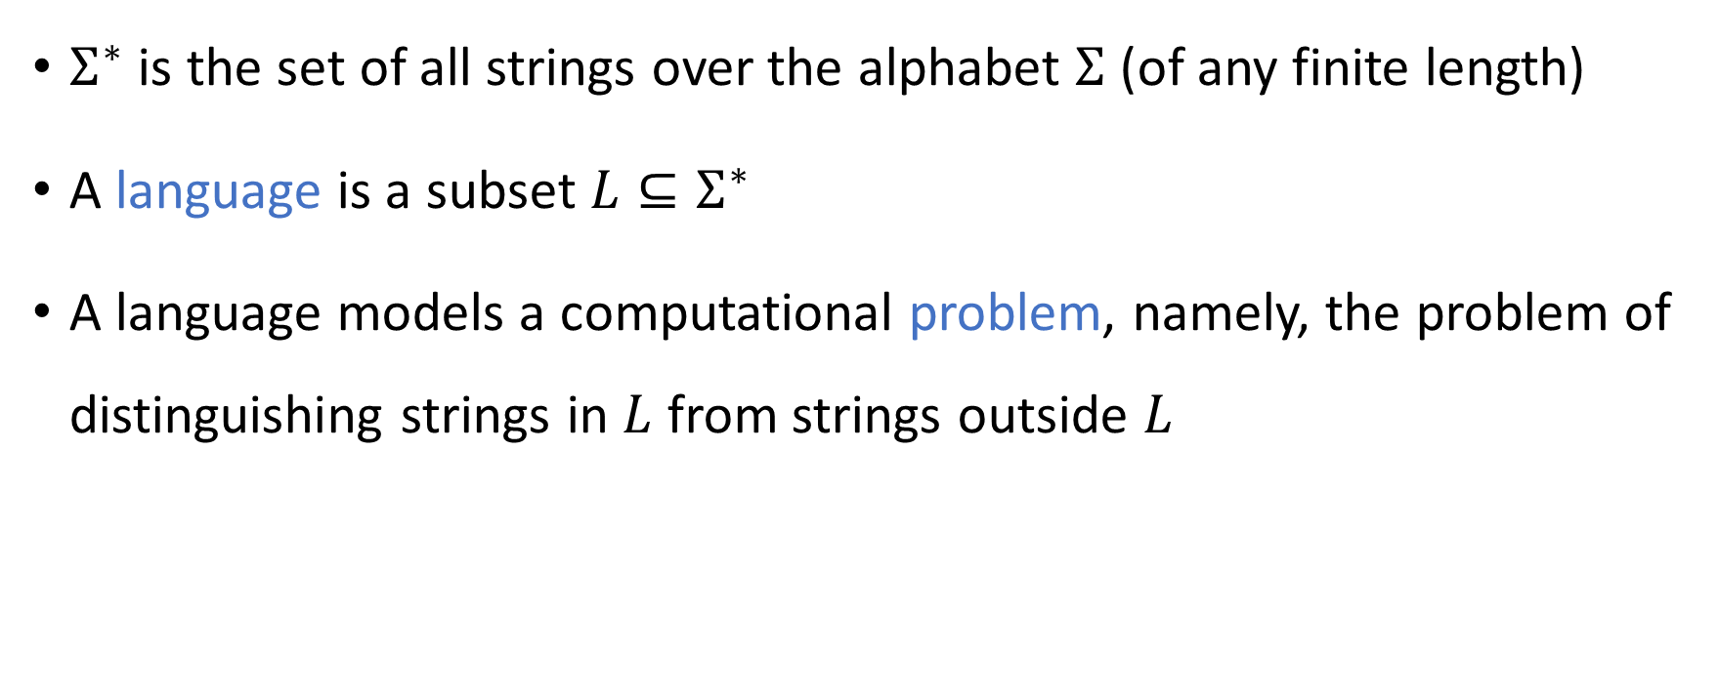
Strings and languages
$Σ^{∗}$ is the set of all strings over the alphabet $Σ$ (of any finite length)
A language is a subset $L⊆Σ^{∗}$
A language models a computational problem, namely, the problem of distinguishing strings in $L$ from strings outside $L$

Slide 5
Which problems can be solved through computation?

Slide 6
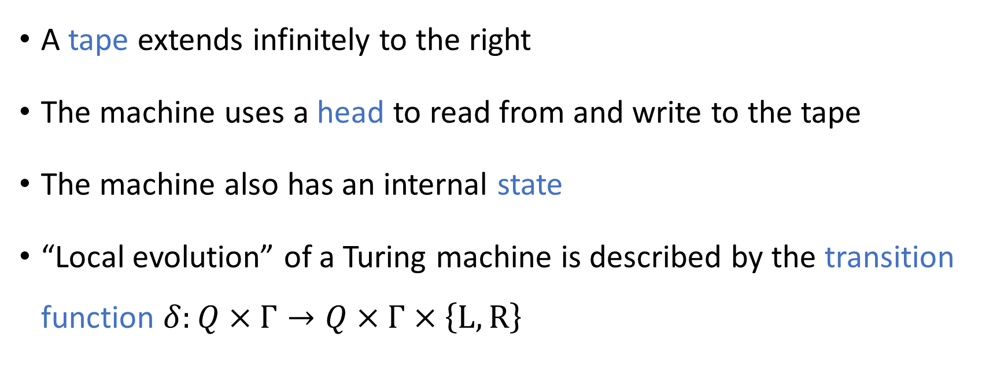
Turing machines
#
1
1
0
A tape extends infinitely to the right
The machine uses a head to read from and write to the tape
The machine also has an internal state
“Local evolution” of a Turing machine is described by the transition function $δ:Q×Γ→Q×Γ×\left\{\text{L},\text{R}\right\}$

Slide 7
Which problems can be solved through computation?

Slide 8
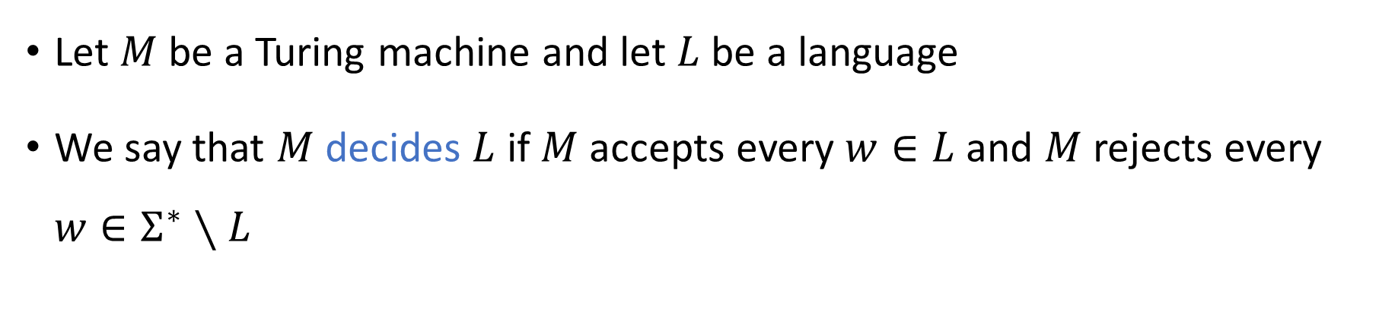
Deciding a language
Turing Machine
Accept
Reject
Run forever (“loop”)
Input
Let $M$ be a Turing machine and let $L$ be a language
We say that $M$ decides $L$ if $M$ accepts every $w∈L$ and $M$ rejects every $w∈Σ^{∗}∖L$

Slide 9
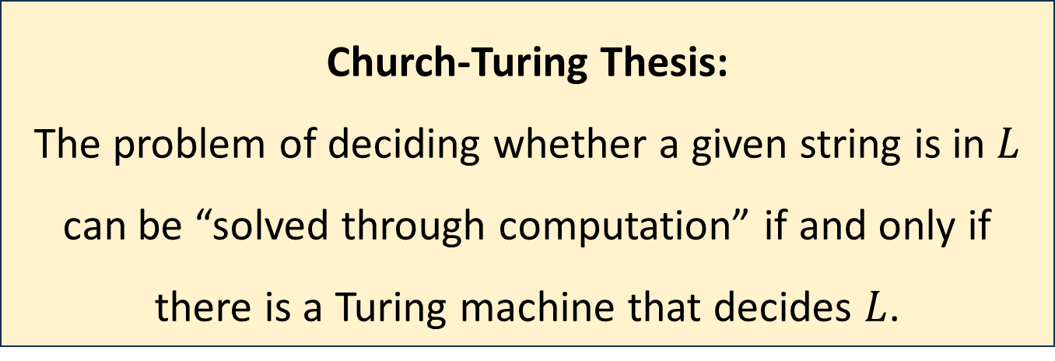

The Church-Turing Thesis
Let $L$ be a language
Church-Turing Thesis:
The problem of deciding whether a given string is in $L$ can be “solved through computation” if and only if there is a Turing machine that decides $L$.
Intuitive notion
Mathematically precise notion

Slide 10
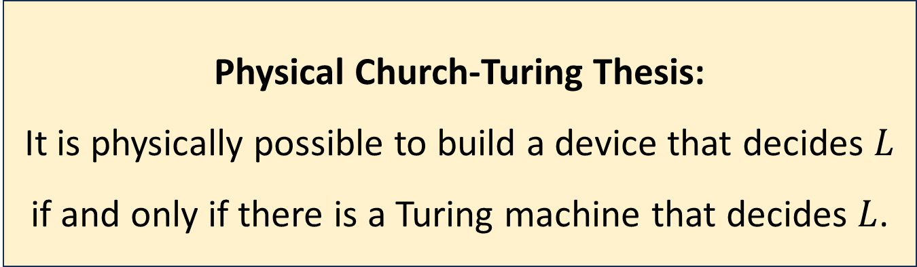
The Physical Church-Turing Thesis
Let $L$ be a language
Physical Church-Turing Thesis:
It is physically possible to build a device that decides $L$ if and only if there is a Turing machine that decides $L$.

Slide 11
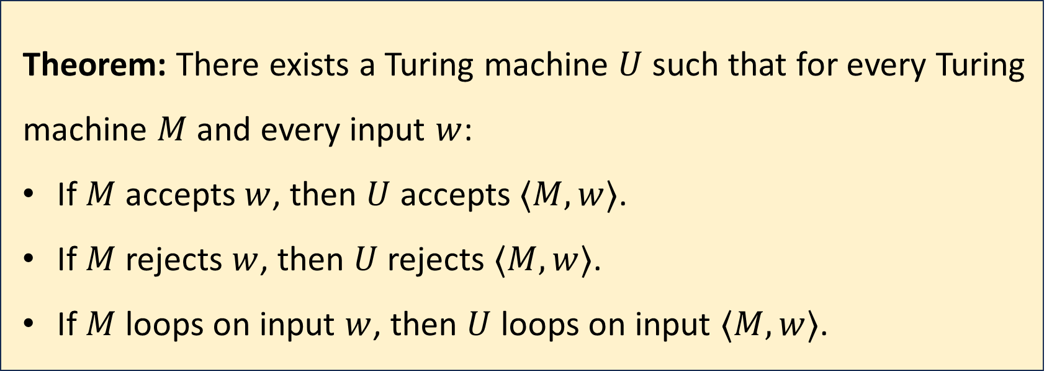
Universal Turing machines
Theorem: There exists a Turing machine $U$ such that for every Turing machine $M$ and every input $w$:
If $M$ accepts $w$, then $U$ accepts $⟨M,w⟩$.
If $M$ rejects $w$, then $U$ rejects $⟨M,w⟩$.
If $M$ loops on input $w$, then $U$ loops on input $⟨M,w⟩$.

Slide 12
Universal Turing machines
If you are stranded on an alien planet and you are trying to build a computer, your job is to build a universal Turing machine
A universal Turing machine can be “programmed” to do anything that is computationally possible

Slide 13


Undecidability
$\text{HALT}=\{\left\langle M,w\right\rangle :M \text{is} \text{a} \text{Turing} \text{machine} \text{that} \text{halts} \text{on} \text{input} w\}$
Theorem: $\text{HALT}$ is undecidable

Slide 14





Reductions
A mapping reduction from $L_{1}$ to $L_{2}$ is a way of converting instances of $L_{1}$ into equivalent instances of $L_{2}$
“YES” maps to “YES”
“NO” maps to “NO”
$$L_{2}$$
$$L_{1}$$
$$Σ_{1}^{∗}$$
$$Σ_{2}^{∗}$$

Slide 15
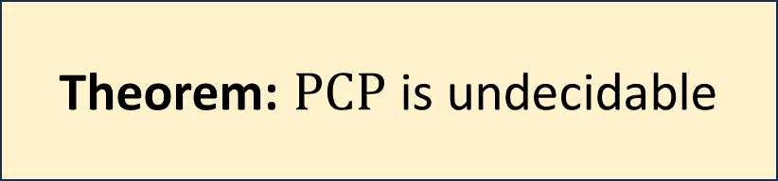
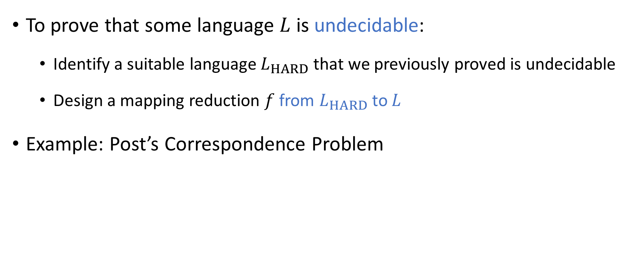
Undecidability via reductions
To prove that some language $L$ is undecidable:
Identify a suitable language $L_{HARD}$ that we previously proved is undecidable
Design a mapping reduction $f$ from $L_{HARD}$ to $L$
Example: Post’s Correspondence Problem
Theorem: $\text{PCP}$ is undecidable

Slide 16
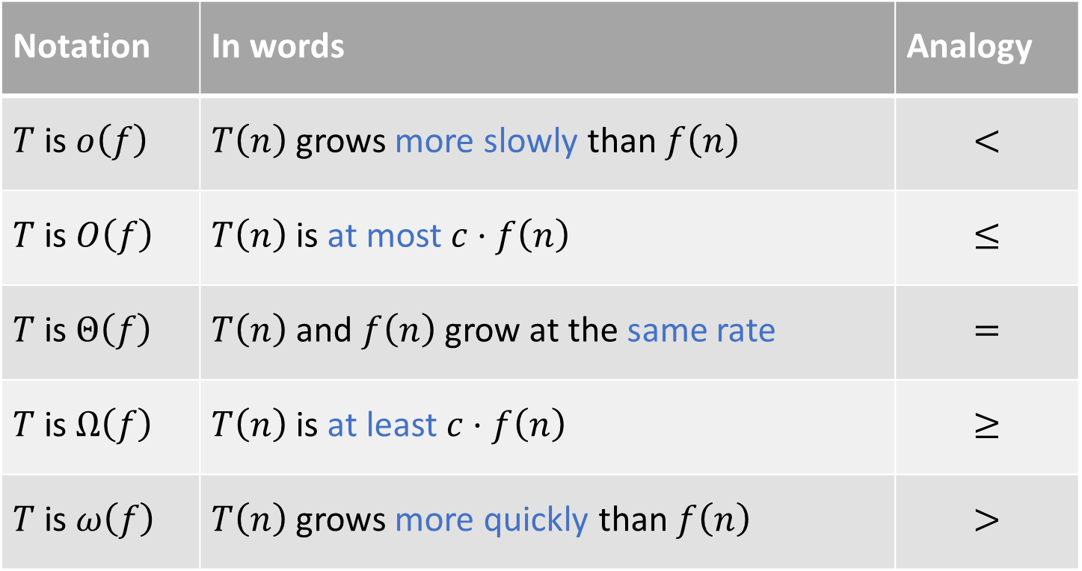
Asymptotic analysis
Notation | In words | Analogy
$T$ is $o\left(f\right)$ | $T\left(n\right)$ grows more slowly than $f\left(n\right)$ | $$<$$
$T$ is $O\left(f\right)$ | $T\left(n\right)$ is at most $c⋅f\left(n\right)$ | $$≤$$
$T$ is $Θ\left(f\right)$ | $T\left(n\right)$ and $f\left(n\right)$ grow at the same rate | $$=$$
$T$ is $Ω\left(f\right)$ | $T\left(n\right)$ is at least $c⋅f\left(n\right)$ | $$≥$$
$T$ is $ω\left(f\right)$ | $T\left(n\right)$ grows more quickly than $f\left(n\right)$ | $$>$$

Slide 17
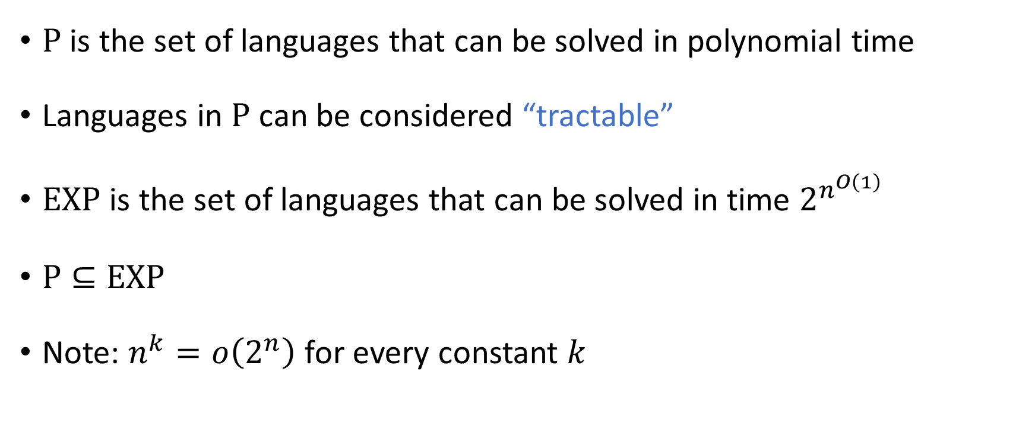

$\text{P}$ and $\text{EXP}$
$\text{P}$ is the set of languages that can be solved in polynomial time
Languages in $\text{P}$ can be considered “tractable”
$\text{EXP}$ is the set of languages that can be solved in time $2^{n^{O\left(1\right)}}$
$\text{P}⊆\text{EXP}$
Note: $n^{k}=o\left(2^{n}\right)$ for every constant $k$

Slide 18


The Time Hierarchy Theorem
Let $T:ℕ→ℕ$ be any “reasonable” (time-constructible) function
Consequence: $\text{P}≠\text{EXP}$
Theorem: $\text{TIME}\left(o\left(T\right)\right)≠\text{TIME}\left(T^{3}\right)$

Slide 19
Boolean circuits
$$∨$$
A “circuit” is a network of AND/OR/NOT gates applied to Boolean variables
$$∧$$
$$∧$$
$$¬$$
$$¬$$
$$∨$$
$$∨$$
$$∧$$
$$∧$$
$$∧$$
$$∧$$
$$¬$$
$$¬$$
$$¬$$
$$¬$$
$$x_{1}$$
$$x_{2}$$
$$x_{3}$$
$$x_{4}$$

Slide 20
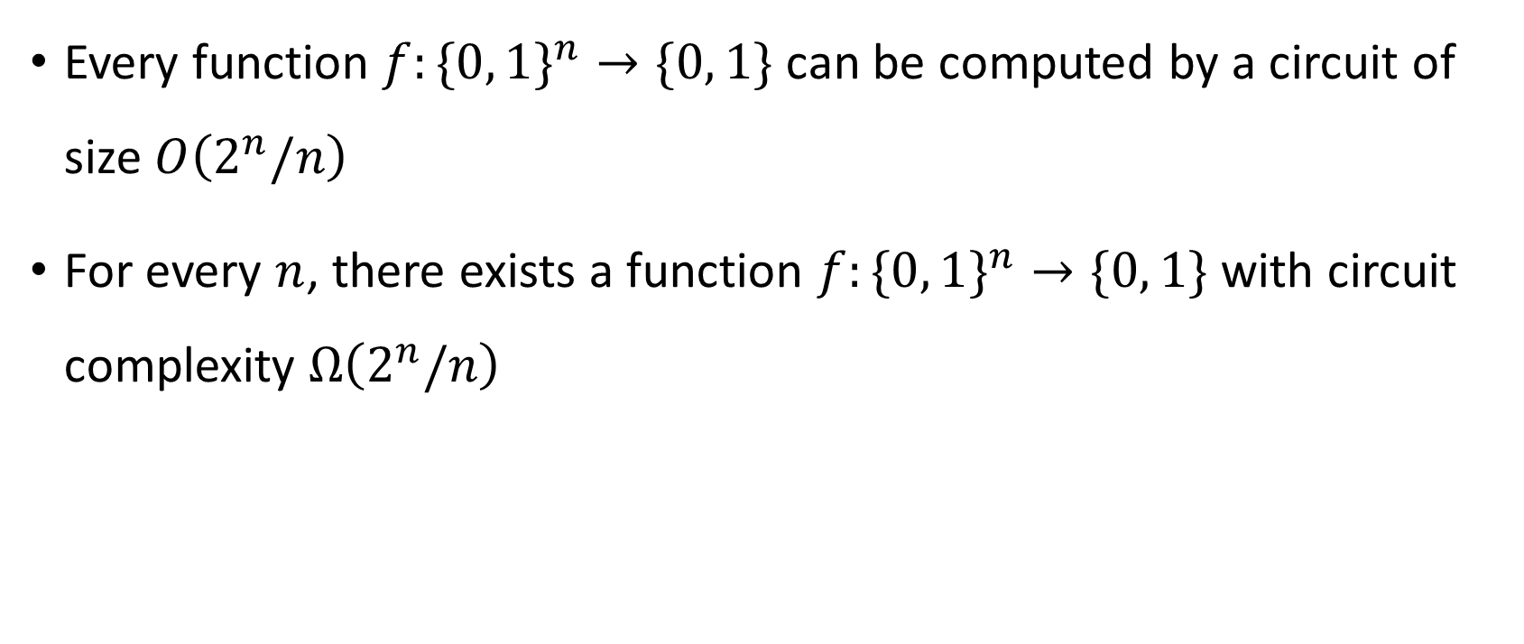
Circuit complexity
Every function $f:\{0, 1\}^{n}→\{0, 1\}$can be computed by a circuit of size $O\left(2^{n}/n\right)$
For every $n$, there exists a function $f:\{0, 1\}^{n}→\{0, 1\}$ with circuit complexity $Ω\left(2^{n}/n\right)$

Slide 21

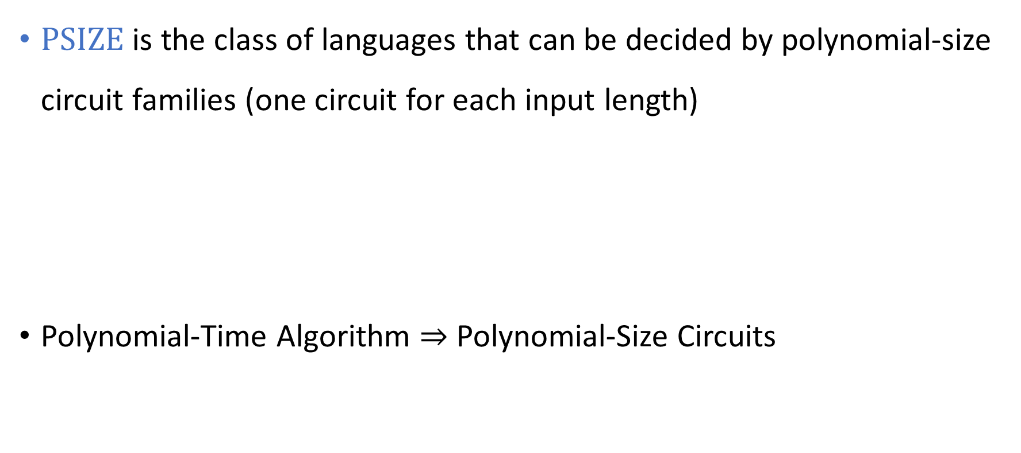
Polynomial-size circuit families
$\text{PSIZE}$ is the class of languages that can be decided by polynomial-size circuit families (one circuit for each input length)
Polynomial-Time Algorithm $⇒$ Polynomial-Size Circuits
Theorem: $\text{P}⊆\text{PSIZE}$.

Slide 22


The complexity class $\text{NP}$
A language $L$ is in $\text{NP}$ if elements of $L$have polynomial-size certificates of membership that can be verified in polynomial time
$\text{P}⊆\text{NP}⊆\text{EXP}$

Slide 23
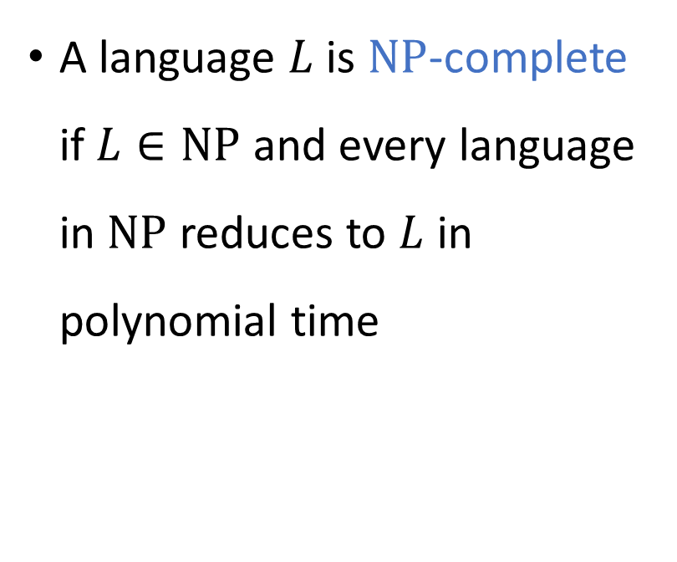

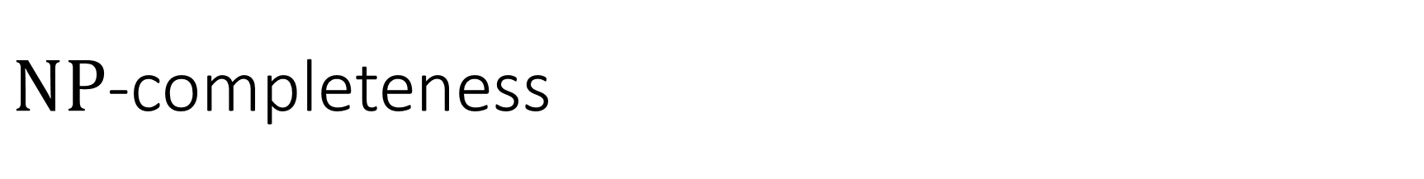



$\text{NP}$-completeness
$\text{NP}$-hard
A language $L$ is $\text{NP}$-complete if $L∈\text{NP}$ and every language in $\text{NP}$ reduces to $L$ in polynomial time
$\text{NP}$-complete
$$\text{NP}$$
$$\text{P}$$

Slide 24

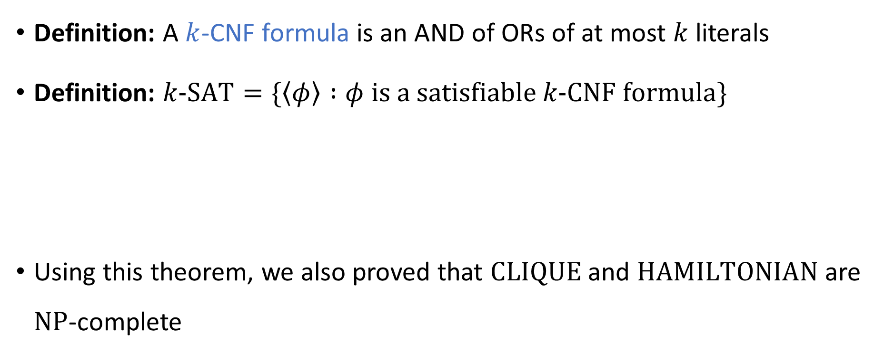
The Cook-Levin Theorem
Definition: A $k$-CNF formula is an AND of ORs of at most $k$ literals
Definition: $k\text{‑}\text{SAT}=\{\left\langle φ\right\rangle :φ \text{is} \text{a} \text{satisfiable} k\text{‑}\text{CNF} \text{formula}\}$
Using this theorem, we also proved that $\text{CLIQUE}$ and $\text{HAMILTONIAN}$ are $\text{NP}$-complete
The Cook-Levin Theorem: $3\text{‑}\text{SAT}$ is $\text{NP}$-complete

Slide 25
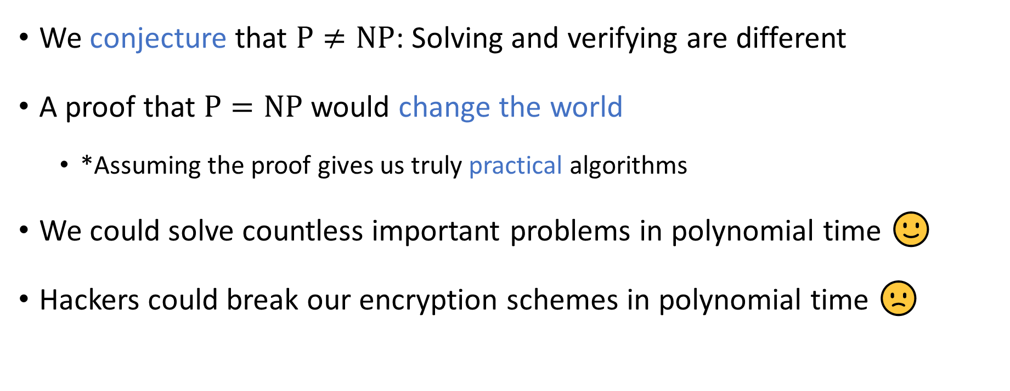

The $\text{P}$ vs. $\text{NP}$ problem
We conjecture that $\text{P}≠\text{NP}$: Solving and verifying are different
A proof that $\text{P}=\text{NP}$ would change the world
*Assuming the proof gives us truly practical algorithms
We could solve countless important problems in polynomial time 🙂
Hackers could break our encryption schemes in polynomial time 🙁

Slide 26
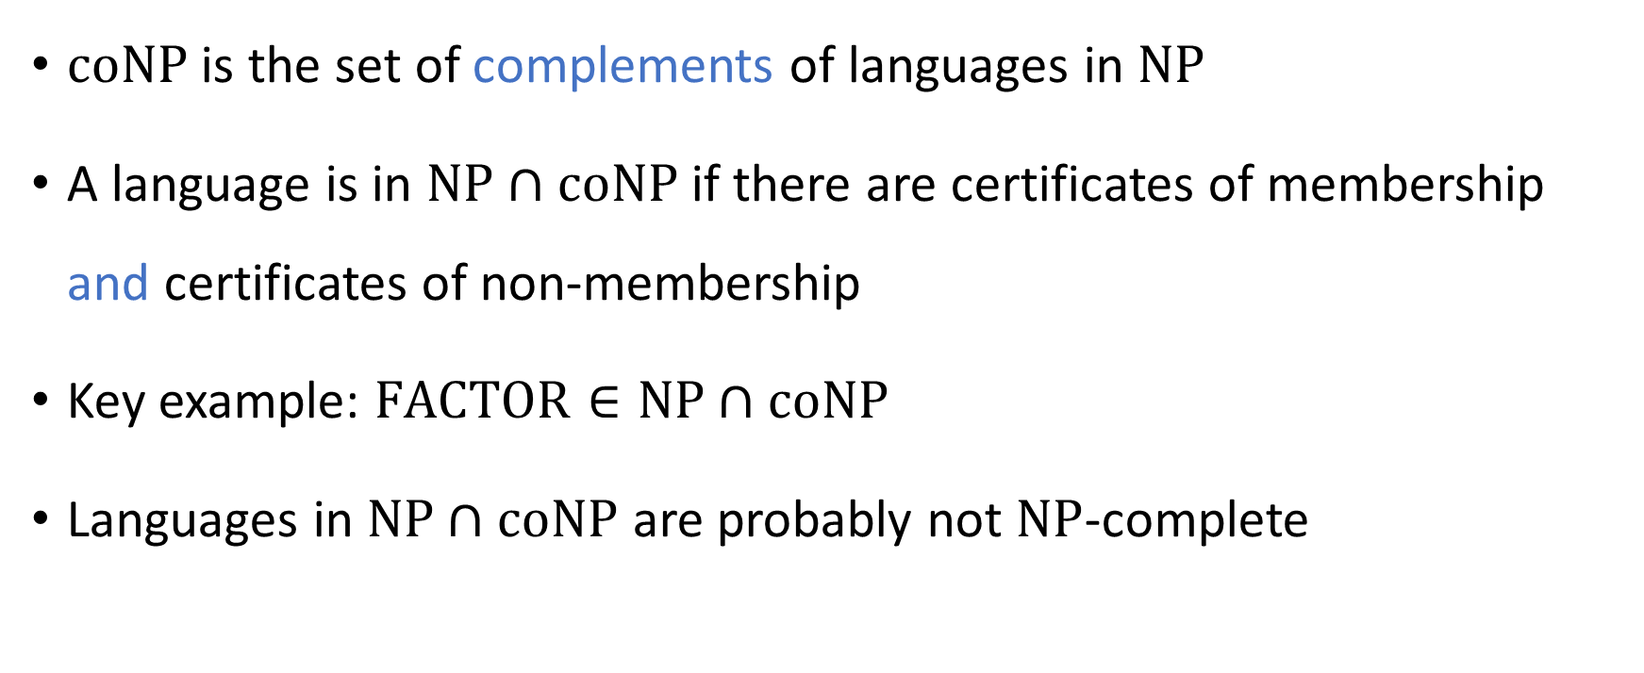

The complexity class $\text{NP}∩\text{coNP}$
$\text{coNP}$ is the set of complements of languages in $\text{NP}$
A language is in $\text{NP}∩\text{coNP}$ if there are certificates of membership and certificates of non-membership
Key example: $\text{FACTOR}∈\text{NP}∩\text{coNP}$
Languages in $\text{NP}∩\text{coNP}$ are probably not $\text{NP}$-complete

Slide 27
$\text{coNP}$-hard
$\text{NP}$-hard
$\text{coNP}$-complete
$\text{NP}$-complete
$$\text{coNP}$$
$$\text{NP}$$
$$\text{FACTOR}$$
$$\text{NP}∩\text{coNP}$$
$$\text{P}$$

Slide 28
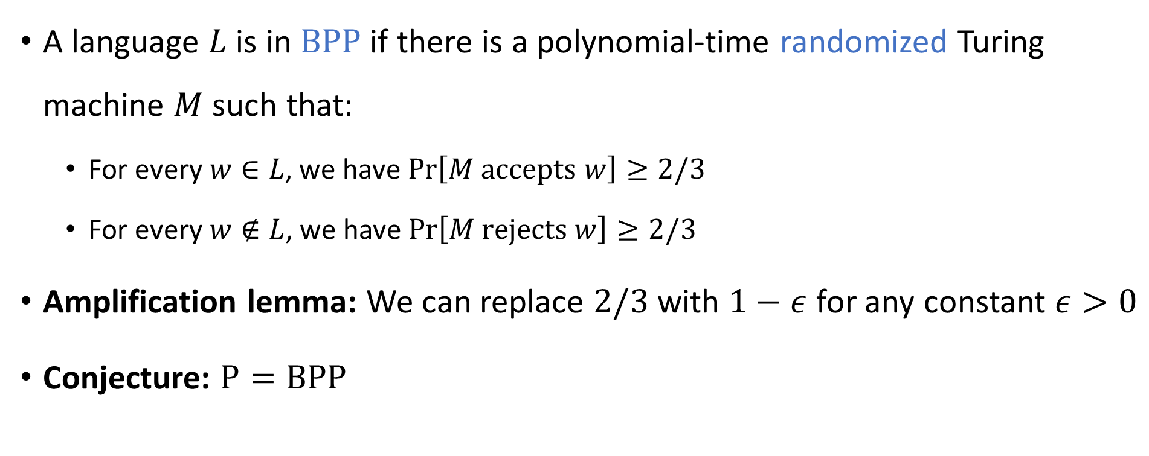

The complexity class $\text{BPP}$
A language $L$ is in $\text{BPP}$ if there is a polynomial-time randomized Turing machine $M$ such that:
For every $w∈L$, we have $\operatorname{Pr}\left[M \text{accepts} w\right]≥2/3$
For every $w∉L$, we have $\operatorname{Pr}\left[M \text{rejects} w\right]≥2/3$
Amplification lemma: We can replace $2/3$ with $1−ε$ for any constant $ε>0$
Conjecture: $\text{P}=\text{BPP}$

Slide 29




Communication complexity
Goal: Compute $f\left(x, y\right)$ using as little communication as possible
Communication channel
Alice holds $x$
Bob holds $y$

Slide 30


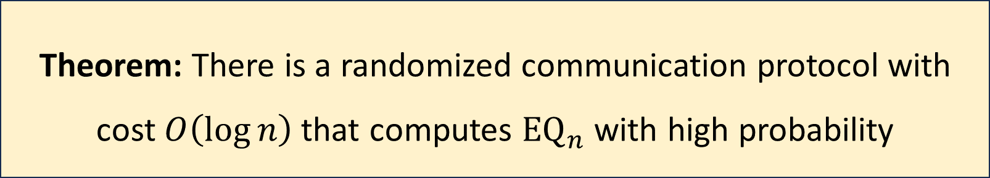
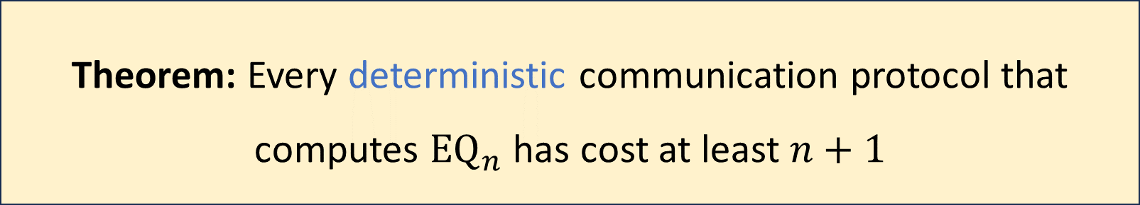
Communication complexity of ${\text{EQ}}_{n}$
${\text{EQ}}_{n}\left(x, y\right)=1⇔x=y$
Theorem: Every deterministic communication protocol that computes ${\text{EQ}}_{n}$ has cost at least $n+1$
Theorem: There is a randomized communication protocol with cost $O\left(\log{n}\right)$ that computes ${\text{EQ}}_{n}$ with high probability

Slide 31

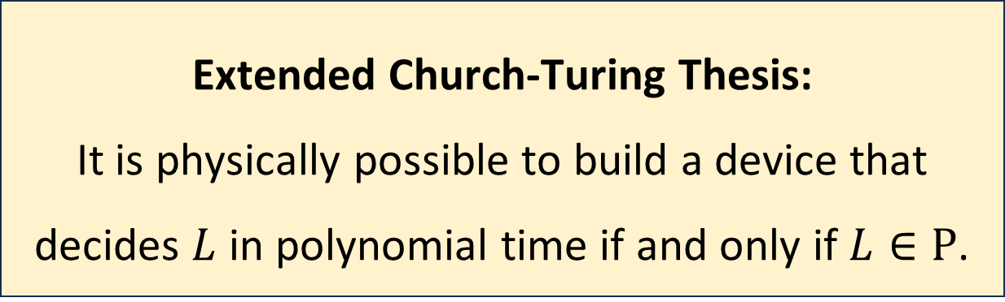
The Extended Church-Turing Thesis
Let $L$ be a language
The Extended Church-Turing thesis is probably false because of quantum computing
Extended Church-Turing Thesis:
It is physically possible to build a device that decides $L$ in polynomial time if and only if $L∈\text{P}$.

Slide 32

Space complexity
Read-only input tape ➡
$$♢$$
1
1
0
1
1
Read-write work tape ➡
0
#
1
0

Slide 33

Space complexity
$\text{PSPACE}$ is the set of languages can be decided in polynomial space
$\text{L}$ is the set of languages that can be decided in logarithmic space
$\text{L}⊆\text{P}⊆\text{NP}⊆\text{PSPACE}⊆\text{EXP}$

Slide 34





$$\text{EXP}$$
$$\text{PSPACE}$$
$$\text{NP}$$
$$\text{P}$$
$$\text{L}$$

Slide 35
Lessons
Not every problem can be solved by an efficient algorithm, or even an inefficient algorithm
Mathematics and computer science form a powerful combination
Complexity theory enables us to formulate and study profound questions about the human condition and the physical universe

Slide 36
Thank you!
Teaching you has been a privilege
I hope you’ve enjoyed taking the course as much as I’ve enjoyed teaching it
Please fill out the College Course Feedback Form using My.UChicago (deadline is March 10)
See you next week for office hours and the final exam!

