Slide 1





Depth-$d$ Threshold Circuits vs. Depth-$\left(d+1\right)$ AND-OR Trees
STOC 2023
Pooya Hatami¹
Ohio State University
William M. Hoza²
UC Berkeley
Avishay Tal³
UC Berkeley
Roei Tell⁴
IAS & DIMACS
¹Supported by NSF grant CCF-1947546.
²Part of this work was supported by the NSF GRFP under Grant DGE-1610403 and by a Harrington Fellowship from UT Austin. Part of this work was done while the author was visiting the Simons Institute for the Theory of Computing.
³Supported by NSF CAREER award CCF-2145474 and by a Sloan Fellowship from the Sloan Foundation.
⁴Part of this work was supported by the National Science Foundation under grant number CCF-1445755 and under grant number CCF-1900460. Part of this work was done while the author was at DIMACS, and part of this work was done while the author was a fellow at the Simons Institute for the Theory of Computing.

Slide 2



















Bounded-depth circuit models
${\text{AC}}^{0}$ circuits: AND gates and OR gates
${\text{AC}}^{0}\left[m\right]$ circuits: AND gates, OR gates, and ${\text{MOD}}_{m}$ gates
${\text{TC}}^{0}$ circuits: linear threshold function ($\text{THR}$) gates
$$∧$$
$$\text{P}/\text{poly}$$
$$∨$$
$$∨$$
$$∨$$
$$∨$$
$${\text{NC}}^{1}$$
$$∧$$
$$∧$$
$$∧$$
$${\text{TC}}^{0}$$
$$x_{1}$$
$$x_{4}$$
$$x_{2}$$
$$¬x_{1}$$
$$x_{3}$$
$${\text{AC}}^{0}\left[m\right]$$
$${\text{AC}}^{0}$$

Slide 3
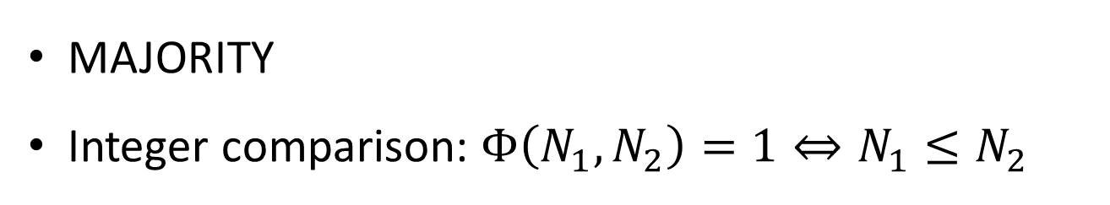
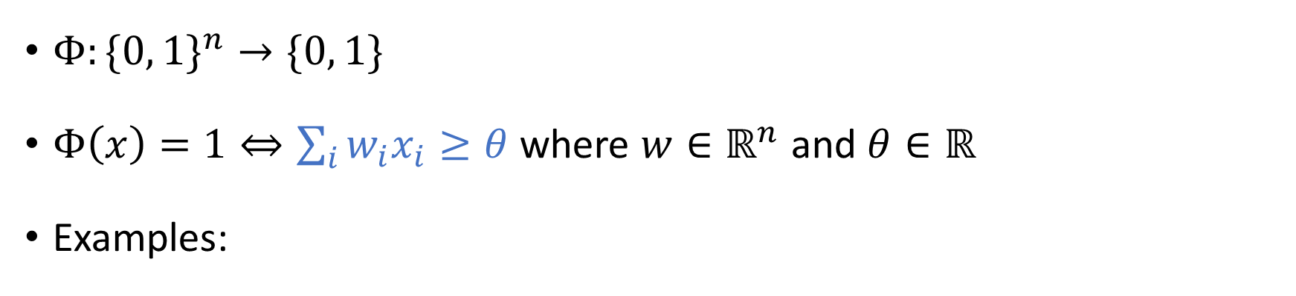
Linear threshold functions (THR)
$Φ:\{0, 1\}^{n}→\{0, 1\}$
$Φ\left(x\right)=\text{1}⇔\sum_{i}{w_{i}x_{i}≥θ}$ where $w∈ℝ^{n}$ and $θ∈ℝ$
Examples:
AND
OR
MAJORITY
Integer comparison: $Φ\left(N_{1}, N_{2}\right)=1⇔N_{1}≤N_{2}$

Slide 4
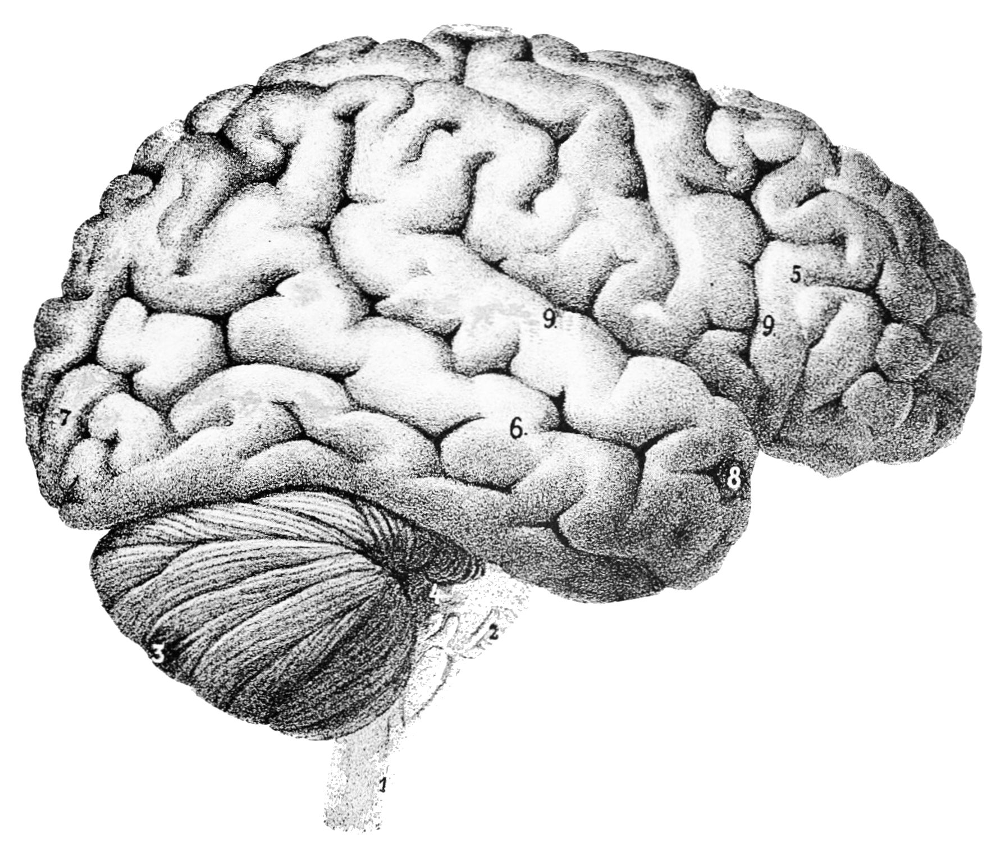
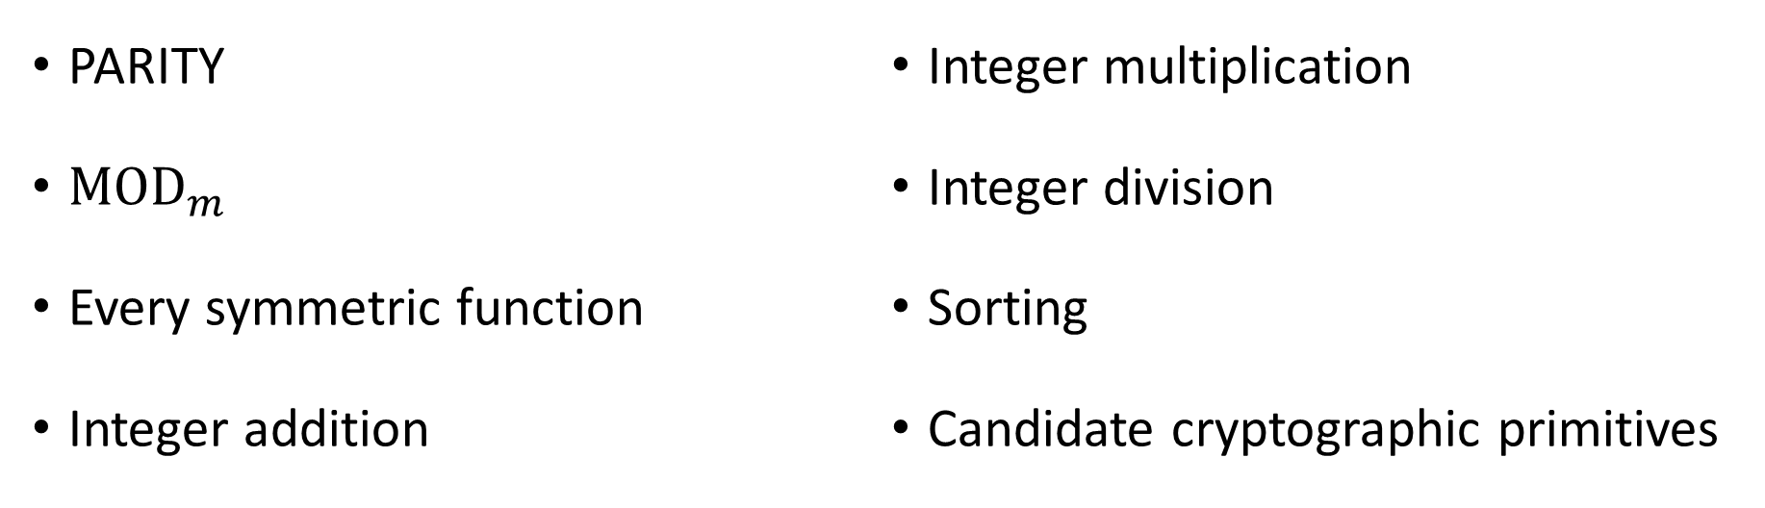

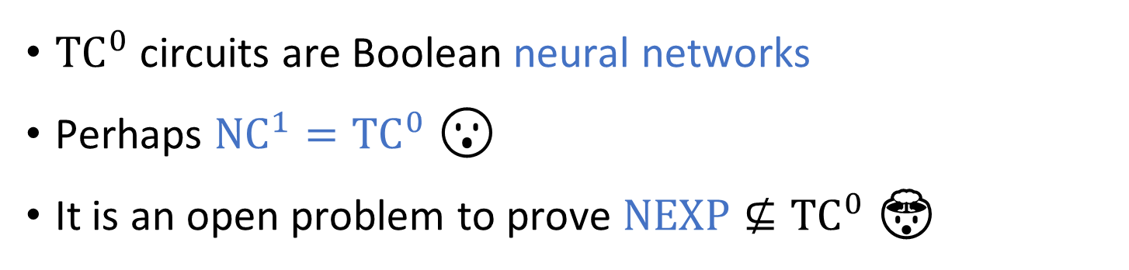
The power of ${\text{TC}}^{0}$ circuits (constant depth, polynomial size)
[HMPST 1993] [BCH 1986] [CSV 1984] [NR 1997] [KL 2001] …
PARITY
${\text{MOD}}_{m}$
Every symmetric function
Integer addition
Integer multiplication
Integer division
Sorting
Candidate cryptographic primitives
${\text{TC}}^{0}$ circuits are Boolean neural networks
Perhaps ${\text{NC}}^{1}={\text{TC}}^{0}$ 😮
It is an open problem to prove $\text{NEXP}⊈{\text{TC}}^{0}$ 🤯

Slide 5

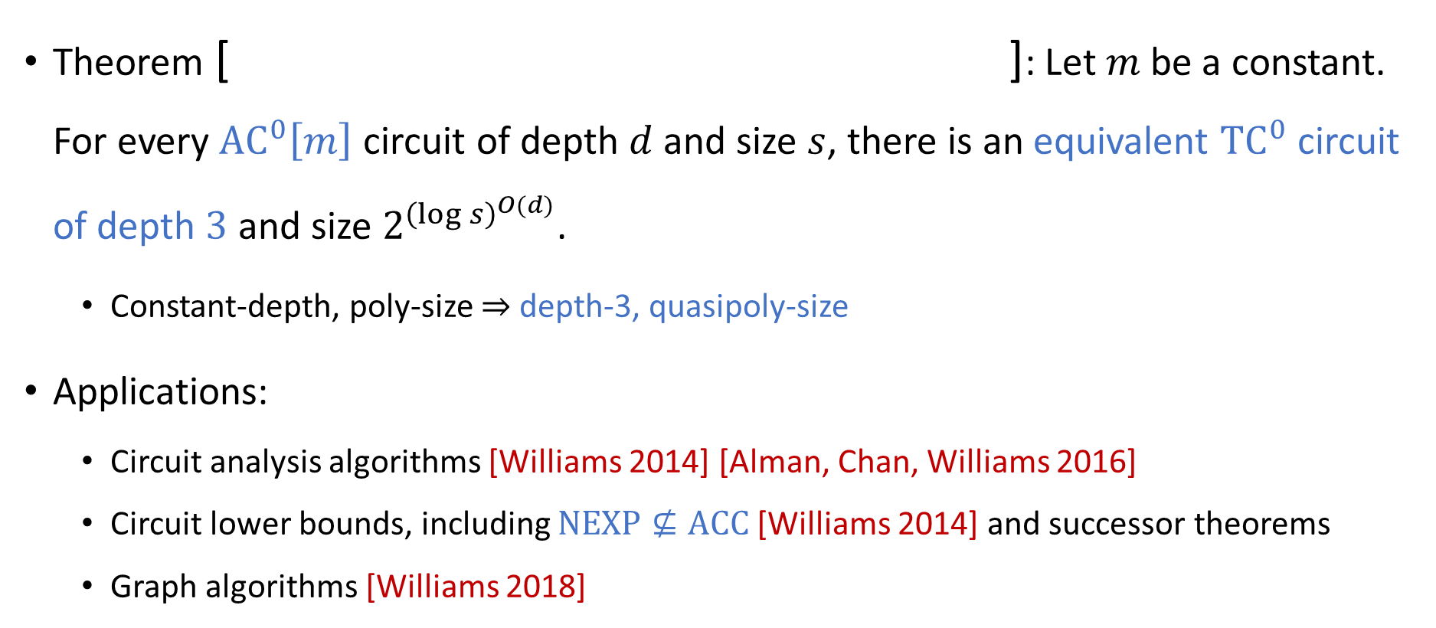
Depth reduction theorems
$$⇒$$
Theorem [ ]: Let $m$ be a constant. For every ${\text{AC}}^{0}\left[m\right]$ circuit of depth $d$ and size $s$, there is an equivalent ${\text{TC}}^{0}$ circuit of depth $3$ and size $2^{{\left(\log{s}\right)}^{O(d)}}$.
Constant-depth, poly-size $⇒$ depth-3, quasipoly-size
Applications:
Circuit analysis algorithms [Williams 2014] [Alman, Chan, Williams 2016]
Circuit lower bounds, including $\text{NEXP}⊈\text{ACC}$ [Williams 2014] and successor theorems
Graph algorithms [Williams 2018]
[Toda 1989] [Allender 1989] [Allender, Hertrampf 1994] [Yao 1990] [Beigel, Tarui 1994] [Allender, Gore 1994] [Chen, Papakonstantinou 2019]

Slide 6
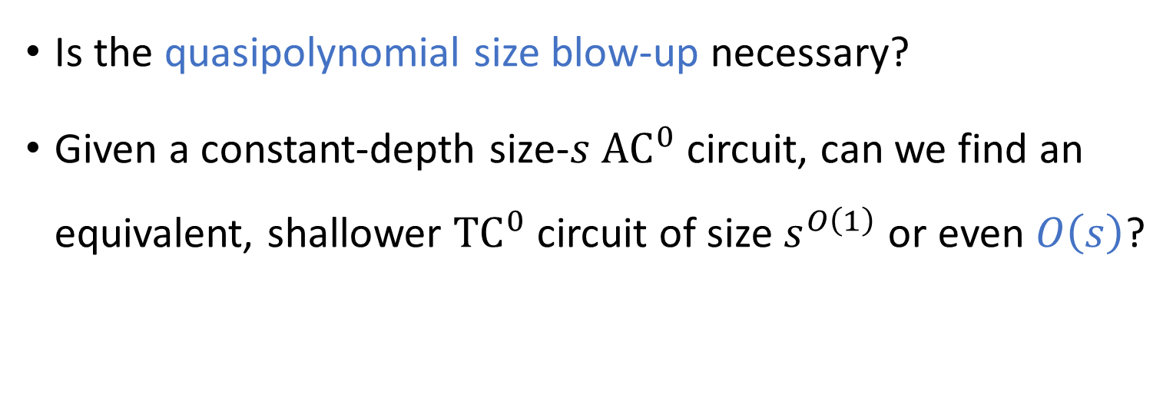
Size penalty for depth reduction
Is the quasipolynomial size blow-up necessary?
Given a constant-depth size-$s$ ${\text{AC}}^{0}$ circuit, can we find an equivalent, shallower ${\text{TC}}^{0}$ circuit of size $s^{O\left(1\right)}$ or even $O\left(s\right)$?

Slide 7


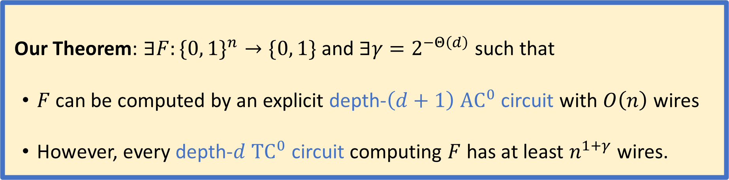
Limitations of depth reduction
$$⇏$$
Let $n,d∈ℕ$ with $d=o\left(\log{\log{n}}\right)$
Our Theorem: $∃F:\{0, 1\}^{n}→\{0, 1\}$and $∃γ=2^{−Θ\left(d\right)}$such that
$F$ can be computed by an explicit depth-$\left(d+1\right)$ ${\text{AC}}^{0}$ circuit with $O\left(n\right)$ wires
However, every depth-$d$ ${\text{TC}}^{0}$ circuit computing $F$ has at least $n^{1+γ}$ wires.

Slide 8
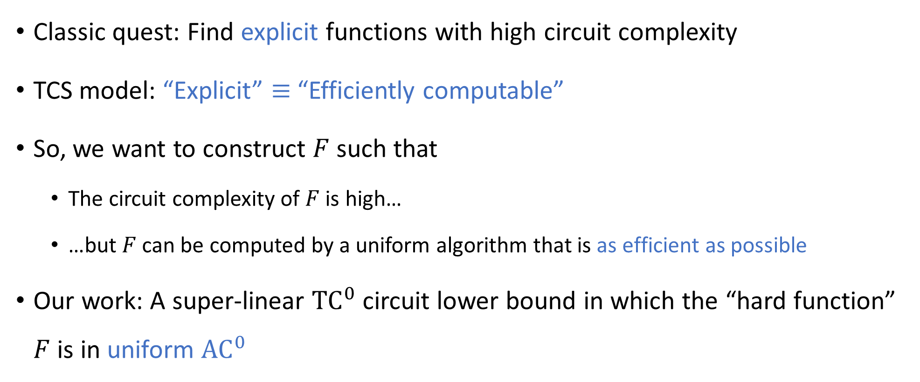
“Hyperexplicit” circuit lower bounds
Classic quest: Find explicit functions with high circuit complexity
TCS model: “Explicit” $≡$ “Efficiently computable”
So, we want to construct $F$ such that
The circuit complexity of $F$ is high…
…but $F$ can be computed by a uniform algorithm that is as efficient as possible
Our work: A super-linear ${\text{TC}}^{0}$ circuit lower bound in which the “hard function” $F$ is in uniform ${\text{AC}}^{0}$

Slide 9
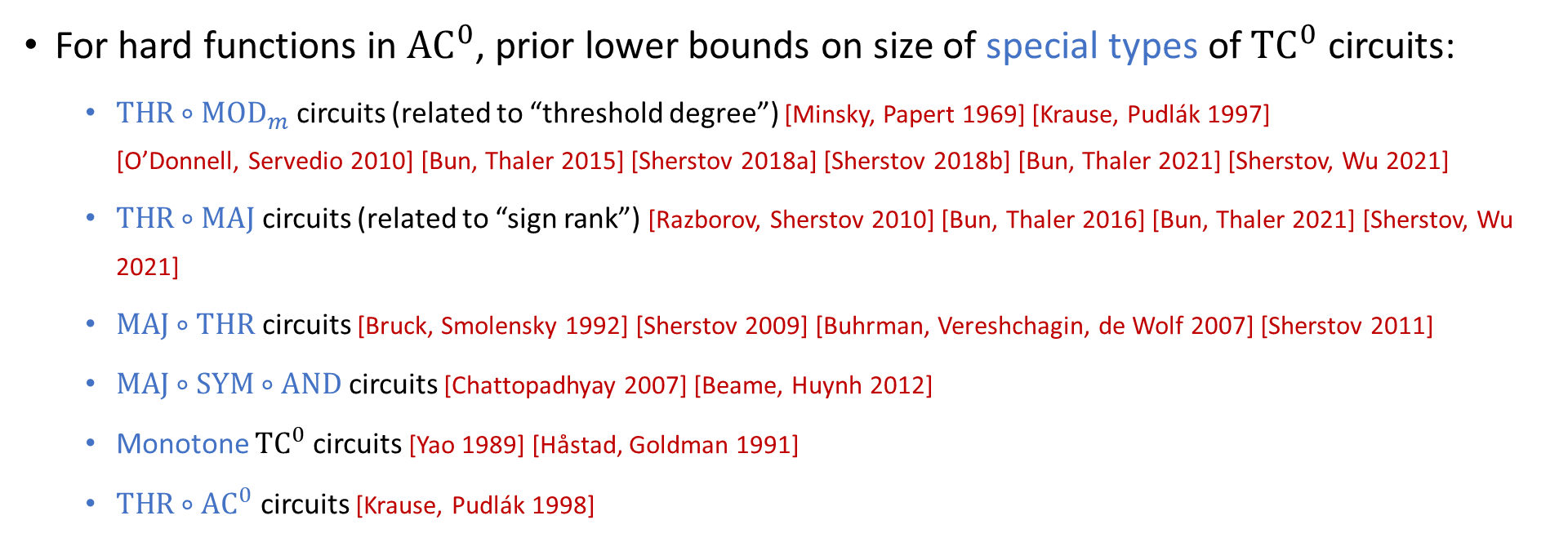

Some prior ${\text{TC}}^{0}$ circuit lower bounds
Theorem [Impagliazzo, Paturi, Saks 1997]: $∃γ=2^{−Θ\left(d\right)}$such that every depth-$d$ ${\text{TC}}^{0}$ circuit computing the parity function has at least $n^{1+γ}$ wires. Note: parity $∉{\text{AC}}^{0}$.
For hard functions in ${\text{AC}}^{0}$, prior lower bounds on size of special types of ${\text{TC}}^{0}$ circuits:
$\text{THR}∘{\text{MOD}}_{m}$ circuits (related to “threshold degree”) [Minsky, Papert 1969] [Krause, Pudlák 1997] [O’Donnell, Servedio 2010] [Bun, Thaler 2015] [Sherstov 2018a] [Sherstov 2018b] [Bun, Thaler 2021] [Sherstov, Wu 2021]
$\text{THR}∘\text{MAJ}$ circuits (related to “sign rank”) [Razborov, Sherstov 2010] [Bun, Thaler 2016] [Bun, Thaler 2021] [Sherstov, Wu 2021]
$\text{MAJ}∘\text{THR}$ circuits [Bruck, Smolensky 1992] [Sherstov 2009] [Buhrman, Vereshchagin, de Wolf 2007] [Sherstov 2011]
$\text{MAJ}∘\text{SYM}∘\text{AND}$ circuits [Chattopadhyay 2007] [Beame, Huynh 2012]
Monotone ${\text{TC}}^{0}$ circuits [Yao 1989] [Håstad, Goldman 1991]
$\text{THR}∘{\text{AC}}^{0}$ circuits [Krause, Pudlák 1998]

Slide 10



































Our hard function $F$
$F$ is a monotone read-once ${\text{AC}}^{0}$ formula (an AND-OR tree)
Every gate at distance $i$ from the input has fan-in $f_{i}$
The fan-ins grow rapidly as we move up the tree ($f_{1}≪f_{2}≪…≪f_{d+1}$)
$$∧$$
$$f_{5}=\tilde{Θ}\left(f_{4}^{100}\right)$$
$$⋯$$
$$∨$$
$$⋯$$
$$∨$$
$$⋯$$
$$⋯$$
$$f_{4}=\tilde{Θ}\left(f_{3}^{100}\right)$$
$$∧$$
$$⋯$$
$$∧$$
$$f_{3}=\tilde{Θ}\left(f_{2}^{100}\right)$$
$$⋯$$
$$⋯$$
$$∨$$
$$⋯$$
$$∨$$
$$f_{2}=n^{2^{−Θ\left(d\right)}}$$
$$⋯$$
$$⋯$$
$$∧$$
$$∧$$
$$⋯$$
$$f_{1}=2^{−Θ\left(d\right)}⋅\log{n}$$
$$⋯$$
$$⋯$$
$$x_{1}$$
$$x_{2}$$
$$⋯$$
$$x_{f_{1}}$$
$$⋯$$
$$x_{n}$$

Slide 11








Lower bound proof: random restrictions?
Theorem: Every depth-$d$ ${\text{TC}}^{0}$ circuit computing $F$ has at least $n^{1+γ}$ wires.
Can we prove this theorem using random restrictions?
[Chen, Santhanam, Srinivasan 2018]: ${\text{TC}}^{0}$ simplifies under random restrictions 🙂
Issue: ${\text{AC}}^{0}$ also simplifies 😟
Restrictions are too “blunt” for our theorem
random restriction
Depth-$d$ ${\text{TC}}^{0}$
Depth-$(d+1)$ ${\text{AC}}^{0}$
Parity

Slide 12
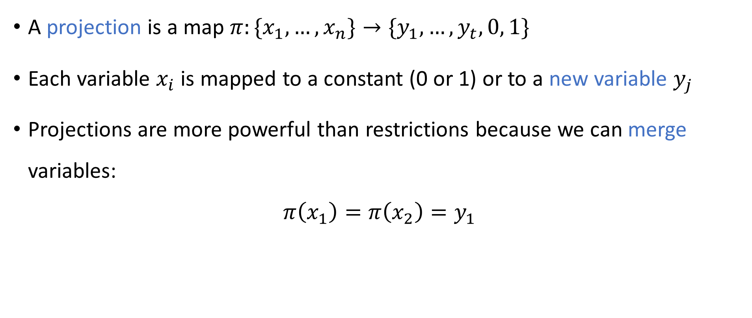
Random projections
[Impagliazzo, Segerlind 2001] [Håstad, Rossman, Servedio, Tan 2017] [Filmus, Meir, Tal 2021]
A projection is a map $π:\{x_{1},…, x_{n}\}→\{y_{1},…, y_{t}, 0, 1\}$
Each variable $x_{i}$ is mapped to a constant (0 or 1) or to a new variable $y_{j}$
Projections are more powerful than restrictions because we can merge variables:
$$π\left(x_{1}\right)=π\left(x_{2}\right)=y_{1}$$

Slide 13




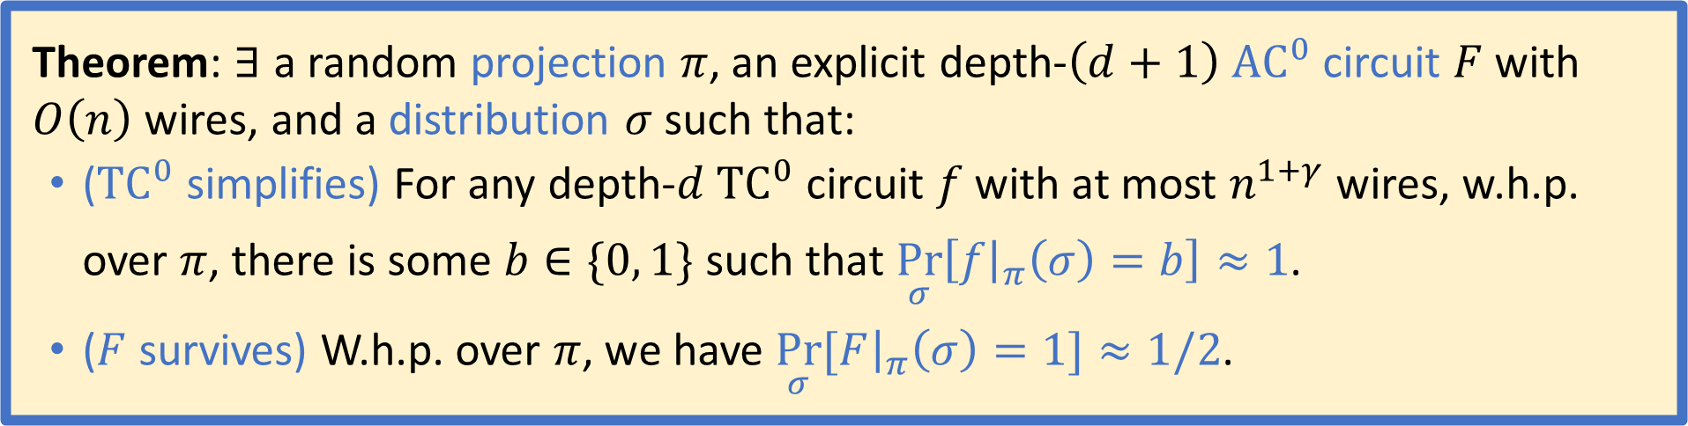
Random projections for ${\text{TC}}^{0}$ vs. ${\text{AC}}^{0}$
Theorem: $∃$ a random projection $π$, an explicit depth-$\left(d+1\right)$ ${\text{AC}}^{0}$ circuit $F$ with $O\left(n\right)$ wires, and a distribution $σ$ such that:
(${\text{TC}}^{0}$ simplifies) For any depth-$d$ ${\text{TC}}^{0}$ circuit $f$ with at most $n^{1+γ}$ wires, w.h.p. over $π$, there is some $b∈\{0, 1\}$ such that $\underset{σ}{Pr}\left[f{\left.​\right|}_{π}\left(σ\right)=b\right]≈1$.
($F$ survives) W.h.p. over $π$, we have $\underset{σ}{Pr}{[F{\left.​\right|}_{π}\left(σ\right)=1]}≈1/2$.
Proof combines techniques from:
[Chen, Santhanam, Srinivasan 2018]
[Håstad, Rossman, Servedio, Tan 2017]
random projection
Depth-$d$ ${\text{TC}}^{0}$
$$F$$

Slide 14
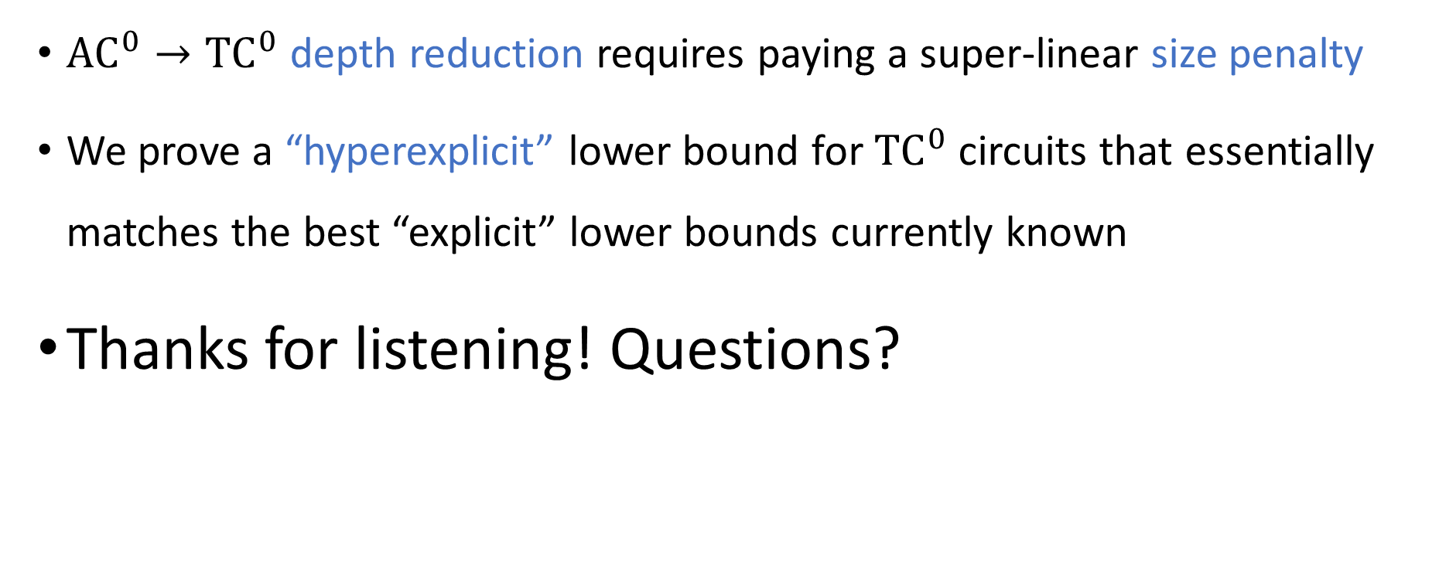
Summary
$$⇏$$
${\text{AC}}^{0}→{\text{TC}}^{0}$ depth reduction requires paying a super-linear size penalty
We prove a “hyperexplicit” lower bound for ${\text{TC}}^{0}$ circuits that essentially matches the best “explicit” lower bounds currently known
Thanks for listening! Questions?

