Slide 1
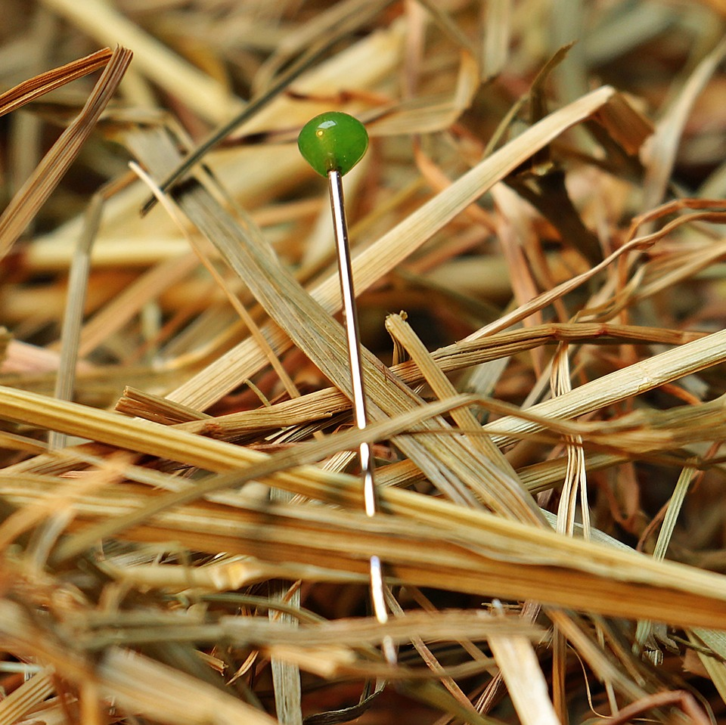
CMSC 28100 Introduction to Complexity Theory Spring 2025 Instructor: William Hoza

Slide 2
Course Review

Slide 3
Which problems can be solved through computation?

Slide 4
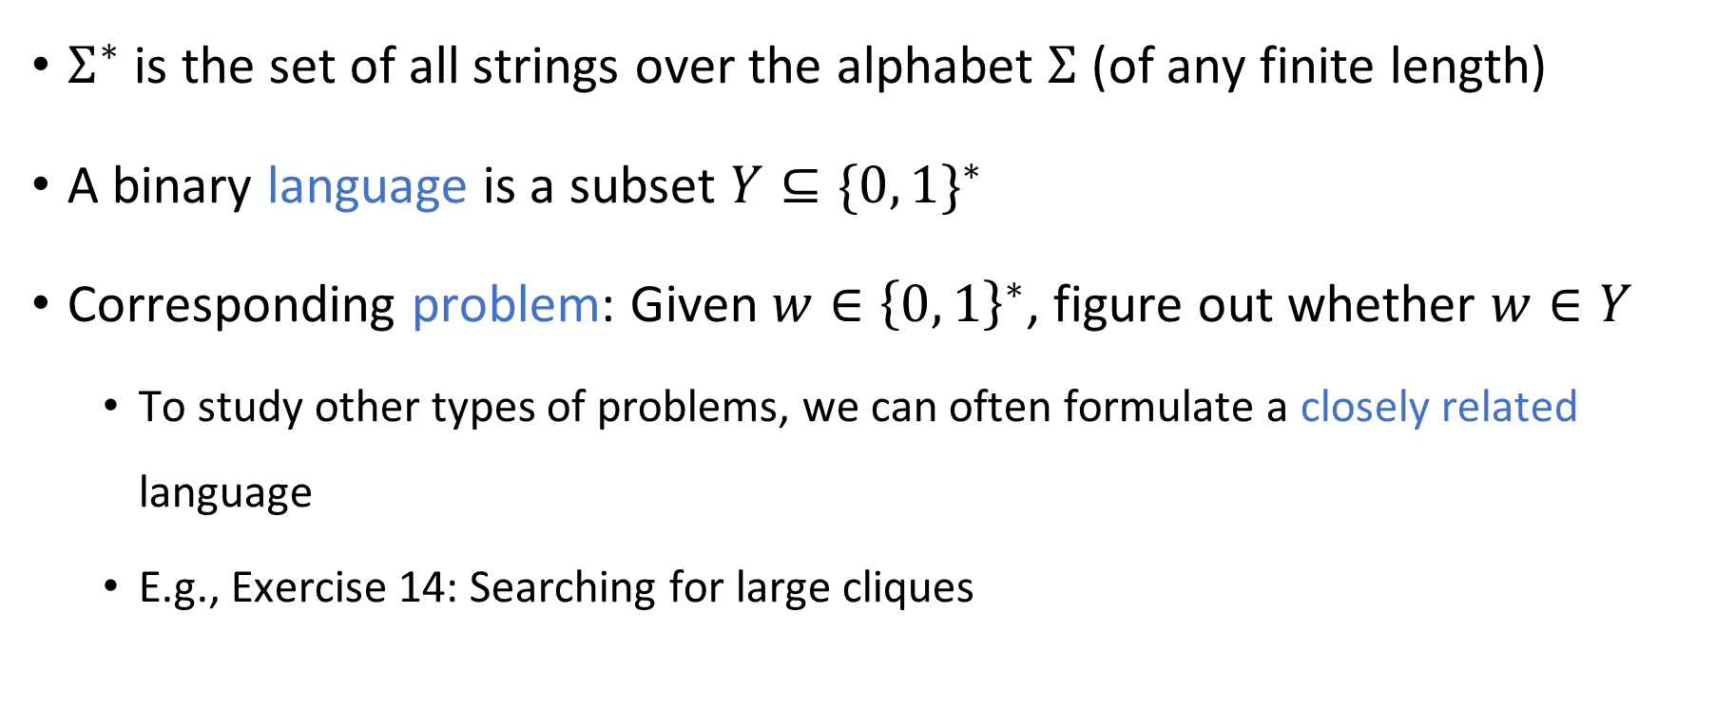
Strings and languages
$Σ^{∗}$ is the set of all strings over the alphabet $Σ$ (of any finite length)
A binary language is a subset $Y⊆{\{0, 1\}}^{∗}$
Corresponding problem: Given $w∈{\left\{0, 1\right\}}^{∗}$, figure out whether $w∈Y$
To study other types of problems, we can often formulate a closely related language
E.g., Exercise 14: Searching for large cliques

Slide 5
Which problems can be solved through computation?

Slide 6
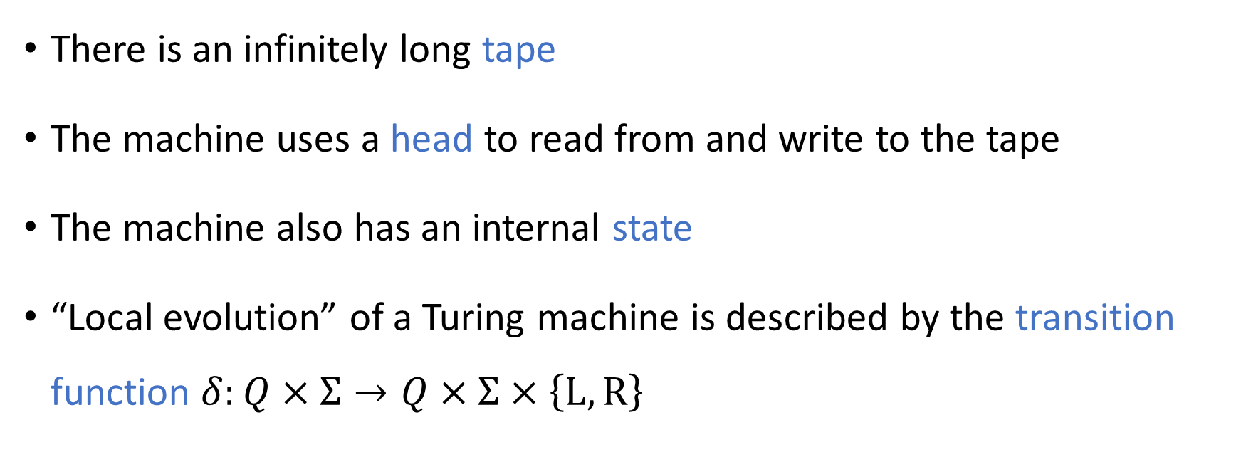



Turing machines
$$⊔$$
1
1
1
0
$$⊔$$
$$⊔$$
There is an infinitely long tape
The machine uses a head to read from and write to the tape
The machine also has an internal state
“Local evolution” of a Turing machine is described by the transition function $δ:Q×Σ→Q×Σ×\left\{\text{L},\text{R}\right\}$

Slide 7
Which problems can be solved through computation?

Slide 8
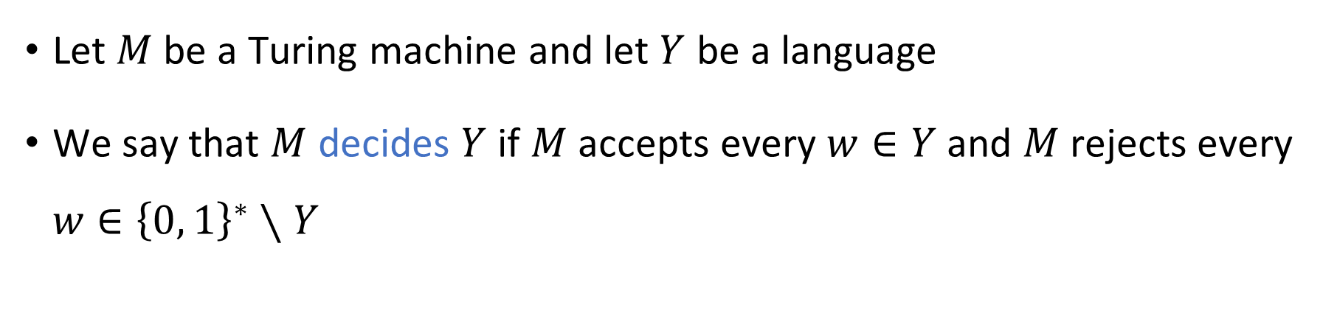
Deciding a language
Turing Machine
Accept
Reject
Run forever (“loop”)
Input
Let $M$ be a Turing machine and let $Y$ be a language
We say that $M$ decides $Y$ if $M$ accepts every $w∈Y$ and $M$ rejects every $w∈{\left\{0, 1\right\}}^{∗}∖Y$

Slide 9
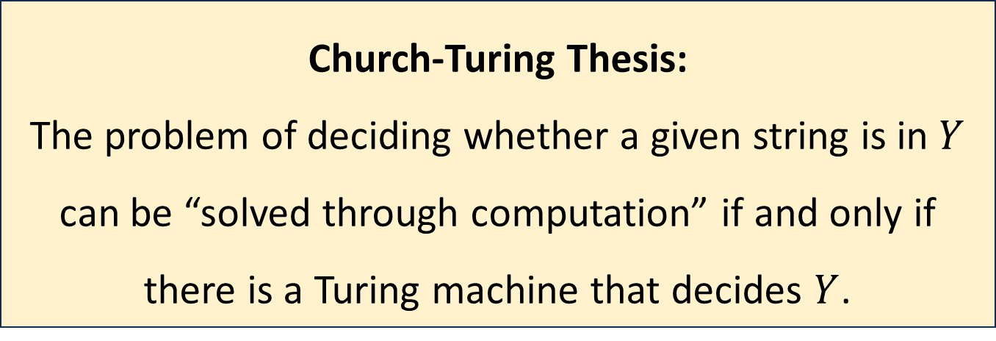

The Church-Turing Thesis
Let $Y⊆{\left\{0, 1\right\}}^{∗}$
Church-Turing Thesis:
The problem of deciding whether a given string is in $Y$ can be “solved through computation” if and only if there is a Turing machine that decides $Y$.
Intuitive notion
Mathematically precise notion

Slide 10
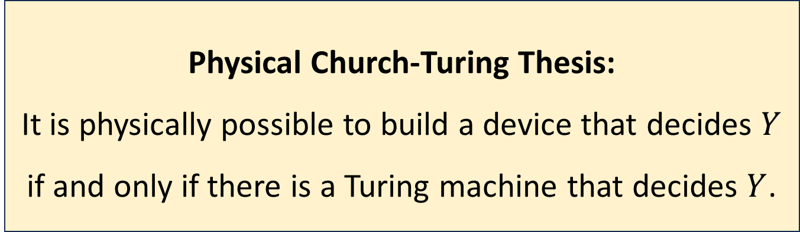
The Physical Church-Turing Thesis
Let $Y⊆{\left\{0, 1\right\}}^{∗}$
Physical Church-Turing Thesis:
It is physically possible to build a device that decides $Y$ if and only if there is a Turing machine that decides $Y$.

Slide 11

Code as data
A Turing machine $M$ represents an algorithm
At the same time, $M$ can be encoded as a string $\left\langle M\right\rangle$
This string $\left\langle M\right\rangle$ could be the input or output of a different algorithm!

Slide 12
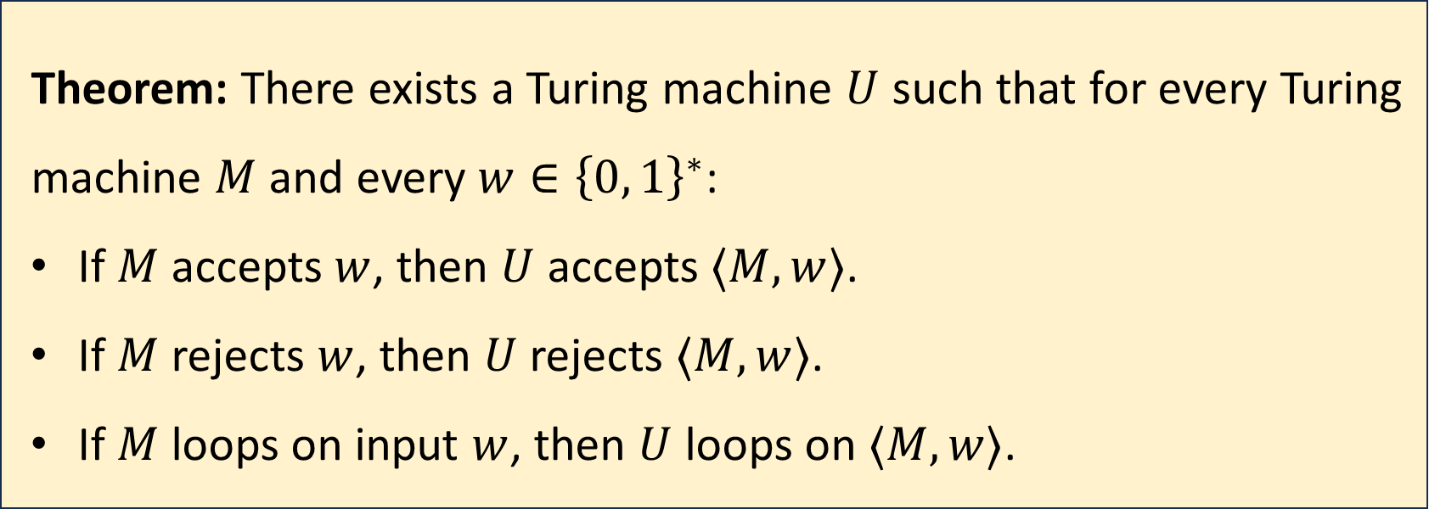
Universal Turing machines
Theorem: There exists a Turing machine $U$ such that for every Turing machine $M$ and every $w∈{\left\{0, 1\right\}}^{∗}$:
If $M$ accepts $w$, then $U$ accepts $⟨M,w⟩$.
If $M$ rejects $w$, then $U$ rejects $⟨M,w⟩$.
If $M$ loops on input $w$, then $U$ loops on $⟨M,w⟩$.

Slide 13
Universal Turing machines
If you are stranded on an alien planet and you are trying to build a computer, your job is to build a universal Turing machine
A universal Turing machine can be “programmed” to do anything that is computationally possible

Slide 14
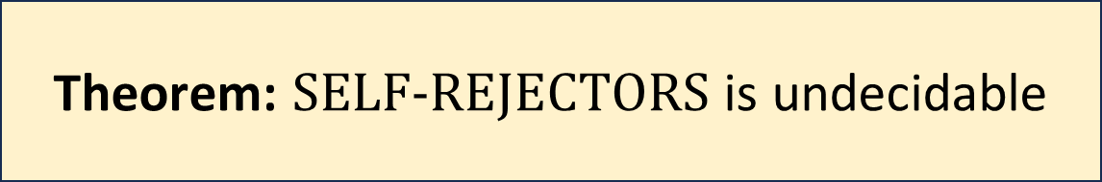

Undecidability
$\text{SELF}‑\text{REJECTORS}=\left\{\left\langle M\right\rangle :M \text{rejects} \left\langle M\right\rangle \right\}$
We can rule out all possible algorithms!
Theorem: $\text{SELF}‑\text{REJECTORS}$ is undecidable

Slide 15



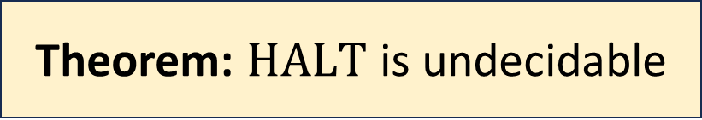
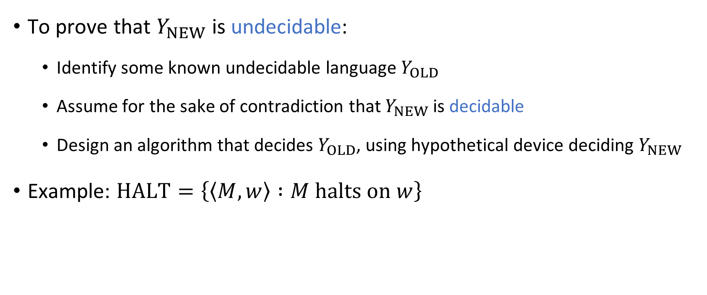
Reductions
To prove that $Y_{NEW}$ is undecidable:
Identify some known undecidable language $Y_{OLD}$
Assume for the sake of contradiction that $Y_{NEW}$ is decidable
Design an algorithm that decides $Y_{OLD}$, using hypothetical device deciding $Y_{NEW}$
Example: $\text{HALT}=\left\{\left\langle M,w\right\rangle :M \text{halts} \text{on} w\right\}$
Theorem: $\text{HALT}$ is undecidable

Slide 16













Post’s Correspondence Problem
Input: A set of “dominos”
Goal: Determine whether it is possible to generate a “match”
in which the sequence of top symbols equals the sequence of bottom symbols
$$\begin{matrix}t_{1} \\ b_{1}\end{matrix}$$
$$\begin{matrix}t_{2} \\ b_{2}\end{matrix}$$
$$\begin{matrix}t_{3} \\ b_{3}\end{matrix}$$
$$\begin{matrix}t_{k} \\ b_{k}\end{matrix}$$
$$⋯$$
$$\begin{matrix}t_{i_{1}} \\ b_{i_{1}}\end{matrix}$$
$$\begin{matrix}t_{i_{2}} \\ b_{i_{2}}\end{matrix}$$
$$\begin{matrix}t_{i_{3}} \\ b_{i_{3}}\end{matrix}$$
$$\begin{matrix}t_{i_{4}} \\ b_{i_{4}}\end{matrix}$$
$$\begin{matrix}t_{i_{5}} \\ b_{i_{5}}\end{matrix}$$
$$\begin{matrix}t_{i_{n}} \\ b_{i_{n}}\end{matrix}$$
$$⋯$$
Theorem: $\text{PCP}$ is undecidable

Slide 17
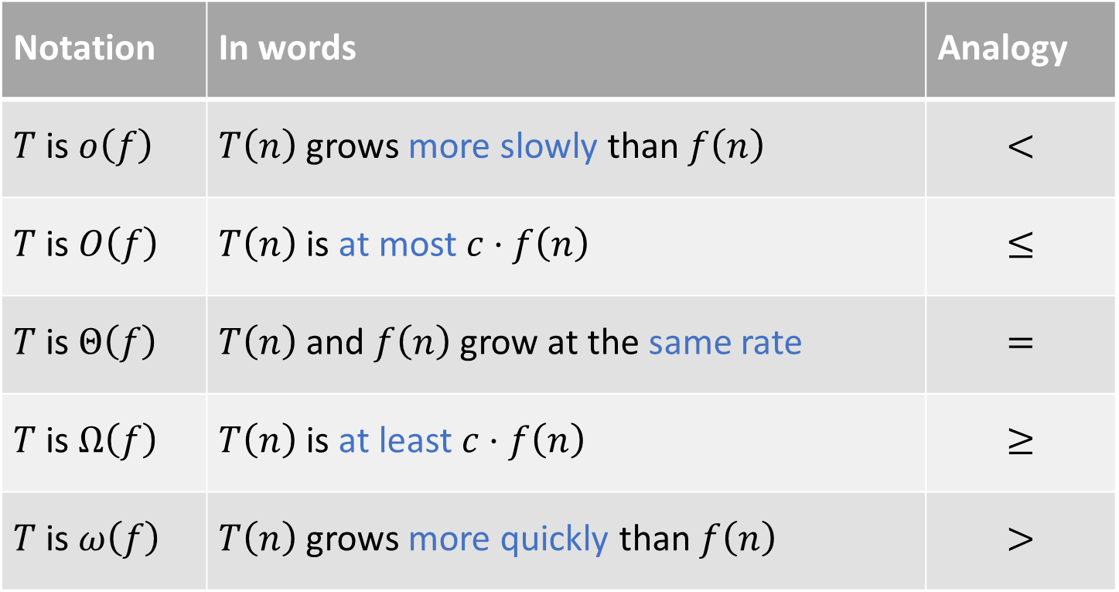
Asymptotic analysis
Notation | In words | Analogy
$T$ is $o\left(f\right)$ | $T\left(n\right)$ grows more slowly than $f\left(n\right)$ | $$<$$
$T$ is $O\left(f\right)$ | $T\left(n\right)$ is at most $c⋅f\left(n\right)$ | $$≤$$
$T$ is $Θ\left(f\right)$ | $T\left(n\right)$ and $f\left(n\right)$ grow at the same rate | $$=$$
$T$ is $Ω\left(f\right)$ | $T\left(n\right)$ is at least $c⋅f\left(n\right)$ | $$≥$$
$T$ is $ω\left(f\right)$ | $T\left(n\right)$ grows more quickly than $f\left(n\right)$ | $$>$$

Slide 18

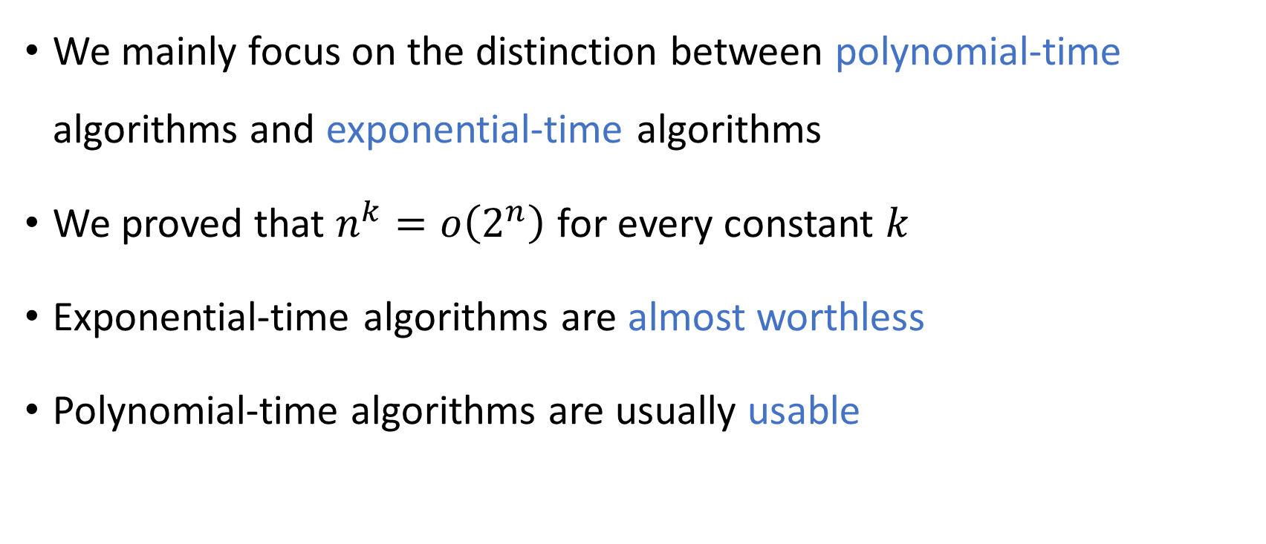
Polynomial-time computation
We mainly focus on the distinction between polynomial-time algorithms and exponential-time algorithms
We proved that $n^{k}=o\left(2^{n}\right)$ for every constant $k$
Exponential-time algorithms are almost worthless
Polynomial-time algorithms are usually usable

Slide 19
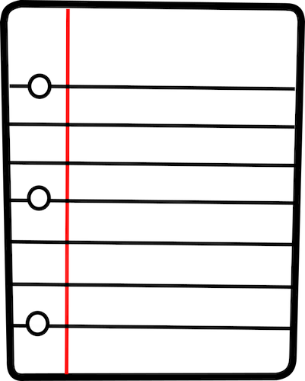

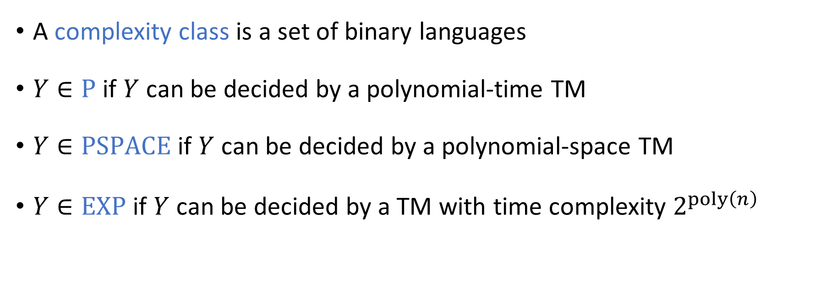
Complexity classes
A complexity class is a set of binary languages
$Y∈\text{P}$ if $Y$ can be decided by a polynomial-time TM
$Y∈\text{PSPACE}$ if $Y$ can be decided by a polynomial-space TM
$Y∈\text{EXP}$ if $Y$ can be decided by a TM with time complexity $2^{poly\left(n\right)}$

Slide 20






Randomized Turing machines
Input tape ➡
$$⊔$$
1
1
1
0
$$⊔$$
$$⊔$$
Randomness tape ➡
$$⊔$$

Slide 21
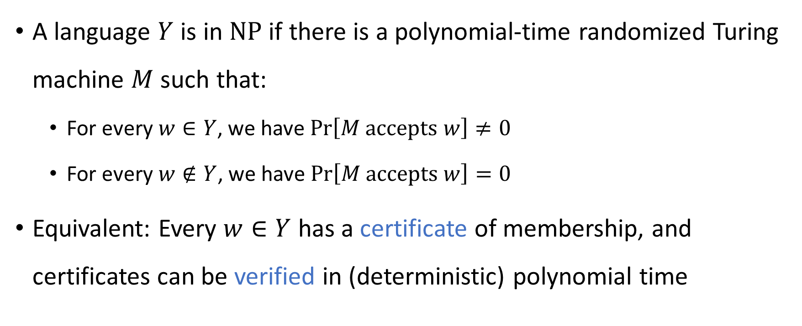

The complexity class $\text{NP}$
A language $Y$ is in $\text{NP}$ if there is a polynomial-time randomized Turing machine $M$ such that:
For every $w∈Y$, we have $\operatorname{Pr}\left[M \text{accepts} w\right]≠0$
For every $w∉Y$, we have $\operatorname{Pr}\left[M \text{accepts} w\right]=0$
Equivalent: Every $w∈Y$ has a certificate of membership, and certificates can be verified in (deterministic) polynomial time

Slide 22

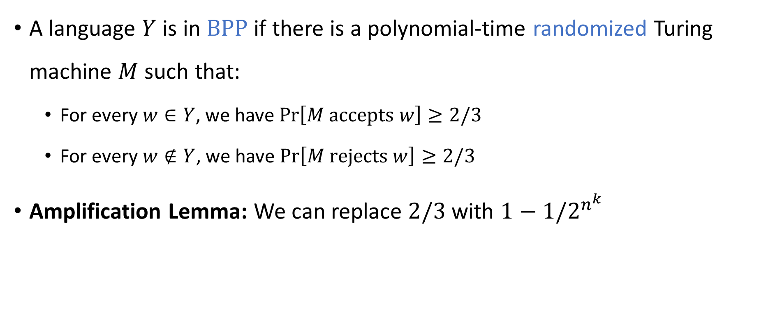

The complexity class $\text{BPP}$
A language $Y$ is in $\text{BPP}$ if there is a polynomial-time randomized Turing machine $M$ such that:
For every $w∈Y$, we have $\operatorname{Pr}\left[M \text{accepts} w\right]≥2/3$
For every $w∉Y$, we have $\operatorname{Pr}\left[M \text{rejects} w\right]≥2/3$
Amplification Lemma: We can replace $2/3$ with $1−1/2^{n^{k}}$

Slide 23




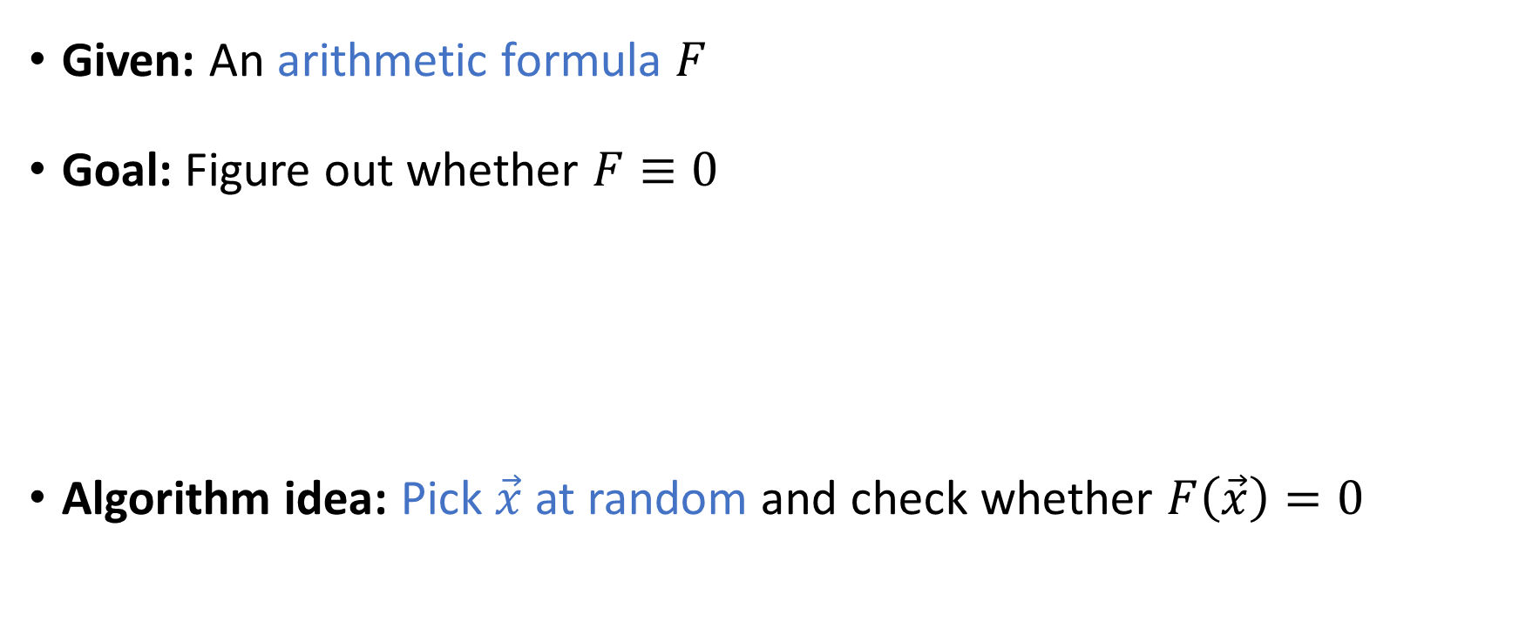






Example: Polynomial identity testing
$$×$$
Given: An arithmetic formula $F$
Goal: Figure out whether $F≡0$
Algorithm idea: Pick $\vec{x}$ at random and check whether $F\left(\vec{x}\right)=0$
$$+$$
$$+$$
$$x_{1}$$
$$×$$
$$x_{1}$$
$$x_{2}$$
Theorem: $\text{PIT}∈\text{BPP}$
$$−1$$
$$x_{2}$$

Slide 24
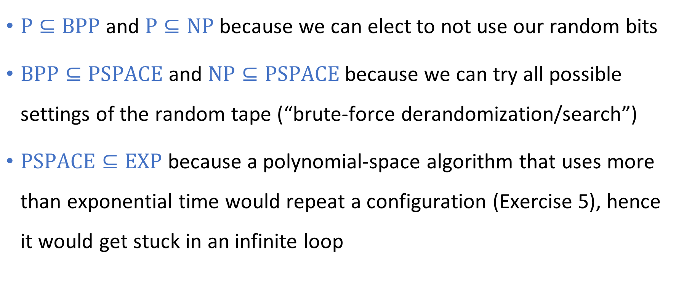
Relationships between complexity classes
$\text{P}⊆\text{BPP}$ and $\text{P}⊆\text{NP}$ because we can elect to not use our random bits
$\text{BPP}⊆\text{PSPACE}$ and $\text{NP}⊆\text{PSPACE}$ because we can try all possible settings of the random tape (“brute-force derandomization/search”)
$\text{PSPACE}⊆\text{EXP}$ because a polynomial-space algorithm that uses more than exponential time would repeat a configuration (Exercise 5), hence it would get stuck in an infinite loop

Slide 25




Decidable languages
$$\text{EXP}$$
$$\text{PSPACE}$$
$$\text{NP}$$
$$\text{P}$$

Slide 26




Communication complexity
Goal: Compute $f\left(x, y\right)$ using as little communication as possible
Communication channel
Alice holds $x$
Bob holds $y$

Slide 27


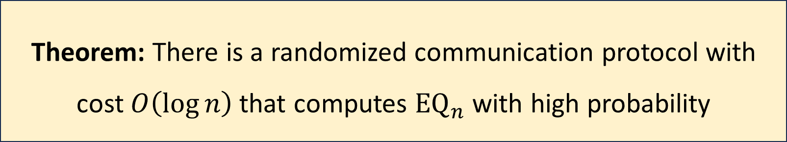
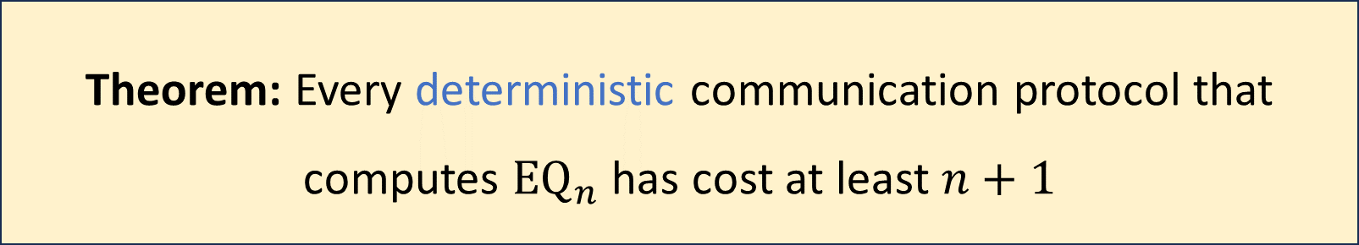
Communication complexity of ${\text{EQ}}_{n}$
${\text{EQ}}_{n}\left(x, y\right)=1⇔x=y$
Theorem: Every deterministic communication protocol that computes ${\text{EQ}}_{n}$ has cost at least $n+1$
Theorem: There is a randomized communication protocol with cost $O\left(\log{n}\right)$ that computes ${\text{EQ}}_{n}$ with high probability

Slide 28
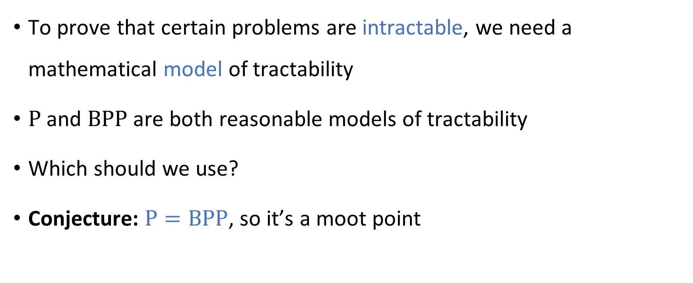
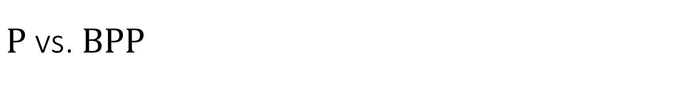
$\text{P}$ vs. $\text{BPP}$
To prove that certain problems are intractable, we need a mathematical model of tractability
$\text{P}$ and $\text{BPP}$ are both reasonable models of tractability
Which should we use?
Conjecture: $\text{P}=\text{BPP}$, so it’s a moot point

Slide 29

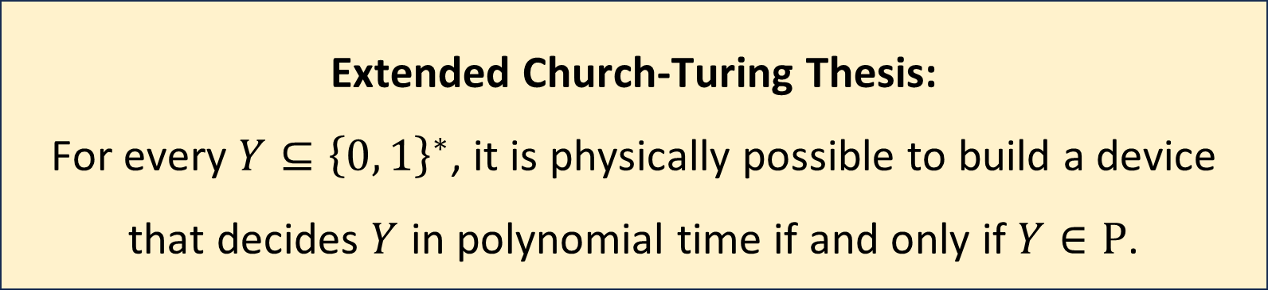
Extended Church-Turing Thesis
Extended Church-Turing Thesis:
For every $Y⊆{\left\{0, 1\right\}}^{∗}$, it is physically possible to build a device that decides $Y$ in polynomial time if and only if $Y∈\text{P}$.
The Extended Church-Turing Thesis is probably false because of quantum computing

Slide 30
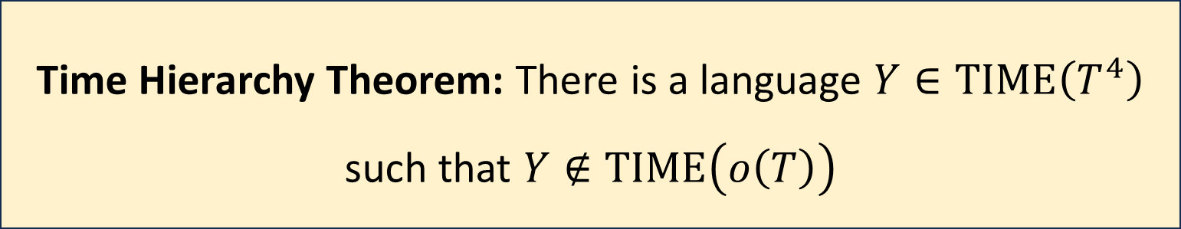

The Time Hierarchy Theorem
Let $T:ℕ→ℕ$ be any “reasonable” (time-constructible) function
Consequence: $\text{P}≠\text{EXP}$
Time Hierarchy Theorem: There is a language $Y∈\text{TIME}\left(T^{4}\right)$ such that $Y∉\text{TIME}\left(o\left(T\right)\right)$

Slide 31



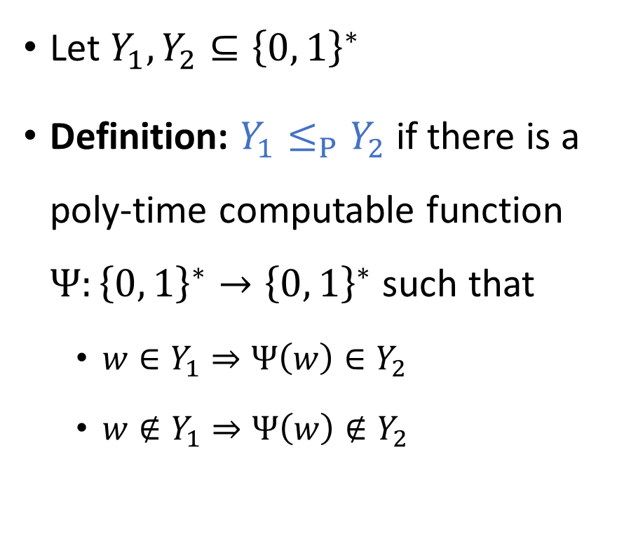
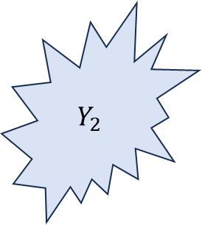


Mapping reductions
$$Ψ$$
Let $Y_{1},Y_{2}⊆{\left\{0, 1\right\}}^{∗}$
Definition: $Y_{1}≤_{P}Y_{2}$ if there is a poly-time computable function $Ψ:{\left\{0, 1\right\}}^{∗}→{\left\{0, 1\right\}}^{∗}$ such that
$w∈Y_{1}⇒Ψ\left(w\right)∈Y_{2}$
$w∉Y_{1}⇒Ψ\left(w\right)∉Y_{2}$
$$Y_{2}$$
$$Y_{1}$$
$$Ψ$$
$${\left\{0, 1\right\}}^{∗}$$
$${\left\{0, 1\right\}}^{∗}$$

Slide 32
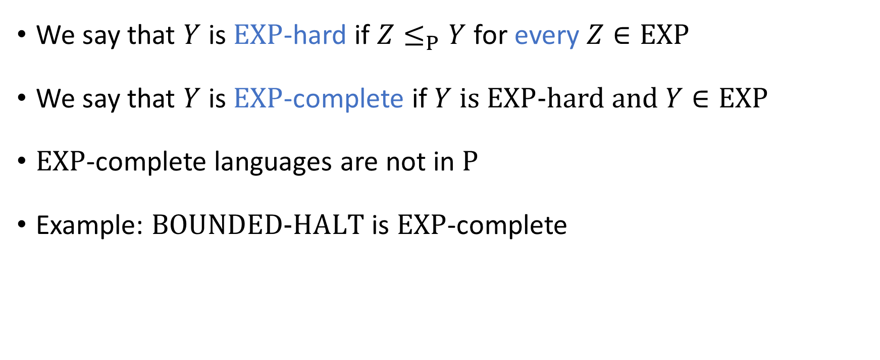
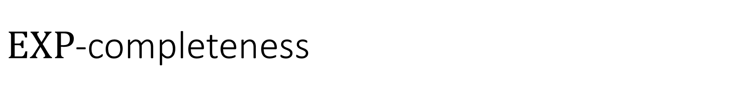
$\text{EXP}$-completeness
We say that $Y$ is $\text{EXP}$-hard if $Z≤_{P}Y$ for every $Z∈\text{EXP}$
We say that $Y$ is $\text{EXP}$-complete if $Y$ is $\text{EXP}$-hard and $Y∈\text{EXP}$
$\text{EXP}$-complete languages are not in $\text{P}$
Example: $\text{BOUNDED}\text{‑}\text{HALT}$ is $\text{EXP}$-complete

Slide 33


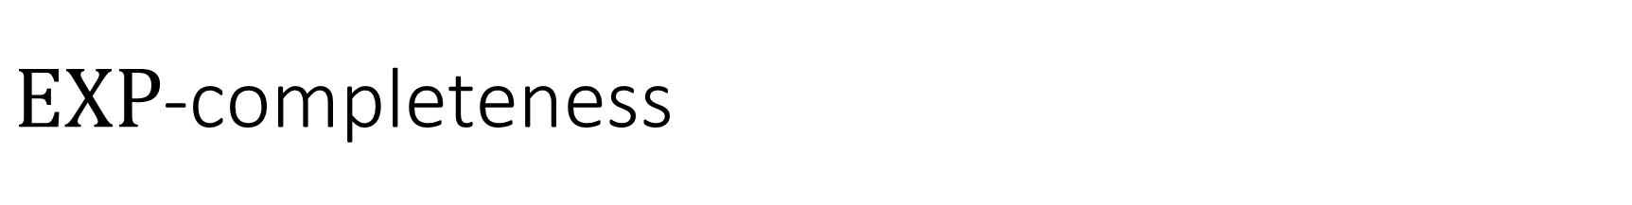



$\text{EXP}$-completeness
$\text{EXP}$-hard
$$\text{BOUNDED}\text{‑}\text{HALT}$$
$\text{EXP}$-complete
$$\text{EXP}$$
$$\text{P}$$

Slide 34


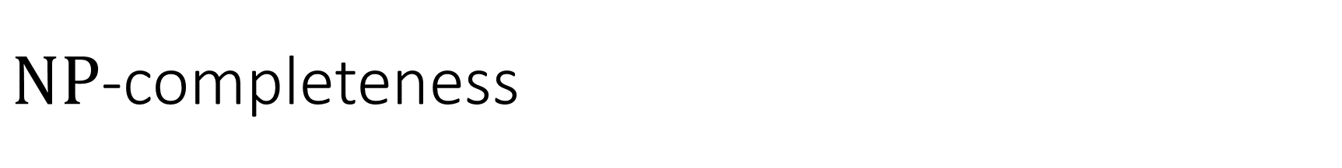


$\text{NP}$-completeness
$\text{NP}$-hard
A language $Y$ is $\text{NP}$-complete if $Y∈\text{NP}$ and $Z≤_{P}Y$ for every $Z∈\text{NP}$
$\text{NP}$-complete
$$\text{NP}$$
$$\text{P}$$

Slide 35
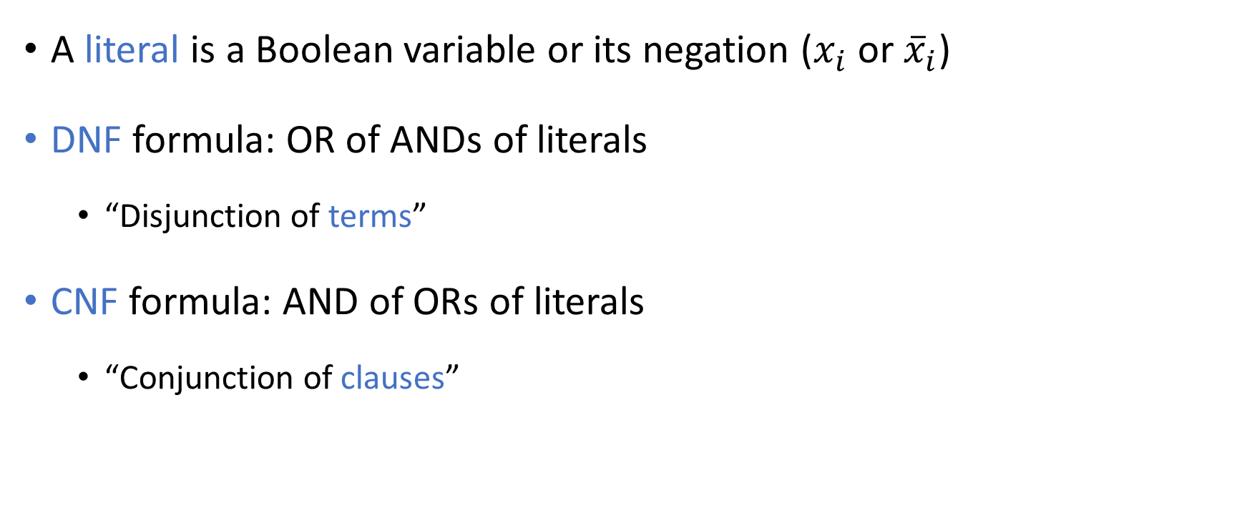
Disjunctive/conjunctive normal form
A literal is a Boolean variable or its negation ($x_{i}$ or ${\overline{x}}_{i}$)
DNF formula: OR of ANDs of literals
“Disjunction of terms”
CNF formula: AND of ORs of literals
“Conjunction of clauses”

Slide 36
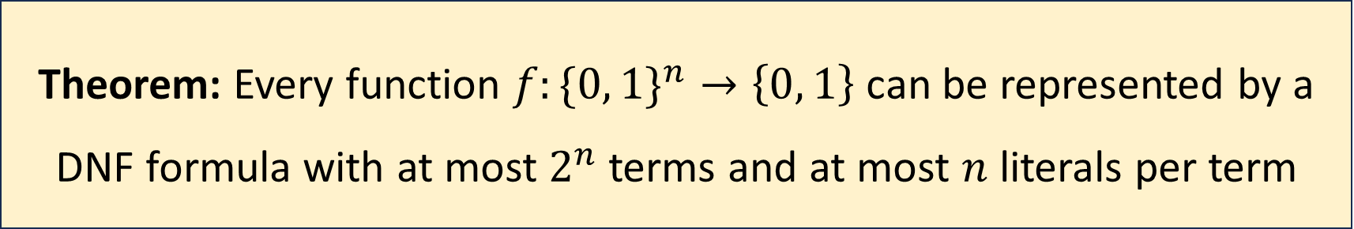
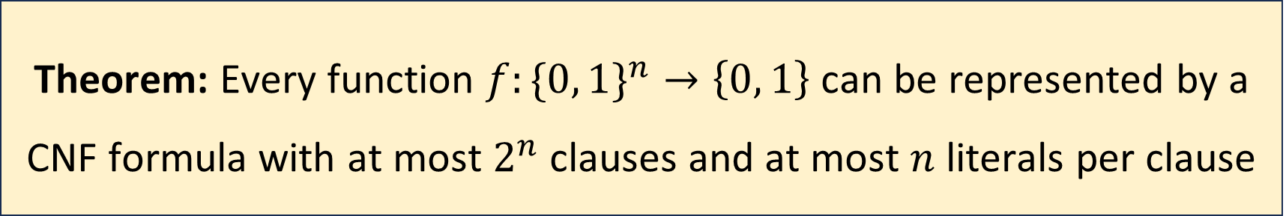
Disjunctive/conjunctive normal form
Theorem: Every function $f:\{0, 1\}^{n}→\left\{0, 1\right\}$ can be represented by a DNF formula with at most $2^{n}$ terms and at most $n$ literals per term
Theorem: Every function $f:\{0, 1\}^{n}→\left\{0, 1\right\}$ can be represented by a CNF formula with at most $2^{n}$ clauses and at most $n$ literals per clause

Slide 37
Boolean circuits
$$∨$$
A “circuit” is a network of AND/OR/NOT gates applied to Boolean variables
$$∧$$
$$∧$$
$$¬$$
$$¬$$
$$∨$$
$$∨$$
$$∧$$
$$∧$$
$$∧$$
$$∧$$
$$¬$$
$$¬$$
$$¬$$
$$¬$$
$$x_{1}$$
$$x_{2}$$
$$x_{3}$$
$$x_{4}$$

Slide 38
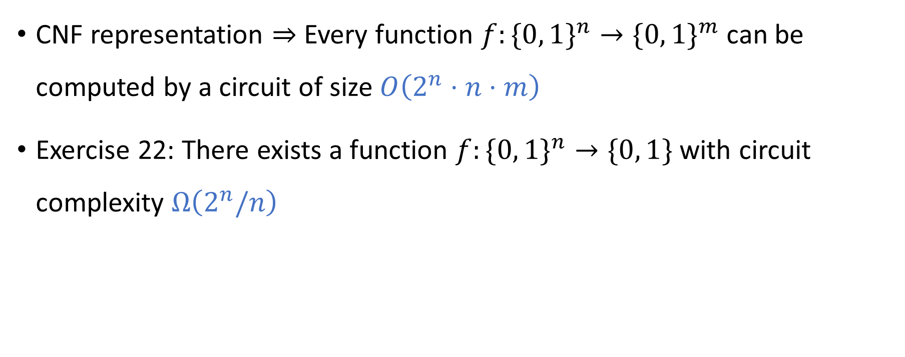
Circuit complexity
CNF representation $⇒$ Every function $f:\{0, 1\}^{n}→\{0, 1\}^{m}$can be computed by a circuit of size $O\left(2^{n}⋅n⋅m\right)$
Exercise 22: There exists a function $f:\{0, 1\}^{n}→\{0, 1\}$ with circuit complexity $Ω\left(2^{n}/n\right)$

Slide 39

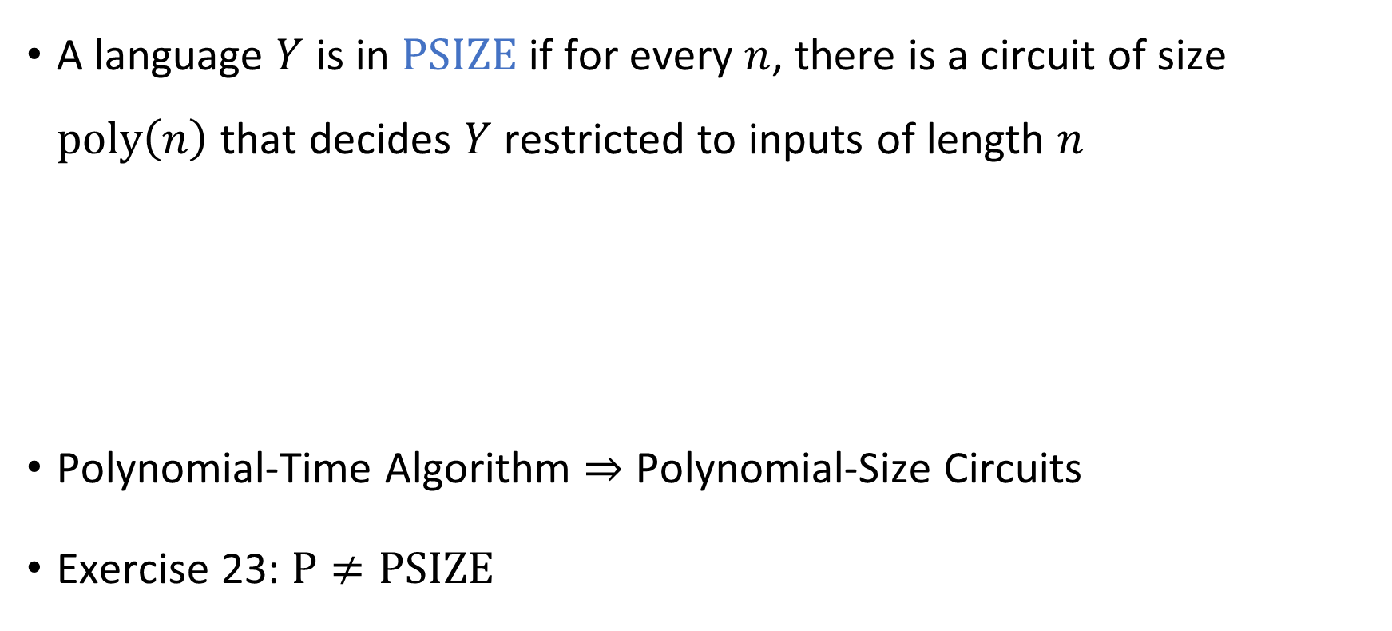
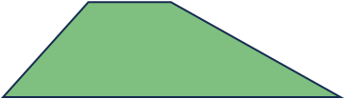

Polynomial-size circuits
A language $Y$ is in $\text{PSIZE}$ if for every $n$, there is a circuit of size $\text{poly}\left(n\right)$ that decides $Y$ restricted to inputs of length $n$
Polynomial-Time Algorithm $⇒$ Polynomial-Size Circuits
Exercise 23: $\text{P}≠\text{PSIZE}$
Theorem: $\text{P}⊆\text{PSIZE}$

Slide 40

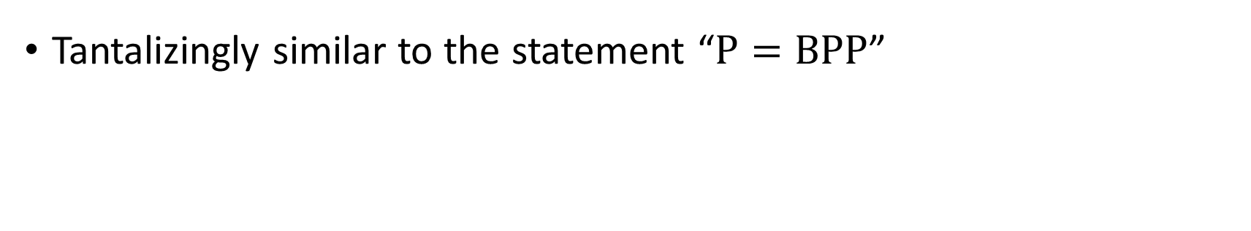
Adleman’s theorem
Adleman’s Theorem: $BP\text{P}⊆\text{PSIZE}$
Tantalizingly similar to the statement “$\text{P}=\text{BPP}$”

Slide 41


Circuit satisfiability
$\text{CIRCUIT}\text{‑}\text{SAT}=\left\{\left\langle C\right\rangle :C \text{is} \text{a} \text{satisfiable} \text{circuit}\right\}$
Theorem: $\text{CIRCUIT}\text{‑}\text{SAT}$ is $\text{NP}$-complete

Slide 42


The Cook-Levin Theorem
Definition: A $k$-CNF formula is an AND of ORs of at most $k$ literals
Definition: $k\text{‑}\text{SAT}=\{\left\langle φ\right\rangle :φ \text{is} \text{a} \text{satisfiable} k\text{‑}\text{CNF} \text{formula}\}$
The Cook-Levin Theorem: $3\text{‑}\text{SAT}$ is $\text{NP}$-complete

Slide 43


More $\text{NP}$-complete problems
$\text{CLIQUE}$
$\text{UNDIRECTED}\text{‑}\text{HAM}\text{‑}\text{CYCLE}$
$\text{3}\text{‑}\text{COLORABLE}$ (Exercise 26)
$\text{SUBSET}\text{‑}\text{SUM}$
$\text{KNAPSACK}$

Slide 44
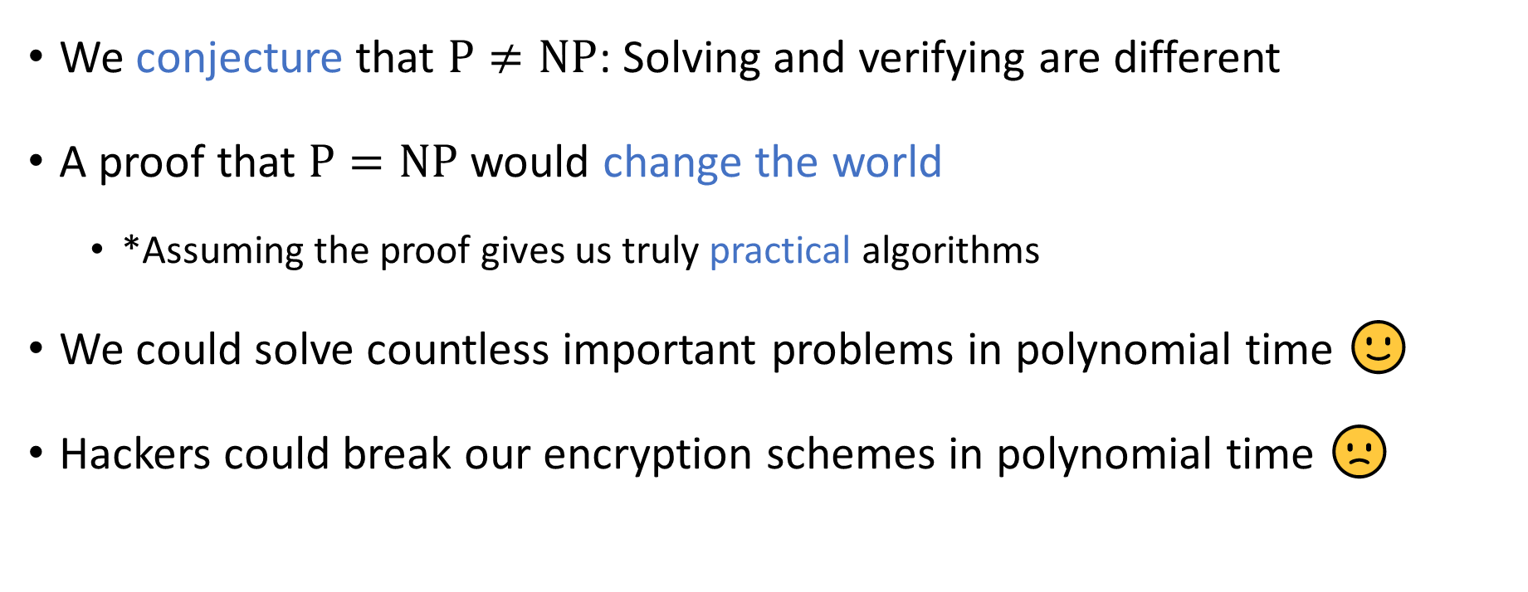

The $\text{P}$ vs. $\text{NP}$ problem
We conjecture that $\text{P}≠\text{NP}$: Solving and verifying are different
A proof that $\text{P}=\text{NP}$ would change the world
*Assuming the proof gives us truly practical algorithms
We could solve countless important problems in polynomial time 🙂
Hackers could break our encryption schemes in polynomial time 🙁

Slide 45
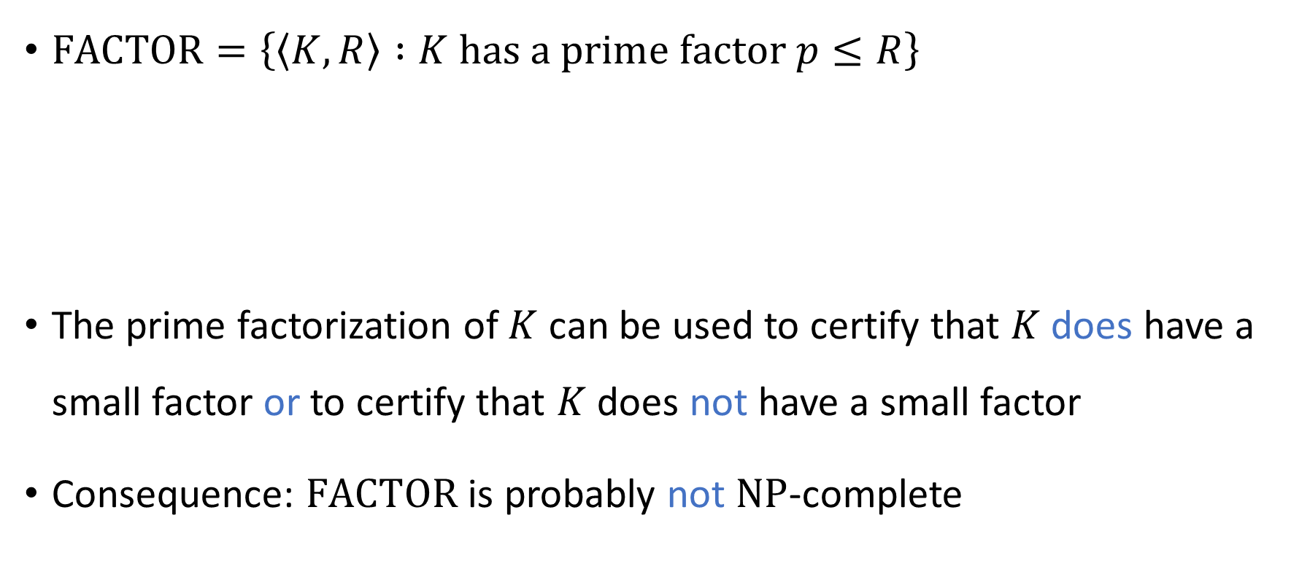


The complexity class $\text{NP}∩\text{coNP}$
$\text{FACTOR}=\left\{\left\langle K,R\right\rangle :K \text{has} \text{a} \text{prime} \text{factor} p≤R\right\}$
The prime factorization of $K$ can be used to certify that $K$ does have a small factor or to certify that $K$ does not have a small factor
Consequence: $\text{FACTOR}$ is probably not $\text{NP}$-complete
Theorem: $\text{FACTOR}∈\text{NP}∩\text{coNP}$

Slide 46









$\text{coNP}$-hard
$\text{NP}$-hard
$\text{coNP}$-complete
$\text{NP}$-complete
$$\text{coNP}$$
$$\text{NP}$$
$$\text{FACTOR}$$
$$\text{NP}∩\text{coNP}$$
$$\text{P}$$

Slide 47

Approximation algorithms
We can find a “99% optimal” solution to a given instance of the knapsack problem in polynomial time 🙂
If $\text{P}≠\text{NP}$, then we cannot even find a “1% optimal” solution to a given instance of the clique problem in polynomial time ☹️

Slide 48
Thank you!
Teaching you has been a privilege
I hope you’ve enjoyed taking the course as much as I’ve enjoyed teaching it
Please fill out the College Course Feedback Form using My.UChicago (deadline is June 1)

Slide 49
Three big lessons
We can study all possible algorithms simultaneously by developing mathematical models of computation!
Computation has severe unavoidable limitations!
Computer science is deep / profound / sublime, not merely useful!
What is the nature of the physical universe?
What is the nature of the human condition?
See you at office hours and the final exam!

