Slide 1
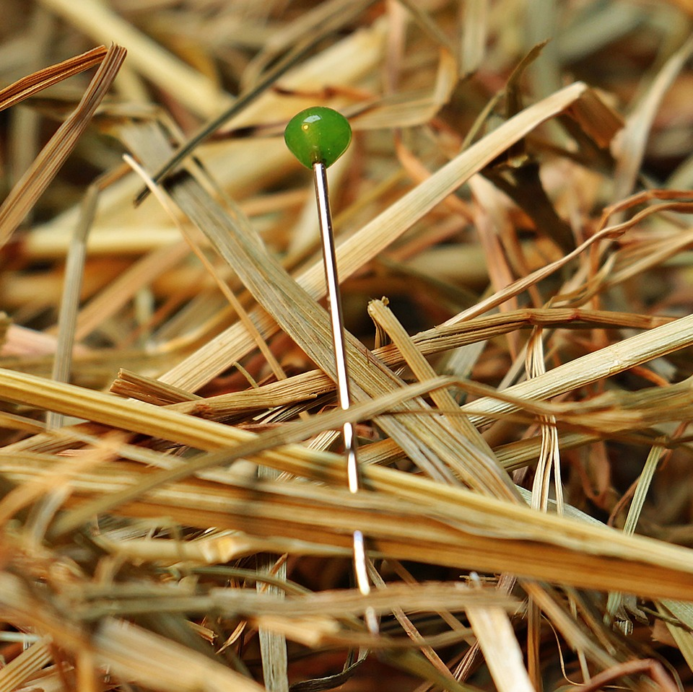
CMSC 28100 Introduction to Complexity Theory Spring 2024 Instructor: William Hoza

Slide 2

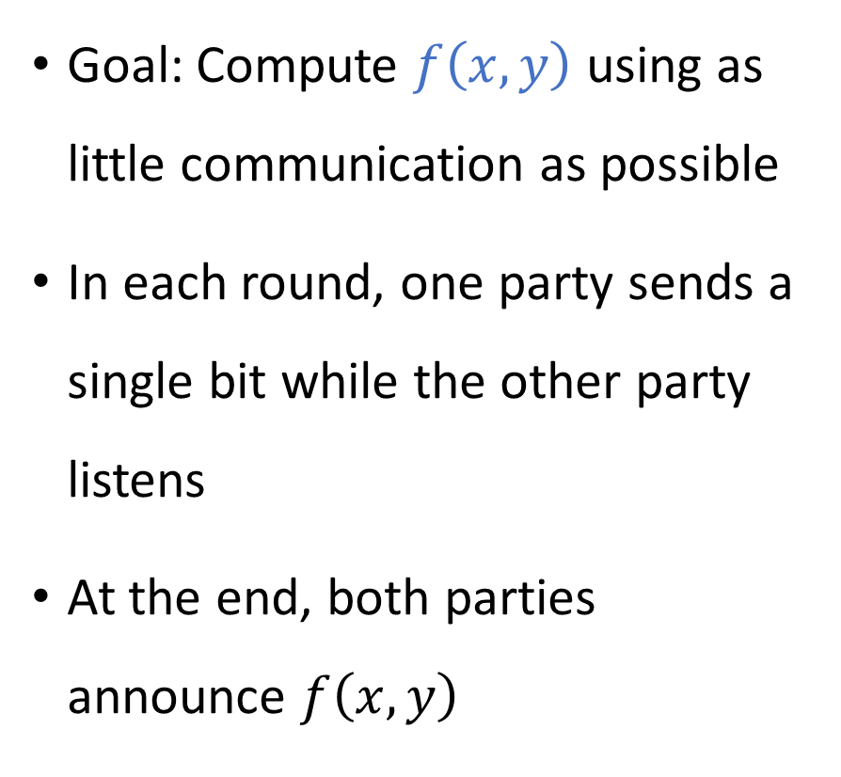


Communication complexity
Goal: Compute $f\left(x, y\right)$ using as little communication as possible
In each round, one party sends a single bit while the other party listens
At the end, both parties announce $f\left(x, y\right)$
Communication channel
Alice holds $x$
Bob holds $y$

Slide 3
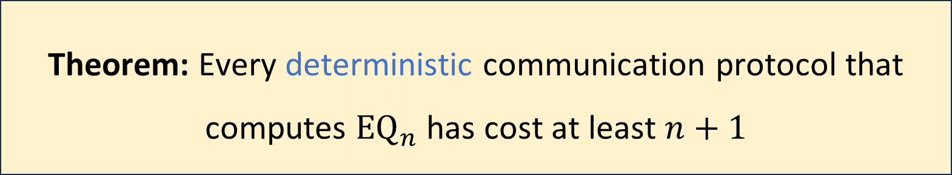

Communication complexity of equality
$${\text{EQ}}_{n}\left(x, y\right)=\left\{\begin{aligned}1 \text{if} x=y \\ 0 \text{if} x≠y\end{aligned}\right.$$
Theorem: Every deterministic communication protocol that computes ${\text{EQ}}_{n}$ has cost at least $n+1$

Slide 4


Randomized communication complexity
In a randomized communication protocol, Alice and Bob are permitted to make decisions based on coin tosses
Communication channel
Alice holds $x$
Bob holds $y$

Slide 5
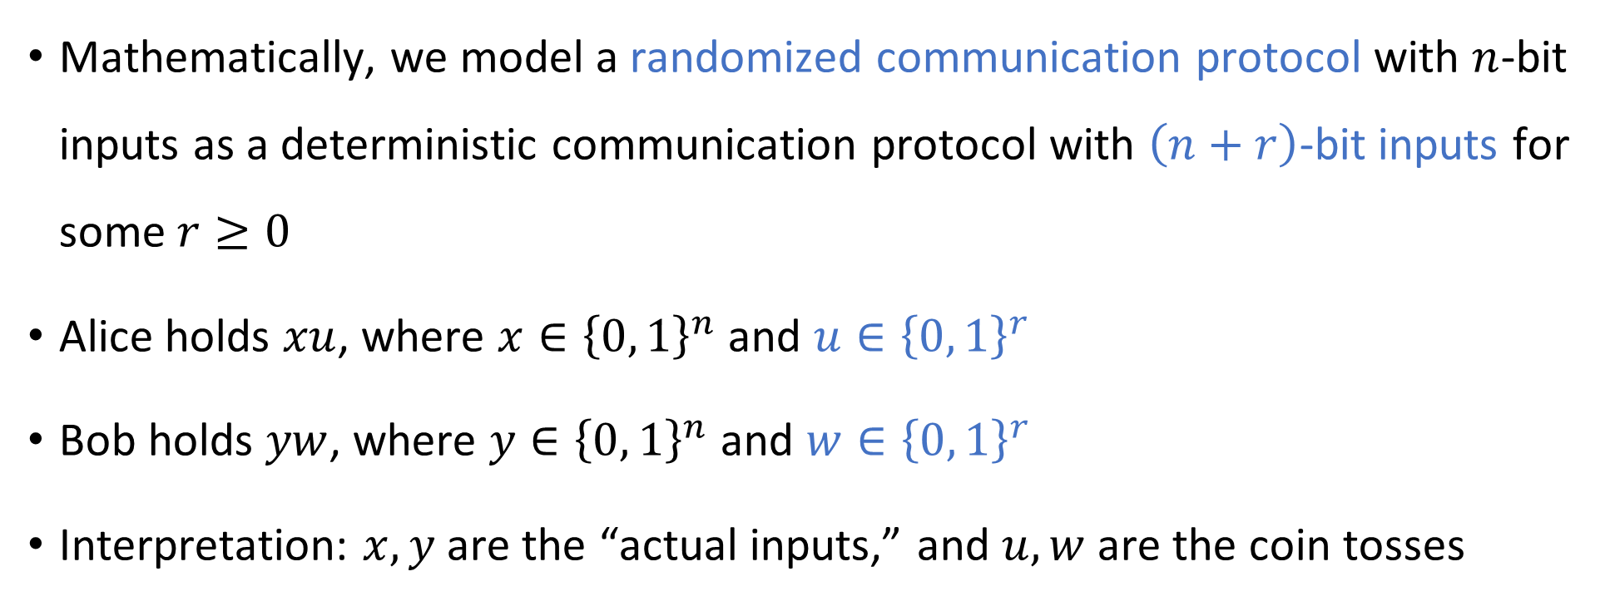
Randomized communication protocols
Mathematically, we model a randomized communication protocol with $n$-bit inputs as a deterministic communication protocol with $\left(n+r\right)$-bit inputs for some $r≥0$
Alice holds $xu$, where $x∈{\left\{0, 1\right\}}^{n}$ and $u∈{\left\{0, 1\right\}}^{r}$
Bob holds $yw$, where $y∈{\left\{0, 1\right\}}^{n}$ and $w∈{\left\{0, 1\right\}}^{r}$
Interpretation: $x, y$ are the “actual inputs,” and $u, w$ are the coin tosses

Slide 6
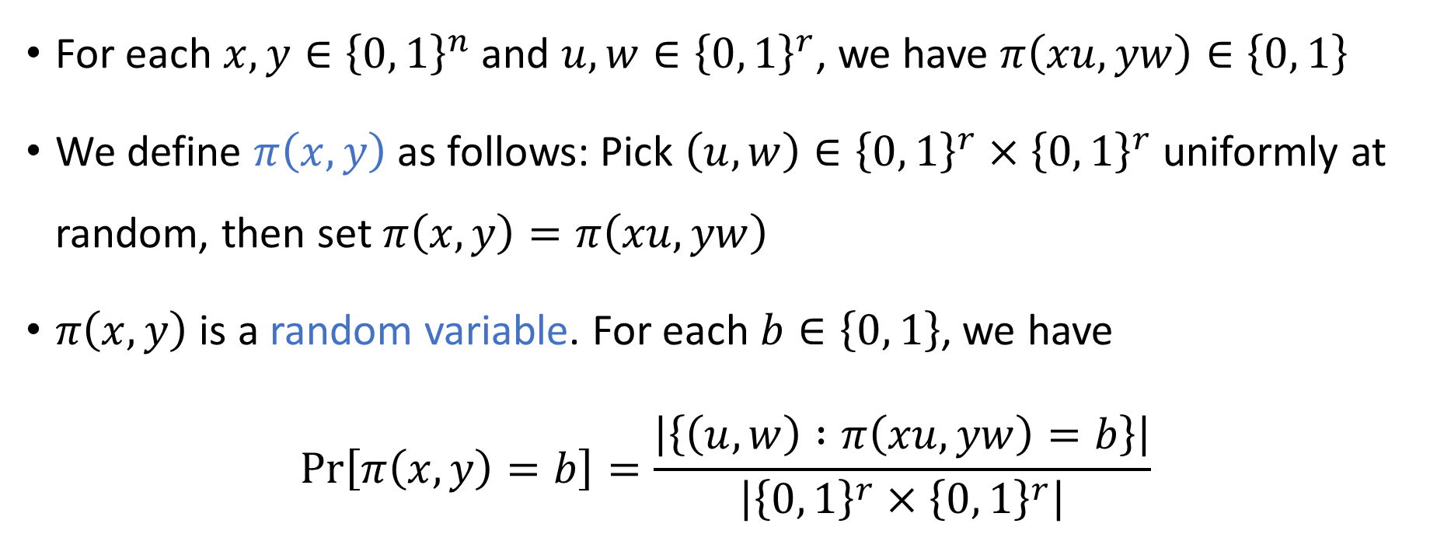
The output of a randomized protocol
For each $x,y∈{\left\{0, 1\right\}}^{n}$ and $u,w∈{\left\{0, 1\right\}}^{r}$, we have $π\left(xu, yw\right)∈\left\{0, 1\right\}$
We define $π\left(x, y\right)$ as follows: Pick $\left(u, w\right)∈{\left\{0, 1\right\}}^{r}×{\left\{0, 1\right\}}^{r}$ uniformly at random, then set $π\left(x, y\right)=π\left(xu, yw\right)$
$π\left(x, y\right)$ is a random variable. For each $b∈\left\{0, 1\right\}$, we have
$$\operatorname{Pr}\left[π\left(x, y\right)=b\right]=\frac{\left|\left\{\left(u, w\right) :π\left(xu, yw\right)=b\right\}\right|}{\left|{\left\{0, 1\right\}}^{r}×{\left\{0, 1\right\}}^{r}\right|}$$

Slide 7
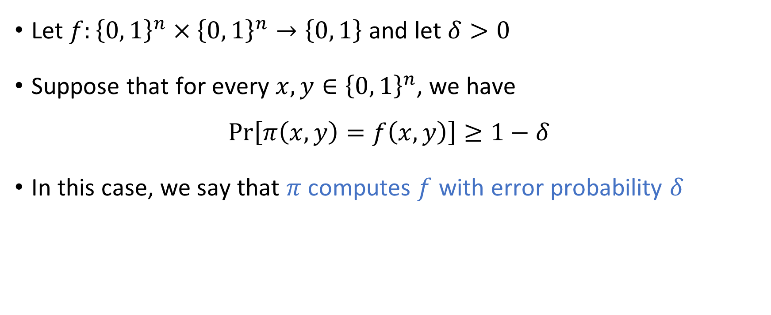
Computing a function with a randomized protocol
Let $f:{\left\{0, 1\right\}}^{n}×{\left\{0, 1\right\}}^{n}→\left\{0, 1\right\}$ and let $δ>0$
Suppose that for every $x, y∈{\left\{0, 1\right\}}^{n}$, we have
$$\operatorname{Pr}\left[π\left(x, y\right)=f\left(x, y\right)\right]≥1−δ$$
In this case, we say that $π$ computes $f$ with error probability $δ$

Slide 8

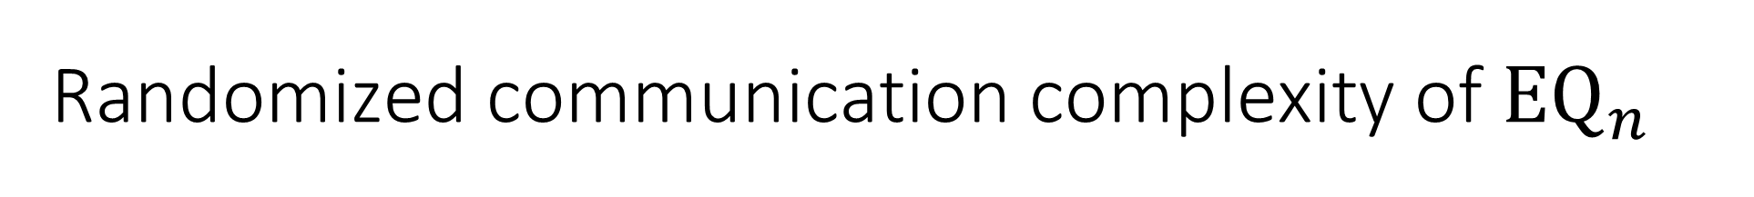
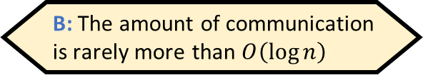
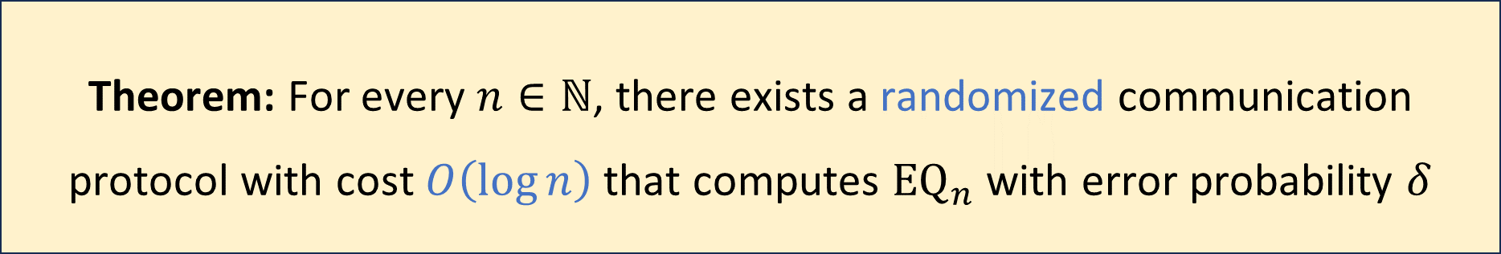
Randomized communication complexity of ${\text{EQ}}_{n}$
Which of the following is an accurate description of the protocol?
A: The protocol succeeds on most pairs of inputs
B: The amount of communication is rarely more than $O\left(\log{n}\right)$
Let $δ>0$ be any constant
Randomized protocols are exponentially better than deterministic protocols!
C: For every pair of inputs, the protocol is likely to succeed
D: It is likely that for every pair of inputs, the protocol succeeds
Respond at PollEv.com/whoza or text “whoza” to 22333
Theorem: For every $n∈ℕ$, there exists a randomized communication protocol with cost $O\left(\log{n}\right)$ that computes ${\text{EQ}}_{n}$ with error probability $δ$

Slide 9
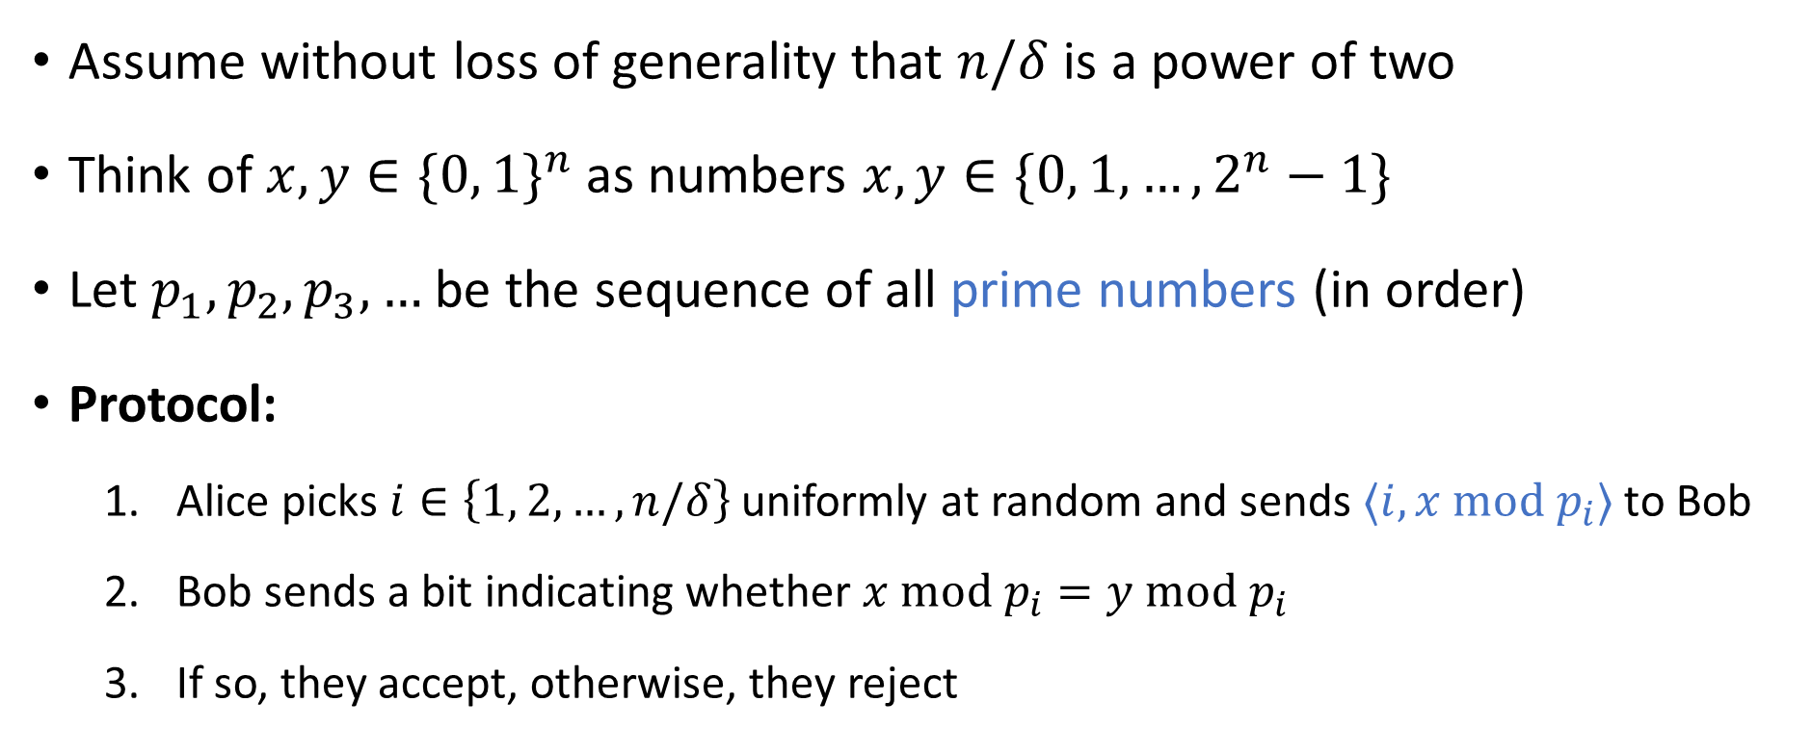

Randomized protocol for ${\text{EQ}}_{n}$
Assume without loss of generality that $n/δ$ is a power of two
Think of $x,y∈\{0, 1\}^{n}$ as numbers $x,y∈\{0, 1, …, 2^{n}−1\}$
Let $p_{1},p_{2},p_{3},…$ be the sequence of all prime numbers (in order)
Protocol:
Alice picks $i∈\left\{1, 2, …, n/δ\right\}$ uniformly at random and sends $⟨i, x \text{mod} p_{i}⟩$ to Bob
Bob sends a bit indicating whether $x \text{mod} p_{i}=y \text{mod} p_{i}$
If so, they accept, otherwise, they reject

Slide 10
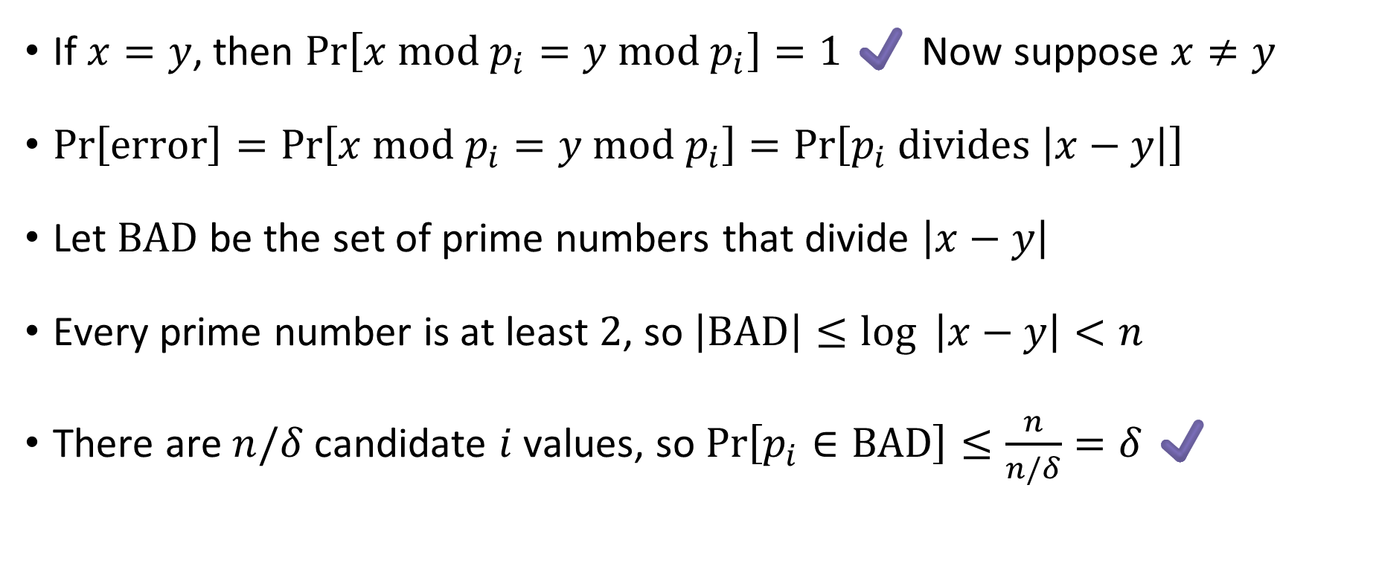
Analysis of the protocol: Correctness
If $x=y$, then $\operatorname{Pr}\left[x \text{mod} p_{i}=y \text{mod} p_{i}\right]=1$ ✔️ Now suppose $x≠y$
$\operatorname{Pr}\left[\text{error}\right]=\operatorname{Pr}\left[x \text{mod} p_{i}=y \text{mod} p_{i}\right]=\operatorname{Pr}\left[p_{i} \text{divides} \left|x−y\right|\right]$
Let $\text{BAD}$ be the set of prime numbers that divide $\left|x−y\right|$
Every prime number is at least $2$, so $\left|\text{BAD}\right|≤\log{ \left|x−y\right|}<n$
There are $n/δ$ candidate $i$ values, so $\operatorname{Pr}\left[p_{i}∈\text{BAD}\right]≤\frac{n}{n/δ}=δ$ ✔️

Slide 11
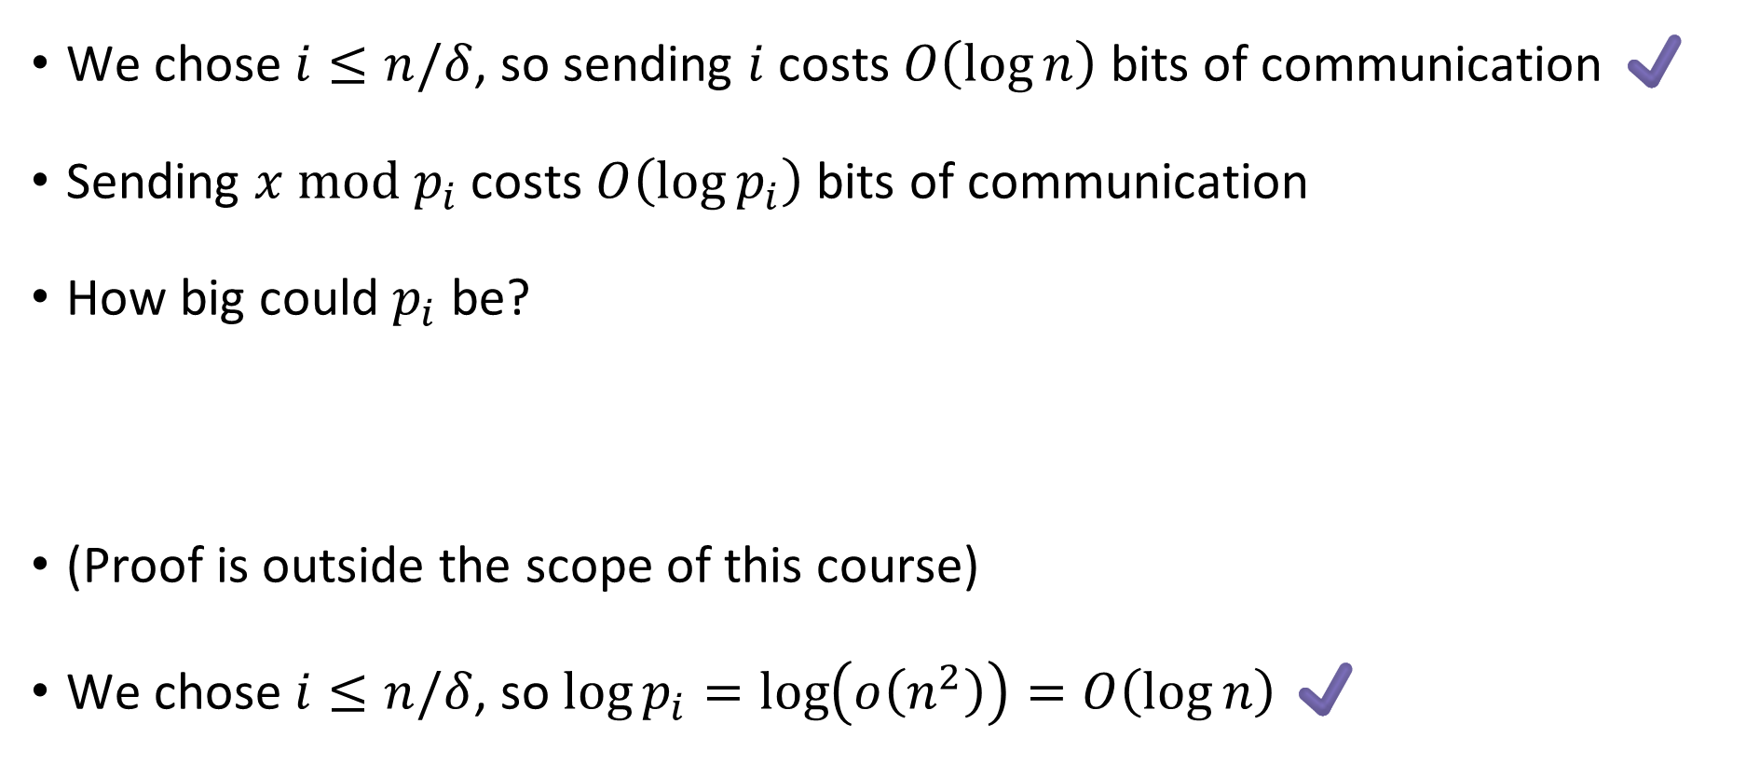
Analysis of the protocol: Efficiency
We chose $i≤n/δ$, so sending $i$ costs $O\left(\log{n}\right)$ bits of communication ✔️
Sending $x \text{mod} p_{i}$ costs $O\left(\log{p_{i}}\right)$ bits of communication
How big could $p_{i}$ be?
(Proof is outside the scope of this course)
We chose $i≤n/δ$, so $\log{p_{i}}=\log\left(o\left(n^{2}\right)\right)=O\left(\log{n}\right)$ ✔️
Theorem: Let $p_{k}$ be the $k$-th prime. Then $p_{k}=Θ\left(k⋅\log{k}\right)=o\left(k^{2}\right)$.

Slide 12
Which problems can be solved through computation?

Slide 13




Randomized Turing machines
Input tape ➡
$$♢$$
1
1
0
$$⊔$$
$$⊔$$
Randomness tape ➡
$$♢$$

Slide 14
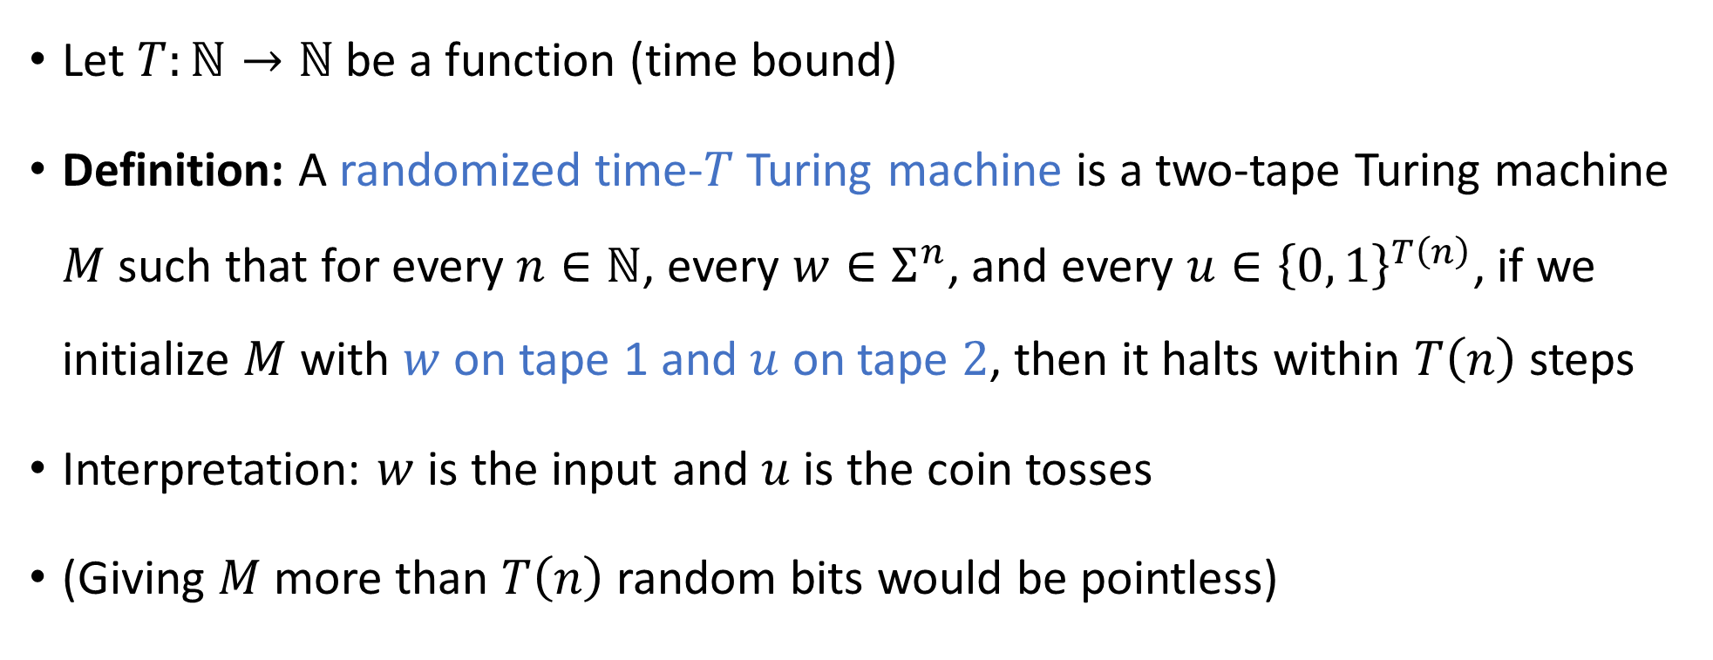
Randomized Turing machines
Let $T:ℕ→ℕ$ be a function (time bound)
Definition: A randomized time-$T$Turing machine is a two-tape Turing machine $M$ such that for every $n∈ℕ$, every $w∈Σ^{n}$, and every $u∈{\left\{0, 1\right\}}^{T\left(n\right)}$, if we initialize $M$ with $w$ on tape 1 and $u$ on tape $2$, then it halts within $T\left(n\right)$ steps
Interpretation: $w$ is the input and $u$ is the coin tosses
(Giving $M$ more than $T\left(n\right)$ random bits would be pointless)

Slide 15
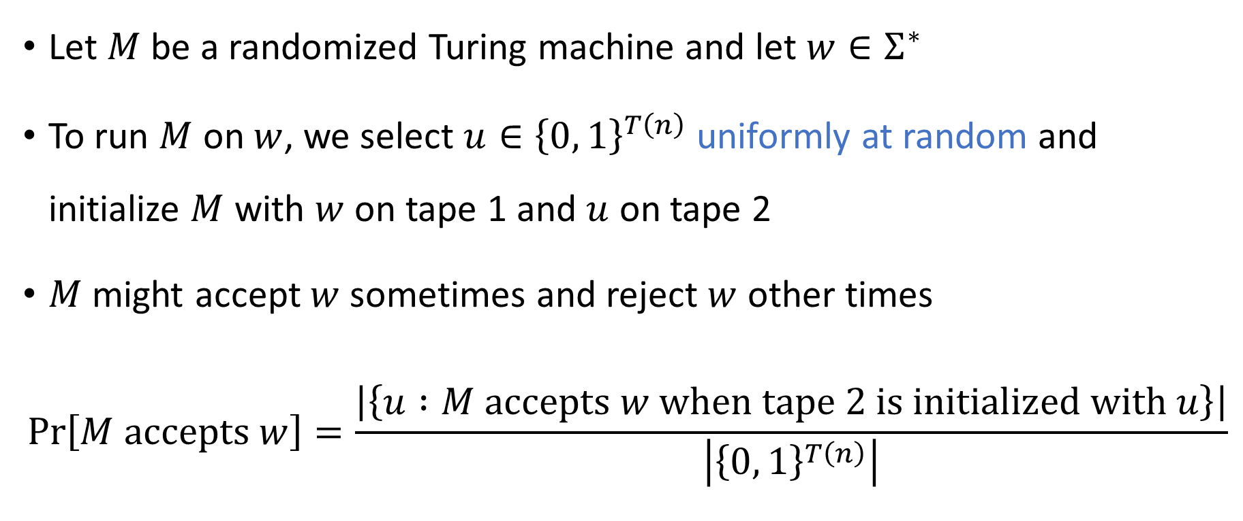
Acceptance probability
Let $M$ be a randomized Turing machine and let $w∈Σ^{∗}$
To run $M$ on $w$, we select $u∈{\left\{0, 1\right\}}^{T\left(n\right)}$ uniformly at random and initialize $M$ with $w$ on tape 1 and $u$ on tape 2
$M$ might accept $w$ sometimes and reject $w$ other times
$$\operatorname{Pr}\left[M \text{accepts} w\right]=\frac{\left|\left\{u :M \text{accepts} w \text{when} \text{tape} \text{2 }\text{is} \text{initialized} \text{with} u\right\}\right|}{\left|{\left\{0, 1\right\}}^{T\left(n\right)}\right|}$$

Slide 16
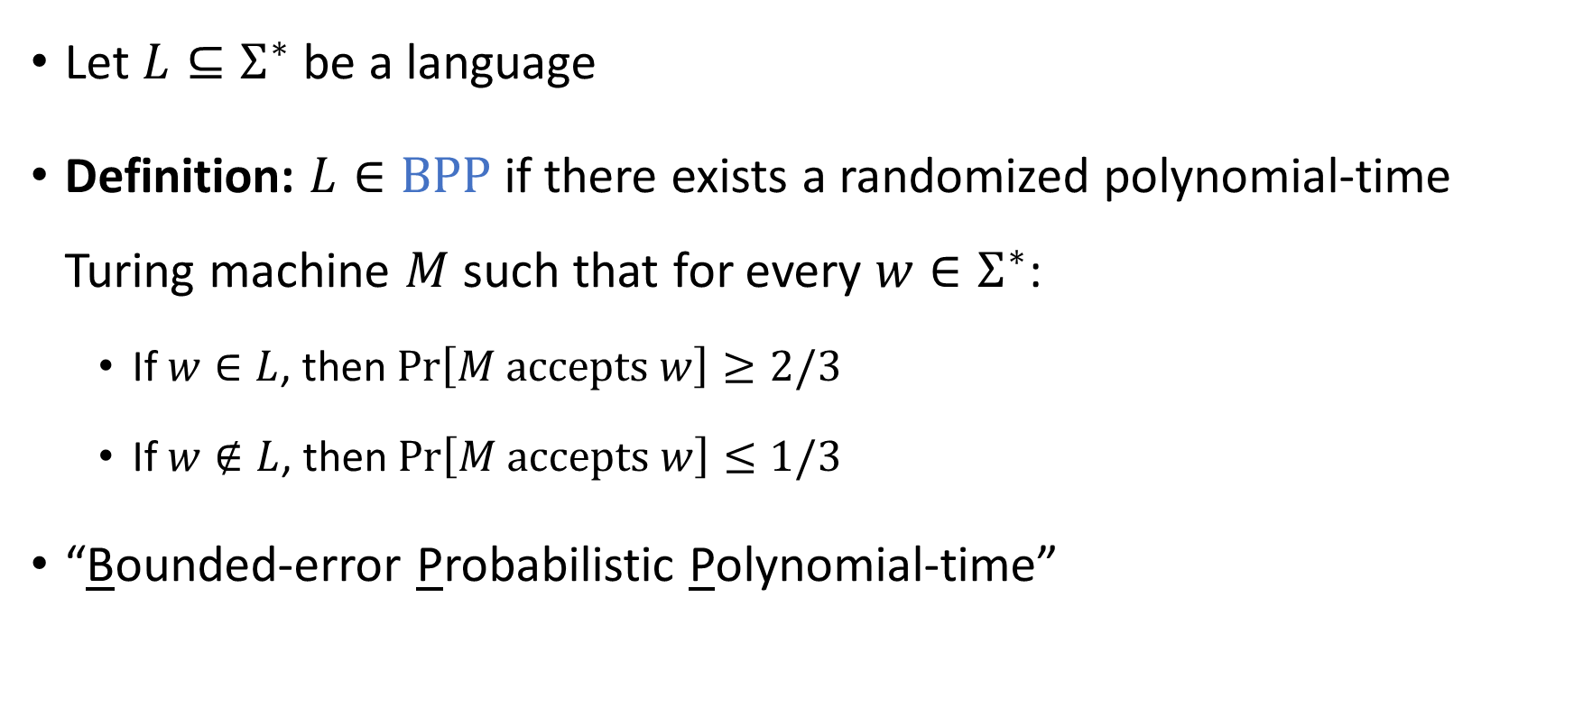

The complexity class $\text{BPP}$
Let $L⊆Σ^{∗}$ be a language
Definition: $L∈\text{BPP}$ if there exists a randomized polynomial-time Turing machine $M$ such that for every $w∈Σ^{∗}$:
If $w∈L$, then $\operatorname{Pr}\left[M \text{accepts} w\right]≥2/3$
If $w∉L$, then $\operatorname{Pr}\left[M \text{accepts} w\right]≤1/3$
“Bounded-error Probabilistic Polynomial-time”

