Slide 1
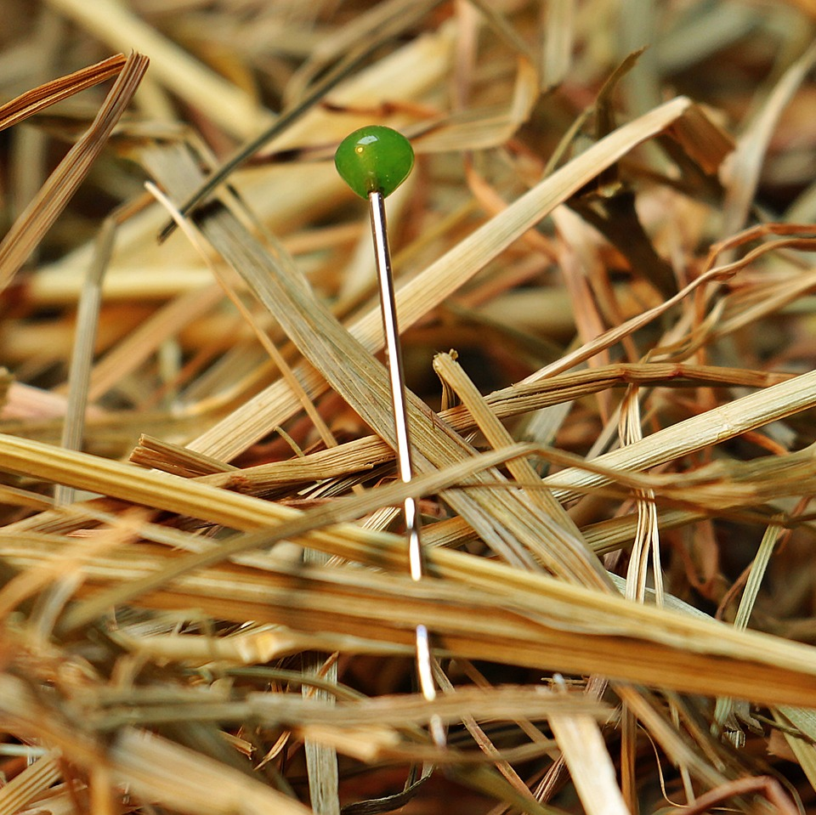
CMSC 28100 Introduction to Complexity Theory Spring 2025 Instructor: William Hoza

Slide 2
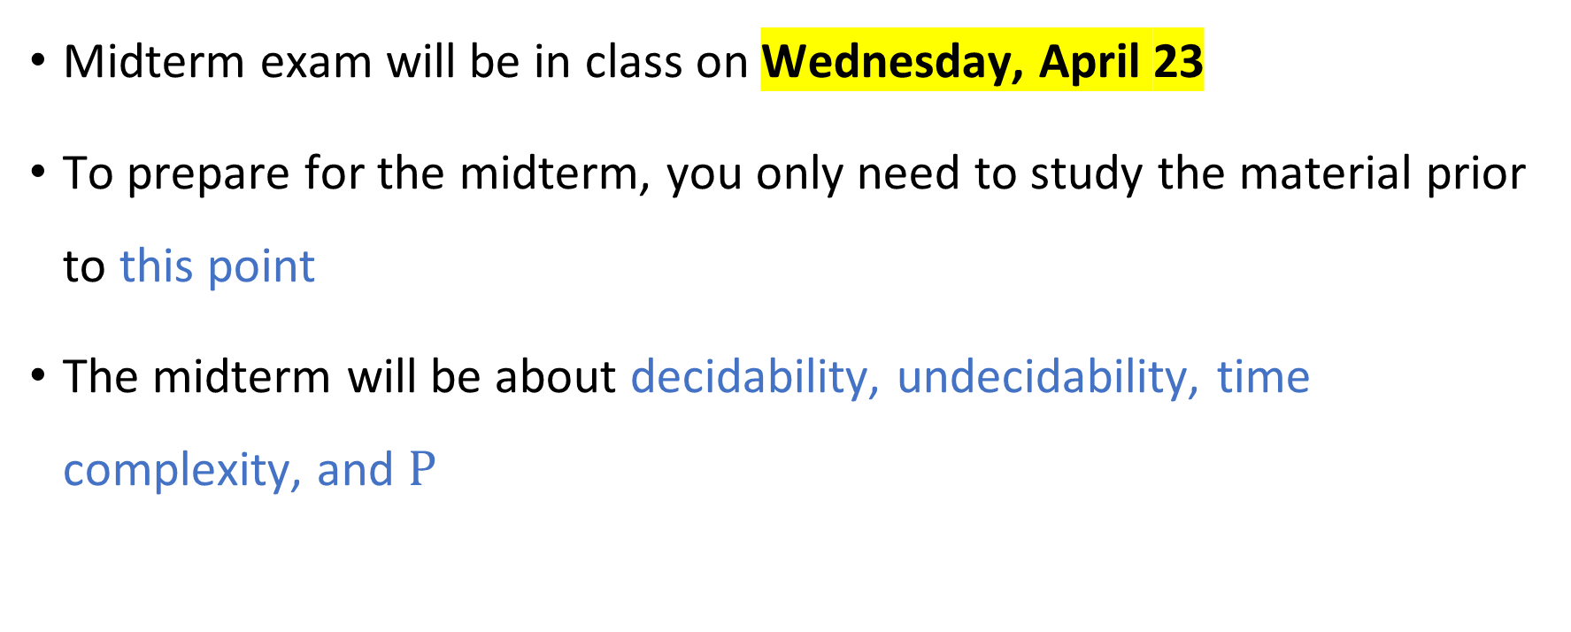
Midterm exam
Midterm exam will be in class on Wednesday, April 23
To prepare for the midterm, you only need to study the material prior to this point
The midterm will be about decidability, undecidability, time complexity, and $\text{P}$

Slide 3

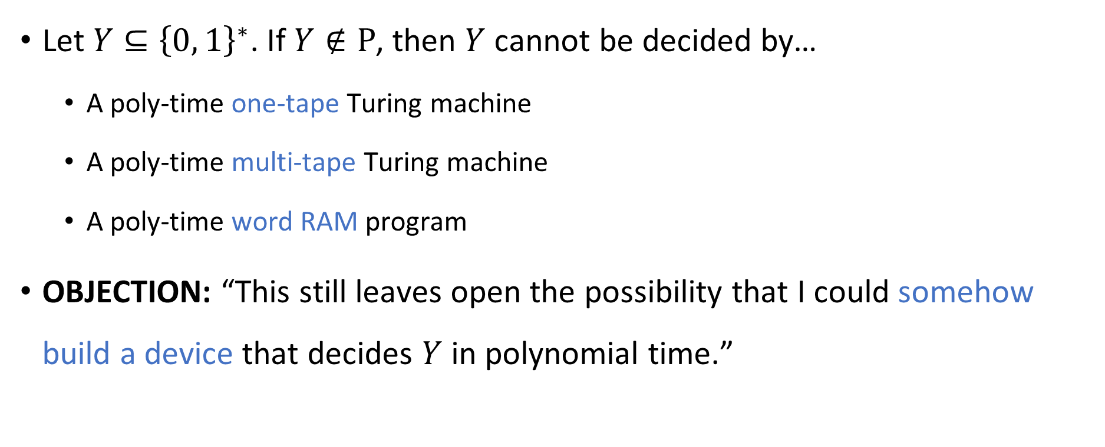
Robustness of $\text{P}$, revisited
Let $Y⊆{\left\{0, 1\right\}}^{∗}$. If $Y∉\text{P}$, then $Y$ cannot be decided by…
A poly-time one-tape Turing machine
A poly-time multi-tape Turing machine
A poly-time word RAM program
OBJECTION: “This still leaves open the possibility that I could somehow build a device that decides $Y$ in polynomial time.”

Slide 4
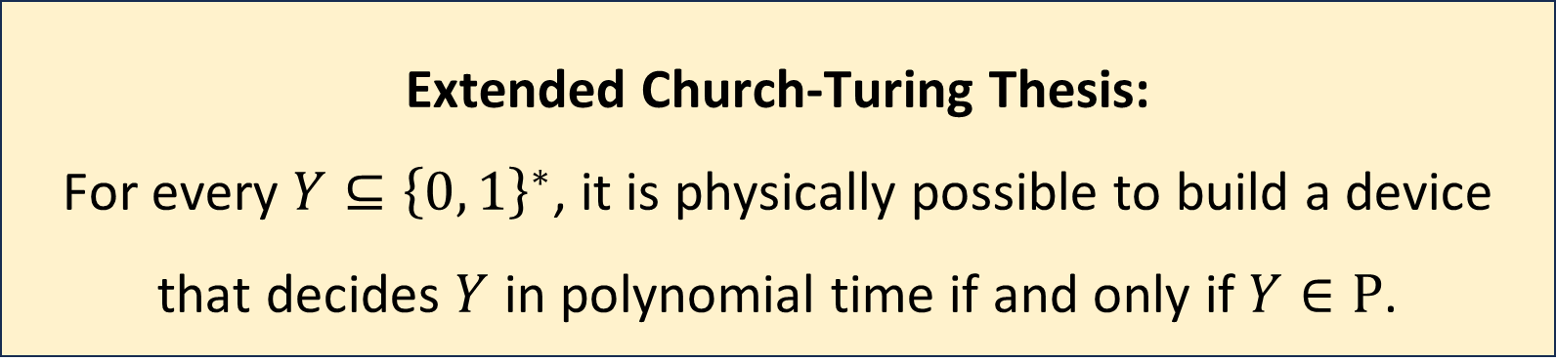
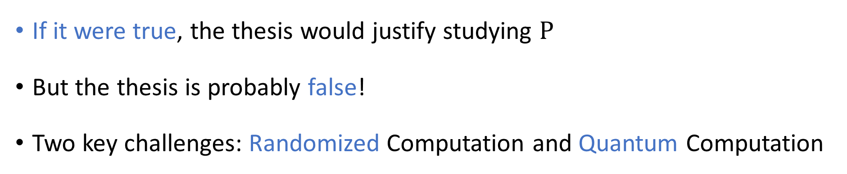
Extended Church-Turing Thesis
Extended Church-Turing Thesis:
For every $Y⊆{\left\{0, 1\right\}}^{∗}$, it is physically possible to build a device that decides $Y$ in polynomial time if and only if $Y∈\text{P}$.
If it were true, the thesis would justify studying $\text{P}$
But the thesis is probably false!
Two key challenges: Randomized Computation and Quantum Computation

Slide 5
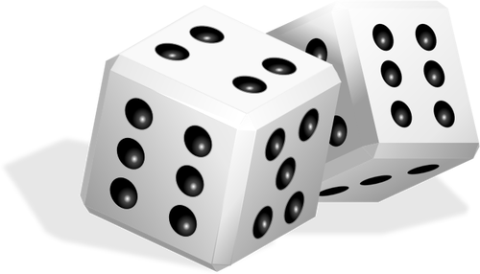
Randomized computation
Researchers often use randomness to answer questions
Random sampling for opinion polls
Randomized controlled trials in science/medicine
What if we incorporate this ability into our computational model?

Slide 6
Randomized computation
Eventually, we will define and study randomized Turing machines
First, to build intuition, let’s study the role of randomness in a different situation

Slide 7
Communication Complexity

Slide 8

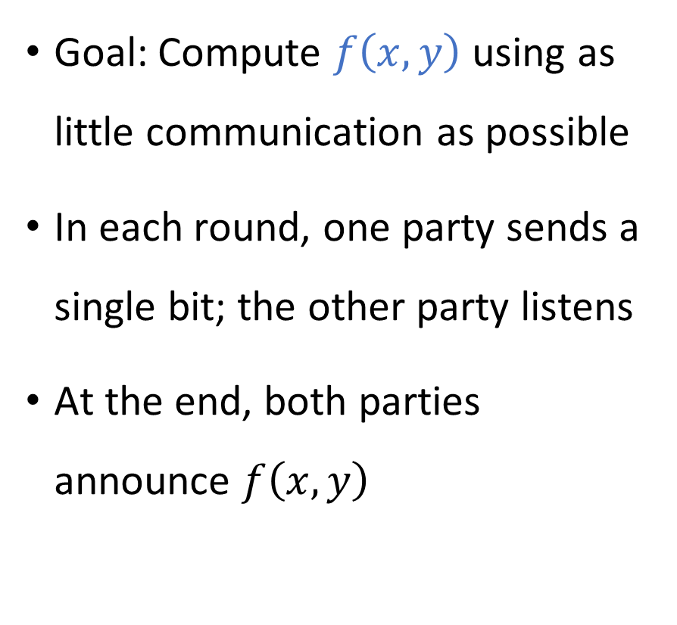


Communication complexity
Goal: Compute $f\left(x, y\right)$ using as little communication as possible
In each round, one party sends a single bit; the other party listens
At the end, both parties announce $f\left(x, y\right)$
Communication channel
Alice holds $x$
Bob holds $y$

Slide 9
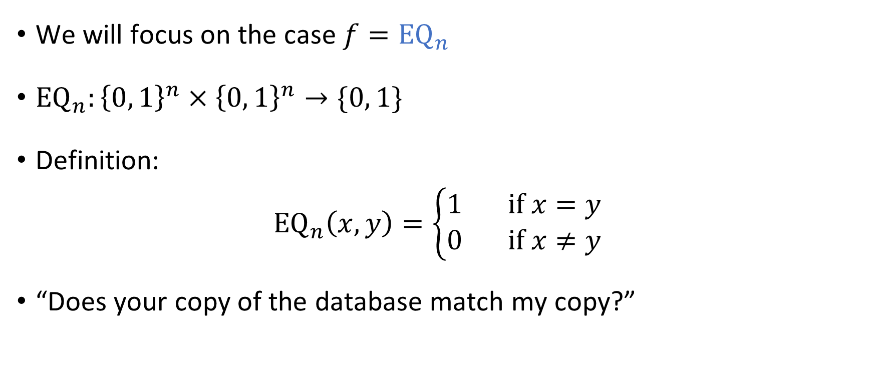
The equality function
We will focus on the case $f={\text{EQ}}_{n}$
${\text{EQ}}_{n}:{\left\{0, 1\right\}}^{n}×{\left\{0, 1\right\}}^{n}→\{0, 1\}$
Definition:
$${\text{EQ}}_{n}\left(x, y\right)=\left\{\begin{aligned}1 \text{if} x=y \\ 0 \text{if} x≠y\end{aligned}\right.$$
“Does your copy of the database match my copy?”

Slide 10
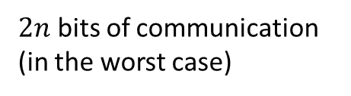


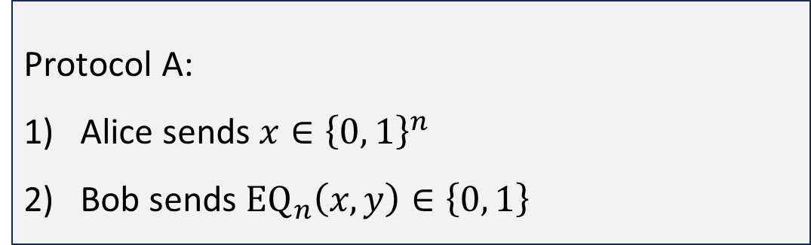
Protocols for equality
Protocol A:
Alice sends $x∈{\left\{0, 1\right\}}^{n}$
Bob sends ${\text{EQ}}_{n}\left(x, y\right)∈\left\{0, 1\right\}$
$n+1$ bits of communication
Protocol B:
For $i=1$ to $n$:
Alice sends $x_{i}$
Bob sends a bit indicating whether $x_{i}=y_{i}$
$2n$ bits of communication (in the worst case)

Slide 11
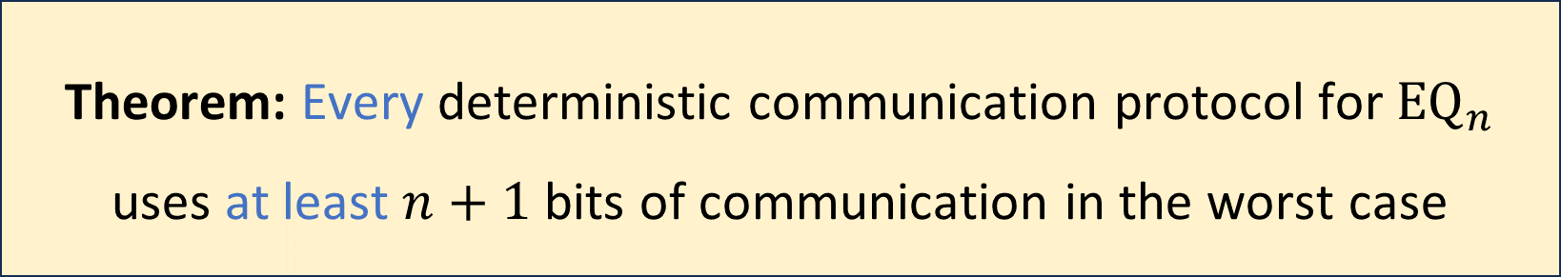
Communication complexity of equality
Is there a better protocol?
Before we can prove it, we must clarify how we model communication protocols mathematically
Theorem: Every deterministic communication protocol for ${\text{EQ}}_{n}$ uses at least $n+1$ bits of communication in the worst case

Slide 12
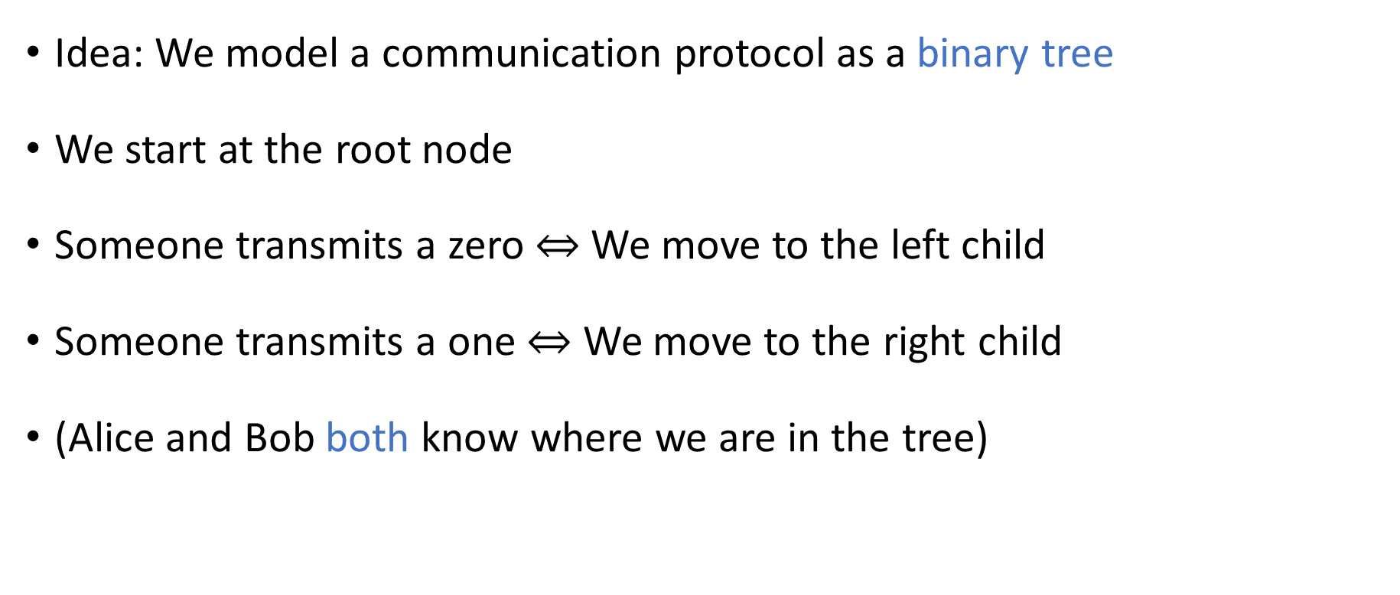
Communication protocol model
Idea: We model a communication protocol as a binary tree
We start at the root node
Someone transmits a zero $⇔$ We move to the left child
Someone transmits a one $⇔$ We move to the right child
(Alice and Bob both know where we are in the tree)

Slide 13

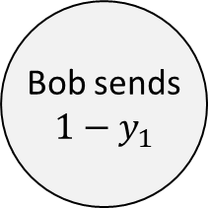

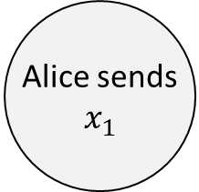

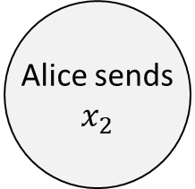

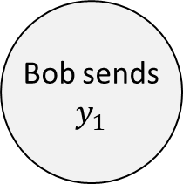

Example protocol tree
Alice sends $$x_{1}$$
0
1
Bob sends $$1−y_{1}$$
Bob sends
$$y_{1}$$
0
1
0
1
Reject
Alice sends $$x_{2}$$
Reject
Alice sends $$x_{2}$$
$$⋮$$
$$⋮$$
$$⋮$$
$$⋮$$

Slide 14
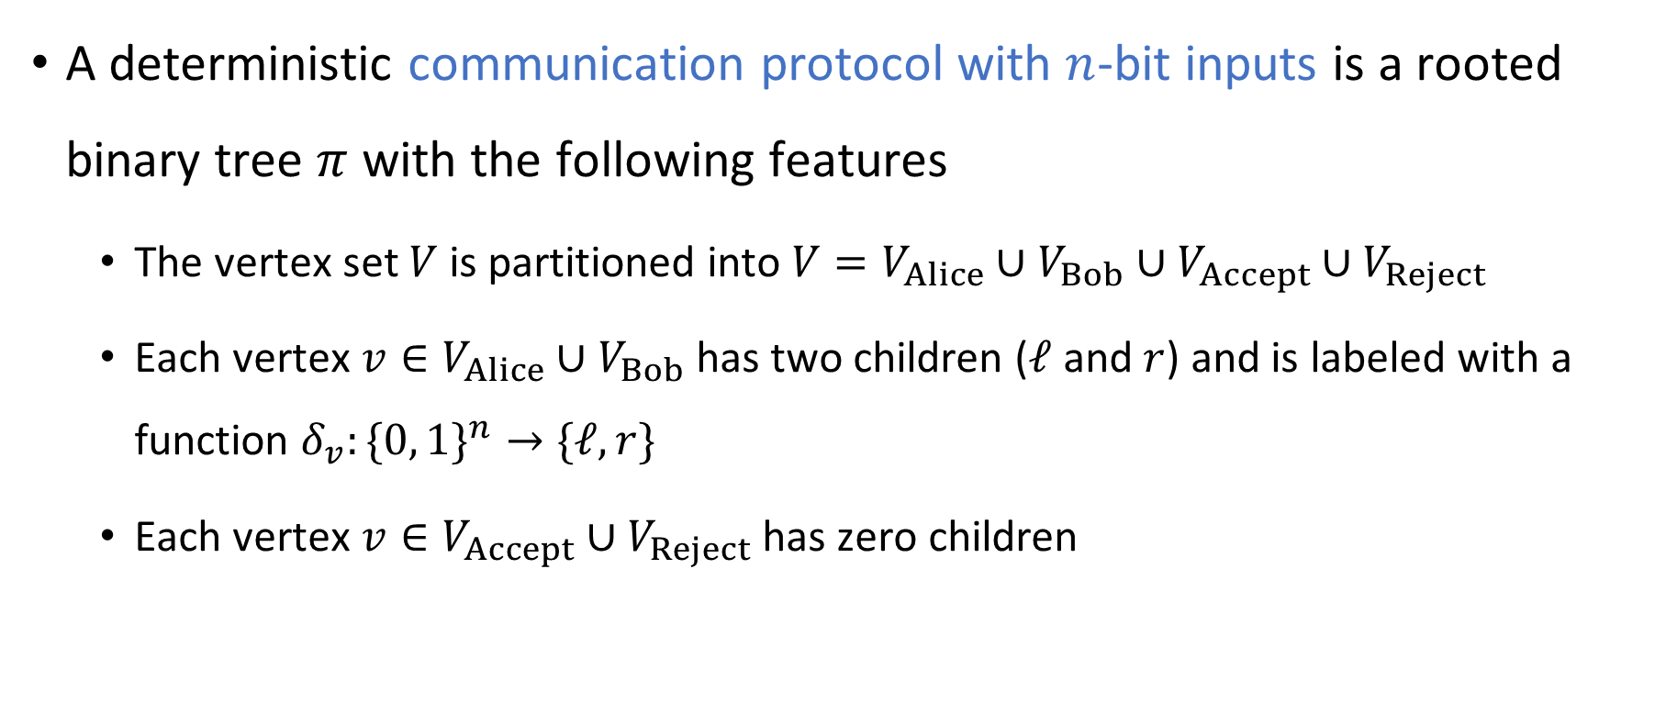
Rigorously defining communication protocols
A deterministic communication protocol with $n$-bit inputs is a rooted binary tree $π$ with the following features
The vertex set $V$ is partitioned into $V=V_{Alice}∪V_{Bob}∪V_{Accept}∪V_{Reject}$
Each vertex $v∈V_{Alice}∪V_{Bob}$ has two children ($ℓ$ and $r$) and is labeled with a function $δ_{v}:\{0, 1\}^{n}→\text{\{}ℓ, r\}$
Each vertex $v∈V_{Accept}∪V_{Reject}$ has zero children

Slide 15
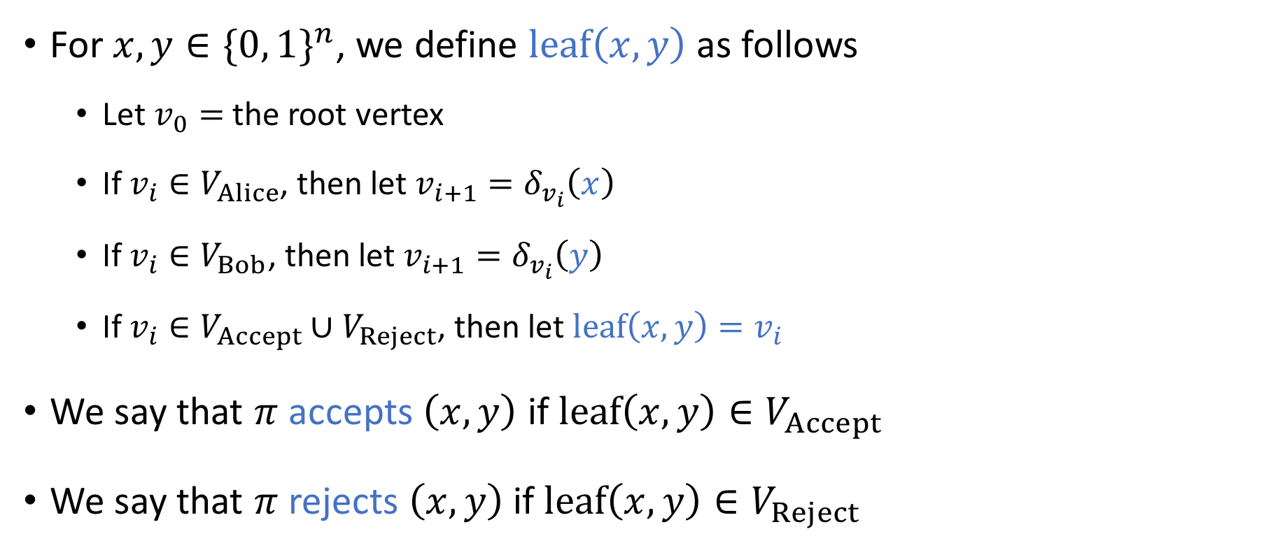
Rigorously defining communication protocols
In this model, what happens if Alice and Bob speak at the same time?
A: Trick question. In this model, they never speak simultaneously
B: Only one of the messages is successfully transmitted
For $x, y∈\{0, 1\}^{n}$, we define $\text{leaf}\left(x,y\right)$ as follows
Let $v_{0}=$ the root vertex
If $v_{i}∈V_{Alice}$, then let $v_{i+1}=δ_{v_{i}}\left(x\right)$
If $v_{i}∈V_{Bob}$, then let $v_{i+1}=δ_{v_{i}}\left(y\right)$
If $v_{i}∈V_{Accept}∪V_{Reject}$, then let $\text{leaf}\left(x,y\right)=v_{i}$
We say that $π$ accepts $\left(x, y\right)$ if $\text{leaf}\left(x,y\right)∈V_{Accept}$
We say that $π$ rejects $\left(x,y\right)$ if $\text{leaf}\left(x,y\right)∈V_{Reject}$
C: Both of the messages are successfully transmitted
D: Neither message is successfully transmitted
Respond at PollEv.com/whoza or text “whoza” to 22333

Slide 16
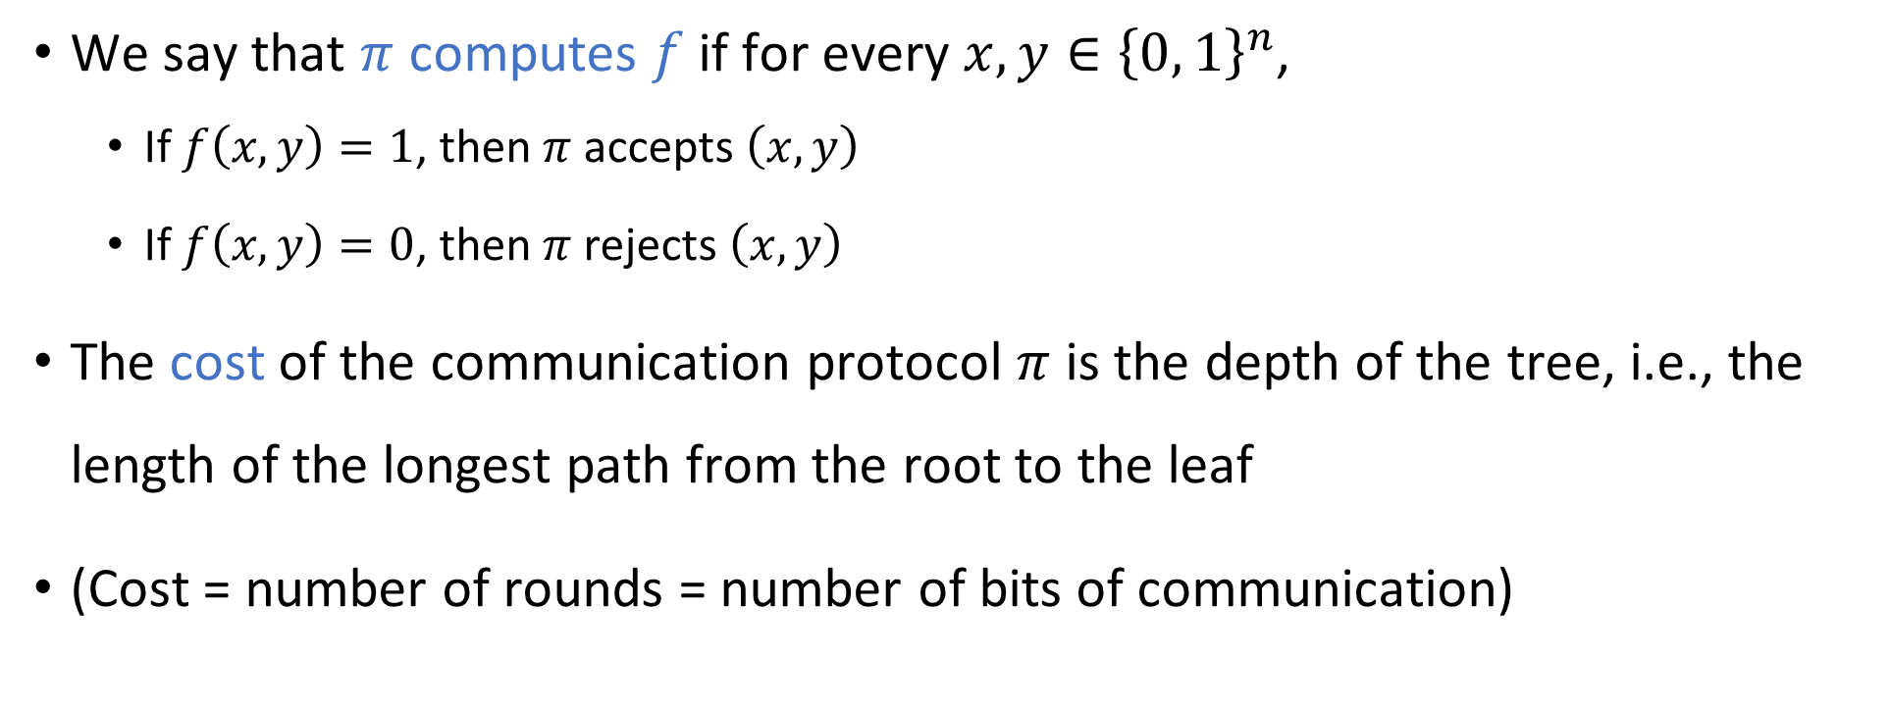
Communication complexity
We say that $π$ computes $f$ if for every $x, y∈{\left\{0, 1\right\}}^{n}$,
If $f\left(x,y\right)=1$, then $π$ accepts $\left(x,y\right)$
If $f\left(x,y\right)=0$, then $π$ rejects $\left(x,y\right)$
The cost of the communication protocol $π$ is the depth of the tree, i.e., the length of the longest path from the root to the leaf
(Cost = number of rounds = number of bits of communication)

Slide 17
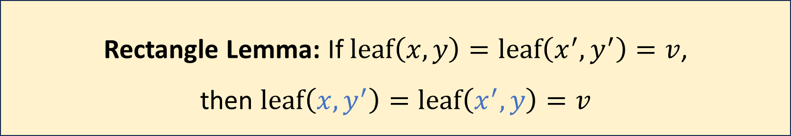

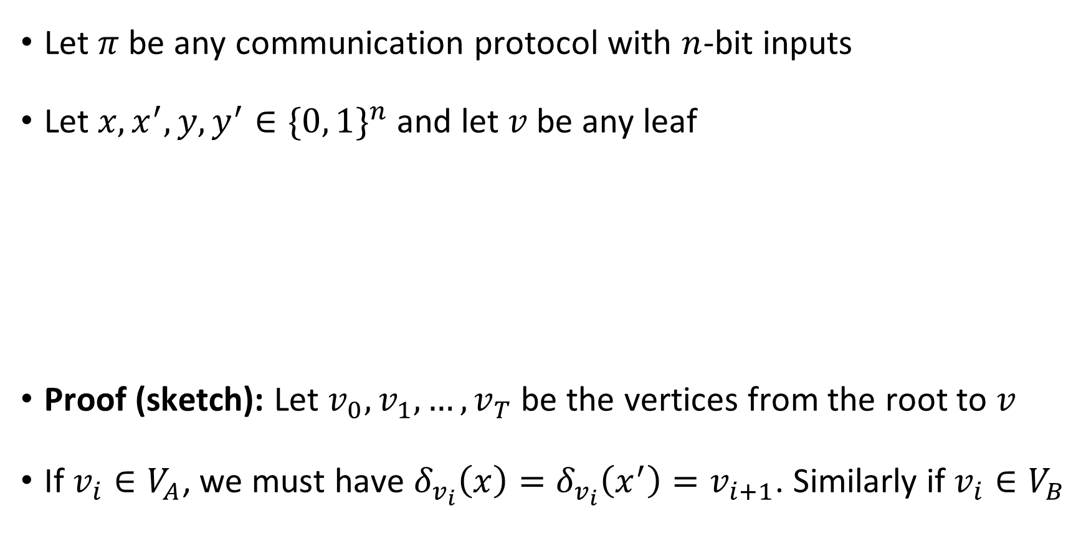



Rectangle lemma
$$\left(x, y\right)$$
$$\left(x′, y\right)$$
Let $π$ be any communication protocol with $n$-bit inputs
Let $x, x^{′}, y, y^{′}∈\{0, 1\}^{n}$ and let $v$ be any leaf
Proof (sketch): Let $v_{0},v_{1},…, v_{T}$ be the vertices from the root to $v$
If $v_{i}∈V_{A}$, we must have $δ_{v_{i}}\left(x\right)=δ_{v_{i}}\left(x^{′}\right)=v_{i+1}$. Similarly if $v_{i}∈V_{B}$
$$\left(x, y′\right)$$
$$\left(x′, y′\right)$$
Rectangle Lemma: If $\text{leaf}\left(x, y\right)=\text{leaf}\left(x^{′},y^{′}\right)=v$, then $\text{leaf}\left(x,y^{′}\right)=\text{leaf}\left(x^{′},y\right)=v$

Slide 18
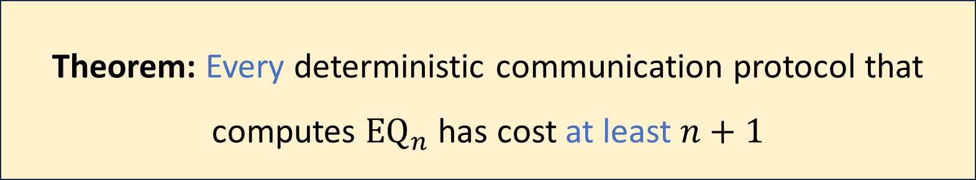
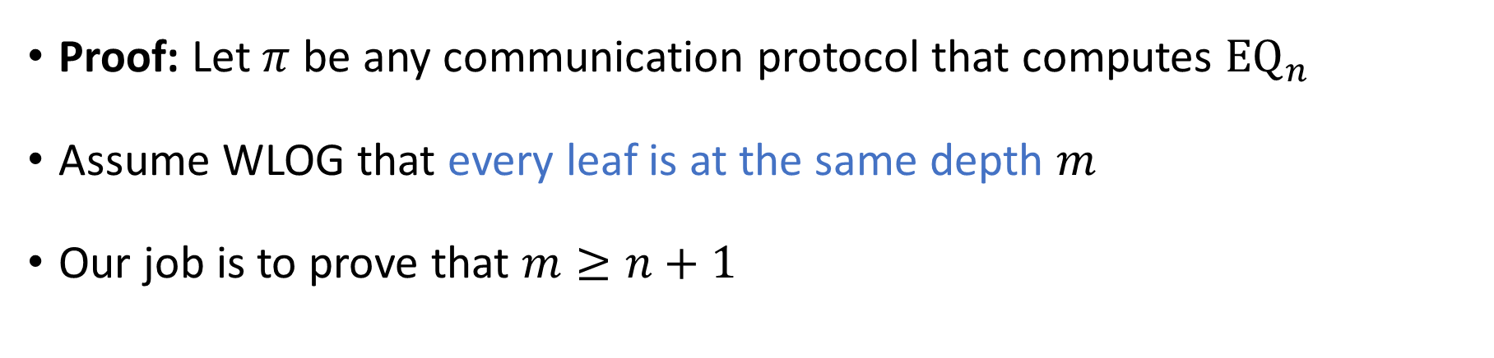
Communication complexity of equality
Theorem: Every deterministic communication protocol that computes ${\text{EQ}}_{n}$ has cost at least $n+1$
Proof: Let $π$ be any communication protocol that computes ${\text{EQ}}_{n}$
Assume WLOG that every leaf is at the same depth $m$
Our job is to prove that $m≥n+1$

Slide 19
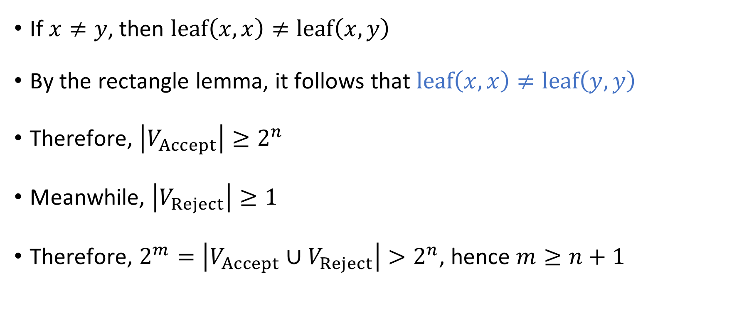





Communication complexity of ${\text{EQ}}_{n}$
$$\left(x, x\right)$$
$$\left(x, y\right)$$
$$\left(y, x\right)$$
$$\left(y, y\right)$$
If $x≠y$, then $\text{leaf}\left(x,x\right)≠\text{leaf}\left(x,y\right)$
By the rectangle lemma, it follows that $\text{leaf}\left(x,x\right)≠\text{leaf}\left(y,y\right)$
Therefore, $\left|V_{Accept}\right|≥2^{n}$
Meanwhile, $\left|V_{Reject}\right|≥1$
Therefore, $2^{m}=\left|V_{Accept}∪V_{Reject}\right|>2^{n}$, hence $m≥n+1$

Slide 20
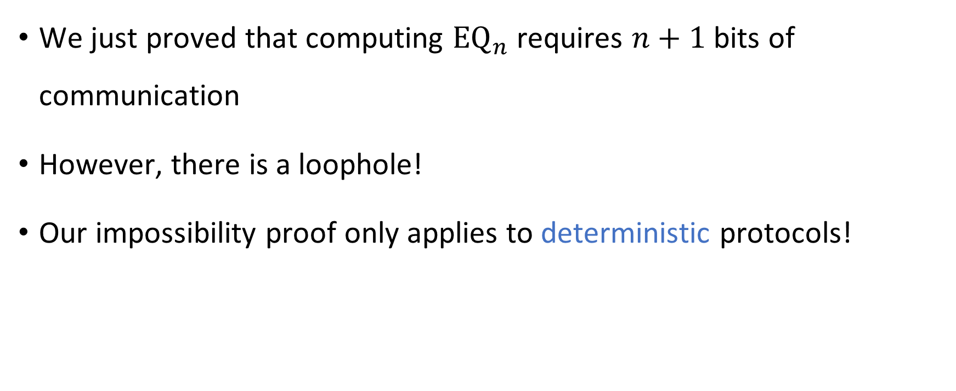

Communication complexity of ${\text{EQ}}_{n}$
We just proved that computing ${\text{EQ}}_{n}$ requires $n+1$ bits of communication
However, there is a loophole!
Our impossibility proof only applies to deterministic protocols!

Slide 21


Randomized communication complexity
In a randomized communication protocol, Alice and Bob are permitted to make decisions based on coin tosses
Communication channel
Alice holds $x$
Bob holds $y$

Slide 22
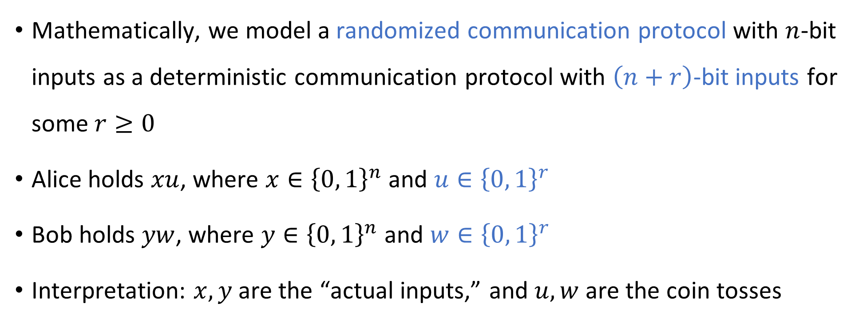
Randomized communication protocols
Mathematically, we model a randomized communication protocol with $n$-bit inputs as a deterministic communication protocol with $\left(n+r\right)$-bit inputs for some $r≥0$
Alice holds $xu$, where $x∈{\left\{0, 1\right\}}^{n}$ and $u∈{\left\{0, 1\right\}}^{r}$
Bob holds $yw$, where $y∈{\left\{0, 1\right\}}^{n}$ and $w∈{\left\{0, 1\right\}}^{r}$
Interpretation: $x, y$ are the “actual inputs,” and $u, w$ are the coin tosses

Slide 23
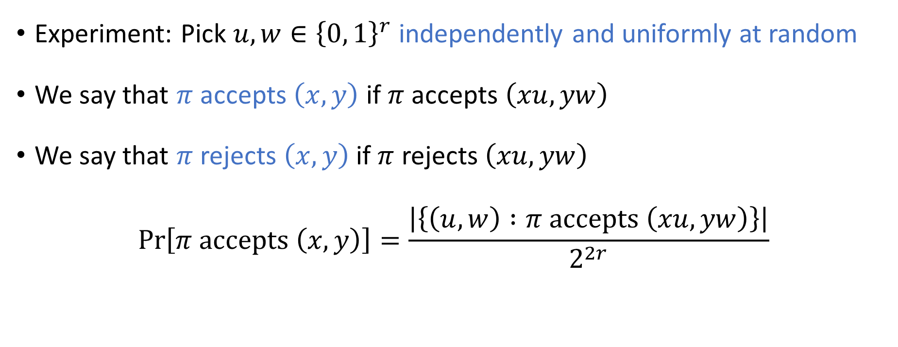
Randomized protocols: Accepting/rejecting
Experiment: Pick $u,w∈{\left\{0, 1\right\}}^{r}$ independently and uniformly at random
We say that $π$ accepts $\left(x,y\right)$ if $π$ accepts $\left(xu, yw\right)$
We say that $π$ rejects $\left(x,y\right)$ if $π$ rejects $\left(xu, yw\right)$
$$\operatorname{Pr}\left[π \text{accepts} \left(x, y\right)\right]=\frac{\left|\left\{\left(u, w\right) :π \text{accepts} \left(xu, yw\right)\right\}\right|}{2^{2r}}$$

Slide 24
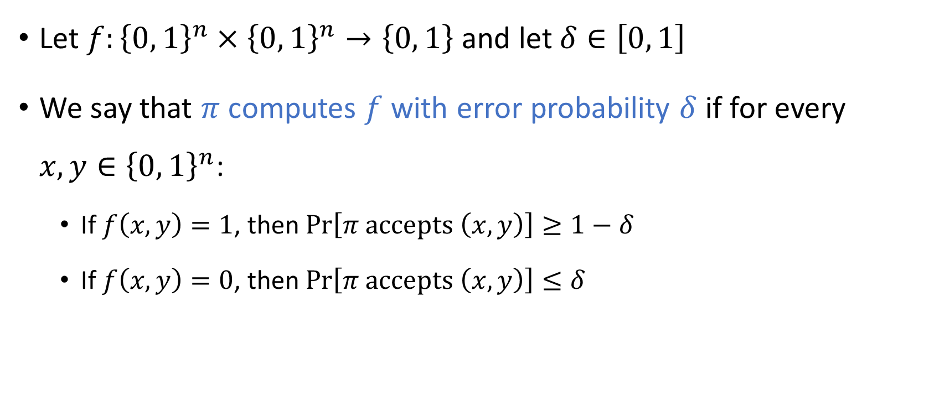
Randomized protocols: Computing a function
Let $f:{\left\{0, 1\right\}}^{n}×{\left\{0, 1\right\}}^{n}→\left\{0, 1\right\}$ and let $δ∈\left[0, 1\right]$
We say that $π$ computes $f$ with error probability $δ$ if for every $x,y∈{\left\{0, 1\right\}}^{n}$:
If $f\left(x,y\right)=1$, then $\operatorname{Pr}\left[π \text{accepts} \left(x,y\right)\right]≥1−δ$
If $f\left(x,y\right)=0$, then $\operatorname{Pr}\left[π \text{accepts} \left(x,y\right)\right]≤δ$

Slide 25

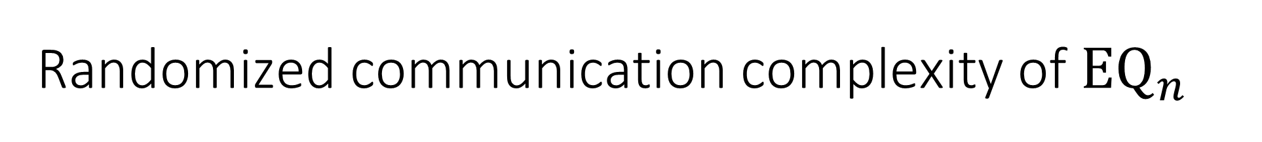
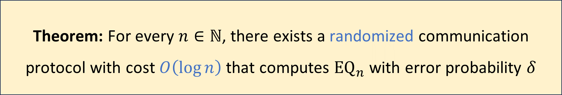
Randomized communication complexity of ${\text{EQ}}_{n}$
Let $δ>0$ be any constant
Randomized protocols are exponentially better than deterministic protocols!
Theorem: For every $n∈ℕ$, there exists a randomized communication protocol with cost $O\left(\log{n}\right)$ that computes ${\text{EQ}}_{n}$ with error probability $δ$

