Slide 1
CMSC 28100 Introduction to Complexity Theory Winter 2024 Instructor: William Hoza
7 |  |  |  |  |  |  | 5 | 3
 |  |  |  |  |  |  |  | 4
 | 4 | 8 |  | 3 |  | 1 | 2
8 |  | 1 | 3 |  |  | 2 | 7 | 5
 | 9 |  | 1 |  |  |  | 4
 | 5 |  |  |  |  | 3
2 |  | 5 |  | 8 | 4
1 | 3 | 4 |  | 5

Slide 2
Which problems can be solved through computation?

Slide 3
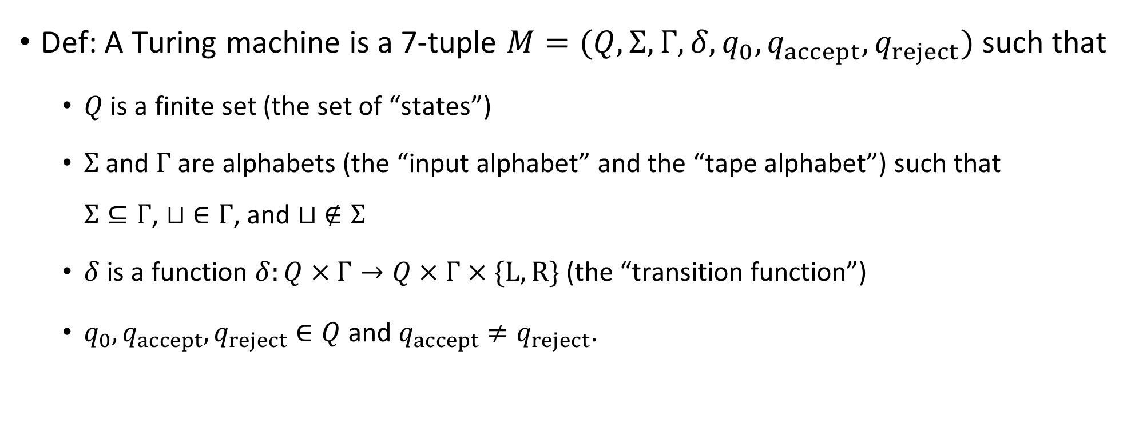
Turing machines: Mathematically rigorous version
Def: A Turing machine is a 7-tuple $M=(Q, Σ, Γ, δ, q_{0},q_{accept},q_{reject})$ such that
$Q$ is a finite set (the set of “states”)
$Σ$ and $Γ$ are alphabets (the “input alphabet” and the “tape alphabet”) such that $Σ⊆Γ$, $⊔ ∈Γ$, and $⊔ ∉Σ$
$δ$ is a function $δ:Q×Γ→Q×Γ×\{\text{L}, \text{R}\}$ (the “transition function”)
$q_{0},q_{accept},q_{reject}∈Q$ and $q_{accept}≠q_{reject}$.

Slide 4
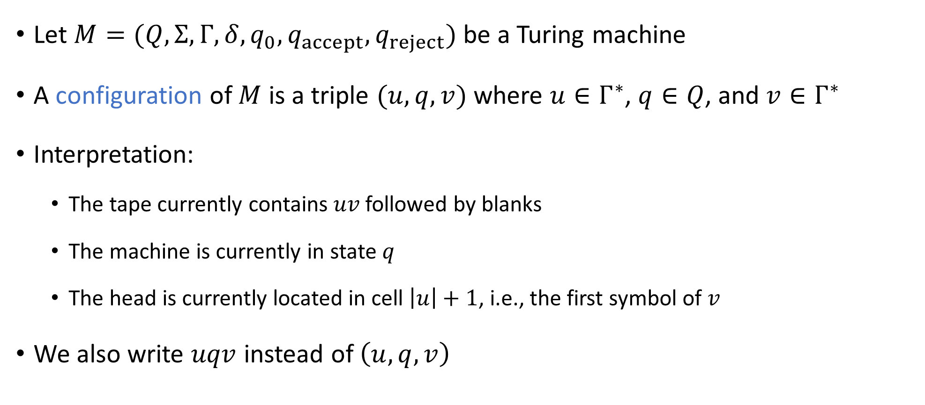
Configurations of a TM
Let $M=(Q, Σ, Γ, δ, q_{0},q_{accept}, q_{reject})$ be a Turing machine
A configuration of $M$ is a triple $(u, q, v)$ where $u∈Γ^{∗}$, $q∈Q$, and $v∈Γ^{∗}$
Interpretation:
The tape currently contains $uv$ followed by blanks
The machine is currently in state $q$
The head is currently located in cell $\left|u\right|+1$, i.e., the first symbol of $v$
We also write $uqv$ instead of $\left(u, q, v\right)$

Slide 5

The initial configuration
Let $w∈Σ^{∗}$ be an input
The initial configuration of $M$ on input $w$ is $q_{0}w$

Slide 6
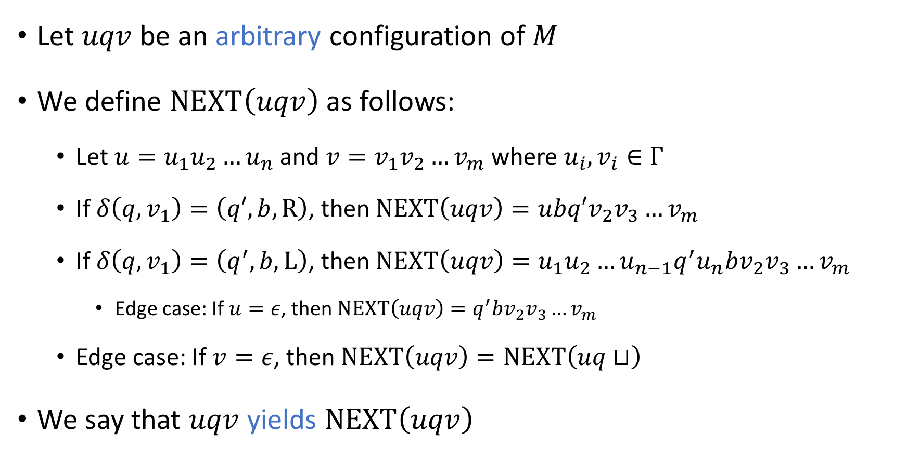
The “next” configuration
Let $uqv$ be an arbitrary configuration of $M$
We define $\text{NEXT}\left(uqv\right)$ as follows:
Let $u=u_{1}u_{2}…u_{n}$ and $v=v_{1}v_{2}…v_{m}$ where $u_{i},v_{i}∈Γ$
If $δ\left(q,v_{1}\right)=\left(q′,b,\text{R}\right)$, then $\text{NEXT}\left(uqv\right)=ubq′v_{2}v_{3}…v_{m}$
If $δ\left(q, v_{1}\right)=\left(q^{′},b,\text{L}\right)$, then $\text{NEXT}\left(uqv\right)=u_{1}u_{2}…u_{n−1}q^{′}u_{n}bv_{2}v_{3}…v_{m}$
Edge case: If $u=ε$, then $\text{NEXT}\left(uqv\right)=q^{′}bv_{2}v_{3}…v_{m}$
Edge case: If $v=ε$, then $\text{NEXT}\left(uqv\right)=\text{NEXT}\left(uq⊔\right)$
We say that $uqv$ yields $\text{NEXT}\left(uqv\right)$

Slide 7
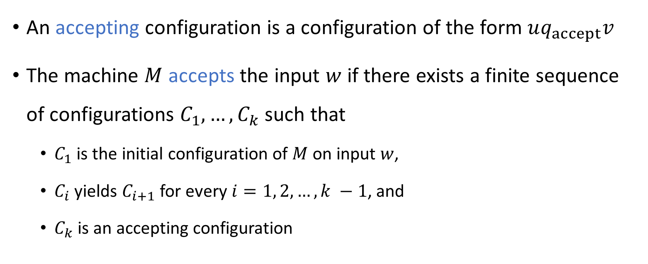
Accepting
An accepting configuration is a configuration of the form $uq_{accept}v$
The machine $M$ accepts the input $w$ if there exists a finite sequence of configurations $C_{1},…, C_{k}$ such that
$C_{1}$ is the initial configuration of $M$ on input $w$,
$C_{i}$ yields $C_{i+1}$ for every $i=1, 2, …, k −1$, and
$C_{k}$ is an accepting configuration

Slide 8
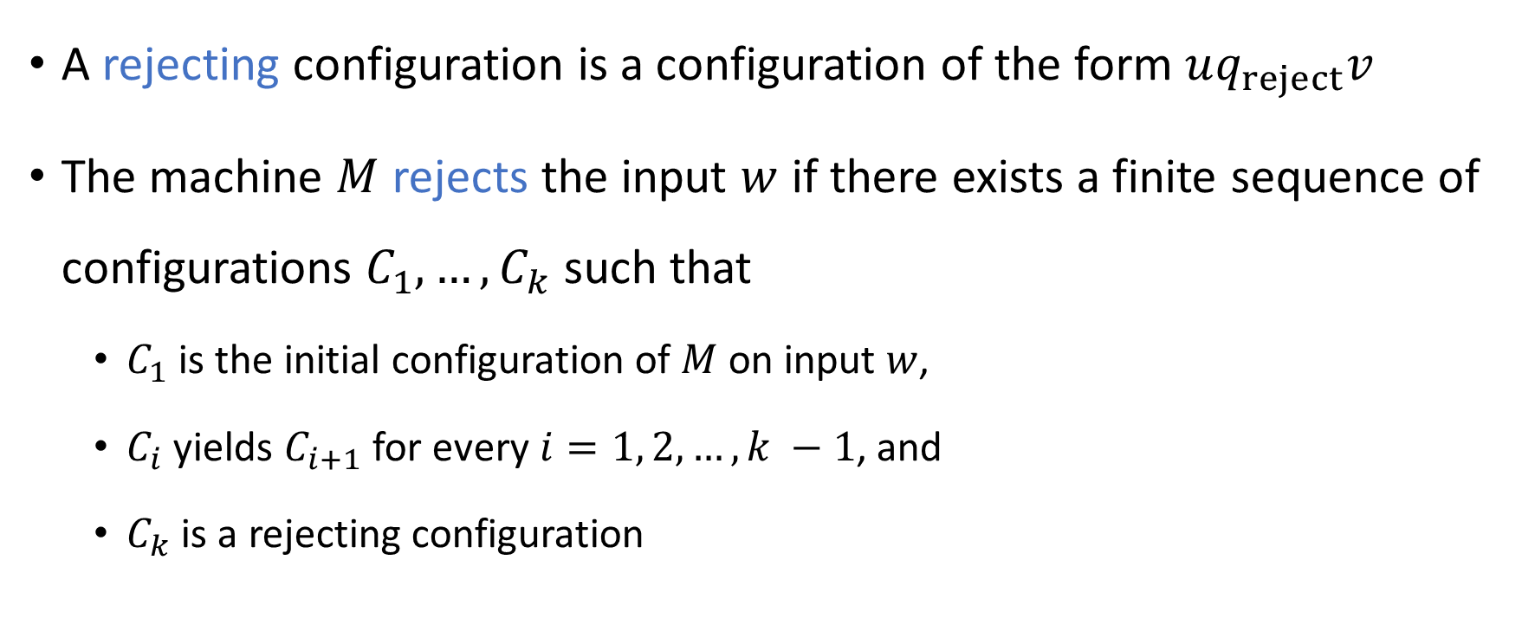
Rejecting
A rejecting configuration is a configuration of the form $uq_{reject}v$
The machine $M$ rejects the input $w$ if there exists a finite sequence of configurations $C_{1},…, C_{k}$ such that
$C_{1}$ is the initial configuration of $M$ on input $w$,
$C_{i}$ yields $C_{i+1}$ for every $i=1, 2, …, k −1$, and
$C_{k}$ is a rejecting configuration

Slide 9

Halting
A halting configuration is a configuration that is either accepting or rejecting
We say that $M$ halts on input $w$ if $M$ accepts $w$ or $M$ rejects $w$

Slide 10
Which problems can be solved through computation?

Slide 11
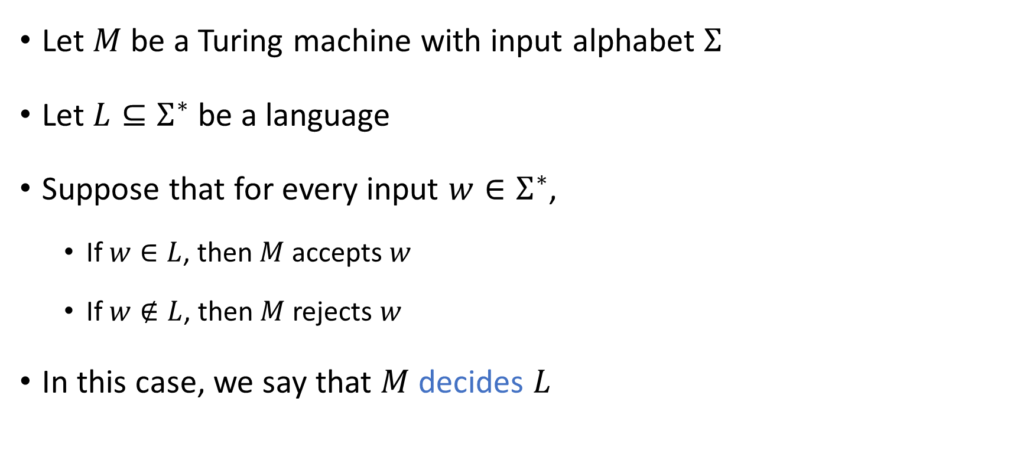
Deciding a language
Let $M$ be a Turing machine with input alphabet $Σ$
Let $L⊆Σ^{∗}$ be a language
Suppose that for every input $w∈Σ^{∗}$,
If $w∈L$, then $M$ accepts $w$
If $w∉L$, then $M$ rejects $w$
In this case, we say that $M$ decides $L$

Slide 12

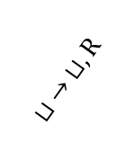
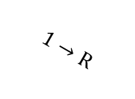

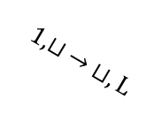

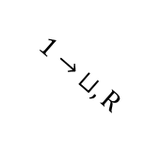


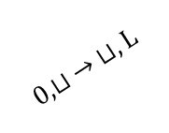

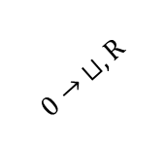



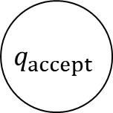
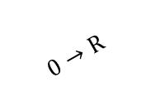

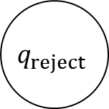


Example: What language does this TM decide?
$$0,1→\text{R}$$
$$r_{0}$$
$$⊔ →\text{L}$$
$$ℓ_{0}$$
$$0→ ⊔,\text{R}$$
$$0,⊔ → ⊔,\text{L}$$
$$1→\text{R}$$
$$q_{reject}$$
$$q_{0}$$
$$⊔ →\text{R}$$
$$ℓ$$
$$0,1←\text{L}$$
$$⊔ → ⊔,\text{R}$$
$$1→ ⊔,\text{R}$$
$$1,⊔ → ⊔,\text{L}$$
$$0→\text{R}$$
$$r_{1}$$
$$⊔ →\text{L}$$
$$ℓ_{1}$$
$$q_{accept}$$
$$0,1→\text{R}$$
Notes:
Palindromes

Slide 13
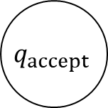
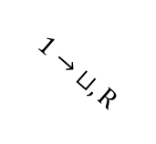

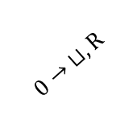


Example: This TM does not decide any language
$$q_{accept}$$
$$0→ ⊔,\text{R}$$
$$q_{0}$$
$$1→ ⊔,\text{R}$$
$$⊔ → ⊔,\text{R}$$
$$q_{reject}$$

Slide 14
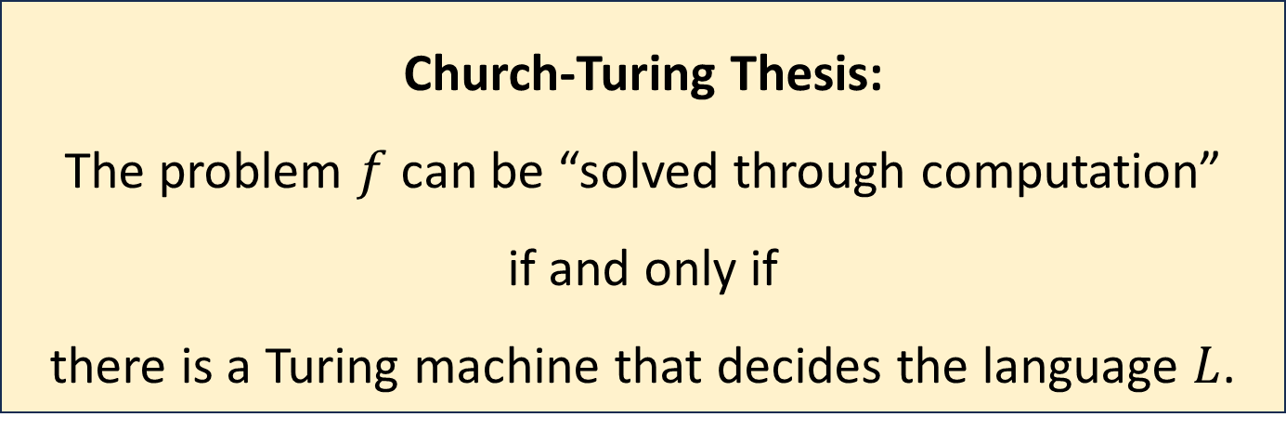
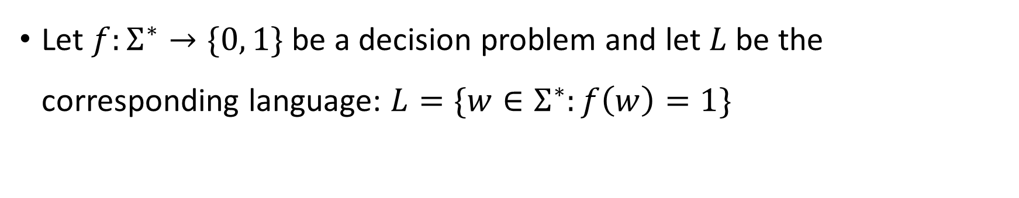
Church-Turing Thesis
Let $f:Σ^{∗}→\{0, 1\}$ be a decision problem and let $L$ be the corresponding language: $L=\{w∈Σ^{∗}:f\left(w\right)=1\}$
Church-Turing Thesis:
The problem $f$ can be “solved through computation”
if and only if
there is a Turing machine that decides the language $L$.
Intuitive notion
Mathematically precise notion

Slide 15
Church-Turing Thesis
The Church-Turing thesis says that the Turing machine model is the “correct” model of arbitrary computation
The thesis says that the informal concept of an “algorithm” is successfully captured by the rigorous definition of a Turing machine

Slide 16
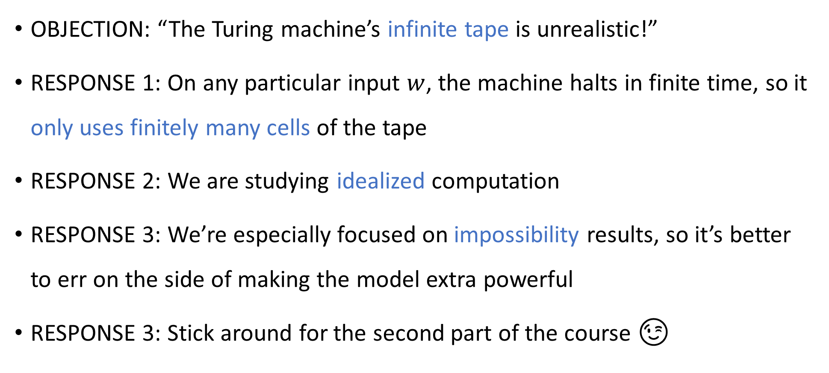
Are Turing machines too powerful?
OBJECTION: “The Turing machine’s infinite tape is unrealistic!”
RESPONSE 1: On any particular input $w$, the machine halts in finite time, so it only uses finitely many cells of the tape
RESPONSE 2: We are studying idealized computation
RESPONSE 3: We’re especially focused on impossibility results, so it’s better to err on the side of making the model extra powerful
RESPONSE 3: Stick around for the second part of the course 😉

