Slide 1
CMSC 28100 Introduction to Complexity Theory Autumn 2025 Instructor: William Hoza
⏳

Slide 2




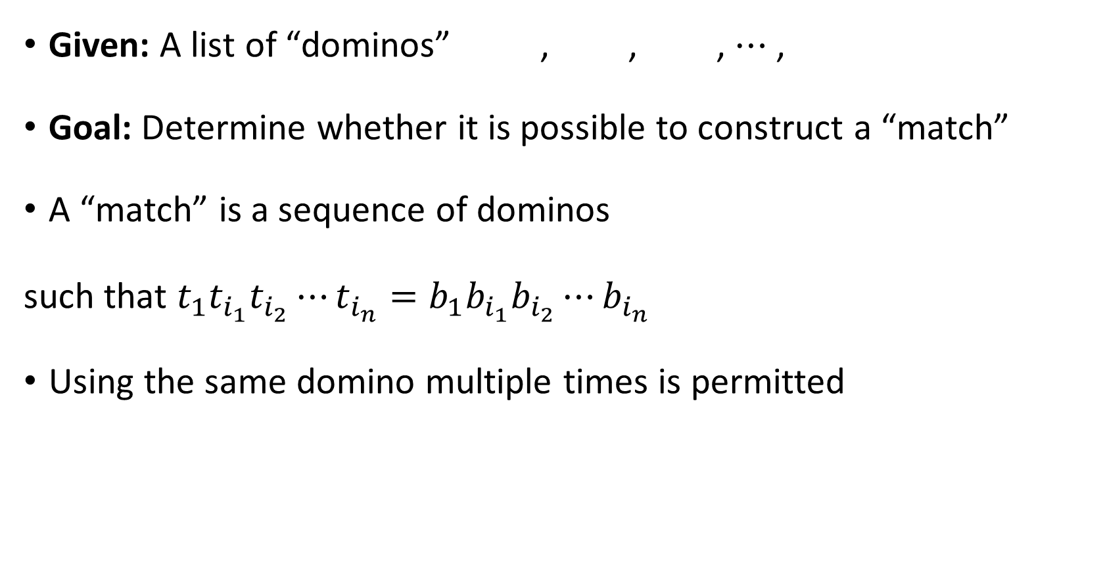









Modified Post’s Correspondence Problem
Given: A list of “dominos” , , , $⋯$ ,
Goal: Determine whether it is possible to construct a “match”
A “match” is a sequence of dominos
such that $t_{1}t_{i_{1}}t_{i_{2}}⋯t_{i_{n}}=b_{1}b_{i_{1}}b_{i_{2}}⋯b_{i_{n}}$
Using the same domino multiple times is permitted
$$\begin{matrix}t_{1} \\ b_{1}\end{matrix}$$
$$\begin{matrix}t_{2} \\ b_{2}\end{matrix}$$
$$\begin{matrix}t_{3} \\ b_{3}\end{matrix}$$
$$\begin{matrix}t_{k} \\ b_{k}\end{matrix}$$
$$\begin{matrix}t_{1} \\ b_{1}\end{matrix}$$
$$\begin{matrix}t_{i_{1}} \\ b_{i_{1}}\end{matrix}$$
$$\begin{matrix}t_{i_{2}} \\ b_{i_{2}}\end{matrix}$$
$$\begin{matrix}t_{i_{3}} \\ b_{i_{3}}\end{matrix}$$
$$\begin{matrix}t_{i_{4}} \\ b_{i_{4}}\end{matrix}$$
$$\begin{matrix}t_{i_{5}} \\ b_{i_{5}}\end{matrix}$$
$$\begin{matrix}t_{i_{n}} \\ b_{i_{n}}\end{matrix}$$
$$⋯$$
Lemma: $M\text{PCP}$ is undecidable

Slide 3






Proof that $\text{MPCP}$ is undecidable
Assume there is a TM $P$ that decides $\text{MPCP}$
Let’s construct a new TM $H$ that decides $\text{HALT}$
Given $\left\langle M,w\right\rangle$:
Construct dominos $t_{1},…, t_{k},b_{1},…b_{k}$ based on $M$ and $w$ (details on next slide)
Simulate $P$ on $\left\langle t_{1},…, t_{k},b_{1},…, b_{k}\right\rangle$
If $P$ accepts, accept. If $P$ rejects, reject.
$$H$$

Slide 4






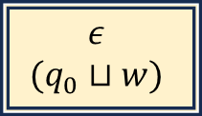









The dominos for $\left\langle M,w\right\rangle$
, , , , and
For every $q∈Q∖\left\{q_{accept},q_{reject}\right\}$ and every $b∈Σ$:
If $δ\left(q,b\right)=\left(q^{′},b^{′},\text{R}\right)$, we include , and we include for every $a∈Σ$
If $δ\left(q,b\right)=\left(q^{′},b^{′},\text{L}\right)$, we include , and we include for every $a∈Σ$
, , , , and for every $b∈Σ$
$$\begin{matrix}ε \\ (q_{0}⊔w)\end{matrix}$$
$$\begin{matrix}( \\ (\end{matrix}$$
$$\begin{matrix}) \\ )\end{matrix}$$
$$\begin{matrix}(q_{accept}) \\ ε\end{matrix}$$
$$\begin{matrix}(q_{reject}) \\ ε\end{matrix}$$
$$\begin{matrix}qb) \\ b^{′}q^{′}⊔)\end{matrix}$$
$$\begin{matrix}qba \\ b^{′}q^{′}a\end{matrix}$$
$$\begin{matrix}(qb \\ (q^{′}⊔b′\end{matrix}$$
$$\begin{matrix}aqb \\ q^{′}ab′\end{matrix}$$
$$\begin{matrix}b \\ b\end{matrix}$$
$$\begin{matrix}bq_{accept} \\ q_{accept}\end{matrix}$$
$$\begin{matrix}q_{accept}b \\ q_{accept}\end{matrix}$$
$$\begin{matrix}q_{reject}b \\ q_{reject}\end{matrix}$$
$$\begin{matrix}bq_{reject} \\ q_{reject}\end{matrix}$$

Slide 5



Proof that $\text{MPCP}$ is undecidable
Assume there is a TM $P$ that decides $\text{MPCP}$
Let’s construct a new TM $H$ that decides $\text{HALT}$
Given $\left\langle M,w\right\rangle$:
Construct dominos $t_{1},…, t_{k},b_{1},…b_{k}$ based on $M$ and $w$ (details on preceding slides)
Simulate $P$ on $\left\langle t_{1},…, t_{k},b_{1},…, b_{k}\right\rangle$
If $P$ accepts, accept. If $P$ rejects, reject.
Need to show:
If $M$ halts on $w$, then there is a match
If there is a match, then $M$ halts on $w$
$$H$$

Slide 6




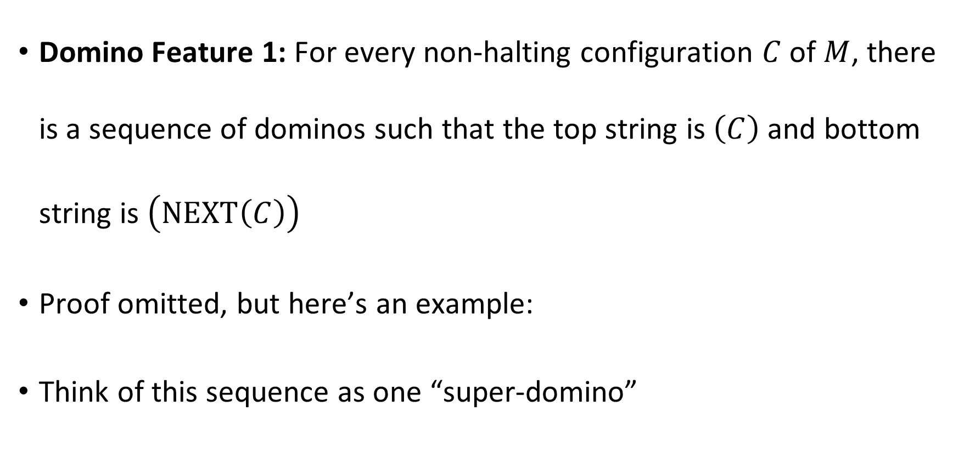






Domino Feature 1
Domino Feature 1: For every non-halting configuration $C$ of $M$, there is a sequence of dominos such that the top string is $\left(C\right)$ and bottom string is $\left(\text{NEXT}\left(C\right)\right)$
Proof omitted, but here’s an example:
Think of this sequence as one “super-domino”
$$\begin{matrix}( \\ (\end{matrix}$$
$$\begin{matrix}0 \\ 0\end{matrix}$$
$$\begin{matrix}1 \\ 1\end{matrix}$$
$$\begin{matrix}\# \\ \#\end{matrix}$$
$$\begin{matrix}0 \\ 0\end{matrix}$$
$$\begin{matrix}0q_{1}0 \\ q_{2}01\end{matrix}$$
$$\begin{matrix}0 \\ 1\end{matrix}$$
$$\begin{matrix}⊔ \\ ⊔\end{matrix}$$
$$\begin{matrix}) \\ )\end{matrix}$$
$$\begin{matrix}\left(C\right) \\ \left(\text{NEXT}\left(C\right)\right)\end{matrix}$$

Slide 7
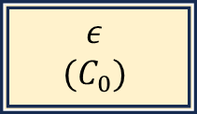












If $M$ halts on $w$, then there is a match
Let $C_{0},…, C_{T}$ be the halting computation history of $M$ on $w$
Match:
$\left|D_{i}+1\right|=\left|D_{i}\right|−1$
$$\begin{matrix}ε \\ (C_{0})\end{matrix}$$
$$\begin{matrix}(C_{0}) \\ \left(C_{1}\right)\end{matrix}$$
$$\begin{matrix}(C_{1}) \\ \left(C_{2}\right)\end{matrix}$$
$$\begin{matrix}(C_{T−1}) \\ \left(C_{T}\right)\end{matrix}$$
$$\begin{matrix}(C_{T}) \\ (D_{1})\end{matrix}$$
$$\begin{matrix}(D_{1}) \\ (D_{2})\end{matrix}$$
$$\begin{matrix}(D_{2}) \\ (D_{3})\end{matrix}$$
$$\begin{matrix}(D_{n−1}) \\ (D_{n})\end{matrix}$$
$$\begin{matrix}(D_{n}) \\ ε\end{matrix}$$
$$⋯$$
$$⋯$$

Slide 8



Proof that $\text{MPCP}$ is undecidable
Assume there is a TM $P$ that decides $\text{MPCP}$
Let’s construct a new TM $H$ that decides $\text{HALT}$
Given $\left\langle M,w\right\rangle$:
Construct dominos $t_{1},…, t_{k},b_{1},…b_{k}$ based on $M$ and $w$ (details on preceding slides)
Simulate $P$ on $\left\langle t_{1},…, t_{k},b_{1},…, b_{k}\right\rangle$
If $P$ accepts, accept. If $P$ rejects, reject.
Need to show:
If $M$ halts on $w$, then there is a match ✔️
If there is a match, then $M$ halts on $w$
$$H$$

Slide 9

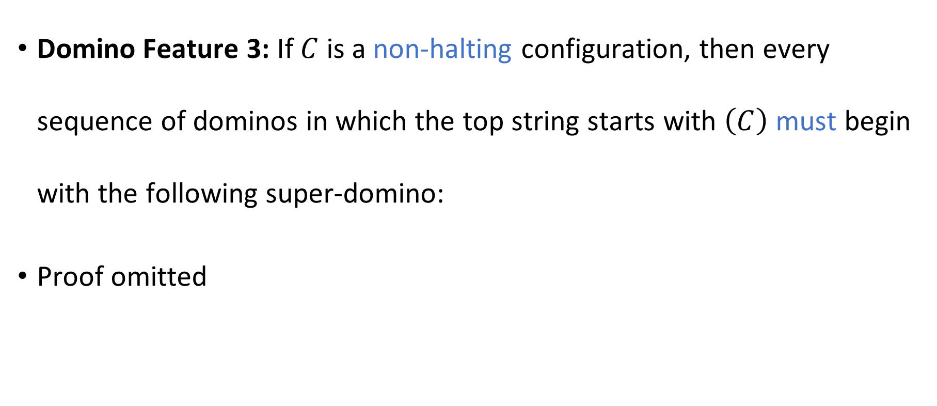
Domino Feature 3
Domino Feature 3: If $C$ is a non-halting configuration, then every sequence of dominos in which the top string starts with $\left(C\right)$ must begin with the following super-domino:
Proof omitted
$$\begin{matrix}\left(C\right) \\ \left(\text{NEXT}\left(C\right)\right)\end{matrix}$$

Slide 10








If there is a match, then $M$ halts on $w$
Assume there is a match
By Domino Feature 3, it must have the form
where $C_{T}$ is a halting configuration and $x∈Γ^{∗}$
$$\begin{matrix}ε \\ (C_{0})\end{matrix}$$
$$\begin{matrix}(C_{0}) \\ \left(C_{1}\right)\end{matrix}$$
$$\begin{matrix}(C_{1}) \\ \left(C_{2}\right)\end{matrix}$$
$$\begin{matrix}(C_{T−1}) \\ \left(C_{T}\right)\end{matrix}$$
$$\begin{matrix}\left(C_{T}\right)x \\ x\end{matrix}$$
$$⋯$$

Slide 11

Proof that $\text{MPCP}$ is undecidable
Assume there is a TM $P$ that decides $\text{MPCP}$
Let’s construct a new TM $H$ that decides $\text{HALT}$
Given $\left\langle M,w\right\rangle$:
Construct dominos $t_{1},…, t_{k},b_{1},…b_{k}$ based on $M$ and $w$ (details on preceding slides)
Simulate $P$ on $\left\langle t_{1},…, t_{k},b_{1},…, b_{k}\right\rangle$
If $P$ accepts, accept. If $P$ rejects, reject.
Need to show:
If $M$ halts on $w$, then there is a match ✔️
If there is a match, then $M$ halts on $w$ ✔️
$$H$$

Slide 12

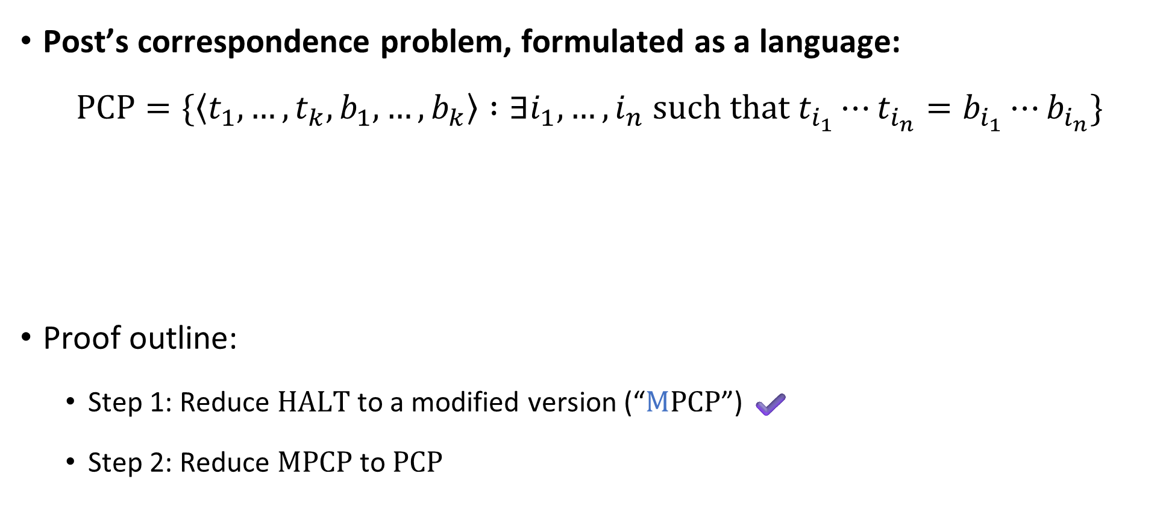
Post’s Correspondence Problem is undecidable
Post’s correspondence problem, formulated as a language:
$$\text{PCP}=\{\left\langle t_{1},…, t_{k}, b_{1},…, b_{k}\right\rangle :∃i_{1},…, i_{n} \text{such} \text{that} t_{i_{1}}⋯t_{i_{n}}=b_{i_{1}}⋯b_{i_{n}}\}$$
Proof outline:
Step 1: Reduce $\text{HALT}$ to a modified version (“$\text{M}\text{PCP}$”) ✔️
Step 2: Reduce $\text{MPCP}$ to $\text{PCP}$
Theorem: $\text{PCP}$ is undecidable

Slide 13




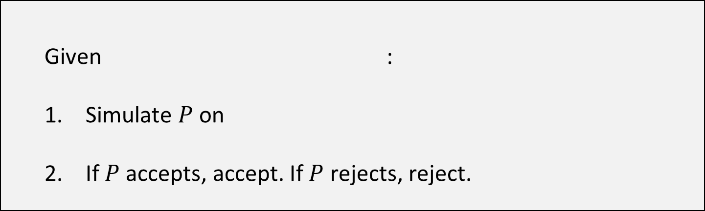











Proof that $\text{PCP}$ is undecidable
Assume there is a TM $P$ that decides $\text{PCP}$
Let’s construct a new TM $M$ that decides $\text{MPCP}$
For a string $u=u_{1}u_{2}…u_{n}$, define $\overline{u}=u_{1}⋆u_{2}⋆⋯⋆u_{n}$
Given :
Simulate $P$ on
If $P$ accepts, accept. If $P$ rejects, reject.
$$\begin{matrix}t_{1} \\ b_{1}\end{matrix}$$
$$\begin{matrix}t_{2} \\ b_{2}\end{matrix}$$
$$\begin{matrix}t_{3} \\ b_{3}\end{matrix}$$
$$\begin{matrix}t_{k} \\ b_{k}\end{matrix}$$
$$⋯$$
$$M$$
$$\begin{matrix}⋆\overline{t_{1}} \\ ⋆\overline{b_{1}}⋆\end{matrix}$$
$$\begin{matrix}⋆\overline{t_{1}} \\ \overline{b_{1}}⋆\end{matrix}$$
$$\begin{matrix}⋆\overline{t_{2}} \\ \overline{b_{2}}⋆\end{matrix}$$
$$\begin{matrix}⋆\overline{t_{3}} \\ \overline{b_{3}}⋆\end{matrix}$$
$$\begin{matrix}⋆\overline{t_{k}} \\ \overline{b_{k}}⋆\end{matrix}$$
$$\begin{matrix}⋆ \\ ε\end{matrix}$$
$$⋯$$

Slide 14


























Given :
Simulate $P$ on
If $P$ accepts, accept. If $P$ rejects, reject.
$$\begin{matrix}t_{1} \\ b_{1}\end{matrix}$$
$$\begin{matrix}t_{2} \\ b_{2}\end{matrix}$$
$$\begin{matrix}t_{3} \\ b_{3}\end{matrix}$$
$$\begin{matrix}t_{k} \\ b_{k}\end{matrix}$$
$$⋯$$
$$\begin{matrix}⋆\overline{t_{1}} \\ ⋆\overline{b_{1}}⋆\end{matrix}$$
$$\begin{matrix}⋆\overline{t_{1}} \\ \overline{b_{1}}⋆\end{matrix}$$
$$\begin{matrix}⋆\overline{t_{2}} \\ \overline{b_{2}}⋆\end{matrix}$$
$$\begin{matrix}⋆\overline{t_{3}} \\ \overline{b_{3}}⋆\end{matrix}$$
$$\begin{matrix}⋆\overline{t_{k}} \\ \overline{b_{k}}⋆\end{matrix}$$
$$\begin{matrix}⋆ \\ ε\end{matrix}$$
$$⋯$$
Suppose the MPCP instance has a match:
Then the PCP instance also has a match:
$$\begin{matrix}t_{1} \\ b_{1}\end{matrix}$$
$$\begin{matrix}t_{i_{1}} \\ b_{i_{1}}\end{matrix}$$
$$\begin{matrix}t_{i_{2}} \\ b_{i_{2}}\end{matrix}$$
$$\begin{matrix}t_{i_{3}} \\ b_{i_{3}}\end{matrix}$$
$$\begin{matrix}t_{i_{4}} \\ b_{i_{4}}\end{matrix}$$
$$\begin{matrix}t_{i_{n}} \\ b_{i_{n}}\end{matrix}$$
$$⋯$$
$$\begin{matrix}⋆\overline{t_{1}} \\ ⋆\overline{b_{1}}⋆\end{matrix}$$
$$\begin{matrix}⋆\overline{t_{i_{1}}} \\ \overline{b_{i_{1}}}⋆\end{matrix}$$
$$\begin{matrix}⋆\overline{t_{i_{2}}} \\ \overline{b_{i_{2}}}⋆\end{matrix}$$
$$\begin{matrix}⋆\overline{t_{i_{n}}} \\ \overline{b_{i_{n}}}⋆\end{matrix}$$
$$\begin{matrix}⋆ \\ ε\end{matrix}$$
$$⋯$$

Slide 15


Given :
Simulate $P$ on
If $P$ accepts, accept. If $P$ rejects, reject.
$$\begin{matrix}t_{1} \\ b_{1}\end{matrix}$$
$$\begin{matrix}t_{2} \\ b_{2}\end{matrix}$$
$$\begin{matrix}t_{3} \\ b_{3}\end{matrix}$$
$$\begin{matrix}t_{k} \\ b_{k}\end{matrix}$$
$$⋯$$
$$\begin{matrix}⋆\overline{t_{1}} \\ ⋆\overline{b_{1}}⋆\end{matrix}$$
$$\begin{matrix}⋆\overline{t_{1}} \\ \overline{b_{1}}⋆\end{matrix}$$
$$\begin{matrix}⋆\overline{t_{2}} \\ \overline{b_{2}}⋆\end{matrix}$$
$$\begin{matrix}⋆\overline{t_{3}} \\ \overline{b_{3}}⋆\end{matrix}$$
$$\begin{matrix}⋆\overline{t_{k}} \\ \overline{b_{k}}⋆\end{matrix}$$
$$\begin{matrix}⋆ \\ ε\end{matrix}$$
$$⋯$$
Conversely, suppose the PCP instance has a match
Must start with , because that’s the only domino in which the top string and bottom string start with the same symbol
Delete all $⋆$ symbols $⇒$ MPCP match
$$\begin{matrix}⋆\overline{t_{1}} \\ ⋆\overline{b_{1}}⋆\end{matrix}$$

Slide 16

Post’s Correspondence Problem is undecidable
Post’s correspondence problem, formulated as a language:
$$\text{PCP}=\{\left\langle t_{1},…, t_{k}, b_{1},…, b_{k}\right\rangle :∃i_{1},…, i_{n} \text{such} \text{that} t_{i_{1}}⋯t_{i_{n}}=b_{i_{1}}⋯b_{i_{n}}\}$$
Proof outline:
Step 1: Reduce $\text{REJECT}$ to a modified version (“$\text{M}\text{PCP}$”) ✔️
Step 2: Reduce $\text{MPCP}$ to $\text{PCP}$ ✔️
Theorem: $\text{PCP}$ is undecidable

Slide 17
Post’s Correspondence Problem: Recap
Post’s Correspondence Problem seems like “just a domino puzzle”
However, we showed how to build a computer out of dominos!
PCP was secretly a problem about Turing machines all along!

Slide 18


Undecidability
Known undecidable languages:
$\text{SELF}‑\text{REJECTORS}$
$\text{HALT}$
$\text{PCP}$ and $\text{MPCP}$
Next: One more example

Slide 19


The acceptance problem
Informal problem statement: Given a Turing machine $M$ and an input $w$, determine whether $M$ accepts $w$.
The same problem, formulated as a language:
$$\text{ACCEPT}=\left\{\left\langle M,w\right\rangle :M \text{is} \text{a} \text{Turing} \text{machine} \text{that} \text{accepts} w\right\}$$
$\text{HALT}$ and $\text{ACCEPT}$ are both about predicting TMs’ behavior
Theorem: $\text{ACCEPT}$ is undecidable

Slide 20


Code as data II
Our proof that $\text{ACCEPT}$ is undecidable will involve Turing machines constructing Turing machines
Turing machines can both read and write descriptions $\left\langle M\right\rangle$ where $M$ is a Turing machine
“Drawing Hands.”
(1948 lithograph by M. C. Escher)

Slide 21







Proof that $\text{ACCEPT}$ is undecidable
Assume there is a TM $A$ that decides $\text{ACCEPT}$
Let’s construct a new TM $H$ that decides $\text{HALT}$
Given $\left\langle M,w\right\rangle$:
Construct $\left\langle M^{′}\right\rangle$, where $M^{′}$ is the following TM:
Simulate $A$ on $\left\langle M′,w\right\rangle$
If $A$ accepts, accept. If $A$ rejects, reject.
If $M$ halts on $w$…
Then $M^{′}$ accepts $w$
Therefore, $A$ accepts $\left\langle M^{′},w\right\rangle$
Therefore, $H$ accepts $\left\langle M,w\right\rangle$ ✔️
If $M$ loops on $w$…
Then $M^{′}$ loops on $w$
Therefore, $A$ rejects $\left\langle M^{′},w\right\rangle$
Therefore, $H$ rejects $\left\langle M,w\right\rangle$ ✔️
Given $x$:
Simulate $M$ on $x$
If $M$ halts, accept.
$$H$$
$$M′$$

Slide 22

Some more undecidable problems
We have seen several interesting examples of undecidable languages
$\text{SELF}‑\text{REJECTORS}$, $HALT$, $\text{PCP}$, $\text{MPCP}$, $\text{ACCEPT}$
I’ll describe a few more examples one more example
Each can be proven undecidable via reduction from $\text{HALT}$
But we will not do the proofs
(This material will not be on exercises or exams)

Slide 23


Hilbert’s 10th problem
Informal problem statement: Given a polynomial equation with integer coefficients such as
$$x^{2}+3xz+y^{3}+z^{2}x^{2}=4xy^{2}+6yz+2,$$
determine whether there is an integer solution
As a language: $\text{HILBERT}\text{10}=\{\left\langle p,q\right\rangle :∃\vec{x} \text{such} \text{that} p\left(\vec{x}\right)=q\left(\vec{x}\right)\}$
Theorem: $\text{HILBERT}\text{10}$ is undecidable

