Slide 1
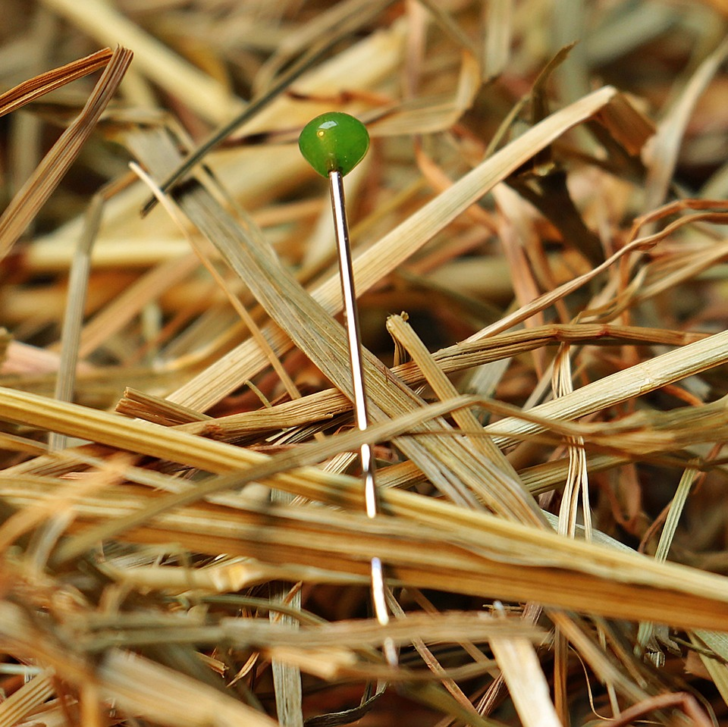
CMSC 28100 Introduction to Complexity Theory Spring 2024 Instructor: William Hoza

Slide 2
The nature of this course
In this course, we will study
The mathematical and philosophical foundations of computer science
The ultimate limits of computation
This course will give you powerful conceptual tools for reasoning about computation
There will be very little programming
Homework and exams will be primarily proof-based

Slide 3
Who this course is designed for
CS students, math students, and anyone who is curious
Prerequisites:
Experience with mathematical proofs
CMSC 27200 or CMSC 27230 or CMSC 37000, or MATH 15900 or MATH 15910 or MATH 16300 or MATH 16310 or MATH 19900 or MATH 25500

Slide 4
Who this course is designed for
I would like every CS student to take this course
It’s okay if you don’t consider yourself “theory-oriented.” You belong here
I consider it my job to give you resources so you can learn and succeed
I also consider it my job to persuade you that complexity theory is important, interesting, enlightening, fun, cool, and generally worthy of your attention

Slide 5
Class participation
Please ask questions!
“How do we know _____?”
“Can you remind me what _____ means?”
“I don’t get it. Can you explain that again?”
We are not in a hurry

Slide 6

Textbook
Classic
Popular
High-quality
Not free ☹️

Slide 7
My office hours
Mondays, 10:30am – 12:30pm, JCL 205
Exception: No office hours today (3/18)
Stop by! This is the best time to discuss:
Questions about the course material or the homework
Concerns, complaints, or suggestions about how to improve the course
Complexity theory topics that you’re simply curious about

Slide 8
Course staff
Zelin Lv (TA)
Office hours: Fridays, 1pm – 2pm, JCL 205
Rohan Soni (TA)
Office hours: Thursdays, 2:30pm – 3:30pm, JCL 205
Nico Marin Gamboa (Grader)
Loren Troan (Grader)

Slide 9
Technology
Course webpage: https://williamhoza.com/teaching/spring2024-intro-to-complexity
Course policies; slides
Canvas: https://canvas.uchicago.edu/courses/55826
Problem sets; practice exams; official solutions
Ed: https://edstem.org/us/courses/56687/
Discussions; announcements
Gradescope: https://www.gradescope.com/courses/748307
Submitting homework solutions; grades and feedback

Slide 10
Assessment
There will be 6 or 7 problem sets throughout the quarter
The first problem set is due Tuesday, March 26
There will be a midterm exam and a final exam

Slide 11
The central question of this course: Which problems can be solved through computation?

Slide 12
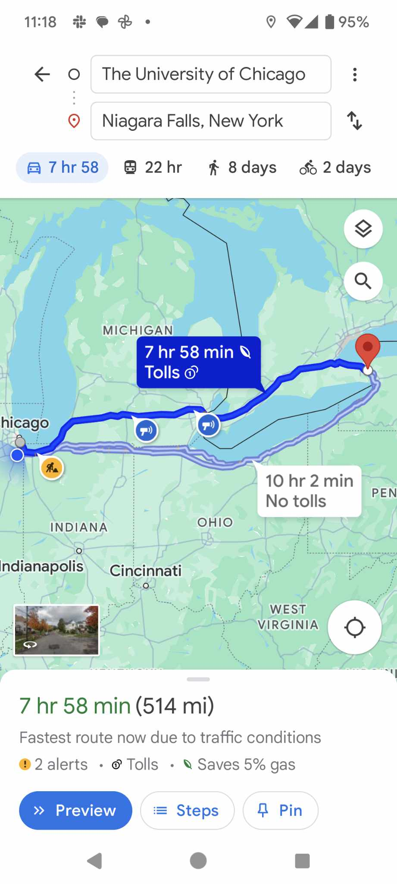
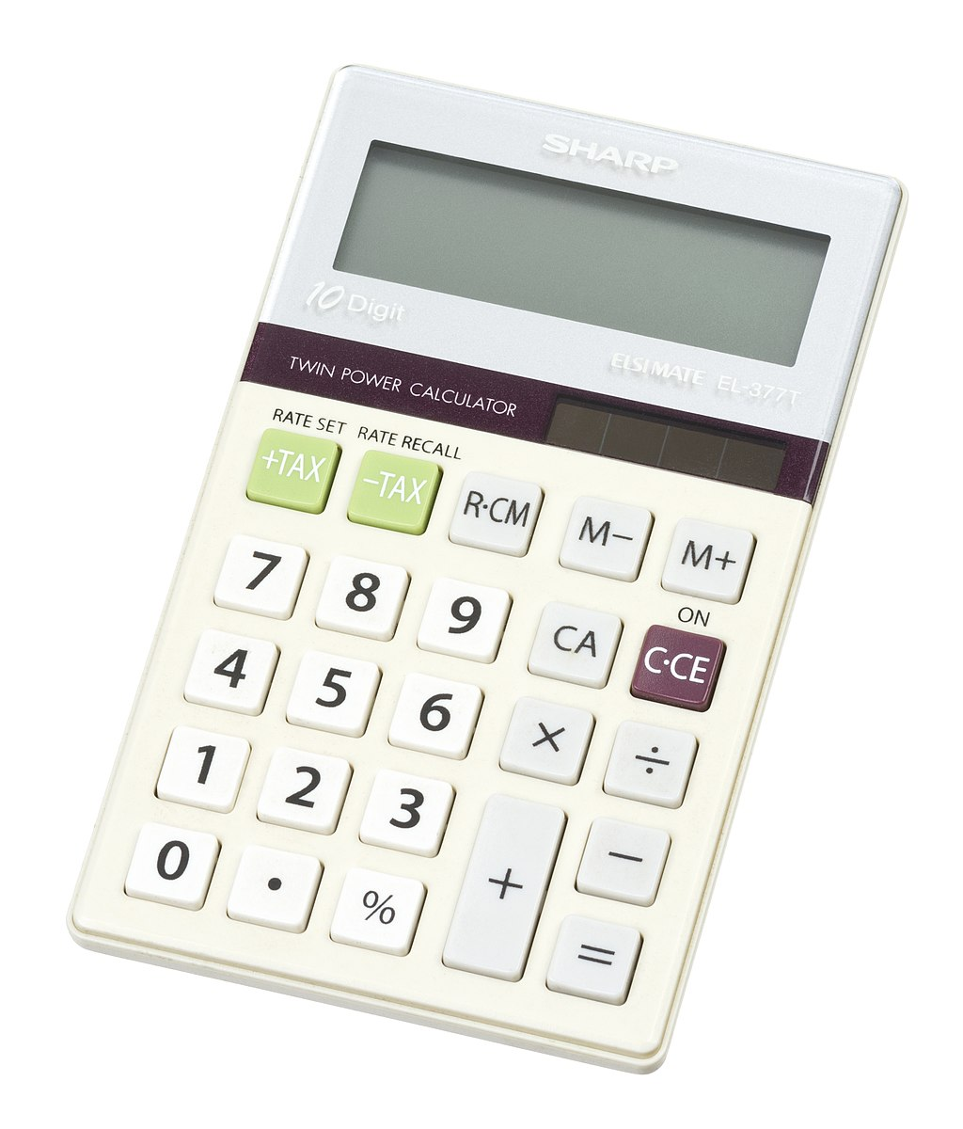
Examples
The following problems can be solved through computation:
Addition
Multiplication
Shortest path
Are there any problems that cannot be solved through computation?

Slide 13
Impossibility proofs
To persuasively argue that certain problems cannot be solved through computation, we will take a mathematical approach
We will formulate precise mathematical models
“Problem”
“Computation”
“Solve”
Then we will write rigorous mathematical proofs of impossibility

Slide 14
Which problems can be solved through computation?

Slide 15


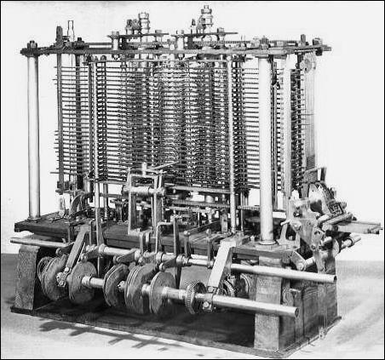
Computation
You might think of “computers” as modern technology, but computation is ancient
Computation can be performed by
A human being with paper and a pencil
A smartphone
A steam-powered machine
We want a mathematical model that describes all of these and transcends any one technology

Slide 16
Human computation vs. technological
Smartphones and laptops merely automate the process of computation
They can compute faster and more reliably than a human being, but what they do is essentially the same as what we do
Consequence: We do not need to understand electronics to understand computation 🙂
Computation is a familiar, everyday, human act
“Mathematical anthropology”

Slide 17

Ex: Palindromes
01110000110100111100101100011110
Suppose a long string of bits is written on a blackboard
Your job: Figure out whether the string is a “palindrome,” i.e., whether it is the same forwards and backwards
What’s your approach?

Slide 18
Ex: Palindromes
01110000110100111100101100011110
Idea: Compare and cross off the first and last symbols
Repeat until we find a mismatch or everything is crossed off
Not a palindrome
At the end of the process, where might we be standing?
A: Anywhere
B: Right half only
C: Even-numbered positions only
D: Odd-numbered positions only
Respond at PollEv.com/whoza or text “whoza” to 22333

Slide 19
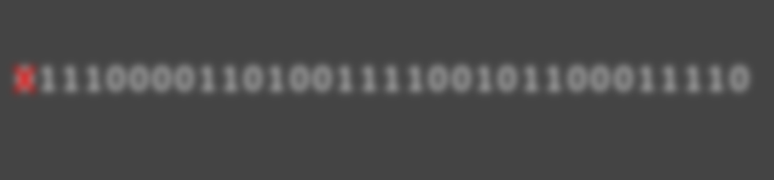
Local decisions
In each step, what information do we use to decide what to do next?
We keep track of some information (“state”) in our mind
We look at the local contents of the blackboard (one symbol is sufficient)
We can describe the algorithm in excruciating detail using a “state diagram” (next slide)
01110000110100111100101100011110
I just crossed off a zero, and now I’m heading over to the right end of the string

Slide 20
See an uncrossed symbol: move right
See a crossed-off symbol or a blank spot: move left
Checking for a matching zero
Heading right to check for a matching zero
See a crossed-off symbol
See a zero: cross it off; move right
See a zero: cross it off; move left
See a one
See a crossed-off symbol: move right
Output NO
Output YES
Start
Heading left
See an uncrossed symbol: move left
See a one: cross it off; move right
Heading right to check for a matching one
See a one: cross it off; move left
See a zero
See a crossed-off symbol
Checking for a matching one
See a crossed-off symbol or a blank spot: move left
See an uncrossed symbol: move right
See a crossed-off symbol or a blank spot

Slide 21
The Turing machine model
Turing machines: A mathematical model of human computation
Basic idea: a Turing machine is any algorithm that can be described by a state diagram similar to what we just saw

Slide 22

Turing machines
$$♢$$
1
1
0
0
1
We imagine a one-dimensional “tape” that extends infinitely to the right
The tape is divided into “cells.” Each cell has one symbol written in it
There is a “head” pointing at one cell of the tape
The machine can be in one of finitely many internal “states”

Slide 23
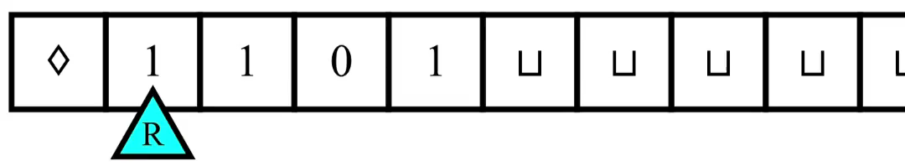
Turing machines
In each step, the machine decides
What to write
Which direction to move the head (left or right)
The new state
The decision is based only on the current state and the observed symbol

Slide 24

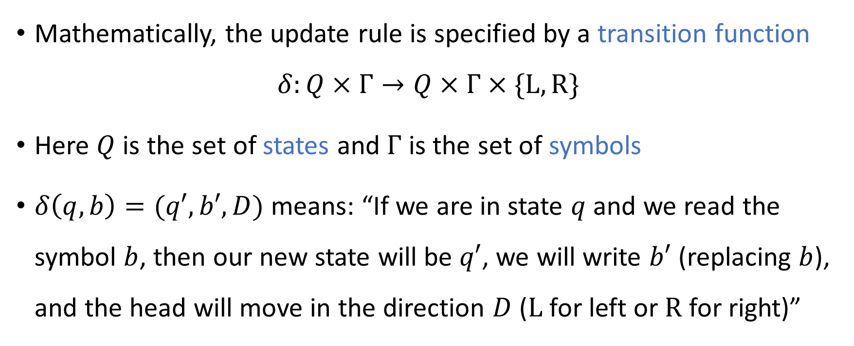
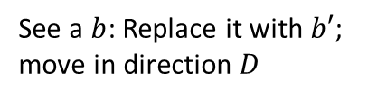

Transition function
See a $b$: Replace it with $b′$; move in direction $D$
$$q$$
$$q′$$
Mathematically, the update rule is specified by a transition function
$$δ:Q×Γ→Q×Γ×\{\text{L}, \text{R}\}$$
Here $Q$ is the set of states and $Γ$ is the set of symbols
$δ\left(q, b\right)=(q′,b′,D)$ means: “If we are in state $q$ and we read the symbol $b$, then our new state will be $q′$, we will write $b′$ (replacing $b$), and the head will move in the direction $D$ ($\text{L}$ for left or $\text{R}$ for right)”

Slide 25
The input to a Turing machine
A Turing machine represents an algorithm
The input to a Turing machine is always a finite string of symbols

Slide 26

Symbols and alphabets
An “alphabet” $Σ$is any nonempty, finite set of “symbols”
$Σ=\{0, 1\}$
$Σ=\left\{0, 1, 0, 1\right\}$
$Σ=\{\text{A}, \text{B}, \text{C}, …,\text{Z}\}$
$Σ=\{😍,\text{⚾}\text{,}\text{🐍},\text{⏰},🍕\}$

Slide 27

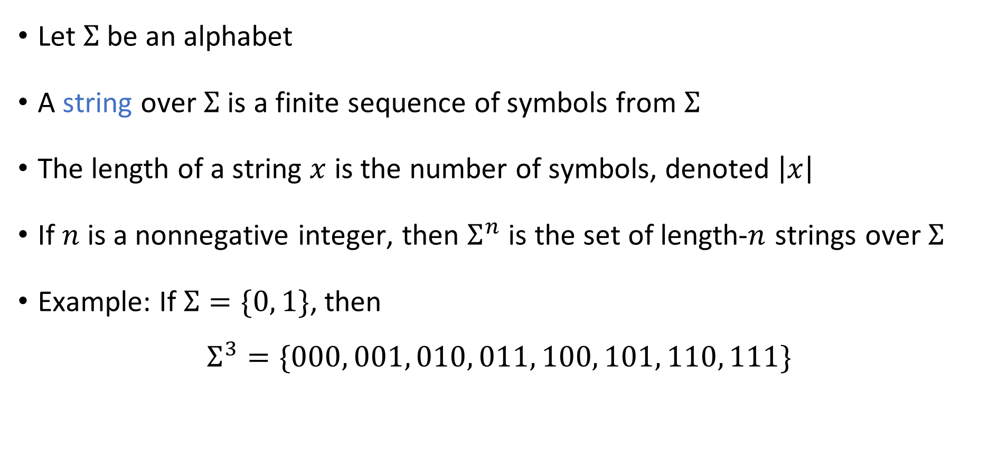
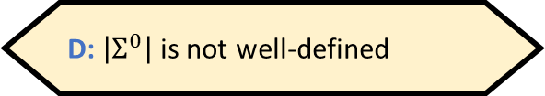

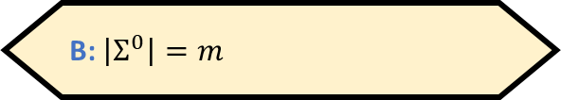
Strings
If $\left|Σ\right|=m$, then what is $\left|Σ^{0}\right|$?
A: $\left|Σ^{0}\right|=0$
B: $\left|Σ^{0}\right|=m$
Let $Σ$ be an alphabet
A string over $Σ$ is a finite sequence of symbols from $Σ$
The length of a string $x$ is the number of symbols, denoted $\left|x\right|$
If $n$ is a nonnegative integer, then $Σ^{n}$ is the set of length-$n$ strings over $Σ$
Example: If $Σ=\{0, 1\}$, then
$$Σ^{3}=\{000, 001, 010, 011, 100, 101, 110, 111\}$$
C: $\left|Σ^{0}\right|=1$
D: $\left|Σ^{0}\right|$ is not well-defined
Respond at PollEv.com/whoza or text “whoza” to 22333

Slide 28
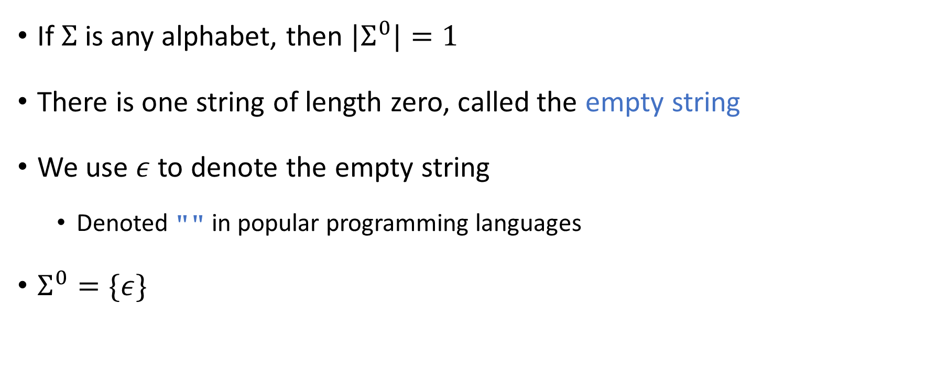
The empty string
If $Σ$ is any alphabet, then ${|Σ}^{0}|=1$
There is one string of length zero, called the empty string
We use $ε$ to denote the empty string
Denoted "" in popular programming languages
$Σ^{0}=\{ε\}$

Slide 29
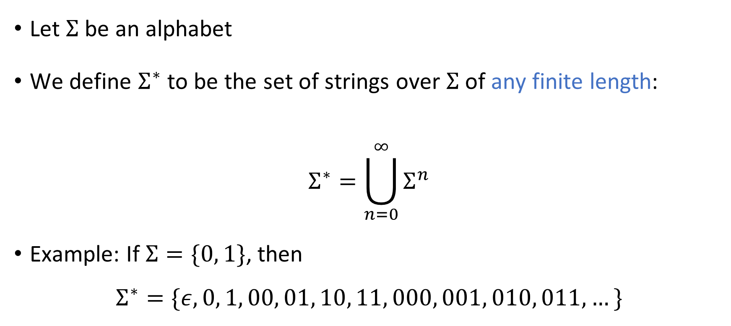
Arbitrary-length strings
Let $Σ$ be an alphabet
We define $Σ^{∗}$ to be the set of strings over $Σ$ of any finite length:
$$Σ^{∗}=\bigcup_{n=0}^{∞}{Σ^{n}}$$
Example: If $Σ=\{0, 1\}$, then
$$Σ^{∗}=\{ε,0, 1, 00, 01, 10, 11, 000, 001, 010, 011, …\}$$

Slide 30





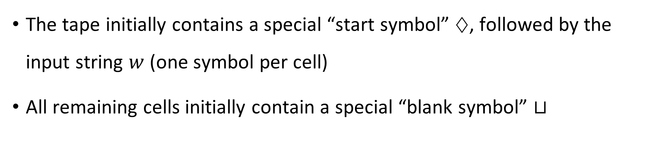








Turing machine initialization
The tape initially contains a special “start symbol” $♢$, followed by the input string $w$ (one symbol per cell)
All remaining cells initially contain a special “blank symbol” $⊔$
$$♢$$
$$w_{1}$$
$$w_{2}$$
$$w_{3}$$
$$⋯$$
$$w_{n}$$
$$⊔$$
$$⊔$$
$$⊔$$
$$⊔$$
$$⊔$$
$$⊔$$
$$q_{0}$$

Slide 31
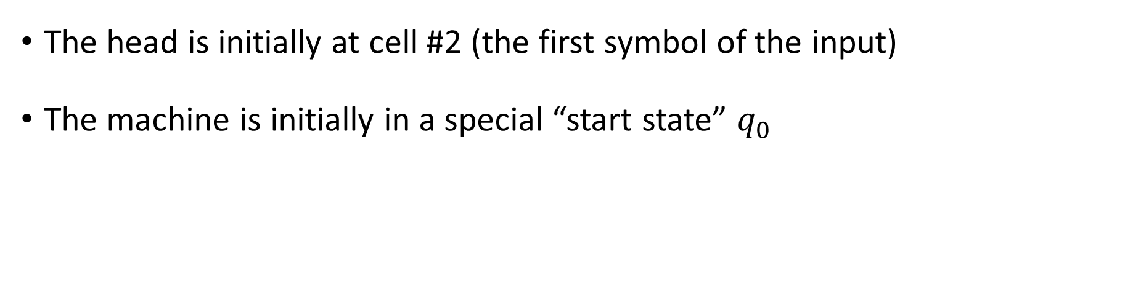

Turing machine initialization
The head is initially at cell #2 (the first symbol of the input)
The machine is initially in a special “start state” $q_{0}$
$$♢$$
$$w_{1}$$
$$w_{2}$$
$$w_{3}$$
$$⋯$$
$$w_{n}$$
$$⊔$$
$$⊔$$
$$⊔$$
$$⊔$$
$$⊔$$
$$⊔$$
$$q_{0}$$

Slide 32
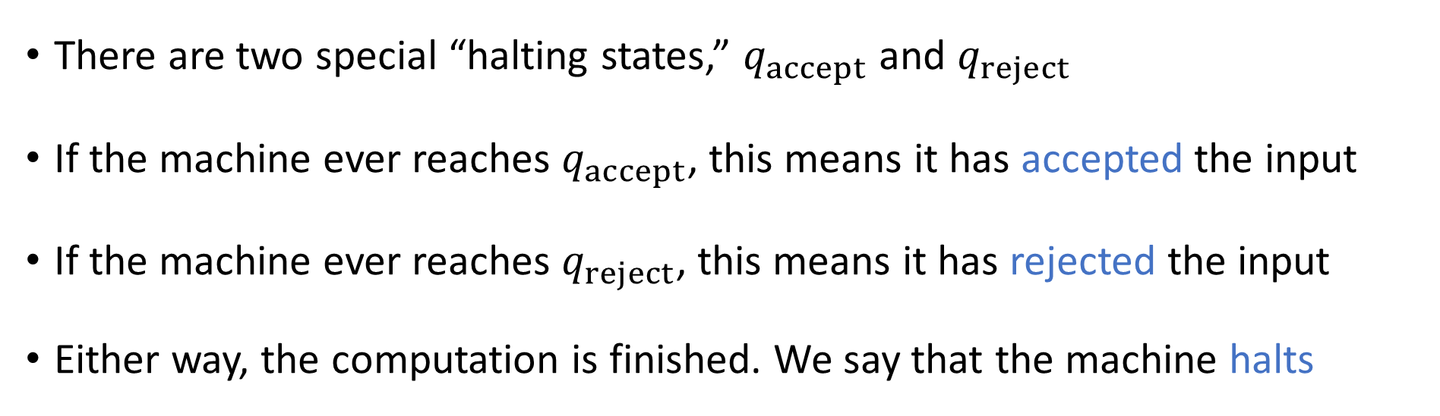
Halting states
Turing Machine
Accept
Reject
Run forever (“loop”)
Input
There are two special “halting states,” $q_{accept}$ and $q_{reject}$
If the machine ever reaches $q_{accept}$, this means it has accepted the input
If the machine ever reaches $q_{reject}$, this means it has rejected the input
Either way, the computation is finished. We say that the machine halts

Slide 33
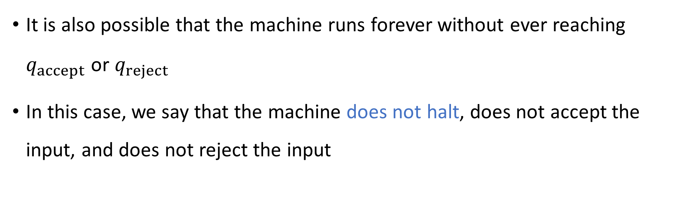
Looping
Turing Machine
Accept
Reject
Run forever (“loop”)
Input
It is also possible that the machine runs forever without ever reaching $q_{accept}$ or $q_{reject}$
In this case, we say that the machine does not halt, does not accept the input, and does not reject the input

