Slide 1
CMSC 28100 Introduction to Complexity Theory Autumn 2025 Instructor: William Hoza
⏳

Slide 2
Which problems can be solved through computation?

Slide 3

Randomized computation
Researchers often use randomness to answer questions
Random sampling for opinion polls
Randomized controlled trials in science/medicine
What if we incorporate this ability into our computational model?

Slide 4






Randomized Turing machines
Input tape ➡
$$⊔$$
1
1
1
0
$$⊔$$
$$⊔$$
Randomness tape ➡
$$⊔$$

Slide 5
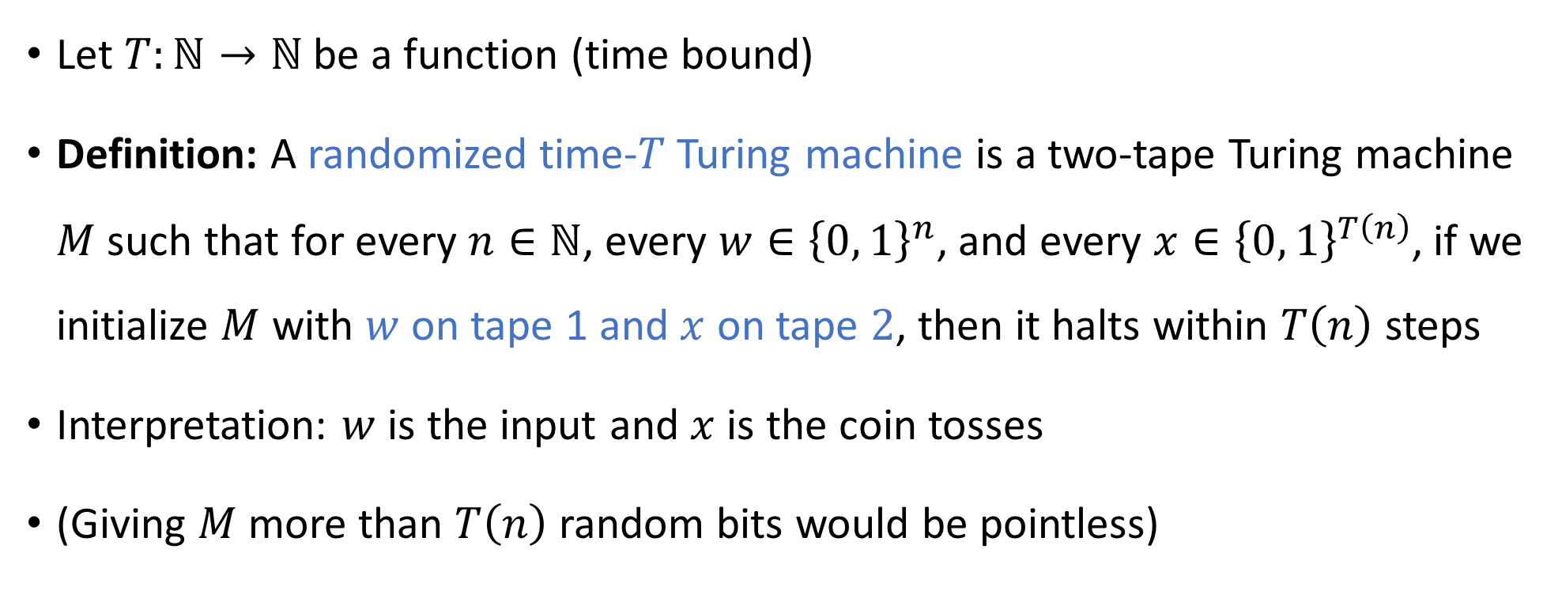
Randomized Turing machines
Let $T:ℕ→ℕ$ be a function (time bound)
Definition: A randomized time-$T$Turing machine is a two-tape Turing machine $M$ such that for every $n∈ℕ$, every $w∈{\left\{0, 1\right\}}^{n}$, and every $x∈{\left\{0, 1\right\}}^{T\left(n\right)}$, if we initialize $M$ with $w$ on tape 1 and $x$ on tape $2$, then it halts within $T\left(n\right)$ steps
Interpretation: $w$ is the input and $x$ is the coin tosses
(Giving $M$ more than $T\left(n\right)$ random bits would be pointless)

Slide 6
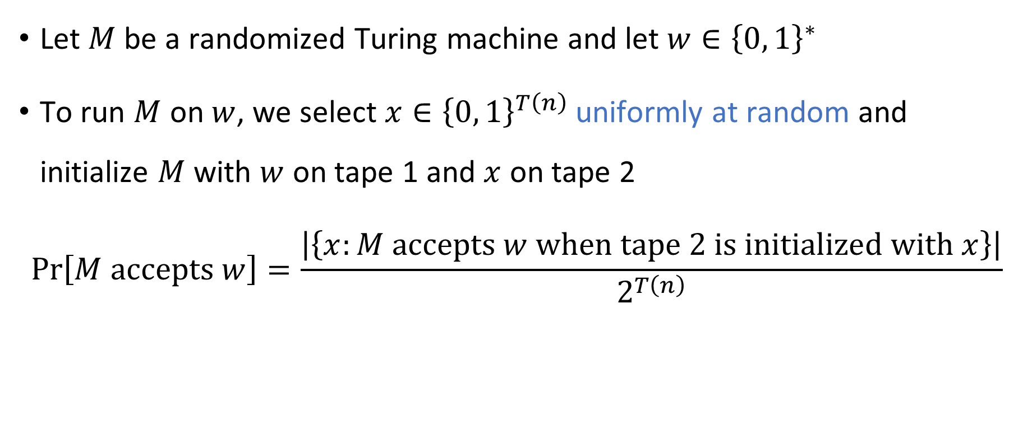
Acceptance probability
Let $M$ be a randomized Turing machine and let $w∈{\left\{0, 1\right\}}^{∗}$
To run $M$ on $w$, we select $x∈{\left\{0, 1\right\}}^{T\left(n\right)}$ uniformly at random and initialize $M$ with $w$ on tape 1 and $x$ on tape 2
$$\operatorname{Pr}\left[M \text{accepts} w\right]=\frac{\left|\left\{x:M \text{accepts} w \text{when} \text{tape} \text{2 }\text{is} \text{initialized} \text{with} x\right\}\right|}{2^{T\left(n\right)}}$$

Slide 7
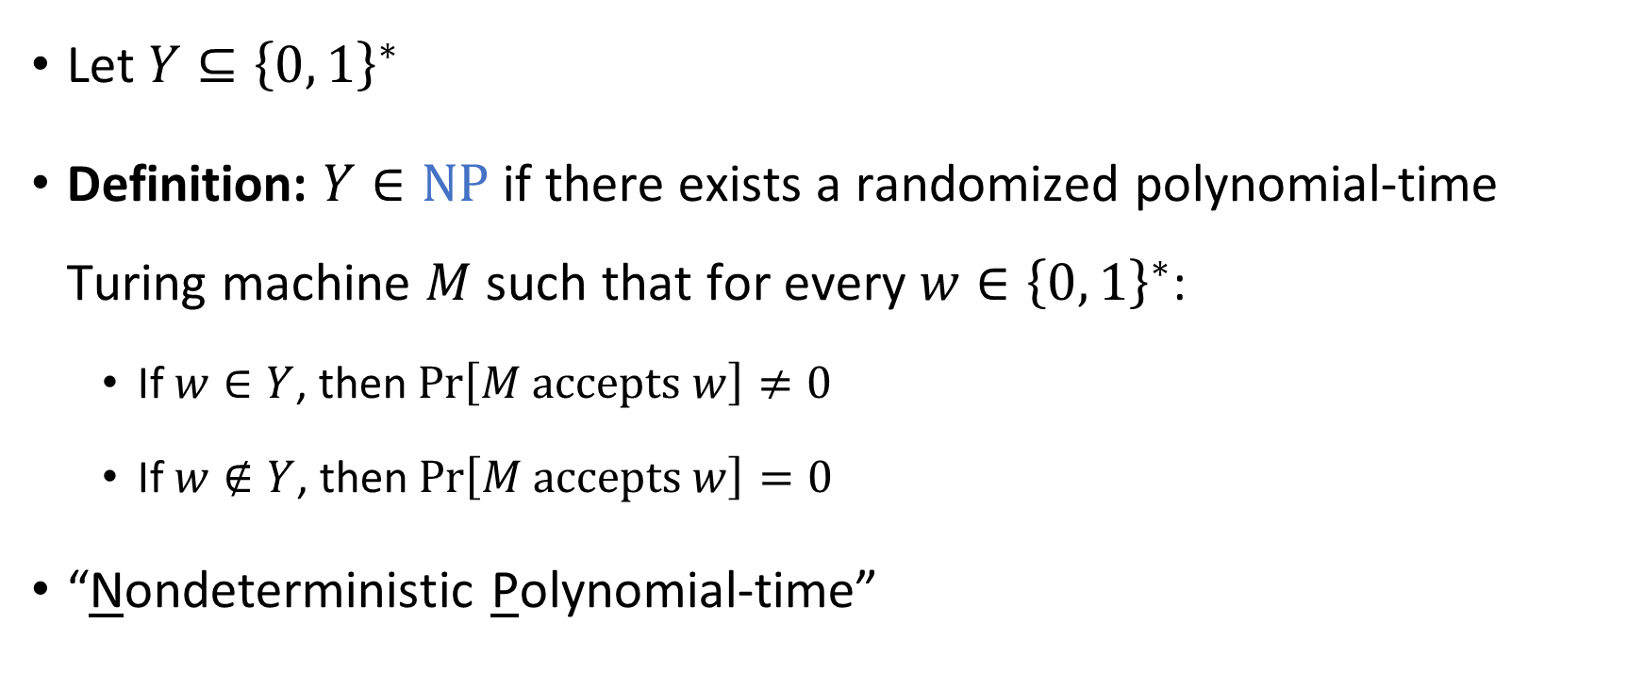
Randomized polynomial time, attempt #1
Let $Y⊆{\left\{0, 1\right\}}^{∗}$
Definition: $Y∈\text{NP}$ if there exists a randomized polynomial-time Turing machine $M$ such that for every $w∈{\left\{0, 1\right\}}^{∗}$:
If $w∈Y$, then $\operatorname{Pr}\left[M \text{accepts} w\right]≠0$
If $w∉Y$, then $\operatorname{Pr}\left[M \text{accepts} w\right]=0$
“Nondeterministic Polynomial-time”
“Nondeterministic Turing machine”

Slide 8
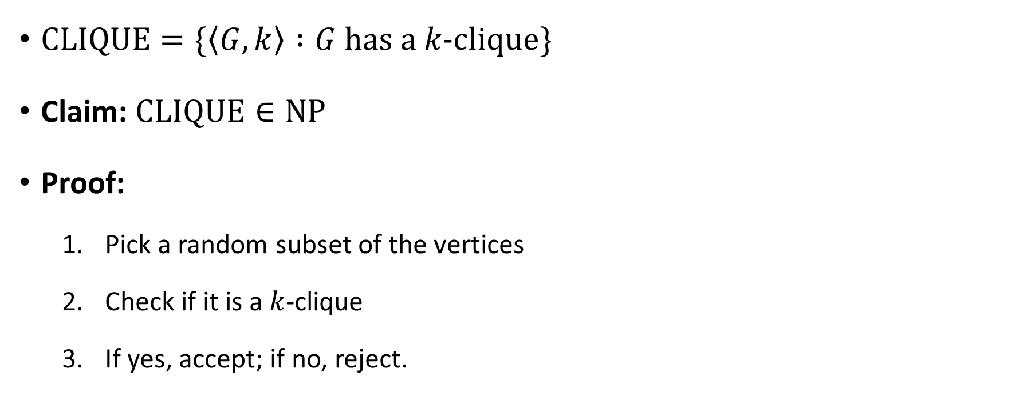

Example: $\text{CLIQUE}$
$\text{CLIQUE}=\{\left\langle G,k\right\rangle :G \text{has} \text{a} k\text{‑}\text{clique}\}$
Claim: $\text{CLIQUE}∈\text{NP}$
Proof:
Pick a random subset of the vertices
Check if it is a $k$-clique
If yes, accept; if no, reject.

Slide 9

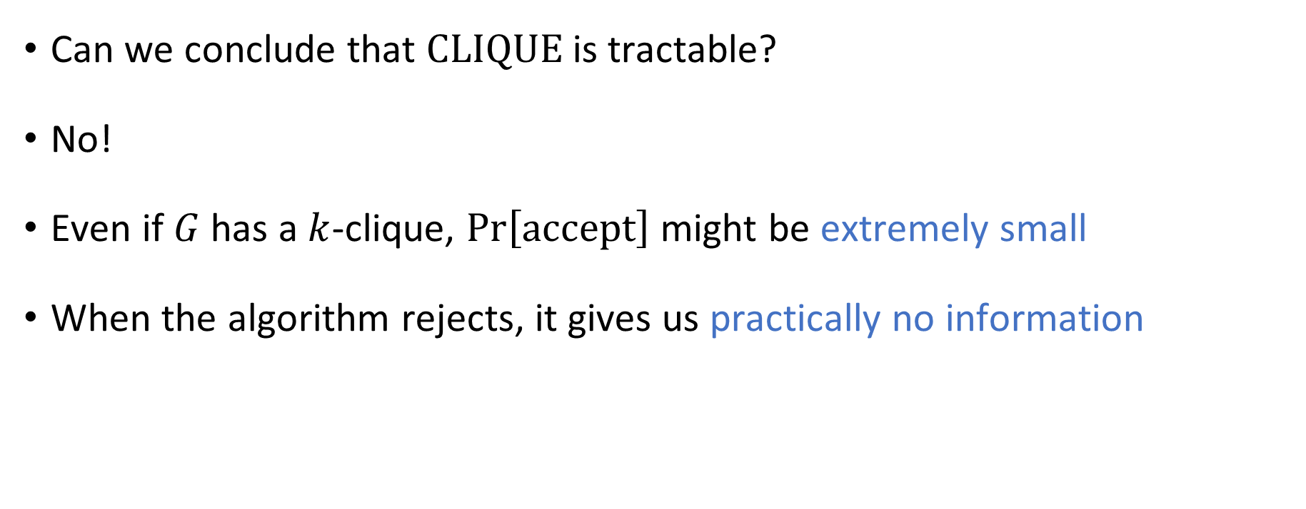

How to interpret $\text{NP}$
Can we conclude that $\text{CLIQUE}$ is tractable?
No!
Even if $G$ has a $k$-clique, $\operatorname{Pr}\left[\text{accept}\right]$ might be extremely small
When the algorithm rejects, it gives us practically no information

Slide 10

How to interpret $\text{NP}$
$\text{NP}$ is not a good model of tractability
$\text{NP}$ is an extremely useful conceptual tool…
More on this later

Slide 11
Which problems can be solved through computation?

Slide 12
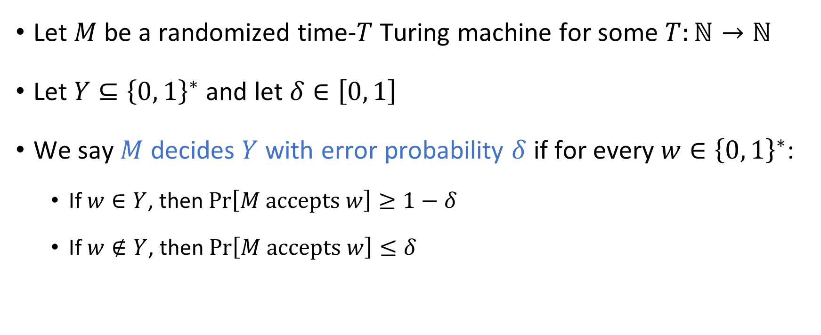
Error probability
Let $M$ be a randomized time-$T$ Turing machine for some $T:ℕ→ℕ$
Let $Y⊆{\left\{0, 1\right\}}^{∗}$ and let $δ∈\left[0, 1\right]$
We say $M$ decides $Y$ with error probability $δ$ if for every $w∈{\left\{0, 1\right\}}^{∗}$:
If $w∈Y$, then $\operatorname{Pr}\left[M \text{accepts} w\right]≥1−δ$
If $w∉Y$, then $\operatorname{Pr}\left[M \text{accepts} w\right]≤δ$

Slide 13
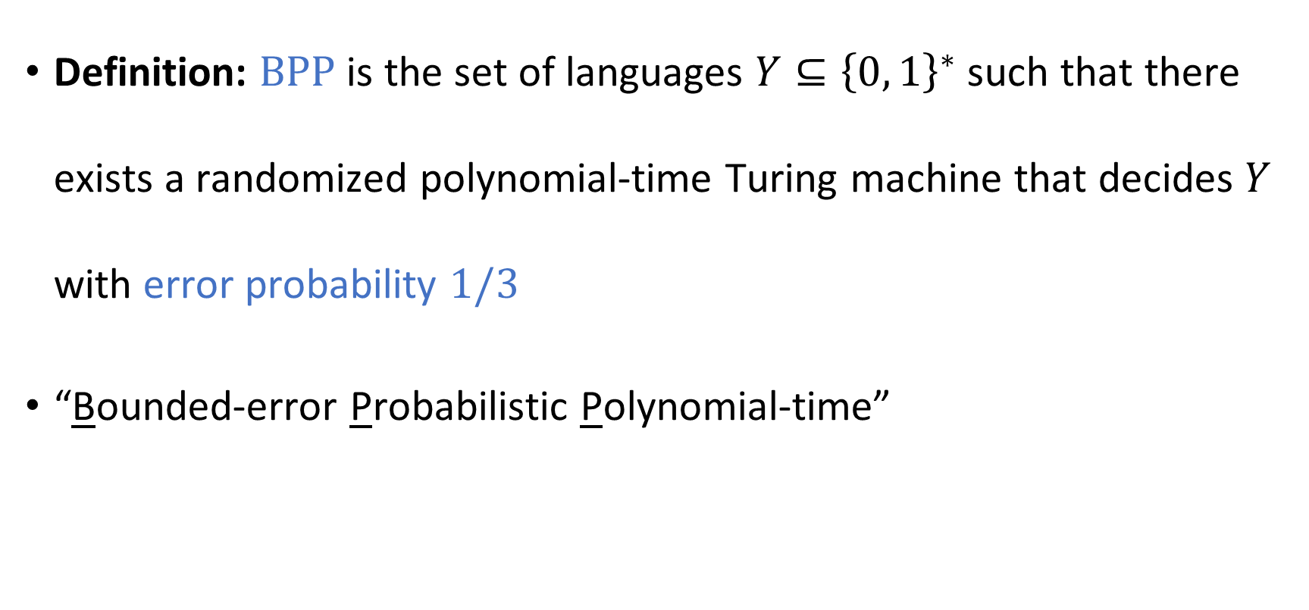

The complexity class $\text{BPP}$
Definition: $\text{BPP}$ is the set of languages $Y⊆{\left\{0, 1\right\}}^{∗}$ such that there exists a randomized polynomial-time Turing machine that decides $Y$ with error probability $1/3$
“Bounded-error Probabilistic Polynomial-time”

Slide 14
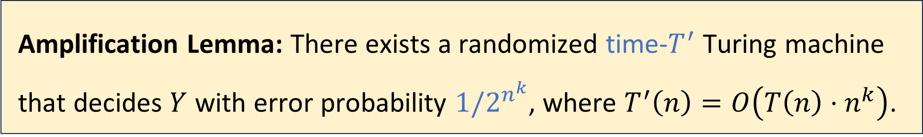

Amplification lemma
Suppose a language $Y⊆{\left\{0, 1\right\}}^{∗}$ can be decided by a time-$T$ Turing machine $M_{0}$ with error probability $1/3$
Let $k∈ℕ$ be any constant
As $n→∞$, the error probability goes to $0$ extremely rapidly!
Amplification Lemma: There exists a randomized time-$T^{′}$ Turing machine that decides $Y$ with error probability $1/2^{n^{k}}$, where $T^{′}\left(n\right)=O\left(T\left(n\right)⋅n^{k}\right)$.

Slide 15



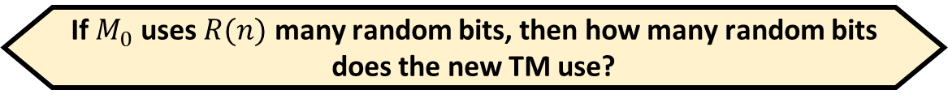
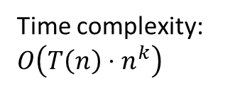
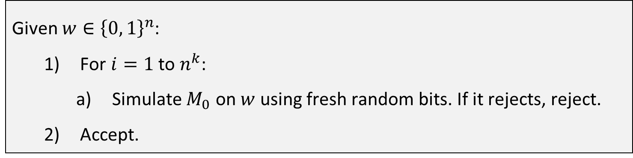

Proof of the amplification lemma (1 slide)
If $M_{0}$ uses $R(n)$ many random bits, then how many random bits does the new TM use?
For simplicity, assume that for every $w∈Y$, we have $\operatorname{Pr}\left[M_{0} \text{accepts} w\right]=1$
For $w∉Y$, we merely assume $\operatorname{Pr}\left[M_{0} \text{accepts} w\right]≤1/2$
If $w∈Y$, then $\operatorname{Pr}\left[M \text{accepts} w\right]=1$
If $w∉Y$, then $\operatorname{Pr}\left[M \text{accepts} w\right]≤{\left(1/2\right)}^{n^{k}}=1/2^{n^{k}}$
A: $R\left(n\right)+n^{k}$
B: $R(n)⋅n^{k}$
C: $R{\left(n\right)}^{k}$
D: Not enough information
Given $w∈{\left\{0, 1\right\}}^{n}$:
For $i=1$ to $n^{k}$:
Simulate $M_{0}$ on $w$ using fresh random bits. If it rejects, reject.
Accept.
Respond at PollEv.com/whoza or text “whoza” to 22333
Time complexity: $O\left(T\left(n\right)⋅n^{k}\right)$
Notes:
See the textbook for a proof of the general case

Slide 16
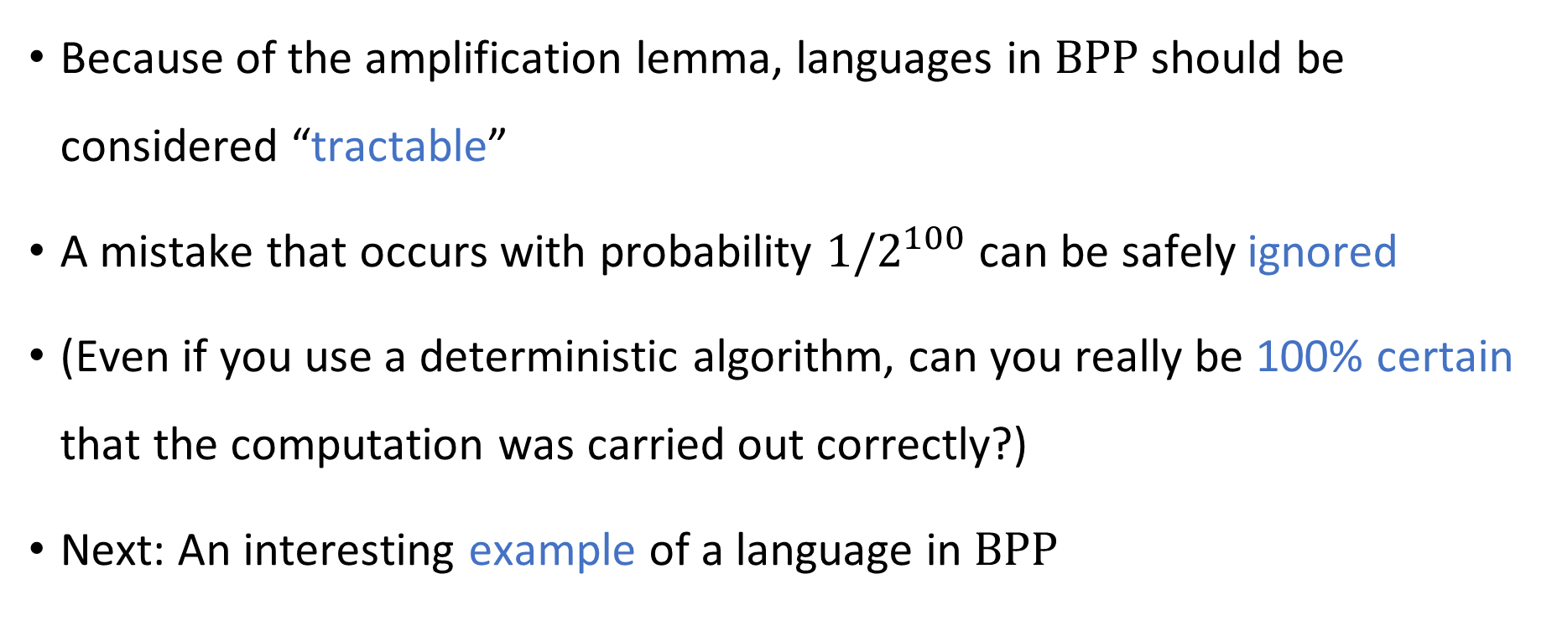

$\text{BPP}$ as a model of tractability
Because of the amplification lemma, languages in $\text{BPP}$ should be considered “tractable”
A mistake that occurs with probability $1/2^{100}$ can be safely ignored
(Even if you use a deterministic algorithm, can you really be 100% certain that the computation was carried out correctly?)
Next: An interesting example of a language in $\text{BPP}$

Slide 17

Example: High school algebra
“Expand and simplify: $\left(x+1\right)⋅\left(x−1\right)$”
How difficult is this type of exercise?
This type of expression is called an arithmetic formula

Slide 18



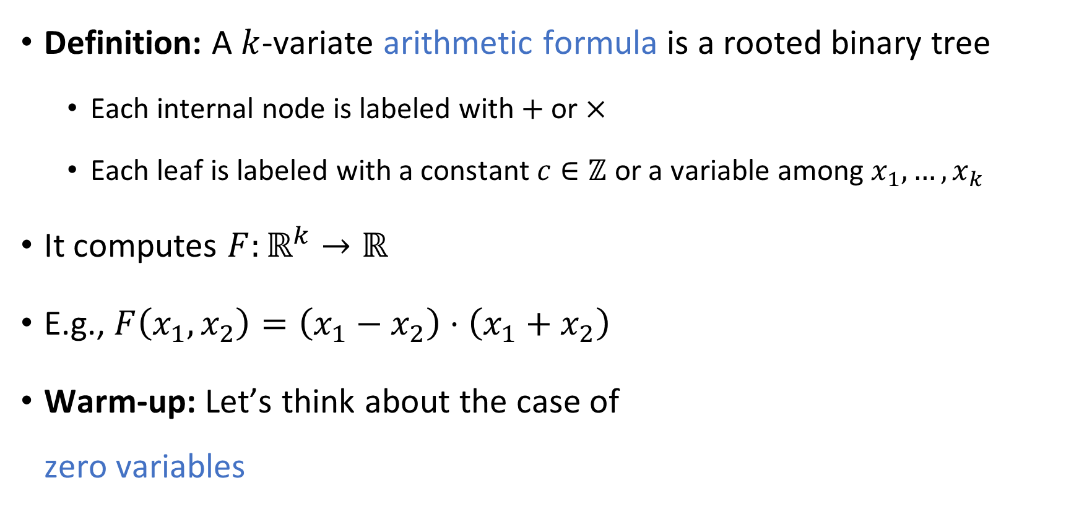






Arithmetic formulas
Compare to Boolean formulas
Definition: A $k$-variate arithmetic formula is a rooted binary tree
Each internal node is labeled with $+$ or $×$
Each leaf is labeled with a constant $c∈ℤ$ or a variable among $x_{1},…, x_{k}$
It computes $F:ℝ^{k}→ℝ$
E.g., $F\left(x_{1},x_{2}\right)=\left(x_{1}−x_{2}\right)⋅\left(x_{1}+x_{2}\right)$
Warm-up: Let’s think about the case of zero variables
$$×$$
$$+$$
$$+$$
$$x_{1}$$
$$×$$
$$x_{1}$$
$$x_{2}$$
$$−1$$
$$x_{2}$$

Slide 19
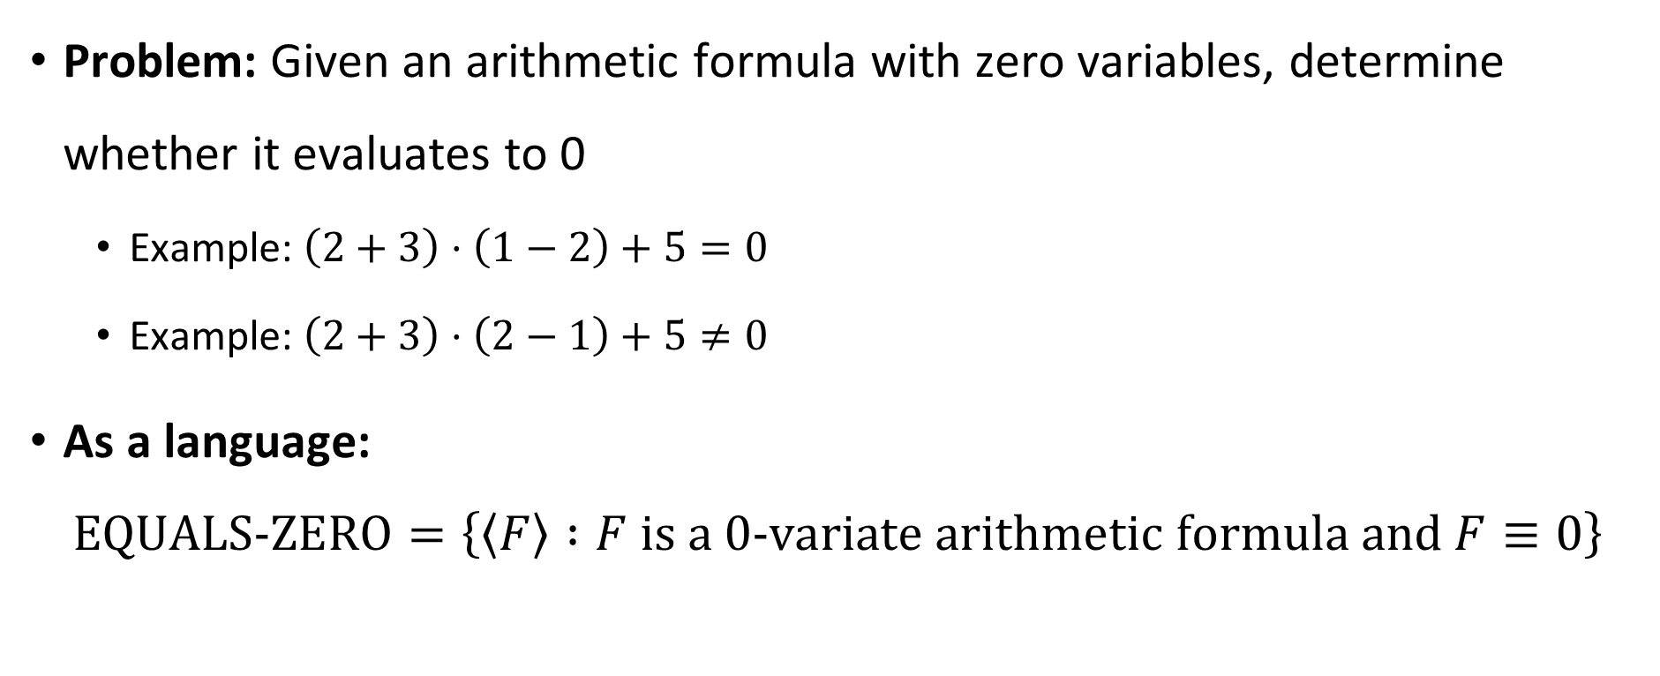
Evaluating an arithmetic formula
Problem: Given an arithmetic formula with zero variables, determine whether it evaluates to 0
Example: $\left(2+3\right)⋅\left(1−2\right)+5=0$
Example: $\left(2+3\right)⋅\left(2−1\right)+5≠0$
As a language:
$$\text{EQUALS}‑\text{ZERO}=\left\{\left\langle F\right\rangle :F \text{is} \text{a} \text{0}‑\text{variate} \text{arithmetic} \text{formula} \text{and} F≡0\right\}$$

Slide 20
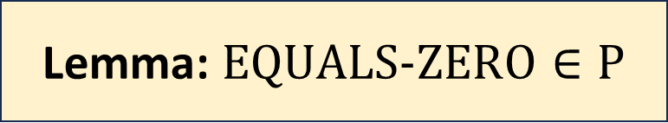
Evaluating an arithmetic formula
Lemma: $\text{EQUALS}‑\text{ZERO}∈\text{P}$
Proof idea: Grade-school arithmetic
Possible concern: How big are the numbers we are working with?

Slide 21
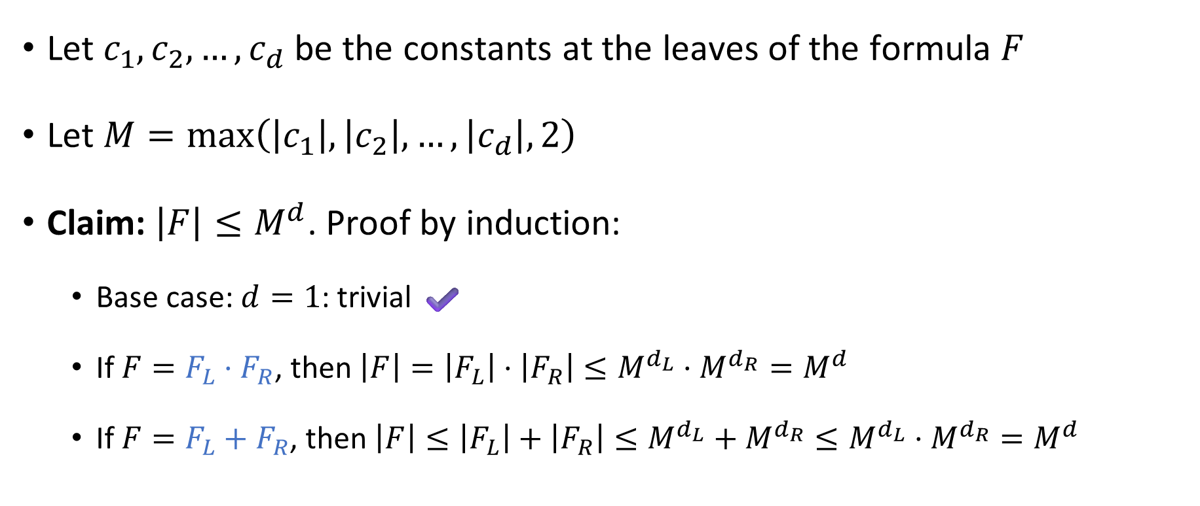
Numbers are not getting terribly big
Let $c_{1},c_{2},…, c_{d}$ be the constants at the leaves of the formula $F$
Let $M=\max\left(\left|c_{1}\right|, \left|c_{2}\right|, …, \left|c_{d}\right|,2\right)$
Claim: $\left|F\right|≤M^{d}$. Proof by induction:
Base case: $d=1$: trivial ✔️
If $F=F_{L}⋅F_{R}$, then $\left|F\right|=\left|F_{L}\right|⋅\left|F_{R}\right|≤M^{d_{L}}⋅M^{d_{R}}=M^{d}$
If $F=F_{L}+F_{R}$, then $\left|F\right|≤\left|F_{L}\right|+\left|F_{R}\right|≤M^{d_{L}}+M^{d_{R}}≤M^{d_{L}}⋅M^{d_{R}}=M^{d}$

Slide 22
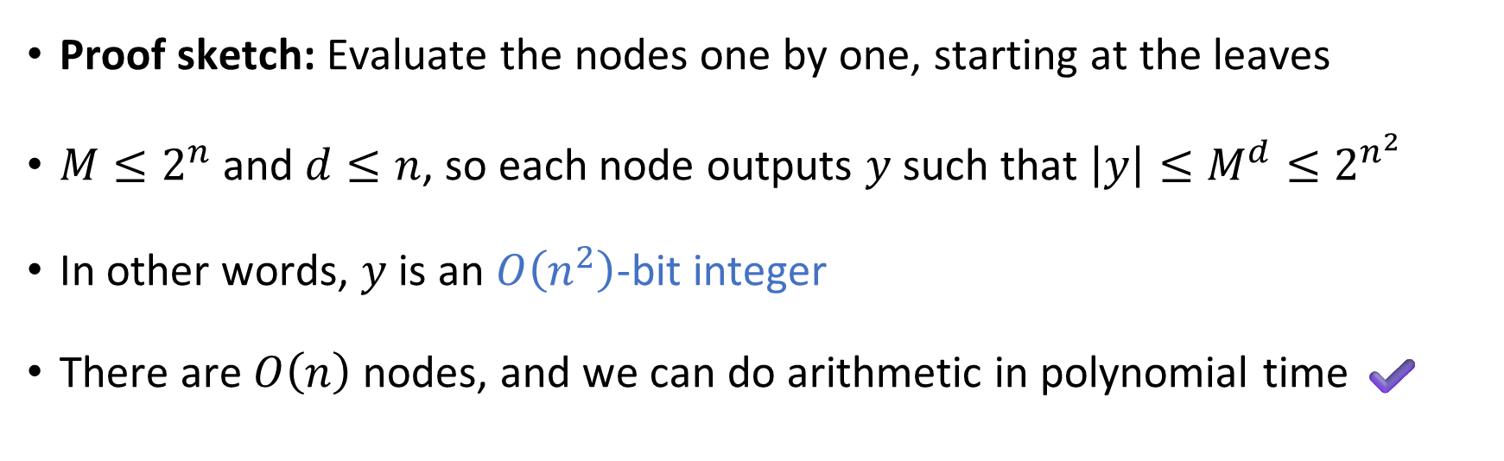
Evaluating an arithmetic formula
Lemma: $\text{EQUALS}‑\text{ZERO}∈\text{P}$
Proof sketch: Evaluate the nodes one by one, starting at the leaves
$M≤2^{n}$ and $d≤n$, so each node outputs $y$ such that $\left|y\right|≤M^{d}≤2^{n^{2}}$
In other words, $y$ is an $O\left(n^{2}\right)$-bit integer
There are $O\left(n\right)$ nodes, and we can do arithmetic in polynomial time ✔️

Slide 23
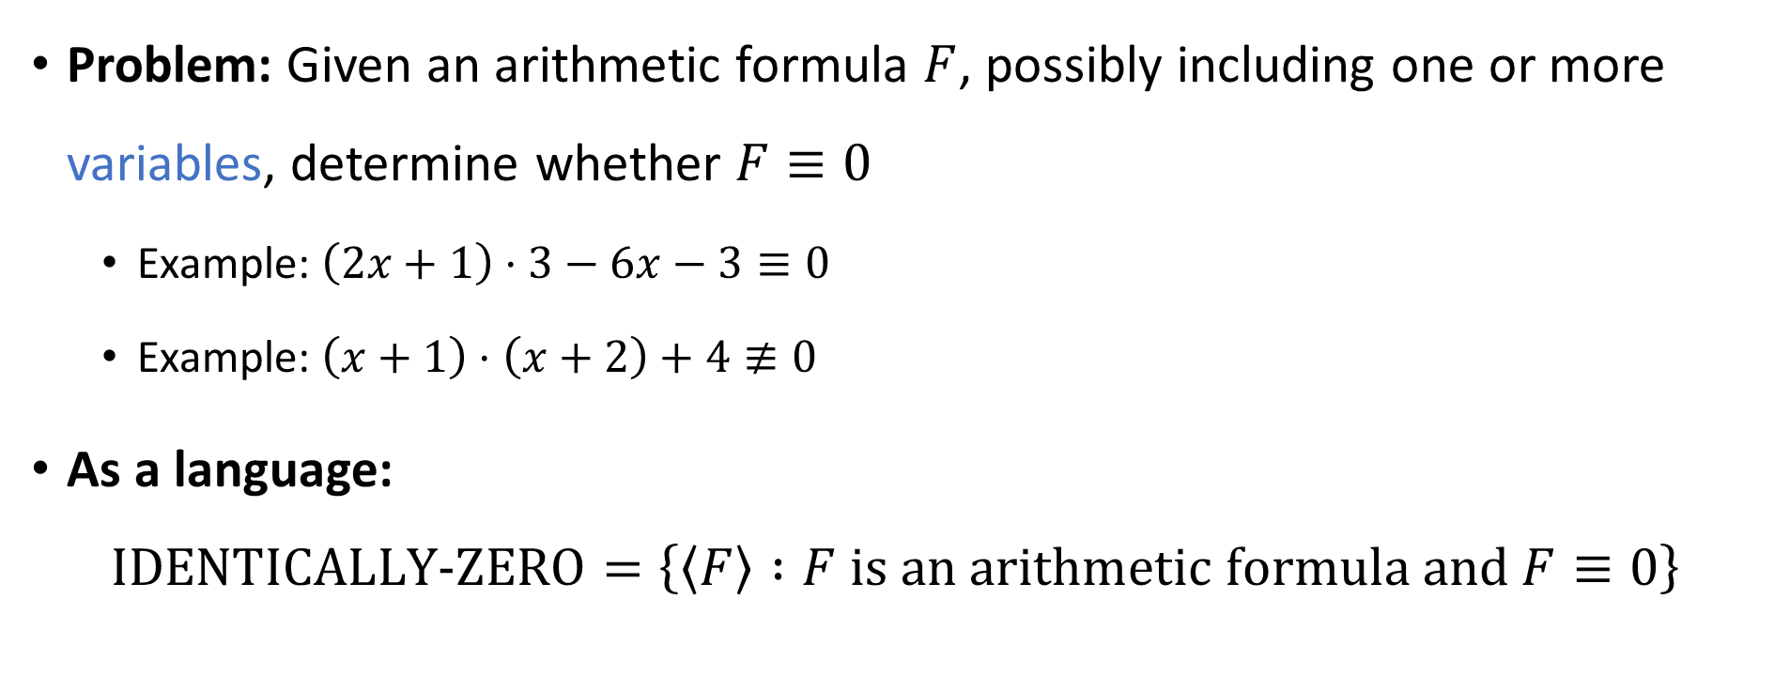
Identity testing
Problem: Given an arithmetic formula $F$, possibly including one or more variables, determine whether $F≡0$
Example: $\left(2x+1\right)⋅3−6x−3≡0$
Example: $\left(x+1\right)⋅\left(x+2\right)+4≢0$
As a language:
$$\text{IDENTICALLY}‑\text{ZERO}=\left\{\left\langle F\right\rangle :F \text{is} \text{an} \text{arithmetic} \text{formula} \text{and} F≡0\right\}$$

Slide 24





Complexity of identity testing
$\text{IDENTICALLY}‑\text{ZERO}=\left\{\left\langle F\right\rangle :F \text{is} \text{an} \text{arithmetic} \text{formula} \text{and} F≡0\right\}$
High school algorithm: Expand $F$ into monomials, then simplify by canceling like terms
What is the time complexity of this algorithm?
A: $\text{poly}\left(n\right)$
B: $2^{Ω\left(n\right)}$
C: $O\left(1\right)$
D: $∞$
Respond at PollEv.com/whoza or text “whoza” to 22333

Slide 25
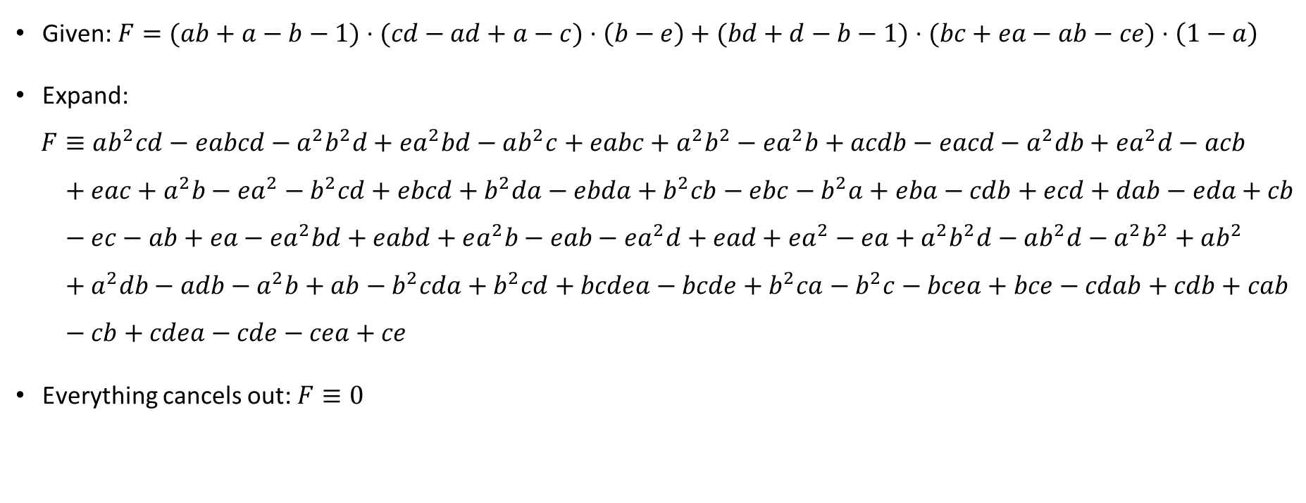
Identity testing example
Given: $F=(ab+a−b−1)⋅(cd−ad+a−c)⋅\left(b−e\right)+(bd+d−b−1)⋅(bc+ea−ab−ce)⋅\left(1−a\right)$
Expand:
$$F≡ab^{2}cd−eabcd−a^{2}b^{2}d+ea^{2}bd−ab^{2}c+eabc+a^{2}b^{2}−ea^{2}b+acdb−eacd−a^{2}db+ea^{2}d−acb \\ + eac+a^{2}b−ea^{2}−b^{2}cd+ebcd+b^{2}da−ebda+b^{2}cb−ebc−b^{2}a+eba−cdb+ecd+dab−eda+cb \\ − ec−ab+ea−ea^{2}bd+eabd+ea^{2}b−eab−ea^{2}d+ead+ea^{2}−ea+a^{2}b^{2}d−ab^{2}d−a^{2}b^{2}+ab^{2} \\ +{ a}^{2}db−adb−a^{2}b+ab−b^{2}cda+b^{2}cd+bcdea−bcde+b^{2}ca−b^{2}c−bcea+bce−cdab+cdb+cab \\ − cb+cdea−cde−cea+ce$$
Everything cancels out: $F≡0$

Slide 26

Complexity of identity testing
Expanding $F$ takes $2^{Ω\left(n\right)}$ time in some cases ☹️
E.g., $F=\left(x+y\right)⋅\left(x+y\right)⋅\left(x+y\right)⋯\left(x+y\right)$

