Slide 1
CMSC 28100 Introduction to Complexity Theory Autumn 2025 Instructor: William Hoza
⏳

Slide 2
The nature of this course
We will study:
The mathematical/philosophical foundations of computer science
The ultimate limits of computation
We will develop conceptual tools for reasoning about computation
Expect lots of proofs and very little programming

Slide 3
Who this course is designed for
CS students, math students, and anyone who is curious
Prerequisites:
Experience with mathematical proofs
CMSC 27200 or CMSC 27230 or CMSC 37000, or MATH 15900 or MATH 15910 or MATH 16300 or MATH 16310 or MATH 19900 or MATH 25500

Slide 4
Who this course is designed for
It’s okay if you don’t consider yourself “theory-oriented”
You belong here
My job:
Give you resources so you can learn and succeed
Persuade you that complexity theory is worthy of your attention

Slide 5
Class participation
Please ask questions!
“What does that notation mean?”
“I forget what a _____ is. Can you remind me?”
“How do we know _____?”
“I’m lost. Can you explain that again?”

Slide 6

Textbook
Classic
Popular
High-quality
Not free ☹️

Slide 7
Assessment
29 homework exercises
Exercises 1-3 are due Friday, October 3
Midterm exam in class on Friday, October 24
Final exam at the end of the quarter

Slide 8
My office hours
Fridays, 9am to 11am, JCL 205
Confused/curious? 👉 I’ll try to help you learn
Stuck on the homework? 👉 I’ll try to think of a good hint
Have a complaint? 👉 I’ll listen and try to make things better

Slide 9
Teaching assistants
Mirza Mehmedagic
Office hours: Thursdays, 11am to noon, JCL 205
Zelin Lv
Office hours: Thursdays, 3pm to 4pm, JCL 205

Slide 10
Student meet-up time
Thursdays, 2pm to 3pm, JCL Common Area A
Immediately before Zelin’s office hours
Find study partners
Discuss course topics
Collaborate on homework

Slide 11

https://canvas.uchicago.edu/courses/66278
Discussions
Announcements
Course policies
Slides
Submitting your homework solutions
Grades
Feedback on your work
Exercises
Practice exams
Official solutions

Slide 12
The central question of this course: Which problems can be solved through computation?

Slide 13
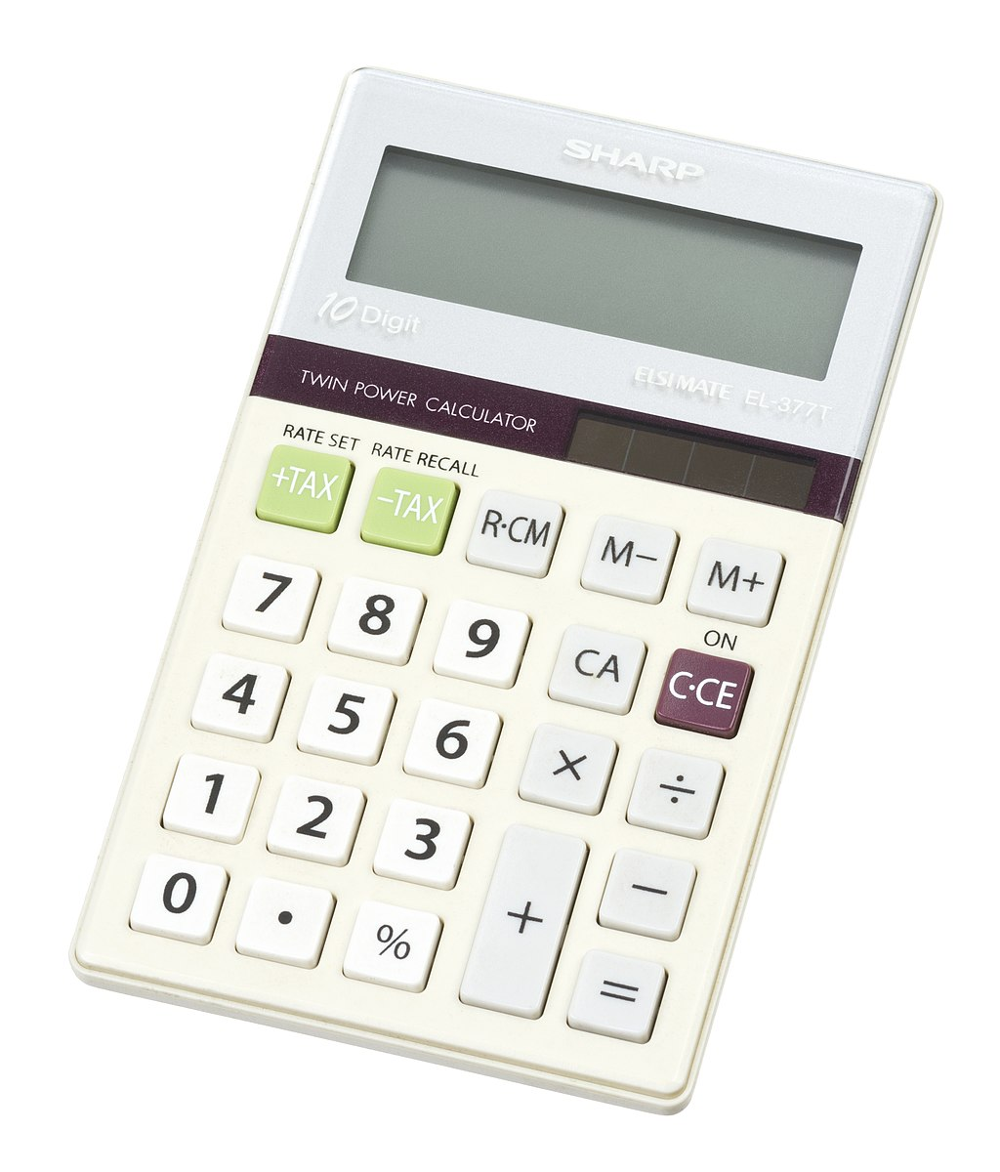
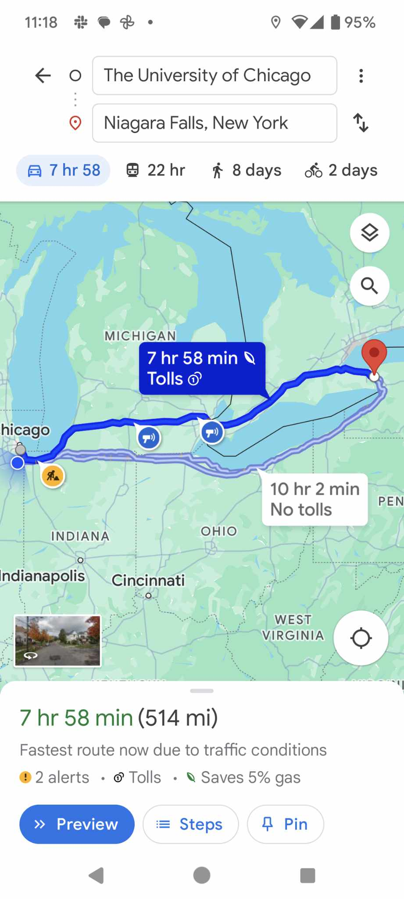
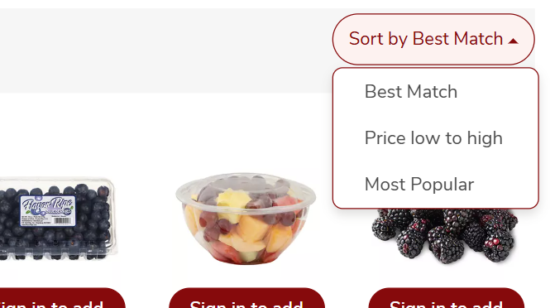
Examples
Many problems can be solved through computation:
Multiplication
Sorting
Shortest path
Are there any problems that cannot be solved through computation?

Slide 14
Impossibility proofs
We will take a mathematical approach to this question
Formulate precise mathematical models
“Computation”
“Problem”
“Solve”
Write rigorous mathematical proofs of impossibility

Slide 15
Which problems can be solved through computation?

Slide 16
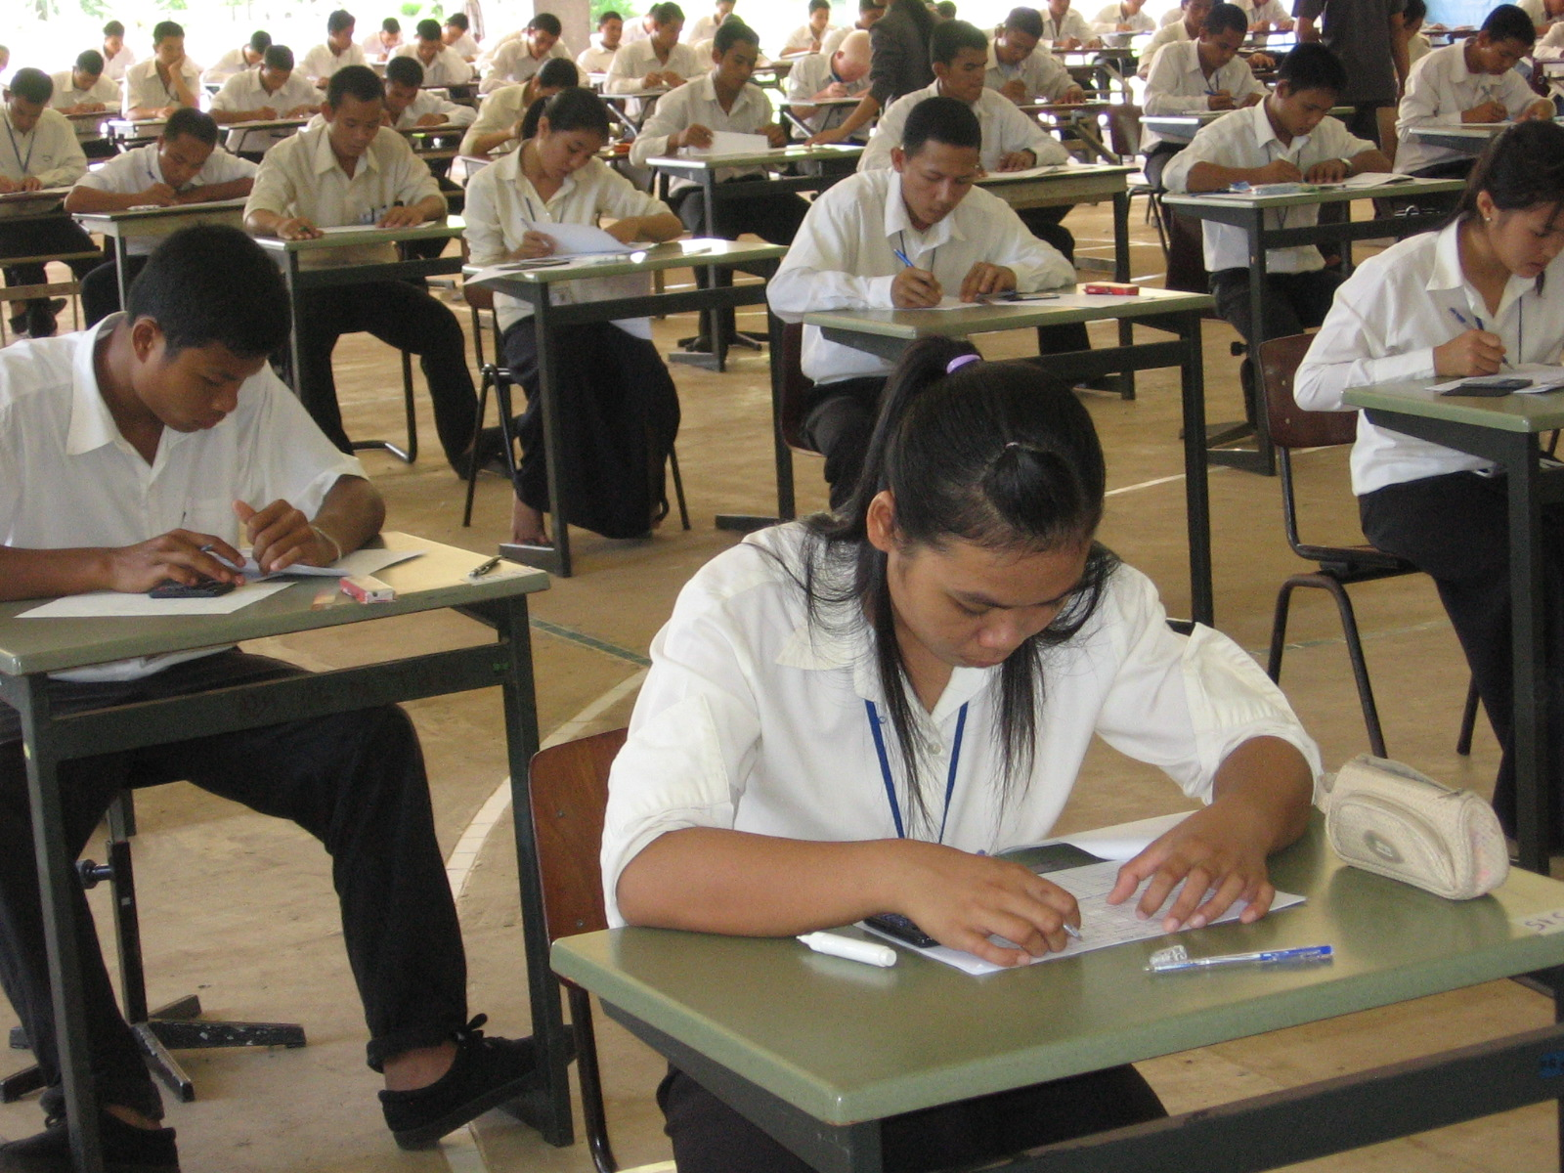
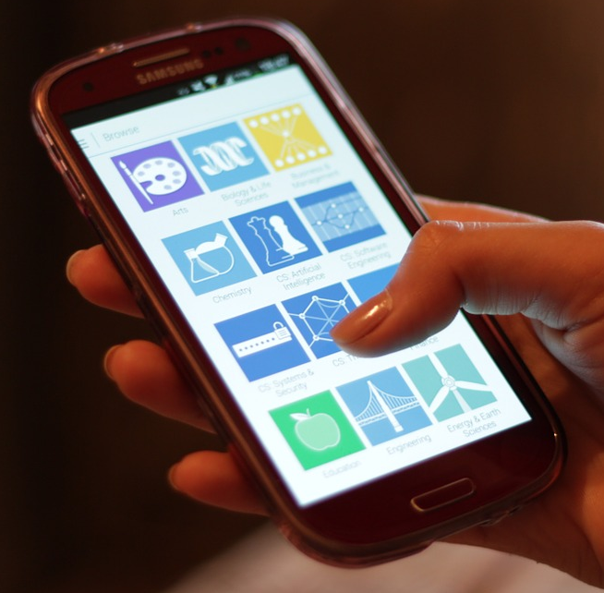
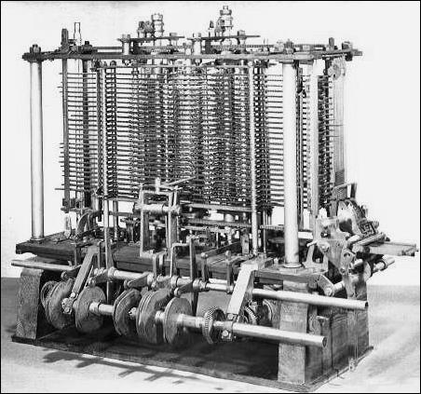
Computation
Computers: Modern technology?
Computation is ancient
Can be performed by:
A human being with paper and a pencil
A smartphone
A steam-powered machine
We want a mathematical model that describes all of these and transcends any one technology

Slide 17
Computation
Note: Humans can do all the same computations that smartphones/laptops do
(less quickly/reliably)
Consequence: We can study computation without understanding electronics 🙂
Computation is a familiar, everyday, human act

Slide 18

Ex: Palindromes
01110000110100111100101100011110
Suppose a long string of bits is written on a blackboard
Our job: Figure out whether the string is a “palindrome,” i.e., whether it is the same forwards and backwards
What should we do?

Slide 19
Ex: Palindromes
01110000110100111100101100011110
Idea: Compare and cross off the first and last symbols
Repeat until we find a mismatch or everything is crossed off
Not a palindrome

Slide 20
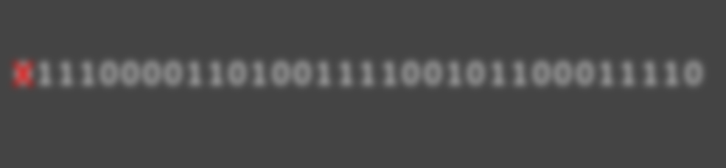
Local decisions
In each step, how do we know what to do next?
We keep track of some information (“state”) in our mind
We look at the local contents of the blackboard (one symbol is sufficient)
We can describe the algorithm using “transition function” (next slide)
01110000110100111100101100011110
I just crossed off a zero, and now I’m heading over to the right end of the string

Slide 21
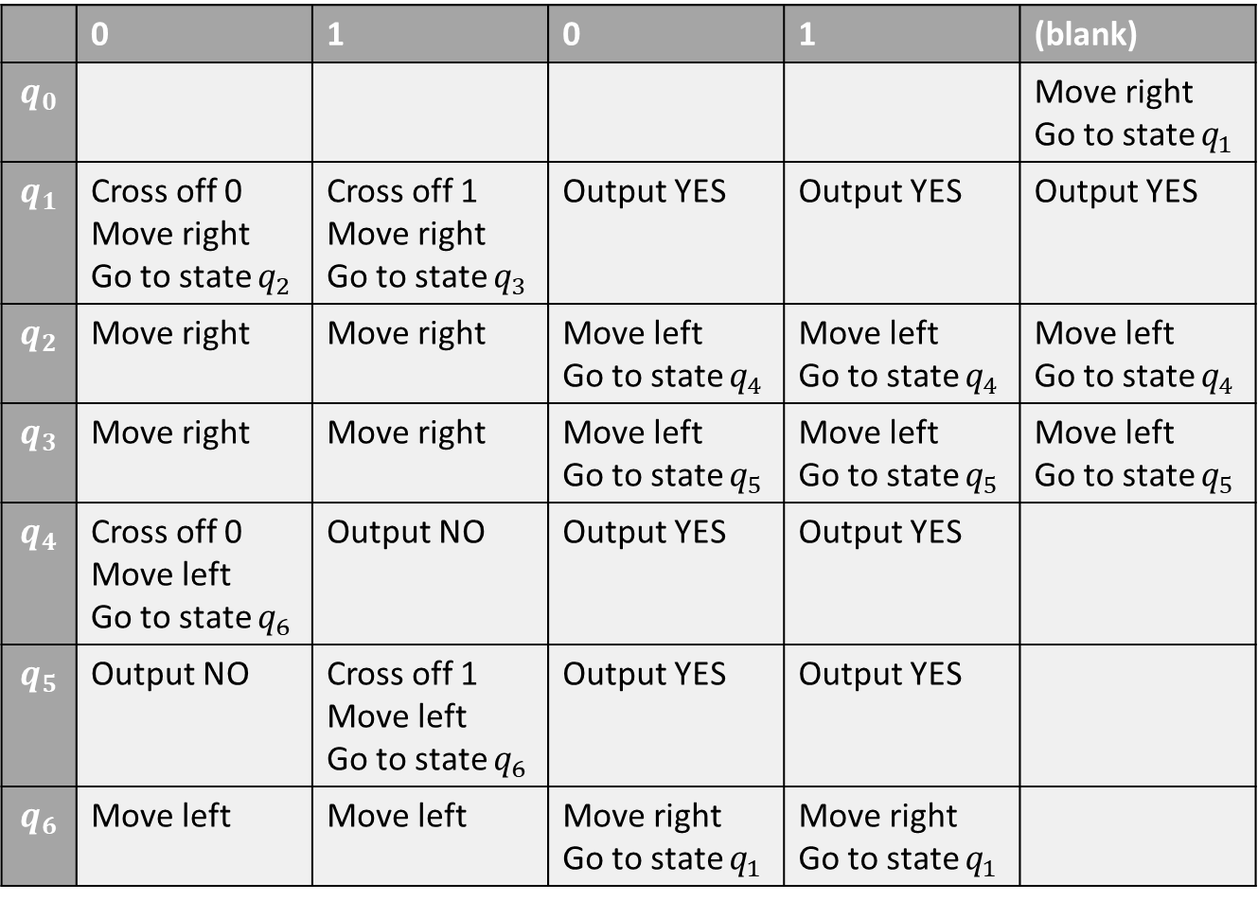
and we see this symbol…
If we’re in this state…
 | 0 | 1 | 0 | 1 | (blank)
$$q_{0}$$ |  |  |  |  | Move right Go to state $q_{1}$
$$q_{1}$$ | Cross off 0 Move right Go to state $q_{2}$ | Cross off 1 Move right Go to state $q_{3}$ | Output YES | Output YES | Output YES
$$q_{2}$$ | Move right | Move right | Move left Go to state $q_{4}$ | Move left Go to state $q_{4}$ | Move left Go to state $q_{4}$
$$q_{3}$$ | Move right | Move right | Move left Go to state $q_{5}$ | Move left Go to state $q_{5}$ | Move left Go to state $q_{5}$
$$q_{4}$$ | Cross off 0 Move left Go to state $q_{6}$ | Output NO | Output YES | Output YES
$$q_{5}$$ | Output NO | Cross off 1 Move left Go to state $q_{6}$ | Output YES | Output YES
$$q_{6}$$ | Move left | Move left | Move right Go to state $q_{1}$ | Move right Go to state $q_{1}$

Slide 22
and we see this symbol…
If we’re in this state…
 | 0 | 1 | 0 | 1 | (blank)
$$q_{0}$$ |  |  |  |  | Move right Go to state $q_{1}$
$$q_{1}$$ | Cross off 0 Move right Go to state $q_{2}$ | Cross off 1 Move right Go to state $q_{3}$ | Output YES | Output YES | Output YES
$$q_{2}$$ | Move right | Move right | Move left Go to state $q_{4}$ | Move left Go to state $q_{4}$ | Move left Go to state $q_{4}$
$$q_{3}$$ | Move right | Move right | Move left Go to state $q_{5}$ | Move left Go to state $q_{5}$ | Move left Go to state $q_{5}$
$$q_{4}$$ | Cross off 0 Move left Go to state $q_{6}$ | Output NO | Output YES | Output YES
$$q_{5}$$ | Output NO | Cross off 1 Move left Go to state $q_{6}$ | Output YES | Output YES
$$q_{6}$$ | Move left | Move left | Move right Go to state $q_{1}$ | Move right Go to state $q_{1}$
then we should do this

Slide 23
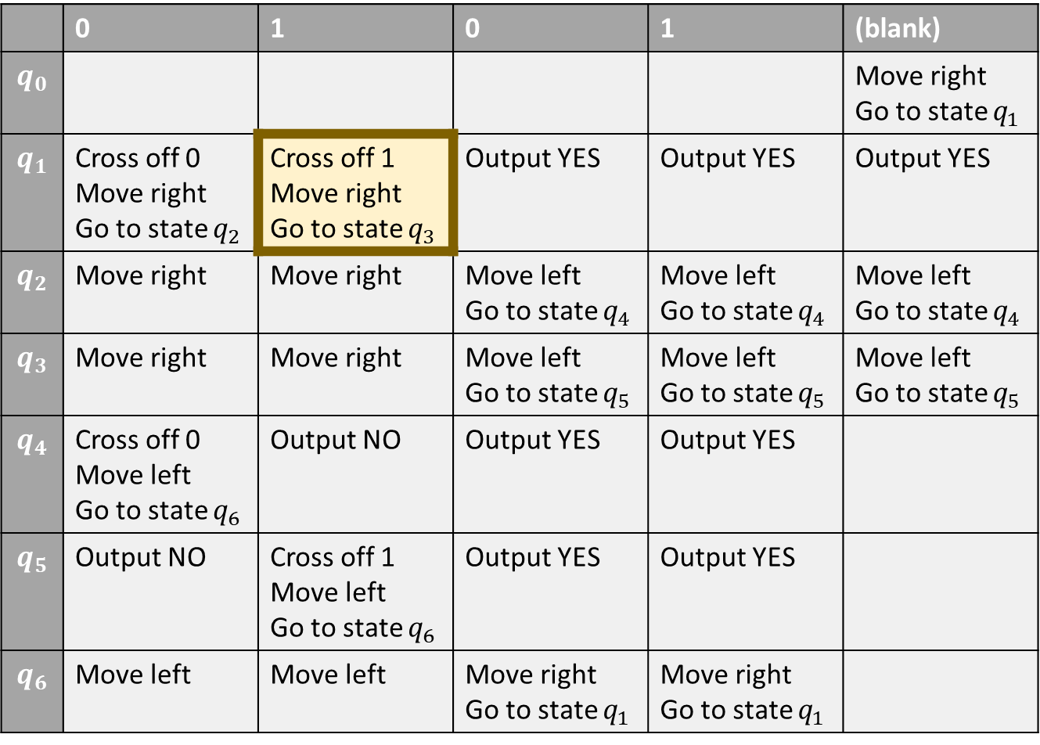
and we see this symbol…
If we’re in this state…
 | 0 | 1 | 0 | 1 | (blank)
$$q_{0}$$ |  |  |  |  | Move right Go to state $q_{1}$
$$q_{1}$$ | Cross off 0 Move right Go to state $q_{2}$ | Cross off 1 Move right Go to state $q_{3}$ | Output YES | Output YES | Output YES
$$q_{2}$$ | Move right | Move right | Move left Go to state $q_{4}$ | Move left Go to state $q_{4}$ | Move left Go to state $q_{4}$
$$q_{3}$$ | Move right | Move right | Move left Go to state $q_{5}$ | Move left Go to state $q_{5}$ | Move left Go to state $q_{5}$
$$q_{4}$$ | Cross off 0 Move left Go to state $q_{6}$ | Output NO | Output YES | Output YES
$$q_{5}$$ | Output NO | Cross off 1 Move left Go to state $q_{6}$ | Output YES | Output YES
$$q_{6}$$ | Move left | Move left | Move right Go to state $q_{1}$ | Move right Go to state $q_{1}$
then we should do this

Slide 24
The Turing machine model
Turing machines: A mathematical model of human computation
In a nutshell, a Turing machine is any algorithm that can be described by a transition function like the one we just saw

Slide 25






The Turing machine model
$$⊔$$
$$⊔$$
$$⊔$$
0
1
#
@
1
0
$$⊔$$
$$⊔$$
$$⊔$$
There is a “tape” that is divided into “cells”
Each cell has one symbol written in it
There is a “head” pointing at one cell
The machine can be in one of finitely many internal “states”

Slide 26
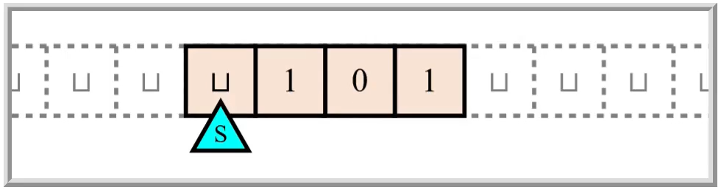
Turing machines
In each step, the machine decides
What to write
Which direction to move the head (left or right)
The new state
Decision is based only on current state and observed symbol
New cells are automatically “created” when needed

Slide 27
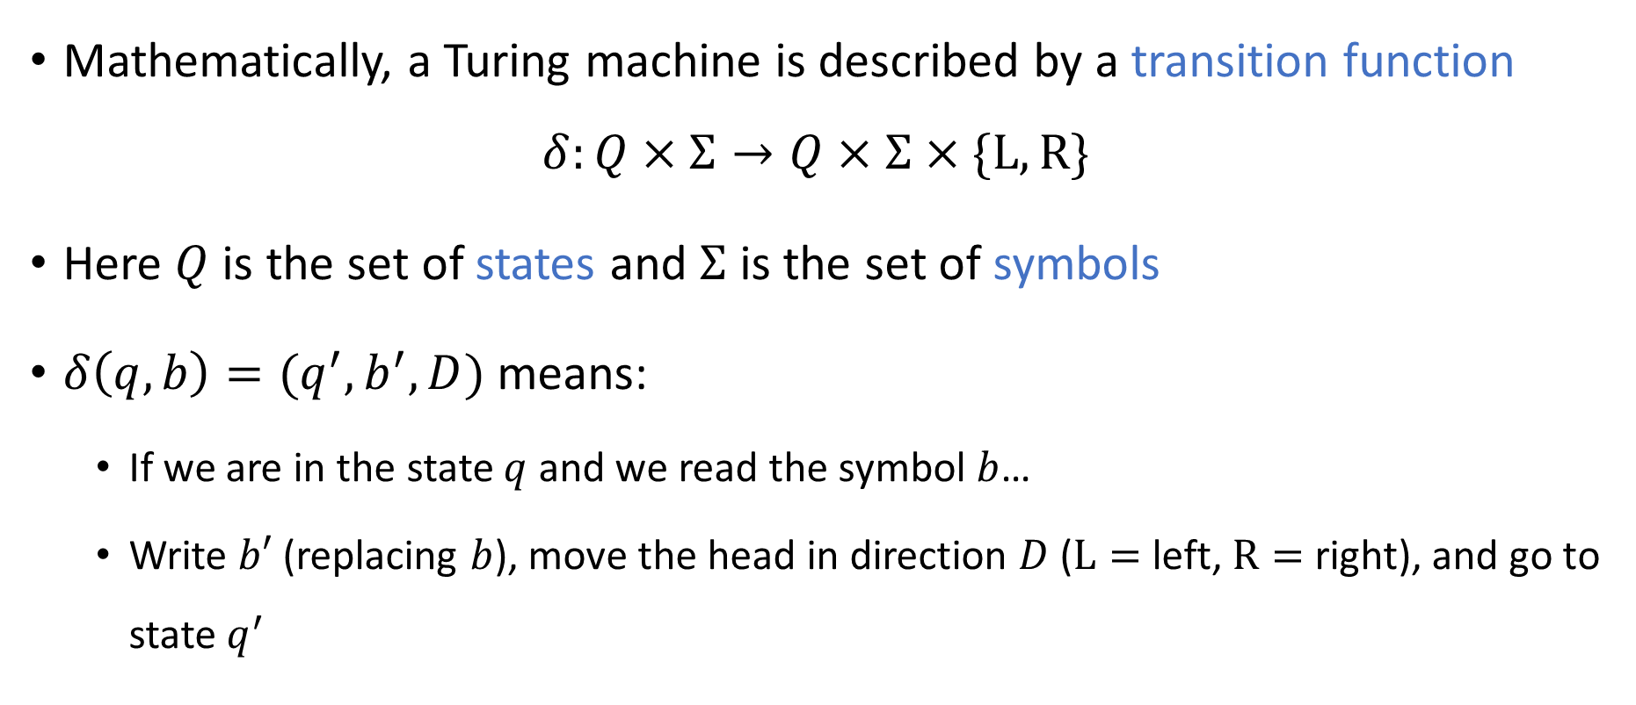
Transition function
Mathematically, a Turing machine is described by a transition function
$$δ:Q×Σ→Q×Σ×\{\text{L}, \text{R}\}$$
Here $Q$ is the set of states and $Σ$ is the set of symbols
$δ\left(q, b\right)=(q^{′}, b^{′},D)$ means:
If we are in the state $q$ and we read the symbol $b$…
Write $b′$ (replacing $b$), move the head in direction $D$ ($\text{L}=$ left, $\text{R}=$ right), and go to state $q^{′}$

Slide 28
Input
One Turing machine represents one algorithm
For us, the input to a Turing machine will always be a finite string over the binary alphabet

Slide 29

Symbols and alphabets
An “alphabet” $Σ$is any nonempty, finite set of “symbols”
$Σ=\{0, 1\}$
$Σ=\left\{⊔,0, 1, 0, 1\right\}$
$Σ=\{\text{A}, \text{B}, \text{C}, …,\text{Z}\}$
$Σ=\{😍,\text{⚾}\text{,}\text{🐍},\text{⏰},🍕\}$

Slide 30
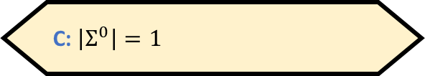
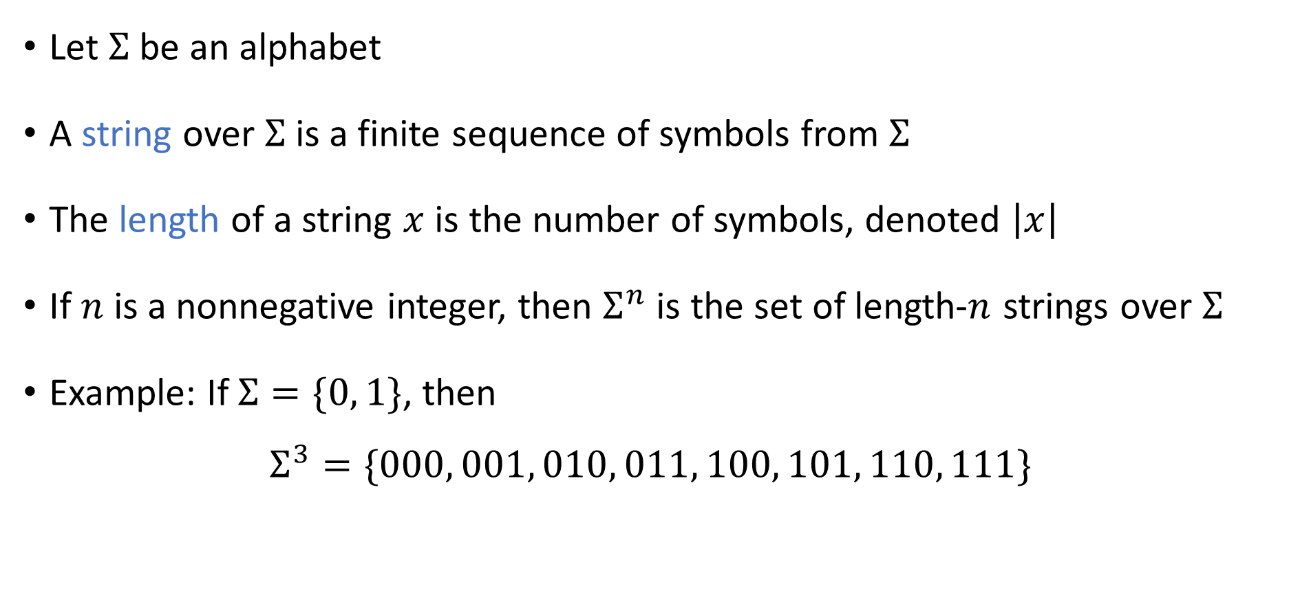
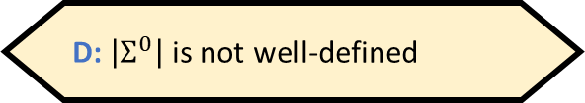
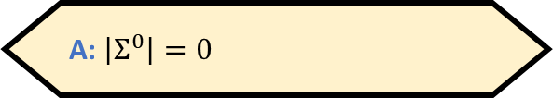
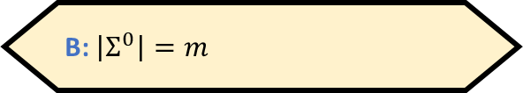
Strings
If $\left|Σ\right|=m$, then what is $\left|Σ^{0}\right|$?
A: $\left|Σ^{0}\right|=0$
B: $\left|Σ^{0}\right|=m$
Let $Σ$ be an alphabet
A string over $Σ$ is a finite sequence of symbols from $Σ$
The length of a string $x$ is the number of symbols, denoted $\left|x\right|$
If $n$ is a nonnegative integer, then $Σ^{n}$ is the set of length-$n$ strings over $Σ$
Example: If $Σ=\{0, 1\}$, then
$$Σ^{3}=\{000, 001, 010, 011, 100, 101, 110, 111\}$$
C: $\left|Σ^{0}\right|=1$
D: $\left|Σ^{0}\right|$ is not well-defined
Respond at PollEv.com/whoza or text “whoza” to 22333

Slide 31
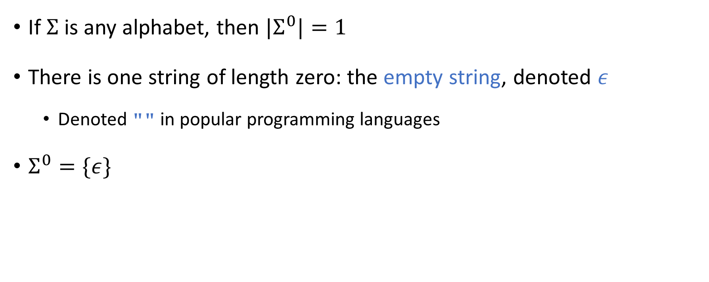
The empty string
If $Σ$ is any alphabet, then ${|Σ}^{0}|=1$
There is one string of length zero: the empty string, denoted $ε$
Denoted "" in popular programming languages
$Σ^{0}=\{ε\}$

Slide 32
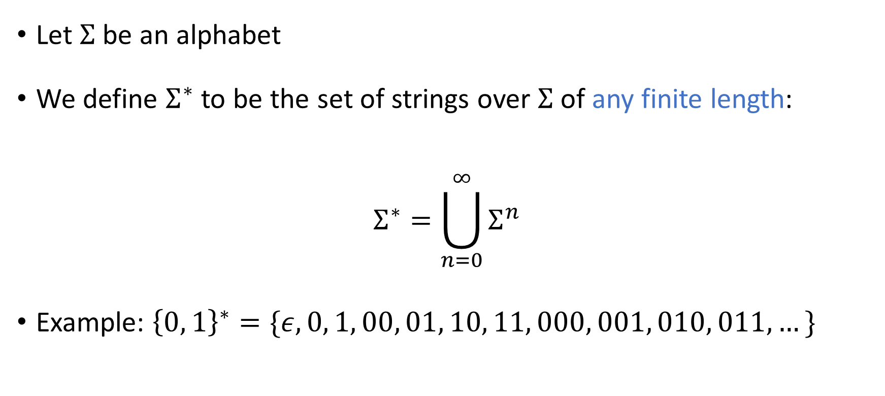
Arbitrary-length strings
Let $Σ$ be an alphabet
We define $Σ^{∗}$ to be the set of strings over $Σ$ of any finite length:
$$Σ^{∗}=\bigcup_{n=0}^{∞}{Σ^{n}}$$
Example: ${\left\{0, 1\right\}}^{∗}=\{ε,0, 1, 00, 01, 10, 11, 000, 001, 010, 011, …\}$

Slide 33





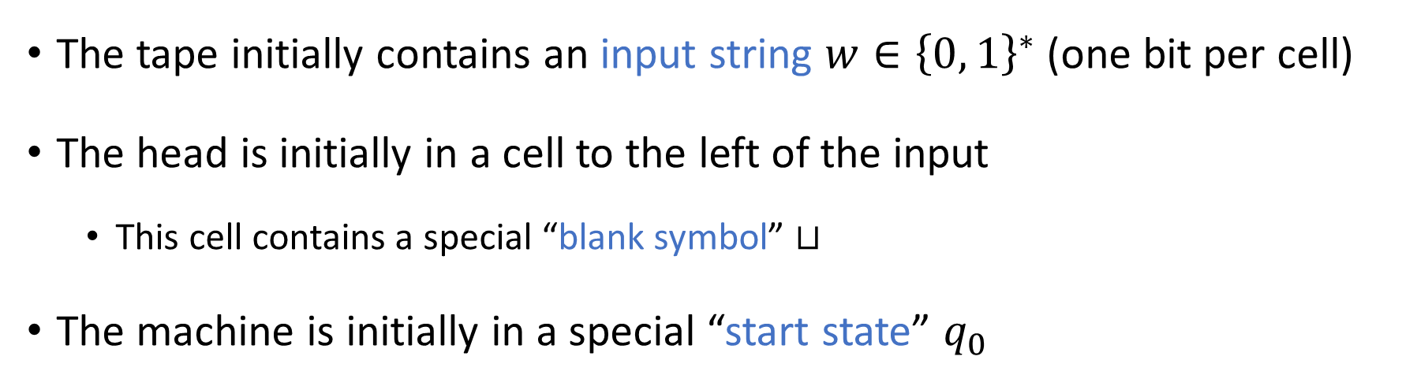








Turing machine initialization
The tape initially contains an input string $w∈{\left\{0, 1\right\}}^{∗}$ (one bit per cell)
The head is initially in a cell to the left of the input
This cell contains a special “blank symbol” $⊔$
The machine is initially in a special “start state” $q_{0}$
$$⊔$$
$$⊔$$
$$⊔$$
$$⊔$$
$$w_{1}$$
$$w_{2}$$
$$w_{3}$$
$$⋯$$
$$w_{n}$$
$$⊔$$
$$⊔$$
$$⊔$$
$$⊔$$
$$q_{0}$$

Slide 34
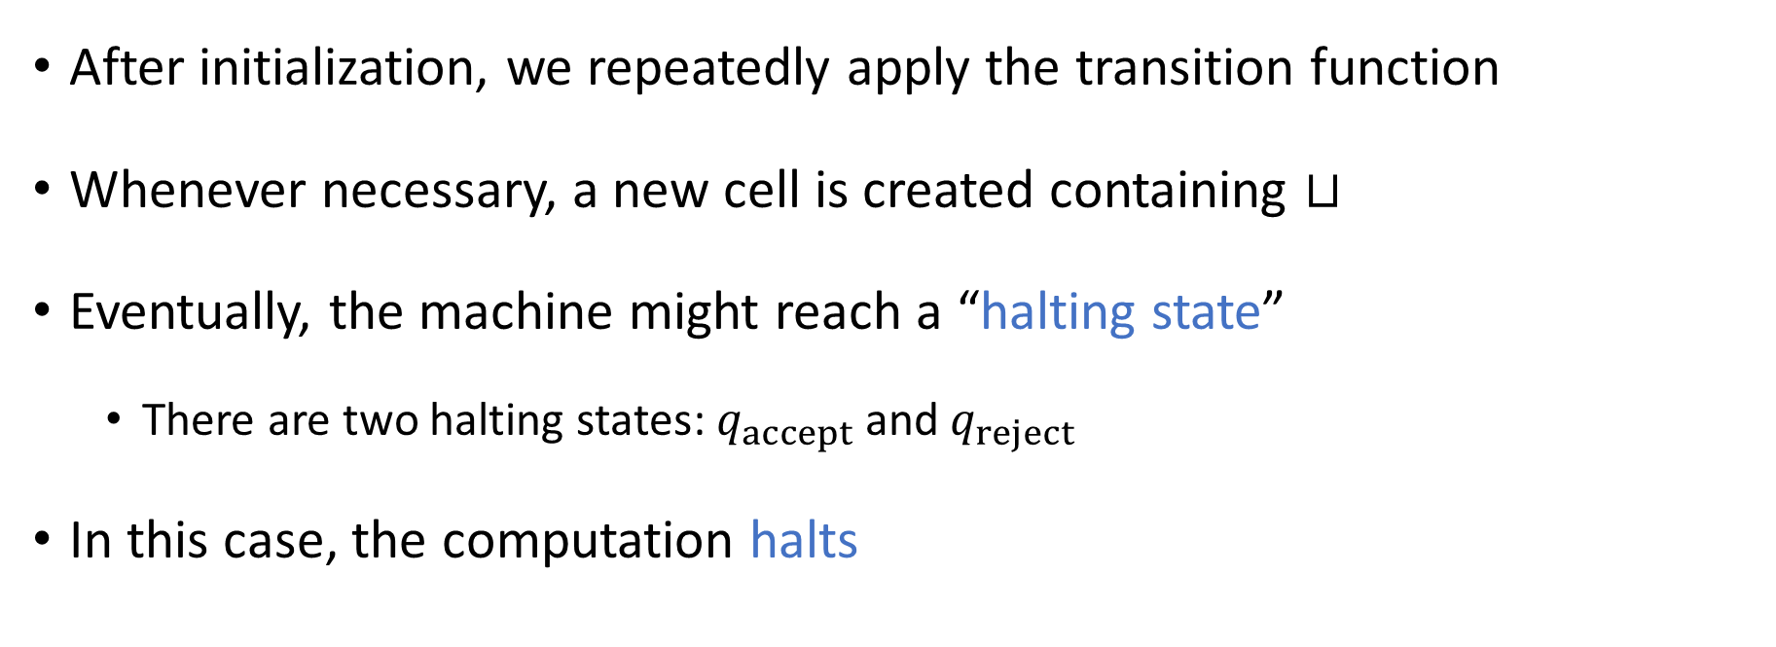
Halting
After initialization, we repeatedly apply the transition function
Whenever necessary, a new cell is created containing $⊔$
Eventually, the machine might reach a “halting state”
There are two halting states: $q_{accept}$ and $q_{reject}$
In this case, the computation halts

Slide 35
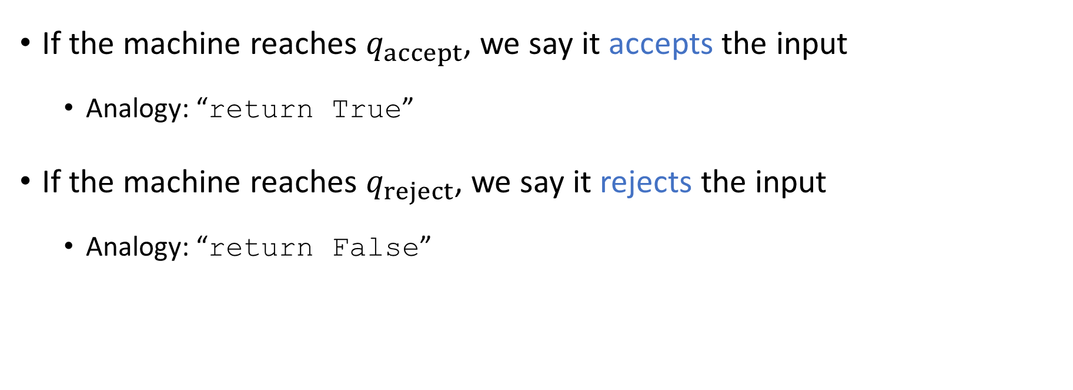
Accepting and rejecting
If the machine reaches $q_{accept}$, we say it accepts the input
Analogy: “return True”
If the machine reaches $q_{reject}$, we say it rejects the input
Analogy: “return False”

Slide 36
Looping
It is also possible that the machine runs forever without halting
In this case, we say the machine “loops”
Turing Machine
Accept
Reject
Loop
Input

Slide 37
Which problems can be solved through computation?

Slide 38

Languages
A binary language is a set $Y⊆{\left\{0, 1\right\}}^{∗}$
Each language $Y⊆{\left\{0, 1\right\}}^{∗}$ represents a distinct computational problem: “Given $w∈{\left\{0, 1\right\}}^{∗}$, figure out whether $w∈Y$”

Slide 39
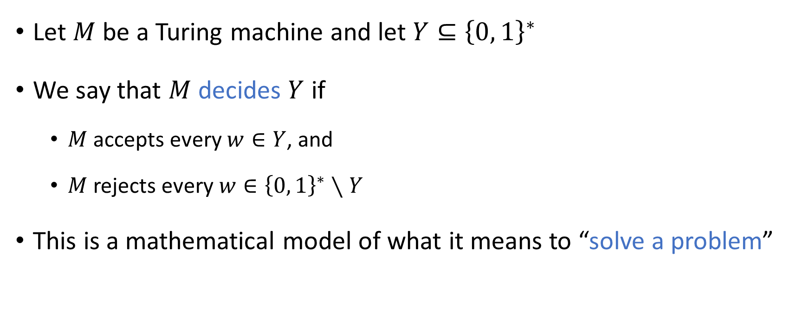
Deciding a language
Let $M$ be a Turing machine and let $Y⊆{\left\{0, 1\right\}}^{∗}$
We say that $M$ decides $Y$ if
$M$ accepts every $w∈Y$, and
$M$ rejects every $w∈{\left\{0, 1\right\}}^{∗}∖Y$
This is a mathematical model of what it means to “solve a problem”

Slide 40
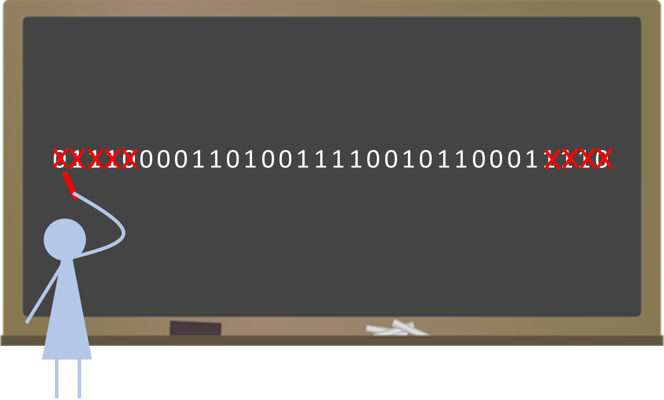
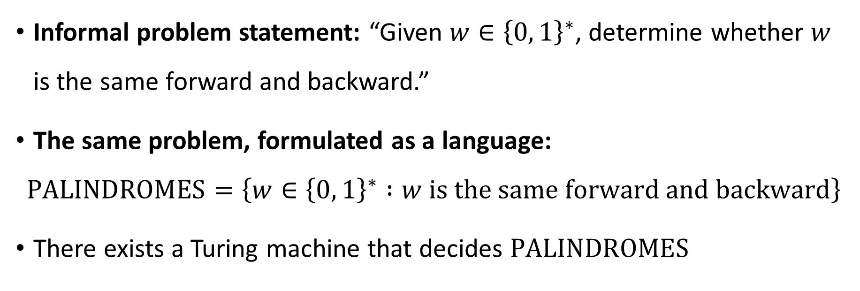
Example: Palindromes
Informal problem statement: “Given $w∈{\left\{0, 1\right\}}^{∗}$, determine whether $w$ is the same forward and backward.”
The same problem, formulated as a language:
$$\text{PALINDROMES}=\left\{w∈{\left\{0, 1\right\}}^{∗} :w \text{is} \text{the} \text{same} \text{forward} \text{and} \text{backward}\right\}$$
There exists a Turing machine that decides $\text{PALINDROMES}$

Slide 41
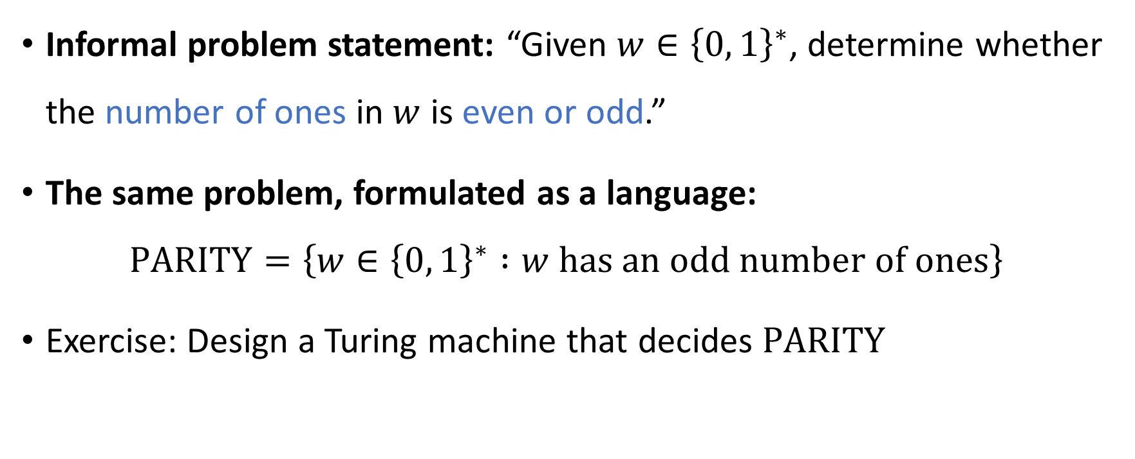
Example: Parity
Informal problem statement: “Given $w∈{\left\{0, 1\right\}}^{∗}$, determine whether the number of ones in $w$ is even or odd.”
The same problem, formulated as a language:
$$\text{PARITY}=\left\{w∈{\left\{0, 1\right\}}^{∗} :w \text{has} \text{an} \text{odd} \text{number} \text{of} \text{ones}\right\}$$
Exercise: Design a Turing machine that decides $\text{PARITY}$

Slide 42


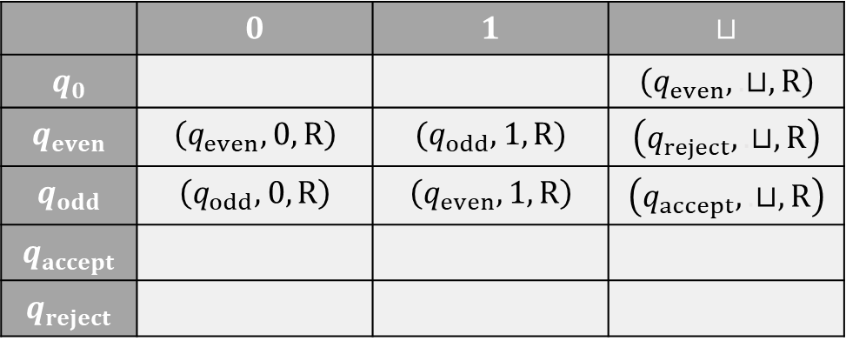










Example: A Turing machine that decides $\text{PARITY}$
 | $$0$$ | $$1$$ | $$⊔$$
$$q_{0}$$ |  |  | $$\left(q_{even},.⊔, \text{R}\right)$$
$$q_{even}$$ | $$\left(q_{even},0,\text{R}\right)$$ | $$(q_{odd},1,\text{R}\text{)}$$ | $$\left(q_{reject},.⊔, \text{R}\right)$$
$$q_{odd}$$ | $$\left(q_{odd},0,\text{R}\right)$$ | $$\left(q_{even},1,\text{R}\right)$$ | $$\left(q_{accept},.⊔,\text{R}\right)$$
$$q_{accept}$$
$$q_{reject}$$
$$⊔$$
$$⊔$$
$$⊔$$
$$⊔$$
$$1$$
$$0$$
$$1$$
$$⊔$$
$$⊔$$
$$⊔$$
$$⊔$$
$$⊔$$
$$⊔$$
$$q_{0}$$

Slide 43
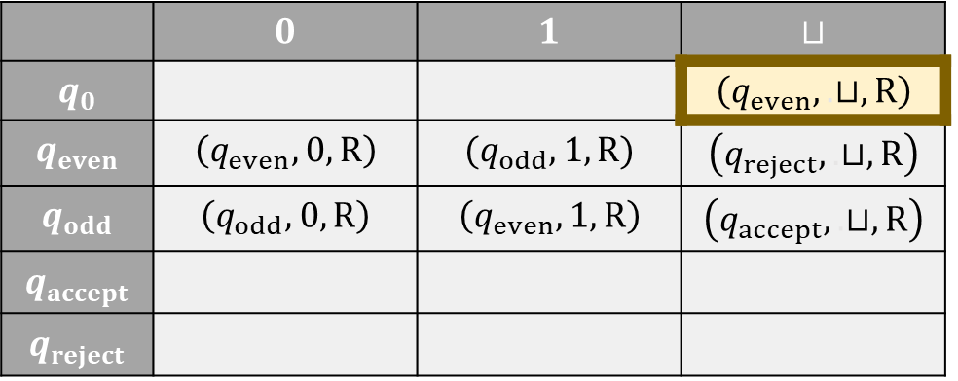
Example: A Turing machine that decides $\text{PARITY}$
 | $$0$$ | $$1$$ | $$⊔$$
$$q_{0}$$ |  |  | $$\left(q_{even},.⊔, \text{R}\right)$$
$$q_{even}$$ | $$\left(q_{even},0,\text{R}\right)$$ | $$(q_{odd},1,\text{R}\text{)}$$ | $$\left(q_{reject},.⊔, \text{R}\right)$$
$$q_{odd}$$ | $$\left(q_{odd},0,\text{R}\right)$$ | $$\left(q_{even},1,\text{R}\right)$$ | $$\left(q_{accept},.⊔,\text{R}\right)$$
$$q_{accept}$$
$$q_{reject}$$
$$⊔$$
$$⊔$$
$$⊔$$
$$⊔$$
$$1$$
$$0$$
$$1$$
$$⊔$$
$$⊔$$
$$⊔$$
$$⊔$$
$$⊔$$
$$⊔$$
$$q_{0}$$

Slide 44

Example: A Turing machine that decides $\text{PARITY}$
 | $$0$$ | $$1$$ | $$⊔$$
$$q_{0}$$ |  |  | $$\left(q_{even},.⊔, \text{R}\right)$$
$$q_{even}$$ | $$\left(q_{even},0,\text{R}\right)$$ | $$(q_{odd},1,\text{R}\text{)}$$ | $$\left(q_{reject},.⊔, \text{R}\right)$$
$$q_{odd}$$ | $$\left(q_{odd},0,\text{R}\right)$$ | $$\left(q_{even},1,\text{R}\right)$$ | $$\left(q_{accept},.⊔,\text{R}\right)$$
$$q_{accept}$$
$$q_{reject}$$
$$⊔$$
$$⊔$$
$$⊔$$
$$⊔$$
$$1$$
$$0$$
$$1$$
$$⊔$$
$$⊔$$
$$⊔$$
$$⊔$$
$$⊔$$
$$⊔$$
$$q_{even}$$

Slide 45
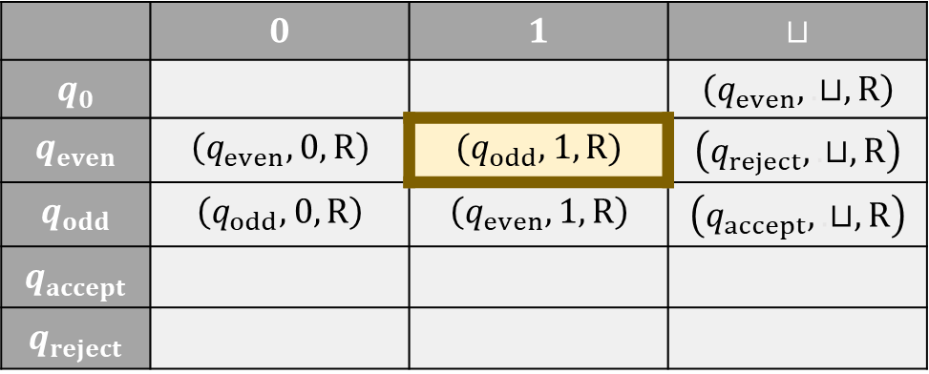
Example: A Turing machine that decides $\text{PARITY}$
 | $$0$$ | $$1$$ | $$⊔$$
$$q_{0}$$ |  |  | $$\left(q_{even},.⊔, \text{R}\right)$$
$$q_{even}$$ | $$\left(q_{even},0,\text{R}\right)$$ | $$(q_{odd},1,\text{R}\text{)}$$ | $$\left(q_{reject},.⊔, \text{R}\right)$$
$$q_{odd}$$ | $$\left(q_{odd},0,\text{R}\right)$$ | $$\left(q_{even},1,\text{R}\right)$$ | $$\left(q_{accept},.⊔,\text{R}\right)$$
$$q_{accept}$$
$$q_{reject}$$
$$⊔$$
$$⊔$$
$$⊔$$
$$⊔$$
$$1$$
$$0$$
$$1$$
$$⊔$$
$$⊔$$
$$⊔$$
$$⊔$$
$$⊔$$
$$⊔$$
$$q_{even}$$

Slide 46

Example: A Turing machine that decides $\text{PARITY}$
 | $$0$$ | $$1$$ | $$⊔$$
$$q_{0}$$ |  |  | $$\left(q_{even},.⊔, \text{R}\right)$$
$$q_{even}$$ | $$\left(q_{even},0,\text{R}\right)$$ | $$(q_{odd},1,\text{R}\text{)}$$ | $$\left(q_{reject},.⊔, \text{R}\right)$$
$$q_{odd}$$ | $$\left(q_{odd},0,\text{R}\right)$$ | $$\left(q_{even},1,\text{R}\right)$$ | $$\left(q_{accept},.⊔,\text{R}\right)$$
$$q_{accept}$$
$$q_{reject}$$
$$⊔$$
$$⊔$$
$$⊔$$
$$⊔$$
$$1$$
$$0$$
$$1$$
$$⊔$$
$$⊔$$
$$⊔$$
$$⊔$$
$$⊔$$
$$⊔$$
$$q_{odd}$$

Slide 47
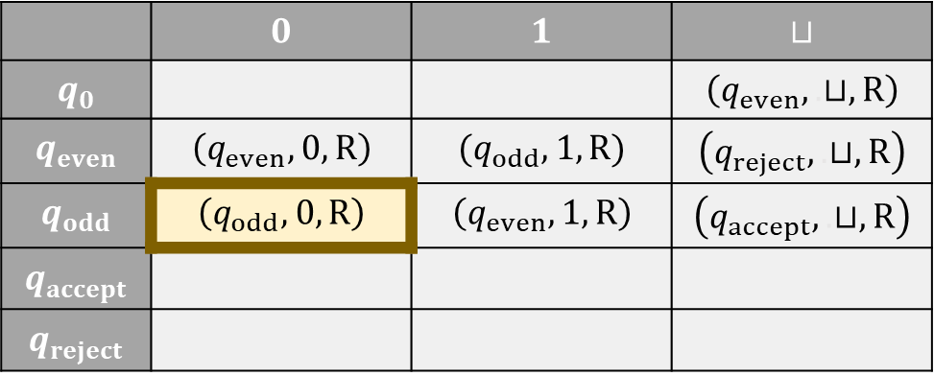
Example: A Turing machine that decides $\text{PARITY}$
 | $$0$$ | $$1$$ | $$⊔$$
$$q_{0}$$ |  |  | $$\left(q_{even},.⊔, \text{R}\right)$$
$$q_{even}$$ | $$\left(q_{even},0,\text{R}\right)$$ | $$(q_{odd},1,\text{R}\text{)}$$ | $$\left(q_{reject},.⊔, \text{R}\right)$$
$$q_{odd}$$ | $$\left(q_{odd},0,\text{R}\right)$$ | $$\left(q_{even},1,\text{R}\right)$$ | $$\left(q_{accept},.⊔,\text{R}\right)$$
$$q_{accept}$$
$$q_{reject}$$
$$⊔$$
$$⊔$$
$$⊔$$
$$⊔$$
$$1$$
$$0$$
$$1$$
$$⊔$$
$$⊔$$
$$⊔$$
$$⊔$$
$$⊔$$
$$⊔$$
$$q_{odd}$$

Slide 48

Example: A Turing machine that decides $\text{PARITY}$
 | $$0$$ | $$1$$ | $$⊔$$
$$q_{0}$$ |  |  | $$\left(q_{even},.⊔, \text{R}\right)$$
$$q_{even}$$ | $$\left(q_{even},0,\text{R}\right)$$ | $$(q_{odd},1,\text{R}\text{)}$$ | $$\left(q_{reject},.⊔, \text{R}\right)$$
$$q_{odd}$$ | $$\left(q_{odd},0,\text{R}\right)$$ | $$\left(q_{even},1,\text{R}\right)$$ | $$\left(q_{accept},.⊔,\text{R}\right)$$
$$q_{accept}$$
$$q_{reject}$$
$$⊔$$
$$⊔$$
$$⊔$$
$$⊔$$
$$1$$
$$0$$
$$1$$
$$⊔$$
$$⊔$$
$$⊔$$
$$⊔$$
$$⊔$$
$$⊔$$
$$q_{odd}$$

Slide 49
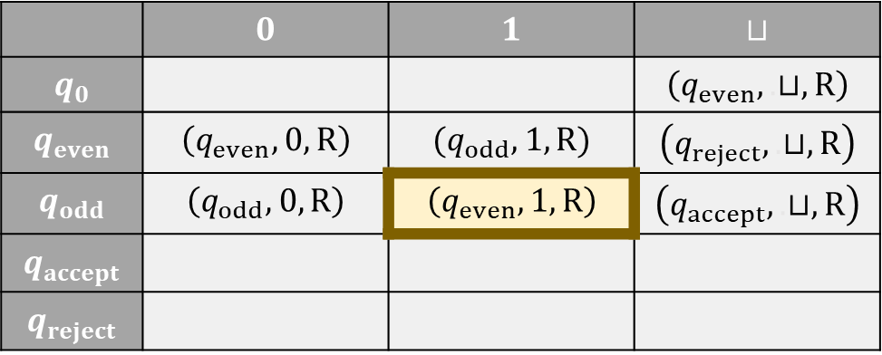
Example: A Turing machine that decides $\text{PARITY}$
 | $$0$$ | $$1$$ | $$⊔$$
$$q_{0}$$ |  |  | $$\left(q_{even},.⊔, \text{R}\right)$$
$$q_{even}$$ | $$\left(q_{even},0,\text{R}\right)$$ | $$(q_{odd},1,\text{R}\text{)}$$ | $$\left(q_{reject},.⊔, \text{R}\right)$$
$$q_{odd}$$ | $$\left(q_{odd},0,\text{R}\right)$$ | $$\left(q_{even},1,\text{R}\right)$$ | $$\left(q_{accept},.⊔,\text{R}\right)$$
$$q_{accept}$$
$$q_{reject}$$
$$⊔$$
$$⊔$$
$$⊔$$
$$⊔$$
$$1$$
$$0$$
$$1$$
$$⊔$$
$$⊔$$
$$⊔$$
$$⊔$$
$$⊔$$
$$⊔$$
$$q_{odd}$$

Slide 50


Example: A Turing machine that decides $\text{PARITY}$
 | $$0$$ | $$1$$ | $$⊔$$
$$q_{0}$$ |  |  | $$\left(q_{even},.⊔, \text{R}\right)$$
$$q_{even}$$ | $$\left(q_{even},0,\text{R}\right)$$ | $$(q_{odd},1,\text{R}\text{)}$$ | $$\left(q_{reject},.⊔, \text{R}\right)$$
$$q_{odd}$$ | $$\left(q_{odd},0,\text{R}\right)$$ | $$\left(q_{even},1,\text{R}\right)$$ | $$\left(q_{accept},.⊔,\text{R}\right)$$
$$q_{accept}$$
$$q_{reject}$$
$$⊔$$
$$⊔$$
$$⊔$$
$$⊔$$
$$1$$
$$0$$
$$1$$
$$⊔$$
$$⊔$$
$$⊔$$
$$⊔$$
$$⊔$$
$$⊔$$
$$q_{even}$$

Slide 51
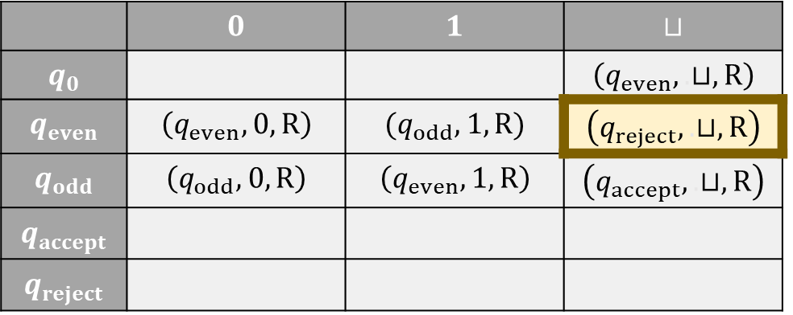
Example: A Turing machine that decides $\text{PARITY}$
 | $$0$$ | $$1$$ | $$⊔$$
$$q_{0}$$ |  |  | $$\left(q_{even},.⊔, \text{R}\right)$$
$$q_{even}$$ | $$\left(q_{even},0,\text{R}\right)$$ | $$(q_{odd},1,\text{R}\text{)}$$ | $$\left(q_{reject},.⊔, \text{R}\right)$$
$$q_{odd}$$ | $$\left(q_{odd},0,\text{R}\right)$$ | $$\left(q_{even},1,\text{R}\right)$$ | $$\left(q_{accept},.⊔,\text{R}\right)$$
$$q_{accept}$$
$$q_{reject}$$
$$⊔$$
$$⊔$$
$$⊔$$
$$⊔$$
$$1$$
$$0$$
$$1$$
$$⊔$$
$$⊔$$
$$⊔$$
$$⊔$$
$$⊔$$
$$⊔$$
$$q_{even}$$

Slide 52

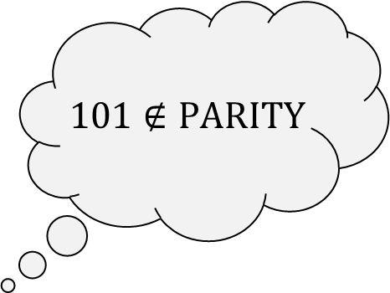

Example: A Turing machine that decides $\text{PARITY}$
 | $$0$$ | $$1$$ | $$⊔$$
$$q_{0}$$ |  |  | $$\left(q_{even},.⊔, \text{R}\right)$$
$$q_{even}$$ | $$\left(q_{even},0,\text{R}\right)$$ | $$(q_{odd},1,\text{R}\text{)}$$ | $$\left(q_{reject},.⊔, \text{R}\right)$$
$$q_{odd}$$ | $$\left(q_{odd},0,\text{R}\right)$$ | $$\left(q_{even},1,\text{R}\right)$$ | $$\left(q_{accept},.⊔,\text{R}\right)$$
$$q_{accept}$$
$$q_{reject}$$
$$101∉\text{PARITY}$$
$$⊔$$
$$⊔$$
$$⊔$$
$$⊔$$
$$1$$
$$0$$
$$1$$
$$⊔$$
$$⊔$$
$$⊔$$
$$⊔$$
$$⊔$$
$$⊔$$
$$q_{reject}$$

