Slide 1


Hitting Sets Give Two-Sided Derandomization of Small Space
CCC 2020
Kuan Cheng¹
University of Texas at Austin
ckkcdh@hotmail.com
William M. Hoza²
University of Texas at Austin
whoza@utexas.edu
¹Supported by a Simons Investigator Award (#409864, David Zuckerman).
²Supported by the NSF GRFP under Grant DGE-1610403 and by a Harrington Fellowship from UT Austin.

Slide 2



No known efficient algorithm
Efficient randomized algorithm
Efficient deterministic algorithm

Slide 3
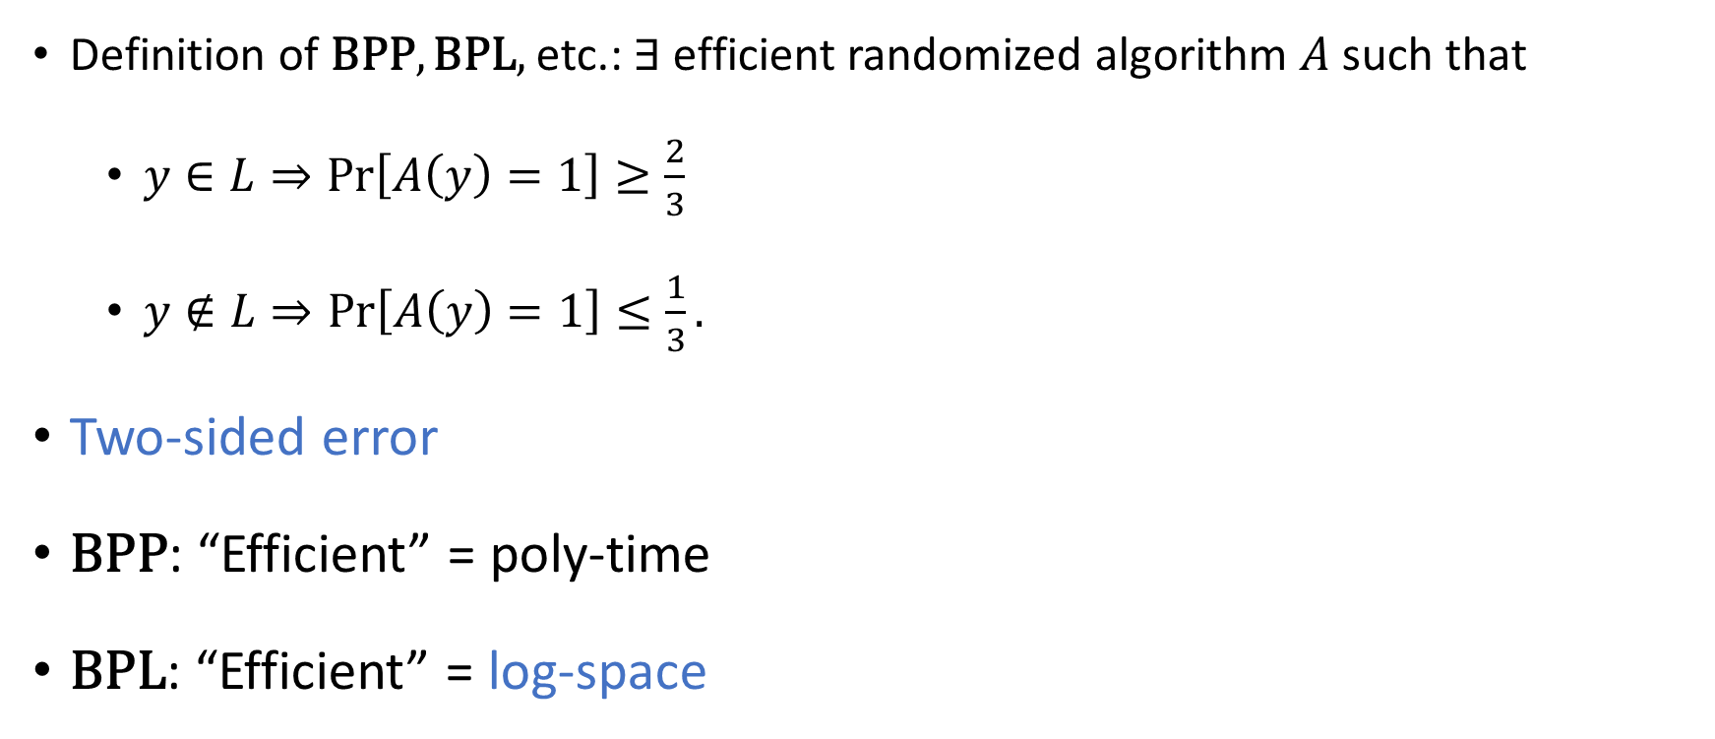
Randomized complexity classes
Definition of $\text{BPP},\text{BPL},$ etc.: $∃$ efficient randomized algorithm $A$ such that
$y∈L⇒\text{Pr}\left[A\left(y\right)=1\right]≥\frac{2}{3}$
$y∉L⇒\text{Pr}\left[A\left(y\right)=1\right]≤\frac{1}{3}.$
Two-sided error
$\text{BPP}$: “Efficient” = poly-time
$\text{BPL}$: “Efficient” = log-space

Slide 4



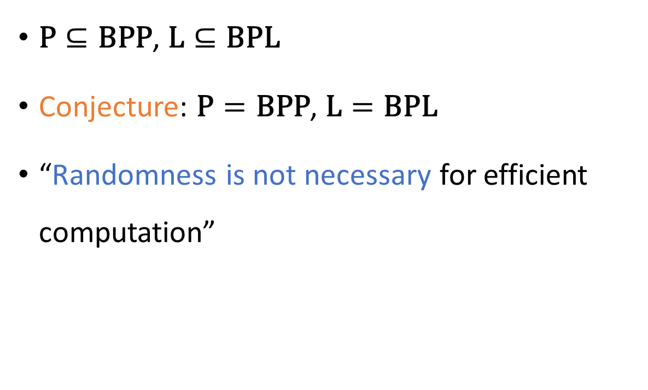
Power of randomness?
$\text{P}⊆\text{BPP}$, $\text{L}⊆\text{BPL}$
Conjecture: $\text{P}=\text{BPP}$, $\text{L}=\text{BPL}$
“Randomness is not necessary for efficient computation”

Slide 5


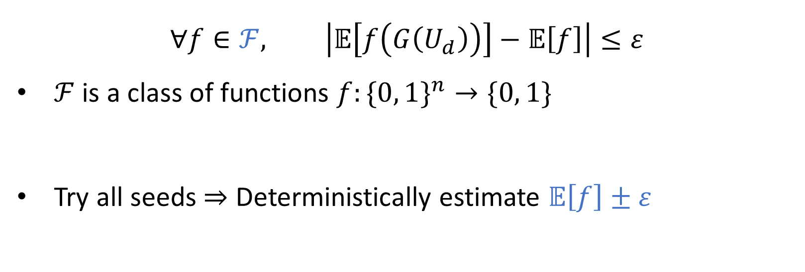
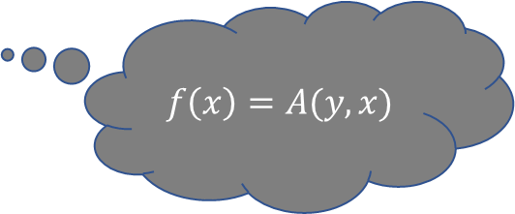
Pseudorandom generators (PRGs)
$G:\{0, 1\}^{d}→\{0, 1\}^{n}$
$$∀f∈ℱ, \left|𝔼\left[f\left(G\left(U_{d}\right)\right)\right]−𝔼\left[f\right]\right|≤ε$$
$ℱ$ is a class of functions $f:\{0, 1\}^{n}→\{0, 1\}$
Try all seeds $⇒$ Deterministically estimate $𝔼\left[f\right]±ε$
$$f\left(x\right)=A(y,x)$$
Good PRG $⇒\text{P}=\text{BPP} \text{and} \text{L}=\text{BPL}$
Constructing good PRGs is difficult

Slide 6
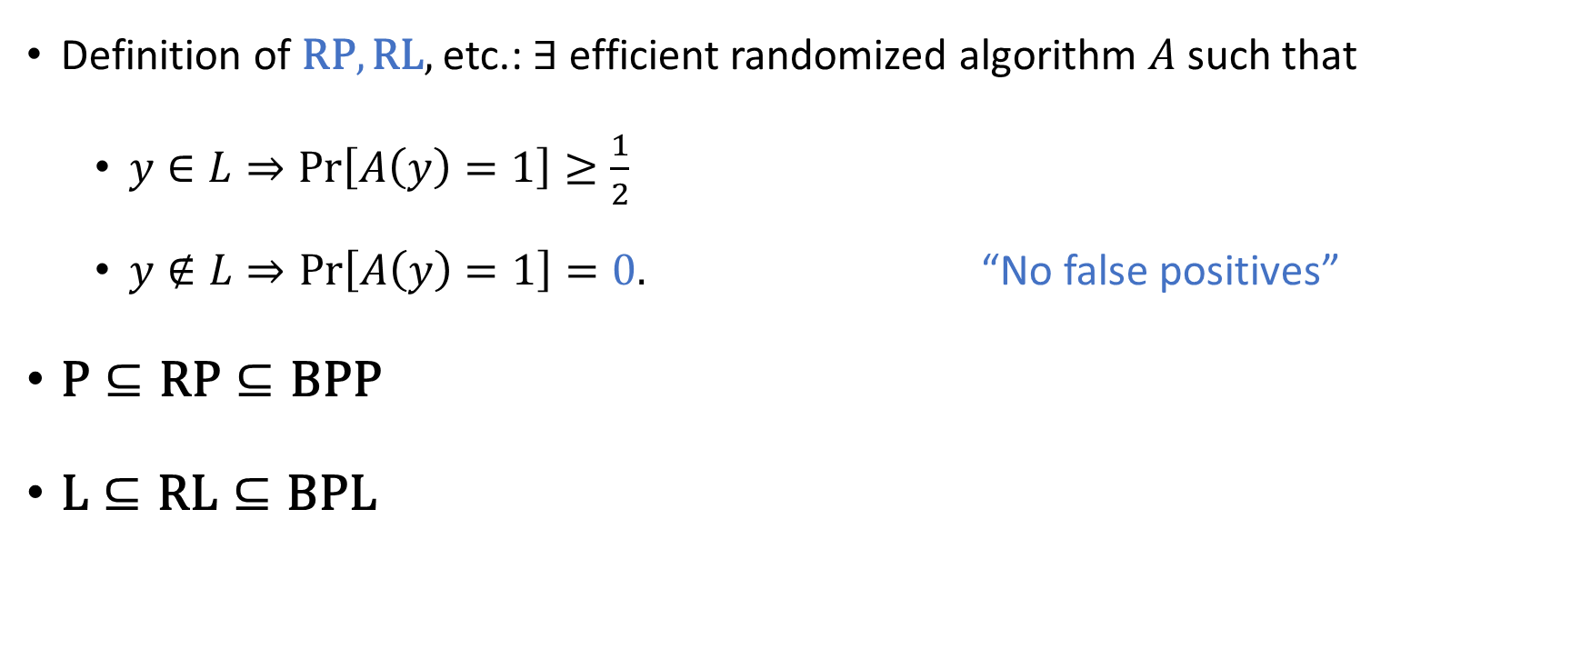
One-sided error
Definition of $\text{RP}, \text{RL},$etc.: $∃$ efficient randomized algorithm $A$ such that
$y∈L⇒\text{Pr}\left[A\left(y\right)=1\right]≥\frac{1}{2}$
$y∉L⇒\text{Pr}\left[A\left(y\right)=1\right]=0.$ “No false positives”
$\text{P}⊆\text{RP}⊆\text{BPP}$
$\text{L}⊆\text{RL}⊆\text{BPL}$

Slide 7
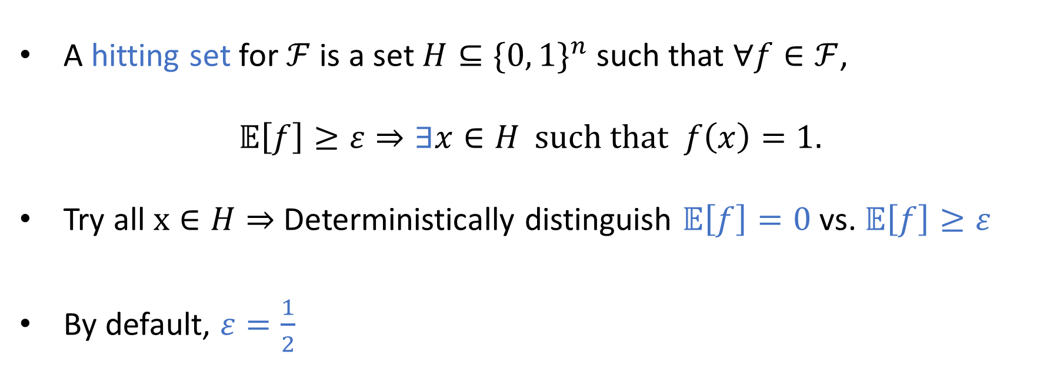
Hitting sets: “One-sided PRG”
A hitting set for $ℱ$ is a set $H⊆\{0, 1\}^{n}$ such that $∀f∈ℱ$,
$$𝔼\left[f\right]≥ε⇒∃x∈H \text{such} \text{that} f\left(x\right)=1.$$
Try all $x∈H⇒$ Deterministically distinguish $𝔼\left[f\right]=0$ vs. $𝔼\left[f\right]≥ε$
By default, $ε=\frac{1}{2}$

Slide 8
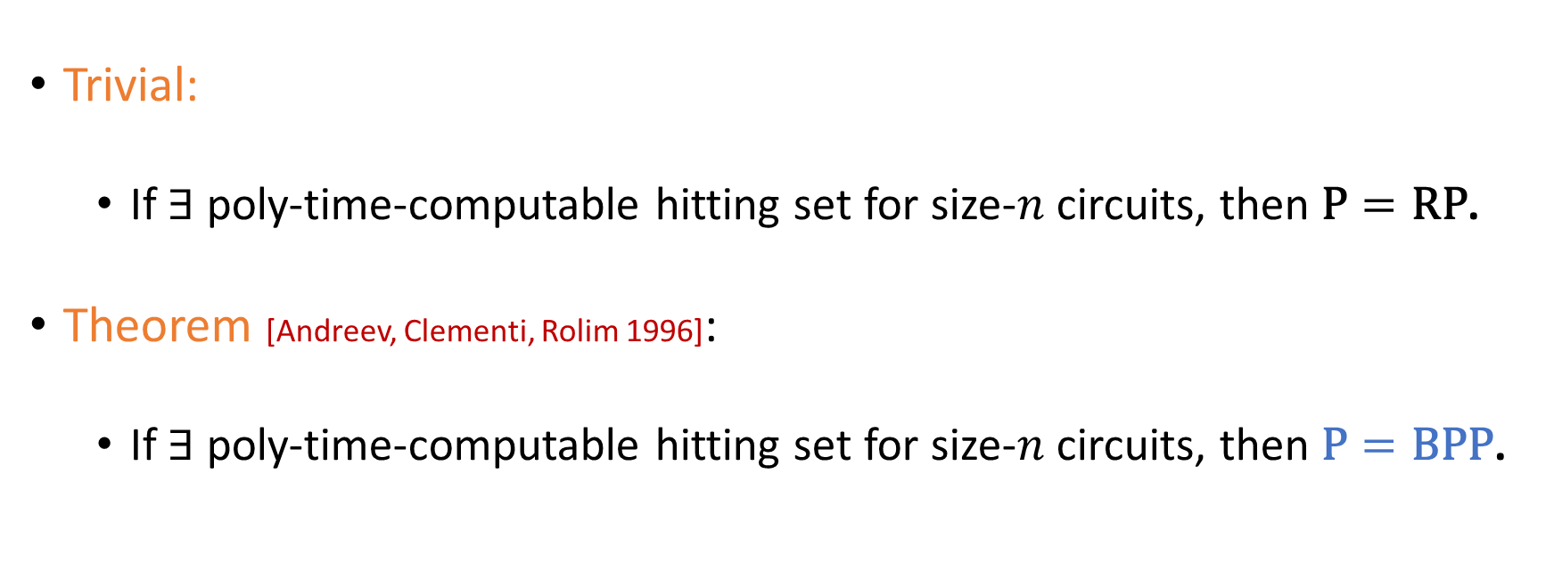
Using hitting sets for poly-time derandomization
Trivial:
If $∃$ poly-time-computable hitting set for size-$n$ circuits, then $\text{P}=\text{RP}$.
Theorem [Andreev, Clementi, Rolim 1996]:
If $∃$ poly-time-computable hitting set for size-$n$ circuits, then $\text{P}=\text{BPP}$.

Slide 9
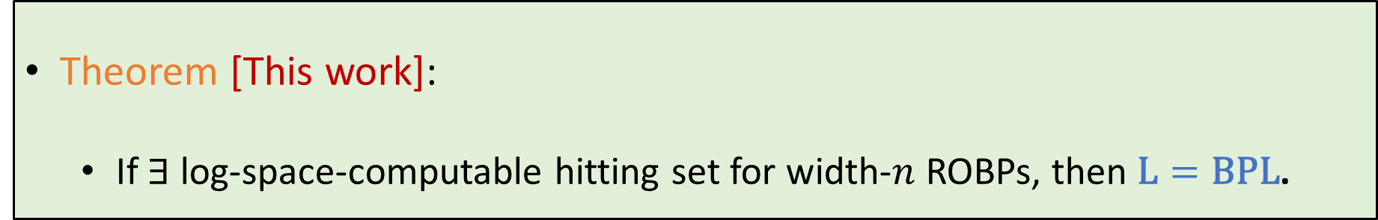
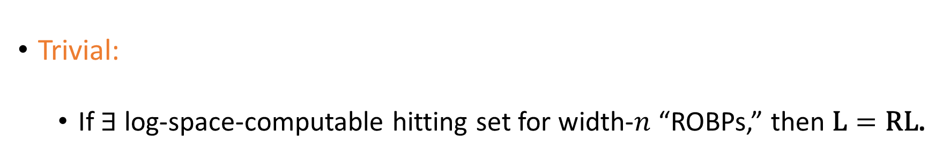
Using hitting sets for log-space derandomization
Trivial:
If $∃$ log-space-computable hitting set for width-$n$ “ROBPs,” then $\text{L}=\text{R}\text{L}$.
Theorem [This work]:
If $∃$ log-space-computable hitting set for width-$n$ ROBPs, then $\text{L}=\text{BPL}$.
In other words: If $∃$ black-box derandomization of $\text{promise}\text{−}\text{RL}$, then $\text{L}=\text{BPL}.$

Slide 10











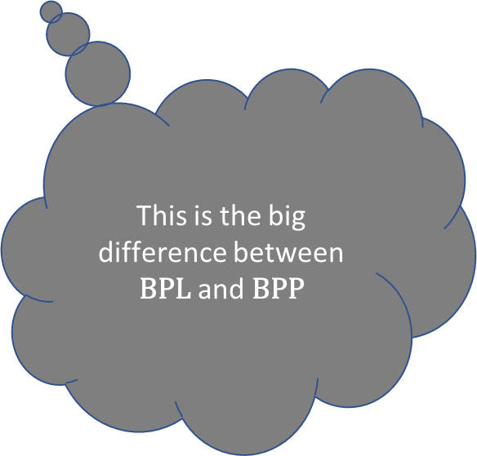



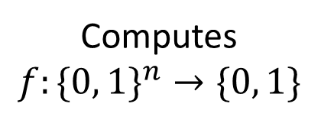
Read-once branching programs (ROBPs)
Read-once
$$x=$$
$$1$$
$$0$$
$$0$$
$$1$$
$$0$$
$$1$$
This is the big difference between $\text{BPL}$ and $\text{BPP}$
0
1
$$v_{\text{acc}}$$
$$v_{\text{start}}$$
1
0
1
Computes
$$f:\{0, 1\}^{n}→\{0, 1\}$$
Width
0
1
1
0
0
0
1
$$V_{0}$$
$$V_{1}$$
$$V_{2}$$
$$⋯$$
$$V_{n}$$

Slide 11



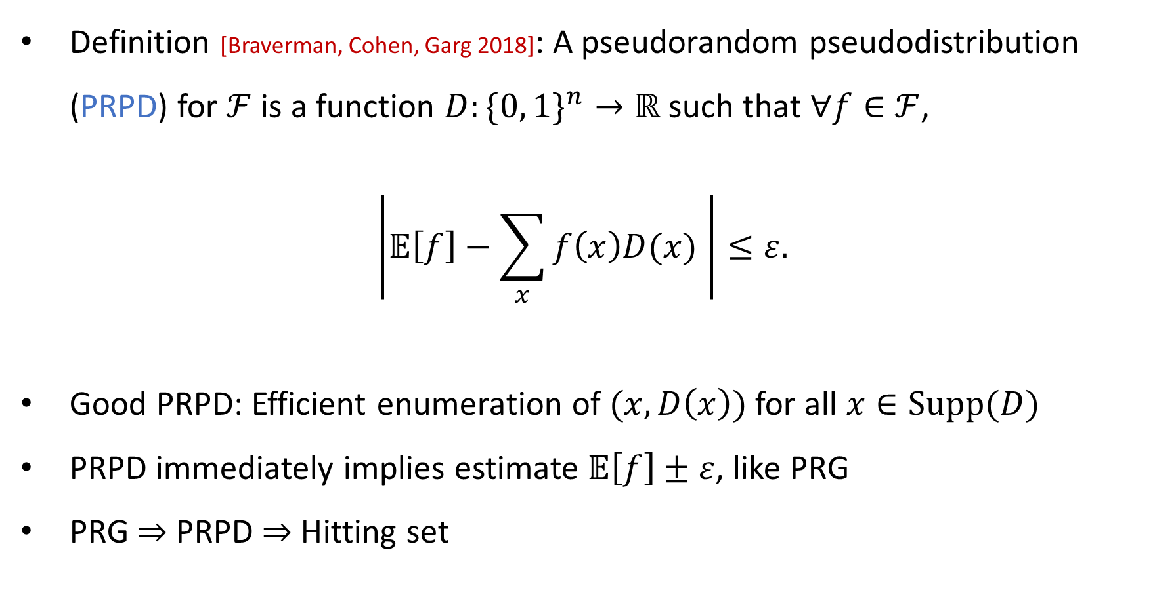
Context: Pseudorandom pseudodistributions
Definition [Braverman, Cohen, Garg 2018]: A pseudorandom pseudodistribution (PRPD) for $ℱ$ is a function $D:\{0, 1\}^{n}→ℝ$ such that $∀f∈ℱ$,
$$\left|𝔼\left[f\right]−\sum_{x}{f\left(x\right)D(x)} \right|≤ε.$$
Good PRPD: Efficient enumeration of $(x, D\left(x\right))$ for all $x∈\text{Supp}(D)$
PRPD immediately implies estimate $𝔼\left[f\right]±ε$, like PRG
PRG $⇒$ PRPD $⇒$ Hitting set

Slide 12
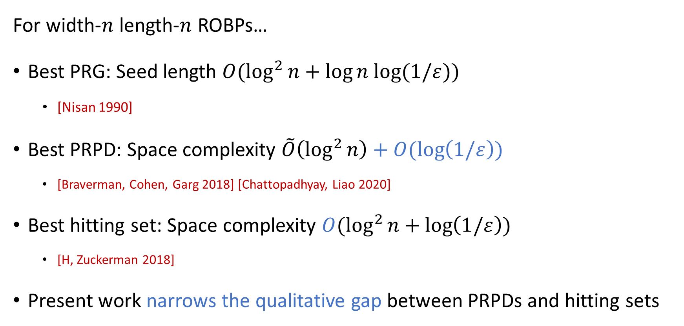
Context: Recent hitting sets for ROBPs
For width-$n$ length-$n$ ROBPs…
Best PRG: Seed length $O(\log^{2}{n+\log{n log⁡(1/ε))}}$
[Nisan 1990]
Best PRPD: Space complexity $\tilde{O}\left(\log^{2}{n}\right)+O(\log\left(1/ε\right))$
[Braverman, Cohen, Garg 2018] [Chattopadhyay, Liao 2020]
Best hitting set: Space complexity $O(\log^{2}{n}+\log\left(1/ε\right))$
[H, Zuckerman 2018]
Present work narrows the qualitative gap between PRPDs and hitting sets

Slide 13
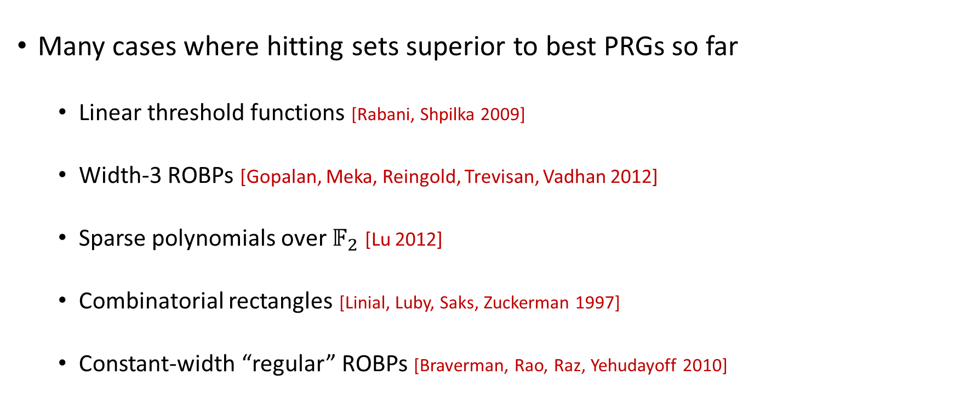
Motivation: Hitting set success stories
Many cases where hitting sets superior to best PRGs so far
Linear threshold functions [Rabani, Shpilka 2009]
Width-3 ROBPs [Gopalan, Meka, Reingold, Trevisan, Vadhan 2012]
Sparse polynomials over $𝔽_{2}$ [Lu 2012]
Combinatorial rectangles [Linial, Luby, Saks, Zuckerman 1997]
Constant-width “regular” ROBPs [Braverman, Rao, Raz, Yehudayoff 2010]

Slide 14
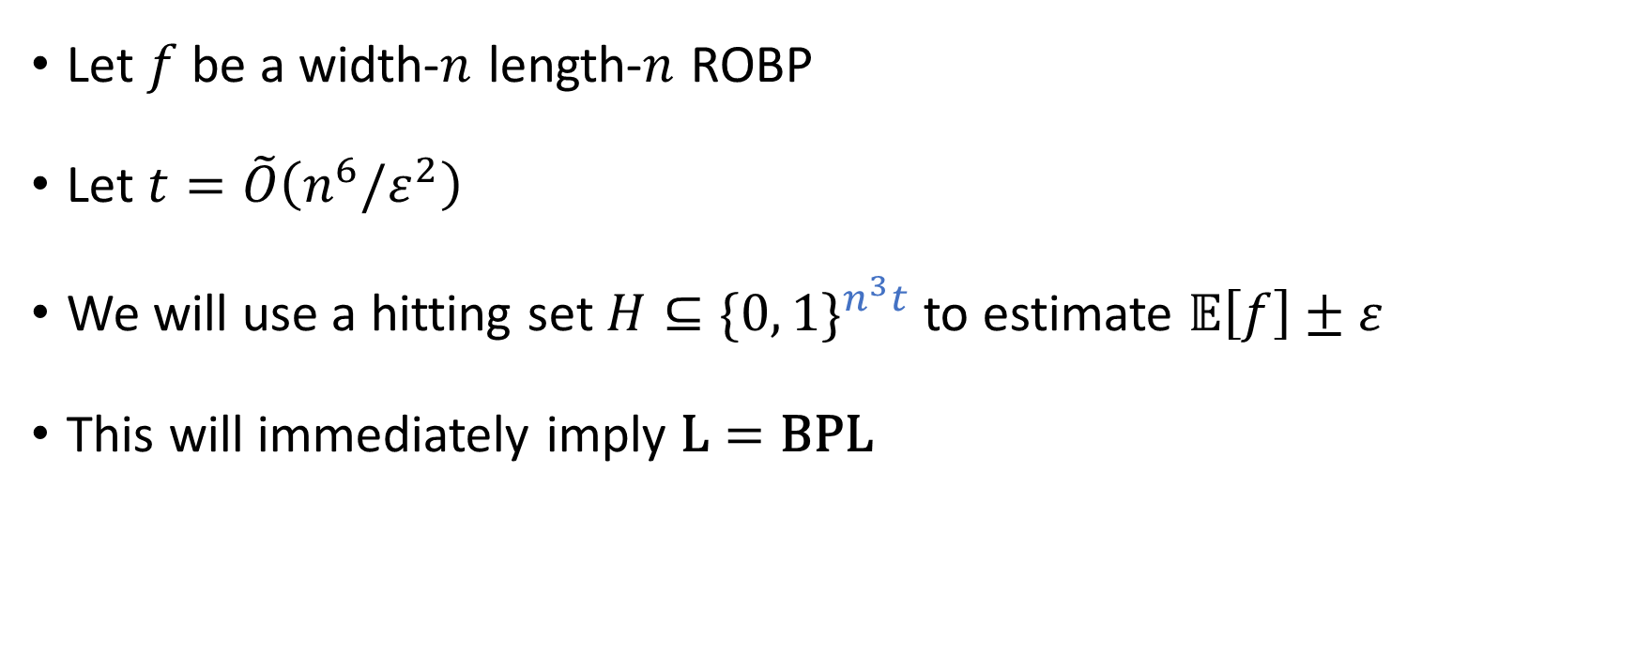
Derandomization setup
Let $f$ be a width-$n$ length-$n$ ROBP
Let $t=\tilde{O}\left(n^{6}/ε^{2}\right)$
We will use a hitting set $H⊆\{0, 1\}^{n^{3}t}$ to estimate $𝔼\left[f\right]±ε$
This will immediately imply $\text{L}=\text{BPL}$

Slide 15
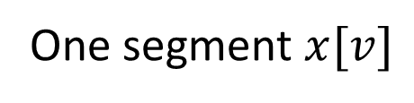



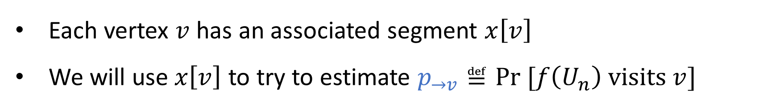
Segments
Each $x∈\{0, 1\}^{n^{3}t}$ consists of $n^{2}$ segments (one per vertex)
$$n^{3}t$$
$x=$
$$nt$$
One segment $x[v]$
Each vertex $v$ has an associated segment $x\left[v\right]$
We will use $x\left[v\right]$ to try to estimate $p_{→v}≝\text{Pr} [f\left(U_{n}\right) \text{visits} v]$

Slide 16

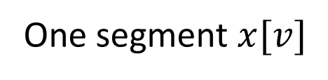
Sample inputs
Each segment $x[v]$ is divided into $t$ sample inputs of length $n$
One sample input
$$n$$
One segment $x[v]$
$$x\left[v\right]=x\left[v,1\right]∘…∘x\left[v,t\right]$$

Slide 17

Estimated visit probabilities
Define ${\hat{p}}_{→v}(x)$ to be the fraction of $j$ such that $f(x\left[v,j\right])$ visits $v$
Shorthand ${\hat{p}}_{→v}={\hat{p}}_{→v}(x)$

Slide 18




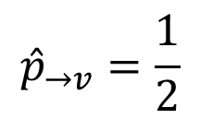















Example with $t=2$
$$x[v,1]=$$
$$1$$
$$0$$
$$0$$
$$1$$
$$0$$
$$1$$
$${\hat{p}}_{→v}=\frac{1}{2}$$
$$x[v,2]=$$
$$1$$
$$0$$
$$1$$
$$0$$
$$1$$
$$1$$
0
$$v_{\text{start}}$$
1
1
0
$$v$$
0
1

Slide 19
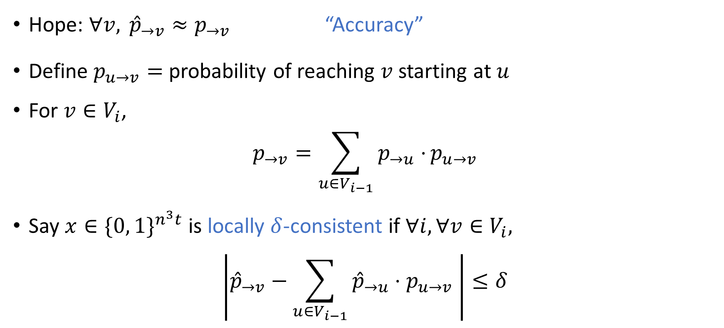
Local consistency test
Hope: $∀v, {\hat{p}}_{→v}≈p_{→v}$ “Accuracy”
Define $p_{u→v}=$ probability of reaching $v$ starting at $u$
For $v∈V_{i}$,
$$p_{→v}=\sum_{u∈V_{i−1}}{p_{→u}⋅}p_{u→v}$$
Say $x∈\{0, 1\}^{n^{3}t}$ is locally $δ$-consistent if $∀i, ∀v∈V_{i},$
$$\left|{\hat{p}}_{→v}−\sum_{u∈V_{i−1}}{{\hat{p}}_{→u}⋅p_{u→v}} \right|≤δ$$

Slide 20
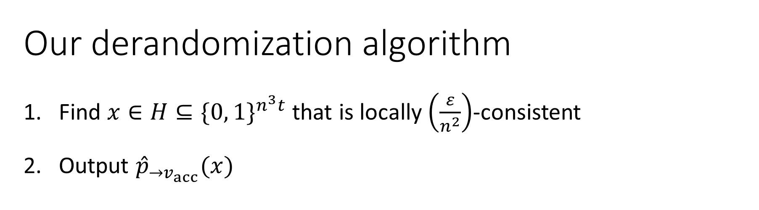
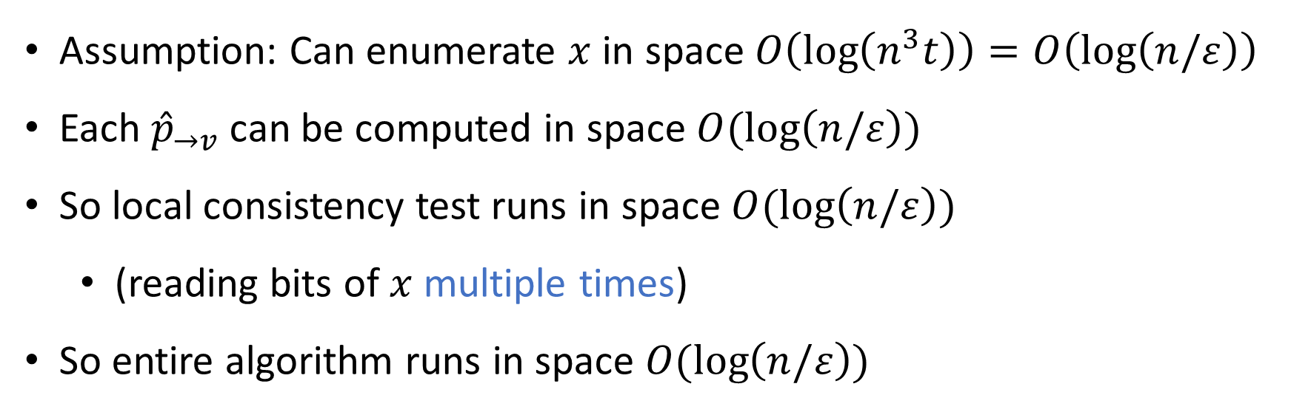
Our derandomization algorithm
Find $x∈H⊆\{0, 1\}^{n^{3}t}$ that is locally $\left(\frac{ε}{n^{2}}\right)$-consistent
Output ${\hat{p}}_{→v_{acc}}(x)$
Assumption: Can enumerate $x$ in space $O\left(\log\left(n^{3}t\right)\right)=O\left(\log\left(n/ε\right)\right)$
Each ${\hat{p}}_{→v}$ can be computed in space $O(\log\left(n/ε\right))$
So local consistency test runs in space $O(\log\left(n/ε\right))$
(reading bits of $x$ multiple times)
So entire algorithm runs in space $O(\log\left(n/ε\right))$

Slide 21
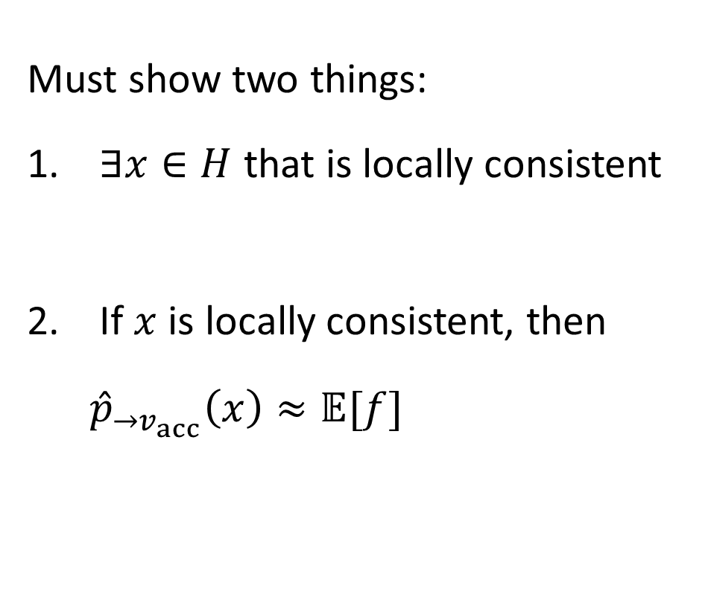
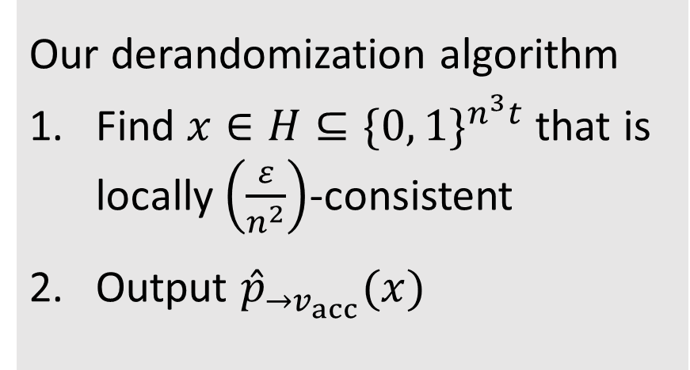
Correctness proof outline
Must show two things:
$∃x∈H$ that is locally consistent
If $x$ is locally consistent, then ${\hat{p}}_{→v_{acc}}\left(x\right)≈𝔼[f]$
Our derandomization algorithm
Find $x∈H⊆\{0, 1\}^{n^{3}t}$ that is locally $\left(\frac{ε}{n^{2}}\right)$-consistent
Output ${\hat{p}}_{→v_{acc}}(x)$

Slide 22
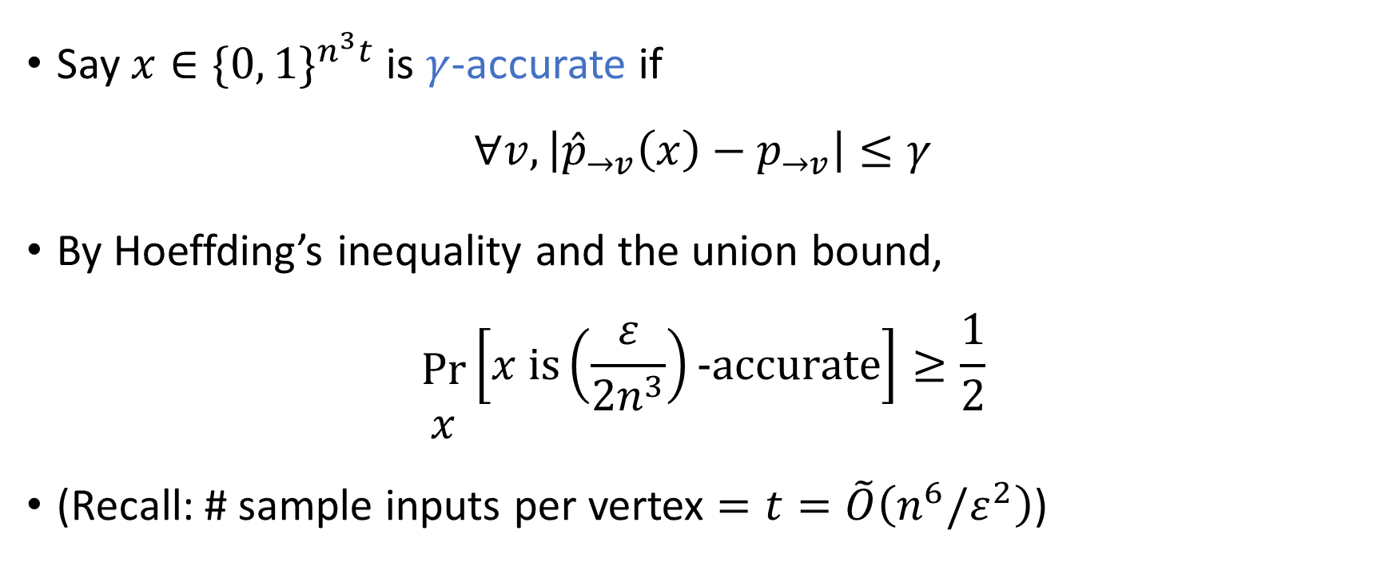

A random $x$ is accurate
Say $x∈\{0, 1\}^{n^{3}t}$ is $γ$-accurate if
$$∀v, \left|{\hat{p}}_{→v}\left(x\right)−p_{→v}\right|≤γ$$
By Hoeffding’s inequality and the union bound,
$$\begin{matrix} \\ \text{Pr} \\ x\end{matrix}\left[x \text{is}\left(\frac{ε}{2n^{3}}\right)\text{−}\text{accurate}\right]≥\frac{1}{2}$$
(Recall: # sample inputs per vertex $=t=\tilde{O}\left(n^{6}/ε^{2}\right)$)

Slide 23
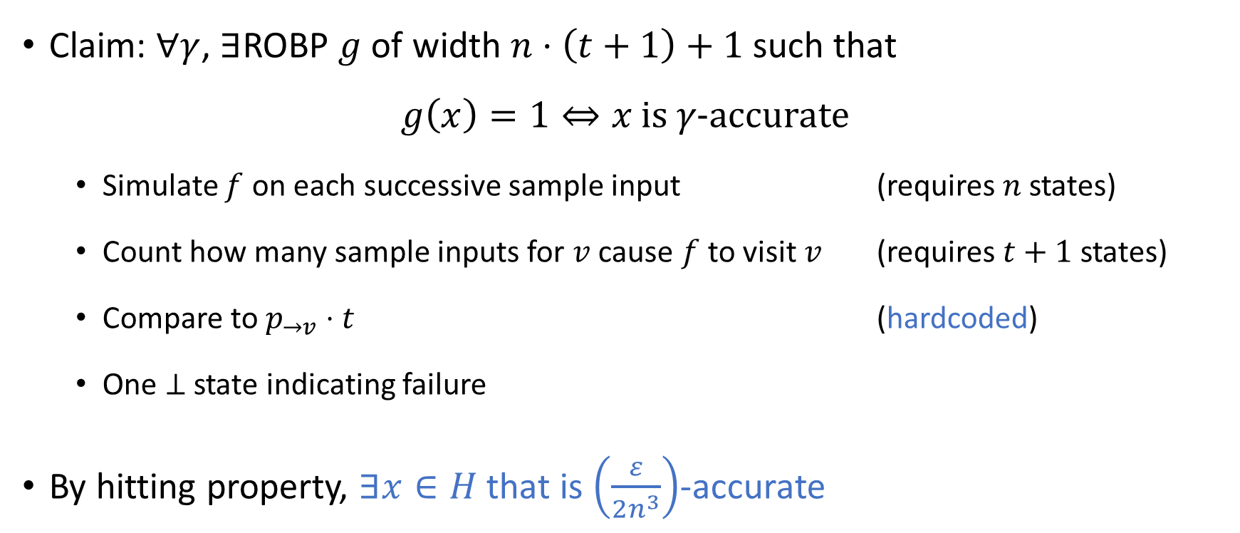
Accuracy can be checked by an ROBP
Claim: $∀γ$, $∃$ROBP $g$ of width $n⋅\left(t+1\right)+1$ such that
$$g\left(x\right)=1⇔x \text{is} γ\text{−}\text{accurate}$$
Simulate $f$ on each successive sample input (requires $n$ states)
Count how many sample inputs for $v$ cause $f$ to visit $v$ (requires $t+1$ states)
Compare to $p_{→v}⋅t$ (hardcoded)
One $⊥$ state indicating failure
By hitting property, $∃x∈H$ that is $\left(\frac{ε}{2n^{3}}\right)$-accurate

Slide 24
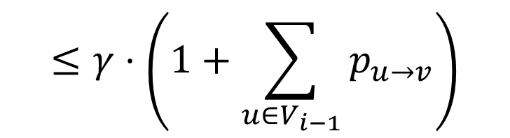
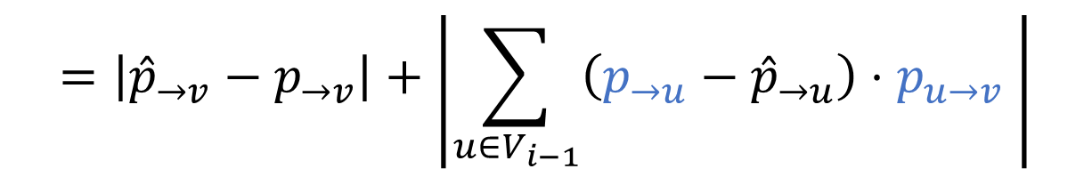
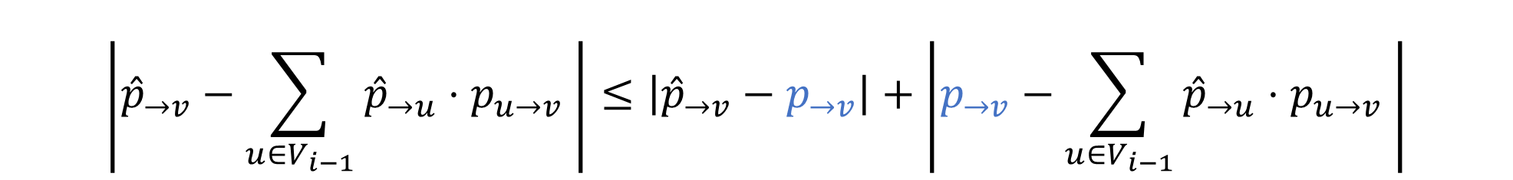


Accuracy $⇒$ local consistency
$$\left|{\hat{p}}_{→v}−\sum_{u∈V_{i−1}}{{\hat{p}}_{→u}⋅p_{u→v}} \right|≤\left|{\hat{p}}_{→v}−p_{→v}\right|+\left|p_{→v}−\sum_{u∈V_{i−1}}{{\hat{p}}_{→u}⋅p_{u→v}} \right|$$
$$=\left|{\hat{p}}_{→v}−p_{→v}\right|+\left|\sum_{u∈V_{i−1}}{\left({p_{→u}−\hat{p}}_{→u}\right)⋅p_{u→v}} \right|$$
$$≤γ⋅\left(1+\sum_{u∈V_{i−1}}{p_{u→v}}\right)$$
$$≤2nγ$$

Slide 25

Correctness proof outline
Our derandomization algorithm
Find $x∈H⊆\{0, 1\}^{n^{3}t}$ that is locally $\left(\frac{ε}{n^{2}}\right)$-consistent
Output ${\hat{p}}_{→v_{acc}}(x)$
Must show two things:
$∃x∈H$ that is locally consistent
If $x$ is locally consistent, then ${\hat{p}}_{→v_{acc}}\left(x\right)≈𝔼[f]$

Slide 26

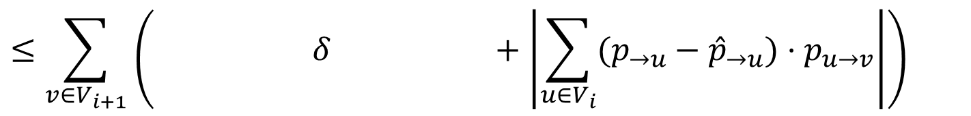
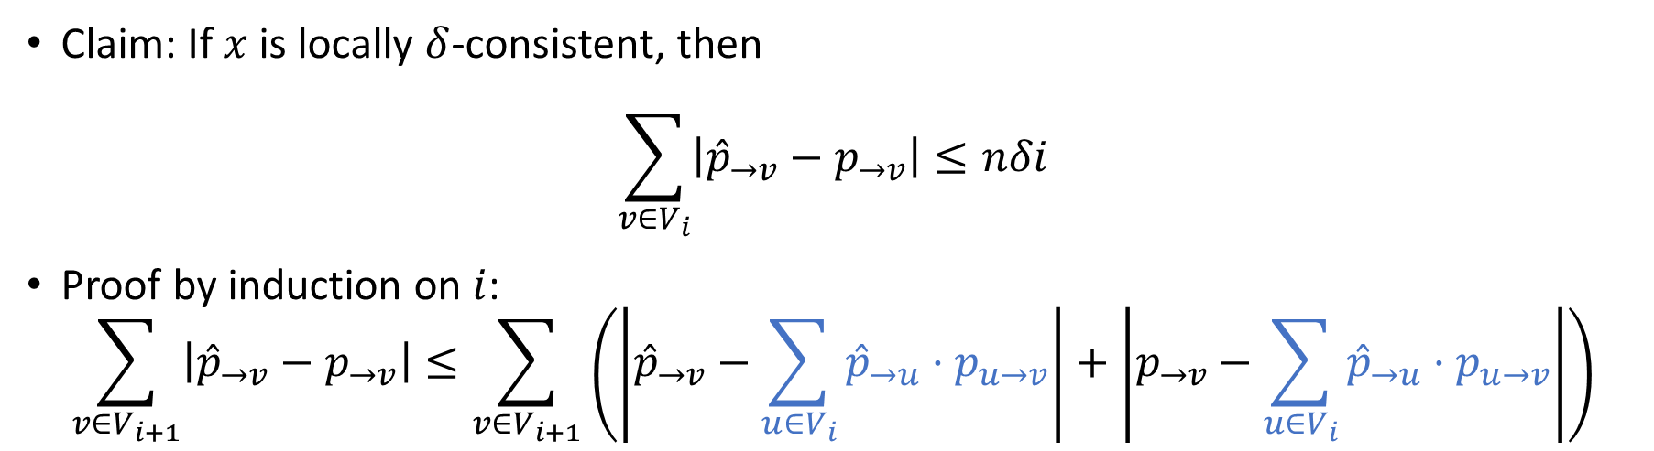


Local consistency $⇒$ accuracy
Claim: If $x$ is locally $δ$-consistent, then
$$\sum_{v∈V_{i}}{\left|{\hat{p}}_{→v}−p_{→v}\right|}≤nδi$$
Proof by induction on $i$:
$$\sum_{v∈V_{i+1}}{\left|{\hat{p}}_{→v}−p_{→v}\right|}≤\sum_{v∈V_{i+1}}{\left(\left|{\hat{p}}_{→v}−\sum_{u∈V_{i}}{{\hat{p}}_{→u}⋅p_{u→v}}\right|+\left|p_{→v}−\sum_{u∈V_{i}}{{\hat{p}}_{→u}⋅p_{u→v}}\right|\right)}$$
$$≤\sum_{v∈V_{i+1}}{\left( δ +\left|\sum_{u∈V_{i}}{(p_{→u}−{\hat{p}}_{→u})⋅p_{u→v}}\right|\right)}$$
$$≤nδ+\sum_{v∈V_{i+1}}{\sum_{u∈V_{i}}{|p_{→u}−{\hat{p}}_{→u}|⋅p_{u→v}}}$$
$$=nδ+\sum_{u∈V_{i}}{\left|p_{→u}−{\hat{p}}_{→u}\right|}⋅\sum_{v∈V_{i+1}}{p_{u→v}}$$

Slide 27

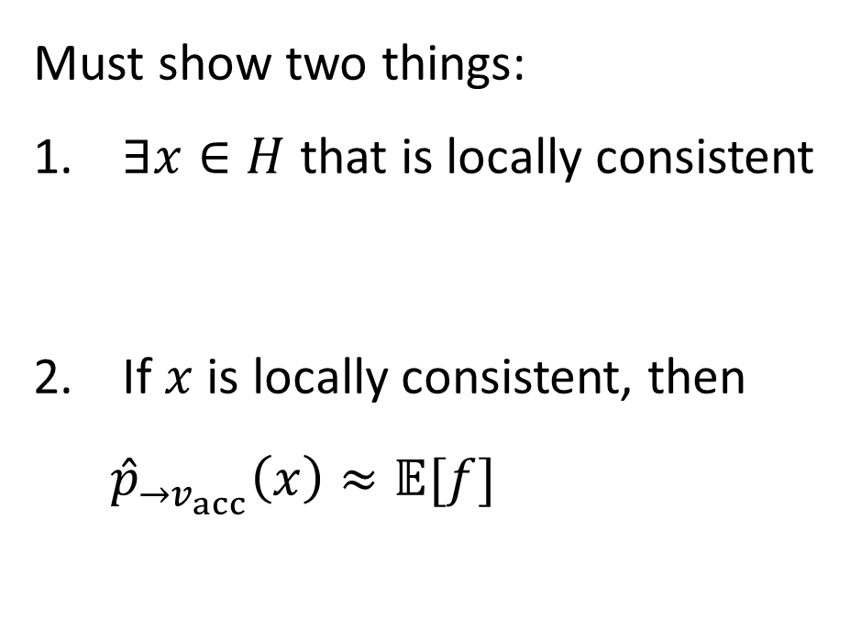
Correctness proof outline
Must show two things:
$∃x∈H$ that is locally consistent
If $x$ is locally consistent, then ${\hat{p}}_{→v_{acc}}\left(x\right)≈𝔼[f]$
Our derandomization algorithm
Find $x∈H⊆\{0, 1\}^{n^{3}t}$ that is locally $\left(\frac{ε}{n^{2}}\right)$-consistent
Output ${\hat{p}}_{→v_{acc}}(x)$

Slide 28
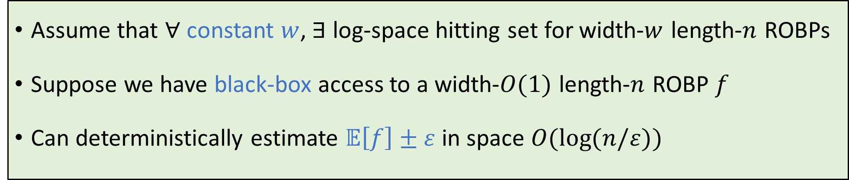
A theorem for constant width (see paper)
Assume that $∀$ constant $w$, $∃$ log-space hitting set for width-$w$ length‑$n$ ROBPs
Suppose we have black-box access to a width-$O(1)$ length-$n$ ROBP $f$
Can deterministically estimate $𝔼\left[f\right]±ε$ in space $O(\log{(n/ε))}$

Slide 29
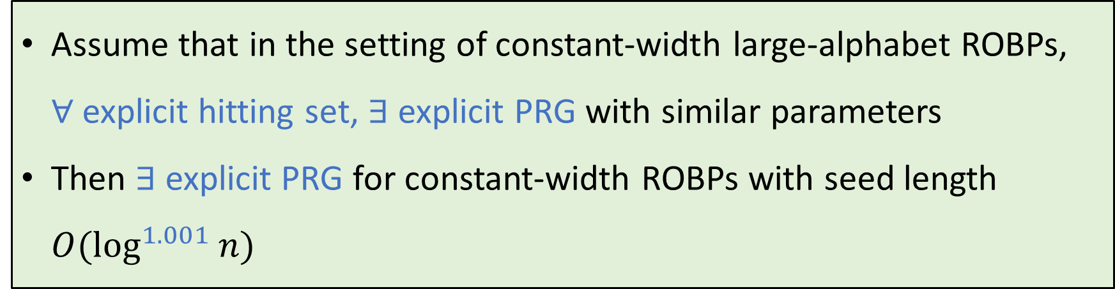
A barrier (see paper)
Assume that in the setting of constant-width large-alphabet ROBPs, $∀$explicit hitting set, $∃$ explicit PRG with similar parameters
Then $∃$explicit PRG for constant-width ROBPs with seed length $O(\log^{1.001}{n)}$
Interpretation: Probably not wise to try to prove “hitting set $⇒$ PRG”

Slide 30
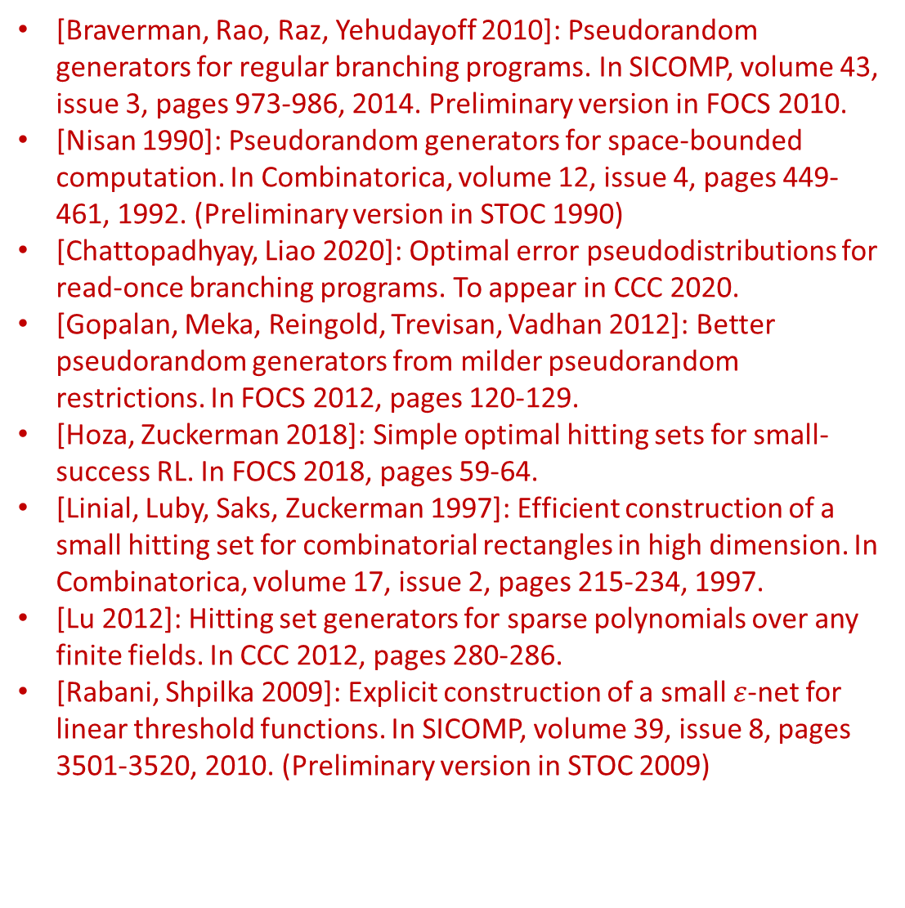

Conclusions
[Braverman, Rao, Raz, Yehudayoff 2010]: Pseudorandom generators for regular branching programs. In SICOMP, volume 43, issue 3, pages 973-986, 2014. Preliminary version in FOCS 2010.
[Nisan 1990]: Pseudorandom generators for space-bounded computation. In Combinatorica, volume 12, issue 4, pages 449-461, 1992. (Preliminary version in STOC 1990)
[Chattopadhyay, Liao 2020]: Optimal error pseudodistributions for read-once branching programs. To appear in CCC 2020.
[Gopalan, Meka, Reingold, Trevisan, Vadhan 2012]: Better pseudorandom generators from milder pseudorandom restrictions. In FOCS 2012, pages 120-129.
[Hoza, Zuckerman 2018]: Simple optimal hitting sets for small-success RL. In FOCS 2018, pages 59-64.
[Linial, Luby, Saks, Zuckerman 1997]: Efficient construction of a small hitting set for combinatorial rectangles in high dimension. In Combinatorica, volume 17, issue 2, pages 215-234, 1997.
[Lu 2012]: Hitting set generators for sparse polynomials over any finite fields. In CCC 2012, pages 280-286.
[Rabani, Shpilka 2009]: Explicit construction of a small $ε$-net for linear threshold functions. In SICOMP, volume 39, issue 8, pages 3501-3520, 2010. (Preliminary version in STOC 2009)
Open problems (more in paper):
Does $\text{L}=\text{RL}$ imply $\text{L}=\text{BPL}?$
Does $\text{L}=\text{NL}$ imply $\text{L}=\text{BPL}$?
Thanks for watching!
Contact us if you have questions!
References
[Andreev, Clementi, Rolim 1996]: Hitting sets derandomize BPP. In ICALP 1996, pages 357-368.
[Braverman, Cohen, Garg 2018]: Pseudorandom pseudodistributions with near-optimal error for read-once branching programs. In SICOMP Special Section for STOC 2018, pages 242-299. (Preliminary version in STOC 2018)

