Slide 1



Pseudorandom Generators for Unbounded-Width Permutation Branching Programs
ITCS 2021
William M. Hoza¹
University of Texas at Austin
whoza@utexas.edu
Edward Pyne²
Harvard University
epyne@college.harvard.edu
Salil Vadhan³
Harvard University
salil_vadhan@harvard.edu
¹Supported by the NSF GRFP under Grant DGE-1610403 and by a Harrington Fellowship from UT Austin.
²Supported by NSF grant CCF-1763299.
³Supported by NSF grant CCF-1763299 and a Simons Investigator Award.

Slide 2

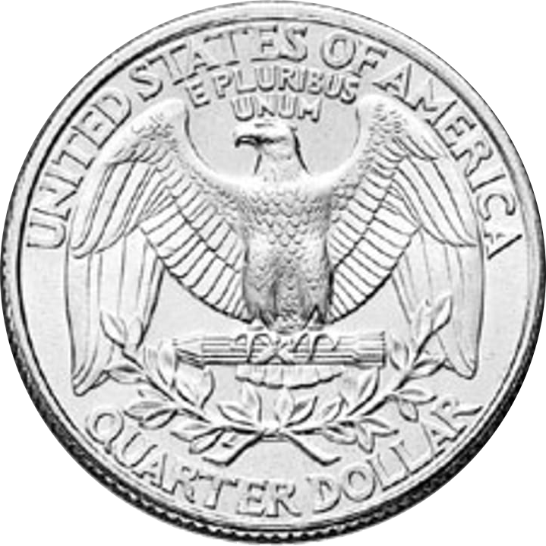
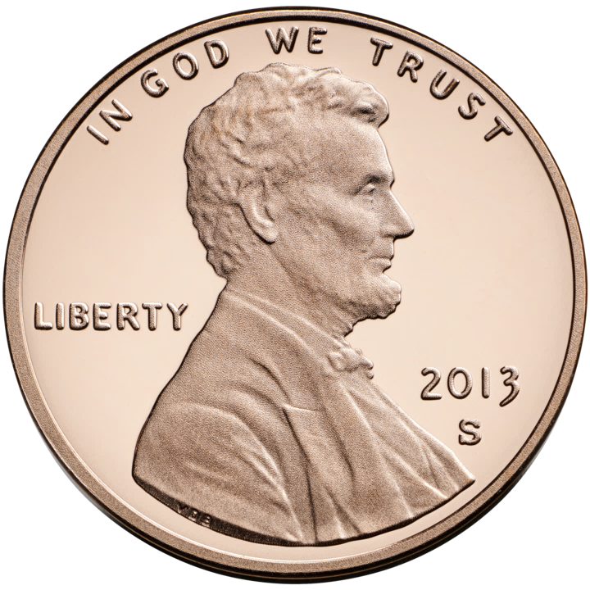

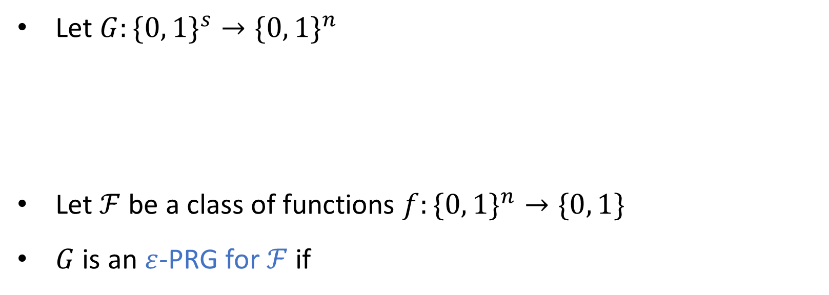
Pseudorandom generators (PRGs)
Let $G:\{0, 1\}^{s}→\{0, 1\}^{n}$
Let $ℱ$ be a class of functions $f:\{0, 1\}^{n}→\{0, 1\}$
$G$ is an $ε$-PRG for $ℱ$ if
$$∀f∈ℱ, \left|\operatorname{Pr}\left[f\left(G\left(U_{s}\right)\right)=1\right]−Pr⁡[f\left(U_{n}\right)=1]\right|≤ε$$

Slide 3














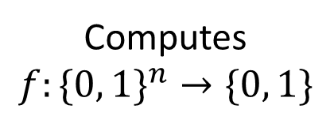
Ordered branching programs (BPs)
$$x=$$
$$1$$
$$0$$
$$0$$
$$1$$
$$0$$
$$1$$
0
1
$$v_{\text{acc}}$$
$$v_{\text{start}}$$
1
0
1
Computes
$$f:\{0, 1\}^{n}→\{0, 1\}$$
Width
0
1
1
0
0
0
1
$$V_{0}$$
$$V_{1}$$
$$V_{2}$$
$$⋯$$
$$V_{n}$$

Slide 4

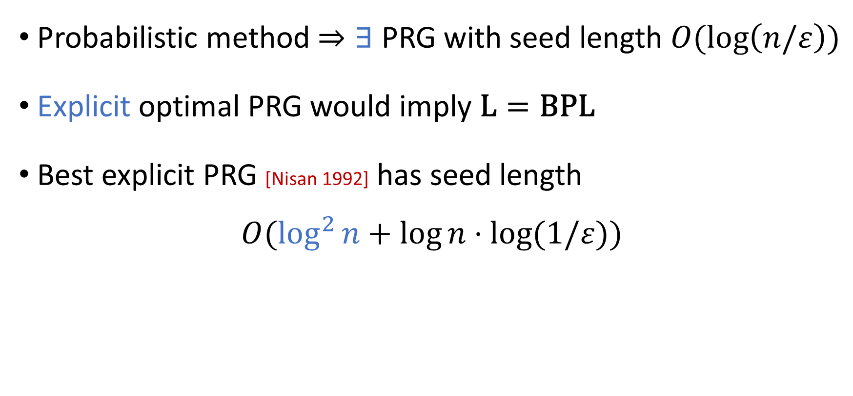
PRGs for width-$n$ length-$n$ ordered BPs
Probabilistic method $⇒∃$ PRG with seed length $O(\log\left(n/ε\right))$
Explicit optimal PRG would imply $\text{L}=\text{BPL}$
Best explicit PRG [Nisan 1992] has seed length
$$O(\log^{2}{n}+\log{n}⋅log⁡(1/ε))$$

Slide 5
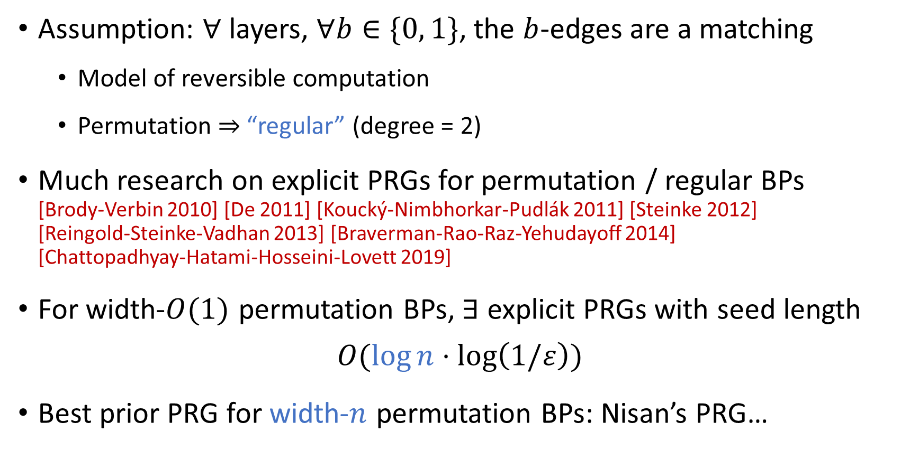
Permutation branching programs
Assumption: $∀$ layers, $∀b∈\{0, 1\}$, the $b$-edges are a matching
Model of reversible computation
Permutation $⇒$ “regular” (degree = 2)
Much research on explicit PRGs for permutation / regular BPs [Brody‑Verbin 2010] [De 2011] [Koucký-Nimbhorkar-Pudlák 2011] [Steinke 2012] [Reingold‑Steinke-Vadhan 2013] [Braverman-Rao-Raz-Yehudayoff 2014] [Chattopadhyay‑Hatami‑Hosseini-Lovett 2019]
For width-$O(1)$ permutation BPs, $∃$ explicit PRGs with seed length
$$O(\log{n}⋅\log\left(1/ε\right))$$
Best prior PRG for width-$n$ permutation BPs: Nisan’s PRG…
0
0
0
0
0

Slide 6

Unbounded-width permutation BPs
Let’s go all the way to unbounded $w$. Unlimited space complexity!
Theorem: $∃$ explicit $ε$-PRG (the INW PRG) for unbounded-width permutation BPs with seed length
$$\tilde{O}\left(\log{n}⋅\log\left(1/ε\right)\right).$$
Assumption: only one accept vertex
Only previous result: Seed length $O\left(\log^{2}{n}+\log{n}⋅\log\left(1/ε\right)\right)$ [De 2011]
Proof concepts: Derandomized square [Rozenman-Vadhan 2005] and unit-circle approximation [Ahmadinejad-Kelner-Murtagh-Peebles-Sidford-Vadhan 2020]

Slide 7
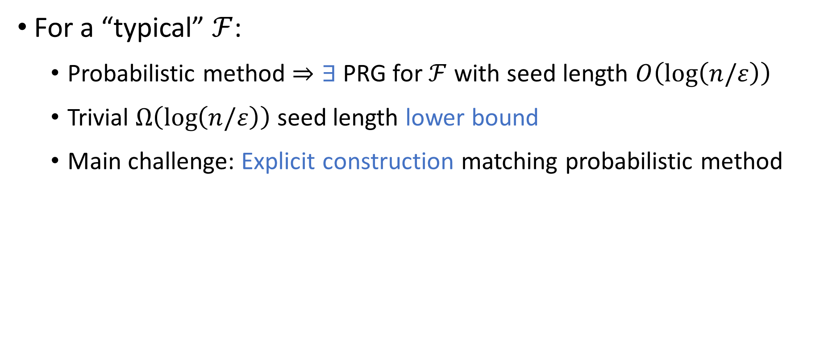
Context: Typical PRG methodology
For a “typical” $ℱ$:
Probabilistic method $⇒∃$ PRG for $ℱ$ with seed length $O\left(\log\left(n/ε\right)\right)$
Trivial $Ω\left(\log\left(n/ε\right)\right)$ seed length lower bound
Main challenge: Explicit construction matching probabilistic method

Slide 8
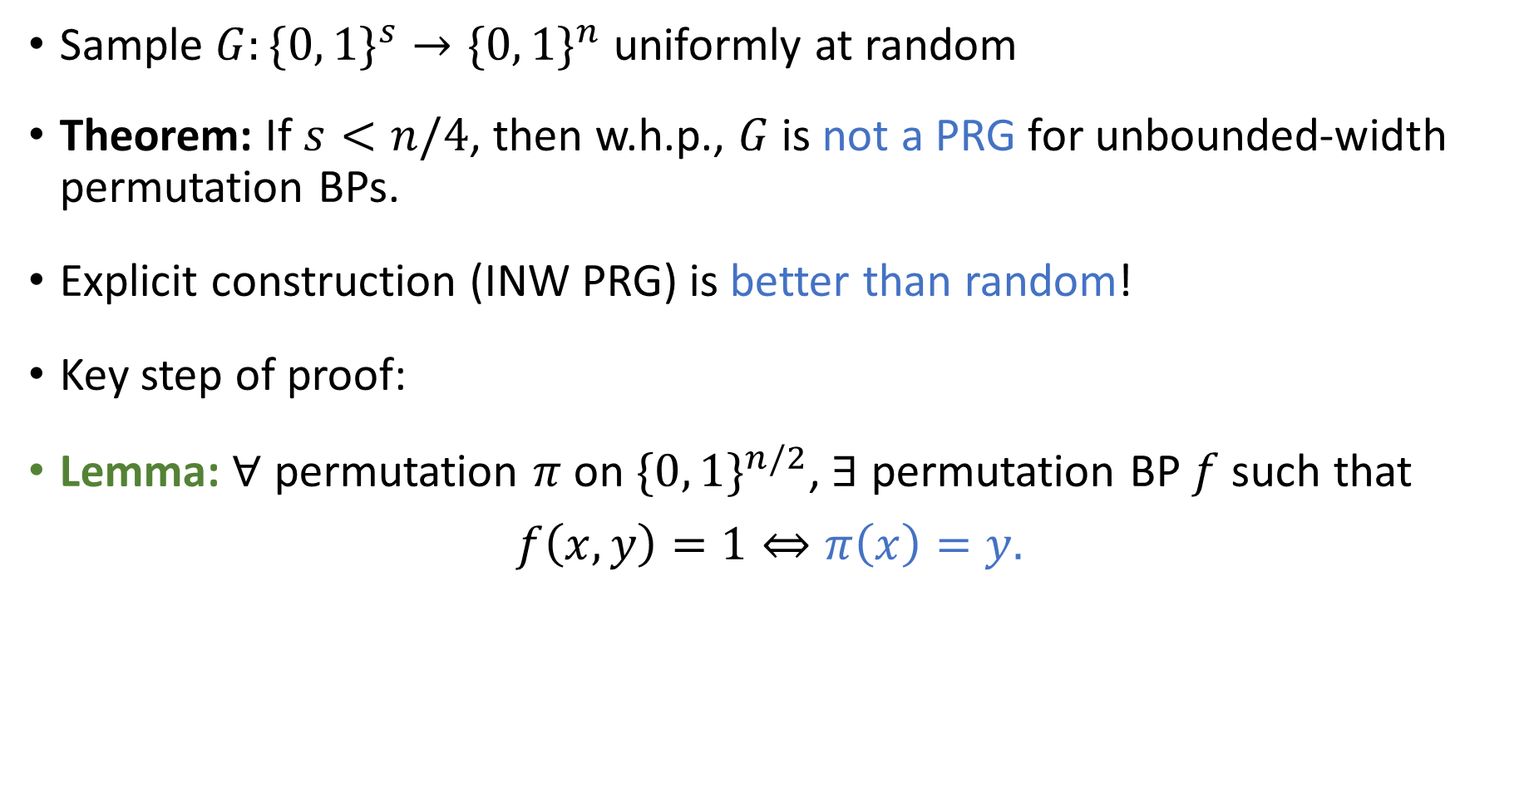
Failure of probabilistic method
Sample $G:\{0, 1\}^{s}→\{0, 1\}^{n}$ uniformly at random
Theorem: If $s<n/4$, then w.h.p., $G$ is not a PRG for unbounded-width permutation BPs.
Explicit construction (INW PRG) is better than random!
Key step of proof:
Lemma: $∀$ permutation $π$ on $\{0, 1\}^{n/2}$, $∃$ permutation BP $f$ such that
$$f\left(x, y\right)=1⇔π\left(x\right)=y.$$

Slide 9
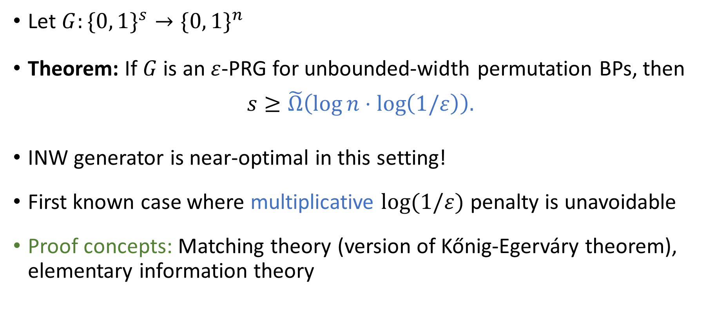
Seed length lower bound
Let $G:\{0, 1\}^{s}→\{0, 1\}^{n}$
Theorem: If $G$ is an $ε$-PRG for unbounded-width permutation BPs, then
$$s≥\tilde{Ω}\left(\log{n}⋅\log\left(1/ε\right)\right).$$
INW generator is near-optimal in this setting!
First known case where multiplicative $log⁡(1/ε)$ penalty is unavoidable
Proof concepts: Matching theory (version of Kőnig-Egerváry theorem), elementary information theory

Slide 10
Conclusions
Unbounded-width permutation BPs show limits of standard intuitions
Might serve as useful counterexamples
PRGs for unbounded-width regular BPs?
PRGs for unbounded-width arbitrary-order permutation BPs?
Thanks for listening!

