Slide 1
Pseudorandom Generators and Small-Space Derandomization
Simons Institute Meet the Fellows Welcome Event
September 8, 2021
🎲
William M. Hoza
williamhoza@berkeley.edu

Slide 2
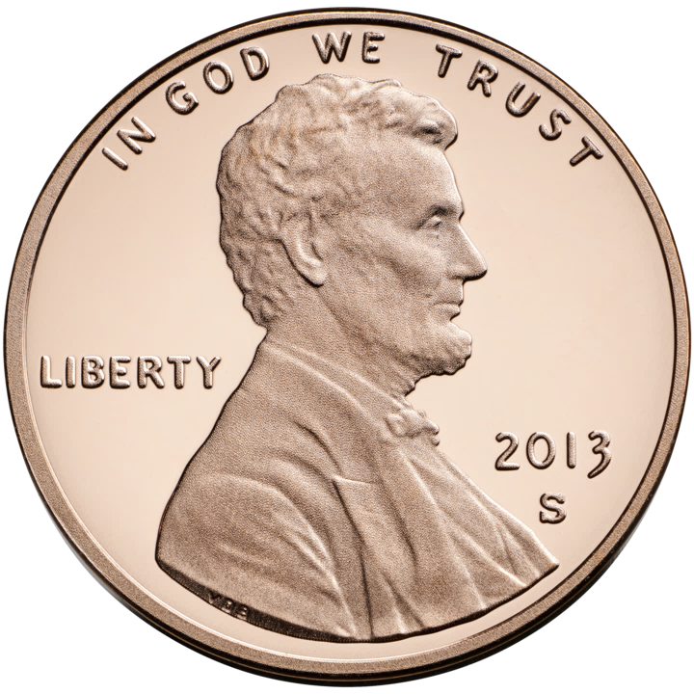



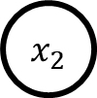
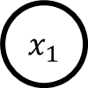
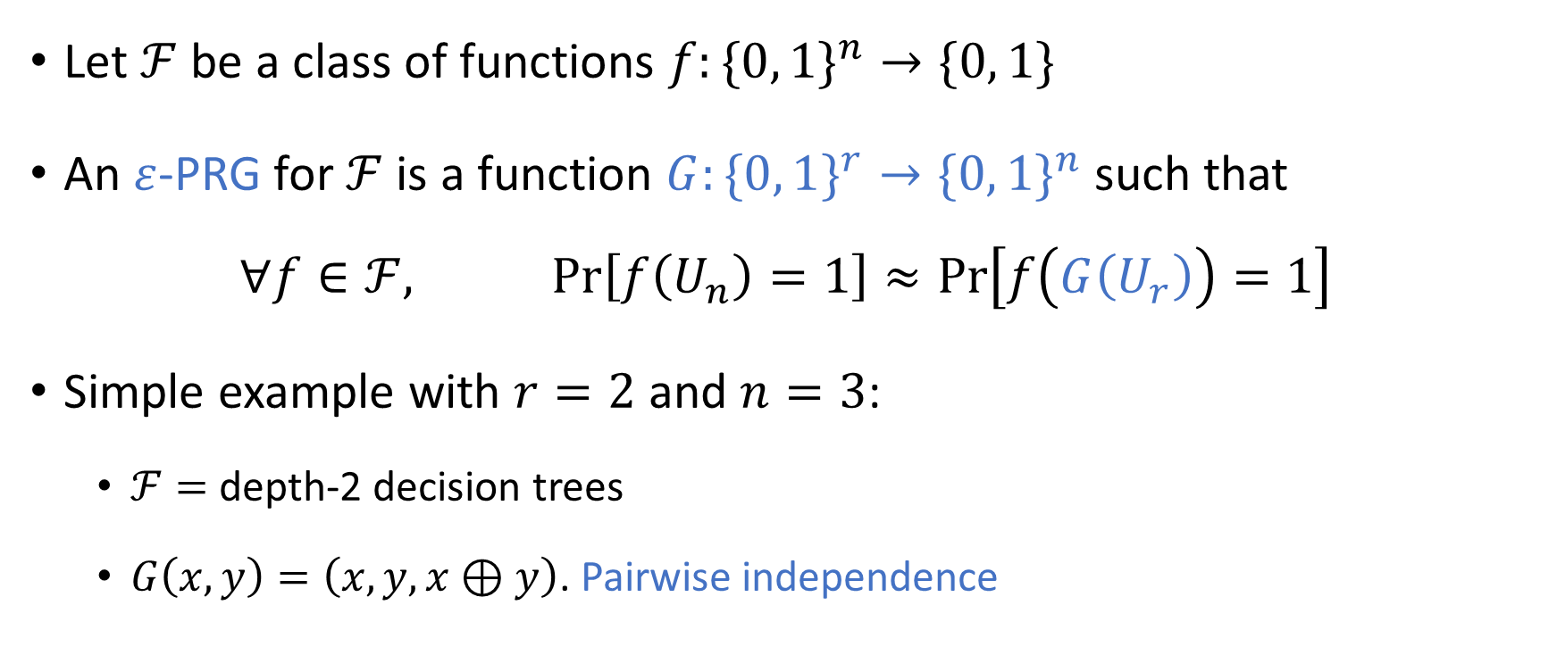
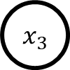
Pseudorandom generators (PRGs)
Let $ℱ$ be a class of functions $f:\{0, 1\}^{n}→\{0, 1\}$
An $ε$-PRG for $ℱ$ is a function $G:\{0, 1\}^{r}→\{0, 1\}^{n}$ such that
$$∀f∈ℱ, \operatorname{Pr}\left[f\left(U_{n}\right)=1\right]≈\operatorname{Pr}\left[f\left(G\left(U_{r}\right)\right)=1\right]$$
Simple example with $r=2$ and $n=3$:
$ℱ=$ depth-2 decision trees
$G\left(x,y\right)=\left(x,y,x⊕y\right)$. Pairwise independence
$$x_{1}$$
0
1
$$x_{2}$$
$$x_{3}$$
0
1
0
1
0
1
1
0

Slide 3
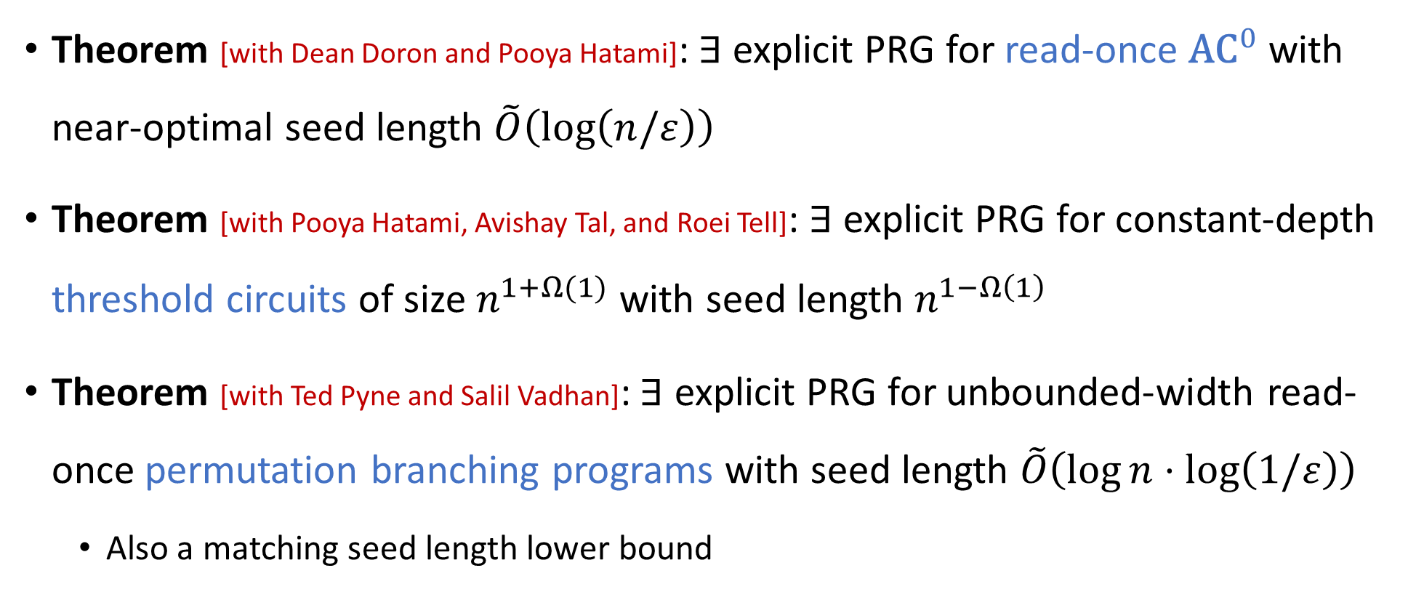
Some examples of my PRG research
Theorem [with Dean Doron and Pooya Hatami]: $∃$ explicit PRG for read-once ${\text{AC}}^{0}$ with near-optimal seed length $\tilde{O}\left(\log\left(n/ε\right)\right)$
Theorem [with Pooya Hatami, Avishay Tal, and Roei Tell]: $∃$ explicit PRG for constant-depth threshold circuits of size $n^{1+Ω(1)}$ with seed length $n^{1−Ω\left(1\right)}$
Theorem [with Ted Pyne and Salil Vadhan]: $∃$ explicit PRG for unbounded-width read-once permutation branching programs with seed length $\tilde{O}\left(\log{n}⋅\log\left(1/ε\right)\right)$
Also a matching seed length lower bound

Slide 4
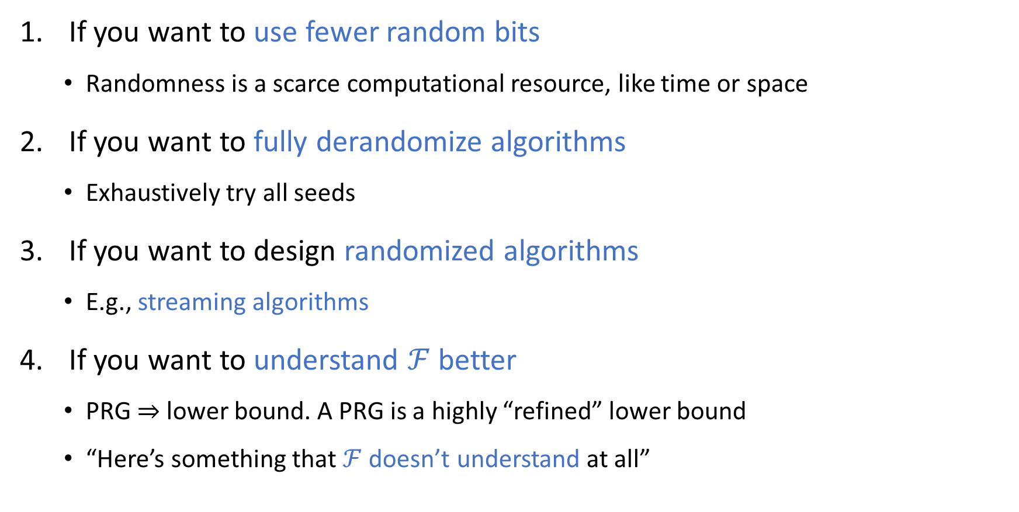
Why study PRGs?
If you want to use fewer random bits
Randomness is a scarce computational resource, like time or space
If you want to fully derandomize algorithms
Exhaustively try all seeds
If you want to design randomized algorithms
E.g., streaming algorithms
If you want to understand $ℱ$ better
PRG $⇒$ lower bound. A PRG is a highly “refined” lower bound
“Here’s something that $ℱ$ doesn’t understand at all”

Slide 5
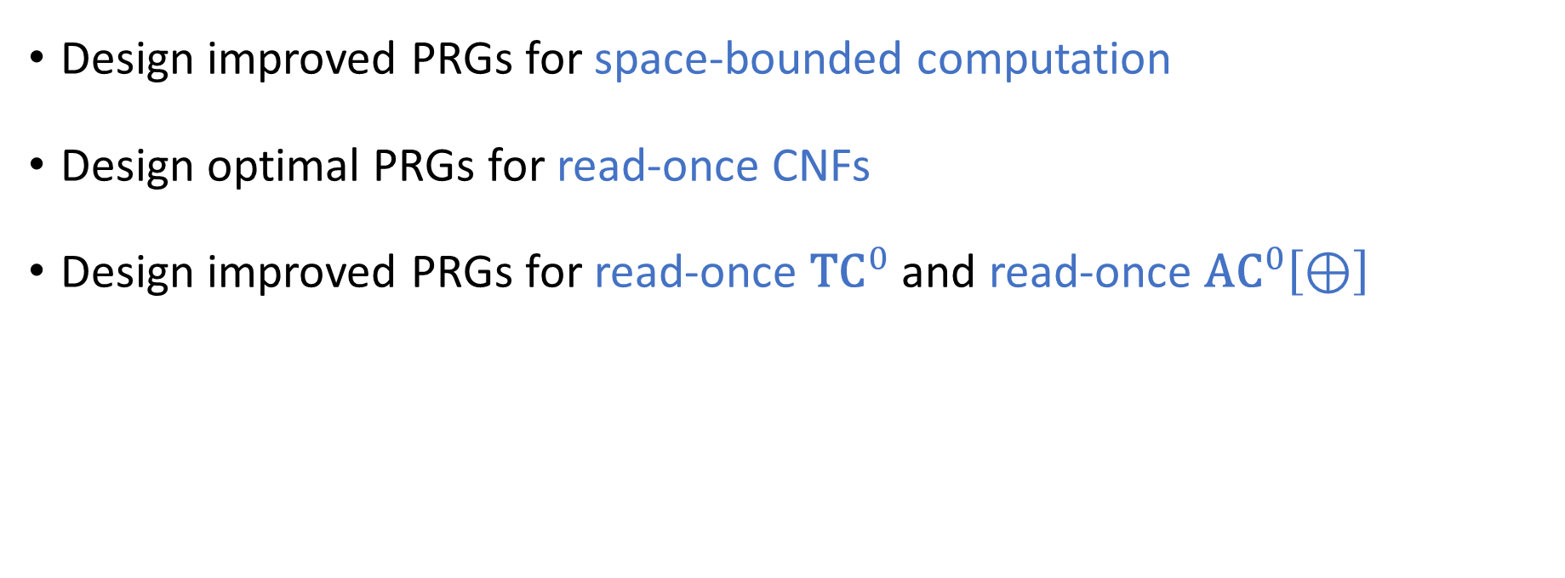
Some open problems about PRGs
Design improved PRGs for space-bounded computation
Design optimal PRGs for read-once CNFs
Design improved PRGs for read-once ${\text{TC}}^{0}$ and read-once ${\text{AC}}^{0}\left[⊕\right]$

Slide 6

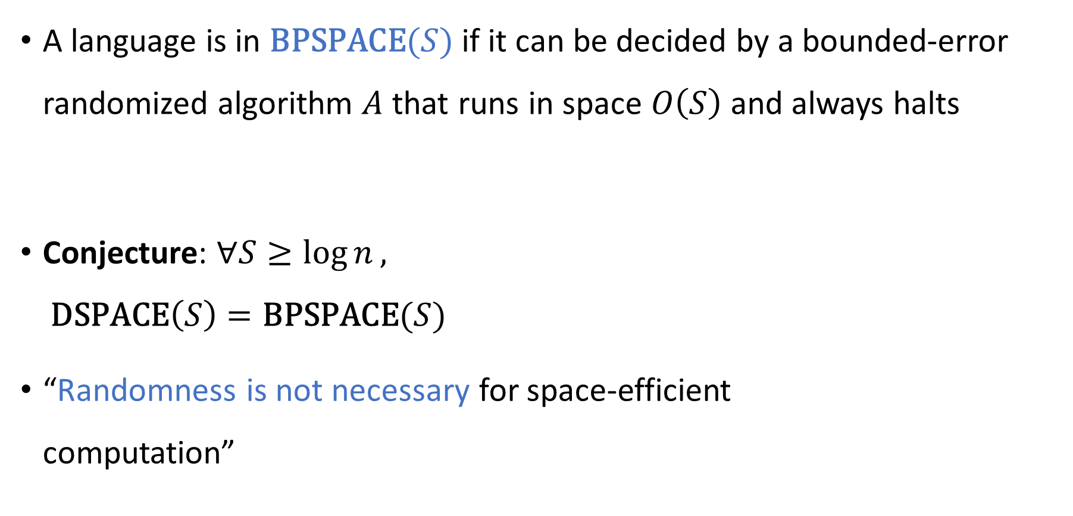
Small-space derandomization
A language is in $\text{BPSPACE}(S)$ if it can be decided by a bounded-error randomized algorithm $A$ that runs in space $O\left(S\right)$ and always halts
Conjecture: $∀S≥\log{n},$ $\text{DSPACE}\left(S\right)=\text{BPSPACE}(S)$
“Randomness is not necessary for space-efficient computation”

Slide 7
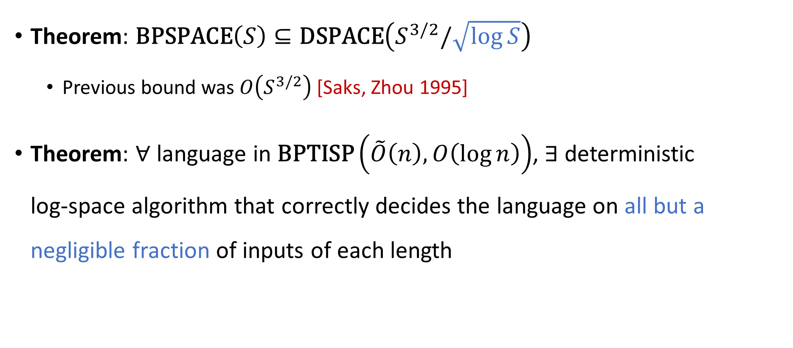
Some examples of my derandomization research
Theorem: $\text{BPSPACE}\left(S\right)⊆\text{DSPACE}\left(S^{3/2}/\sqrt{\log{S}}\right)$
Previous bound was $O\left(S^{3/2}\right)$ [Saks, Zhou 1995]
Theorem: $∀$ language in $\text{BPTISP}\left(\tilde{O}\left(n\right), O\left(\log{n}\right)\right)$, $∃$ deterministic log-space algorithm that correctly decides the language on all but a negligible fraction of inputs of each length

Slide 8
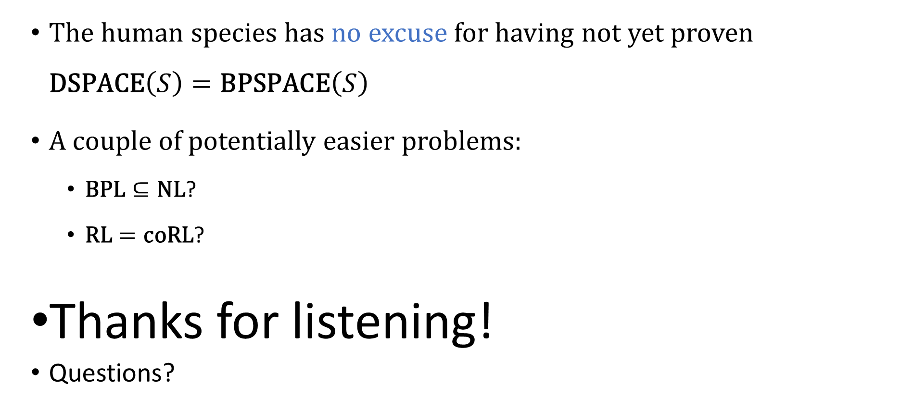
Conclusions
The human species has no excuse for having not yet proven $\text{DSPACE}\left(S\right)=\text{BPSPACE}\left(S\right)$
A couple of potentially easier problems:
$\text{BPL}⊆\text{NL}$?
$\text{RL}=\text{coRL}$?
Thanks for listening!
Questions?

