Slide 1
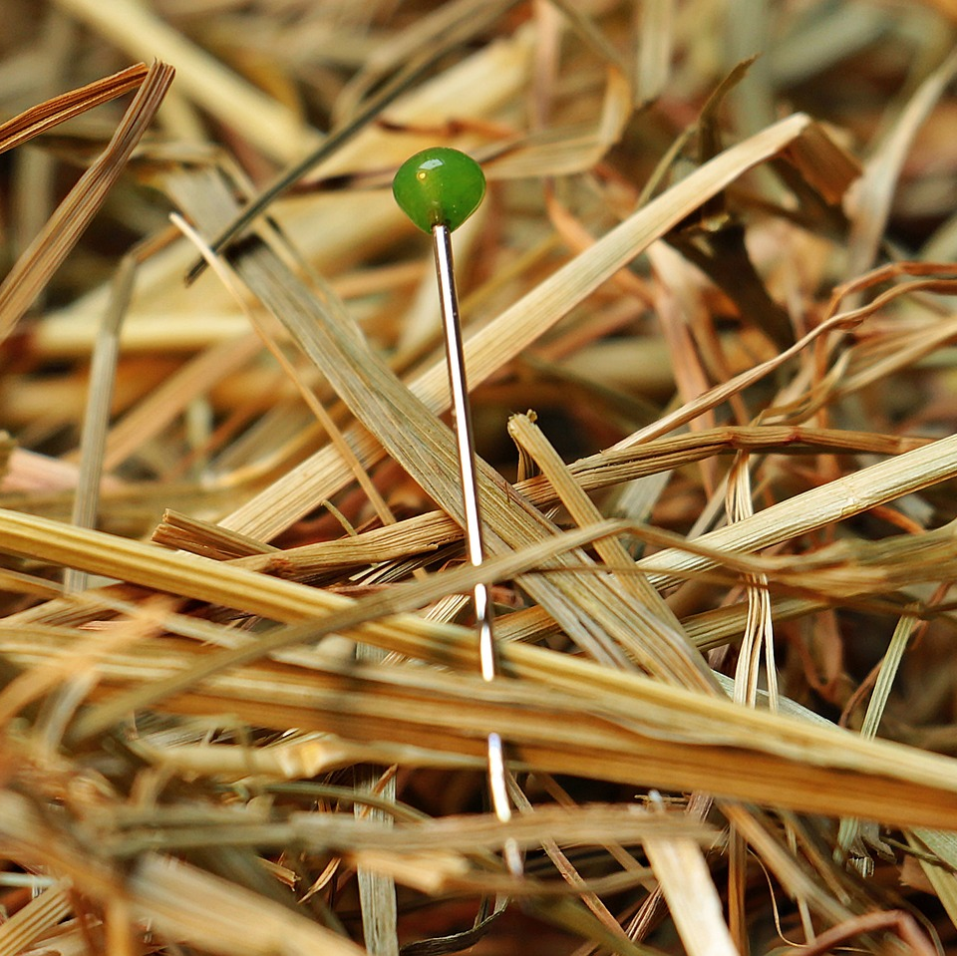
CMSC 28100 Introduction to Complexity Theory Spring 2025 Instructor: William Hoza

Slide 2









The complexity class $\text{PSIZE}$
$$∨$$
$$∧$$
$$∧$$
$$¬$$
$$¬$$
$$x_{1}$$
$$x_{2}$$
Let $Y⊆{\left\{0, 1\right\}}^{∗}$
By definition, $Y∈\text{PSIZE}$ if for each $n$, there exists a $\text{poly}\left(n\right)$-size circuit $C_{n}$ that decides $Y$ restricted to inputs of length $n$

Slide 3
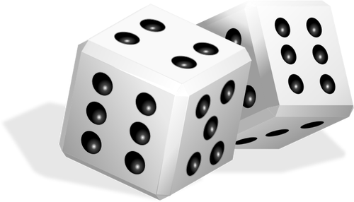

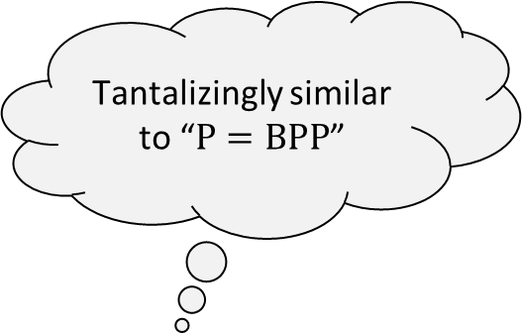




Adleman’s theorem
$$\text{PSIZE}$$
Tantalizingly similar to “$\text{P}=\text{BPP}$”
$$\text{BPP}$$
Last class: $\text{P}⊆\text{PSIZE}$
Next, we will prove a stronger theorem:
Note: The circuit model is a deterministic model of computation!
Proof of Adleman’s theorem: Next 6 slides
$$\text{P}$$
Adleman’s Theorem: $\text{BPP}⊆\text{PSIZE}$

Slide 4
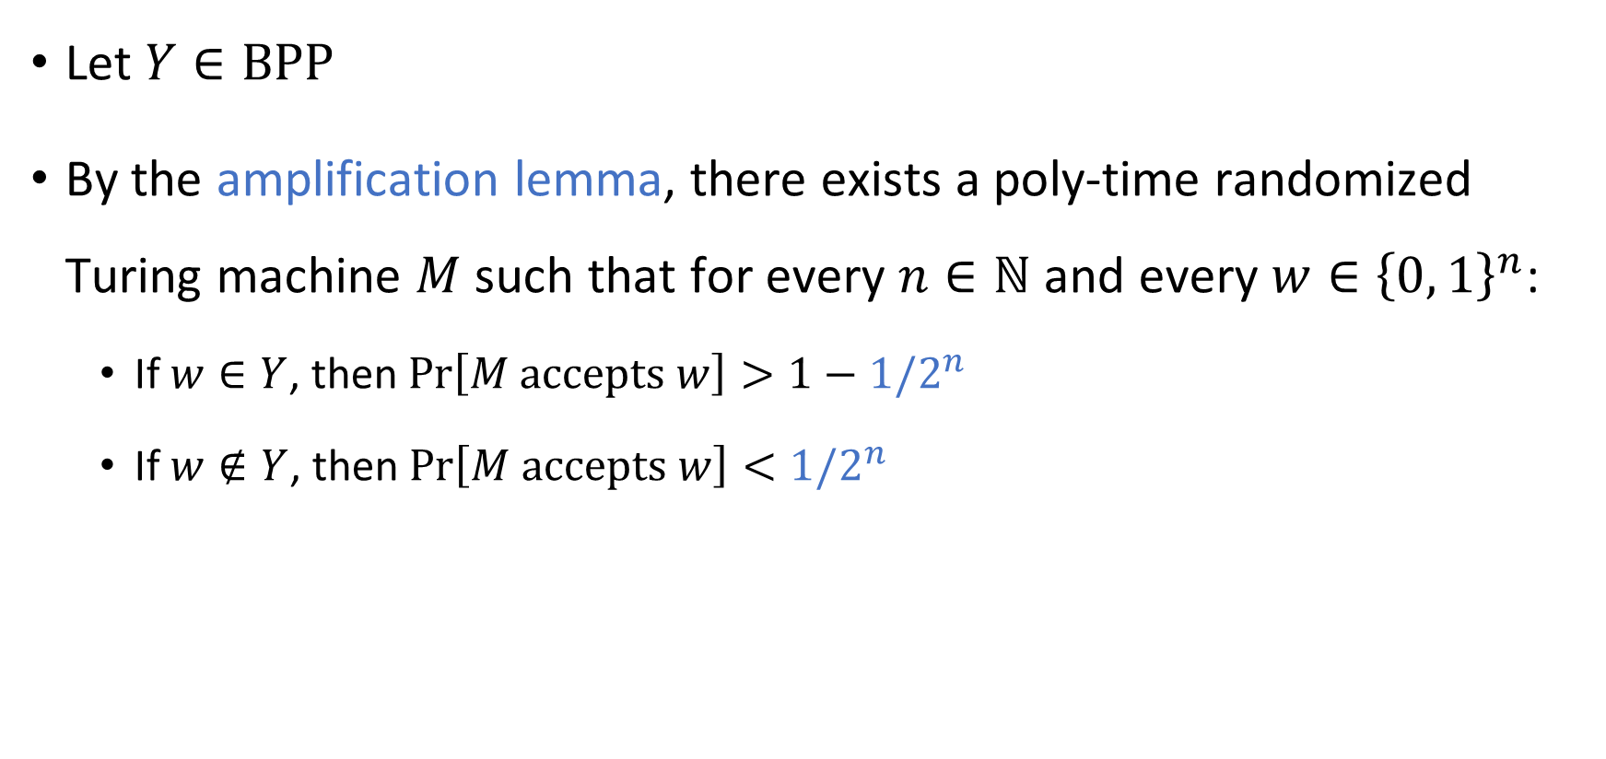
Adleman proof step 1: Amplification
Let $Y∈\text{BPP}$
By the amplification lemma, there exists a poly-time randomized Turing machine $M$ such that for every $n∈ℕ$ and every $w∈{\left\{0, 1\right\}}^{n}$:
If $w∈Y$, then $\operatorname{Pr}\left[M \text{accepts} w\right]>1−1/2^{n}$
If $w∉Y$, then $\operatorname{Pr}\left[M \text{accepts} w\right]<1/2^{n}$

Slide 5



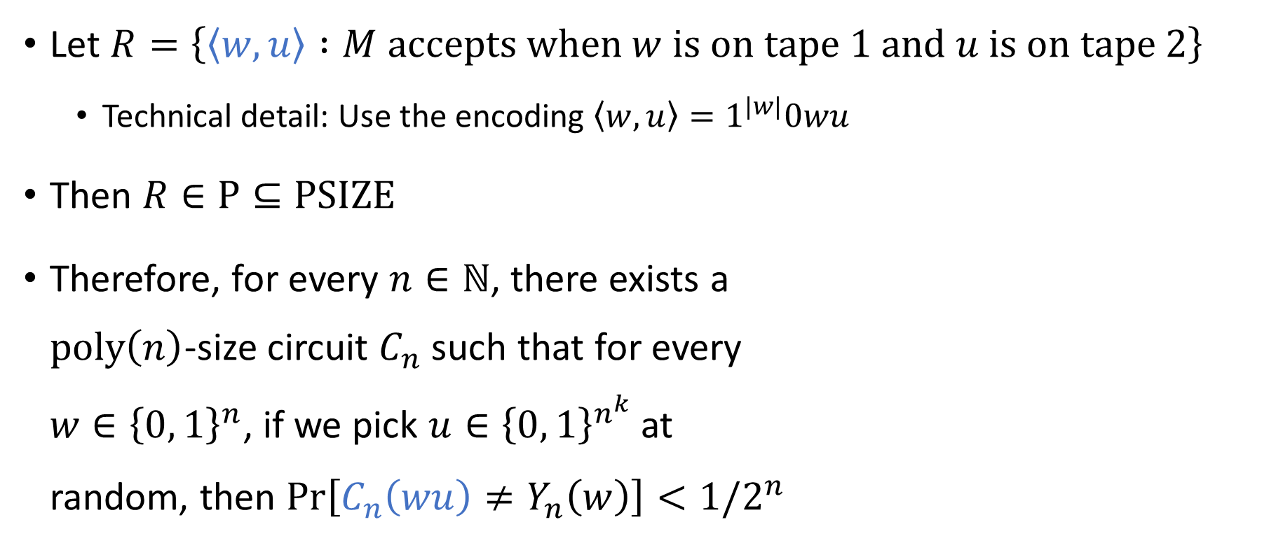












Adleman proof step 2: TM $⇒$ Circuit
Let $R=\left\{\left\langle w,u\right\rangle :M \text{accepts} \text{when} w \text{is} \text{on} \text{tape} \text{1 }\text{and} u \text{is} \text{on} \text{tape} \text{2}\right\}$
Technical detail: Use the encoding $\left\langle w,u\right\rangle =1^{|w|}0wu$
Then $R∈\text{P}⊆\text{PSIZE}$
Therefore, for every $n∈ℕ$, there exists a $\text{poly}\left(n\right)$-size circuit $C_{n}$ such that for every $w∈{\left\{0, 1\right\}}^{n}$, if we pick $u∈{\left\{0, 1\right\}}^{n^{k}}$ at random, then $\text{Pr}\left[C_{n}\left(wu\right)≠Y_{n}\left(w\right)\right]<1/2^{n}$
$$C_{n}$$
$$⋯$$
$$⋯$$
$$⋯$$
$$1$$
$$1$$
$$\left\langle w,u\right\rangle$$
$$u_{2}$$
$$u_{3}$$
$$1$$
$$0$$
$$w_{1}$$
$$w_{2}$$
$$w_{n}$$
$$u_{1}$$
$$u_{n^{k}}$$

Slide 6
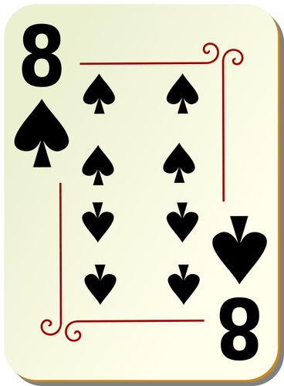
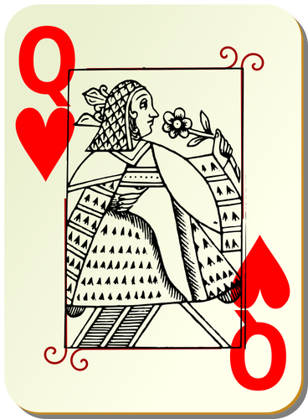
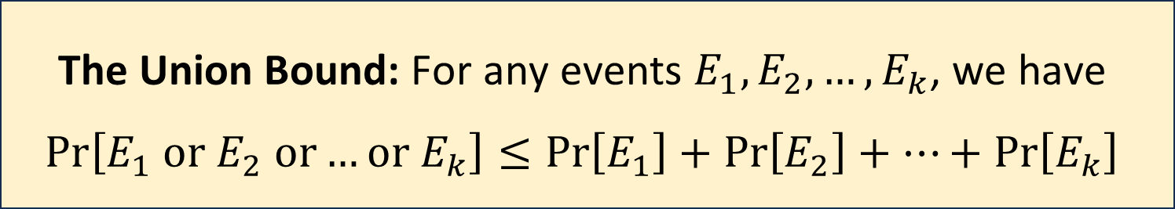

Adleman proof step 3: The union bound
Key fact from probability theory:
Example: If we pick two cards from a deck, then
$\operatorname{Pr}\left[\text{card} \text{1 }\text{is} \text{a} \text{queen} \text{or} \text{card} \text{2 }\text{is} \text{a} \text{queen}\right]≤\frac{1}{13}+\frac{1}{13}=\frac{2}{13}$
The Union Bound: For any events $E_{1},E_{2},…, E_{k}$, we have $$\operatorname{Pr}\left[E_{1} \text{or} E_{2} \text{or}…\text{or} E_{k}\right]≤\operatorname{Pr}\left[E_{1}\right]+\operatorname{Pr}\left[E_{2}\right]+…+\operatorname{Pr}\left[E_{k}\right]$$

Slide 7
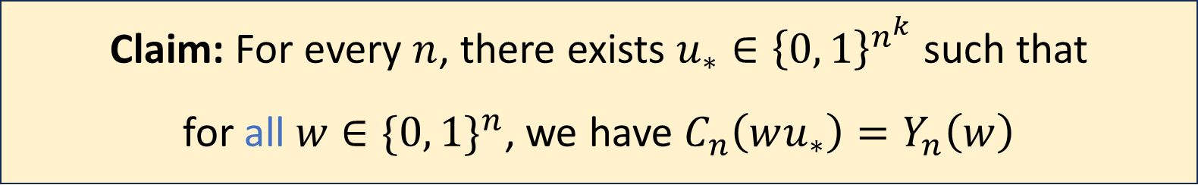
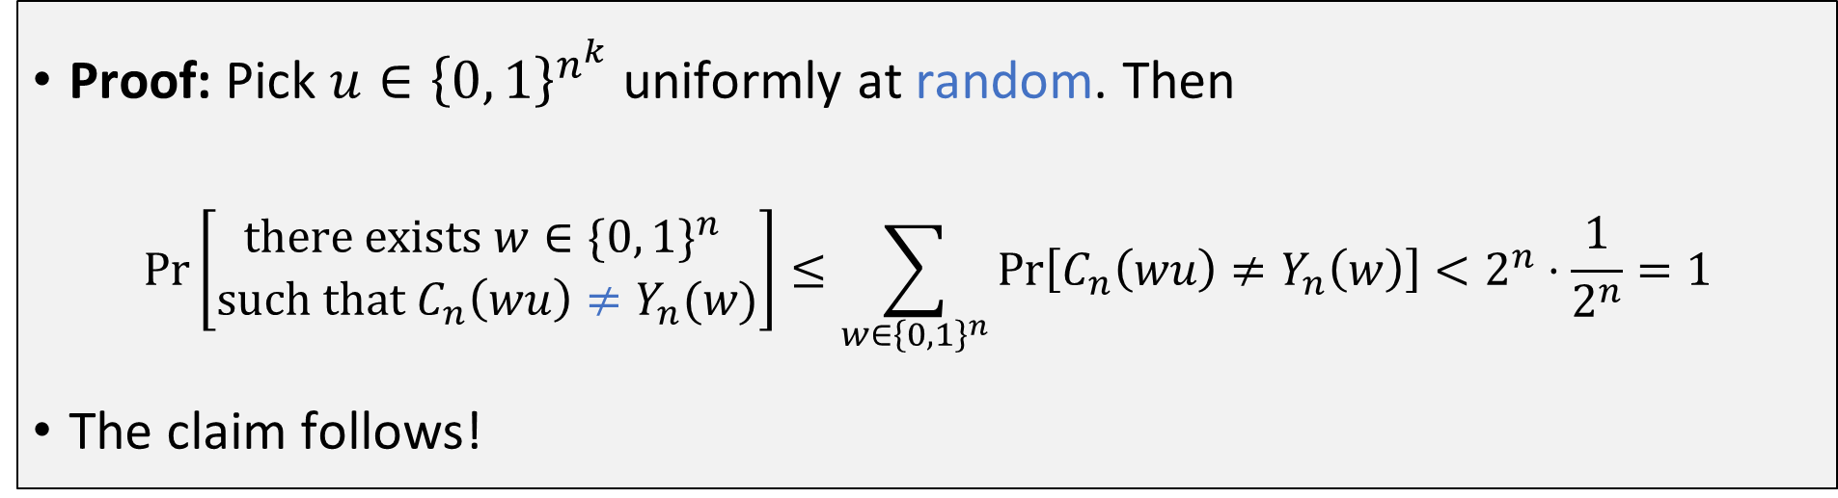
Adleman proof step 3: The union bound
Claim: For every $n$, there exists $u_{∗}∈{\left\{0, 1\right\}}^{n^{k}}$ such that for all $w∈{\{0, 1\}}^{n}$, we have $C_{n}\left(wu_{∗}\right)=Y_{n}\left(w\right)$
Proof: Pick $u∈{\left\{0, 1\right\}}^{n^{k}}$ uniformly at random. Then
$$\operatorname{Pr}\left[\begin{matrix}\text{there} \text{exists} w∈{\{0, 1\}}^{n} \\ \text{such} \text{that} C_{n}\left(wu\right)≠Y_{n}(w)\end{matrix}\right]≤\sum_{w∈{\left\{0, 1\right\}}^{n}}{\operatorname{Pr}\left[C_{n}\left(wu\right)≠Y_{n}\left(w\right)\right]}<2^{n}⋅\frac{1}{2^{n}}=1$$
The claim follows!
Union Bound

Slide 8



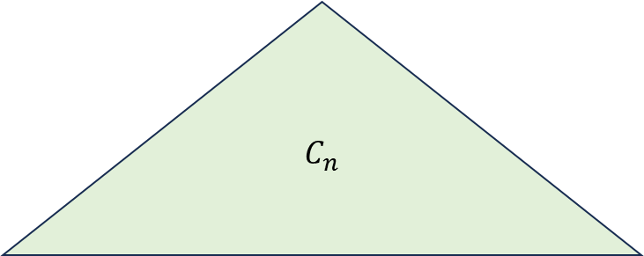

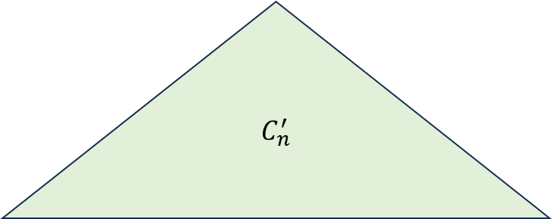
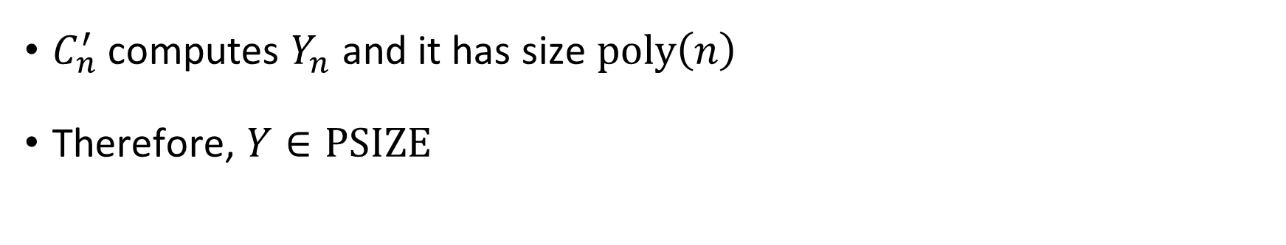











Adleman proof step 4: Hard-coding
$$C_{n}$$
$$C_{n}^{′}$$
$$⋯$$
$$⋯$$
$$⋯$$
$$⋯$$
$$⋯$$
$$⋯$$
$$1$$
$$1$$
$$1$$
$$0$$
$$w_{1}$$
$$w_{2}$$
$$w_{n}$$
$$u_{1}$$
$$u_{2}$$
$$u_{3}$$
$$u_{n^{k}}$$
$$1$$
$$1$$
$$1$$
$$0$$
$$w_{1}$$
$$w_{2}$$
$$w_{n}$$
$$0$$
$$1$$
$$1$$
$$0$$
$u_{∗}$ “hard-coded” into circuit
$C_{n}^{′}$ computes $Y_{n}$ and it has size $\text{poly}\left(n\right)$
Therefore, $Y∈\text{PSIZE}$

Slide 9
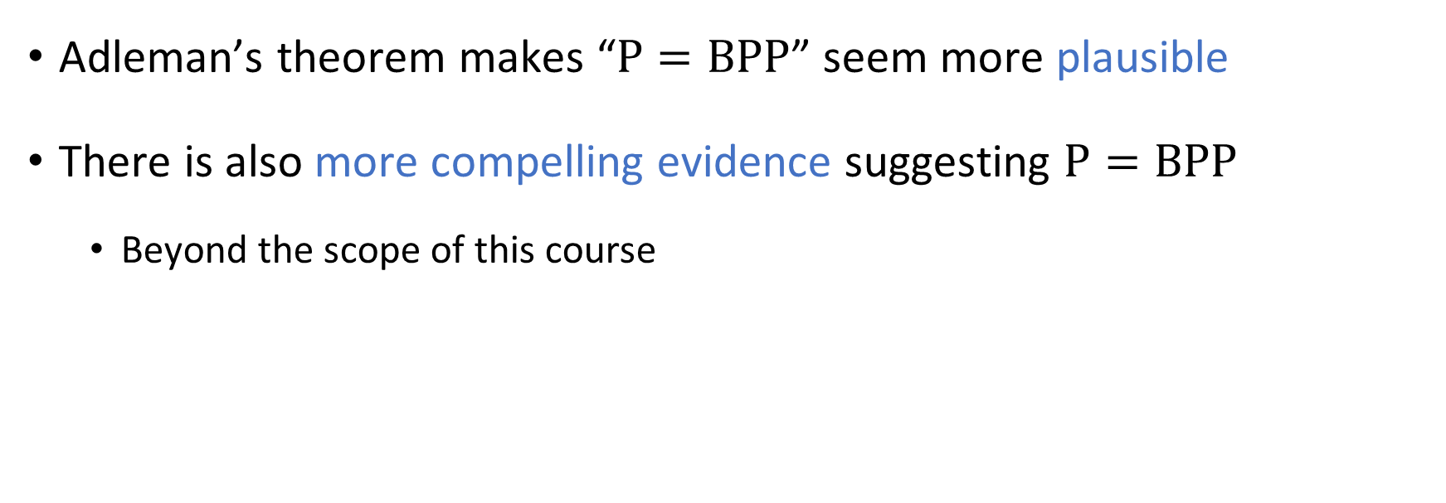
Adleman’s theorem and P vs. BPP
Adleman’s theorem makes “$\text{P}=\text{BPP}$” seem more plausible
There is also more compelling evidence suggesting $\text{P}=\text{BPP}$
Beyond the scope of this course

Slide 10
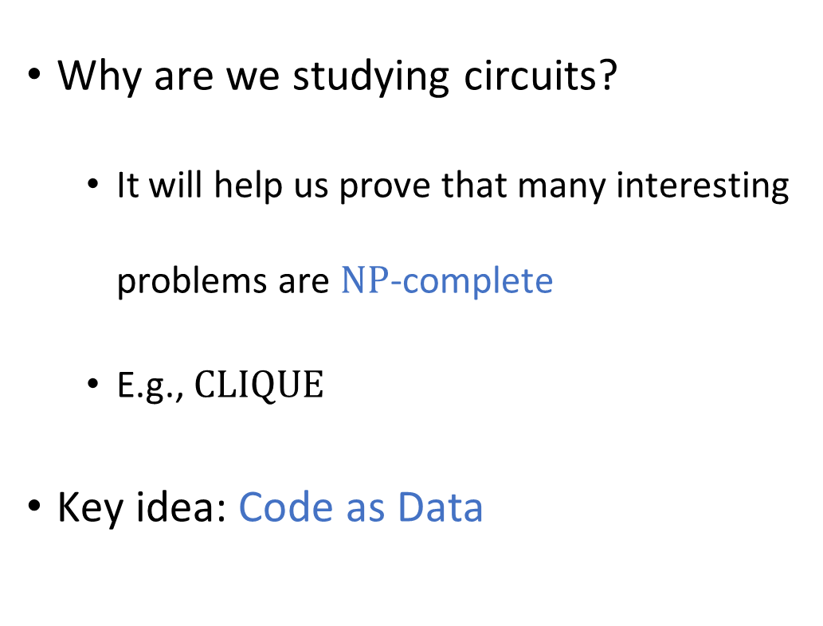





Circuits and $\text{NP}$-completeness
Why are we studying circuits?
It will help us prove that many interesting problems are $\text{NP}$-complete
E.g., $\text{CLIQUE}$
Key idea: Code as Data
$\text{NP}$-hard
$\text{NP}$-complete
$$\text{NP}$$
$$\text{P}$$

Slide 11
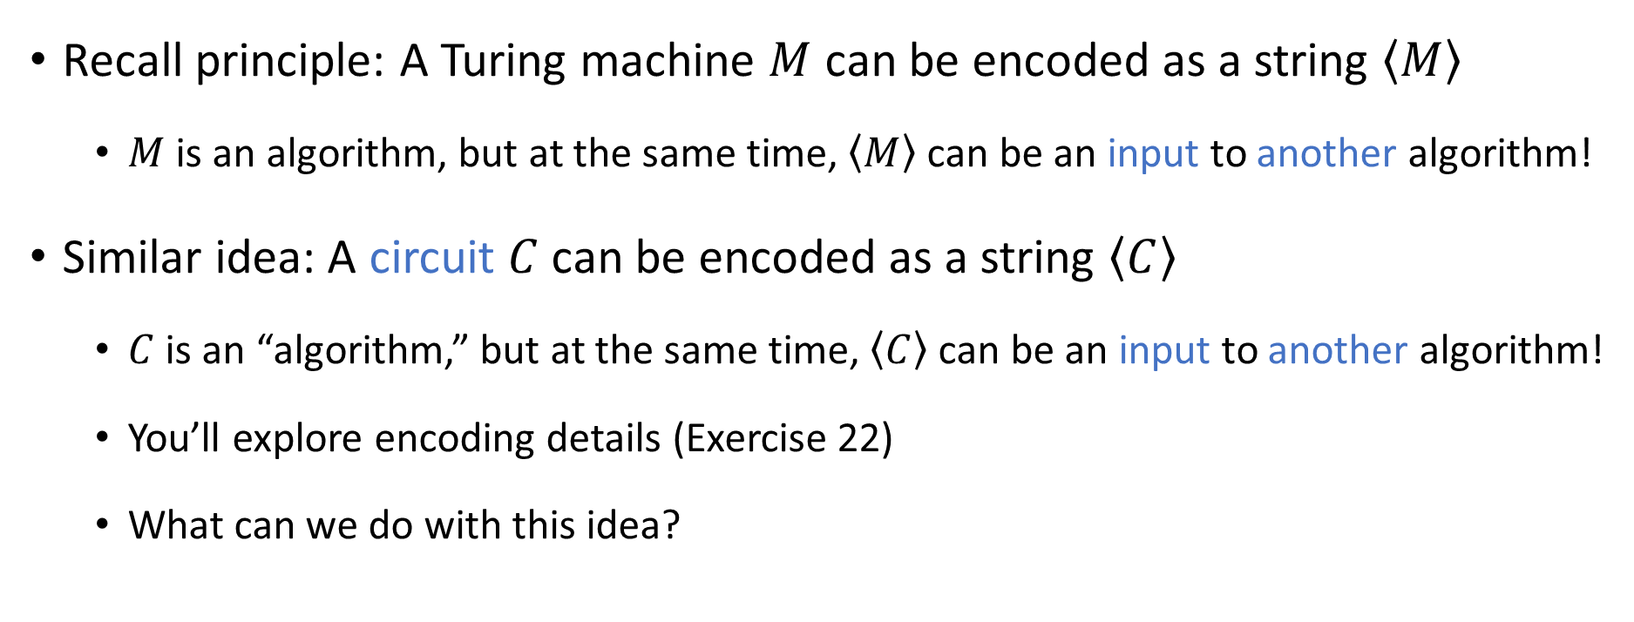
Code as data III
Recall principle: A Turing machine $M$ can be encoded as a string $\left\langle M\right\rangle$
$M$ is an algorithm, but at the same time, $\left\langle M\right\rangle$ can be an input to another algorithm!
Similar idea: A circuit $C$ can be encoded as a string $\left\langle C\right\rangle$
$C$ is an “algorithm,” but at the same time, $\left\langle C\right\rangle$ can be an input to another algorithm!
You’ll explore encoding details (Exercise 22)
What can we do with this idea?

Slide 12
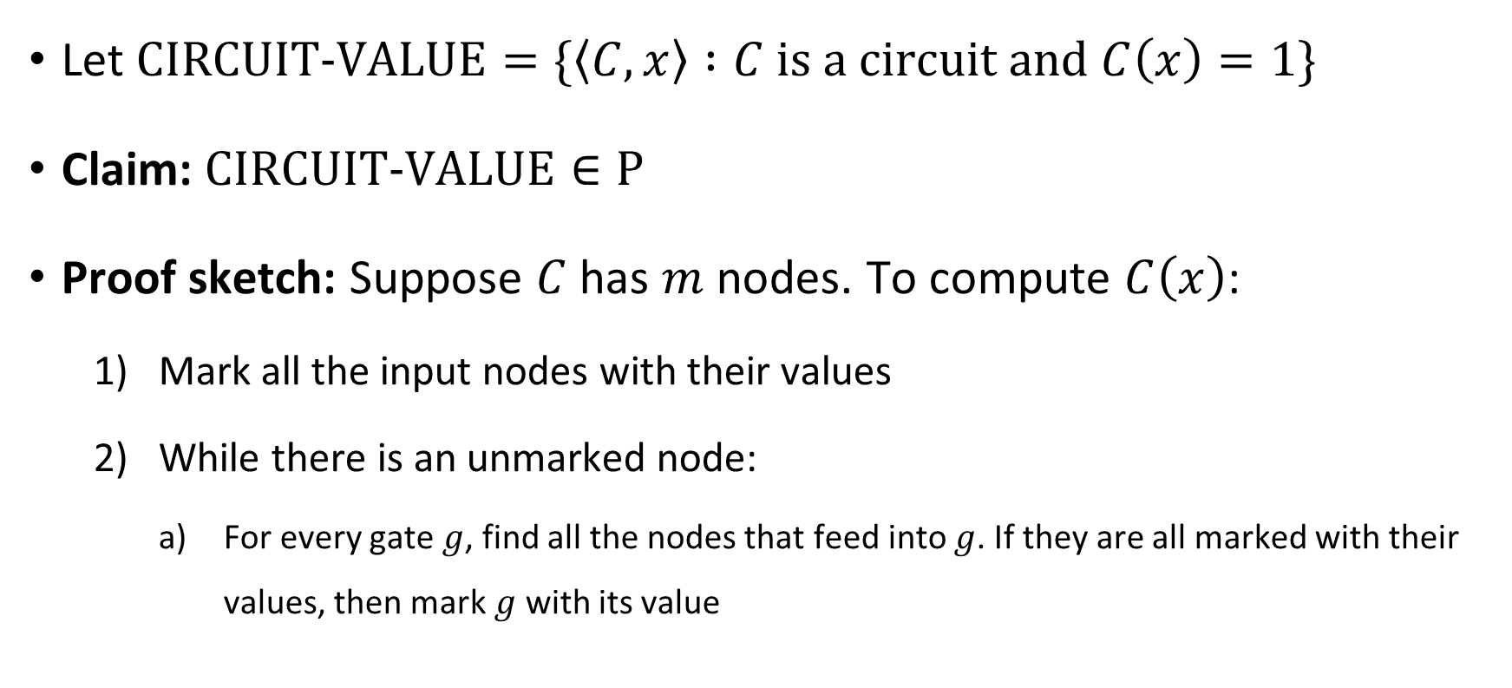
Circuit value problem
Let $\text{CIRCUIT}\text{‑}\text{VALUE}=\{\left\langle C,x\right\rangle :C \text{is} \text{a} \text{circuit} \text{and} C\left(x\right)=1\}$
Claim: $\text{CIRCUIT}\text{‑}\text{VALUE}∈\text{P}$
Proof sketch: Suppose $C$ has $m$ nodes. To compute $C\left(x\right)$:
Mark all the input nodes with their values
While there is an unmarked node:
For every gate $g$, find all the nodes that feed into $g$. If they are all marked with their values, then mark $g$ with its value

Slide 13














Circuit satisfiability
$$∨$$
$$∧$$
$$∧$$
Satisfiable ✔️
$$¬$$
Let $C$ be an $n$-input $1$-output circuit
We say that $C$ is satisfiable if there exists $x∈\{0, 1\}^{n}$ such that $C\left(x\right)=1$
$$x_{1}$$
$$x_{2}$$
$$∨$$
$$∧$$
$$∧$$
$$¬$$
Unsatisfiable ❌
$$¬$$
$$x_{1}$$
$$x_{2}$$

Slide 14



Circuit satisfiability is $\text{NP}$-complete
Let $\text{CIRCUIT}\text{‑}\text{SAT}=\{\left\langle C\right\rangle :C \text{is} \text{a} \text{satisfiable} \text{circuit}\}$
Proof: Next 8 slides
Theorem: $\text{CIRCUIT}\text{‑}\text{SAT}$ is $\text{NP}$-complete.

Slide 15
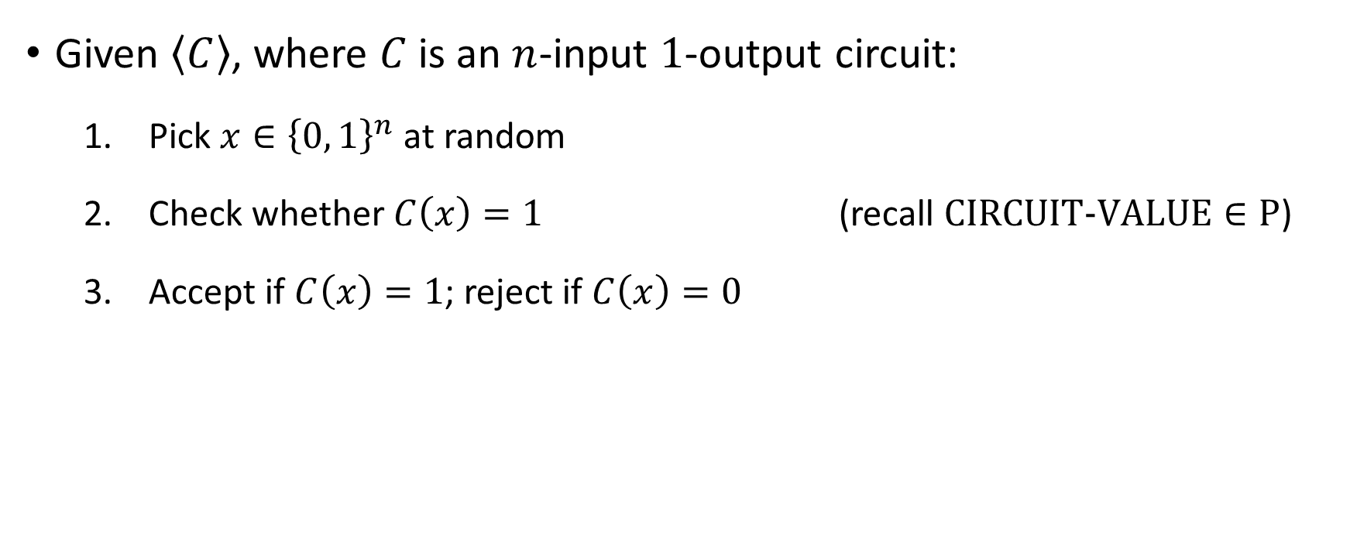

Proof that $\text{CIRCUIT}\text{‑}\text{SAT}∈\text{NP}$
Given $\left\langle C\right\rangle$, where $C$ is an $n$-input $1$-output circuit:
Pick $x∈{\left\{0, 1\right\}}^{n}$ at random
Check whether $C\left(x\right)=1$ (recall $\text{CIRCUIT}\text{‑}\text{VALUE}∈\text{P}$)
Accept if $C\left(x\right)=1$; reject if $C\left(x\right)=0$

Slide 16
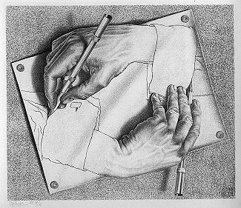
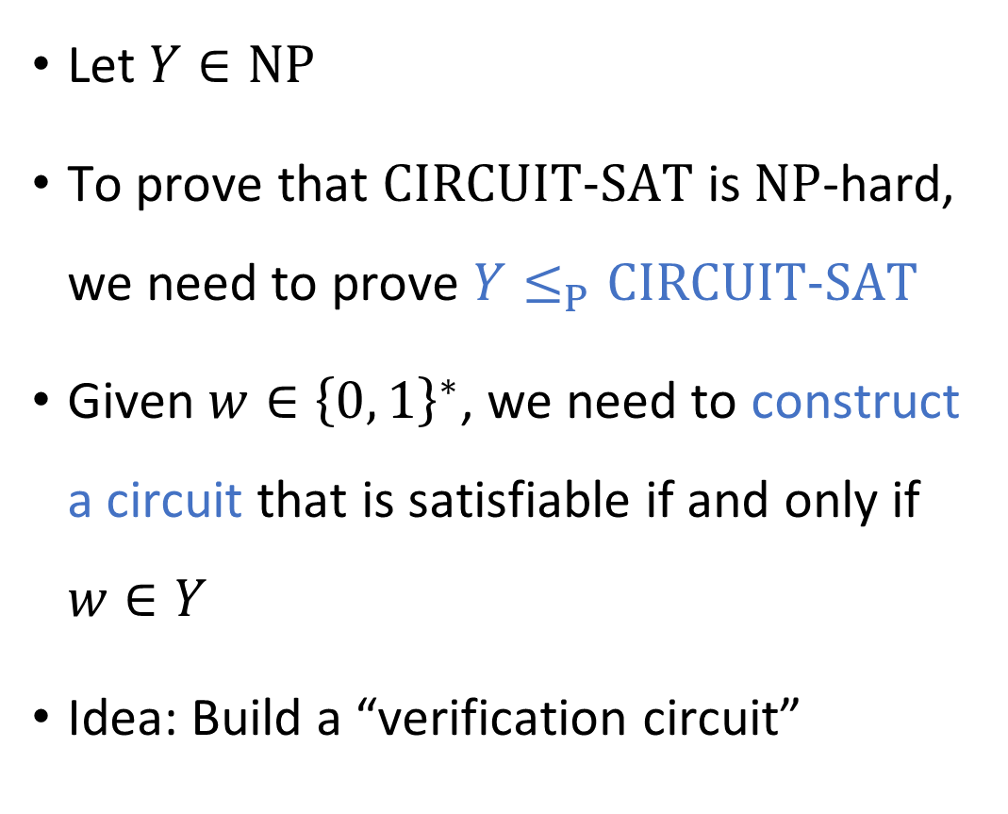
Code as data IV
Let $Y∈\text{NP}$
To prove that $\text{CIRCUIT}\text{‑}\text{SAT}$ is $\text{NP}$-hard, we need to prove $Y≤_{P}\text{CIRCUIT}\text{‑}\text{SAT}$
Given $w∈{\left\{0, 1\right\}}^{∗}$, we need to construct a circuit that is satisfiable if and only if $w∈Y$
Idea: Build a “verification circuit”
“Drawing Hands.”
(1948 lithograph by M. C. Escher)

Slide 17
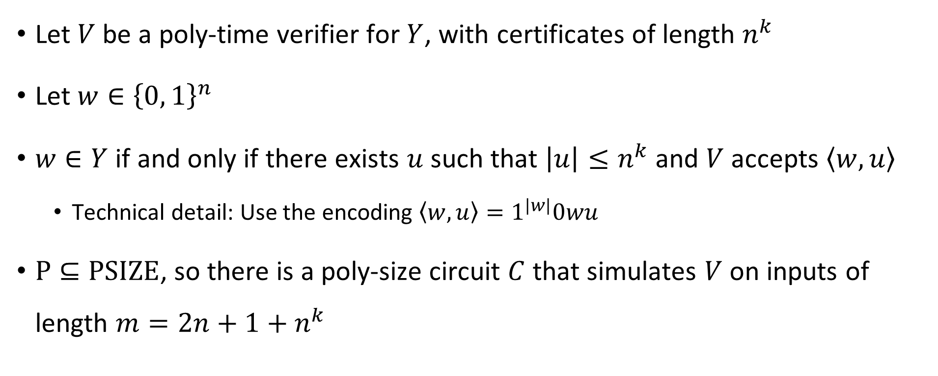
Constructing the verification circuit
Let $V$ be a poly-time verifier for $Y$, with certificates of length $n^{k}$
Let $w∈{\left\{0, 1\right\}}^{n}$
$w∈Y$ if and only if there exists $u$ such that $\left|u\right|≤n^{k}$ and $V$ accepts $\left\langle w,u\right\rangle$
Technical detail: Use the encoding $\left\langle w,u\right\rangle =1^{|w|}0wu$
$\text{P}⊆\text{PSIZE}$, so there is a poly-size circuit $C$ that simulates $V$ on inputs of length $m=2n+1+n^{k}$

Slide 18

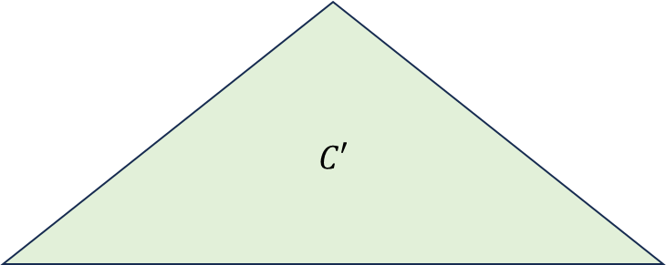

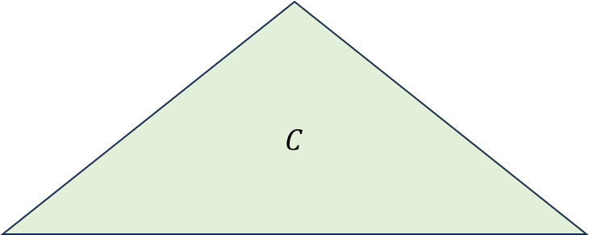


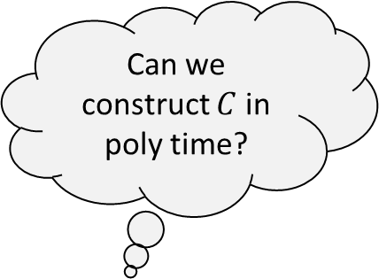
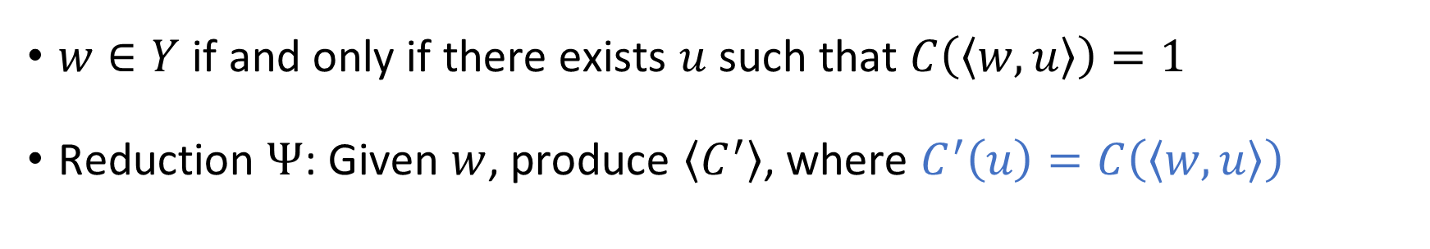












Constructing the verification circuit
$$C$$
$$C′$$
$$⋯$$
$$⋯$$
$$⋯$$
$$⋯$$
$$x_{1}$$
$$x_{2}$$
$$x_{3}$$
$$x_{4}$$
$$x_{5}$$
$$x_{6}$$
$$x_{7}$$
$$x_{m}$$
$$1$$
$$1$$
$$1$$
$$0$$
$$0$$
$$1$$
$$1$$
$$u_{1}$$
$$u_{2}$$
$$u_{3}$$
$$u_{n^{k}}$$
Can we construct $C$ in poly time?
$1^{n}0w$ “hard-coded” into circuit
$w∈Y$ if and only if there exists $u$ such that $C\left(\left\langle w,u\right\rangle \right)=1$
Reduction $Ψ$: Given $w$, produce $\left\langle C^{′}\right\rangle$, where $C^{′}\left(u\right)=C\left(\left\langle w,u\right\rangle \right)$

