Slide 1
CMSC 28100 Introduction to Complexity Theory Winter 2024 Instructor: William Hoza
7 |  |  |  |  |  |  | 5 | 3
 |  |  |  |  |  |  |  | 4
 | 4 | 8 |  | 3 |  | 1 | 2
8 |  | 1 | 3 |  |  | 2 | 7 | 5
 | 9 |  | 1 |  |  |  | 4
 | 5 |  |  |  |  | 3
2 |  | 5 |  | 8 | 4
1 | 3 | 4 |  | 5

Slide 2
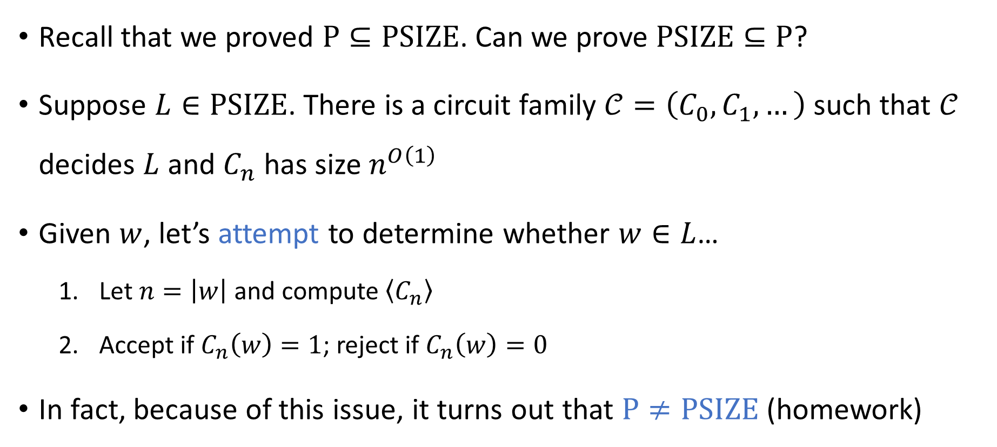
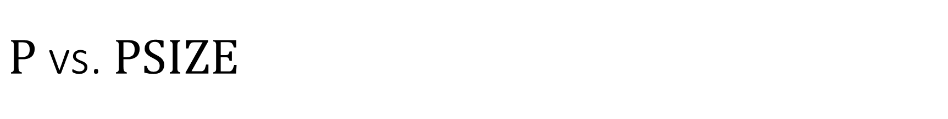

$\text{P}$ vs. $\text{PSIZE}$
Recall that we proved $\text{P}⊆\text{PSIZE}$. Can we prove $\text{PSIZE}⊆\text{P}$?
Suppose $L∈\text{PSIZE}$. There is a circuit family $𝒞=\left(C_{0},C_{1},…\right)$ such that $𝒞$ decides $L$ and $C_{n}$ has size $n^{O\left(1\right)}$
Given $w$, let’s attempt to determine whether $w∈L$…
Let $n=\left|w\right|$ and compute $\left\langle C_{n}\right\rangle$
Accept if $C_{n}\left(w\right)=1$; reject if $C_{n}\left(w\right)=0$
In fact, because of this issue, it turns out that $\text{P}≠\text{PSIZE}$ (homework)
⬅ How do we do this step…? 🙁
⬅ Recall $\text{CIRCUIT}\text{‑}\text{EVAL}∈\text{P}$ 🙂

Slide 3
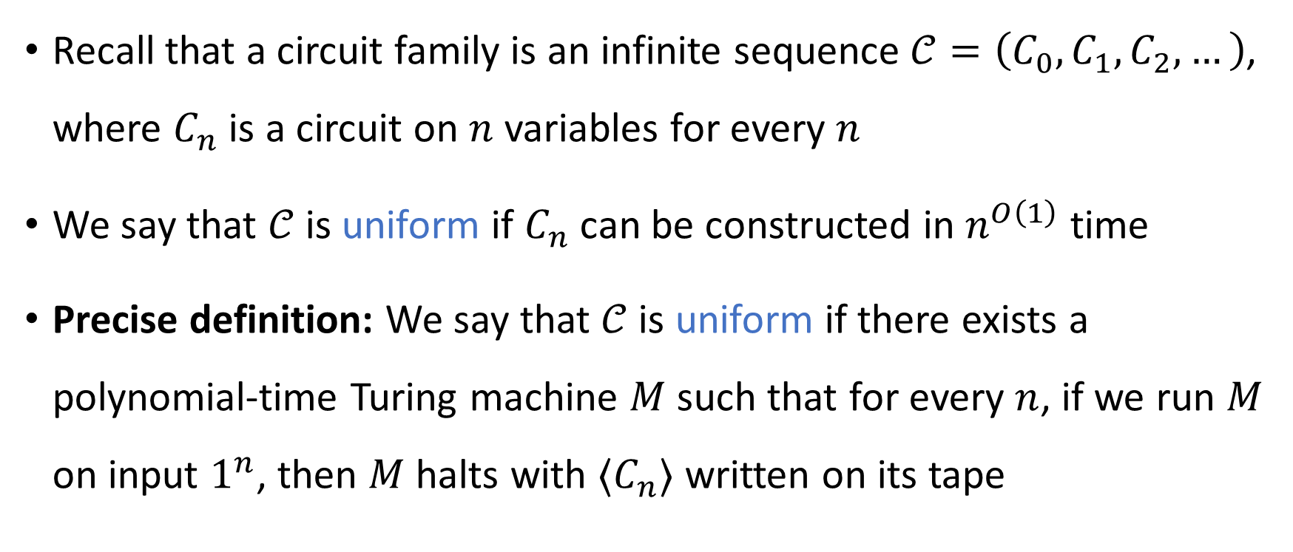
Uniform circuit family
Recall that a circuit family is an infinite sequence $𝒞=\left(C_{0},C_{1},C_{2},…\right)$, where $C_{n}$ is a circuit on $n$ variables for every $n$
We say that $𝒞$ is uniform if $C_{n}$ can be constructed in $n^{O\left(1\right)}$ time
Precise definition: We say that $𝒞$ is uniform if there exists a polynomial-time Turing machine $M$ such that for every $n$, if we run $M$ on input $1^{n}$, then $M$ halts with $⟨C_{n}⟩$ written on its tape

Slide 4

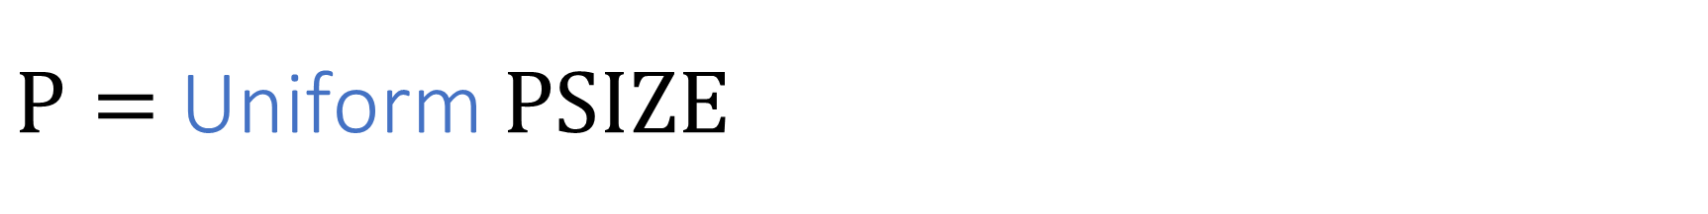
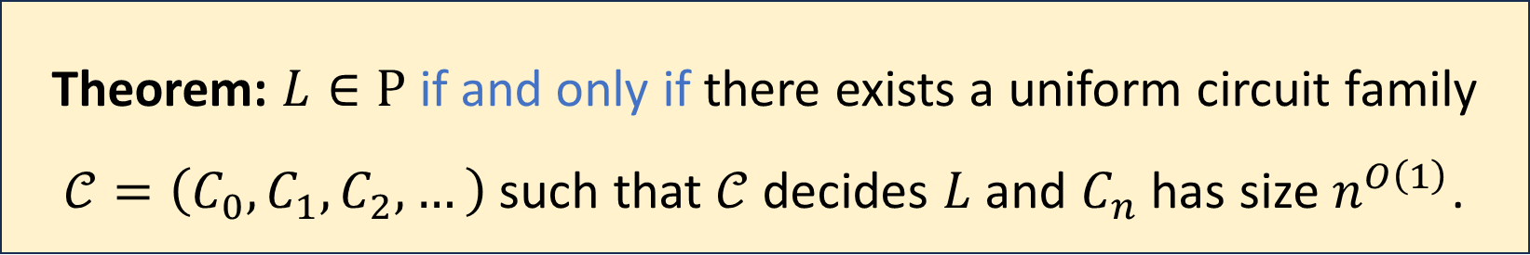
$\text{P}=$ Uniform $\text{PSIZE}$
Let $L$ be any language
Theorem: $L∈\text{P}$ if and only if there exists a uniform circuit family $𝒞=\left(C_{0},C_{1},C_{2},…\right)$ such that $𝒞$ decides $L$ and $C_{n}$ has size $n^{O\left(1\right)}$.

Slide 5
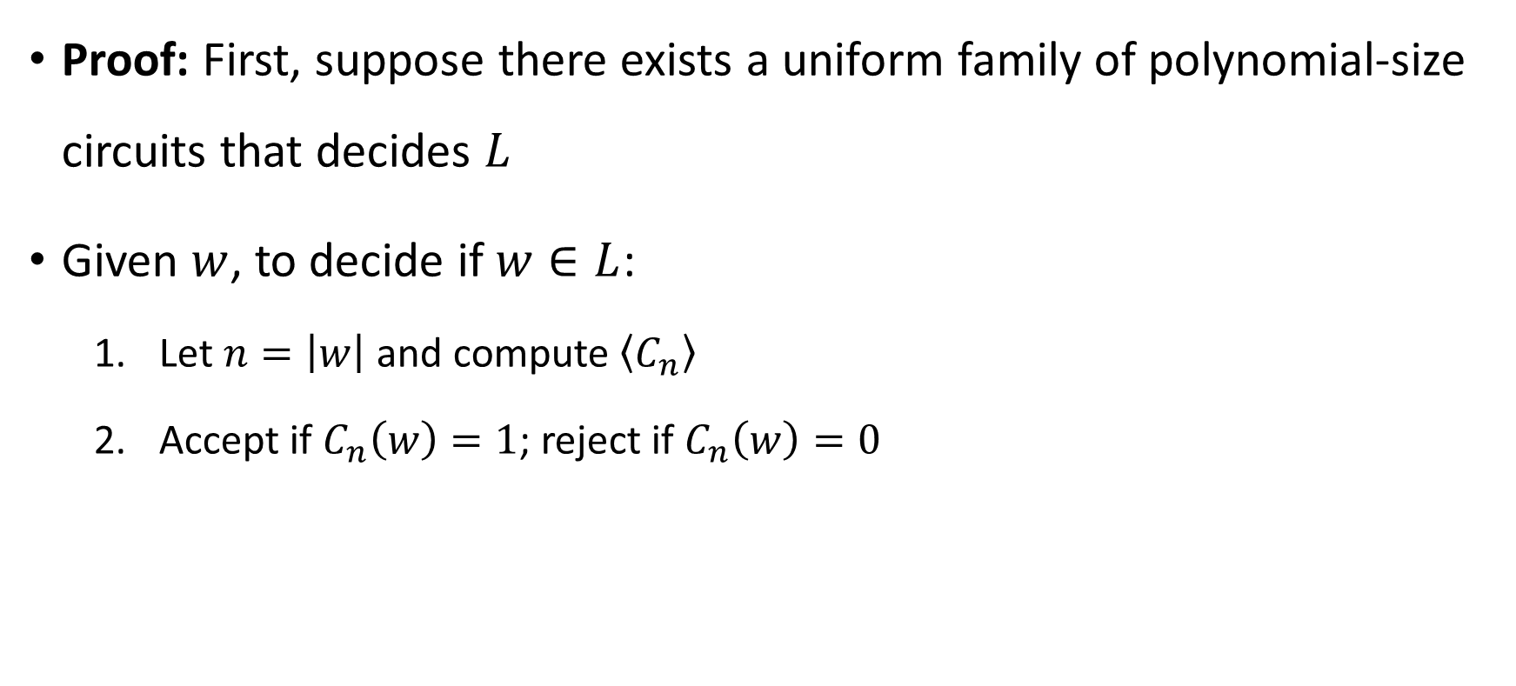


Uniform $\text{PSIZE}$ is contained in $\text{P}$
Proof: First, suppose there exists a uniform family of polynomial-size circuits that decides $L$
Given $w$, to decide if $w∈L$:
Let $n=\left|w\right|$ and compute $\left\langle C_{n}\right\rangle$
Accept if $C_{n}\left(w\right)=1$; reject if $C_{n}\left(w\right)=0$
⬅ Can do this in poly time by uniformity 🙂
⬅ Recall $\text{CIRCUIT}\text{‑}\text{EVAL}∈\text{P}$ 🙂

Slide 6
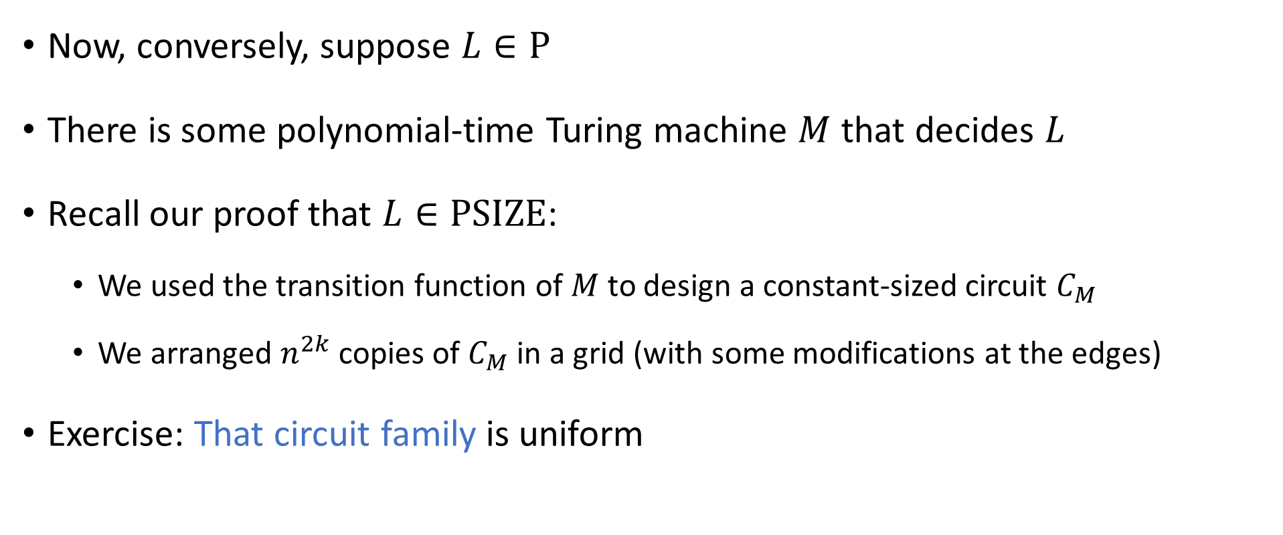
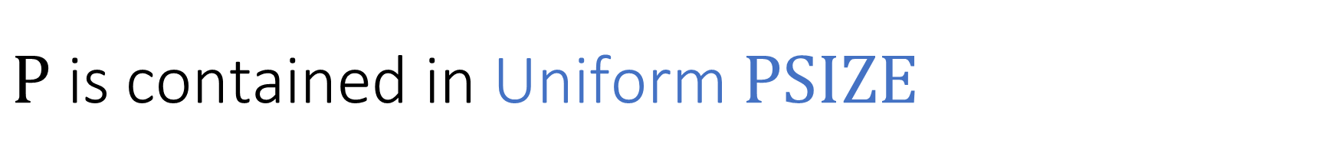
$\text{P}$ is contained in Uniform $\text{PSIZE}$
Now, conversely, suppose $L∈\text{P}$
There is some polynomial-time Turing machine $M$ that decides $L$
Recall our proof that $L∈\text{PSIZE}$:
We used the transition function of $M$ to design a constant-sized circuit $C_{M}$
We arranged $n^{2k}$ copies of $C_{M}$ in a grid (with some modifications at the edges)
Exercise: That circuit family is uniform

Slide 7



$\text{CIRCUIT}\text{‑}\text{SAT}$ is $\text{NP}$-complete
Recall $\text{CIRCUIT}\text{‑}\text{SAT}=\{\left\langle C\right\rangle :C \text{is} \text{a} \text{satisfiable} \text{circuit}\}$
This theorem provides evidence that $\text{CIRCUIT}\text{‑}\text{SAT}∉\text{P}$
Theorem: $\text{CIRCUIT}\text{‑}\text{SAT}$ is $\text{NP}$-complete.

Slide 8


Proof that $\text{CIRCUIT}\text{‑}\text{SAT}$ is $\text{NP}$-complete
We have already shown that $\text{CIRCUIT}\text{‑}\text{SAT}∈\text{NP}$
Remaining job: Prove that $\text{CIRCUIT}\text{‑}\text{SAT}$ is $\text{NP}$-hard

Slide 9
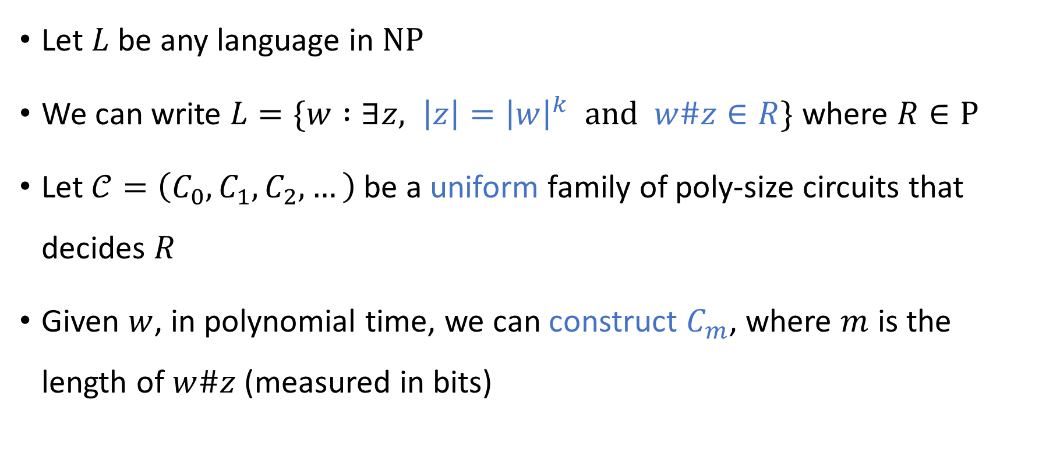

Proof that $\text{CIRCUIT}\text{‑}\text{SAT}$ is $\text{NP}$-hard
Let $L$ be any language in $\text{NP}$
We can write $L=\{w :∃z, \left|z\right|={\left|w\right|}^{k} \text{and} w\#z∈R\}$ where $R∈\text{P}$
Let $𝒞=\left(C_{0},C_{1},C_{2},…\right)$ be a uniform family of poly-size circuits that decides $R$
Given $w$, in polynomial time, we can construct $C_{m}$, where $m$ is the length of $w\#z$ (measured in bits)

Slide 10



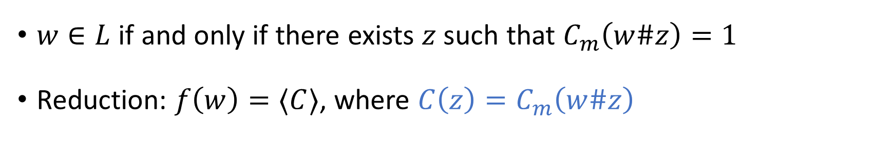













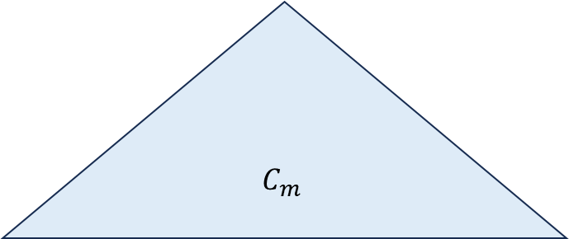

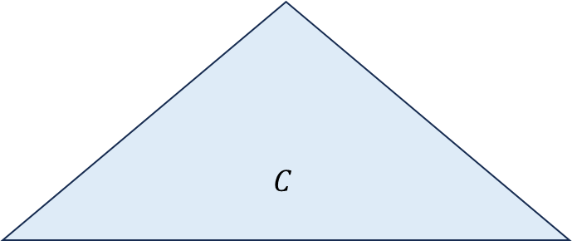

Proof that $\text{CIRCUIT}\text{‑}\text{SAT}$ is $\text{NP}$-hard
$$C_{m}$$
$$C$$
$$⋯$$
$$⋯$$
$$⋯$$
$$x_{1}$$
$$x_{2}$$
$$x_{3}$$
$$x_{4}$$
$$x_{5}$$
$$x_{6}$$
$$x_{7}$$
$$x_{m}$$
$$0$$
$$1$$
$$1$$
$$0$$
$$1$$
$$x_{1}$$
$$x_{2}$$
$$x_{r}$$
$w\#$ “hard-coded” into circuit
$w∈L$ if and only if there exists $z$ such that $C_{m}\left(w\#z\right)=1$
Reduction: $f\left(w\right)=⟨C⟩$, where $C\left(z\right)=C_{m}\left(w\#z\right)$

Slide 11
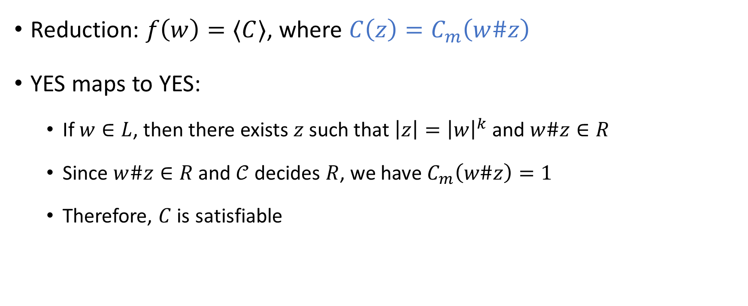

Proof that $\text{CIRCUIT}\text{‑}\text{SAT}$ is $\text{NP}$-complete
Reduction: $f\left(w\right)=⟨C⟩$, where $C\left(z\right)=C_{m}\left(w\#z\right)$
YES maps to YES:
If $w∈L$, then there exists $z$ such that $\left|z\right|={\left|w\right|}^{k}$ and $w\#z∈R$
Since $w\#z∈R$ and $𝒞$ decides $R$, we have $C_{m}\left(w\#z\right)=1$
Therefore, $C$ is satisfiable

Slide 12

Proof that $\text{CIRCUIT}\text{‑}\text{SAT}$ is $\text{NP}$-complete
Reduction: $f\left(w\right)=⟨C⟩$, where $C\left(z\right)=C_{m}\left(w\#z\right)$
NO maps to NO:
Suppose $C$ is satisfiable, i.e., there exists $z$ such that $C\left(z\right)=1$
Then $C_{m}\left(w\#z\right)=1$
Since $𝒞$ decides $R$, this implies that $w\#z∈R$
Therefore $w∈L$

Slide 13
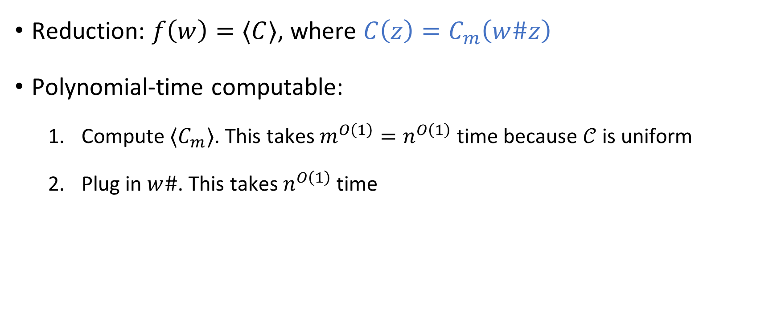
Proof that $\text{CIRCUIT}\text{‑}\text{SAT}$ is $\text{NP}$-complete
Reduction: $f\left(w\right)=⟨C⟩$, where $C\left(z\right)=C_{m}\left(w\#z\right)$
Polynomial-time computable:
Compute $⟨C_{m}⟩$. This takes $m^{O\left(1\right)}=n^{O\left(1\right)}$ time because $𝒞$ is uniform
Plug in $w\#$. This takes $n^{O\left(1\right)}$ time

Slide 14
Note on standards of rigor
When we want to construct a polynomial-time algorithm, we will simply describe the algorithm in such a way that it is (hopefully) clear that it can be implemented to run in polynomial time
Each algorithm can be implemented as a poly-time TM, but this is tedious
You should follow this convention on problem set 5 and beyond
Nevertheless, the Turing machine model remains extremely valuable for us, because it tells us what an arbitrary poly-time algorithm looks like!

Slide 15

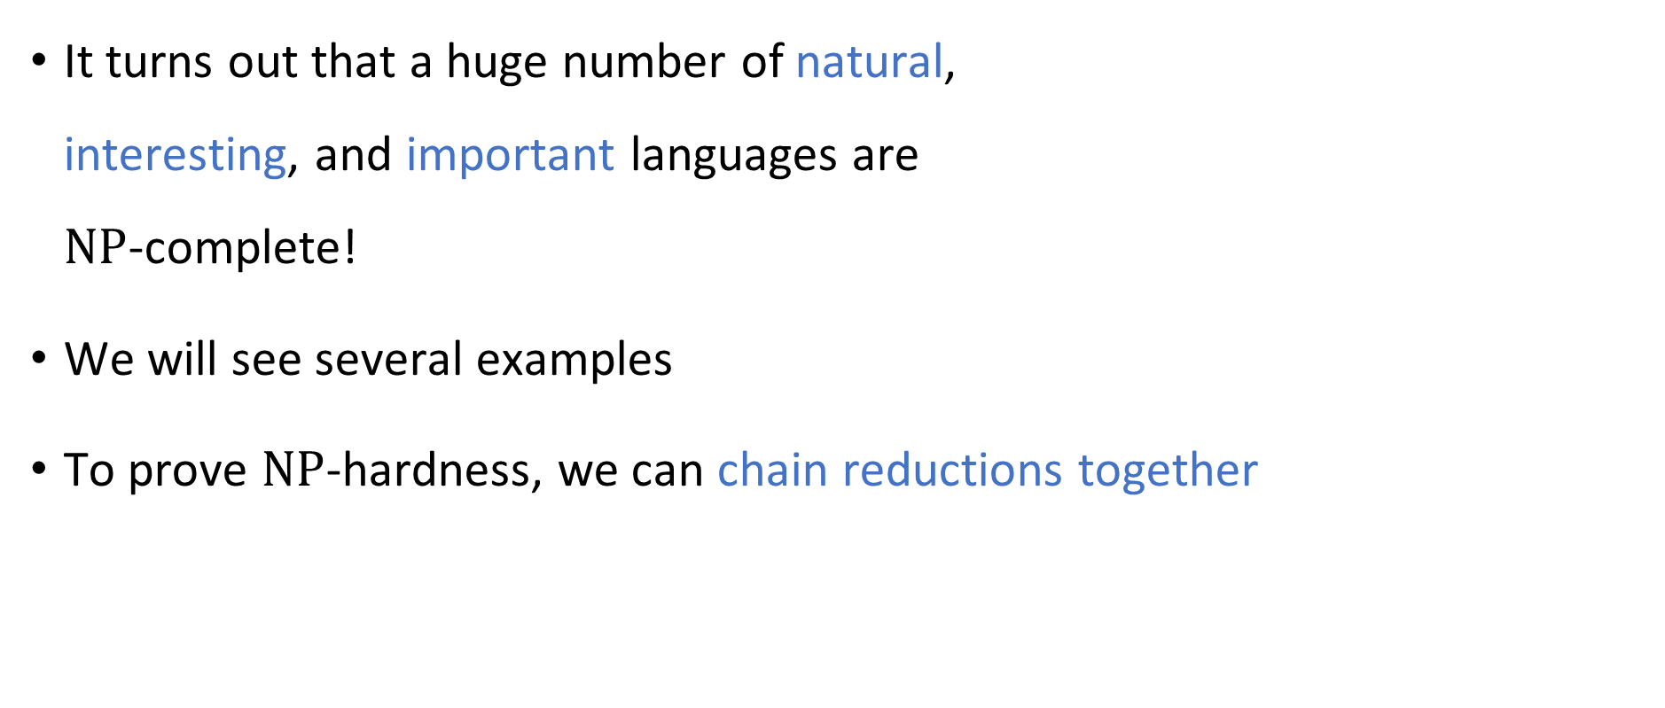

What else is $\text{NP}$-complete?
It turns out that a huge number of natural, interesting, and important languages are $\text{NP}$-complete!
We will see several examples
To prove $\text{NP}$-hardness, we can chain reductions together

Slide 16
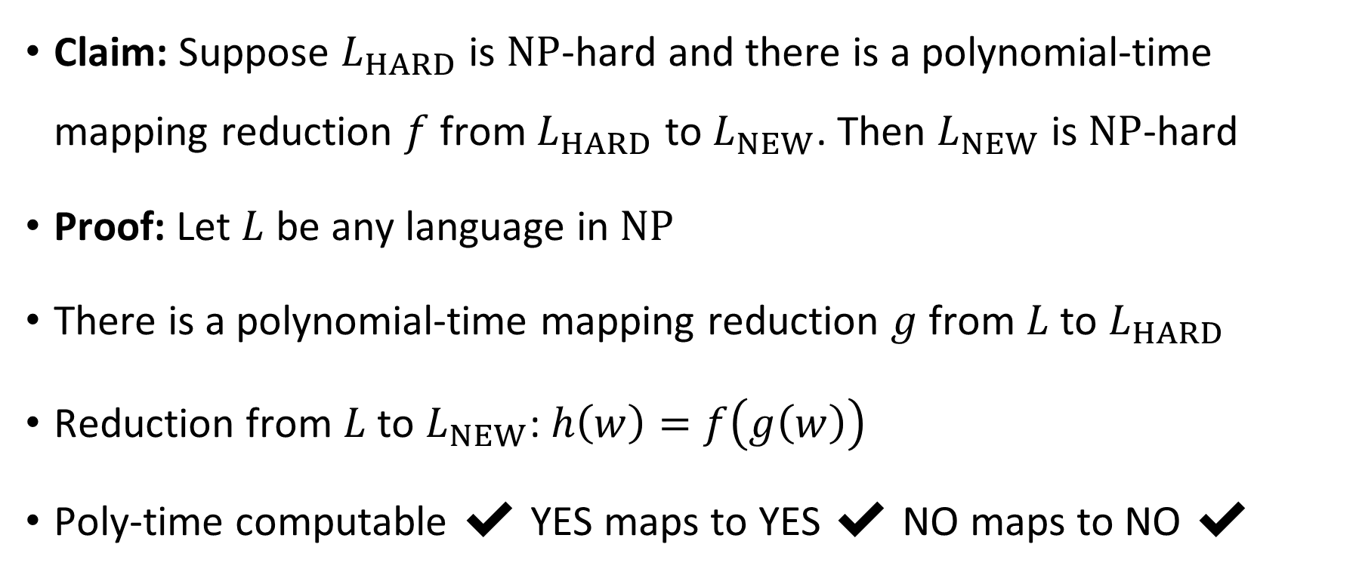
Chaining reductions together
Claim: Suppose $L_{HARD}$ is $\text{NP}$-hard and there is a polynomial-time mapping reduction $f$ from $L_{HARD}$ to $L_{NEW}$. Then $L_{NEW}$ is $\text{NP}$-hard
Proof: Let $L$ be any language in $\text{NP}$
There is a polynomial-time mapping reduction $g$ from $L$ to $L_{HARD}$
Reduction from $L$ to $L_{NEW}$: $h\left(w\right)=f\left(g\left(w\right)\right)$
Poly-time computable ✔️ YES maps to YES ✔️ NO maps to NO ✔️

Slide 17
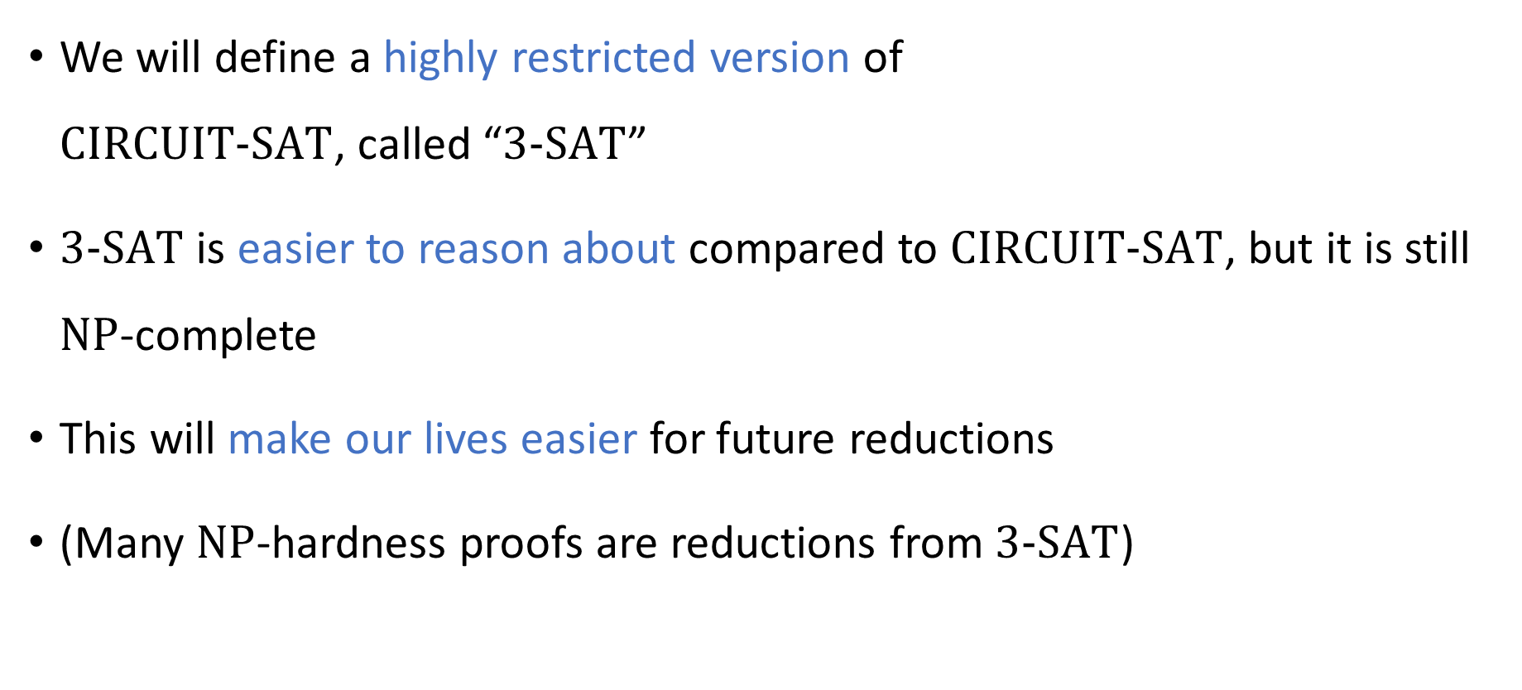
Chaining reductions together
We will define a highly restricted version of $\text{CIRCUIT}\text{‑}\text{SAT}$, called “$3\text{‑}\text{SAT}$”
$3\text{‑}\text{SAT}$ is easier to reason about compared to $\text{CIRCUIT}\text{‑}\text{SAT}$, but it is still $\text{NP}$-complete
This will make our lives easier for future reductions
(Many $\text{NP}$-hardness proofs are reductions from $\text{3‑}\text{SAT}$)

Slide 18
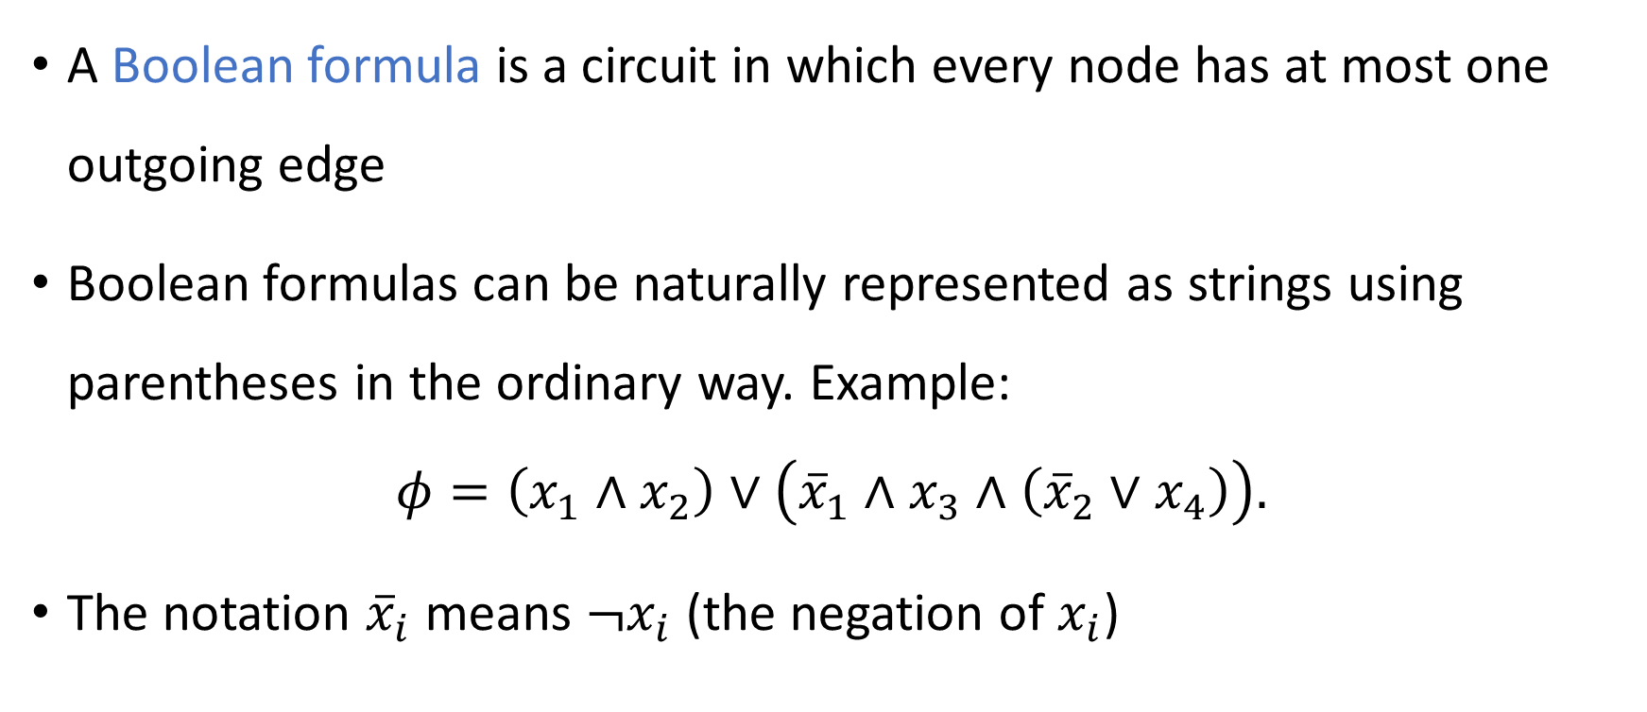
Boolean formulas
A Boolean formula is a circuit in which every node has at most one outgoing edge
Boolean formulas can be naturally represented as strings using parentheses in the ordinary way. Example:
$$φ=\left(x_{1}∧x_{2}\right)∨\left({\overline{x}}_{1}∧x_{3}∧\left({\overline{x}}_{2}∨x_{4}\right)\right).$$
The notation ${\overline{x}}_{i}$ means $¬x_{i}$ (the negation of $x_{i}$)

Slide 19
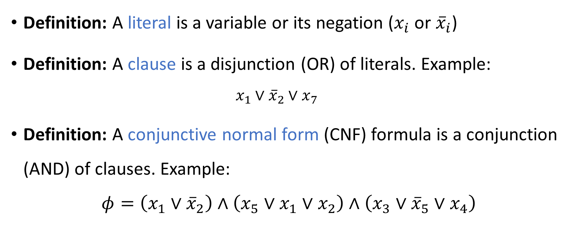
Literals, clauses, conjunctive normal form
Definition: A literal is a variable or its negation ($x_{i}$ or ${\overline{x}}_{i}$)
Definition: A clause is a disjunction (OR) of literals. Example:
$$x_{1}∨{\overline{x}}_{2}∨x_{7}$$
Definition: A conjunctive normal form (CNF) formula is a conjunction (AND) of clauses. Example:
$$φ=\left(x_{1}∨{\overline{x}}_{2}\right)∧\left(x_{5}∨x_{1}∨x_{2}\right)∧\left(x_{3}∨{\overline{x}}_{5}∨x_{4}\right)$$

Slide 20
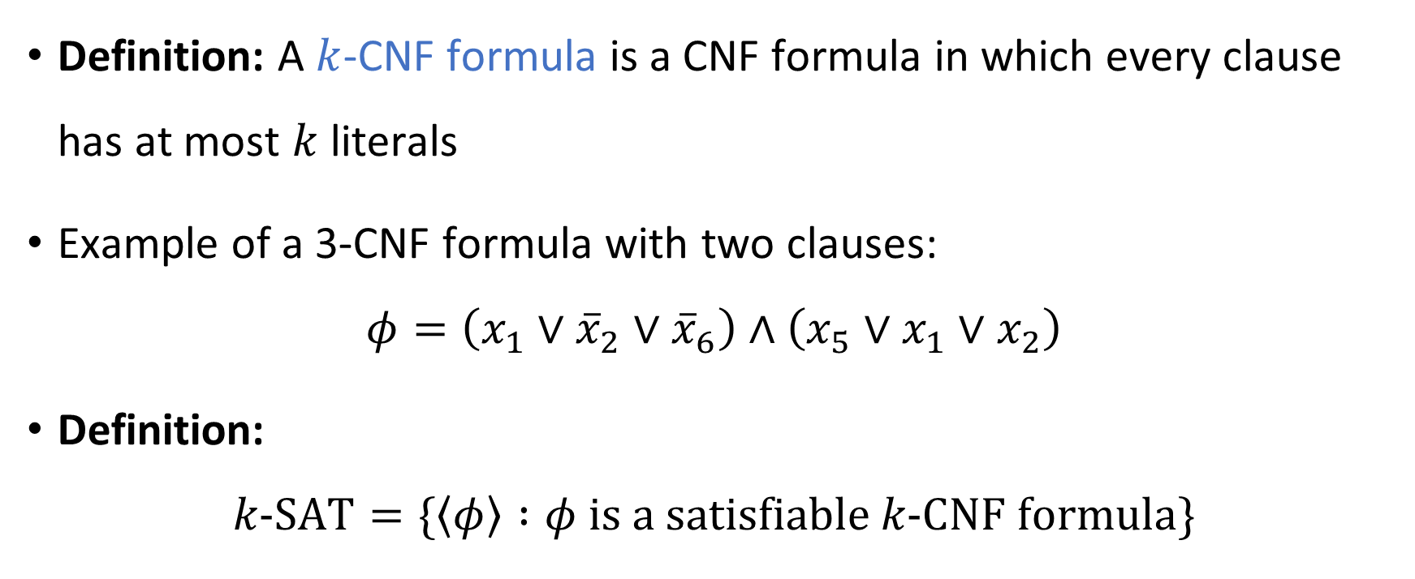
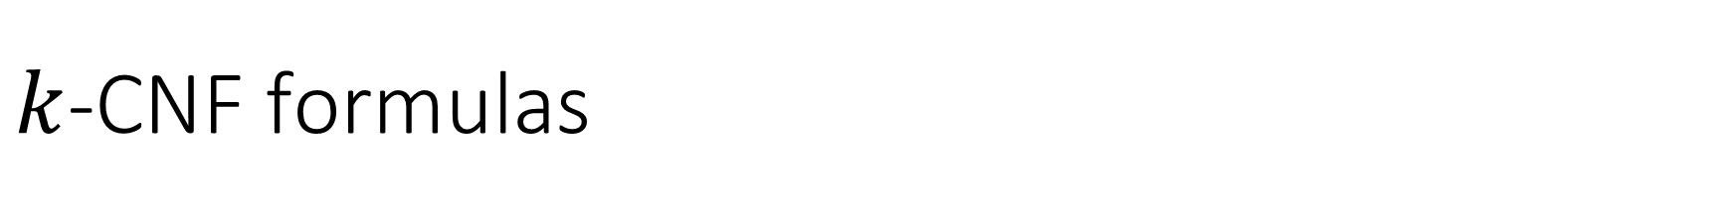
$k$-CNF formulas
Definition: A $k$-CNF formula is a CNF formula in which every clause has at most $k$ literals
Example of a 3-CNF formula with two clauses:
$$φ=\left(x_{1}∨{\overline{x}}_{2}∨{\overline{x}}_{6}\right)∧\left(x_{5}∨x_{1}∨x_{2}\right)$$
Definition:
$$k\text{‑}\text{SAT}=\{\left\langle φ\right\rangle :φ \text{is} \text{a} \text{satisfiable} k\text{‑}\text{CNF} \text{formula}\}$$

Slide 21

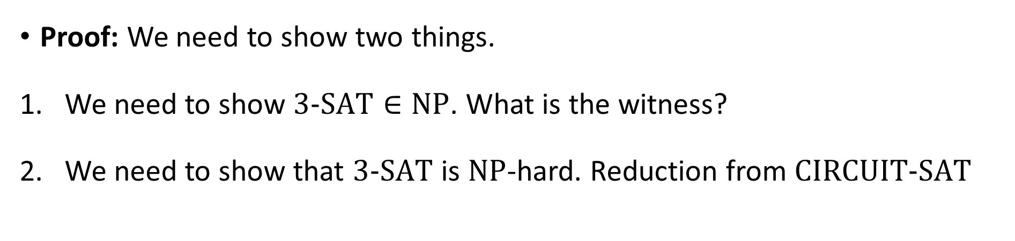
The Cook-Levin Theorem
The Cook-Levin Theorem: $3\text{‑}\text{SAT}$ is $\text{NP}$-complete
Proof: We need to show two things.
We need to show $3\text{‑}\text{SAT}∈\text{NP}$. What is the witness?
We need to show that $3\text{‑}\text{SAT}$ is $\text{NP}$-hard. Reduction from $\text{CIRCUIT}\text{‑}\text{SAT}$

Slide 22
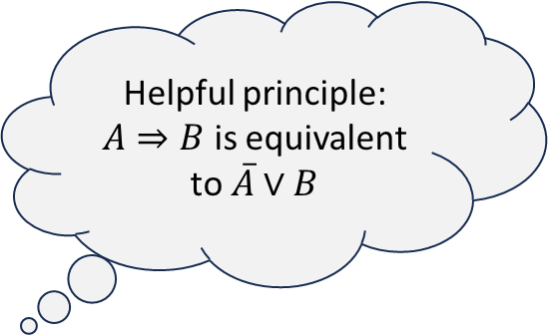
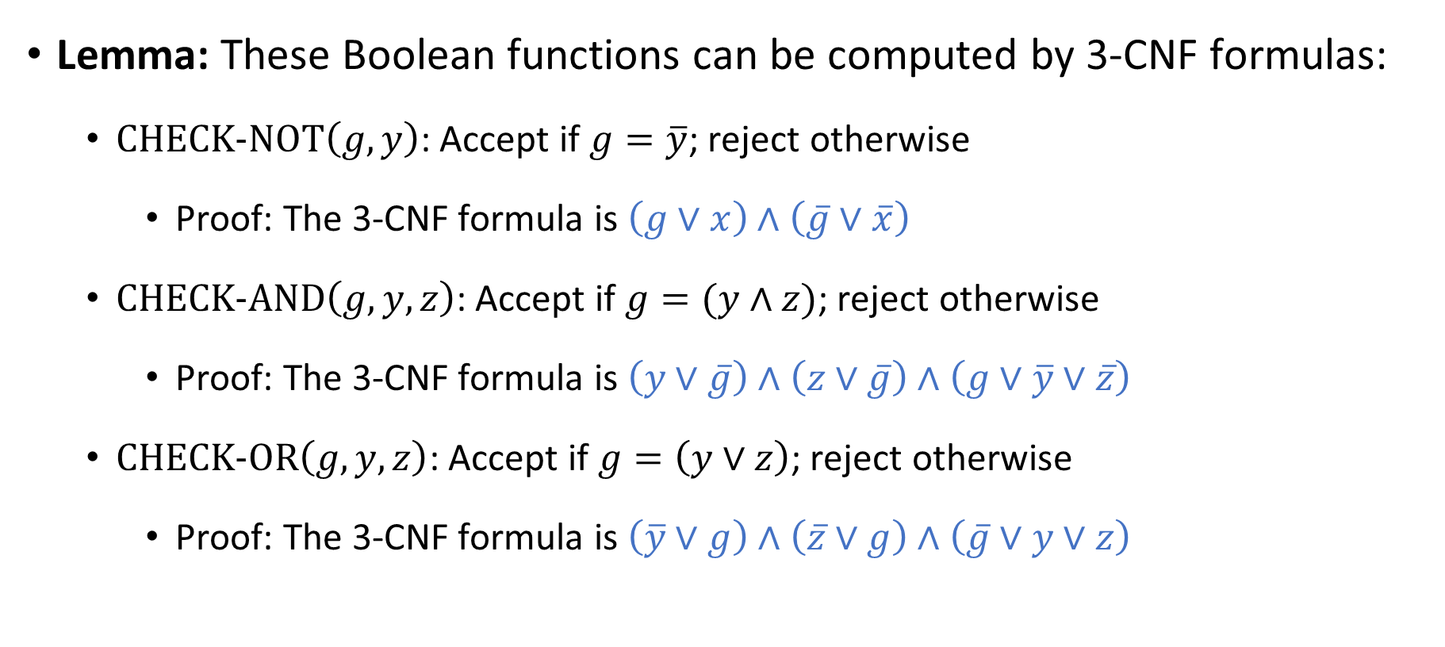
Gate gadgets
Lemma: These Boolean functions can be computed by 3-CNF formulas:
$\text{CHECK}\text{‑}\text{NOT}\left(g, y\right)$: Accept if $g=\overline{y}$; reject otherwise
Proof: The 3-CNF formula is $\left(g∨x\right)∧\left(\overline{g}∨\overline{x}\right)$
$\text{CHECK}\text{‑}\text{AND}\left(g, y,z\right)$: Accept if $g=(y∧z)$; reject otherwise
Proof: The 3-CNF formula is $\left(y∨\overline{g}\right)∧\left(z∨\overline{g}\right)∧\left(g∨\overline{y}∨\overline{z}\right)$
$\text{CHECK}\text{‑}\text{OR}\left(g, y, z\right)$: Accept if $g=\left(y∨z\right)$; reject otherwise
Proof: The 3-CNF formula is $\left(\overline{y}∨g\right)∧\left(\overline{z}∨g\right)∧\left(\overline{g}∨y∨z\right)$
Helpful principle: $A⇒B$ is equivalent to $\overline{A}∨B$

