Slide 1
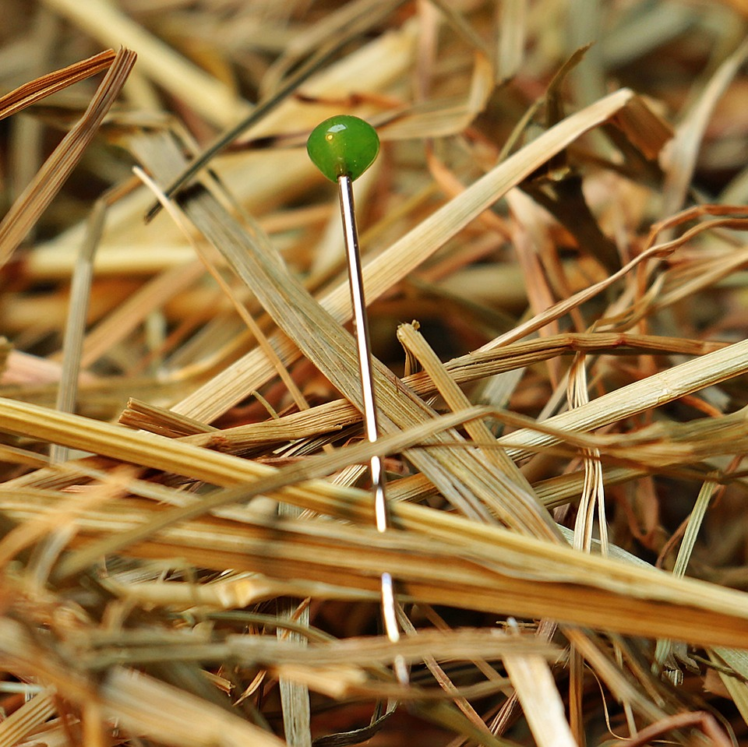
CMSC 28100 Introduction to Complexity Theory Spring 2024 Instructor: William Hoza

Slide 2
Which languages are decidable?

Slide 3


Undecidability
We have seen several examples of undecidable languages
$\text{SELF}‑\text{REJECTORS}$, $\text{HALT}$, $\overline{\text{HALT}}$, ${\text{A}}_{TM}$, ${\text{E}}_{TM}$

Slide 4
Undecidability beyond analysis of TMs
So far, every undecidable problem we have seen has been a problem about analyzing the behavior of a given Turing machine
Does it halt on such-and-such input?
Is there any input it accepts?
Etc.
What else is undecidable?

Slide 5
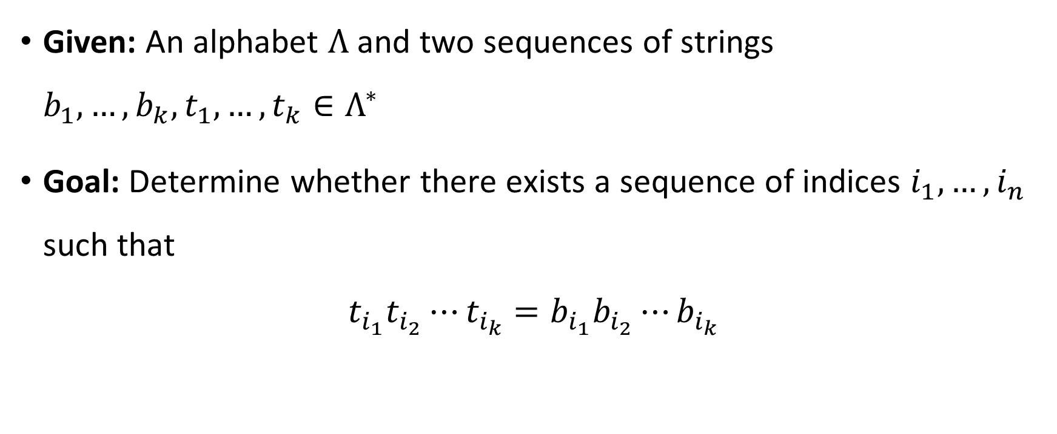
Post’s Correspondence Problem
Given: An alphabet $Λ$ and two sequences of strings $b_{1},…, b_{k}, t_{1},…, t_{k}∈Λ^{∗}$
Goal: Determine whether there exists a sequence of indices $i_{1},…, i_{n}$ such that
$$t_{i_{1}}t_{i_{2}}⋯t_{i_{k}}=b_{i_{1}}b_{i_{2}}⋯b_{i_{k}}$$

Slide 6












Post’s Correspondence Problem
Helpful picture: We are given a set of “dominos”
Goal: Determine whether it is possible to generate a “match”
in which the sequence of symbols on top equals the sequence of symbols on the bottom
Using the same domino multiple times is permitted
$$\begin{matrix}t_{1} \\ b_{1}\end{matrix}$$
$$\begin{matrix}t_{2} \\ b_{2}\end{matrix}$$
$$\begin{matrix}t_{3} \\ b_{3}\end{matrix}$$
$$\begin{matrix}t_{k} \\ b_{k}\end{matrix}$$
$$⋯$$
$$\begin{matrix}t_{i_{1}} \\ b_{i_{1}}\end{matrix}$$
$$\begin{matrix}t_{i_{2}} \\ b_{i_{2}}\end{matrix}$$
$$\begin{matrix}t_{i_{3}} \\ b_{i_{3}}\end{matrix}$$
$$\begin{matrix}t_{i_{4}} \\ b_{i_{4}}\end{matrix}$$
$$\begin{matrix}t_{i_{5}} \\ b_{i_{5}}\end{matrix}$$
$$\begin{matrix}t_{i_{n}} \\ b_{i_{n}}\end{matrix}$$
$$⋯$$

Slide 7









Post’s Correspondence Problem: Example 1
Suppose we are given
This is a YES case. Match:
$$\begin{matrix}\text{0} \\ \text{1}\end{matrix}$$
$$\begin{matrix}\text{1} \\ \text{0}\end{matrix}$$
$$\begin{matrix}\text{1}\text{1} \\ ϵ\end{matrix}$$
$$\begin{matrix}ϵ \\ 00\end{matrix}$$
$$\begin{matrix}\text{1}\text{1} \\ ϵ\end{matrix}$$
$$\begin{matrix}\text{0} \\ \text{1}\end{matrix}$$
$$\begin{matrix}\text{0} \\ \text{1}\end{matrix}$$
$$\begin{matrix}ϵ \\ 00\end{matrix}$$
$←$1100
$←$1100

Slide 8



















Post’s Correspondence Problem: Example 2
Suppose we are given
This is a YES case because there is a match:
…and another match:
$$\begin{matrix}\text{M}\text{P} \\ \text{OM}\end{matrix}$$
$$\begin{matrix}\text{I}\text{O} \\ \text{T}\end{matrix}$$
$$\begin{matrix}\text{N} \\ \text{ION}\end{matrix}$$
$$\begin{matrix}\text{C}\text{O} \\ \text{C}\end{matrix}$$
$$\begin{matrix}\text{U}\text{T} \\ \text{PU}\end{matrix}$$
$$\begin{matrix}\text{A}\text{T} \\ \text{TA}\end{matrix}$$
$$\begin{matrix}\text{C}\text{O} \\ \text{C}\end{matrix}$$
$$\begin{matrix}\text{M}\text{P} \\ \text{OM}\end{matrix}$$
$$\begin{matrix}\text{U}\text{T} \\ \text{PU}\end{matrix}$$
$$\begin{matrix}\text{A}\text{T} \\ \text{TA}\end{matrix}$$
$$\begin{matrix}\text{I}\text{O} \\ \text{T}\end{matrix}$$
$$\begin{matrix}\text{N} \\ \text{ION}\end{matrix}$$
$←$COMPUTATION
$←$COMPUTATION
$$\begin{matrix}\text{C}\text{O} \\ \text{C}\end{matrix}$$
$$\begin{matrix}\text{M}\text{P} \\ \text{OM}\end{matrix}$$
$$\begin{matrix}\text{U}\text{T} \\ \text{PU}\end{matrix}$$
$$\begin{matrix}\text{I}\text{O} \\ \text{T}\end{matrix}$$
$$\begin{matrix}\text{N} \\ \text{ION}\end{matrix}$$
$←$COMPUTION
$←$COMPUTION

Slide 9




Post’s Correspondence Problem: Example 3
Suppose we are given
This is a NO case. Proof: A match would have to start with ,
and consequently, we will always have more ones on the bottom than on the top
$$\begin{matrix}\text{0} \\ \text{01}\end{matrix}$$
$$\begin{matrix}\text{0}\text{10} \\ \text{10}\end{matrix}$$
$$\begin{matrix}\text{1} \\ \text{01}\end{matrix}$$
$$\begin{matrix}\text{0} \\ \text{01}\end{matrix}$$

Slide 10

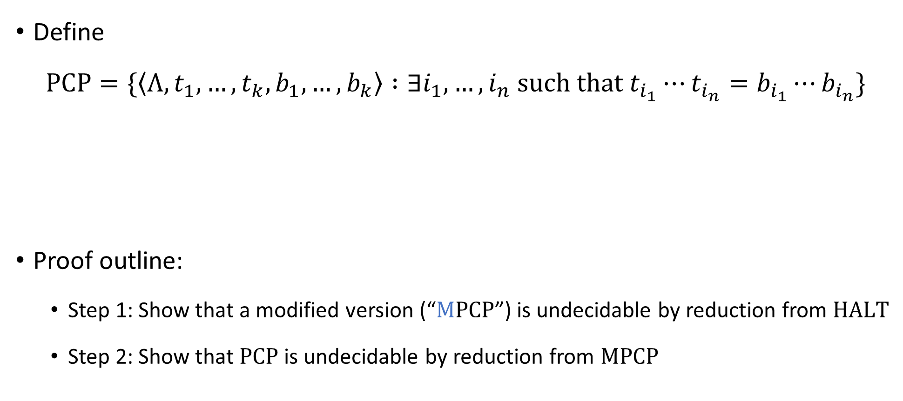
Post’s Correspondence Problem is undecidable
Define
$$\text{PCP}=\{\left\langle Λ, t_{1},…, t_{k}, b_{1},…, b_{k}\right\rangle :∃i_{1},…, i_{n} \text{such} \text{that} t_{i_{1}}⋯t_{i_{n}}=b_{i_{1}}⋯b_{i_{n}}\}$$
Proof outline:
Step 1: Show that a modified version (“$\text{M}\text{PCP}$”) is undecidable by reduction from $\text{HALT}$
Step 2: Show that $\text{PCP}$ is undecidable by reduction from $\text{MPCP}$
Theorem: $\text{PCP}$ is undecidable

Slide 11

Modified PCP
$$\text{MPCP}=\{\left\langle Λ, t_{1},…, t_{k}, b_{1},…, b_{k}\right\rangle :∃i_{1},…, i_{n} \text{such} \text{that} t_{1}t_{i_{1}}⋯t_{i_{n}}=b_{1}b_{i_{1}}⋯b_{i_{n}}\}$$
The difference between $\text{PCP}$ and $\text{MPCP}$: In $\text{MPCP}$, matches must start with the first domino

Slide 12
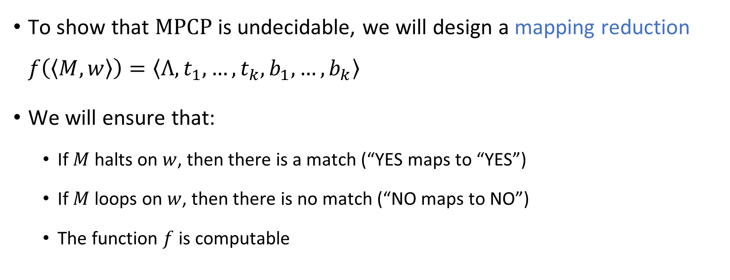

Reduction from $\text{HALT}$ to $\text{MPCP}$
To show that $\text{MPCP}$ is undecidable, we will design a mapping reduction $f\left(\left\langle M,w\right\rangle \right)=\left\langle Λ,t_{1},…, t_{k},b_{1},…, b_{k}\right\rangle$
We will ensure that:
If $M$ halts on $w$, then there is a match (“YES maps to “YES”)
If $M$ loops on $w$, then there is no match (“NO maps to NO”)
The function $f$ is computable

Slide 13
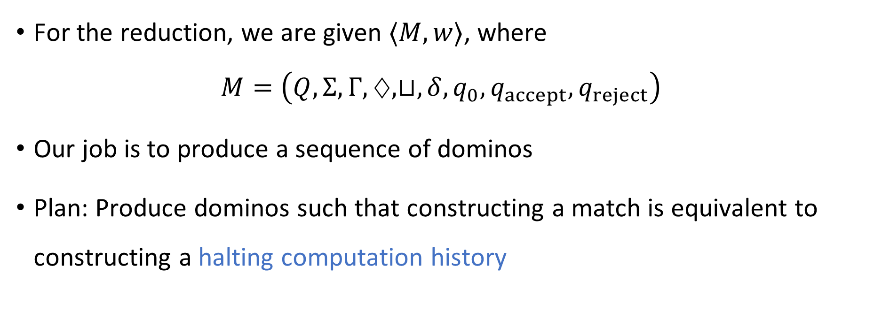

Reduction from $\text{HALT}$ to $\text{MPCP}$
For the reduction, we are given $⟨M,w⟩$, where $M=\left(Q,Σ, Γ,♢,⊔,δ,q_{0},q_{accept},q_{reject}\right)$
Our job is to produce a sequence of dominos
Plan: Produce dominos such that constructing a match is equivalent to constructing a halting computation history

Slide 14


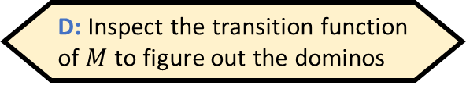



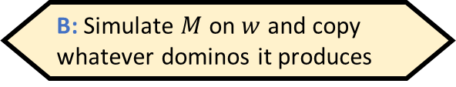
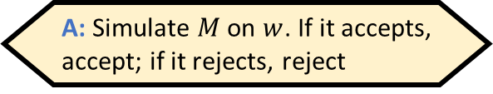



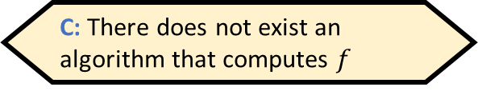



Reduction from $\text{HALT}$ to $\text{MPCP}$
Given $⟨M,w⟩$, how would we compute $f\left(\left\langle M,w\right\rangle \right)$?
A: Simulate $M$ on $w$. If it accepts, accept; if it rejects, reject
B: Simulate $M$ on $w$ and copy whatever dominos it produces
We produce the following dominos:
, , , , and
for every $q,b,q^{′},b′$ such that $δ\left(q,b\right)=(q^{′},b^{′},\text{R})$ and $q∉\left\{q_{accept},q_{reject}\right\}$
for every $q,b,q^{′},b^{′},a$ such that $δ\left(q,b\right)=(q^{′},b^{′},\text{L})$ and $q∉\left\{q_{accept},q_{reject}\right\}$
, , and for every $b∈Γ$ and $q∈\left\{q_{accept},q_{reject}\right\}$
C: There does not exist an algorithm that computes $f$
D: Inspect the transition function of $M$ to figure out the dominos
$$\begin{matrix}\# \\ ⊔\#\end{matrix}$$
$$\begin{matrix}q_{accept}\# \\ ε\end{matrix}$$
$$\begin{matrix}q_{reject}\# \\ ε\end{matrix}$$
$$\begin{matrix}ε \\ ♢q_{0}w⊔\#\end{matrix}$$
$$\begin{matrix}\# \\ \#\end{matrix}$$
Respond at PollEv.com/whoza or text “whoza” to 22333
Reduction is computable ✔️
$$\begin{matrix}qb \\ b^{′}q′\end{matrix}$$
$$\begin{matrix}aqb \\ q^{′}ab′\end{matrix}$$
$$\begin{matrix}b \\ b\end{matrix}$$
$$\begin{matrix}bq \\ b\end{matrix}$$
$$\begin{matrix}qb \\ b\end{matrix}$$

Slide 15

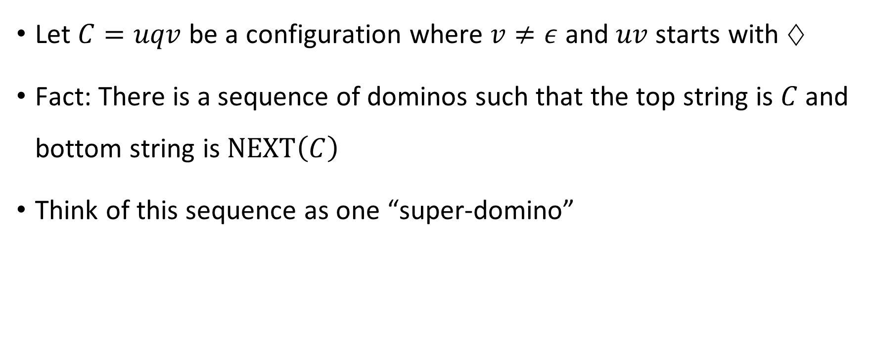
Domino feature 1
Let $C=uqv$ be a configuration where $v≠ε$ and $uv$ starts with $♢$
Fact: There is a sequence of dominos such that the top string is $C$ and bottom string is $\text{NEXT}\left(C\right)$
Think of this sequence as one “super-domino”
$$\begin{matrix}C \\ \text{NEXT}\left(C\right)\end{matrix}$$

Slide 16



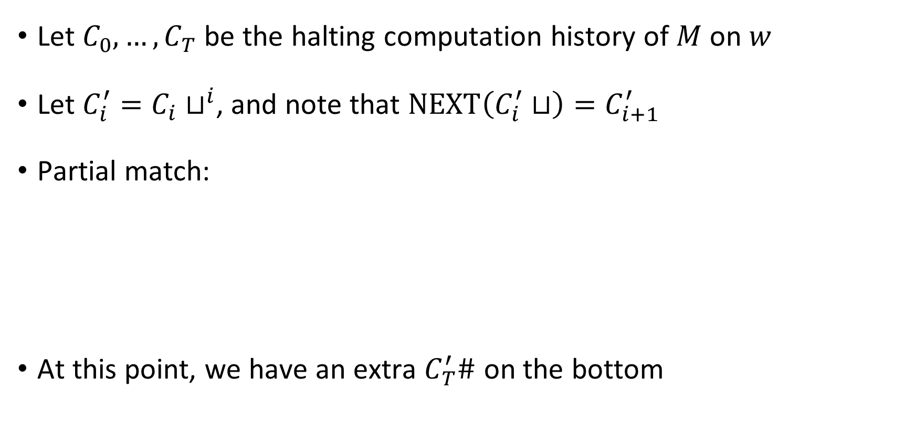






YES maps to YES
Let $C_{0},…, C_{T}$ be the halting computation history of $M$ on $w$
Let $C_{i}^{′}=C_{i}⊔^{i}$, and note that $\text{NEXT}\left(C_{i}^{′}⊔\right)=C_{i+1}^{′}$
Partial match:
At this point, we have an extra $C_{T}^{′}\#$ on the bottom
$$\begin{matrix}ε \\ ♢q_{0}w⊔\#\end{matrix}$$
$$\begin{matrix}C_{0}^{′}⊔ \\ C_{1}^{′}\end{matrix}$$
$$\begin{matrix}\# \\ ⊔\#\end{matrix}$$
$$\begin{matrix}C_{1}^{′}⊔ \\ C_{2}^{′}\end{matrix}$$
$$\begin{matrix}\# \\ ⊔\#\end{matrix}$$
$$\begin{matrix}\# \\ ⊔\#\end{matrix}$$
$$\begin{matrix}C_{T−1}^{′}⊔ \\ C_{T}^{′}\end{matrix}$$
$$\begin{matrix}\# \\ \#\end{matrix}$$
$$⋯$$

Slide 17

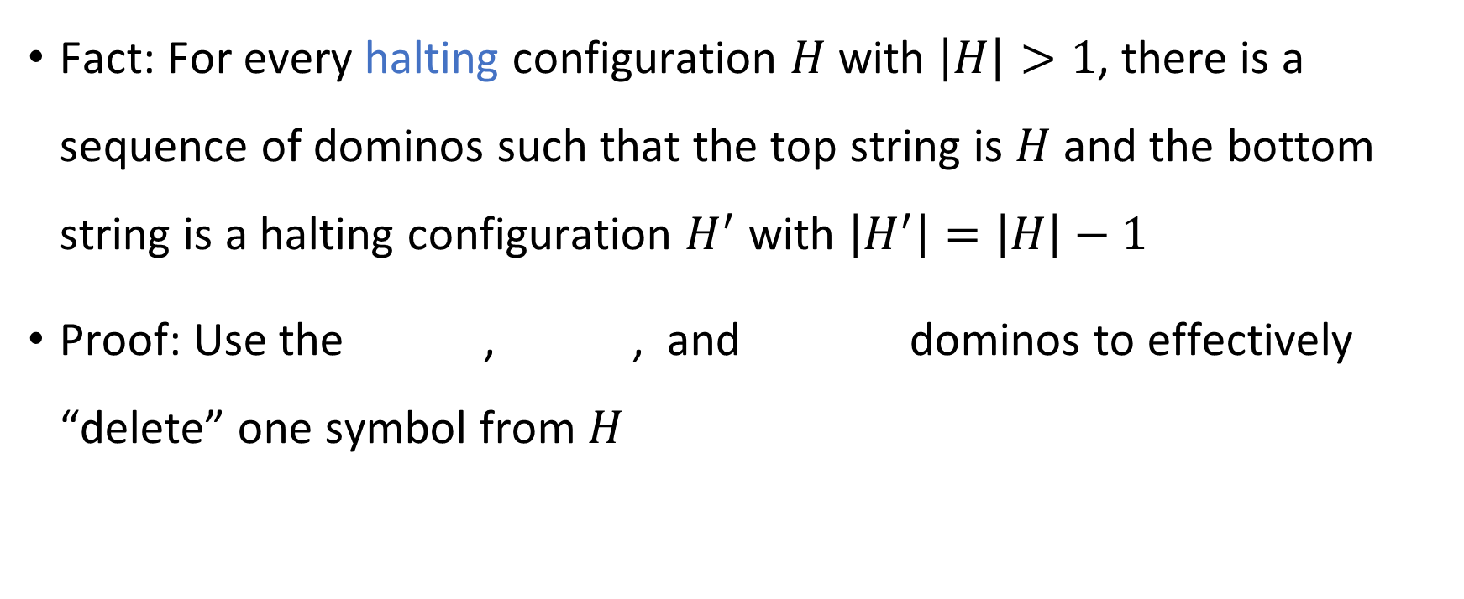



Domino feature 2
Fact: For every halting configuration $H$ with $\left|H\right|>1$, there is a sequence of dominos such that the top string is $H$ and the bottom string is a halting configuration $H^{′}$ with $\left|H^{′}\right|=\left|H\right|−1$
Proof: Use the , , and dominos to effectively “delete” one symbol from $H$
$$\begin{matrix}H \\ H′\end{matrix}$$
$$\begin{matrix}b \\ b\end{matrix}$$
$$\begin{matrix}bq \\ q\end{matrix}$$
$$\begin{matrix}qb \\ q\end{matrix}$$

Slide 18








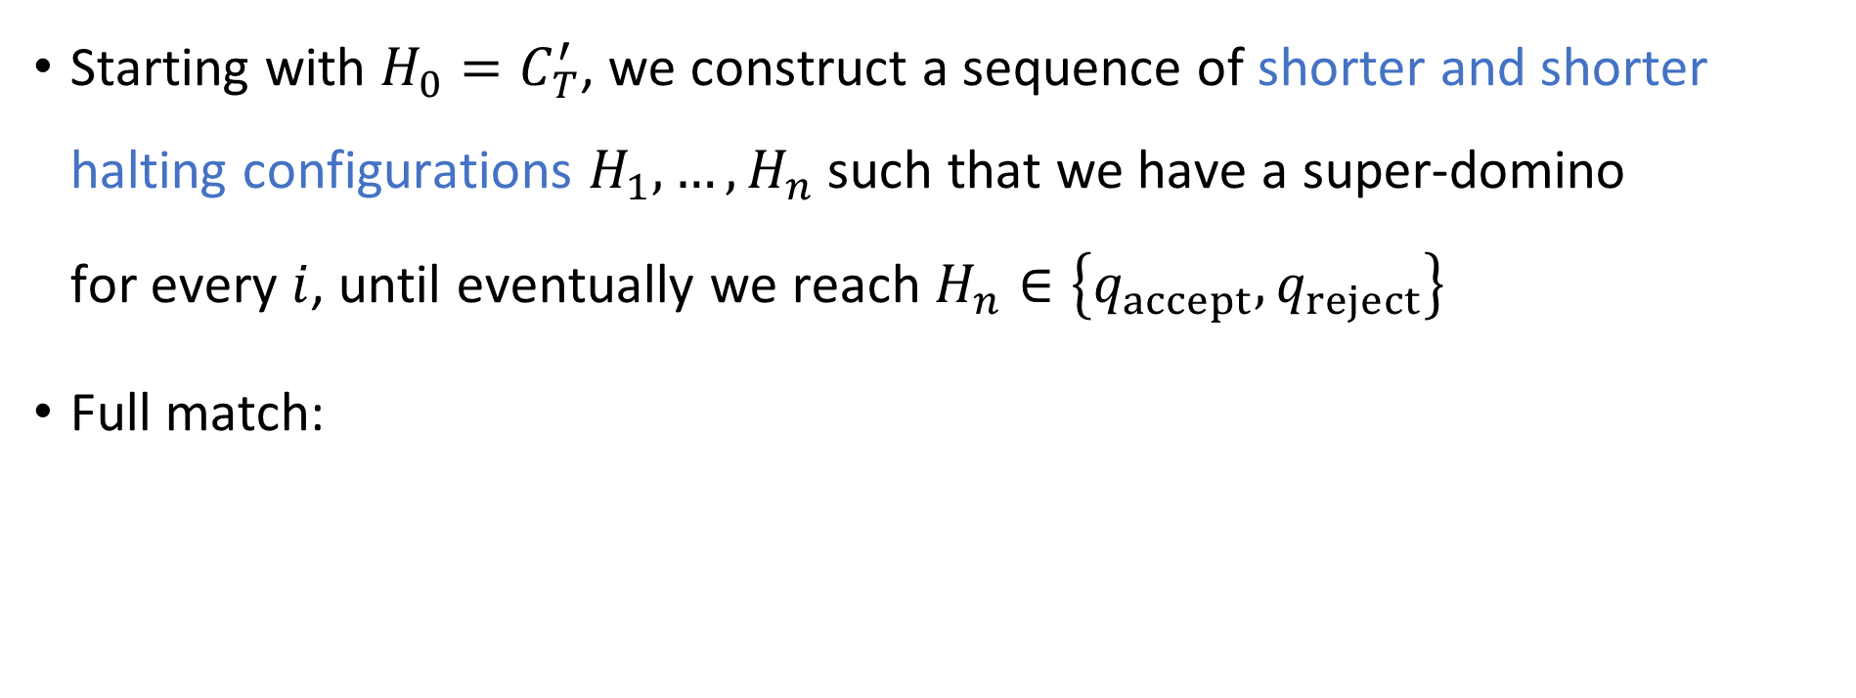











YES maps to YES
Starting with $H_{0}=C_{T}^{′}$, we construct a sequence of shorter and shorter halting configurations $H_{1},…, H_{n}$ such that we have a super-domino for every $i$, until eventually we reach $H_{n}∈\left\{q_{accept},q_{reject}\right\}$
Full match:
$$\begin{matrix}H_{i−1} \\ H_{i}\end{matrix}$$
$$\begin{matrix}ε \\ ♢q_{0}w⊔\#\end{matrix}$$
$$\begin{matrix}C_{0}^{′}⊔ \\ C_{1}^{′}\end{matrix}$$
$$\begin{matrix}\# \\ ⊔\#\end{matrix}$$
$$\begin{matrix}C_{1}^{′}⊔ \\ C_{2}^{′}\end{matrix}$$
$$\begin{matrix}\# \\ ⊔\#\end{matrix}$$
$$\begin{matrix}\# \\ ⊔\#\end{matrix}$$
$$\begin{matrix}C_{T−1}^{′}⊔ \\ C_{T}^{′}\end{matrix}$$
$$\begin{matrix}\# \\ \#\end{matrix}$$
$$\begin{matrix}H_{0} \\ H_{1}\end{matrix}$$
$$\begin{matrix}\# \\ \#\end{matrix}$$
$$\begin{matrix}H_{1} \\ H_{2}\end{matrix}$$
$$\begin{matrix}\# \\ \#\end{matrix}$$
$$\begin{matrix}\# \\ \#\end{matrix}$$
$$\begin{matrix}H_{n−1} \\ H_{n}\end{matrix}$$
$$\begin{matrix}\# \\ \#\end{matrix}$$
$$\begin{matrix}H_{n}\# \\ ε\end{matrix}$$
$$⋯$$
$$⋯$$

Slide 19

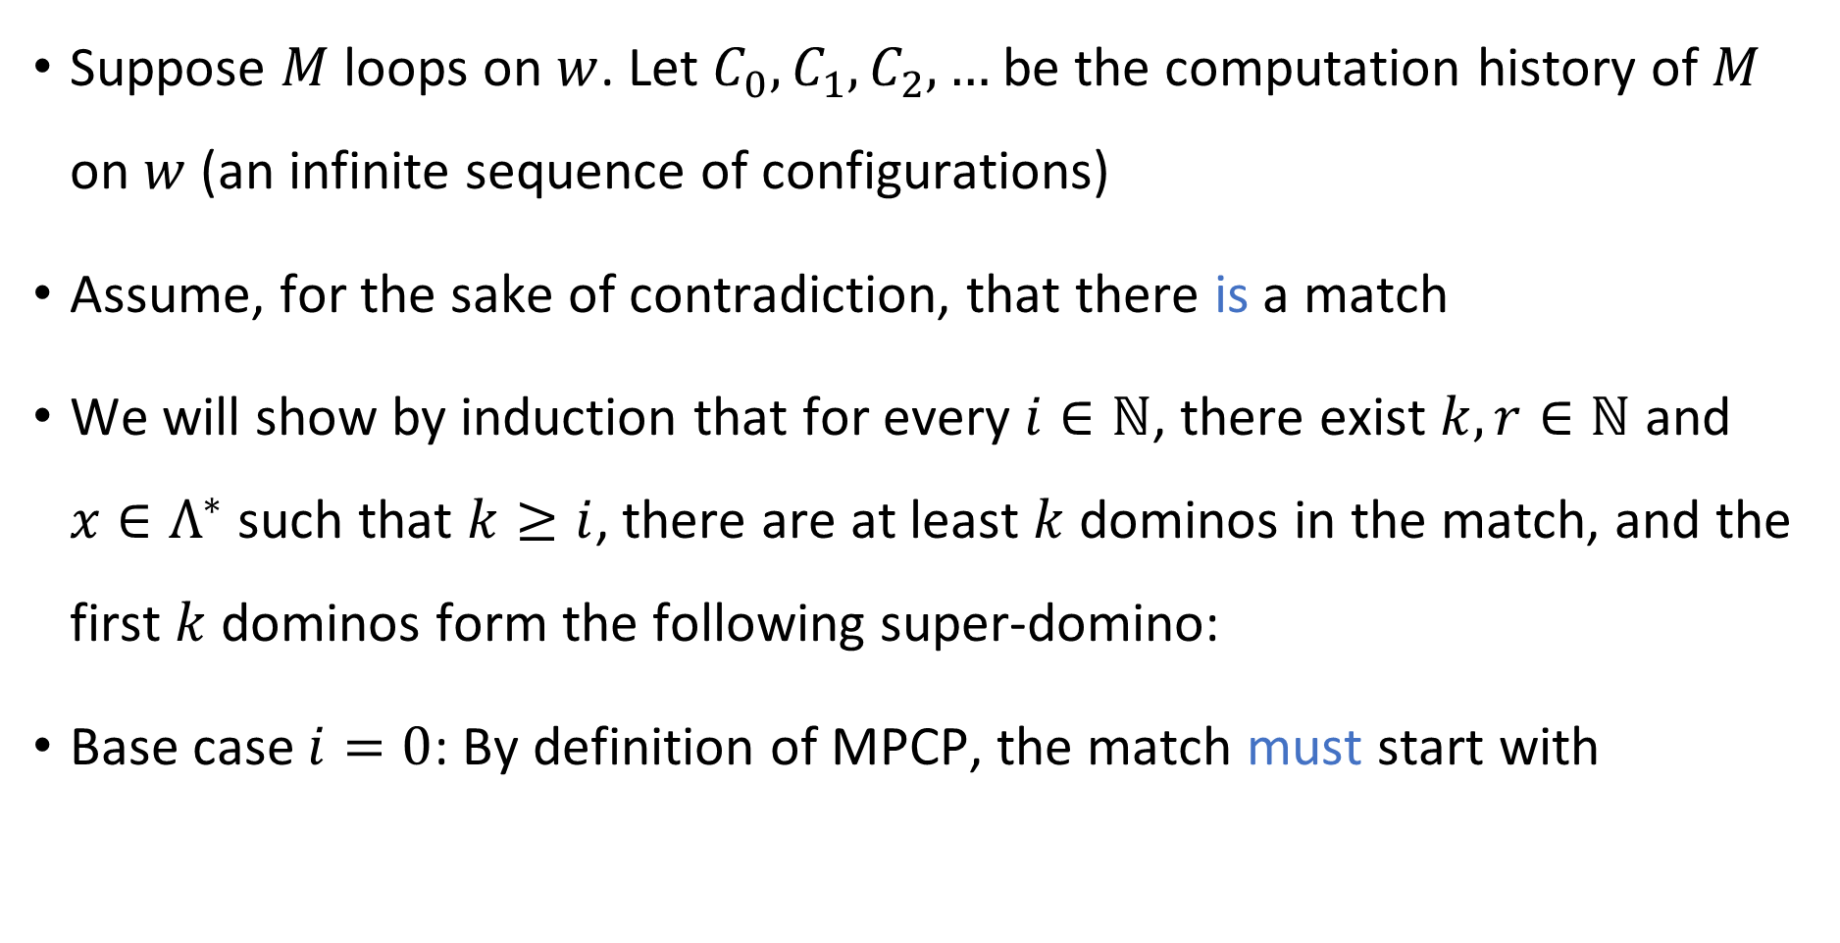

NO maps to NO
Suppose $M$ loops on $w$. Let $C_{0},C_{1},C_{2},…$ be the computation history of $M$ on $w$ (an infinite sequence of configurations)
Assume, for the sake of contradiction, that there is a match
We will show by induction that for every $i∈ℕ$, there exist $k,r∈ℕ$ and $x∈Λ^{∗}$ such that $k≥i$, there are at least $k$ dominos in the match, and the first $k$ dominos form the following super-domino:
Base case $i=0$: By definition of MPCP, the match must start with
$$\begin{matrix}x \\ xC_{i}⊔^{r}\#\end{matrix}$$
$$\begin{matrix}ε \\ ♢q_{0}w⊔\#\end{matrix}$$

Slide 20


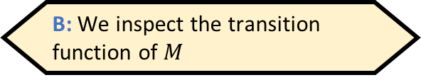




NO maps to NO
When we are computing the reduction, how do we know whether there is a match?
A: We simulate $M$ on $w$ and observe what happens
B: We inspect the transition function of $M$
Inductive step: Assume that the first $k$ dominos in the match form
Subsequent dominos must spell out $C_{i}⊔^{r}\#$ on top
Exercise: There are only two possible ways to do this, namely
followed by either or
Either way, the inductive step is complete
Consequence: The match is infinitely long, a contradiction
$$\begin{matrix}x \\ xC_{i}⊔^{r}\#\end{matrix}$$
C: We do not know whether there is a match, and that’s okay
D: We do not know whether there is a match, and that’s an issue
Respond at PollEv.com/whoza or text “whoza” to 22333
$$\begin{matrix}C_{i}⊔^{r} \\ C_{i+1}⊔^{r}\end{matrix}$$
$$\begin{matrix}\# \\ \#\end{matrix}$$
$$\begin{matrix}\# \\ ⊔\#\end{matrix}$$

Slide 21

NO maps to NO
This completes the proof that $\text{M}\text{PCP}$ is undecidable
We designed a mapping reduction from $\text{HALT}$ to $\text{MPCP}$
If $\text{MPCP}$ were decidable, then $\text{HALT}$ would be decidable too

Slide 22
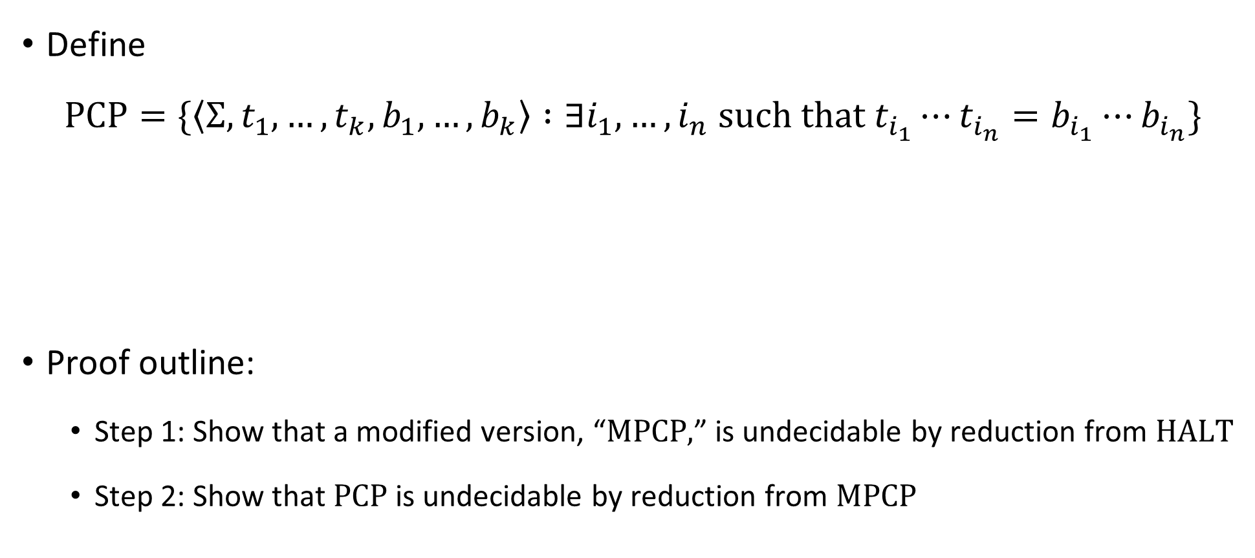
Post’s Correspondence Problem is undecidable
Define
$$\text{PCP}=\{\left\langle Σ, t_{1},…, t_{k}, b_{1},…, b_{k}\right\rangle :∃i_{1},…, i_{n} \text{such} \text{that} t_{i_{1}}⋯t_{i_{n}}=b_{i_{1}}⋯b_{i_{n}}\}$$
Proof outline:
Step 1: Show that a modified version, “$\text{MPCP}\text{,}$” is undecidable by reduction from $\text{HALT}$
Step 2: Show that $\text{PCP}$ is undecidable by reduction from $\text{MPCP}$
Theorem: $\text{PCP}$ is undecidable

Slide 23













Reduction from MPCP to PCP
For each string $u=u_{1}u_{2}…u_{n}$, define $\overline{u}=u_{1}⋆u_{2}⋆⋯⋆u_{n}$
Reduction:
$f\left( \begin{matrix} \\ \end{matrix} \right)=$
Computable ✔️
$$\begin{matrix}t_{1} \\ b_{1}\end{matrix}$$
$$\begin{matrix}t_{2} \\ b_{2}\end{matrix}$$
$$\begin{matrix}t_{3} \\ b_{3}\end{matrix}$$
$$\begin{matrix}t_{k} \\ b_{k}\end{matrix}$$
$$\begin{matrix}⋆\overline{t_{1}} \\ ⋆\overline{b_{1}}⋆\end{matrix}$$
$$\begin{matrix}⋆\overline{t_{1}} \\ \overline{b_{1}}⋆\end{matrix}$$
$$\begin{matrix}⋆\overline{t_{2}} \\ \overline{b_{2}}⋆\end{matrix}$$
$$\begin{matrix}⋆\overline{t_{3}} \\ \overline{b_{3}}⋆\end{matrix}$$
$$\begin{matrix}⋆\overline{t_{k}} \\ \overline{b_{k}}⋆\end{matrix}$$
$$\begin{matrix}⋆ \\ ε\end{matrix}$$
$$⋯$$
$$⋯$$

Slide 24













YES maps to YES
Suppose the MPCP instance has a match
Then the constructed PCP instance also has a match:
$$\begin{matrix}t_{1} \\ b_{1}\end{matrix}$$
$$\begin{matrix}t_{i_{1}} \\ b_{i_{1}}\end{matrix}$$
$$\begin{matrix}t_{i_{2}} \\ b_{i_{2}}\end{matrix}$$
$$\begin{matrix}t_{i_{3}} \\ b_{i_{3}}\end{matrix}$$
$$\begin{matrix}t_{i_{4}} \\ b_{i_{4}}\end{matrix}$$
$$\begin{matrix}t_{i_{n}} \\ b_{i_{n}}\end{matrix}$$
$$⋯$$
$$\begin{matrix}⋆\overline{t_{1}} \\ ⋆\overline{b_{1}}⋆\end{matrix}$$
$$\begin{matrix}⋆\overline{t_{i_{1}}} \\ \overline{b_{i_{1}}}⋆\end{matrix}$$
$$\begin{matrix}⋆\overline{t_{i_{2}}} \\ \overline{b_{i_{2}}}⋆\end{matrix}$$
$$\begin{matrix}⋆\overline{t_{i_{n}}} \\ \overline{b_{i_{n}}}⋆\end{matrix}$$
$$\begin{matrix}⋆ \\ ε\end{matrix}$$
$$⋯$$

Slide 25


NO maps to NO
We prove the contrapositive. Suppose the constructed PCP instance has a match
Must start with because that’s the only domino with the same first symbol on top and on bottom
Delete all the $⋆$ symbols from the match, and we get a match for the original MPCP instance
$$\begin{matrix}⋆\overline{t_{1}} \\ ⋆\overline{b_{1}}⋆\end{matrix}$$

Slide 26
Using reductions to prove undecidability
OBJECTION: “I don’t like mapping reductions. I preferred the first few undecidability proofs, where we did proofs by contradiction and the concept of a reduction was implicit.”
RESPONSE 1: Mapping reductions help us to reason clearly about undecidability
RESPONSE 2: You should get comfortable with the concept of a mapping reduction now in preparation for what will come later
The concept might feel “optional” now, but later it will be essential

Slide 27





The “emptiness problem”
Given $⟨M,w⟩$, how would we compute $f\left(\left\langle M,w\right\rangle \right)$?
A: Simulate $M$ on $w$, and if it ever halts, accept
B: Simulate $M$ on $w$ and construct $\left\langle M^{′}\right\rangle$ based on simulation results
Let ${\text{E}}_{TM}=\left\{\left\langle M\right\rangle :\text{there} \text{does} \text{not} \text{exist} w \text{such} \text{that} M \text{accepts} w\right\}$
Claim: ${\text{E}}_{TM}$ is undecidable
Proof: We will design a mapping reduction from $\overline{\text{HALT}}$ to ${\text{E}}_{TM}$
Let $f\left(\left\langle M,w\right\rangle \right)=\left\langle M^{′}\right\rangle$, where $M^{′}$ is a TM that does the following on input $x$:
Simulate $M$ on $w$
If $M$ ever halts, accept
YES maps to YES ✔️ NO maps to NO ✔️
C: Modify the transition function of $M$ to construct $\left\langle M^{′}\right\rangle$
D: There does not exist an algorithm that computes $f$
Respond at PollEv.com/whoza or text “whoza” to 22333
Computable ✔️

Slide 28
Which languages are undecidable?

Slide 29
Some more undecidable problems
We have seen several interesting examples of undecidable problems
To wrap up our discussion of undecidability, I’ll mention a few more examples of undecidable problems – but we won’t do the proofs
(This material will not be on problem sets or exams)

Slide 30


Hilbert’s 10th problem
Problem: Given a polynomial equation with integer coefficients such as
$$x^{2}+3xz+y^{3}+z^{2}x^{2}=4xy^{2}+6yz+2,$$
determine whether there is an integer solution
Let $\text{HILBERT}\text{10}=\{\left\langle p,q\right\rangle :∃\vec{x} \text{such} \text{that} p\left(\vec{x}\right)=q\left(\vec{x}\right)\}$
Theorem: $\text{HILBERT}\text{10}$ is undecidable

Slide 31

Derivatives vs. Integrals
Recall: Calculus
Computing derivatives is mechanistic
Sum rule ${\left(f+g\right)}^{′}=f^{′}+g′$, product rule ${\left(fg\right)}^{′}=f^{′}g+fg^{′}$, chain rule ${\left(f∘g\right)}^{′}=\left(f^{′}∘g\right)⋅g′$, etc.
In contrast, computing integrals seems to involve creativity
$u$-substitutions, integration by parts, etc.

Slide 32

Elementary functions
Definition: A function $f:ℝ→ℝ$ is elementary if it can be defined by a formula using addition, multiplication, rational constants, powers, exponentials, logarithms, trigonometric functions, and $π$
E.g. $f\left(x\right)=x⋅\sin\left(x^{4}\right)−3π⋅e^{e^{\sqrt{x}}}$

Slide 33


Integration is undecidable
Fact: There exist elementary functions that do not have elementary antiderivatives, such as $f\left(x\right)=e^{−x^{2}}$
Let $\text{INTEGRABLE}=\{\left\langle f\right\rangle :f \text{is} \text{an} \text{elementary} \text{function} \text{with} \text{an} \text{elementary} \text{antiderivative}\}$
Theorem: $\text{INTEGRABLE}$ is undecidable
Notes:
https://en.wikipedia.org/wiki/Richardson%27s_theorem

Slide 34


Matrix mortality
Let $M_{0}$ and $M_{1}$ be $n×n$ matrices with integer entries
We say that $\left(M_{0},M_{1}\right)$ is a mortal pair if there exists $w∈\{0, 1\}^{∗}$ such that
$$\prod_{i=1}^{|w|}{M_{w_{i}}}=\left[\begin{matrix}0 & 0 & ⋯ & 0 \\ 0 & 0 & ⋯ & 0 \\ ⋮ & ⋮ & ⋱ & ⋮ \\ 0 & 0 & ⋯ & 0\end{matrix}\right].$$
Let $\text{MORTAL}=\{\left\langle M_{0},M_{1}\right\rangle :\left(M_{0},M_{1}\right) \text{is} \text{a} \text{mortal} \text{pair}\}$
Theorem: $\text{MORTAL}$ is undecidable

Slide 35
Computability theory: Conclusions

Slide 36
Undecidability
For some problems, including some natural and interesting problems, there does not exist an algorithm that solves the problem
Key example: The halting problem

Slide 37
Computability theory beyond undecidability
We have only scratched the surface of computability theory
For example, which languages would be decidable if we had access to a device that solved the halting problem?
If you want to learn more about these subjects, consider taking MATH 30200-30300-30400

Slide 38
Midterm cutoff point
Midterm exam will be in class on Wednesday, April 17
To prepare for the midterm, you only need to study the material up to this point

