Slide 1
CMSC 28100 Introduction to Complexity Theory Autumn 2025 Instructor: William Hoza
⏳

Slide 2
Which problems can be solved through computation?

Slide 3
What are Turing machines capable of?

Slide 4
Which languages are decidable?

Slide 5
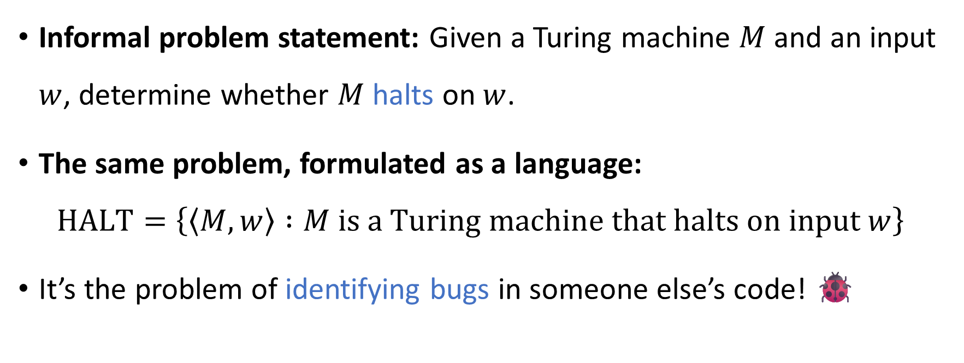
The halting problem
?
Informal problem statement: Given a Turing machine $M$ and an input $w$, determine whether $M$ halts on $w$.
The same problem, formulated as a language:
$$\text{HALT}=\left\{\left\langle M,w\right\rangle :M \text{is} \text{a} \text{Turing} \text{machine} \text{that} \text{halts} \text{on} \text{input} w\right\}$$
It’s the problem of identifying bugs in someone else’s code! 🐞

Slide 6



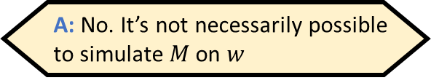
Attempting to decide $\text{HALT}$
?
Given $\left\langle M,w\right\rangle$:
Simulate $M$ on $w$
If it halts, accept
Otherwise, reject
Does the proposed algorithm work?
A: No. It’s not necessarily possible to simulate $M$ on $w$
B: No. There are inputs for which it should accept, but it doesn’t
C: No. There are inputs for which it should reject, but it doesn’t
D: Yes. $\text{HALT}$ is decidable
Respond at PollEv.com/whoza or text “whoza” to 22333

Slide 7


The halting problem is undecidable
?
$\text{HALT}=\{\left\langle M,w\right\rangle :M \text{is} \text{a} \text{Turing} \text{machine} \text{that} \text{halts} \text{on} w\}$
How should we prove it?
Theorem: $\text{HALT}$ is undecidable

Slide 8

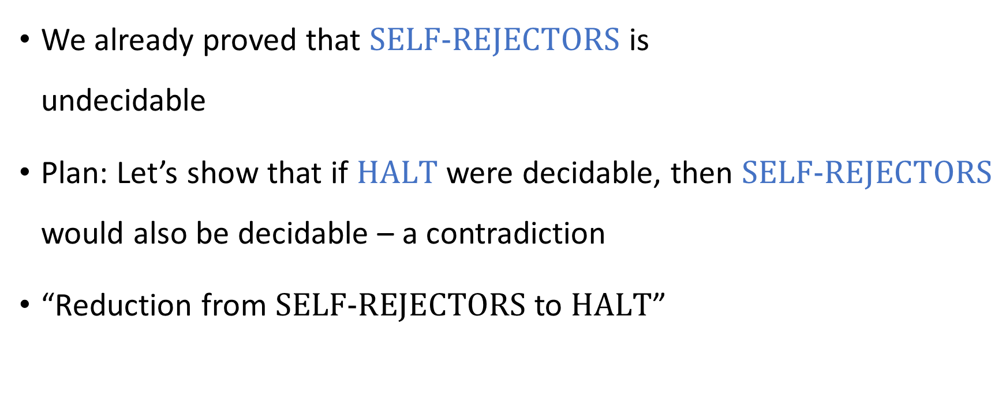
Reductions
We already proved that $\text{SELF}‑\text{REJECTORS}$ is undecidable
Plan: Let’s show that if $\text{HALT}$ were decidable, then $\text{SELF}‑\text{REJECTORS}$ would also be decidable – a contradiction
“Reduction from $\text{SELF}‑\text{REJECTORS}$ to $\text{HALT}$”

Slide 9







Proof that $\text{HALT}$ is undecidable
Assume for the sake of contradiction that there is some Turing machine $H$ that decides $\text{HALT}$
Let’s construct a new TM $S$ that decides $\text{SELF}‑\text{REJECTORS}$
If $M$ loops on $\left\langle M\right\rangle$, then $H$ rejects, so $S$ rejects ✔️
If $M$ accepts $\left\langle M\right\rangle$, then $H$ accepts and $M$ accepts, so $S$ rejects ✔️
If $M$ rejects $\left\langle M\right\rangle$, then $H$ accepts and $M$ rejects, so $S$ accepts ✔️
Given the input $\left\langle M\right\rangle$:
Simulate $H$ on $\left\langle M,\left\langle M\right\rangle \right\rangle$
If $H$ rejects, reject. Otherwise:
Simulate $M$ on $\left\langle M\right\rangle$
If $M$ rejects, accept; if $M$ accepts, reject.
$$S$$

Slide 10
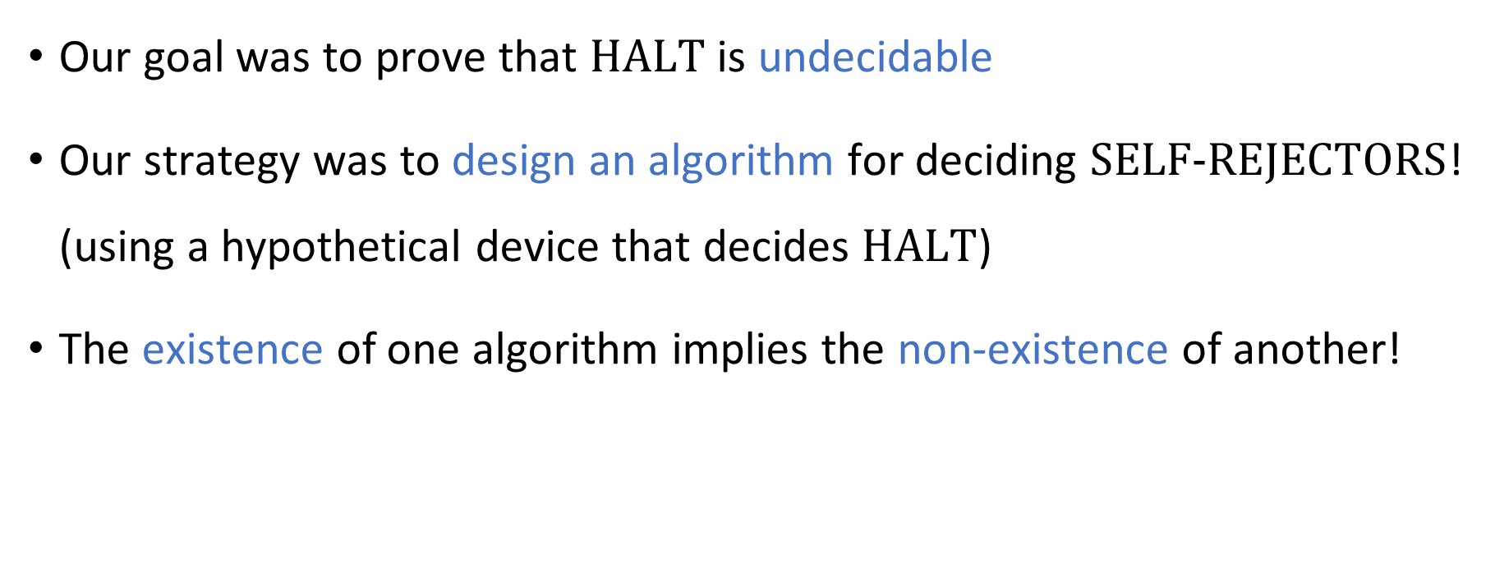
Reductions
Our goal was to prove that $\text{HALT}$ is undecidable
Our strategy was to design an algorithm for deciding $\text{SELF}‑\text{REJECTORS}$! (using a hypothetical device that decides $\text{HALT}$)
The existence of one algorithm implies the non-existence of another!

Slide 11

Note on standards of rigor
Given the input $\left\langle M\right\rangle$:
Simulate $H$ on $\left\langle M,\left\langle M\right\rangle \right\rangle$
If $H$ rejects, reject. Otherwise:
Simulate $M$ on $\left\langle M\right\rangle$
If $M$ rejects, accept; if $M$ accepts, reject.
Going forward, when we want to construct a Turing machine (e.g., for a reduction), we will simply describe what it does in plain English
As if we were giving instructions to a human being
Plain English description can be formalized as a Turing machine, but this is tedious
You should follow this convention on Exercise 8 and beyond

Slide 12
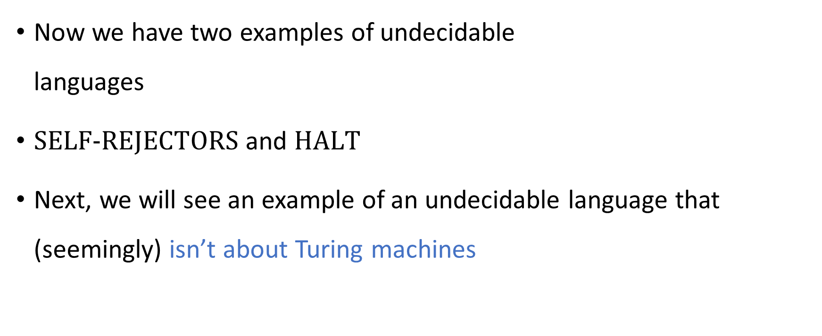
Undecidability
Now we have two examples of undecidable languages
$\text{SELF}‑\text{REJECTORS}$ and $\text{HALT}$
Next, we will see an example of an undecidable language that (seemingly) isn’t about Turing machines

Slide 13





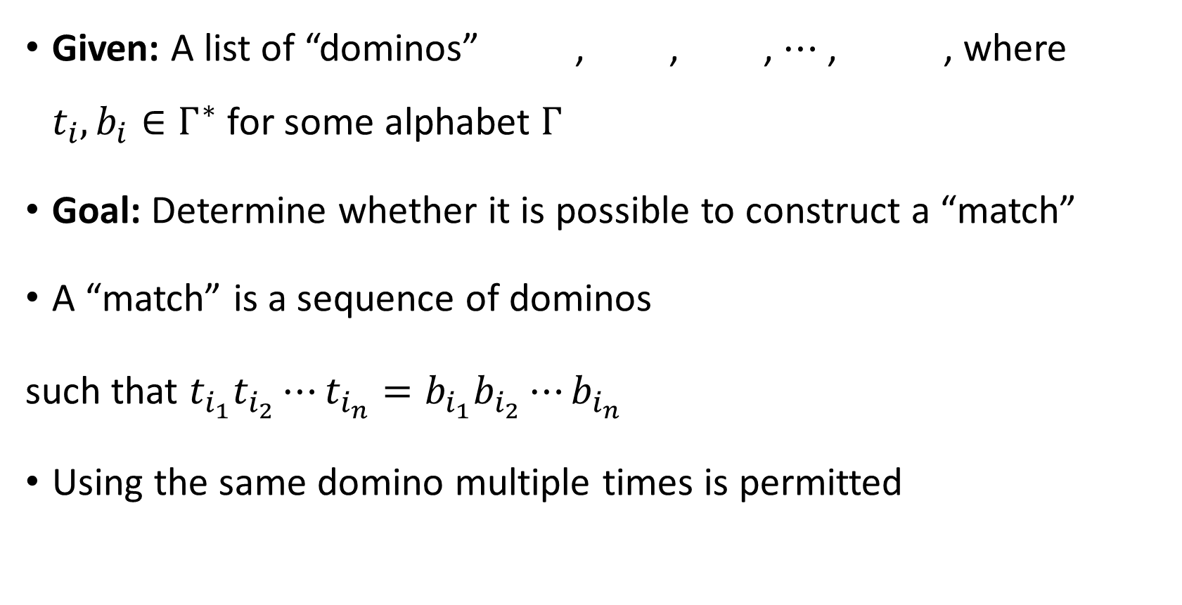






Post’s Correspondence Problem
Given: A list of “dominos” , , , $⋯$ , , where $t_{i},b_{i}∈Γ^{∗}$ for some alphabet $Γ$
Goal: Determine whether it is possible to construct a “match”
A “match” is a sequence of dominos
such that $t_{i_{1}}t_{i_{2}}⋯t_{i_{n}}=b_{i_{1}}b_{i_{2}}⋯b_{i_{n}}$
Using the same domino multiple times is permitted
$$\begin{matrix}t_{1} \\ b_{1}\end{matrix}$$
$$\begin{matrix}t_{2} \\ b_{2}\end{matrix}$$
$$\begin{matrix}t_{3} \\ b_{3}\end{matrix}$$
$$\begin{matrix}t_{k} \\ b_{k}\end{matrix}$$
$$\begin{matrix}t_{i_{1}} \\ b_{i_{1}}\end{matrix}$$
$$\begin{matrix}t_{i_{2}} \\ b_{i_{2}}\end{matrix}$$
$$\begin{matrix}t_{i_{3}} \\ b_{i_{3}}\end{matrix}$$
$$\begin{matrix}t_{i_{4}} \\ b_{i_{4}}\end{matrix}$$
$$\begin{matrix}t_{i_{5}} \\ b_{i_{5}}\end{matrix}$$
$$\begin{matrix}t_{i_{n}} \\ b_{i_{n}}\end{matrix}$$
$$⋯$$

Slide 14






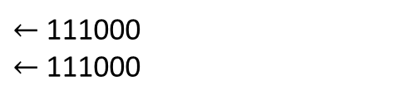


Post’s Correspondence Problem: Example 1
Suppose we are given
This is a YES case. Match:
$$\begin{matrix}\text{0} \\ \text{1}\end{matrix}$$
$$\begin{matrix}\text{1} \\ \text{0}\end{matrix}$$
$$\begin{matrix}\text{1}\text{11} \\ 1\end{matrix}$$
$$\begin{matrix}0 \\ 000\end{matrix}$$
$$\begin{matrix}\text{1}\text{11} \\ 1\end{matrix}$$
$$\begin{matrix}\text{0} \\ \text{1}\end{matrix}$$
$$\begin{matrix}\text{0} \\ \text{1}\end{matrix}$$
$$\begin{matrix}0 \\ 000\end{matrix}$$
$←$111000
$←$111000

Slide 15





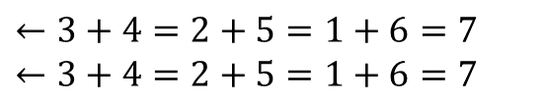






Post’s Correspondence Problem: Example 2
Suppose we are given
This is a YES case. Match:
$$\begin{matrix}+5= \\ =1+\end{matrix}$$
$$\begin{matrix}6=7 \\ 7\end{matrix}$$
$$\begin{matrix}3+ \\ 3+4=\end{matrix}$$
$$\begin{matrix}1+ \\ 6=\end{matrix}$$
$$\begin{matrix}4= \\ 1+6\end{matrix}$$
$$\begin{matrix}4=2 \\ 2+5\end{matrix}$$
$$\begin{matrix}3+ \\ 3+4=\end{matrix}$$
$$\begin{matrix}4=2 \\ 2+5\end{matrix}$$
$$\begin{matrix}+5= \\ =1+\end{matrix}$$
$$\begin{matrix}1+ \\ 6=\end{matrix}$$
$$\begin{matrix}6=7 \\ 7\end{matrix}$$
$←3+4=2+5=1+6=7$
$←3+4=2+5=1+6=7$

Slide 16

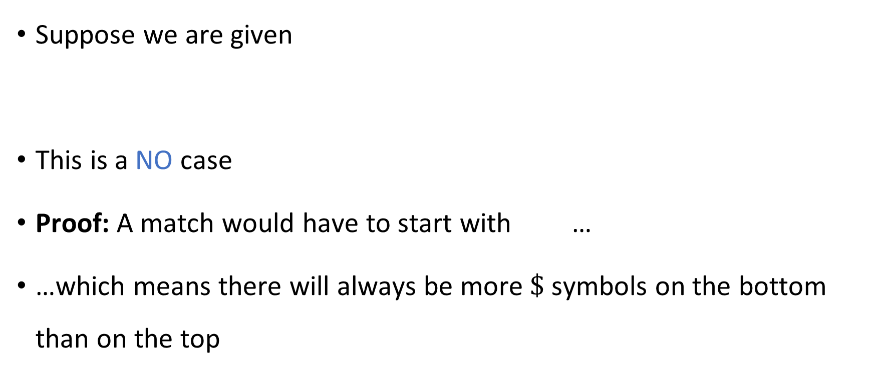



Post’s Correspondence Problem: Example 3
Suppose we are given
This is a NO case
Proof: A match would have to start with …
…which means there will always be more $\$$ symbols on the bottom than on the top
$$\begin{matrix}\text{\#} \\ \text{\#\$}\end{matrix}$$
$$\begin{matrix}\text{\#}\text{\$\#} \\ \text{\$\#}\end{matrix}$$
$$\begin{matrix}\text{\$} \\ \text{\#\$}\end{matrix}$$
$$\begin{matrix}\text{\#} \\ \text{\#\$}\end{matrix}$$

Slide 17
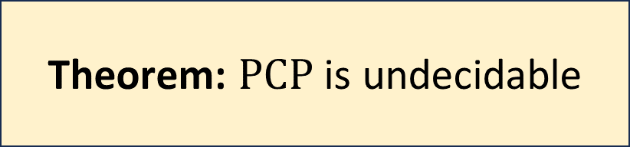
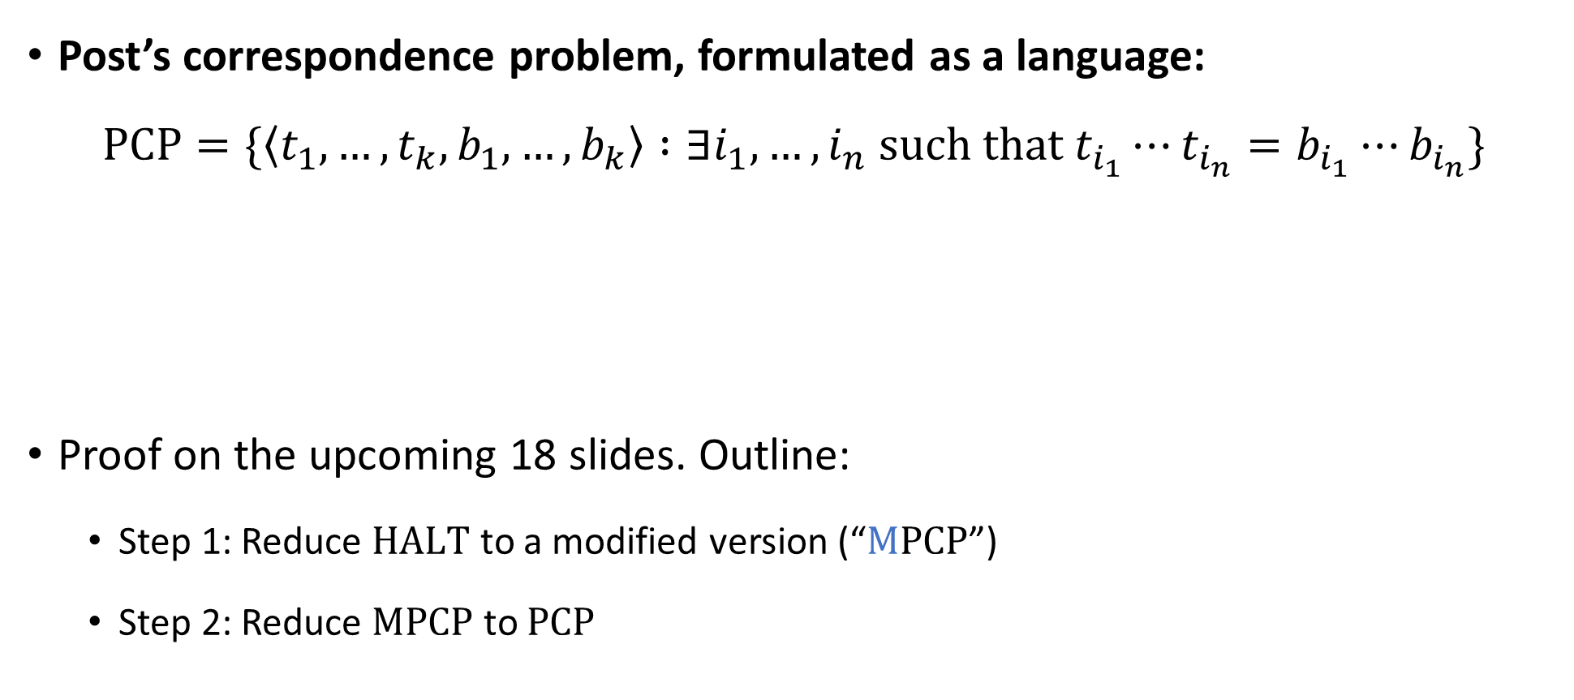
Post’s Correspondence Problem is undecidable
Post’s correspondence problem, formulated as a language:
$$\text{PCP}=\{\left\langle t_{1},…, t_{k}, b_{1},…, b_{k}\right\rangle :∃i_{1},…, i_{n} \text{such} \text{that} t_{i_{1}}⋯t_{i_{n}}=b_{i_{1}}⋯b_{i_{n}}\}$$
Proof on the upcoming 18 slides. Outline:
Step 1: Reduce $\text{HALT}$ to a modified version (“$\text{M}\text{PCP}$”)
Step 2: Reduce $\text{MPCP}$ to $\text{PCP}$
Theorem: $\text{PCP}$ is undecidable

Slide 18


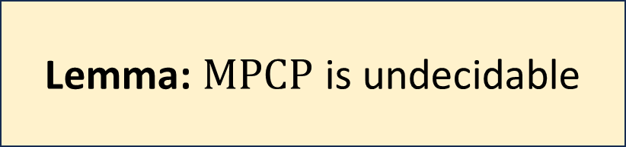
Modified PCP
$$\text{MPCP}=\{\left\langle t_{1},…, t_{k}, b_{1},…, b_{k}\right\rangle :∃i_{1},…, i_{n} \text{such} \text{that} t_{1}t_{i_{1}}⋯t_{i_{n}}=b_{1}b_{i_{1}}⋯b_{i_{n}}\}$$
New feature: In $\text{MPCP}$, matches must start with the first domino
We’ll use a double outline to indicate the special first domino:
$$\begin{matrix}t_{1} \\ b_{1}\end{matrix}$$
Lemma: $M\text{PCP}$ is undecidable

Slide 19




Proof that $\text{MPCP}$ is undecidable
Assume there is a TM $P$ that decides $\text{MPCP}$
Let’s construct a new TM $H$ that decides $\text{HALT}$
Given $\left\langle M,w\right\rangle$:
Construct dominos $t_{1},…, t_{k},b_{1},…b_{k}$ based on $M$ and $w$ (details on upcoming slides)
Simulate $P$ on $\left\langle t_{1},…, t_{k},b_{1},…, b_{k}\right\rangle$
If $P$ accepts, accept. If $P$ rejects, reject.
$$H$$

Slide 20
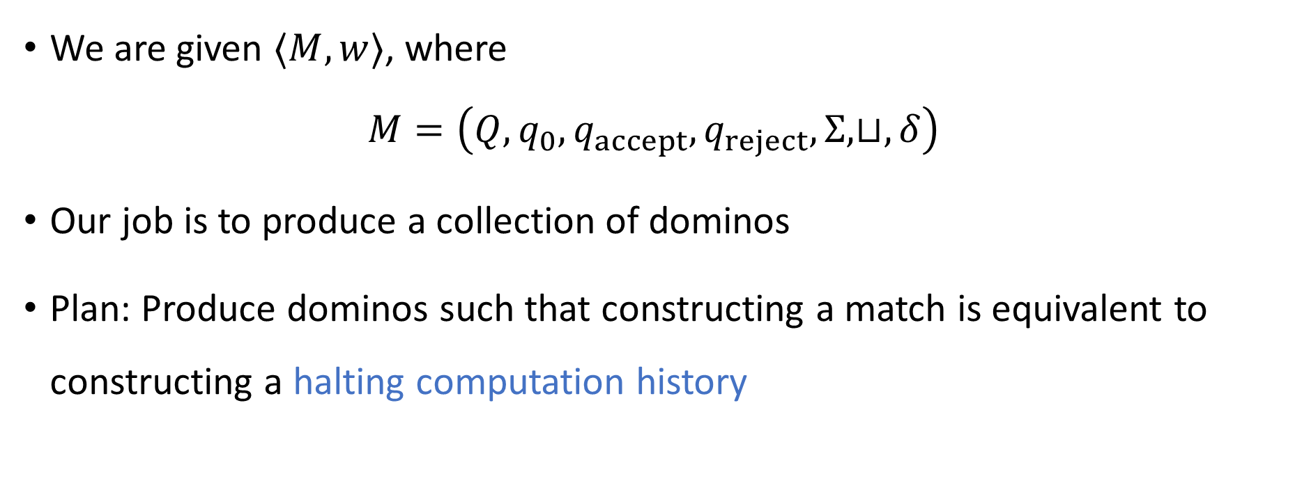

Reducing $\text{HALT}$ to $\text{MPCP}$
We are given $⟨M,w⟩$, where $M=\left(Q, q_{0},q_{accept},q_{reject},Σ,⊔,δ\right)$
Our job is to produce a collection of dominos
Plan: Produce dominos such that constructing a match is equivalent to constructing a halting computation history

Slide 21



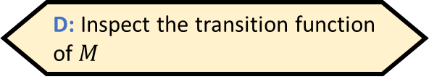



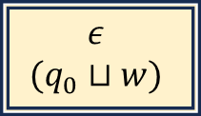

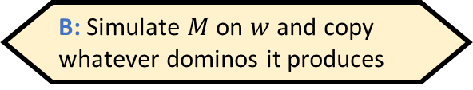





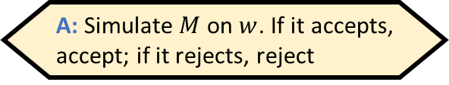



The dominos for $\left\langle M,w\right\rangle$
Given $⟨M,w⟩$, how does one construct these dominos?
A: Simulate $M$ on $w$. If it accepts, accept; if it rejects, reject
B: Simulate $M$ on $w$ and copy whatever dominos it produces
C: There is no algorithm for constructing the dominos
D: Inspect the transition function of $M$
, , , , and
For every $q∈Q∖\left\{q_{accept},q_{reject}\right\}$ and every $b∈Σ$:
If $δ\left(q,b\right)=\left(q^{′},b^{′},\text{R}\right)$, we include , and we include for every $a∈Σ$
If $δ\left(q,b\right)=\left(q^{′},b^{′},\text{L}\right)$, we include , and we include for every $a∈Σ$
, , , , and for every $b∈Σ$
$$\begin{matrix}ε \\ (q_{0}⊔w)\end{matrix}$$
$$\begin{matrix}( \\ (\end{matrix}$$
$$\begin{matrix}) \\ )\end{matrix}$$
$$\begin{matrix}(q_{accept}) \\ ε\end{matrix}$$
$$\begin{matrix}(q_{reject}) \\ ε\end{matrix}$$
Respond at PollEv.com/whoza or text “whoza” to 22333
$$\begin{matrix}qb) \\ b^{′}q^{′}⊔)\end{matrix}$$
$$\begin{matrix}qba \\ b^{′}q^{′}a\end{matrix}$$
$$\begin{matrix}(qb \\ (q^{′}⊔b′\end{matrix}$$
$$\begin{matrix}aqb \\ q^{′}ab′\end{matrix}$$
$$\begin{matrix}b \\ b\end{matrix}$$
$$\begin{matrix}bq_{accept} \\ q_{accept}\end{matrix}$$
$$\begin{matrix}q_{accept}b \\ q_{accept}\end{matrix}$$
$$\begin{matrix}q_{reject}b \\ q_{reject}\end{matrix}$$
$$\begin{matrix}bq_{reject} \\ q_{reject}\end{matrix}$$

Slide 22



Proof that $\text{MPCP}$ is undecidable
Assume there is a TM $P$ that decides $\text{MPCP}$
Let’s construct a new TM $H$ that decides $\text{HALT}$
Given $\left\langle M,w\right\rangle$:
Construct dominos $t_{1},…, t_{k},b_{1},…b_{k}$ based on $M$ and $w$ (details on preceding slides)
Simulate $P$ on $\left\langle t_{1},…, t_{k},b_{1},…, b_{k}\right\rangle$
If $P$ accepts, accept. If $P$ rejects, reject.
Need to show:
If $M$ halts on $w$, then there is a match
If there is a match, then $M$ halts on $w$
$$H$$

Slide 23











Domino Feature 1
Domino Feature 1: For every non-halting configuration $C$ of $M$, there is a sequence of dominos such that the top string is $\left(C\right)$ and bottom string is $\left(\text{NEXT}\left(C\right)\right)$
Proof omitted, but here’s an example:
Think of this sequence as one “super-domino”
$$\begin{matrix}( \\ (\end{matrix}$$
$$\begin{matrix}0 \\ 0\end{matrix}$$
$$\begin{matrix}1 \\ 1\end{matrix}$$
$$\begin{matrix}\# \\ \#\end{matrix}$$
$$\begin{matrix}0 \\ 0\end{matrix}$$
$$\begin{matrix}0q_{1}0 \\ q_{2}01\end{matrix}$$
$$\begin{matrix}0 \\ 1\end{matrix}$$
$$\begin{matrix}⊔ \\ ⊔\end{matrix}$$
$$\begin{matrix}) \\ )\end{matrix}$$
$$\begin{matrix}\left(C\right) \\ \left(\text{NEXT}\left(C\right)\right)\end{matrix}$$

Slide 24







If $M$ halts on $w$, then there is a match
Let $C_{0},…, C_{T}$ be the halting computation history of $M$ on $w$
Partial match:
At this point, we have an extra $\left(C_{T}\right)$ on the bottom
$$\begin{matrix}ε \\ (C_{0})\end{matrix}$$
$$\begin{matrix}(C_{0}) \\ \left(C_{1}\right)\end{matrix}$$
$$\begin{matrix}(C_{1}) \\ \left(C_{2}\right)\end{matrix}$$
$$\begin{matrix}(C_{T−1}) \\ \left(C_{T}\right)\end{matrix}$$
$$⋯$$

Slide 25











Domino Feature 2
Domino Feature 2: For every halting configuration $D$, there is a sequence of dominos such that the top string is $\left(D\right)$ and the bottom string is $\left(D^{′}\right)$, where $D^{′}$ is a halting configuration* of length $\left|D\right|−1$
*Possibly $D^{′}=q_{accept}$ or $q_{reject}$ by itself
Proof omitted, but here’s an example:
Think of this sequence as one “super domino”
$$\begin{matrix}( \\ (\end{matrix}$$
$$\begin{matrix}0 \\ 0\end{matrix}$$
$$\begin{matrix}1 \\ 1\end{matrix}$$
$$\begin{matrix}\# \\ \#\end{matrix}$$
$$\begin{matrix}0 \\ 0\end{matrix}$$
$$\begin{matrix}0q_{reject} \\ q_{reject}\end{matrix}$$
$$\begin{matrix}0 \\ 1\end{matrix}$$
$$\begin{matrix}⊔ \\ ⊔\end{matrix}$$
$$\begin{matrix}) \\ )\end{matrix}$$
$$\begin{matrix}\left(D\right) \\ \left(D^{′}\right)\end{matrix}$$

Slide 26













If $M$ halts on $w$, then there is a match
We construct a sequence of shorter and shorter halting configurations ${C_{T}=D}_{0},D_{1},…, D_{n}$ such that $\left|D_{n}\right|=1$ and we have a super-domino for every $i$
Full match:
$$\begin{matrix}{(D}_{i−1}) \\ \left(D_{i}\right)\end{matrix}$$
$$\begin{matrix}ε \\ (C_{0})\end{matrix}$$
$$\begin{matrix}(C_{0}) \\ \left(C_{1}\right)\end{matrix}$$
$$\begin{matrix}(C_{1}) \\ \left(C_{2}\right)\end{matrix}$$
$$\begin{matrix}(C_{T−1}) \\ \left(C_{T}\right)\end{matrix}$$
$$\begin{matrix}(C_{T}) \\ (D_{1})\end{matrix}$$
$$\begin{matrix}(D_{1}) \\ (D_{2})\end{matrix}$$
$$\begin{matrix}(D_{2}) \\ (D_{3})\end{matrix}$$
$$\begin{matrix}(D_{n−1}) \\ (D_{n})\end{matrix}$$
$$\begin{matrix}(D_{n}) \\ ε\end{matrix}$$
$$⋯$$
$$⋯$$

Slide 27



Proof that $\text{MPCP}$ is undecidable
Assume there is a TM $P$ that decides $\text{MPCP}$
Let’s construct a new TM $H$ that decides $\text{HALT}$
Given $\left\langle M,w\right\rangle$:
Construct dominos $t_{1},…, t_{k},b_{1},…b_{k}$ based on $M$ and $w$ (details on preceding slides)
Simulate $P$ on $\left\langle t_{1},…, t_{k},b_{1},…, b_{k}\right\rangle$
If $P$ accepts, accept. If $P$ rejects, reject.
Need to show:
If $M$ halts on $w$, then there is a match ✔️
If there is a match, then $M$ halts on $w$
$$H$$

