Slide 1
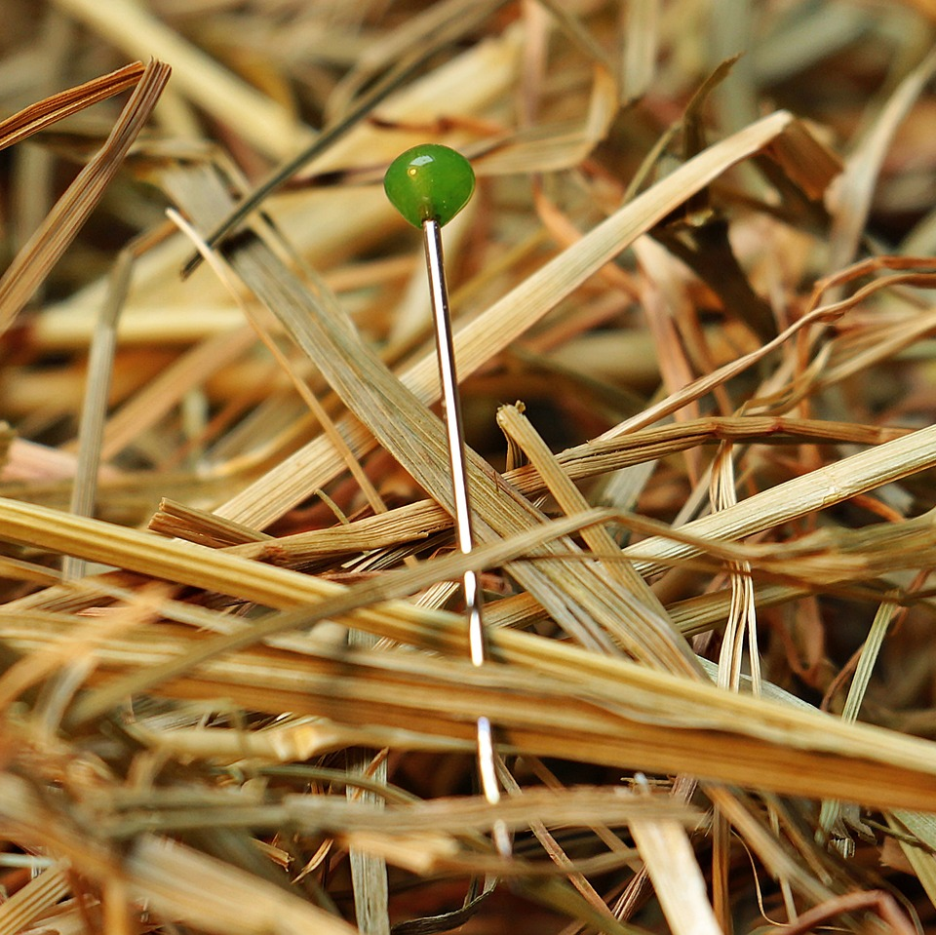
CMSC 28100 Introduction to Complexity Theory Spring 2025 Instructor: William Hoza

Slide 2










Circuit satisfiability is $\text{NP}$-complete
$$∨$$
$$∧$$
$$∧$$
$$¬$$
$$¬$$
Let $\text{CIRCUIT}\text{‑}\text{SAT}=\{\left\langle C\right\rangle :C \text{is} \text{a} \text{satisfiable} \text{circuit}\}$
Proof: Next 8 slides
$$x_{1}$$
$$x_{2}$$
Theorem: $\text{CIRCUIT}\text{‑}\text{SAT}$ is $\text{NP}$-complete.

Slide 3
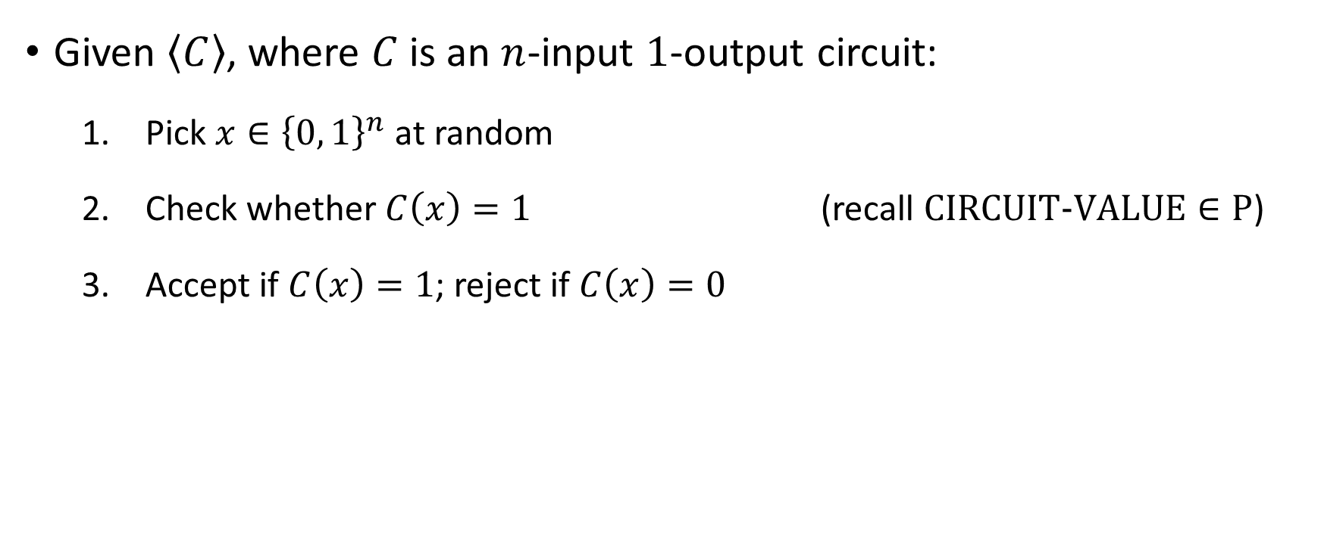

Proof that $\text{CIRCUIT}\text{‑}\text{SAT}∈\text{NP}$
Given $\left\langle C\right\rangle$, where $C$ is an $n$-input $1$-output circuit:
Pick $x∈{\left\{0, 1\right\}}^{n}$ at random
Check whether $C\left(x\right)=1$ (recall $\text{CIRCUIT}\text{‑}\text{VALUE}∈\text{P}$)
Accept if $C\left(x\right)=1$; reject if $C\left(x\right)=0$

Slide 4
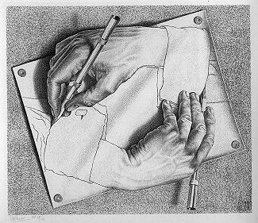
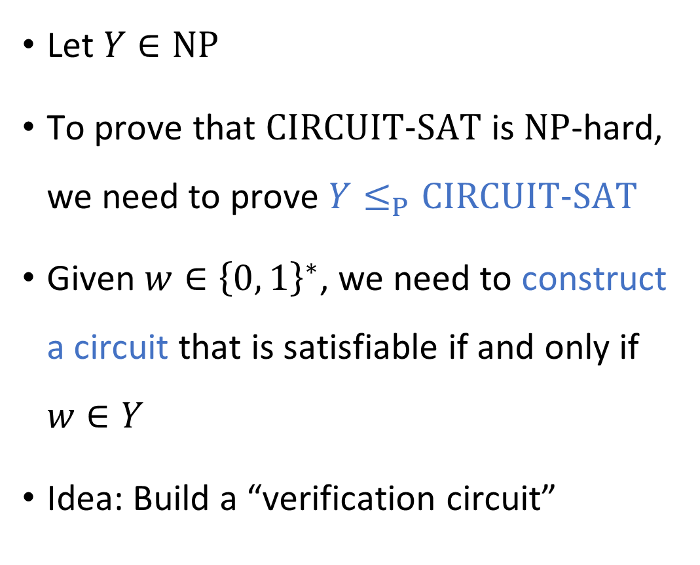
Code as data IV
Let $Y∈\text{NP}$
To prove that $\text{CIRCUIT}\text{‑}\text{SAT}$ is $\text{NP}$-hard, we need to prove $Y≤_{P}\text{CIRCUIT}\text{‑}\text{SAT}$
Given $w∈{\left\{0, 1\right\}}^{∗}$, we need to construct a circuit that is satisfiable if and only if $w∈Y$
Idea: Build a “verification circuit”
“Drawing Hands.”
(1948 lithograph by M. C. Escher)

Slide 5
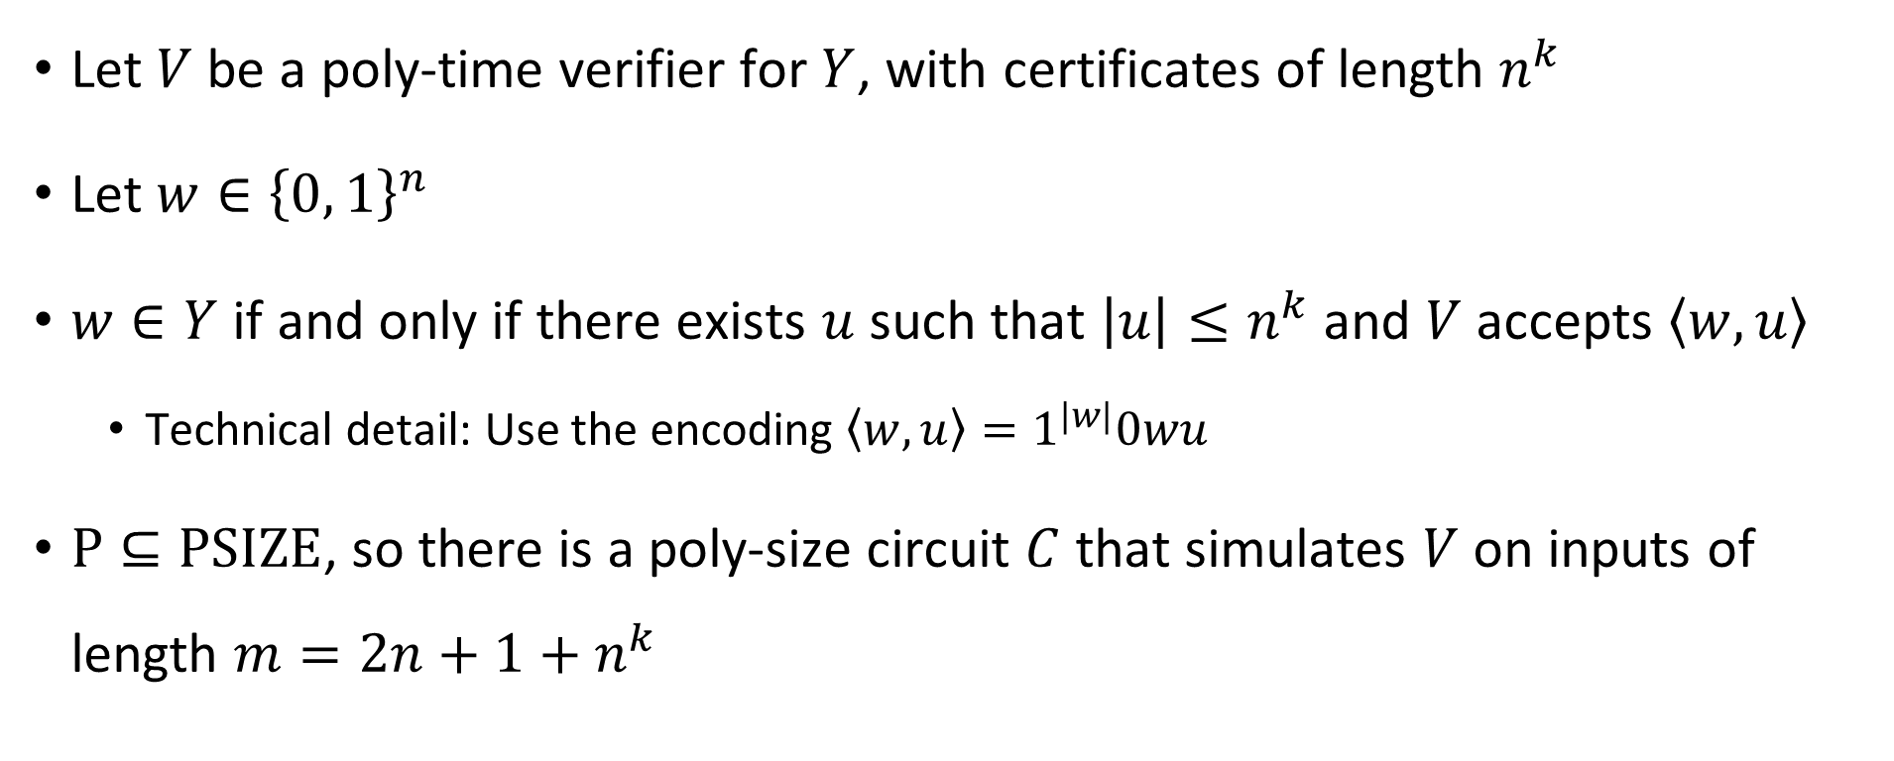
Constructing the verification circuit
Let $V$ be a poly-time verifier for $Y$, with certificates of length $n^{k}$
Let $w∈{\left\{0, 1\right\}}^{n}$
$w∈Y$ if and only if there exists $u$ such that $\left|u\right|≤n^{k}$ and $V$ accepts $\left\langle w,u\right\rangle$
Technical detail: Use the encoding $\left\langle w,u\right\rangle =1^{|w|}0wu$
$\text{P}⊆\text{PSIZE}$, so there is a poly-size circuit $C$ that simulates $V$ on inputs of length $m=2n+1+n^{k}$

Slide 6

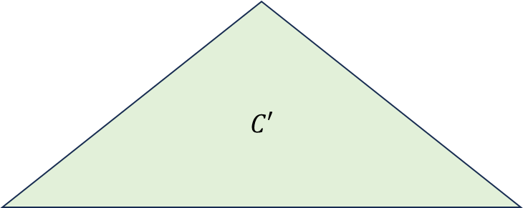

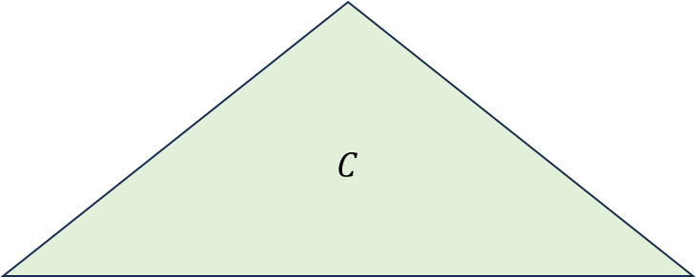




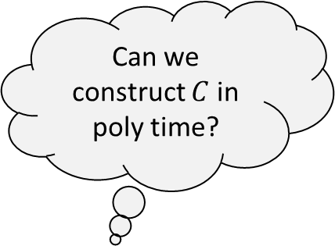
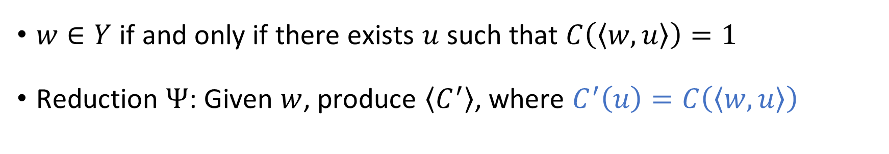














Constructing the verification circuit
$$C$$
$$C′$$
$$⋯$$
$$⋯$$
$$⋯$$
$$⋯$$
$$x_{1}$$
$$x_{2}$$
$$x_{3}$$
$$x_{4}$$
$$x_{5}$$
$$x_{6}$$
$$x_{7}$$
$$x_{m}$$
$$1$$
$$1$$
$$1$$
$$0$$
$$0$$
$$1$$
$$1$$
$$u_{1}$$
$$u_{2}$$
$$u_{3}$$
$$u_{n^{k}}$$
Can we construct $C$ in poly time?
$1^{n}0w$ “hard-coded” into circuit
$w∈Y$ if and only if there exists $u$ such that $C\left(\left\langle w,u\right\rangle \right)=1$
Reduction $Ψ$: Given $w$, produce $\left\langle C^{′}\right\rangle$, where $C^{′}\left(u\right)=C\left(\left\langle w,u\right\rangle \right)$

Slide 7










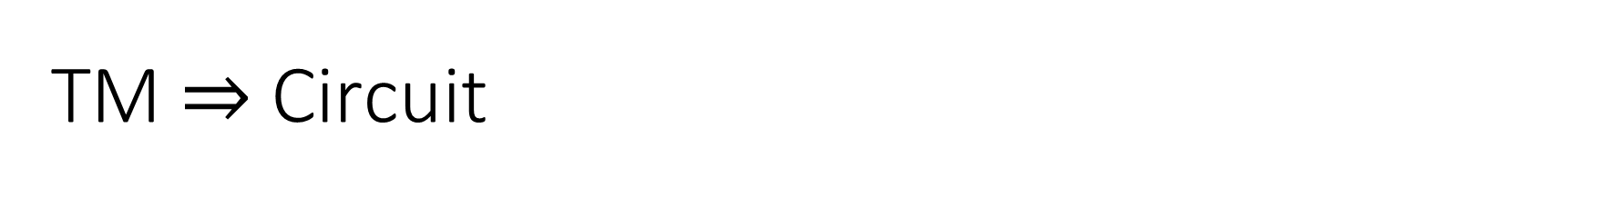








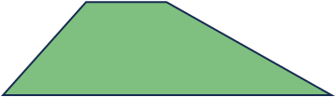



















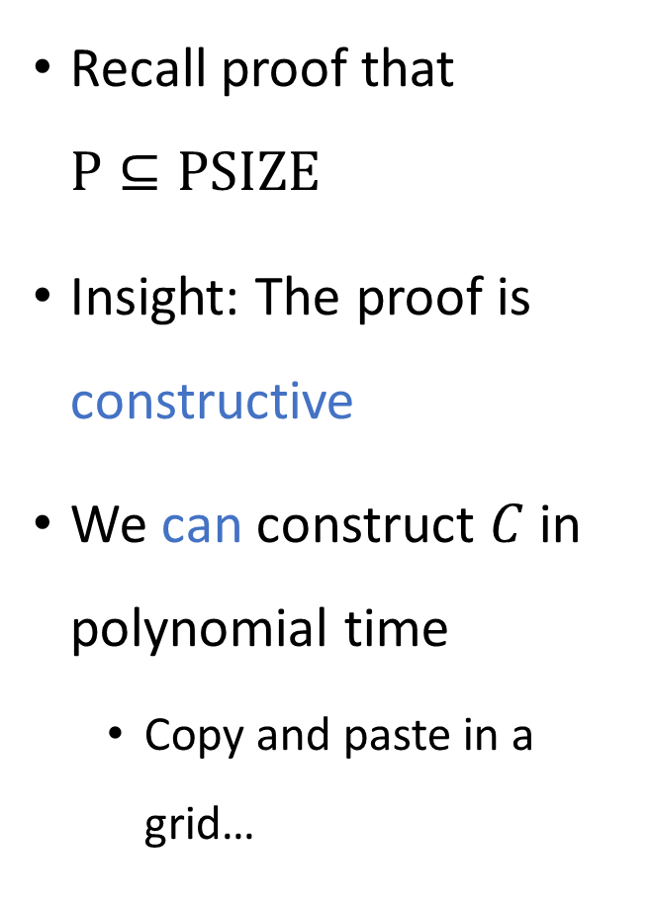









TM $⇒$ Circuit
$$V_{m}\left(x\right)$$
Recall proof that $\text{P}⊆\text{PSIZE}$
Insight: The proof is constructive
We can construct $C$ in polynomial time
Copy and paste in a grid…
$$\left\langle ⊔\right\rangle$$
$$\left\langle ⊔\right\rangle$$
$$\left\langle ⊔\right\rangle$$
$$\left\langle ⊔\right\rangle$$
$$\left\langle ⊔\right\rangle$$
$$\left\langle ⊔\right\rangle$$
$$\left\langle ⊔\right\rangle$$
$$\left\langle ⊔\right\rangle$$
$$\left\langle ⊔\right\rangle$$
$$\left\langle ⊔\right\rangle$$
$$\left\langle ⊔\right\rangle$$
$$\left\langle ⊔\right\rangle$$
$$\left\langle ⊔\right\rangle$$
$$\left\langle ⊔\right\rangle$$
$$\left\langle ⊔\right\rangle$$
$$\left\langle ⊔\right\rangle$$
$$\left\langle ⊔\right\rangle$$
$$\left\langle ⊔\right\rangle$$
$$\left\langle ⊔\right\rangle$$
$$\left\langle ⊔\right\rangle$$
$$\left\langle ⊔\right\rangle$$
$$\left\langle ⊔\right\rangle$$
$$\left\langle ⊔\right\rangle$$
$$\left\langle ⊔\right\rangle$$
$$\left\langle ⊔\right\rangle$$
$$\left\langle ⊔\right\rangle$$
$$\left\langle ⊔\right\rangle$$
$$\left\langle ⊔\right\rangle$$
$$\left\langle ⊔\right\rangle$$
$$\left\langle ⊔\right\rangle$$
$$\left\langle ⊔\right\rangle$$
$$\left\langle ⊔\right\rangle$$
$$\left\langle ⊔\right\rangle$$
$$\left\langle ⊔\right\rangle$$
$$\left\langle q_{0}\right\rangle$$
$$0$$
$$\left\langle ⊔\right\rangle$$
$$\left\langle ⊔\right\rangle$$
$$\left\langle ⊔\right\rangle$$
$$\left\langle ⊔\right\rangle$$
$$0$$
$$0$$
$$0$$
$$0$$
$$0$$
$$x_{1}$$
$$x_{2}$$
$$x_{3}$$

Slide 8
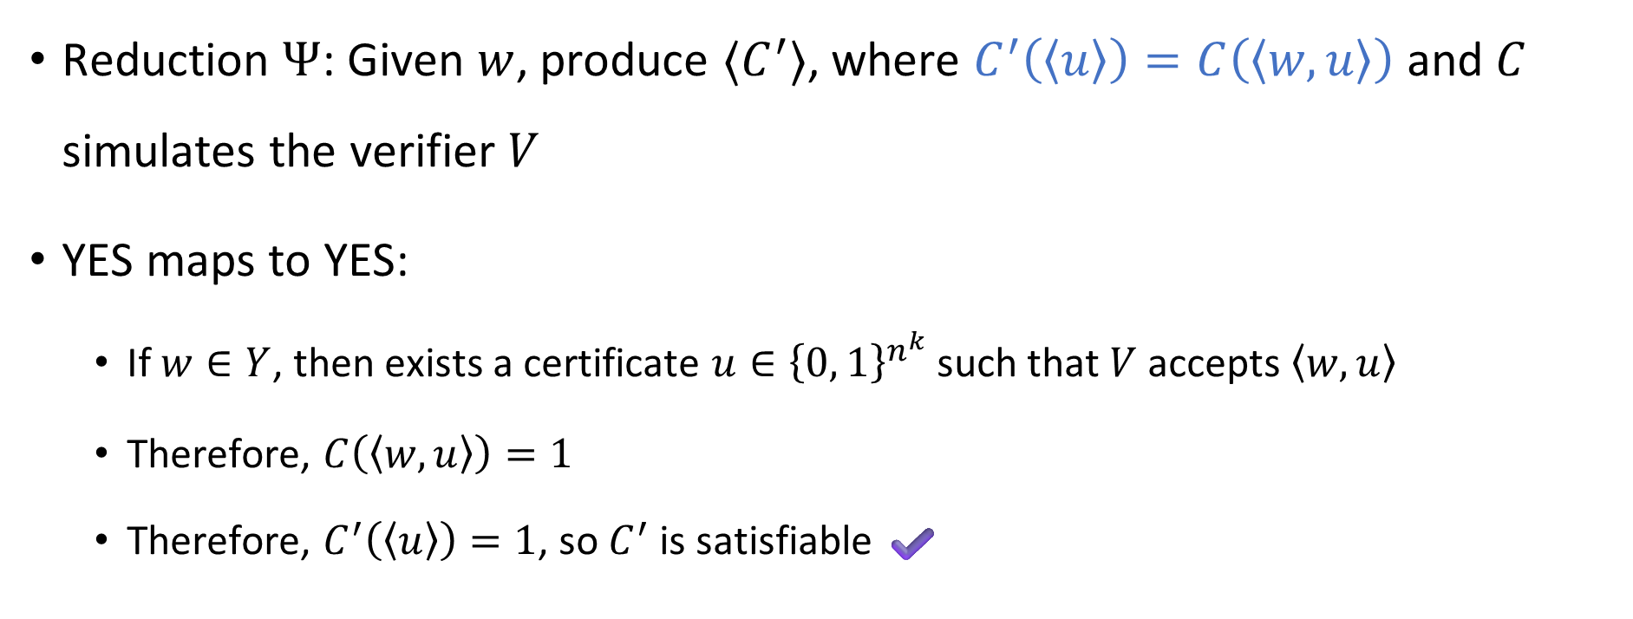

Proof that $\text{CIRCUIT}\text{‑}\text{SAT}$ is $\text{NP}$-hard
Reduction $Ψ$: Given $w$, produce $⟨C^{′}⟩$, where $C^{′}\left(\left\langle u\right\rangle \right)=C\left(\left\langle w,u\right\rangle \right)$ and $C$ simulates the verifier $V$
YES maps to YES:
If $w∈Y$, then exists a certificate $u∈{\left\{0, 1\right\}}^{n^{k}}$ such that $V$ accepts $\left\langle w,u\right\rangle$
Therefore, $C\left(\left\langle w,u\right\rangle \right)=1$
Therefore, $C^{′}\left(\left\langle u\right\rangle \right)=1$, so $C^{′}$ is satisfiable ✔️

Slide 9
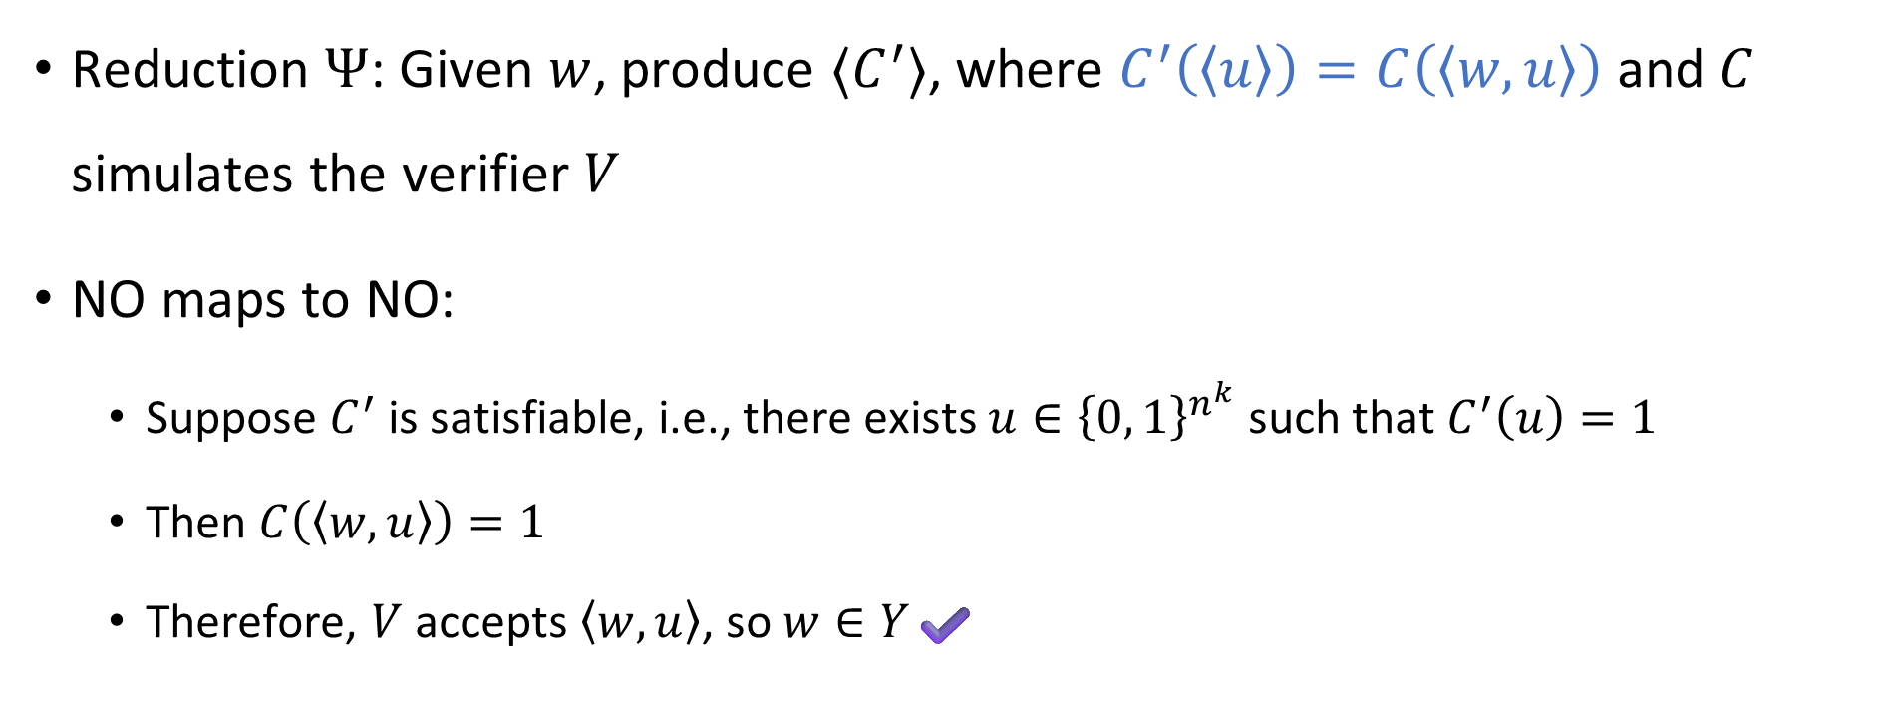

Proof that $\text{CIRCUIT}\text{‑}\text{SAT}$ is $\text{NP}$-hard
Reduction $Ψ$: Given $w$, produce $⟨C^{′}⟩$, where $C^{′}\left(\left\langle u\right\rangle \right)=C\left(\left\langle w,u\right\rangle \right)$ and $C$ simulates the verifier $V$
NO maps to NO:
Suppose $C^{′}$ is satisfiable, i.e., there exists $u∈{\left\{0, 1\right\}}^{n^{k}}$ such that $C^{′}\left(u\right)=1$
Then $C\left(\left\langle w,u\right\rangle \right)=1$
Therefore, $V$ accepts $\left\langle w,u\right\rangle$, so $w∈Y$✔️

Slide 10
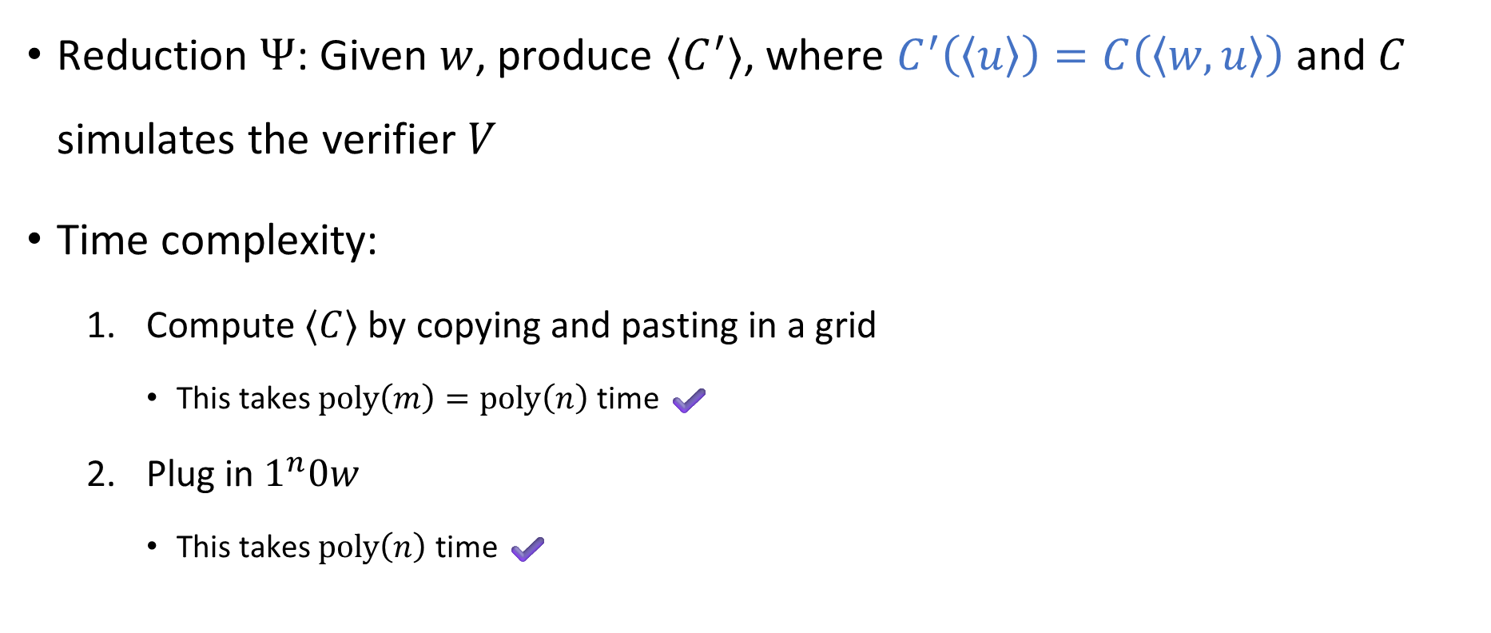

Proof that $\text{CIRCUIT}\text{‑}\text{SAT}$ is $\text{NP}$-hard
Reduction $Ψ$: Given $w$, produce $⟨C^{′}⟩$, where $C^{′}\left(\left\langle u\right\rangle \right)=C\left(\left\langle w,u\right\rangle \right)$ and $C$ simulates the verifier $V$
Time complexity:
Compute $⟨C⟩$ by copying and pasting in a grid
This takes $\text{poly}\left(m\right)=\text{poly}\left(n\right)$ time ✔️
Plug in $1^{n}0w$
This takes $\text{poly}\left(n\right)$ time ✔️

Slide 11

Theorem: $\text{CIRCUIT}\text{‑}\text{SAT}$ is $\text{NP}$-complete.
Make sure you thoroughly understand this theorem and its proof!
A ton of key concepts from this course are involved

Slide 12


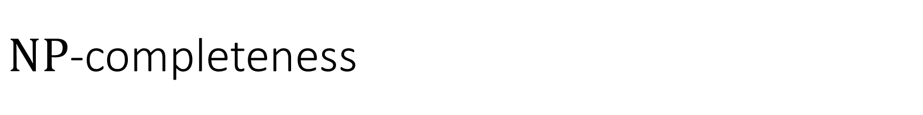



$\text{NP}$-completeness
$\text{NP}$-hard
$$\text{CIRCUIT}\text{‑}\text{SAT}$$
$\text{NP}$-complete
$$\text{NP}$$
$$\text{P}$$

Slide 13

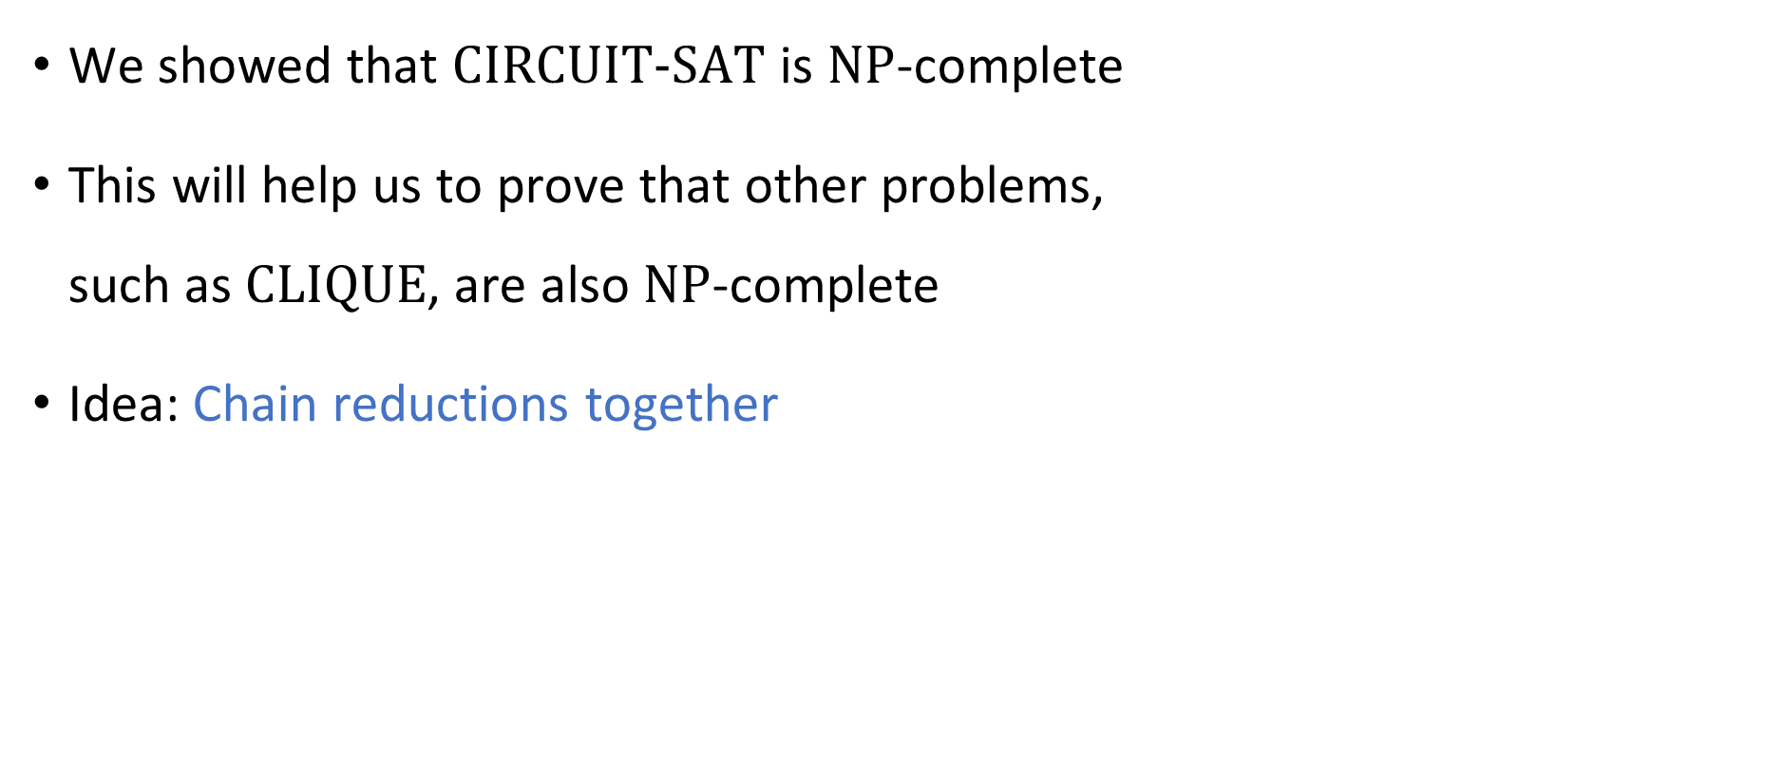

What else is $\text{NP}$-complete?
We showed that $\text{CIRCUIT}\text{‑}\text{SAT}$ is $\text{NP}$-complete
This will help us to prove that other problems, such as $\text{CLIQUE}$, are also $\text{NP}$-complete
Idea: Chain reductions together

Slide 14
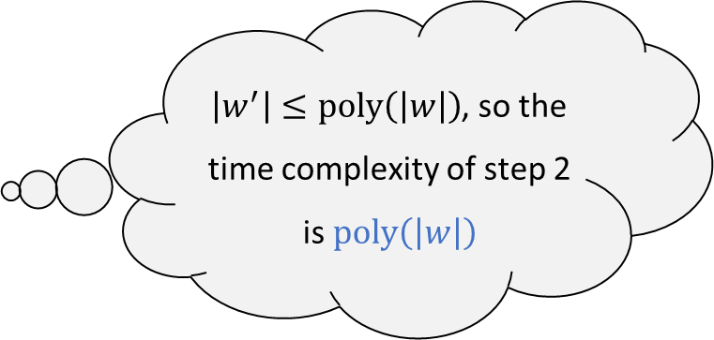
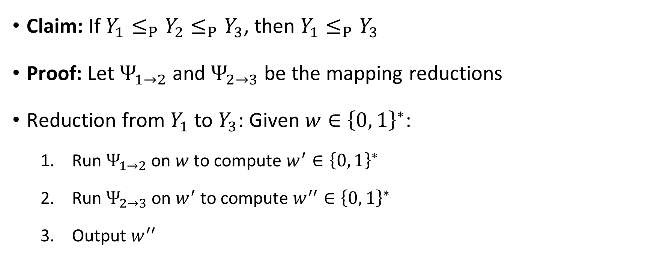
Chaining reductions together
Claim: If $Y_{1}≤_{P}Y_{2}≤_{P}Y_{3}$, then $Y_{1}≤_{P}Y_{3}$
Proof: Let $Ψ_{1→2}$ and $Ψ_{2→3}$ be the mapping reductions
Reduction from $Y_{1}$ to $Y_{3}$: Given $w∈{\left\{0, 1\right\}}^{∗}$:
Run $Ψ_{1→2}$ on $w$ to compute $w^{′}∈{\left\{0, 1\right\}}^{∗}$
Run $Ψ_{2→3}$ on $w^{′}$ to compute $w^{′′}∈{\left\{0, 1\right\}}^{∗}$
Output $w^{′′}$
$\left|w^{′}\right|≤\text{poly}\left(\left|w\right|\right)$, so the time complexity of step 2 is $\text{poly}\left(\left|w\right|\right)$

Slide 15










Chaining reductions together
$$Ψ_{1→2}$$
$$Ψ_{2→3}$$
$$Y_{2}$$
$$Y_{1}$$
$$Y_{3}$$
$$Ψ_{1→2}$$
$$Ψ_{2→3}$$
$${\left\{0, 1\right\}}^{∗}$$
$${\left\{0, 1\right\}}^{∗}$$
$${\left\{0, 1\right\}}^{∗}$$

Slide 16
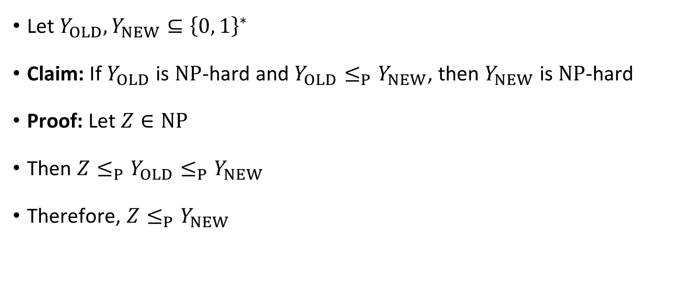
Chaining reductions together
Let $Y_{OLD},Y_{NEW}⊆{\left\{0, 1\right\}}^{∗}$
Claim: If $Y_{OLD}$ is $\text{NP}$-hard and $Y_{OLD}≤_{P}Y_{NEW}$, then $Y_{NEW}$ is $\text{NP}$-hard
Proof: Let $Z∈\text{NP}$
Then $Z≤_{P}Y_{OLD}≤_{P}Y_{NEW}$
Therefore, $Z≤_{P}Y_{NEW}$

Slide 17

Roadmap
We will define a language called “$3‑\text{SAT}$”
We will prove $\text{CIRCUIT}‑\text{SAT}≤_{P}\text{3}‑\text{SAT}≤_{P}\text{CLIQUE}$
This will show that $\text{CLIQUE}$ is $\text{NP}$-hard

Slide 18
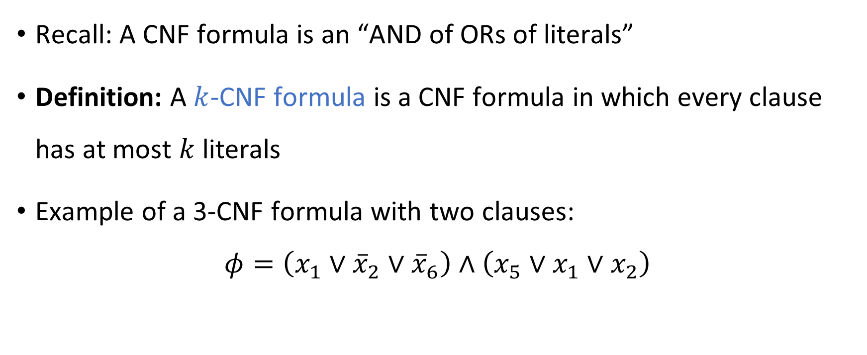
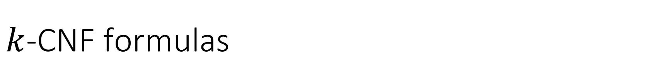
$k$-CNF formulas
Recall: A CNF formula is an “AND of ORs of literals”
Definition: A $k$-CNF formula is a CNF formula in which every clause has at most $k$ literals
Example of a 3-CNF formula with two clauses:
$$φ=\left(x_{1}∨{\overline{x}}_{2}∨{\overline{x}}_{6}\right)∧\left(x_{5}∨x_{1}∨x_{2}\right)$$

Slide 19

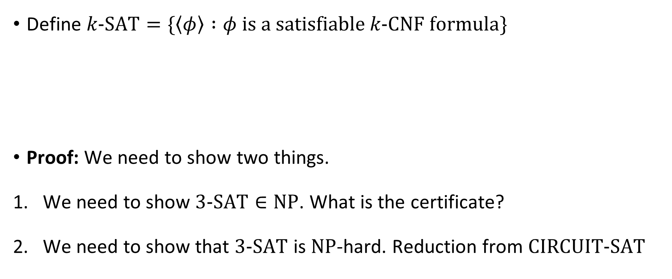
The Cook-Levin Theorem
Define $k\text{‑}\text{SAT}=\{\left\langle φ\right\rangle :φ \text{is} \text{a} \text{satisfiable} k\text{‑}\text{CNF} \text{formula}\}$
Proof: We need to show two things.
We need to show $3\text{‑}\text{SAT}∈\text{NP}$. What is the certificate?
We need to show that $3\text{‑}\text{SAT}$ is $\text{NP}$-hard. Reduction from $\text{CIRCUIT}\text{‑}\text{SAT}$
The Cook-Levin Theorem: $3\text{‑}\text{SAT}$ is $\text{NP}$-complete

Slide 20



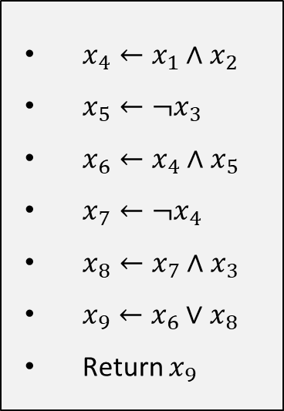














Reduction step 1: Circuit $→$ Instructions
$$x_{9}$$
$$∨$$
$x_{4}←x_{1}∧x_{2}$
$x_{5}←¬x_{3}$
$x_{6}←x_{4}∧x_{5}$
$x_{7}←¬x_{4}$
$x_{8}←x_{7}∧x_{3}$
$x_{9}←x_{6}∨x_{8}$
Return $x_{9}$
$$∧$$
$$x_{8}$$
$$x_{6}$$
$$∧$$
$$¬$$
$$x_{7}$$
$$x_{4}$$
$$∧$$
$$¬$$
$$x_{5}$$
$$x_{1}$$
$$x_{2}$$
$$x_{3}$$
Initial circuit $C$

Slide 21
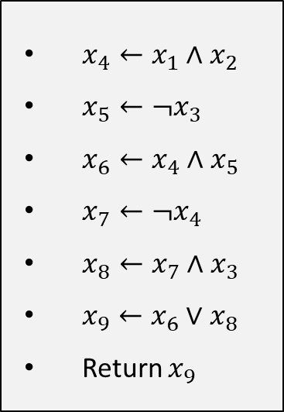

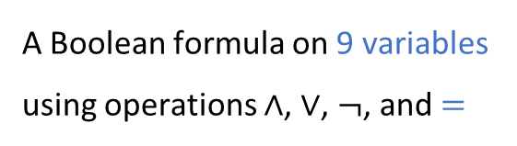
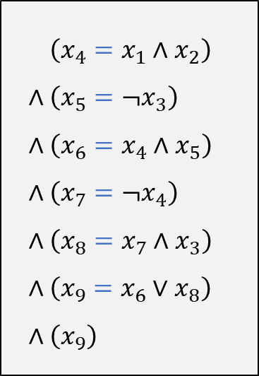
Reduction step 2: Instructions $→$ Formula
$x_{4}←x_{1}∧x_{2}$
$x_{5}←¬x_{3}$
$x_{6}←x_{4}∧x_{5}$
$x_{7}←¬x_{4}$
$x_{8}←x_{7}∧x_{3}$
$x_{9}←x_{6}∨x_{8}$
Return $x_{9}$
$∧\left(x_{4}=x_{1}∧x_{2}\right)$
$∧\left(x_{5}=¬x_{3}\right)$
$∧\left(x_{6}=x_{4}∧x_{5}\right)$
$∧\left(x_{7}=¬x_{4}\right)$
$∧\left(x_{8}=x_{7}∧x_{3}\right)$
$∧\left(x_{9}=x_{6}∨x_{8}\right)$
$∧\left(x_{9}\right)$
A Boolean formula on 9 variables using operations $∧$, $∨$, $¬$, and $=$

Slide 22
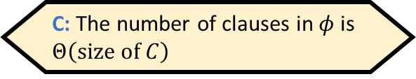

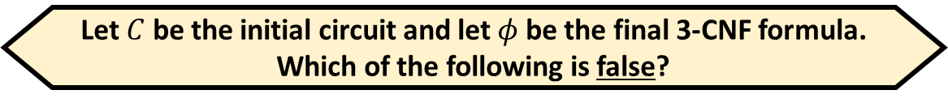


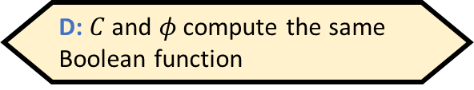



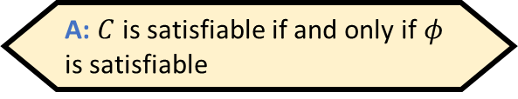
Reduction step 3: Formula $→$ 3-CNF formula
Let $C$ be the initial circuit and let $φ$ be the final 3-CNF formula. Which of the following is false?
A: $C$ is satisfiable if and only if $φ$ is satisfiable
B: $\left|\left\langle φ\right\rangle \right|≤\text{poly}\left(\left|\left\langle C\right\rangle \right|\right)$
C: The number of clauses in $φ$ is $Θ\left(\text{size} \text{of} C\right)$
D: $C$ and $φ$ compute the same Boolean function
$∧\left(x_{4}=x_{1}∧x_{2}\right)$
$∧\left(x_{5}=¬x_{3}\right)$
$∧\left(x_{6}=x_{4}∧x_{5}\right)$
$∧\left(x_{7}=¬x_{4}\right)$
$∧\left(x_{8}=x_{7}∧x_{3}\right)$
$∧\left(x_{9}=x_{6}∨x_{8}\right)$
$∧\left(x_{9}\right)$
$$∧\left({\overline{x}}_{4}∨x_{1}\right)∧\left({\overline{x}}_{4}∨x_{2}\right)∧(x_{4}∨{\overline{x}}_{1}∨{\overline{x}}_{2})$$
$$∧\left(x_{5}∨x_{3}\right)∧\left({\overline{x}}_{5}∨{\overline{x}}_{3}\right)$$
$$∧\left({\overline{x}}_{6}∨x_{4}\right)∧\left({\overline{x}}_{6}∨x_{5}\right)∧\left(x_{6}∨{\overline{x}}_{4}∨{\overline{x}}_{5}\right)$$
$$∧\left(x_{7}∨{\overline{x}}_{4}\right)∧\left({\overline{x}}_{7}∨x_{4}\right)$$
$$∧\left({\overline{x}}_{8}∨x_{7}\right)∧\left({\overline{x}}_{8}∨x_{3}\right)∧\left(x_{8}∨{\overline{x}}_{7}∨{\overline{x}}_{3}\right)$$
$$∧\left(x_{9}∨{\overline{x}}_{6}\right)∧\left(x_{9}∨{\overline{x}}_{8}\right)∧\left({\overline{x}}_{9}∨x_{6}∨x_{8}\right)$$
$$∧\left(x_{9}\right)$$
Respond at PollEv.com/whoza or text “whoza” to 22333
Every Boolean function has a CNF representation!
A Boolean formula on 9 variables using operations $∧$, $∨$, $¬$, and $=$
Final 3-CNF formula $φ$

Slide 23
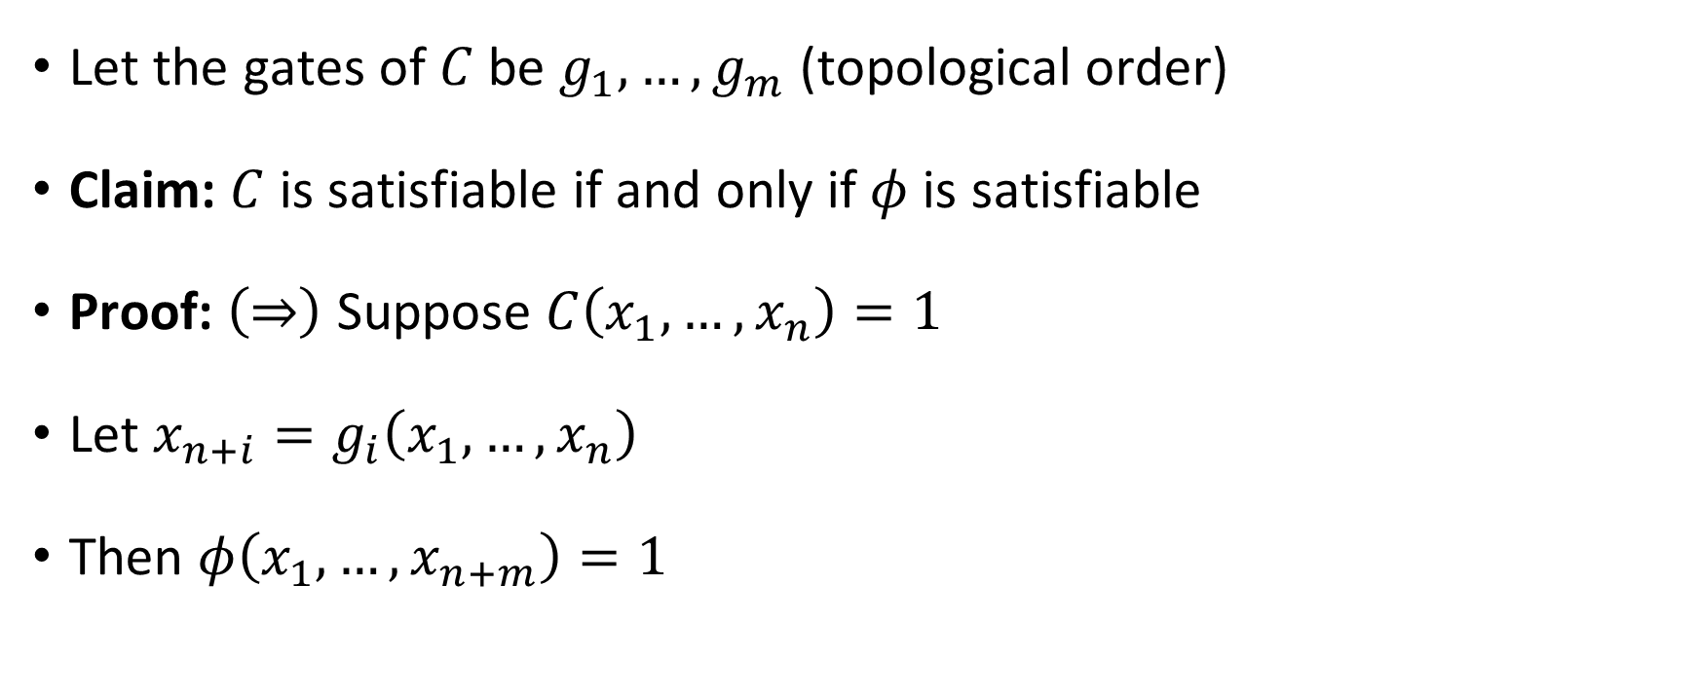
Reduction correctness
Let the gates of $C$ be $g_{1},…, g_{m}$ (topological order)
Claim: $C$ is satisfiable if and only if $φ$ is satisfiable
Proof: $\left(⇒\right)$ Suppose $C\left(x_{1},…, x_{n}\right)=1$
Let $x_{n+i}=g_{i}\left(x_{1},…, x_{n}\right)$
Then $φ\left(x_{1},…, x_{n+m}\right)=1$

Slide 24
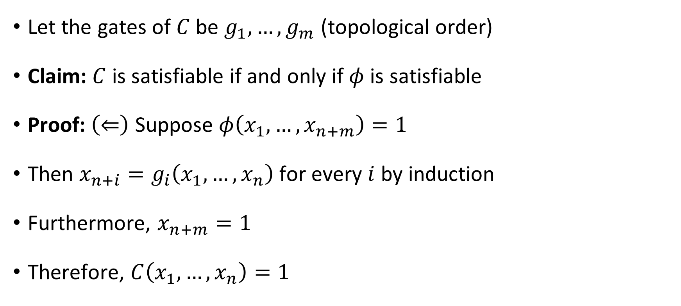
Reduction correctness
Let the gates of $C$ be $g_{1},…, g_{m}$ (topological order)
Claim: $C$ is satisfiable if and only if $φ$ is satisfiable
Proof: $\left(⇐\right)$ Suppose $φ\left(x_{1},…, x_{n+m}\right)=1$
Then $x_{n+i}=g_{i}\left(x_{1},…, x_{n}\right)$ for every $i$ by induction
Furthermore, $x_{n+m}=1$
Therefore, $C\left(x_{1},…, x_{n}\right)=1$

Slide 25






$\text{NP}$-hard
$$\text{CIRCUIT}\text{‑}\text{SAT}$$
$$\text{3}\text{‑}\text{SAT}$$
$\text{NP}$-complete
$$\text{NP}$$
$$\text{P}$$

