Slide 1
CMSC 28100 Introduction to Complexity Theory Winter 2024 Instructor: William Hoza
7 |  |  |  |  |  |  | 5 | 3
 |  |  |  |  |  |  |  | 4
 | 4 | 8 |  | 3 |  | 1 | 2
8 |  | 1 | 3 |  |  | 2 | 7 | 5
 | 9 |  | 1 |  |  |  | 4
 | 5 |  |  |  |  | 3
2 |  | 5 |  | 8 | 4
1 | 3 | 4 |  | 5

Slide 2

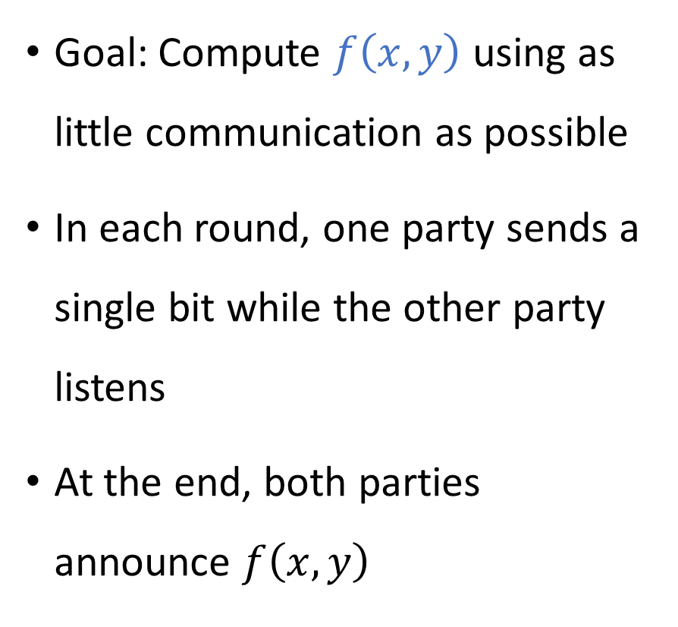


Communication complexity
Goal: Compute $f\left(x, y\right)$ using as little communication as possible
In each round, one party sends a single bit while the other party listens
At the end, both parties announce $f\left(x, y\right)$
Communication channel
Alice holds $x$
Bob holds $y$

Slide 3


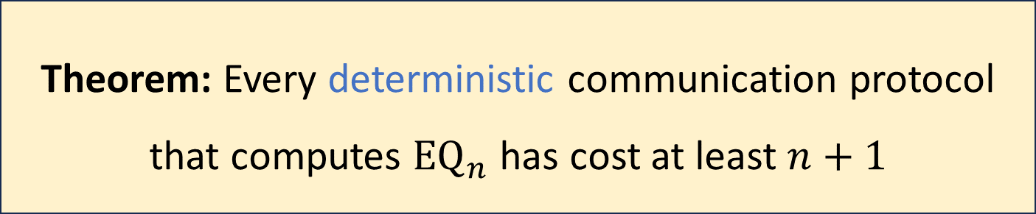
Communication complexity of ${\text{EQ}}_{n}$
Recall: ${\text{EQ}}_{n}\left(x, y\right)=1⇔x=y$
Naïve protocol: Alice sends $x$ to Bob, then Bob sends ${\text{EQ}}_{n}\left(x, y\right)$ to Alice
Naïve protocol has cost $n+1$
Theorem: Every deterministic communication protocol that computes ${\text{EQ}}_{n}$ has cost at least $n+1$

Slide 4
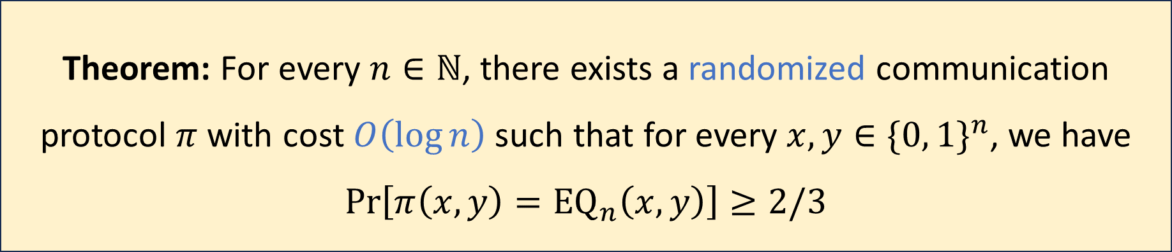
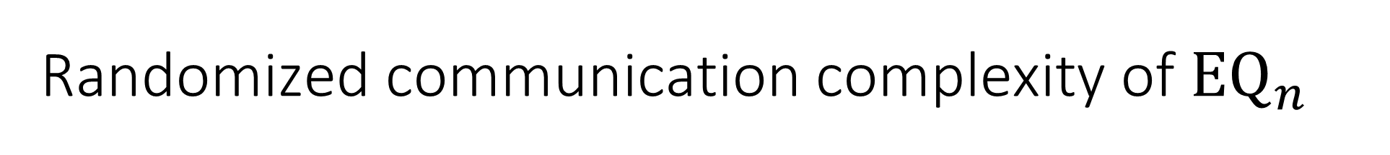
Randomized communication complexity of ${\text{EQ}}_{n}$
Theorem: For every $n∈ℕ$, there exists a randomized communication protocol $π$ with cost $O\left(\log{n}\right)$ such that for every $x,y∈\{0, 1\}^{n}$, we have $\operatorname{Pr}\left[π\left(x,y\right)={\text{EQ}}_{n}\left(x,y\right)\right]≥2/3$
Randomized protocols are exponentially better than deterministic protocols!

Slide 5
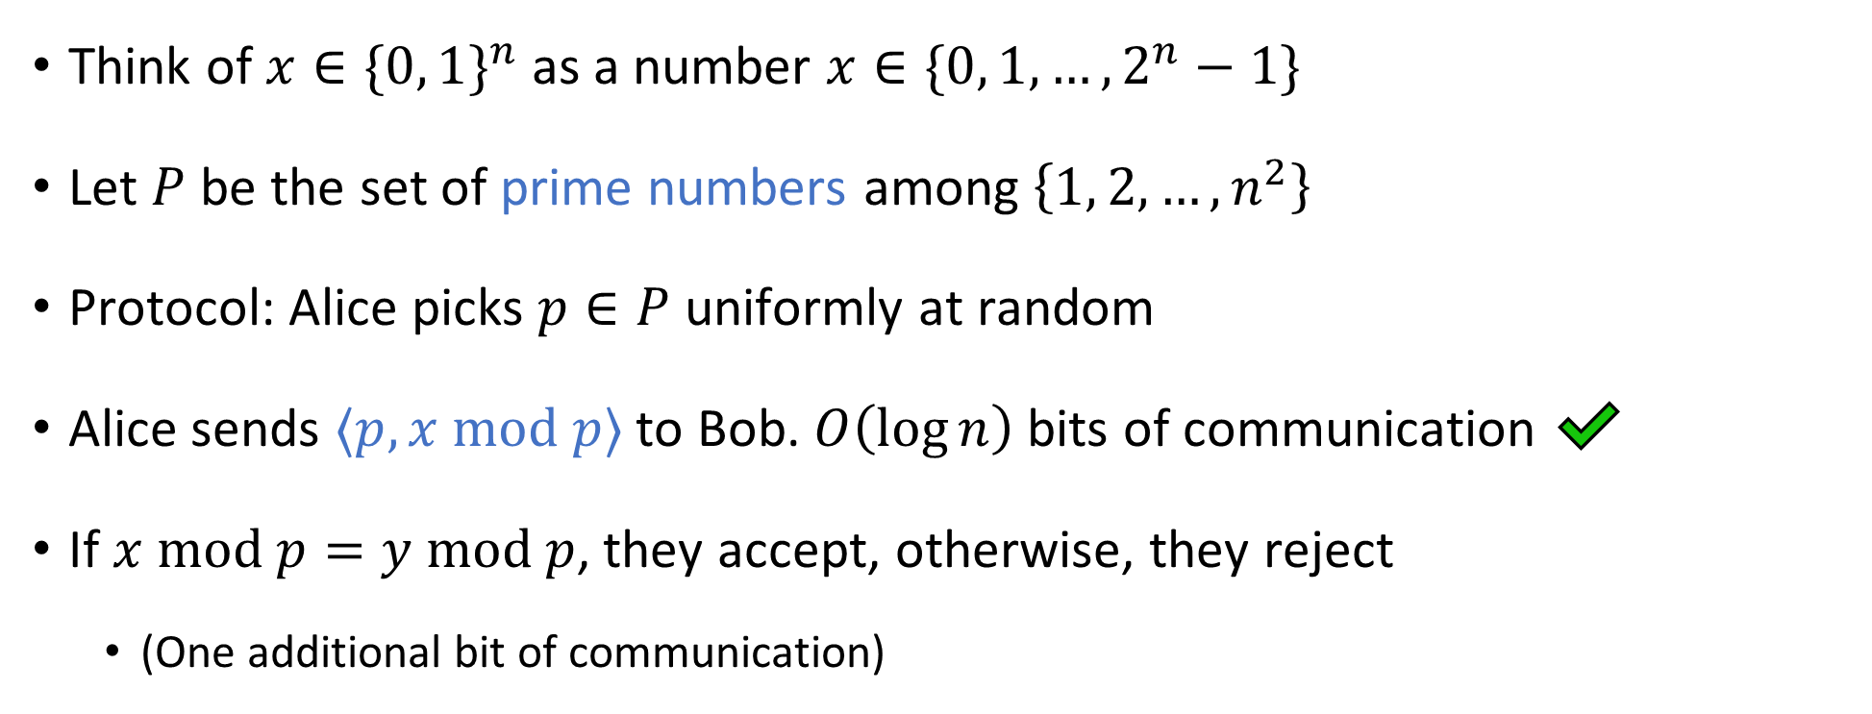
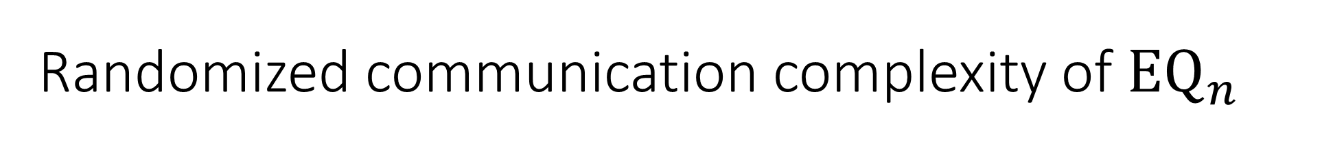
Randomized communication complexity of ${\text{EQ}}_{n}$
Think of $x∈\{0, 1\}^{n}$ as a number $x∈\{0, 1, …, 2^{n}−1\}$
Let $P$ be the set of prime numbers among $\left\{1, 2, …, n^{2}\right\}$
Protocol: Alice picks $p∈P$ uniformly at random
Alice sends $⟨p, x \text{mod} p⟩$ to Bob. $O\left(\log{n}\right)$ bits of communication ✔️
If $x \text{mod} p=y \text{mod} p$, they accept, otherwise, they reject
(One additional bit of communication)

Slide 6
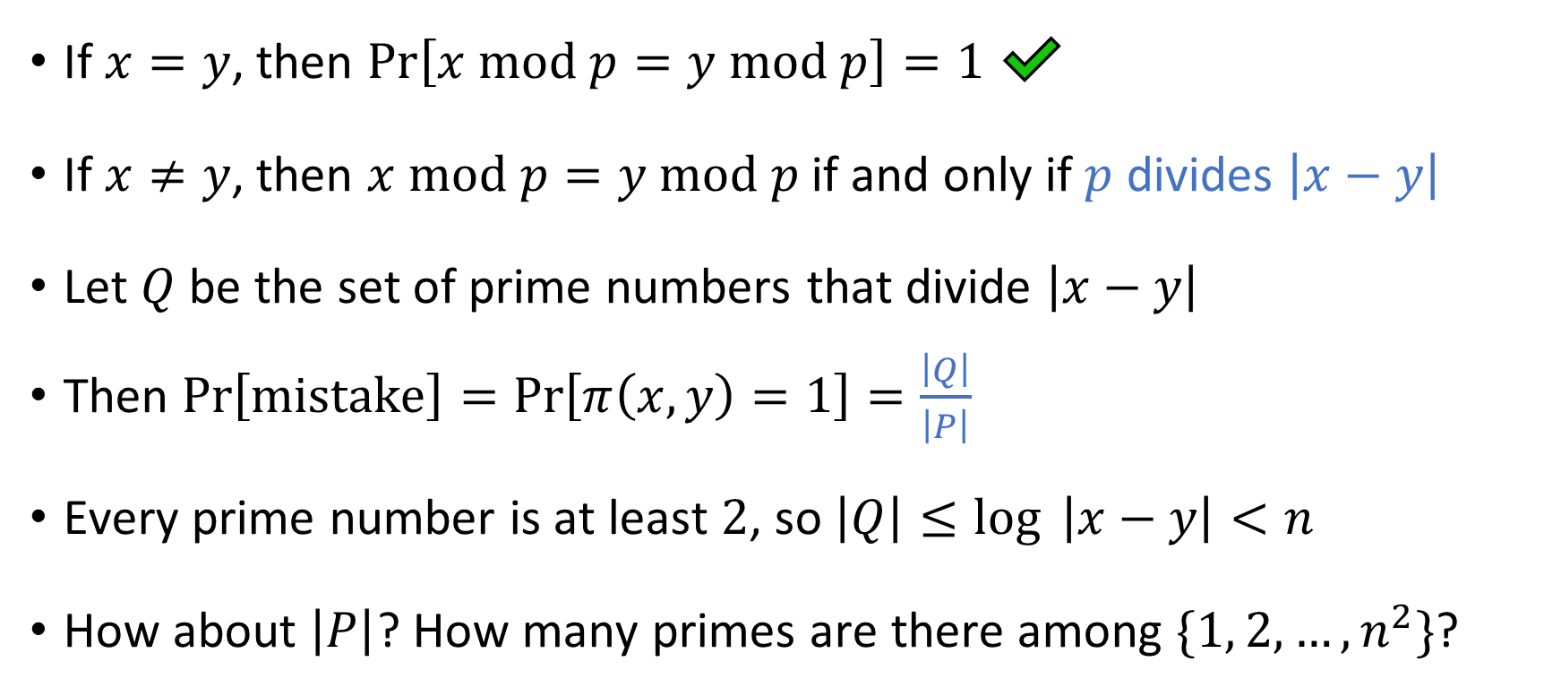
Analysis of the randomized protocol
If $x=y$, then $\operatorname{Pr}\left[x \text{mod} p=y \text{mod} p\right]=1$ ✔️
If $x≠y$, then $x \text{mod} p=y \text{mod} p$ if and only if $p$ divides $\left|x−y\right|$
Let $Q$ be the set of prime numbers that divide $\left|x−y\right|$
Then $Pr\left[mistake\right]=\operatorname{Pr}\left[π\left(x,y\right)=1\right]=\frac{\left|Q\right|}{\left|P\right|}$
Every prime number is at least $2$, so $\left|Q\right|≤\log{ \left|x−y\right|}<n$
How about $\left|P\right|$? How many primes are there among $\{1, 2, …, n^{2}\}$?

Slide 7
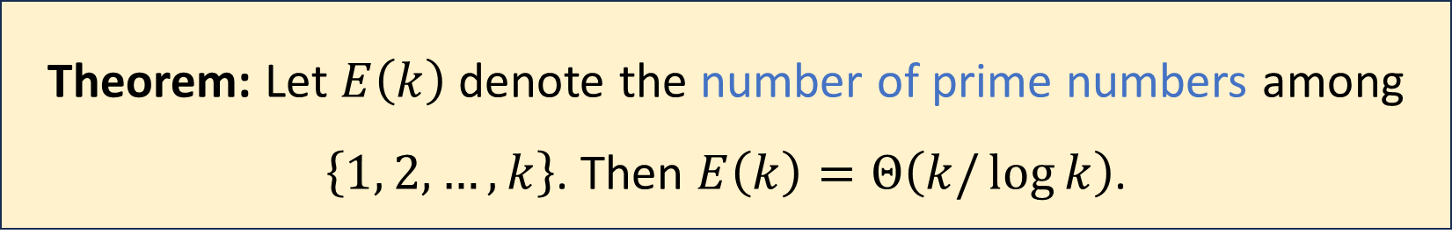
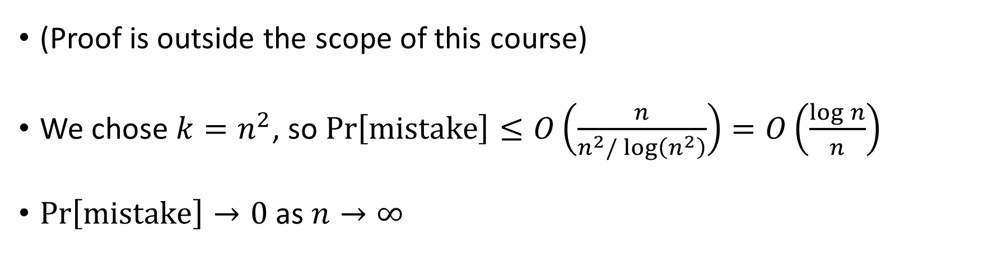
Density of primes
Theorem: Let $E\left(k\right)$ denote the number of prime numbers among $\left\{1, 2, …, k\right\}$. Then $E\left(k\right)=Θ\left(k/\log{k}\right)$.
(Proof is outside the scope of this course)
We chose $k=n^{2}$, so $\operatorname{Pr}\left[\text{mistake}\right]≤O\left(\frac{n}{n^{2}/\log\left(n^{2}\right)}\right)=O\left(\frac{\log{n}}{n}\right)$
$\operatorname{Pr}\left[\text{mistake}\right]→0$ as $n→∞$

Slide 8
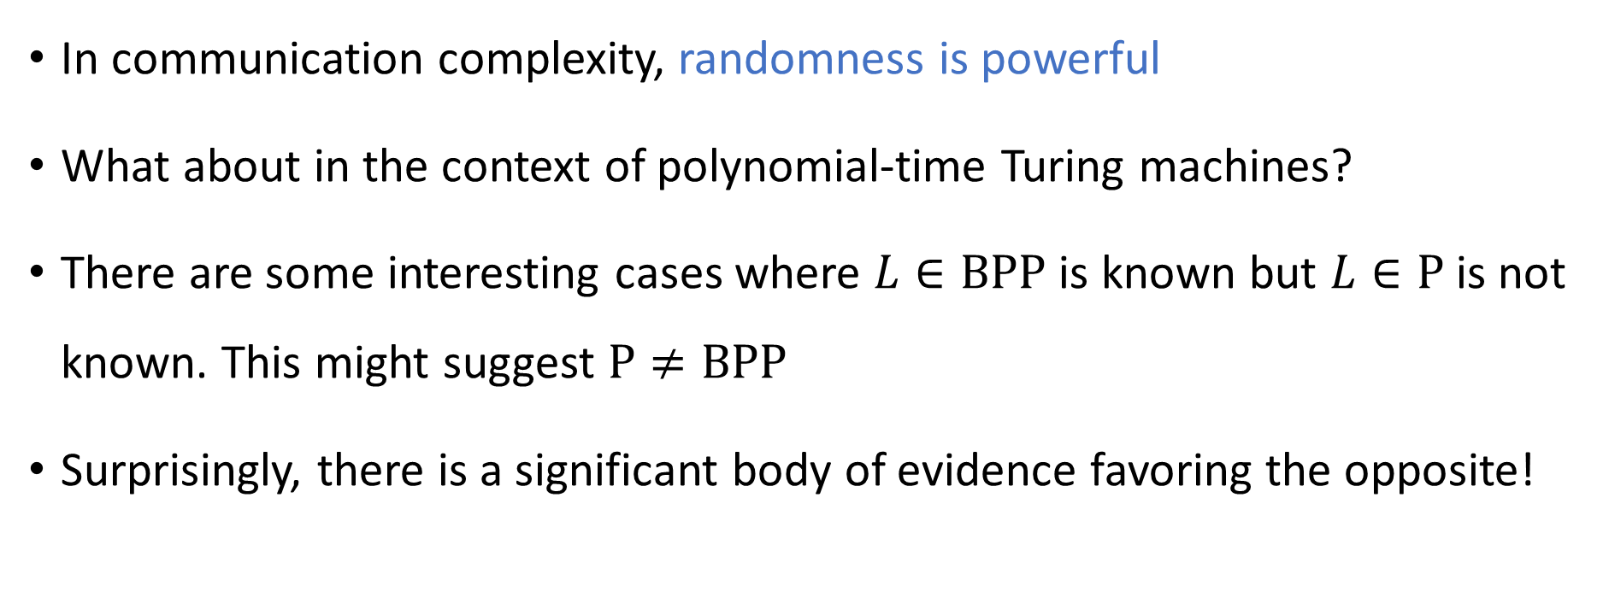
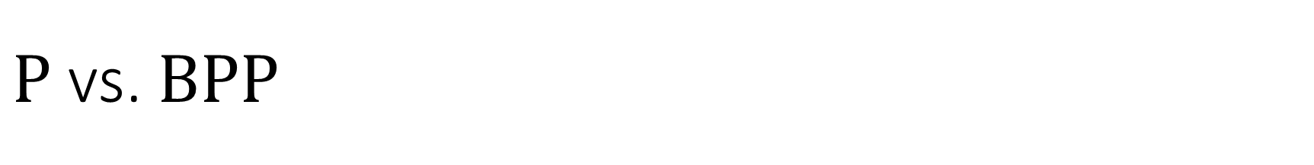

$\text{P}$ vs. $\text{BPP}$
In communication complexity, randomness is powerful
What about in the context of polynomial-time Turing machines?
There are some interesting cases where $L∈\text{BPP}$ is known but $L∈\text{P}$ is not known. This might suggest $\text{P}≠\text{BPP}$
Surprisingly, there is a significant body of evidence favoring the opposite!
Conjecture: $\text{P}=\text{BPP}$

Slide 9


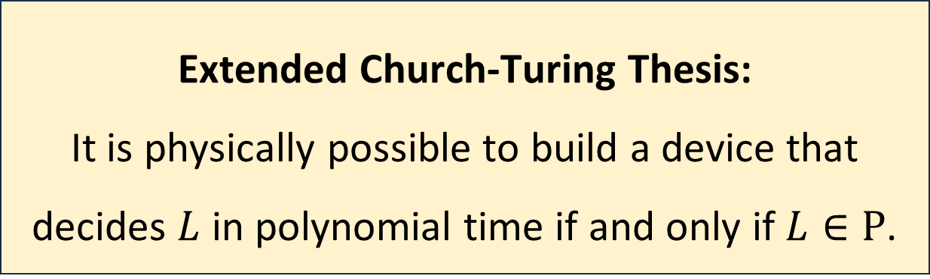
$\text{BPP}$ and the Extended Church-Turing Thesis
Let $L$ be a language
Assuming $\text{P}=\text{BPP}$, the extended Church-Turing thesis survives the challenge posed by randomized computation!
Extended Church-Turing Thesis:
It is physically possible to build a device that decides $L$ in polynomial time if and only if $L∈\text{P}$.

Slide 10
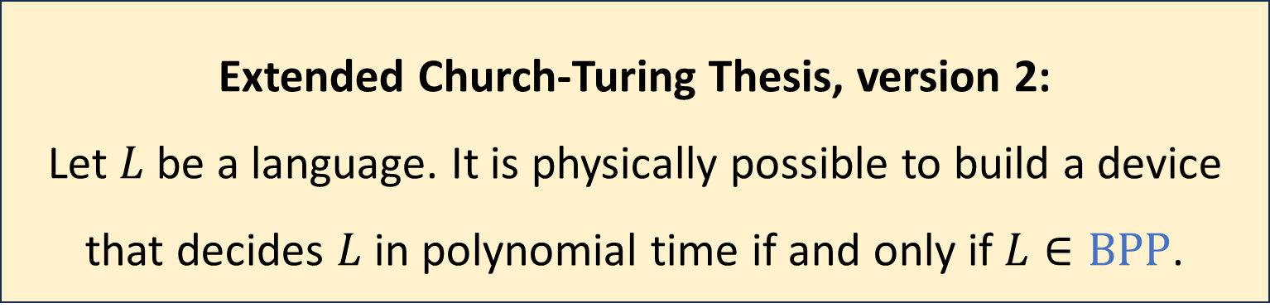

$\text{BPP}$ and the Extended Church-Turing Thesis
Just in case, the thesis is sometimes revised to allow randomization:
This version is immune to the challenge posed by randomization
However, there is a bigger threat: Quantum Computation
Extended Church-Turing Thesis, version 2:
Let $L$ be a language. It is physically possible to build a device that decides $L$ in polynomial time if and only if $L∈\text{BPP}$.

Slide 11
Quantum computing
A quantum computer is a computational device that uses special features of quantum physics
A detailed discussion of quantum computing is outside the scope of this course
We will discuss only some key facts about quantum computing
Quantum computing will not be on the final exam

Slide 12
Quantum computing
Quantum computers are, to some extent, hypothetical
So far, researchers have constructed rudimentary quantum computers
There are huge ongoing efforts to build fully-functional quantum computers

Slide 13
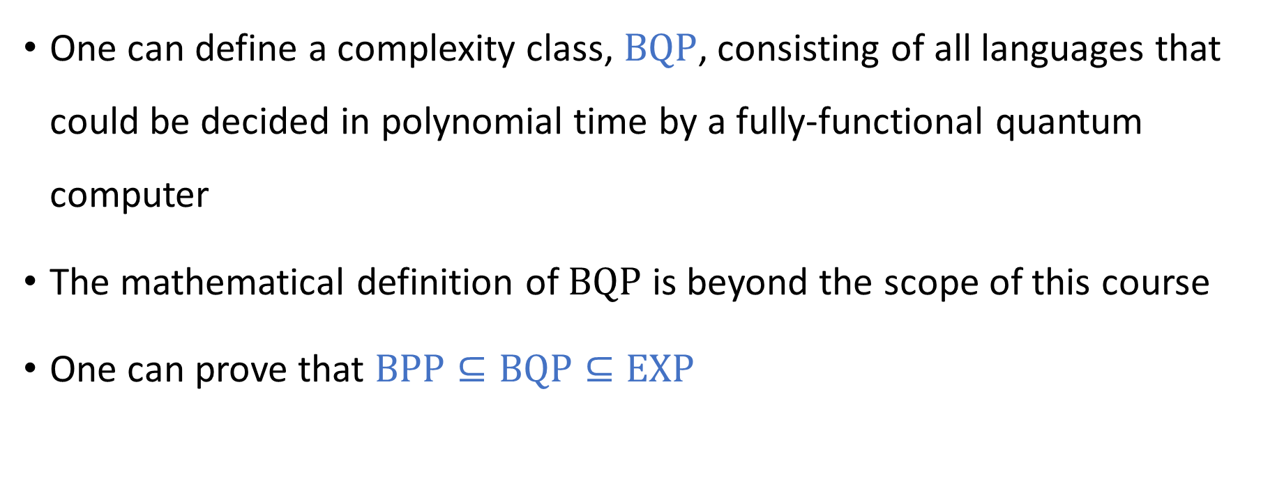
Quantum complexity theory
One can define a complexity class, $\text{BQP}$, consisting of all languages that could be decided in polynomial time by a fully-functional quantum computer
The mathematical definition of $\text{BQP}$ is beyond the scope of this course
One can prove that $\text{BPP}⊆\text{BQP}⊆\text{EXP}$

Slide 14

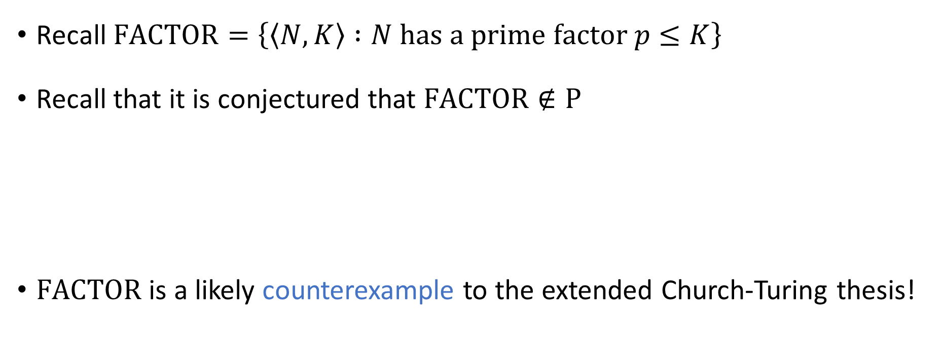
Shor’s algorithm
Recall $\text{FACTOR}=\left\{\left\langle N, K\right\rangle :N \text{has} \text{a} \text{prime} \text{factor} p≤K\right\}$
Recall that it is conjectured that $\text{FACTOR}∉\text{P}$
$\text{FACTOR}$ is a likely counterexample to the extended Church-Turing thesis!
Theorem (Shor’s algorithm): $\text{FACTOR}∈\text{BQP}$

Slide 15
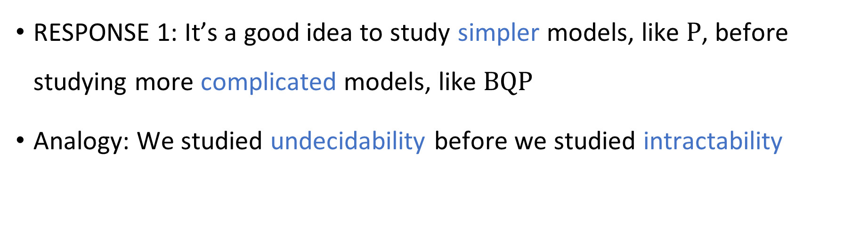

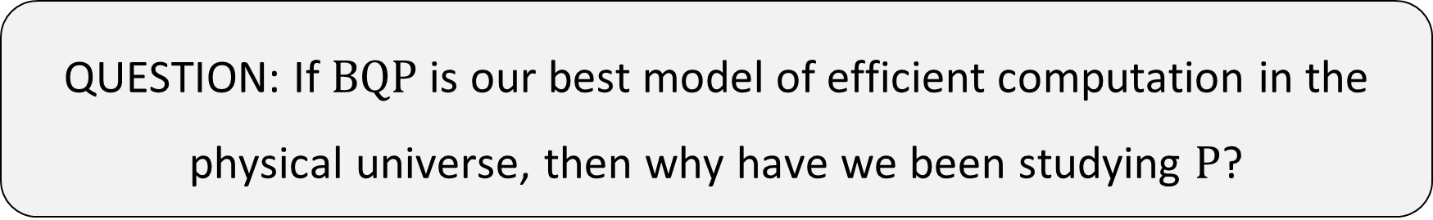
$\text{P}$ as a warm-up for $\text{BQP}$
QUESTION: If $\text{BQP}$ is our best model of efficient computation in the physical universe, then why have we been studying $\text{P}$?
RESPONSE 1: It’s a good idea to study simpler models, like $\text{P}$, before studying more complicated models, like $\text{BQP}$
Analogy: We studied undecidability before we studied intractability

Slide 16

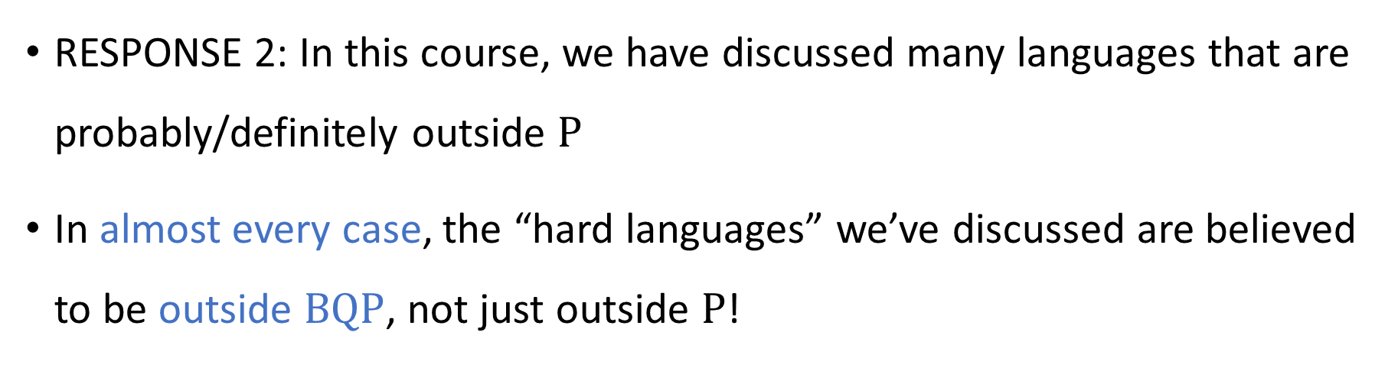
Intractability for quantum computers
QUESTION: If $\text{BQP}$ is our best model of efficient computation in the physical universe, then why have we been studying $\text{P}$?
RESPONSE 2: In this course, we have discussed many languages that are probably/definitely outside $\text{P}$
In almost every case, the “hard languages” we’ve discussed are believed to be outside $\text{BQP}$, not just outside $\text{P}$!

Slide 17
Intractability for quantum computers
Languages that are undecidable for deterministic Turing machines are also undecidable for quantum computers
Quantum computers cannot solve the halting problem, even if we are not concerned with time complexity

Slide 18

Intractability for quantum computers
We expect that $\text{BQP}≠\text{EXP}$
In this case, even a fully-functional quantum computer would not be able to solve $\text{EXP}$-complete problems in polynomial time

Slide 19
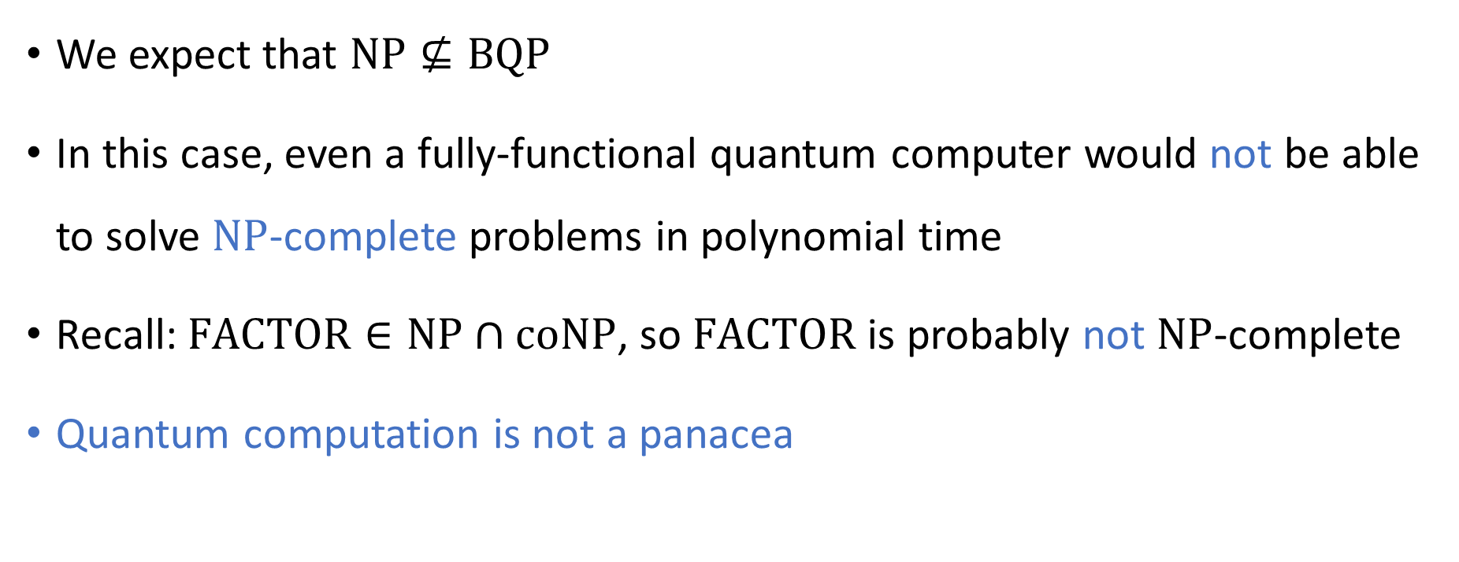
Intractability for quantum computers
We expect that $\text{NP}⊈\text{BQP}$
In this case, even a fully-functional quantum computer would not be able to solve $\text{NP}$-complete problems in polynomial time
Recall: $\text{FACTOR}∈\text{NP}∩\text{coNP}$, so $\text{FACTOR}$ is probably not $\text{NP}$-complete
Quantum computation is not a panacea

Slide 20








$\text{NP}$-hard
$$\text{3‑}\text{SAT}$$
$$\text{EXP}$$
$\text{NP}$-complete
$$\text{NP}$$
$$\text{FACTOR}$$
$$\text{BQP}$$
$$\text{P}$$

Slide 21
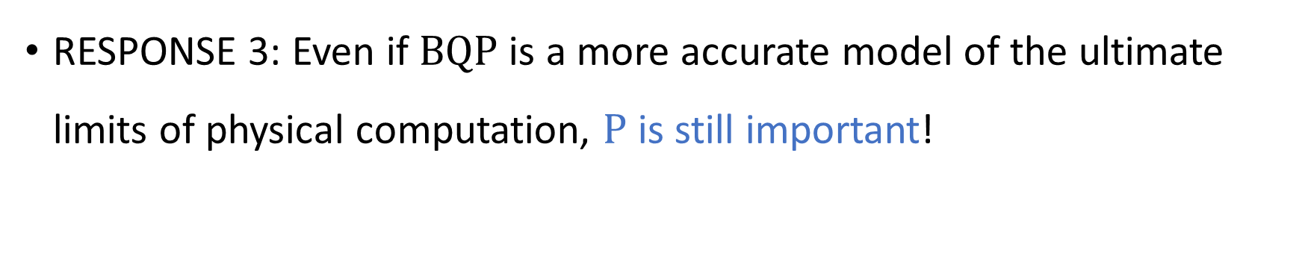


In defense of $\text{P}$
QUESTION: If $\text{BQP}$ is our best model of efficient computation in the physical universe, then why have we been studying $\text{P}$?
RESPONSE 3: Even if $\text{BQP}$ is a more accurate model of the ultimate limits of physical computation, $\text{P}$ is still important!

Slide 22
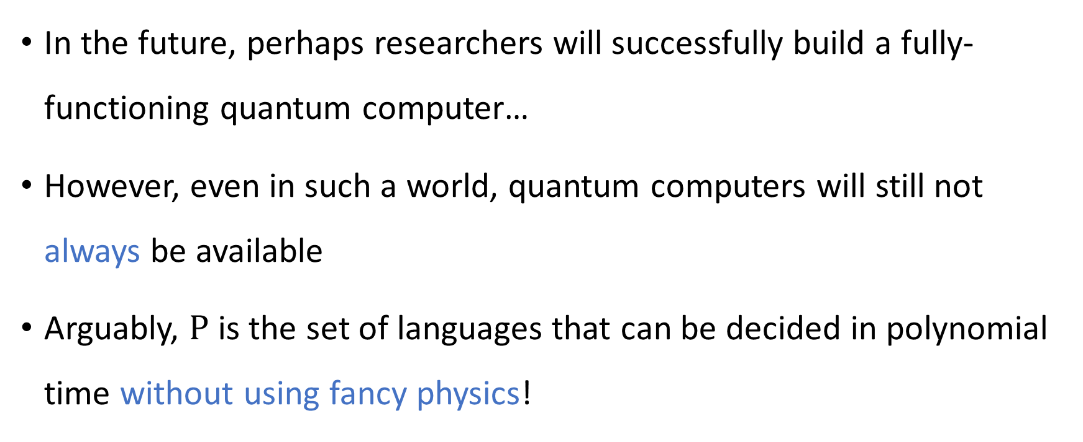
In defense of $\text{P}$
In the future, perhaps researchers will successfully build a fully-functioning quantum computer…
However, even in such a world, quantum computers will still not always be available
Arguably, $\text{P}$ is the set of languages that can be decided in polynomial time without using fancy physics!

Slide 23
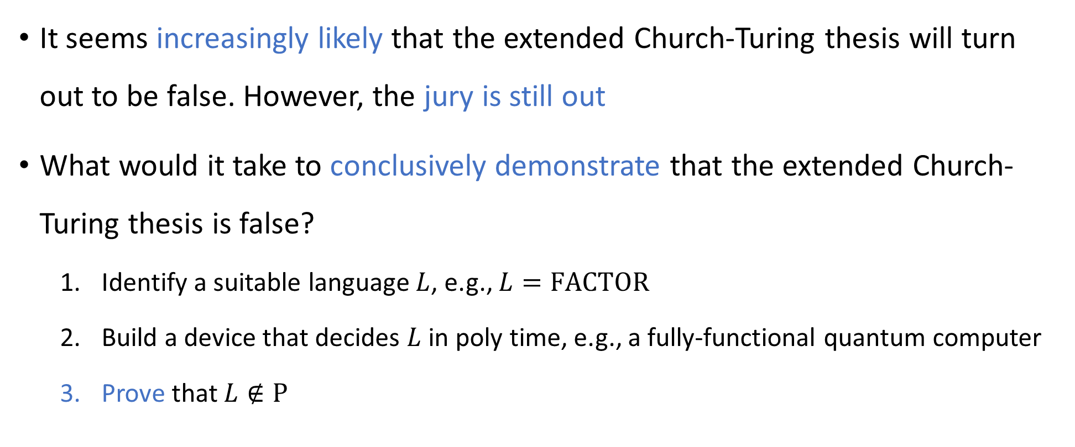
In defense of $\text{P}$
It seems increasingly likely that the extended Church-Turing thesis will turn out to be false. However, the jury is still out
What would it take to conclusively demonstrate that the extended Church-Turing thesis is false?
Identify a suitable language $L$, e.g., $L=\text{FACTOR}$
Build a device that decides $L$ in poly time, e.g., a fully-functional quantum computer
Prove that $L∉\text{P}$
⬅ This step requires understanding the limitations of $\text{P}$!

Slide 24
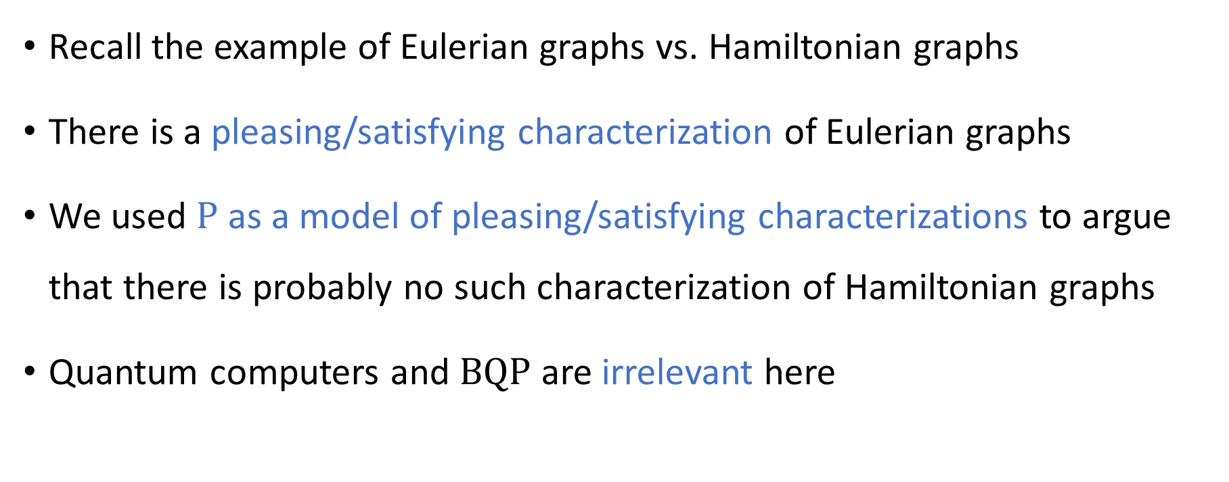
In defense of $\text{P}$
Recall the example of Eulerian graphs vs. Hamiltonian graphs
There is a pleasing/satisfying characterization of Eulerian graphs
We used $\text{P}$ as a model of pleasing/satisfying characterizations to argue that there is probably no such characterization of Hamiltonian graphs
Quantum computers and $\text{BQP}$ are irrelevant here

Slide 25
Which problems can be solved through computation?

Slide 26
Complexity theory: The study of computational resources

Slide 27
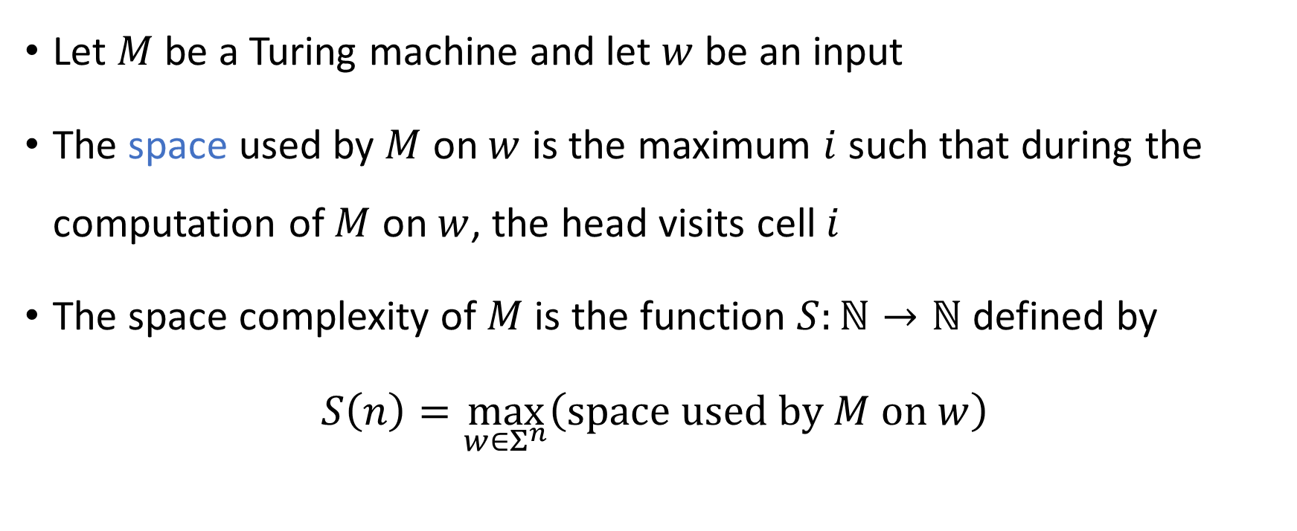
Space complexity
Let $M$ be a Turing machine and let $w$ be an input
The space used by $M$ on $w$ is the maximum $i$ such that during the computation of $M$ on $w$, the head visits cell $i$
The space complexity of $M$ is the function $S:ℕ→ℕ$ defined by
$$S\left(n\right)=\max_{w∈Σ^{n}}\left(\text{space} \text{used} \text{by} M \text{on} w\right)$$

Slide 28


The complexity class $\text{PSPACE}$
Let $L$ be a language
Definition: $L∈\text{PSPACE}$ if there exists a Turing machine $M$ that decides $L$ with space complexity $O\left(n^{k}\right)$ for some constant $k∈ℕ$

Slide 29
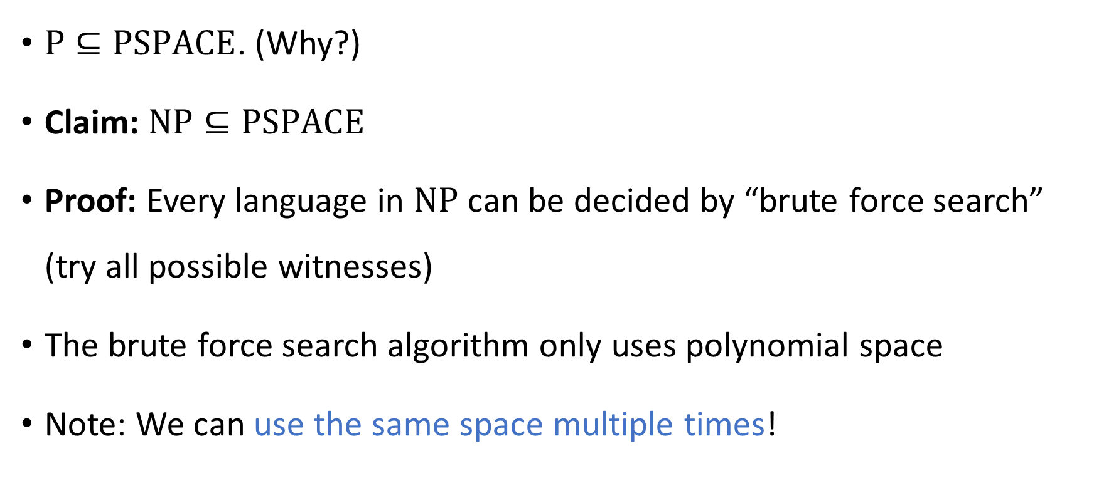
Polynomial-space algorithms
$\text{P}⊆\text{PSPACE}$. (Why?)
Claim: $\text{NP}⊆\text{PSPACE}$
Proof: Every language in $\text{NP}$ can be decided by “brute force search” (try all possible witnesses)
The brute force search algorithm only uses polynomial space
Note: We can use the same space multiple times!

Slide 30



$$\text{PSPACE}$$
$$\text{NP}$$
$$\text{P}$$

