Slide 1
CMSC 28100 Introduction to Complexity Theory Winter 2024 Instructor: William Hoza
7 |  |  |  |  |  |  | 5 | 3
 |  |  |  |  |  |  |  | 4
 | 4 | 8 |  | 3 |  | 1 | 2
8 |  | 1 | 3 |  |  | 2 | 7 | 5
 | 9 |  | 1 |  |  |  | 4
 | 5 |  |  |  |  | 3
2 |  | 5 |  | 8 | 4
1 | 3 | 4 |  | 5

Slide 2
Which problems can be solved through computation?

Slide 3
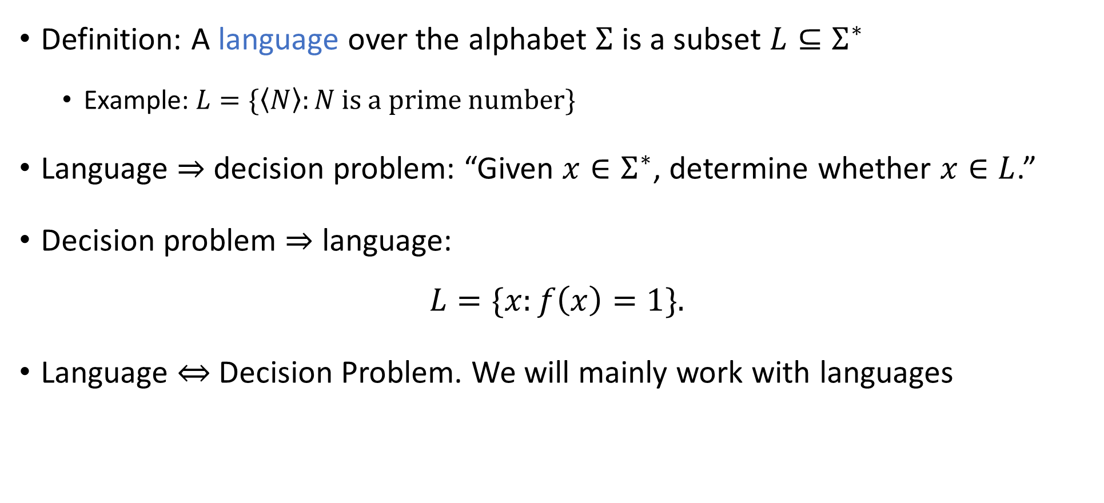
Languages
Definition: A language over the alphabet $Σ$ is a subset $L⊆Σ^{∗}$
Example: $L=\{\left\langle N\right\rangle :N \text{is} \text{a} \text{prime} \text{number}\}$
Language $⇒$ decision problem: “Given $x∈Σ^{∗}$, determine whether $x∈L$.”
Decision problem $⇒$ language:
$$L=\{x:f\left(x\right)=1\}.$$
Language $⇔$ Decision Problem. We will mainly work with languages

Slide 4
Which problems can be solved through computation?

Slide 5


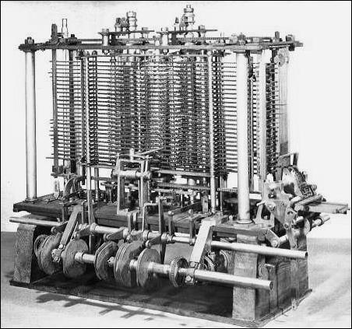
Computation
You might think of “computers” as modern technology, but computation is ancient
Computation can be performed by
A human being with paper and a pencil
A smartphone
A steam-powered machine
We want a mathematical model that describes all of these and transcends any one technology

Slide 6
Human computation vs. technological
Smartphones and laptops merely automate the process of computation
They can compute faster and more reliably than a human being, but what they do is essentially the same as what we do
Consequence: We do not need to understand electronics to understand computation 🙂
Computation is a familiar, everyday, human act
“Mathematical anthropology”

Slide 7
Key characteristic of computation
Computation is all about following a set of instructions (an “algorithm”) to process some data / information
Each individual instruction is simple and easy to follow
Does not require creativity or ingenuity
Does not require understanding why the algorithm works or even what problem is being solved

Slide 8
Modeling computation
Think of a 10-year-old who is solving a multiplication problem, or an addition problem, or a long division problem, or …
In each step, they decide what to do based on:
What is written on the paper
Which step of the algorithm they are currently doing
Based on this information, they decide
What to write/erase
Which step of the algorithm to do next

Slide 9
Turing machines
#
1
1
0
A Turing machine is a mathematical model of this process
We imagine a one-dimensional “tape” that extends infinitely to the right
The tape is divided into “cells.” Each cell can be blank or have a symbol written in it
There is a “head” pointing at one cell of the tape
The machine can be in one of finitely many internal “states”

Slide 10
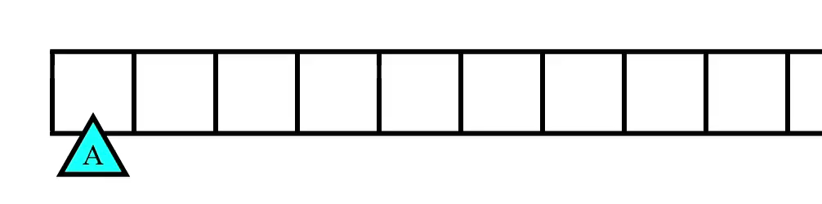
Turing machines
In each step, the machine decides
What to write on the cell (or whether to erase it)
Which direction to move the head (left or right)
What the machine’s new state will be
The decision is based only on
The contents of the cell
The state of the machine

Slide 11
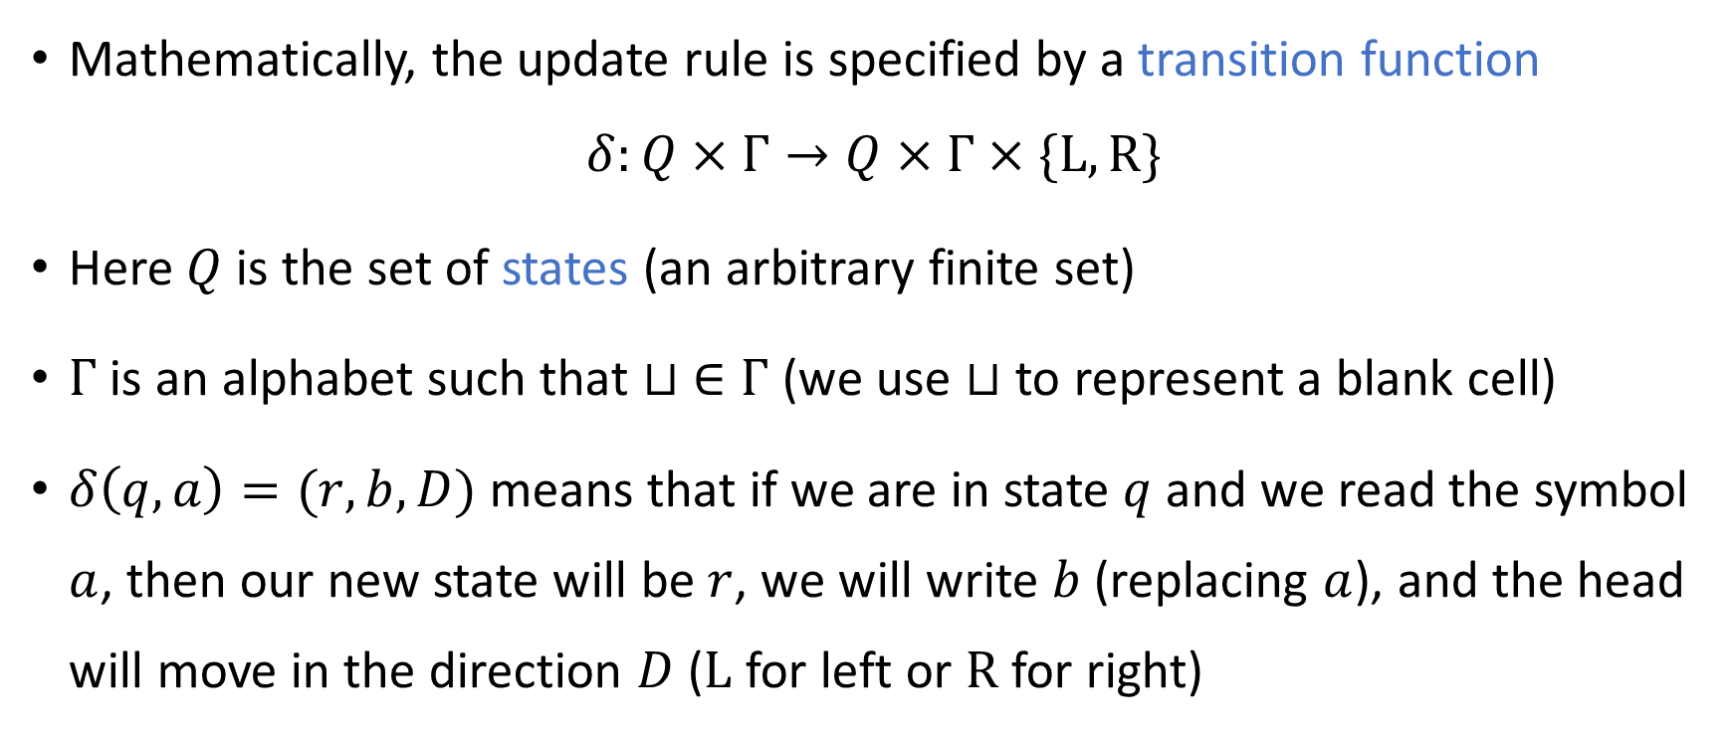
Transition function
Mathematically, the update rule is specified by a transition function
$$δ:Q×Γ→Q×Γ×\{\text{L}, \text{R}\}$$
Here $Q$ is the set of states (an arbitrary finite set)
$Γ$ is an alphabet such that $⊔ ∈Γ$ (we use $⊔$ to represent a blank cell)
$δ\left(q, a\right)=(r,b,D)$ means that if we are in state $q$ and we read the symbol $a$, then our new state will be $r$, we will write $b$ (replacing $a$), and the head will move in the direction $D$ ($\text{L}$ for left or $\text{R}$ for right)

Slide 12


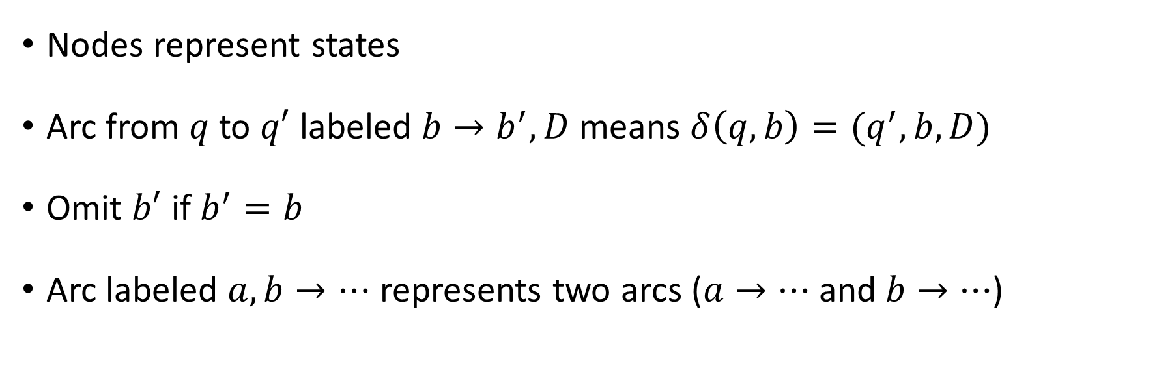


Representing a Turing machine with a diagram
$$⊔,\# →\#,\text{R}$$
$$0,1→\text{L}$$
A
B
$$1→\text{0,}\text{R}$$
Nodes represent states
Arc from $q$ to $q′$ labeled $b→b^{′},D$ means $δ\left(q,b\right)=(q^{′},b,D)$
Omit $b′$ if $b^{′}=b$
Arc labeled $a,b→⋯$ represents two arcs ($a→⋯$ and $b→⋯$)
$$⊔,0 →1,\text{L}$$

Slide 13
Which problems can be solved through computation?

Slide 14
Turing machines: Inputs and outputs
Turing Machine
Accept
Reject
Run forever (“loop”)
Input
The tape initially contains the input followed by infinitely many blank cells
The head is initially in the left-most cell (looking at the first symbol of the input)

Slide 15
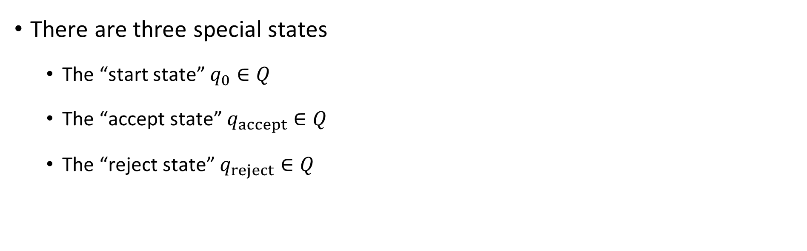
Turing machines: Inputs and outputs
Turing Machine
Accept
Reject
Run forever (“loop”)
Input
There are three special states
The “start state” $q_{0}∈Q$
The “accept state” $q_{accept}∈Q$
The “reject state” $q_{reject}∈Q$

Slide 16
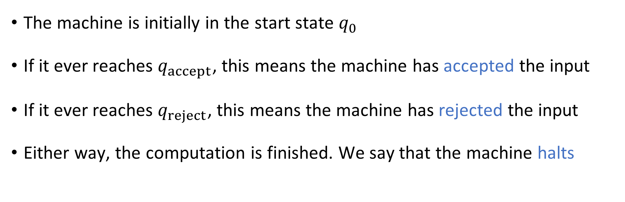
Turing machines: Inputs and outputs
Turing Machine
Accept
Reject
Run forever (“loop”)
Input
The machine is initially in the start state $q_{0}$
If it ever reaches $q_{accept}$, this means the machine has accepted the input
If it ever reaches $q_{reject}$, this means the machine has rejected the input
Either way, the computation is finished. We say that the machine halts

Slide 17
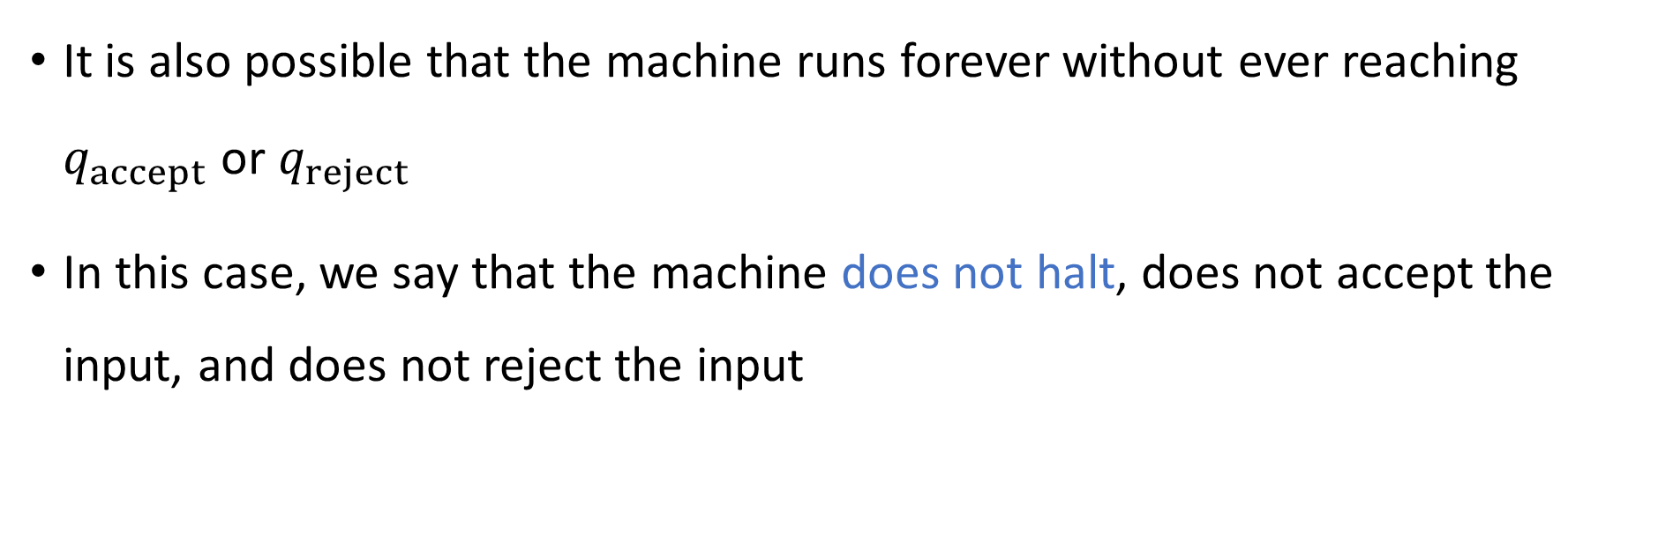
Turing machines: Inputs and outputs
Turing Machine
Accept
Reject
Run forever (“loop”)
Input
It is also possible that the machine runs forever without ever reaching $q_{accept}$ or $q_{reject}$
In this case, we say that the machine does not halt, does not accept the input, and does not reject the input

Slide 18
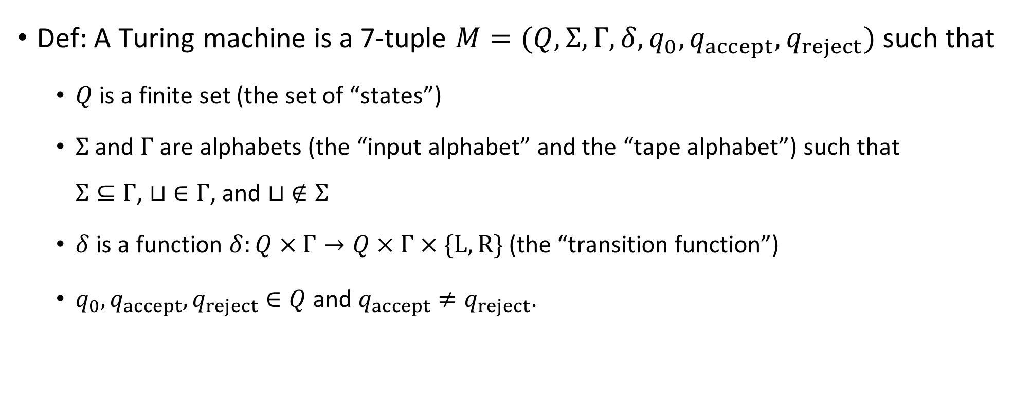
Turing machines: Mathematically rigorous version
Def: A Turing machine is a 7-tuple $M=(Q, Σ, Γ, δ, q_{0},q_{accept},q_{reject})$ such that
$Q$ is a finite set (the set of “states”)
$Σ$ and $Γ$ are alphabets (the “input alphabet” and the “tape alphabet”) such that $Σ⊆Γ$, $⊔ ∈Γ$, and $⊔ ∉Σ$
$δ$ is a function $δ:Q×Γ→Q×Γ×\{\text{L}, \text{R}\}$ (the “transition function”)
$q_{0},q_{accept},q_{reject}∈Q$ and $q_{accept}≠q_{reject}$.

Slide 19
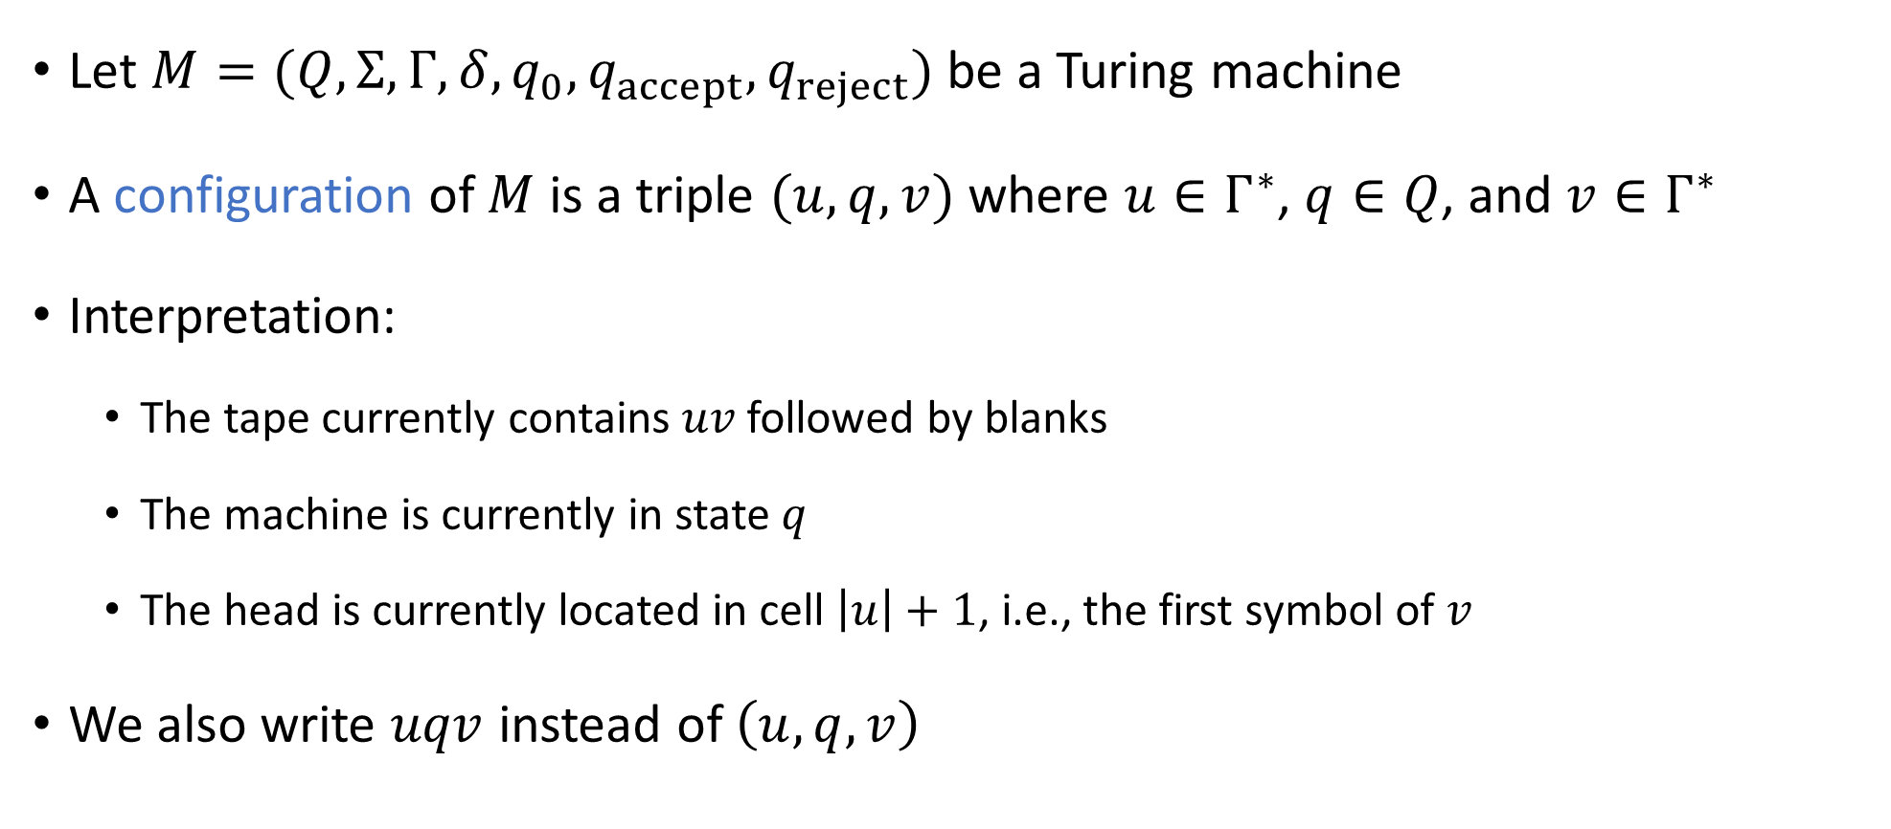
Configurations of a TM
Let $M=(Q, Σ, Γ, δ, q_{0},q_{accept}, q_{reject})$ be a Turing machine
A configuration of $M$ is a triple $(u, q, v)$ where $u∈Γ^{∗}$, $q∈Q$, and $v∈Γ^{∗}$
Interpretation:
The tape currently contains $uv$ followed by blanks
The machine is currently in state $q$
The head is currently located in cell $\left|u\right|+1$, i.e., the first symbol of $v$
We also write $uqv$ instead of $\left(u, q, v\right)$

Slide 20

The initial configuration
Let $w∈Σ^{∗}$ be an input
The initial configuration of $M$ on input $w$ is $q_{0}w$

Slide 21
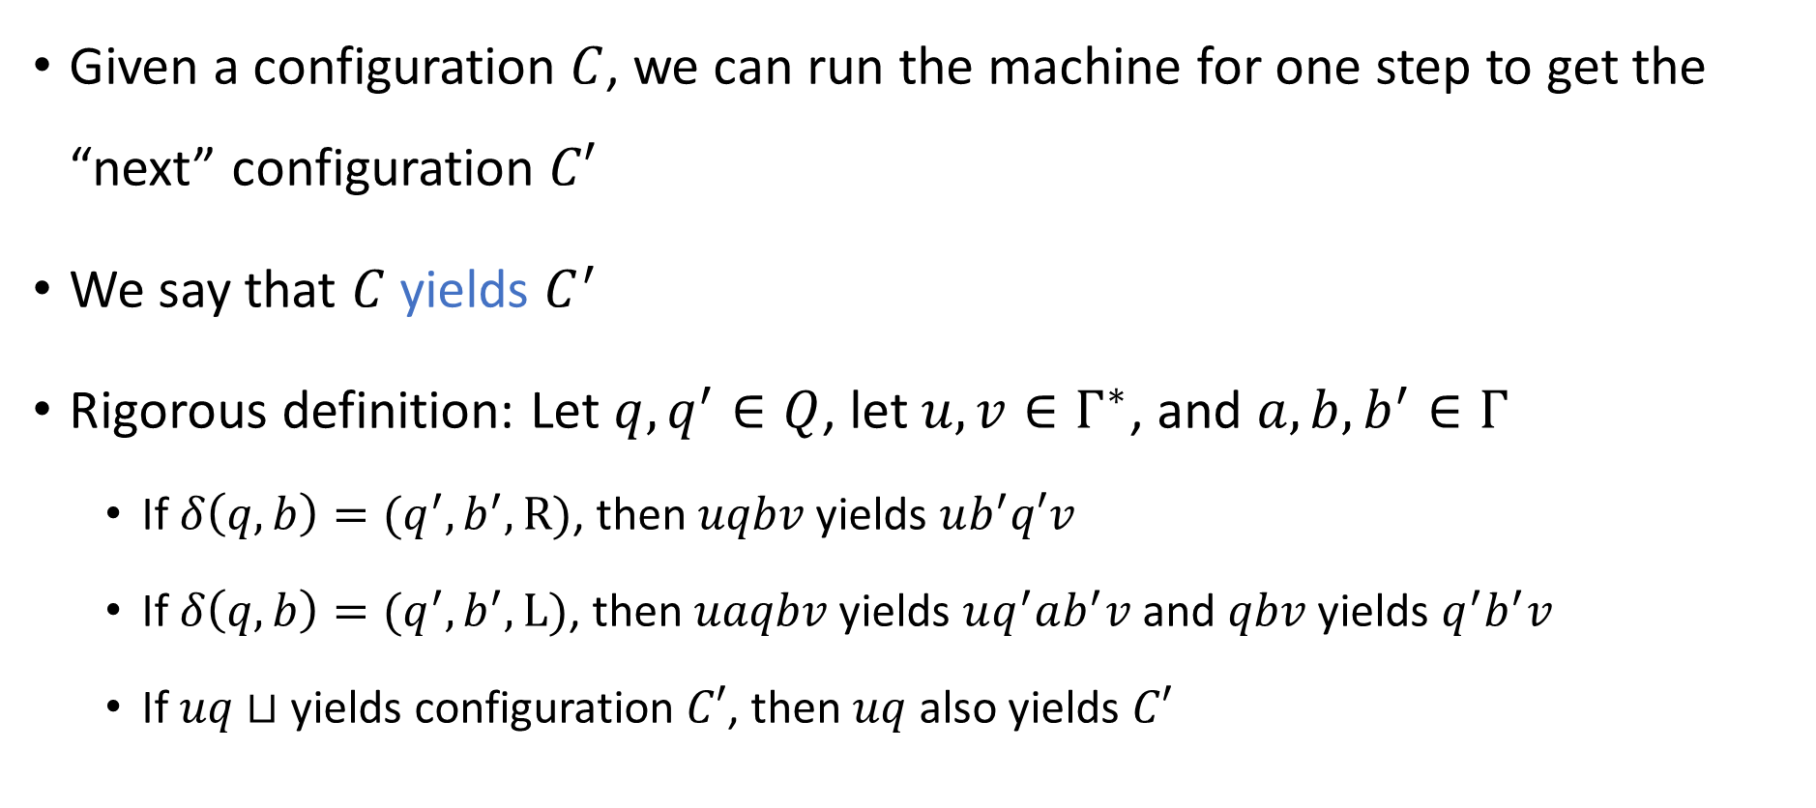
The “next” configuration
Given a configuration $C$, we can run the machine for one step to get the “next” configuration $C′$
We say that $C$ yields $C^{′}$
Rigorous definition: Let $q, q^{′}∈Q$, let $u, v∈Γ^{∗}$, and $a,b,b^{′}∈Γ$
If $δ\left(q,b\right)=(q^{′},b^{′},\text{R})$, then $uqbv$ yields $ub^{′}q′v$
If $δ\left(q,b\right)=(q^{′},b^{′},\text{L}\text{)}$, then $uaqbv$ yields $uq^{′}ab^{′}v$ and $qbv$ yields $q^{′}b^{′}v$
If $uq⊔$ yields configuration $C′$, then $uq$ also yields $C′$
Notes:
For each C, there is a unique C’ such that C yields C’. So why do we use relation terminology instead of NEXT(C)?

