Slide 1
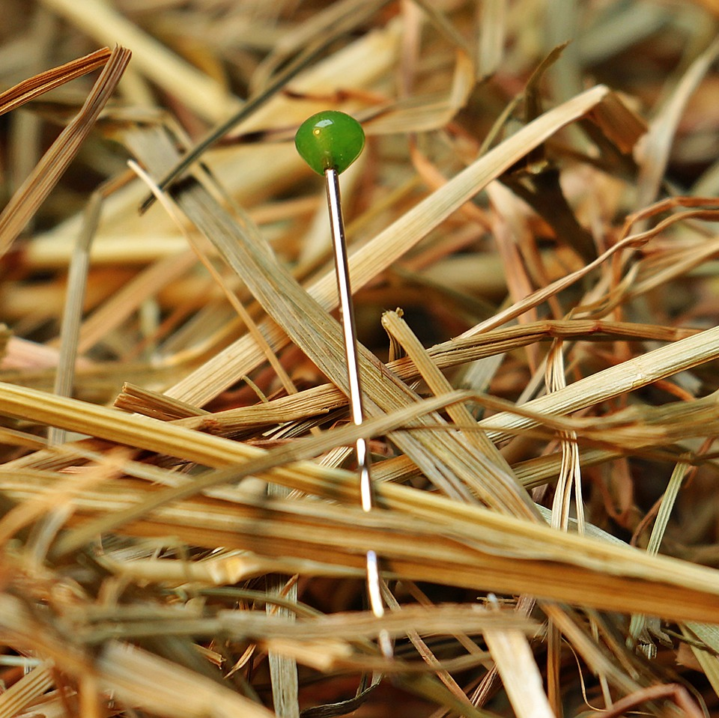
CMSC 28100 Introduction to Complexity Theory Spring 2024 Instructor: William Hoza

Slide 2
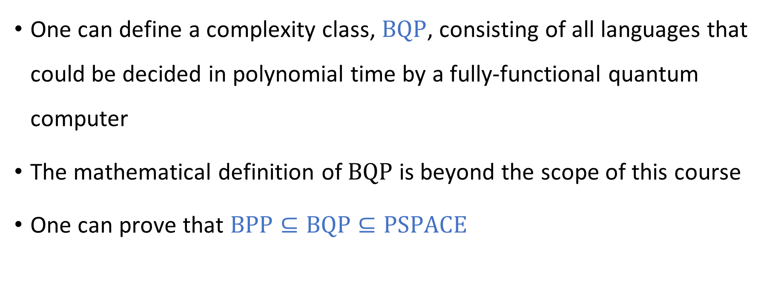
Quantum complexity theory
One can define a complexity class, $\text{BQP}$, consisting of all languages that could be decided in polynomial time by a fully-functional quantum computer
The mathematical definition of $\text{BQP}$ is beyond the scope of this course
One can prove that $\text{BPP}⊆\text{BQP}⊆\text{PSPACE}$

Slide 3

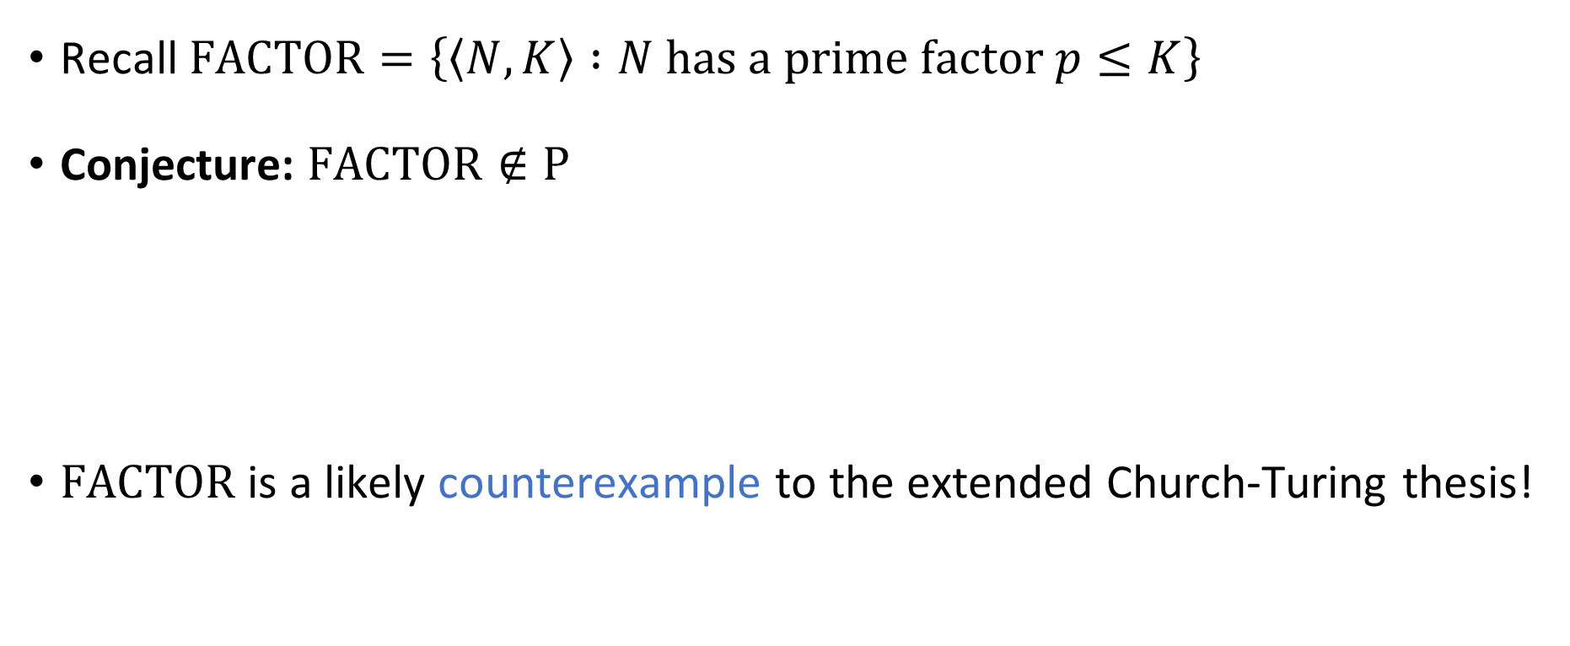
Shor’s algorithm
Recall $\text{FACTOR}=\left\{\left\langle N, K\right\rangle :N \text{has} \text{a} \text{prime} \text{factor} p≤K\right\}$
Conjecture: $\text{FACTOR}∉\text{P}$
$\text{FACTOR}$ is a likely counterexample to the extended Church-Turing thesis!
Theorem (Shor’s algorithm): $\text{FACTOR}∈\text{BQP}$

Slide 4
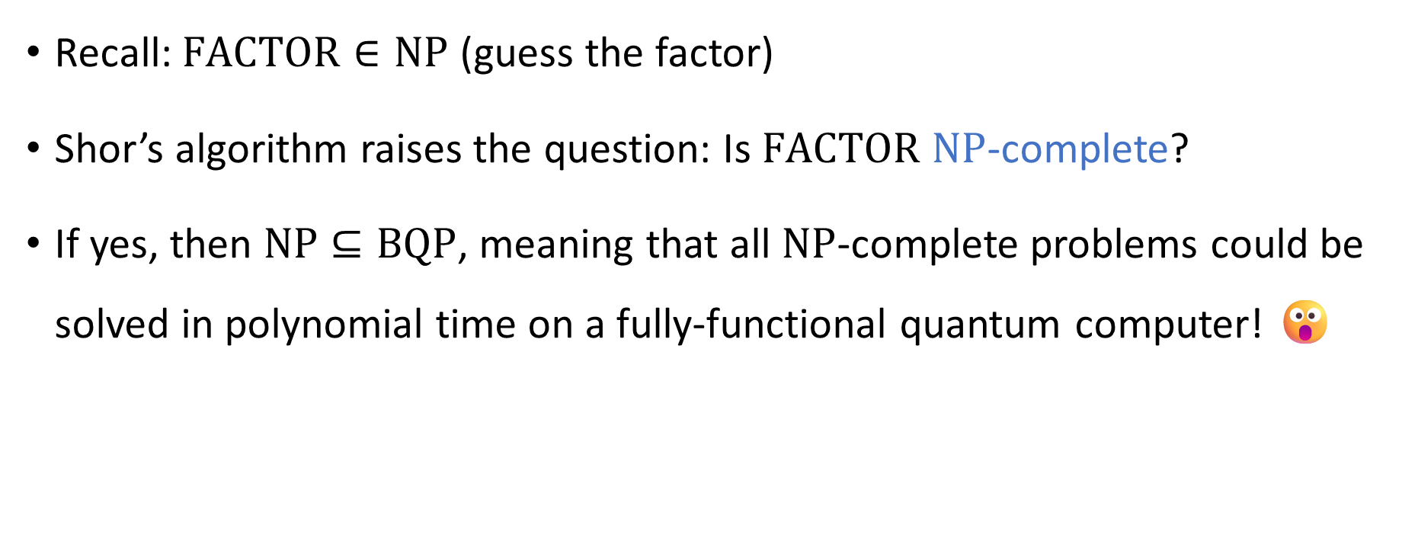

Quantum computing and $\text{NP}$-completeness
Recall: $\text{FACTOR}∈\text{NP}$ (guess the factor)
Shor’s algorithm raises the question: Is $\text{FACTOR}$ $\text{NP}$-complete?
If yes, then $\text{NP}⊆\text{BQP}$, meaning that all $\text{NP}$-complete problems could be solved in polynomial time on a fully-functional quantum computer! 😮

Slide 5
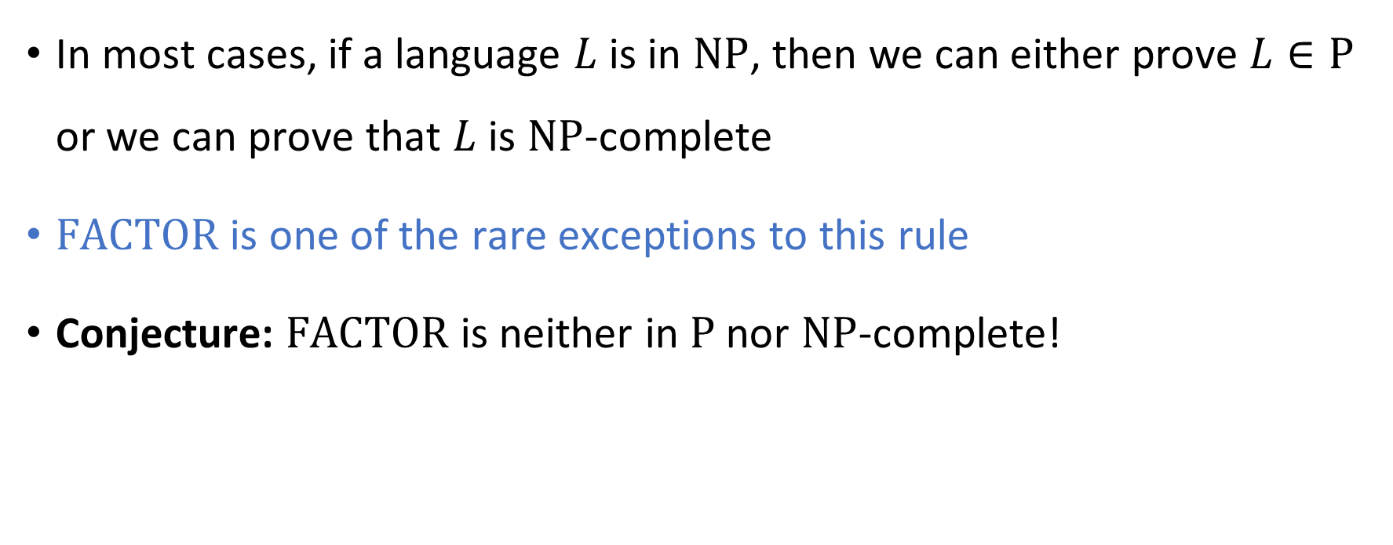
Complexity of factoring integers
In most cases, if a language $L$ is in $\text{NP}$, then we can either prove $L∈\text{P}$ or we can prove that $L$ is $\text{NP}$-complete
$\text{FACTOR}$ is one of the rare exceptions to this rule
Conjecture: $\text{FACTOR}$ is neither in $\text{P}$ nor $\text{NP}$-complete!

Slide 6


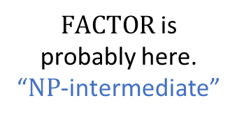




$\text{NP}$-hard
$$\text{3}\text{‑}\text{SAT}$$
$\text{NP}$-complete
$\text{FACTOR}$ is probably here. “$\text{NP}$-intermediate”
$$\text{NP}$$
$$\text{P}$$
$$\text{PRIMES}$$

Slide 7
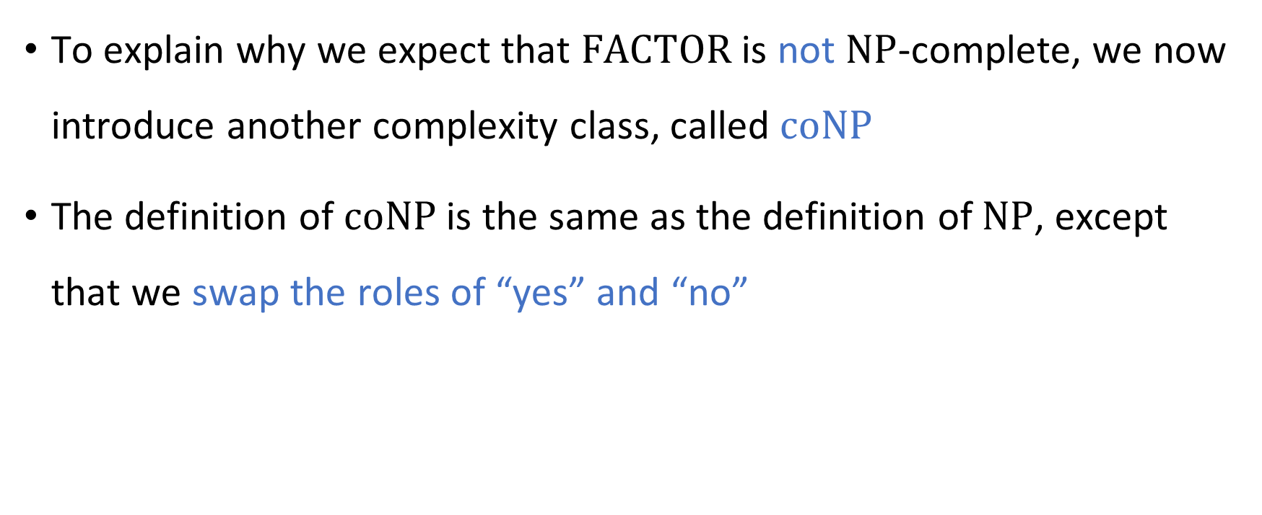
Complexity of factoring integers
To explain why we expect that $\text{FACTOR}$ is not $\text{NP}$-complete, we now introduce another complexity class, called $\text{coNP}$
The definition of $\text{coNP}$ is the same as the definition of $\text{NP}$, except that we swap the roles of “yes” and “no”

Slide 8
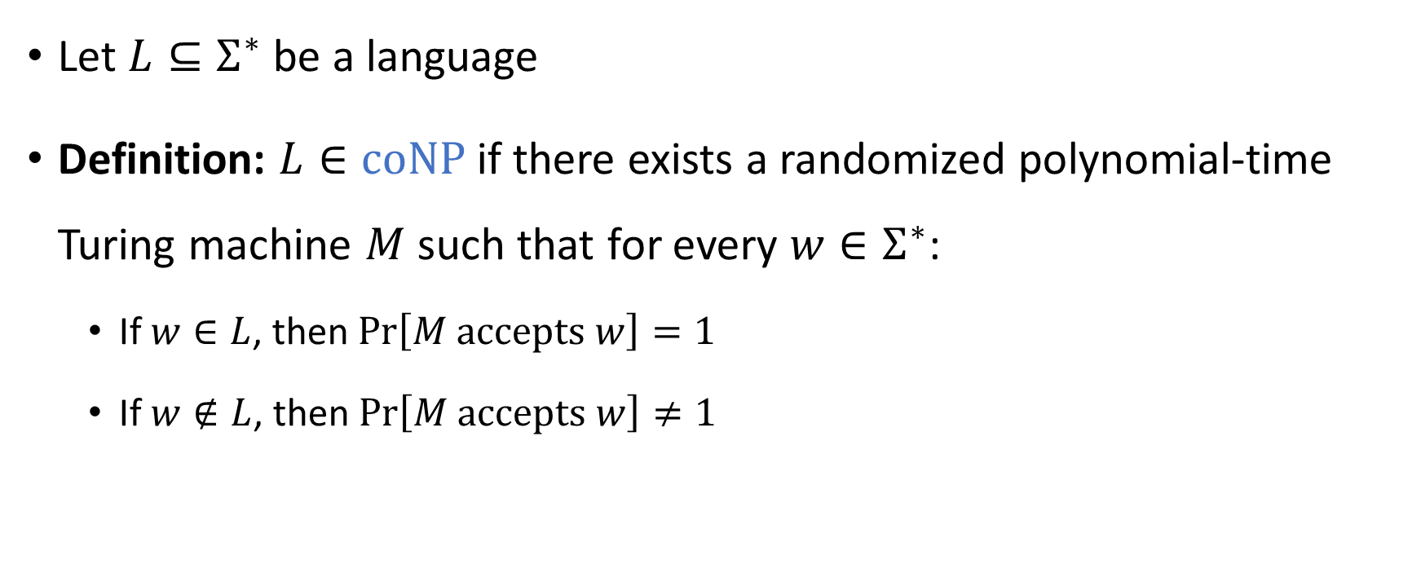

The complexity class $co\text{NP}$
Let $L⊆Σ^{∗}$ be a language
Definition: $L∈\text{coNP}$ if there exists a randomized polynomial-time Turing machine $M$ such that for every $w∈Σ^{∗}$:
If $w∈L$, then $\operatorname{Pr}\left[M \text{accepts} w\right]=1$
If $w∉L$, then $\operatorname{Pr}\left[M \text{accepts} w\right]≠1$

Slide 9
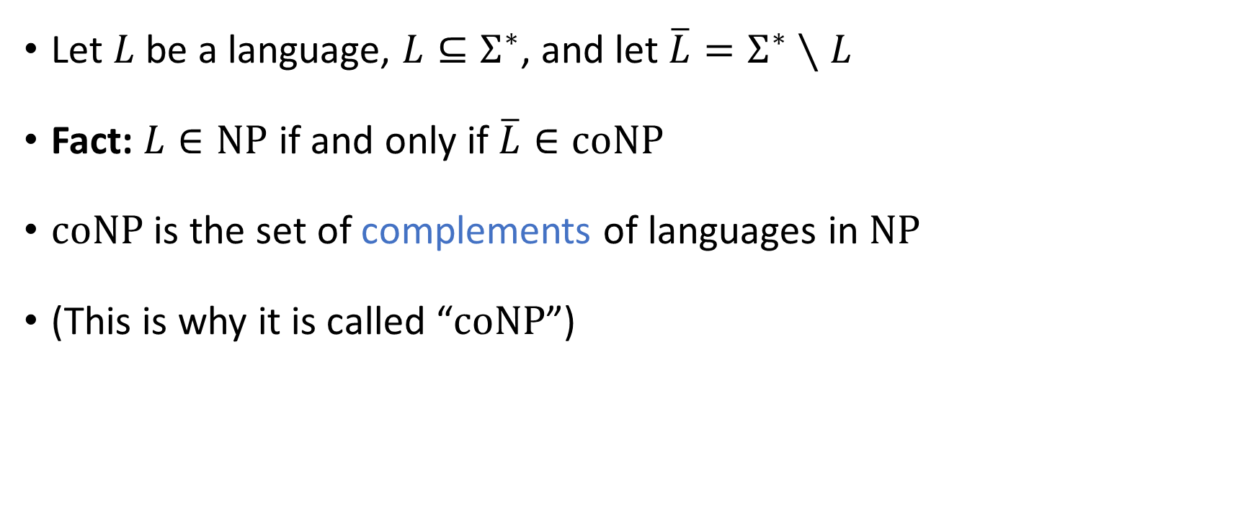

The complexity class $\text{coNP}$
Let $L$ be a language, $L⊆Σ^{∗}$, and let $\overline{L}=Σ^{∗}∖L$
Fact: $L∈\text{NP}$ if and only if $\overline{L}∈\text{coNP}$
$\text{coNP}$ is the set of complements of languages in $\text{NP}$
(This is why it is called “$\text{coNP}$”)

Slide 10
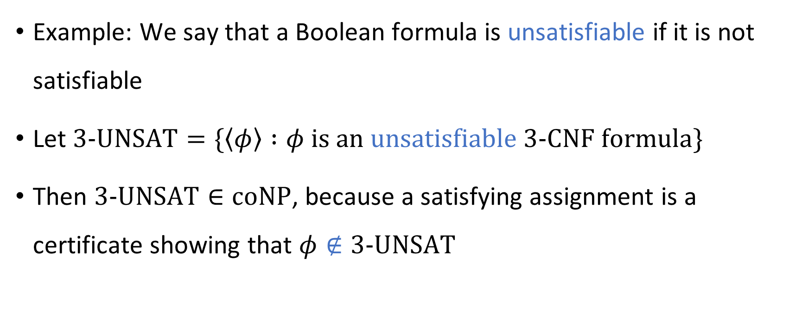
The complexity class $\text{coNP}$
Example: We say that a Boolean formula is unsatisfiable if it is not satisfiable
Let $\text{3}\text{‑}\text{UNSAT}=\{\left\langle φ\right\rangle :φ is an unsatisfiable \text{3}\text{‑}\text{CNF} formula\}$
Then $\text{3}\text{‑}\text{UNSAT}∈\text{coNP}$, because a satisfying assignment is a certificate showing that $φ∉\text{3}\text{‑}\text{UNSAT}$

Slide 11
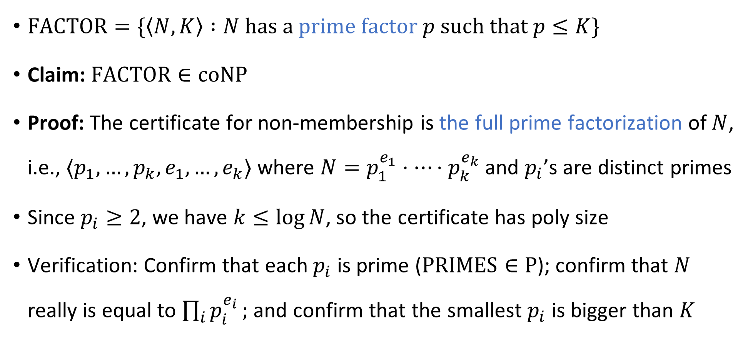

$\text{FACTOR}∈\text{coNP}$
$\text{FACTOR}=\{\left\langle N,K\right\rangle :N \text{has} \text{a} \text{prime} \text{factor} p \text{such} \text{that} p≤K\}$
Claim: $\text{FACTOR}∈\text{coNP}$
Proof: The certificate for non-membership is the full prime factorization of $N$, i.e., $⟨p_{1}, …, p_{k}, e_{1}, …, e_{k}⟩$ where $N=p_{1}^{e_{1}}⋅⋯⋅p_{k}^{e_{k}}$ and $p_{i}$’s are distinct primes
Since $p_{i}≥2$, we have $k≤\log{N}$, so the certificate has poly size
Verification: Confirm that each $p_{i}$ is prime ($\text{PRIMES}∈\text{P}$); confirm that $N$ really is equal to $\prod_{i}{p_{i}^{e_{i}}};$ and confirm that the smallest $p_{i}$ is bigger than $K$

Slide 12
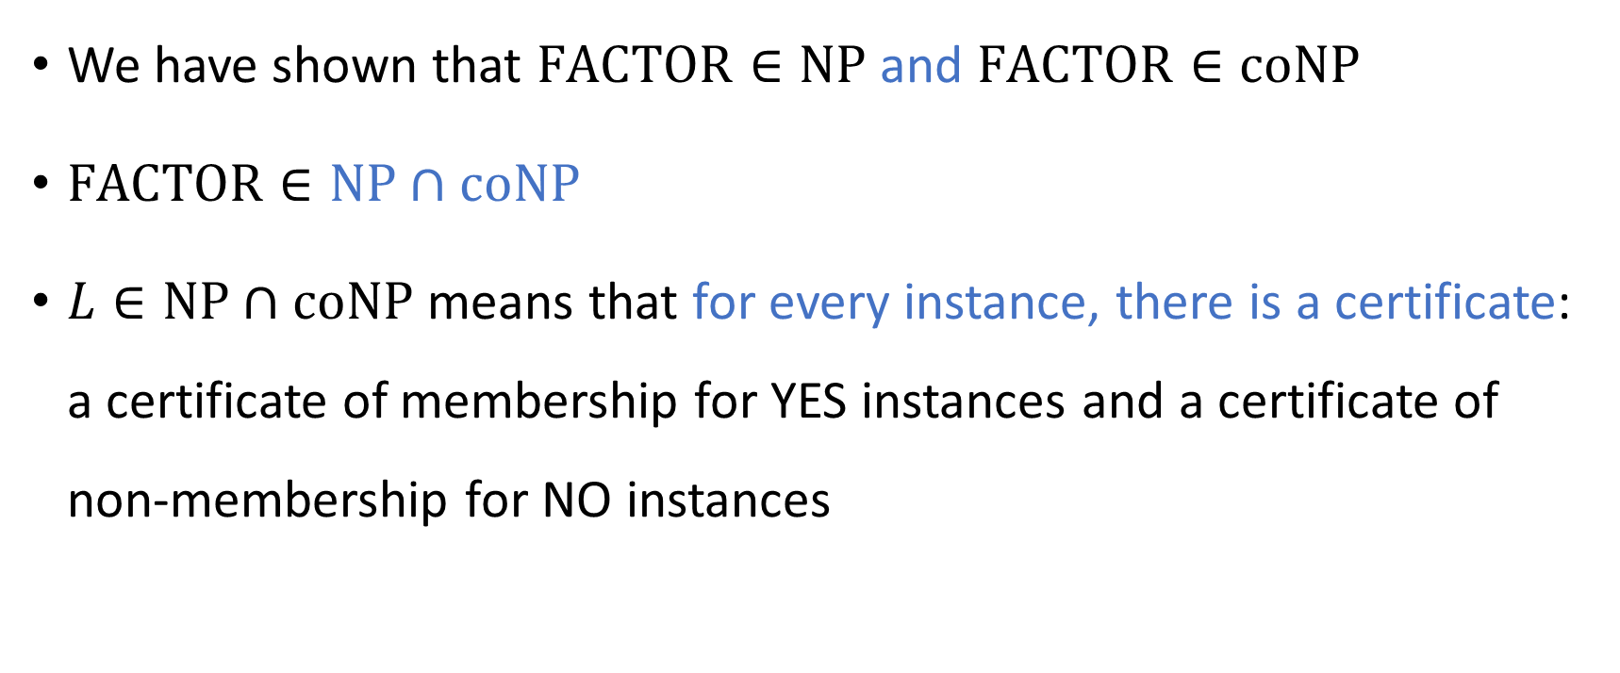

The complexity class $\text{NP}∩\text{coNP}$
We have shown that $\text{FACTOR}∈\text{NP}$ and $\text{FACTOR}∈\text{coNP}$
$\text{FACTOR}∈\text{NP}∩\text{coNP}$
$L∈\text{NP}∩\text{coNP}$ means that for every instance, there is a certificate: a certificate of membership for YES instances and a certificate of non-membership for NO instances

Slide 13
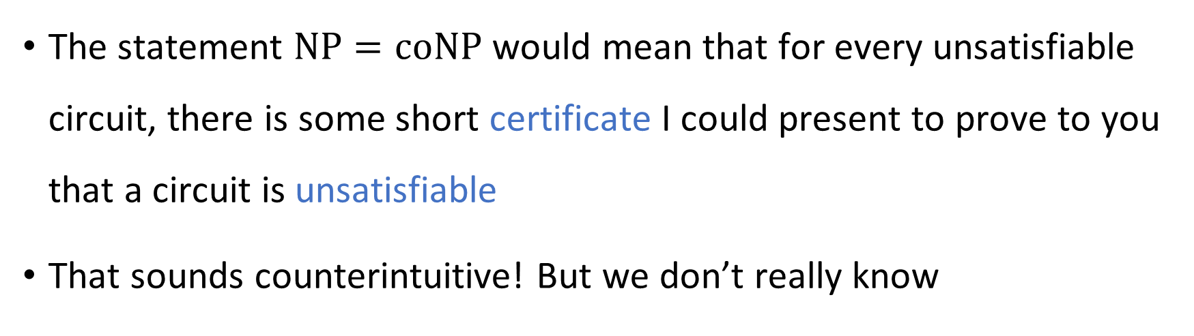


The $\text{NP}$ vs. $\text{coNP}$ problem
Conjecture: $\text{NP}≠\text{coNP}$
The statement $\text{NP}=\text{coNP}$ would mean that for every unsatisfiable circuit, there is some short certificate I could present to prove to you that a circuit is unsatisfiable
That sounds counterintuitive! But we don’t really know

Slide 14






$$\text{PSPACE}$$
$$\text{coNP}$$
$$\text{NP}$$
$$\text{FACTOR}$$
$$\text{NP}∩\text{coNP}$$
$$\text{P}$$

Slide 15
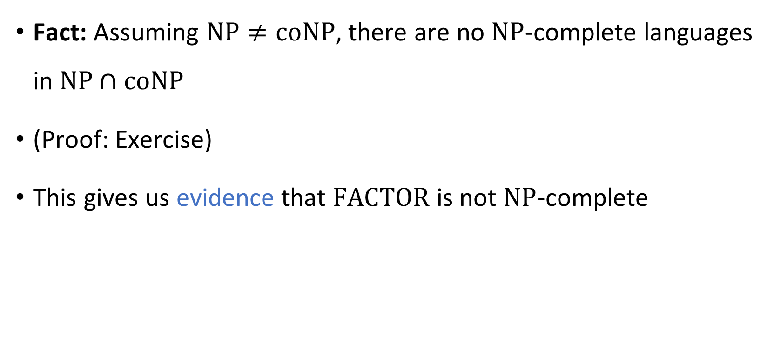
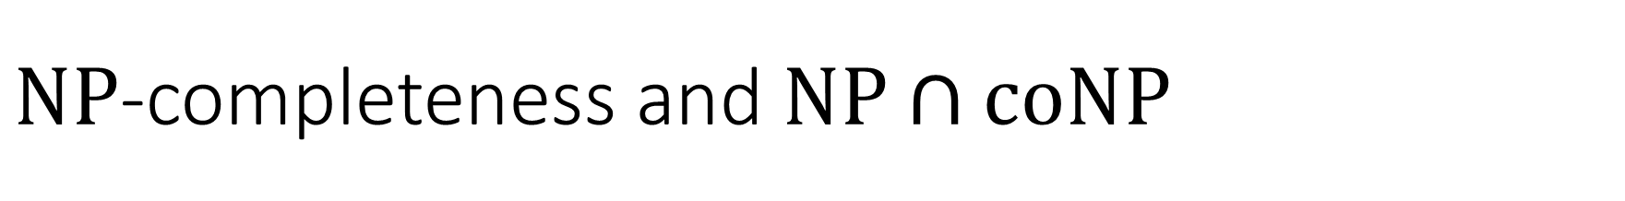
$\text{NP}$-completeness and $\text{NP}∩\text{coNP}$
Fact: Assuming $\text{NP}≠\text{coNP}$, there are no $\text{NP}$-complete languages in $\text{NP}∩\text{coNP}$
(Proof: Exercise)
This gives us evidence that $\text{FACTOR}$ is not $\text{NP}$-complete

Slide 16






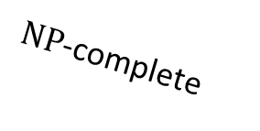

$\text{coNP}$-hard
$\text{NP}$-hard
$\text{coNP}$-complete
$\text{NP}$-complete
$$\text{coNP}$$
$$\text{NP}$$
$$\text{FACTOR}$$
$$\text{NP}∩\text{coNP}$$
$$\text{P}$$

Slide 17
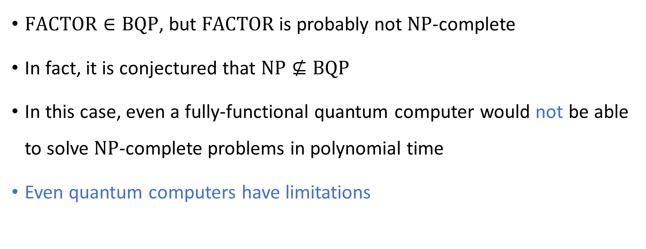
Quantum computing is not a panacea
$\text{FACTOR}∈\text{BQP}$, but $\text{FACTOR}$ is probably not $\text{NP}$-complete
In fact, it is conjectured that $\text{NP}⊈\text{BQP}$
In this case, even a fully-functional quantum computer would not be able to solve $\text{NP}$-complete problems in polynomial time
Even quantum computers have limitations

Slide 18








$\text{NP}$-hard
$$\text{3}\text{‑}\text{SAT}$$
$$\text{EXP}$$
$\text{NP}$-complete
$$\text{NP}$$
$$\text{FACTOR}$$
$$\text{BQP}$$
$$\text{P}$$

Slide 19
Which problems can be solved through computation?
CLASSICAL

Slide 20
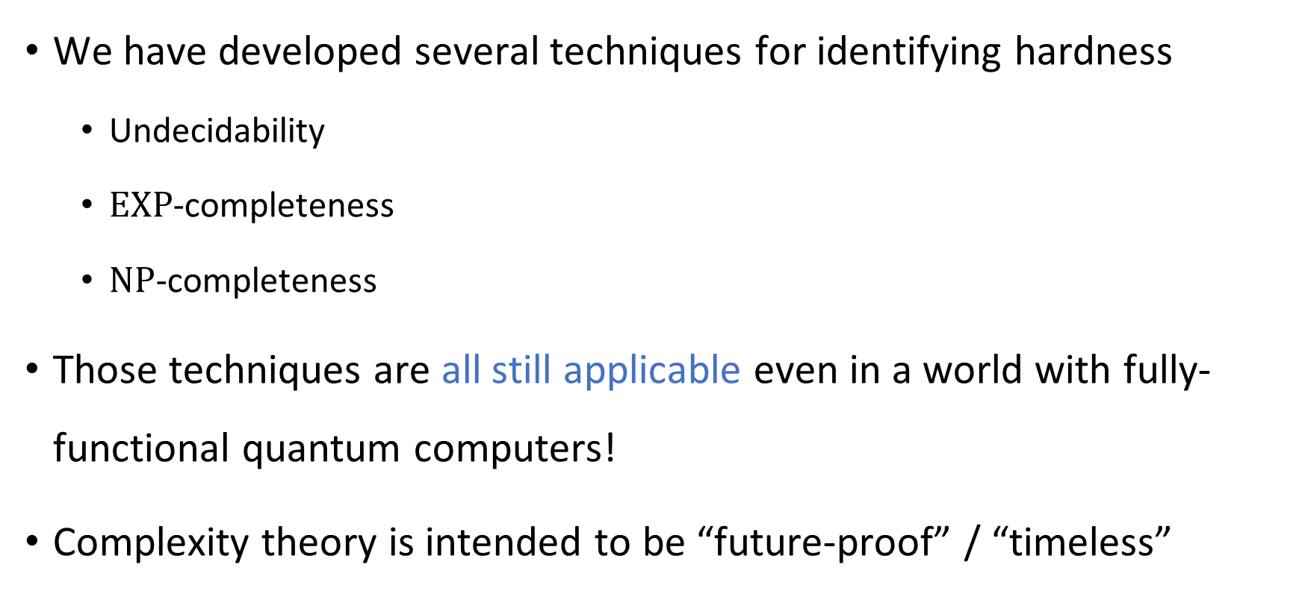
Limitations of quantum computers
We have developed several techniques for identifying hardness
Undecidability
$\text{EXP}$-completeness
$\text{NP}$-completeness
Those techniques are all still applicable even in a world with fully-functional quantum computers!
Complexity theory is intended to be “future-proof” / “timeless”

Slide 21
Which problems can be solved through computation?

Slide 22
Complexity theory: The study of computational resources

Slide 23

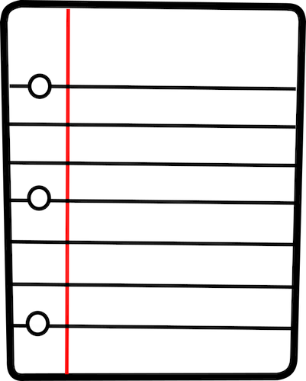
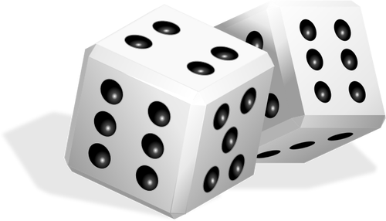




Computational resources: Fuel for algorithms
TIME
SPACE
RANDOMNESS
COMMUNICATION
QUANTUM PHYSICS
PARALLELISM

Slide 24

Sublinear-space computation
Can we solve any interesting problems using $o\left(n\right)$ space?
The one-tape Turing machine is the not the right model of computation for studying sublinear-space algorithms

Slide 25


Sublinear-space computation
Read-only input tape ➡
$$♢$$
1
1
0
1
1
Read-write work tape ➡
$$♢$$
0
1
0

Slide 26
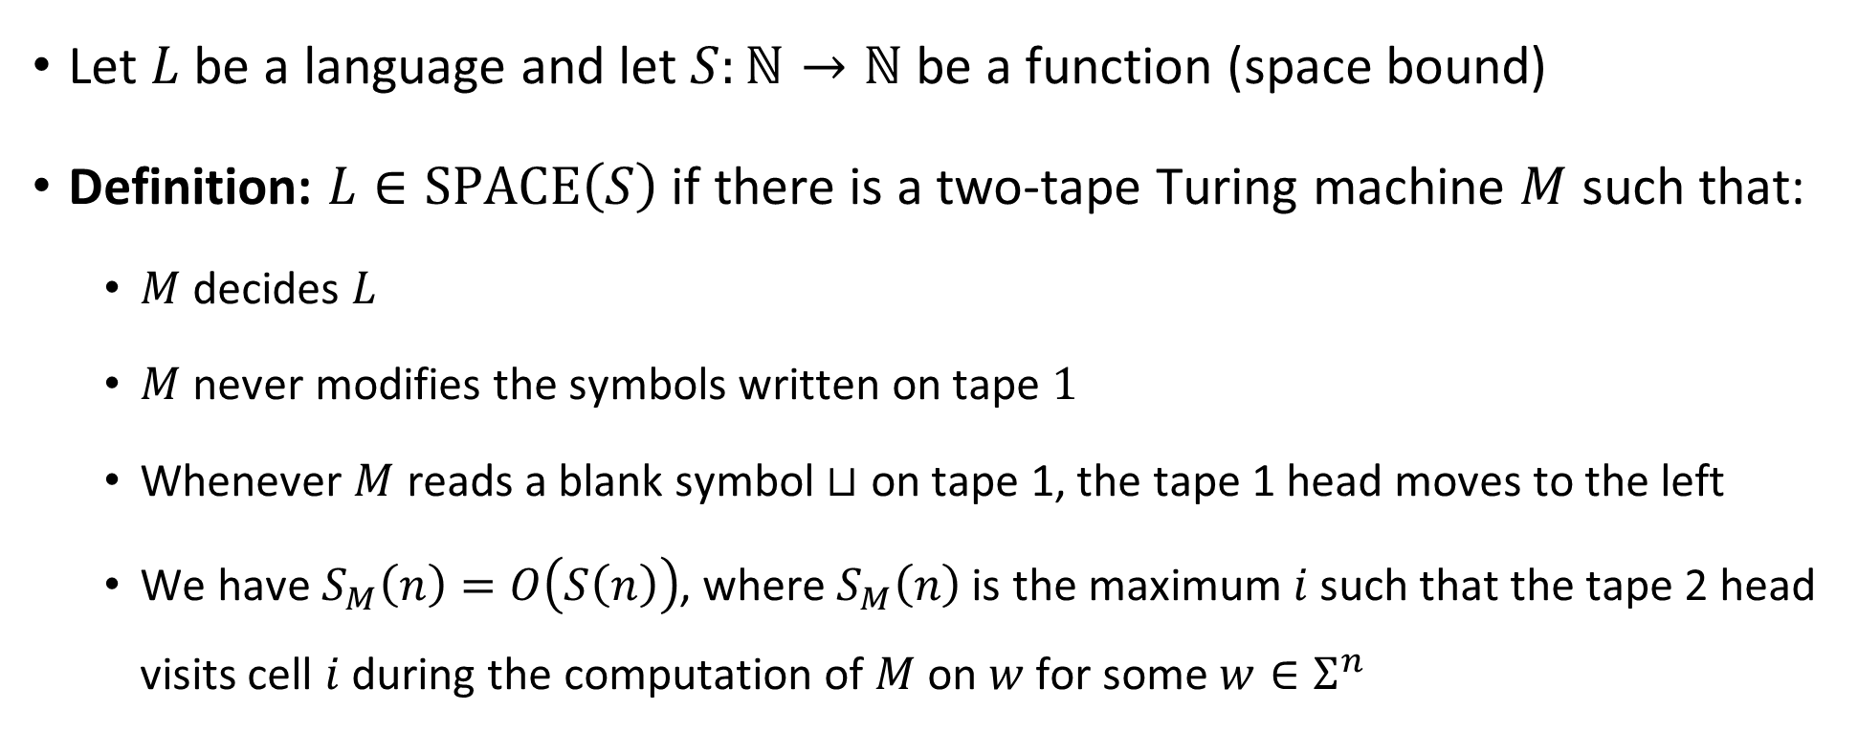

The complexity class $\text{SPACE}\left(S\right)$
Let $L$ be a language and let $S:ℕ→ℕ$ be a function (space bound)
Definition: $L∈\text{SPACE}\left(S\right)$ if there is a two-tape Turing machine $M$ such that:
$M$ decides $L$
$M$ never modifies the symbols written on tape $1$
Whenever $M$ reads a blank symbol $⊔$ on tape 1, the tape 1 head moves to the left
We have $S_{M}\left(n\right)=O\left(S\left(n\right)\right)$, where $S_{M}\left(n\right)$ is the maximum $i$ such that the tape 2 head visits cell $i$ during the computation of $M$ on $w$ for some $w∈Σ^{n}$

Slide 27
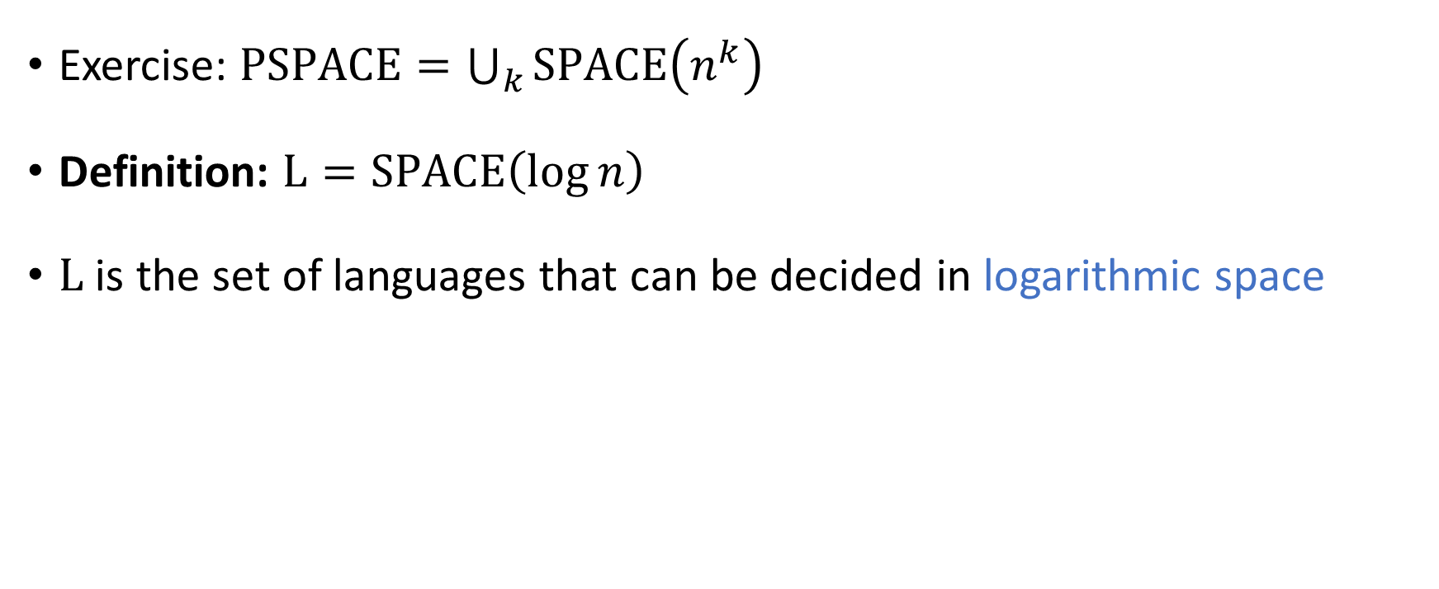

The complexity class $\text{L}$
Exercise: $\text{PSPACE}=\bigcup_{k}{\text{SPACE}\left(n^{k}\right)}$
Definition: $\text{L}=\text{SPACE}\left(\log{n}\right)$
$\text{L}$ is the set of languages that can be decided in logarithmic space

Slide 28
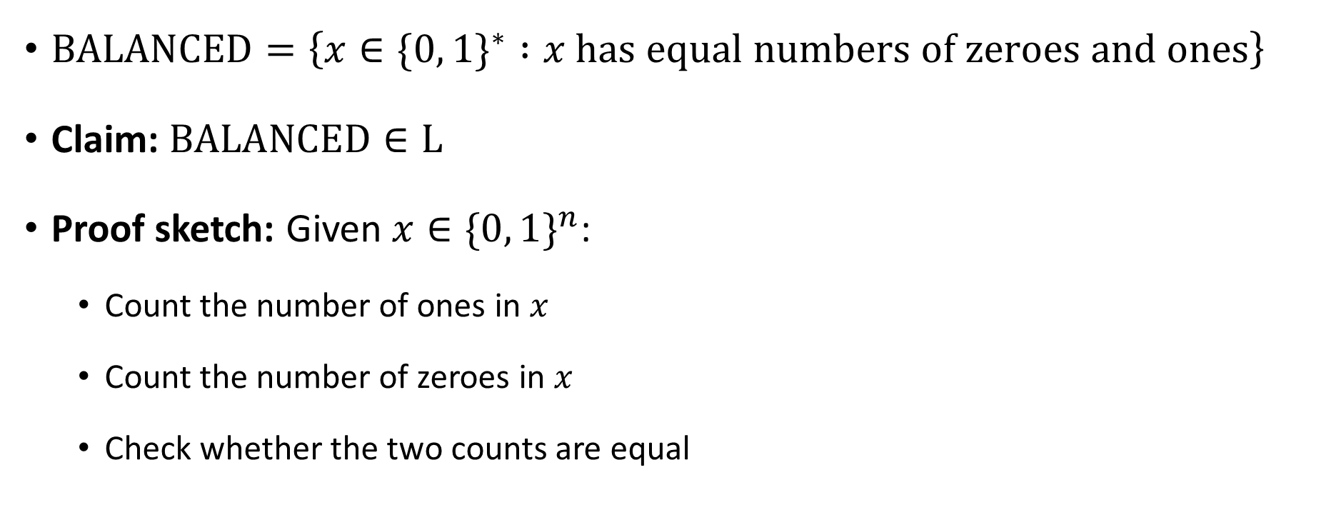


$\text{BALANCED}∈\text{L}$
$\text{BALANCED}=\left\{x∈\{0, 1\}^{∗} :x \text{has} \text{equal} \text{numbers} \text{of} \text{zeroes} \text{and} \text{ones}\right\}$
Claim: $\text{BALANCED}∈\text{L}$
Proof sketch: Given $x∈\{0, 1\}^{n}$:
Count the number of ones in $x$
Count the number of zeroes in $x$
Check whether the two counts are equal
These counters are only $\log{n}$ bits each!

Slide 29


$\text{L}⊆\text{P}$
Exercise: Show that $\text{L}⊆\text{P}$
(Similar to the proof that $\text{PSPACE}⊆\text{EXP}$)

Slide 30





$$\text{EXP}$$
$$\text{PSPACE}$$
$$\text{NP}$$
$$\text{P}$$
$$\text{L}$$

Slide 31


The $\text{L}$ vs. $\text{P}$ problem
We expect that $\text{L}≠\text{P}$, but we don’t know how to prove it
$\text{L}=\text{P}$ would mean that every efficient algorithm can be modified so that it only uses a tiny amount of work space

Slide 32

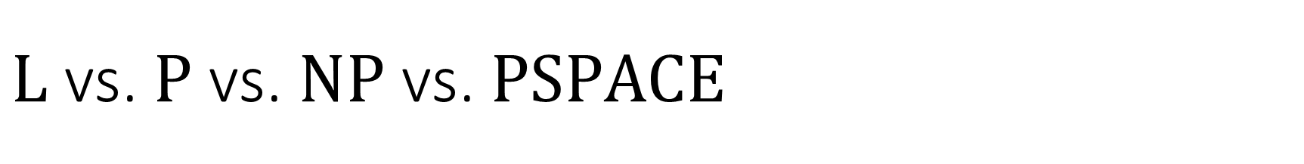

$\text{L}$ vs. $\text{P}$ vs. $\text{NP}$ vs. $\text{PSPACE}$
$\text{L}⊆\text{P}⊆\text{NP}⊆\text{PSPACE}$
What we expect: All of these containments are strict
What we can prove: At least one of these containments is strict:
Theorem: $\text{L}≠\text{PSPACE}$

Slide 33
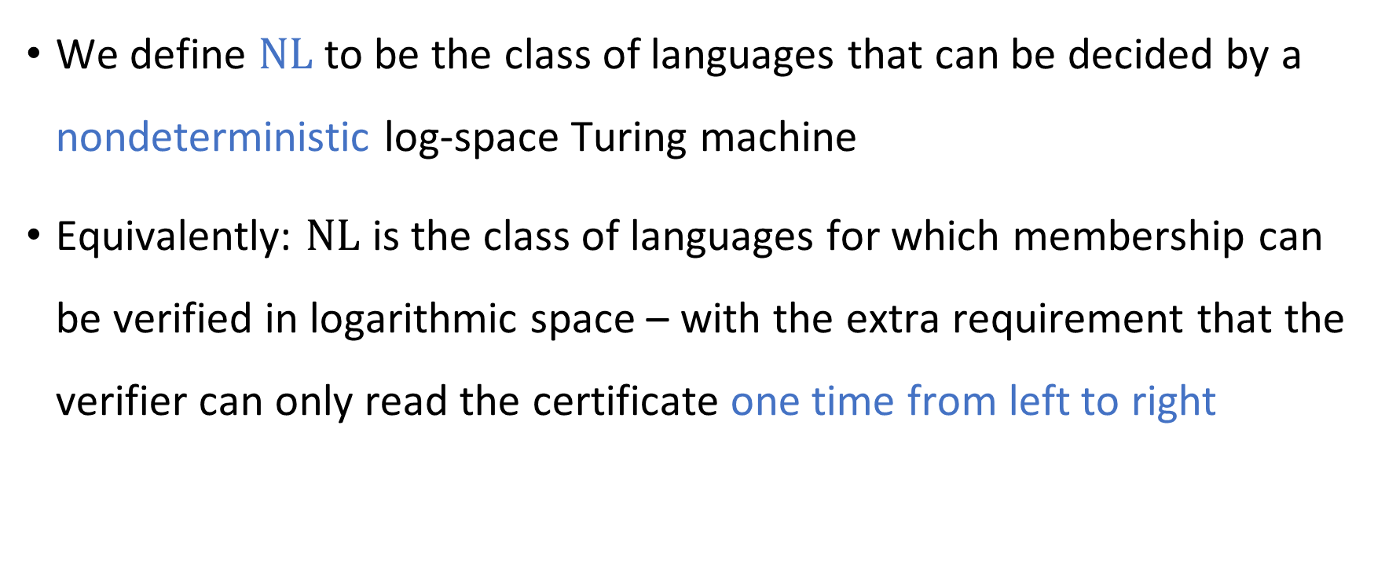
Nondeterministic log space computation
We define $\text{NL}$ to be the class of languages that can be decided by a nondeterministic log-space Turing machine
Equivalently: $\text{NL}$ is the class of languages for which membership can be verified in logarithmic space – with the extra requirement that the verifier can only read the certificate one time from left to right

Slide 34

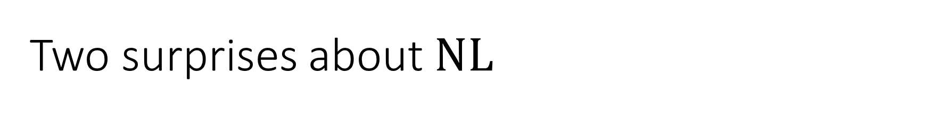

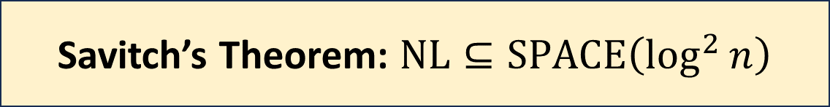
Two surprises about $\text{NL}$
We expect that $\text{P}≠\text{NP}$. However, in the space complexity world…
We expect that $\text{NP}≠\text{coNP}$. However, in the space complexity world…
Savitch’s Theorem: $\text{NL}⊆\text{SPACE}\left(\log^{2}{n}\right)$
Immerman-Szelepcsényi Theorem: $\text{NL}=\text{coNL}$

