Slide 1
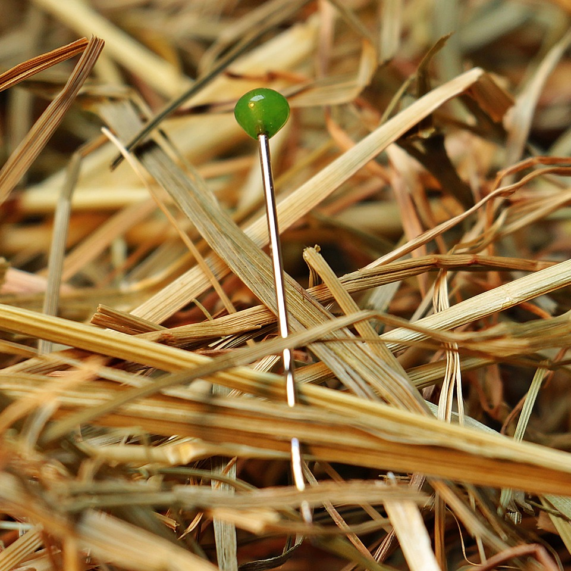
CMSC 28100 Introduction to Complexity Theory Spring 2025 Instructor: William Hoza

Slide 2
The nature of this course
In this course, we will study
The mathematical and philosophical foundations of computer science
The ultimate limits of computation
This course will give you powerful conceptual tools for reasoning about computation
There will be very little programming
Homework and exams will be primarily proof-based

Slide 3
Who this course is designed for
CS students, math students, and anyone who is curious
Prerequisites:
Experience with mathematical proofs
CMSC 27200 or CMSC 27230 or CMSC 37000, or MATH 15900 or MATH 15910 or MATH 16300 or MATH 16310 or MATH 19900 or MATH 25500

Slide 4
Who this course is designed for
It’s okay if you don’t consider yourself “theory-oriented”
You belong here
It’s my job to give you resources so you can learn and succeed
I also consider it my job to persuade you that complexity theory is important, interesting, enlightening, fun, cool, and worthy of your attention

Slide 5
Class participation
Please ask questions!
“What does that notation mean?”
“I forget what a _____ is. Can you remind me?”
“How do we know _____?”
“I’m lost. Can you explain that again?”

Slide 6

Textbook
Classic
Popular
High-quality
Not free ☹️

Slide 7
Assessment
28 homework exercises
Exercises 1-4 are due Tuesday, April 1
Midterm exam in class on 4/23
Final exam at the end of the quarter

Slide 8
My office hours
Mondays (starting next week), 9am to 11am, JCL 205
Stop by! This is a great time for discussions
If you are confused/curious about something, I’ll try to help you figure it out
If you are stuck on a homework exercise, I’ll try to think of a good hint
If you have a complaint, I’ll listen and try to make things better

Slide 9
Teaching assistants
Zelin Lv
Office hours: Fridays, 2pm to 3pm, JCL 205
Yakov Shalunov
Office hours: Thursdays, 5pm to 6pm, JCL 205

Slide 10

Technology
Canvas: https://canvas.uchicago.edu/courses/62607
Homework exercises; practice exams; official solutions
Course webpage: https://williamhoza.com/teaching/spring2025-intro-to-complexity
Course policies; slides
Ed: https://edstem.org/us/courses/76353/
Discussions ($≈$ office hours); announcements
Gradescope: https://www.gradescope.com/courses/988815
Submitting homework solutions; grades and feedback

Slide 11
The central question of this course: Which problems can be solved through computation?

Slide 12
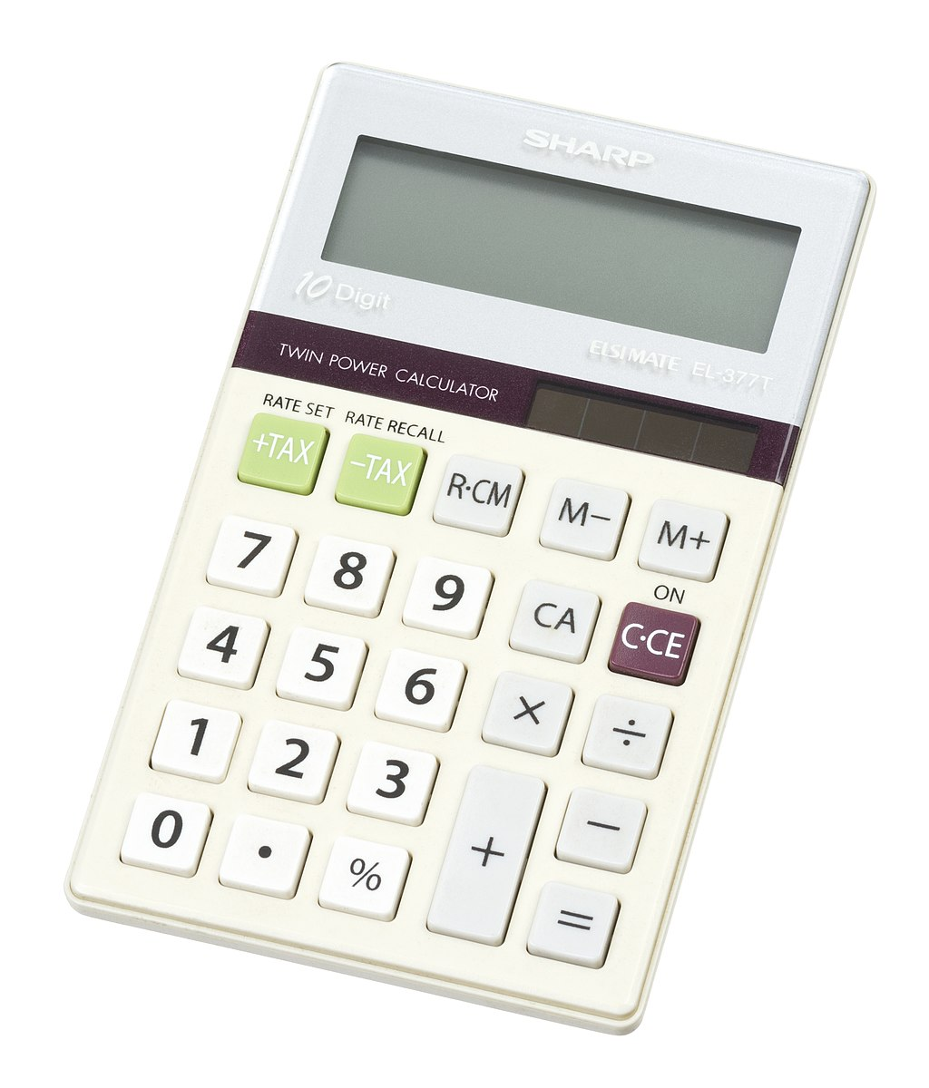
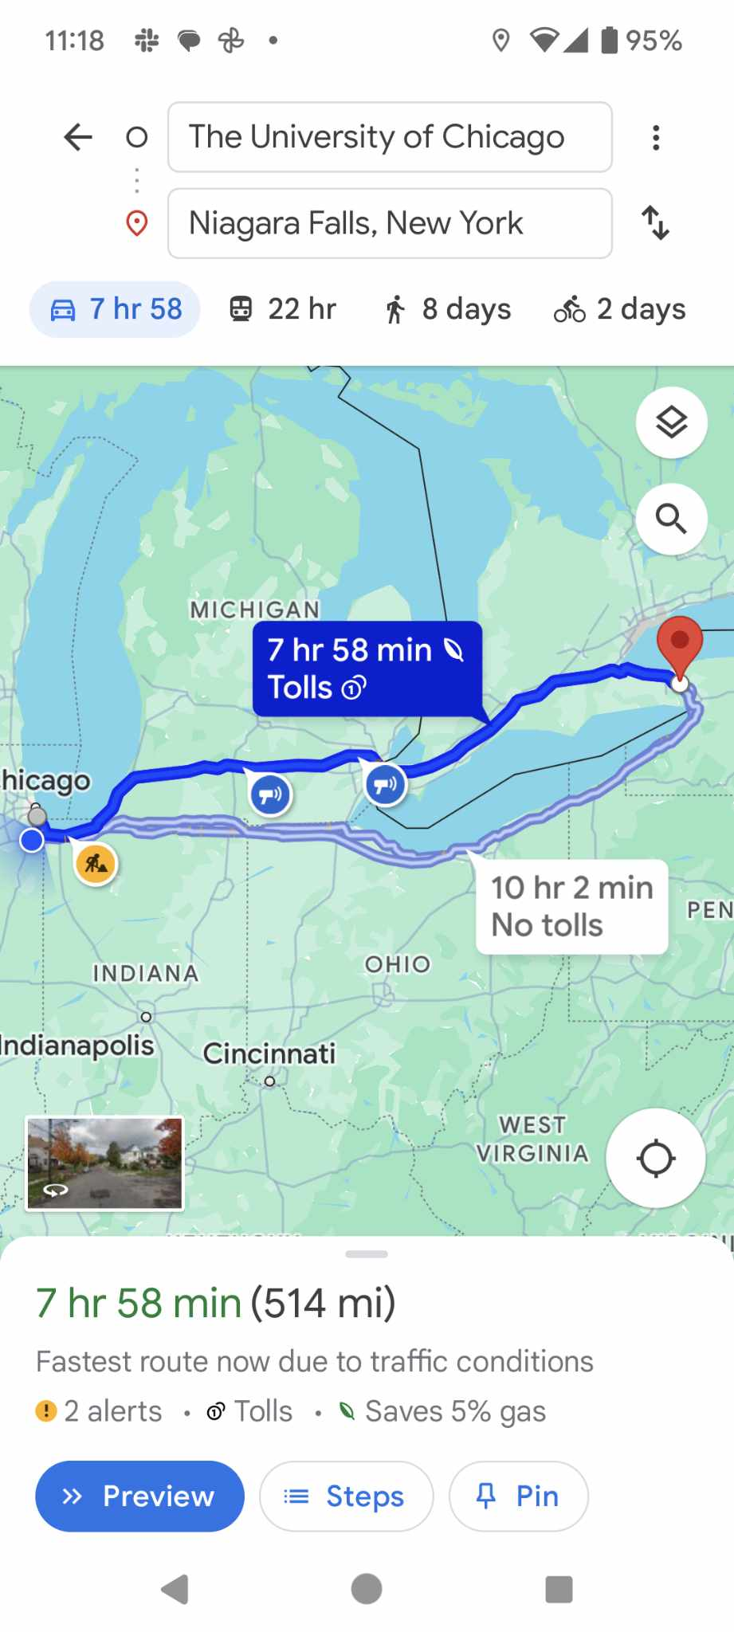

Examples
Many problems can be solved through computation:
Multiplication
Sorting
Shortest path
Are there any problems that cannot be solved through computation?

Slide 13
Impossibility proofs
We will take a mathematical approach to this question
We will formulate precise mathematical models
“Computation”
“Problem”
“Solve”
Then we will write rigorous mathematical proofs of impossibility

Slide 14
Which problems can be solved through computation?

Slide 15

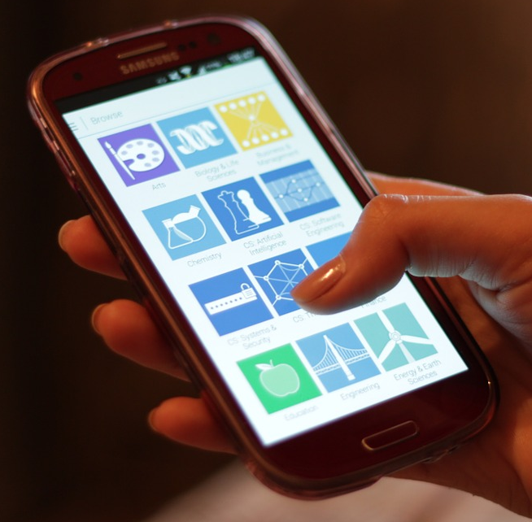
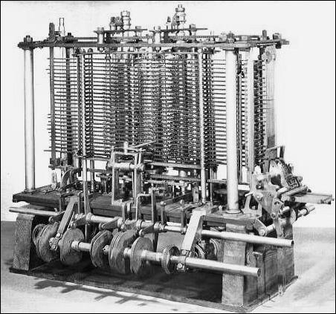
Computation
Computers: Modern technology?
Computation is ancient
Can be performed by:
A human being with paper and a pencil
A smartphone
A steam-powered machine
We want a mathematical model that describes all of these and transcends any one technology

Slide 16
Computation
Note: Humans can do all the same computations that smartphones/laptops do
(less quickly and less reliably)
Consequence: We can study computation without understanding electronics 🙂
Computation is a familiar, everyday, human act

Slide 17

Ex: Palindromes
01110000110100111100101100011110
Suppose a long string of bits is written on a blackboard
Our job: Figure out whether the string is a “palindrome,” i.e., whether it is the same forwards and backwards
What should we do?

Slide 18
Ex: Palindromes
01110000110100111100101100011110
Idea: Compare and cross off the first and last symbols
Repeat until we find a mismatch or everything is crossed off
Not a palindrome

Slide 19
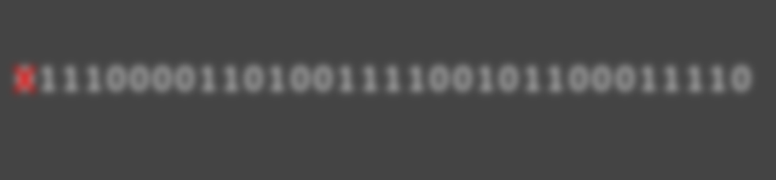
Local decisions
In each step, how do we know what to do next?
We keep track of some information (“state”) in our mind
We look at the local contents of the blackboard (one symbol is sufficient)
We can describe the algorithm using a “state diagram” (next slide)
01110000110100111100101100011110
I just crossed off a zero, and now I’m heading over to the right end of the string

Slide 20
See 0 or 1: move right
See 0 or 1 or a blank spot: move left
Checking for a matching 0
Just crossed off 0
See 0 or 1
See 0: cross it off; move right
See 0: cross it off; move left
See 1
Output NO
Output YES
Start
See 0 or 1: move right
Returning to start
See 0 or 1: move left
See 1: cross it off; move right
Just crossed off 1
See 1: cross it off; move left
See 0
See 0 or 1
Checking for a matching 1
See 0 or 1 or a blank spot: move left
See 0 or 1: move right
See 0 or 1 or a blank spot

Slide 21
The Turing machine model
Turing machines: A mathematical model of human computation
In a nutshell, a Turing machine is any algorithm that can be described by a state diagram like the one we just saw

Slide 22




The Turing machine model
$$⊔$$
$$⊔$$
1
0
1
0
0
1
1
0
$$⊔$$
$$⊔$$
We imagine an infinite, one-dimensional “tape”
The tape is divided into “cells.” Each cell has one symbol written in it
There is a “head” pointing at one cell of the tape
The machine can be in one of finitely many internal “states”

Slide 23
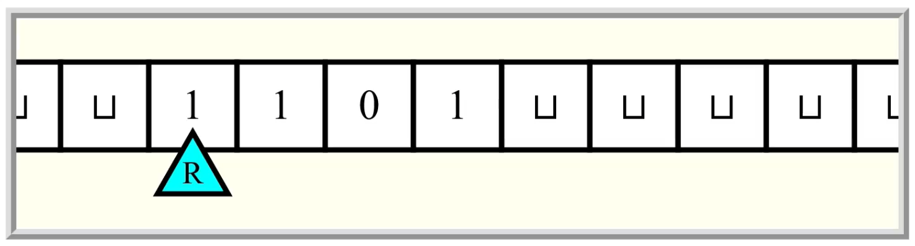
Turing machines
In each step, the machine decides
What to write
Which direction to move the head (left or right)
The new state
The decision is based only on the current state and the observed symbol

Slide 24

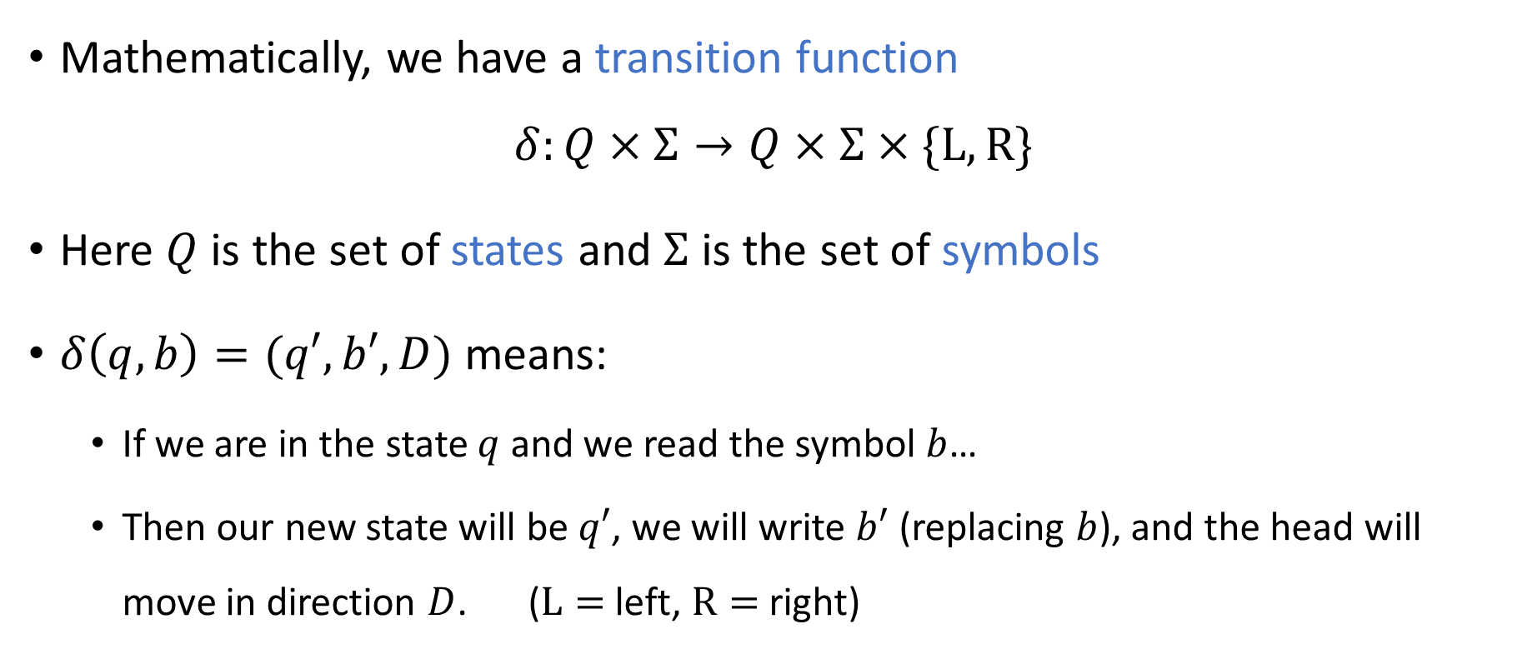
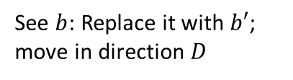

Transition function
See $b$: Replace it with $b′$; move in direction $D$
$$q$$
$$q′$$
Mathematically, we have a transition function
$$δ:Q×Σ→Q×Σ×\{\text{L}, \text{R}\}$$
Here $Q$ is the set of states and $Σ$ is the set of symbols
$δ\left(q, b\right)=(q′,b′,D)$ means:
If we are in the state $q$ and we read the symbol $b$…
Then our new state will be $q′$, we will write $b′$ (replacing $b$), and the head will move in direction $D$. ($\text{L}=$ left, $\text{R}=$ right)

Slide 25
The input to a Turing machine
One Turing machine represents one algorithm
For us, the input to a Turing machine will always be a finite string of bits

Slide 26

Symbols and alphabets
An “alphabet” $Σ$is any nonempty, finite set of “symbols”
$Σ=\{0, 1\}$
$Σ=\left\{0, 1, 0, 1\right\}$
$Σ=\{\text{A}, \text{B}, \text{C}, …,\text{Z}\}$
$Σ=\{😍,\text{⚾}\text{,}\text{🐍},\text{⏰},🍕\}$

Slide 27
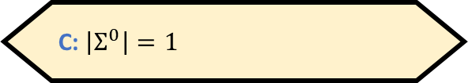
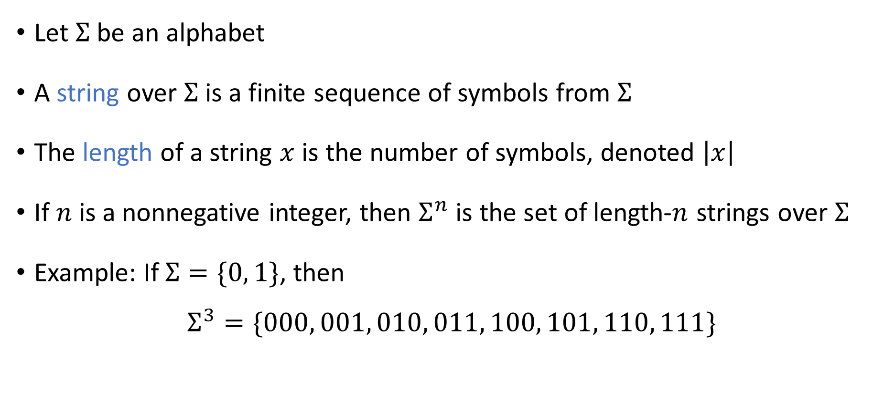
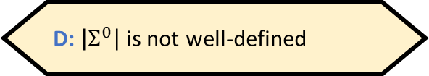
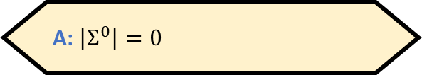
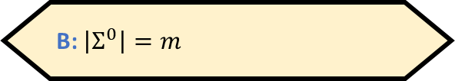
Strings
If $\left|Σ\right|=m$, then what is $\left|Σ^{0}\right|$?
A: $\left|Σ^{0}\right|=0$
B: $\left|Σ^{0}\right|=m$
Let $Σ$ be an alphabet
A string over $Σ$ is a finite sequence of symbols from $Σ$
The length of a string $x$ is the number of symbols, denoted $\left|x\right|$
If $n$ is a nonnegative integer, then $Σ^{n}$ is the set of length-$n$ strings over $Σ$
Example: If $Σ=\{0, 1\}$, then
$$Σ^{3}=\{000, 001, 010, 011, 100, 101, 110, 111\}$$
C: $\left|Σ^{0}\right|=1$
D: $\left|Σ^{0}\right|$ is not well-defined
Respond at PollEv.com/whoza or text “whoza” to 22333

Slide 28
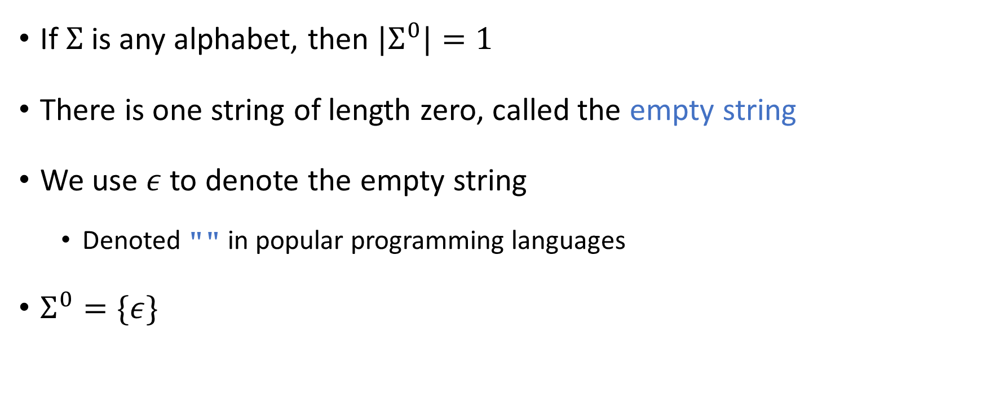
The empty string
If $Σ$ is any alphabet, then ${|Σ}^{0}|=1$
There is one string of length zero, called the empty string
We use $ε$ to denote the empty string
Denoted "" in popular programming languages
$Σ^{0}=\{ε\}$

Slide 29
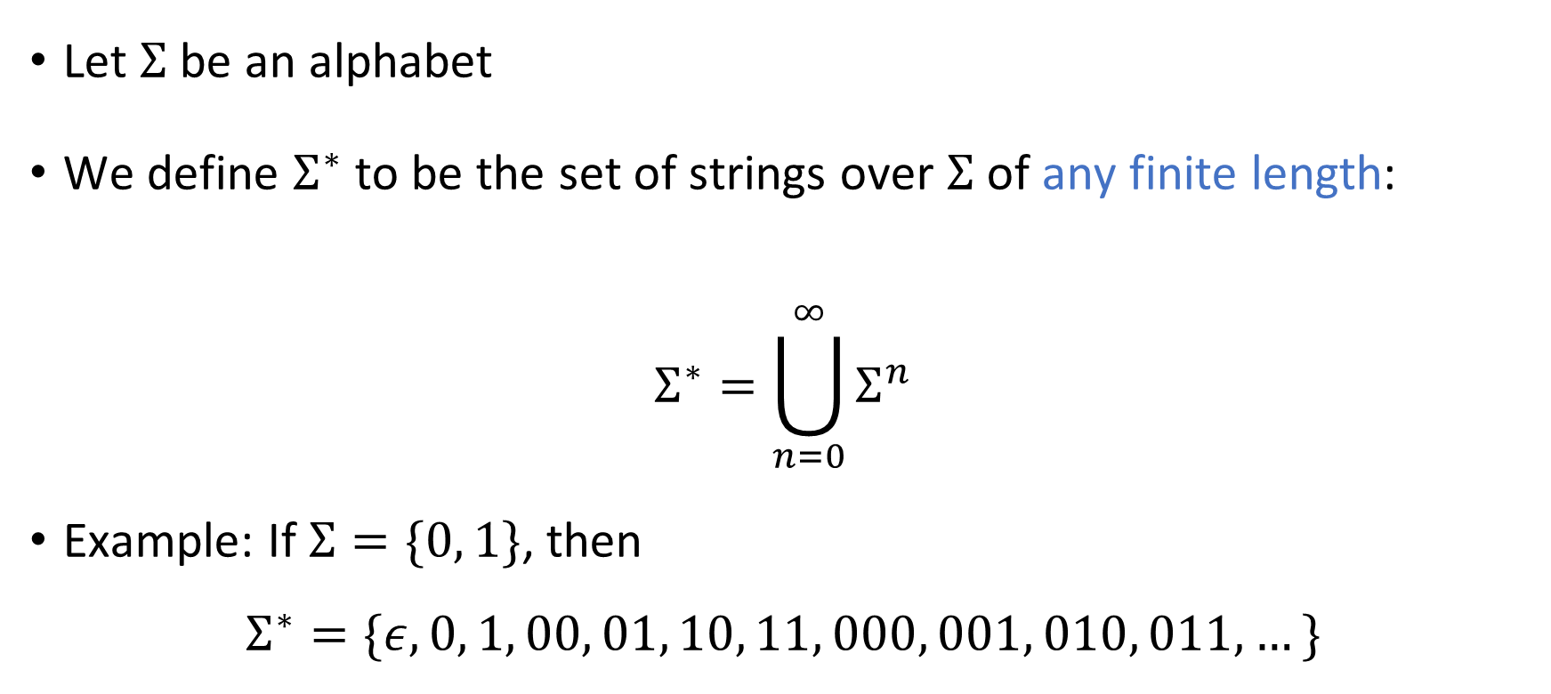
Arbitrary-length strings
Let $Σ$ be an alphabet
We define $Σ^{∗}$ to be the set of strings over $Σ$ of any finite length:
$$Σ^{∗}=\bigcup_{n=0}^{∞}{Σ^{n}}$$
Example: If $Σ=\{0, 1\}$, then
$$Σ^{∗}=\{ε,0, 1, 00, 01, 10, 11, 000, 001, 010, 011, …\}$$

Slide 30





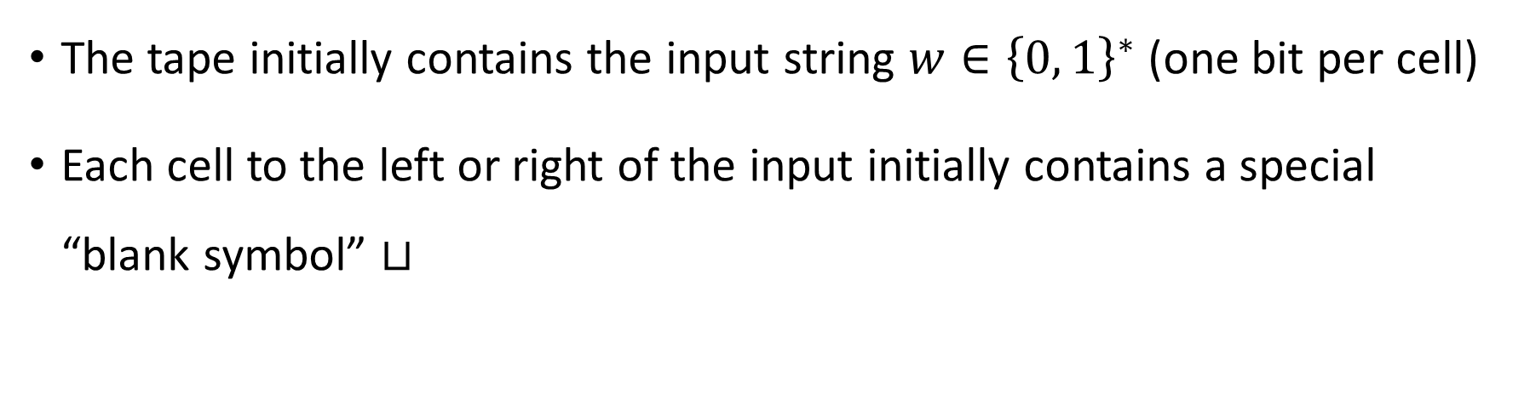









Turing machine initialization
The tape initially contains the input string $w∈{\left\{0, 1\right\}}^{∗}$ (one bit per cell)
Each cell to the left or right of the input initially contains a special “blank symbol” $⊔$
$$⊔$$
$$⊔$$
$$⊔$$
$$w_{1}$$
$$w_{2}$$
$$w_{3}$$
$$⋯$$
$$w_{n}$$
$$⊔$$
$$⊔$$
$$⊔$$
$$⊔$$
$$⊔$$
$$q_{0}$$

Slide 31
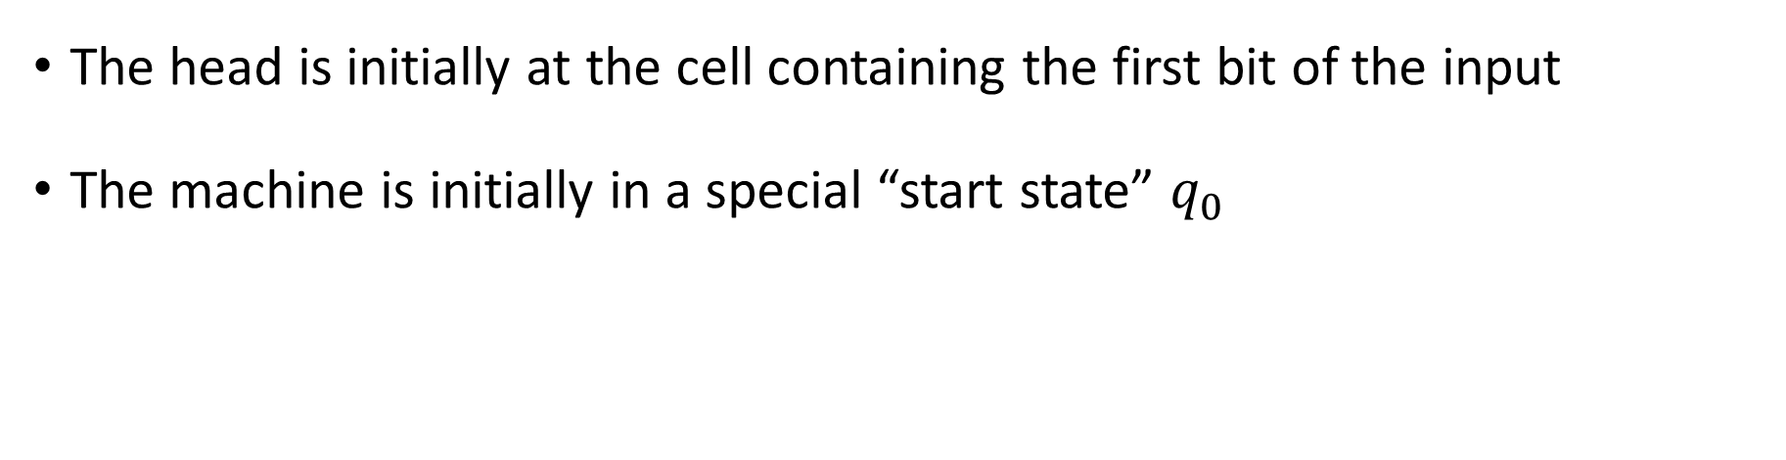
Turing machine initialization
The head is initially at the cell containing the first bit of the input
The machine is initially in a special “start state” $q_{0}$
$$⊔$$
$$⊔$$
$$⊔$$
$$w_{1}$$
$$w_{2}$$
$$w_{3}$$
$$⋯$$
$$w_{n}$$
$$⊔$$
$$⊔$$
$$⊔$$
$$⊔$$
$$⊔$$
$$q_{0}$$

Slide 32
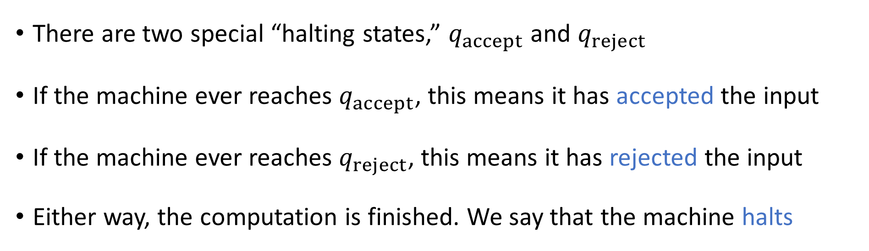
Halting states
Turing Machine
Accept
Reject
Run forever (“loop”)
Input
There are two special “halting states,” $q_{accept}$ and $q_{reject}$
If the machine ever reaches $q_{accept}$, this means it has accepted the input
If the machine ever reaches $q_{reject}$, this means it has rejected the input
Either way, the computation is finished. We say that the machine halts

Slide 33
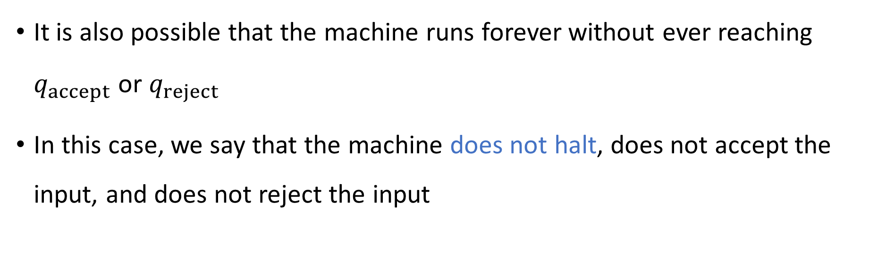
Looping
Turing Machine
Accept
Reject
Run forever (“loop”)
Input
It is also possible that the machine runs forever without ever reaching $q_{accept}$ or $q_{reject}$
In this case, we say that the machine does not halt, does not accept the input, and does not reject the input

Slide 34
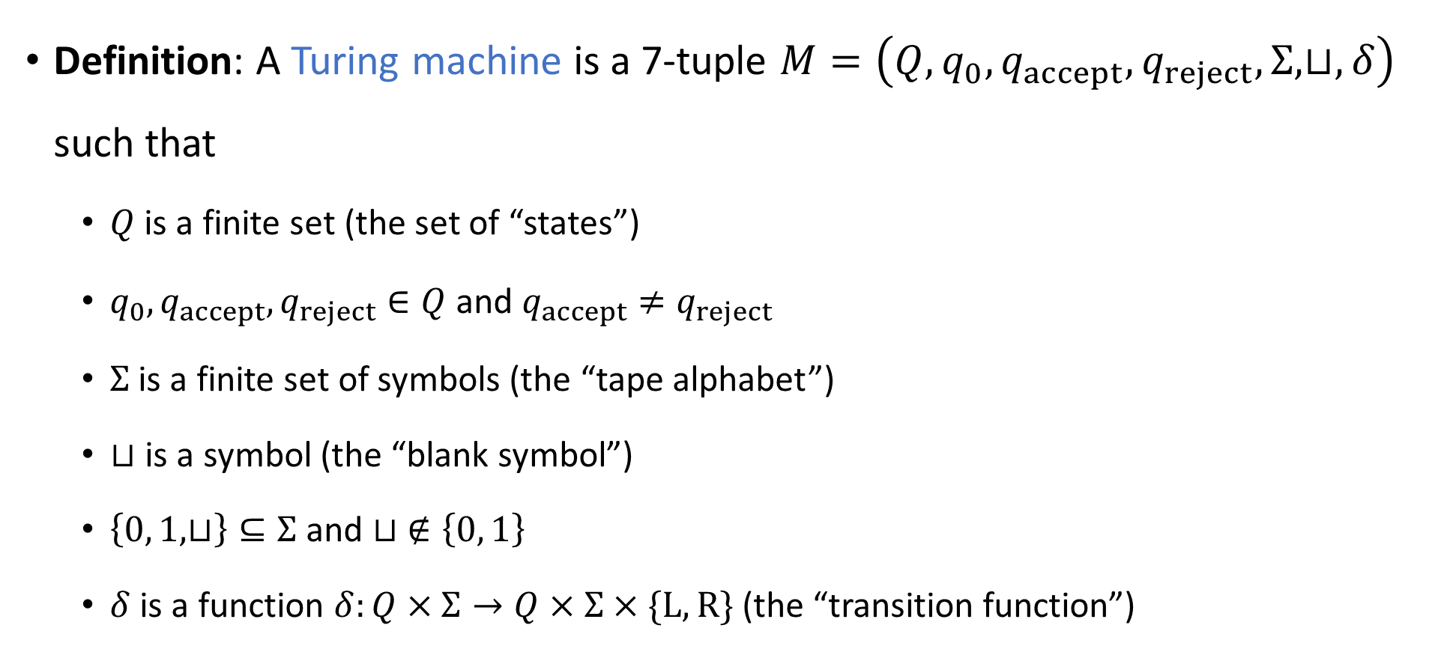
Defining Turing machines rigorously
Definition: A Turing machine is a 7-tuple $M=\left(Q,q_{0},q_{accept},q_{reject}, Σ,⊔,δ\right)$ such that
$Q$ is a finite set (the set of “states”)
$q_{0},q_{accept},q_{reject}∈Q$ and $q_{accept}≠q_{reject}$
$Σ$ is a finite set of symbols (the “tape alphabet”)
$⊔$ is a symbol (the “blank symbol”)
$\left\{0, 1, ⊔\right\}⊆Σ$ and $⊔ ∉\left\{0, 1\right\}$
$δ$ is a function $δ:Q×Σ→Q×Σ×\{\text{L}, \text{R}\}$ (the “transition function”)
⚠️Warning: The definition in the textbook is slightly different. Sorry! (The two models are equivalent.)

Slide 35

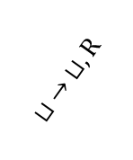
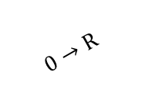



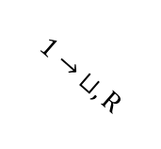
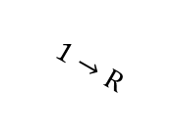
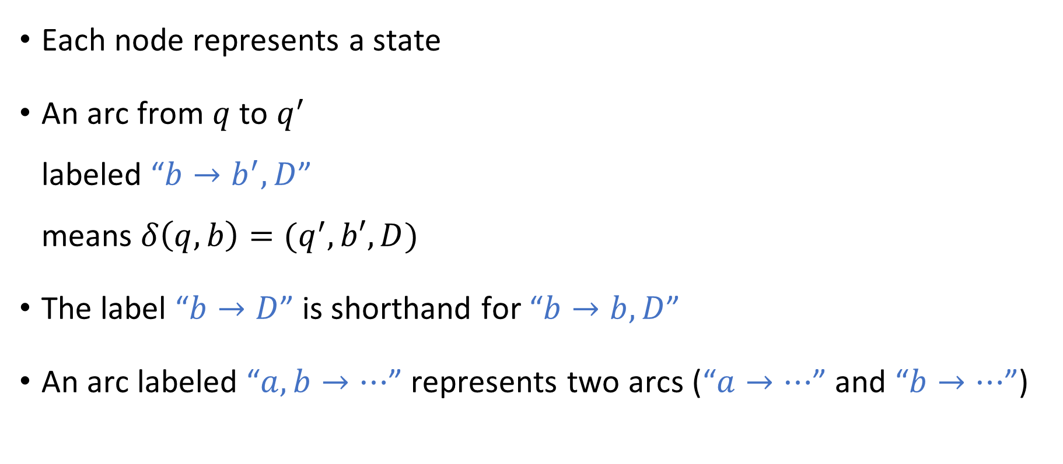

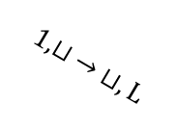

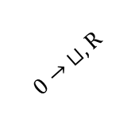



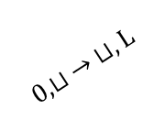




State diagram
$$0,1→\text{R}$$
$$r_{0}$$
$$⊔ →\text{L}$$
$$ℓ_{0}$$
$$0→ ⊔,\text{R}$$
$$0,⊔ → ⊔,\text{L}$$
$$1→\text{R}$$
$$q_{reject}$$
Each node represents a state
An arc from $q$ to $q^{′}$ labeled “$b→b^{′},D$” means $δ\left(q,b\right)=(q^{′},b′,D)$
The label “$b→D$” is shorthand for “$b→b,D$”
An arc labeled “$a,b→⋯$” represents two arcs (“$a→⋯$” and “$b→⋯$”)
$$q_{0}$$
$$⊔ →\text{R}$$
$$ℓ$$
$$0,1→\text{L}$$
$$⊔ → ⊔,\text{R}$$
$$1→ ⊔,\text{R}$$
$$1,⊔ → ⊔,\text{L}$$
$$0→\text{R}$$
$$r_{1}$$
$$⊔ →\text{L}$$
$$ℓ_{1}$$
$$q_{accept}$$
$$0,1→\text{R}$$

Slide 36

Defining TM computation rigorously
Transition function $δ$ describes the local evolution of the computation
What about the global evolution?

Slide 37





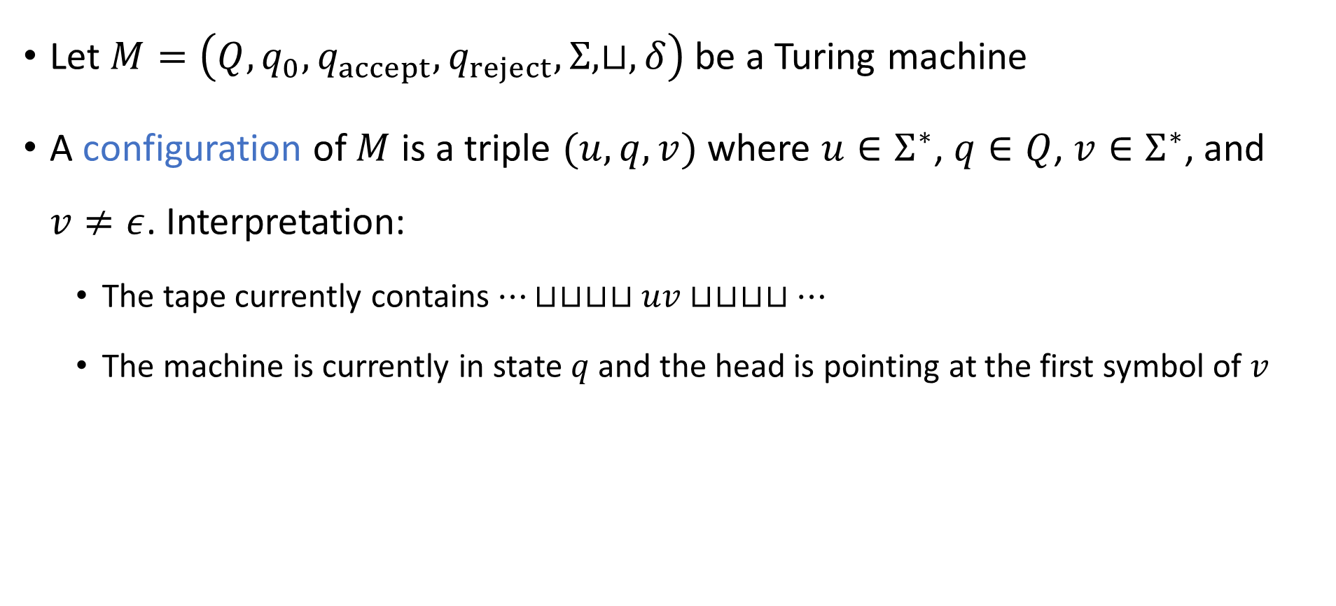








Configurations of a Turing machine
Let $M=\left(Q,q_{0},q_{accept},q_{reject}, Σ,⊔,δ\right)$ be a Turing machine
A configuration of $M$ is a triple $(u, q, v)$ where $u∈Σ^{∗}$, $q∈Q$, $v∈Σ^{∗}$, and $v≠ε$. Interpretation:
The tape currently contains $⋯⊔⊔⊔⊔uv⊔⊔⊔⊔…$
The machine is currently in state $q$ and the head is pointing at the first symbol of $v$
$$⊔$$
$$⊔$$
$$u_{1}$$
$$u_{2}$$
$$⋯$$
$$u_{n}$$
$$v_{1}$$
$$v_{2}$$
$$⋯$$
$$v_{m}$$
$$⊔$$
$$⊔$$
$$⊔$$
$$q$$

Slide 38
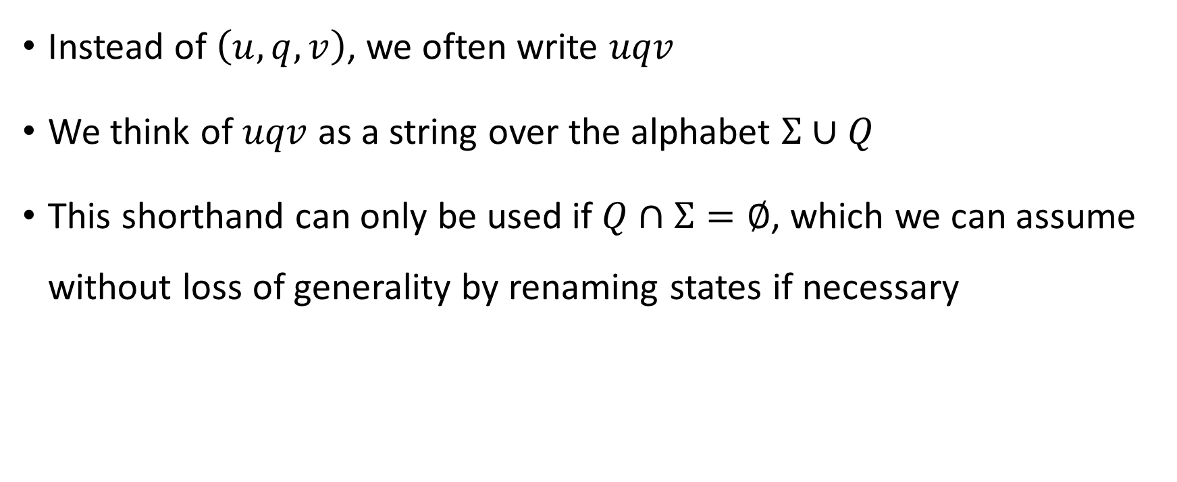
Configuration shorthand
Instead of $\left(u,q,v\right)$, we often write $uqv$
We think of $uqv$ as a string over the alphabet $Σ∪Q$
This shorthand can only be used if $Q∩Σ=∅$, which we can assume without loss of generality by renaming states if necessary

Slide 39
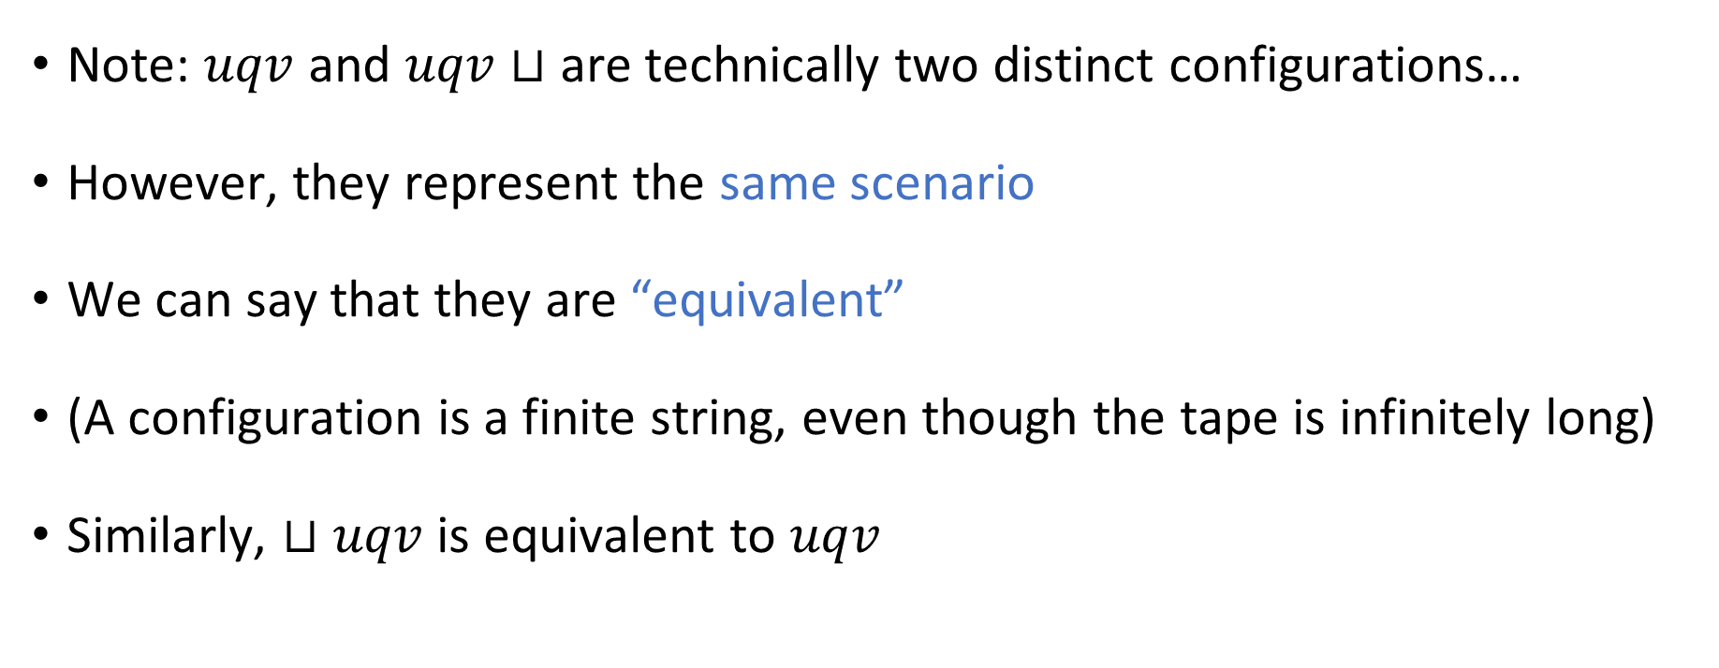
Equivalent configurations
Note: $uqv$ and $uqv⊔$ are technically two distinct configurations…
However, they represent the same scenario
We can say that they are “equivalent”
(A configuration is a finite string, even though the tape is infinitely long)
Similarly, $⊔uqv$ is equivalent to $uqv$

Slide 40

The initial configuration
Let $w∈{\left\{0, 1\right\}}^{∗}$ be an input
The initial configuration of $M$ on $w$ is
$$\left\{\begin{aligned}q_{0}w \text{if} w≠ε \\ q_{0}⊔ \text{if} w=ε\end{aligned}\right.$$

Slide 41
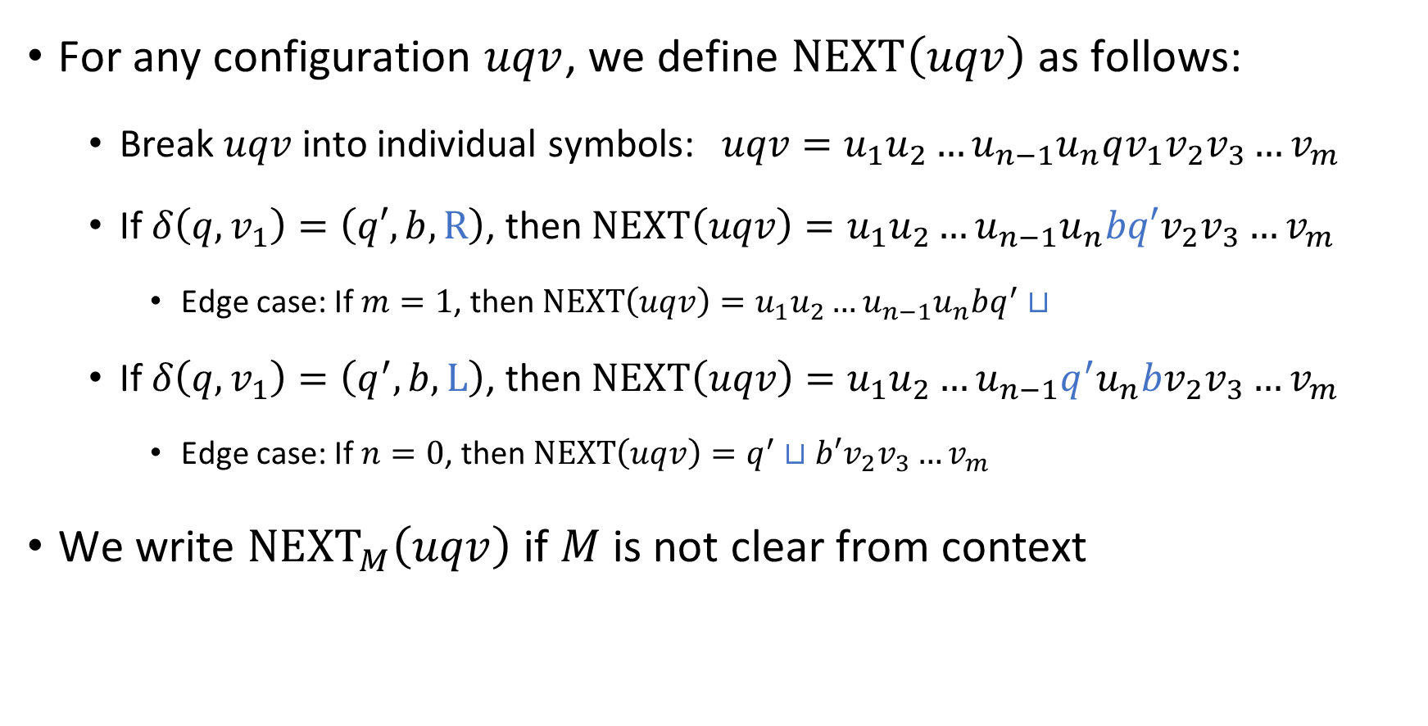
The “next” configuration
For any configuration $uqv$, we define $\text{NEXT}\left(uqv\right)$ as follows:
Break $uqv$ into individual symbols: $uqv=u_{1}u_{2}…u_{n−1}u_{n}qv_{1}v_{2}v_{3}…v_{m}$
If $δ\left(q,v_{1}\right)=\left(q′,b,\text{R}\right)$, then $\text{NEXT}\left(uqv\right)=u_{1}u_{2}…u_{n−1}u_{n}bq′v_{2}v_{3}…v_{m}$
Edge case: If $m=1$, then $\text{NEXT}\left(uqv\right)=u_{1}u_{2}…u_{n−1}u_{n}bq^{′}⊔$
If $δ\left(q, v_{1}\right)=\left(q^{′},b,\text{L}\right)$, then $\text{NEXT}\left(uqv\right)=u_{1}u_{2}…u_{n−1}q^{′}u_{n}bv_{2}v_{3}…v_{m}$
Edge case: If $n=0$, then $\text{NEXT}\left(uqv\right)=q^{′}⊔b′v_{2}v_{3}…v_{m}$
We write ${\text{NEXT}}_{M}\left(uqv\right)$ if $M$ is not clear from context

Slide 42
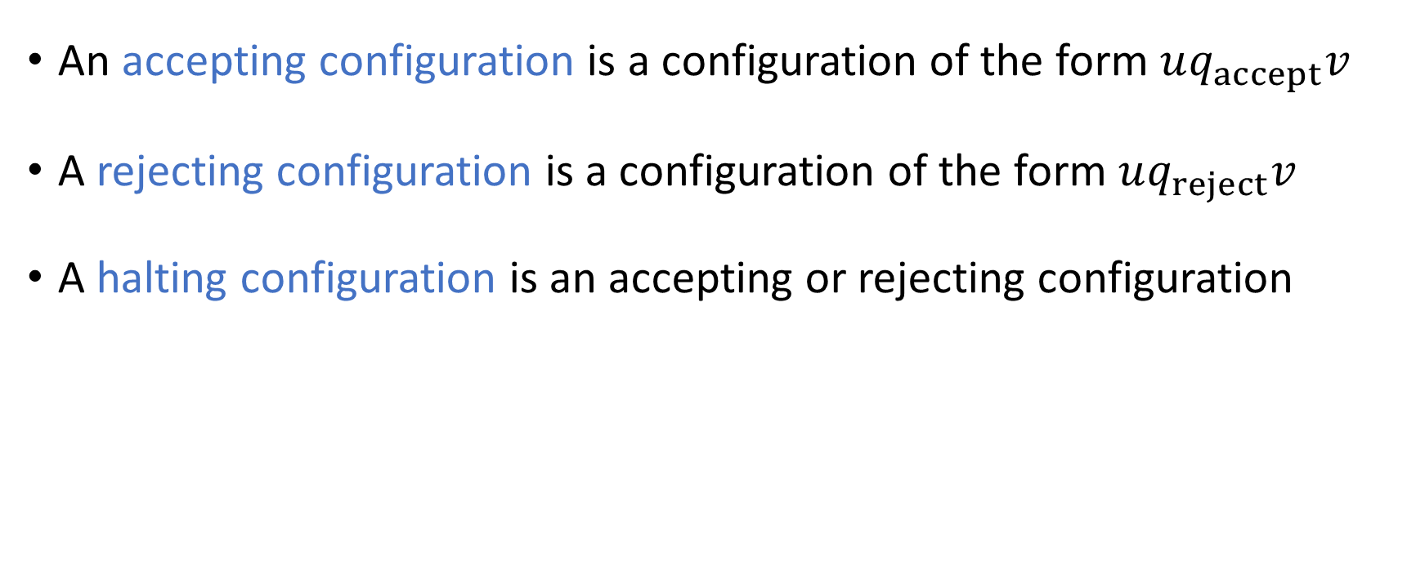
Halting configurations
An accepting configuration is a configuration of the form $uq_{accept}v$
A rejecting configuration is a configuration of the form $uq_{reject}v$
A halting configuration is an accepting or rejecting configuration

