Slide 1
CMSC 28100 Introduction to Complexity Theory Winter 2024 Instructor: William Hoza
7 |  |  |  |  |  |  | 5 | 3
 |  |  |  |  |  |  |  | 4
 | 4 | 8 |  | 3 |  | 1 | 2
8 |  | 1 | 3 |  |  | 2 | 7 | 5
 | 9 |  | 1 |  |  |  | 4
 | 5 |  |  |  |  | 3
2 |  | 5 |  | 8 | 4
1 | 3 | 4 |  | 5

Slide 2
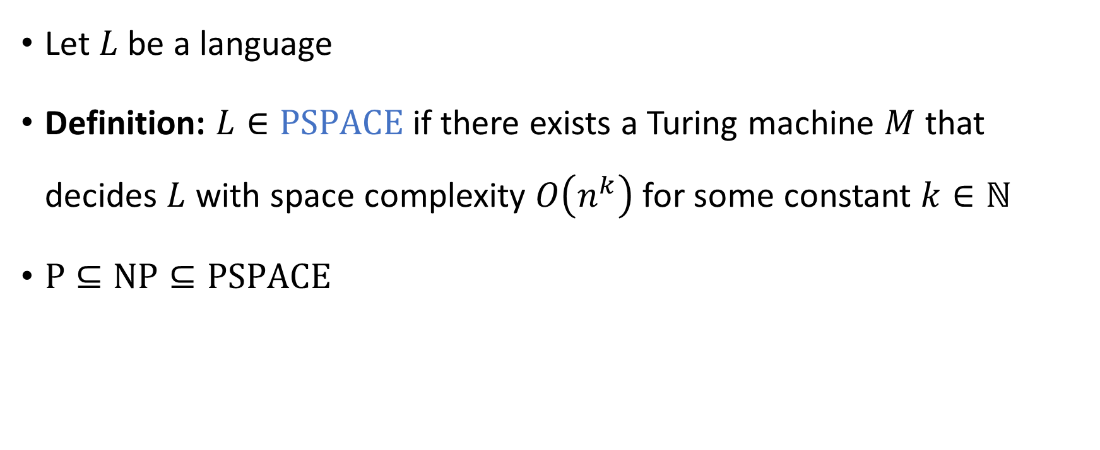

The complexity class $\text{PSPACE}$
Let $L$ be a language
Definition: $L∈\text{PSPACE}$ if there exists a Turing machine $M$ that decides $L$ with space complexity $O\left(n^{k}\right)$ for some constant $k∈ℕ$
$\text{P}⊆\text{NP}⊆\text{PSPACE}$

Slide 3



$$\text{PSPACE}$$
$$\text{NP}$$
$$\text{P}$$

Slide 4

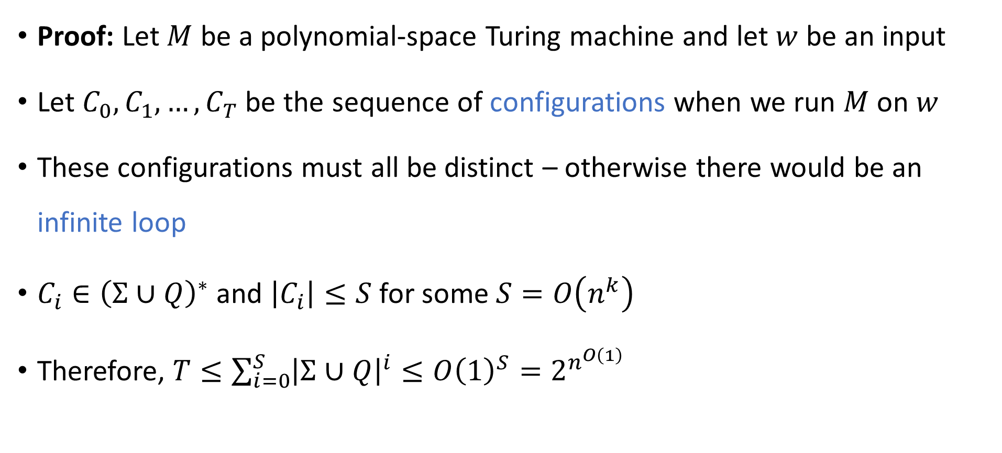
Theorem: $\text{PSPACE}⊆\text{EXP}$
Proof: Let $M$ be a polynomial-space Turing machine and let $w$ be an input
Let $C_{0},C_{1},…, C_{T}$ be the sequence of configurations when we run $M$ on $w$
These configurations must all be distinct – otherwise there would be an infinite loop
$C_{i}∈{\left(Σ∪Q\right)}^{∗}$ and $\left|C_{i}\right|≤S$ for some $S=O\left(n^{k}\right)$
Therefore, $T≤\sum_{i=0}^{S}{{\left|Σ∪Q\right|}^{i}}≤O{\left(1\right)}^{S}=2^{n^{O\left(1\right)}}$

Slide 5




$$\text{EXP}$$
$$\text{PSPACE}$$
$$\text{NP}$$
$$\text{P}$$

Slide 6

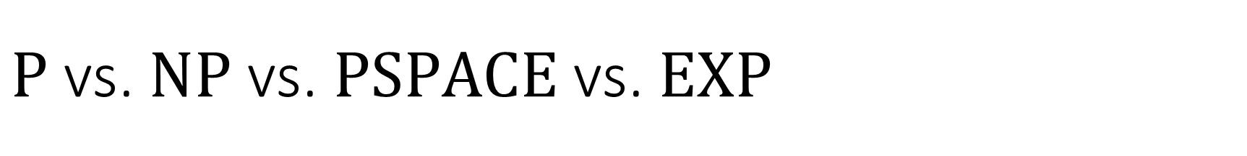
$\text{P}$ vs. $\text{NP}$ vs. $\text{PSPACE}$ vs. $\text{EXP}$
$\text{P}⊆\text{NP}⊆\text{PSPACE}⊆\text{EXP}$
What we expect: All of these containments are strict
What we can prove: At least one of these containments is strict. (Why?)

Slide 7

Sublinear-space computation
Can we solve any interesting problems using $o\left(n\right)$ space?
The one-tape Turing machine is the not the right model of computation for studying sublinear-space algorithms

Slide 8

Sublinear-space computation
Read-only input tape ➡
$$♢$$
1
1
0
1
1
Read-write work tape ➡
0
#
1
0

Slide 9
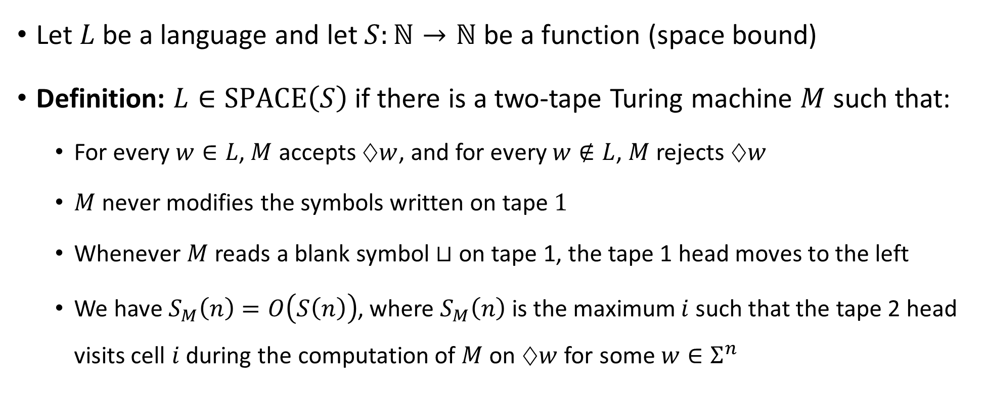

The complexity class $\text{SPACE}\left(S\right)$
Let $L$ be a language and let $S:ℕ→ℕ$ be a function (space bound)
Definition: $L∈\text{SPACE}\left(S\right)$ if there is a two-tape Turing machine $M$ such that:
For every $w∈L$, $M$ accepts $♢w$, and for every $w∉L$, $M$ rejects $♢w$
$M$ never modifies the symbols written on tape $1$
Whenever $M$ reads a blank symbol $⊔$ on tape 1, the tape 1 head moves to the left
We have $S_{M}\left(n\right)=O\left(S\left(n\right)\right)$, where $S_{M}\left(n\right)$ is the maximum $i$ such that the tape 2 head visits cell $i$ during the computation of $M$ on $♢w$ for some $w∈Σ^{n}$

Slide 10
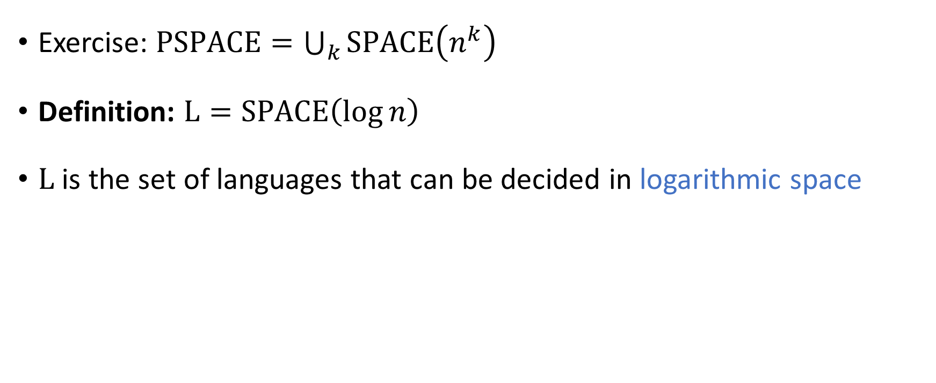

The complexity class $\text{L}$
Exercise: $\text{PSPACE}=\bigcup_{k}{\text{SPACE}\left(n^{k}\right)}$
Definition: $\text{L}=\text{SPACE}\left(\log{n}\right)$
$\text{L}$ is the set of languages that can be decided in logarithmic space

Slide 11
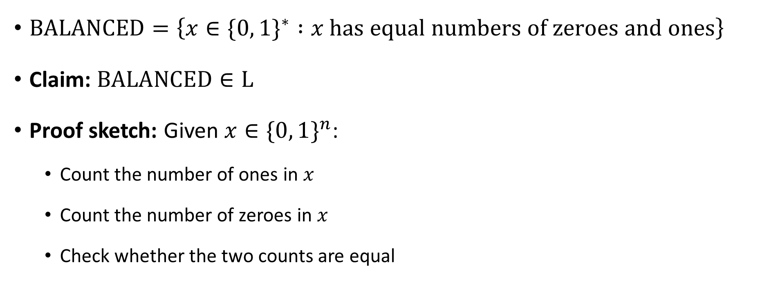


$\text{BALANCED}∈\text{L}$
$\text{BALANCED}=\left\{x∈\{0, 1\}^{∗} :x \text{has} \text{equal} \text{numbers} \text{of} \text{zeroes} \text{and} \text{ones}\right\}$
Claim: $\text{BALANCED}∈\text{L}$
Proof sketch: Given $x∈\{0, 1\}^{n}$:
Count the number of ones in $x$
Count the number of zeroes in $x$
Check whether the two counts are equal
These counters are only $\log{n}$ bits each!

Slide 12

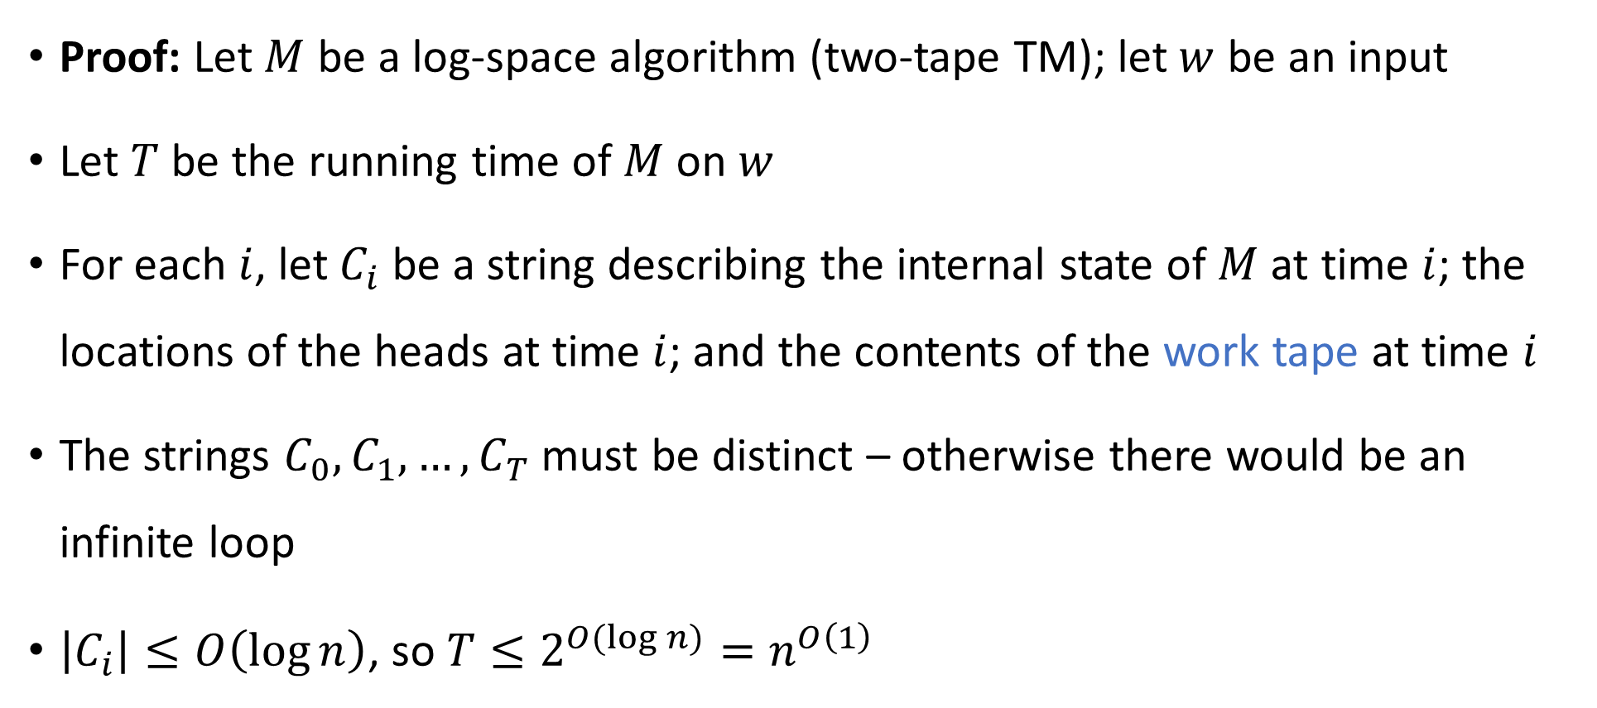
Theorem: $\text{L}⊆\text{P}$
Proof: Let $M$ be a log-space algorithm (two-tape TM); let $w$ be an input
Let $T$ be the running time of $M$ on $w$
For each $i$, let $C_{i}$ be a string describing the internal state of $M$ at time $i$; the locations of the heads at time $i$; and the contents of the work tape at time $i$
The strings $C_{0},C_{1},…, C_{T}$ must be distinct – otherwise there would be an infinite loop
$\left|C_{i}\right|≤O\left(\log{n}\right)$, so $T≤2^{O(\log{n)}}=n^{O\left(1\right)}$

Slide 13




$$\text{EXP}$$
$$\text{PSPACE}$$
$$\text{NP}$$
$$\text{P}$$
$$\text{L}$$

Slide 14


The $\text{L}$ vs. $\text{P}$ problem
We expect that $\text{L}≠\text{P}$, but we don’t know how to prove it
$\text{L}=\text{P}$ would mean that every efficient algorithm can be modified so that it only uses a tiny amount of work space

Slide 15
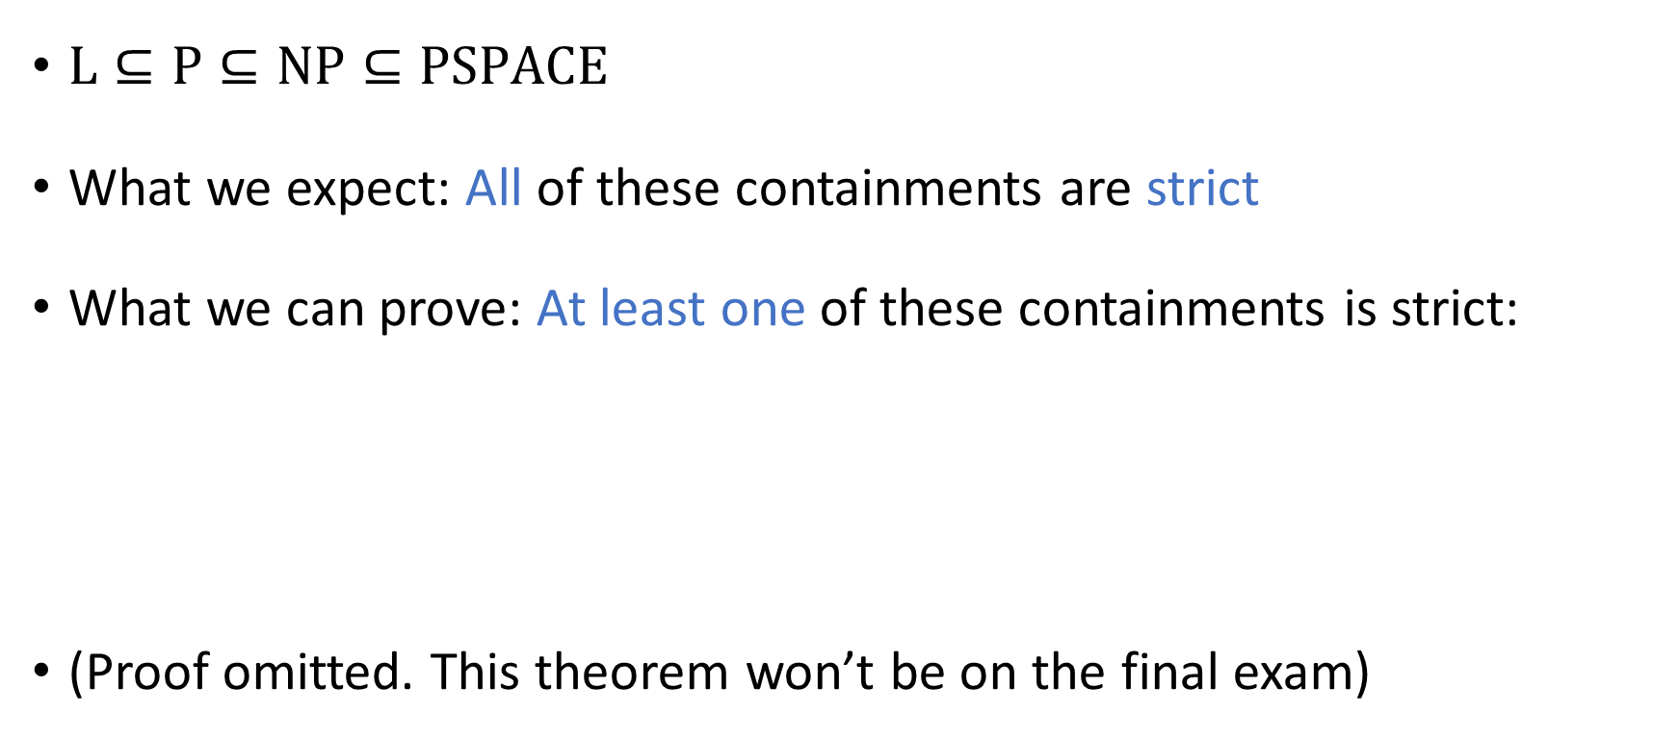
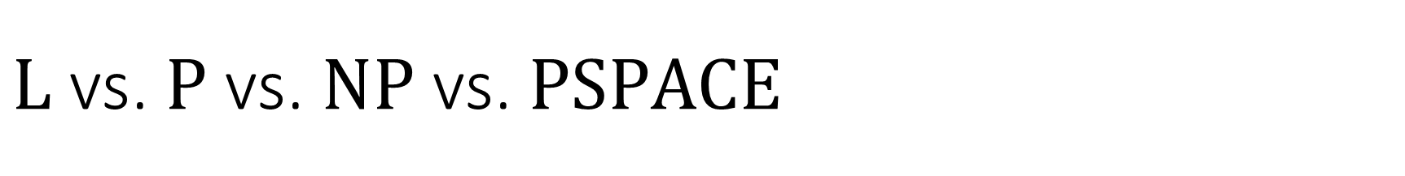

$\text{L}$ vs. $\text{P}$ vs. $\text{NP}$ vs. $\text{PSPACE}$
$\text{L}⊆\text{P}⊆\text{NP}⊆\text{PSPACE}$
What we expect: All of these containments are strict
What we can prove: At least one of these containments is strict:
(Proof omitted. This theorem won’t be on the final exam)
Theorem: $\text{L}≠\text{PSPACE}$

Slide 16
Final exam cutoff point
Final exam will be Tuesday, March 5 from 7:30am to 9:30am
Exam will take place in this room (RY 276)
To prepare for the final exam, you only need to study the material up to this point

Slide 17
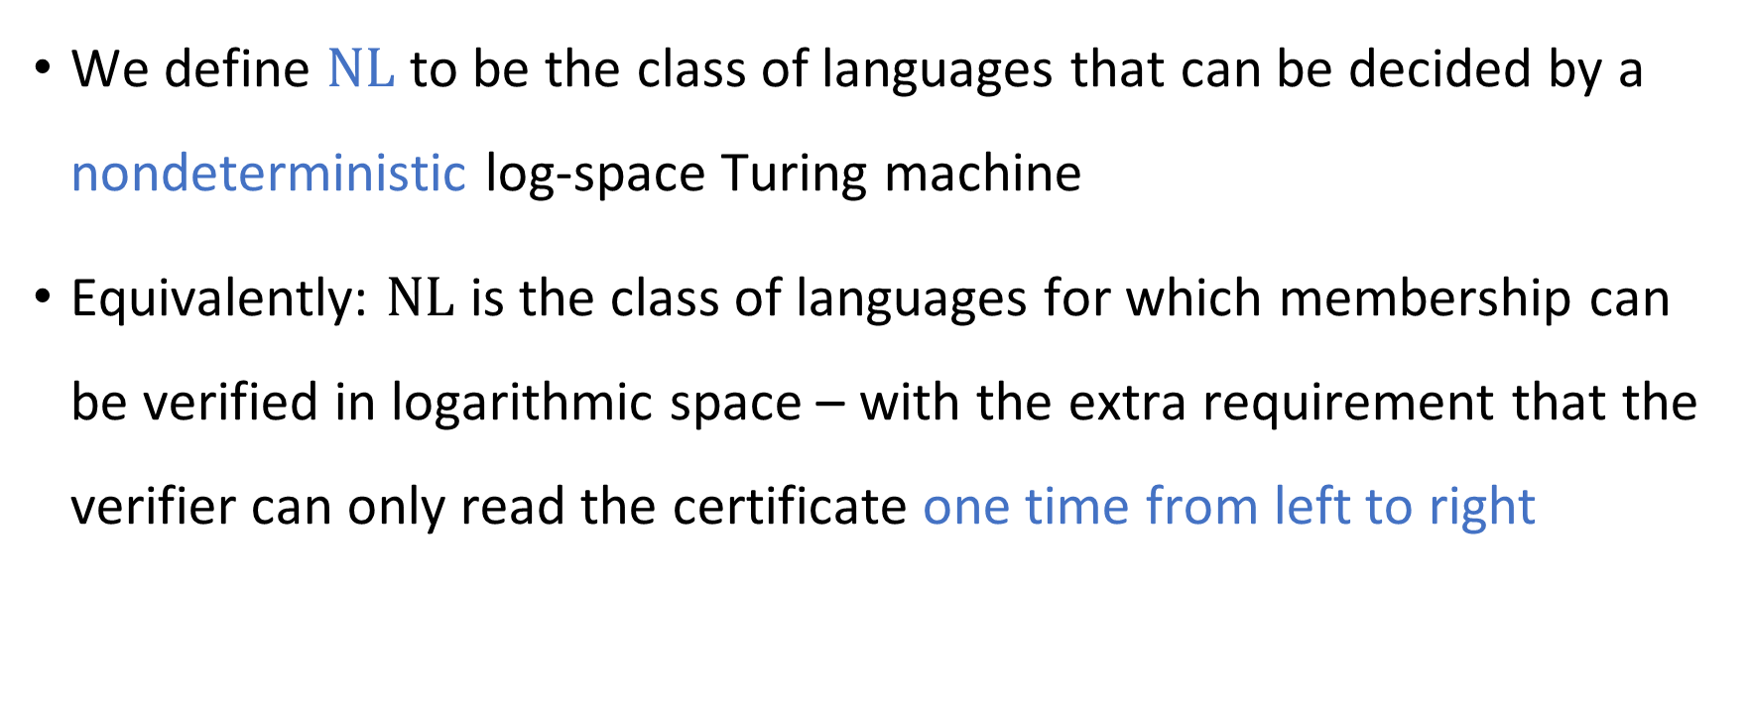
Nondeterministic log space computation
We define $\text{NL}$ to be the class of languages that can be decided by a nondeterministic log-space Turing machine
Equivalently: $\text{NL}$ is the class of languages for which membership can be verified in logarithmic space – with the extra requirement that the verifier can only read the certificate one time from left to right

Slide 18
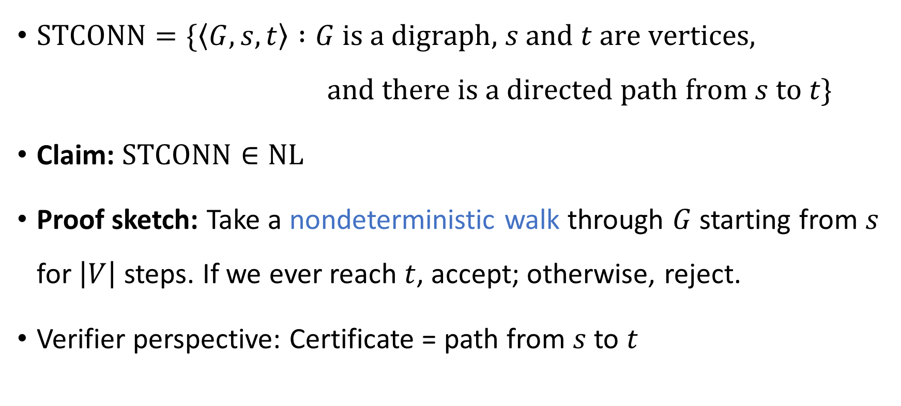

The $s$-$t$ connectivity problem
$\text{STCONN}=\{\left\langle G,s,t\right\rangle :G \text{is} \text{a} \text{digraph}\text{,} s \text{and} t \text{are} \text{vertices}\text{,}$ $\text{and} \text{there} \text{is} \text{a} \text{directed} \text{path} \text{from} s \text{to} t\}$
Claim: $\text{STCONN}∈\text{NL}$
Proof sketch: Take a nondeterministic walk through $G$ starting from $s$ for $\left|V\right|$ steps. If we ever reach $t$, accept; otherwise, reject.
Verifier perspective: Certificate = path from $s$ to $t$

Slide 19

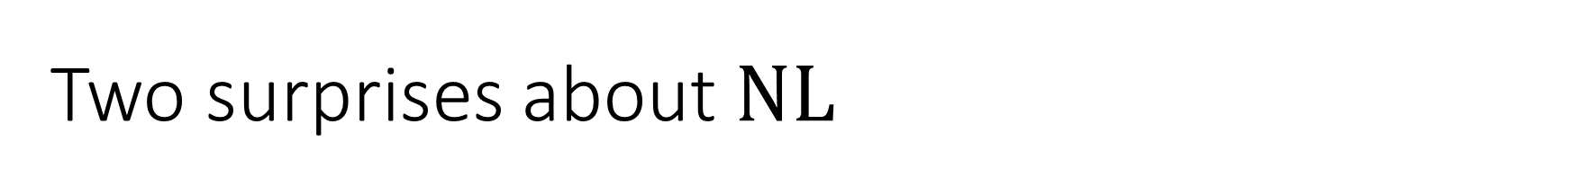

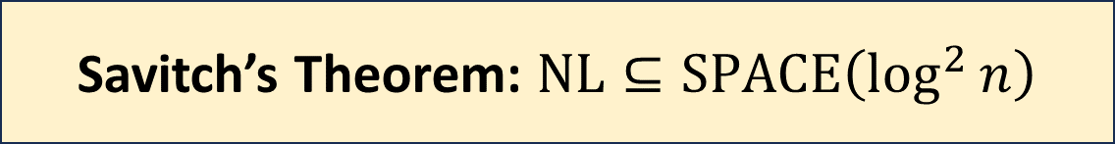
Two surprises about $\text{NL}$
We expect that $\text{P}≠\text{NP}$. However, in the space complexity world…
We expect that $\text{NP}≠\text{coNP}$. However, in the space complexity world…
Savitch’s Theorem: $\text{NL}⊆\text{SPACE}\left(\log^{2}{n}\right)$
Immerman-Szelepcsényi Theorem: $\text{NL}=\text{coNL}$

Slide 20

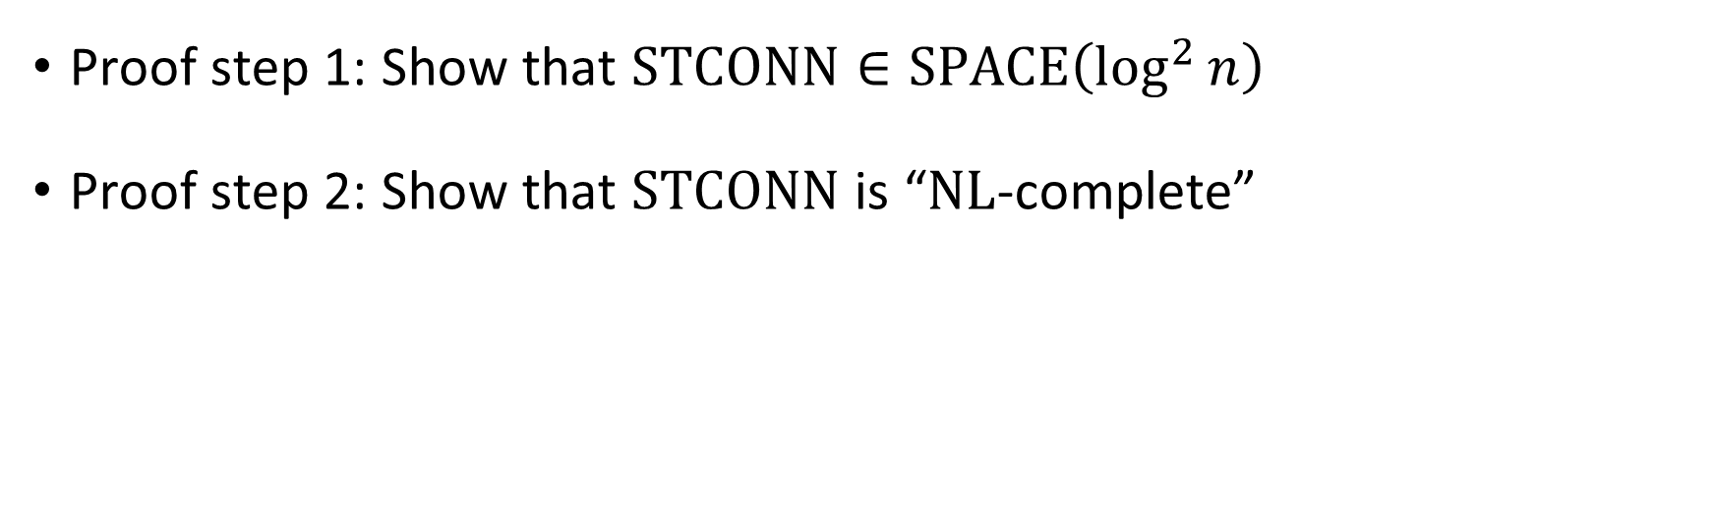
Proof of Savitch’s theorem
Savitch’s Theorem: $\text{NL}⊆\text{SPACE}\left(\log^{2}{n}\right)$
Proof step 1: Show that $\text{STCONN}∈\text{SPACE}\left(\log^{2}{n}\right)$
Proof step 2: Show that $\text{STCONN}$ is “$\text{NL}$-complete”

Slide 21
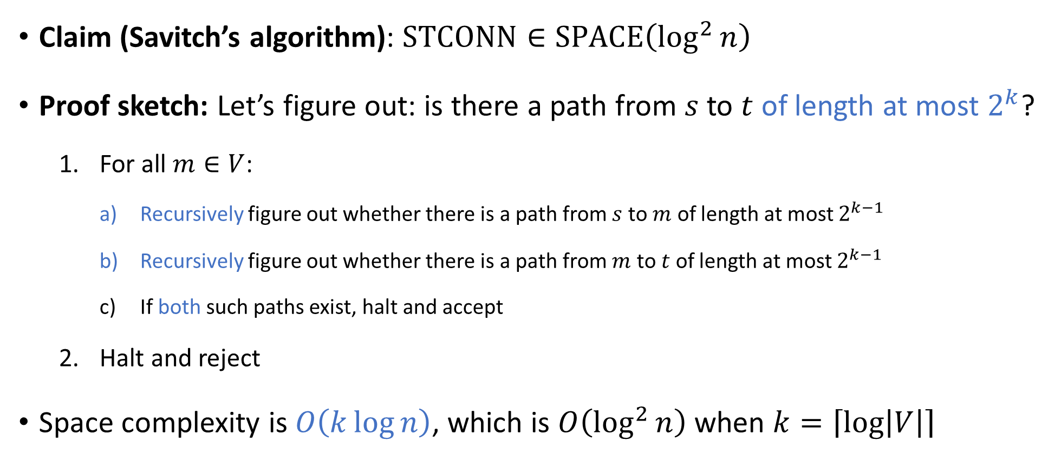
Savitch’s algorithm
Claim (Savitch’s algorithm): $\text{STCONN}∈\text{SPACE}\left(\log^{2}{n}\right)$
Proof sketch: Let’s figure out: is there a path from $s$ to $t$ of length at most $2^{k}$?
For all $m∈V$:
Recursively figure out whether there is a path from $s$ to $m$ of length at most $2^{k−1}$
Recursively figure out whether there is a path from $m$ to $t$ of length at most $2^{k−1}$
If both such paths exist, halt and accept
Halt and reject
Space complexity is $O\left(k\log{n}\right)$, which is $O\left(\log^{2}{n}\right)$ when $k=\left\lceil \log\left|V\right|\right\rceil$

Slide 22
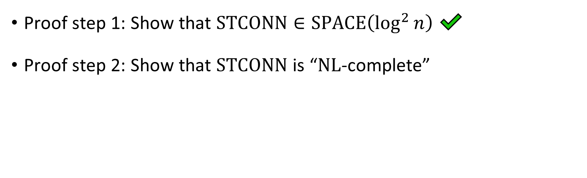
Proof of Savitch’s theorem
Savitch’s Theorem: $\text{NL}⊆\text{SPACE}\left(\log^{2}{n}\right)$
Proof step 1: Show that $\text{STCONN}∈\text{SPACE}\left(\log^{2}{n}\right)$ ✔️
Proof step 2: Show that $\text{STCONN}$ is “$\text{NL}$-complete”

Slide 23
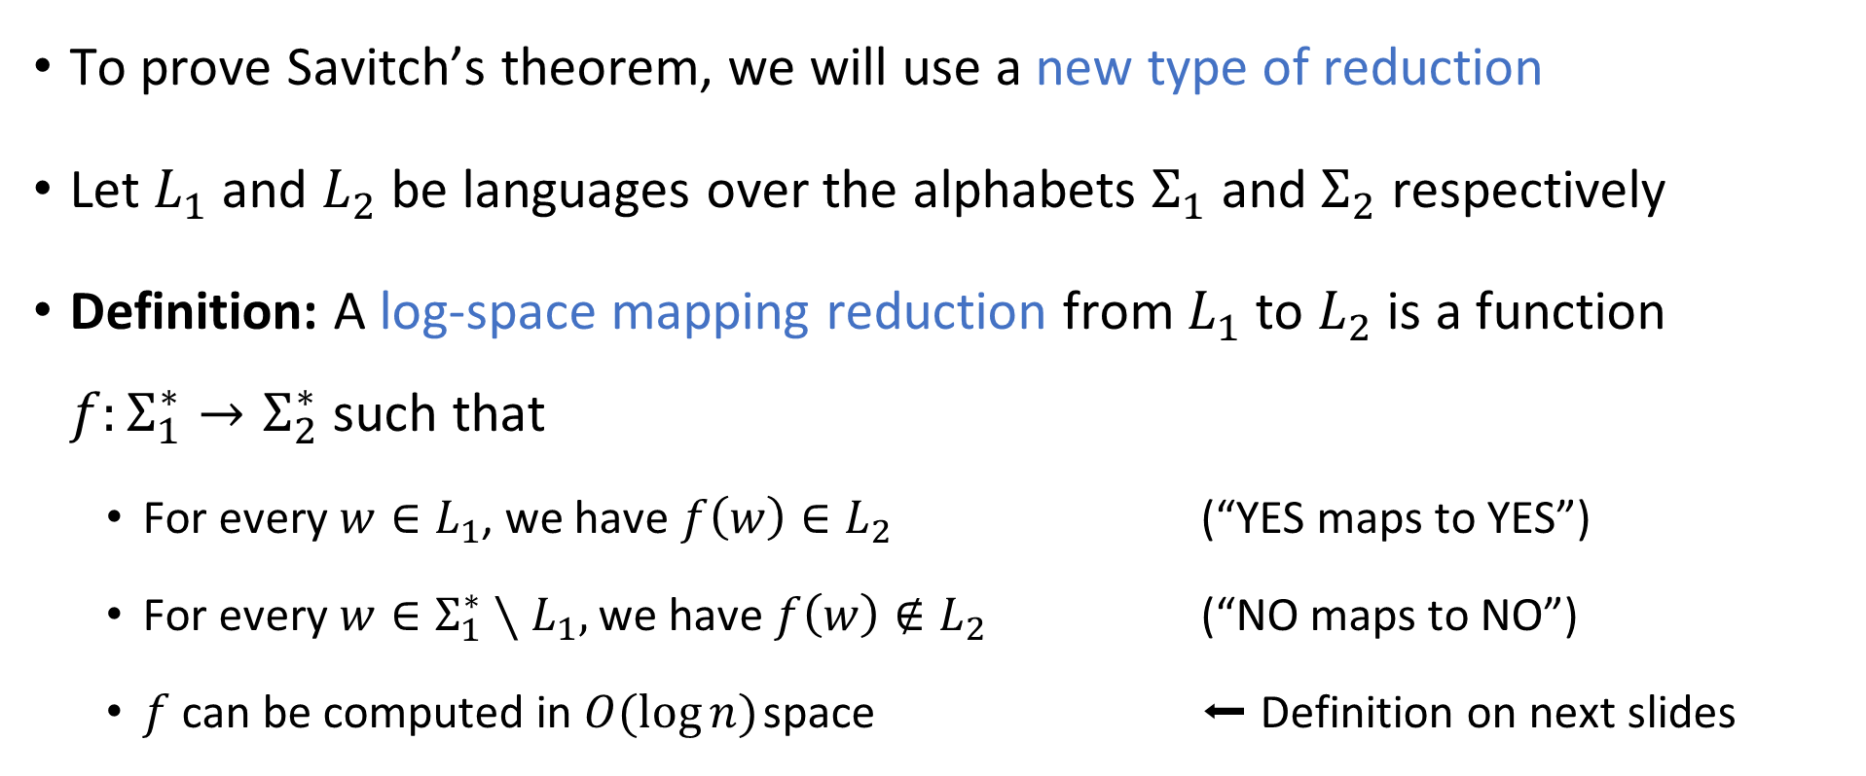
Log-space reductions
To prove Savitch’s theorem, we will use a new type of reduction
Let $L_{1}$ and $L_{2}$ be languages over the alphabets $Σ_{1}$ and $Σ_{2}$ respectively
Definition: A log-space mapping reduction from $L_{1}$ to $L_{2}$ is a function $f:Σ_{1}^{∗}→Σ_{2}^{∗}$ such that
For every $w∈L_{1}$, we have $f\left(w\right)∈L_{2}$ (“YES maps to YES”)
For every $w∈Σ_{1}^{∗}∖L_{1},$ we have $f\left(w\right)∉L_{2}$ (“NO maps to NO”)
$f$ can be computed in $O(\log{n})$ space ⬅ Definition on next slides

Slide 24

Space-bounded “transducer”
Read-only input tape ➡
$$♢$$
1
1
0
1
1
Read-write work tape ➡
0
#
1
0
Write-only output tape ➡
1
1
0
0
1
1

Slide 25
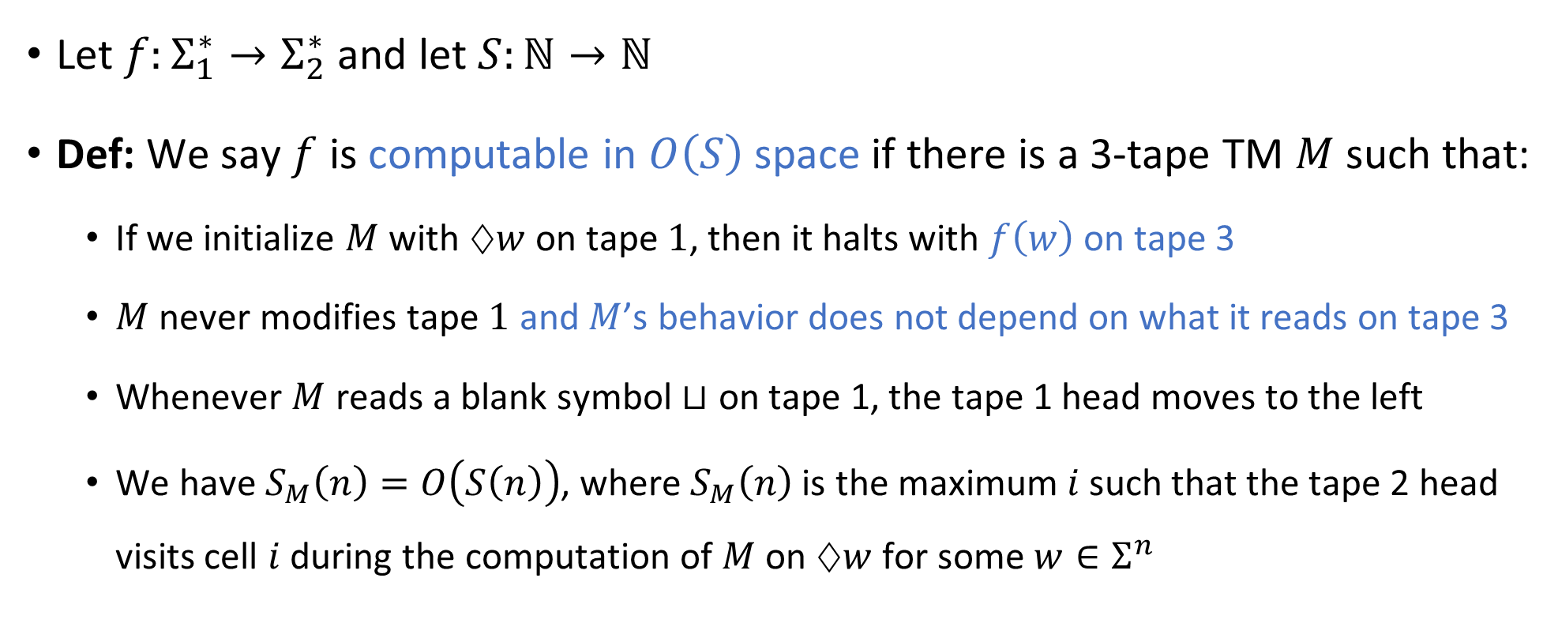
Space complexity for string-valued functions
Let $f:Σ_{1}^{∗}→Σ_{2}^{∗}$ and let $S:ℕ→ℕ$
Def: We say $f$ is computable in $O\left(S\right)$ space if there is a 3-tape TM $M$ such that:
If we initialize $M$ with $♢w$ on tape $1$, then it halts with $f\left(w\right)$ on tape 3
$M$ never modifies tape $1$ and $M$’s behavior does not depend on what it reads on tape 3
Whenever $M$ reads a blank symbol $⊔$ on tape 1, the tape 1 head moves to the left
We have $S_{M}\left(n\right)=O\left(S\left(n\right)\right)$, where $S_{M}\left(n\right)$ is the maximum $i$ such that the tape 2 head visits cell $i$ during the computation of $M$ on $♢w$ for some $w∈Σ^{n}$

Slide 26
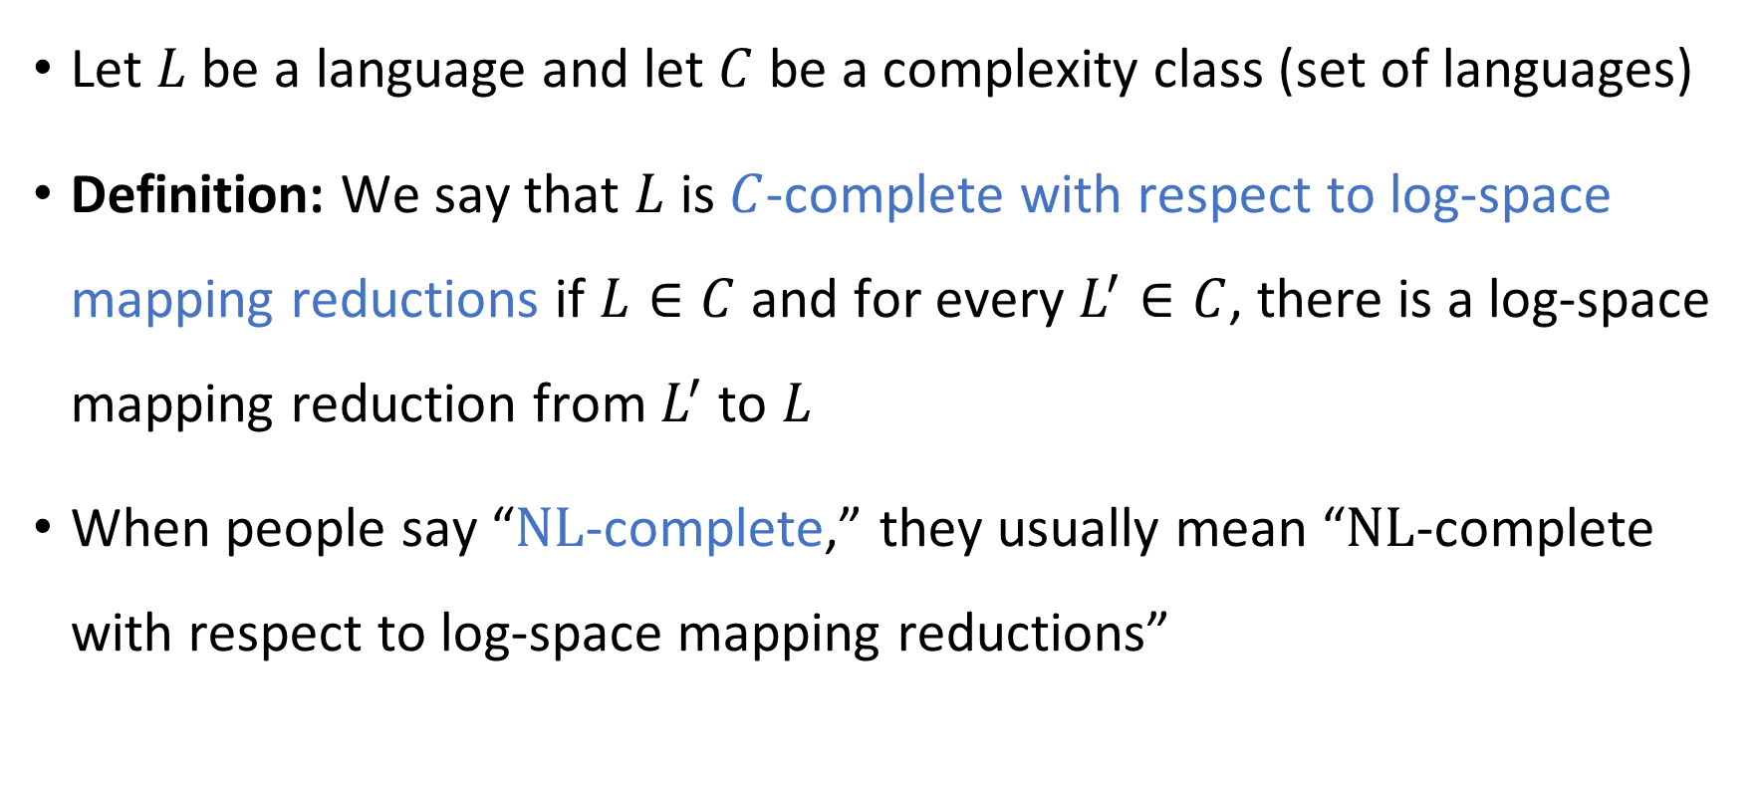
Completeness w.r.t. log-space reductions
Let $L$ be a language and let $C$ be a complexity class (set of languages)
Definition: We say that $L$ is $C$-complete with respect to log-space mapping reductions if $L∈C$ and for every $L^{′}∈C$, there is a log-space mapping reduction from $L^{′}$ to $L$
When people say “$\text{NL}$-complete,” they usually mean “$\text{NL}$-complete with respect to log-space mapping reductions”

Slide 27
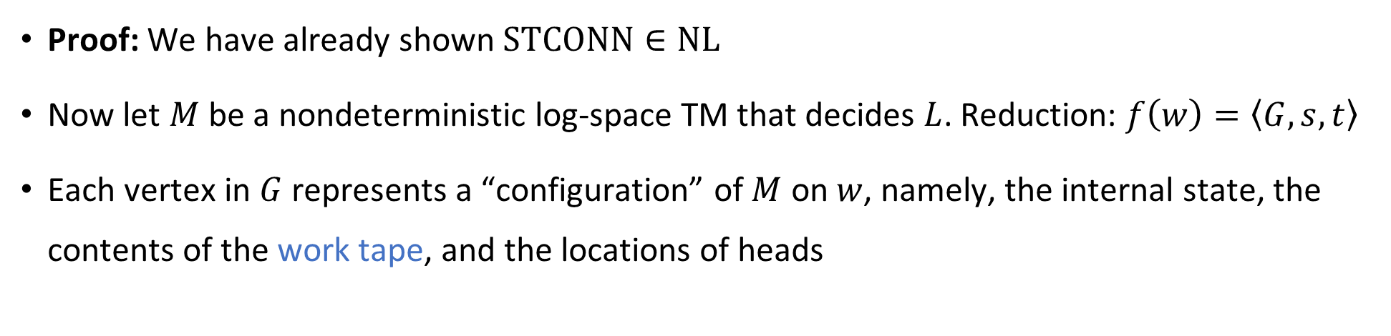

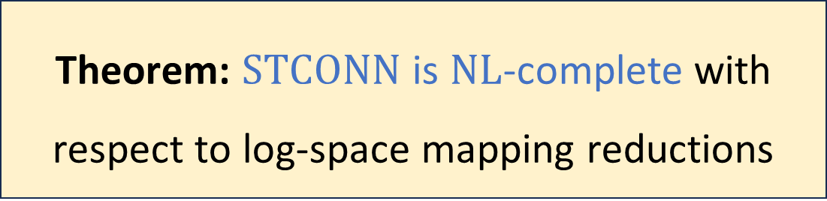
$\text{STCONN}$ is $\text{NL}$-complete
Theorem: $\text{STCONN}$ is $\text{NL}$-complete with respect to log-space mapping reductions
Proof: We have already shown $\text{STCONN}∈\text{NL}$
Now let $M$ be a nondeterministic log-space TM that decides $L$. Reduction: $f\left(w\right)=\left\langle G,s,t\right\rangle$
Each vertex in $G$ represents a “configuration” of $M$ on $w$, namely, the internal state, the contents of the work tape, and the locations of heads

Slide 28
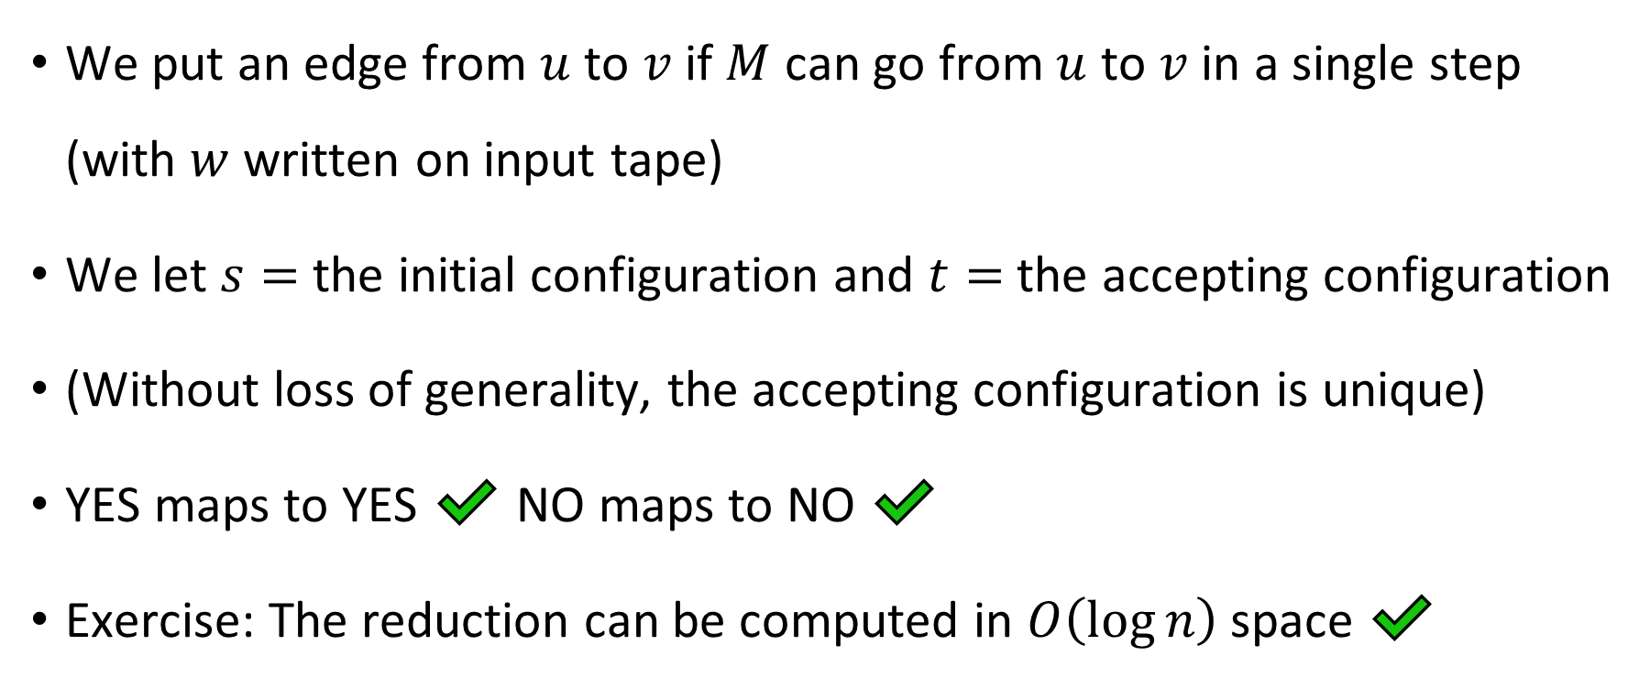

$\text{STCONN}$ is $\text{NL}$-complete
We put an edge from $u$ to $v$ if $M$ can go from $u$ to $v$ in a single step (with $w$ written on input tape)
We let $s=$ the initial configuration and $t=$ the accepting configuration
(Without loss of generality, the accepting configuration is unique)
YES maps to YES ✔️ NO maps to NO ✔️
Exercise: The reduction can be computed in $O\left(\log{n}\right)$ space ✔️

Slide 29
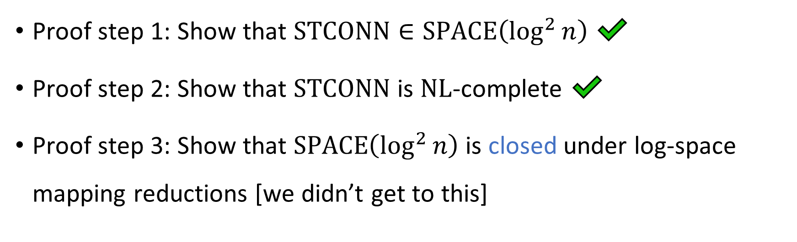
Proof of Savitch’s theorem
Savitch’s Theorem: $\text{NL}⊆\text{SPACE}\left(\log^{2}{n}\right)$
Proof step 1: Show that $\text{STCONN}∈\text{SPACE}\left(\log^{2}{n}\right)$ ✔️
Proof step 2: Show that $\text{STCONN}$ is $\text{NL}$-complete ✔️
Proof step 3: Show that $\text{SPACE}\left(\log^{2}{n}\right)$ is closed under log-space mapping reductions [we didn’t get to this]

