Slide 1

CMSC 28100 Introduction to Complexity Theory Spring 2024 Instructor: William Hoza

Slide 2


Circuit satisfiability
We say that a circuit $C$ is satisfiable if there exists $x∈\{0, 1\}^{n}$ such that $C\left(x\right)=1$
Let $\text{CIRCUIT}\text{‑}\text{SAT}=\{\left\langle C\right\rangle :C \text{is} \text{a} \text{satisfiable} \text{circuit}\}$
Theorem: $\text{CIRCUIT}\text{‑}\text{SAT}$ is $\text{NP}$-complete.

Slide 3
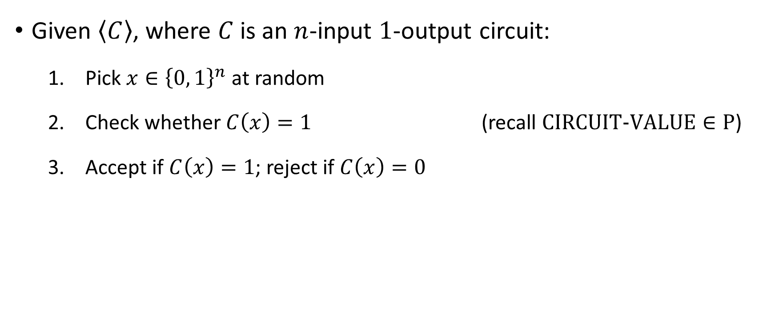

Proof that $\text{CIRCUIT}\text{‑}\text{SAT}∈\text{NP}$
Given $\left\langle C\right\rangle$, where $C$ is an $n$-input $1$-output circuit:
Pick $x∈{\left\{0, 1\right\}}^{n}$ at random
Check whether $C\left(x\right)=1$ (recall $\text{CIRCUIT}\text{‑}\text{VALUE}∈\text{P}$)
Accept if $C\left(x\right)=1$; reject if $C\left(x\right)=0$

Slide 4


Proof that $\text{CIRCUIT}\text{‑}\text{SAT}$ is $\text{NP}$-hard
Let $L$ be any language in $\text{NP}$
Our job: Design a mapping reduction from $L$ to $\text{CIRCUIT}\text{‑}\text{SAT}$
Idea: Let’s build a “verification circuit” for $L$

Slide 5
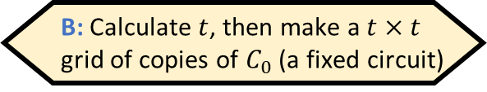
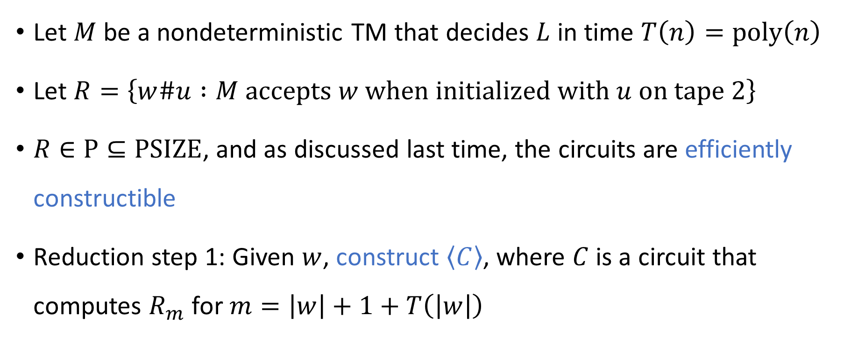
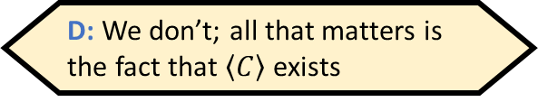
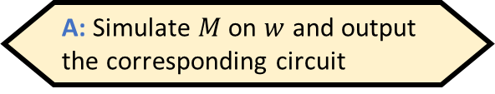
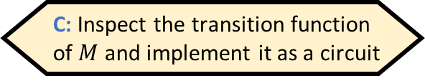
Proof that $\text{CIRCUIT}\text{‑}\text{SAT}$ is $\text{NP}$-hard
Given $w$, how do we efficiently construct $⟨C⟩$?
A: Simulate $M$ on $w$ and output the corresponding circuit
B: Calculate $t$, then make a $t×t$ grid of copies of $C_{0}$ (a fixed circuit)
C: Inspect the transition function of $M$ and implement it as a circuit
D: We don’t; all that matters is the fact that $\left\langle C\right\rangle$ exists
Let $M$ be a nondeterministic TM that decides $L$ in time $T\left(n\right)=\text{poly}\left(n\right)$
Let $R=\left\{w\#u :M \text{accepts} w \text{when} \text{initialized} \text{with} u \text{on} \text{tape} 2\right\}$
$R∈\text{P}⊆\text{PSIZE}$, and as discussed last time, the circuits are efficiently constructible
Reduction step 1: Given $w$, construct $\left\langle C\right\rangle$, where $C$ is a circuit that computes $R_{m}$ for $m=\left|w\right|+1+T\left(\left|w\right|\right)$
Respond at PollEv.com/whoza or text “whoza” to 22333

Slide 6



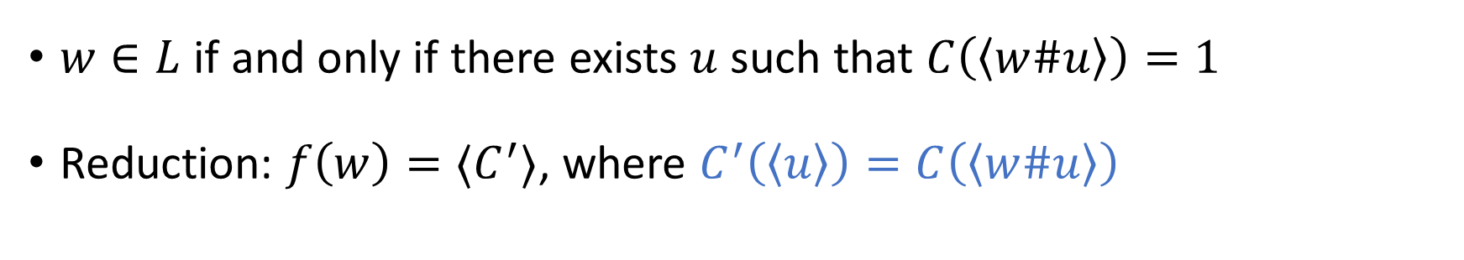














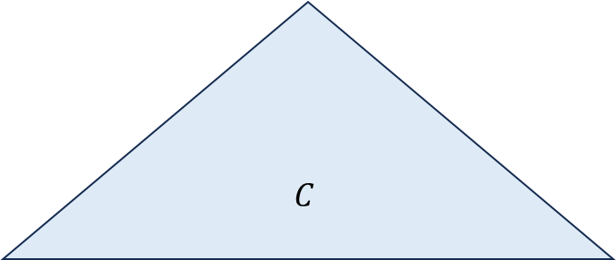

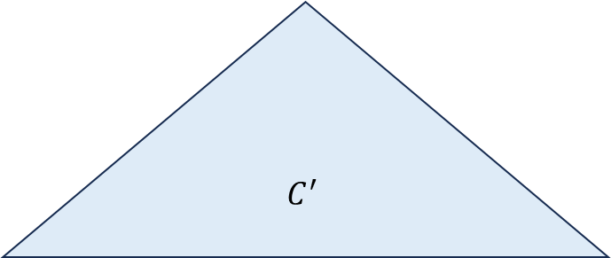

Proof that $\text{CIRCUIT}\text{‑}\text{SAT}$ is $\text{NP}$-hard
$$C$$
Reduction step 2
$$C^{′}$$
$$⋯$$
$$⋯$$
$$⋯$$
$$x_{1}$$
$$x_{2}$$
$$x_{3}$$
$$x_{4}$$
$$x_{5}$$
$$x_{6}$$
$$x_{7}$$
$$x_{m}$$
$$0$$
$$1$$
$$1$$
$$0$$
$$1$$
$$x_{1}$$
$$x_{2}$$
$$x_{r}$$
$w\#$ “hard-coded” into circuit
$w∈L$ if and only if there exists $u$ such that $C\left(\left\langle w\#u\right\rangle \right)=1$
Reduction: $f\left(w\right)=⟨C^{′}⟩$, where $C^{′}\left(\left\langle u\right\rangle \right)=C\left(\left\langle w\#u\right\rangle \right)$

Slide 7
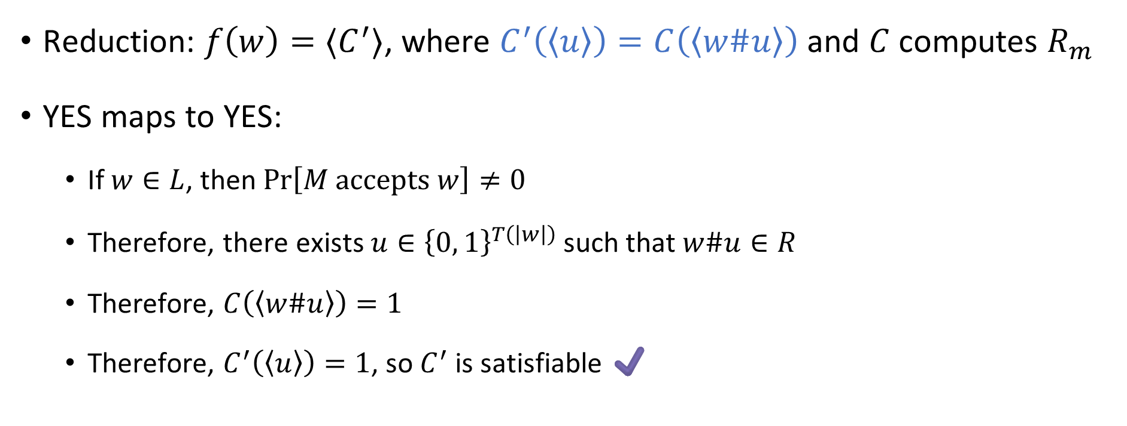
Proof that $\text{CIRCUIT}\text{‑}\text{SAT}$ is $\text{NP}$-hard
Reduction: $f\left(w\right)=⟨C^{′}⟩$, where $C^{′}\left(\left\langle u\right\rangle \right)=C\left(\left\langle w\#u\right\rangle \right)$ and $C$ computes $R_{m}$
YES maps to YES:
If $w∈L$, then $\operatorname{Pr}\left[M accepts w\right]≠0$
Therefore, there exists $u∈{\left\{0, 1\right\}}^{T\left(\left|w\right|\right)}$ such that $w\#u∈R$
Therefore, $C\left(\left\langle w\#u\right\rangle \right)=1$
Therefore, $C^{′}\left(\left\langle u\right\rangle \right)=1$, so $C^{′}$ is satisfiable ✔️

Slide 8
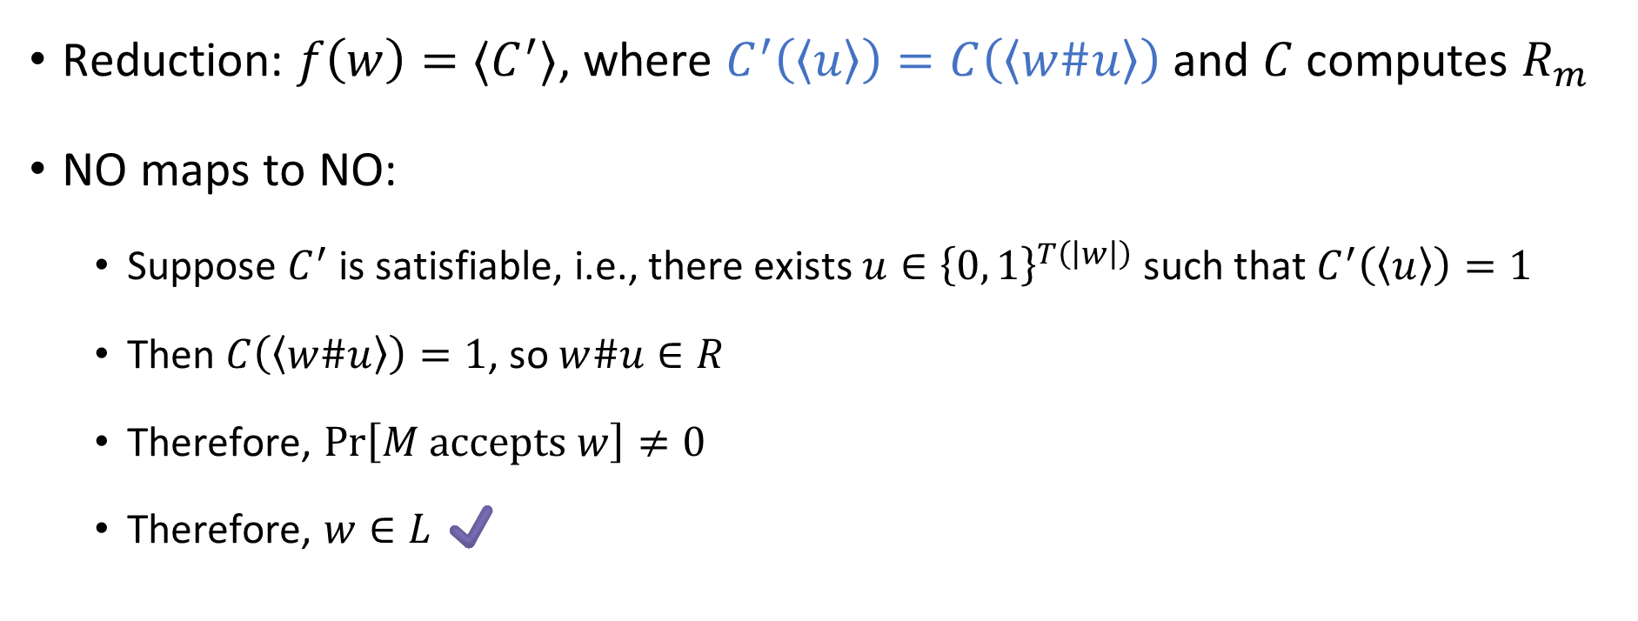
Proof that $\text{CIRCUIT}\text{‑}\text{SAT}$ is $\text{NP}$-hard
Reduction: $f\left(w\right)=⟨C^{′}⟩$, where $C^{′}\left(\left\langle u\right\rangle \right)=C\left(\left\langle w\#u\right\rangle \right)$ and $C$ computes $R_{m}$
NO maps to NO:
Suppose $C^{′}$ is satisfiable, i.e., there exists $u∈{\left\{0, 1\right\}}^{T\left(\left|w\right|\right)}$ such that $C^{′}\left(\left\langle u\right\rangle \right)=1$
Then $C\left(\left\langle w\#u\right\rangle \right)=1$, so $w\#u∈R$
Therefore, $\operatorname{Pr}\left[M \text{accepts} w\right]≠0$
Therefore, $w∈L$ ✔️

Slide 9
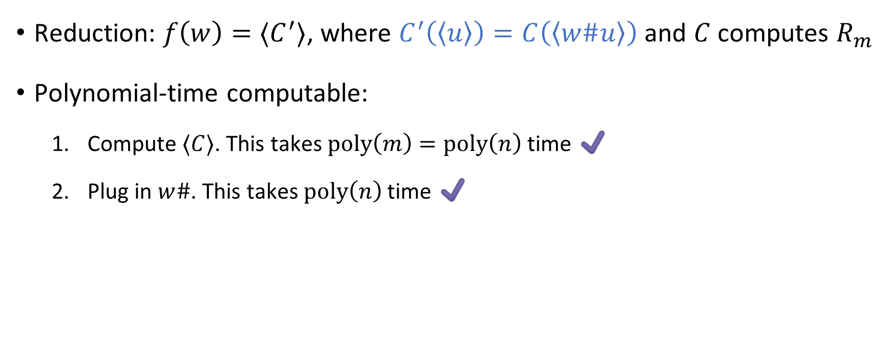
Proof that $\text{CIRCUIT}\text{‑}\text{SAT}$ is $\text{NP}$-hard
Reduction: $f\left(w\right)=⟨C^{′}⟩$, where $C^{′}\left(\left\langle u\right\rangle \right)=C\left(\left\langle w\#u\right\rangle \right)$ and $C$ computes $R_{m}$
Polynomial-time computable:
Compute $⟨C⟩$. This takes $\text{poly}\left(m\right)=\text{poly}\left(n\right)$ time ✔️
Plug in $w\#$. This takes $\text{poly}\left(n\right)$ time ✔️

Slide 10


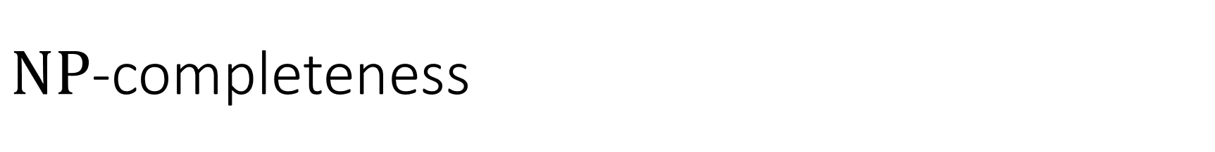



$\text{NP}$-completeness
$\text{NP}$-hard
$$\text{CIRCUIT}\text{‑}\text{SAT}$$
$\text{NP}$-complete
$$\text{NP}$$
$$\text{P}$$

Slide 11

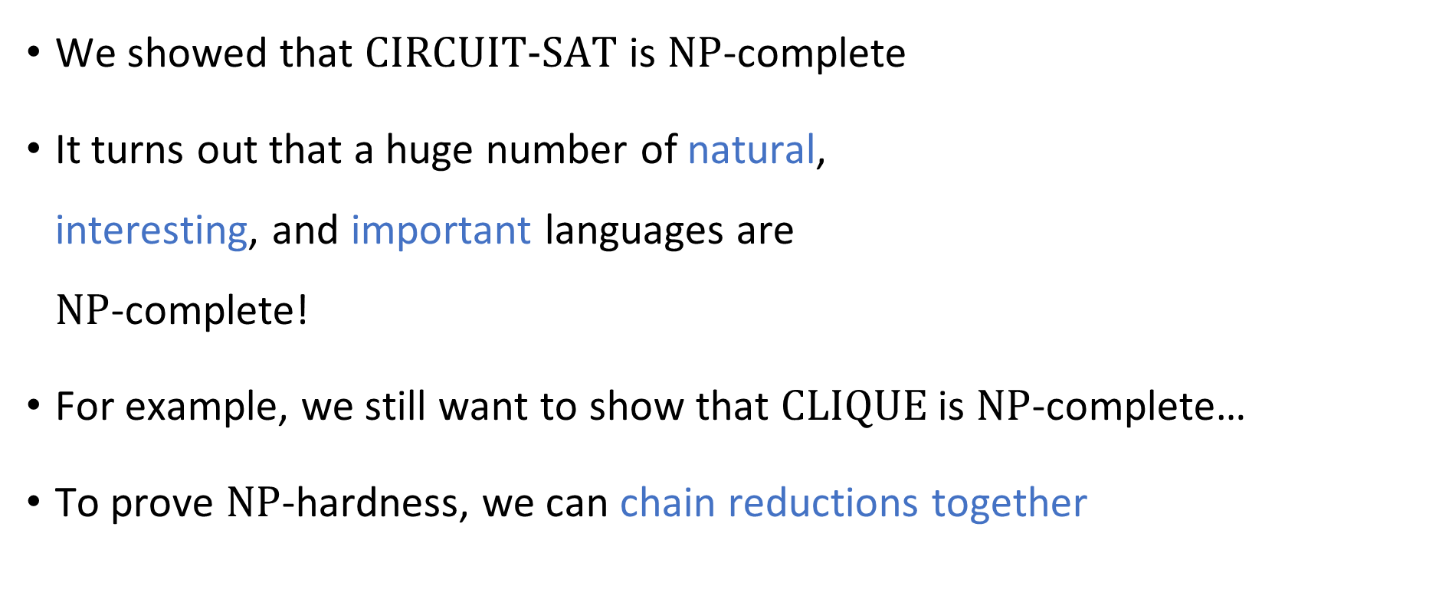

What else is $\text{NP}$-complete?
We showed that $\text{CIRCUIT}\text{‑}\text{SAT}$ is $\text{NP}$-complete
It turns out that a huge number of natural, interesting, and important languages are $\text{NP}$-complete!
For example, we still want to show that $\text{CLIQUE}$ is $\text{NP}$-complete…
To prove $\text{NP}$-hardness, we can chain reductions together

Slide 12
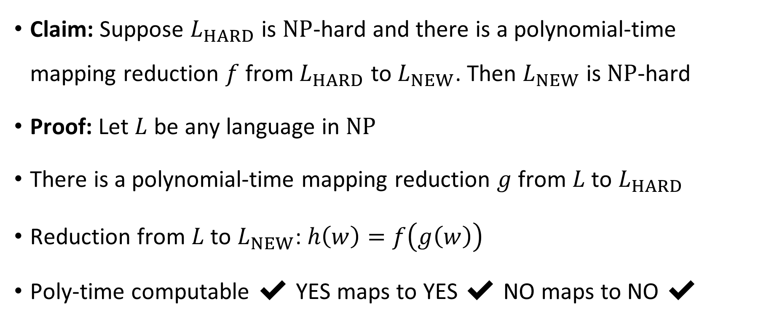
Chaining reductions together
Claim: Suppose $L_{HARD}$ is $\text{NP}$-hard and there is a polynomial-time mapping reduction $f$ from $L_{HARD}$ to $L_{NEW}$. Then $L_{NEW}$ is $\text{NP}$-hard
Proof: Let $L$ be any language in $\text{NP}$
There is a polynomial-time mapping reduction $g$ from $L$ to $L_{HARD}$
Reduction from $L$ to $L_{NEW}$: $h\left(w\right)=f\left(g\left(w\right)\right)$
Poly-time computable ✔️ YES maps to YES ✔️ NO maps to NO ✔️

Slide 13
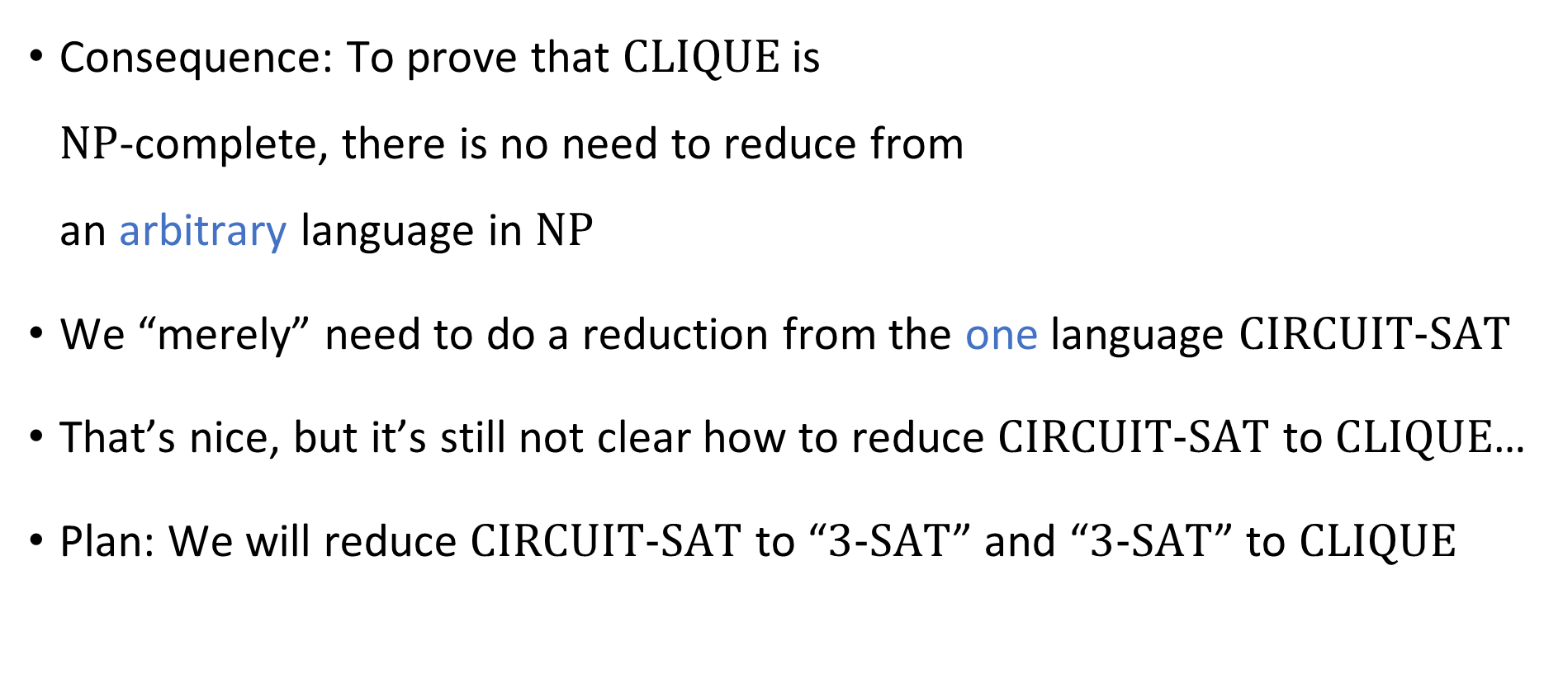
Chaining reductions together
Consequence: To prove that $\text{CLIQUE}$ is $\text{NP}$-complete, there is no need to reduce from an arbitrary language in $\text{NP}$
We “merely” need to do a reduction from the one language $\text{CIRCUIT}\text{‑}\text{SAT}$
That’s nice, but it’s still not clear how to reduce $\text{CIRCUIT}\text{‑}\text{SAT}$ to $\text{CLIQUE}$…
Plan: We will reduce $\text{CIRCUIT}\text{‑}\text{SAT}$ to “$3‑\text{SAT}$” and “$3‑\text{SAT}$” to $\text{CLIQUE}$

Slide 14
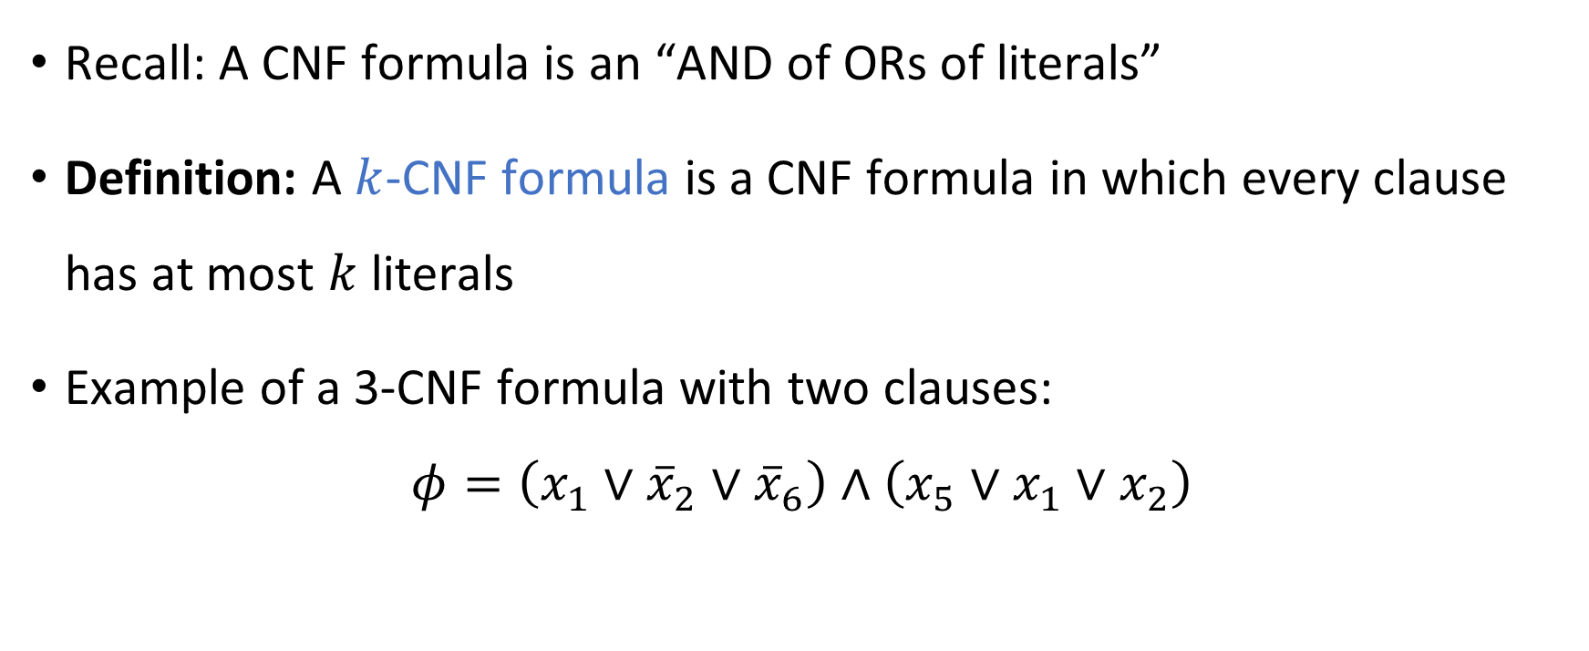
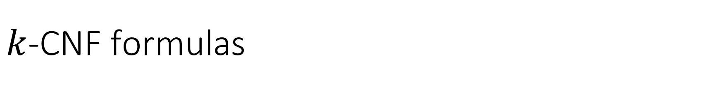
$k$-CNF formulas
Recall: A CNF formula is an “AND of ORs of literals”
Definition: A $k$-CNF formula is a CNF formula in which every clause has at most $k$ literals
Example of a 3-CNF formula with two clauses:
$$φ=\left(x_{1}∨{\overline{x}}_{2}∨{\overline{x}}_{6}\right)∧\left(x_{5}∨x_{1}∨x_{2}\right)$$

Slide 15

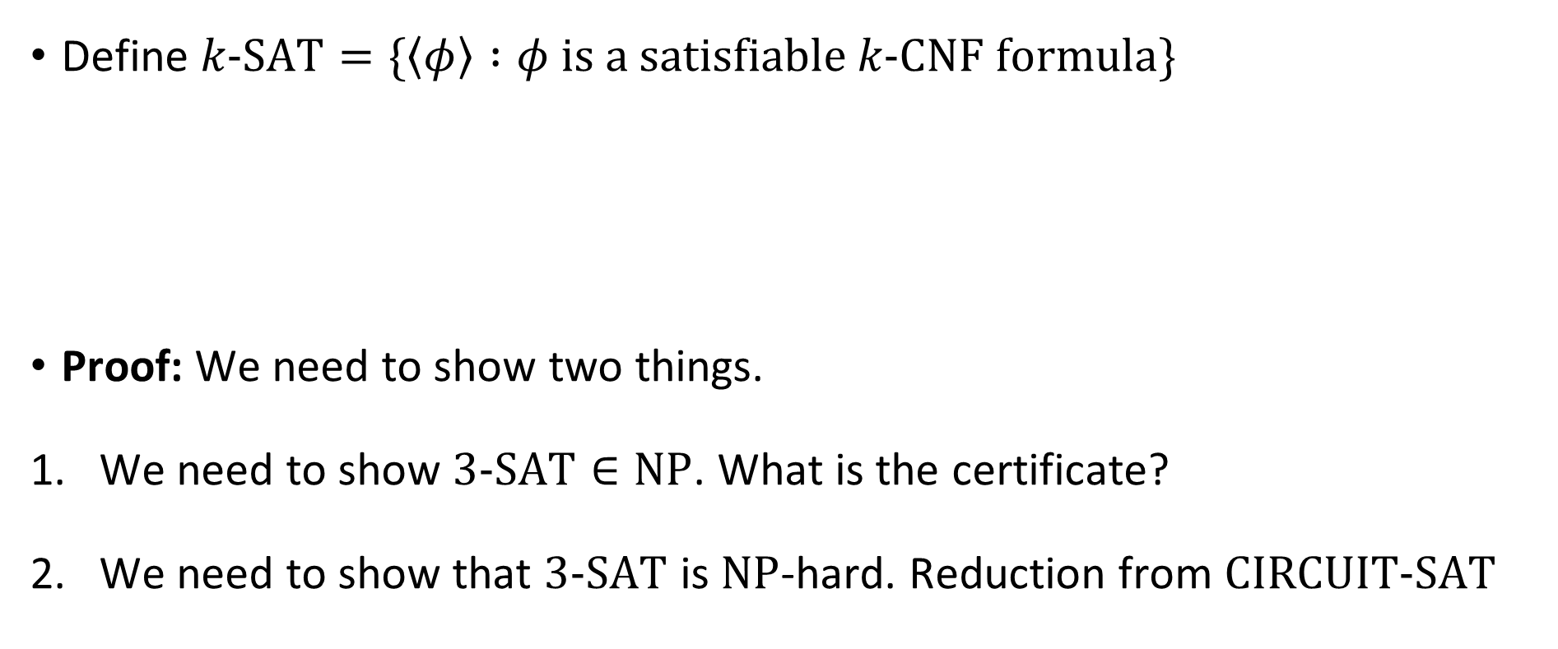
The Cook-Levin Theorem
Define $k\text{‑}\text{SAT}=\{\left\langle φ\right\rangle :φ \text{is} \text{a} \text{satisfiable} k\text{‑}\text{CNF} \text{formula}\}$
Proof: We need to show two things.
We need to show $3\text{‑}\text{SAT}∈\text{NP}$. What is the certificate?
We need to show that $3\text{‑}\text{SAT}$ is $\text{NP}$-hard. Reduction from $\text{CIRCUIT}\text{‑}\text{SAT}$
The Cook-Levin Theorem: $3\text{‑}\text{SAT}$ is $\text{NP}$-complete

Slide 16
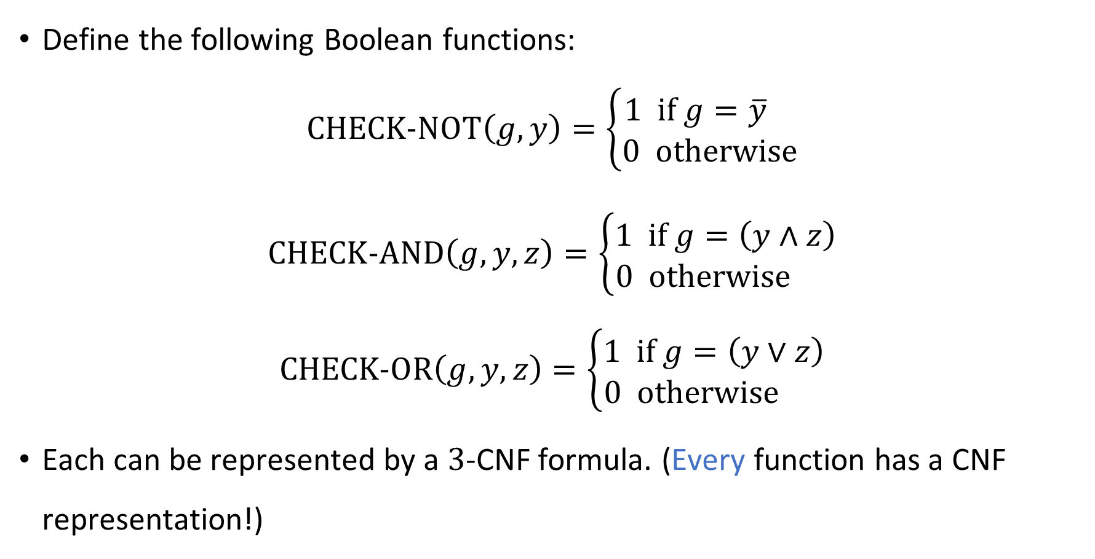
Gate gadgets
Define the following Boolean functions:
$$\text{CHECK}\text{‑}\text{NOT}\left(g, y\right)=\left\{\begin{aligned}1 \text{if} g=\overline{y} \\ 0 \text{otherwise}\end{aligned}\right.$$
$$\text{CHECK}\text{‑}\text{AND}\left(g, y,z\right)=\left\{\begin{aligned}1 \text{if} g=\left(y∧z\right) \\ 0 \text{otherwise} \end{aligned}\right.$$
$$\text{CHECK}\text{‑}\text{OR}\left(g, y,z\right)=\left\{\begin{aligned}1 \text{if} g=\left(y∨z\right) \\ 0 \text{otherwise} \end{aligned}\right.$$
Each can be represented by a $3$-CNF formula. (Every function has a CNF representation!)

Slide 17
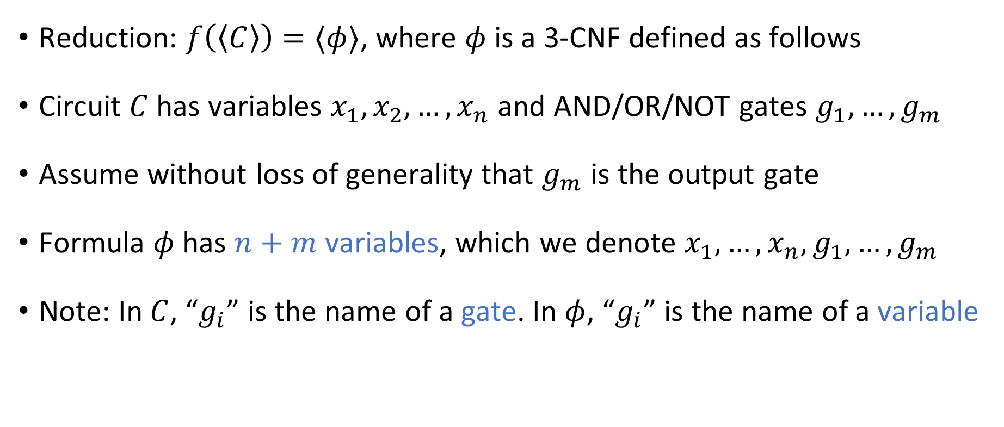

Reduction from $\text{CIRCUIT}\text{‑}\text{SAT}$ to $\text{3‑}\text{SAT}$
Reduction: $f\left(\left\langle C\right\rangle \right)=⟨φ⟩$, where $φ$ is a 3-CNF defined as follows
Circuit $C$ has variables $x_{1},x_{2},…, x_{n}$ and AND/OR/NOT gates $g_{1},…, g_{m}$
Assume without loss of generality that $g_{m}$ is the output gate
Formula $φ$ has $n+m$ variables, which we denote $x_{1},…, x_{n}, g_{1},…, g_{m}$
Note: In $C$, “$g_{i}$” is the name of a gate. In $φ$, “$g_{i}$” is the name of a variable

Slide 18
















Reduction from $\text{CIRCUIT}\text{‑}\text{SAT}$ to $\text{3‑}\text{SAT}$
For each AND/OR/NOT gate $g_{i}$ in the circuit $C$, define a 3-CNF $φ_{i}$:
Reduction produces $φ:=φ_{1}∧φ_{2}∧…∧φ_{m}∧\left(g_{m}\right)$
$$g_{i}$$
$$¬$$
$$g_{i}$$
$$∧$$
$$g_{i}$$
$$∨$$
$$y$$
$$y$$
$$z$$
$$y$$
$$z$$
$$φ_{i}=\text{CHECK}\text{‑}\text{NOT}\left(g_{i}, y\right)$$
$$φ_{i}=\text{CHECK}\text{‑}\text{AND}\left(g_{i}, y, z\right)$$
$$φ_{i}=\text{CHECK}\text{‑}\text{OR}\left(g_{i}, y, z\right)$$

Slide 19





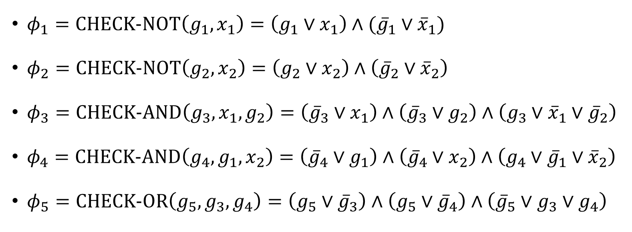



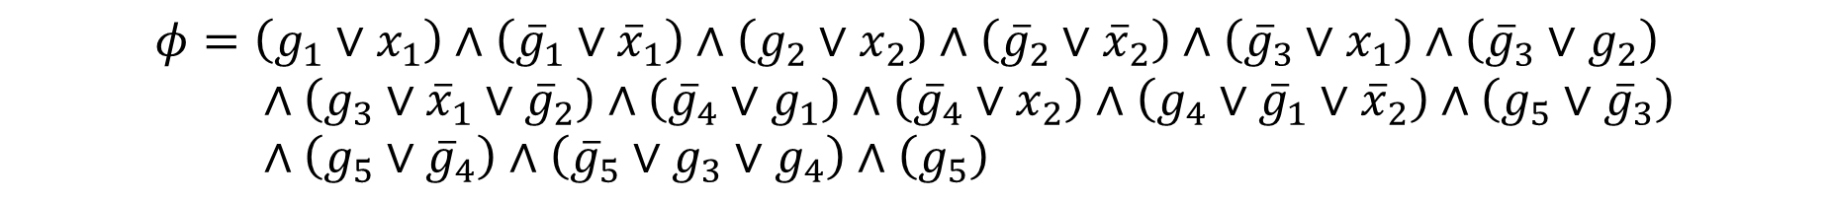




Reduction example
$$g_{5}$$
$φ_{1}=\text{CHECK}\text{‑}\text{NOT}\left(g_{1},x_{1}\right)=\left(g_{1}∨x_{1}\right)∧({\overline{g}}_{1}∨{\overline{x}}_{1})$
$φ_{2}=\text{CHECK}\text{‑}\text{NOT}\left(g_{2},x_{2}\right)=\left(g_{2}∨x_{2}\right)∧\left({\overline{g}}_{2}∨{\overline{x}}_{2}\right)$
$φ_{3}=\text{CHECK}\text{‑}\text{AND}\left(g_{3},x_{1},g_{2}\right)=\left({\overline{g}}_{3}∨x_{1}\right)∧\left({\overline{g}}_{3}∨g_{2}\right)∧\left(g_{3}∨{\overline{x}}_{1}∨{\overline{g}}_{2}\right)$
$φ_{4}=\text{CHECK}\text{‑}\text{AND}\left(g_{4},g_{1},x_{2}\right)=\left({\overline{g}}_{4}∨g_{1}\right)∧\left({\overline{g}}_{4}∨x_{2}\right)∧\left(g_{4}∨{\overline{g}}_{1}∨{\overline{x}}_{2}\right)$
$φ_{5}=\text{CHECK}\text{‑}\text{OR}\left(g_{5},g_{3},g_{4}\right)=\left(g_{5}∨{\overline{g}}_{3}\right)∧\left(g_{5}∨{\overline{g}}_{4}\right)∧\left({\overline{g}}_{5}∨g_{3}∨g_{4}\right)$
$$∨$$
$$g_{3}$$
$$g_{4}$$
$$∧$$
$$∧$$
$$g_{1}$$
$$g_{2}$$
$$¬$$
$$¬$$
$$x_{1}$$
$$x_{2}$$
$$φ=\left(g_{1}∨x_{1}\right)∧\left({\overline{g}}_{1}∨{\overline{x}}_{1}\right)∧\left(g_{2}∨x_{2}\right)∧\left({\overline{g}}_{2}∨{\overline{x}}_{2}\right)∧\left({\overline{g}}_{3}∨x_{1}\right)∧\left({\overline{g}}_{3}∨g_{2}\right) \\ ∧\left(g_{3}∨{\overline{x}}_{1}∨{\overline{g}}_{2}\right)∧\left({\overline{g}}_{4}∨g_{1}\right)∧\left({\overline{g}}_{4}∨x_{2}\right)∧\left(g_{4}∨{\overline{g}}_{1}∨{\overline{x}}_{2}\right)∧\left(g_{5}∨{\overline{g}}_{3}\right) \\ ∧\left(g_{5}∨{\overline{g}}_{4}\right)∧\left({\overline{g}}_{5}∨g_{3}∨g_{4}\right)∧\left(g_{5}\right)$$

Slide 20
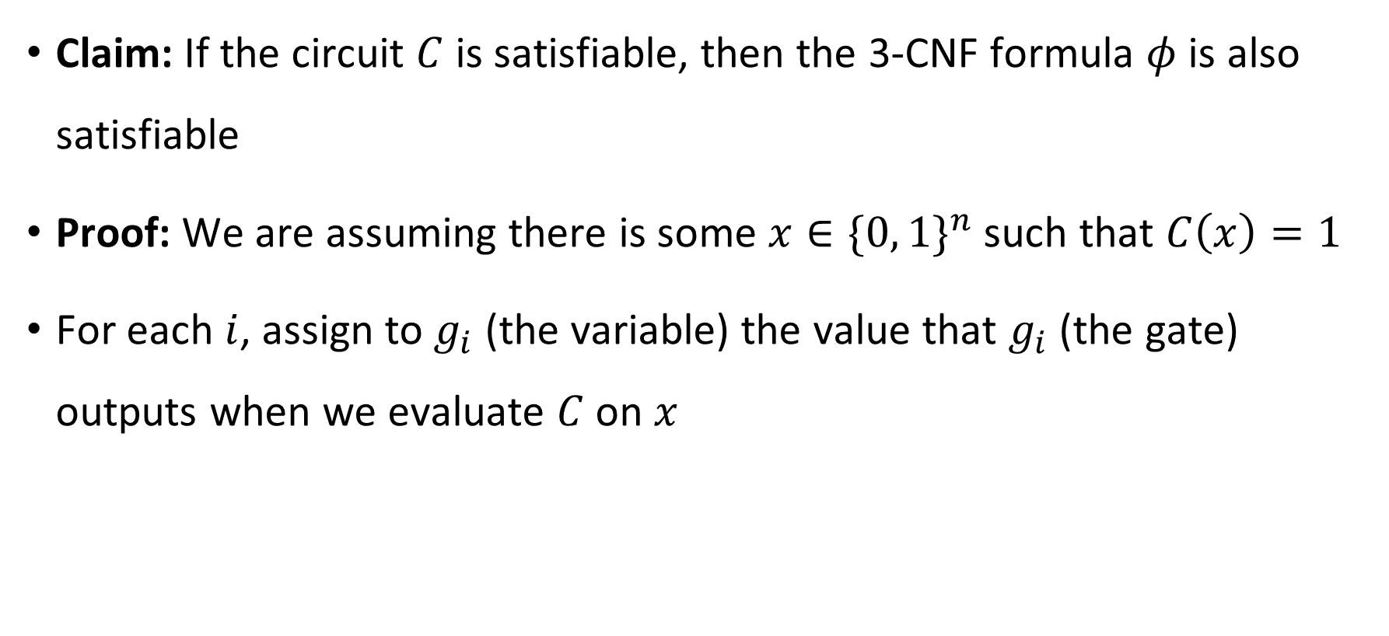
YES maps to YES
Claim: If the circuit $C$ is satisfiable, then the 3-CNF formula $φ$ is also satisfiable
Proof: We are assuming there is some $x∈\{0, 1\}^{n}$ such that $C\left(x\right)=1$
For each $i$, assign to $g_{i}$ (the variable) the value that $g_{i}$ (the gate) outputs when we evaluate $C$ on $x$

