Slide 1
CMSC 28100 Introduction to Complexity Theory Winter 2024 Instructor: William Hoza
7 |  |  |  |  |  |  | 5 | 3
 |  |  |  |  |  |  |  | 4
 | 4 | 8 |  | 3 |  | 1 | 2
8 |  | 1 | 3 |  |  | 2 | 7 | 5
 | 9 |  | 1 |  |  |  | 4
 | 5 |  |  |  |  | 3
2 |  | 5 |  | 8 | 4
1 | 3 | 4 |  | 5

Slide 2




The class $\text{EXP}$
All languages
Definition: $\text{EXP}$ is the class of languages that can be decided in time $2^{n^{O\left(1\right)}}$:
$$\text{EXP}=\bigcup_{k=1}^{∞}{\text{TIME}\left(2^{n^{k}}\right)}$$
Decidable languages
$$\text{EXP}$$
$$\text{P}$$

Slide 3
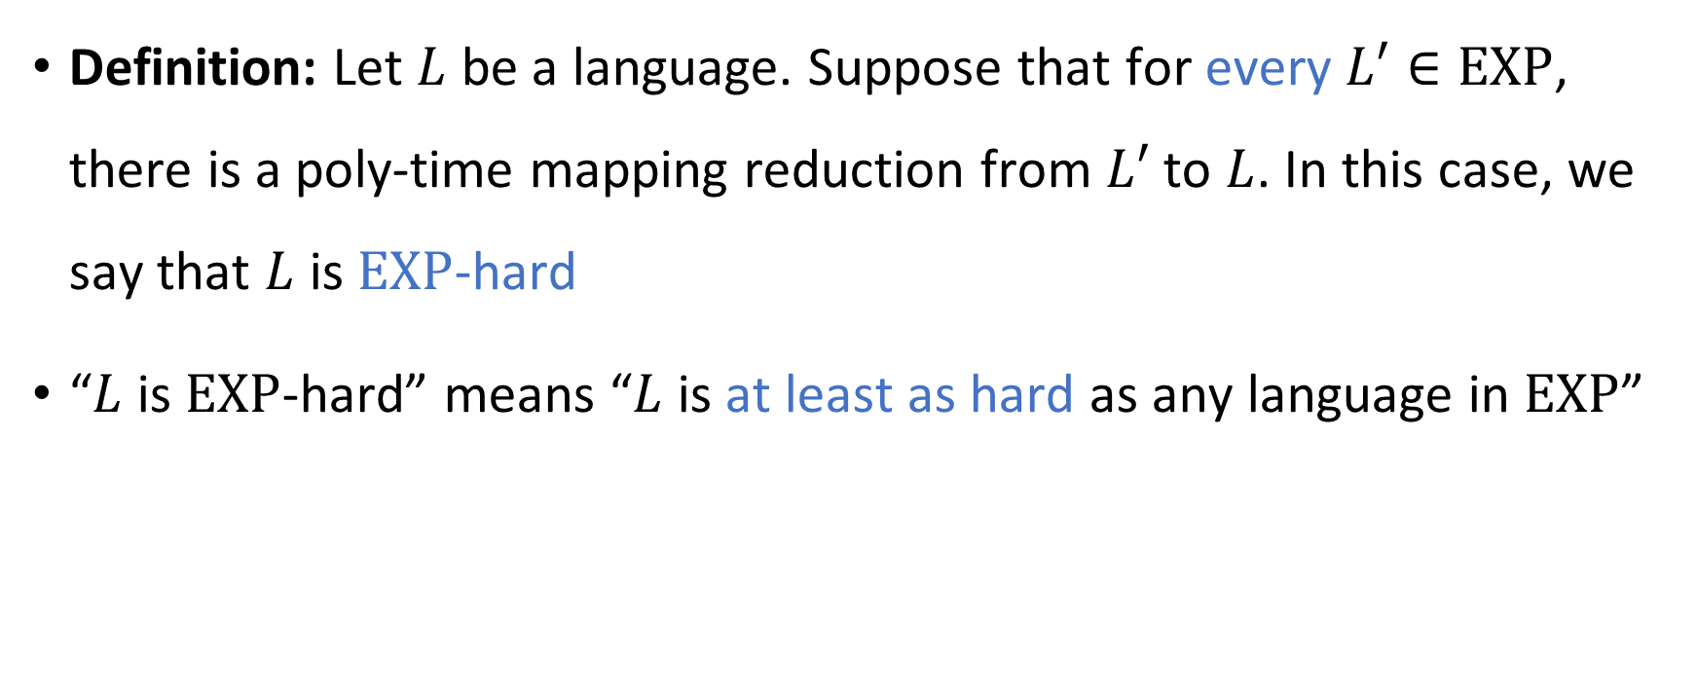
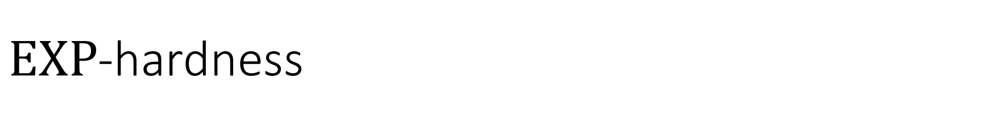
$\text{EXP}$-hardness
Definition: Let $L$ be a language. Suppose that for every $L′∈\text{EXP}$, there is a poly-time mapping reduction from $L′$ to $L$. In this case, we say that $L$ is $\text{EXP}$-hard
“$L$ is $\text{EXP}$-hard” means “$L$ is at least as hard as any language in $\text{EXP}$”

Slide 4
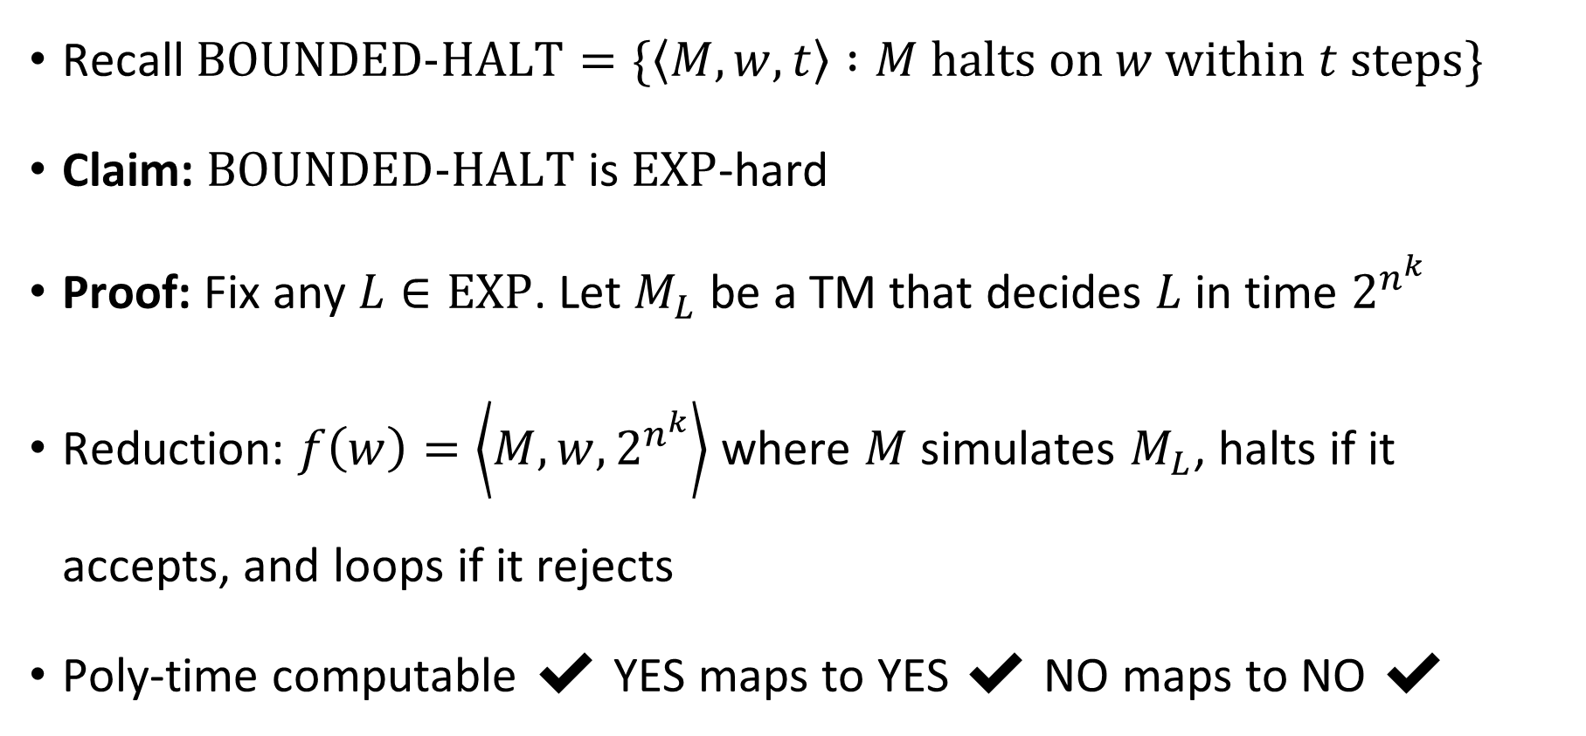

$\text{BOUNDED}\text{‑}\text{HALT}$ is $\text{EXP}$-hard
Recall $\text{BOUNDED}\text{‑}\text{HALT}=\{\left\langle M,w,t\right\rangle :M \text{halts} \text{on} w \text{within} t \text{steps}\}$
Claim: $\text{BOUNDED}\text{‑}\text{HALT}$ is $\text{EXP}$-hard
Proof: Fix any $L∈\text{EXP}$. Let $M_{L}$ be a TM that decides $L$ in time $2^{n^{k}}$
Reduction: $f\left(w\right)=\left\langle M,w,2^{n^{k}}\right\rangle$ where $M$ simulates $M_{L}$, halts if it accepts, and loops if it rejects
Poly-time computable ✔️ YES maps to YES ✔️ NO maps to NO ✔️

Slide 5
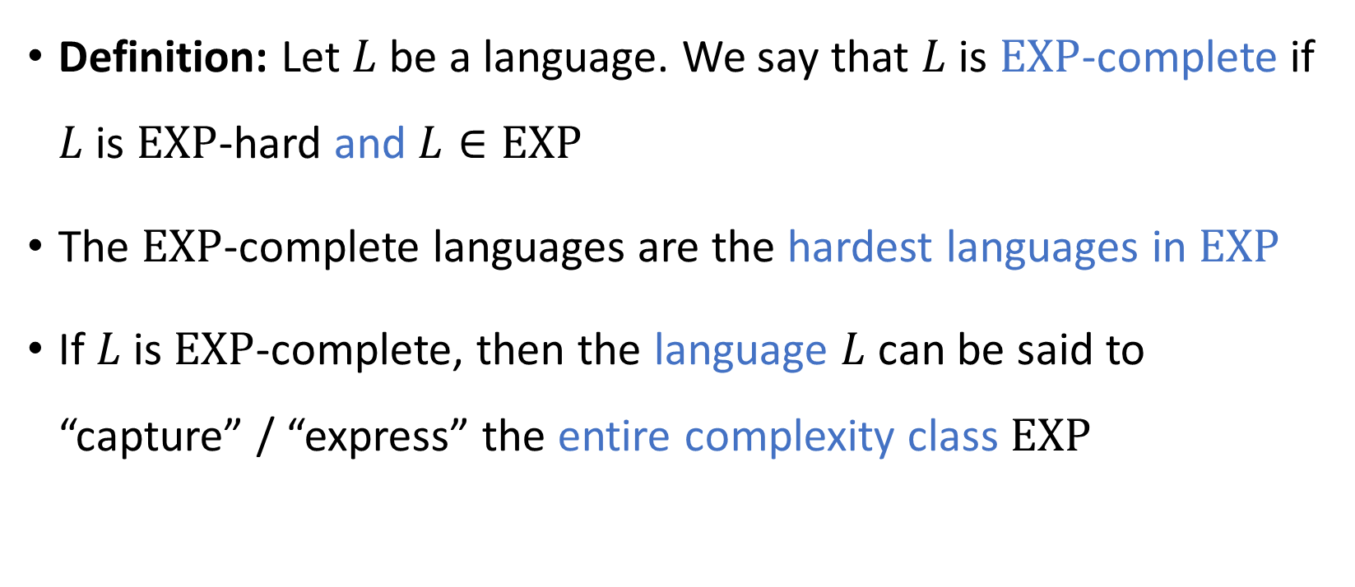
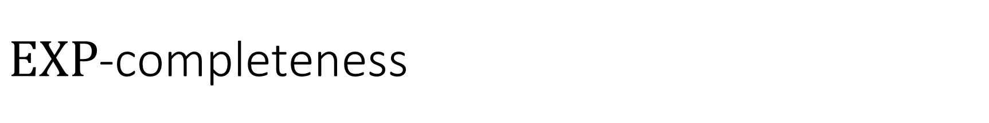
$\text{EXP}$-completeness
Definition: Let $L$ be a language. We say that $L$ is $\text{EXP}$-complete if $L$ is $\text{EXP}$-hard and $L∈\text{EXP}$
The $\text{EXP}$-complete languages are the hardest languages in $\text{EXP}$
If $L$ is $\text{EXP}$-complete, then the language $L$ can be said to “capture” / “express” the entire complexity class $\text{EXP}$

Slide 6
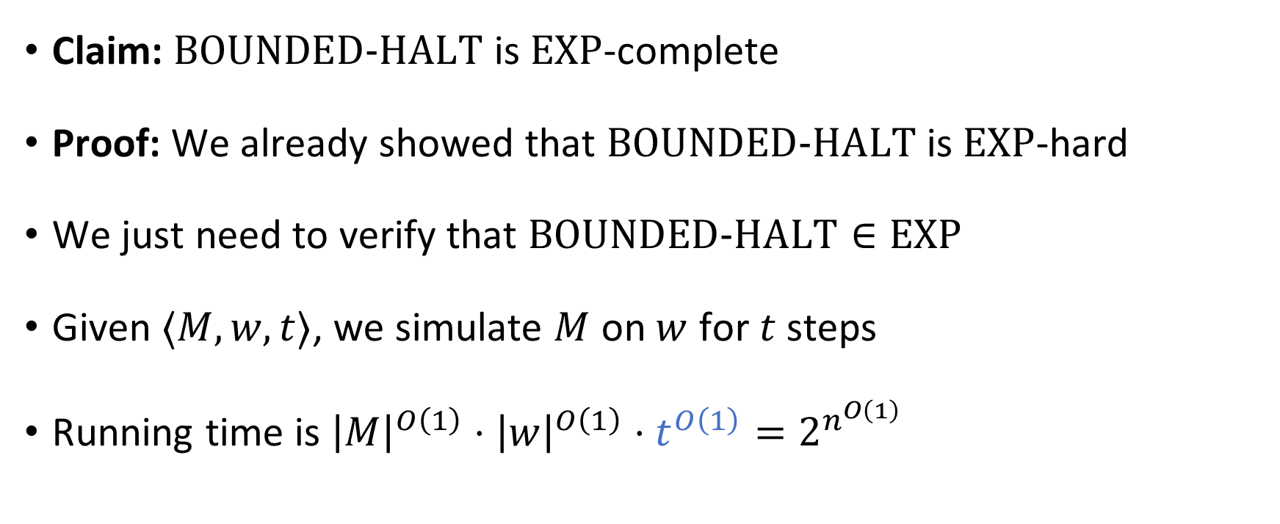

$\text{BOUNDED}\text{‑}\text{HALT}$ is $\text{EXP}$-complete
Claim: $\text{BOUNDED}\text{‑}\text{HALT}$ is $\text{EXP}$-complete
Proof: We already showed that $\text{BOUNDED}\text{‑}\text{HALT}$ is $\text{EXP}$-hard
We just need to verify that $\text{BOUNDED}\text{‑}\text{HALT}∈\text{EXP}$
Given $⟨M,w,t⟩$, we simulate $M$ on $w$ for $t$ steps
Running time is ${\left|M\right|}^{O\left(1\right)}⋅{\left|w\right|}^{O\left(1\right)}⋅t^{O\left(1\right)}=2^{n^{O\left(1\right)}}$

Slide 7





$\text{EXP}$-completeness
$\text{EXP}$-hard
$$\text{BOUNDED}\text{‑}\text{HALT}$$
$\text{EXP}$-complete
$$\text{EXP}$$
$$\text{P}$$

Slide 8
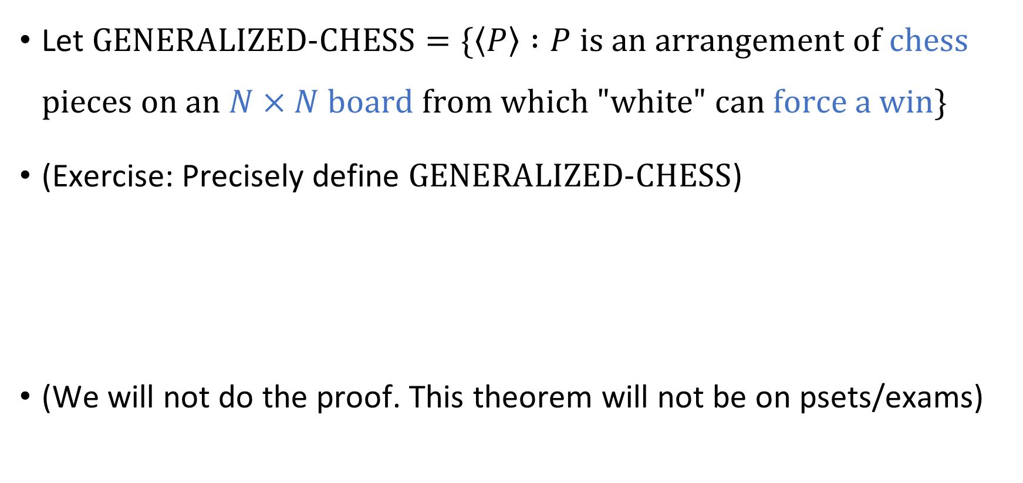

An $\text{EXP}$-complete problem that isn’t about TMs
Let $\text{GENERALIZED}\text{‑}\text{CHESS}=\{\left\langle P\right\rangle :P \text{is} \text{an} \text{arrangement} \text{of} \text{chess} \text{pieces} \text{on} \text{an} N×N \text{board} \text{from} \text{which}\text{ "}\text{white}\text{" }\text{can} \text{force} \text{a} \text{win}\}$
(Exercise: Precisely define $\text{GENERALIZED}\text{‑}\text{CHESS}$)
(We will not do the proof. This theorem will not be on psets/exams)
Theorem: $\text{GENERALIZED}\text{‑}\text{CHESS}$ is $\text{EXP}$-complete (and hence not in $\text{P}$)

Slide 9

Which languages are in $\text{P}$?

Slide 10

Which languages are not in $\text{P}$?

Slide 11
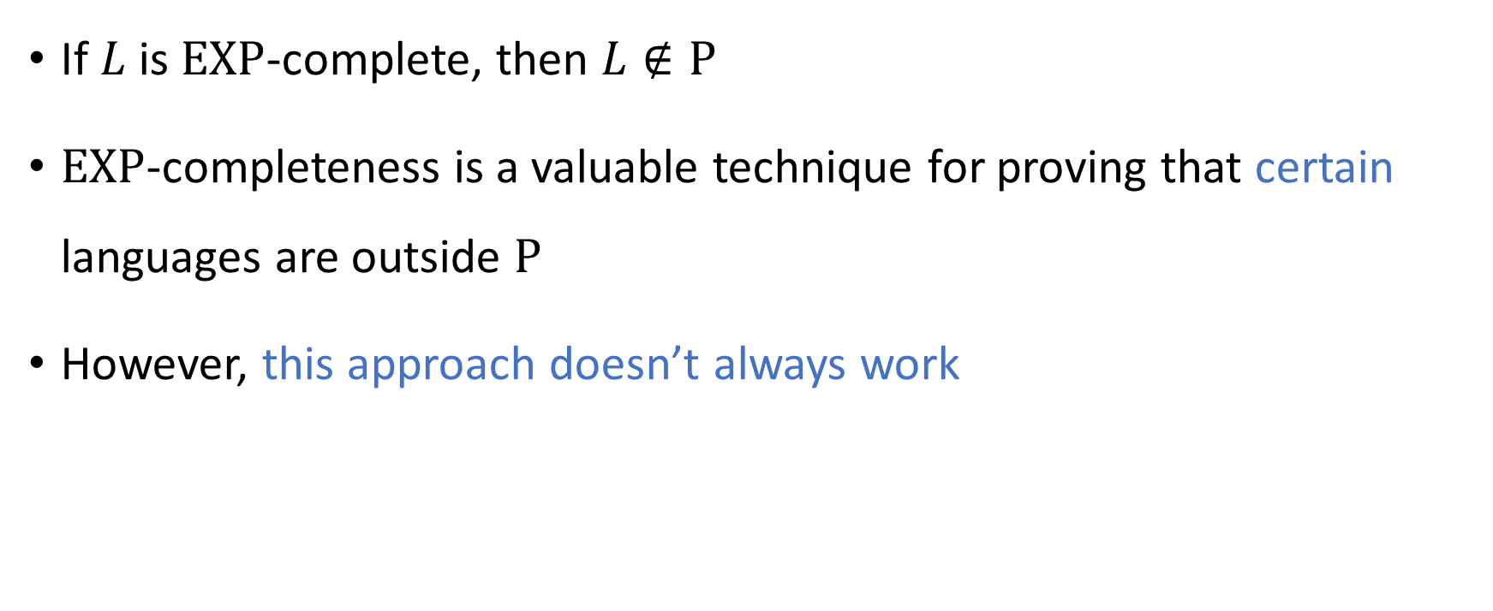
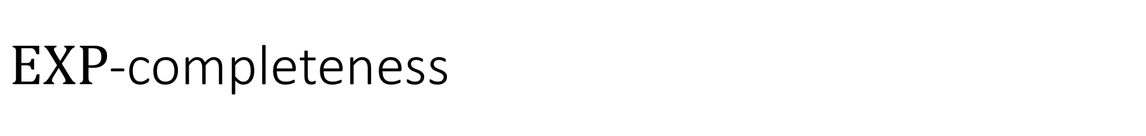
$\text{EXP}$-completeness
If $L$ is $\text{EXP}$-complete, then $L∉\text{P}$
$\text{EXP}$-completeness is a valuable technique for proving that certain languages are outside $\text{P}$
However, this approach doesn’t always work

Slide 12




















Circuit satisfiability
$$∨$$
$$∧$$
$$∧$$
Satisfiable
$$¬$$
Let $C$ be a circuit on $n$ variables
We say that $C$ is satisfiable if there exists $x∈\{0, 1\}^{n}$ such that $C\left(x\right)=1$
$$x_{1}$$
$$x_{2}$$
$$∧$$
$$∧$$
$$∧$$
$$∨$$
$$∨$$
$$∨$$
$$∨$$
Unsatisfiable
$$¬$$
$$¬$$
$$¬$$
$$x_{2}$$
$$x_{1}$$
$$x_{3}$$

Slide 13
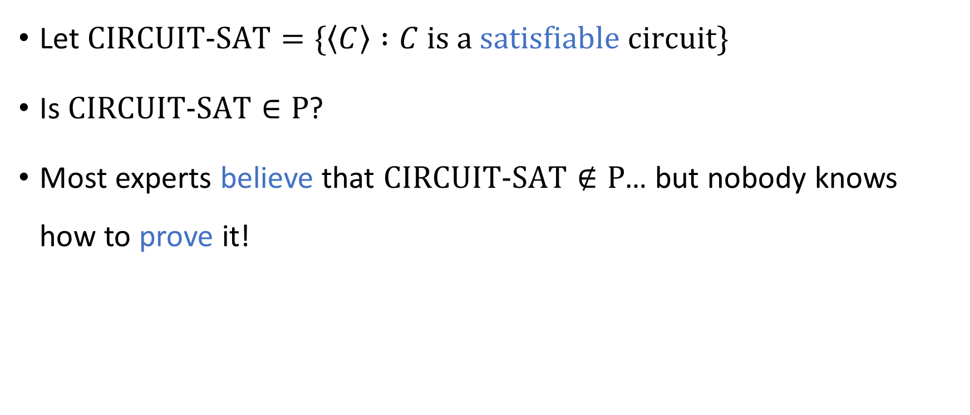
The CIRCUIT-SAT problem
Let $\text{CIRCUIT}‑\text{SAT}=\{\left\langle C\right\rangle :C \text{is} \text{a} \text{satisfiable} \text{circuit}\}$
Is $\text{CIRCUIT}‑\text{SAT}∈\text{P}$?
Most experts believe that $\text{CIRCUIT}\text{‑}\text{SAT}∉\text{P}$… but nobody knows how to prove it!

Slide 14


Complexity of $\text{CIRCUIT}\text{‑}\text{SAT}$
Can we use the $\text{EXP}$-completeness approach to prove that $\text{CIRCUIT}\text{‑}\text{SAT}∉\text{P}$?
Probably not, because $\text{CIRCUIT}\text{‑}\text{SAT}$ is probably not $\text{EXP}$-complete

Slide 15


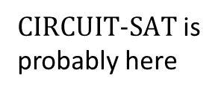


$\text{EXP}$-hard
$\text{CIRCUIT}\text{‑}\text{SAT}$ is probably here
$\text{EXP}$-complete
$$\text{EXP}$$
$$\text{P}$$

Slide 16
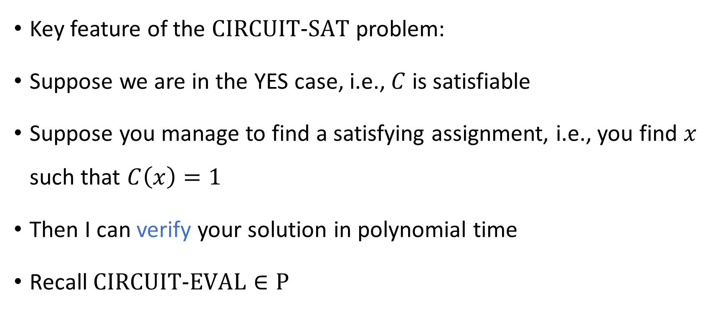
Complexity of $\text{CIRCUIT}\text{‑}\text{SAT}$
Key feature of the $\text{CIRCUIT}\text{‑}\text{SAT}$ problem:
Suppose we are in the YES case, i.e., $C$ is satisfiable
Suppose you manage to find a satisfying assignment, i.e., you find $x$ such that $C\left(x\right)=1$
Then I can verify your solution in polynomial time
Recall $\text{CIRCUIT}\text{‑}\text{EVAL}∈\text{P}$

Slide 17
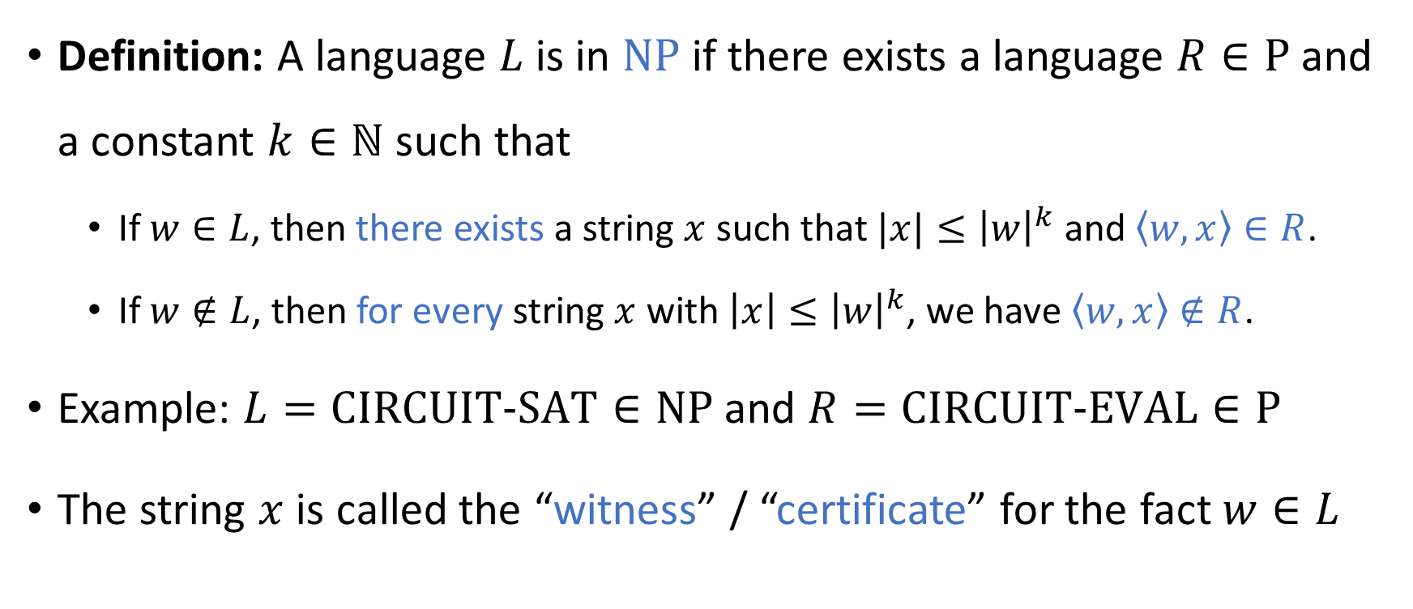

The complexity class $\text{NP}$
Definition: A language $L$ is in $\text{NP}$ if there exists a language $R∈\text{P}$ and a constant $k∈ℕ$ such that
If $w∈L$, then there exists a string $x$ such that $|x|≤{\left|w\right|}^{k}$ and $\left\langle w,x\right\rangle ∈R$.
If $w∉L$, then for every string $x$ with $\left|x\right|≤{\left|w\right|}^{k}$, we have $\left\langle w,x\right\rangle ∉R$.
Example: $L=\text{CIRCUIT}\text{‑}\text{SAT}∈\text{NP}$ and $R=\text{CIRCUIT}\text{‑}\text{EVAL}∈\text{P}$
The string $x$ is called the “witness” / “certificate” for the fact $w∈L$

Slide 18
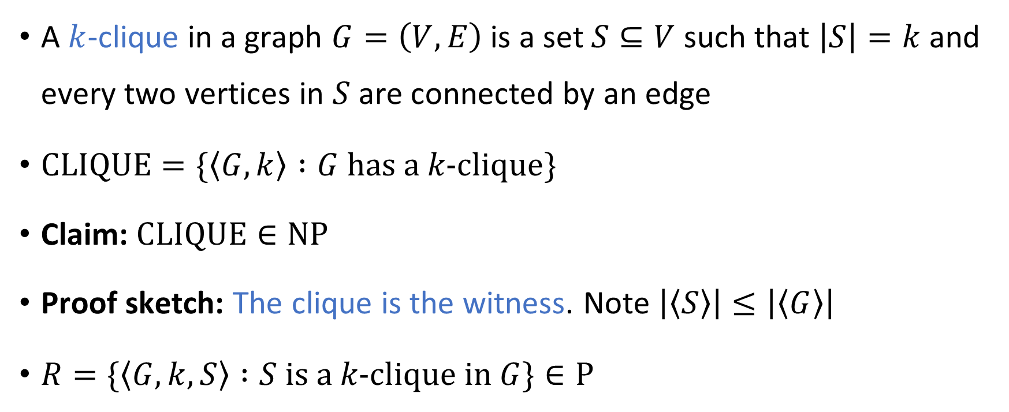

Another example of a language in $\text{NP}$
A $k$-clique in a graph $G=\left(V, E\right)$ is a set $S⊆V$ such that $\left|S\right|=k$ and every two vertices in $S$ are connected by an edge
$\text{CLIQUE}=\{\left\langle G,k\right\rangle :G \text{has} \text{a} k\text{‑}\text{clique}\}$
Claim: $\text{CLIQUE}∈\text{NP}$
Proof sketch: The clique is the witness. Note $\left|\left\langle S\right\rangle \right|≤\left|\left\langle G\right\rangle \right|$
$R=\{\left\langle G,k,S\right\rangle :S \text{is} \text{a} k\text{‑}\text{clique} \text{in} G\}∈\text{P}$

Slide 19
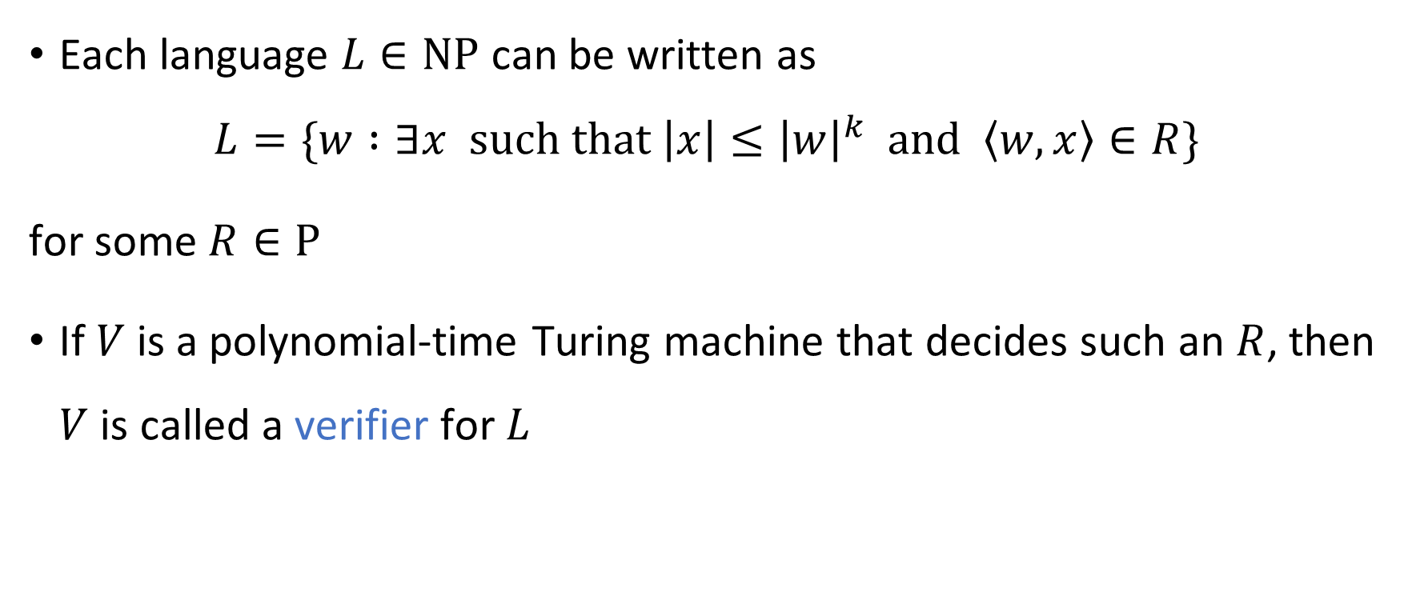
Verifiers
Each language $L∈\text{NP}$ can be written as
$$L=\{w :∃x \text{such} \text{that} \left|x\right|≤{\left|w\right|}^{k} \text{and} \left\langle w,x\right\rangle ∈R\}$$
for some $R∈\text{P}$
If $V$ is a polynomial-time Turing machine that decides such an $R$, then $V$ is called a verifier for $L$

Slide 20
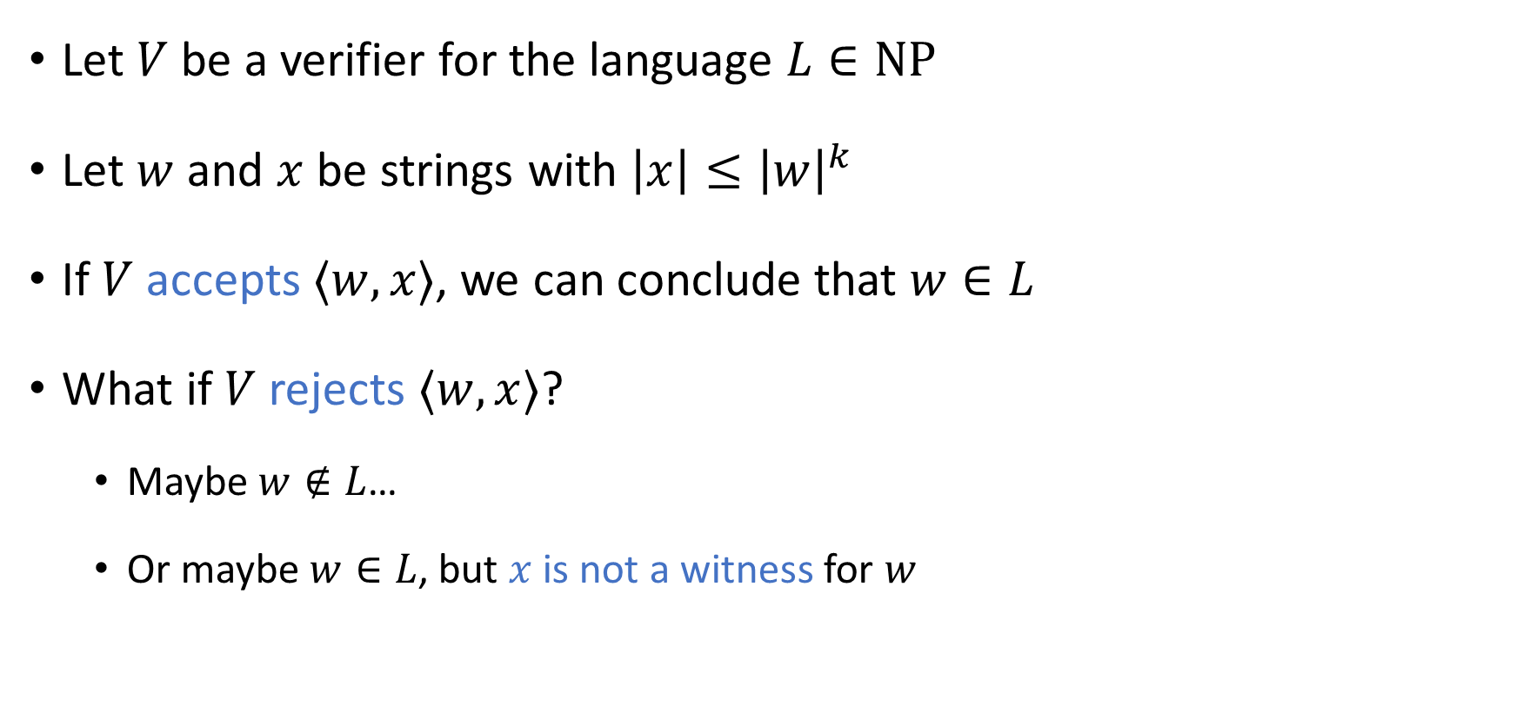
Verifiers
Let $V$ be a verifier for the language $L∈\text{NP}$
Let $w$ and $x$ be strings with $\left|x\right|≤{\left|w\right|}^{k}$
If $V$ accepts $⟨w,x⟩$, we can conclude that $w∈L$
What if $V$ rejects $⟨w,x⟩$?
Maybe $w∉L$…
Or maybe $w∈L$, but $x$ is not a witness for $w$

Slide 21
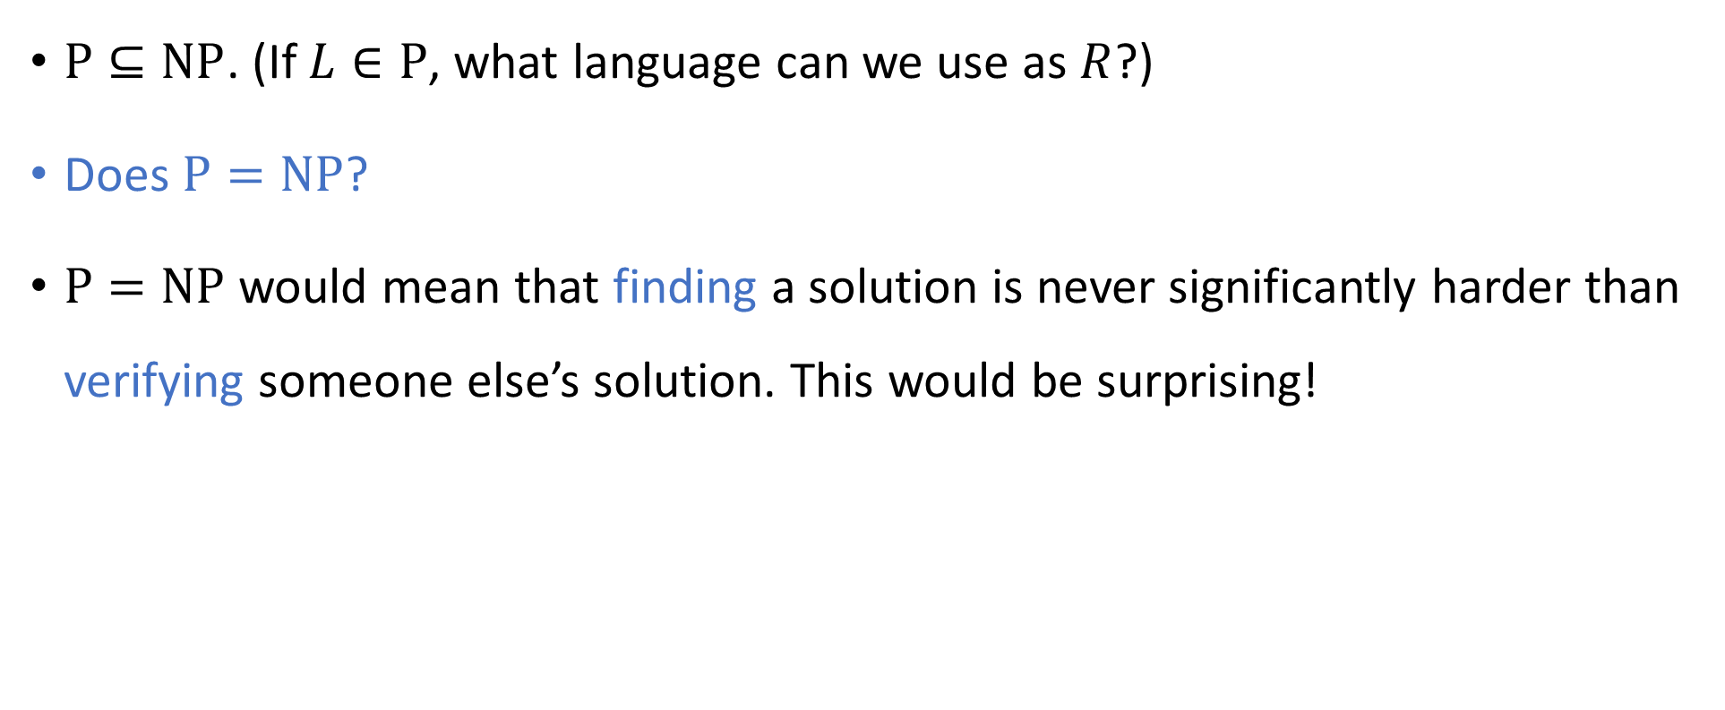

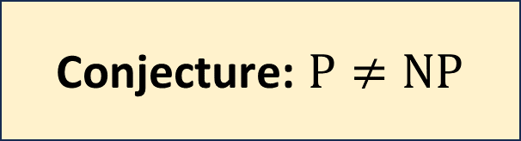
The $\text{P}$ vs. $\text{NP}$ problem
$\text{P}⊆\text{NP}$. (If $L∈\text{P}$, what language can we use as $R$?)
Does $\text{P}=\text{NP}$?
$\text{P}=\text{NP}$ would mean that finding a solution is never significantly harder than verifying someone else’s solution. This would be surprising!
Conjecture: $\text{P}≠\text{NP}$

Slide 22
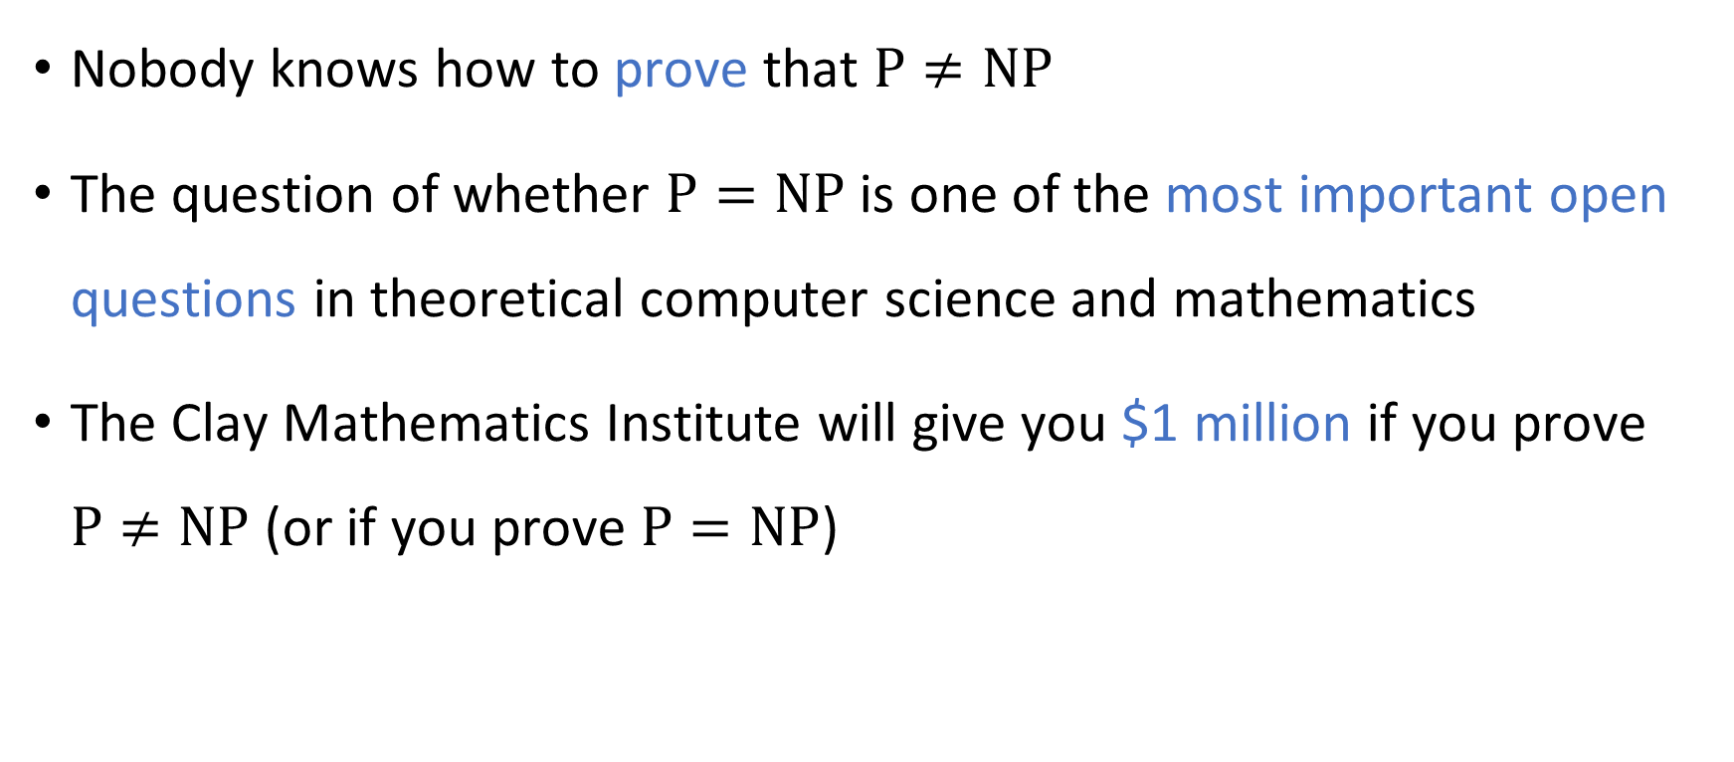
The $\text{P}$ vs. $\text{NP}$ problem
Nobody knows how to prove that $\text{P}≠\text{NP}$
The question of whether $\text{P}=\text{NP}$ is one of the most important open questions in theoretical computer science and mathematics
The Clay Mathematics Institute will give you $1 million if you prove $\text{P}≠\text{NP}$ (or if you prove $\text{P}=\text{NP}$)

