Slide 1
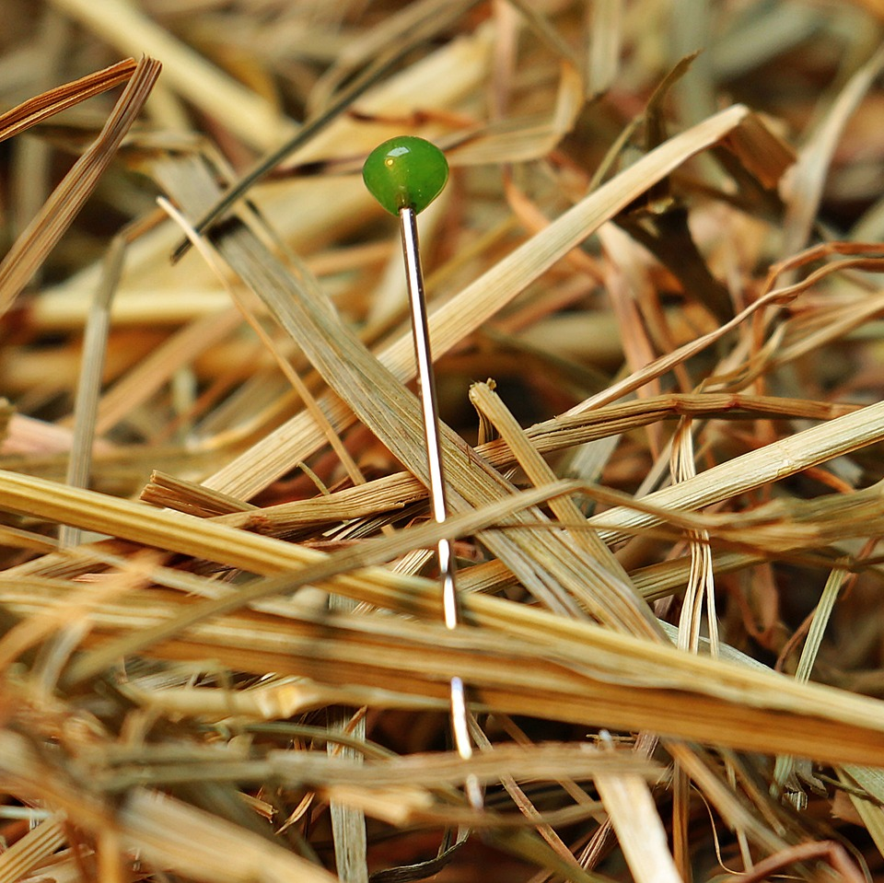
CMSC 28100 Introduction to Complexity Theory Spring 2024 Instructor: William Hoza

Slide 2
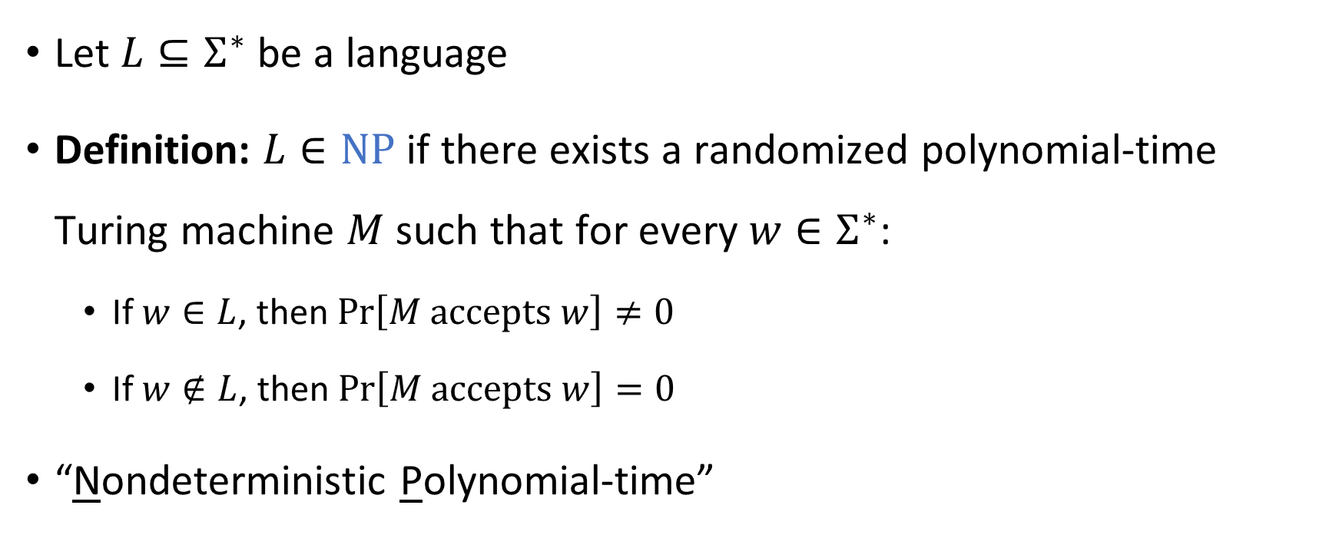

The complexity class $\text{NP}$
Let $L⊆Σ^{∗}$ be a language
Definition: $L∈\text{NP}$ if there exists a randomized polynomial-time Turing machine $M$ such that for every $w∈Σ^{∗}$:
If $w∈L$, then $\operatorname{Pr}\left[M \text{accepts} w\right]≠0$
If $w∉L$, then $\operatorname{Pr}\left[M \text{accepts} w\right]=0$
“Nondeterministic Polynomial-time”

Slide 3
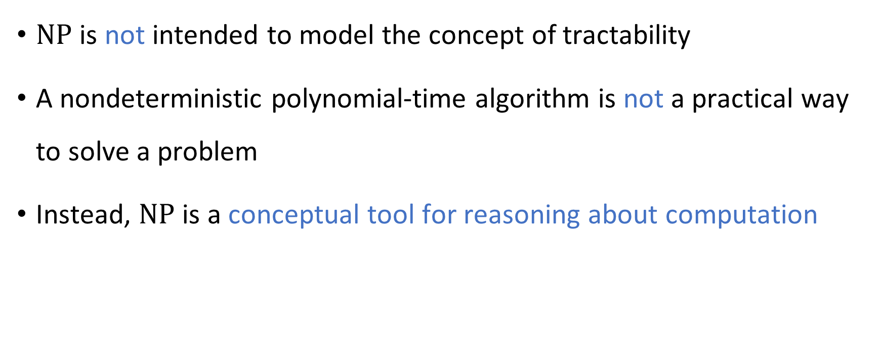

How to interpret $\text{NP}$
$\text{NP}$ is not intended to model the concept of tractability
A nondeterministic polynomial-time algorithm is not a practical way to solve a problem
Instead, $\text{NP}$ is a conceptual tool for reasoning about computation

Slide 4
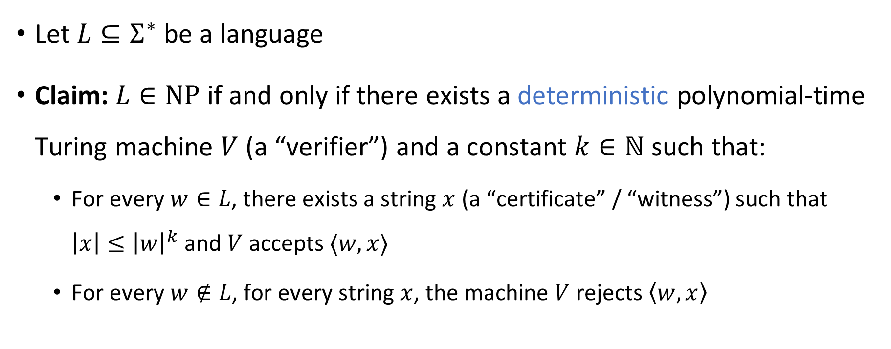
“Verification of certificates” perspective
Let $L⊆Σ^{∗}$ be a language
Claim: $L∈\text{NP}$ if and only if there exists a deterministic polynomial-time Turing machine $V$ (a “verifier”) and a constant $k∈ℕ$ such that:
For every $w∈L$, there exists a string $x$ (a “certificate” / “witness”) such that $\left|x\right|≤{\left|w\right|}^{k}$ and $V$ accepts $⟨w,x⟩$
For every $w∉L$, for every string $x$, the machine $V$ rejects $\left\langle w,x\right\rangle$

Slide 5




The $\text{P}$ vs. $\text{NP}$ problem
$$\text{NP}$$
$$\text{P}$$
$\text{P}⊆\text{NP}$
It is conjectured that $\text{P}≠\text{NP}$, but nobody knows how to prove it

Slide 6
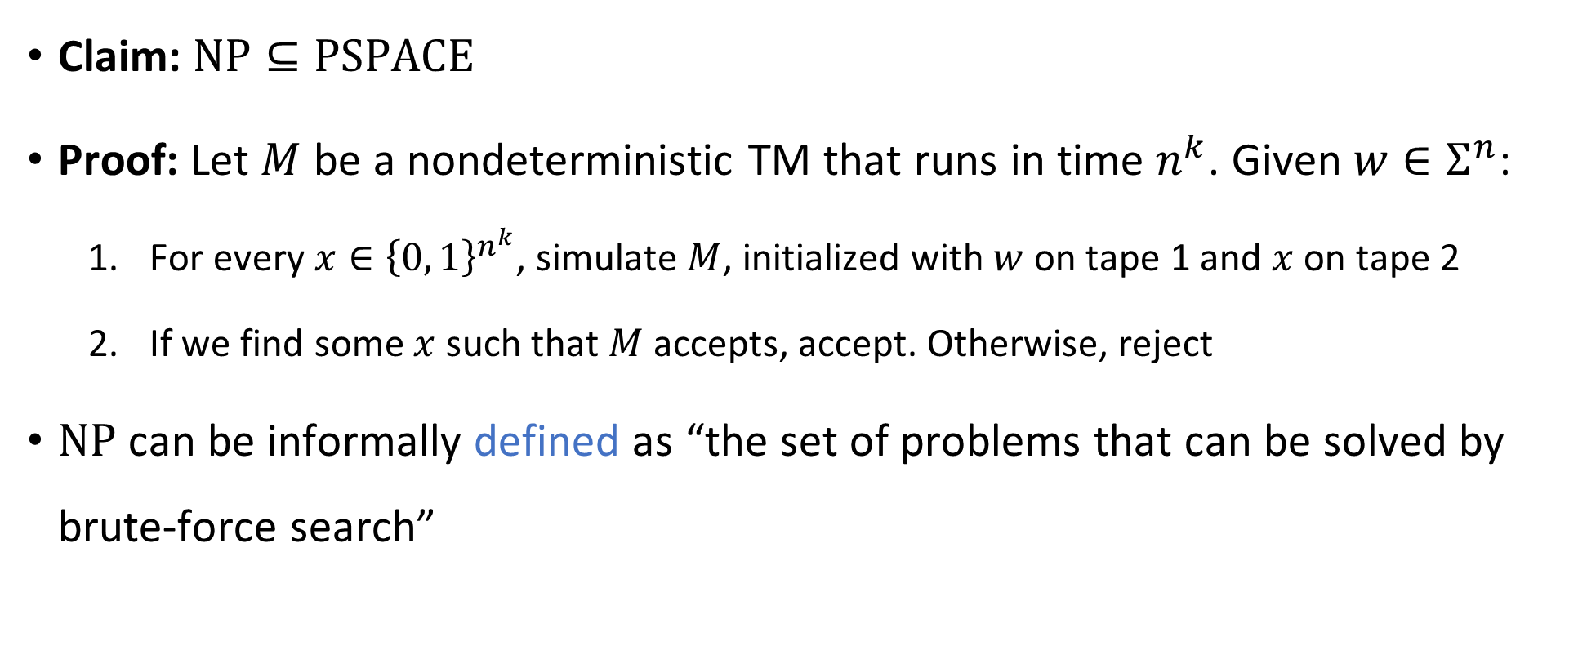

Solving problems in $\text{NP}$ by brute force
Claim: $\text{NP}⊆\text{PSPACE}$
Proof: Let $M$ be a nondeterministic TM that runs in time $n^{k}$. Given $w∈Σ^{n}$:
For every $x∈{\left\{0, 1\right\}}^{n^{k}}$, simulate $M$, initialized with $w$ on tape 1 and $x$ on tape 2
If we find some $x$ such that $M$ accepts, accept. Otherwise, reject
$\text{NP}$ can be informally defined as “the set of problems that can be solved by brute-force search”

Slide 7




$$\text{EXP}$$
$$\text{PSPACE}$$
$$\text{NP}$$
$$\text{P}$$

Slide 8

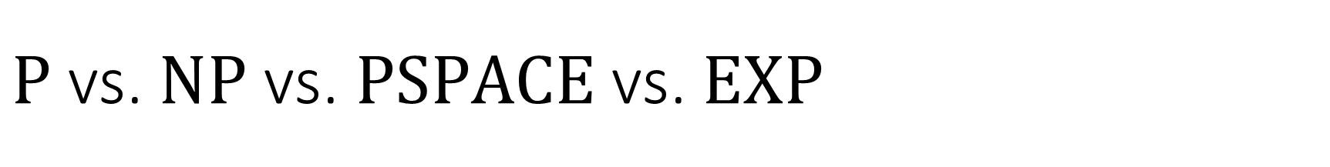
$\text{P}$ vs. $\text{NP}$ vs. $\text{PSPACE}$ vs. $\text{EXP}$
$\text{P}⊆\text{NP}⊆\text{PSPACE}⊆\text{EXP}$
What we expect: All of these containments are strict
What we can prove: At least one of these containments is strict. (Why?)

Slide 9
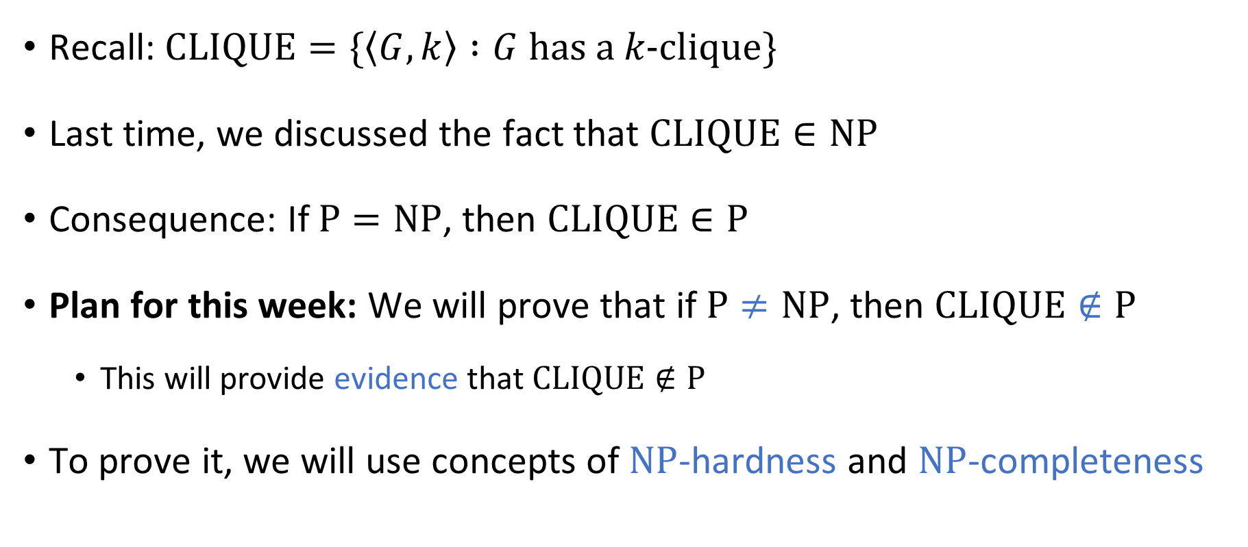

Complexity of $\text{CLIQUE}$
Recall: $\text{CLIQUE}=\{\left\langle G,k\right\rangle :G \text{has} \text{a} k\text{‑}\text{clique}\}$
Last time, we discussed the fact that $\text{CLIQUE}∈\text{NP}$
Consequence: If $\text{P}=\text{NP}$, then $\text{CLIQUE}∈\text{P}$
Plan for this week: We will prove that if $\text{P}≠\text{NP}$, then $\text{CLIQUE}∉\text{P}$
This will provide evidence that $\text{CLIQUE}∉\text{P}$
To prove it, we will use concepts of $\text{NP}$-hardness and $\text{NP}$-completeness

Slide 10
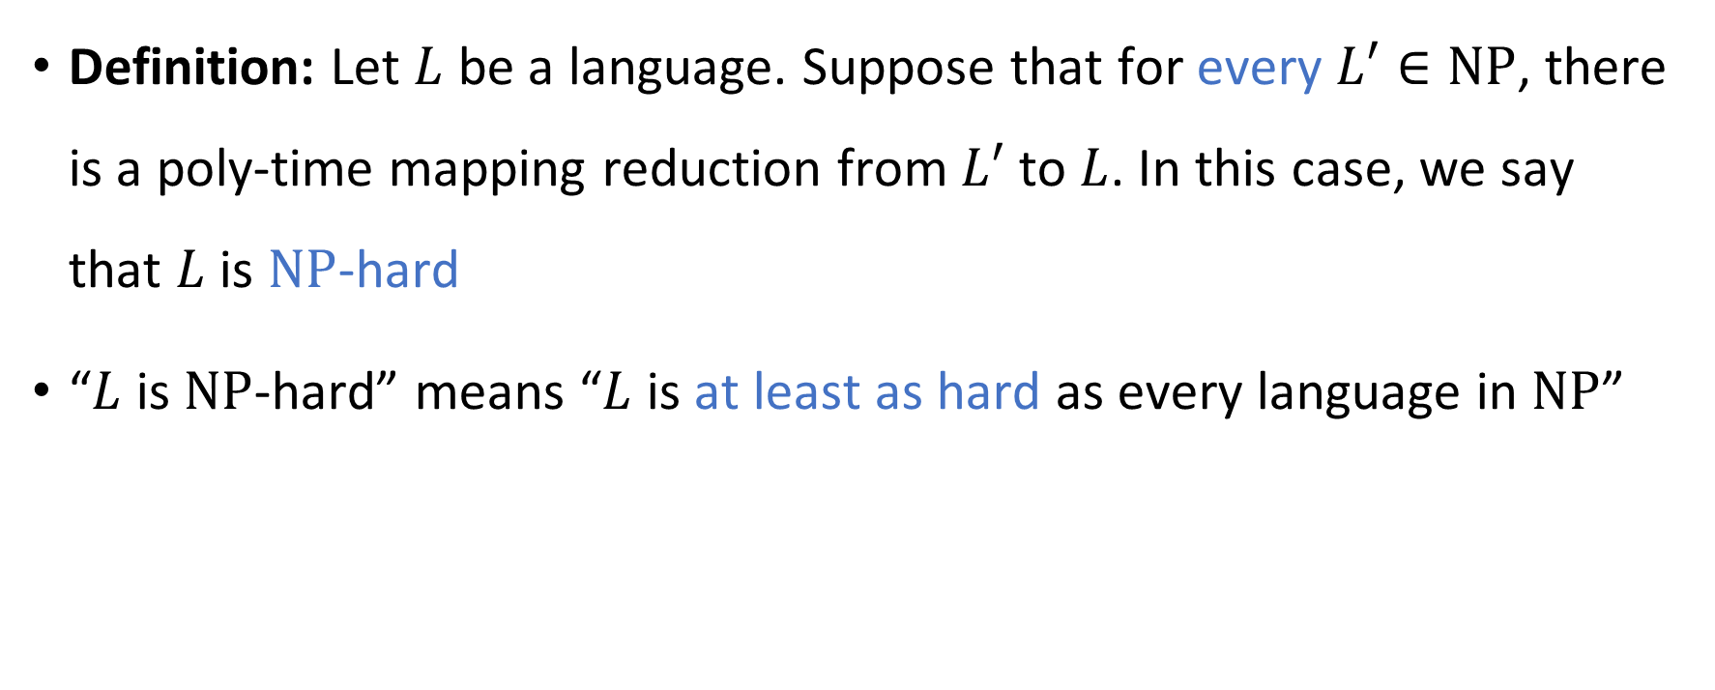
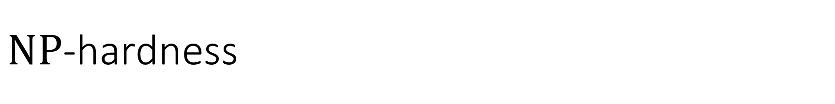
$\text{NP}$-hardness
Definition: Let $L$ be a language. Suppose that for every $L′∈\text{NP}$, there is a poly-time mapping reduction from $L′$ to $L$. In this case, we say that $L$ is $\text{NP}$-hard
“$L$ is $\text{NP}$-hard” means “$L$ is at least as hard as every language in $\text{NP}$”

Slide 11
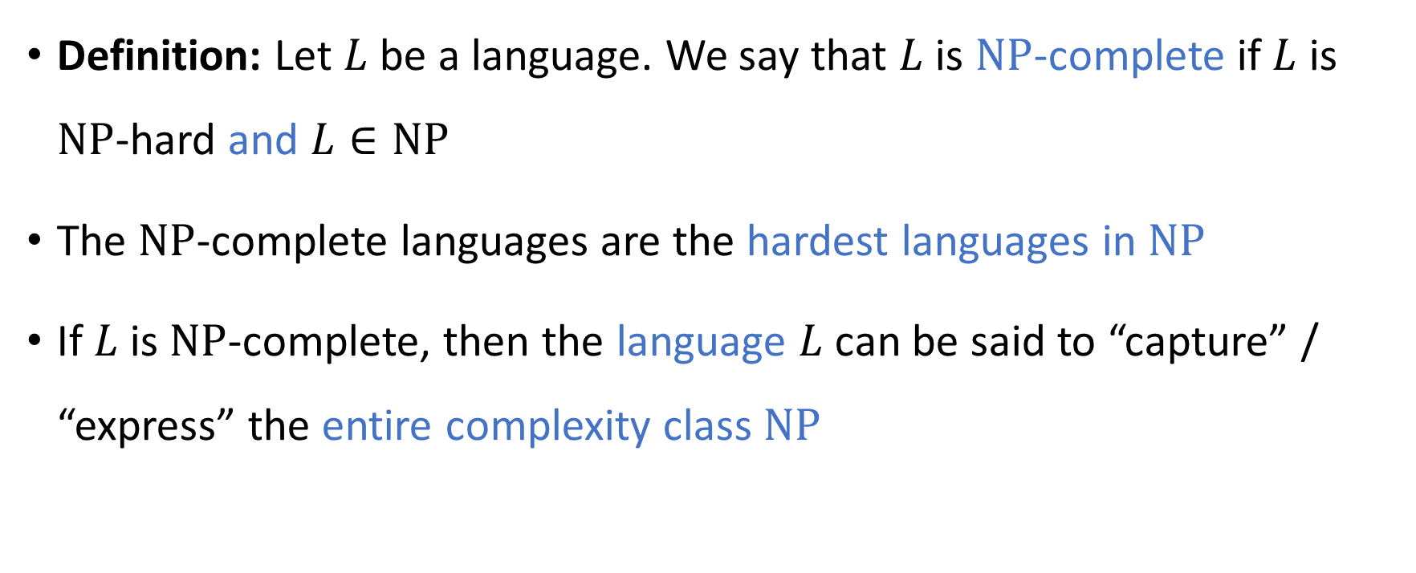
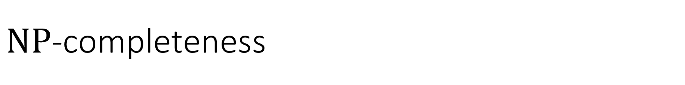
$\text{NP}$-completeness
Definition: Let $L$ be a language. We say that $L$ is $\text{NP}$-complete if $L$ is $\text{NP}$-hard and $L∈\text{NP}$
The $\text{NP}$-complete languages are the hardest languages in $\text{NP}$
If $L$ is $\text{NP}$-complete, then the language $L$ can be said to “capture” / “express” the entire complexity class $\text{NP}$

Slide 12
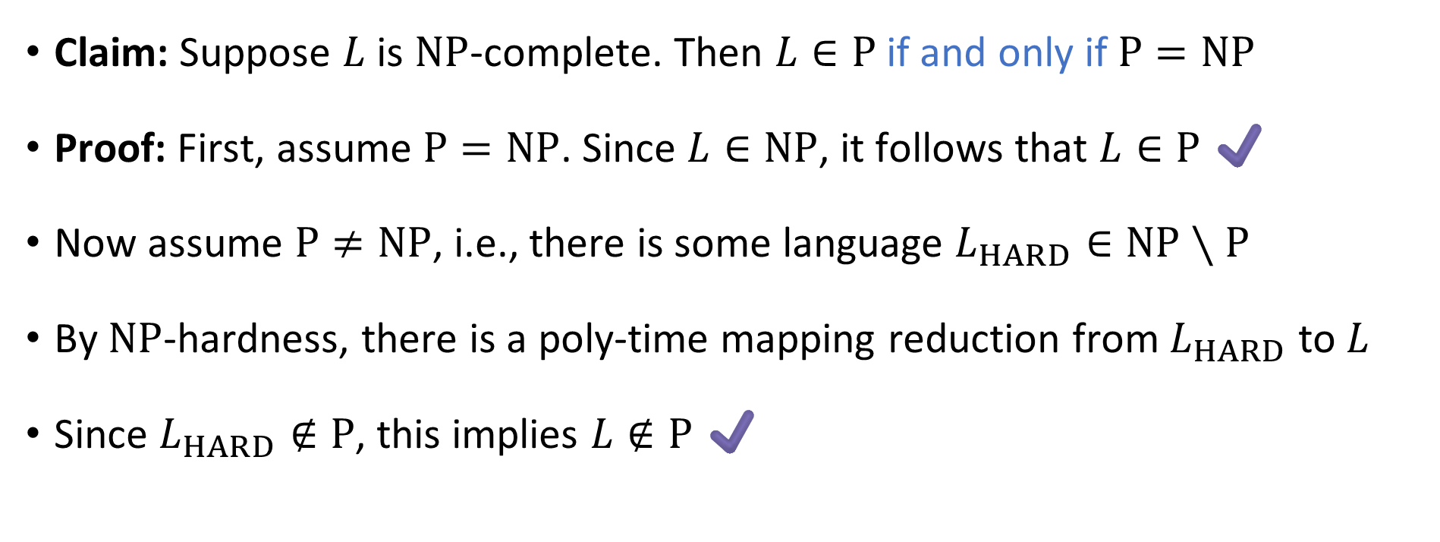

$\text{NP}$-complete languages are probably not in $\text{P}$
Claim: Suppose $L$ is $\text{NP}$-complete. Then $L∈\text{P}$ if and only if $\text{P}=\text{NP}$
Proof: First, assume $\text{P}=\text{NP}$. Since $L∈\text{NP}$, it follows that $L∈\text{P}$ ✔️
Now assume $\text{P}≠\text{NP}$, i.e., there is some language $L_{HARD}∈\text{NP}∖\text{P}$
By $\text{NP}$-hardness, there is a poly-time mapping reduction from $L_{HARD}$ to $L$
Since $L_{HARD}∉\text{P}$, this implies $L∉\text{P}$ ✔️

Slide 13

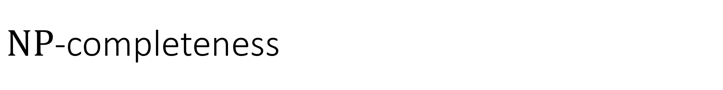



$\text{NP}$-completeness
$\text{NP}$-hard
$\text{NP}$-complete
$$\text{NP}$$
$$\text{P}$$

Slide 14


Proving $\text{NP}$-completeness
How can we prove that a language like $\text{CLIQUE}$ is $\text{NP}$-complete?
How can we use graph theory to simulate Turing machines?
Key idea: Code as Data

Slide 15
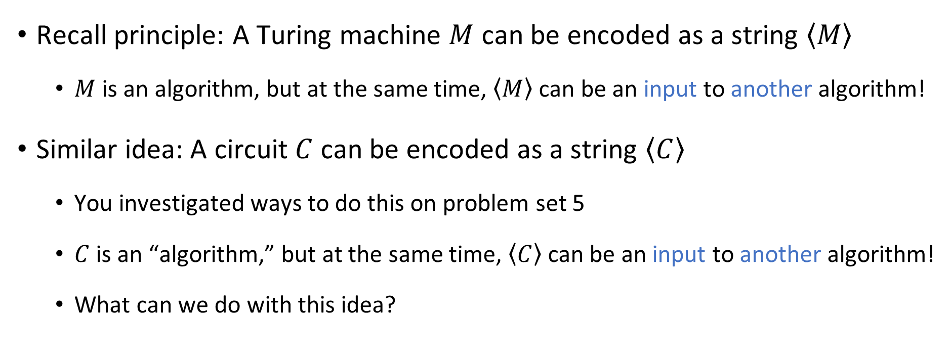
Code as data, revisited
Recall principle: A Turing machine $M$ can be encoded as a string $\left\langle M\right\rangle$
$M$ is an algorithm, but at the same time, $\left\langle M\right\rangle$ can be an input to another algorithm!
Similar idea: A circuit $C$ can be encoded as a string $\left\langle C\right\rangle$
You investigated ways to do this on problem set 5
$C$ is an “algorithm,” but at the same time, $\left\langle C\right\rangle$ can be an input to another algorithm!
What can we do with this idea?

Slide 16
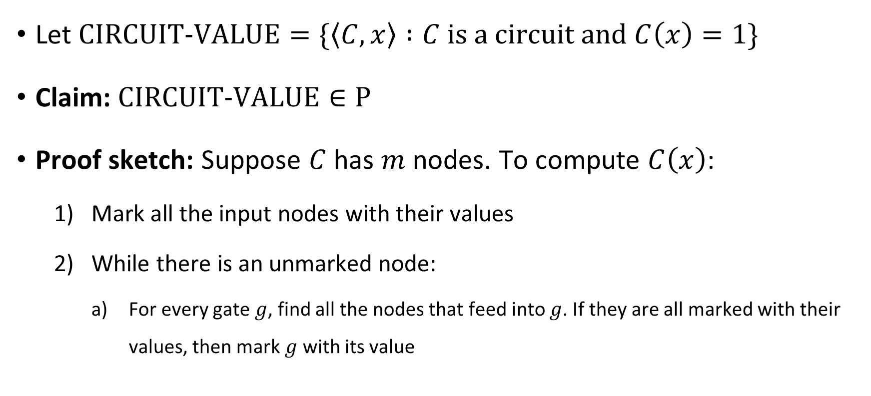
Circuit value problem
Let $\text{CIRCUIT}\text{‑}\text{VALUE}=\{\left\langle C,x\right\rangle :C \text{is} \text{a} \text{circuit} \text{and} C\left(x\right)=1\}$
Claim: $\text{CIRCUIT}\text{‑}\text{VALUE}∈\text{P}$
Proof sketch: Suppose $C$ has $m$ nodes. To compute $C\left(x\right)$:
Mark all the input nodes with their values
While there is an unmarked node:
For every gate $g$, find all the nodes that feed into $g$. If they are all marked with their values, then mark $g$ with its value

Slide 17
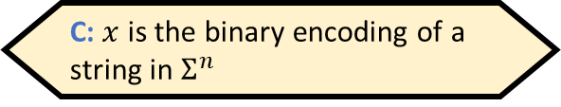
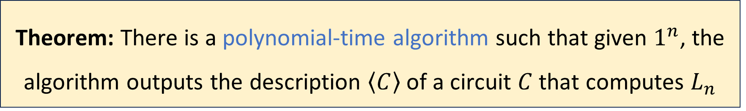
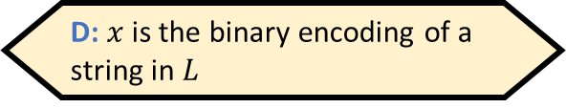

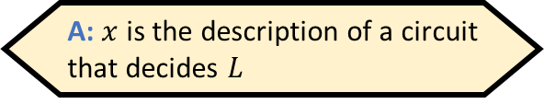
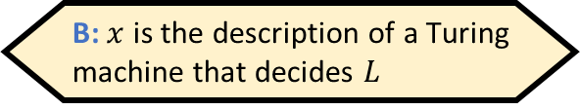
Constructing circuits that implement TMs
Let $x$ be an input to $C$. How should $x$ be interpreted?
A: $x$ is the description of a circuit that decides $L$
B: $x$ is the description of a Turing machine that decides $L$
Let $L∈\text{P}$ where $L⊆Σ^{∗}$
Since $\text{P}⊆\text{PSIZE}$, we know that for every $n$, there exists a polynomial-size circuit that computes $L_{n}$, i.e., it decides $L$ on inputs of length $n$
Proof sketch: Use the circuit construction we used to prove $\text{P}⊆\text{PSIZE}$
C: $x$ is the binary encoding of a string in $Σ^{n}$
D: $x$ is the binary encoding of a string in $L$
Respond at PollEv.com/whoza or text “whoza” to 22333
Theorem: There is a polynomial-time algorithm such that given $1^{n}$, the algorithm outputs the description $\left\langle C\right\rangle$ of a circuit $C$ that computes $L_{n}$

Slide 18














Circuit satisfiability
$$∨$$
$$∧$$
$$∧$$
Satisfiable
$$¬$$
Let $C$ be an $n$-input $1$-output circuit
We say that $C$ is satisfiable if there exists $x∈\{0, 1\}^{n}$ such that $C\left(x\right)=1$
$$x_{1}$$
$$x_{2}$$
$$∨$$
$$∧$$
$$∧$$
$$¬$$
$$¬$$
Unsatisfiable
$$x_{1}$$
$$x_{2}$$

Slide 19
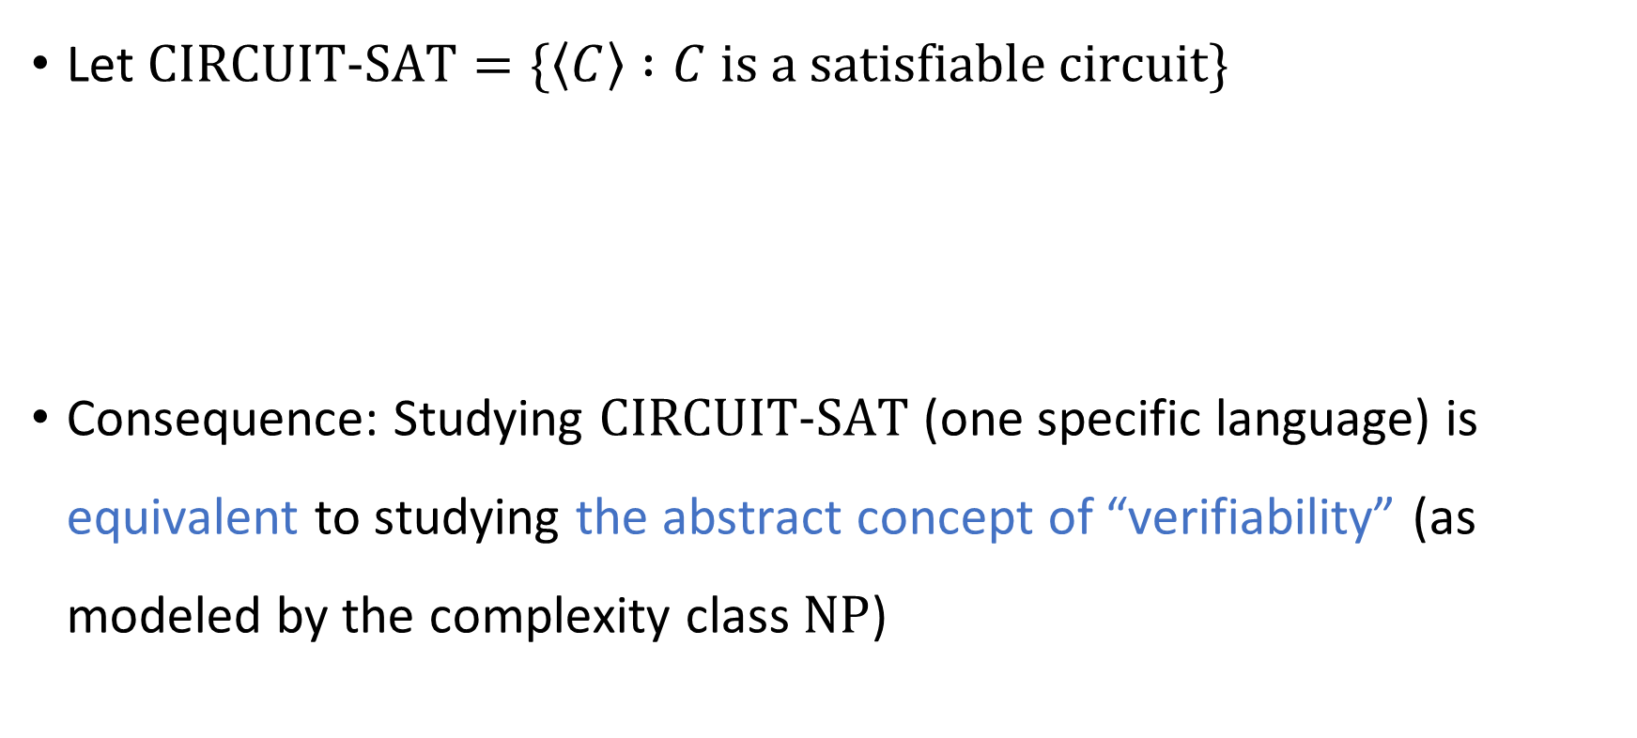


Circuit satisfiability is $\text{NP}$-complete
Let $\text{CIRCUIT}\text{‑}\text{SAT}=\{\left\langle C\right\rangle :C \text{is} \text{a} \text{satisfiable} \text{circuit}\}$
Consequence: Studying $\text{CIRCUIT}\text{‑}\text{SAT}$ (one specific language) is equivalent to studying the abstract concept of “verifiability” (as modeled by the complexity class $\text{NP}$)
Theorem: $\text{CIRCUIT}\text{‑}\text{SAT}$ is $\text{NP}$-complete.

Slide 20
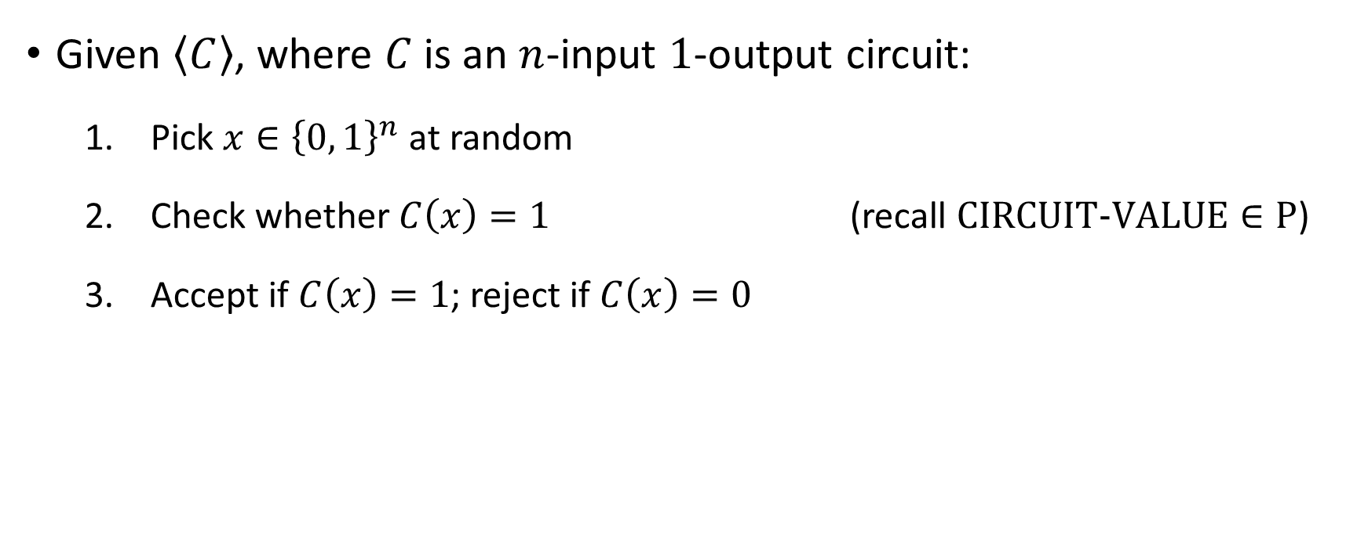

Proof that $\text{CIRCUIT}\text{‑}\text{SAT}∈\text{NP}$
Given $\left\langle C\right\rangle$, where $C$ is an $n$-input $1$-output circuit:
Pick $x∈{\left\{0, 1\right\}}^{n}$ at random
Check whether $C\left(x\right)=1$ (recall $\text{CIRCUIT}\text{‑}\text{VALUE}∈\text{P}$)
Accept if $C\left(x\right)=1$; reject if $C\left(x\right)=0$

Slide 21


Proof that $\text{CIRCUIT}\text{‑}\text{SAT}$ is $\text{NP}$-hard
Let $L$ be any language in $\text{NP}$
Our job: Design a mapping reduction from $L$ to $\text{CIRCUIT}\text{‑}\text{SAT}$

