Slide 1
CMSC 28100
Introduction to Complexity Theory
Autumn 2025
Instructor: William Hoza
⏳

Slide 2
Which problems can be solved through computation?

Slide 3
Complexity theory:
The study of computational resources

Slide 4

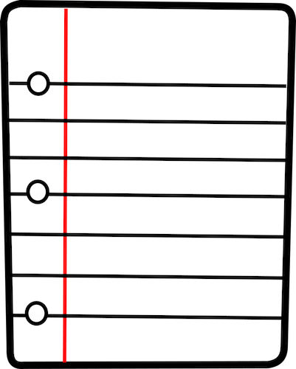





Computational resources: Fuel for algorithms
TIME
SPACE
RANDOMNESS
ADVICE
QUANTUM PHYSICS
COMMUNICATION

Slide 5


$\text{P}$ vs. $\text{NP}$ vs. $\text{PSPACE}$ vs. $\text{EXP}$
$\text{P}⊆\text{NP}⊆\text{PSPACE}⊆\text{EXP}$
What we expect: All of these containments are strict
What we can prove: At least one of these containments is strict. (Why?)

Slide 6

Sublinear-space computation
Can we solve any interesting problems using $o\left(n\right)$ space?
The one-tape Turing machine is the not the right model of computation for studying sublinear-space algorithms

Slide 7




Sublinear-space computation
Read-only input tape ➡
$$⊔$$
1
1
1
0
$$⊔$$
$$⊔$$
Read-write work tape ➡
$$⊔$$
1
0
#
1
$
0

Slide 8
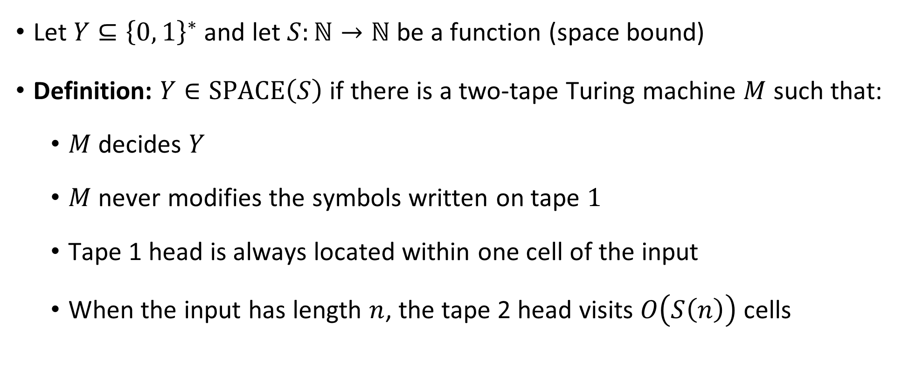

The complexity class $\text{SPACE}\left(S\right)$
Let $Y⊆{\left\{0, 1\right\}}^{∗}$ and let $S:ℕ→ℕ$ be a function (space bound)
Definition: $Y∈\text{SPACE}\left(S\right)$ if there is a two-tape Turing machine $M$ such that:
  $M$ decides $Y$
  $M$ never modifies the symbols written on tape $1$
  Tape 1 head is always located within one cell of the input
  When the input has length $n$, the tape 2 head visits $O\left(S\left(n\right)\right)$ cells

Slide 9



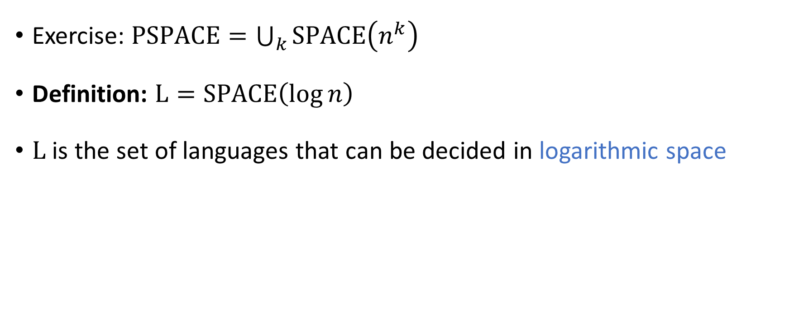

The complexity class $\text{L}$
Exercise: $\text{PSPACE}=\bigcup_{k}{\text{SPACE}\left(n^{k}\right)}$
Definition: $\text{L}=\text{SPACE}\left(\log{n}\right)$
$\text{L}$ is the set of languages that can be decided in logarithmic space

Slide 10
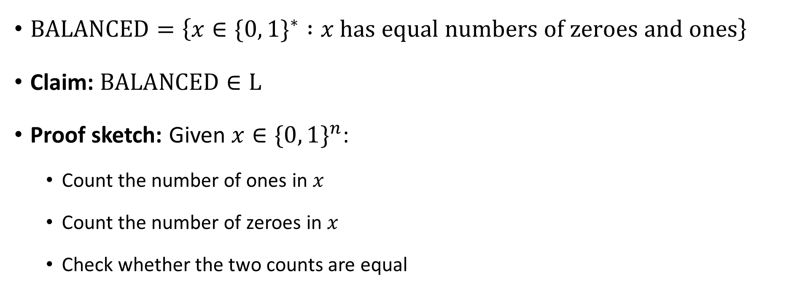

Example: Balanced binary strings
$\text{BALANCED}=\left\{x∈\{0, 1\}^{∗} :x \text{has} \text{equal} \text{numbers} \text{of} \text{zeroes} \text{and} \text{ones}\right\}$
Claim: $\text{BALANCED}∈\text{L}$
Proof sketch: Given $x∈\{0, 1\}^{n}$:
  Count the number of ones in $x$
  Count the number of zeroes in $x$
  Check whether the two counts are equal
These counters are only $\log{n}$ bits each!

Slide 11


$\text{L}⊆\text{P}$
Exercise: Show that $\text{L}⊆\text{P}$
(Similar to the proof that $\text{PSPACE}⊆\text{EXP}$)

Slide 12





$$\text{EXP}$$
$$\text{PSPACE}$$
$$\text{NP}$$
$$\text{P}$$
$$\text{L}$$

Slide 13


The $\text{L}$ vs. $\text{P}$ problem
We expect that $\text{L}≠\text{P}$, but we don’t know how to prove it
$\text{L}=\text{P}$ would mean that every efficient algorithm can be modified so that it only uses a tiny amount of work space

Slide 14
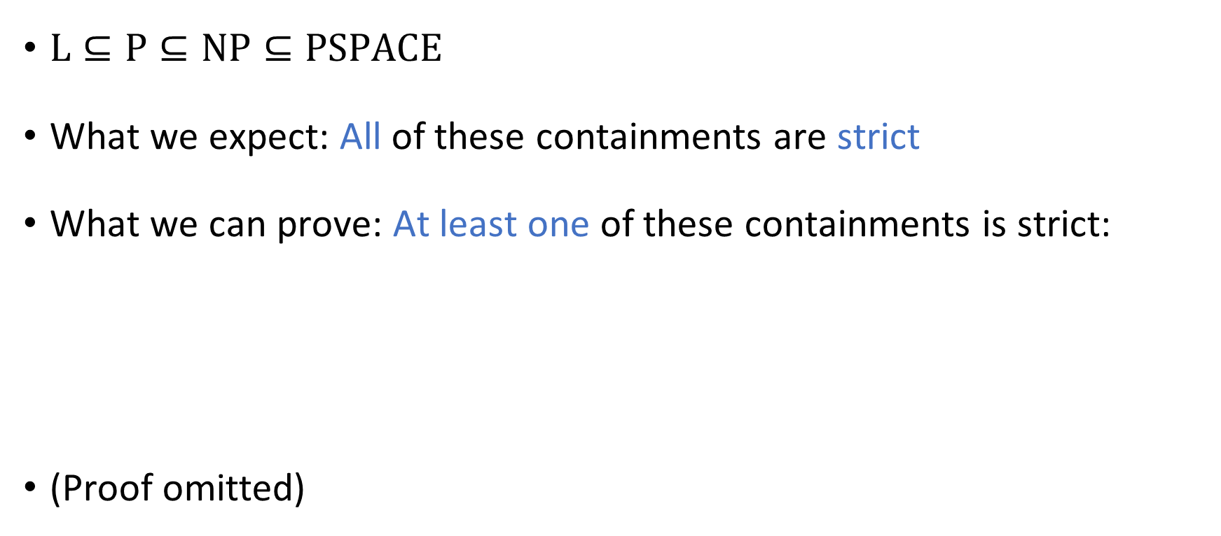
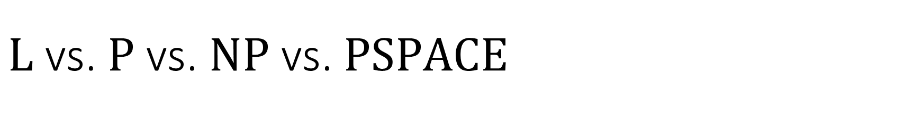

$\text{L}$ vs. $\text{P}$ vs. $\text{NP}$ vs. $\text{PSPACE}$
$\text{L}⊆\text{P}⊆\text{NP}⊆\text{PSPACE}$
What we expect: All of these containments are strict
What we can prove: At least one of these containments is strict:
(Proof omitted)
Theorem: $\text{L}≠\text{PSPACE}$

Slide 15


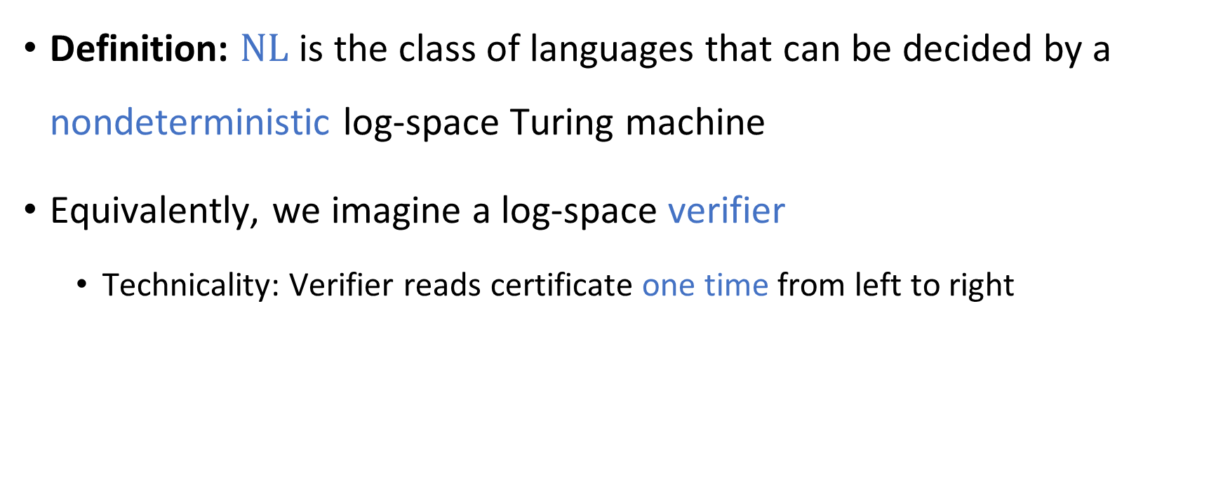
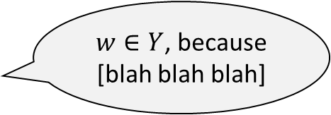
Nondeterministic log space computation
Definition: $\text{NL}$ is the class of languages that can be decided by a nondeterministic log-space Turing machine
Equivalently, we imagine a log-space verifier
  Technicality: Verifier reads certificate one time from left to right
$w∈Y$, because
[blah blah blah]
Accept/Reject

Slide 16
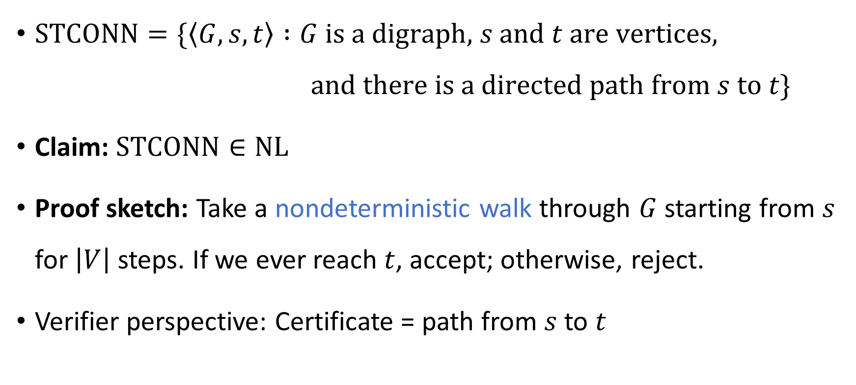

The $s$-$t$ connectivity problem
$\text{STCONN}=\{\left\langle G,s,t\right\rangle :G \text{is} \text{a} \text{digraph}\text{,} s \text{and} t \text{are} \text{vertices}\text{,}$
$\text{and} \text{there} \text{is} \text{a} \text{directed} \text{path} \text{from} s \text{to} t\}$
Claim: $\text{STCONN}∈\text{NL}$
Proof sketch: Take a nondeterministic walk through $G$ starting from $s$ for $\left|V\right|$ steps. If we ever reach $t$, accept; otherwise, reject.
Verifier perspective: Certificate = path from $s$ to $t$

Slide 17



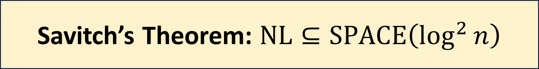
Two surprises about $\text{NL}$
We expect that $\text{P}≠\text{NP}$. In contrast:
We expect that $\text{NP}≠\text{coNP}$. In contrast:
Savitch’s Theorem: $\text{NL}⊆\text{SPACE}\left(\log^{2}{n}\right)$
Immerman-Szelepcsényi Theorem: $\text{NL}=\text{coNL}$

Slide 18

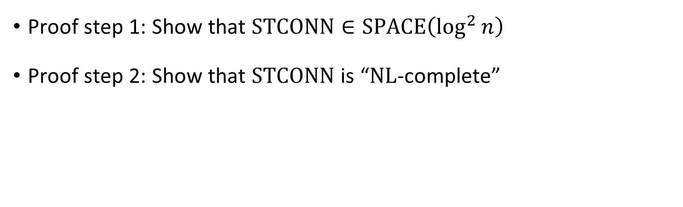
Proof of Savitch’s theorem
Savitch’s Theorem: $\text{NL}⊆\text{SPACE}\left(\log^{2}{n}\right)$
Proof step 1: Show that $\text{STCONN}∈\text{SPACE}\left(\log^{2}{n}\right)$
Proof step 2: Show that $\text{STCONN}$ is “$\text{NL}$-complete”

Slide 19
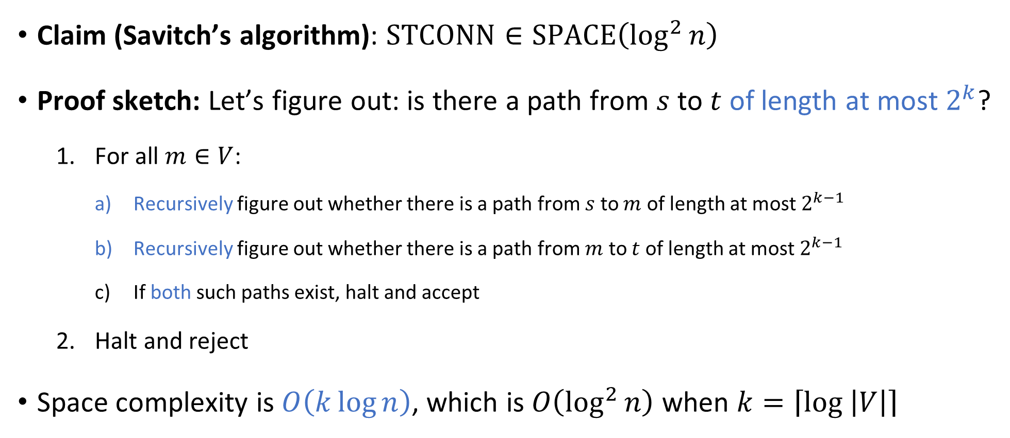
Savitch’s algorithm
Claim (Savitch’s algorithm): $\text{STCONN}∈\text{SPACE}\left(\log^{2}{n}\right)$
Proof sketch: Let’s figure out: is there a path from $s$ to $t$ of length at most $2^{k}$?
  For all $m∈V$:
    Recursively figure out whether there is a path from $s$ to $m$ of length at most $2^{k−1}$
    Recursively figure out whether there is a path from $m$ to $t$ of length at most $2^{k−1}$
    If both such paths exist, halt and accept
  Halt and reject
Space complexity is $O\left(k\log{n}\right)$, which is $O\left(\log^{2}{n}\right)$ when $k=\left\lceil \log\left|V\right|\right\rceil$

Slide 20
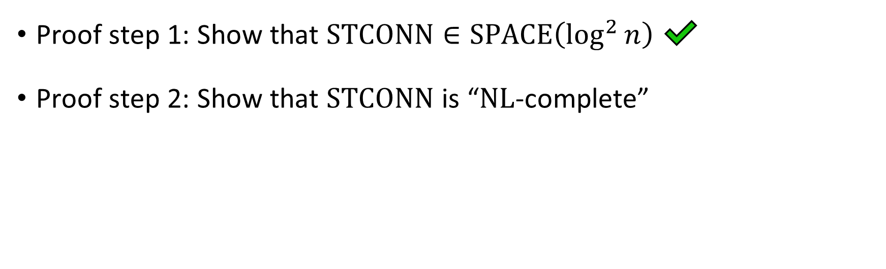
Proof of Savitch’s theorem
Savitch’s Theorem: $\text{NL}⊆\text{SPACE}\left(\log^{2}{n}\right)$
Proof step 1: Show that $\text{STCONN}∈\text{SPACE}\left(\log^{2}{n}\right)$ ✔️
Proof step 2: Show that $\text{STCONN}$ is “$\text{NL}$-complete”

Slide 21
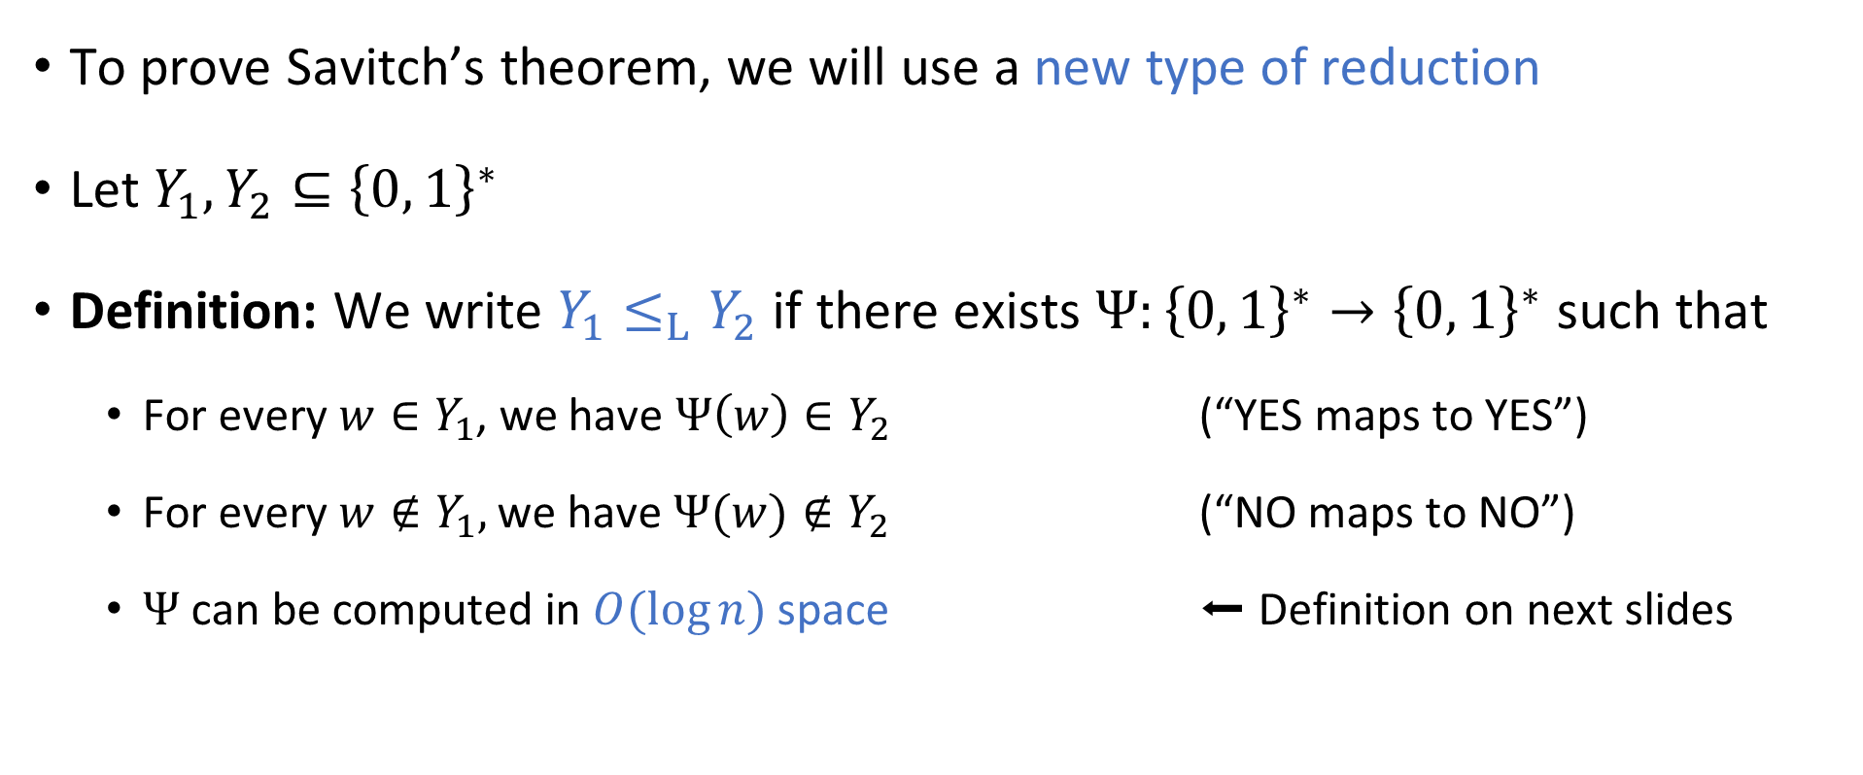
Log-space reductions
To prove Savitch’s theorem, we will use a new type of reduction
Let $Y_{1},Y_{2}⊆{\left\{0, 1\right\}}^{∗}$
Definition: We write $Y_{1}≤_{L}Y_{2}$ if there exists $Ψ:{\left\{0, 1\right\}}^{∗}→{\left\{0, 1\right\}}^{∗}$ such that
  For every $w∈Y_{1}$, we have $Ψ\left(w\right)∈Y_{2}$ (“YES maps to YES”)
  For every $w∉Y_{1},$ we have $Ψ(w)∉Y_{2}$ (“NO maps to NO”)
  $Ψ$ can be computed in $O(\log{n})$ space ⬅ Definition on next slides

Slide 22






Space-bounded “transducer”
Read-only input tape ➡
$$⊔$$
1
1
1
0
$$⊔$$
$$⊔$$
Read-write work tape ➡
$$⊔$$
1
$
1
#
$$⊔$$
$$⊔$$
Write-only output tape ➡
$$⊔$$
1
1
1
0
0
1

Slide 23
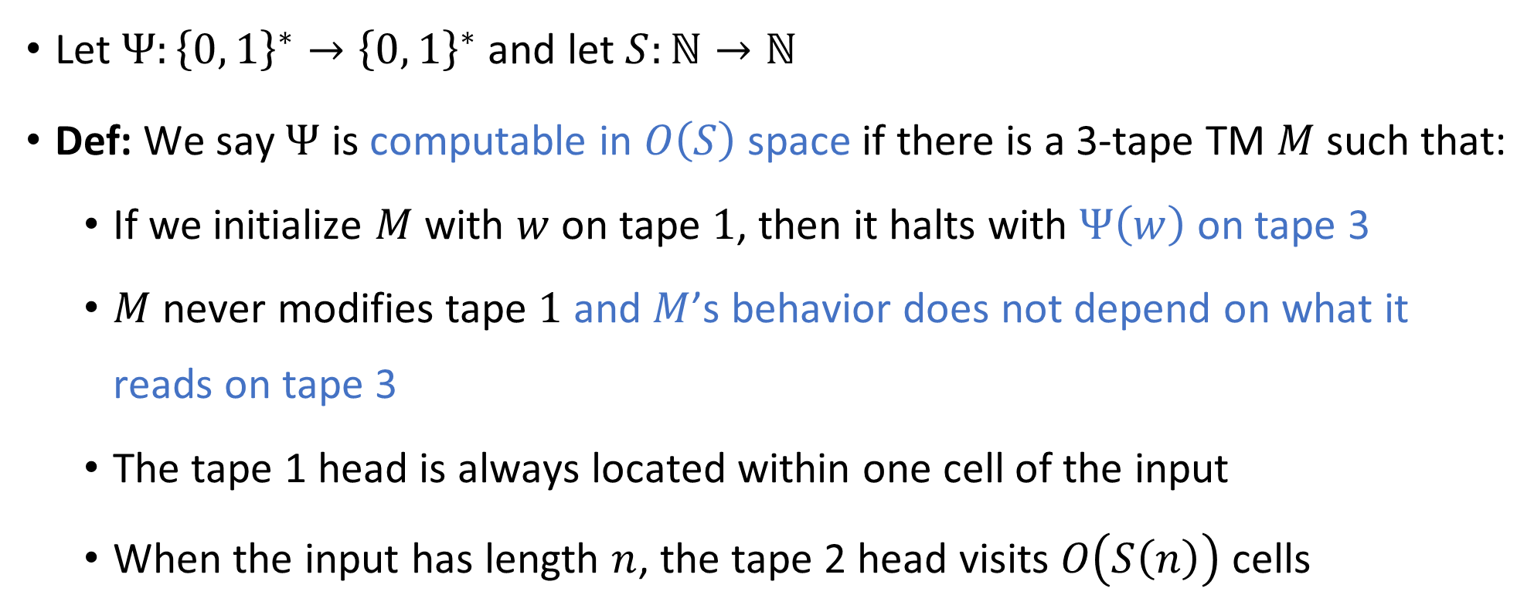
Space complexity for string-valued functions
Let $Ψ:{\left\{0, 1\right\}}^{∗}→{\left\{0, 1\right\}}^{∗}$ and let $S:ℕ→ℕ$
Def: We say $Ψ$ is computable in $O\left(S\right)$ space if there is a 3-tape TM $M$ such that:
  If we initialize $M$ with $w$ on tape $1$, then it halts with $Ψ\left(w\right)$ on tape 3
  $M$ never modifies tape $1$ and $M$’s behavior does not depend on what it reads on tape 3
  The tape 1 head is always located within one cell of the input
  When the input has length $n$, the tape 2 head visits $O\left(S\left(n\right)\right)$ cells

Slide 24


$\text{NL}$-completeness
Let $Y⊆{\left\{0, 1\right\}}^{∗}$
Definition: We say that $Y$ is $\text{NL}$-complete if $Y∈\text{NL}$ and for every $Z∈\text{NL}$, we have $Z≤_{L}Y$

Slide 25
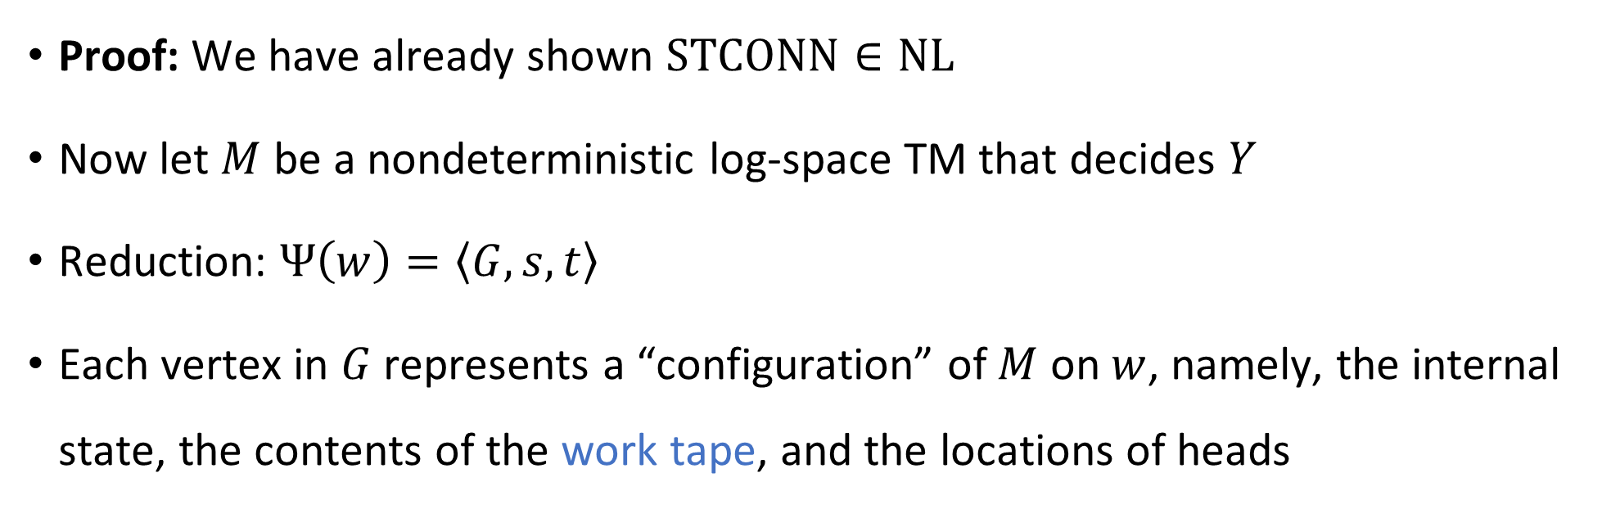


$\text{STCONN}$ is $\text{NL}$-complete
Theorem: $\text{STCONN}$ is $\text{NL}$-complete
Proof: We have already shown $\text{STCONN}∈\text{NL}$
Now let $M$ be a nondeterministic log-space TM that decides $Y$
Reduction: $Ψ\left(w\right)=\left\langle G,s,t\right\rangle$
Each vertex in $G$ represents a “configuration” of $M$ on $w$, namely, the internal state, the contents of the work tape, and the locations of heads

Slide 26
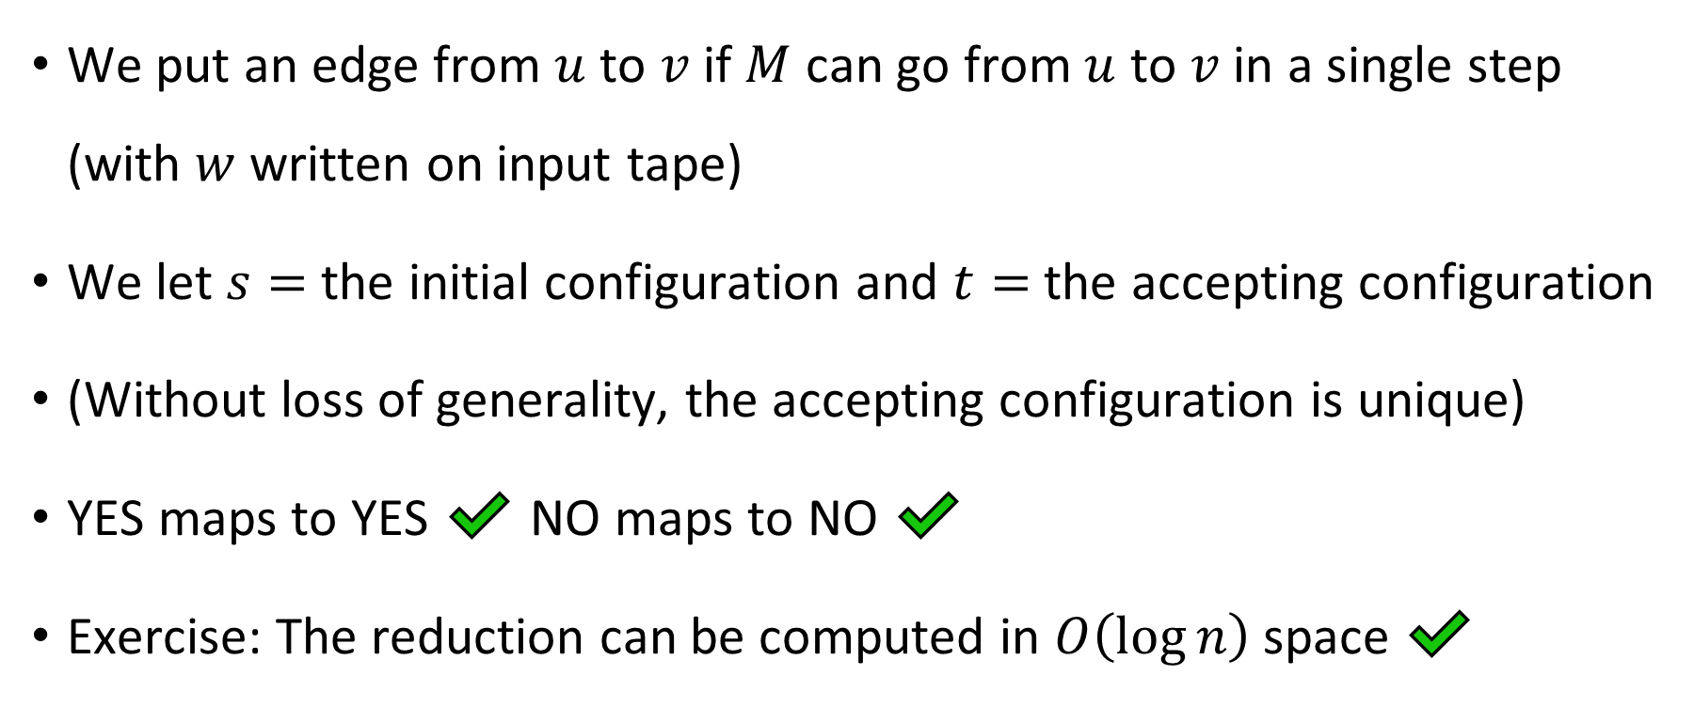

$\text{STCONN}$ is $\text{NL}$-complete
We put an edge from $u$ to $v$ if $M$ can go from $u$ to $v$ in a single step (with $w$ written on input tape)
We let $s=$ the initial configuration and $t=$ the accepting configuration
(Without loss of generality, the accepting configuration is unique)
YES maps to YES ✔️ NO maps to NO ✔️
Exercise: The reduction can be computed in $O\left(\log{n}\right)$ space ✔️

Slide 27
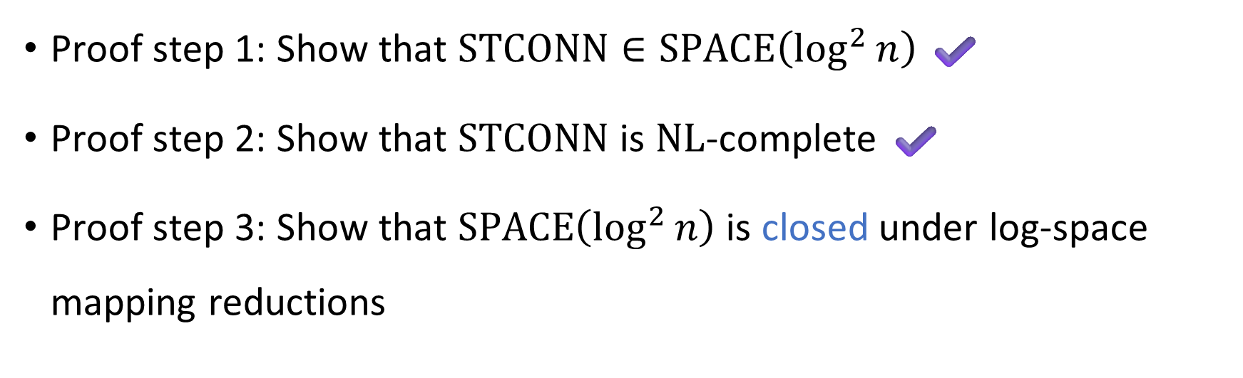
Proof of Savitch’s theorem
Savitch’s Theorem: $\text{NL}⊆\text{SPACE}\left(\log^{2}{n}\right)$
Proof step 1: Show that $\text{STCONN}∈\text{SPACE}\left(\log^{2}{n}\right)$ ✔️
Proof step 2: Show that $\text{STCONN}$ is $\text{NL}$-complete ✔️
Proof step 3: Show that $\text{SPACE}\left(\log^{2}{n}\right)$ is closed under log-space mapping reductions

