Slide 1

CMSC 28100 Introduction to Complexity Theory Spring 2024 Instructor: William Hoza

Slide 2
Which problems can be solved through computation?

Slide 3






Randomized Turing machines
Input tape ➡
$$♢$$
1
1
0
$$⊔$$
$$⊔$$
Randomness tape ➡
$$♢$$

Slide 4
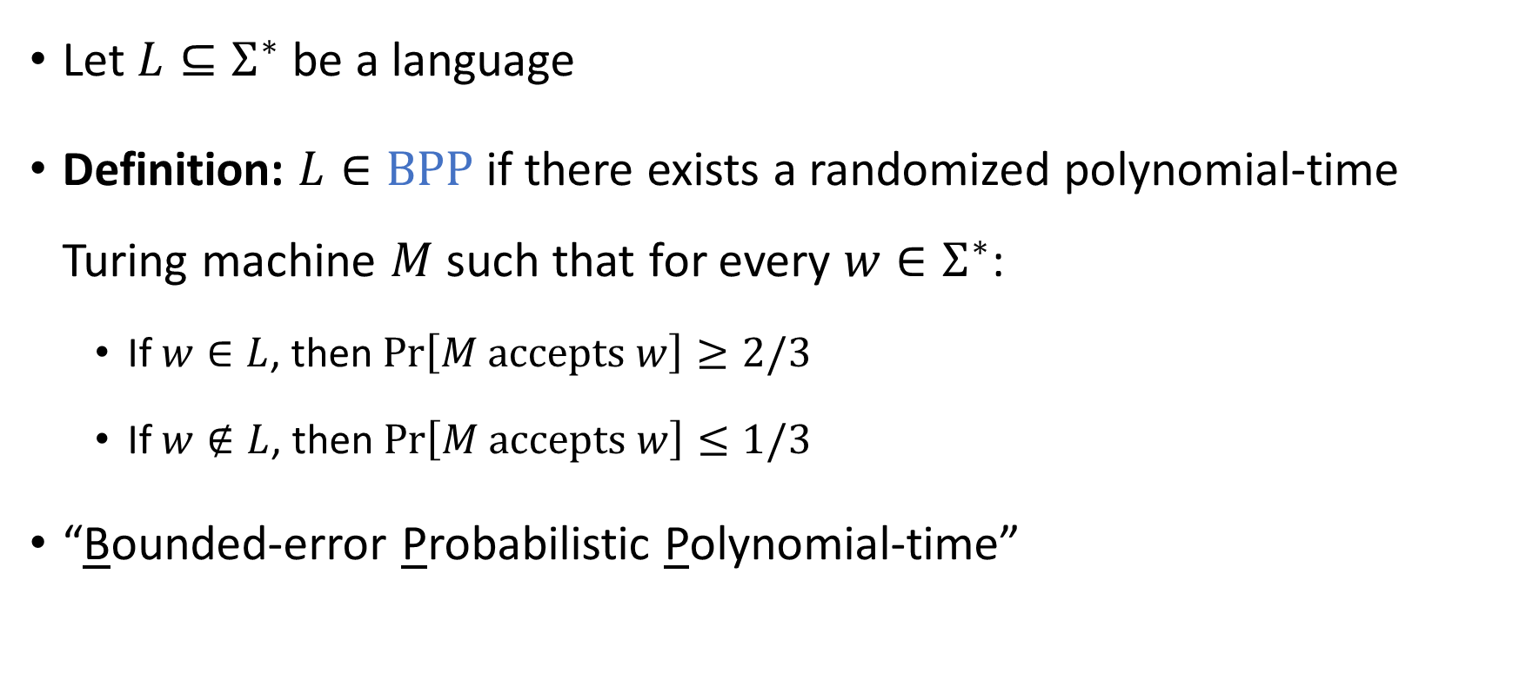

The complexity class $\text{BPP}$
Let $L⊆Σ^{∗}$ be a language
Definition: $L∈\text{BPP}$ if there exists a randomized polynomial-time Turing machine $M$ such that for every $w∈Σ^{∗}$:
If $w∈L$, then $\operatorname{Pr}\left[M \text{accepts} w\right]≥2/3$
If $w∉L$, then $\operatorname{Pr}\left[M \text{accepts} w\right]≤1/3$
“Bounded-error Probabilistic Polynomial-time”

Slide 5
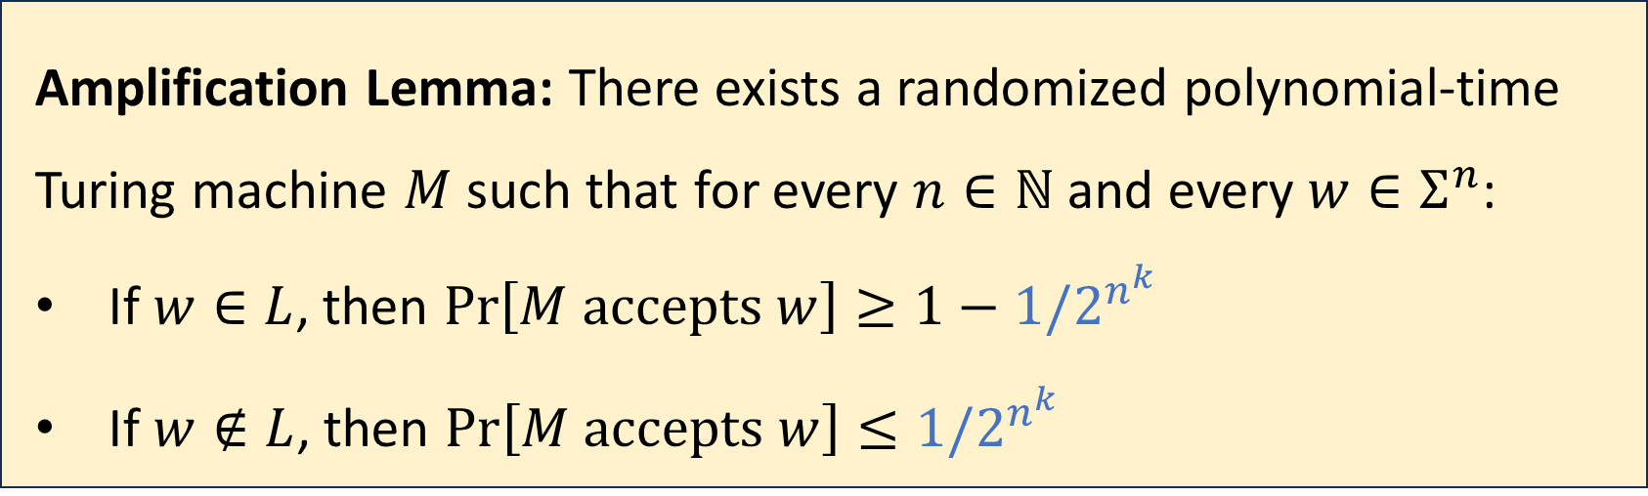

Amplification lemma
Let $L∈\text{BPP}$, and let $k∈ℕ$ be any constant
As $n→∞$, the error probability goes to $0$ extremely rapidly!
Amplification Lemma: There exists a randomized polynomial-time Turing machine $M$ such that for every $n∈ℕ$ and every $w∈Σ^{n}$:
If $w∈L$, then $\operatorname{Pr}\left[M \text{accepts} w\right]≥1−1/2^{n^{k}}$
If $w∉L$, then $\operatorname{Pr}\left[M \text{accepts} w\right]≤{1/2}^{n^{k}}$

Slide 6
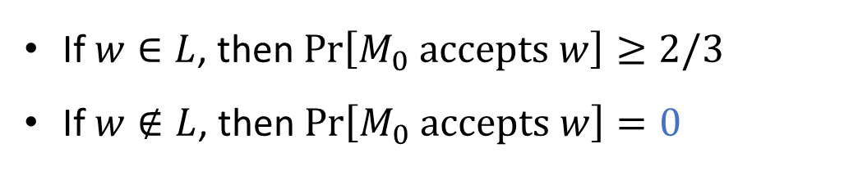
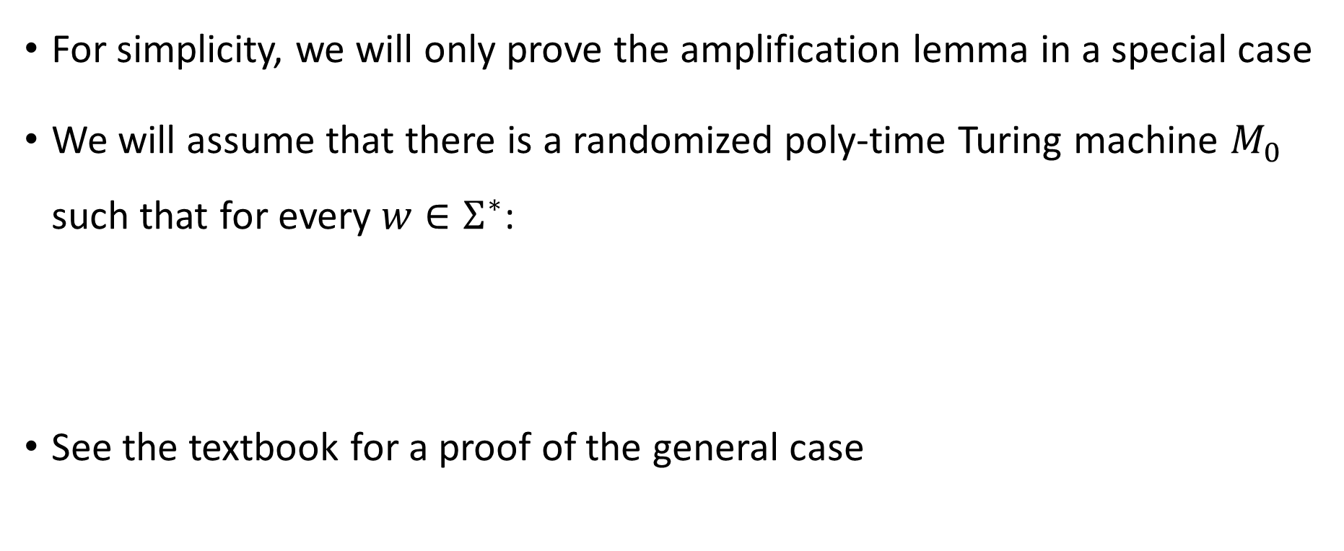
Proof of the amplification lemma
For simplicity, we will only prove the amplification lemma in a special case
We will assume that there is a randomized poly-time Turing machine $M_{0}$ such that for every $w∈Σ^{∗}$:
See the textbook for a proof of the general case
If $w∈L$, then $\operatorname{Pr}\left[M_{0} \text{accepts} w\right]≥2/3$
If $w∉L$, then $\operatorname{Pr}\left[M_{0} \text{accepts} w\right]=0$
⬅️ No false positives!

Slide 7


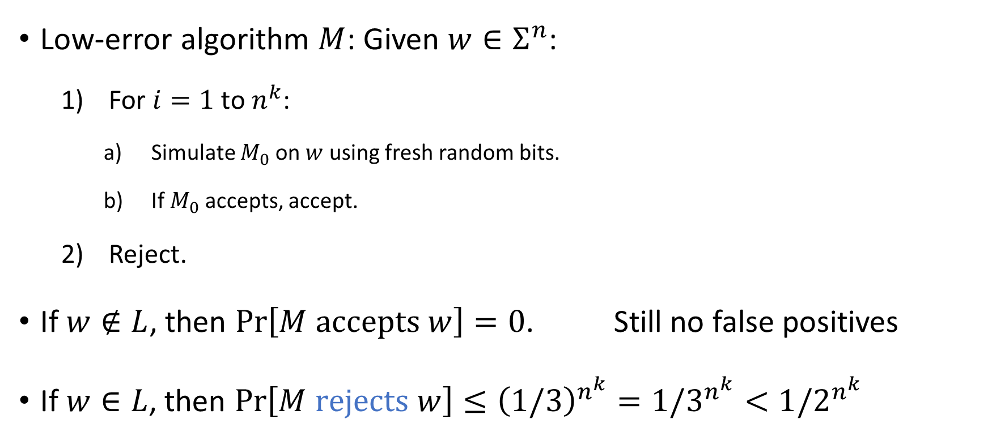



Proof of the amplification lemma
If $w∈L$, then $\operatorname{Pr}\left[M_{0} \text{accepts} w\right]≥2/3$
If $w∉L$, then $\operatorname{Pr}\left[M_{0} \text{accepts} w\right]=0$
If $M_{0}$ uses $R(n)$ many random bits, then how many random bits does $M$ use?
A: $R\left(n\right)+n^{k}$
B: $R(n)⋅n^{k}$
C: $R{\left(n\right)}^{k}$
D: Not enough information
Low-error algorithm $M$: Given $w∈Σ^{n}$:
For $i=1$ to $n^{k}$:
Simulate $M_{0}$ on $w$ using fresh random bits.
If $M_{0}$ accepts, accept.
Reject.
If $w∉L$, then $\operatorname{Pr}\left[M \text{accepts} w\right]=0$. Still no false positives
If $w∈L$, then $\operatorname{Pr}\left[M \text{rejects} w\right]≤{\left(1/3\right)}^{n^{k}}=1/3^{n^{k}}<1/2^{n^{k}}$
Respond at PollEv.com/whoza or text “whoza” to 22333
Polynomial time

Slide 8
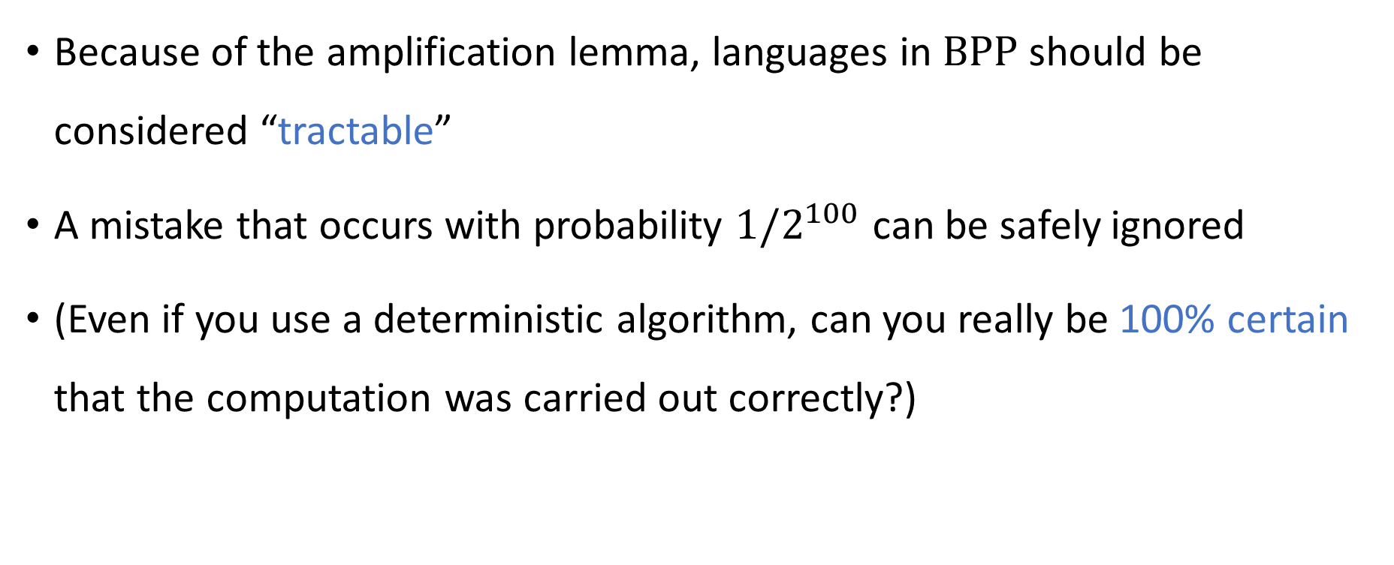

$\text{BPP}$ as a model of tractability
Because of the amplification lemma, languages in $\text{BPP}$ should be considered “tractable”
A mistake that occurs with probability $1/2^{100}$ can be safely ignored
(Even if you use a deterministic algorithm, can you really be 100% certain that the computation was carried out correctly?)

Slide 9
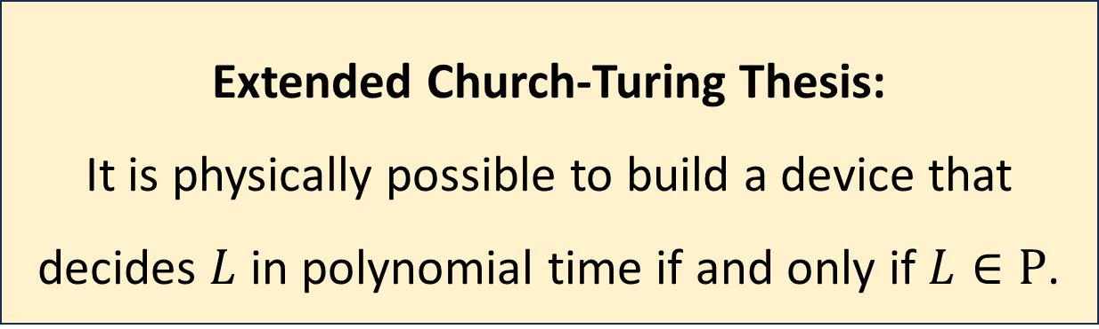

Extended Church-Turing Thesis
Let $L$ be a language
Does the $\text{BPP}$ model disprove the extended Church-Turing thesis?
Extended Church-Turing Thesis:
It is physically possible to build a device that decides $L$ in polynomial time if and only if $L∈\text{P}$.

Slide 10
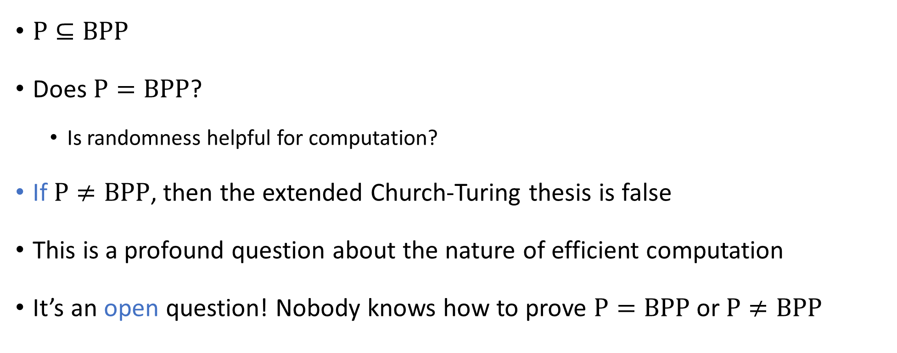
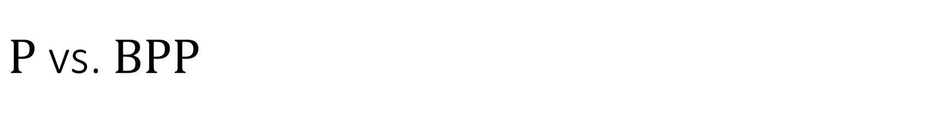


$\text{P}$ vs. $\text{BPP}$
$$\text{BPP}$$
$\text{P}⊆\text{BPP}$
Does $\text{P}=\text{BPP}$?
Is randomness helpful for computation?
If $\text{P}≠\text{BPP}$, then the extended Church-Turing thesis is false
This is a profound question about the nature of efficient computation
It’s an open question! Nobody knows how to prove $\text{P}=\text{BPP}$ or $\text{P}≠\text{BPP}$
$$\text{P}$$

Slide 11
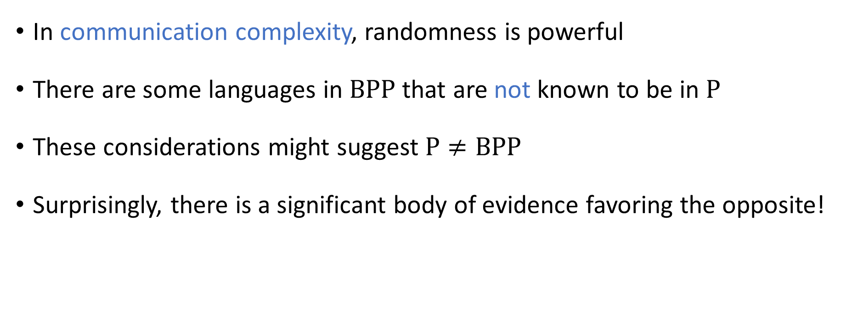
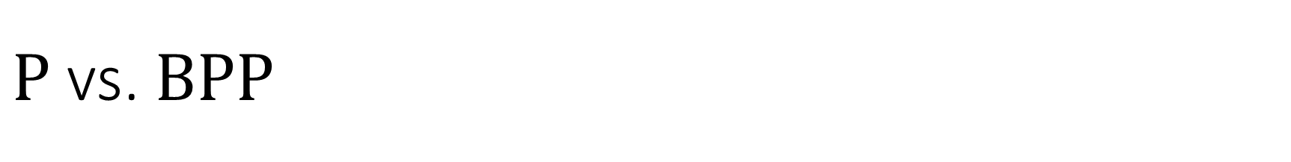
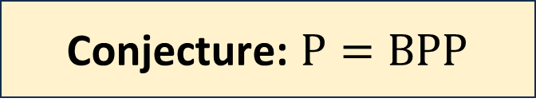
$\text{P}$ vs. $\text{BPP}$
In communication complexity, randomness is powerful
There are some languages in $\text{BPP}$ that are not known to be in $\text{P}$
These considerations might suggest $\text{P}≠\text{BPP}$
Surprisingly, there is a significant body of evidence favoring the opposite!
Conjecture: $\text{P}=\text{BPP}$

Slide 12
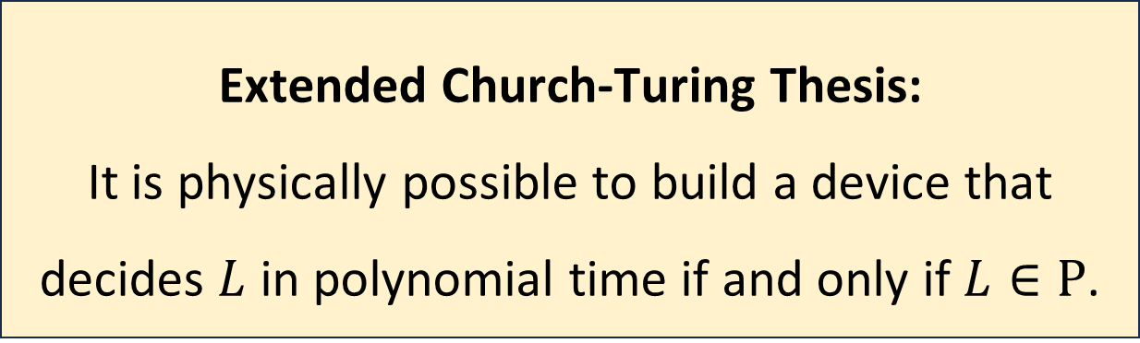

Extended Church-Turing Thesis
Let $L$ be a language
Assuming $\text{P}=\text{BPP}$, the extended Church-Turing thesis survives the challenge posed by randomized computation!
Extended Church-Turing Thesis:
It is physically possible to build a device that decides $L$ in polynomial time if and only if $L∈\text{P}$.

Slide 13
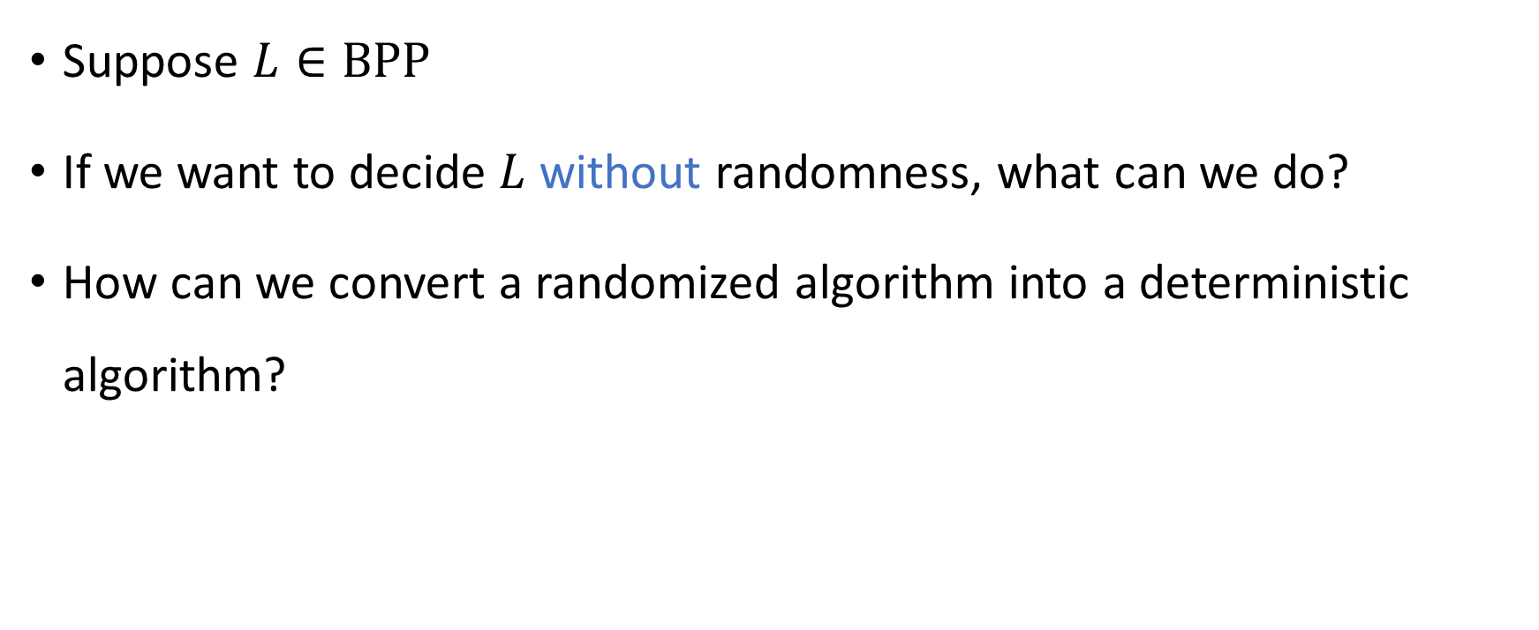
Derandomization
Suppose $L∈\text{BPP}$
If we want to decide $L$ without randomness, what can we do?
How can we convert a randomized algorithm into a deterministic algorithm?

Slide 14
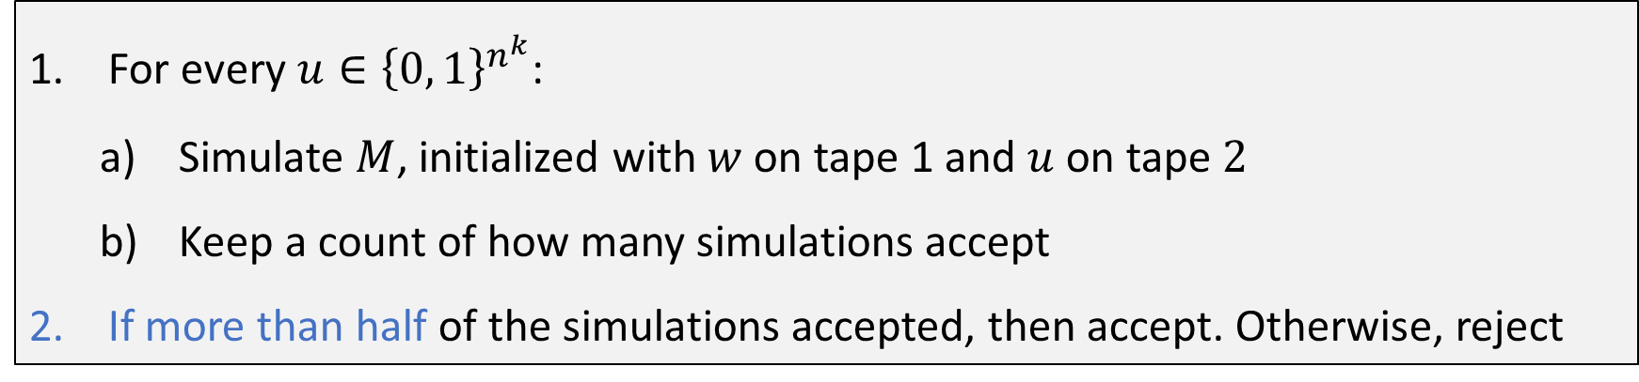

Brute-force derandomization
Let $M$ be the randomized polynomial-time Turing machine guaranteed by the assumption $L∈\text{BPP}$. Say $M$ runs in time $n^{k}$
Deterministic algorithm that decides $L$: Given $w∈Σ^{n}$:
For every $u∈{\left\{0, 1\right\}}^{n^{k}}$:
Simulate $M$, initialized with $w$ on tape 1 and $u$ on tape $2$
Keep a count of how many simulations accept
If more than half of the simulations accepted, then accept. Otherwise, reject

Slide 15


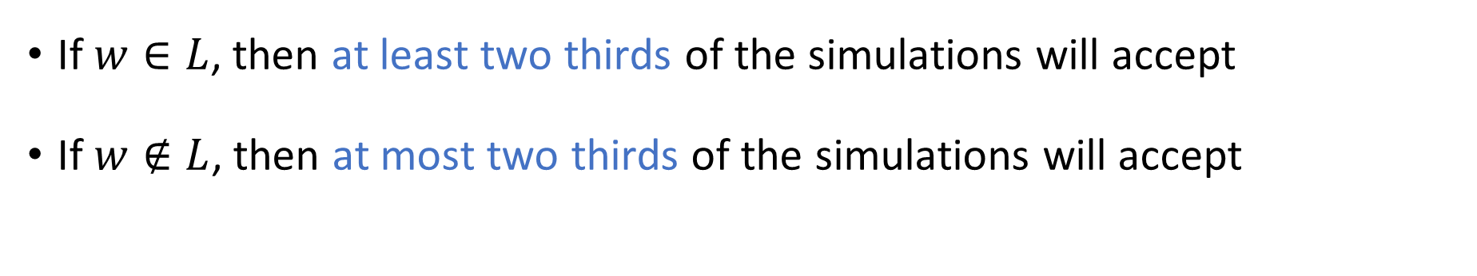



Brute-force derandomization: Correctness
For every $u∈{\left\{0, 1\right\}}^{n^{k}}$:
Simulate $M$, initialized with $w$ on tape 1 and $u$ on tape $2$
Keep a count of how many simulations accept
If more than half of the simulations accepted, then accept. Otherwise, reject
What is the time complexity of the algorithm?
If $w∈L$, then at least two thirds of the simulations will accept
If $w∉L$, then at most two thirds of the simulations will accept
A: $2^{poly\left(n\right)}$
B: $\text{poly}\left(n\right)$
C: $2^{2^{Θ\left(n\right)}}$
D: $∞$
Respond at PollEv.com/whoza or text “whoza” to 22333

Slide 16
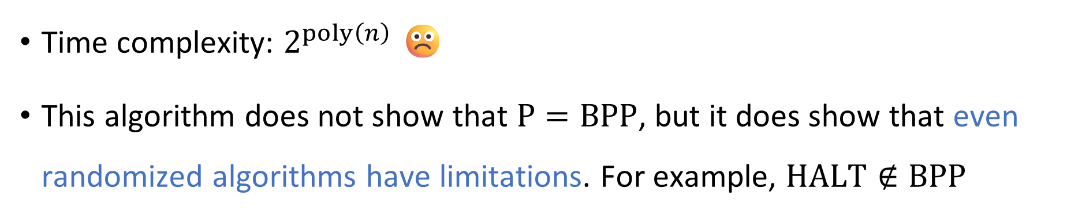
Brute-force derandomization: Time complexity
For every $u∈{\left\{0, 1\right\}}^{n^{k}}$:
Simulate $M$, initialized with $w$ on tape 1 and $u$ on tape $2$
Keep a count of how many simulations accept
If more than half of the simulations accepted, then accept. Otherwise, reject
Time complexity: $2^{poly\left(n\right)}$ ☹️
This algorithm does not show that $\text{P}=\text{BPP}$, but it does show that even randomized algorithms have limitations. For example, $\text{HALT}∉\text{BPP}$

Slide 17
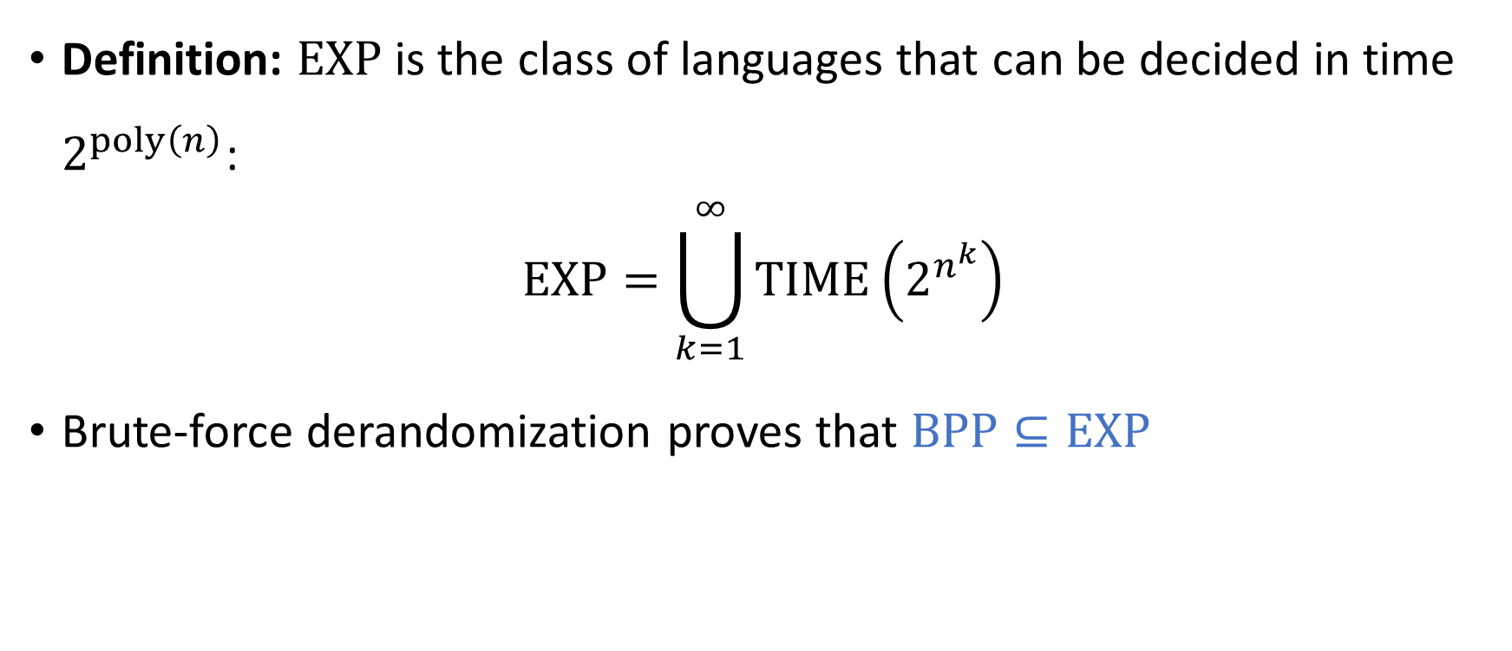

The complexity class $\text{EXP}$
Definition: $\text{EXP}$ is the class of languages that can be decided in time $2^{poly\left(n\right)}$:
$$\text{EXP}=\bigcup_{k=1}^{∞}{\text{TIME}\left(2^{n^{k}}\right)}$$
Brute-force derandomization proves that $\text{BPP}⊆\text{EXP}$

Slide 18







$\text{P}⊆\text{BPP}⊆\text{EXP}$
$$\text{HALT}$$
Decidable languages
$$\text{EXP}$$
$$\text{BPP}$$
$$\text{DECOMPOSABLE}\text{‑}\text{INTO}\text{‑}\text{SQUARES}$$
$$\text{P}$$
$$\text{PALINDROMES}$$

Slide 19




Brute-force derandomization: Space complexity
For every $u∈{\left\{0, 1\right\}}^{n^{k}}$:
Simulate $M$, initialized with $w$ on tape 1 and $u$ on tape $2$
Keep a count of how many simulations accept
If more than half of the simulations accepted, then accept. Otherwise, reject
What is the space complexity of the algorithm?
A: $2^{Θ\left(n^{k}\right)}$
B: $\text{poly}\left(n\right)$
C: $2^{2^{Θ\left(n\right)}}$
D: $∞$
Respond at PollEv.com/whoza or text “whoza” to 22333

Slide 20
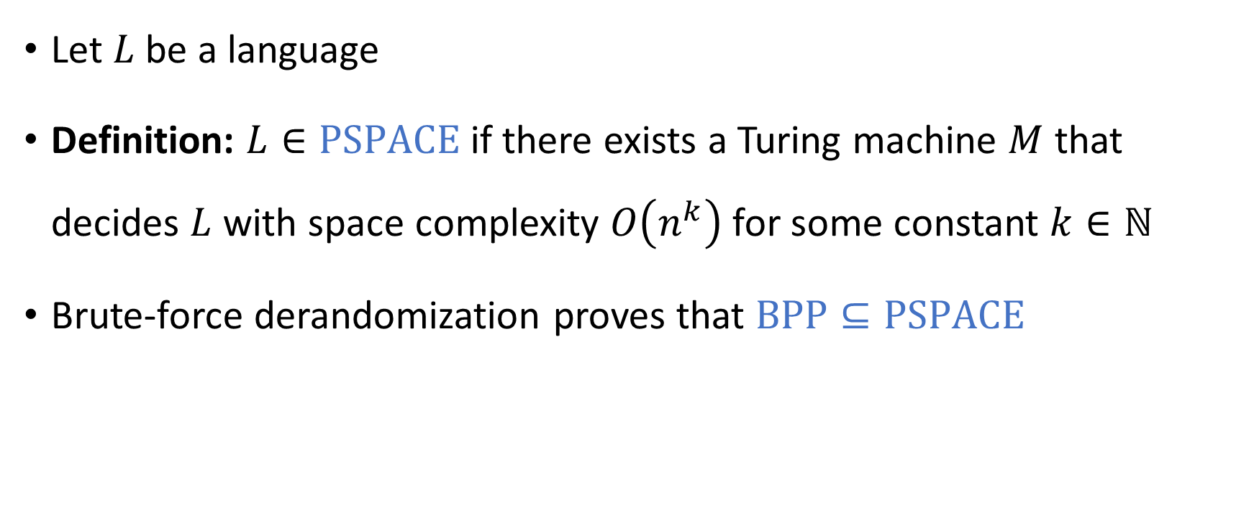

The complexity class $\text{PSPACE}$
Let $L$ be a language
Definition: $L∈\text{PSPACE}$ if there exists a Turing machine $M$ that decides $L$ with space complexity $O\left(n^{k}\right)$ for some constant $k∈ℕ$
Brute-force derandomization proves that $\text{BPP}⊆\text{PSPACE}$

Slide 21
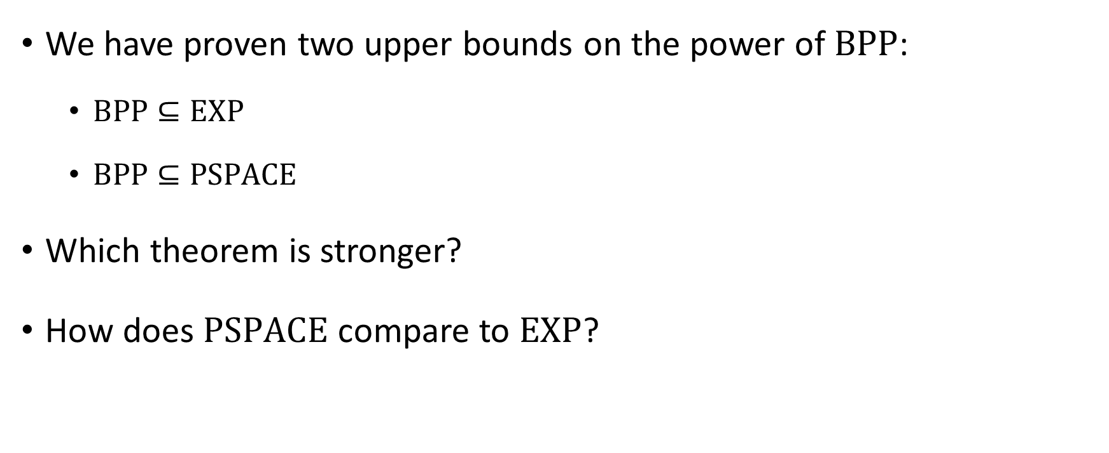

$\text{PSPACE}$ vs. $\text{EXP}$
We have proven two upper bounds on the power of $\text{BPP}$:
$\text{BPP}⊆\text{EXP}$
$\text{BPP}⊆\text{PSPACE}$
Which theorem is stronger?
How does $\text{PSPACE}$ compare to $\text{EXP}$?

Slide 22

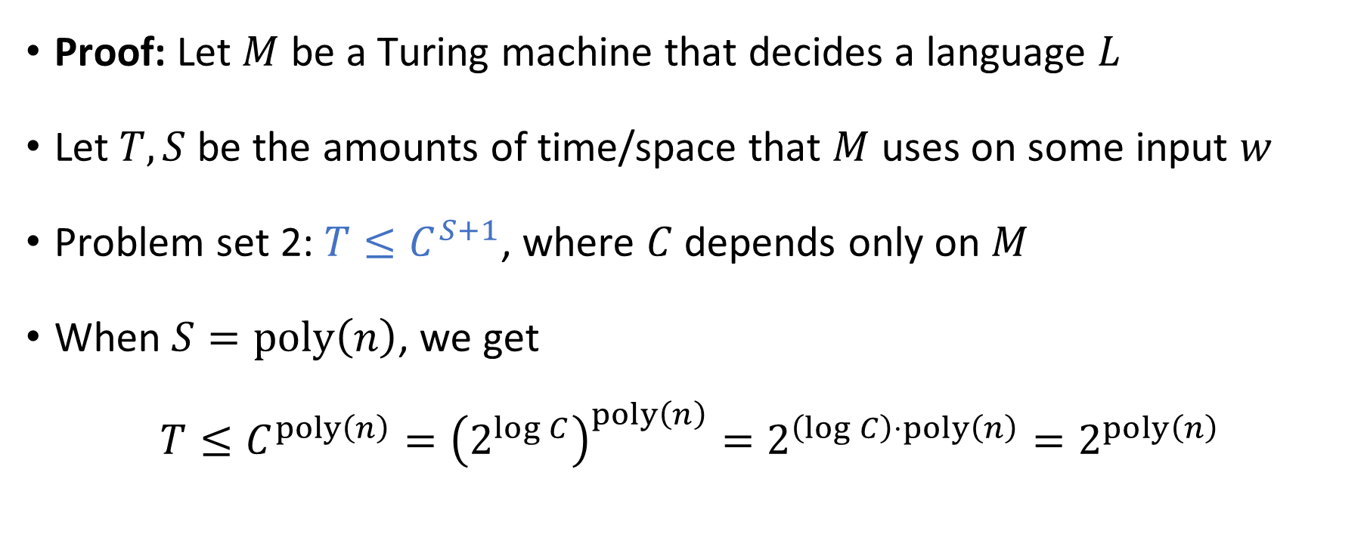
Theorem: $\text{PSPACE}⊆\text{EXP}$
Proof: Let $M$ be a Turing machine that decides a language $L$
Let $T,S$ be the amounts of time/space that $M$ uses on some input $w$
Problem set 2: $T≤C^{S+1}$, where $C$ depends only on $M$
When $S=\text{poly}\left(n\right)$, we get
$$T≤C^{poly\left(n\right)}={\left(2^{\log{C}}\right)}^{poly\left(n\right)}=2^{\left(\log{C}\right)⋅poly\left(n\right)}=2^{poly\left(n\right)}$$

Slide 23




Decidable languages
$$\text{EXP}$$
$$\text{PSPACE}$$
$$\text{BPP}$$
$$\text{P}$$

