Slide 1

CMSC 28100 Introduction to Complexity Theory Spring 2024 Instructor: William Hoza

Slide 2












Post’s Correspondence Problem
Given: a set of “dominos”
Goal: Determine whether it is possible to generate a “match”
in which the sequence of symbols on top equals the sequence of symbols on the bottom
Using the same domino multiple times is permitted
$$\begin{matrix}t_{1} \\ b_{1}\end{matrix}$$
$$\begin{matrix}t_{2} \\ b_{2}\end{matrix}$$
$$\begin{matrix}t_{3} \\ b_{3}\end{matrix}$$
$$\begin{matrix}t_{k} \\ b_{k}\end{matrix}$$
$$⋯$$
$$\begin{matrix}t_{i_{1}} \\ b_{i_{1}}\end{matrix}$$
$$\begin{matrix}t_{i_{2}} \\ b_{i_{2}}\end{matrix}$$
$$\begin{matrix}t_{i_{3}} \\ b_{i_{3}}\end{matrix}$$
$$\begin{matrix}t_{i_{4}} \\ b_{i_{4}}\end{matrix}$$
$$\begin{matrix}t_{i_{5}} \\ b_{i_{5}}\end{matrix}$$
$$\begin{matrix}t_{i_{n}} \\ b_{i_{n}}\end{matrix}$$
$$⋯$$

Slide 3

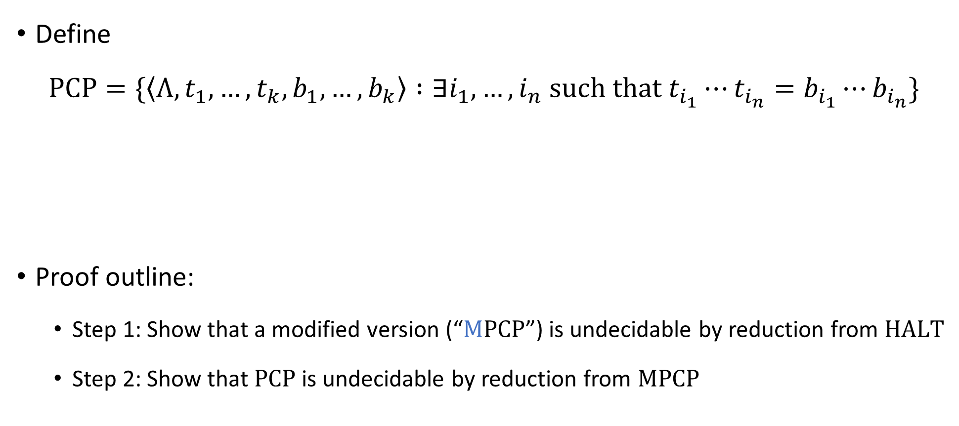
Post’s Correspondence Problem is undecidable
Define
$$\text{PCP}=\{\left\langle Λ, t_{1},…, t_{k}, b_{1},…, b_{k}\right\rangle :∃i_{1},…, i_{n} \text{such} \text{that} t_{i_{1}}⋯t_{i_{n}}=b_{i_{1}}⋯b_{i_{n}}\}$$
Proof outline:
Step 1: Show that a modified version (“$\text{M}\text{PCP}$”) is undecidable by reduction from $\text{HALT}$
Step 2: Show that $\text{PCP}$ is undecidable by reduction from $\text{MPCP}$
Theorem: $\text{PCP}$ is undecidable

Slide 4

Modified PCP
$$\text{MPCP}=\{\left\langle Λ, t_{1},…, t_{k}, b_{1},…, b_{k}\right\rangle :∃i_{1},…, i_{n} \text{such} \text{that} t_{1}t_{i_{1}}⋯t_{i_{n}}=b_{1}b_{i_{1}}⋯b_{i_{n}}\}$$
The difference between $\text{PCP}$ and $\text{MPCP}$: In $\text{MPCP}$, matches must start with the first domino

Slide 5


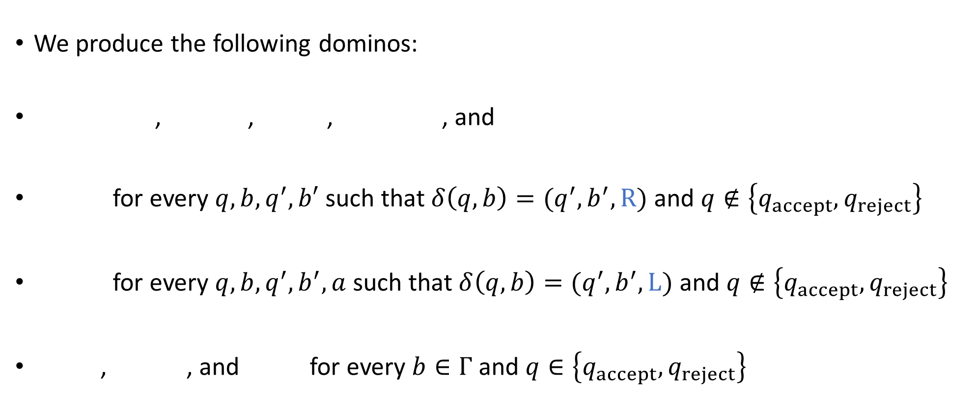









Reduction from $\text{HALT}$ to $\text{MPCP}$
We produce the following dominos:
, , , , and
for every $q,b,q^{′},b′$ such that $δ\left(q,b\right)=(q^{′},b^{′},\text{R})$ and $q∉\left\{q_{accept},q_{reject}\right\}$
for every $q,b,q^{′},b^{′},a$ such that $δ\left(q,b\right)=(q^{′},b^{′},\text{L})$ and $q∉\left\{q_{accept},q_{reject}\right\}$
, , and for every $b∈Γ$ and $q∈\left\{q_{accept},q_{reject}\right\}$
Reduction is computable ✔️
$$\begin{matrix}ε \\ ♢q_{0}w⊔\#\end{matrix}$$
$$\begin{matrix}\# \\ \#\end{matrix}$$
$$\begin{matrix}\# \\ ⊔\#\end{matrix}$$
$$\begin{matrix}q_{accept}\# \\ ε\end{matrix}$$
$$\begin{matrix}q_{reject}\# \\ ε\end{matrix}$$
$$\begin{matrix}qb \\ b^{′}q′\end{matrix}$$
$$\begin{matrix}aqb \\ q^{′}ab′\end{matrix}$$
$$\begin{matrix}b \\ b\end{matrix}$$
$$\begin{matrix}bq \\ q\end{matrix}$$
$$\begin{matrix}qb \\ q\end{matrix}$$

Slide 6



















YES maps to YES
Suppose $M$ halts on $w$
Under this assumption, we showed last time how to construct a match
The construction was based on the computation history of $M$ on $w$:
$$\begin{matrix}ε \\ ♢q_{0}w⊔\#\end{matrix}$$
$$\begin{matrix}C_{0}^{′}⊔ \\ C_{1}^{′}\end{matrix}$$
$$\begin{matrix}\# \\ ⊔\#\end{matrix}$$
$$\begin{matrix}C_{1}^{′}⊔ \\ C_{2}^{′}\end{matrix}$$
$$\begin{matrix}\# \\ ⊔\#\end{matrix}$$
$$\begin{matrix}\# \\ ⊔\#\end{matrix}$$
$$\begin{matrix}C_{T−1}^{′}⊔ \\ C_{T}^{′}\end{matrix}$$
$$\begin{matrix}\# \\ \#\end{matrix}$$
$$\begin{matrix}H_{0} \\ H_{1}\end{matrix}$$
$$\begin{matrix}\# \\ \#\end{matrix}$$
$$\begin{matrix}H_{1} \\ H_{2}\end{matrix}$$
$$\begin{matrix}\# \\ \#\end{matrix}$$
$$\begin{matrix}\# \\ \#\end{matrix}$$
$$\begin{matrix}H_{n−1} \\ H_{n}\end{matrix}$$
$$\begin{matrix}\# \\ \#\end{matrix}$$
$$\begin{matrix}H_{n}\# \\ ε\end{matrix}$$
$$⋯$$
$$⋯$$

Slide 7

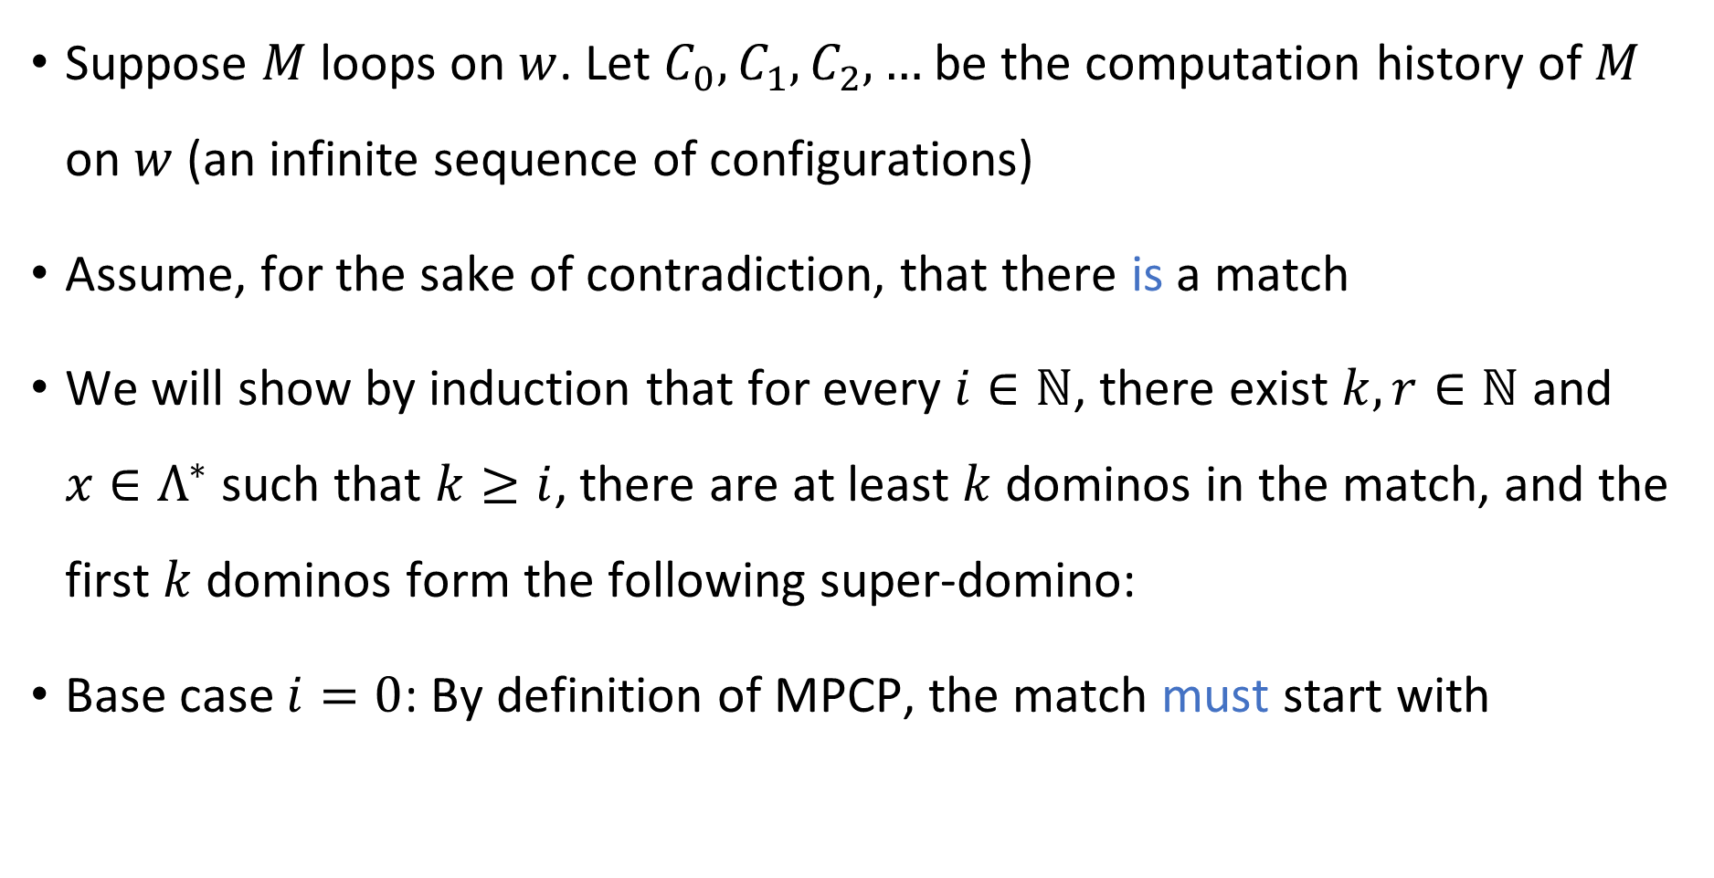

NO maps to NO
Suppose $M$ loops on $w$. Let $C_{0},C_{1},C_{2},…$ be the computation history of $M$ on $w$ (an infinite sequence of configurations)
Assume, for the sake of contradiction, that there is a match
We will show by induction that for every $i∈ℕ$, there exist $k,r∈ℕ$ and $x∈Λ^{∗}$ such that $k≥i$, there are at least $k$ dominos in the match, and the first $k$ dominos form the following super-domino:
Base case $i=0$: By definition of MPCP, the match must start with
$$\begin{matrix}x \\ xC_{i}⊔^{r}\#\end{matrix}$$
$$\begin{matrix}ε \\ ♢q_{0}w⊔\#\end{matrix}$$

Slide 8
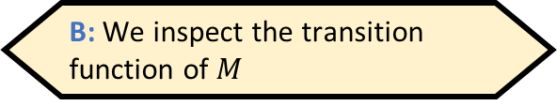







NO maps to NO
When we are computing $f\left(\left\langle M,w\right\rangle \right)$, how do we know whether there is a match?
A: We simulate $M$ on $w$ and observe what happens
B: We inspect the transition function of $M$
Inductive step: Assume that the first $k$ dominos in the match form
Subsequent dominos must spell out $C_{i}⊔^{r}\#$ on top
Exercise: There are only two possible ways to do this, namely
followed by either or
Either way, the inductive step is complete
Consequence: The match is infinitely long, a contradiction
$$\begin{matrix}x \\ xC_{i}⊔^{r}\#\end{matrix}$$
C: We do not know whether there is a match, and that’s okay
D: We do not know whether there is a match, and that’s an issue
Respond at PollEv.com/whoza or text “whoza” to 22333
$$\begin{matrix}C_{i}⊔^{r} \\ C_{i+1}⊔^{r}\end{matrix}$$
$$\begin{matrix}\# \\ \#\end{matrix}$$
$$\begin{matrix}\# \\ ⊔\#\end{matrix}$$

Slide 9

NO maps to NO
This completes the proof that $\text{M}\text{PCP}$ is undecidable
We designed a mapping reduction from $\text{HALT}$ to $\text{MPCP}$
If $\text{MPCP}$ were decidable, then $\text{HALT}$ would be decidable too

Slide 10
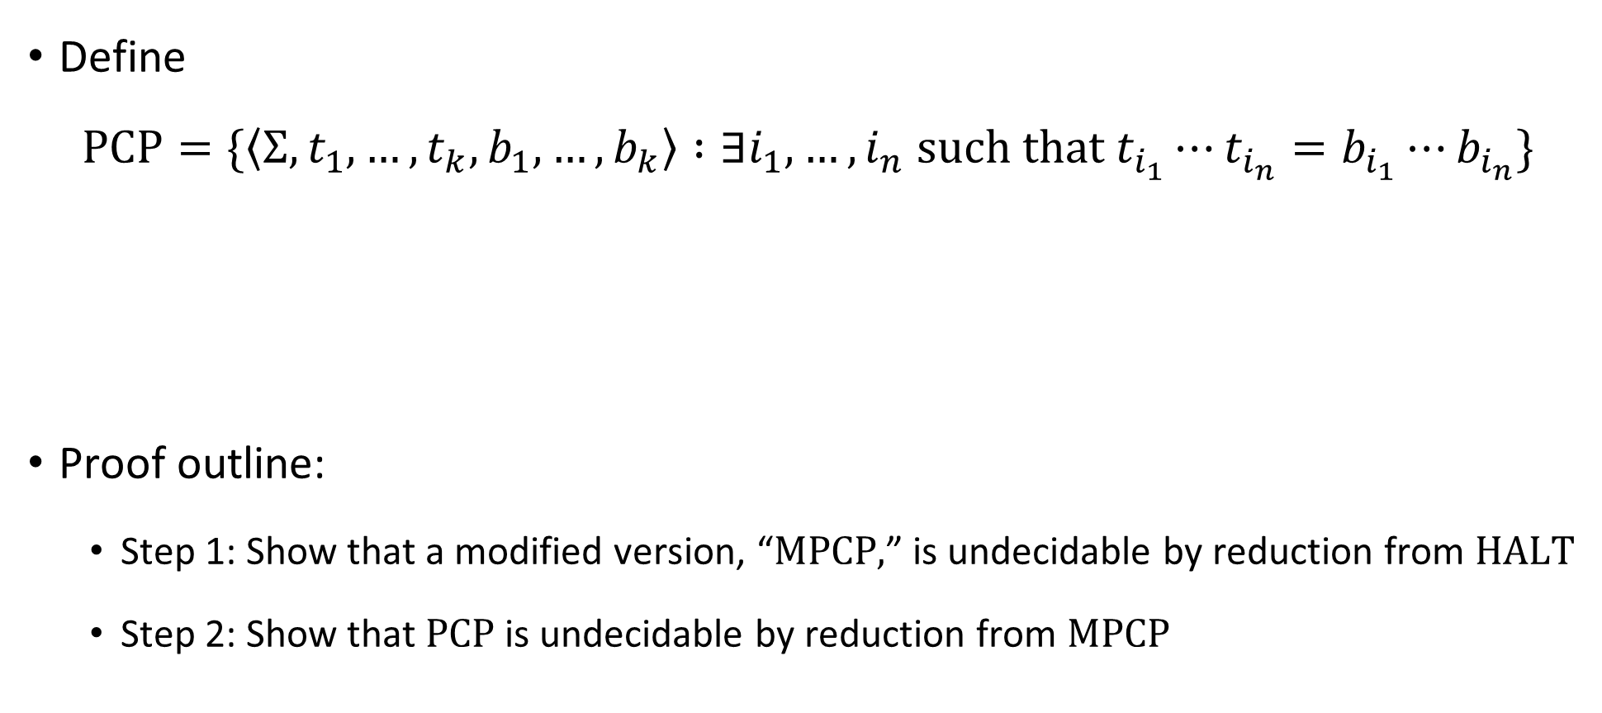
Post’s Correspondence Problem is undecidable
Define
$$\text{PCP}=\{\left\langle Σ, t_{1},…, t_{k}, b_{1},…, b_{k}\right\rangle :∃i_{1},…, i_{n} \text{such} \text{that} t_{i_{1}}⋯t_{i_{n}}=b_{i_{1}}⋯b_{i_{n}}\}$$
Proof outline:
Step 1: Show that a modified version, “$\text{MPCP}\text{,}$” is undecidable by reduction from $\text{HALT}$
Step 2: Show that $\text{PCP}$ is undecidable by reduction from $\text{MPCP}$
Theorem: $\text{PCP}$ is undecidable

Slide 11













Reduction from MPCP to PCP
For each string $u=u_{1}u_{2}…u_{n}$, define $\overline{u}=u_{1}⋆u_{2}⋆⋯⋆u_{n}$
Reduction:
$f\left( \begin{matrix} \\ \end{matrix} \right)=$
Computable ✔️
$$\begin{matrix}t_{1} \\ b_{1}\end{matrix}$$
$$\begin{matrix}t_{2} \\ b_{2}\end{matrix}$$
$$\begin{matrix}t_{3} \\ b_{3}\end{matrix}$$
$$\begin{matrix}t_{k} \\ b_{k}\end{matrix}$$
$$\begin{matrix}⋆\overline{t_{1}} \\ ⋆\overline{b_{1}}⋆\end{matrix}$$
$$\begin{matrix}⋆\overline{t_{1}} \\ \overline{b_{1}}⋆\end{matrix}$$
$$\begin{matrix}⋆\overline{t_{2}} \\ \overline{b_{2}}⋆\end{matrix}$$
$$\begin{matrix}⋆\overline{t_{3}} \\ \overline{b_{3}}⋆\end{matrix}$$
$$\begin{matrix}⋆\overline{t_{k}} \\ \overline{b_{k}}⋆\end{matrix}$$
$$\begin{matrix}⋆ \\ ε\end{matrix}$$
$$⋯$$
$$⋯$$

Slide 12













YES maps to YES
Suppose the MPCP instance has a match
Then the constructed PCP instance also has a match:
$$\begin{matrix}t_{1} \\ b_{1}\end{matrix}$$
$$\begin{matrix}t_{i_{1}} \\ b_{i_{1}}\end{matrix}$$
$$\begin{matrix}t_{i_{2}} \\ b_{i_{2}}\end{matrix}$$
$$\begin{matrix}t_{i_{3}} \\ b_{i_{3}}\end{matrix}$$
$$\begin{matrix}t_{i_{4}} \\ b_{i_{4}}\end{matrix}$$
$$\begin{matrix}t_{i_{n}} \\ b_{i_{n}}\end{matrix}$$
$$⋯$$
$$\begin{matrix}⋆\overline{t_{1}} \\ ⋆\overline{b_{1}}⋆\end{matrix}$$
$$\begin{matrix}⋆\overline{t_{i_{1}}} \\ \overline{b_{i_{1}}}⋆\end{matrix}$$
$$\begin{matrix}⋆\overline{t_{i_{2}}} \\ \overline{b_{i_{2}}}⋆\end{matrix}$$
$$\begin{matrix}⋆\overline{t_{i_{n}}} \\ \overline{b_{i_{n}}}⋆\end{matrix}$$
$$\begin{matrix}⋆ \\ ε\end{matrix}$$
$$⋯$$

Slide 13

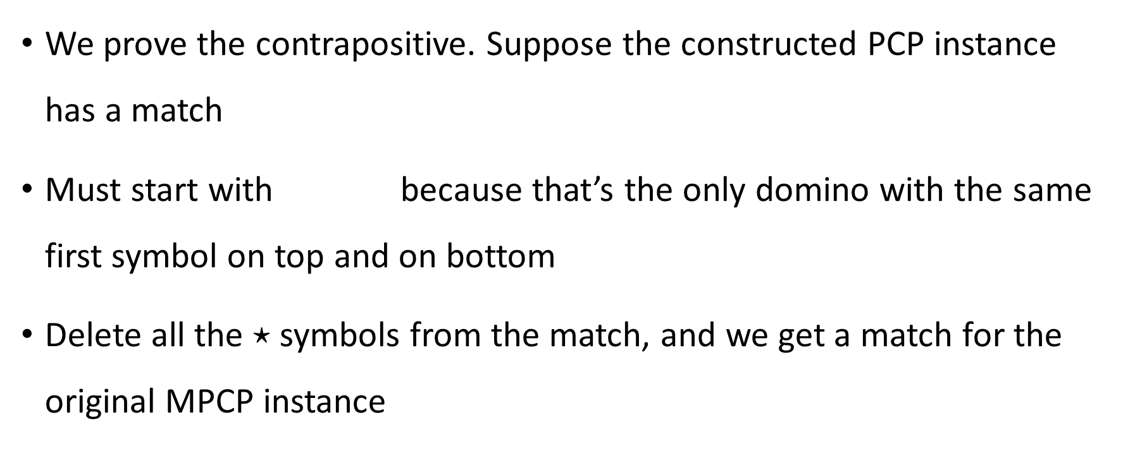
NO maps to NO
We prove the contrapositive. Suppose the constructed PCP instance has a match
Must start with because that’s the only domino with the same first symbol on top and on bottom
Delete all the $⋆$ symbols from the match, and we get a match for the original MPCP instance
$$\begin{matrix}⋆\overline{t_{1}} \\ ⋆\overline{b_{1}}⋆\end{matrix}$$

Slide 14
Using reductions to prove undecidability
OBJECTION: “I don’t like mapping reductions. I preferred our first few undecidability proofs, where we did proofs by contradiction and the concept of a reduction was implicit.”
RESPONSE 1: Mapping reductions help us to reason clearly about undecidability
RESPONSE 2: You should get comfortable with the concept of a mapping reduction now in preparation for what will come later
The concept might feel “optional” now, but later it will be essential

Slide 15
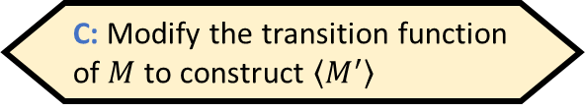
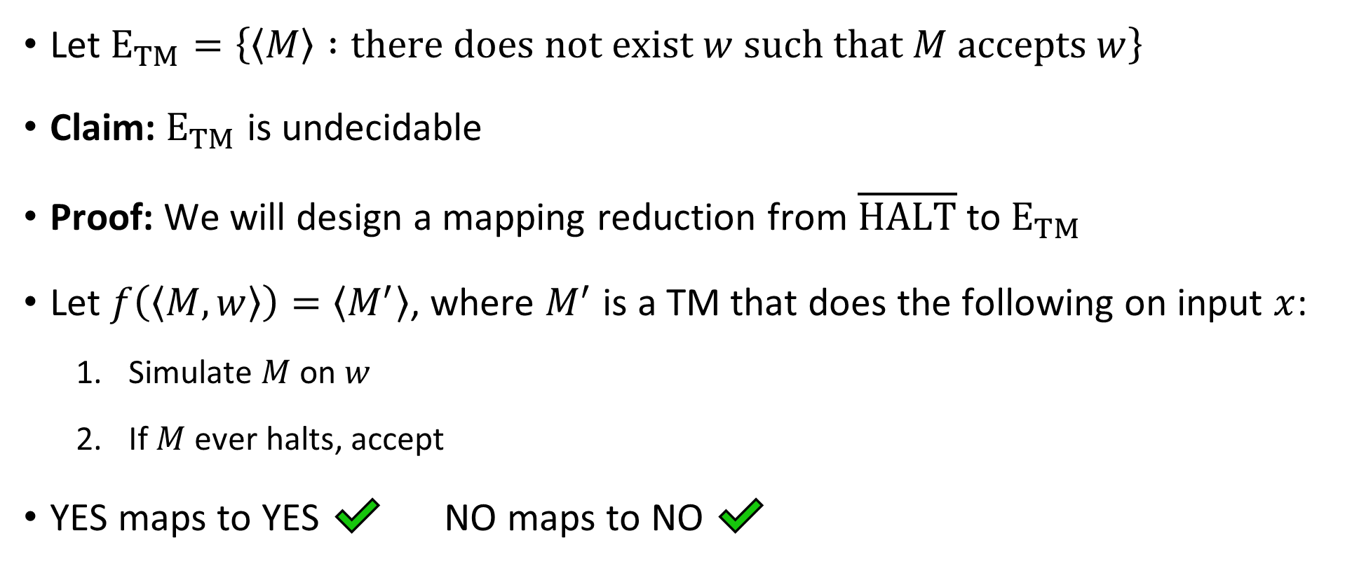
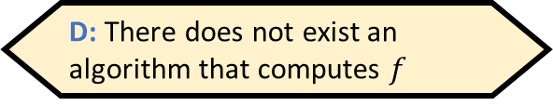
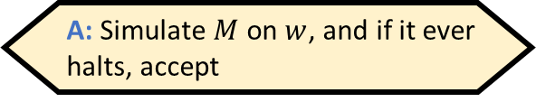
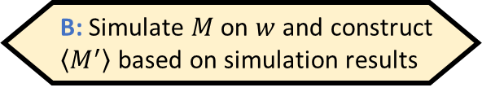
The “emptiness problem”
Given $⟨M,w⟩$, how would we compute $f\left(\left\langle M,w\right\rangle \right)$?
A: Simulate $M$ on $w$, and if it ever halts, accept
B: Simulate $M$ on $w$ and construct $\left\langle M^{′}\right\rangle$ based on simulation results
Let ${\text{E}}_{TM}=\left\{\left\langle M\right\rangle :\text{there} \text{does} \text{not} \text{exist} w \text{such} \text{that} M \text{accepts} w\right\}$
Claim: ${\text{E}}_{TM}$ is undecidable
Proof: We will design a mapping reduction from $\overline{\text{HALT}}$ to ${\text{E}}_{TM}$
Let $f\left(\left\langle M,w\right\rangle \right)=\left\langle M^{′}\right\rangle$, where $M^{′}$ is a TM that does the following on input $x$:
Simulate $M$ on $w$
If $M$ ever halts, accept
YES maps to YES ✔️ NO maps to NO ✔️
C: Modify the transition function of $M$ to construct $\left\langle M^{′}\right\rangle$
D: There does not exist an algorithm that computes $f$
Respond at PollEv.com/whoza or text “whoza” to 22333
Computable ✔️

Slide 16
Which languages are undecidable?

Slide 17
Some more undecidable problems
We have seen several interesting examples of undecidable problems
To wrap up our discussion of undecidability, I’ll mention a few more examples of undecidable problems – but we won’t do the proofs
(This material will not be on problem sets or exams)

Slide 18

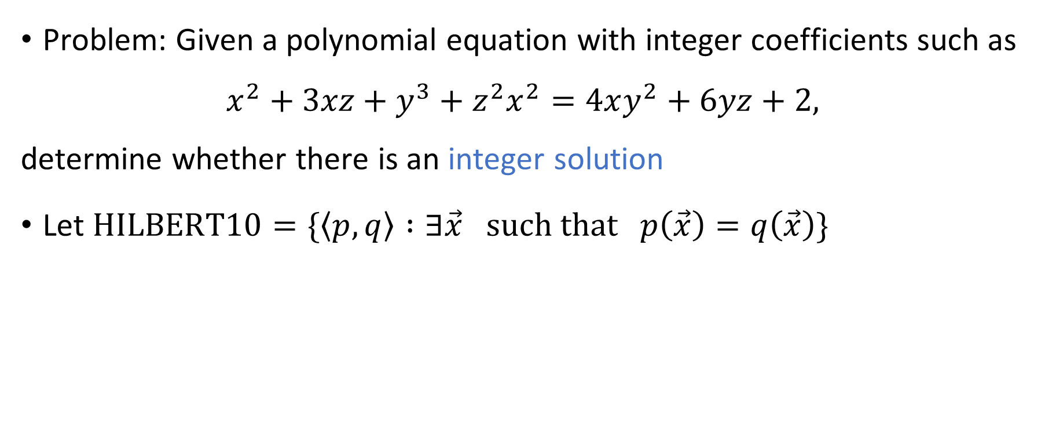
Hilbert’s 10th problem
Problem: Given a polynomial equation with integer coefficients such as
$$x^{2}+3xz+y^{3}+z^{2}x^{2}=4xy^{2}+6yz+2,$$
determine whether there is an integer solution
Let $\text{HILBERT}\text{10}=\{\left\langle p,q\right\rangle :∃\vec{x} \text{such} \text{that} p\left(\vec{x}\right)=q\left(\vec{x}\right)\}$
Theorem: $\text{HILBERT}\text{10}$ is undecidable

Slide 19
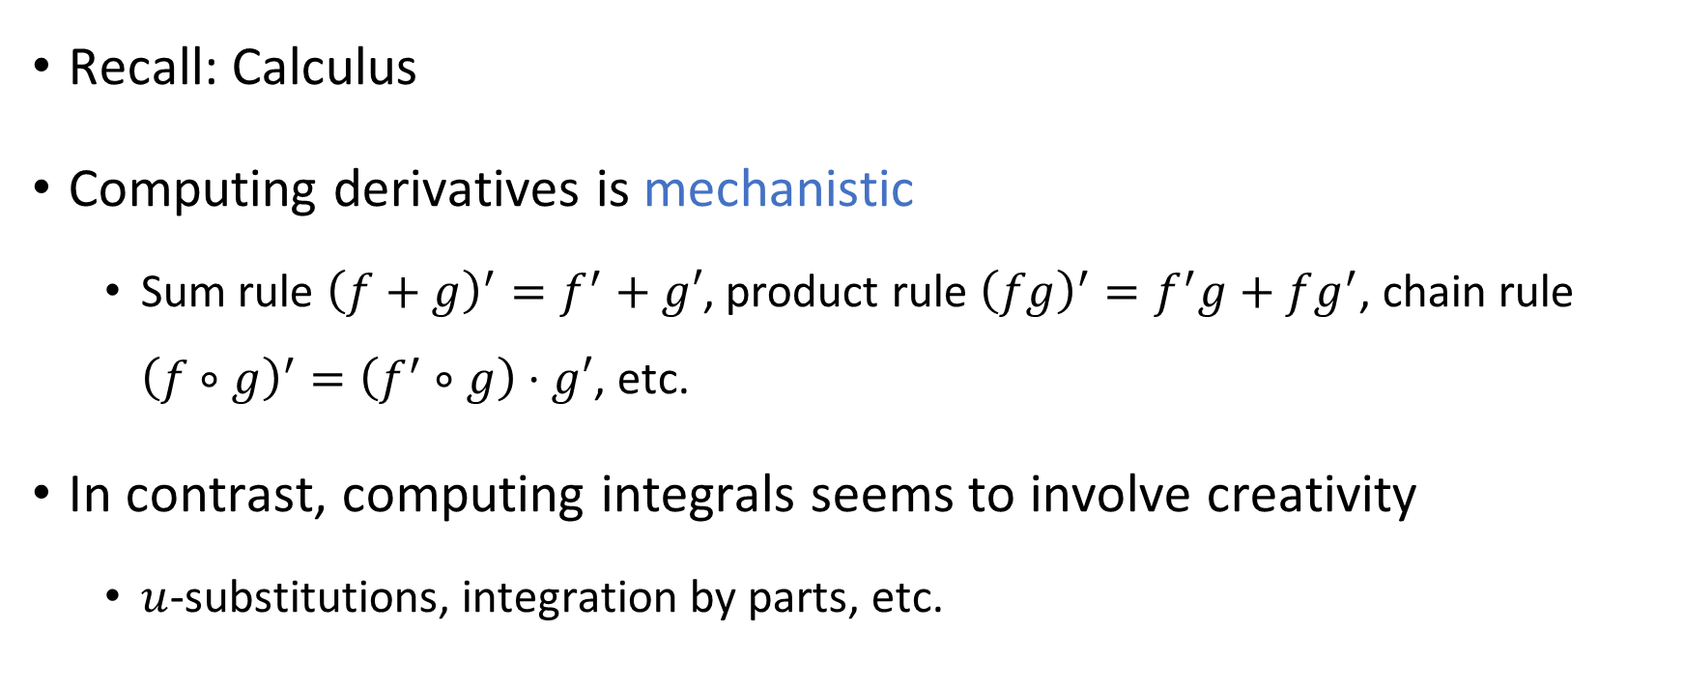
Derivatives vs. Integrals
Recall: Calculus
Computing derivatives is mechanistic
Sum rule ${\left(f+g\right)}^{′}=f^{′}+g′$, product rule ${\left(fg\right)}^{′}=f^{′}g+fg^{′}$, chain rule ${\left(f∘g\right)}^{′}=\left(f^{′}∘g\right)⋅g′$, etc.
In contrast, computing integrals seems to involve creativity
$u$-substitutions, integration by parts, etc.

Slide 20
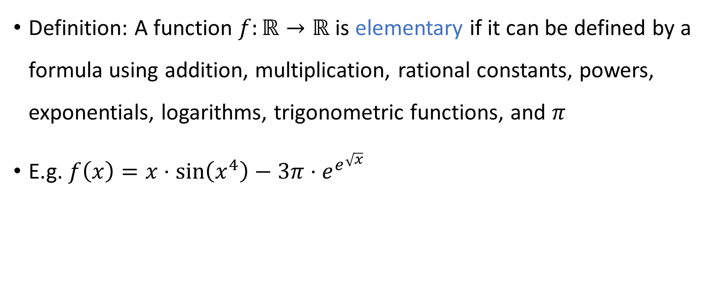
Elementary functions
Definition: A function $f:ℝ→ℝ$ is elementary if it can be defined by a formula using addition, multiplication, rational constants, powers, exponentials, logarithms, trigonometric functions, and $π$
E.g. $f\left(x\right)=x⋅\sin\left(x^{4}\right)−3π⋅e^{e^{\sqrt{x}}}$

Slide 21
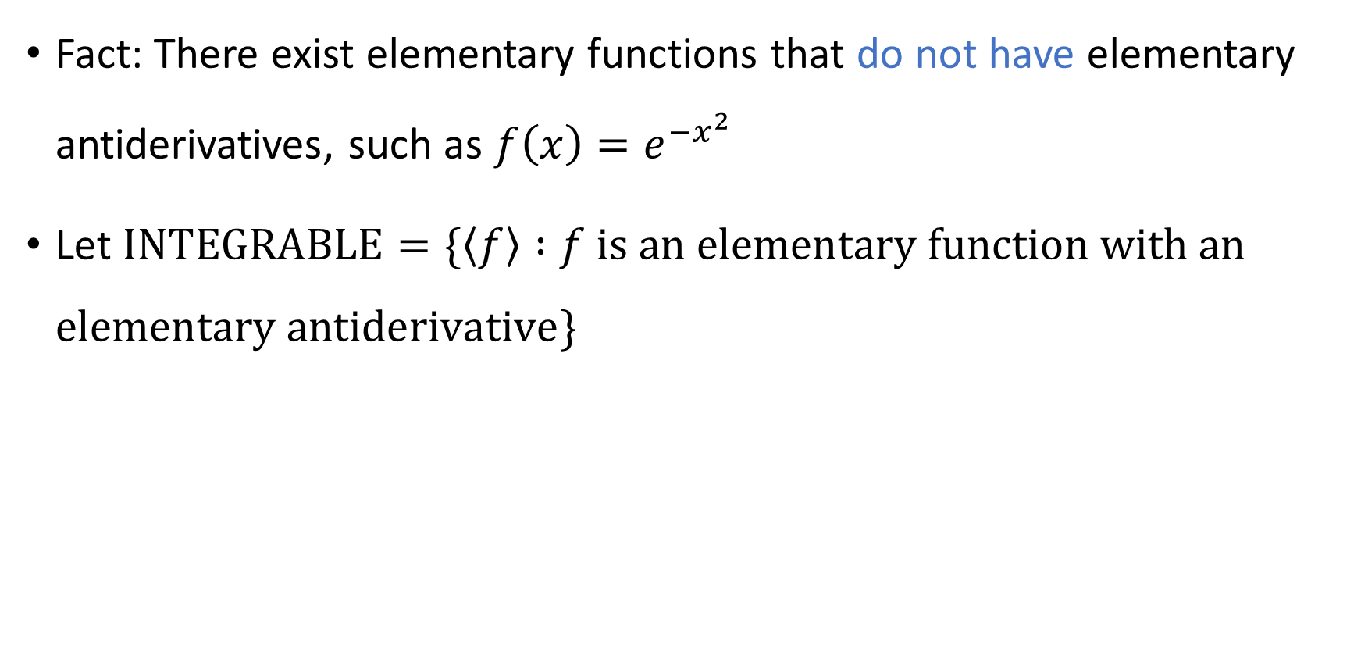

Integration is undecidable
Fact: There exist elementary functions that do not have elementary antiderivatives, such as $f\left(x\right)=e^{−x^{2}}$
Let $\text{INTEGRABLE}=\{\left\langle f\right\rangle :f \text{is} \text{an} \text{elementary} \text{function} \text{with} \text{an} \text{elementary} \text{antiderivative}\}$
Theorem: $\text{INTEGRABLE}$ is undecidable
Notes:
https://en.wikipedia.org/wiki/Richardson%27s_theorem

Slide 22

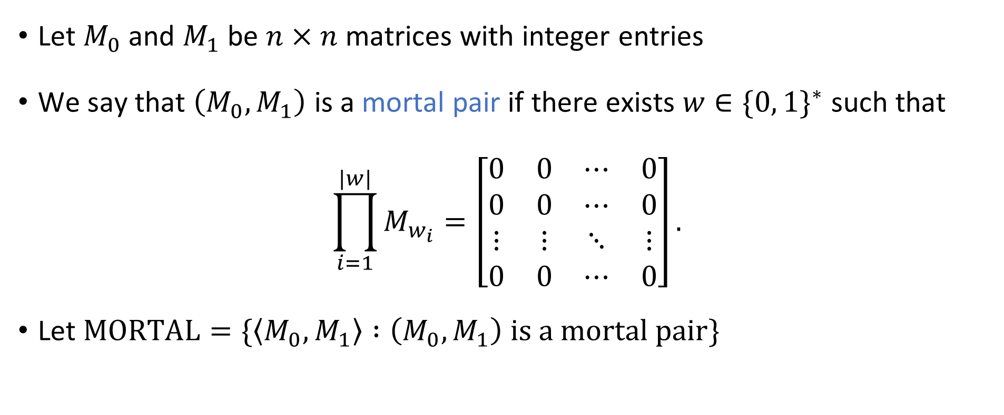
Matrix mortality
Let $M_{0}$ and $M_{1}$ be $n×n$ matrices with integer entries
We say that $\left(M_{0},M_{1}\right)$ is a mortal pair if there exists $w∈\{0, 1\}^{∗}$ such that
$$\prod_{i=1}^{|w|}{M_{w_{i}}}=\left[\begin{matrix}0 & 0 & ⋯ & 0 \\ 0 & 0 & ⋯ & 0 \\ ⋮ & ⋮ & ⋱ & ⋮ \\ 0 & 0 & ⋯ & 0\end{matrix}\right].$$
Let $\text{MORTAL}=\{\left\langle M_{0},M_{1}\right\rangle :\left(M_{0},M_{1}\right) \text{is} \text{a} \text{mortal} \text{pair}\}$
Theorem: $\text{MORTAL}$ is undecidable

Slide 23
Computability theory: Conclusions

Slide 24
Undecidability
For some problems, including some natural and interesting problems, there does not exist an algorithm that solves the problem
Key example: The halting problem

Slide 25
Computability theory beyond undecidability
We have only scratched the surface of computability theory
For example, which languages would be decidable if we had access to a device that solved the halting problem?
If you want to learn more about these subjects, consider taking MATH 30200-30300-30400

Slide 26
Midterm cutoff point
Midterm exam will be in class on Wednesday, April 17
To prepare for the midterm, you only need to study the material up to this point

