Slide 1
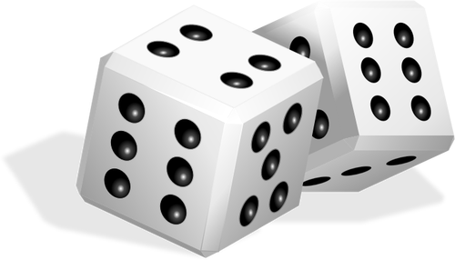
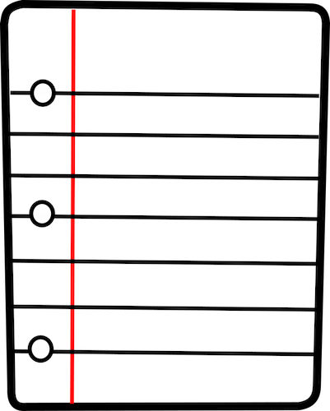

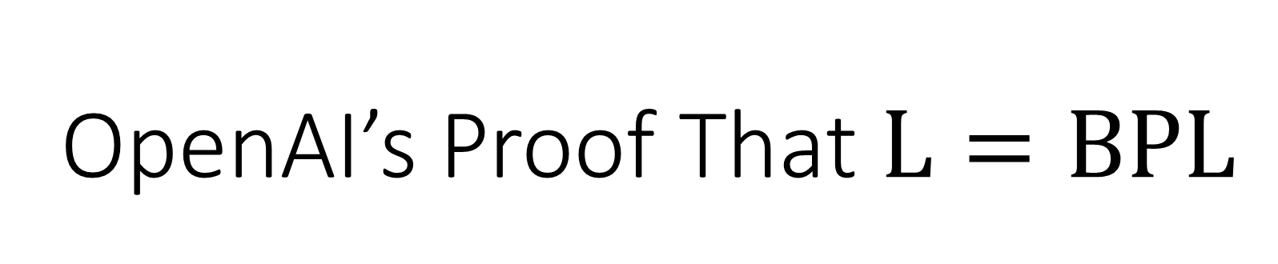
OpenAI’s Proof That $\text{L}=\text{BPL}$
William Hoza
The University of Chicago
October 26, 2026

Slide 2







The complexity class $\text{BPL}$
$n$ bits
Read-only
input tape
0 | 1 | 1 | 0 | 0 | 0 | 1 | 0 | 1 | 0 | 1 | 0 | 1
$O\left(\log{n}\right)$ bits
Read-write
work tape
1 | 0 | 0 | 1 | 1
Read-once
random tape
1 | 1 | 1 | 0 | 1 | 0 | 0 | 1 | 0 | 1 | 0 | 0 | 0 | 1

Slide 3
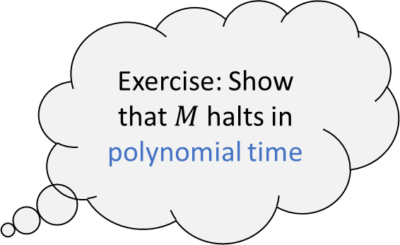
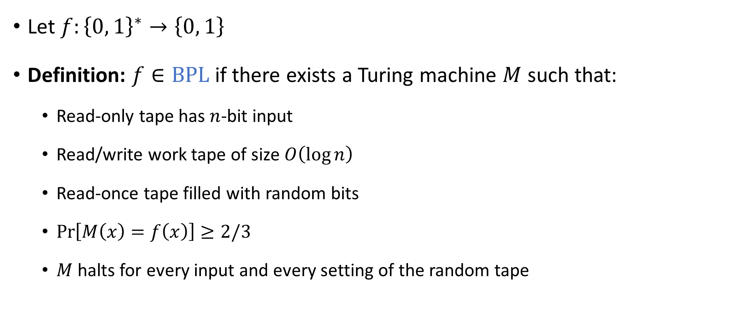

The complexity class $\text{BPL}$
Let $f:{\left\{0, 1\right\}}^{∗}→\left\{0, 1\right\}$
Definition: $f∈\text{BPL}$ if there exists a Turing machine $M$ such that:
  Read-only tape has $n$-bit input
  Read/write work tape of size $O\left(\log{n}\right)$
  Read-once tape filled with random bits
  $\operatorname{Pr}\left[M\left(x\right)=f\left(x\right)\right]≥2/3$
  $M$ halts for every input and every setting of the random tape
Exercise: Show that $M$ halts in polynomial time

Slide 4



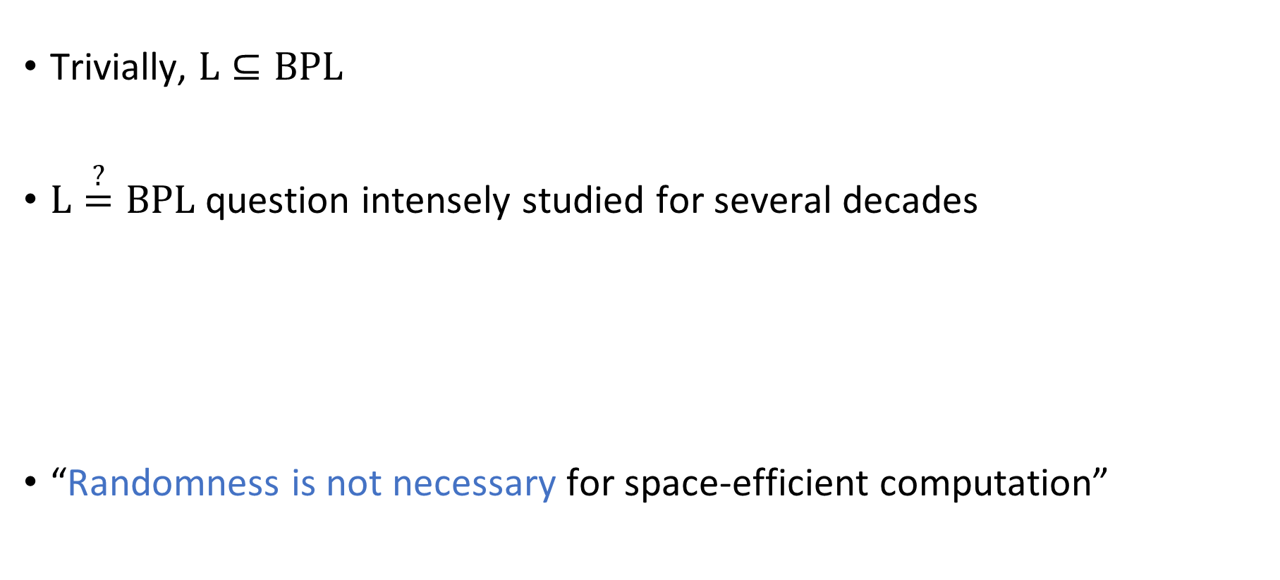

Derandomization of $\text{BPL}$
Trivially, $\text{L}⊆\text{BPL}$
$\text{L}\overset{?}{=}\text{BPL}$ question intensely studied for several decades
“Randomness is not necessary for space-efficient computation”
Theorem [OpenAI 2026]: $\text{L}=\text{BPL}$

Slide 5
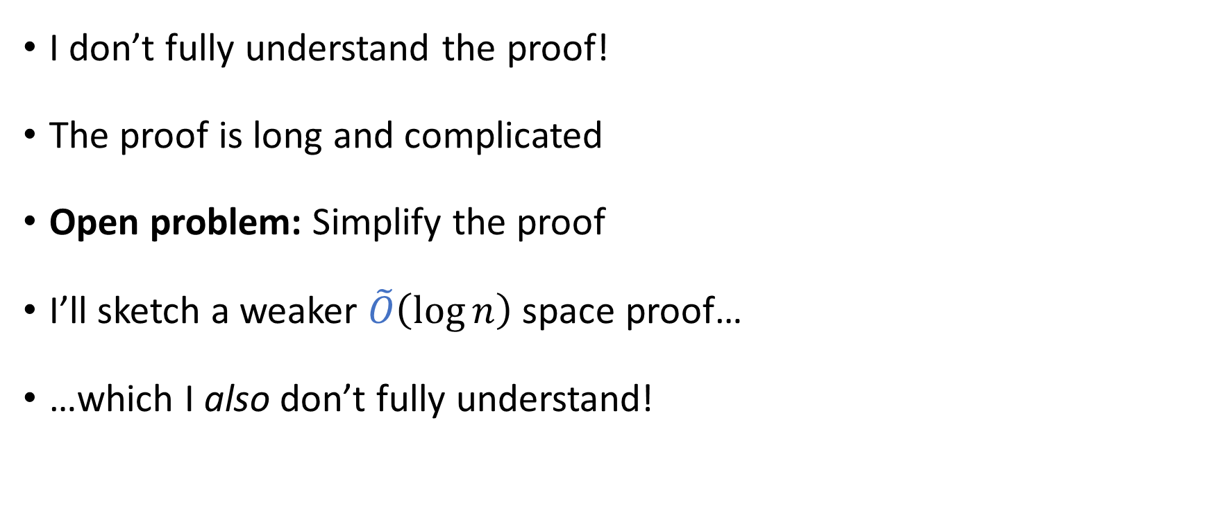
Disclaimers
I don’t fully understand the proof!
The proof is long and complicated
Open problem: Simplify the proof
I’ll sketch a weaker $\tilde{O}\left(\log{n}\right)$ space proof…
…which I also don’t fully understand!

Slide 6
Disclaimers
My (incomplete) understanding of the proof is mostly based on discussions with ChatGPT 🤞
Thanks also to many wonderful humans for sharing insights
Mistakes are my own
Some false things I’ll say are deliberate simplifications

Slide 7
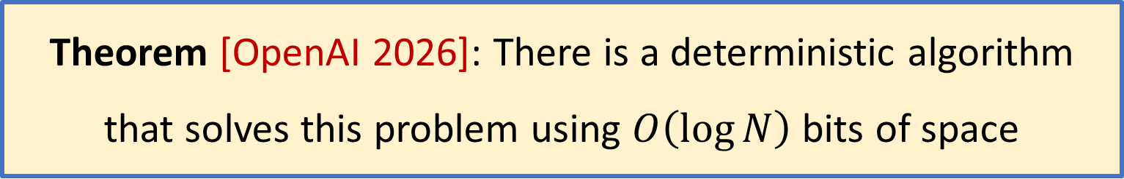
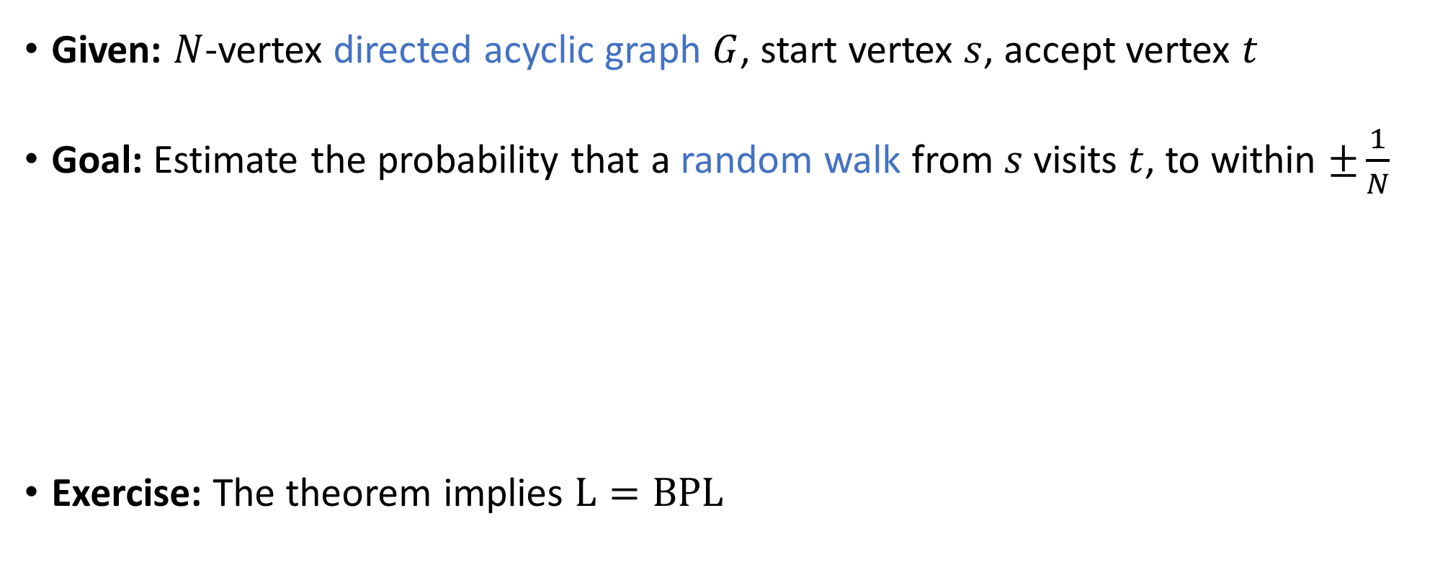
The concrete problem we will solve
Given: $N$-vertex directed acyclic graph $G$, start vertex $s$, accept vertex $t$
Goal: Estimate the probability that a random walk from $s$ visits $t$, to within $±\frac{1}{N}$
Exercise: The theorem implies $\text{L}=\text{BPL}$
Theorem [OpenAI 2026]: There is a deterministic algorithm that solves this problem using $O\left(\log{N}\right)$ bits of space

Slide 8
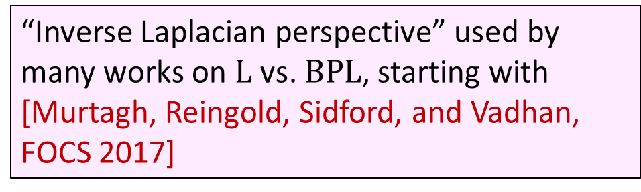
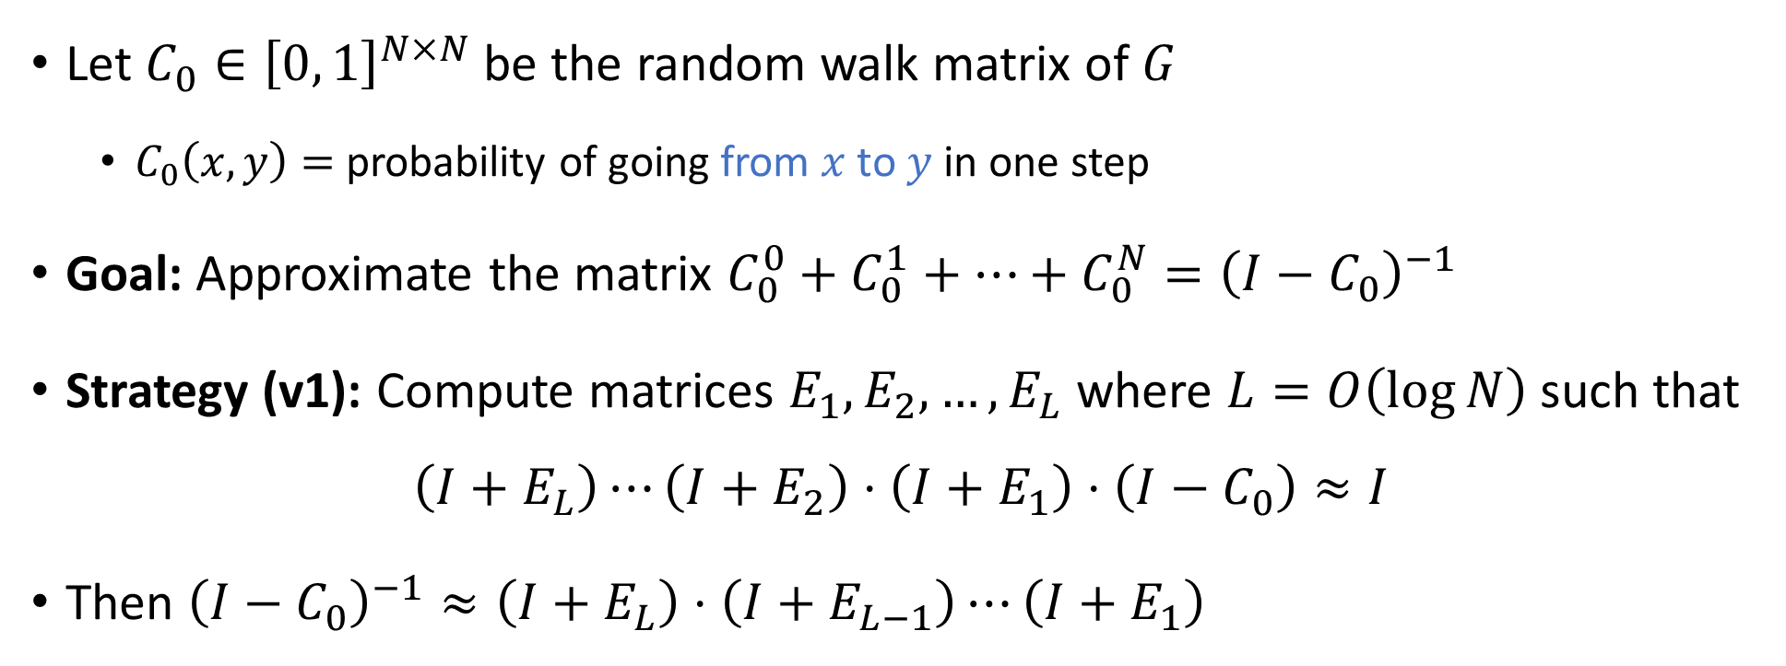
Laplacian approach
“Inverse Laplacian perspective” used by many works on $\text{L}$ vs. $\text{BPL}$, starting with [Murtagh, Reingold, Sidford, and Vadhan, FOCS 2017]
Let $C_{0}∈{\left[0, 1\right]}^{N×N}$ be the random walk matrix of $G$
  $C_{0}\left(x,y\right)=$ probability of going from $x$ to $y$ in one step
Goal: Approximate the matrix $C_{0}^{0}+C_{0}^{1}+…+C_{0}^{N}={\left(I−C_{0}\right)}^{−1}$
Strategy (v1): Compute matrices $E_{1},E_{2},…, E_{L}$ where $L=O\left(\log{N}\right)$ such that
$$\left(I+E_{L}\right)⋯\left(I+E_{2}\right)⋅\left(I+E_{1}\right)⋅\left(I−C_{0}\right)≈I$$
Then ${\left(I−C_{0}\right)}^{−1}≈\left(I+E_{L}\right)⋅\left(I+E_{L−1}\right)⋯\left(I+E_{1}\right)$

Slide 9
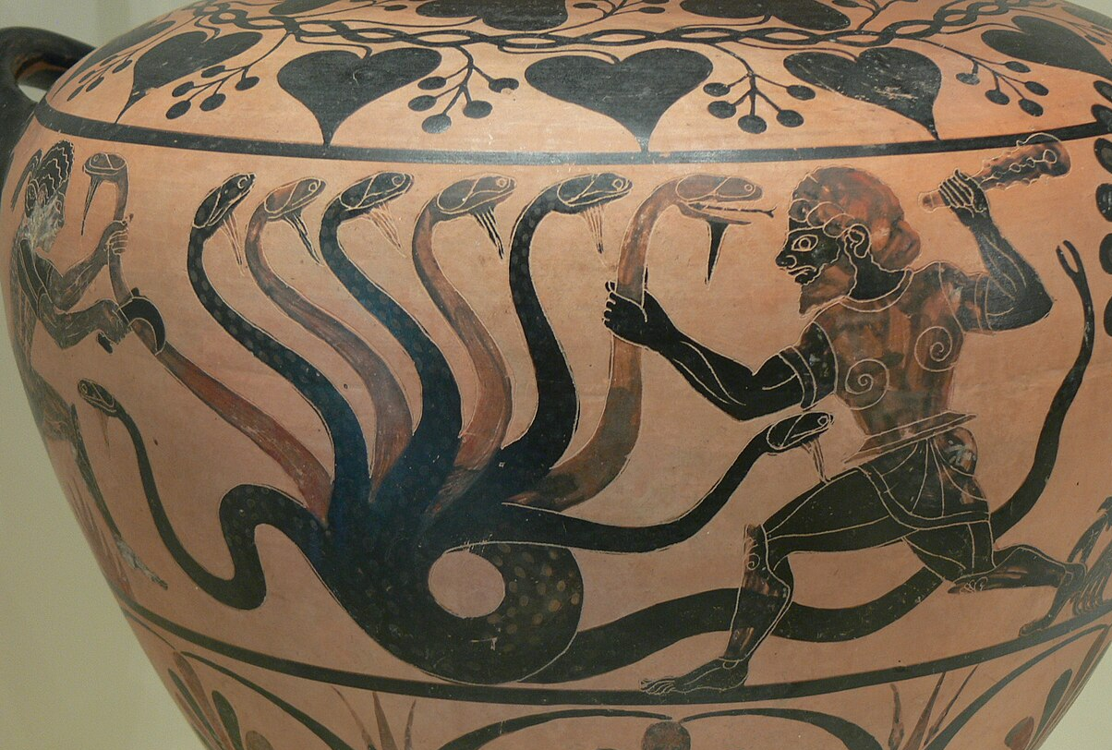

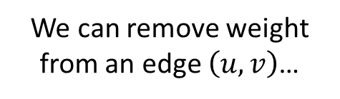

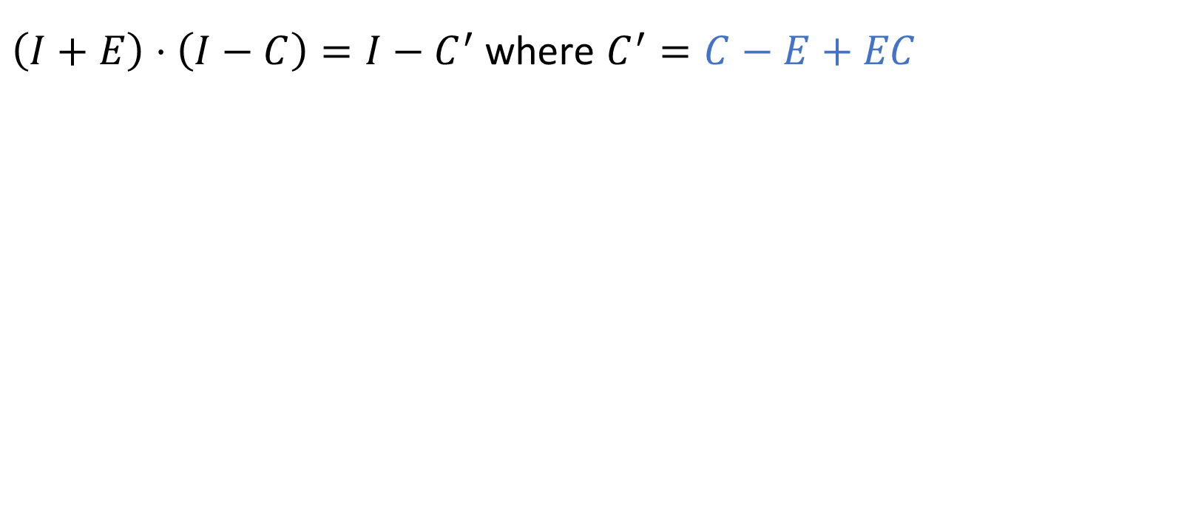


Interpretation: Shortcutting
But it will re-appear going from $u$ to out-neighbors of $v$
$\left(I+E\right)⋅\left(I−C\right)=I−C^{′}$ where $C^{′}=C−E+EC$
We can remove weight from an edge $\left(u, v\right)$…
$$u$$
$$v$$
Photo by Wolfgang Sauber. License: CC-BY-SA 3.0

Slide 10
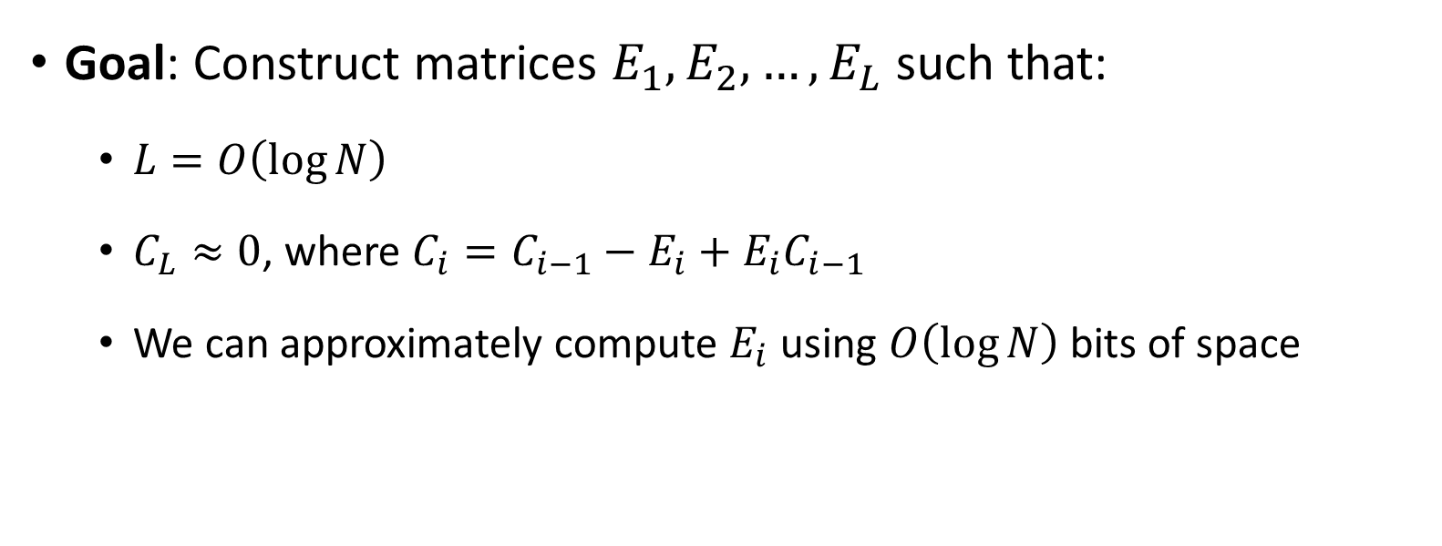
Recap of strategy
Goal: Construct matrices $E_{1},E_{2},…, E_{L}$ such that:
  $L=O\left(\log{N}\right)$
  $C_{L}≈0$, where $C_{i}=C_{i−1}−E_{i}+E_{i}C_{i−1}$
  We can approximately compute $E_{i}$ using $O\left(\log{N}\right)$ bits of space

Slide 11

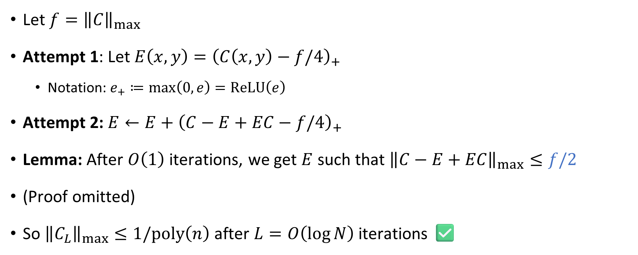


Progress measure: Maximum edge weight
$$E$$
Let $f={\left\|C\right\|}_{max}$
Attempt 1: Let $E\left(x,y\right)={\left(C\left(x,y\right)−f/4\right)}_{+}$
  Notation: $e_{+}≔\max\left(0,e\right)=\text{ReLU}\left(e\right)$
Attempt 2: $E←E+{\left(C−E+EC−f/4\right)}_{+}$
Lemma: After $O\left(1\right)$ iterations, we get $E$ such that ${\left\|C−E+EC\right\|}_{max}≤f/2$
(Proof omitted)
So ${\left\|C_{L}\right\|}_{max}≤1/\text{poly}\left(n\right)$ after $L=O\left(\log{N}\right)$ iterations ✅
$$C$$
$$f/4$$

Slide 12
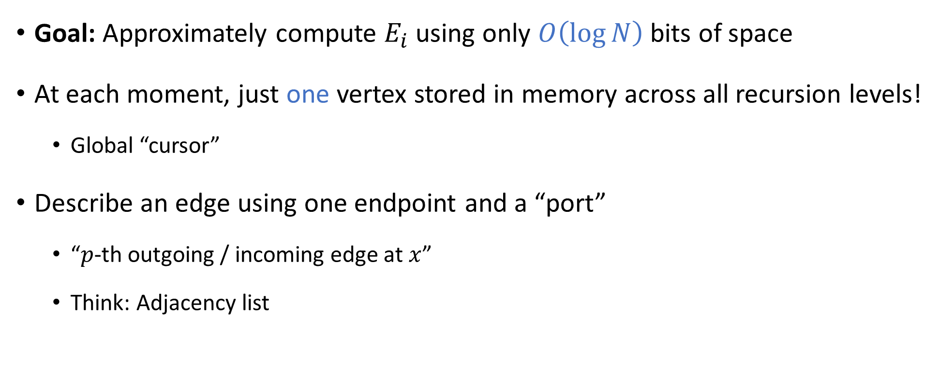
Main challenge: Space complexity
Goal: Approximately compute $E_{i}$ using only $O\left(\log{N}\right)$ bits of space
At each moment, just one vertex stored in memory across all recursion levels!
  Global “cursor”
Describe an edge using one endpoint and a “port”
  “$p$-th outgoing / incoming edge at $x$”
  Think: Adjacency list
We need to beat Savitch!

Slide 13

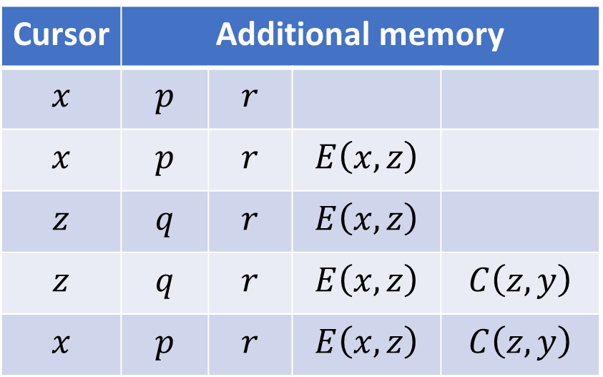

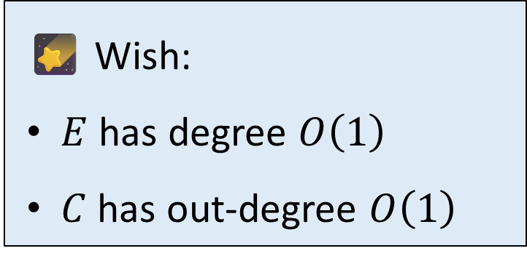
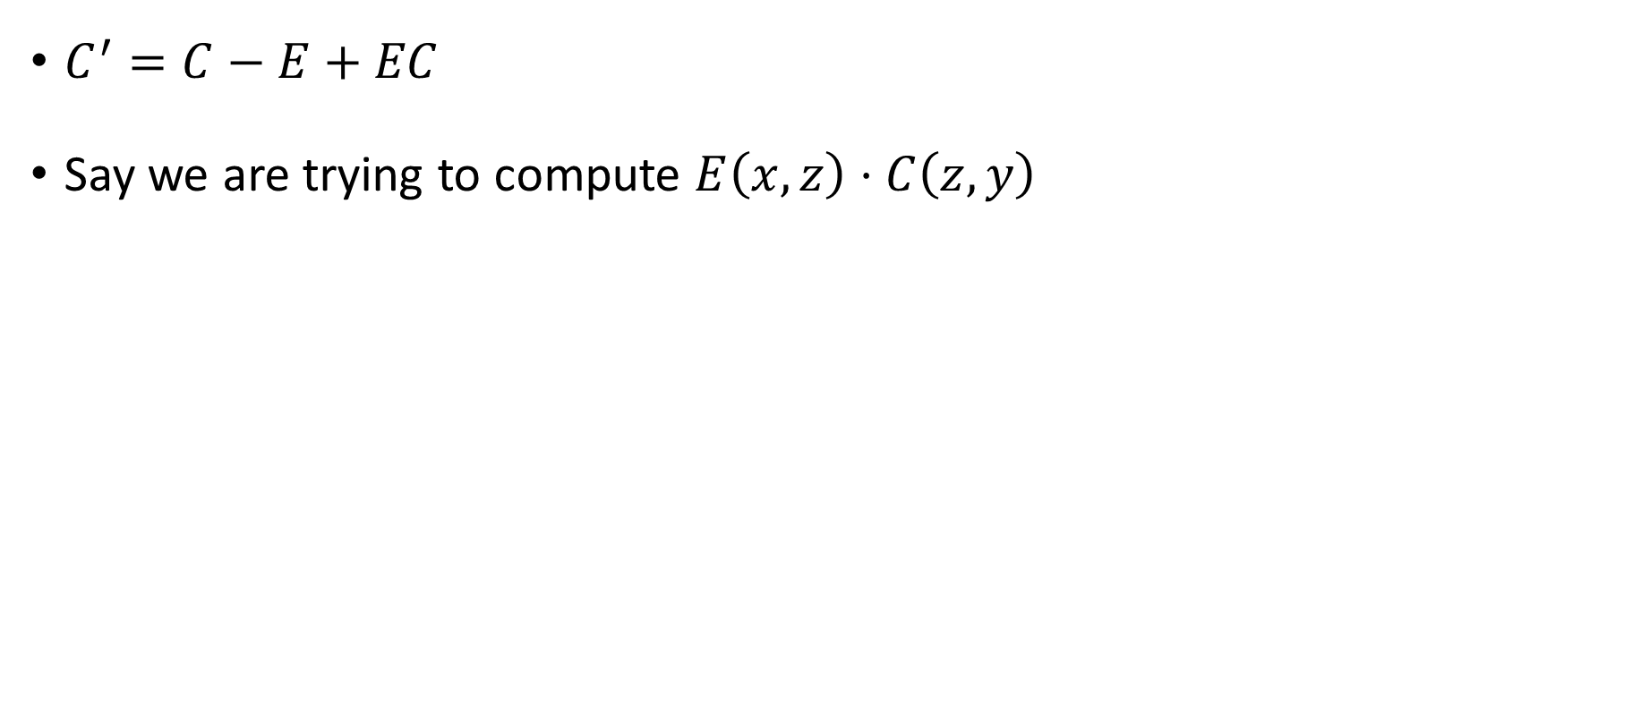






Space complexity
$$E$$
$$C$$
$$x$$
$$y$$
$$p$$
$C^{′}=C−E+EC$
Say we are trying to compute $E\left(x,z\right)⋅C\left(z,y\right)$
$$q$$
$$r$$
$$z$$
Cursor | Additional memory
$$x$$ | $$p$$ | $$r$$
$$x$$ | $$p$$ | $$r$$ | $$E\left(x,z\right)$$
$$z$$ | $$q$$ | $$r$$ | $$E\left(x,z\right)$$
$$z$$ | $$q$$ | $$r$$ | $$E\left(x,z\right)$$ | $$C\left(z,y\right)$$
$$x$$ | $$p$$ | $$r$$ | $$E\left(x,z\right)$$ | $$C\left(z,y\right)$$
🌠 Wish:
$E$ has degree $O\left(1\right)$
$C$ has out-degree $O\left(1\right)$
Time

Slide 14
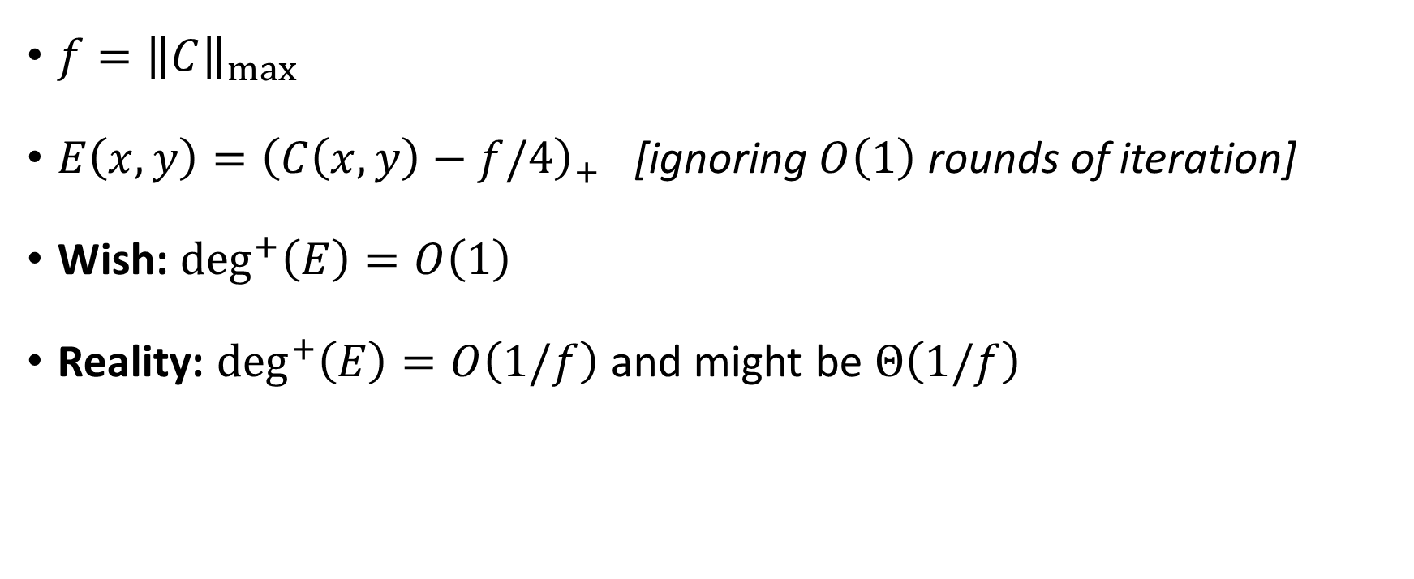

Example: Out-degree of $E$
$f={\left\|C\right\|}_{max}$
$E\left(x,y\right)={\left(C\left(x,y\right)−f/4\right)}_{+}$ [ignoring $O\left(1\right)$ rounds of iteration]
Wish: $\deg^{+}\left(E\right)=O\left(1\right)$
Reality: $\deg^{+}\left(E\right)=O\left(1/f\right)$ and might be $Θ\left(1/f\right)$

Slide 15
Sparsification

Slide 16
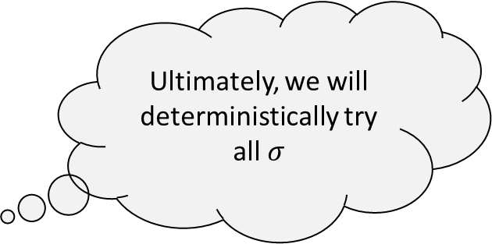
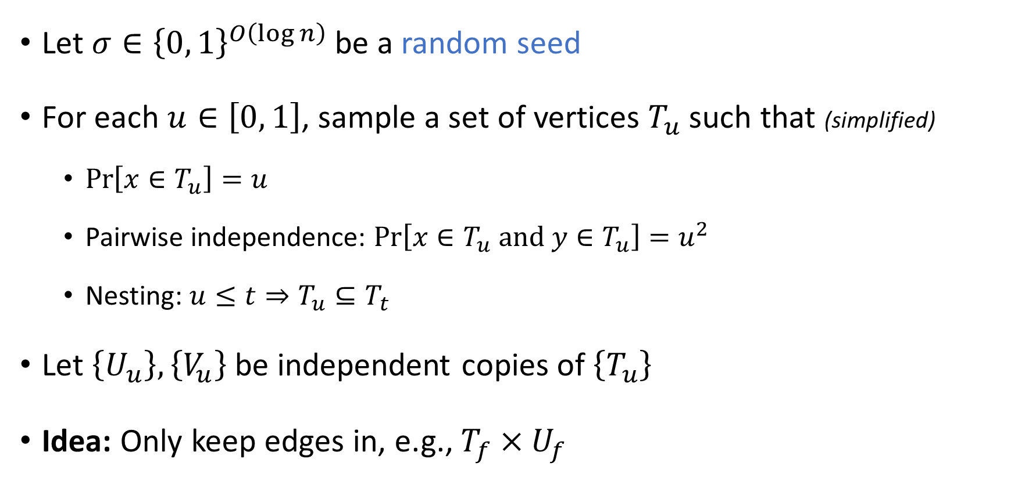
Sparsification
Ultimately, we will deterministically try all $σ$
Let $σ∈{\left\{0, 1\right\}}^{O\left(\log{n}\right)}$ be a random seed
For each $u∈\left[0, 1\right]$, sample a set of vertices $T_{u}$ such that (simplified)
  $\operatorname{Pr}\left[x∈T_{u}\right]=u$
  Pairwise independence: $\operatorname{Pr}\left[x∈T_{u}\text{ and }y∈T_{u}\right]=u^{2}$
  Nesting: $u≤t⇒T_{u}⊆T_{t}$
Let $\left\{U_{u}\right\},\left\{V_{u}\right\}$ be independent copies of $\left\{T_{u}\right\}$
Idea: Only keep edges in, e.g., $T_{f}×U_{f}$
“channel” in OpenAI manuscript

Slide 17
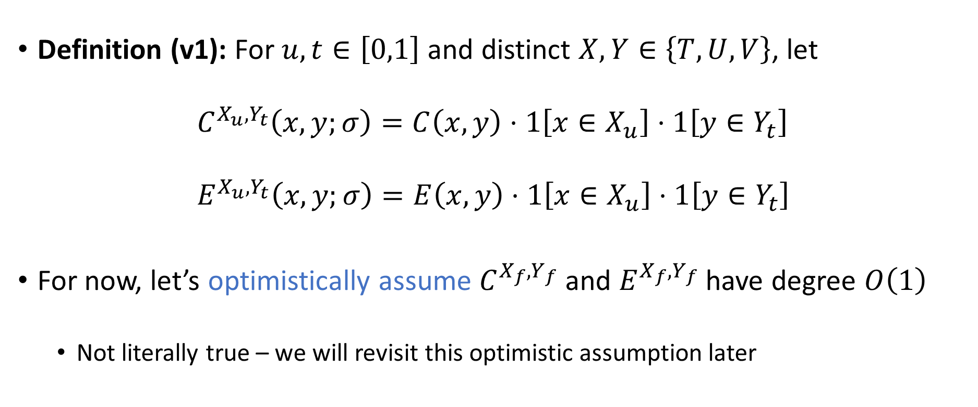
Sparsification
Definition (v1): For $u,t∈\left[0,1\right]$ and distinct $X,Y∈\left\{T,U,V\right\}$, let
$$C^{X_{u},Y_{t}}\left(x,y;σ\right)=C\left(x,y\right)⋅1\left[x∈X_{u}\right]⋅1\left[y∈Y_{t}\right] \\ E^{X_{u},Y_{t}}\left(x,y;σ\right)=E\left(x,y\right)⋅1\left[x∈X_{u}\right]⋅1\left[y∈Y_{t}\right]$$
For now, let’s optimistically assume $C^{X_{f},Y_{f}}$ and $E^{X_{f},Y_{f}}$ have degree $O\left(1\right)$
  Not literally true – we will revisit this optimistic assumption later

Slide 18
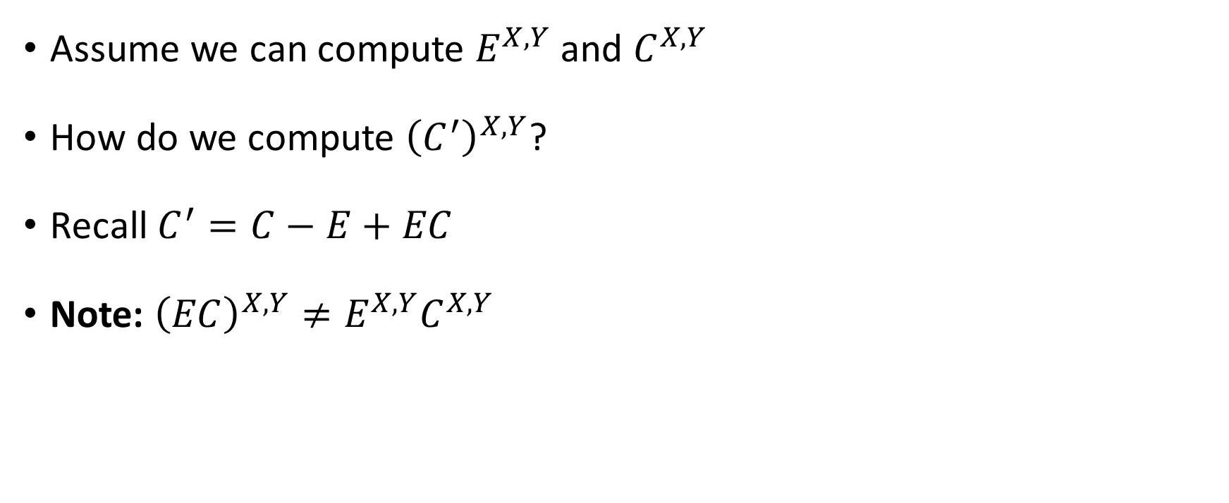
Computing the sparsified matrices
Assume we can compute $E^{X,Y}$ and $C^{X,Y}$
How do we compute ${\left(C^{′}\right)}^{X,Y}$?
Recall $C^{′}=C−E+EC$
Note: ${\left(EC\right)}^{X,Y}≠E^{X,Y}C^{X,Y}$

Slide 19
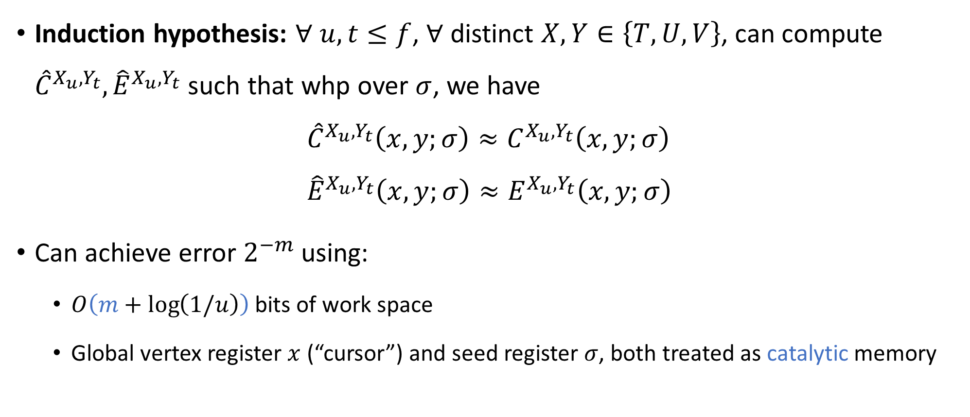
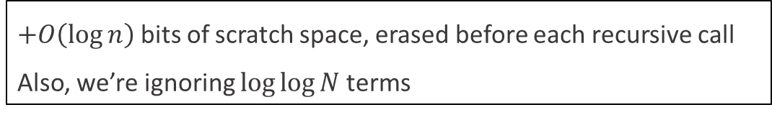
Approximating the sparsified graphs
Induction hypothesis: $∀$ $u,t≤f$, $∀$ distinct $X,Y∈\left\{T,U,V\right\}$, can compute ${\hat{C}}^{X_{u},Y_{t}},{\hat{E}}^{X_{u},Y_{t}}$ such that whp over $σ$, we have
$${\hat{C}}^{X_{u},Y_{t}}\left(x,y;σ\right)≈C^{X_{u},Y_{t}}\left(x,y;σ\right) \\ {\hat{E}}^{X_{u},Y_{t}}\left(x,y;σ\right)≈E^{X_{u},Y_{t}}\left(x,y;σ\right)$$
Can achieve error $2^{−m}$ using:
  $O\left(m+\log\left(1/u\right)\right)$ bits of work space
  Global vertex register $x$ (“cursor”) and seed register $σ$, both treated as catalytic memory
“estimated tables” in OpenAI manuscript
“true tables” in OpenAI manuscript
$+O\left(\log{n}\right)$ bits of scratch space, erased before each recursive call
Also, we’re ignoring $\log{\log{N}}$ terms
Notes:
Error measure:
$$\frac{t}{N}⋅\sum_{x,y}{𝔼_{σ}\left[{\left({\left(\frac{{\hat{C}}^{X_{u},Y_{t}}\left(x,y;σ\right)}{f}\right)}^{1/8}−{\left(\frac{C^{X_{u},Y_{t}}\left(x,y;σ\right)}{f}\right)}^{1/8}\right)}^{8} ∣ x∈X_{u},y∈Y_{t}\right]}$$

Slide 20
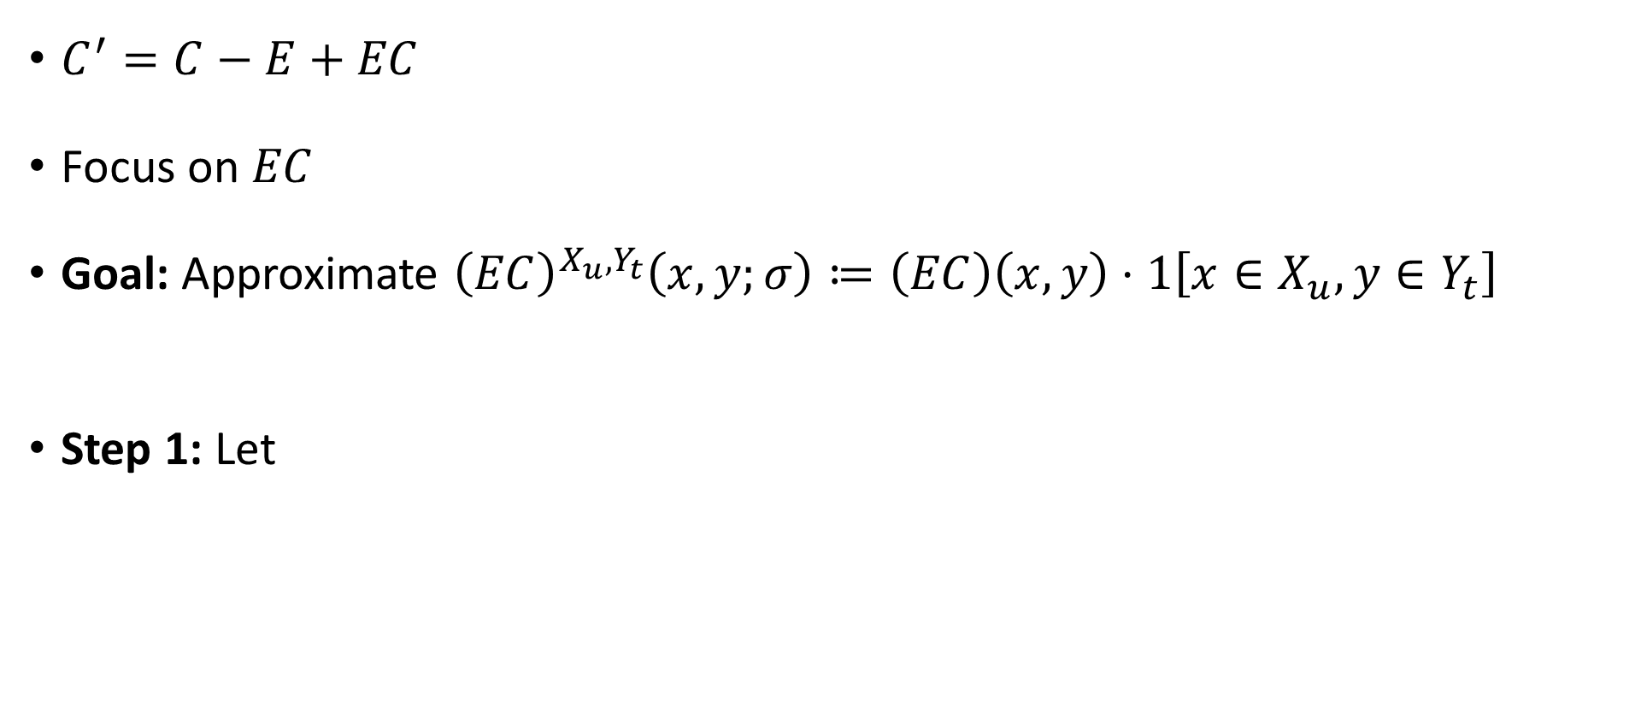

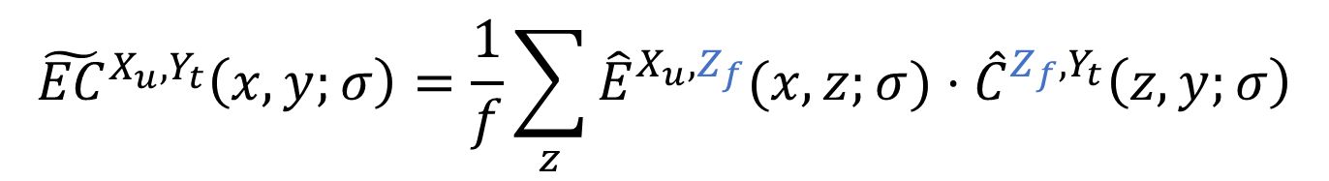
Approximating ${\left(EC\right)}^{X,Y}$
$C^{′}=C−E+EC$
Focus on $EC$
Goal: Approximate ${\left(EC\right)}^{X_{u},Y_{t}}\left(x,y;σ\right)≔\left(EC\right)\left(x,y\right)⋅1\left[x∈X_{u},y∈Y_{t}\right]$
Step 1: Let
$${\tilde{EC}}^{X_{u},Y_{t}}\left(x,y;σ\right)=\frac{1}{f}\sum_{z}{{\hat{E}}^{X_{u},Z_{f}}(x,z;σ)}⋅{\hat{C}}^{Z_{f},Y_{t}}\left(z,y;σ\right)$$
“raw sample term” in OpenAI manuscript

Slide 21
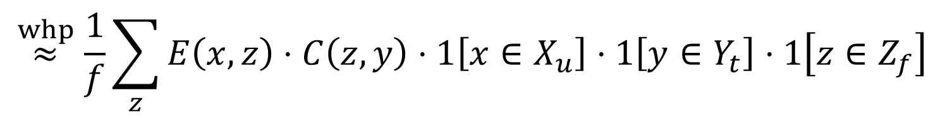
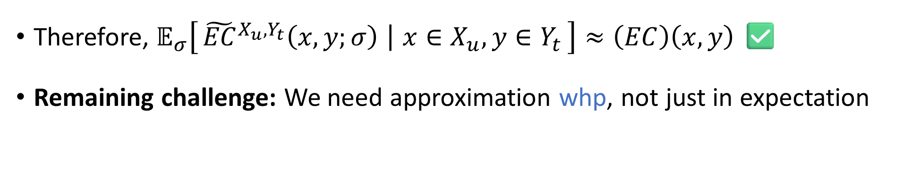

$${\tilde{EC}}^{X_{u},Y_{t}}\left(x,y;σ\right)=\frac{1}{f}\sum_{z}{{\hat{E}}^{X_{u},Z_{f}}(x,z;σ)}⋅{\hat{C}}^{Z_{f},Y_{t}}\left(z,y;σ\right)$$
$$\overset{whp}{≈}\frac{1}{f}\sum_{z}{E\left(x,z\right)}⋅C\left(z,y\right)⋅1\left[x∈X_{u}\right]⋅1\left[y∈Y_{t}\right]⋅1\left[z∈Z_{f}\right]$$
Therefore, $𝔼_{σ}\left[{\tilde{EC}}^{X_{u},Y_{t}}\left(x,y;σ\right) ∣ x∈X_{u},y∈Y_{t}\right]≈\left(EC\right)\left(x,y\right)$ ✅
Remaining challenge: We need approximation whp, not just in expectation

Slide 22
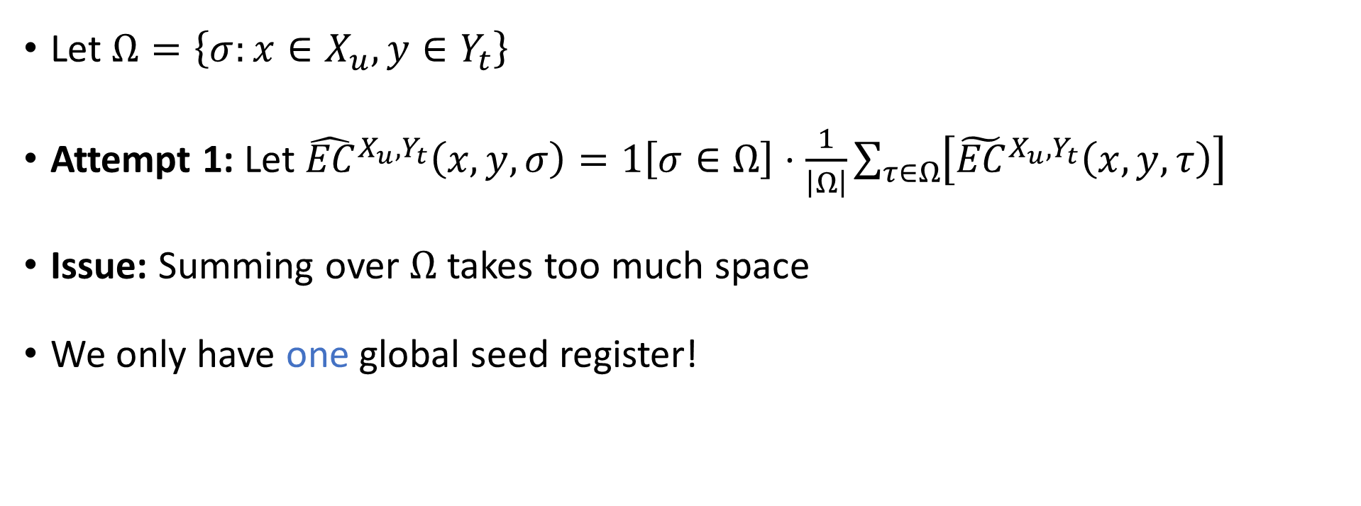
Approximation whp
Let $Ω=\left\{σ:x∈X_{u},y∈Y_{t}\right\}$
Attempt 1: Let ${\hat{EC}}^{X_{u},Y_{t}}\left(x,y,σ\right)=1\left[σ∈Ω\right]⋅\frac{1}{\left|Ω\right|}\sum_{τ∈Ω}{\left[{\tilde{EC}}^{X_{u},Y_{t}}\left(x,y,τ\right)\right]}$
Issue: Summing over $Ω$ takes too much space
We only have one global seed register!
We need to beat Nisan!

Slide 23
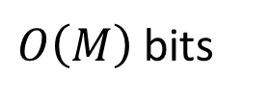
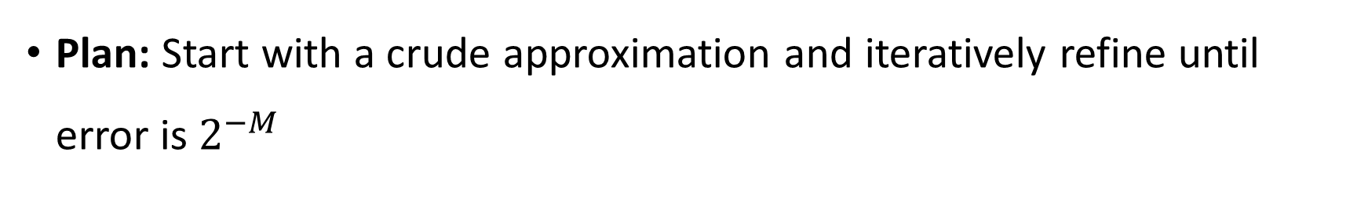
Iterative refinement
Similar spirit as:
Richardson iteration, e.g., [Murtagh, Reingold, Sidford, Vadhan 2017]
WPRGs, e.g., [Braverman, Cohen, Garg 2018]
Plan: Start with a crude approximation and iteratively refine until error is $2^{−M}$
Crude approximation ➡️
Space used at current recursion level
Delicate refinement ➡️
Space used by child + descendants
$O\left(M\right)$ bits

Slide 24
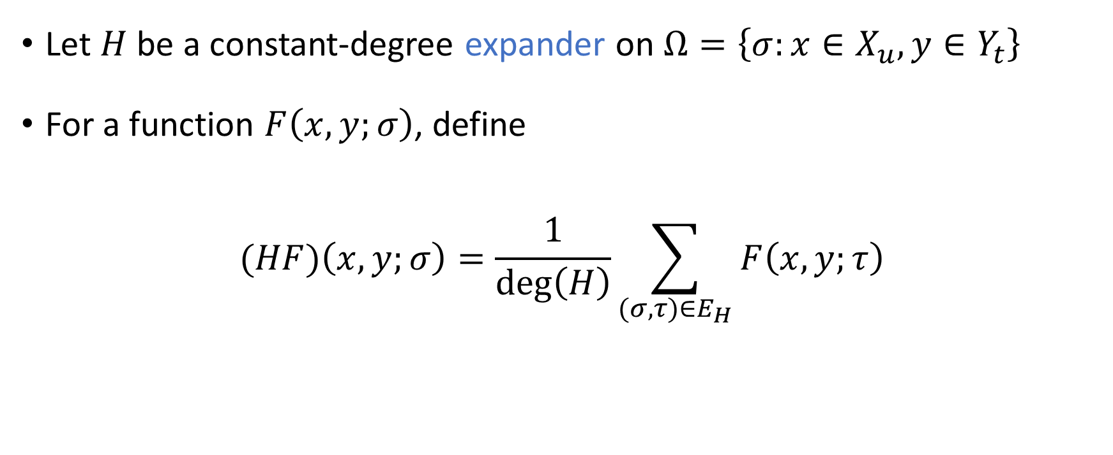
Expander notation
Let $H$ be a constant-degree expander on $Ω=\left\{σ:x∈X_{u},y∈Y_{t}\right\}$
For a function $F\left(x,y;σ\right)$, define
$$(HF)\left(x,y;σ\right)=\frac{1}{\deg\left(H\right)}\sum_{(σ, τ)∈E_{H}}{F\left(x,y;τ\right)}$$

Slide 25
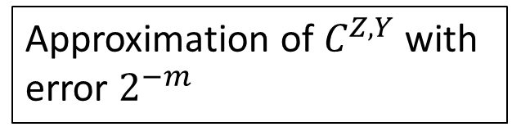
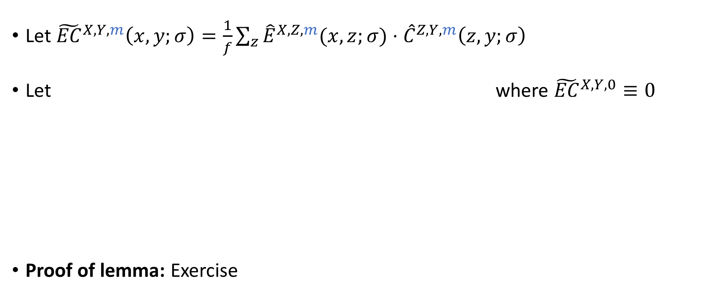
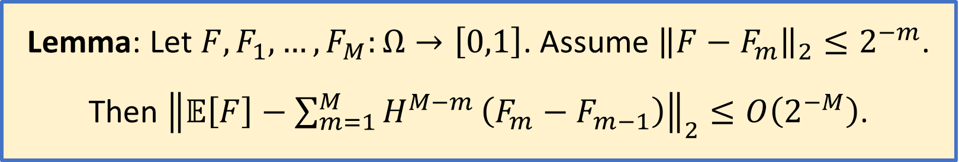
Recursion-friendly sampling
Approximation of $C^{Z,Y}$ with error $2^{−m}$
Let ${\tilde{EC}}^{X,Y,m}\left(x,y;σ\right)=\frac{1}{f}\sum_{z}{{\hat{E}}^{X,Z,m}(x,z;σ)}⋅{\hat{C}}^{Z,Y,m}\left(z,y;σ\right)$
Let where ${\tilde{EC}}^{X,Y,0}≡0$
Proof of lemma: Exercise
${\hat{EC}}^{X,Y,M}=\sum_{m=1}^{M}{H^{M−m}}\left({\tilde{EC}}^{X,Y,m}−{\tilde{EC}}^{X,Y,m−1}\right)$
Lemma: Let $F,F_{1},…, F_{M}:Ω→\left[0,1\right]$. Assume ${\left\|F−F_{m}\right\|}_{2}≤2^{−m}$. Then ${\left\|𝔼\left[F\right]−\sum_{m=1}^{M}{H^{M−m}}\left(F_{m}−F_{m−1}\right)\right\|}_{2}≤O\left(2^{−M}\right)$.

Slide 26
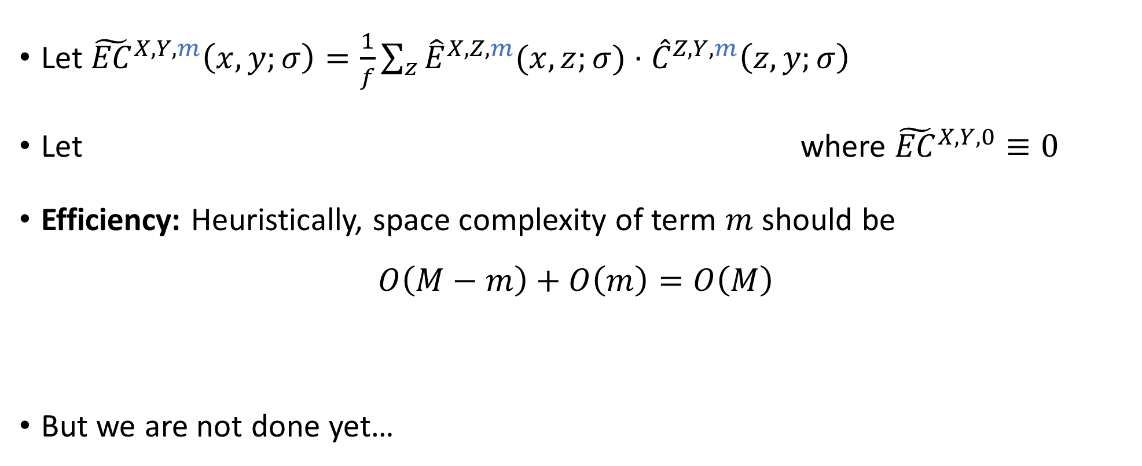
Recursion-friendly sampling
Approximation of $C^{Z,Y}$ with error $2^{−m}$
Let ${\tilde{EC}}^{X,Y,m}\left(x,y;σ\right)=\frac{1}{f}\sum_{z}{{\hat{E}}^{X,Z,m}(x,z;σ)}⋅{\hat{C}}^{Z,Y,m}\left(z,y;σ\right)$
Let where ${\tilde{EC}}^{X,Y,0}≡0$
Efficiency: Heuristically, space complexity of term $m$ should be
$$O\left(M−m\right)+O\left(m\right)=O\left(M\right)$$
But we are not done yet…
${\hat{EC}}^{X,Y,M}=\sum_{m=1}^{M}{H^{M−m}}\left({\tilde{EC}}^{X,Y,m}−{\tilde{EC}}^{X,Y,m−1}\right)$
🙂
Expander walk
Recursion

Slide 27
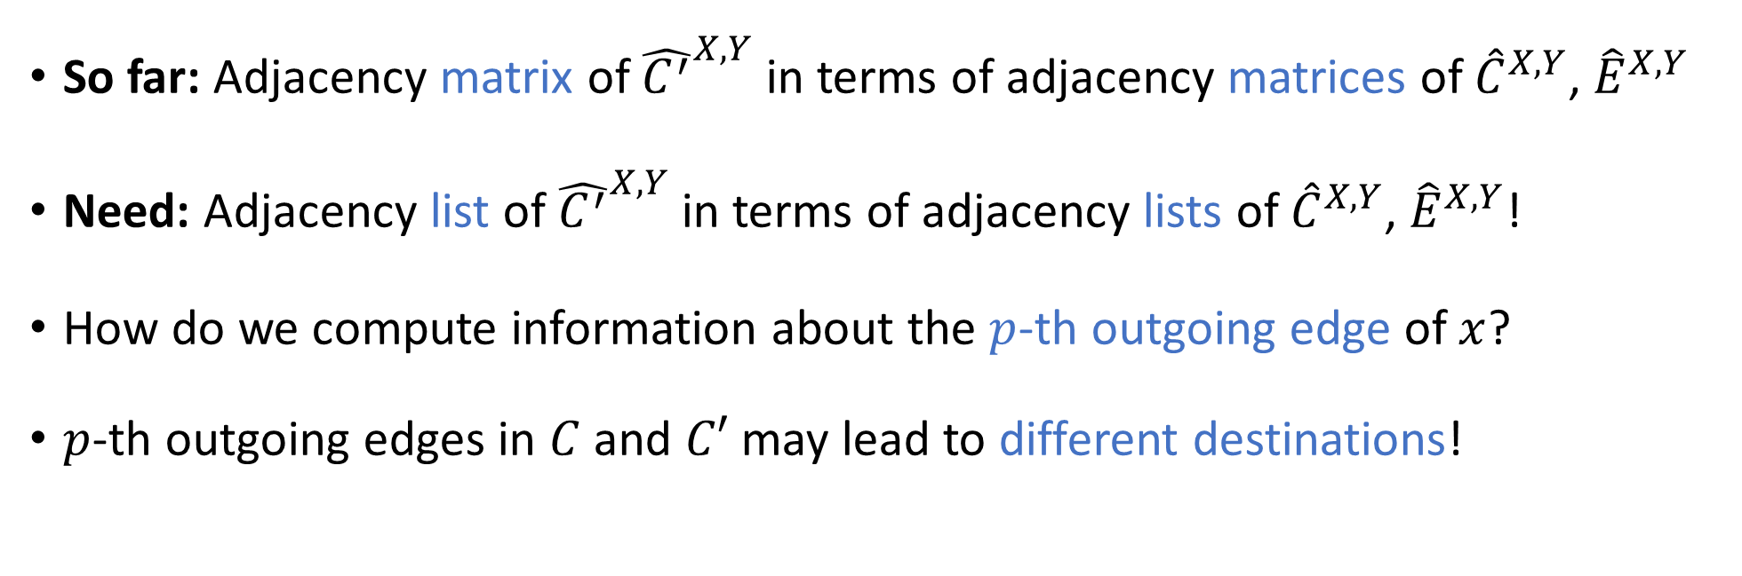
Adjacency matrix vs. adjacency list
${\hat{EC}}^{X,Y,M}=\sum_{m=1}^{M}{H^{M−m}}\left({\tilde{EC}}^{X,Y,m}−{\tilde{EC}}^{X,Y,m−1}\right)$
So far: Adjacency matrix of ${\hat{C^{′}}}^{X,Y}$ in terms of adjacency matrices of ${\hat{C}}^{X,Y}$, ${\hat{E}}^{X,Y}$
Need: Adjacency list of ${\hat{C^{′}}}^{X,Y}$ in terms of adjacency lists of ${\hat{C}}^{X,Y}$, ${\hat{E}}^{X,Y}$!
How do we compute information about the $p$-th outgoing edge of $x$?
$p$-th outgoing edges in $C$ and $C′$ may lead to different destinations!

Slide 28
Adjacency lists

Slide 29
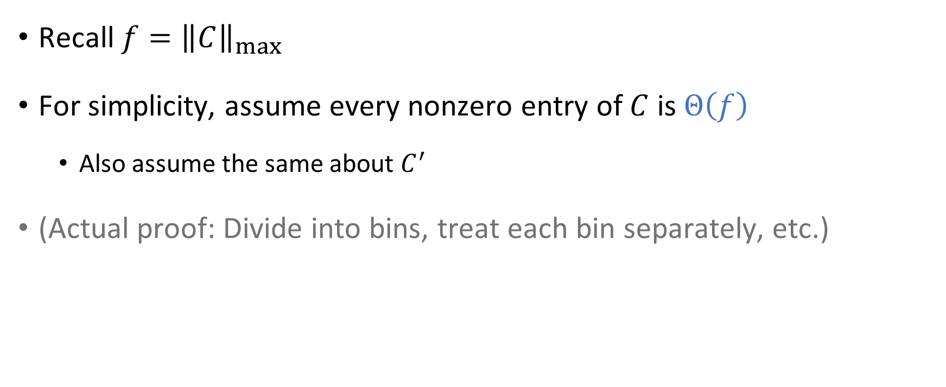
A simplifying assumption
Recall $f={\left\|C\right\|}_{max}$
For simplicity, assume every nonzero entry of $C$ is $Θ\left(f\right)$
  Also assume the same about $C^{′}$
(Actual proof: Divide into bins, treat each bin separately, etc.)

Slide 30

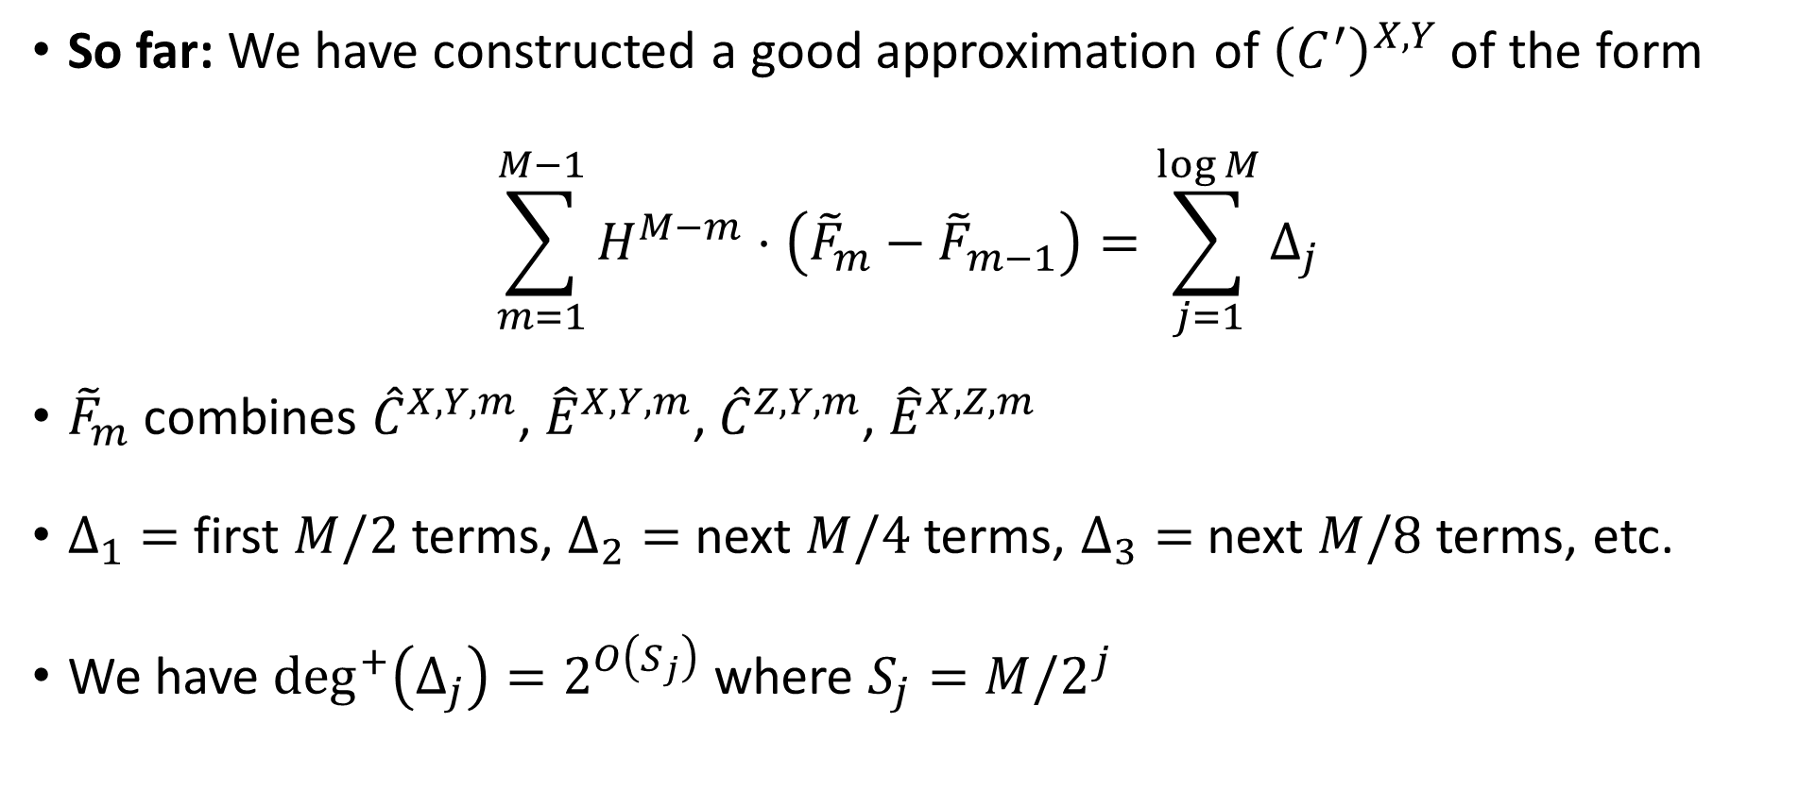
Updates
So far: We have constructed a good approximation of ${\left(C^{′}\right)}^{X,Y}$ of the form
$$\sum_{m=1}^{M−1}{H^{M−m}⋅\left({\tilde{F}}_{m}−{\tilde{F}}_{m−1}\right)}=\sum_{j=1}^{\log{M}}{Δ_{j}}$$
${\tilde{F}}_{m}$ combines ${\hat{C}}^{X,Y,m}$, ${\hat{E}}^{X,Y,m}$, ${\hat{C}}^{Z,Y,m}$, ${\hat{E}}^{X,Z,m}$
$Δ_{1}=$ first $M/2$ terms, $Δ_{2}=$ next $M/4$ terms, $Δ_{3}=$ next $M/8$ terms, etc.
We have $\deg^{+}\left(Δ_{j}\right)=2^{O\left(S_{j}\right)}$ where $S_{j}=M/2^{j}$
“Update $j$”

Slide 31
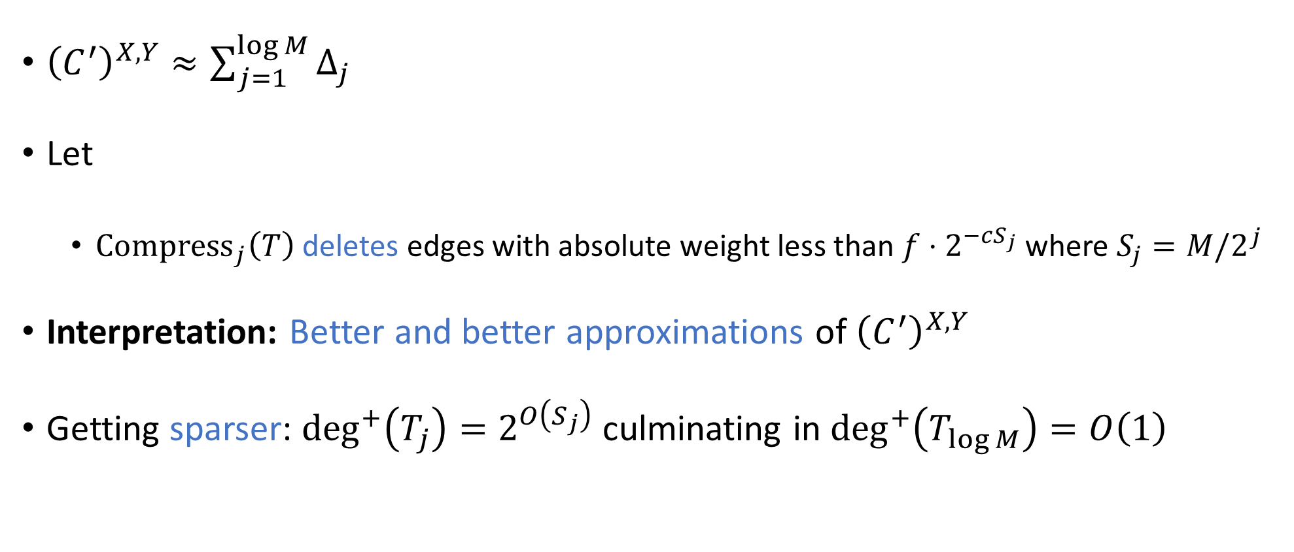
Compression
${\left(C^{′}\right)}^{X,Y}≈\sum_{j=1}^{\log{M}}{Δ_{j}}$
Let
  ${\text{Compress}}_{j}\left(T\right)$ deletes edges with absolute weight less than ${f⋅2}^{−cS_{j}}$ where $S_{j}=M/2^{j}$
Interpretation: Better and better approximations of ${\left(C^{′}\right)}^{X,Y}$
Getting sparser: $\deg^{+}\left(T_{j}\right)=2^{O\left(S_{j}\right)}$ culminating in $\deg^{+}\left(T_{\log{M}}\right)=O\left(1\right)$
${\hat{C^{′}}}^{X,Y,M}=T_{\log{M}}$ where $T_{0}=0$ and $T_{j}={\text{Compress}}_{j}\left(T_{j−1}+Δ_{j}\right)$

Slide 32
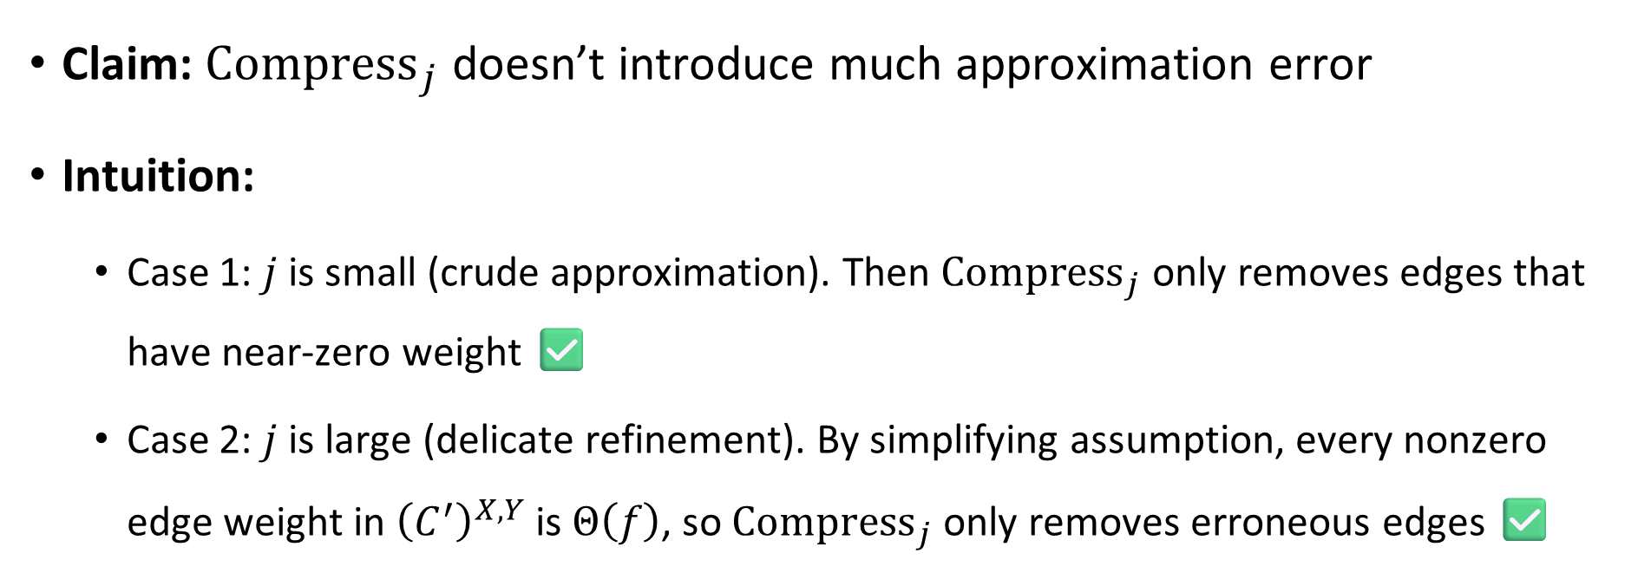
Correctness
${\hat{C^{′}}}^{X,Y,M}=T_{\log{M}}$ where $T_{0}=0$ and $T_{j}={\text{Compress}}_{j}\left(T_{j−1}+Δ_{j}\right)$
Claim: ${\text{Compress}}_{j}$ doesn’t introduce much approximation error
Intuition:
  Case 1: $j$ is small (crude approximation). Then ${\text{Compress}}_{j}$ only removes edges that have near-zero weight ✅
  Case 2: $j$ is large (delicate refinement). By simplifying assumption, every nonzero edge weight in ${\left(C^{′}\right)}^{X,Y}$ is $Θ\left(f\right)$, so ${\text{Compress}}_{j}$ only removes erroneous edges ✅

Slide 33
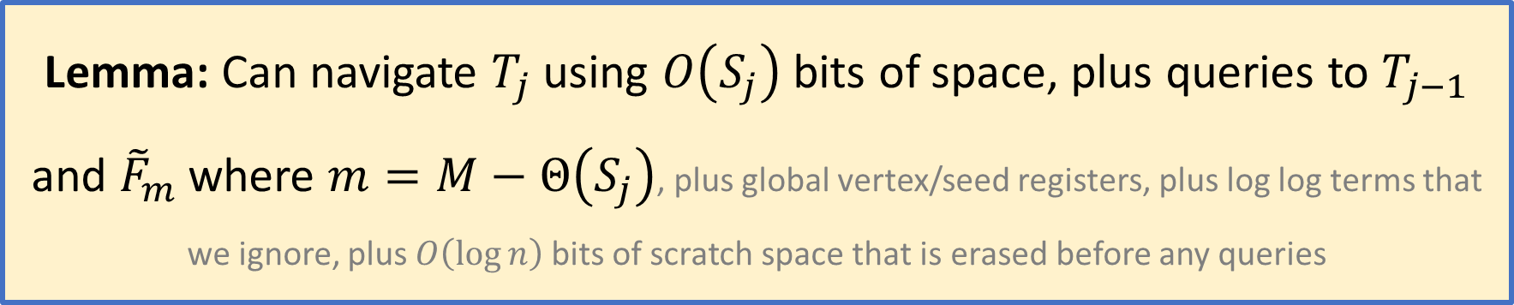
Efficiency
${\hat{C^{′}}}^{X,Y,M}=T_{\log{M}}$ where $T_{0}=0$ and $T_{j}={\text{Compress}}_{j}\left(T_{j−1}+Δ_{j}\right)$
Lemma: Can navigate $T_{j}$ using $O\left(S_{j}\right)$ bits of space, plus queries to $T_{j−1}$ and ${\tilde{F}}_{m}$ where $m=M−Θ\left(S_{j}\right)$, plus global vertex/seed registers, plus log log terms that we ignore, plus $O\left(\log{n}\right)$ bits of scratch space that is erased before any queries
As we will see, the proof of the lemma isn’t hard – just unpack definitions

Slide 34
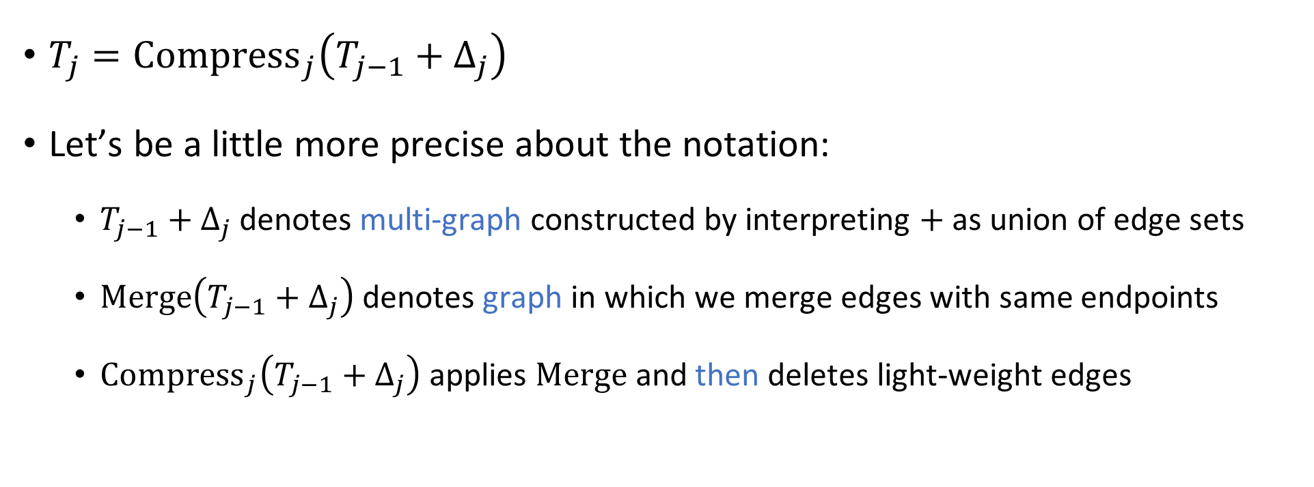
Merging edges
$T_{j}={\text{Compress}}_{j}\left(T_{j−1}+Δ_{j}\right)$
Let’s be a little more precise about the notation:
  $T_{j−1}+Δ_{j}$ denotes multi-graph constructed by interpreting $+$ as union of edge sets
  $\text{Merge}\left(T_{j−1}+Δ_{j}\right)$ denotes graph in which we merge edges with same endpoints
  ${\text{Compress}}_{j}\left(T_{j−1}+Δ_{j}\right)$ applies $\text{Merge}$ and then deletes light-weight edges

Slide 35
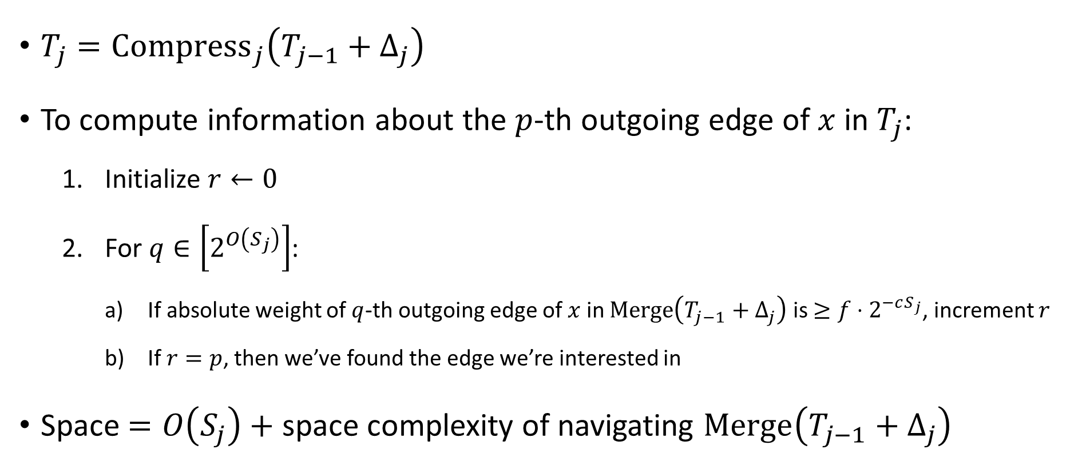

Navigating $T_{j}$
$T_{j}={\text{Compress}}_{j}\left(T_{j−1}+Δ_{j}\right)$
To compute information about the $p$-th outgoing edge of $x$ in $T_{j}$:
  Initialize $r←0$
  For $q∈\left[2^{O\left(S_{j}\right)}\right]$:
    If absolute weight of $q$-th outgoing edge of $x$ in $\text{Merge}\left(T_{j−1}+Δ_{j}\right)$ is $≥{f⋅2}^{−cS_{j}}$, increment $r$
    If $r=p$, then we’ve found the edge we’re interested in
Space $=O\left(S_{j}\right)+$ space complexity of navigating $\text{Merge}\left(T_{j−1}+Δ_{j}\right)$

Slide 36
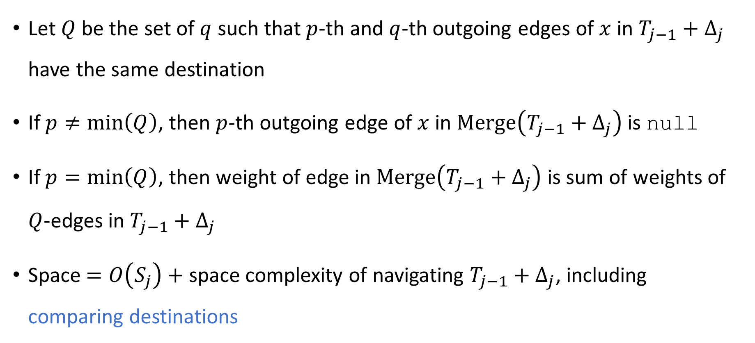

Navigating $\text{Merge}\left(T_{j−1}+Δ_{j}\right)$
Let $Q$ be the set of $q$ such that $p$-th and $q$-th outgoing edges of $x$ in $T_{j−1}+Δ_{j}$ have the same destination
If $p≠\min\left(Q\right)$, then $p$-th outgoing edge of $x$ in $\text{Merge}\left(T_{j−1}+Δ_{j}\right)$ is null
If $p=\min\left(Q\right)$, then weight of edge in $\text{Merge}\left(T_{j−1}+Δ_{j}\right)$ is sum of weights of $Q$-edges in $T_{j−1}+Δ_{j}$
Space $=O\left(S_{j}\right)+$ space complexity of navigating $T_{j−1}+Δ_{j}$, including comparing destinations

Slide 37
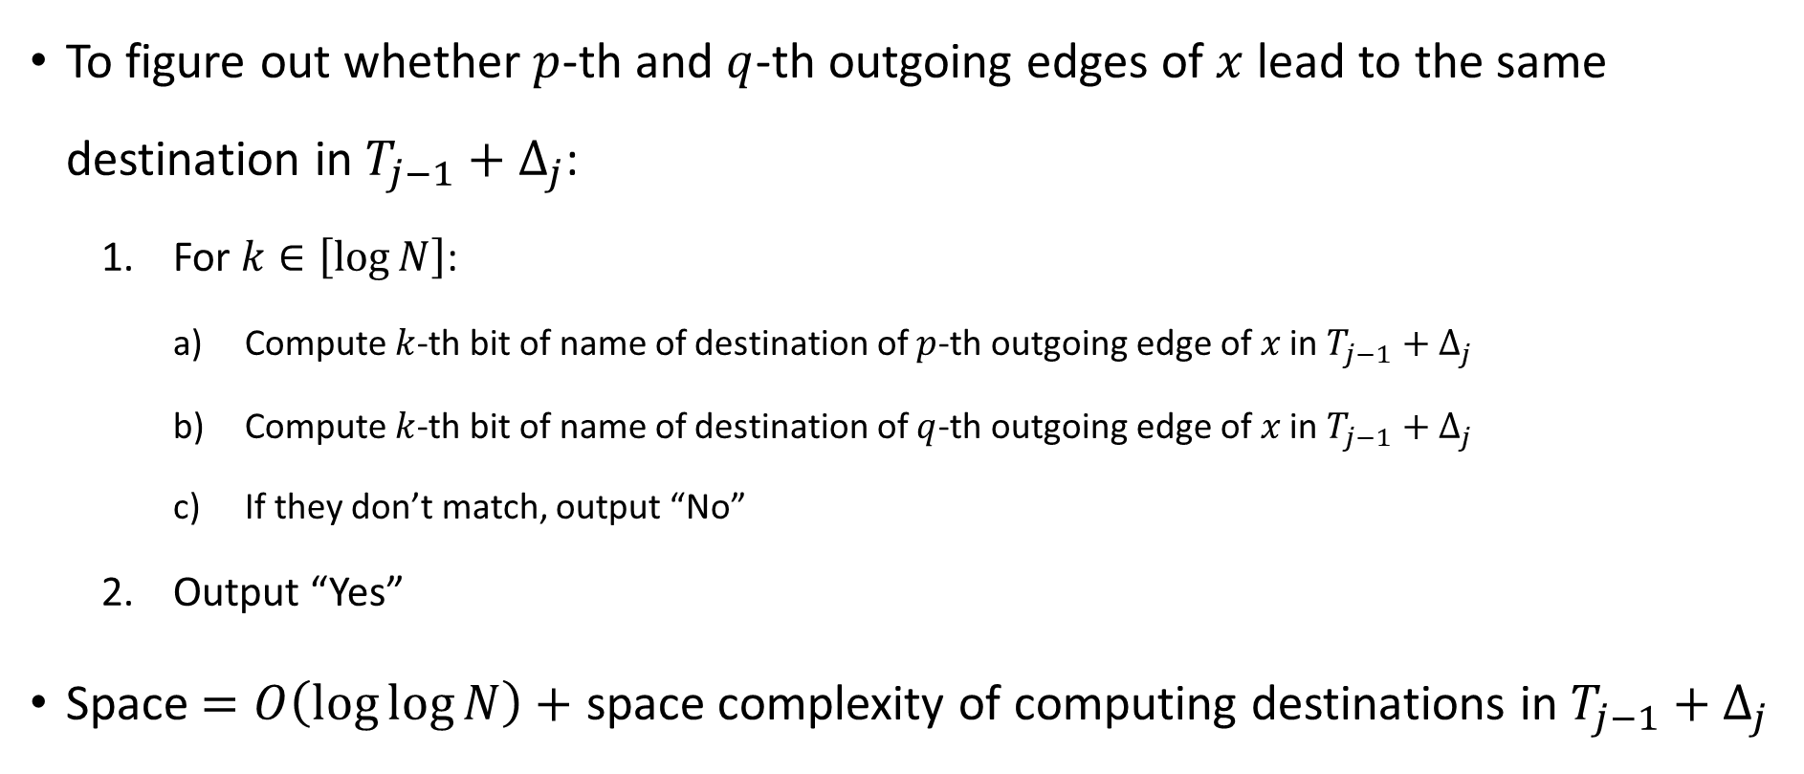
Comparing destinations
To figure out whether $p$-th and $q$-th outgoing edges of $x$ lead to the same destination in $T_{j−1}+Δ_{j}$:
  For $k∈\left[\log{N}\right]$:
    Compute $k$-th bit of name of destination of $p$-th outgoing edge of $x$ in $T_{j−1}+Δ_{j}$
    Compute $k$-th bit of name of destination of $q$-th outgoing edge of $x$ in $T_{j−1}+Δ_{j}$
    If they don’t match, output “No”
  Output “Yes”
Space $=O\left(\log{\log{N}}\right)+$ space complexity of computing destinations in $T_{j−1}+Δ_{j}$

Slide 38
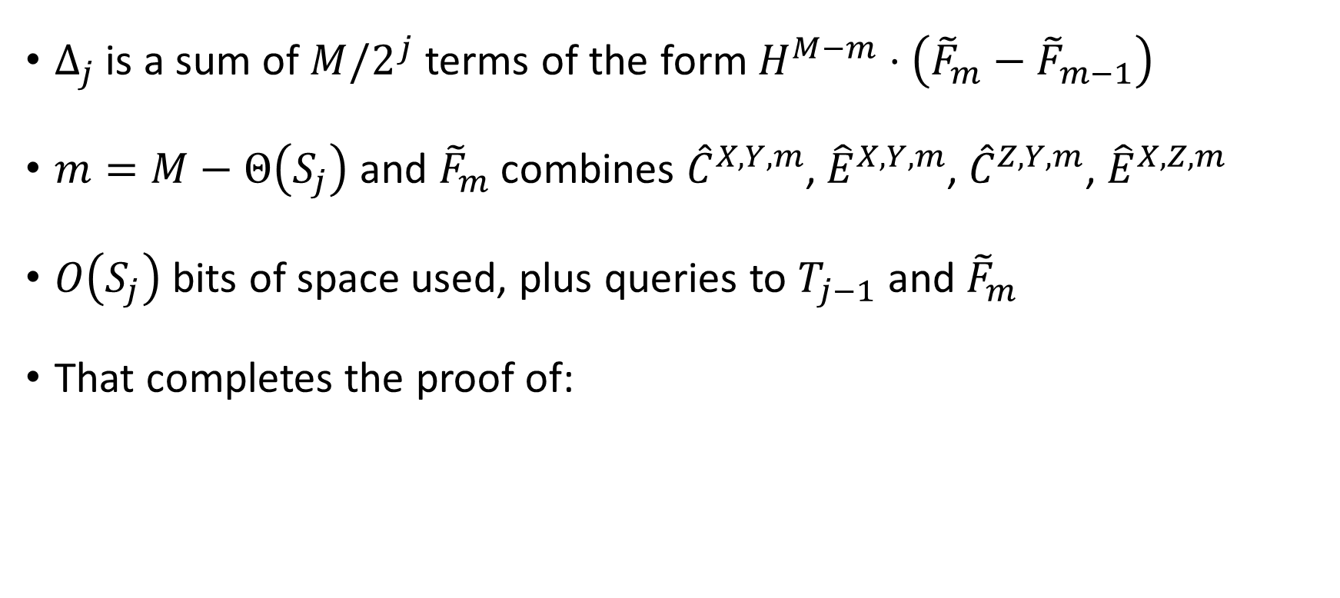


Navigating $T_{j−1}+Δ_{j}$
$Δ_{j}$ is a sum of $M/2^{j}$ terms of the form $H^{M−m}⋅\left({\tilde{F}}_{m}−{\tilde{F}}_{m−1}\right)$
$m=M−Θ\left(S_{j}\right)$ and ${\tilde{F}}_{m}$ combines ${\hat{C}}^{X,Y,m}$, ${\hat{E}}^{X,Y,m}$, ${\hat{C}}^{Z,Y,m}$, ${\hat{E}}^{X,Z,m}$
$O\left(S_{j}\right)$ bits of space used, plus queries to $T_{j−1}$ and ${\tilde{F}}_{m}$
That completes the proof of:
Lemma: Can navigate $T_{j}$ using $O\left(S_{j}\right)$ bits of space, plus queries to $T_{j−1}$ and ${\tilde{F}}_{m}$ where $m=M−Θ\left(S_{j}\right)$, plus unimportant terms

Slide 39




Adding up space used for all $T_{j}$
Lemma: Can navigate $T_{j}$ using $O\left(S_{j}\right)$ bits of space, plus queries to $T_{j−1}$ and ${\tilde{F}}_{m}$ where $m=M−Θ\left(S_{j}\right)$, plus unimportant terms
Query | Space used
$$T_{\log{M}}$$ | $$c_{1}⋅1$$
$$T_{\log{M}−1}$$ | $$c_{1}⋅2$$
$$⋮$$ | $$⋮$$
$$T_{j}$$ | $$c_{1}⋅M/2^{j}$$
$${\tilde{F}}_{m}$$ | $$c_{2}⋅\left(M−M/2^{j}\right)$$
$$\text{Total}=c_{1}⋅\left(1+2+4+⋯+M/2^{j}\right)+c_{2}⋅\left(M−M/2^{j}\right) \\ ≤2c_{1}⋅M/2^{j}+c_{2}⋅\left(M−M/2^{j}\right) \\ ≤c_{2}⋅M, \text{provided we choose }c_{2}≥2c_{1}$$

Slide 40

Iterative refinement
Crude approximation ➡️
Space used at current recursion level
Delicate refinement ➡️
Space used by child + descendants
$O\left(M\right)$ bits

Slide 41
Incoming ports and two-way navigation

Slide 42










Two-way navigation
$$\tilde{E}$$
$$\tilde{C}$$
$$x$$
Recall strategy for computing $\tilde{E}\left(x,z\right)⋅\tilde{C}\left(z,y\right)$
So far: How to compute $\left(x,p\right)↦z$. Need to compute: $\left(x,p\right)↔\left(z,q\right)$
$$y$$
$$p$$
$$q$$
$$r$$
Cursor | Additional memory
$$x$$ | $$p$$ | $$r$$
$$x$$ | $$p$$ | $$r$$ | $$\tilde{E}\left(x,z\right)$$
$$z$$ | $$q$$ | $$r$$ | $$\tilde{E}\left(x,z\right)$$
$$z$$ | $$q$$ | $$r$$ | $$\tilde{E}\left(x,z\right)$$ | $$\tilde{C}\left(z,y\right)$$
$$x$$ | $$p$$ | $$r$$ | $$\tilde{E}\left(x,z\right)$$ | $$\tilde{C}\left(z,y\right)$$
$$z$$
Time

Slide 43


One-way navigator $⇒$ two-way navigator
Generic “upgrade” theorem based on classic work on space-bounded computation [Sipser 1980] [Cook, McKenzie 1987] [Lange, McKenzie, Tapp 2000]
Roughly: Whenever one can efficiently compute the map $\left(x,p\right)↦z$, one can also efficiently compute the maps $\left(x,p\right)↔\left(z,q\right)$
Let’s prove a clean, simplified version of the theorem

Slide 44









Numberings and rotation maps
These concepts are used in prior work on $\text{L}$ vs. $\text{BPL}$, e.g., [Reingold 2008]
Let $A$ be a simple $D$-regular directed graph on vertex set $V$
A one-way numbering of $A$ is a function $Γ:V×\left[D\right]→V$ such that for every $x∈V$, the vertices $Γ\left(x,1\right),…, Γ\left(x,D\right)$ are the $D$ out-neighbors of $x$
A two-way numbering of $A$ is a pair $\left(Γ,Γ^{′}\right)$, where $Γ$ is a one-way numbering of $A$ and $Γ^{′}$ is a one-way numbering of “reverse” graph $A^{⊤}$
  If $Γ\left(x,p\right)=y$ and $Γ^{′}\left(y,p^{′}\right)=x$, we write $\text{Rot}\left(x,p\right)=\left(y,p^{′}\right)$
  Rotation map $\text{Rot}:V×\left[D\right]→V×\left[D\right]$
$$p$$
$$x$$
$$y$$
$$p$$
$$q$$
$$x$$
$$y$$

Slide 45


One-way navigator $⇒$ two-way navigator
[Sipser 1980] [Cook, McKenzie 1987] [Lange, McKenzie, Tapp 2000]
Assume $A$ has a one-way numbering $Γ:V×\left[D\right]→V$ that can be computed in-place using $s$ bits of scratch space: $\left(x,p,0^{s}\right)↦\left(y,{1,0}^{s}\right)$
Theorem: There is a two-way numbering such that the rotation map $\text{Rot}:V×\left[D\right]→V×\left[D\right]$ and its inverse can both be computed in-place using $s^{′}=s+O\left(\log{D}\right)$ bits of scratch space: $\left(x,p,0^{s^{′}}\right)↔\left(y,q,0^{s^{′}}\right)$.

Slide 46

Proof sketch
Consider the computation graph $ℳ$ of the computation of $Γ$
Configurations from which $\left(y,{1,0}^{s}\right)$ is reachable form a tree
Explore tree in “depth-first search” order from $\left(x,p,0^{s}\right)$ until we traverse last incoming edge of $\left(y,{1,0}^{s}\right)$
Output $(y,q)$, where $q$ is the number of $\left(x^{′},p^{′},0^{s}\right)$ configurations visited
Space overhead: $O(\log{D)}$ bits for counter $q$, plus $O\left(1\right)$ bits for ports in $ℳ$

Slide 47
Some difficulties we have glossed over

Slide 48

Ensuring that sparsified graphs are sparse
Definition (v1): For $u,t∈\left[0,1\right]$ and distinct $X,Y∈\left\{T,U,V\right\}$, let
$$C^{X_{u},Y_{t}}\left(x,y;σ\right)=C\left(x,y\right)⋅1\left[x∈X_{u}\right]⋅1\left[y∈Y_{t}\right] \\ E^{X_{u},Y_{t}}\left(x,y;σ\right)=E\left(x,y\right)⋅1\left[x∈X_{u}\right]⋅1\left[y∈Y_{t}\right]$$
So far, we’ve optimistically assumed $C^{X_{f},Y_{f}}$ and $E^{X_{f},Y_{f}}$ have degree $O\left(1\right)$
Now it is time to face reality

Slide 49



Out-degree of $E$
Recall: $E\left(x,y\right)={\left(C\left(x,y\right)−f/4\right)}_{+}$
[ignoring $O\left(1\right)$ rounds of iteration]
$E\left(x,y\right)>0⇒C\left(x,y\right)>f/4$
$\deg^{+}{(E)}≤O\left(1/f\right)$
A vertex in $E^{X_{f},Y_{f}}$ typically has $O\left(1\right)$ out-neighbors, but not always ☹️
🌠Wish:
$E$ has out-degree $O\left(1\right)$
$E$ has in-degree $O\left(1\right)$
$C$ has out-degree $O\left(1\right)$

Slide 50


“Row gate”
Say that $x$ is “good” if $\left|\left\{y∈Y_{t}:E\left(x,y\right)>0\right\}\right|≤1000$
Let $q_{x,y}^{X_{u},Y_{t}}=\operatorname{Pr}\left[x \text{is good} ∣ x∈X_{u},y∈Y_{t}\right]≥0.99$
Definition (v2): $E^{X_{u},Y_{t}}\left(x,y;σ\right)=E\left(x,y\right)⋅1\left[x∈X_{u}\right]⋅1\left[y∈Y_{t}\right]⋅\frac{1\left[x is good\right]}{q_{x,y}^{X_{u},Y_{t}}}$
This way, for every $σ$, we have $\deg^{+}\left(E^{X_{u},Y_{t}}\right)≤1000$ ✅

Slide 51



Out-degree of $C$
🌠Wish:
$E$ has out-degree $O\left(1\right)$
$E$ has in-degree $O\left(1\right)$
$C$ has out-degree $O\left(1\right)$
Recall simplifying assumption: Every nonzero edge weight in $C$ is $Θ\left(f\right)$
Therefore, $\deg^{+}\left(C\right)≤O\left(1/f\right)$
Use row gate to guarantee $\deg^{+}\left(C^{X_{u},Y_{t}}\right)=O\left(1\right)$

Slide 52



In-degree of $E$
$\deg^{+}{(E)}≤O\left(1/f\right)$
So the average in-degree is $O\left(1/f\right)$…
…but there are some “exceptional vertices” with high in-degree ☹️
🌠Wish:
$E$ has out-degree $O\left(1\right)$
$E$ has in-degree $O\left(1\right)$
$C$ has out-degree $O\left(1\right)$

Slide 53









Solution: Splitting vertices
$$a$$
$$b$$
Vertex $y$ is “good” if $\left|\left\{x:C\left(x,y\right)>f/4\right\}\right|≤1000/f$
Definition (v2): $E\left(x,y\right)={\left(C\left(x,y\right)−f/4\right)}_{+}⋅1\left[y\text{ is good}\right]$
Definition (v2): Construct $C^{′}$ from $C−E+EC$ by splitting each bad vertex into a “cloud” of $O\left(1\right)$ vertices
${\left\|C\right\|}_{max}$ still decreases from $f$ down to $f/2$, and # vertices only increases by a factor of 1.01
$$a/3$$
$$b$$
$$a/3$$
$$b$$
$$a/3$$
$$b$$

Slide 54
Shortcutting and splitting: Two distinct weapons
Splitting
Shortcutting
Photo by Wolfgang Sauber. License: CC-BY-SA 3.0

Slide 55

Linear algebra of vertex splitting
Goal: Compute $C_{0}^{0}+C_{0}^{1}+…+C_{0}^{N}={\left(I−C_{0}\right)}^{−1}$
Strategy (v2): ${\left(I−C_{0}\right)}^{−1}≈A⋅P_{L}⋅\left(I+E_{L}\right)⋯P_{1}⋅\left(I+E_{1}\right)$ where $P_{i}$ splits bad vertices into clouds and $A$ deletes all but one member of each cloud
$A$ and $P_{i}$ are rectangular matrices

Slide 56

In-degree of $E$
🌠Wish:
$E$ has out-degree $O\left(1\right)$
$E$ has in-degree $O\left(1\right)$
$C$ has out-degree $O\left(1\right)$
Under new definition, $\deg^{−}\left(E\right)≤O\left(1/f\right)$
Each vertex in $E^{X_{u},Y_{t}}$ has expected in-degree $O\left(1\right)$
Use a “column gate” to guarantee $\deg^{−}\left(E^{X_{u},Y_{t}}\right)=O\left(1\right)$

Slide 57
Another issue: Hard thresholding
We have used hard thresholds in many places
E.g., split vertices if # substantial incoming edges is more than 1000
Difficulty: This rule is sensitive to tiny approximation errors
Solution: Smooth out all the threshold rules
E.g., always split vertices, but use a smooth rule to distribute incoming edge weight among copies

Slide 58

Another issue: Conditional expander walk
We do an expander walk on the vertex set $Ω=\left\{σ:x∈X_{u},y∈Y_{t}\right\}$
But we don’t know $y$! How can we compute neighbors in $Ω$?
Solution involves constructing expander and vertex sampler with special algebraic properties
I don’t understand this part yet
Proof of expansion uses “property (T)”

Slide 59

Conclusions
Proof is complicated, but not beyond human comprehension
Flavor is more “algorithm design” than “math”
  (Or maybe it just seems that way to me because I don’t understand the more “mathy” parts yet…)
More general theorem: For every $S=S\left(n\right)≥\log{n}$, we have
$$\text{BPSPACE}\left(O\left(S\right)\right)=\text{DSPACE}\left(O\left(S\right)\right)$$

Slide 60

Conclusions
Just for fun, here are some word frequencies in the OpenAI manuscript, expanding on observations by Jake Ruotolo
Still open: Design an explicit pseudorandom generator that stretches $O\left(\log{n}\right)$ truly random bits to $n$ pseudorandom bits that can be used to simulate log-space computation
Thanks! Questions?

