Slide 1
Fooling Near-Maximal Decision Trees
@ UChicago CS Theory Lunch
January 29, 2025
William M. Hoza
The University of Chicago

Slide 2


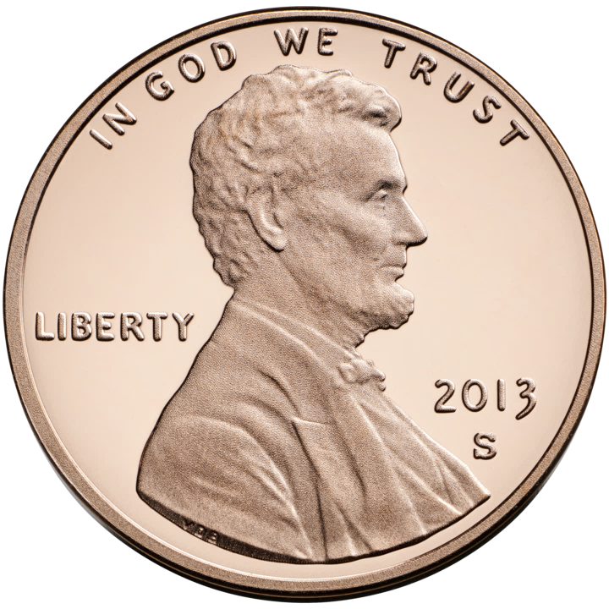

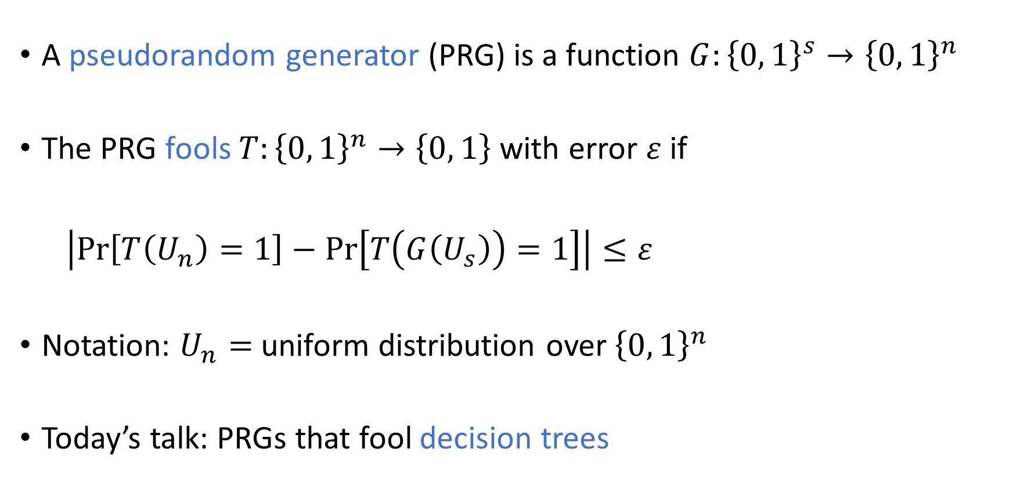
Pseudorandom generators
A pseudorandom generator (PRG) is a function $G:{\left\{0, 1\right\}}^{s}→{\left\{0, 1\right\}}^{n}$
The PRG fools $T:{\left\{0, 1\right\}}^{n}→\left\{0, 1\right\}$ with error $ε$ if
$\left|\operatorname{Pr}\left[T\left(U_{n}\right)=1\right]−\operatorname{Pr}\left[T\left(G\left(U_{s}\right)\right)=1\right]\right|≤ε$
Notation: $U_{n}=$ uniform distribution over ${\left\{0, 1\right\}}^{n}$
Today’s talk: PRGs that fool decision trees
$$G$$

Slide 3

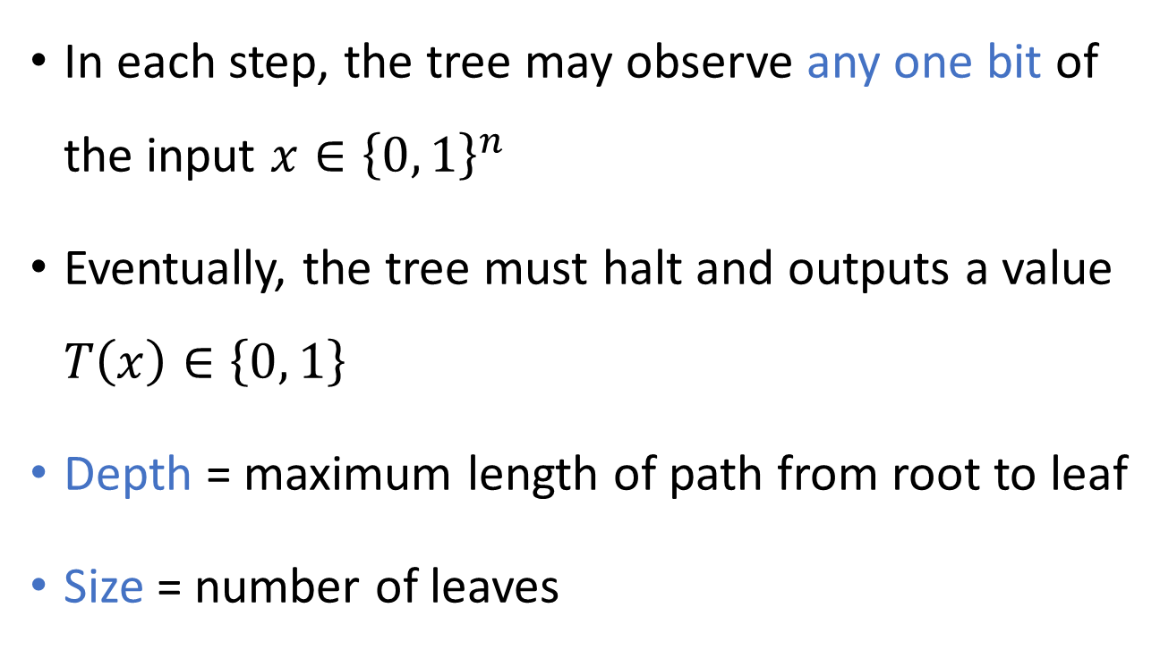



Decision trees
$$x_{1}$$
0
1
$$x_{2}$$
$$x_{3}$$
In each step, the tree may observe any one bit of the input $x∈{\left\{0, 1\right\}}^{n}$
Eventually, the tree must halt and outputs a value $T\left(x\right)∈\left\{0, 1\right\}$
Depth = maximum length of path from root to leaf
Size = number of leaves
0
1
0
1
0
1
$$x_{2}$$
0
0
1
1
0

Slide 4
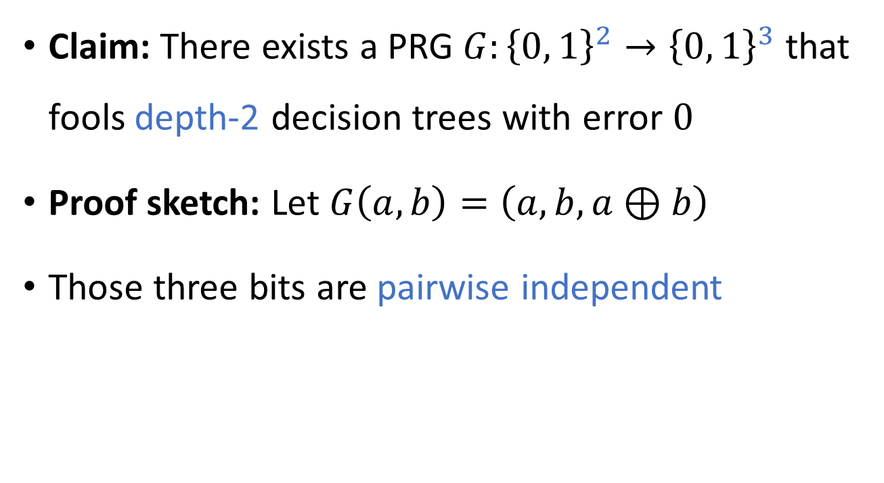


Example: Fooling depth-2 decision trees
$$G$$
Claim: There exists a PRG $G:{\left\{0, 1\right\}}^{2}→{\left\{0, 1\right\}}^{3}$ that fools depth-2 decision trees with error $0$
Proof sketch: Let $G\left(a,b\right)=\left(a, b, a⊕b\right)$
Those three bits are pairwise independent
$$x$$
$$x_{1}$$
0
1
$$x_{2}$$
$$x_{3}$$
0
1
0
1
0
1
1
0

Slide 5
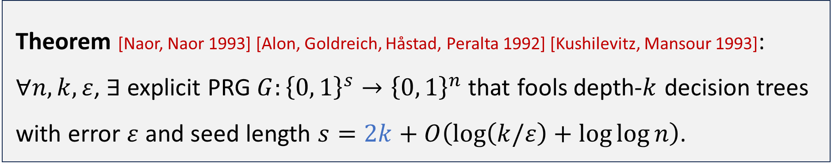

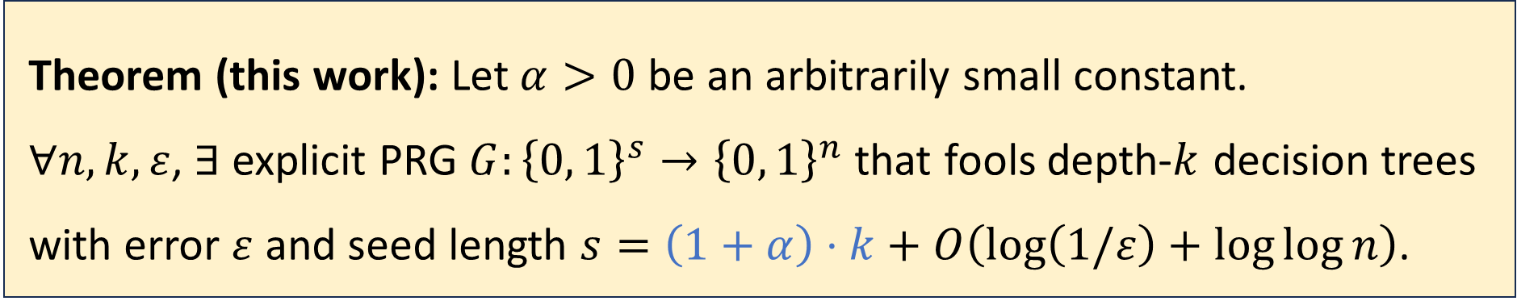
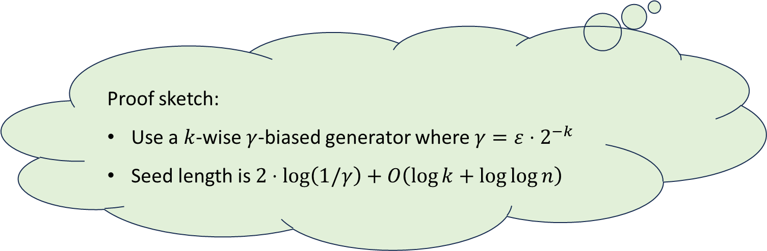
Fooling depth-$k$ decision trees
Theorem [Naor, Naor 1993] [Alon, Goldreich, Håstad, Peralta 1992] [Kushilevitz, Mansour 1993]: $∀n,k,ε$, $∃$ explicit PRG $G:{\left\{0, 1\right\}}^{s}→{\left\{0, 1\right\}}^{n}$ that fools depth-$k$ decision trees with error $ε$ and seed length $s=2k+O\left(\log\left(k/ε\right)+\log{\log{n}}\right)$.
Proof sketch:
Use a $k$-wise $γ$-biased generator where $γ=ε⋅2^{−k}$
Seed length is $2⋅\log\left(1/γ\right)+O\left(\log{k}+\log{\log{n}}\right)$
Theorem (this work): Let $α>0$ be an arbitrarily small constant. $∀n,k,ε$, $∃$ explicit PRG $G:{\left\{0, 1\right\}}^{s}→{\left\{0, 1\right\}}^{n}$ that fools depth-$k$ decision trees with error $ε$ and seed length $s=\left(1+α\right)⋅k+O\left(\log\left(1/ε\right)+\log{\log{n}}\right)$.

Slide 6
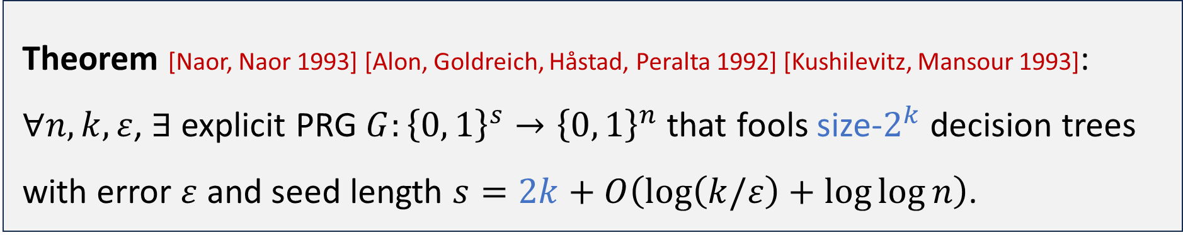

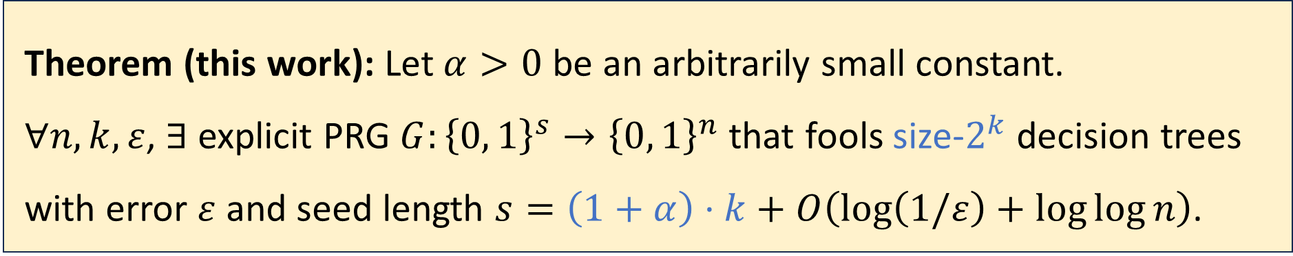
Fooling size-$2^{k}$ decision trees
Theorem [Naor, Naor 1993] [Alon, Goldreich, Håstad, Peralta 1992] [Kushilevitz, Mansour 1993]: $∀n,k,ε$, $∃$ explicit PRG $G:{\left\{0, 1\right\}}^{s}→{\left\{0, 1\right\}}^{n}$ that fools size-$2^{k}$ decision trees with error $ε$ and seed length $s=2k+O\left(\log\left(k/ε\right)+\log{\log{n}}\right)$.
Theorem (this work): Let $α>0$ be an arbitrarily small constant. $∀n,k,ε$, $∃$ explicit PRG $G:{\left\{0, 1\right\}}^{s}→{\left\{0, 1\right\}}^{n}$ that fools size-$2^{k}$ decision trees with error $ε$ and seed length $s=\left(1+α\right)⋅k+O\left(\log\left(1/ε\right)+\log{\log{n}}\right)$.

Slide 7

Why care about this factor of two?
Answer 1: It’s a fundamental problem
Answer 2: One can prove a lower bound of $1⋅k$
Answer 3 (main): There is a connection with circuit complexity!

Slide 8


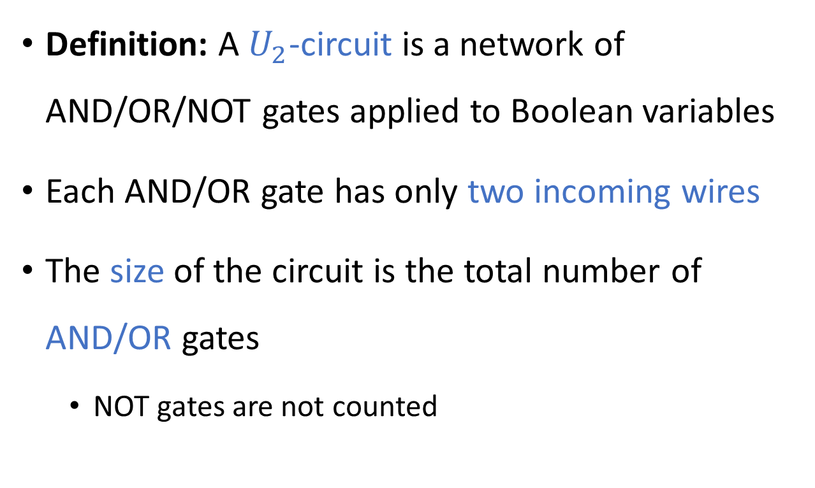













Circuits over the $U_{2}$ basis
$∨$
$∧$
$∧$
Definition: A $U_{2}$-circuit is a network of AND/OR/NOT gates applied to Boolean variables
Each AND/OR gate has only two incoming wires
The size of the circuit is the total number of AND/OR gates
NOT gates are not counted
$¬$
$¬$
$$x_{4}$$
$∨$
$∨$
$∧$
$∧$
$∧$
$$x_{1}$$
$$x_{2}$$
$$x_{3}$$

Slide 9
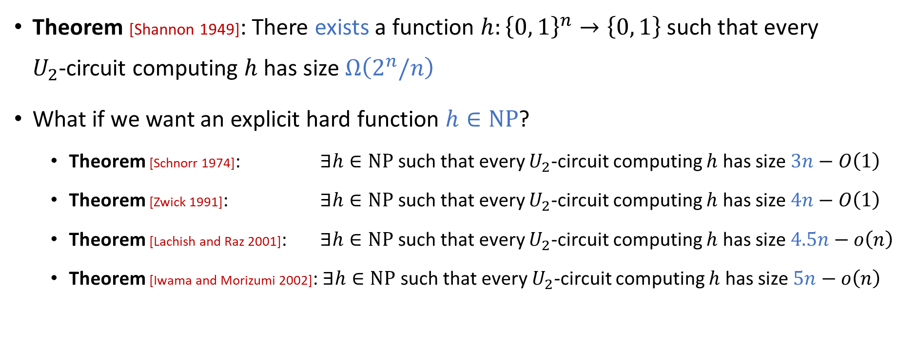
Circuits are poorly understood
Theorem [Shannon 1949]: There exists a function $h:{\left\{0, 1\right\}}^{n}→\left\{0, 1\right\}$ such that every $U_{2}$-circuit computing $h$ has size $Ω\left(2^{n}/n\right)$
What if we want an explicit hard function $h∈\text{NP}$?
Theorem [Schnorr 1974]: $∃h∈\text{NP}$ such that every $U_{2}$-circuit computing $h$ has size $3n−O\left(1\right)$
Theorem [Zwick 1991]: $∃h∈\text{NP}$ such that every $U_{2}$-circuit computing $h$ has size $4n−O\left(1\right)$
Theorem [Lachish and Raz 2001]: $∃h∈\text{NP}$ such that every $U_{2}$-circuit computing $h$ has size $4.5n−o\left(n\right)$
Theorem [Iwama and Morizumi 2002]: $∃h∈\text{NP}$ such that every $U_{2}$-circuit computing $h$ has size $5n−o\left(n\right)$

Slide 10
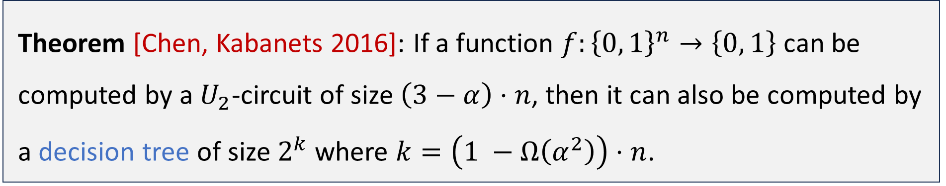

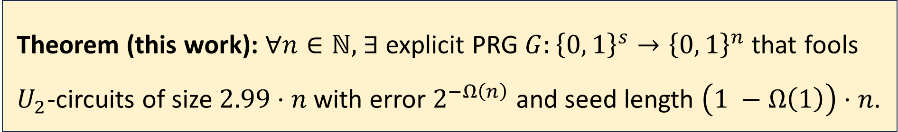
Our contribution: A PRG that fools $U_{2}$-circuits
Theorem (this work): $∀n∈ℕ,$ $∃$ explicit PRG $G:{\left\{0, 1\right\}}^{s}→{\left\{0, 1\right\}}^{n}$ that fools $U_{2}$-circuits of size $2.99⋅n$ with error $2^{−Ω\left(n\right)}$ and seed length $\left(1 −Ω\left(1\right)\right)⋅n$.
Theorem [Chen, Kabanets 2016]: If a function $f:{\left\{0, 1\right\}}^{n}→\left\{0, 1\right\}$ can be computed by a $U_{2}$-circuit of size $\left(3−α\right)⋅n$, then it can also be computed by a decision tree of size $2^{k}$ where $k=\left(1 −Ω\left(α^{2}\right)\right)⋅n$.
“It would be interesting to get pseudorandom generators for general boolean circuits” [Chen, Kabanets 2016]

Slide 11

How we construct our new PRG
Our approach for fooling decision trees is based on a new kind of “almost $k$-wise independence”
Let’s start by reviewing exact $k$-wise independence

Slide 12
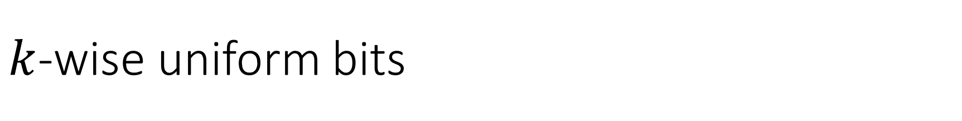
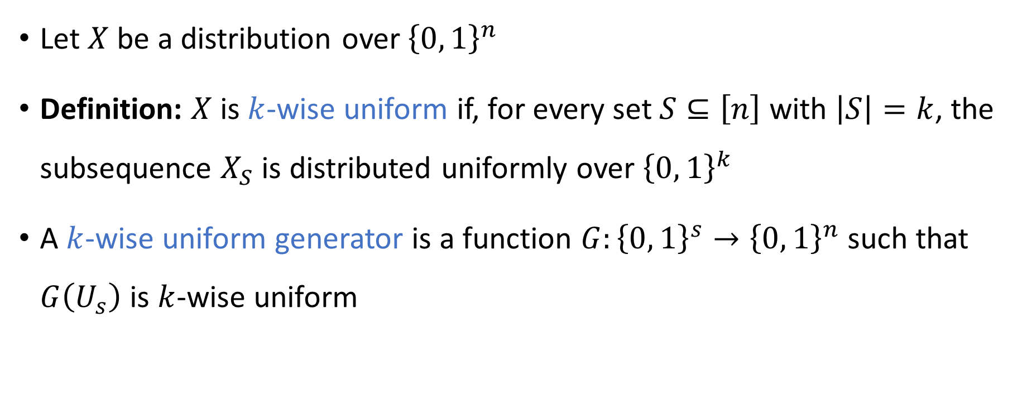
$k$-wise uniform bits
Let $X$ be a distribution over ${\left\{0, 1\right\}}^{n}$
Definition: $X$ is $k$-wise uniform if, for every set $S⊆\left[n\right]$ with $\left|S\right|=k$, the subsequence $X_{S}$ is distributed uniformly over ${\left\{0, 1\right\}}^{k}$
A $k$-wise uniform generator is a function $G:{\left\{0, 1\right\}}^{s}→{\left\{0, 1\right\}}^{n}$ such that $G\left(U_{s}\right)$ is $k$-wise uniform

Slide 13

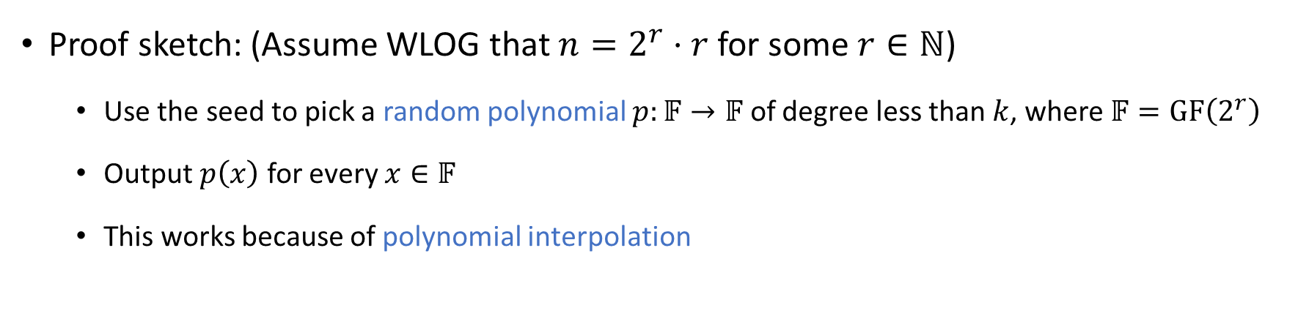
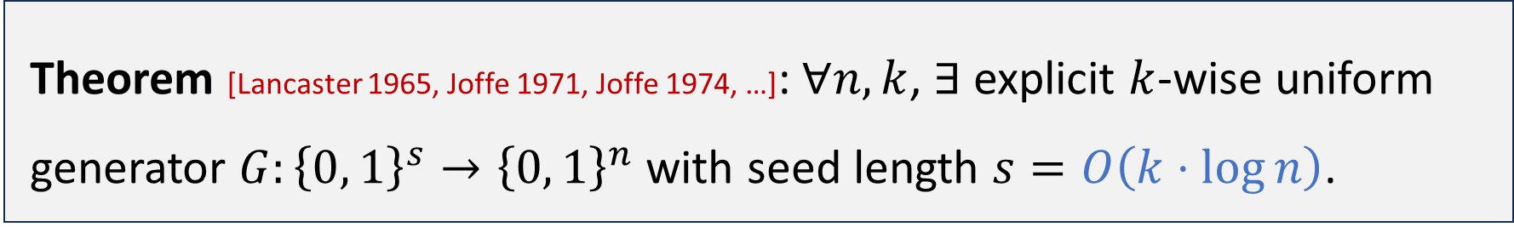
A classic $k$-wise uniform generator
Theorem [Lancaster 1965, Joffe 1971, Joffe 1974, …]: $∀n,k$, $∃$ explicit $k$-wise uniform generator $G:{\left\{0, 1\right\}}^{s}→{\left\{0, 1\right\}}^{n}$ with seed length $s=O\left(k⋅\log{n}\right)$.
Proof sketch: (Assume WLOG that $n=2^{r}⋅r$ for some $r∈ℕ$)
Use the seed to pick a random polynomial $p:𝔽→𝔽$ of degree less than $k$, where $𝔽=\text{GF}\left(2^{r}\right)$
Output $p\left(x\right)$ for every $x∈𝔽$
This works because of polynomial interpolation

Slide 14

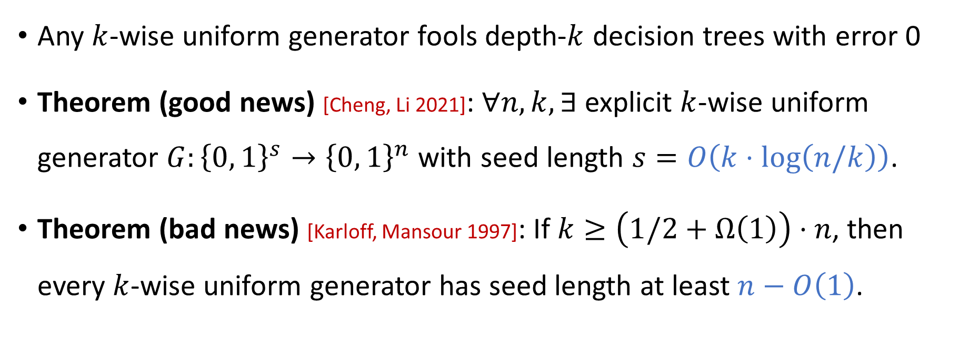
The regime $k=Θ\left(n\right)$
Any $k$-wise uniform generator fools depth-$k$ decision trees with error 0
Theorem (good news) [Cheng, Li 2021]: $∀n,k,∃$ explicit $k$-wise uniform generator $G:{\left\{0, 1\right\}}^{s}→{\left\{0, 1\right\}}^{n}$ with seed length $s=O\left(k⋅\log\left(n/k\right)\right)$.
Theorem (bad news) [Karloff, Mansour 1997]: If $k≥\left(1/2+Ω\left(1\right)\right)⋅n$, then every $k$-wise uniform generator has seed length at least $n−O\left(1\right)$.

Slide 15
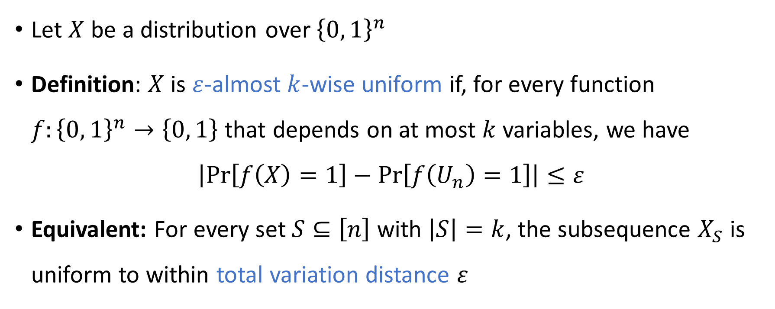

Almost $k$-wise uniformity
Let $X$ be a distribution over ${\left\{0, 1\right\}}^{n}$
Definition: $X$ is $ε$-almost $k$-wise uniform if, for every function $f:{\left\{0, 1\right\}}^{n}→\left\{0, 1\right\}$ that depends on at most $k$ variables, we have
$$\left|\operatorname{Pr}\left[f\left(X\right)=1\right]−\operatorname{Pr}\left[f\left(U_{n}\right)=1\right]\right|≤ε$$
Equivalent: For every set $S⊆\left[n\right]$ with $\left|S\right|=k$, the subsequence $X_{S}$ is uniform to within total variation distance $ε$

Slide 16
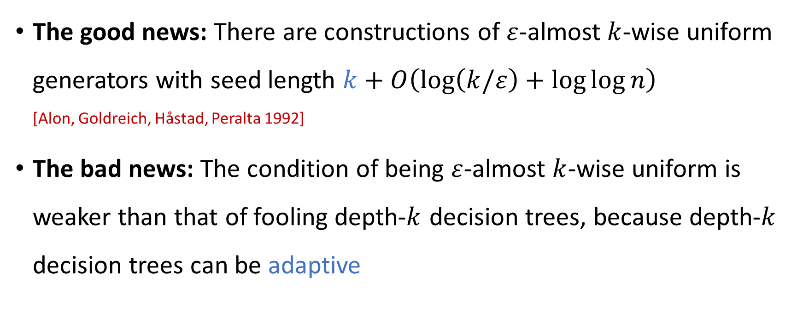
Almost $k$-wise uniformity
The good news: There are constructions of $ε$-almost $k$-wise uniform generators with seed length $k+O\left(\log\left(k/ε\right)+\log{\log{n}}\right)$ [Alon, Goldreich, Håstad, Peralta 1992]
The bad news: The condition of being $ε$-almost $k$-wise uniform is weaker than that of fooling depth-$k$ decision trees, because depth-$k$ decision trees can be adaptive

Slide 17
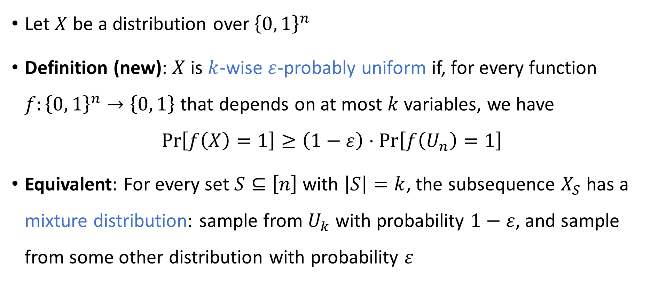

Key new concept: $k$-wise probable uniformity
Let $X$ be a distribution over ${\left\{0, 1\right\}}^{n}$
Definition (new): $X$ is $k$-wise $ε$-probably uniform if, for every function $f:{\left\{0, 1\right\}}^{n}→\left\{0, 1\right\}$ that depends on at most $k$ variables, we have
$$\operatorname{Pr}\left[f\left(X\right)=1\right]≥\left(1−ε\right)⋅\operatorname{Pr}\left[f\left(U_{n}\right)=1\right]$$
Equivalent: For every set $S⊆\left[n\right]$ with $\left|S\right|=k$, the subsequence $X_{S}$ has a mixture distribution: sample from $U_{k}$ with probability $1−ε$, and sample from some other distribution with probability $ε$
“Probably uniform”

Slide 18
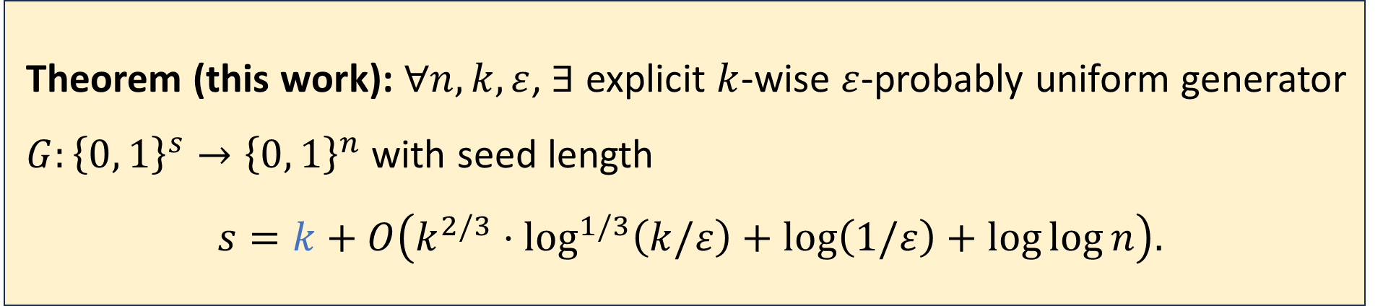
Main technical contribution
Theorem (this work): $∀n,k,ε$, $∃$ explicit $k$-wise $ε$-probably uniform generator $G:{\left\{0, 1\right\}}^{s}→{\left\{0, 1\right\}}^{n}$ with seed length $$s=k+O\left(k^{2/3}⋅\log^{1/3}\left(k/ε\right)+\log\left(1/ε\right)+\log{\log{n}}\right).$$
Today’s talk: A couple of elements of the construction

Slide 19

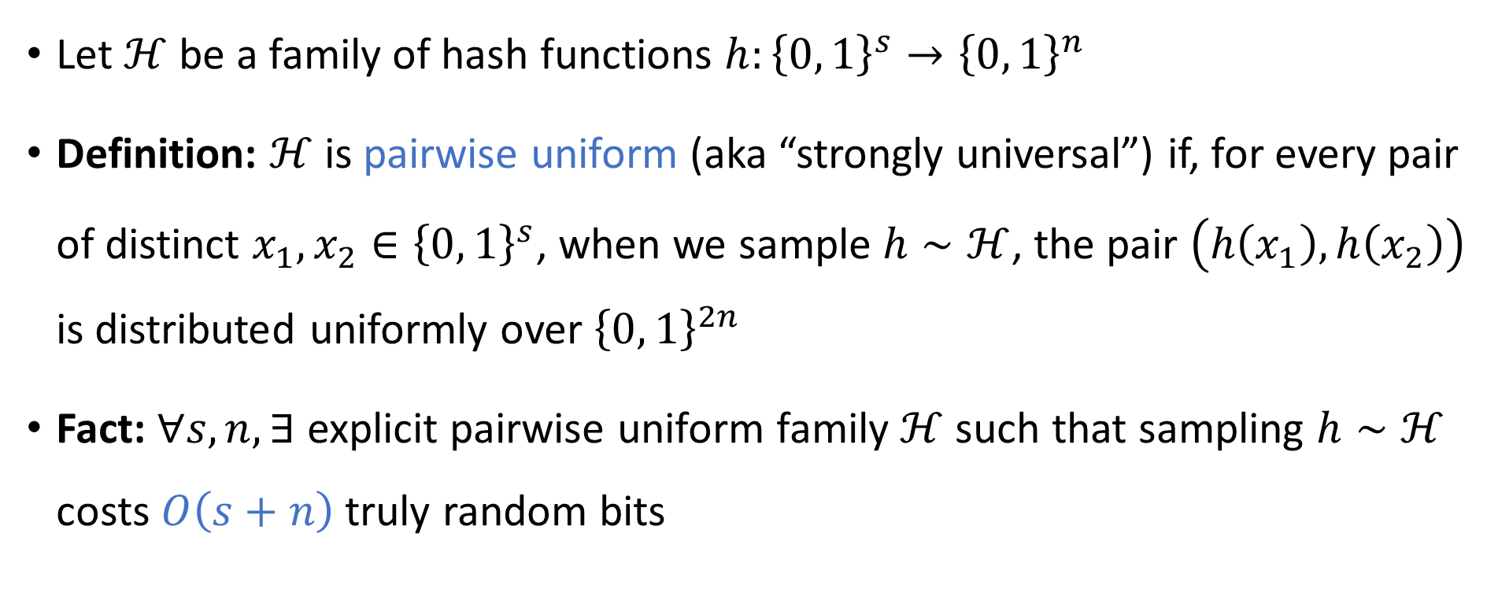
Pairwise uniform hash functions
Let $ℋ$ be a family of hash functions $h:{\left\{0, 1\right\}}^{s}→{\left\{0, 1\right\}}^{n}$
Definition: $ℋ$ is pairwise uniform (aka “strongly universal”) if, for every pair of distinct $x_{1},x_{2}∈{\left\{0, 1\right\}}^{s}$, when we sample $h∼ℋ$, the pair $\left(h\left(x_{1}\right), h\left(x_{2}\right)\right)$ is distributed uniformly over ${\left\{0, 1\right\}}^{2n}$
Fact: $∀s,n, ∃$ explicit pairwise uniform family $ℋ$ such that sampling $h∼ℋ$ costs $O\left(s+n\right)$ truly random bits

Slide 20
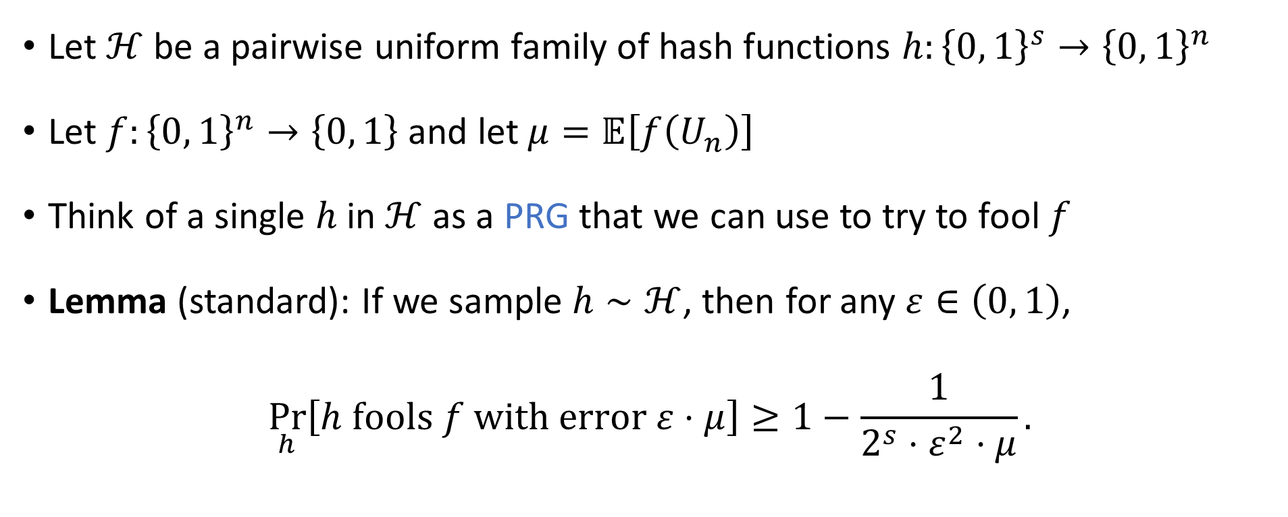
A sampling lemma
Let $ℋ$ be a pairwise uniform family of hash functions $h:{\left\{0, 1\right\}}^{s}→{\left\{0, 1\right\}}^{n}$
Let $f:{\left\{0, 1\right\}}^{n}→\left\{0, 1\right\}$ and let $μ=𝔼\left[f\left(U_{n}\right)\right]$
Think of a single $h$ in $ℋ$ as a PRG that we can use to try to fool $f$
Lemma (standard): If we sample $h∼ℋ$, then for any $ε∈\left(0, 1\right)$,
$$\underset{h}{Pr}\left[h \text{fools} f \text{with} \text{error} ε⋅μ\right]≥1−\frac{1}{2^{s}⋅ε^{2}⋅μ}.$$

Slide 21
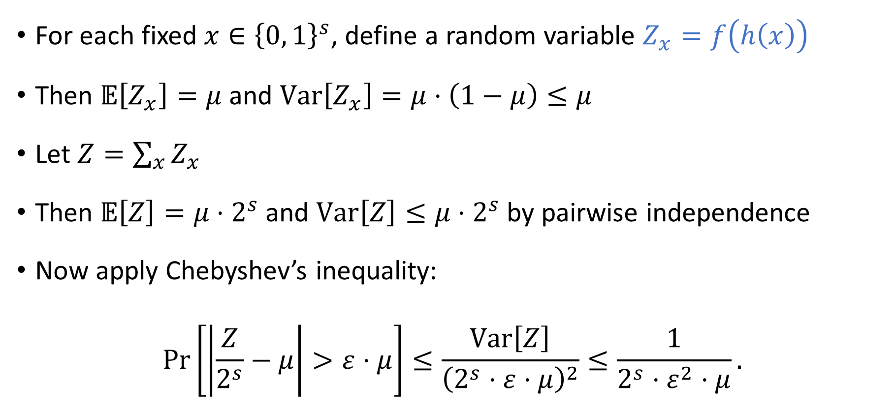
Proof of sampling lemma
For each fixed $x∈{\left\{0, 1\right\}}^{s}$, define a random variable $Z_{x}=f\left(h\left(x\right)\right)$
Then $𝔼\left[Z_{x}\right]=μ$ and $\text{Var}\left[Z_{x}\right]=μ⋅\left(1−μ\right)≤μ$
Let $Z=\sum_{x}{Z_{x}}$
Then $𝔼\left[Z\right]=μ⋅2^{s}$ and $\text{Var}\left[Z\right]≤μ⋅2^{s}$ by pairwise independence
Now apply Chebyshev’s inequality:
$$\operatorname{Pr}\left[\left|\frac{Z}{2^{s}}−μ\right|>ε⋅μ\right]≤\frac{\text{Var}\left[Z\right]}{{\left(2^{s}⋅ε⋅μ\right)}^{2}}≤\frac{1}{2^{s}⋅ε^{2}⋅μ}.$$

Slide 22
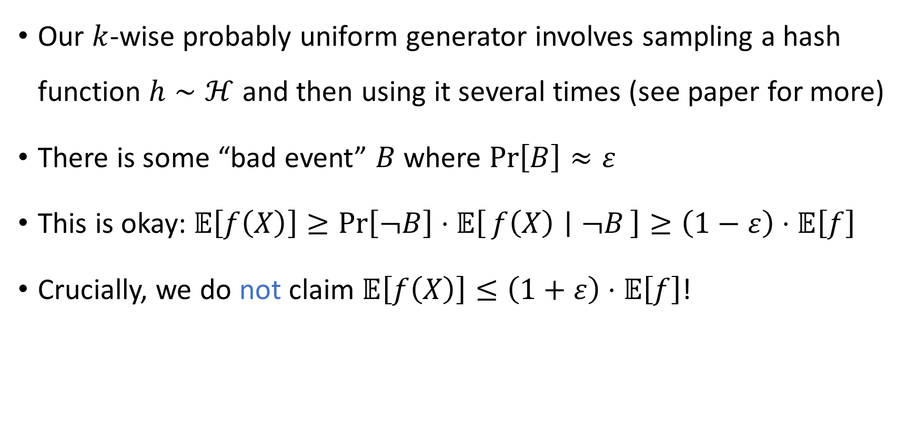
We can tolerate “bad events”
Our $k$-wise probably uniform generator involves sampling a hash function $h∼ℋ$ and then using it several times (see paper for more)
There is some “bad event” $B$ where $\operatorname{Pr}\left[B\right]≈ε$
This is okay: $𝔼\left[f\left(X\right)\right]≥\operatorname{Pr}\left[¬B\right]⋅𝔼\left[f\left(X\right) ∣ ¬B\right]≥\left(1−ε\right)⋅𝔼\left[f\right]$
Crucially, we do not claim $𝔼\left[f\left(X\right)\right]≤\left(1+ε\right)⋅𝔼\left[f\right]$!

Slide 23
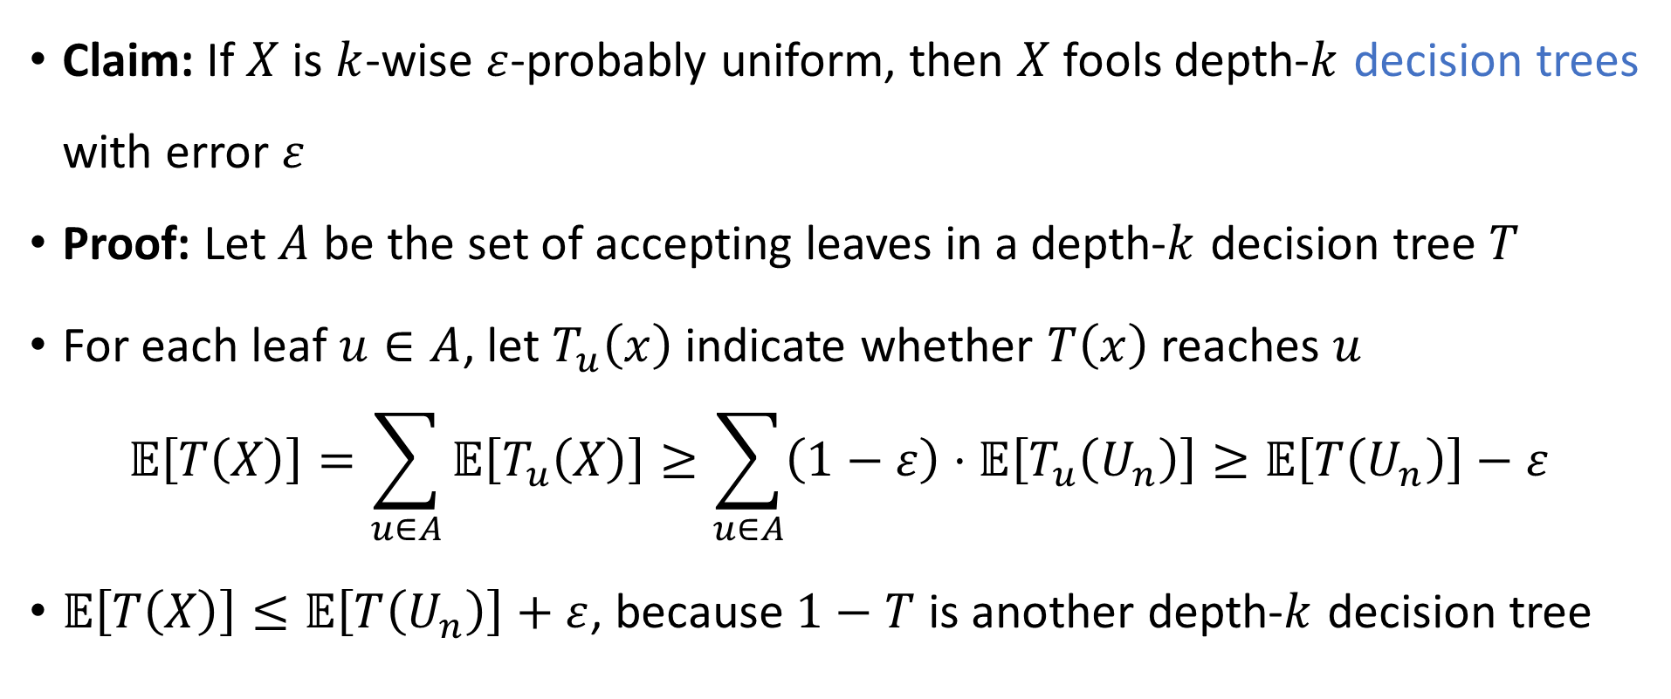
Fooling decision trees
Claim: If $X$ is $k$-wise $ε$-probably uniform, then $X$ fools depth-$k$ decision trees with error $ε$
Proof: Let $A$ be the set of accepting leaves in a depth-$k$ decision tree $T$
For each leaf $u∈A$, let $T_{u}\left(x\right)$ indicate whether $T\left(x\right)$ reaches $u$ $𝔼\left[T\left(X\right)\right]=\sum_{u∈A}{𝔼\left[T_{u}\left(X\right)\right]}≥\sum_{u∈A}{\left(1−ε\right)⋅𝔼\left[T_{u}\left(U_{n}\right)\right]}≥𝔼\left[T\left(U_{n}\right)\right]−ε$
$𝔼\left[T\left(X\right)\right]≤𝔼\left[T\left(U_{n}\right)\right]+ε$, because $1−T$ is another depth-$k$ decision tree

Slide 24
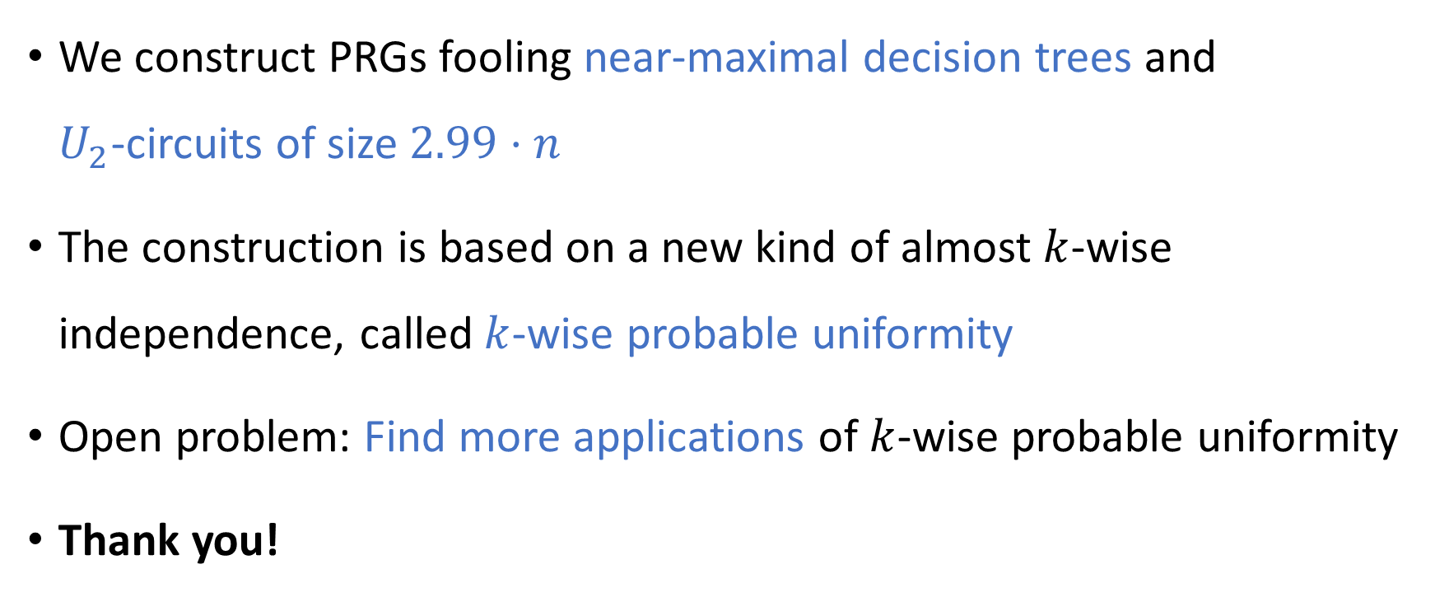
Conclusions
We construct PRGs fooling near-maximal decision trees and $U_{2}$-circuits of size $2.99⋅n$
The construction is based on a new kind of almost $k$-wise independence, called $k$-wise probable uniformity
Open problem: Find more applications of $k$-wise probable uniformity
Thank you!

