Slide 1
CMSC 28100 Introduction to Complexity Theory Winter 2024 Instructor: William Hoza
7 |  |  |  |  |  |  | 5 | 3
 |  |  |  |  |  |  |  | 4
 | 4 | 8 |  | 3 |  | 1 | 2
8 |  | 1 | 3 |  |  | 2 | 7 | 5
 | 9 |  | 1 |  |  |  | 4
 | 5 |  |  |  |  | 3
2 |  | 5 |  | 8 | 4
1 | 3 | 4 |  | 5

Slide 2
Asymptotic analysis

Slide 3
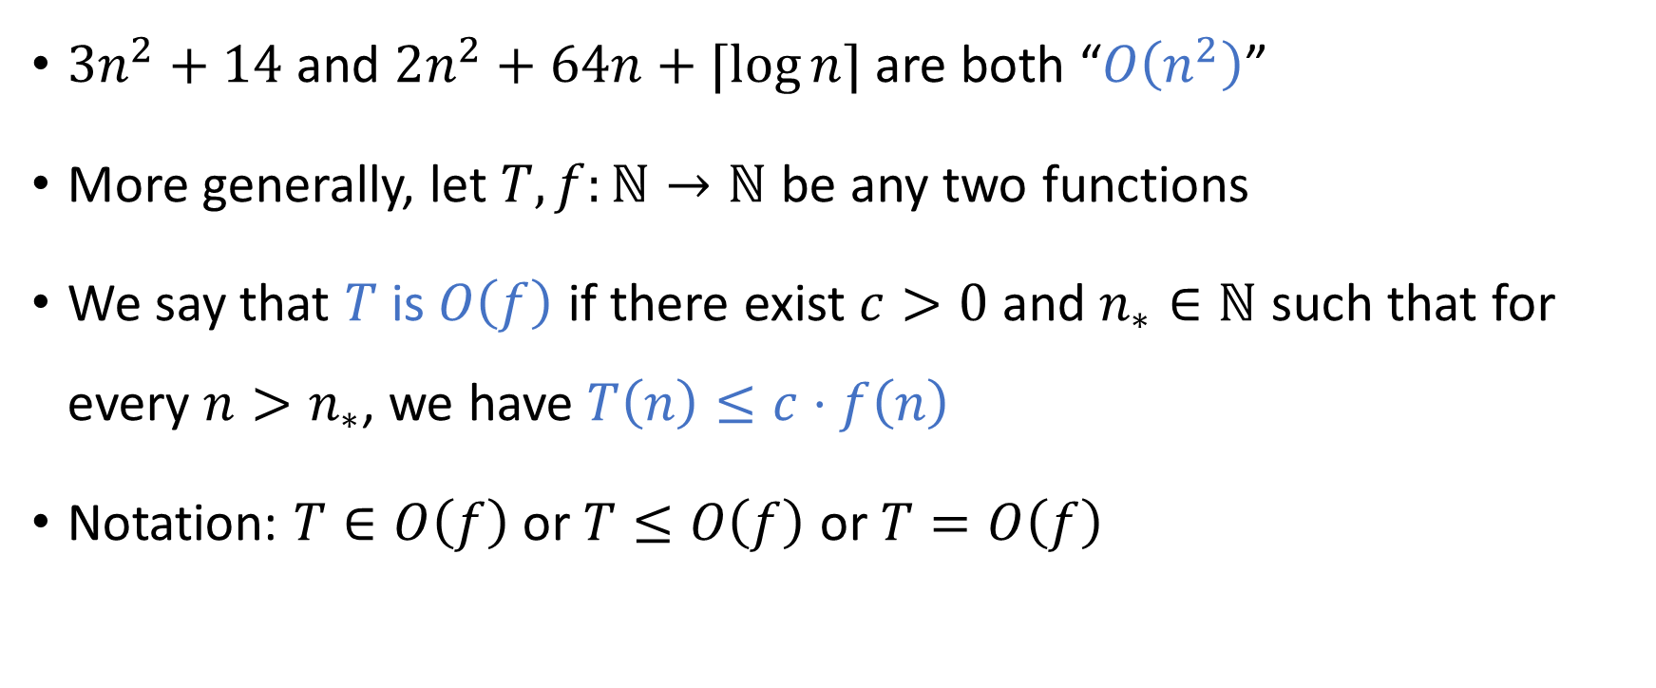
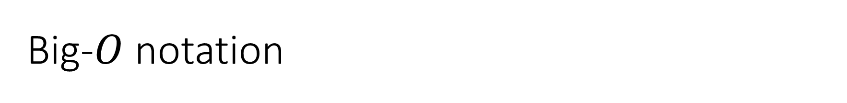
Big-$O$ notation
$3n^{2}+14$ and $2n^{2}+64n+⌈\log{n}⌉$ are both “$O\left(n^{2}\right)$”
More generally, let $T,f:ℕ→ℕ$ be any two functions
We say that $T$ is $O\left(f\right)$ if there exist $c>0$ and $n_{∗}∈ℕ$ such that for every $n>n_{∗}$, we have $T\left(n\right)≤c⋅f\left(n\right)$
Notation: $T∈O\left(f\right)$ or $T≤O\left(f\right)$ or $T=O\left(f\right)$

Slide 4
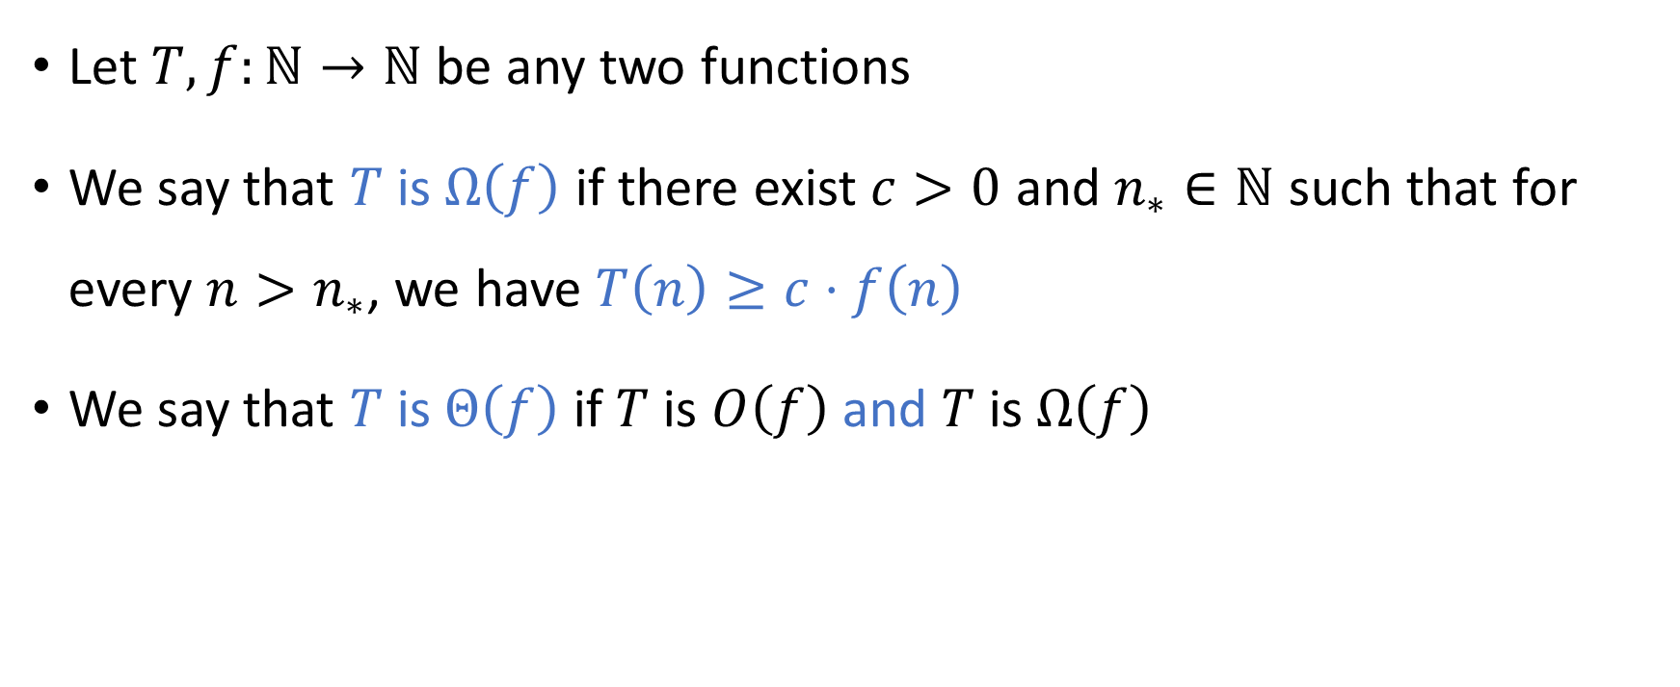
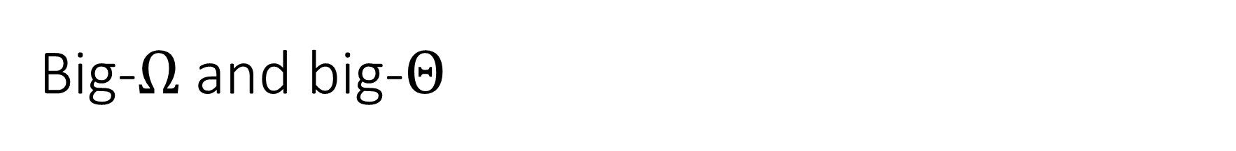
Big-$Ω$ and big-$Θ$
Let $T,f:ℕ→ℕ$ be any two functions
We say that $T$ is $Ω\left(f\right)$ if there exist $c>0$ and $n_{∗}∈ℕ$ such that for every $n>n_{∗}$, we have $T\left(n\right)≥c⋅f\left(n\right)$
We say that $T$ is $Θ\left(f\right)$ if $T$ is $O\left(f\right)$ and $T$ is $Ω\left(f\right)$

Slide 5

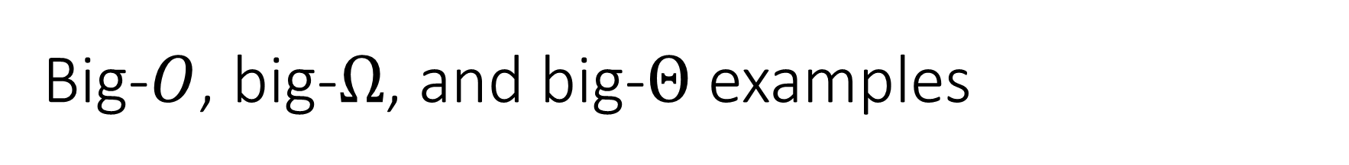
Big-$O$, big-$Ω$, and big-$Θ$ examples
$3n^{2}+14$ is $Ω\left(n^{2}\right)$
$3n^{2}+14$ is $Ω\left(n\right)$
$3n^{2}+14$ is $Θ\left(n^{2}\right)$
$3n^{2}+14$ is $Θ\left(n^{2}+2n^{1.4}\right)$

Slide 6
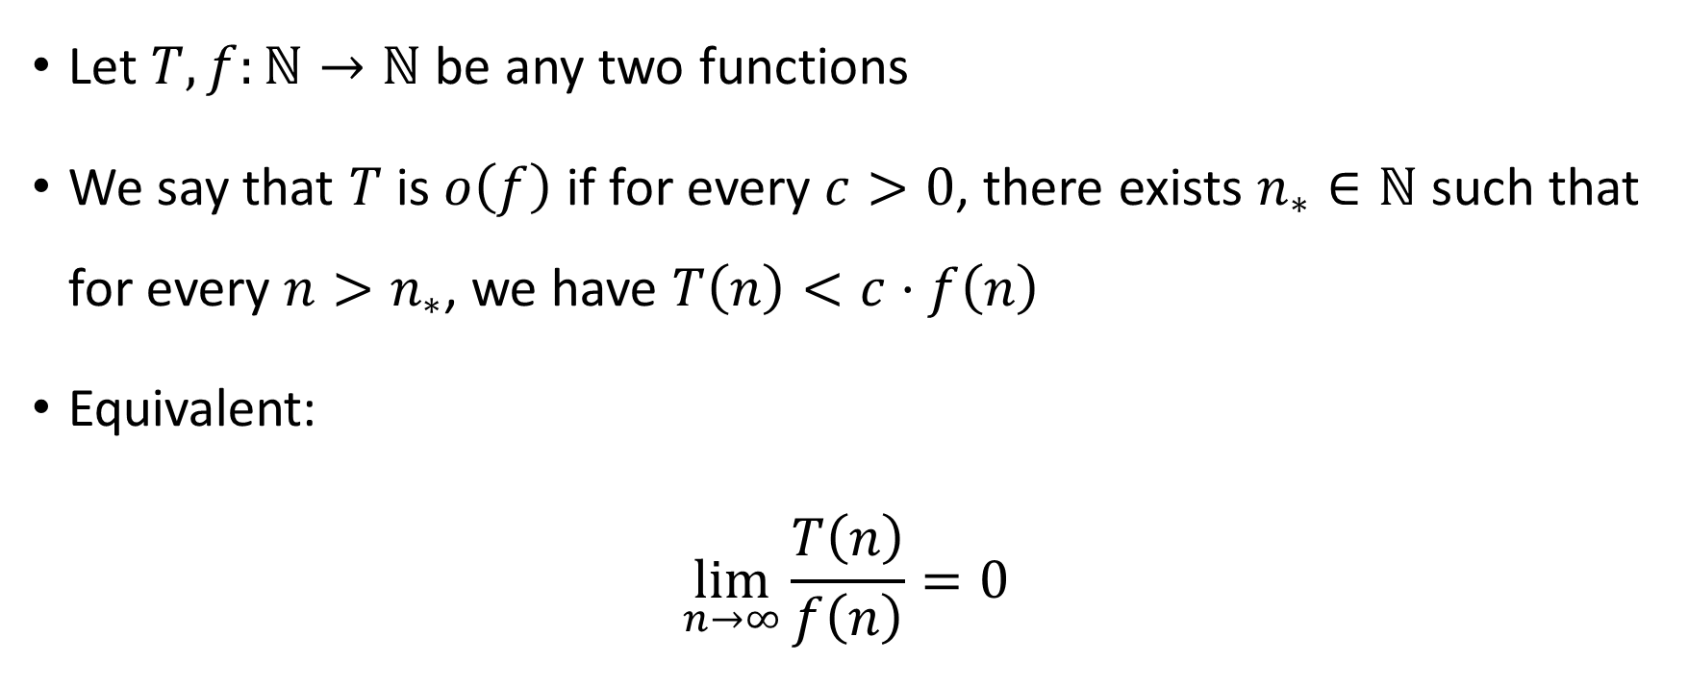

Little-$o$ notation
Let $T,f:ℕ→ℕ$ be any two functions
We say that $T$ is $o\left(f\right)$ if for every $c>0$, there exists $n_{∗}∈ℕ$ such that for every $n>n_{∗}$, we have $T\left(n\right)<c⋅f\left(n\right)$
Equivalent:
$$\lim_{n→∞}{\frac{T\left(n\right)}{f\left(n\right)}}=0$$

Slide 7
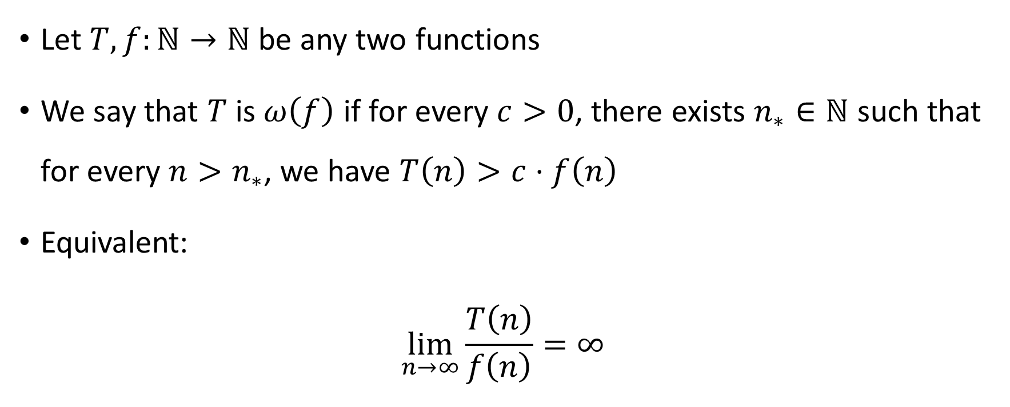

Little-$ω$ notation
Let $T,f:ℕ→ℕ$ be any two functions
We say that $T$ is $ω\left(f\right)$ if for every $c>0$, there exists $n_{∗}∈ℕ$ such that for every $n>n_{∗}$, we have $T\left(n\right)>c⋅f\left(n\right)$
Equivalent:
$$\lim_{n→∞}{\frac{T\left(n\right)}{f\left(n\right)}}=∞$$

Slide 8
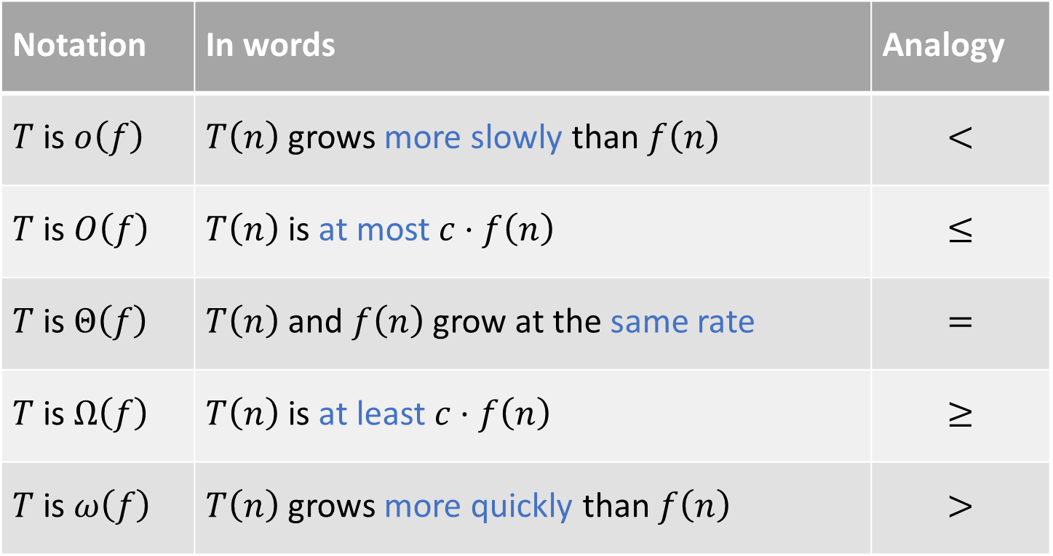
Summary of asymptotic notation
Notation | In words | Analogy
$T$ is $o\left(f\right)$ | $T\left(n\right)$ grows more slowly than $f\left(n\right)$ | $$<$$
$T$ is $O\left(f\right)$ | $T\left(n\right)$ is at most $c⋅f\left(n\right)$ | $$≤$$
$T$ is $Θ\left(f\right)$ | $T\left(n\right)$ and $f\left(n\right)$ grow at the same rate | $$=$$
$T$ is $Ω\left(f\right)$ | $T\left(n\right)$ is at least $c⋅f\left(n\right)$ | $$≥$$
$T$ is $ω\left(f\right)$ | $T\left(n\right)$ grows more quickly than $f\left(n\right)$ | $$>$$

Slide 9
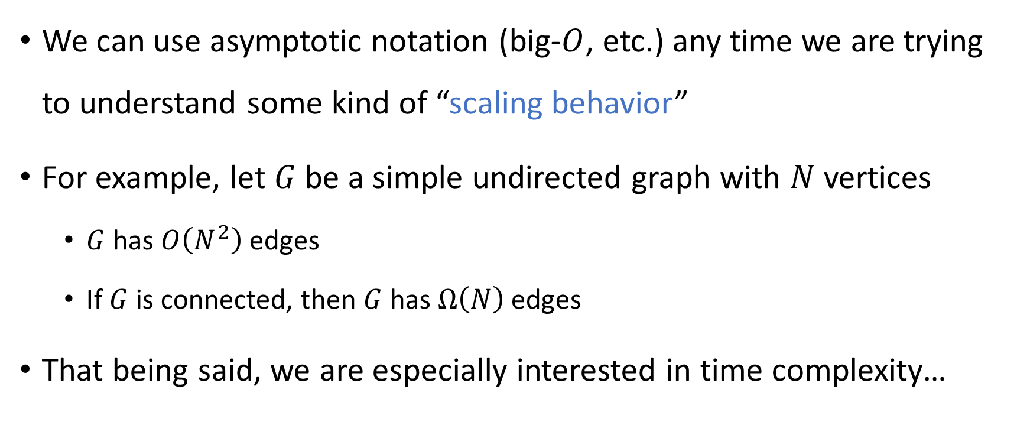

Note: Big-$O$ is not just for time complexity!
We can use asymptotic notation (big-$O$, etc.) any time we are trying to understand some kind of “scaling behavior”
For example, let $G$ be a simple undirected graph with $N$ vertices
$G$ has $O\left(N^{2}\right)$ edges
If $G$ is connected, then $G$ has $Ω\left(N\right)$ edges
That being said, we are especially interested in time complexity…

Slide 10
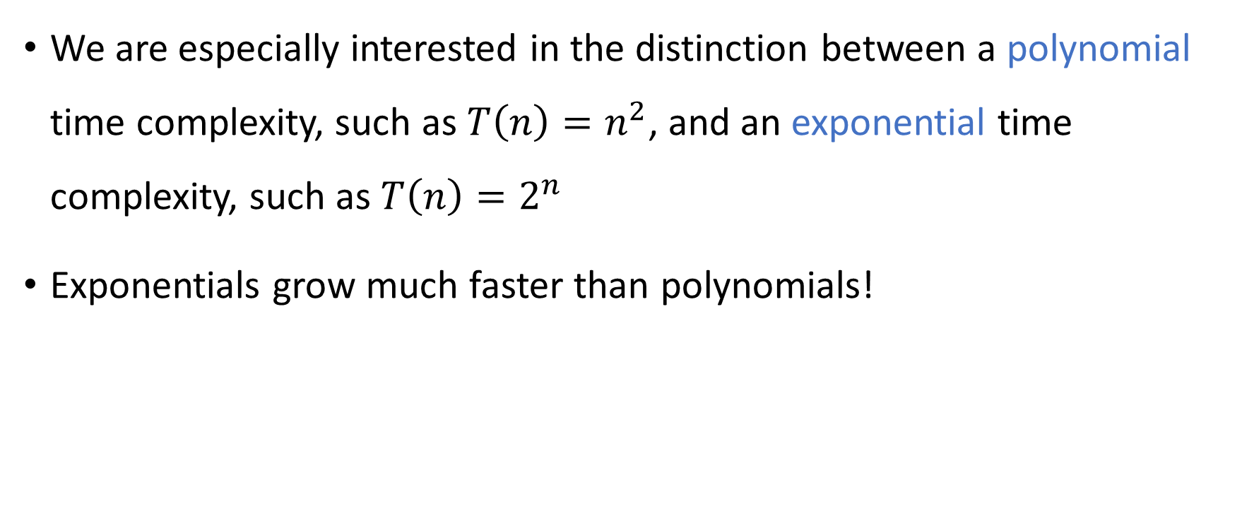
Exponential vs. polynomial
We are especially interested in the distinction between a polynomial time complexity, such as ${T\left(n\right)=n}^{2}$, and an exponential time complexity, such as $T\left(n\right)=2^{n}$
Exponentials grow much faster than polynomials!

Slide 11
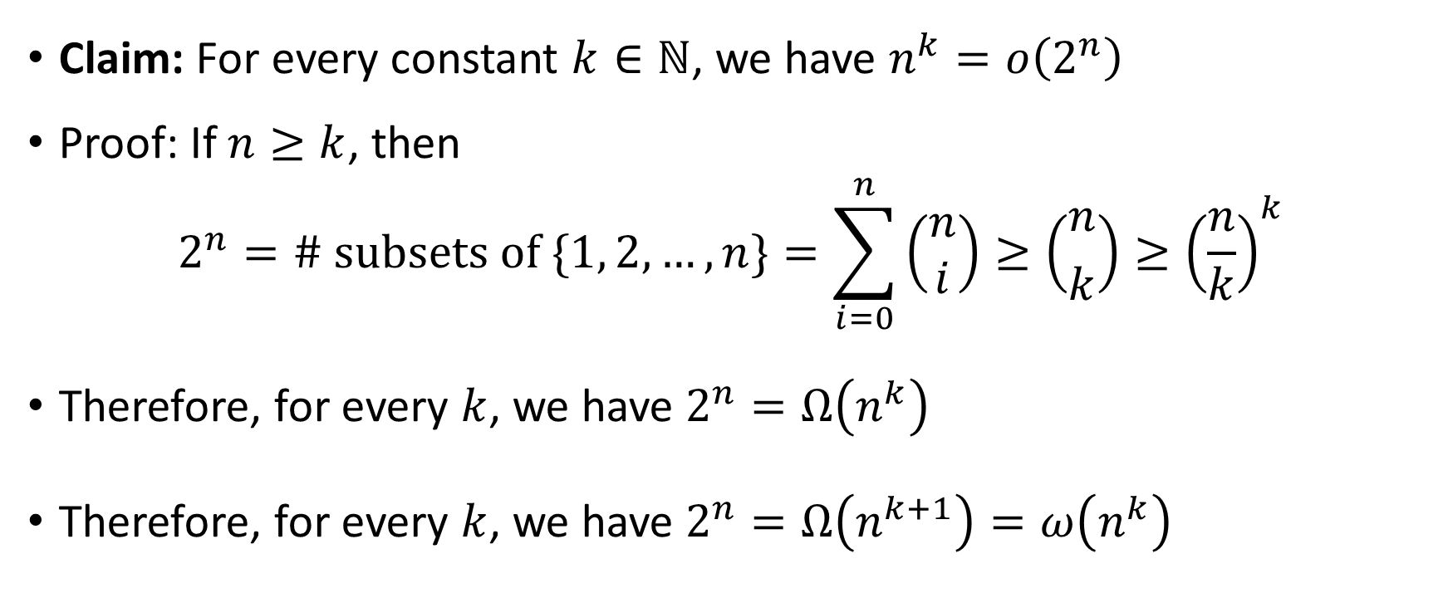
Exponential vs. polynomial
Claim: For every constant $k∈ℕ$, we have $n^{k}=o\left(2^{n}\right)$
Proof: If $n≥k$, then $2^{n}=\# \text{subsets} \text{of} \{1, 2, …, n\}=\sum_{i=0}^{n}{\left(\begin{aligned}n \\ i\end{aligned}\right)}≥\left({n \atop k}\right)≥{\left(\frac{n}{k}\right)}^{k}$
Therefore, for every $k$, we have $2^{n}=Ω\left(n^{k}\right)$
Therefore, for every $k$, we have $2^{n}=Ω\left(n^{k+1}\right)=ω\left(n^{k}\right)$

Slide 12
Which problems can be solved through computation?

Slide 13
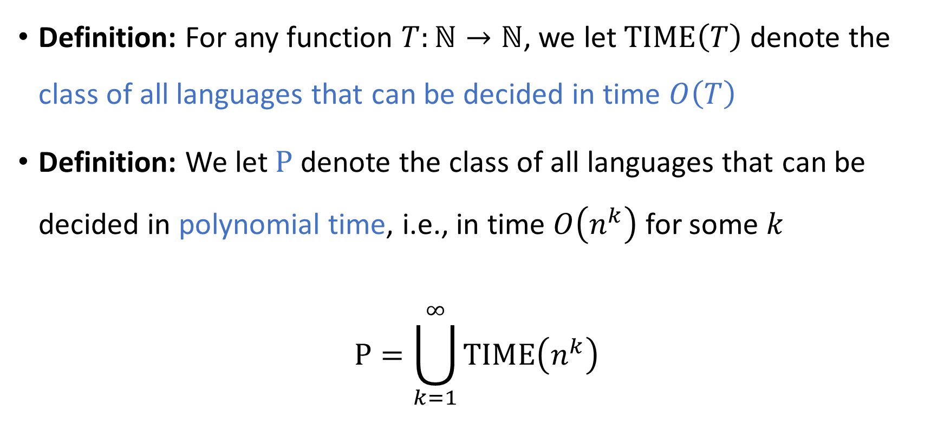

The complexity class $\text{P}$
Definition: For any function $T:ℕ→ℕ$, we let $\text{TIME}\left(T\right)$ denote the class of all languages that can be decided in time $O\left(T\right)$
Definition: We let $\text{P}$ denote the class of all languages that can be decided in polynomial time, i.e., in time $O\left(n^{k}\right)$ for some $k$
$$\text{P}=\bigcup_{k=1}^{∞}{\text{TIME}\left(n^{k}\right)}$$

Slide 14


$\text{P}$: Our model of tractability
Let $L$ be a language
If $L∈\text{P}$, then we will consider $L$ “tractable”
If $L∉\text{P}$, then we will consider $L$ “intractable”

Slide 15
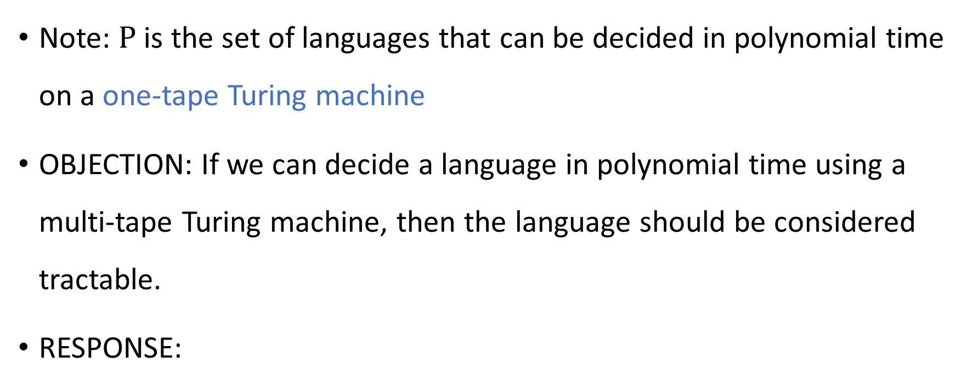
Which model of computation should we use?
Note: $\text{P}$ is the set of languages that can be decided in polynomial time on a one-tape Turing machine
OBJECTION: If we can decide a language in polynomial time using a multi-tape Turing machine, then the language should be considered tractable.
RESPONSE:

Slide 16

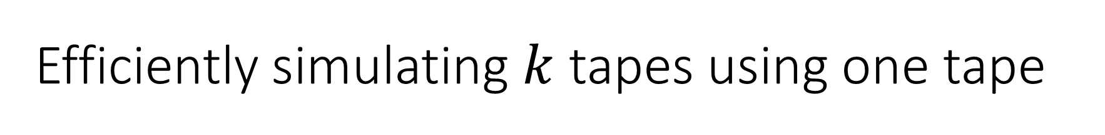
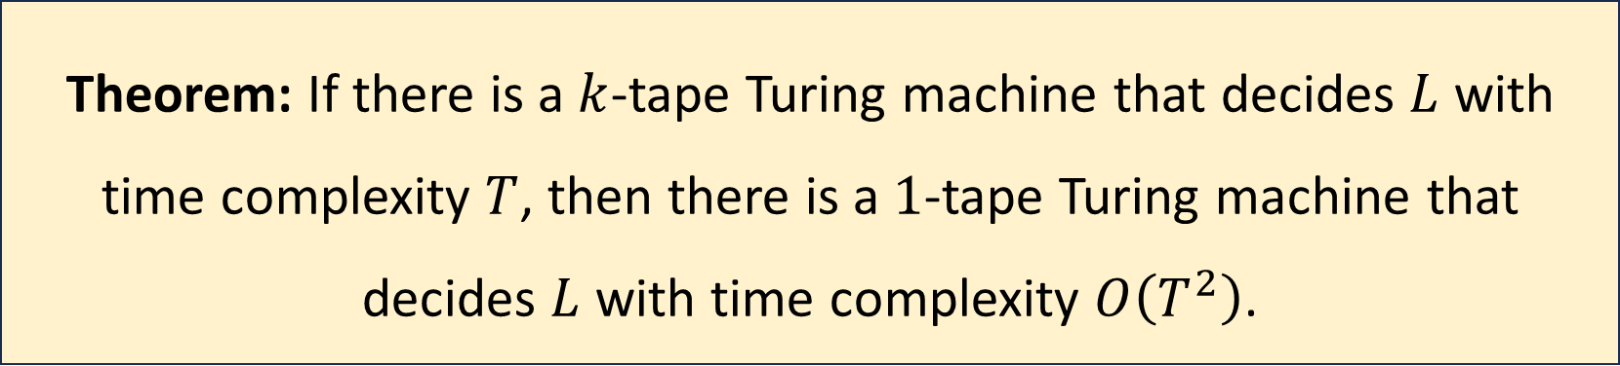
Efficiently simulating $k$ tapes using one tape
Let $L$ be a language, let $k$ be a positive integer, and let $T:ℕ→ℕ$
If $T\left(n\right)=O\left(n^{k}\right)$, then $O\left(T{\left(n\right)}^{2}\right)=O\left(n^{2k}\right)$, which is still polynomial
Theorem: If there is a $k$-tape Turing machine that decides $L$ with time complexity $T$, then there is a $1$-tape Turing machine that decides $L$ with time complexity $O\left(T^{2}\right)$.

Slide 17
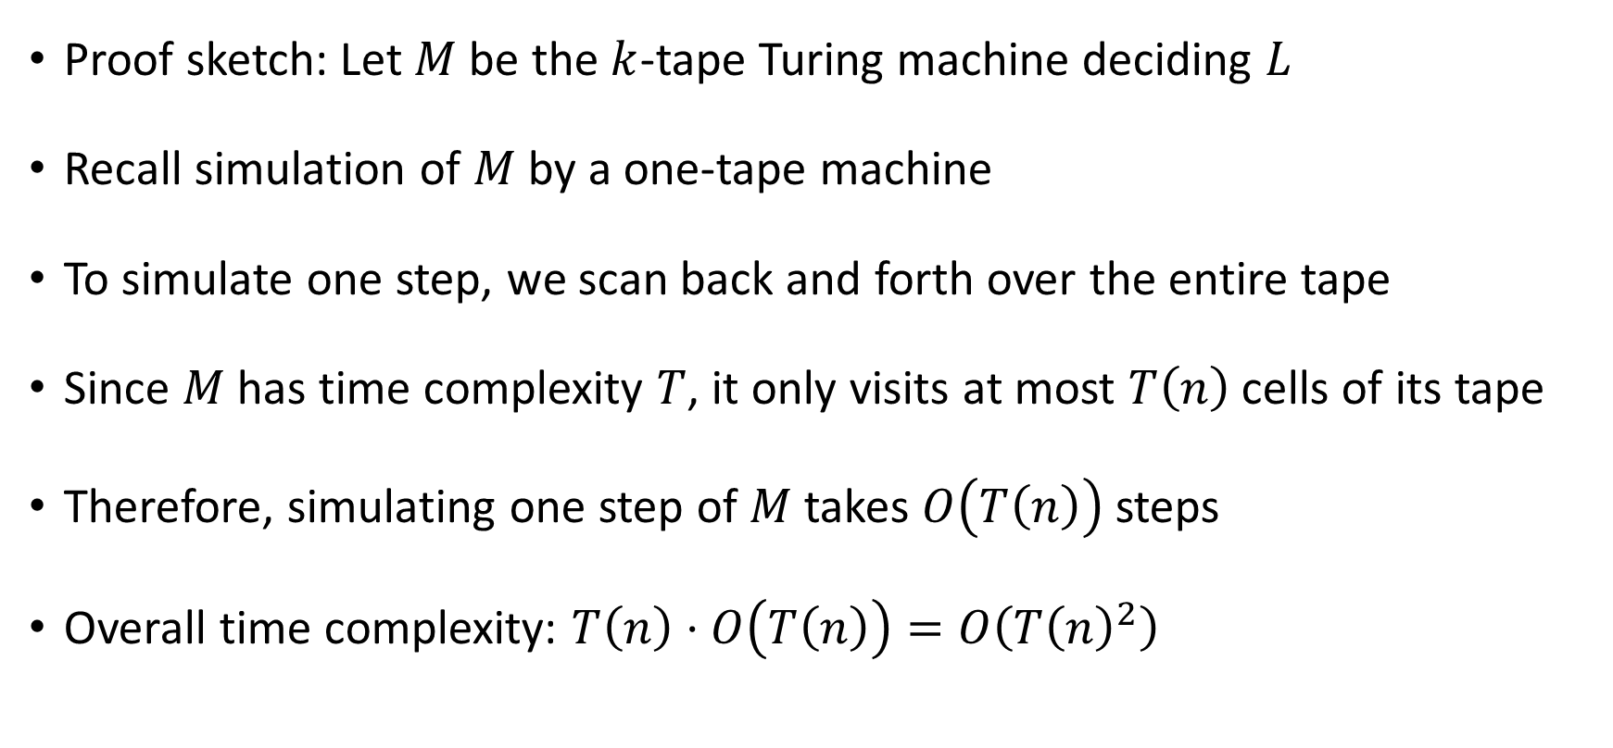
Efficiently simulating $k$ tapes using one tape
Proof sketch: Let $M$ be the $k$-tape Turing machine deciding $L$
Recall simulation of $M$ by a one-tape machine
To simulate one step, we scan back and forth over the entire tape
Since $M$ has time complexity $T$, it only visits at most $T\left(n\right)$ cells of its tape
Therefore, simulating one step of $M$ takes $O\left(T\left(n\right)\right)$ steps
Overall time complexity: $T\left(n\right)⋅O\left(T\left(n\right)\right)=O\left(T{\left(n\right)}^{2}\right)$

Slide 18
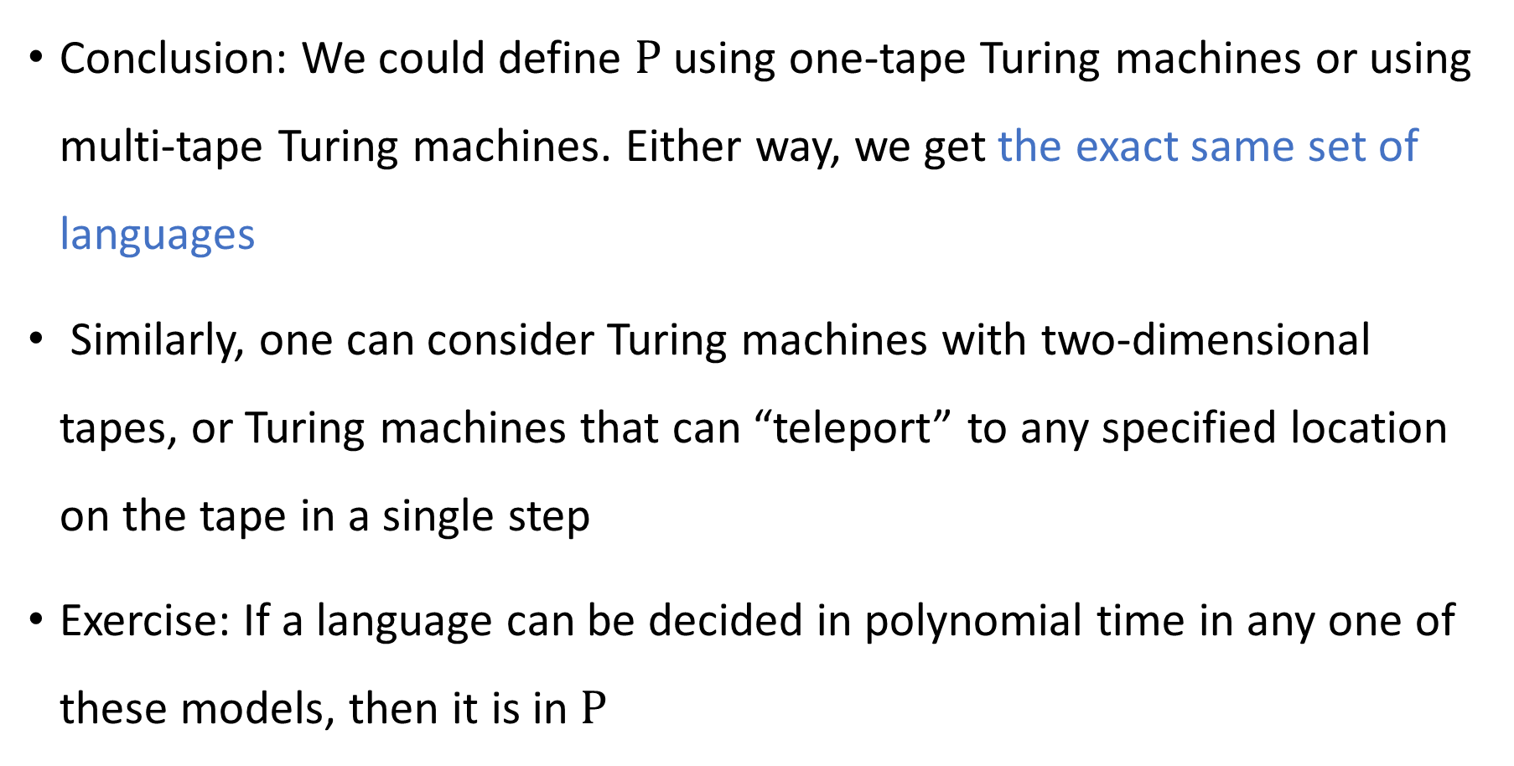
Which model of computation should we use?
Conclusion: We could define $\text{P}$ using one-tape Turing machines or using multi-tape Turing machines. Either way, we get the exact same set of languages
Similarly, one can consider Turing machines with two-dimensional tapes, or Turing machines that can “teleport” to any specified location on the tape in a single step
Exercise: If a language can be decided in polynomial time in any one of these models, then it is in $\text{P}$

Slide 19
Which problems can be solved through computation?

Slide 20

Which languages are in $\text{P}$?

Slide 21

Which languages are not in $\text{P}$?

Slide 22
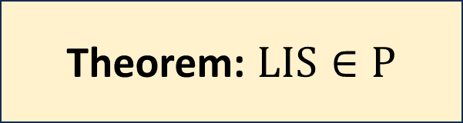
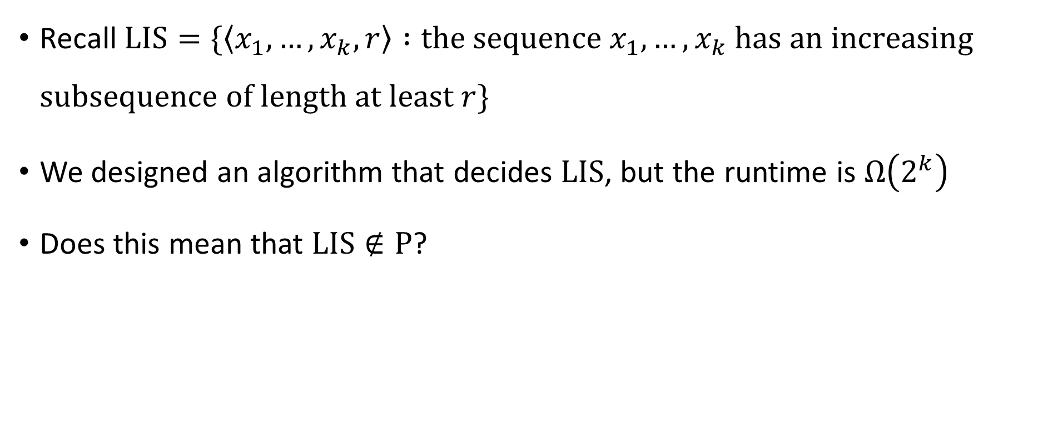
Longest increasing subsequence
Recall $\text{LIS}=\{\left\langle x_{1},…, x_{k},r\right\rangle :\text{the} \text{sequence} x_{1},…,x_{k} \text{has} \text{an} \text{increasing} \text{subsequence} \text{of} \text{length} \text{at} \text{least} r\}$
We designed an algorithm that decides $\text{LIS}$, but the runtime is $Ω\left(2^{k}\right)$
Does this mean that $\text{LIS}∉\text{P}$?
Theorem: $\text{LIS}∈\text{P}$

Slide 23
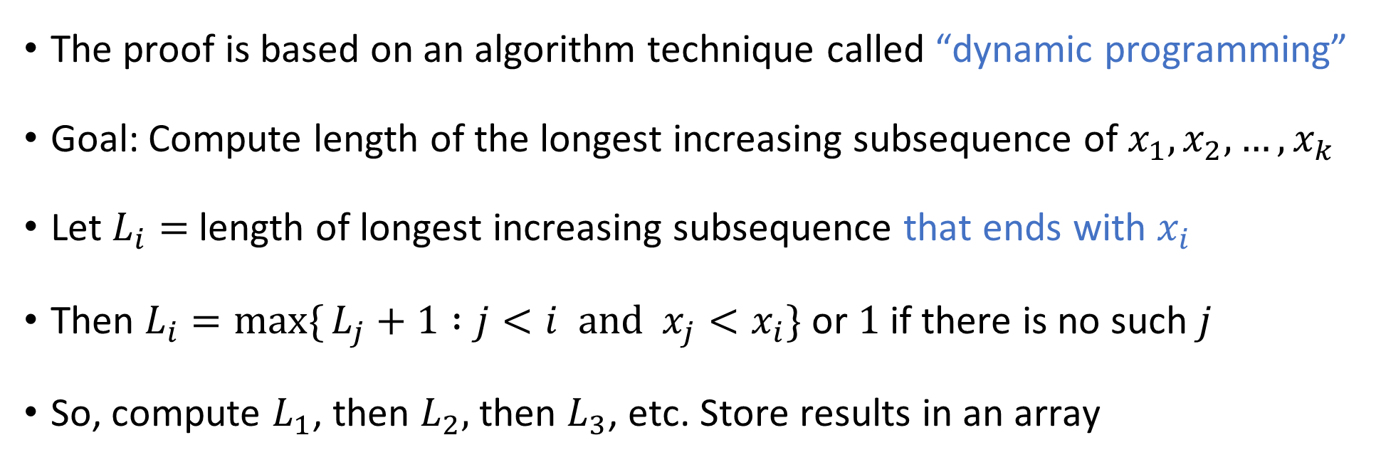
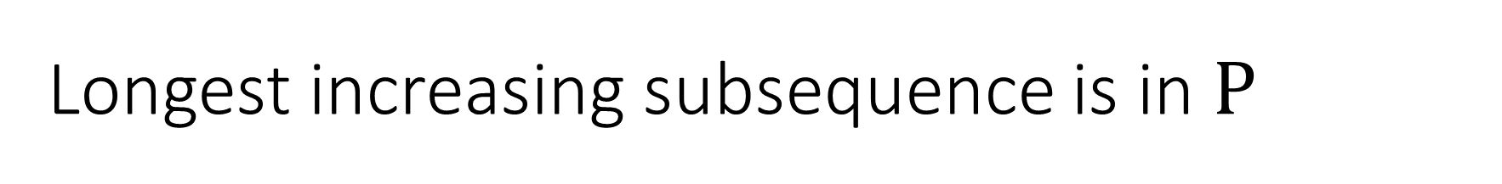

Longest increasing subsequence is in $\text{P}$
Theorem: $\text{LIS}∈\text{P}$
The proof is based on an algorithm technique called “dynamic programming”
Goal: Compute length of the longest increasing subsequence of $x_{1},x_{2},…, x_{k}$
Let $L_{i}=$ length of longest increasing subsequence that ends with $x_{i}$
Then $L_{i}=\max{\{}L_{j}+1 :j<i \text{and} x_{j}<x_{i}\}$ or $1$ if there is no such $j$
So, compute $L_{1}$, then $L_{2},$ then $L_{3}$, etc. Store results in an array

Slide 24
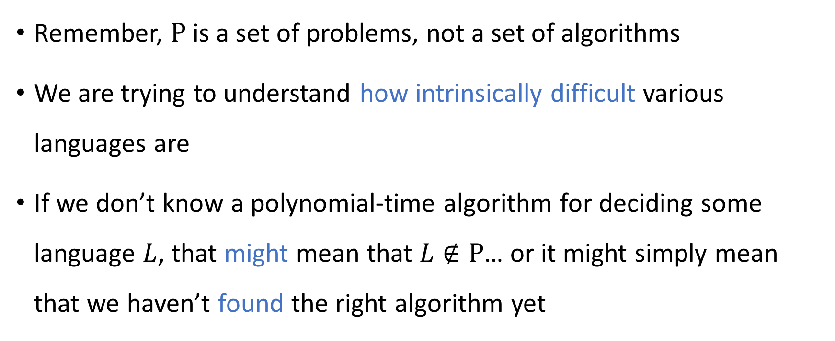
Intrinsic difficulty of problems
Remember, $\text{P}$ is a set of problems, not a set of algorithms
We are trying to understand how intrinsically difficult various languages are
If we don’t know a polynomial-time algorithm for deciding some language $L$, that might mean that $L∉\text{P}$… or it might simply mean that we haven’t found the right algorithm yet

Slide 25
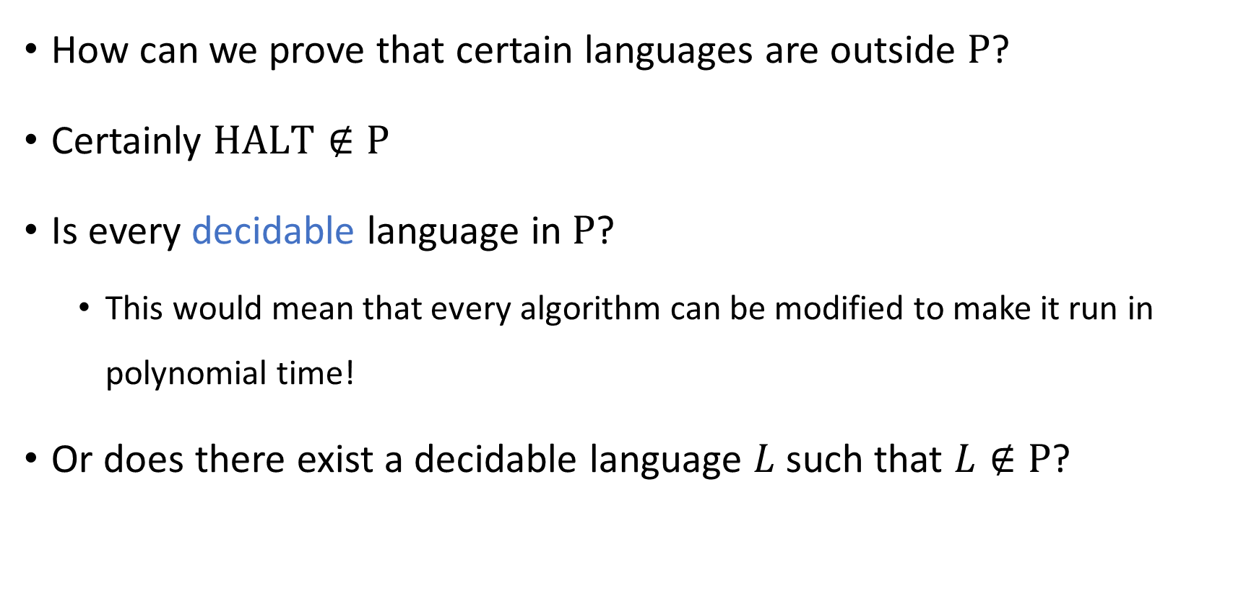
Intractability vs. undecidability
How can we prove that certain languages are outside $\text{P}$?
Certainly $\text{HALT}∉\text{P}$
Is every decidable language in $\text{P}$?
This would mean that every algorithm can be modified to make it run in polynomial time!
Or does there exist a decidable language $L$ such that $L∉\text{P}$?

Slide 26



Intractability vs. undecidability
All languages
$$\text{HALT}$$
Decidable languages
???
$$\text{P}$$
$$\text{LIS}$$

Slide 27
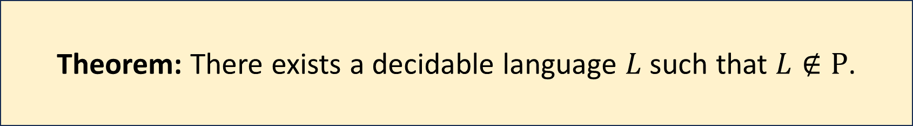
Decidable but intractable
Theorem: There exists a decidable language $L$ such that $L∉\text{P}$.
We will study two distinct proofs of this theorem
Each proof will give us new insights into the nature of efficient computation
Our first proof is based on the “Time Hierarchy Theorem”

Slide 28
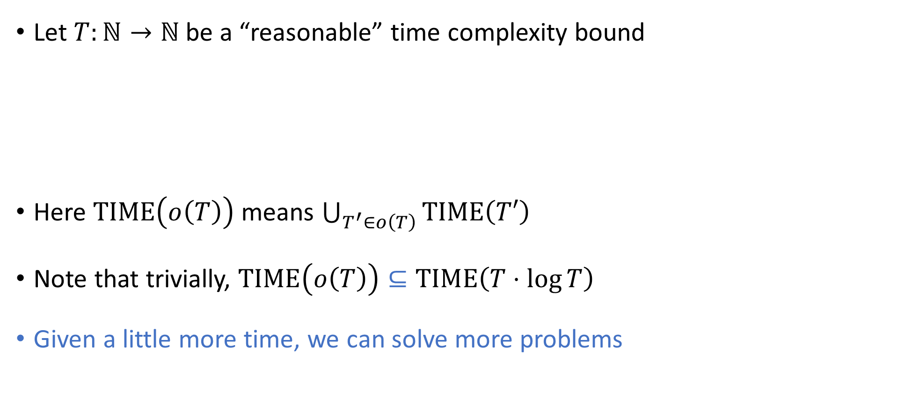
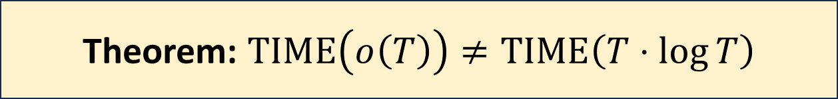
The Time Hierarchy Theorem
Let $T:ℕ→ℕ$ be a “reasonable” time complexity bound
Here $\text{TIME}\left(o\left(T\right)\right)$ means $\bigcup_{T^{′}∈o\left(T\right)}{\text{TIME}\left(T′\right)}$
Note that trivially, $\text{TIME}\left(o\left(T\right)\right)⊆\text{TIME}\left(T⋅\log{T}\right)$
Given a little more time, we can solve more problems
Theorem: $\text{TIME}\left(o\left(T\right)\right)≠\text{TIME}\left(T⋅\log{T}\right)$
Notes:
TODO: State the best known bound, and then say we’ll prove a weaker bound. Also, the small bound should be o(T(n))

Slide 29

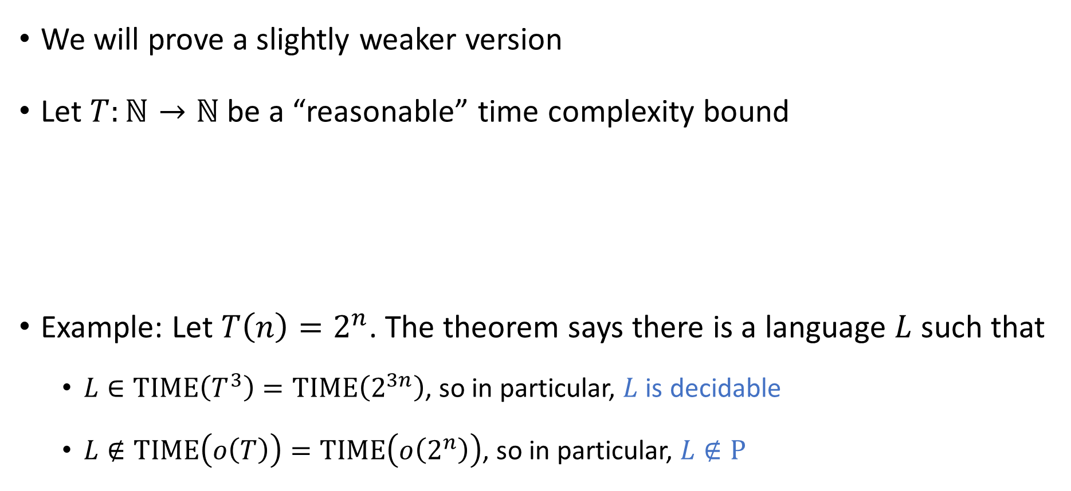
The Time Hierarchy Theorem
We will prove a slightly weaker version
Let $T:ℕ→ℕ$ be a “reasonable” time complexity bound
Example: Let $T\left(n\right)=2^{n}$. The theorem says there is a language $L$ such that
$L∈\text{TIME}\left(T^{3}\right)=\text{TIME}\left(2^{3n}\right)$, so in particular, $L$ is decidable
$L∉\text{TIME}\left(o\left(T\right)\right)=\text{TIME}\left(o\left(2^{n}\right)\right)$, so in particular, $L∉\text{P}$
Theorem: $\text{TIME}\left(o\left(T\right)\right)≠\text{TIME}\left(T^{3}\right)$

Slide 30
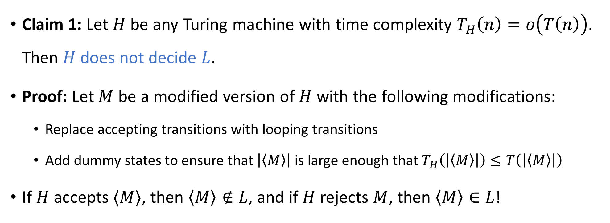

Proof of the Time Hierarchy Theorem
Let $L=\{\left\langle M\right\rangle :M \text{halts} \text{on} 〈M⟩ \text{within} T\left(\left|⟨M⟩\right|\right) \text{steps}\}$
Claim 1: Let $H$ be any Turing machine with time complexity $T_{H}\left(n\right)=o\left(T\left(n\right)\right)$. Then $H$ does not decide $L$.
Proof: Let $M$ be a modified version of $H$ with the following modifications:
Replace accepting transitions with looping transitions
Add dummy states to ensure that $\left|\left\langle M\right\rangle \right|$ is large enough that $T_{H}\left(\left|\left\langle M\right\rangle \right|\right)≤T\left(\left|\left\langle M\right\rangle \right|\right)$
If $H$ accepts $⟨M⟩$, then $\left\langle M\right\rangle ∉L$, and if $H$ rejects $M$, then $\left\langle M\right\rangle ∈L$!

Slide 31


Proof of the Time Hierarchy Theorem
Let $L=\{\left\langle M\right\rangle :M \text{halts} \text{on} 〈M⟩ \text{within} T\left(\left|⟨M⟩\right|\right) \text{steps}\}$
Claim 2: $L∈\text{TIME}\left(T^{3}\right)$

