Slide 1
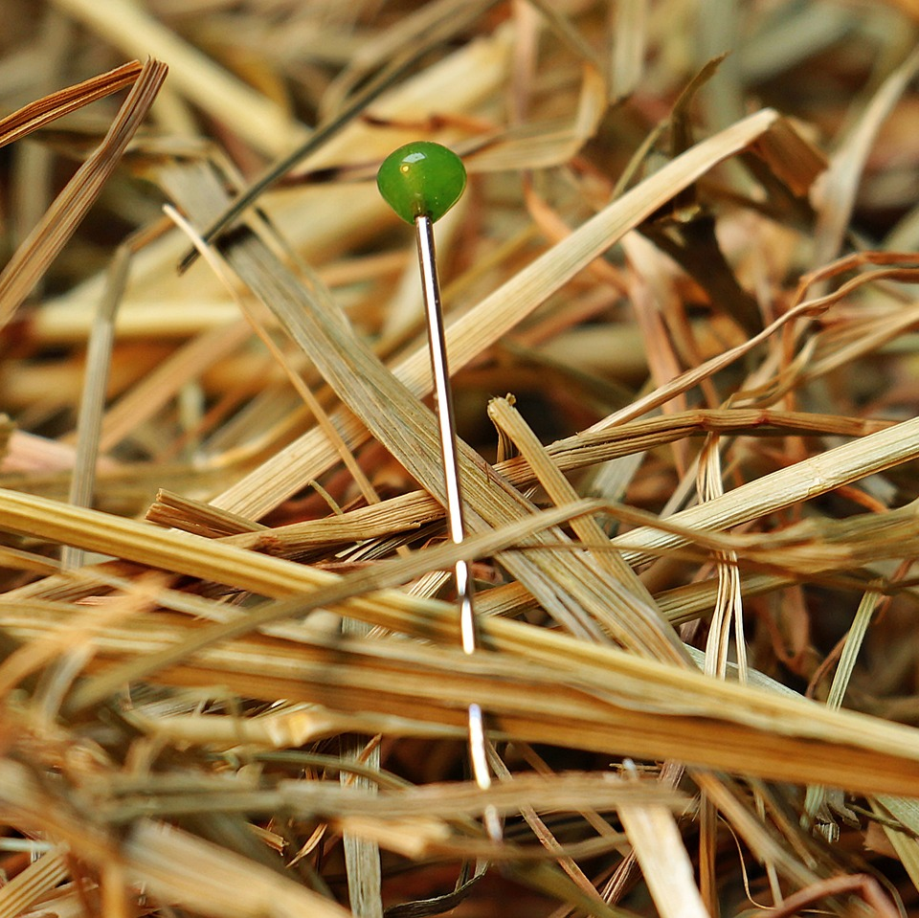
CMSC 28100 Introduction to Complexity Theory Spring 2025 Instructor: William Hoza

Slide 2

Hamiltonian paths
Let $G$ be a directed graph
Definition: A Hamiltonian path is a directed path that visits every vertex exactly once

Slide 3



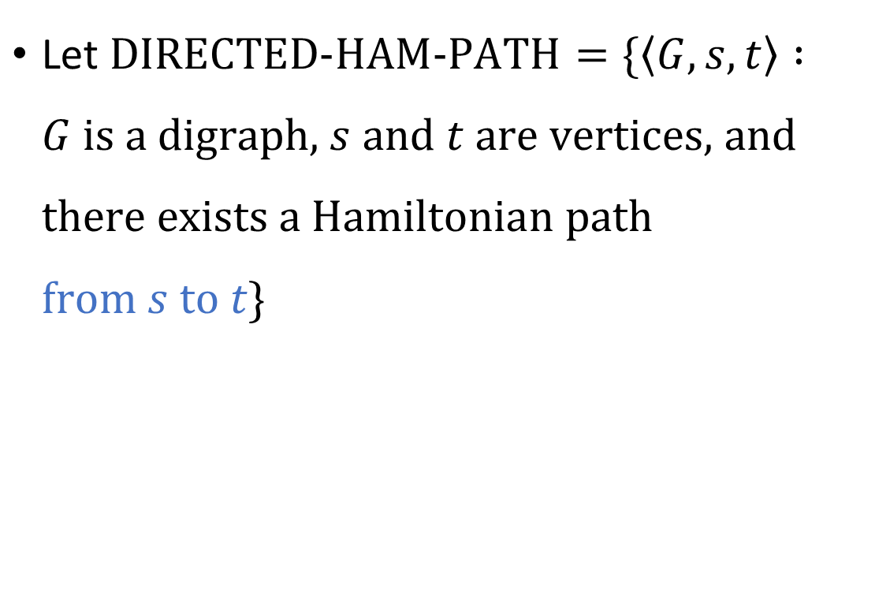













$\text{DIRECTED}\text{‑}\text{HAM}\text{‑}\text{PATH}$ is $\text{NP}$-complete
$$s$$
Let $\text{DIRECTED}\text{‑}\text{HAM}\text{‑}\text{PATH}=\{\left\langle G, s, t\right\rangle :G \text{is} \text{a} \text{digraph}\text{, }s \text{and} t \text{are} \text{vertices}\text{, }\text{and} \text{there} \text{exists} \text{a} \text{Hamiltonian} \text{path} \text{from} s \text{to} t\}$
$$C_{1}$$
$$x_{1}$$
$$⋯$$
$$C_{2}$$
$$x_{2}$$
$$⋯$$
$$C_{3}$$
$$⋮$$
$$⋮$$
$$x_{ℓ}$$
$$⋯$$
$$C_{k}$$
$$t$$
Theorem: $\text{DIRECTED}\text{‑}\text{HAM}\text{‑}\text{PATH}$ is $\text{NP}$-complete

Slide 4









$\text{NP}$-hard
$$\text{CIRCUIT}\text{‑}\text{SAT}$$
$$\text{DIRECTED}\text{‑}\text{HAM}\text{‑}\text{PATH}$$
$$\text{CLIQUE}$$
$\text{NP}$-complete
$$\text{3‑}\text{SAT}$$
$$\text{SUBSET}\text{‑}\text{SUM}$$
$$\text{NP}$$
$$\text{P}$$

Slide 5

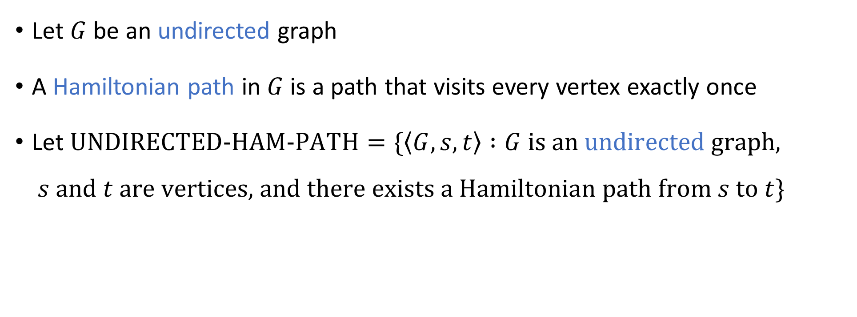
Undirected Hamiltonian path
Let $G$ be an undirected graph
A Hamiltonian path in $G$ is a path that visits every vertex exactly once
Let $\text{UNDIRECTED}\text{‑}\text{HAM}\text{‑}\text{PATH}=\{\left\langle G, s, t\right\rangle :G \text{is} \text{an} \text{undirected} \text{graph}\text{,}$ $s \text{and} t \text{are} \text{vertices}\text{, }\text{and} \text{there} \text{exists} \text{a} \text{Hamiltonian} \text{path} \text{from} s \text{to} t\}$
Theorem: $\text{UNDIRECTED}\text{‑}\text{HAM}\text{‑}\text{PATH}$ is $\text{NP}$-complete

Slide 6


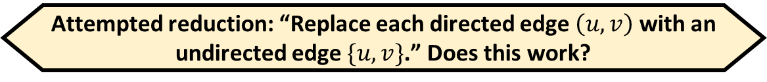
$\text{UNDIRECTED}\text{‑}\text{HAM}\text{‑}\text{PATH}$ is $\text{NP}$-complete
First, note that $\text{UNDIRECTED}\text{‑}\text{HAM}\text{‑}\text{PATH}∈\text{NP}$ (why?)
To prove that $\text{UNDIRECTED}\text{‑}\text{HAM}\text{‑}\text{PATH}$ is $\text{NP}$-hard, we will do a reduction from $\text{DIRECTED}\text{‑}\text{HAM}\text{‑}\text{PATH}$
Attempted reduction: “Replace each directed edge $\left(u, v\right)$ with an undirected edge $\{u, v\}$.” Does this work?
A: Yes
B: It doesn’t work, because it doesn’t run in polynomial time
C: It doesn’t work, because it doesn’t always map YES to YES
D: It doesn’t work, because it doesn’t always map NO to NO
Respond at PollEv.com/whoza or text “whoza” to 22333

Slide 7





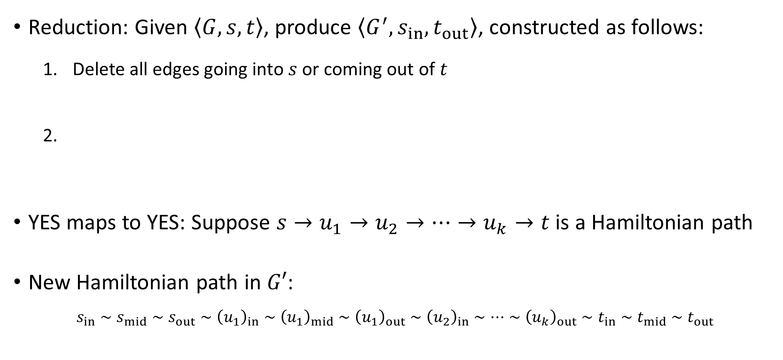









From directed to undirected
Reduction: Given $\left\langle G,s,t\right\rangle$, produce $\left\langle G^{′},s_{in},t_{out}\right\rangle$, constructed as follows:
Delete all edges going into $s$ or coming out of $t$
YES maps to YES: Suppose $s→u_{1}→u_{2}→…→u_{k}→t$ is a Hamiltonian path
New Hamiltonian path in $G′$:
$$s_{in}∼s_{mid}∼s_{out}∼{\left(u_{1}\right)}_{in}∼{\left(u_{1}\right)}_{mid}∼{\left(u_{1}\right)}_{out}∼{\left(u_{2}\right)}_{in}∼⋯∼{\left(u_{k}\right)}_{out}∼t_{in}∼t_{mid}∼t_{out}$$
$$a$$
$$d$$
$$a_{out}$$
$$d_{in}$$
$$b$$
$$b_{out}$$
$$c$$
$$e$$
$$c_{out}$$
$$e_{in}$$
$$u$$
$$u_{in}$$
$$u_{mid}$$
$$u_{out}$$

Slide 8





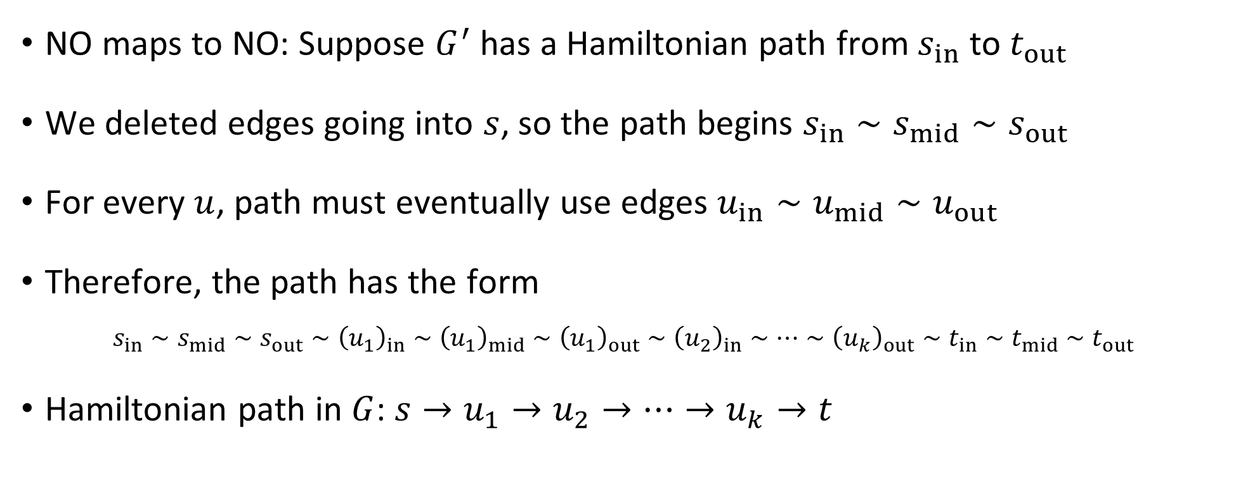









$$a$$
$$d$$
$$a_{out}$$
$$d_{in}$$
$$b$$
$$b_{out}$$
$$c$$
$$e$$
$$c_{out}$$
$$e_{in}$$
$$u$$
$$u_{in}$$
$$u_{mid}$$
$$u_{out}$$
NO maps to NO: Suppose $G^{′}$ has a Hamiltonian path from $s_{in}$ to $t_{out}$
We deleted edges going into $s$, so the path begins $s_{in}∼s_{mid}∼s_{out}$
For every $u$, path must eventually use edges $u_{in}∼u_{mid}∼u_{out}$
Therefore, the path has the form
$$s_{in}∼s_{mid}∼s_{out}∼{\left(u_{1}\right)}_{in}∼{\left(u_{1}\right)}_{mid}∼{\left(u_{1}\right)}_{out}∼{\left(u_{2}\right)}_{in}∼…∼{\left(u_{k}\right)}_{out}∼t_{in}∼t_{mid}∼t_{out}$$
Hamiltonian path in $G$: $s→u_{1}→u_{2}→…→u_{k}→t$

Slide 9



$\text{NP}$-hard
$$\text{CIRCUIT}\text{‑}\text{SAT}$$
$$\text{DIRECTED}\text{‑}\text{HAM}\text{‑}\text{PATH}$$
$$\text{CLIQUE}$$
$$\text{UN}\text{DIRECTED}\text{‑}\text{HAM}\text{‑}\text{PATH}$$
$\text{NP}$-complete
$$\text{3‑}\text{SAT}$$
$$\text{SUBSET}\text{‑}\text{SUM}$$
$$\text{NP}$$
$$\text{P}$$

Slide 10
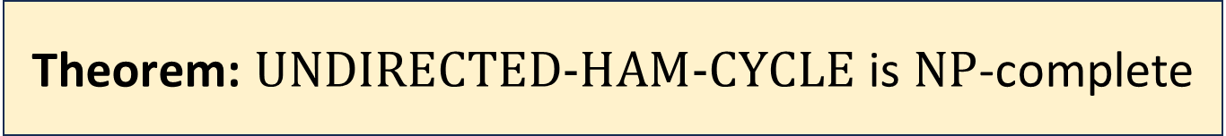
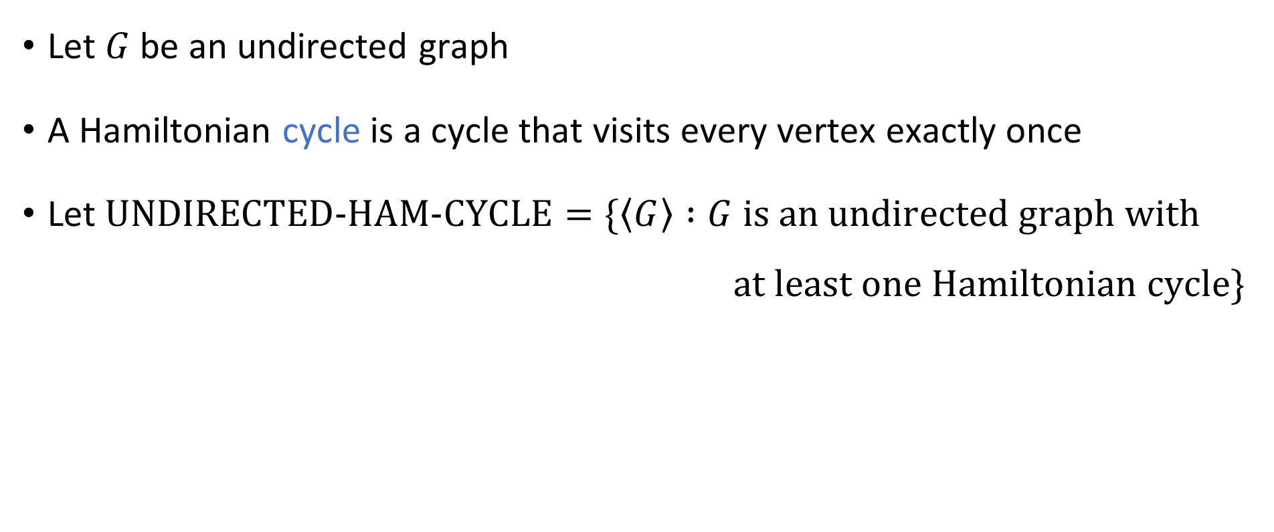
Hamiltonian cycles
Let $G$ be an undirected graph
A Hamiltonian cycle is a cycle that visits every vertex exactly once
Let $\text{UNDIRECTED}\text{‑}\text{HAM}\text{‑}\text{CYCLE}=\{\left\langle G\right\rangle :G \text{is} \text{an} \text{undirected} \text{graph} \text{with}$ $\text{a}\text{t} \text{least} \text{one} \text{Hamiltonian} \text{cycle}\}$
Theorem: $\text{UNDIRECTED}\text{‑}\text{HAM}\text{‑}\text{CYCLE}$ is $\text{NP}$-complete

Slide 11


$\text{UNDIRECTED}\text{‑}\text{HAM}\text{‑}\text{CYCLE}$ is $\text{NP}$-complete
Proof: First note that $\text{UNDIRECTED}\text{‑}\text{HAM}\text{‑}\text{CYCLE}∈\text{NP}$ (why?)
To prove $\text{NP}$-hardness, we do a reduction from $\text{UNDIRECTED}\text{‑}\text{HAM}\text{‑}\text{PATH}$

Slide 12












From paths to cycles
$$G$$
$$s$$
$$v_{∗}$$
$$t$$
Reduction: Given $\left\langle G,s,t\right\rangle$, add one new vertex $v_{∗}$ and two new edges $\{s, v_{∗}\}$ and $\{t, v_{∗}\}$
Poly-time computable ✔️
YES maps to YES
$$s$$
$$s$$
$$⋯$$
$$v_{∗}$$
$$⋯$$
NO maps to NO
$$t$$
$$t$$

Slide 13







$\text{NP}$-hard
$$\text{CIRCUIT}\text{‑}\text{SAT}$$
$$\text{DIRECTED}\text{‑}\text{HAM}\text{‑}\text{PATH}$$
$$\text{CLIQUE}$$
$$\text{UN}\text{DIRECTED}\text{‑}\text{HAM}\text{‑}\text{PATH}$$
$\text{NP}$-complete
$$\text{UNDIRECTED}\text{‑}\text{HAM}\text{‑}\text{CYCLE}$$
$$\text{3‑}\text{SAT}$$
$$\text{SUBSET}\text{‑}\text{SUM}$$
$$\text{NP}$$
$$\text{P}$$

Slide 14
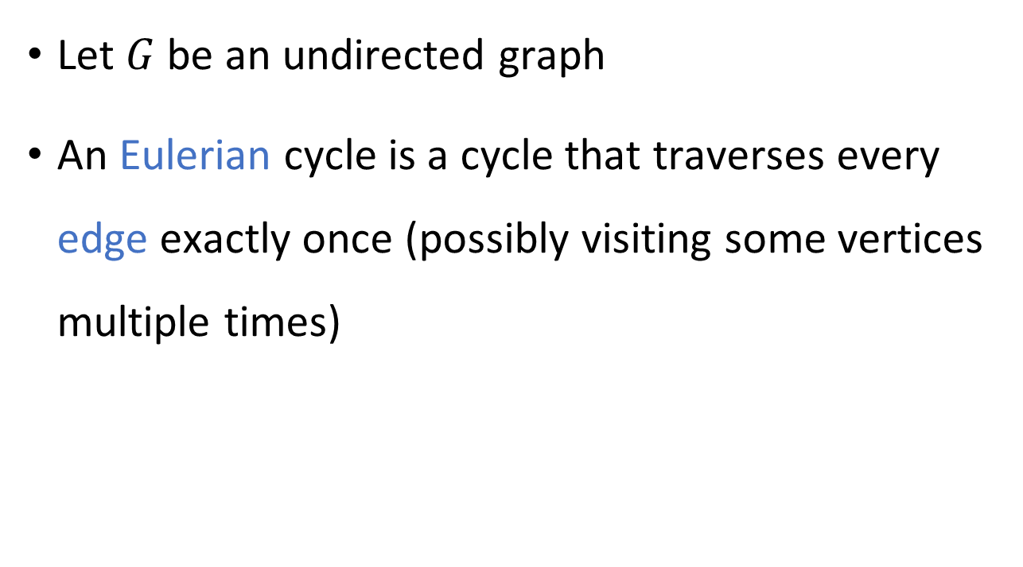
Comparison: Eulerian cycles
Let $G$ be an undirected graph
An Eulerian cycle is a cycle that traverses every edge exactly once (possibly visiting some vertices multiple times)

Slide 15
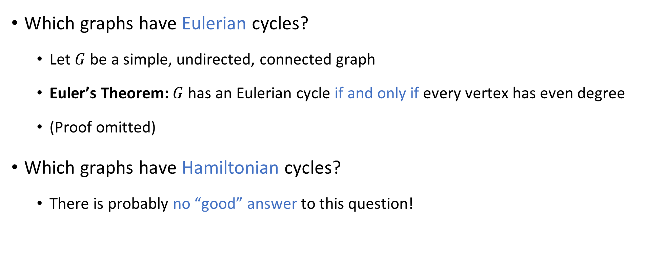
Eulerian cycles vs. Hamiltonian cycles
Which graphs have Eulerian cycles?
Let $G$ be a simple, undirected, connected graph
Euler’s Theorem: $G$ has an Eulerian cycle if and only if every vertex has even degree
(Proof omitted)
Which graphs have Hamiltonian cycles?
There is probably no “good” answer to this question!

Slide 16
$\text{NP}$-hard
$$\text{CIRCUIT}\text{‑}\text{SAT}$$
$$\text{DIRECTED}\text{‑}\text{HAM}\text{‑}\text{PATH}$$
$$\text{CLIQUE}$$
$$\text{UN}\text{DIRECTED}\text{‑}\text{HAM}\text{‑}\text{PATH}$$
$\text{NP}$-complete
$$\text{UNDIRECTED}\text{‑}\text{HAM}\text{‑}\text{CYCLE}$$
$$\text{3‑}\text{SAT}$$
$$\text{SUBSET}\text{‑}\text{SUM}$$
$$\text{NP}$$
$$\text{P}$$

Slide 17
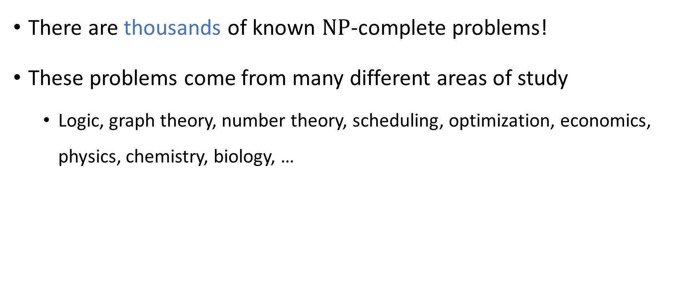
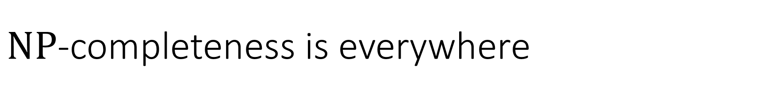
$\text{NP}$-completeness is everywhere
There are thousands of known $\text{NP}$-complete problems!
These problems come from many different areas of study
Logic, graph theory, number theory, scheduling, optimization, economics, physics, chemistry, biology, …

Slide 18
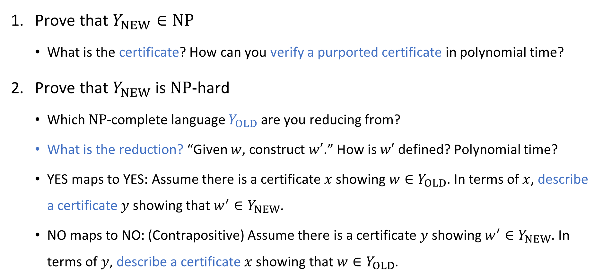

Proving that $Y_{NEW}$ is $\text{NP}$-complete (“cheat sheet”)
Prove that $Y_{NEW}∈\text{NP}$
What is the certificate? How can you verify a purported certificate in polynomial time?
Prove that $Y_{NEW}$ is $\text{NP}$-hard
Which $\text{NP}$-complete language $Y_{OLD}$ are you reducing from?
What is the reduction? “Given $w$, construct $w′$.” How is $w′$ defined? Polynomial time?
YES maps to YES: Assume there is a certificate $x$ showing $w∈Y_{OLD}$. In terms of $x$, describe a certificate $y$ showing that $w^{′}∈Y_{NEW}$.
NO maps to NO: (Contrapositive) Assume there is a certificate $y$ showing $w^{′}∈Y_{NEW}$. In terms of $y$, describe a certificate $x$ showing that $w∈Y_{OLD}$.

Slide 19
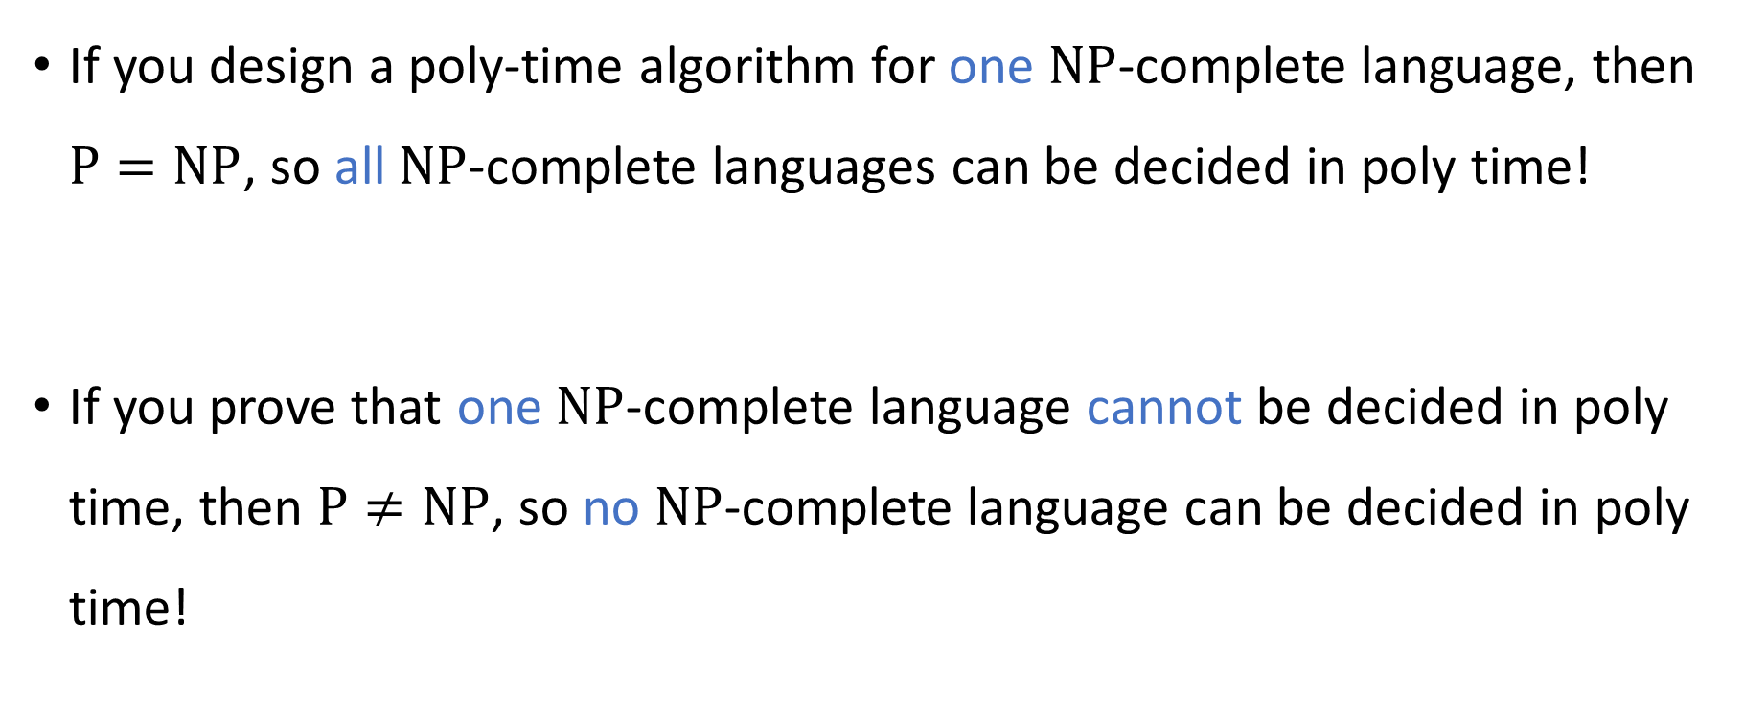

$\text{NP}$-complete languages stand or fall together
If you design a poly-time algorithm for one $\text{NP}$-complete language, then $\text{P}=\text{NP}$, so all $\text{NP}$-complete languages can be decided in poly time!
If you prove that one $\text{NP}$-complete language cannot be decided in poly time, then $\text{P}≠\text{NP}$, so no $\text{NP}$-complete language can be decided in poly time!

Slide 20
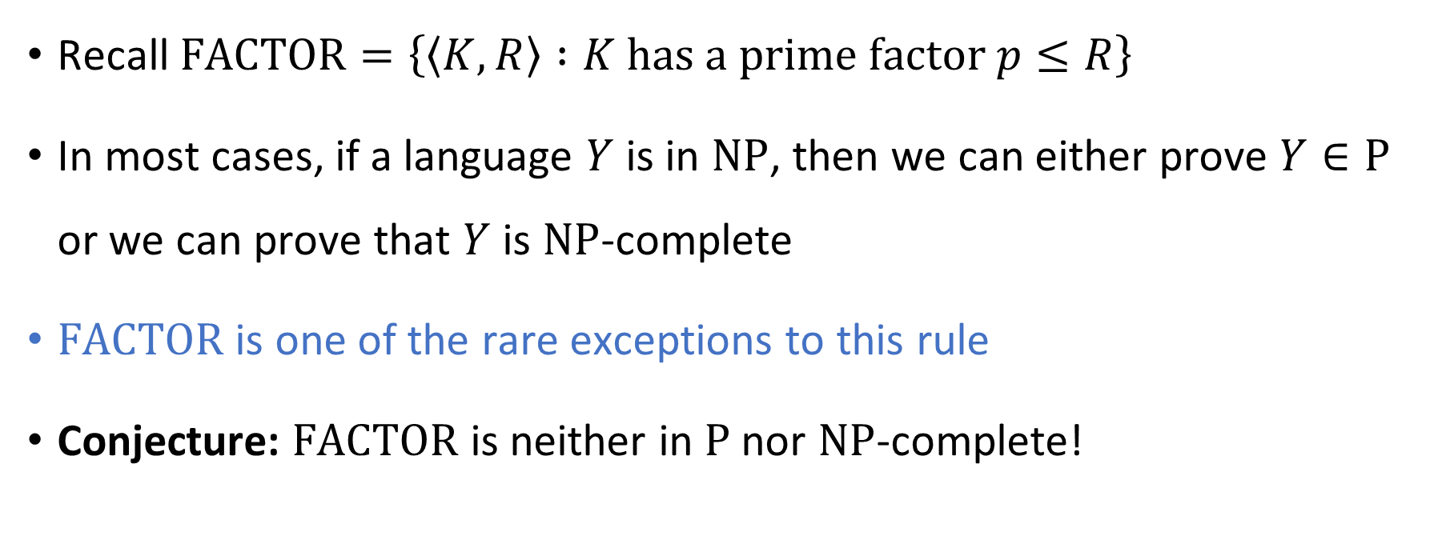
Complexity of factoring integers
Recall $\text{FACTOR}=\left\{\left\langle K,R\right\rangle :K \text{has} \text{a} \text{prime} \text{factor} p≤R\right\}$
In most cases, if a language $Y$ is in $\text{NP}$, then we can either prove $Y∈\text{P}$ or we can prove that $Y$ is $\text{NP}$-complete
$\text{FACTOR}$ is one of the rare exceptions to this rule
Conjecture: $\text{FACTOR}$ is neither in $\text{P}$ nor $\text{NP}$-complete!

Slide 21


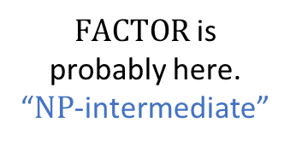




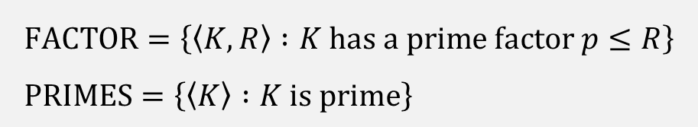
$$\text{FACTOR}=\left\{\left\langle K,R\right\rangle :K \text{has} \text{a} \text{prime} \text{factor} p≤R\right\} \\ \text{PRIMES}=\left\{\left\langle K\right\rangle :K \text{is} \text{prime}\right\}$$
$\text{NP}$-hard
$$\text{3}\text{‑}\text{SAT}$$
$\text{NP}$-complete
$\text{FACTOR}$ is probably here. “$\text{NP}$-intermediate”
$$\text{NP}$$
$$\text{P}$$
$$\text{PRIMES}$$

Slide 22
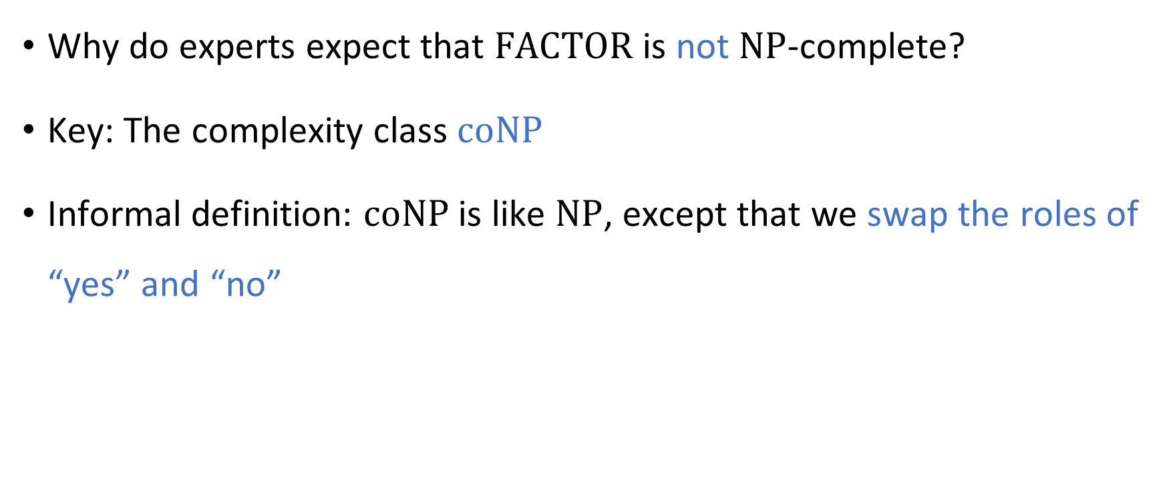
Complexity of factoring integers
Why do experts expect that $\text{FACTOR}$ is not $\text{NP}$-complete?
Key: The complexity class $\text{coNP}$
Informal definition: $\text{coNP}$ is like $\text{NP}$, except that we swap the roles of “yes” and “no”

Slide 23
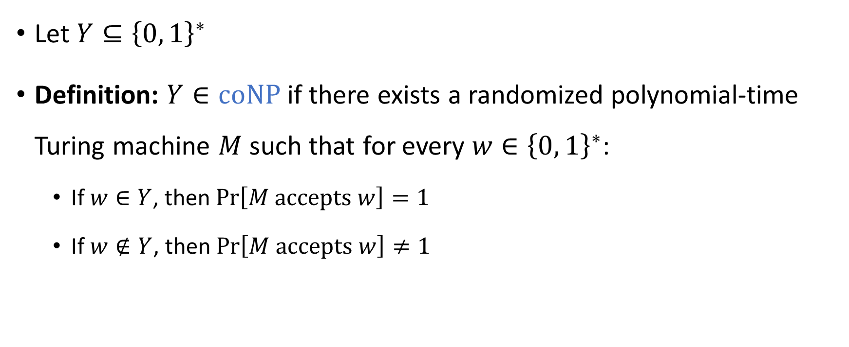

The complexity class $co\text{NP}$
Let $Y⊆{\left\{0, 1\right\}}^{∗}$
Definition: $Y∈\text{coNP}$ if there exists a randomized polynomial-time Turing machine $M$ such that for every $w∈{\left\{0, 1\right\}}^{∗}$:
If $w∈Y$, then $\operatorname{Pr}\left[M \text{accepts} w\right]=1$
If $w∉Y$, then $\operatorname{Pr}\left[M \text{accepts} w\right]≠1$

Slide 24

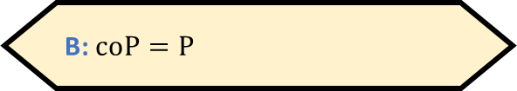

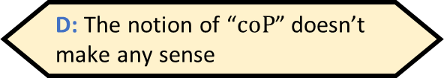
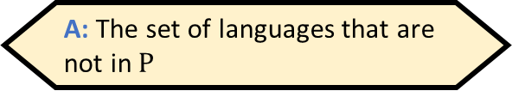
The complexity class $\text{coNP}$
Let $Y⊆{\left\{0, 1\right\}}^{∗}$ and let $\overline{Y}={\left\{0, 1\right\}}^{∗}∖Y$
Fact: $Y∈\text{NP}$ if and only if $\overline{Y}∈\text{coNP}$
$\text{coNP}$ is the set of complements of languages in $\text{NP}$
What is $\text{coP}$?
A: The set of languages that are not in $\text{P}$
B: $\text{coP}=\text{P}$
C: The set of algorithms that do not run in polynomial time
D: The notion of “$\text{coP}$” doesn’t make any sense
Respond at PollEv.com/whoza or text “whoza” to 22333

Slide 25
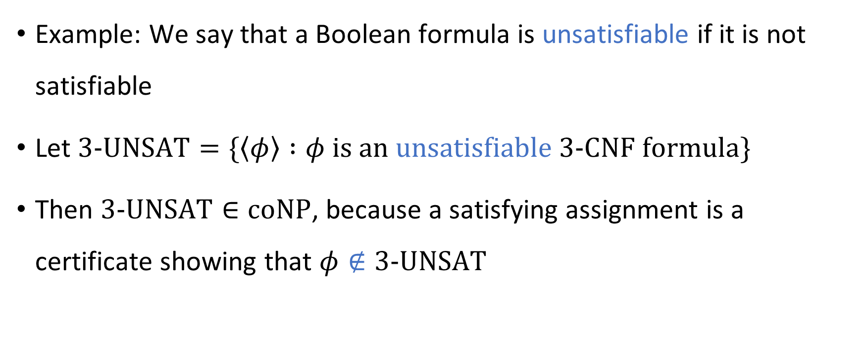
The complexity class $\text{coNP}$
Example: We say that a Boolean formula is unsatisfiable if it is not satisfiable
Let $\text{3‑}\text{UNSAT}=\{\left\langle φ\right\rangle :φ is an unsatisfiable \text{3‑}\text{CNF} formula\}$
Then $\text{3‑}\text{UNSAT}∈\text{coNP}$, because a satisfying assignment is a certificate showing that $φ∉\text{3‑}\text{UNSAT}$

Slide 26
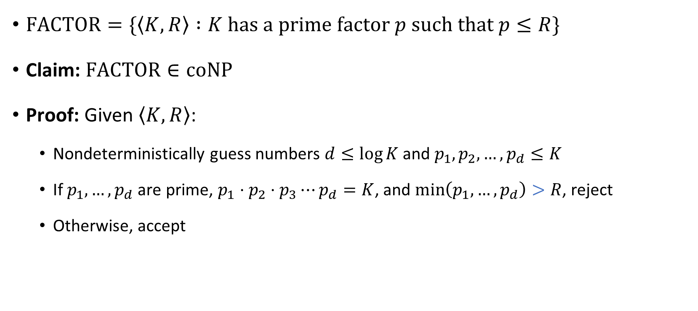


$\text{FACTOR}∈\text{coNP}$
$\text{FACTOR}=\{\left\langle K,R\right\rangle :K \text{has} \text{a} \text{prime} \text{factor} p \text{such} \text{that} p≤R\}$
Claim: $\text{FACTOR}∈\text{coNP}$
Proof: Given $\left\langle K,R\right\rangle$:
Nondeterministically guess numbers $d≤\log{K}$ and $p_{1},p_{2},…, p_{d}≤K$
If $p_{1},…, p_{d}$ are prime, $p_{1}⋅p_{2}⋅p_{3}⋯p_{d}=K$, and $\min\left(p_{1},…, p_{d}\right)>R$, reject
Otherwise, accept
$$\text{PRIMES}∈\text{P}$$

