Slide 1
CMSC 28100 Introduction to Complexity Theory Autumn 2025 Instructor: William Hoza
⏳

Slide 2
Midterm exam
Midterm exam will be in class on Friday, October 24
To prepare for the midterm, you only need to study the material prior to this point
The midterm will be about Turing machines, decidability, and undecidability

Slide 3
Which problems can be solved through computation?

Slide 4
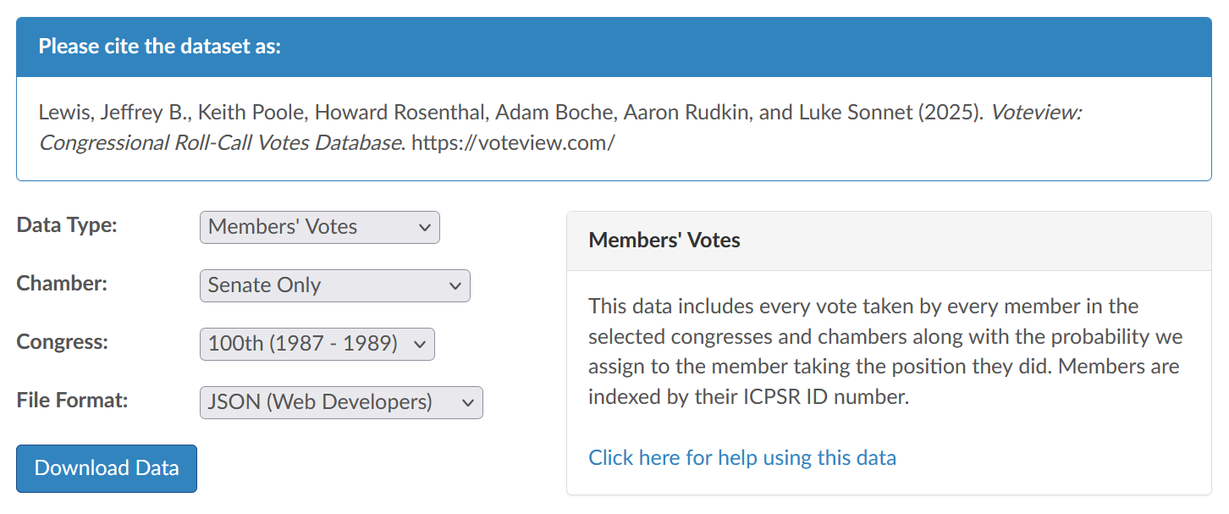
Applying our theory
Question: In the year 1988, were there 50 U.S. senators, every pair of which voted the same way more than 50% of the time?
Step 1: Gather data

Slide 5
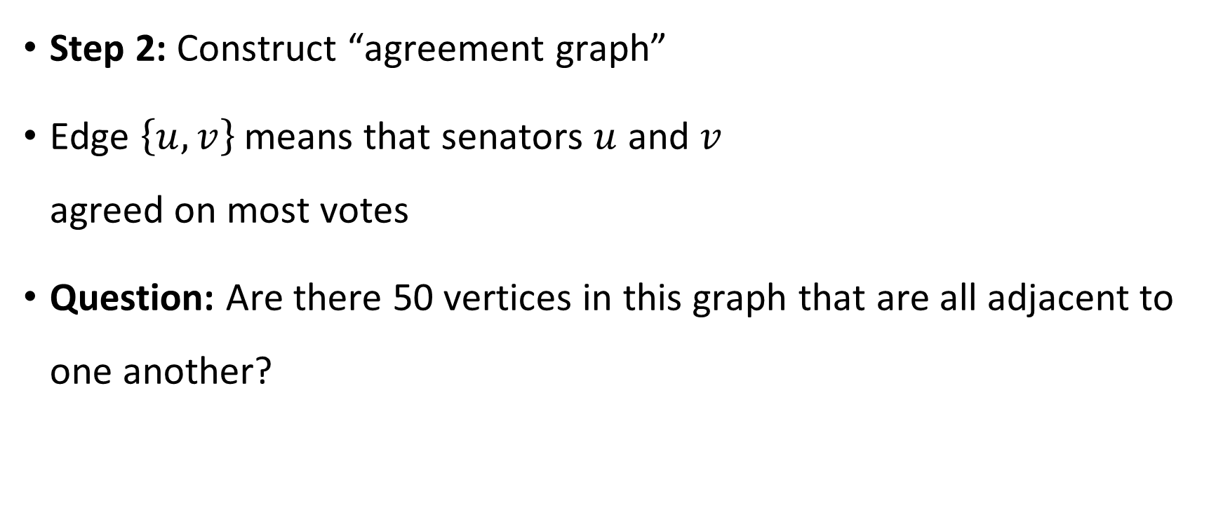
Agreement graph
Senator 1
Senator 2
Step 2: Construct “agreement graph”
Edge $\left\{u, v\right\}$ means that senators $u$ and $v$ agreed on most votes
Question: Are there 50 vertices in this graph that are all adjacent to one another?
Senator 3
Senator 4

Slide 6

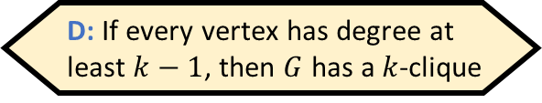
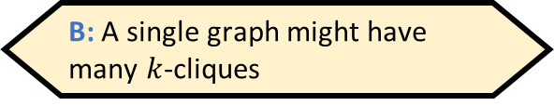
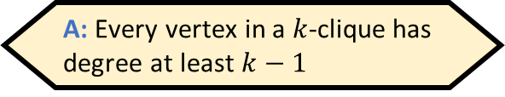
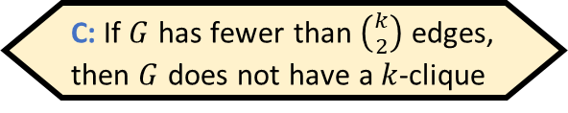
The clique problem
A $k$-clique in a graph $G=\left(V, E\right)$ is a set $S⊆V$ such that $\left|S\right|=k$ and every two vertices in $S$ are connected by an edge
Example: This graph has a $4$-clique
Which of the following statements is false?
A: Every vertex in a $k$-clique has degree at least $k−1$
B: A single graph might have many $k$-cliques
C: If $G$ has fewer than $\left({k \atop 2}\right)$ edges, then $G$ does not have a $k$-clique
D: If every vertex has degree at least $k−1$, then $G$ has a $k$-clique
Respond at PollEv.com/whoza or text “whoza” to 22333
Notes:
A cycle on n > 3 vertices does not have a 3-clique

Slide 7

The clique problem
Let $\text{CLIQUE}=\{\left\langle G,k\right\rangle :G \text{has} \text{a} k\text{‑}\text{clique}\}$
Example: Let $G$ be the graph with the following adjacency matrix
Does $G$ have a $4$-clique?
 | a | b | c | d | e | f | g
a | 0 | 1 | 1 | 0 | 0 | 1 | 0
b | 1 | 0 | 0 | 1 | 1 | 0 | 1
c | 1 | 0 | 0 | 0 | 1 | 0 | 1
d | 0 | 1 | 0 | 0 | 1 | 0 | 1
e | 0 | 1 | 1 | 1 | 0 | 1 | 1
f | 1 | 0 | 0 | 0 | 1 | 0 | 1
g | 0 | 1 | 1 | 1 | 1 | 1 | 0

Slide 8

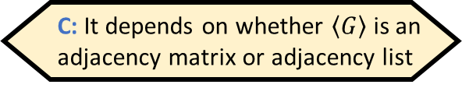
The clique problem
Let $\text{CLIQUE}=\{\left\langle G,k\right\rangle :G \text{has} \text{a} k\text{‑}\text{clique}\}$
Example: Let $G$ be the graph with the following adjacency matrix
Does $G$ have a $4$-clique?
Yes! $S=\{\text{b},\text{d},\text{e},\text{g}\}$
 | a | b | c | d | e | f | g
a | 0 | 1 | 1 | 0 | 0 | 1 | 0
b | 1 | 0 | 0 | 1 | 1 | 0 | 1
c | 1 | 0 | 0 | 0 | 1 | 0 | 1
d | 0 | 1 | 0 | 0 | 1 | 0 | 1
e | 0 | 1 | 1 | 1 | 0 | 1 | 1
f | 1 | 0 | 0 | 0 | 1 | 0 | 1
g | 0 | 1 | 1 | 1 | 1 | 1 | 0
Is $\text{CLIQUE}$ decidable?
A: Yes
B: No
C: It depends on whether $\left\langle G\right\rangle$ is an adjacency matrix or adjacency list
D: It’s not a language, so the question doesn’t make sense
Respond at PollEv.com/whoza or text “whoza” to 22333

Slide 9
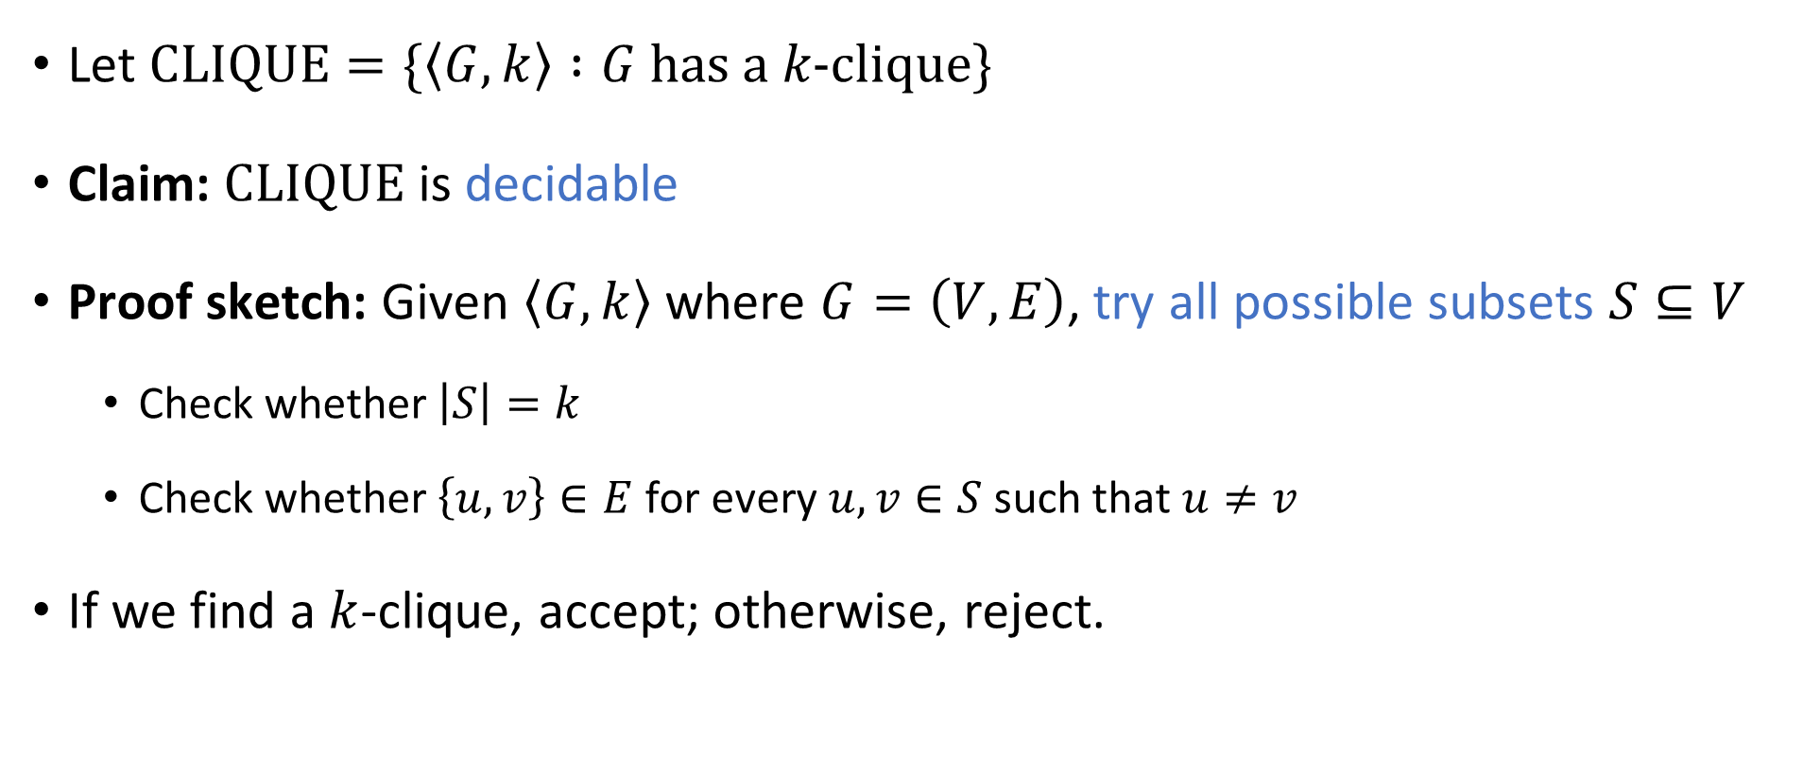
The clique problem
Let $\text{CLIQUE}=\{\left\langle G,k\right\rangle :G \text{has} \text{a} k\text{‑}\text{clique}\}$
Claim: $\text{CLIQUE}$ is decidable
Proof sketch: Given $\left\langle G,k\right\rangle$ where $G=\left(V,E\right)$, try all possible subsets $S⊆V$
Check whether $\left|S\right|=k$
Check whether $\left\{u, v\right\}∈E$ for every $u,v∈S$ such that $u≠v$
If we find a $k$-clique, accept; otherwise, reject.

Slide 10
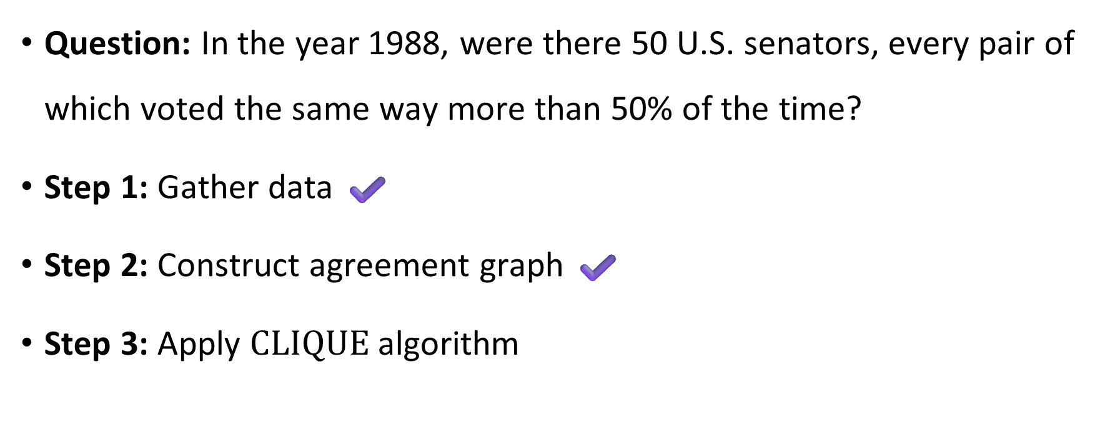
The clique problem
Question: In the year 1988, were there 50 U.S. senators, every pair of which voted the same way more than 50% of the time?
Step 1: Gather data ✔️
Step 2: Construct agreement graph ✔️
Step 3: Apply $\text{CLIQUE}$ algorithm

Slide 11
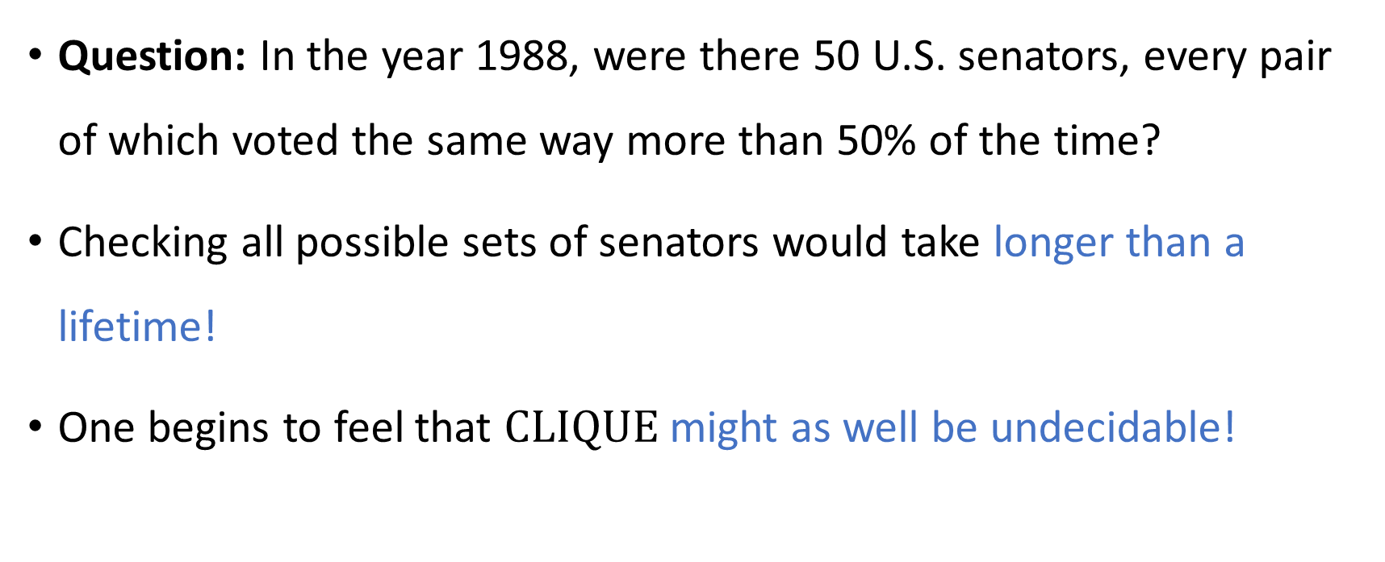
Our algorithm is so slow that it’s worthless
⏳
Question: In the year 1988, were there 50 U.S. senators, every pair of which voted the same way more than 50% of the time?
Checking all possible sets of senators would take longer than a lifetime!
One begins to feel that $\text{CLIQUE}$ might as well be undecidable!

Slide 12
Which problems can be solved through computation?

Slide 13
Refining our model
⏳
Our model so far: Decidable vs. undecidable
Now we will refine our model
We only have a limited amount of time (and other resources)
“Complexity theory” vs. “Computability theory”

Slide 14
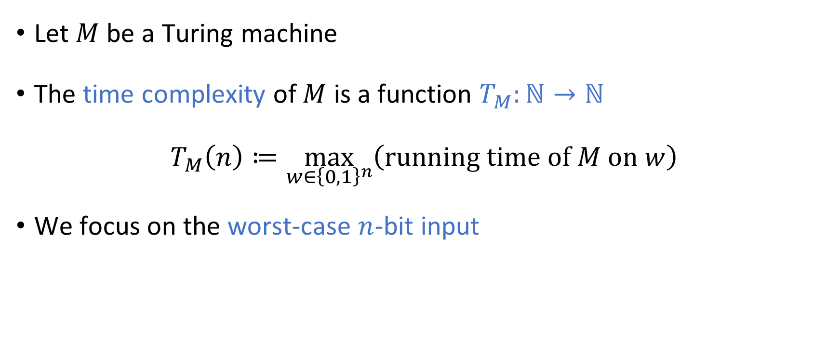
Time complexity
⏳
Let $M$ be a Turing machine
The time complexity of $M$ is a function $T_{M}:ℕ→ℕ$
$$T_{M}\left(n\right)≔\max_{w∈{\left\{0, 1\right\}}^{n}}\left(\text{running} \text{time} \text{of} M \text{on} w\right)$$
We focus on the worst-case $n$-bit input

Slide 15

Scaling behavior
We focus on the limiting behavior of $T_{M}\left(n\right)$ as $n→∞$
How “quickly” does the running time increase when we consider larger and larger inputs?

Slide 16
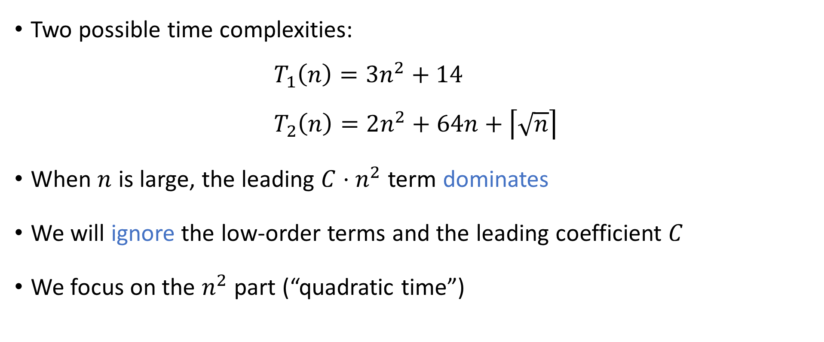
Asymptotic analysis
Two possible time complexities:
$$T_{1}\left(n\right)=3n^{2}+14 \\ T_{2}\left(n\right)=2n^{2}+64n+\left\lceil \sqrt{n}\right\rceil$$
When $n$ is large, the leading ${C⋅n}^{2}$ term dominates
We will ignore the low-order terms and the leading coefficient $C$
We focus on the $n^{2}$ part (“quadratic time”)

Slide 17
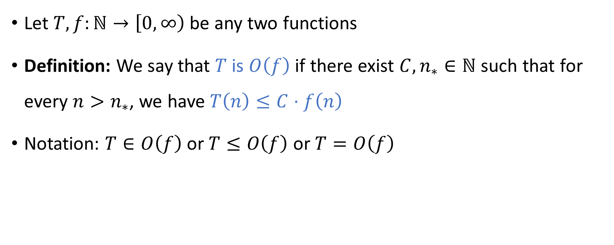
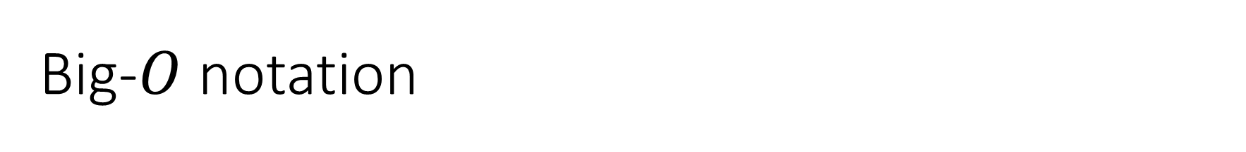
Big-$O$ notation
Let $T,f:ℕ→\left[0, ∞\right)$ be any two functions
Definition: We say that $T$ is $O\left(f\right)$ if there exist ${C,n}_{∗}∈ℕ$ such that for every $n>n_{∗}$, we have $T\left(n\right)≤C⋅f\left(n\right)$
Notation: $T∈O\left(f\right)$ or $T≤O\left(f\right)$ or $T=O\left(f\right)$

Slide 18

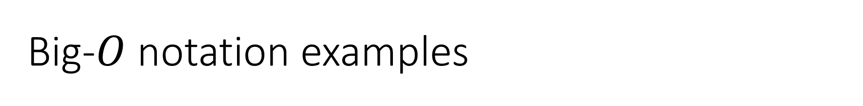
Big-$O$ notation examples
$3n^{2}+14$ is $O\left(n^{2}\right)$
$3n^{2}+14$ is $O\left(n^{2}+n\right)$
$3n^{2}+14$ is $O\left(n^{3}\right)$
$3n^{2}+14$ is not $O\left(n^{1.9}\right)$

Slide 19
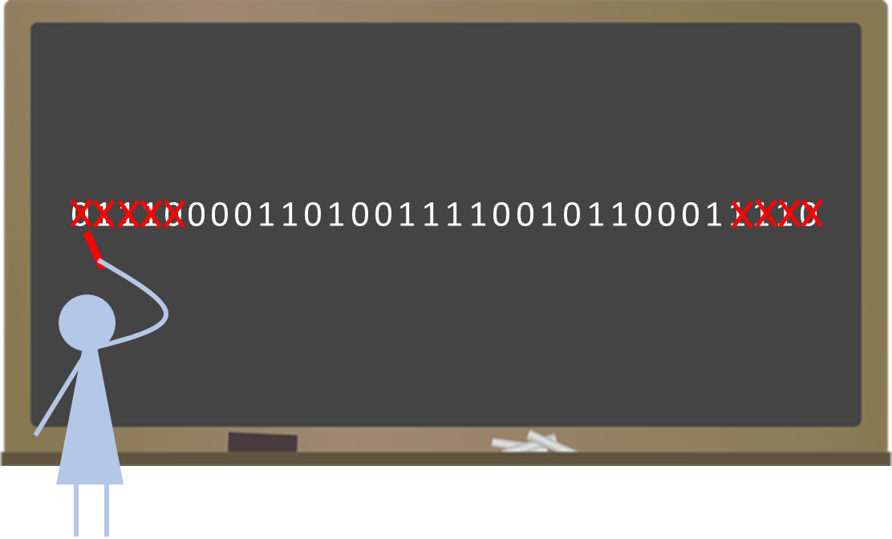
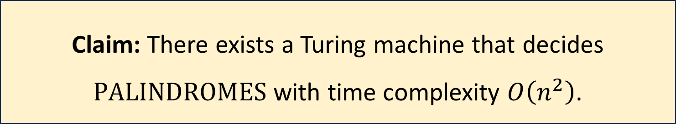
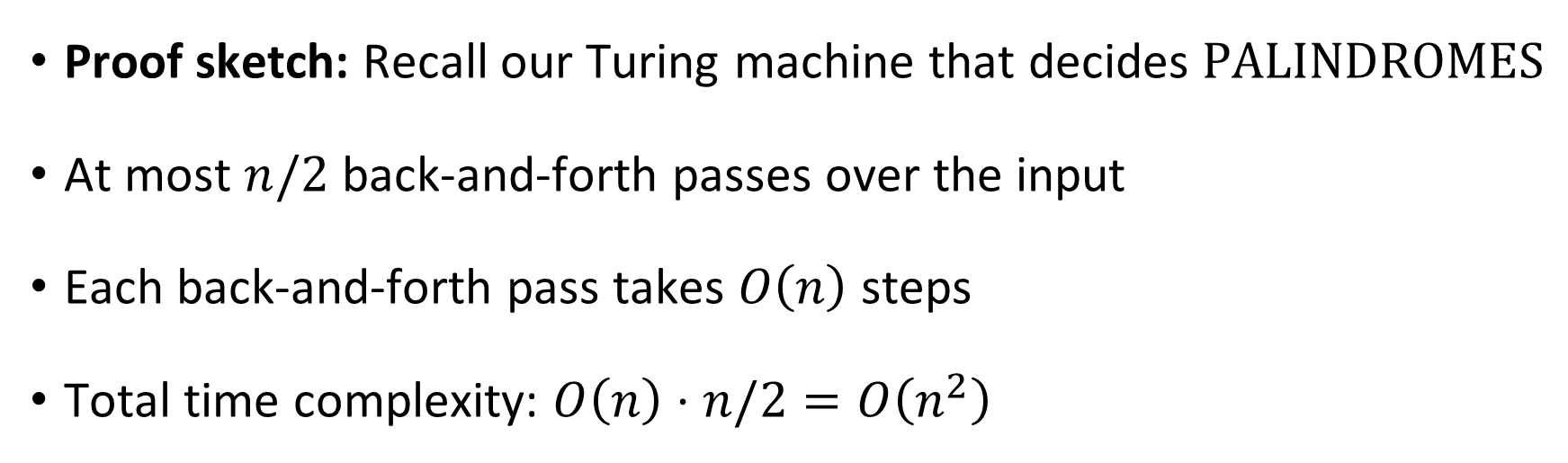
Example: Palindromes
Claim: There exists a Turing machine that decides $\text{PALINDROMES}$ with time complexity $O\left(n^{2}\right)$.
Proof sketch: Recall our Turing machine that decides $\text{PALINDROMES}$
At most $n/2$ back-and-forth passes over the input
Each back-and-forth pass takes $O\left(n\right)$ steps
Total time complexity: $O\left(n\right)⋅n/2=O\left(n^{2}\right)$

Slide 20

Optimality
Is there a faster Turing machine that decides $\text{PALINDROMES}$?
Answer: No
Use big-$Ω$ notation to make this precise

Slide 21
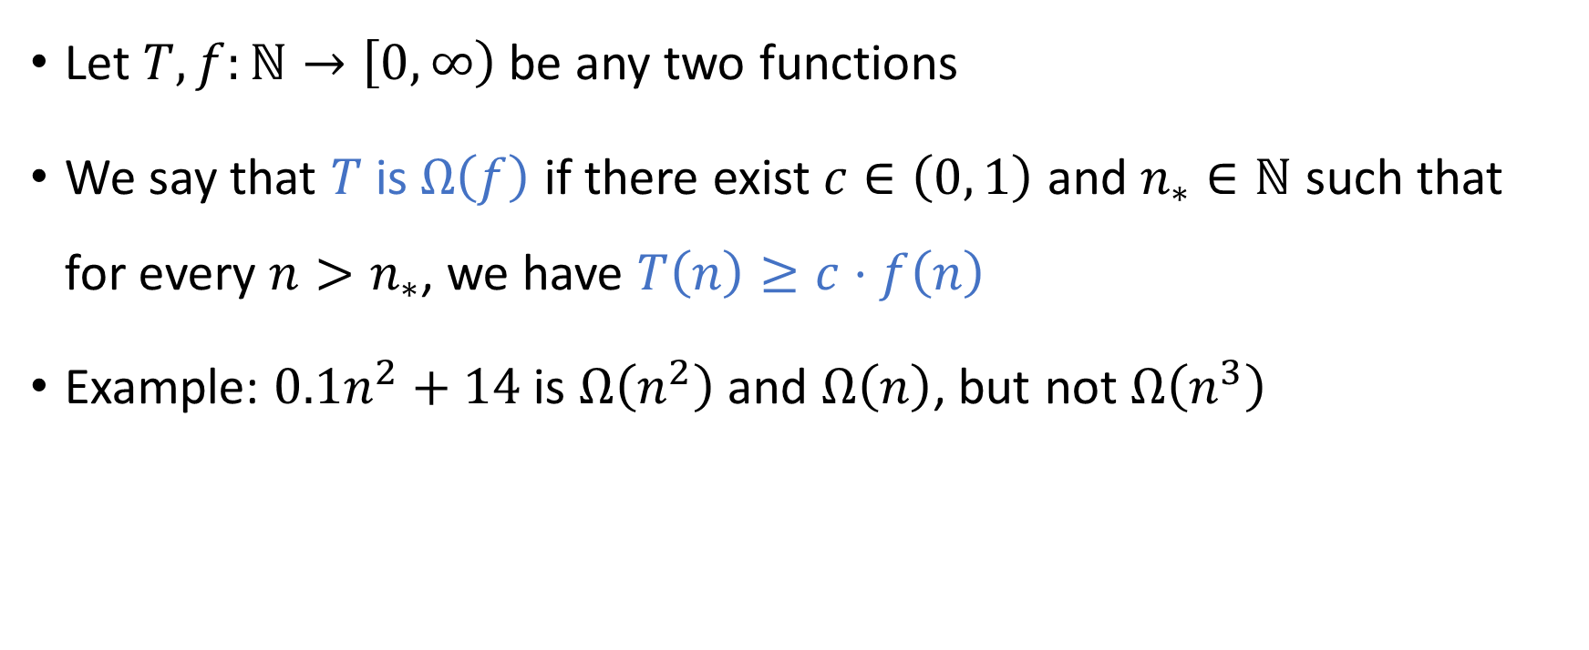
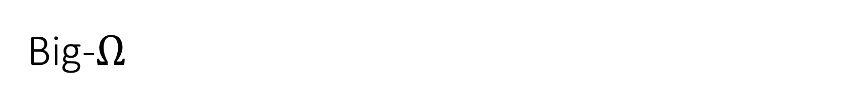
Big-$Ω$
Let $T,f:ℕ→\left[0, ∞\right)$ be any two functions
We say that $T$ is $Ω\left(f\right)$ if there exist $c∈\left(0, 1\right)$ and $n_{∗}∈ℕ$ such that for every $n>n_{∗}$, we have $T\left(n\right)≥c⋅f\left(n\right)$
Example: $0.1n^{2}+14$ is $Ω\left(n^{2}\right)$ and $Ω\left(n\right)$, but not $Ω\left(n^{3}\right)$

Slide 22

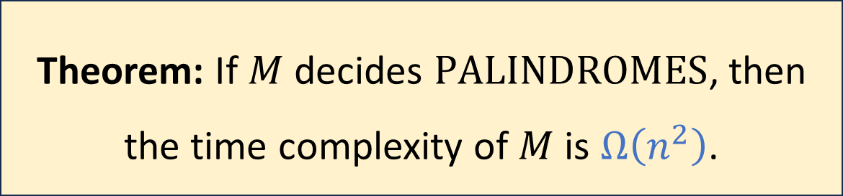
Palindromes time complexity lower bound
Let $M$ be a one-tape Turing machine
(Proof omitted)
Theorem: If $M$ decides $\text{PALINDROMES}$, then the time complexity of $M$ is $Ω\left(n^{2}\right)$.
Notes:
https://www.eecs.yorku.ca/course_archive/2008-09/W/6115/palindrome.pdf

Slide 23
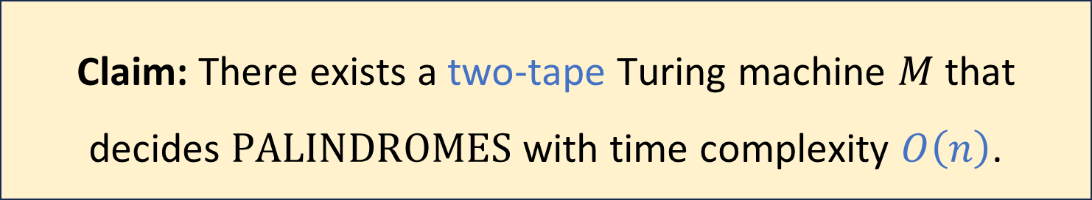
Palindromes, revisited
Claim: There exists a two-tape Turing machine $M$ that decides $\text{PALINDROMES}$ with time complexity $O\left(n\right)$.
Proof sketch:
Copy the input to tape 2
Scan tape 1 from left to right and scan tape 2 from right to left to compare

Slide 24
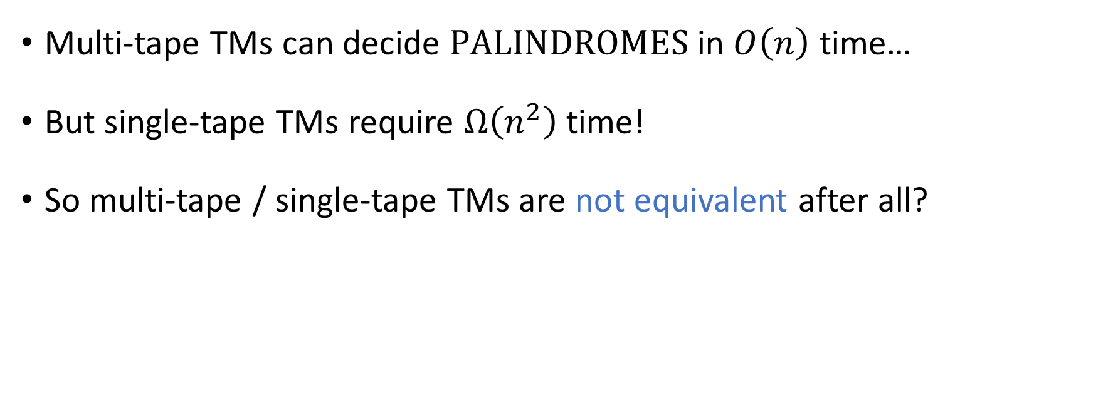
Multi-tape Turing machines, revisited
Multi-tape TMs can decide $\text{PALINDROMES}$ in $O\left(n\right)$ time…
But single-tape TMs require $Ω\left(n^{2}\right)$ time!
So multi-tape / single-tape TMs are not equivalent after all?

Slide 25
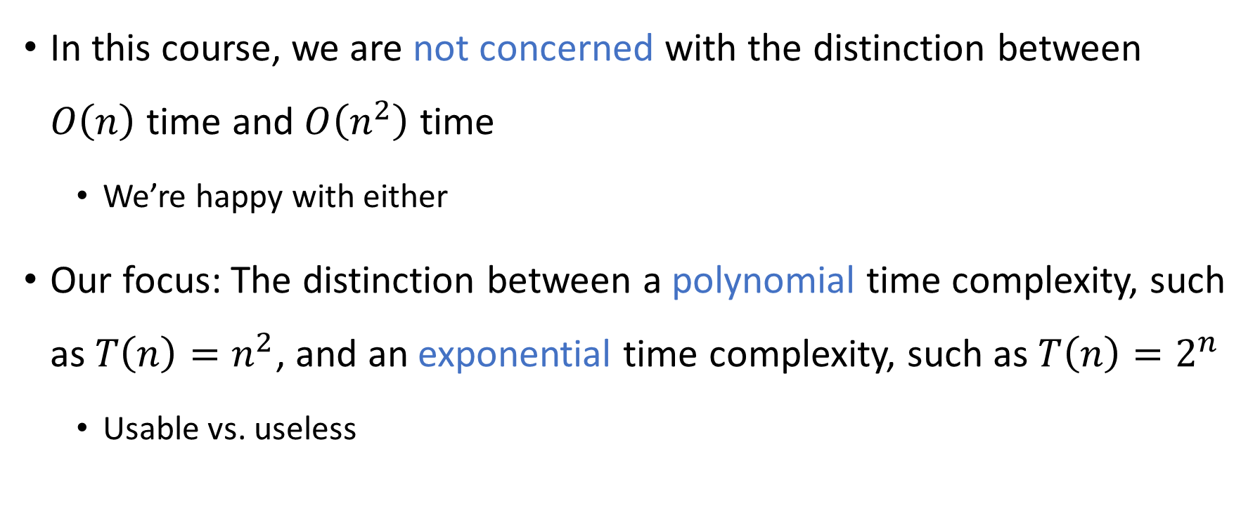
Exponential vs. polynomial
In this course, we are not concerned with the distinction between $O\left(n\right)$ time and $O\left(n^{2}\right)$ time
We’re happy with either
Our focus: The distinction between a polynomial time complexity, such as ${T\left(n\right)=n}^{2}$, and an exponential time complexity, such as $T\left(n\right)=2^{n}$
Usable vs. useless

Slide 26
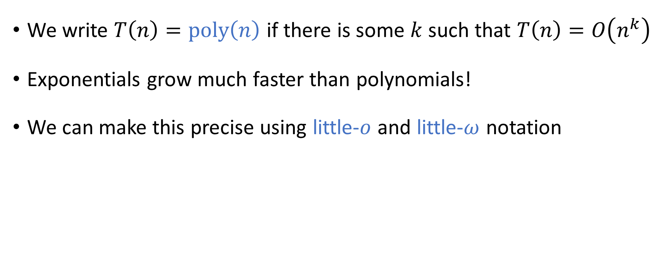
Exponential vs. polynomial
We write $T\left(n\right)=\text{poly}\left(n\right)$ if there is some $k$ such that $T\left(n\right)=O\left(n^{k}\right)$
Exponentials grow much faster than polynomials!
We can make this precise using little-$o$ and little-$ω$ notation

Slide 27
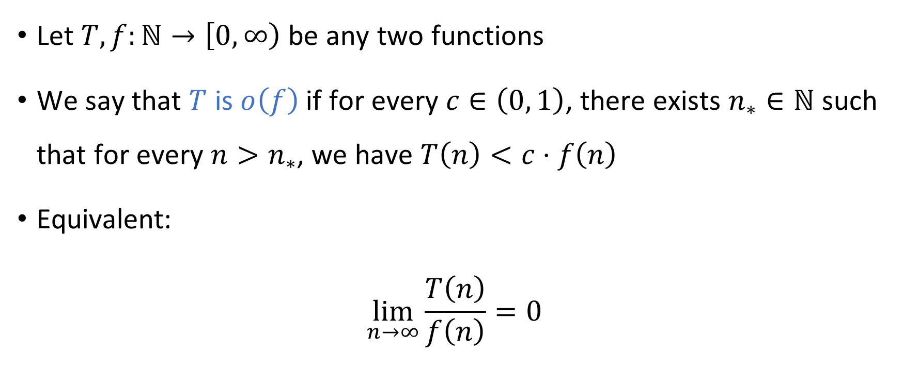

Little-$o$ notation
Let $T,f:ℕ→\left[0, ∞\right)$ be any two functions
We say that $T$ is $o\left(f\right)$ if for every $c∈\left(0, 1\right)$, there exists $n_{∗}∈ℕ$ such that for every $n>n_{∗}$, we have $T\left(n\right)<c⋅f\left(n\right)$
Equivalent:
$$\lim_{n→∞}{\frac{T\left(n\right)}{f\left(n\right)}}=0$$

Slide 28
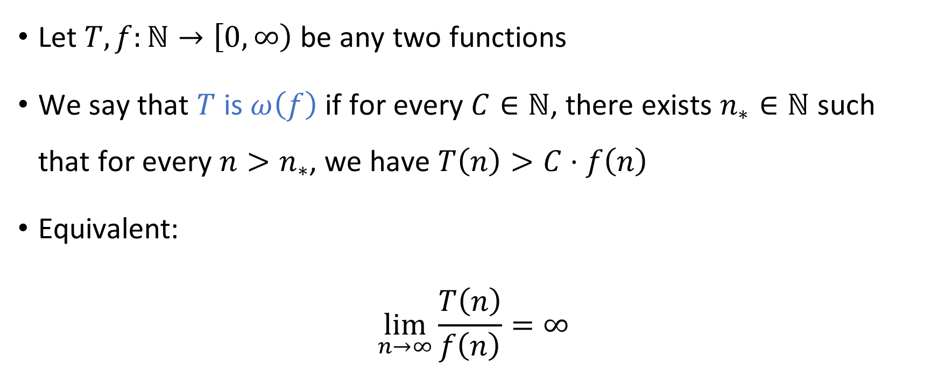

Little-$ω$ notation
Let $T,f:ℕ→\left[0, ∞\right)$ be any two functions
We say that $T$ is $ω\left(f\right)$ if for every $C∈ℕ$, there exists $n_{∗}∈ℕ$ such that for every $n>n_{∗}$, we have $T\left(n\right)>C⋅f\left(n\right)$
Equivalent:
$$\lim_{n→∞}{\frac{T\left(n\right)}{f\left(n\right)}}=∞$$

Slide 29
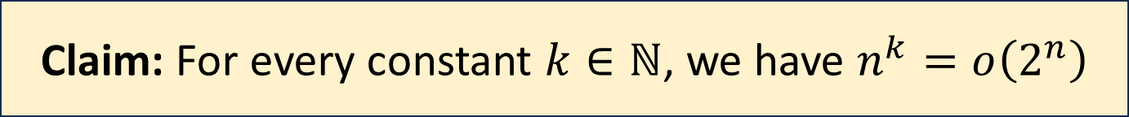
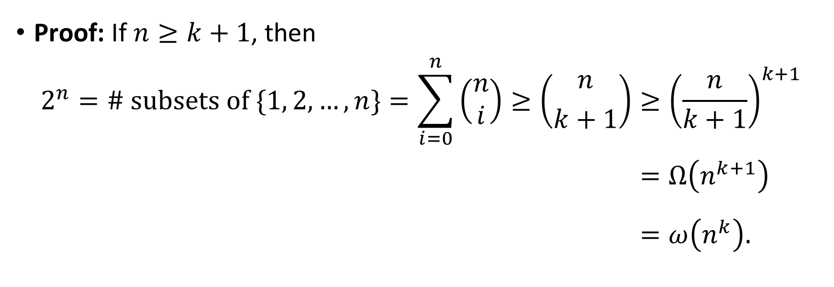
Exponential vs. polynomial
Claim: For every constant $k∈ℕ$, we have $n^{k}=o\left(2^{n}\right)$
Proof: If $n≥k+1$, then
$$2^{n}=\# \text{subsets} \text{of} \{1, 2, …, n\}=\sum_{i=0}^{n}{\left(\begin{aligned}n \\ i\end{aligned}\right)}≥\left({n \atop k+1}\right)≥{\left(\frac{n}{k+1}\right)}^{k+1} \\ =Ω\left(n^{k+1}\right)\begin{matrix} \\ \end{matrix} \\ =ω\left(n^{k}\right).\begin{matrix} \\ \end{matrix}$$

