Slide 1
CMSC 28100 Introduction to Complexity Theory Winter 2024 Instructor: William Hoza
7 |  |  |  |  |  |  | 5 | 3
 |  |  |  |  |  |  |  | 4
 | 4 | 8 |  | 3 |  | 1 | 2
8 |  | 1 | 3 |  |  | 2 | 7 | 5
 | 9 |  | 1 |  |  |  | 4
 | 5 |  |  |  |  | 3
2 |  | 5 |  | 8 | 4
1 | 3 | 4 |  | 5

Slide 2
Midterm exam
Reminder: Midterm exam is in class on Friday
Bring a pencil
Bring scratch paper

Slide 3
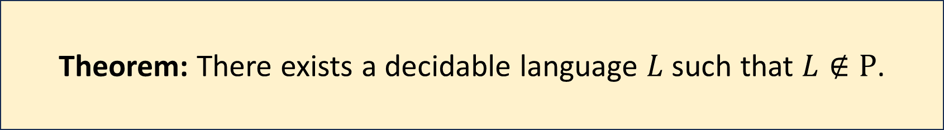
Decidable but not tractable
Theorem: There exists a decidable language $L$ such that $L∉\text{P}$.
We did one proof of this theorem based on the Time Hierarchy Theorem
We are working on another proof, based on the concept of a Boolean circuit

Slide 4
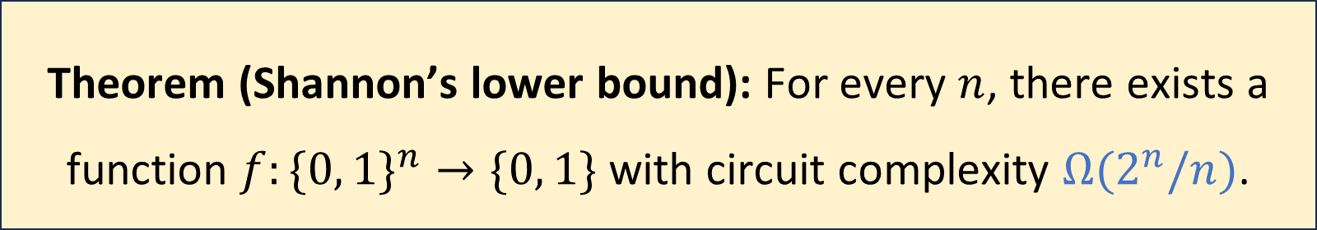
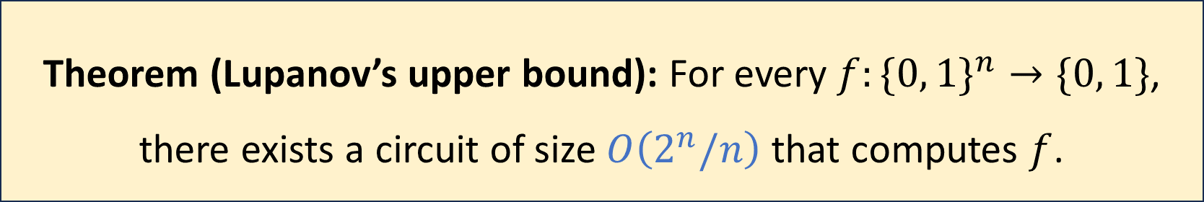
Maximum circuit complexity
Theorem (Lupanov’s upper bound): For every $f:\{0, 1\}^{n}→\{0, 1\}$, there exists a circuit of size $O\left(2^{n}/n\right)$ that computes $f$.
Theorem (Shannon’s lower bound): For every $n$, there exists a function $f:\{0, 1\}^{n}→\{0, 1\}$ with circuit complexity $Ω(2^{n}/n)$.

Slide 5
Circuit complexity vs. time complexity
Circuit size is an interesting complexity measure
However, we were originally interested in time complexity
What is the connection? How can we compare the two?

Slide 6
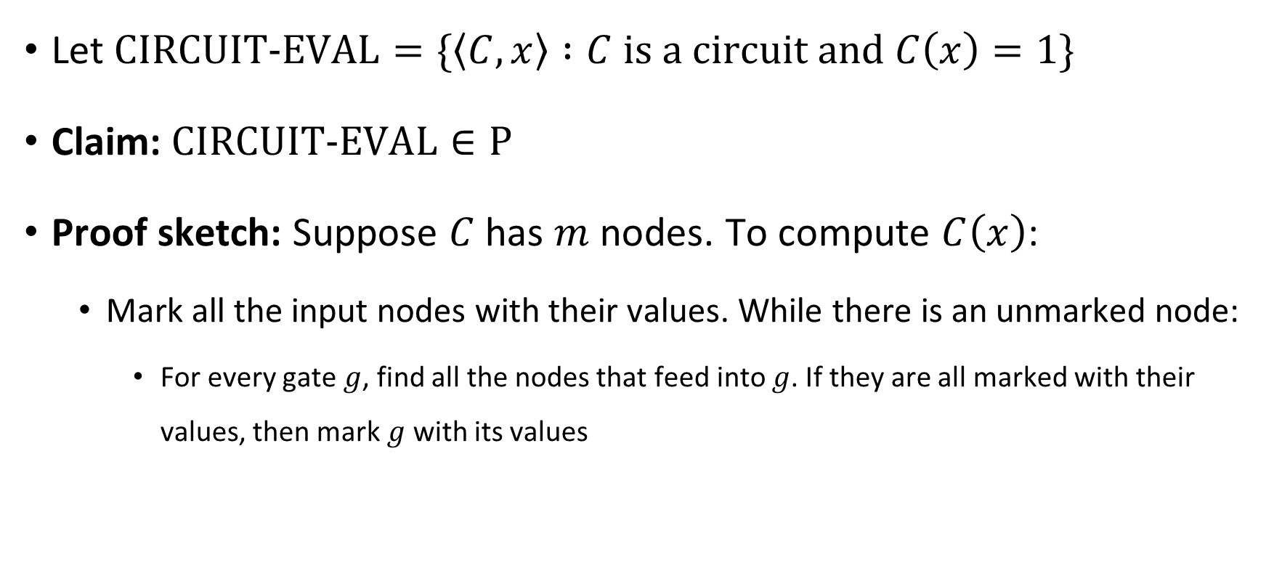
Circuit evaluation problem
Let $\text{CIRCUIT}\text{‑}\text{EVAL}=\{\left\langle C,x\right\rangle :C \text{is} \text{a} \text{circuit} \text{and} C\left(x\right)=1\}$
Claim: $\text{CIRCUIT}\text{‑}\text{EVAL}∈\text{P}$
Proof sketch: Suppose $C$ has $m$ nodes. To compute $C\left(x\right)$:
Mark all the input nodes with their values. While there is an unmarked node:
For every gate $g$, find all the nodes that feed into $g$. If they are all marked with their values, then mark $g$ with its values

Slide 7
Circuit complexity vs. time complexity
We have seen that in some sense, we can simulate circuits using Turing machines
How about the other way around?
Can we simulate Turing machines using circuits?

Slide 8
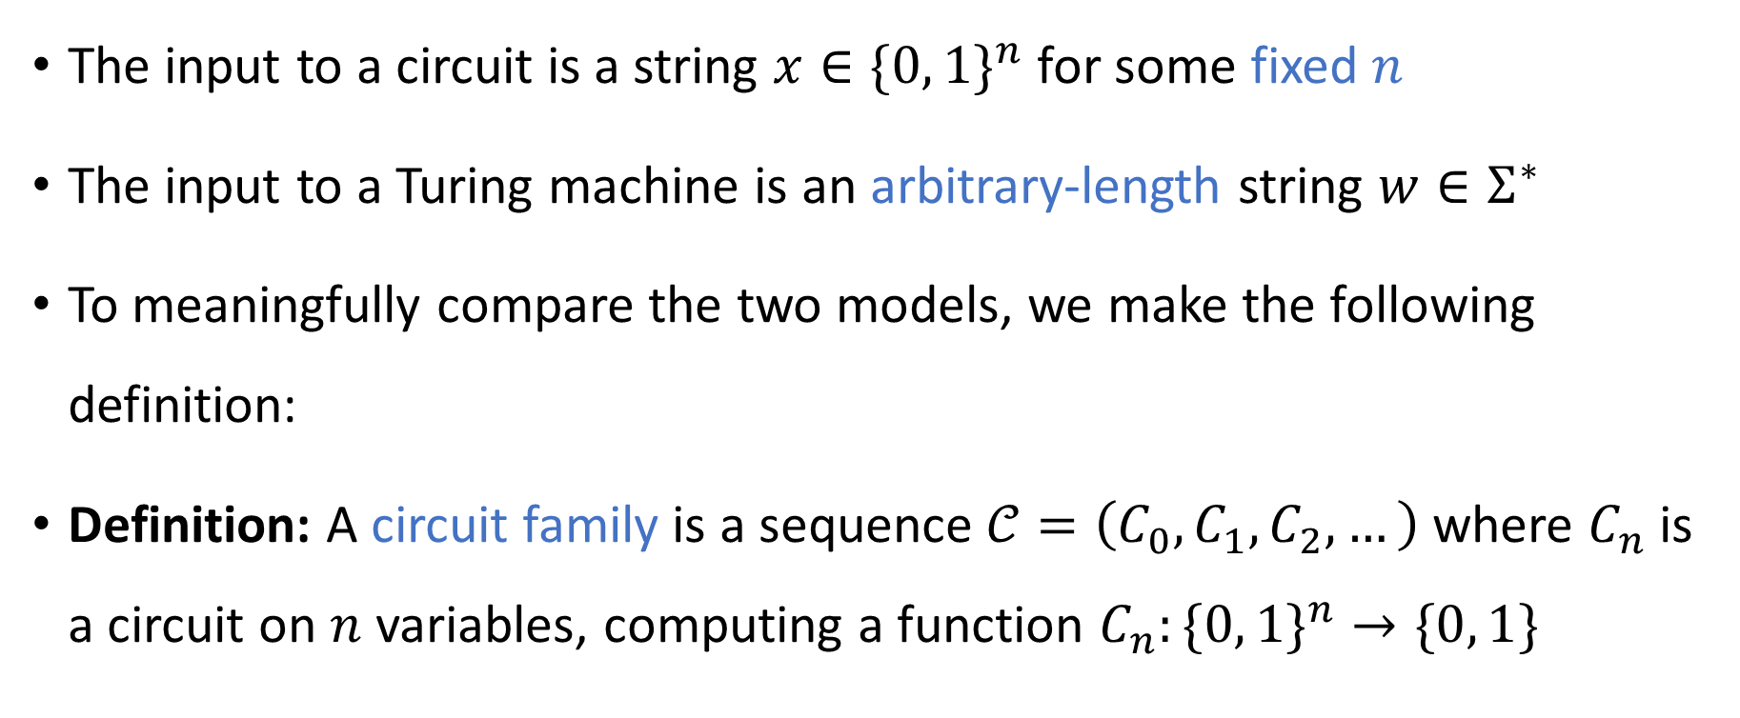
Circuit families
The input to a circuit is a string $x∈\{0, 1\}^{n}$ for some fixed $n$
The input to a Turing machine is an arbitrary-length string $w∈Σ^{∗}$
To meaningfully compare the two models, we make the following definition:
Definition: A circuit family is a sequence $𝒞=\left(C_{0}, C_{1},C_{2},…\right)$ where $C_{n}$ is a circuit on $n$ variables, computing a function $C_{n}:\{0, 1\}^{n}→\{0, 1\}$

Slide 9
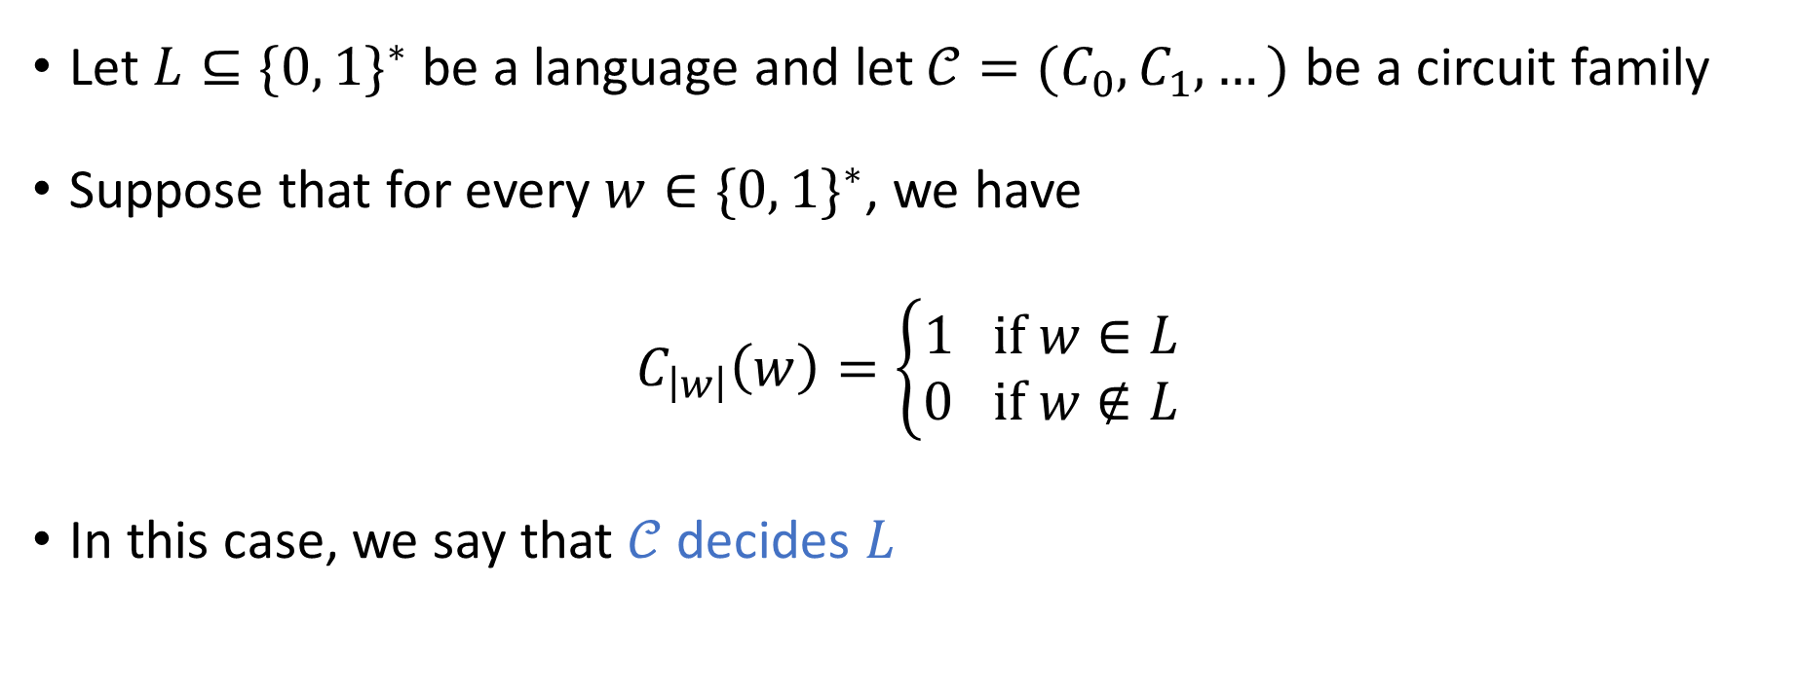
Deciding a language with a circuit family
Let $L⊆\{0, 1\}^{∗}$ be a language and let $𝒞=(C_{0},C_{1},…)$ be a circuit family
Suppose that for every $w∈\{0, 1\}^{∗}$, we have
$$C_{\left|w\right|}\left(w\right)=\left\{\begin{aligned}1 \text{if} w∈L \\ 0 \text{if} w∉L\end{aligned}\right.$$
In this case, we say that $𝒞$ decides $L$

Slide 10
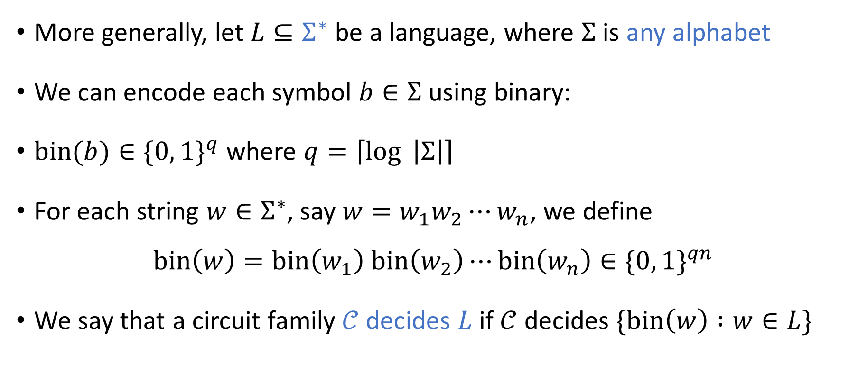
Deciding a language with a circuit family
More generally, let $L⊆Σ^{∗}$ be a language, where $Σ$ is any alphabet
We can encode each symbol $b∈Σ$ using binary:
$\text{bin}(b)∈\{0, 1\}^{q}$ where $q=\left\lceil \log{ \left|Σ\right|}\right\rceil$
For each string $w∈Σ^{∗}$, say $w=w_{1}w_{2}⋯w_{n}$, we define
$$\text{bin}\left(w\right)=\text{bin}\left(w_{1}\right) \text{bin}\left(w_{2}\right)⋯\text{bin}\left(w_{n}\right)∈\{0, 1\}^{qn}$$
We say that a circuit family $𝒞$ decides $L$ if $𝒞$ decides $\{\text{bin}\left(w\right) :w∈L\}$

Slide 11
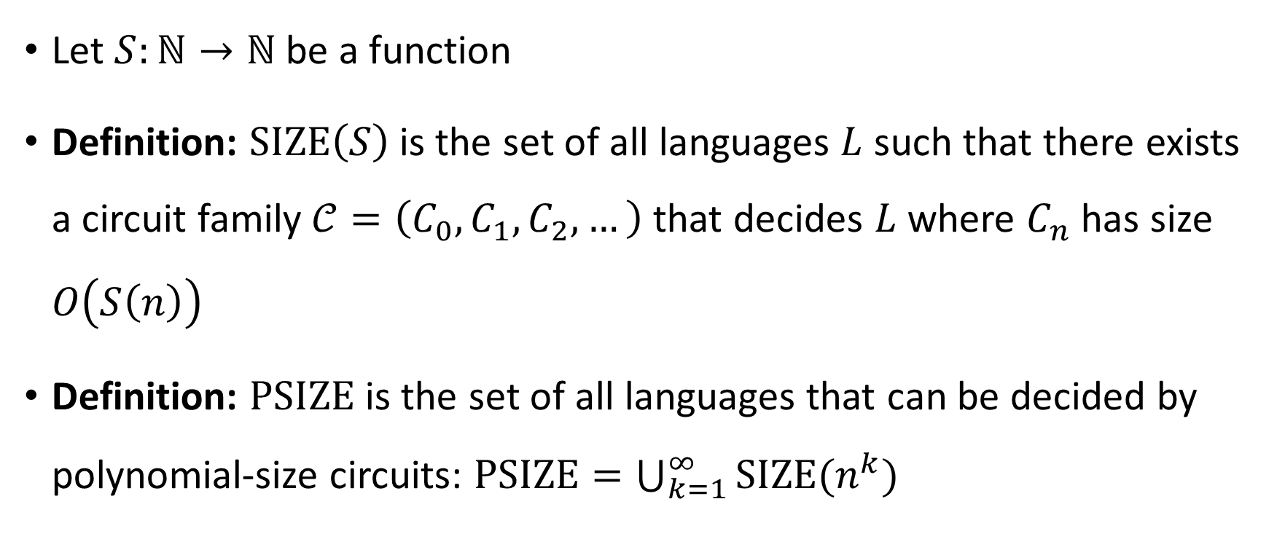

The $\text{PSIZE}$ complexity class
Let $S:ℕ→ℕ$ be a function
Definition: $\text{SIZE}\left(S\right)$ is the set of all languages $L$ such that there exists a circuit family $𝒞=\left(C_{0},C_{1},C_{2},…\right)$ that decides $L$ where $C_{n}$ has size $O\left(S\left(n\right)\right)$
Definition: $\text{PSIZE}$ is the set of all languages that can be decided by polynomial-size circuits: $\text{PSIZE}=\bigcup_{k=1}^{∞}{\text{SIZE}(n^{k}})$

Slide 12
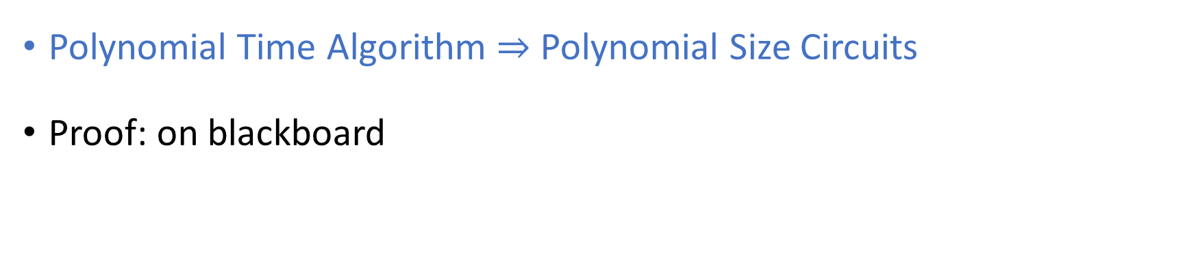


Languages in $\text{P}$ have polynomial-size circuits
Theorem: $\text{P}⊆\text{PSIZE}$.
Polynomial Time Algorithm $⇒$ Polynomial Size Circuits
Proof: on blackboard

