Slide 1
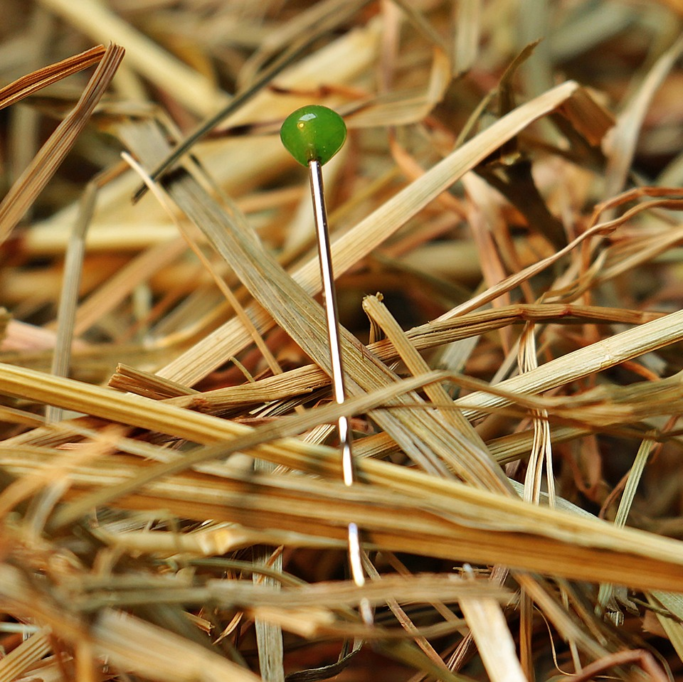
CMSC 28100 Introduction to Complexity Theory Spring 2024 Instructor: William Hoza

Slide 2


Python script $⇒$ Turing machine
Basic idea:
Variable $⇒$ Tape (assuming the variable holds a list of bits)
List index $⇒$ Head
Line of code $⇒$ State

Slide 3
Turing machines as a programming language
You can think of the Turing machine model as a primitive programming language
From a programming perspective, the model is extremely inconvenient and annoying, because it has so few features!
However, our goal is to prove impossibility results
The model has few features, which will make our lives easier, not harder

Slide 4
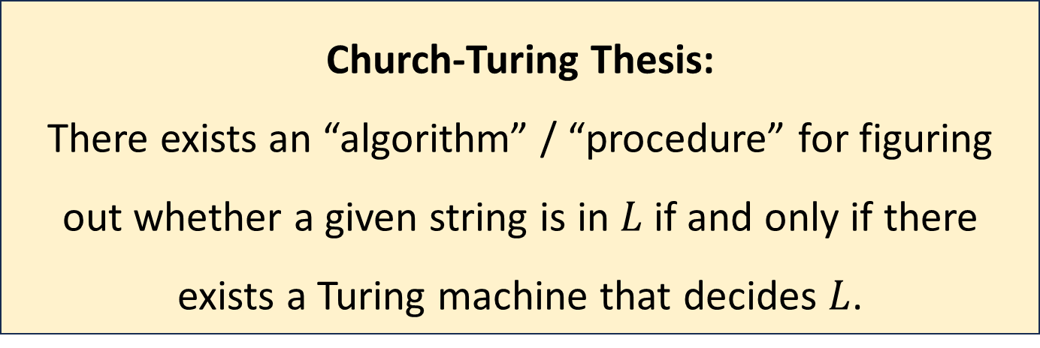
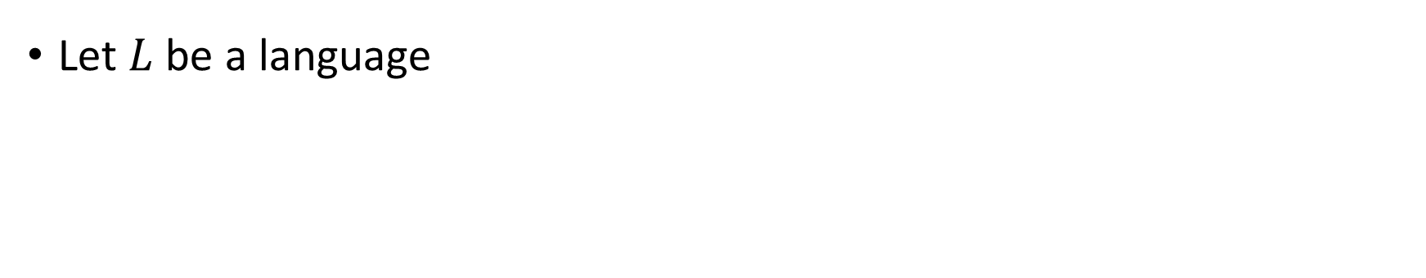
The Church-Turing Thesis
Let $L$ be a language
Church-Turing Thesis:
There exists an “algorithm” / “procedure” for figuring out whether a given string is in $L$ if and only if there exists a Turing machine that decides $L$.
Intuitive notion
Mathematically precise notion

Slide 5
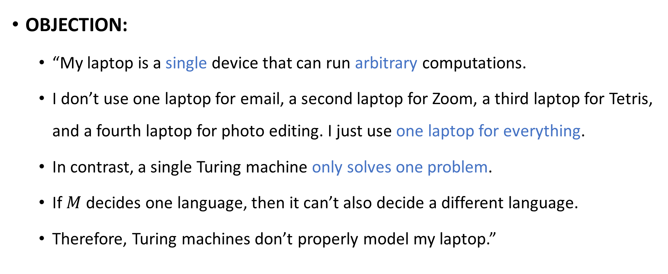
Turing machines vs. your laptop
OBJECTION:
“My laptop is a single device that can run arbitrary computations.
I don’t use one laptop for email, a second laptop for Zoom, a third laptop for Tetris, and a fourth laptop for photo editing. I just use one laptop for everything.
In contrast, a single Turing machine only solves one problem.
If $M$ decides one language, then it can’t also decide a different language.
Therefore, Turing machines don’t properly model my laptop.”

Slide 6

Code as data
The response to this objection is based on the principle of viewing “code as data”
A Turing machine $M$ can be encoded as a string $\left\langle M\right\rangle$

Slide 7

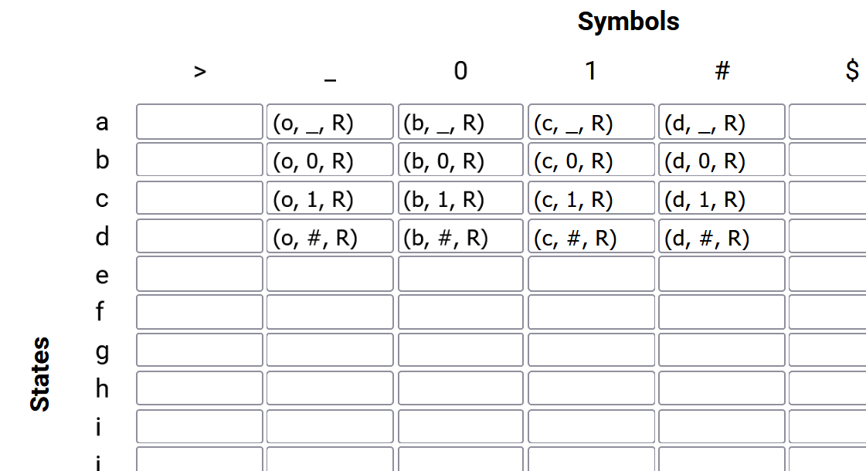


Encoding a Turing machine as a string
Example: Problem set 1, problem 4
$$⇓$$
turing-machine.json
$…$ {"a": {">": null, "_": ["o", "_", "R"], "0": ["b", "_", "R"], "1": ["c", "_", "R"], "#": ["d", "_", "R"], "$": null, "&": null, "%": null}, "b": {">": null, "_": ["o", "0", "R"], "0": ["b", "0", "R"], "1": ["c", "0", "R"], $…$
A text file (string) that encodes a Turing machine

Slide 8
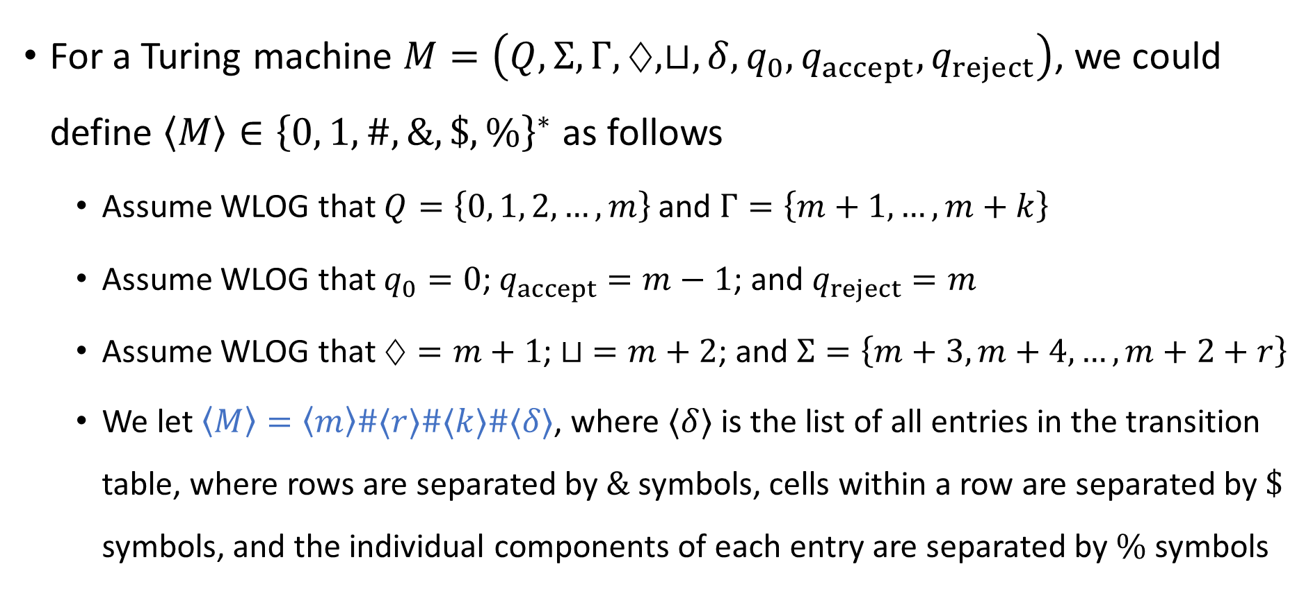
Encoding a Turing machine as a string
For a Turing machine $M=\left(Q,Σ, Γ, ♢,⊔,δ, q_{0},q_{accept}, q_{reject}\right)$, we could define $\left\langle M\right\rangle ∈{\left\{0, 1,\#,\&,\$,\%\right\}}^{∗}$ as follows
Assume WLOG that $Q=\left\{0, 1, 2, …, m\right\}$ and $Γ=\left\{m+1, …, m+k\right\}$
Assume WLOG that $q_{0}=0$; $q_{accept}=m−1$; and $q_{reject}=m$
Assume WLOG that $♢=m+1$; $⊔ =m+2$; and $Σ=\left\{m+3,m+4, …, m+2+r\right\}$
We let $\left\langle M\right\rangle =\left\langle m\right\rangle \#⟨r⟩\#⟨k⟩\#⟨δ⟩$, where $⟨δ⟩$ is the list of all entries in the transition table, where rows are separated by $\&$ symbols, cells within a row are separated by $\$$ symbols, and the individual components of each entry are separated by $\%$ symbols

Slide 9
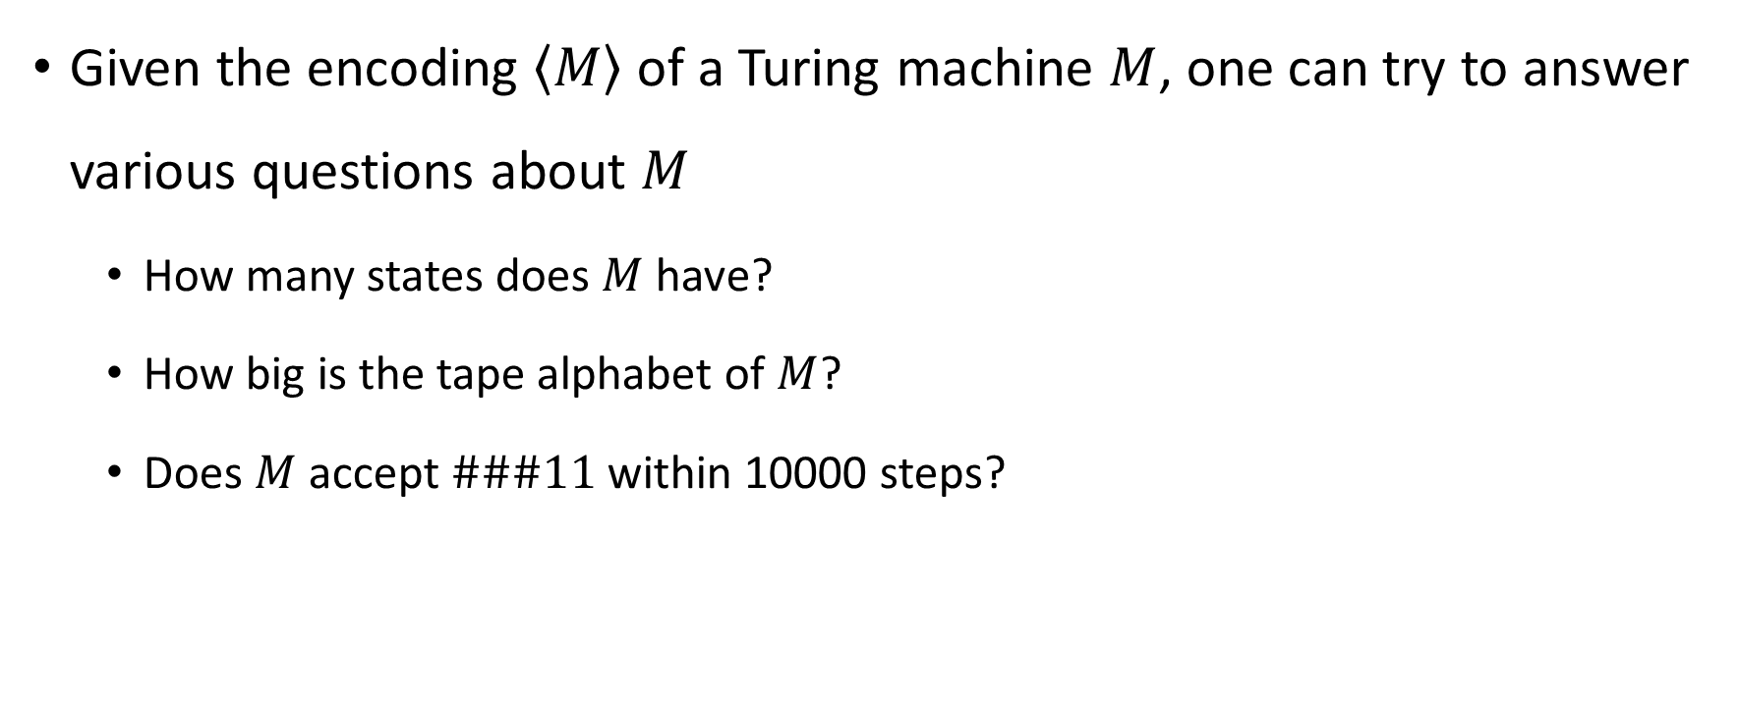
Analyzing a given Turing machine
Given the encoding $\left\langle M\right\rangle$ of a Turing machine $M$, one can try to answer various questions about $M$
How many states does $M$ have?
How big is the tape alphabet of $M$?
Does $M$ accept $\#\#\#11$ within 10000 steps?

Slide 10
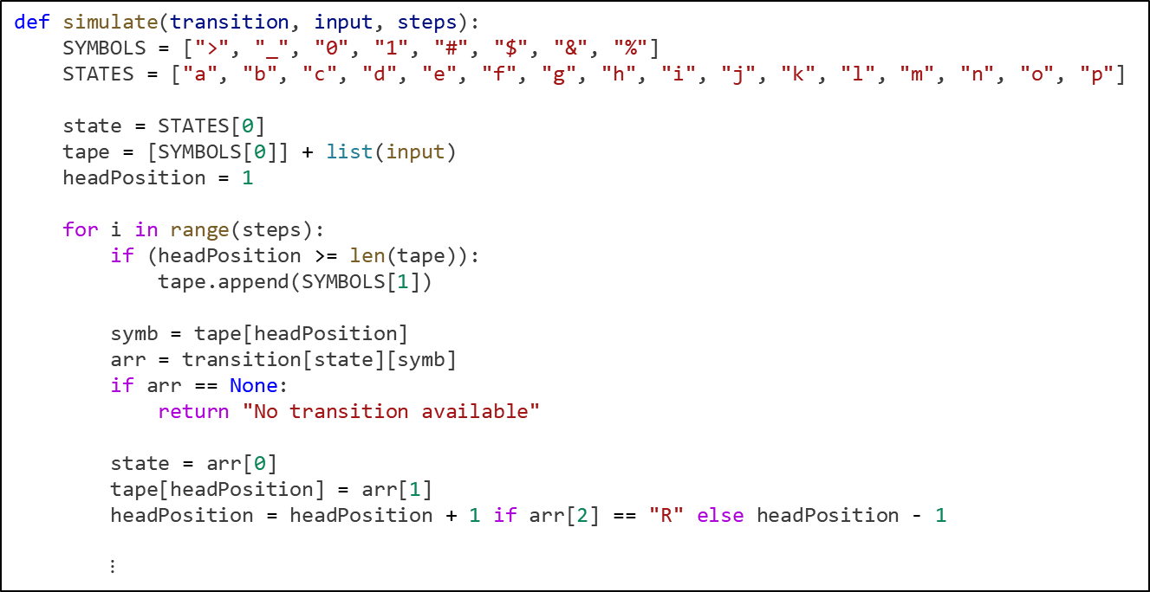
Analyzing TMs
@weight(0.5)
@number("3")
def test3(self):
"""Run the machine on input ###11"""
val = simulate(self.transition, "###11", 10000)
self.assertEqual(val, "Accept")
Example: The autograder for problem set 1, problem 4
def simulate(transition, input, steps):
SYMBOLS = [">", "_", "0", "1", "#", "$", "&", "%"]
STATES = ["a", "b", "c", "d", "e", "f", "g", "h", "i", "j", "k", "l", "m", "n", "o", "p"]
state = STATES[0]
tape = [SYMBOLS[0]] + list(input)
headPosition = 1
for i in range(steps):
if (headPosition >= len(tape)):
tape.append(SYMBOLS[1])
symb = tape[headPosition]
arr = transition[state][symb]
if arr == None:
return "No transition available"
state = arr[0]
tape[headPosition] = arr[1]
headPosition = headPosition + 1 if arr[2] == "R" else headPosition - 1
$⋮$

Slide 11
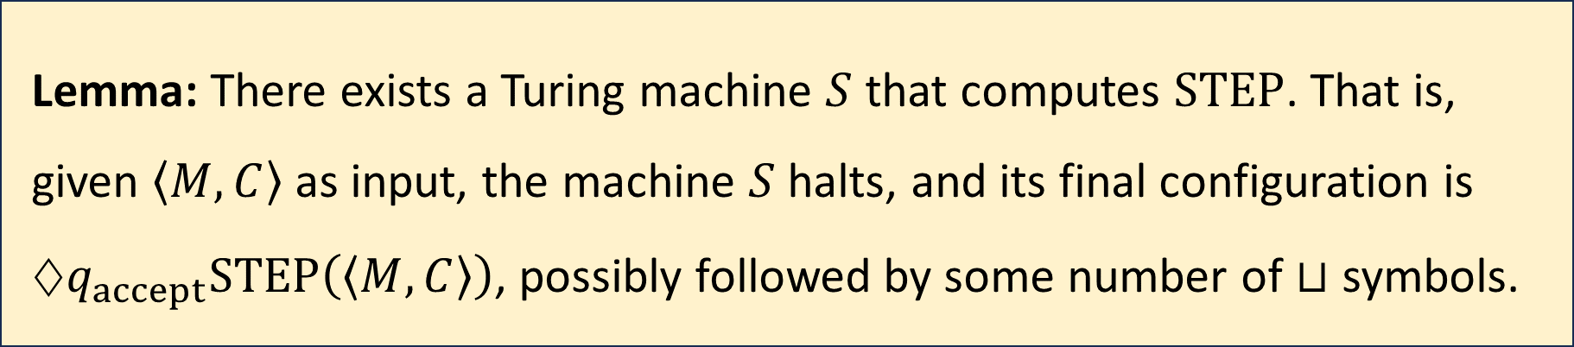

Simulating one step
For every Turing machine $M$ and configuration $C$ of $M$, define
$$\text{STEP}\left(\left\langle M,C\right\rangle \right)=\left\langle M,\text{NEXT}\left(C\right)\right\rangle$$
(Proof left as an exercise)
Lemma: There exists a Turing machine $S$ that computes $\text{STEP}$. That is, given $\left\langle M,C\right\rangle$ as input, the machine $S$ halts, and its final configuration is $♢q_{accept}\text{STEP}\left(\left\langle M,C\right\rangle \right)$, possibly followed by some number of $⊔$ symbols.

Slide 12

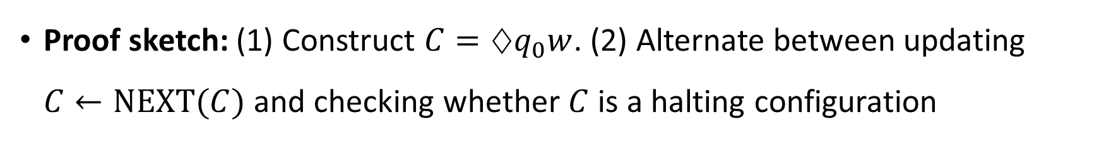
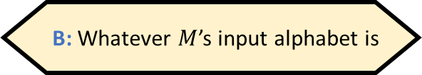
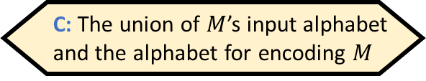
Universal Turing machines
What is the universal Turing machine’s input alphabet?
A: A fixed, constant-size alphabet that doesn’t depend on anything
B: Whatever $M$’s input alphabet is
Theorem: There exists a Turing machine $U$ such that for every Turing machine $M$ and every input $w$:
If $M$ accepts $w$, then $U$ accepts $⟨M,w⟩$.
If $M$ rejects $w$, then $U$ rejects $⟨M,w⟩$.
If $M$ loops on $w$, then $U$ loops on $⟨M,w⟩$.
C: The union of $M$’s input alphabet and the alphabet for encoding $M$
D: The union of all possible alphabets
Respond at PollEv.com/whoza or text “whoza” to 22333
Proof sketch: (1) Construct $C=♢q_{0}w$. (2) Alternate between updating $C←\text{NEXT}(C)$ and checking whether $C$ is a halting configuration

Slide 13
Universal Turing machines
A universal Turing machine can be “programmed” to do anything that is computationally possible
This is why you don’t need separate laptops for separate computational tasks
If you are stranded on an alien planet and you are trying to build a computer, your job is to build a universal Turing machine

Slide 14
The Church-Turing Thesis
Let $L$ be a language
Church-Turing Thesis:
There exists an “algorithm” / “procedure” for figuring out whether a given string is in $L$ if and only if there exists a Turing machine that decides $L$.
Intuitive notion
Mathematically precise notion

Slide 15
Note on standards of rigor
Going forward, when we want to construct a Turing machine (e.g., for an existence proof), we will simply describe what it does in plain English, as if we are giving instructions to a human being
Each plain English description can be formalized as a Turing machine, but this is tedious
You should follow this convention on problem set 3 and beyond
Nevertheless, the Turing machine model is extremely valuable for us, because it tells us what an arbitrary algorithm looks like!

Slide 16
Which problems can be solved through computation?

Slide 17
What are Turing machines capable of?

Slide 18
What are Turing machines NOT capable of?

Slide 19
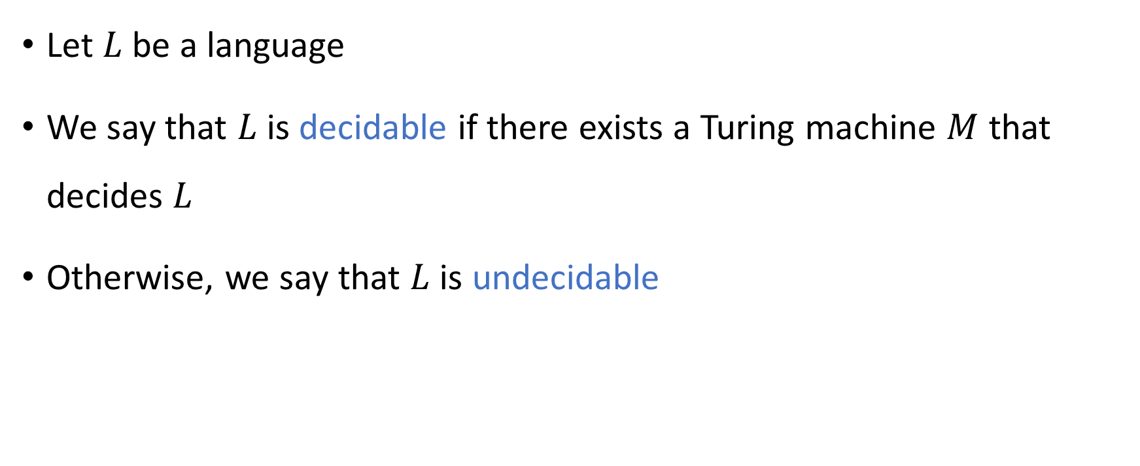
Decidable and undecidable
Let $L$ be a language
We say that $L$ is decidable if there exists a Turing machine $M$ that decides $L$
Otherwise, we say that $L$ is undecidable

Slide 20

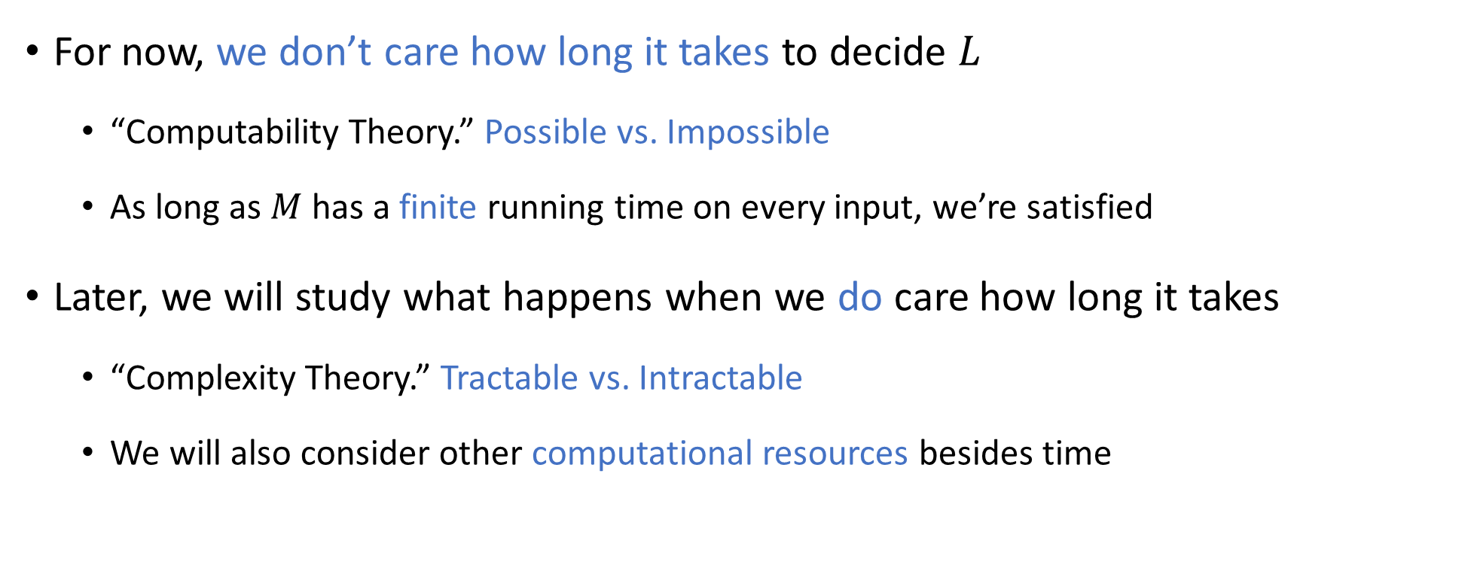
Computability vs. Complexity
For now, we don’t care how long it takes to decide $L$
“Computability Theory.” Possible vs. Impossible
As long as $M$ has a finite running time on every input, we’re satisfied
Later, we will study what happens when we do care how long it takes
“Complexity Theory.” Tractable vs. Intractable
We will also consider other computational resources besides time

Slide 21
Which languages are decidable?

