Slide 1

CMSC 28100 Introduction to Complexity Theory Spring 2025 Instructor: William Hoza

Slide 2










Arithmetic formulas
Definition: A $k$-variate arithmetic formula is a rooted binary tree
Each internal node is labeled with $+$ or $×$
Each leaf is labeled with $0$, $1$, $−1$, or a variable among $x_{1},…, x_{k}$
$$×$$
$$+$$
$$+$$
$$x_{1}$$
$$×$$
$$x_{1}$$
$$x_{2}$$
$$−1$$
$$x_{2}$$

Slide 3
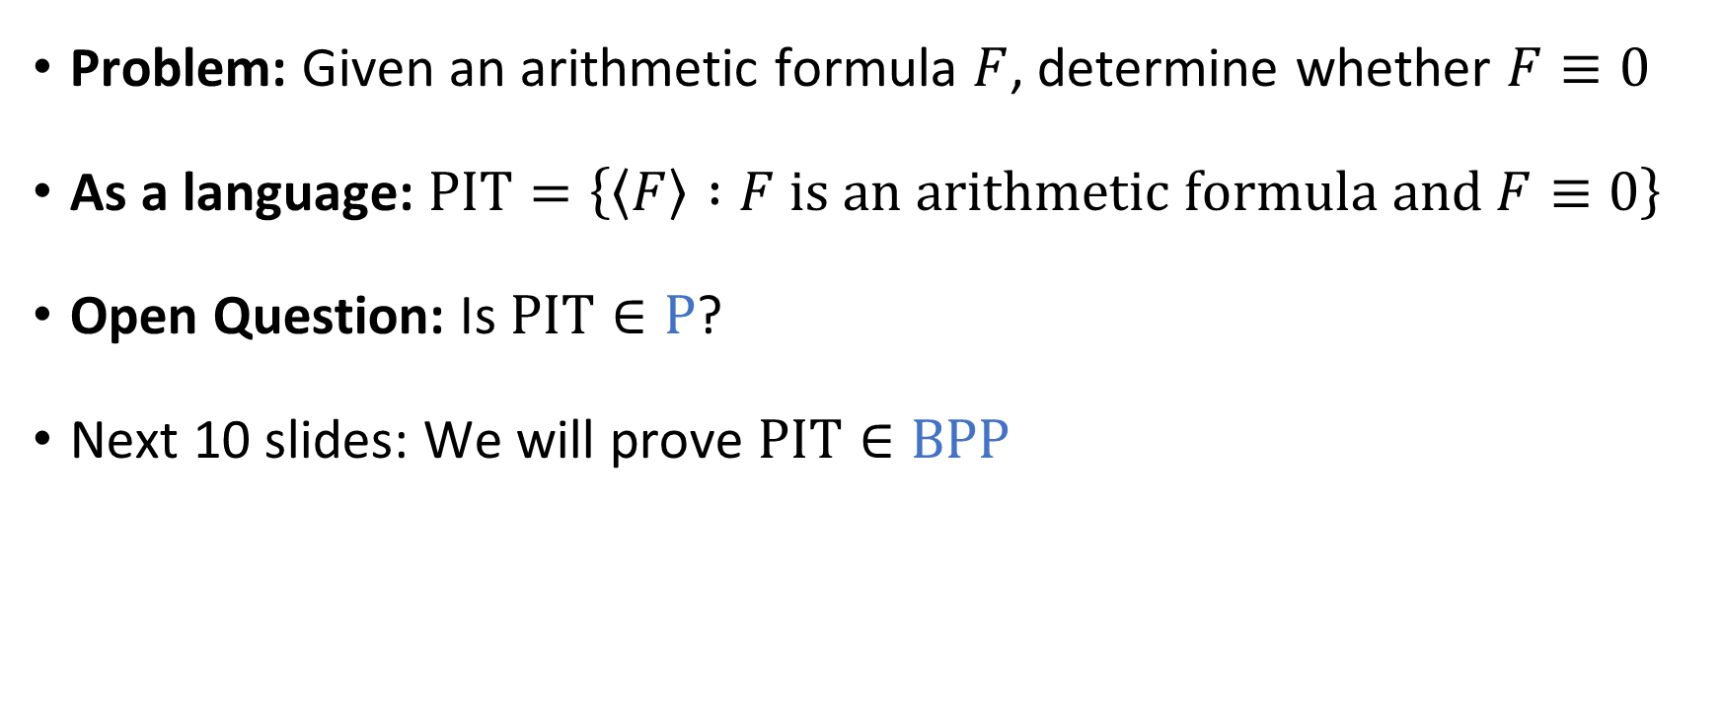
Polynomial identity testing
Problem: Given an arithmetic formula $F$, determine whether $F≡0$
As a language: $\text{PIT}=\left\{\left\langle F\right\rangle :F \text{is} \text{an} \text{arithmetic} \text{formula} \text{and} F≡0\right\}$
Open Question: Is $\text{PIT}∈\text{P}$?
Next 10 slides: We will prove $\text{PIT}∈\text{BPP}$
Notes:
PIT is more commonly defined in terms of arithmetic *circuits* rather than arithmetic formulas, but the distinction is not important for our purposes

Slide 4
















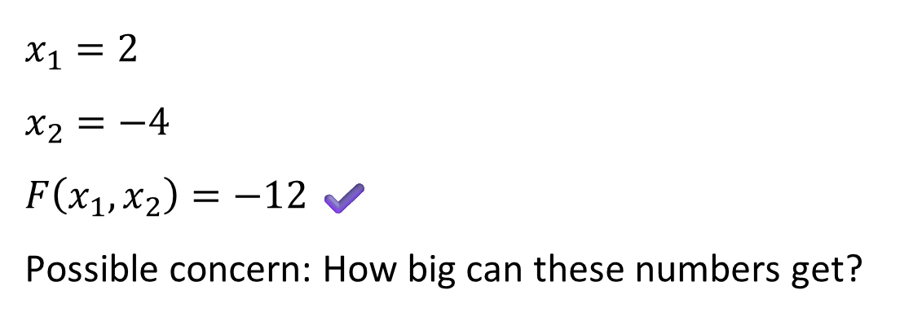


Evaluating an arithmetic formula
Let $F$ be a $k$-variate arithmetic formula and let $\vec{x}∈ℤ^{k}$
Lemma: Given $\left\langle F,\vec{x}\right\rangle$, one can compute $F\left(\vec{x}\right)∈ℤ$ in polynomial time.
$$−12$$
$x_{1}=2$
$x_{2}=−4$
$F\left(x_{1},x_{2}\right)=−12$ ✔️
Possible concern: How big can these numbers get?
$$×$$
$$6$$
$$−2$$
$$+$$
$$+$$
$$4$$
$$x_{1}$$
$$×$$
$$x_{1}$$
$$x_{2}$$
$$2$$
$$2$$
$$−4$$
$$−1$$
$$x_{2}$$
$$−4$$

Slide 5
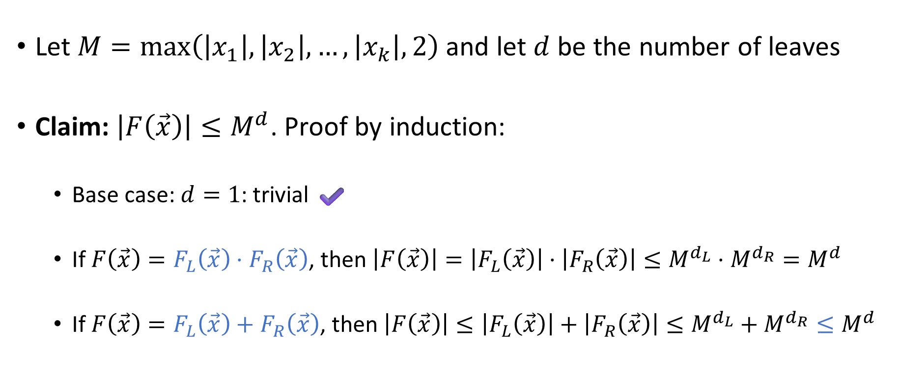
Bound on the magnitude of the output
Let $M=\max\left(\left|x_{1}\right|, \left|x_{2}\right|, …, \left|x_{k}\right|,2\right)$ and let $d$ be the number of leaves
Claim: $\left|F\left(\vec{x}\right)\right|≤M^{d}$. Proof by induction:
Base case: $d=1$: trivial ✔️
If $F\left(\vec{x}\right)=F_{L}\left(\vec{x}\right)⋅F_{R}\left(\vec{x}\right)$, then $\left|F\left(\vec{x}\right)\right|=\left|F_{L}\left(\vec{x}\right)\right|⋅\left|F_{R}\left(\vec{x}\right)\right|≤M^{d_{L}}⋅M^{d_{R}}=M^{d}$
If $F\left(\vec{x}\right)=F_{L}\left(\vec{x}\right)+F_{R}\left(\vec{x}\right)$, then $\left|F\left(\vec{x}\right)\right|≤\left|F_{L}\left(\vec{x}\right)\right|+\left|F_{R}\left(\vec{x}\right)\right|≤M^{d_{L}}+M^{d_{R}}≤M^{d}$

Slide 6
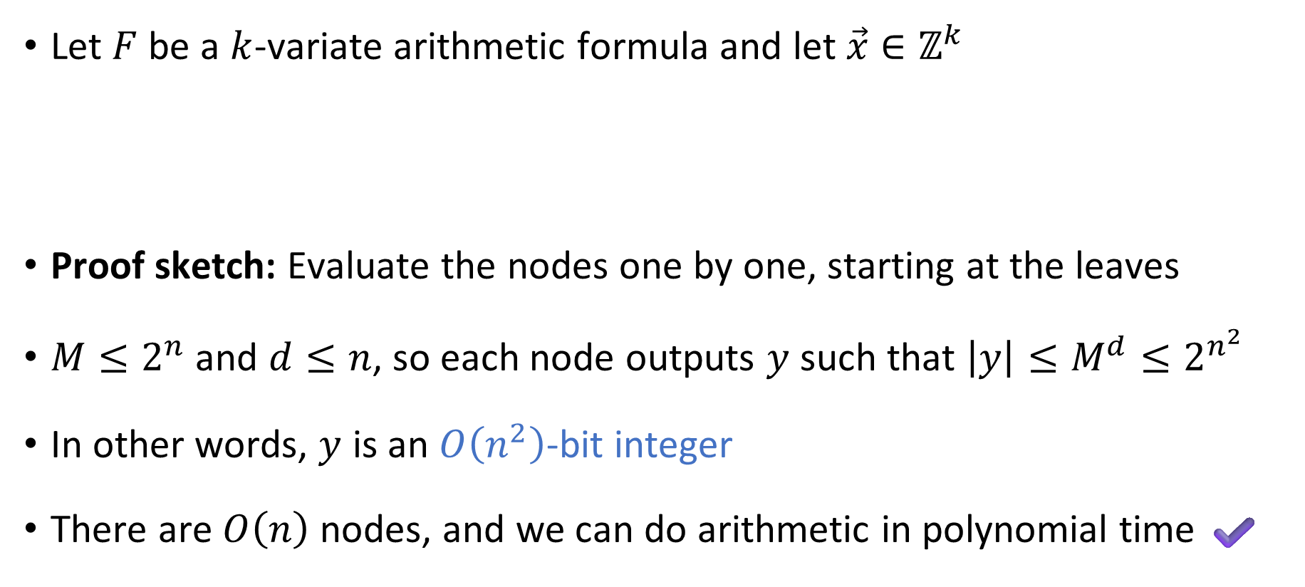
Evaluating an arithmetic formula
Let $F$ be a $k$-variate arithmetic formula and let $\vec{x}∈ℤ^{k}$
Proof sketch: Evaluate the nodes one by one, starting at the leaves
$M≤2^{n}$ and $d≤n$, so each node outputs $y$ such that $\left|y\right|≤M^{d}≤2^{n^{2}}$
In other words, $y$ is an $O\left(n^{2}\right)$-bit integer
There are $O\left(n\right)$ nodes, and we can do arithmetic in polynomial time ✔️
Lemma: Given $\left\langle F,\vec{x}\right\rangle$, one can compute $F\left(\vec{x}\right)∈ℤ$ in polynomial time.

Slide 7
Note on standards of rigor
Going forward, when we analyze specific algorithms, we will often assert that they run in polynomial time without a rigorous proof
In each case, one can rigorously prove the time bound by describing a TM implementation and reasoning about the motions of the heads…
But this is tedious
Note: We still prove correctness whenever it is nontrivial, just not efficiency
You should follow this convention on exercise 14 and beyond

Slide 8
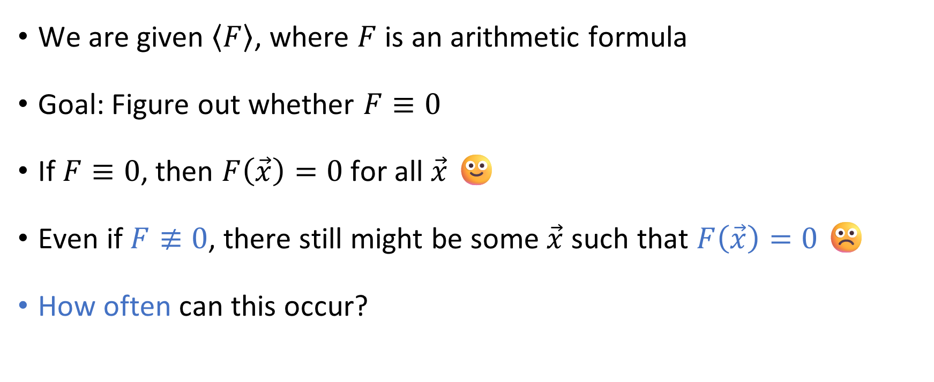
Polynomial identity testing
We are given $\left\langle F\right\rangle$, where $F$ is an arithmetic formula
Goal: Figure out whether $F≡0$
If $F≡0$, then $F\left(\vec{x}\right)=0$ for all $\vec{x}$ 🙂
Even if $F≢0$, there still might be some $\vec{x}$ such that $F\left(\vec{x}\right)=0$ ☹️
How often can this occur?

Slide 9
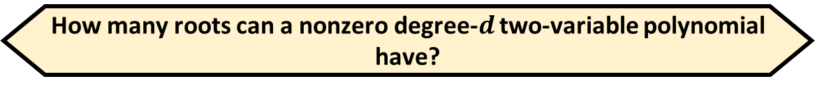
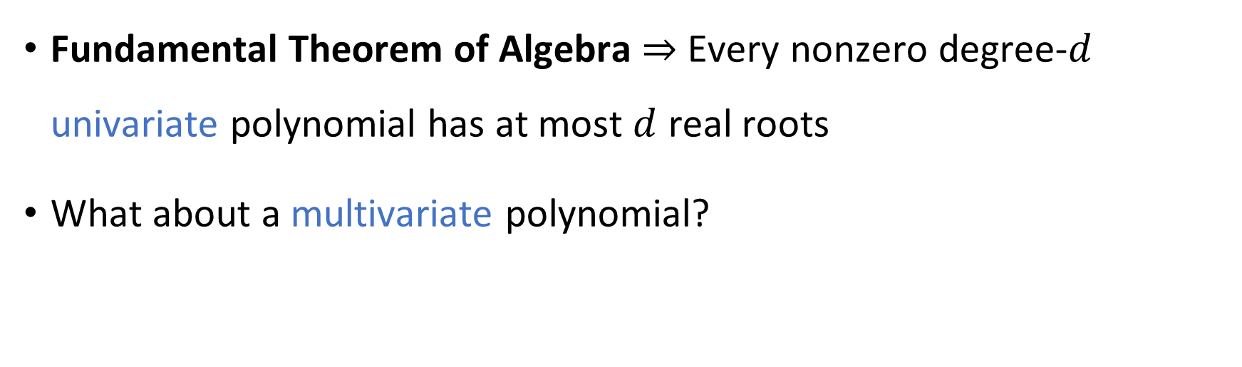
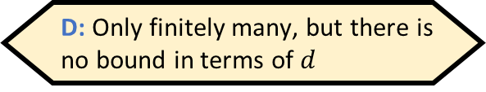


Counting roots
How many roots can a nonzero degree-$d$ two-variable polynomial have?
A: Up to $d$
B: Up to $d^{2}$
C: It might have infinitely many
D: Only finitely many, but there is no bound in terms of $d$
Respond at PollEv.com/whoza or text “whoza” to 22333
Fundamental Theorem of Algebra $⇒$ Every nonzero degree-$d$ univariate polynomial has at most $d$ real roots
What about a multivariate polynomial?

Slide 10
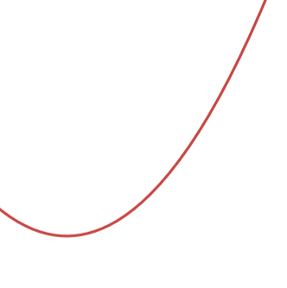
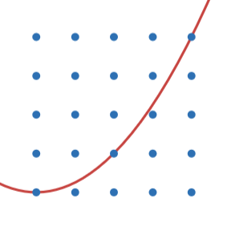
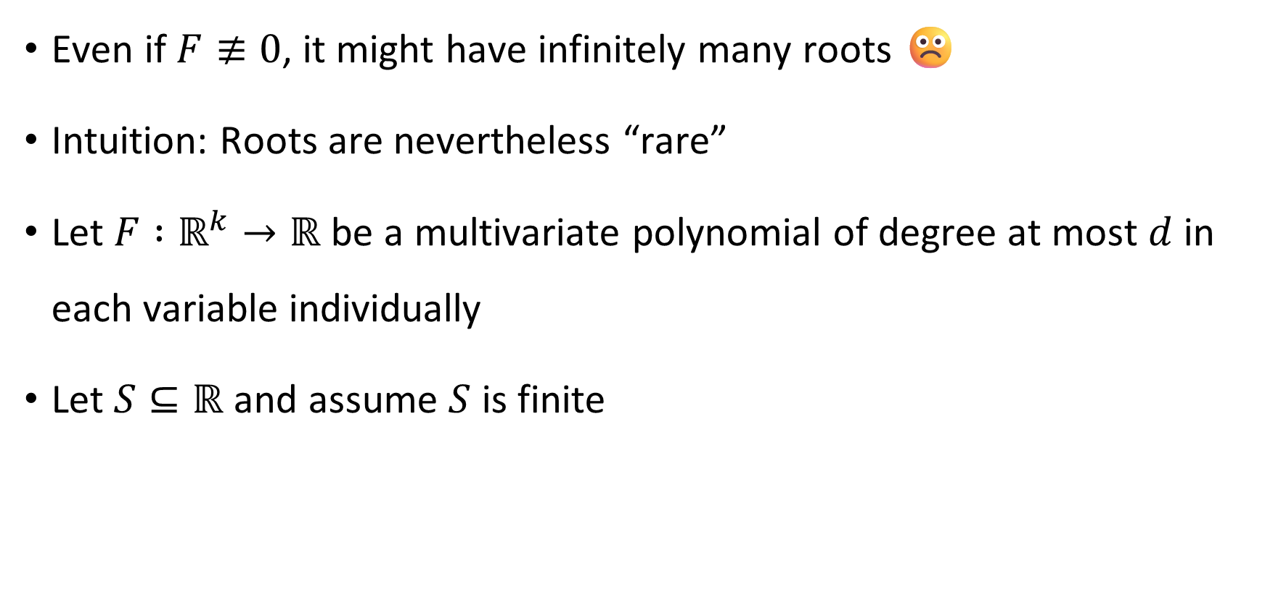

Polynomial Identity Lemma
Even if $F≢0$, it might have infinitely many roots ☹️
Intuition: Roots are nevertheless “rare”
Let $F :ℝ^{k}→ℝ$ be a multivariate polynomial of degree at most $d$ in each variable individually
Let $S⊆ℝ$ and assume $S$ is finite
$$F=y−x^{2}$$
Polynomial Identity Lemma: If $F≢0$, then $\left|F^{−1}\left(0\right)∩S^{k}\right|≤dk⋅{\left|S\right|}^{k−1}$
Notes:
This lemma is also commonly called the “Schwartz-Zippel Lemma.” https://en.wikipedia.org/wiki/Schwartz%E2%80%93Zippel_lemma

Slide 11

Polynomial Identity Lemma: If $F≢0$, then $\left|F^{−1}\left(0\right)∩S^{k}\right|≤dk⋅{\left|S\right|}^{k−1}$
Proof when $k=2$: Write $F\left(x,y\right)=\sum_{i=0}^{d}{F_{i}\left(x\right)⋅y^{i}}$ and suppose $F_{ℓ}≢0$
$$\left|F^{−1}\left(0\right)∩S^{2}\right|=\sum_{x∈S}{\left|\left\{y∈S :F\left(x,y\right)=0\right\}\right|} \begin{matrix} \\ \\ \end{matrix} \\ \begin{matrix} \\ \\ \end{matrix}=\sum_{F_{ℓ}\left(x\right)=0}{\left|\left\{y∈S :F\left(x,y\right)=0\right\}\right|}+\sum_{F_{ℓ}\left(x\right)≠0}{\left|\left\{y∈S :F\left(x,y\right)=0\right\}\right|} \\ ≤d⋅\left|S\right|+\left|S\right|⋅d\begin{matrix} \\ \end{matrix} \\ =2d⋅\left|S\right| \begin{matrix} \\ \end{matrix}$$
Fundamental Theorem of Algebra

Slide 12
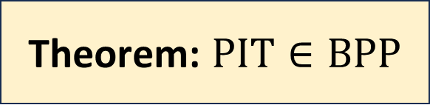
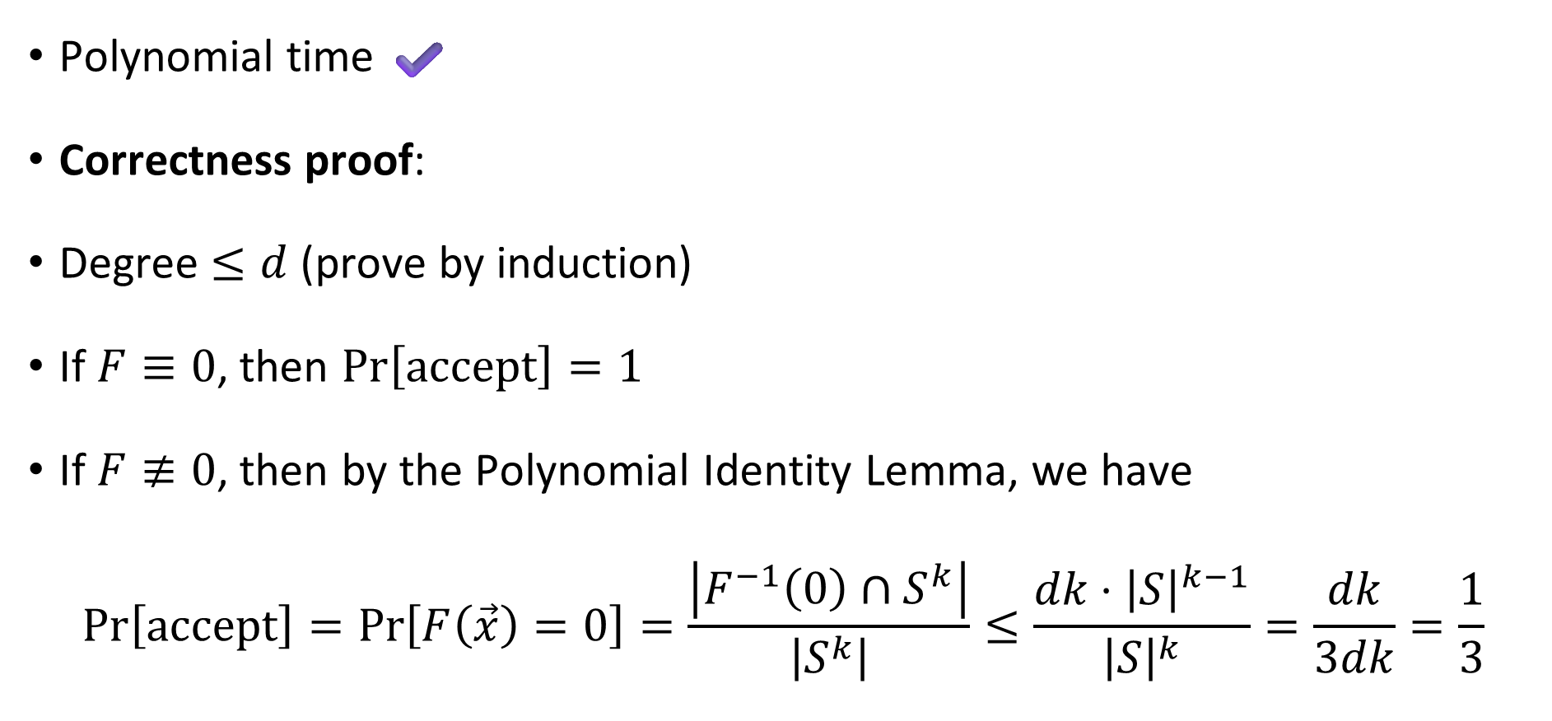

Theorem: $\text{PIT}∈\text{BPP}$
Given $F$ with $k$ variables and $d$ leaves:
Let $S=\left\{1, …, 3dk\right\}$
Pick $\vec{x}∈S^{k}$ uniformly at random
Compute $F\left(\vec{x}\right)∈ℤ$
If $F\left(\vec{x}\right)=0$, accept, otherwise reject
Polynomial time ✔️
Correctness proof:
Degree $≤d$ (prove by induction)
If $F≡0$, then $\operatorname{Pr}\left[\text{accept}\right]=1$
If $F≢0$, then by the Polynomial Identity Lemma, we have
$$\operatorname{Pr}\left[\text{accept}\right]=\operatorname{Pr}\left[F\left(\vec{x}\right)=0\right]=\frac{\left|F^{−1}\left(0\right)∩S^{k}\right|}{\left|S^{k}\right|}≤\frac{dk⋅{\left|S\right|}^{k−1}}{{\left|S\right|}^{k}}=\frac{dk}{3dk}=\frac{1}{3}$$

Slide 13

Polynomial identity testing: Recap
It is an open question whether $\text{PIT}∈\text{P}$
We proved $\text{PIT}∈\text{BPP}$
Does that mean we should consider $\text{PIT}$ “tractable?”

Slide 14

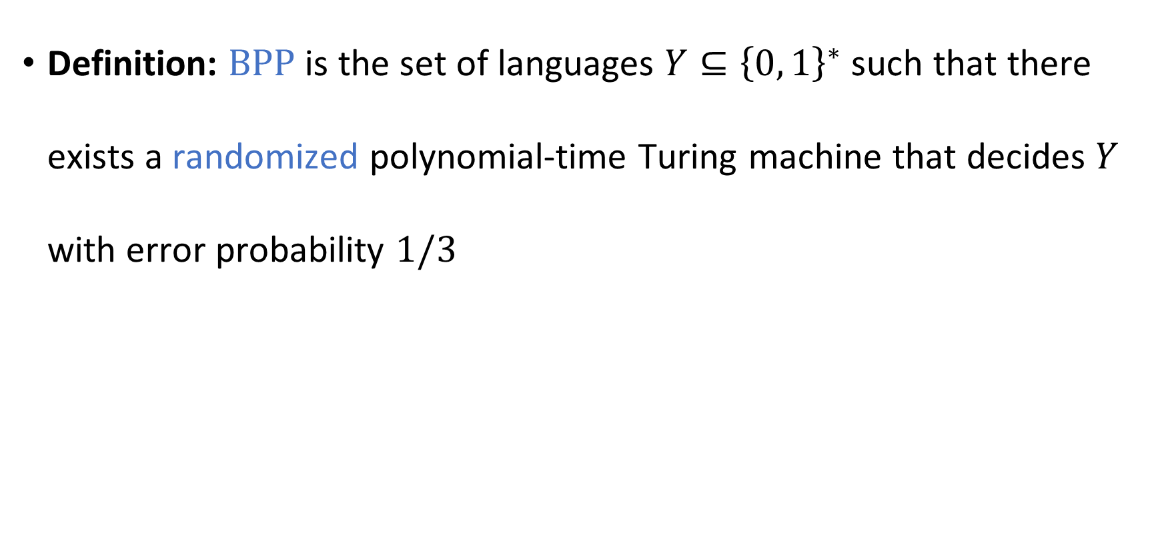

The complexity class $\text{BPP}$
Definition: $\text{BPP}$ is the set of languages $Y⊆{\left\{0, 1\right\}}^{∗}$ such that there exists a randomized polynomial-time Turing machine that decides $Y$ with error probability $1/3$

Slide 15
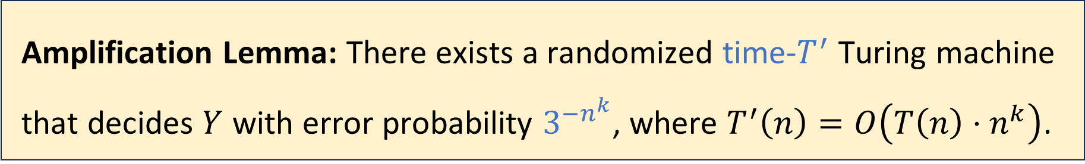

Amplification lemma
Suppose a language $Y⊆{\left\{0, 1\right\}}^{∗}$ can be decided by a time-$T$ Turing machine $M_{0}$ with error probability $1/3$
Let $k∈ℕ$ be any constant
As $n→∞$, the error probability goes to $0$ extremely rapidly!
Amplification Lemma: There exists a randomized time-$T^{′}$ Turing machine that decides $Y$ with error probability $3^{−n^{k}}$, where $T^{′}\left(n\right)=O\left(T\left(n\right)⋅n^{k}\right)$.

Slide 16



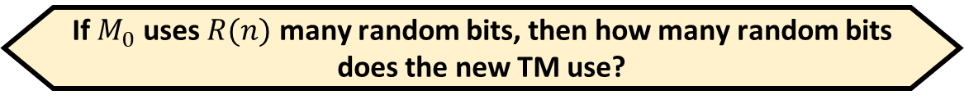
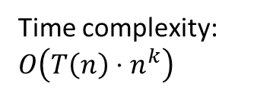
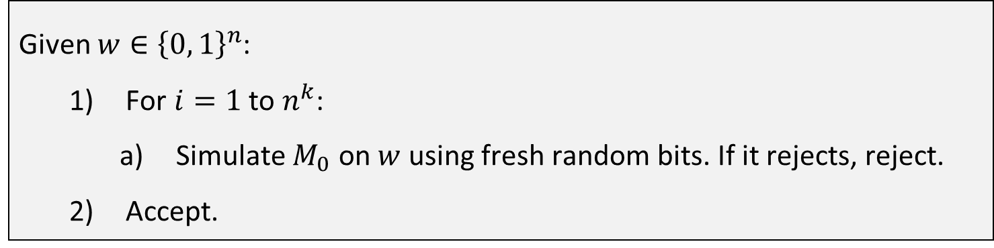

Proof of the amplification lemma (1 slide)
If $M_{0}$ uses $R(n)$ many random bits, then how many random bits does the new TM use?
A: $R\left(n\right)+n^{k}$
B: $R(n)⋅n^{k}$
For simplicity, assume that for every $w∈Y$, we have $\operatorname{Pr}\left[M_{0} \text{accepts} w\right]=1$
For $w∉Y$, we merely assume $\operatorname{Pr}\left[M_{0} \text{accepts} w\right]≤1/3$
If $w∈Y$, then $\operatorname{Pr}\left[M \text{accepts} w\right]=1$
If $w∉Y$, then $\operatorname{Pr}\left[M \text{accepts} w\right]≤{\left(1/3\right)}^{n^{k}}=1/3^{n^{k}}$
C: $R{\left(n\right)}^{k}$
D: Not enough information
Respond at PollEv.com/whoza or text “whoza” to 22333
Given $w∈{\left\{0, 1\right\}}^{n}$:
For $i=1$ to $n^{k}$:
Simulate $M_{0}$ on $w$ using fresh random bits. If it rejects, reject.
Accept.
Time complexity: $O\left(T\left(n\right)⋅n^{k}\right)$
Notes:
See the textbook for a proof of the general case

Slide 17
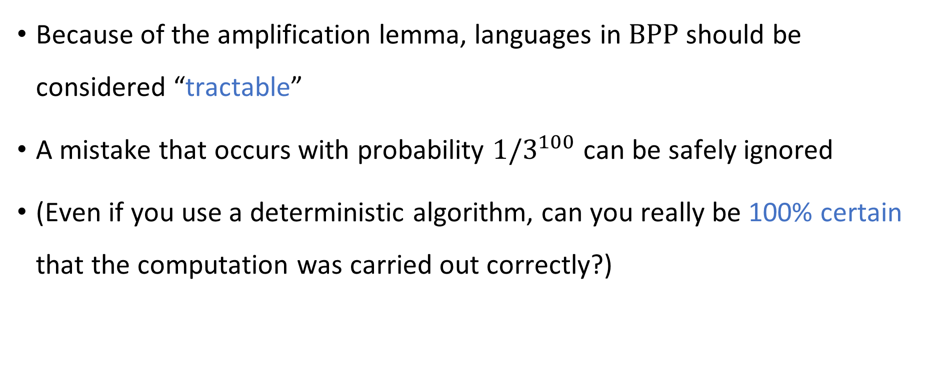

$\text{BPP}$ as a model of tractability
Because of the amplification lemma, languages in $\text{BPP}$ should be considered “tractable”
A mistake that occurs with probability $1/3^{100}$ can be safely ignored
(Even if you use a deterministic algorithm, can you really be 100% certain that the computation was carried out correctly?)

Slide 18
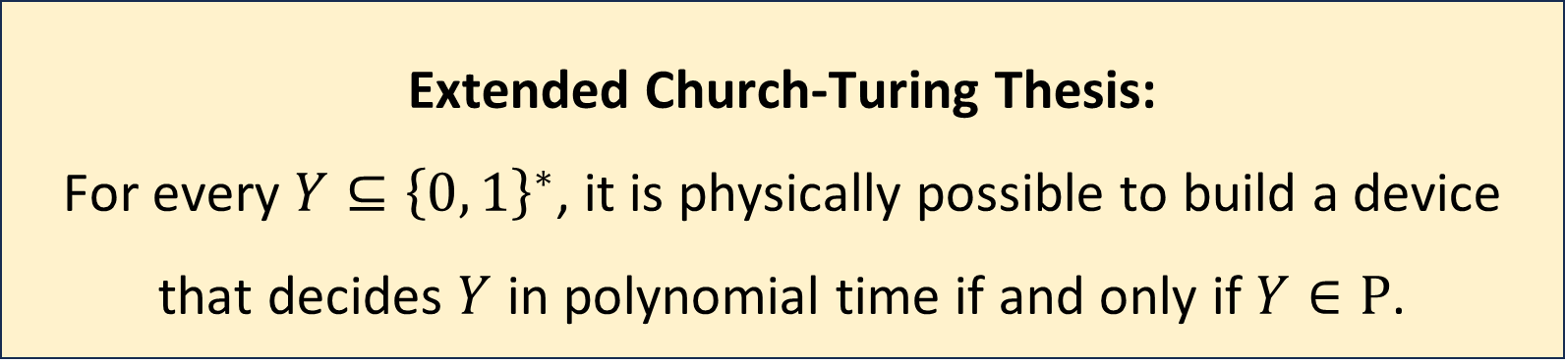
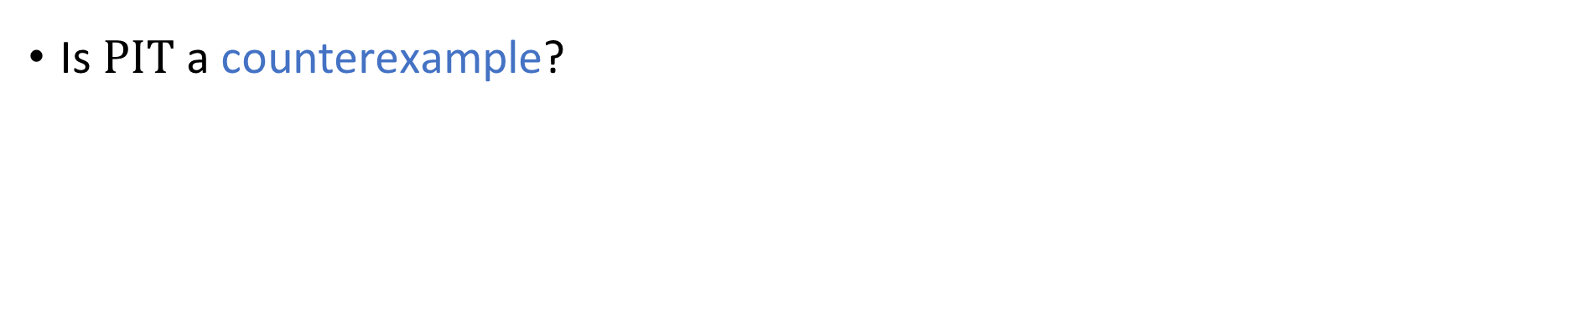
Extended Church-Turing Thesis
Extended Church-Turing Thesis:
For every $Y⊆{\left\{0, 1\right\}}^{∗}$, it is physically possible to build a device that decides $Y$ in polynomial time if and only if $Y∈\text{P}$.
Is $\text{PIT}$ a counterexample?

