Slide 1
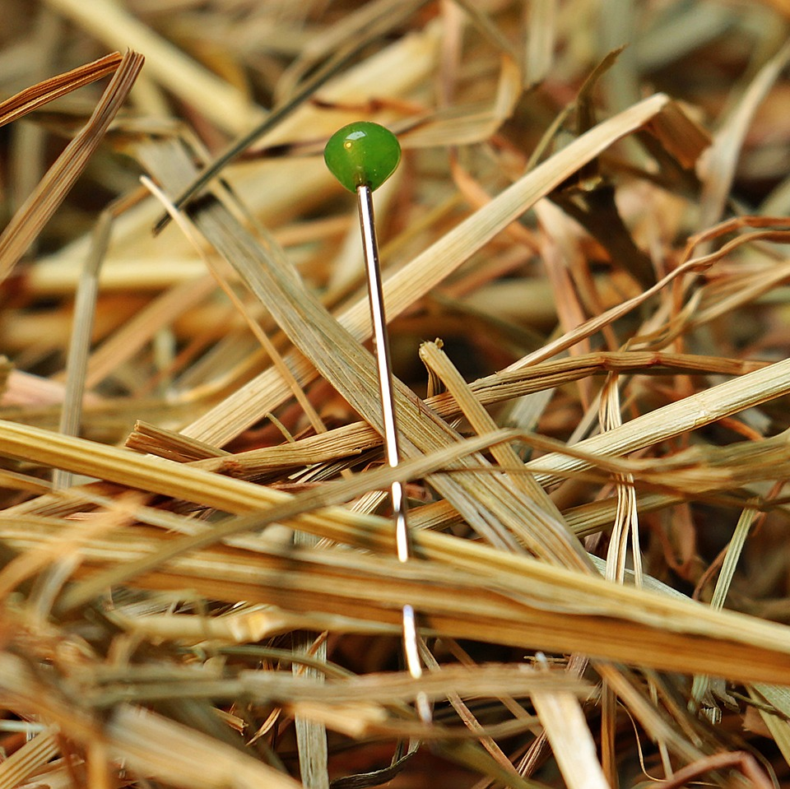
CMSC 28100 Introduction to Complexity Theory Spring 2024 Instructor: William Hoza

Slide 2

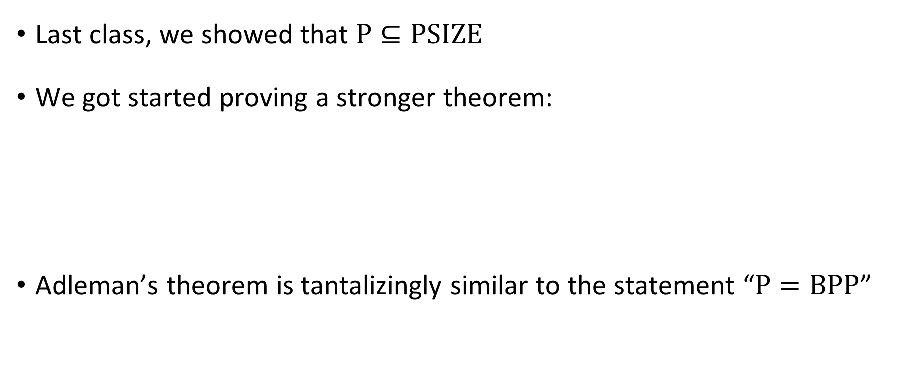



Adleman’s theorem
$$\text{PSIZE}$$
$$\text{BPP}$$
Last class, we showed that $\text{P}⊆\text{PSIZE}$
We got started proving a stronger theorem:
Adleman’s theorem is tantalizingly similar to the statement “$\text{P}=\text{BPP}$”
$$\text{P}$$
Adleman’s Theorem: $\text{BPP}⊆\text{PSIZE}$

Slide 3
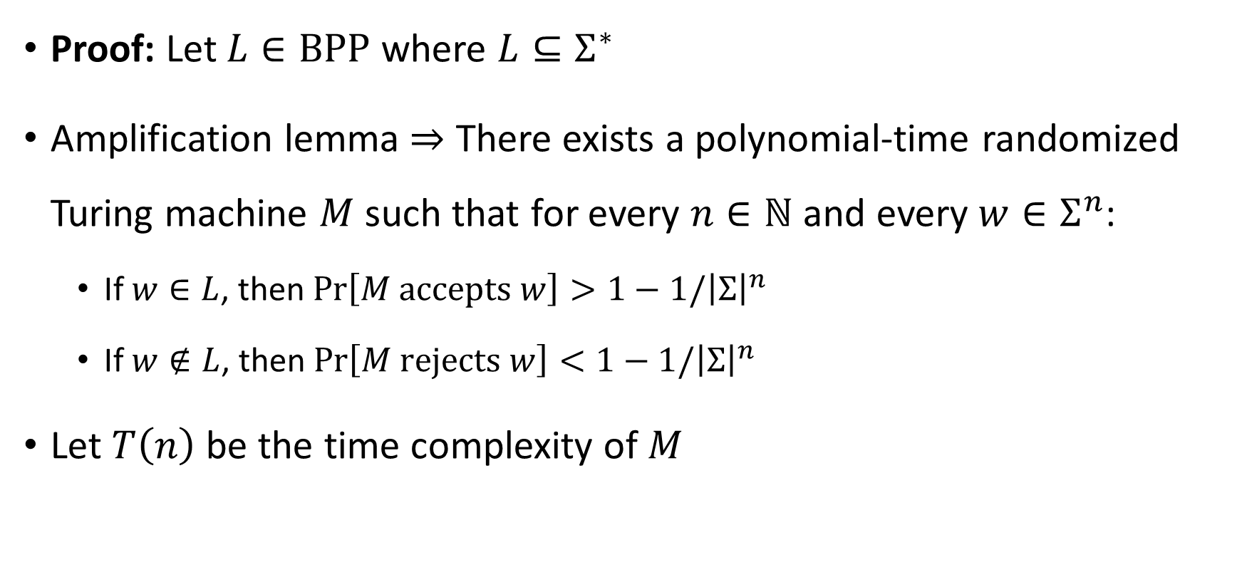
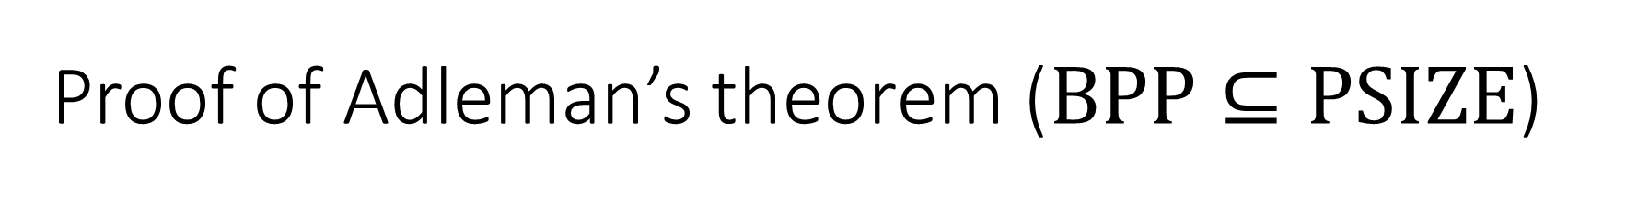
Proof of Adleman’s theorem ($\text{BPP}⊆\text{PSIZE}$)
Proof: Let $L∈\text{BPP}$ where $L⊆Σ^{∗}$
Amplification lemma $⇒$ There exists a polynomial-time randomized Turing machine $M$ such that for every $n∈ℕ$ and every $w∈Σ^{n}$:
If $w∈L$, then $\operatorname{Pr}\left[M \text{accepts} w\right]>1−1/{\left|Σ\right|}^{n}$
If $w∉L$, then $\operatorname{Pr}\left[M \text{rejects} w\right]<1−1/{\left|Σ\right|}^{n}$
Let $T\left(n\right)$ be the time complexity of $M$

Slide 4
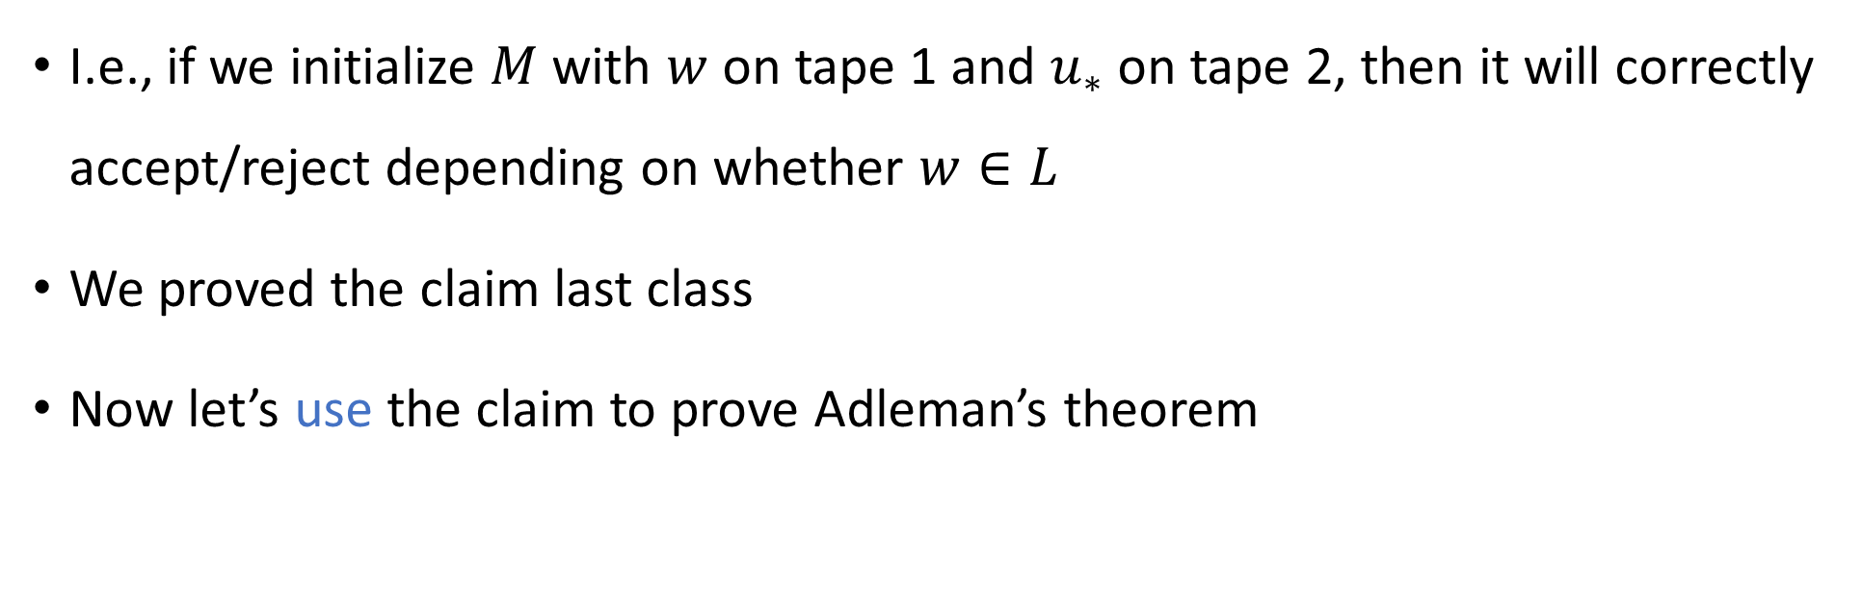
Random bits: Good for all inputs simultaneously
Claim: For every $n$, there exists $u_{∗}∈{\left\{0, 1\right\}}^{T\left(n\right)}$ that is “good” for all $w∈Σ^{n}$
I.e., if we initialize $M$ with $w$ on tape 1 and $u_{∗}$ on tape 2, then it will correctly accept/reject depending on whether $w∈L$
We proved the claim last class
Now let’s use the claim to prove Adleman’s theorem

Slide 5
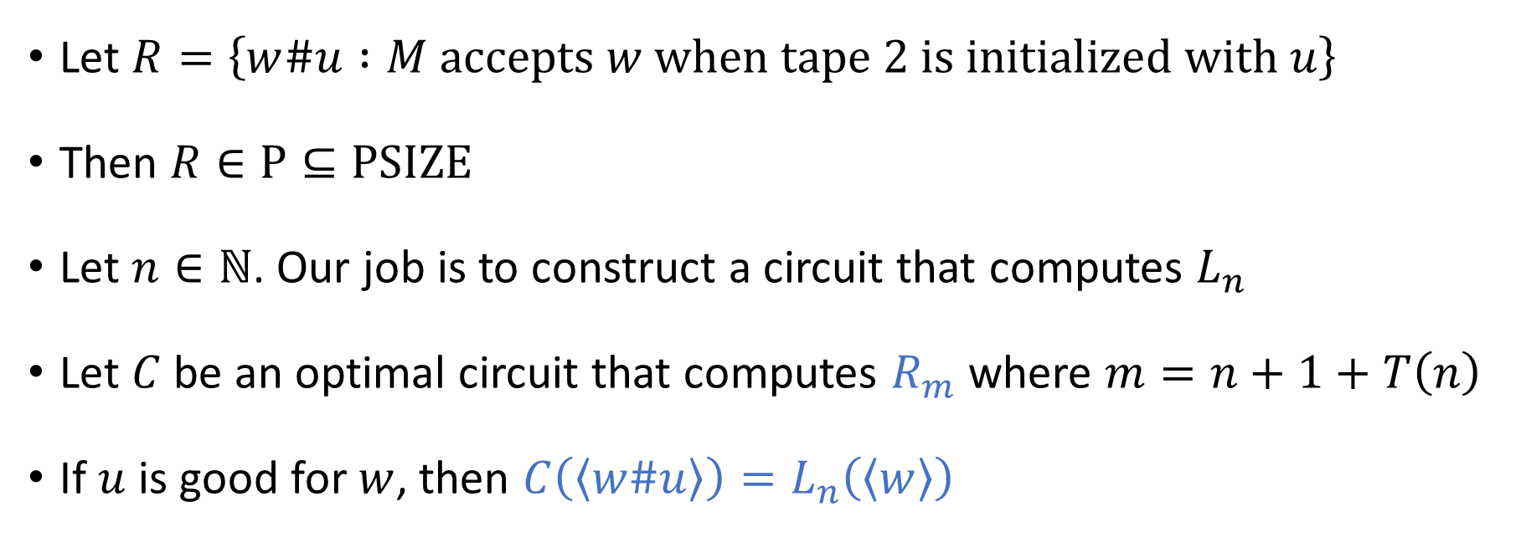
Constructing the circuit
Let $R=\left\{w\#u :M \text{accepts} w \text{when} \text{tape}\text{ 2 }\text{is} \text{initialized} \text{with} u\right\}$
Then $R∈\text{P}⊆\text{PSIZE}$
Let $n∈ℕ$. Our job is to construct a circuit that computes $L_{n}$
Let $C$ be an optimal circuit that computes $R_{m}$ where $m=n+1+T\left(n\right)$
If $u$ is good for $w$, then $C\left(\left\langle w\#u\right\rangle \right)=L_{n}\left(\left\langle w\right\rangle \right)$

Slide 6



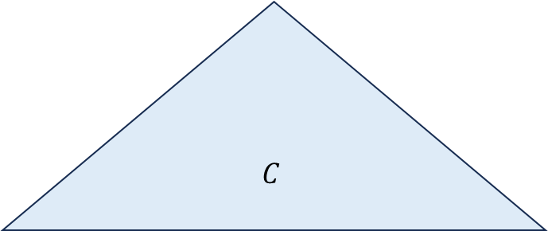



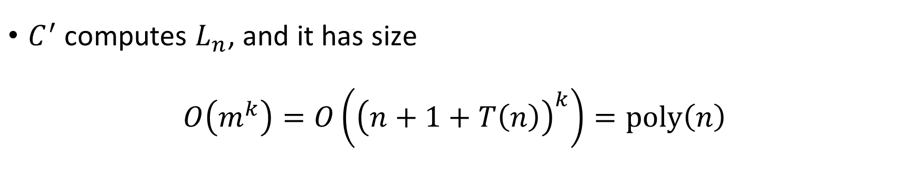









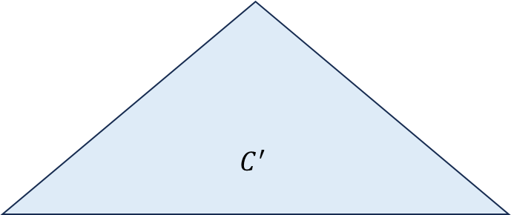
Constructing the circuit
$$C$$
$$C^{′}$$
$$⋯$$
$$⋯$$
$$⋯$$
$$x_{1}$$
$$x_{2}$$
$$x_{3}$$
$$x_{4}$$
$$x_{5}$$
$$x_{6}$$
$$x_{7}$$
$$x_{mr}$$
$$x_{1}$$
$$x_{2}$$
$$x_{nr}$$
0
1
1
0
1
$\#u_{∗}$ “hard-coded” into circuit
$C^{′}$ computes $L_{n}$, and it has size
$$O\left(m^{k}\right)=O\left({\left(n+1+T\left(n\right)\right)}^{k}\right)=\text{poly}\left(n\right)$$

Slide 7
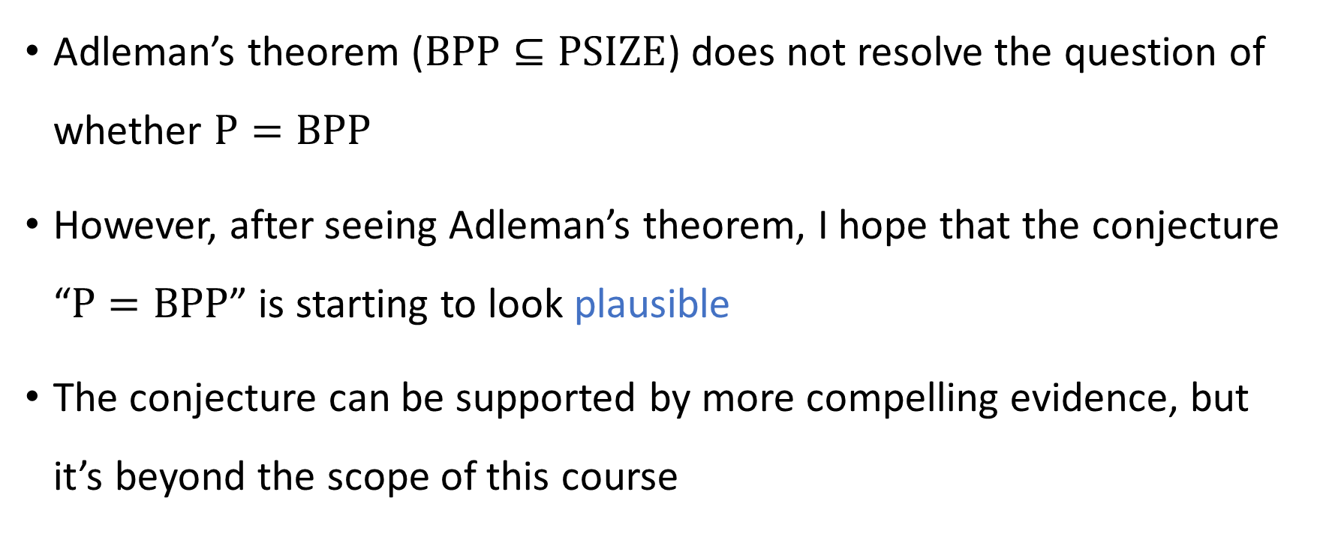
Adleman’s theorem and P vs. BPP
Adleman’s theorem ($\text{BPP}⊆\text{PSIZE}$) does not resolve the question of whether $\text{P}=\text{BPP}$
However, after seeing Adleman’s theorem, I hope that the conjecture “$\text{P}=\text{BPP}$” is starting to look plausible
The conjecture can be supported by more compelling evidence, but it’s beyond the scope of this course

Slide 8


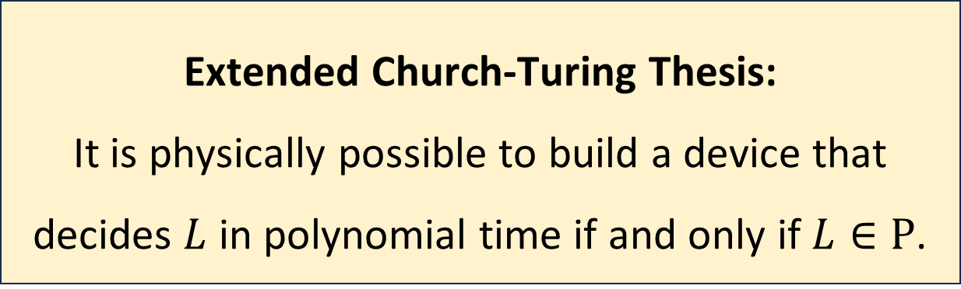
$\text{BPP}$ and the Extended Church-Turing Thesis
Let $L$ be a language
Assuming $\text{P}=\text{BPP}$, the extended Church-Turing thesis survives the challenge posed by randomized computation!
Extended Church-Turing Thesis:
It is physically possible to build a device that decides $L$ in polynomial time if and only if $L∈\text{P}$.

Slide 9
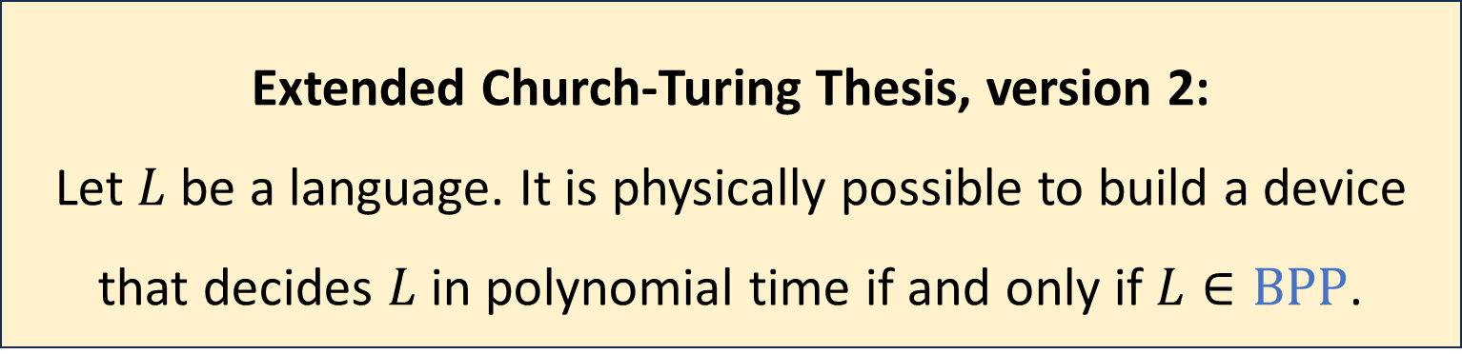

$\text{BPP}$ and the Extended Church-Turing Thesis
Just in case, the thesis is sometimes revised to allow randomization:
This version is immune to the challenge posed by randomization
However, there is a bigger threat: Quantum Computation
Extended Church-Turing Thesis, version 2:
Let $L$ be a language. It is physically possible to build a device that decides $L$ in polynomial time if and only if $L∈\text{BPP}$.

Slide 10
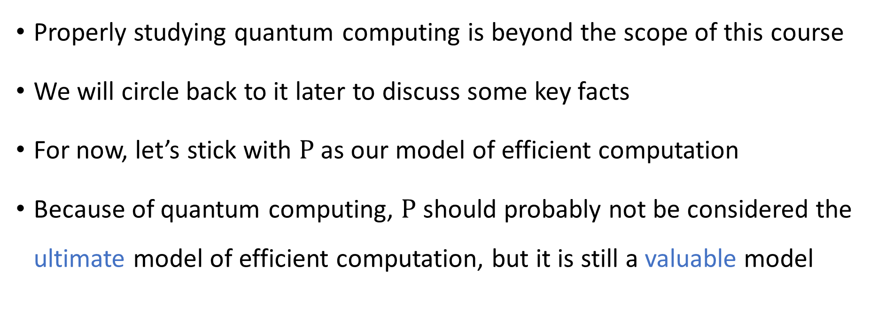
Quantum computing
Properly studying quantum computing is beyond the scope of this course
We will circle back to it later to discuss some key facts
For now, let’s stick with $\text{P}$ as our model of efficient computation
Because of quantum computing, $\text{P}$ should probably not be considered the ultimate model of efficient computation, but it is still a valuable model

Slide 11
Which problems can be solved through computation?
CLASSICAL

Slide 12

Which languages are in $\text{P}$?

Slide 13

Which languages are not in $\text{P}$?

Slide 14
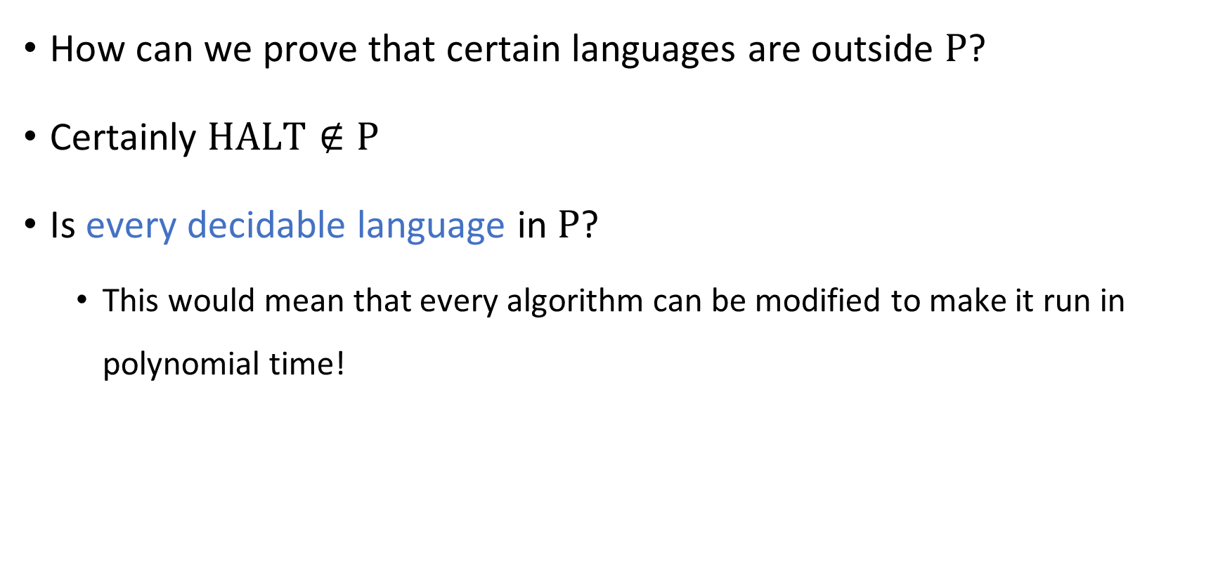
Intractability vs. undecidability
How can we prove that certain languages are outside $\text{P}$?
Certainly $\text{HALT}∉\text{P}$
Is every decidable language in $\text{P}$?
This would mean that every algorithm can be modified to make it run in polynomial time!

Slide 15



Intractability vs. undecidability
All languages
$$\text{HALT}$$
Decidable languages
???
$$\text{P}$$
$$\text{PALINDROMES}$$

Slide 16
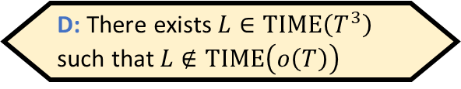

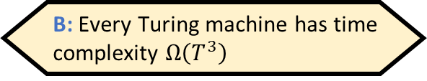
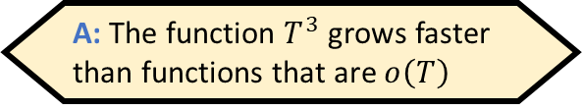
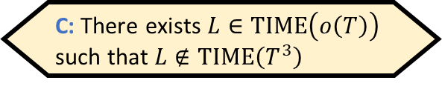

The Time Hierarchy Theorem
To prove this theorem, what should we prove?
A: The function $T^{3}$ grows faster than functions that are $o\left(T\right)$
B: Every Turing machine has time complexity $Ω\left(T^{3}\right)$
Let $T:ℕ→ℕ$ be a “reasonable” time complexity bound (we will come back to this)
“$\text{TIME}\left(o\left(T\right)\right)$” means the class of languages decidable in time $o\left(T\right)$
Note: $\text{TIME}\left(o\left(T\right)\right)⊆\text{TIME}\left(T\right)⊆\text{TIME}\left(T^{3}\right)$
Theorem interpretation: Given a little more time, we can solve more problems
C: There exists $L∈\text{TIME}\left(o\left(T\right)\right)$ such that $L∉\text{TIME}\left(T^{3}\right)$
D: There exists $L∈\text{TIME}\left(T^{3}\right)$ such that $L∉\text{TIME}\left(o\left(T\right)\right)$
Respond at PollEv.com/whoza or text “whoza” to 22333
Theorem: $\text{TIME}\left(o\left(T\right)\right)≠\text{TIME}\left(T^{3}\right)$
Notes:
See the textbook for a tighter version of the theorem, where we have T log T instead of T^3

Slide 17
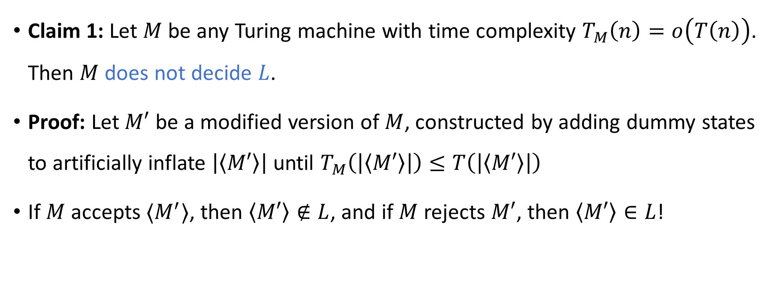

Proof of the Time Hierarchy Theorem
Let $L=\{\left\langle M\right\rangle :M \text{rejects} 〈M⟩ \text{within} T\left(\left|⟨M⟩\right|\right) \text{steps}\}$
Claim 1: Let $M$ be any Turing machine with time complexity $T_{M}\left(n\right)=o\left(T\left(n\right)\right)$. Then $M$ does not decide $L$.
Proof: Let $M′$ be a modified version of $M$, constructed by adding dummy states to artificially inflate $\left|\left\langle M′\right\rangle \right|$ until $T_{M}\left(\left|\left\langle M′\right\rangle \right|\right)≤T\left(\left|\left\langle M′\right\rangle \right|\right)$
If $M$ accepts $⟨M^{′}⟩$, then $\left\langle M′\right\rangle ∉L$, and if $M$ rejects $M′$, then $\left\langle M′\right\rangle ∈L$!

Slide 18
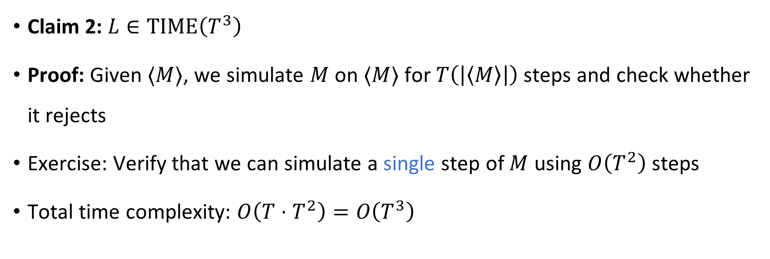
Proof of the Time Hierarchy Theorem
Let $L=\{\left\langle M\right\rangle :M \text{rejects} 〈M⟩ \text{within} T\left(\left|⟨M⟩\right|\right) \text{steps}\}$
Claim 2: $L∈\text{TIME}\left(T^{3}\right)$
Proof: Given $⟨M⟩$, we simulate $M$ on $⟨M⟩$ for $T\left(\left|\left\langle M\right\rangle \right|\right)$ steps and check whether it rejects
Exercise: Verify that we can simulate a single step of $M$ using $O\left(T^{2}\right)$ steps
Total time complexity: $O\left(T⋅T^{2}\right)=O\left(T^{3}\right)$
Subtle point: How do we know when we’re done?

