Slide 1
Circuit Complexity: Autumn 2024 Course Summary & Review
Instructor: William Hoza
The University of Chicago

Slide 2
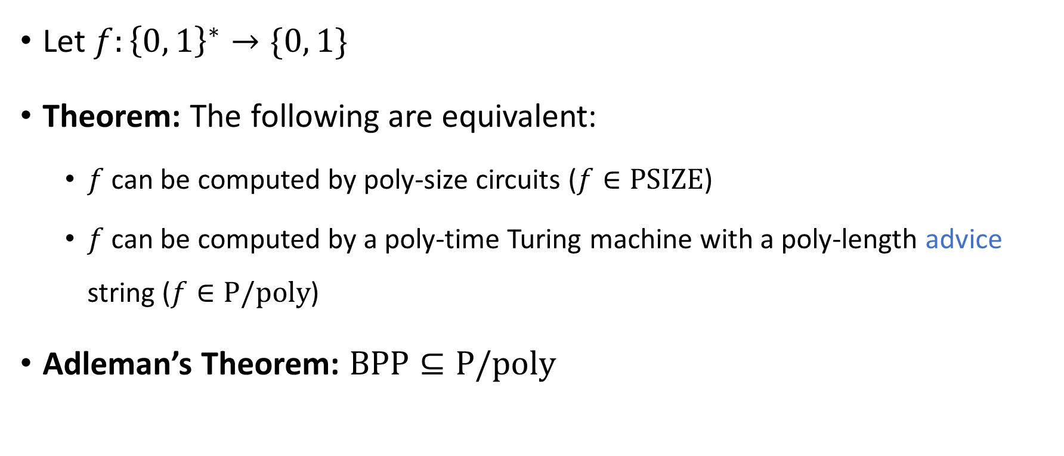
Circuits vs. Turing machines
Let $f:{\left\{0, 1\right\}}^{∗}→\{0, 1\}$
Theorem: The following are equivalent:
$f$ can be computed by poly-size circuits ($f∈\text{PSIZE}$)
$f$ can be computed by a poly-time Turing machine with a poly-length advice string ($f∈\text{P}/\text{poly}$)
Adleman’s Theorem: $\text{BPP}⊆\text{P}/\text{poly}$

Slide 3
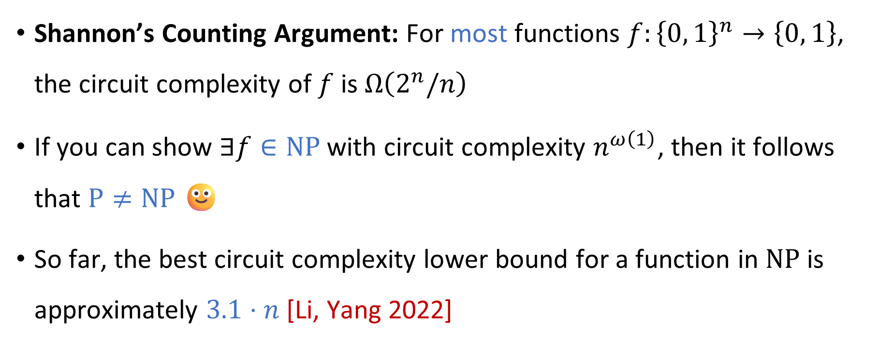

Circuit complexity and $\text{P}$ vs. $\text{NP}$
Shannon’s Counting Argument: For most functions $f:{\left\{0, 1\right\}}^{n}→\left\{0, 1\right\}$, the circuit complexity of $f$ is $Ω\left(2^{n}/n\right)$
If you can show $∃f∈\text{NP}$ with circuit complexity $n^{ω\left(1\right)}$, then it follows that $\text{P}≠\text{NP}$ 🙂
So far, the best circuit complexity lower bound for a function in $\text{NP}$ is approximately $3.1⋅n$ [Li, Yang 2022]

Slide 4
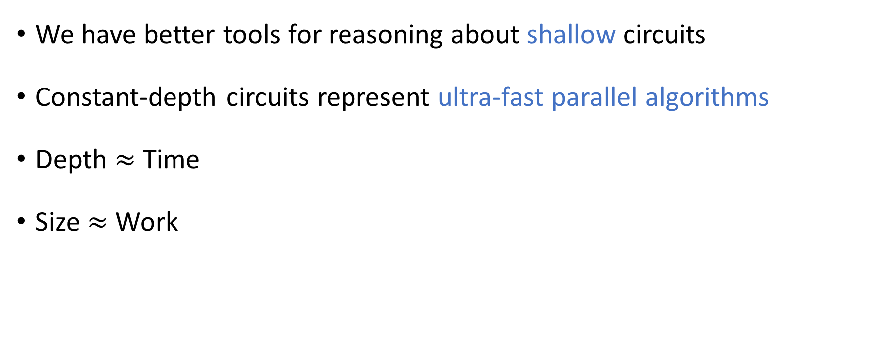
Shallow circuits
We have better tools for reasoning about shallow circuits
Constant-depth circuits represent ultra-fast parallel algorithms
Depth $≈$ Time
Size $≈$ Work

Slide 5
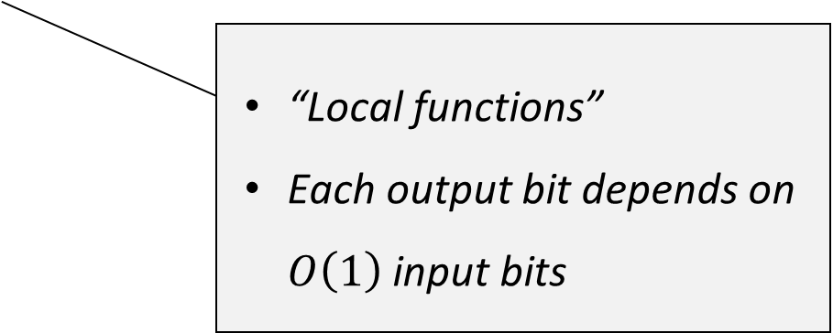
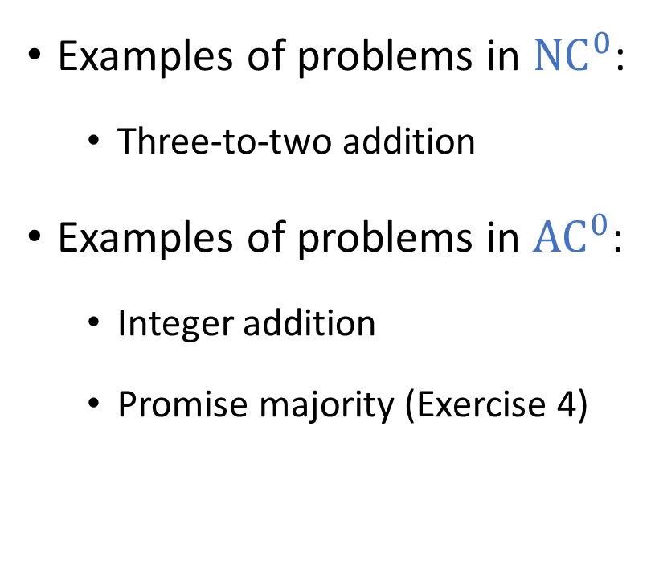
Shallow circuits can do interesting stuff
Examples of problems in ${\text{NC}}^{0}$:
Three-to-two addition
Examples of problems in ${\text{AC}}^{0}$:
Integer addition
Promise majority (Exercise 4)
“Local functions”
Each output bit depends on $O\left(1\right)$ input bits

Slide 6
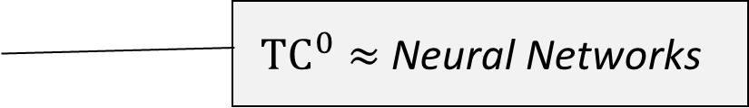

Shallow circuits can do interesting stuff
Examples of problems in ${\text{AC}}^{0}\left[⊕\right]$:
Nisan-Wigderson PRG
Examples of problems in ${\text{TC}}^{0}$:
All symmetric functions ($\text{SYM}⊆{\text{TC}}^{0}$)
Iterated integer addition (Exercise 5)
Candidate cryptographic PRFs
${\text{TC}}^{0}≈$ Neural Networks

Slide 7

Shallow circuits can do interesting stuff
Examples of problems in ${\text{NC}}^{1}$:
Majority (${\text{TC}}^{0}⊆{\text{NC}}^{1}$)
Examples of problems in ${\text{AC}}^{1}$:
$s$-$t$ connectivity ($\text{NL}⊆{\text{AC}}^{1}$)

Slide 8
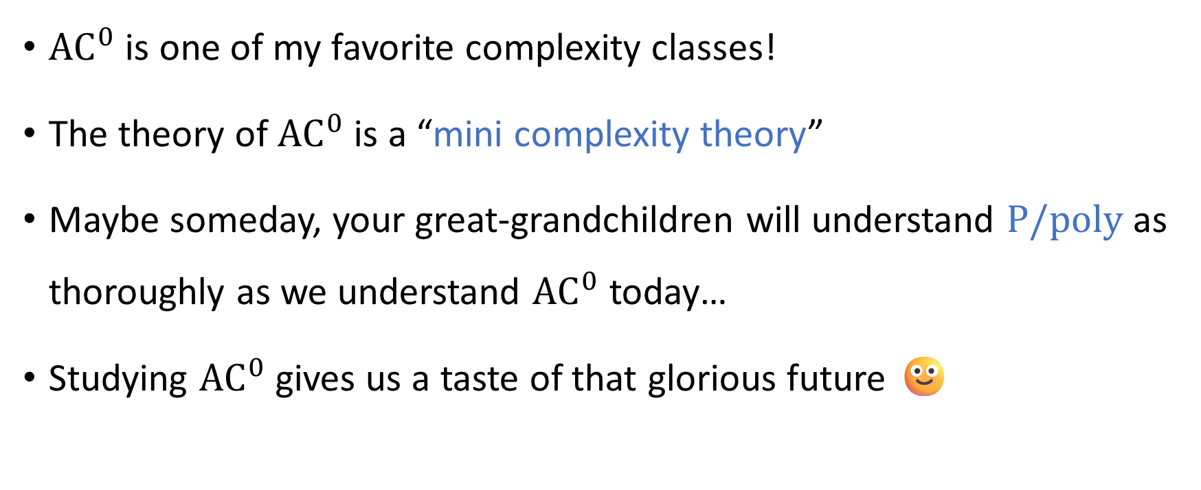

The complexity class ${\text{AC}}^{0}$
${\text{AC}}^{0}$ is one of my favorite complexity classes!
The theory of ${\text{AC}}^{0}$ is a “mini complexity theory”
Maybe someday, your great-grandchildren will understand $\text{P}/\text{poly}$ as thoroughly as we understand ${\text{AC}}^{0}$ today…
Studying ${\text{AC}}^{0}$ gives us a taste of that glorious future 🙂

Slide 9
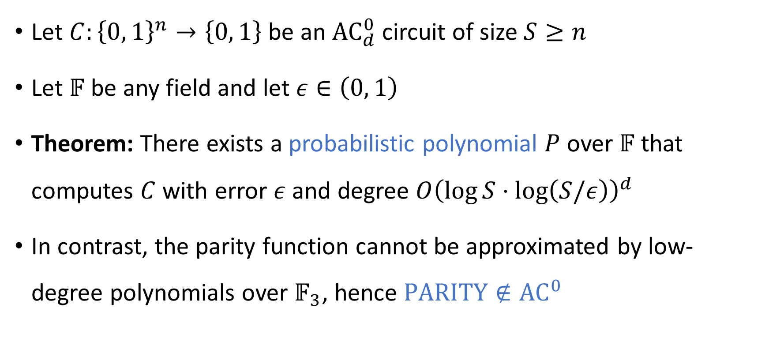
The Razborov-Smolensky method
Let $C:{\left\{0, 1\right\}}^{n}→\left\{0, 1\right\}$ be an ${\text{AC}}_{d}^{0}$ circuit of size $S≥n$
Let $𝔽$ be any field and let $ε∈\left(0, 1\right)$
Theorem: There exists a probabilistic polynomial $P$ over $𝔽$ that computes $C$ with error $ε$ and degree $O{\left(\log{S}⋅\log\left(S/ε\right)\right)}^{d}$
In contrast, the parity function cannot be approximated by low-degree polynomials over $𝔽_{3}$, hence $\text{PARITY}∉{\text{AC}}^{0}$

Slide 10
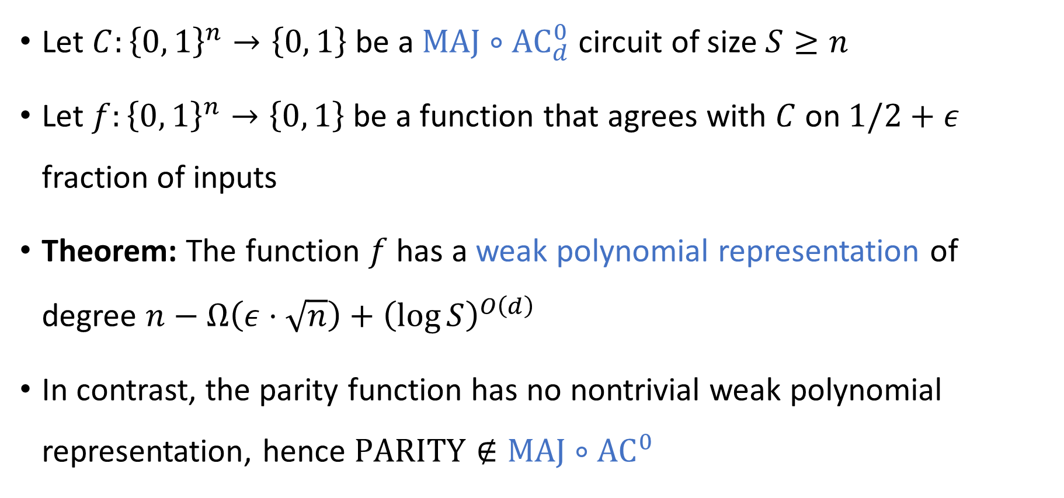
Weak polynomial representations
Let $C:{\left\{0, 1\right\}}^{n}→\left\{0, 1\right\}$ be a $\text{MAJ}∘{\text{AC}}_{d}^{0}$ circuit of size $S≥n$
Let $f:{\left\{0, 1\right\}}^{n}→\left\{0, 1\right\}$ be a function that agrees with $C$ on $1/2+ε$ fraction of inputs
Theorem: The function $f$ has a weak polynomial representation of degree $n−Ω\left(ε⋅\sqrt{n}\right)+{\left(\log{S}\right)}^{O\left(d\right)}$
In contrast, the parity function has no nontrivial weak polynomial representation, hence $\text{PARITY}∉\text{MAJ}∘{\text{AC}}^{0}$

Slide 11
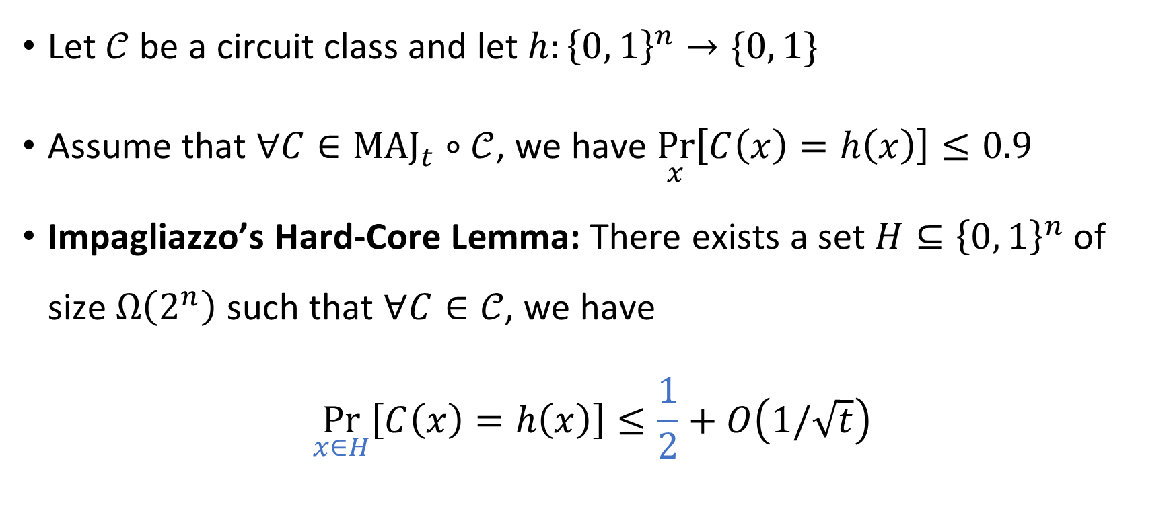
Impagliazzo’s Hard-Core Lemma
Let $𝒞$ be a circuit class and let $h:{\left\{0, 1\right\}}^{n}→\{0, 1\}$
Assume that $∀C∈{\text{MAJ}}_{t}∘𝒞$, we have $\underset{x}{Pr}\left[C\left(x\right)=h\left(x\right)\right]≤0.9$
Impagliazzo’s Hard-Core Lemma: There exists a set $H⊆{\left\{0, 1\right\}}^{n}$ of size $Ω\left(2^{n}\right)$ such that $∀C∈𝒞$, we have
$$\underset{x∈H}{Pr}\left[C\left(x\right)=h\left(x\right)\right]≤\frac{1}{2}+O\left(1/\sqrt{t}\right)$$
Ignoring some technicalities…

Slide 12
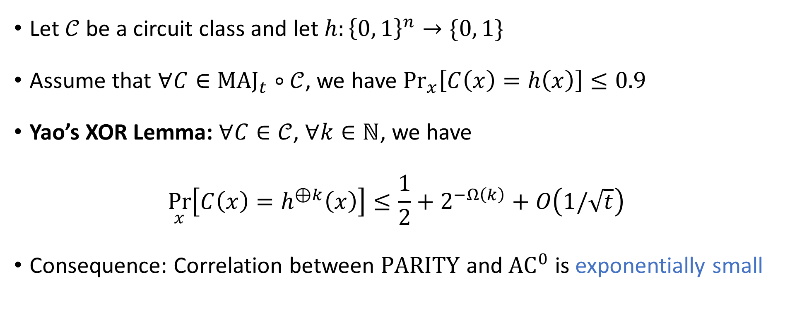
Yao’s XOR Lemma
Let $𝒞$ be a circuit class and let $h:{\left\{0, 1\right\}}^{n}→\{0, 1\}$
Assume that $∀C∈{\text{MAJ}}_{t}∘𝒞$, we have $\underset{x}{Pr}\left[C\left(x\right)=h\left(x\right)\right]≤0.9$
Yao’s XOR Lemma: $∀C∈𝒞$, $∀k∈ℕ$, we have
$$\underset{x}{Pr}\left[C\left(x\right)=h^{⊕k}\left(x\right)\right]≤\frac{1}{2}+2^{−Ω\left(k\right)}+O\left(1/\sqrt{t}\right)$$
Consequence: Correlation between $\text{PARITY}$ and ${\text{AC}}^{0}$ is exponentially small
Ignoring some technicalities…

Slide 13

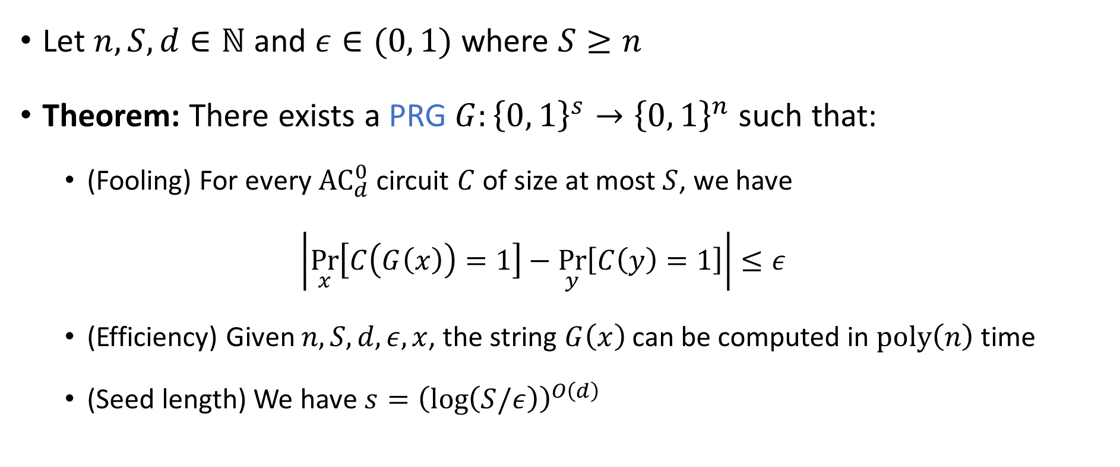
Nisan-Wigderson Pseudorandom Generator
Let $n, S, d∈ℕ$ and $ε∈(0, 1)$ where $S≥n$
Theorem: There exists a PRG $G:{\left\{0, 1\right\}}^{s}→{\left\{0, 1\right\}}^{n}$ such that:
(Fooling) For every ${\text{AC}}_{d}^{0}$ circuit $C$ of size at most $S$, we have
$$\left|\underset{x}{Pr}\left[C\left(G\left(x\right)\right)=1\right]−\underset{y}{Pr}\left[C\left(y\right)=1\right]\right|≤ε$$
(Efficiency) Given $n, S, d, ε,x$, the string $G\left(x\right)$ can be computed in $\text{poly}\left(n\right)$ time
(Seed length) We have $s={\left(\log\left(S/ε\right)\right)}^{O\left(d\right)}$
More sophisticated PRGs are known, with better seed lengths

Slide 14




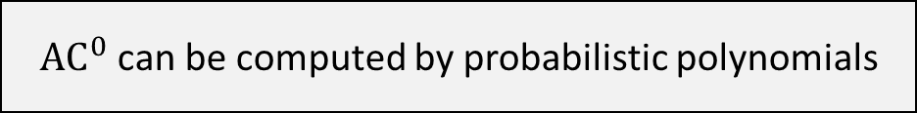


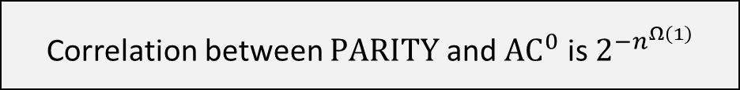

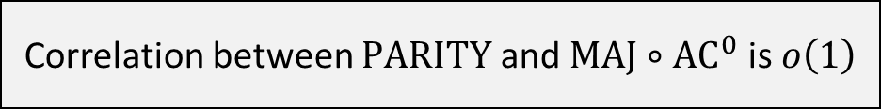

${\text{AC}}^{0}$ can be computed by probabilistic polynomials
Von Neumann’s Minimax Theorem
$$⇒$$
$$⇒$$
$\text{MAJ}∘{\text{AC}}^{0}$ has weak polynomial representations
Impagliazzo’s Hard-Core Lemma
$$⇒$$
$$⇒$$
Correlation between $\text{PARITY}$ and $\text{MAJ}∘{\text{AC}}^{0}$ is $o\left(1\right)$
Yao’s XOR Lemma
$$⇒$$
$$⇒$$
Correlation between $\text{PARITY}$ and ${\text{AC}}^{0}$ is $2^{−n^{Ω\left(1\right)}}$
$$⇒$$
Nisan-Wigderson PRG

Slide 15
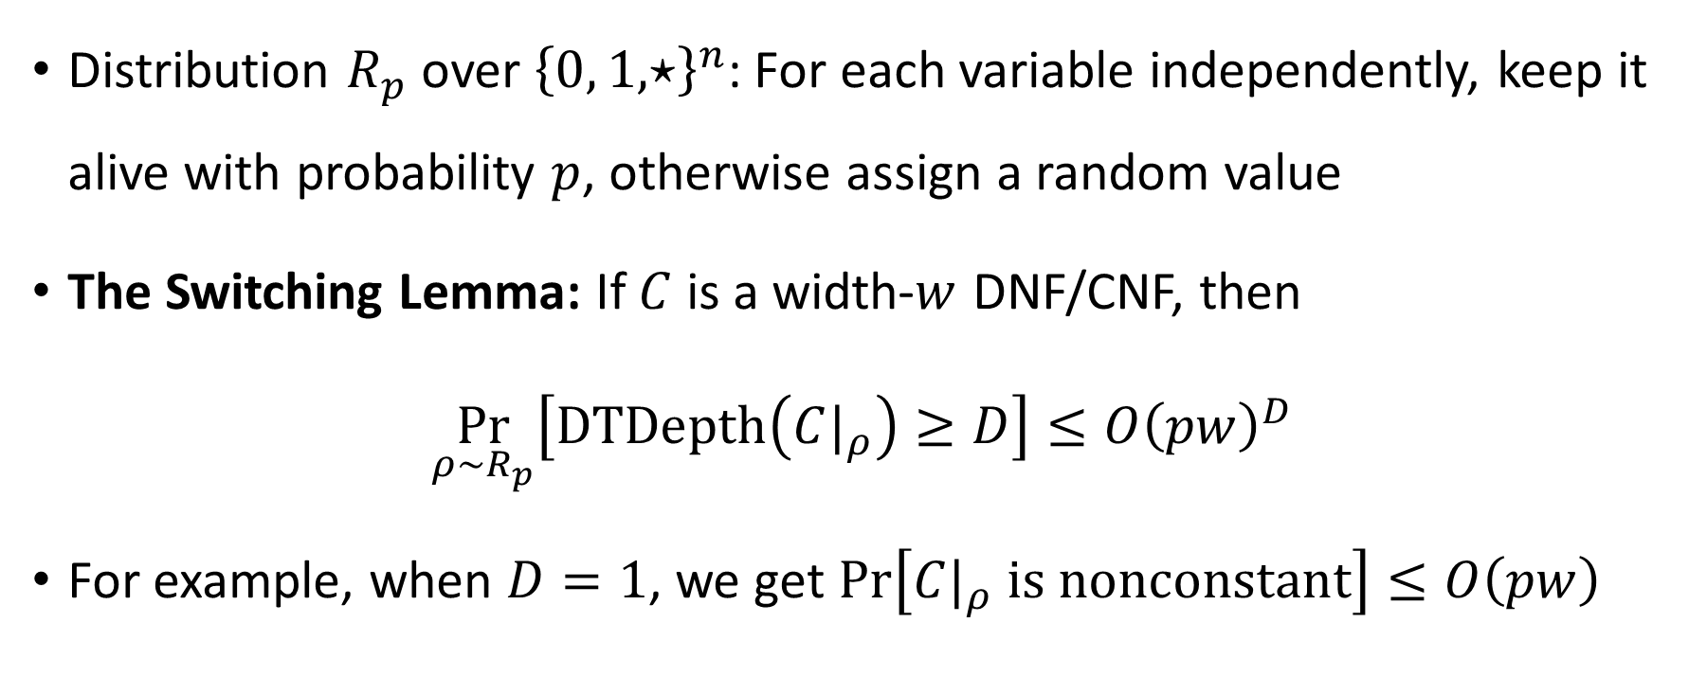
The Switching Lemma
Distribution $R_{p}$ over ${\left\{0, 1, ⋆\right\}}^{n}$: For each variable independently, keep it alive with probability $p$, otherwise assign a random value
The Switching Lemma: If $C$ is a width-$w$ DNF/CNF, then
$$\underset{ρ∼R_{p}}{Pr}\left[\text{DTDepth}\left({C|}_{ρ}\right)≥D\right]≤O{\left(pw\right)}^{D}$$
For example, when $D=1$, we get $\operatorname{Pr}\left[{C|}_{ρ} \text{is} \text{nonconstant}\right]≤O\left(pw\right)$

Slide 16
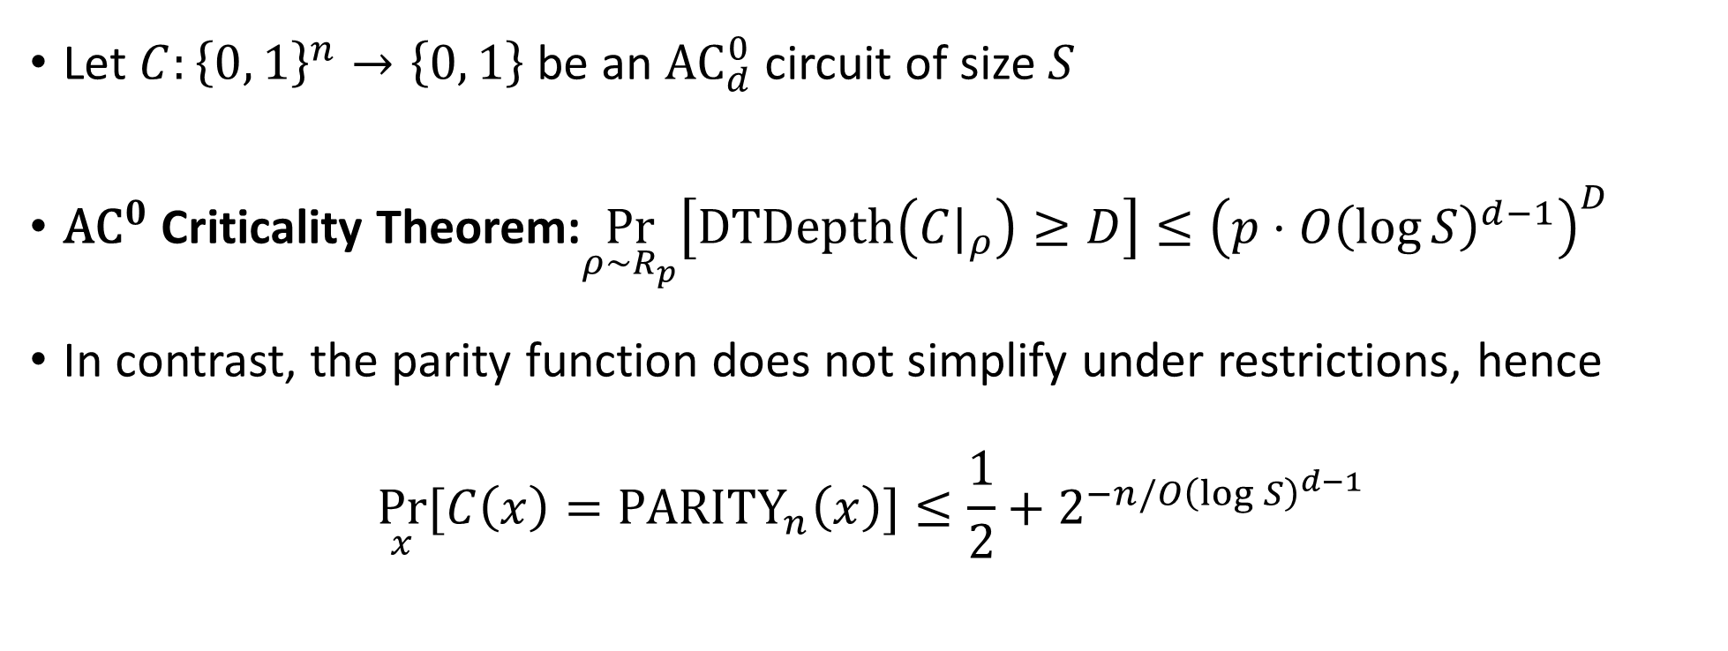

The ${\text{AC}}^{0}$ Criticality Theorem
Let $C:{\left\{0, 1\right\}}^{n}→\left\{0, 1\right\}$ be an ${\text{AC}}_{d}^{0}$ circuit of size $S$
${\text{AC}}^{0}$ Criticality Theorem:$\underset{ρ∼R_{p}}{Pr}\left[\text{DTDepth}\left({C|}_{ρ}\right)≥D\right]≤{\left(p⋅O{\left(\log{S}\right)}^{d−1}\right)}^{D}$
In contrast, the parity function does not simplify under restrictions, hence
$$\underset{x}{Pr}{[C\left(x\right)={\text{PARITY}}_{n}\left(x\right)}]≤\frac{1}{2}+2^{−n/O{\left(\log{S}\right)}^{d−1}}$$

Slide 17
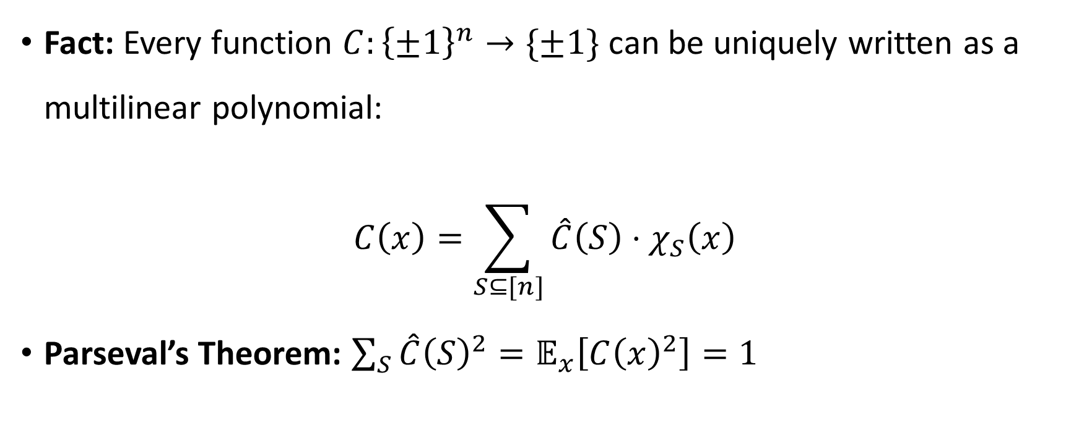
Fourier analysis of Boolean functions
Fact: Every function $C:{\left\{±1\right\}}^{n}→\{±1\}$ can be uniquely written as a multilinear polynomial:
$$C\left(x\right)=\sum_{S⊆[n]}{\hat{C}\left(S\right)⋅χ_{S}\left(x\right)}$$
Parseval’s Theorem: $\sum_{S}{\hat{C}{\left(S\right)}^{2}}=𝔼_{x}\left[C{\left(x\right)}^{2}\right]=1$
Correlation
Parity functions

Slide 18
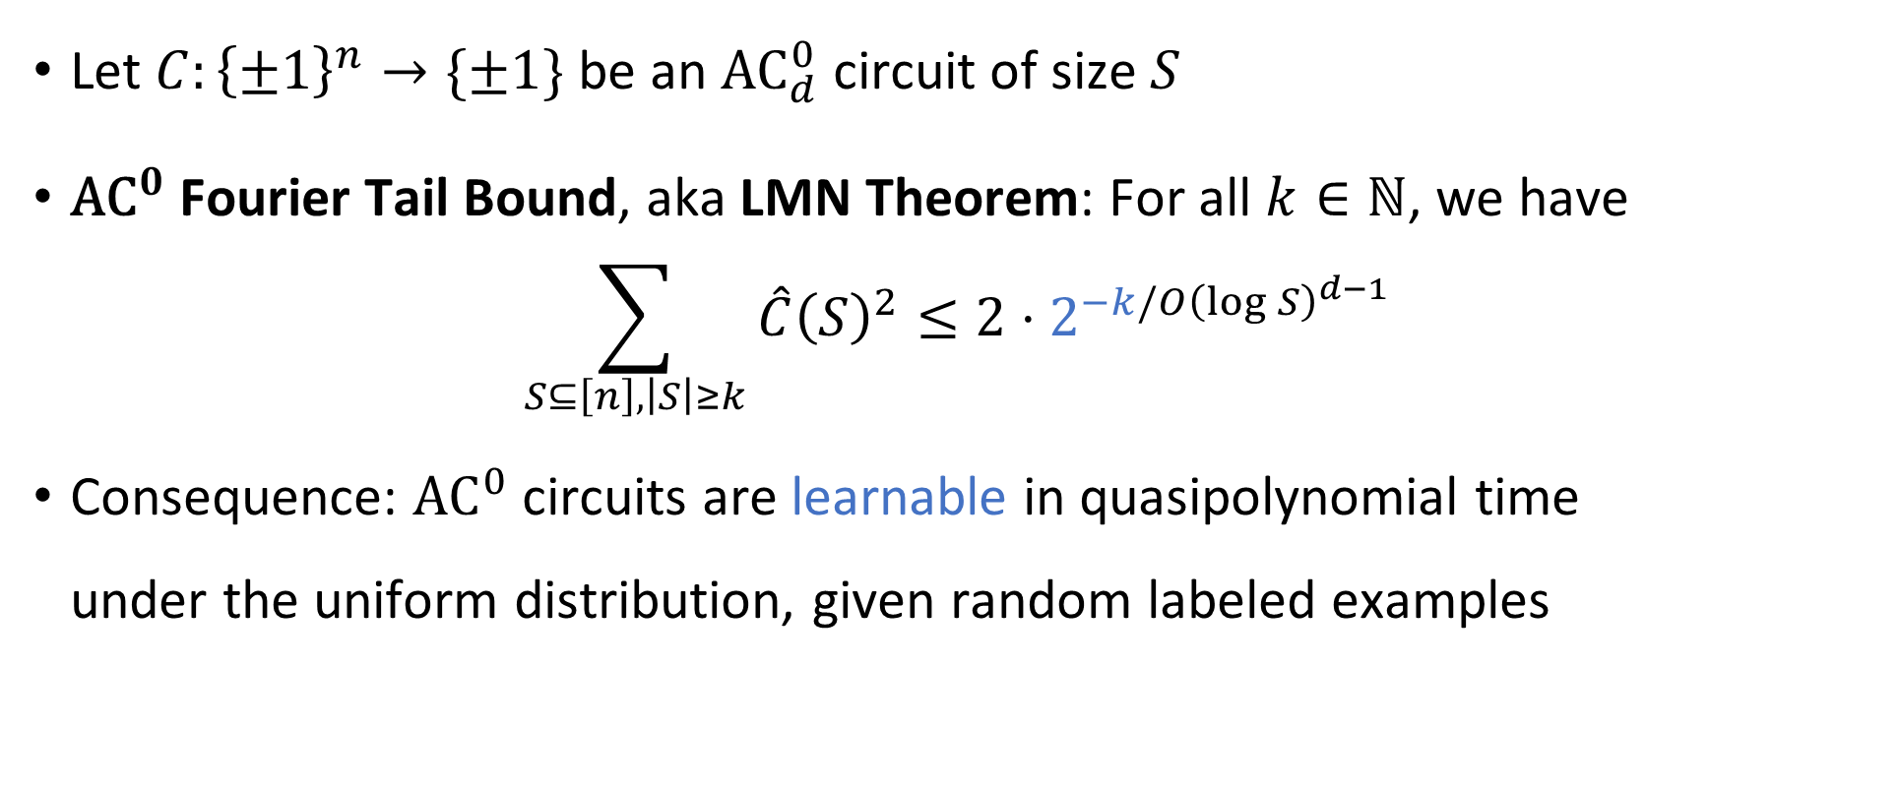
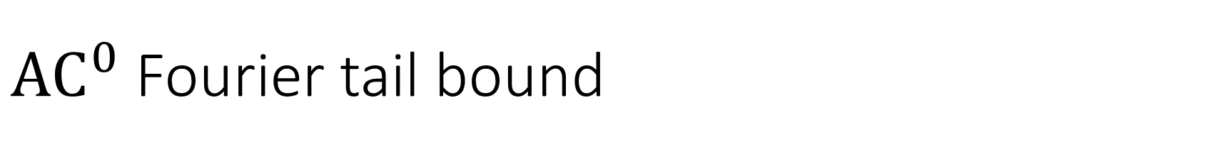
${\text{AC}}^{0}$ Fourier tail bound
Let $C:{\left\{±1\right\}}^{n}→\{±1\}$ be an ${\text{AC}}_{d}^{0}$ circuit of size $S$
${\text{AC}}^{0}$ Fourier Tail Bound, aka LMN Theorem: For all $k∈ℕ$, we have
$$\sum_{S⊆\left[n\right], \left|S\right|≥k}{\hat{C}{\left(S\right)}^{2}}≤2⋅2^{−k/O{\left(\log{S}\right)}^{d−1}}$$
Consequence: ${\text{AC}}^{0}$ circuits are learnable in quasipolynomial time under the uniform distribution, given random labeled examples

Slide 19
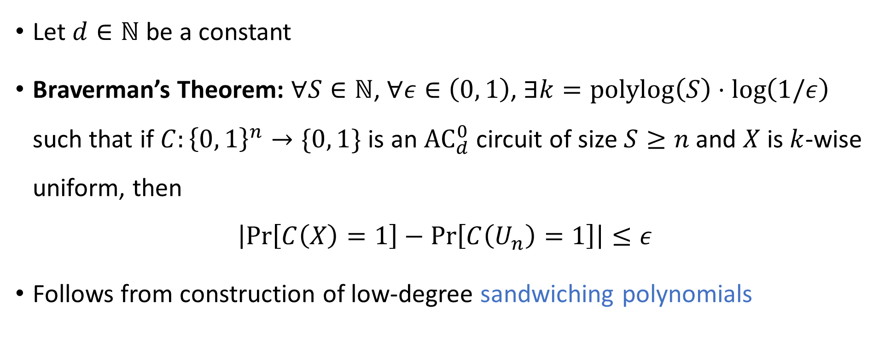

Limited independence fools ${\text{AC}}^{0}$
Let $d∈ℕ$ be a constant
Braverman’s Theorem: $∀S∈ℕ$, $∀ε∈\left(0, 1\right)$, $∃k=\text{polylog}\left(S\right)⋅\log\left(1/ε\right)$ such that if $C:{\left\{0, 1\right\}}^{n}→\{0, 1\}$ is an ${\text{AC}}_{d}^{0}$ circuit of size $S≥n$ and $X$ is $k$-wise uniform, then
$$\left|\operatorname{Pr}\left[C\left(X\right)=1\right]−\operatorname{Pr}\left[C\left(U_{n}\right)=1\right]\right|≤ε$$
Follows from construction of low-degree sandwiching polynomials

Slide 20








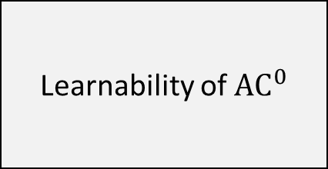
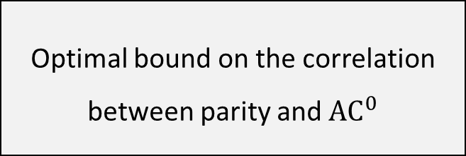
(Multi) Switching Lemma
$$⇒$$
${\text{AC}}^{0}$ Criticality Theorem
$$⇒$$
${\text{AC}}^{0}$ Fourier tail bound
$$⇒$$
$$⇒$$
$$⇒$$
Optimal bound on the correlation between parity and ${\text{AC}}^{0}$
Learnability of ${\text{AC}}^{0}$
Limited independence fools ${\text{AC}}^{0}$

Slide 21
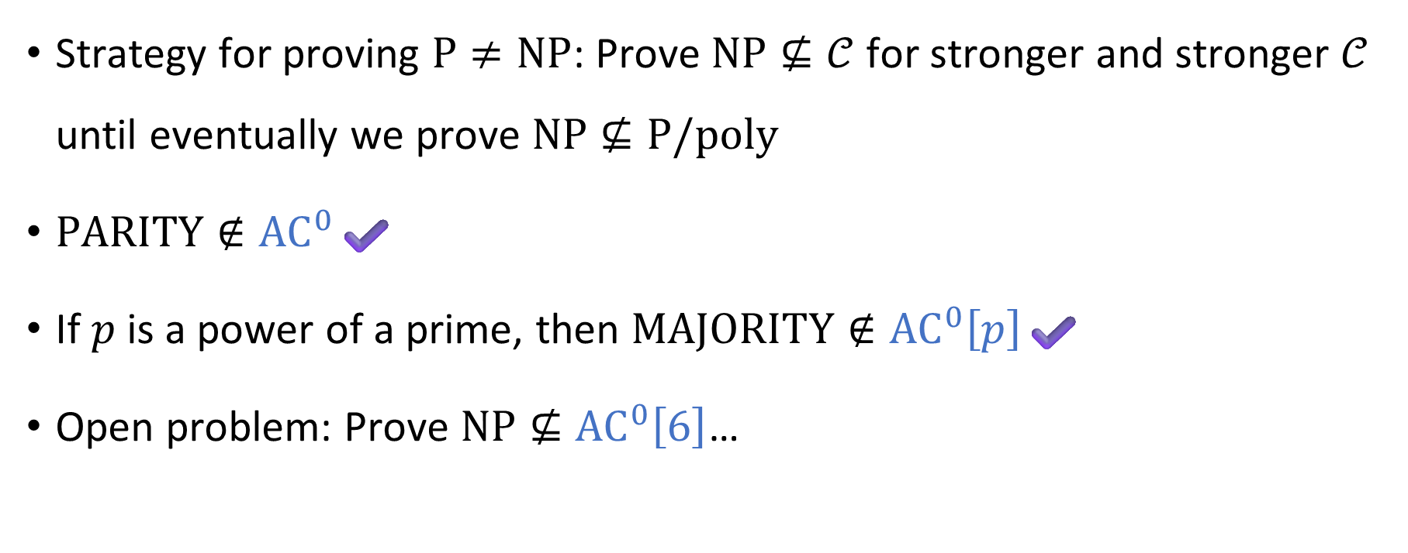

Beyond ${\text{AC}}^{0}$: Sipser’s program
Strategy for proving $\text{P}≠\text{NP}$: Prove $\text{NP}⊈𝒞$ for stronger and stronger $𝒞$ until eventually we prove $\text{NP}⊈\text{P}/\text{poly}$
$\text{PARITY}∉{\text{AC}}^{0}$✔️
If $p$ is a power of a prime, then $\text{MAJORITY}∉{\text{AC}}^{0}\left[p\right]$✔️
Open problem: Prove $\text{NP}⊈{\text{AC}}^{0}\left[6\right]$…

Slide 22
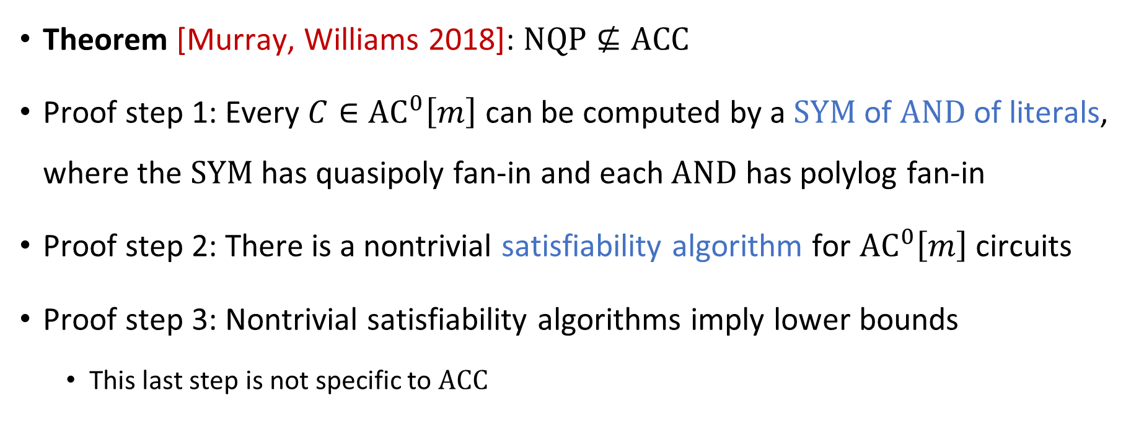

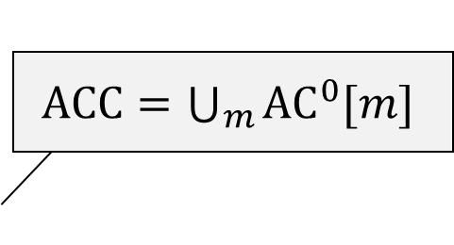
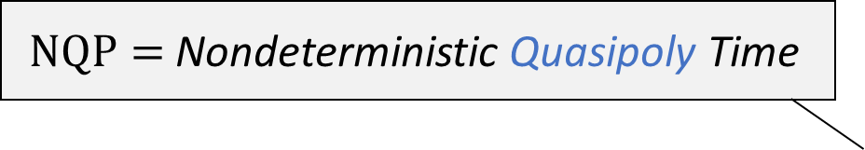
The frontier of Sipser’s program: $\text{ACC}$
$\text{NQP}=$ Nondeterministic Quasipoly Time
$\text{ACC}=\bigcup_{m}{{\text{AC}}^{0}[m]}$
Theorem [Murray, Williams 2018]: $\text{NQP}⊈\text{ACC}$
Proof step 1: Every $C∈{\text{AC}}^{0}\left[m\right]$ can be computed by a $\text{SYM}$ of $\text{AND}$ of literals, where the $\text{SYM}$ has quasipoly fan-in and each $\text{AND}$ has polylog fan-in
Proof step 2: There is a nontrivial satisfiability algorithm for ${\text{AC}}^{0}\left[m\right]$ circuits
Proof step 3: Nontrivial satisfiability algorithms imply lower bounds
This last step is not specific to $\text{ACC}$

Slide 23
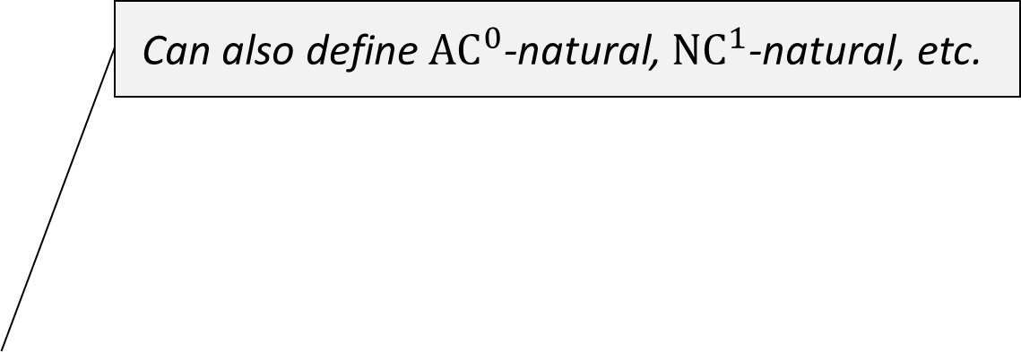
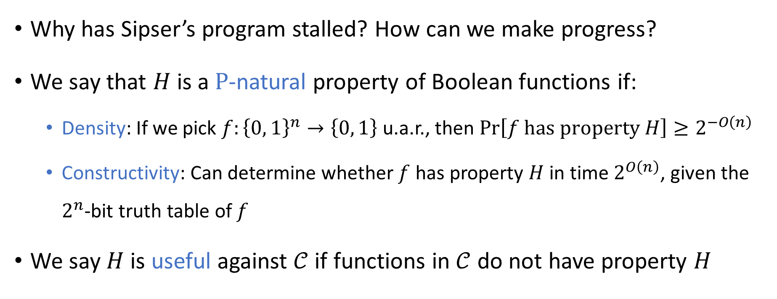
Natural properties
Can also define ${\text{AC}}^{0}$-natural, ${\text{NC}}^{1}$-natural, etc.
Why has Sipser’s program stalled? How can we make progress?
We say that $H$ is a $\text{P}$-natural property of Boolean functions if:
Density: If we pick $f:{\left\{0, 1\right\}}^{n}→\left\{0, 1\right\}$ u.a.r., then $\operatorname{Pr}\left[f \text{has} \text{property} H\right]≥2^{−O\left(n\right)}$
Constructivity: Can determine whether $f$ has property $H$ in time $2^{O\left(n\right)}$, given the $2^{n}$-bit truth table of $f$
We say $H$ is useful against $𝒞$ if functions in $𝒞$ do not have property $H$

Slide 24
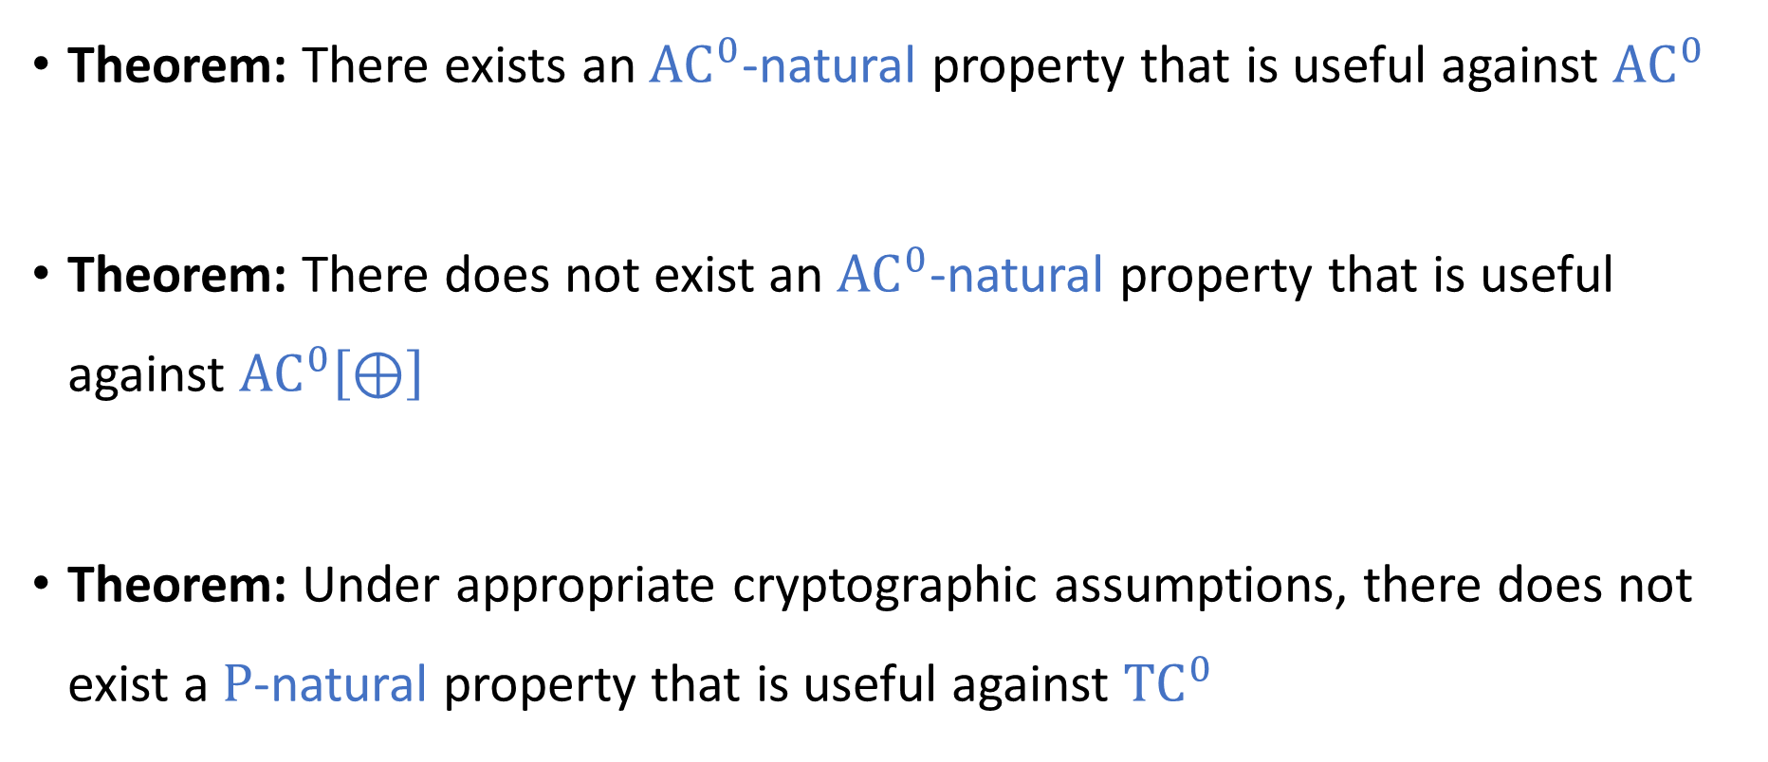
How powerful are natural proofs?
Theorem: There exists an ${\text{AC}}^{0}$-natural property that is useful against ${\text{AC}}^{0}$
Theorem: There does not exist an ${\text{AC}}^{0}$-natural property that is useful against ${\text{AC}}^{0}\left[⊕\right]$
Theorem: Under appropriate cryptographic assumptions, there does not exist a $\text{P}$-natural property that is useful against ${\text{TC}}^{0}$
Random restrictions
Nisan-Wigderson PRG
Naor-Reingold PRF

Slide 25
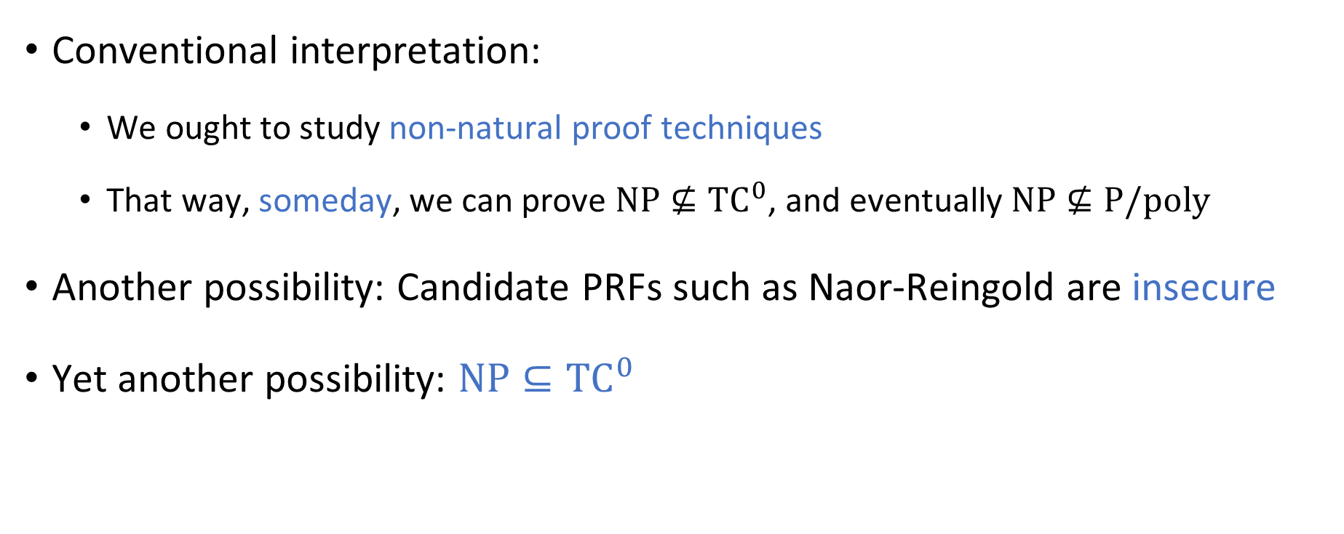
Natural proofs: Interpretation
Conventional interpretation:
We ought to study non-natural proof techniques
That way, someday, we can prove $\text{NP}⊈{\text{TC}}^{0}$, and eventually $\text{NP}⊈\text{P}/\text{poly}$
Another possibility: Candidate PRFs such as Naor-Reingold are insecure
Yet another possibility: $\text{NP}⊆{\text{TC}}^{0}$

Slide 26
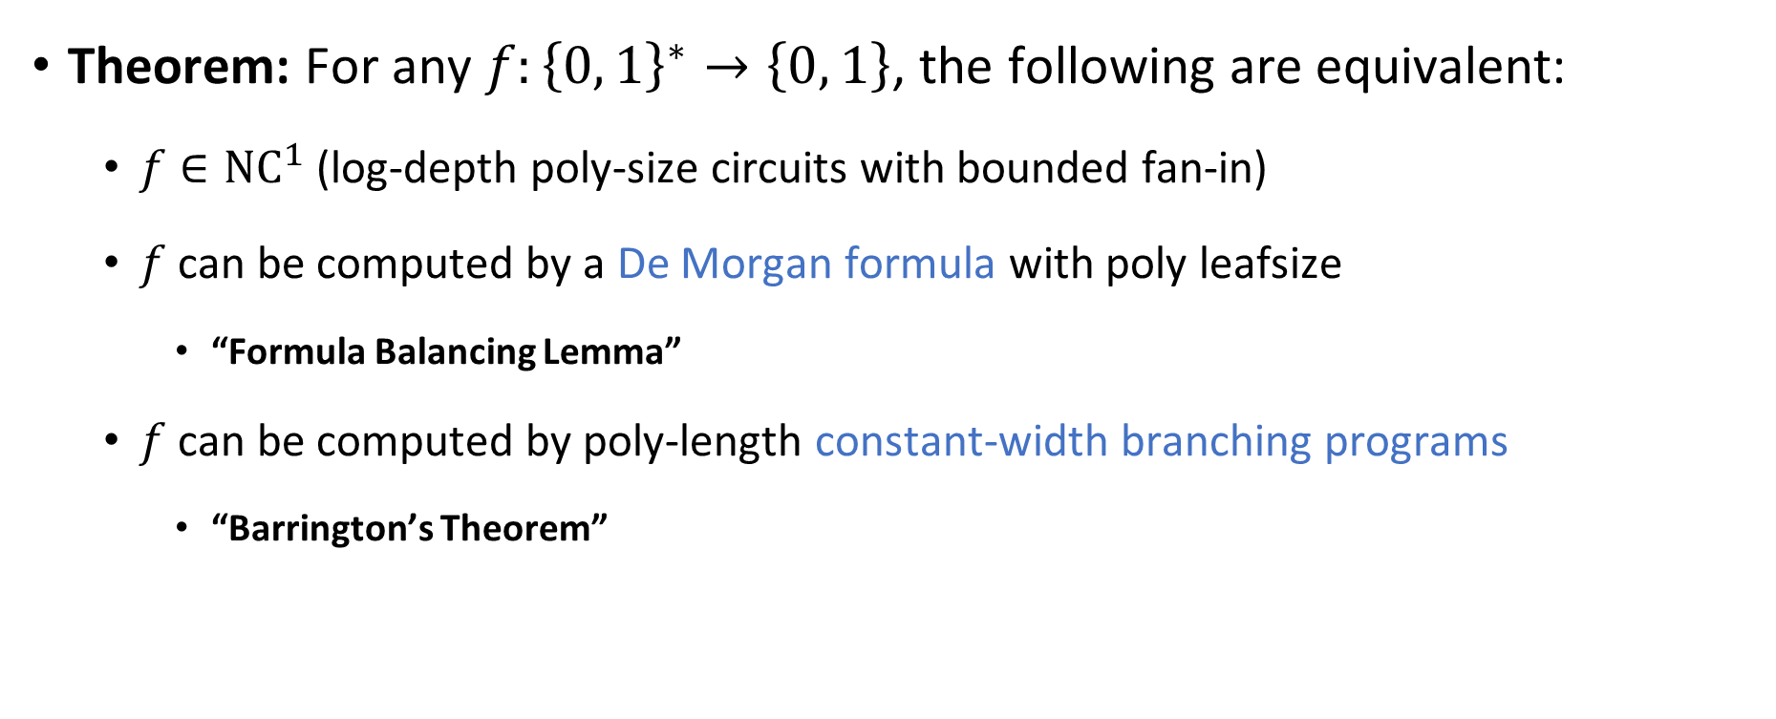

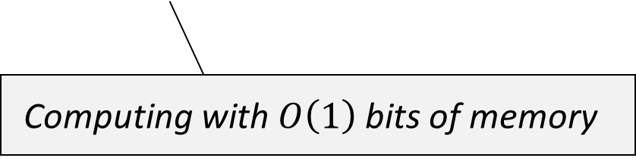
The complexity class ${\text{NC}}^{1}$
Theorem: For any $f:{\left\{0, 1\right\}}^{∗}→\left\{0, 1\right\}$, the following are equivalent:
$f∈{\text{NC}}^{1}$ (log-depth poly-size circuits with bounded fan-in)
$f$ can be computed by a De Morgan formula with poly leafsize
“Formula Balancing Lemma”
$f$ can be computed by poly-length constant-width branching programs
“Barrington’s Theorem”
Computing with $O\left(1\right)$ bits of memory

Slide 27
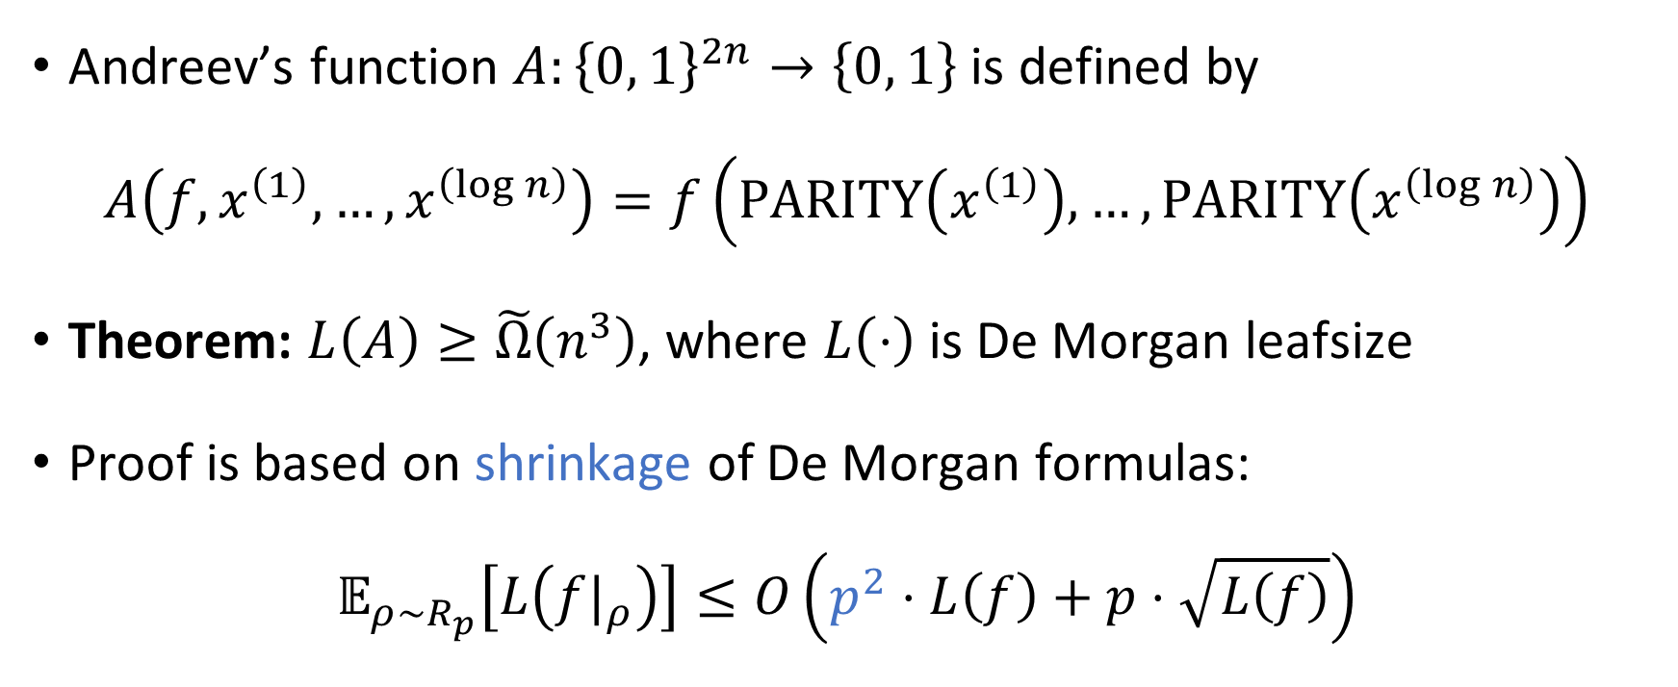
Formula lower bounds
Andreev’s function $A:{\left\{0, 1\right\}}^{2n}→\left\{0, 1\right\}$ is defined by
$$A\left(f, x^{\left(1\right)}, …, x^{\left(\log{n}\right)}\right)=f\left(\text{PARITY}\left(x^{\left(1\right)}\right),…, \text{PARITY}\left(x^{\left(\log{n}\right)}\right)\right)$$
Theorem: $L\left(A\right)≥\tilde{Ω}\left(n^{3}\right)$, where $L\left(⋅\right)$ is De Morgan leafsize
Proof is based on shrinkage of De Morgan formulas:
$$𝔼_{ρ∼R_{p}}\left[L\left({f|}_{ρ}\right)\right]≤O\left(p^{2}⋅L\left(f\right)+p⋅\sqrt{L\left(f\right)}\right)$$

Slide 28













Summary of complexity classes
$${\text{NC}}^{0}≠{\text{AC}}^{0}≠{\text{AC}}^{0}\left[⊕\right]≠\text{ACC}$$
$${\text{NC}}^{0}$$
$${\text{AC}}^{0}$$
$${\text{AC}}^{0}\left[⊕\right]$$
$$\text{ACC}$$
$${\text{TC}}^{0}$$
$${\text{NC}}^{1}$$
$$\text{L}/\text{poly}$$
$$\text{NL}/\text{poly}$$
$${\text{AC}}^{1}$$
$${\text{NC}}^{2}$$
$$\text{NC}$$
$$\text{P}/\text{poly}$$

Slide 29
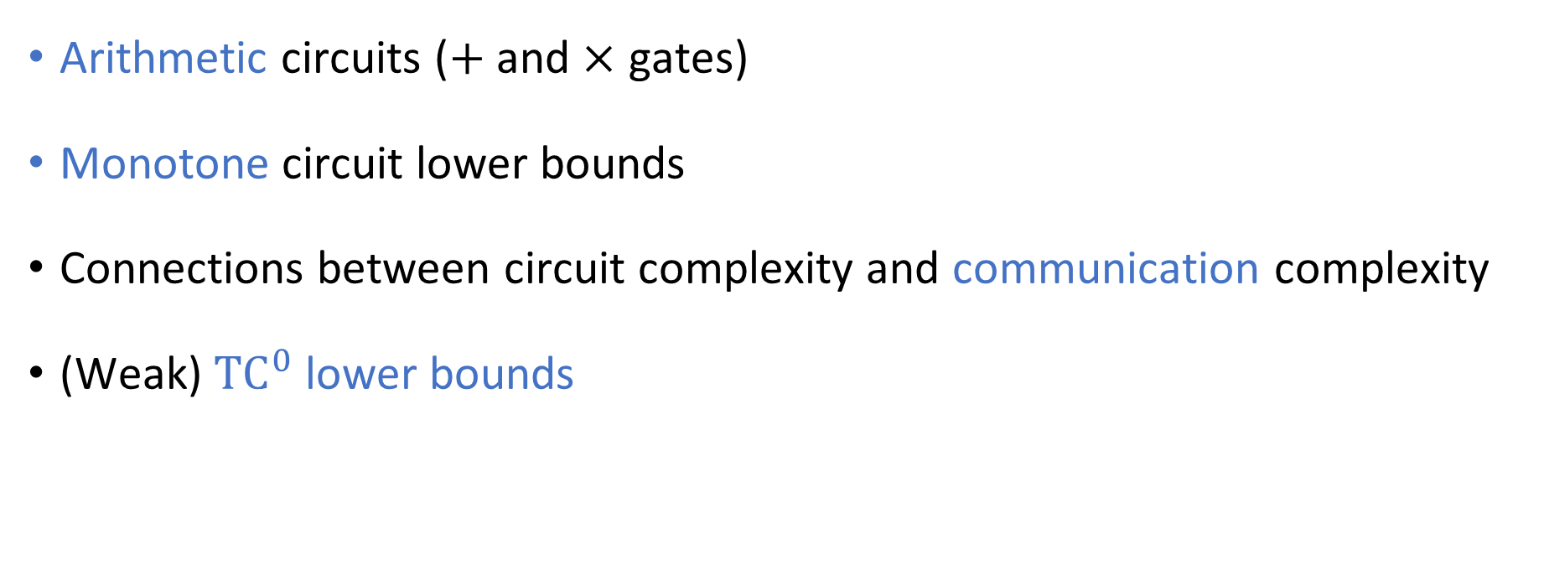
A few of the many topics we didn’t discuss
Arithmetic circuits ($+$ and $×$ gates)
Monotone circuit lower bounds
Connections between circuit complexity and communication complexity
(Weak) ${\text{TC}}^{0}$ lower bounds

Slide 30
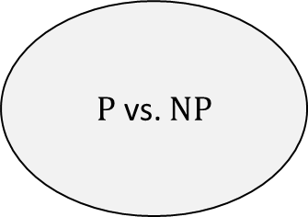
Parallel Algorithms
$\text{P}$ vs. $\text{NP}$
Pseudo-Randomness
Circuit Complexity
Neural Networks
Analysis of Boolean Functions
Learning Theory
Space Complexity
Cryptography

Slide 31
Advertisement
Consider enrolling in my seminar course next quarter!
Topic: Derandomizing Space-Bounded Computation
Is randomness ever necessary for space-efficient computation?
Less emphasis on exercises, more emphasis on cutting-edge research
Will not count as a graduate elective
Also consider Sasha Razborov’s complexity theory course in the spring!

Slide 32
Thank you!
Being your instructor has been a privilege
I look forward to reading your expositions
Please fill out the Graduate Course Feedback Form using My.UChicago (deadline is Sunday, December 15)

