Slide 1
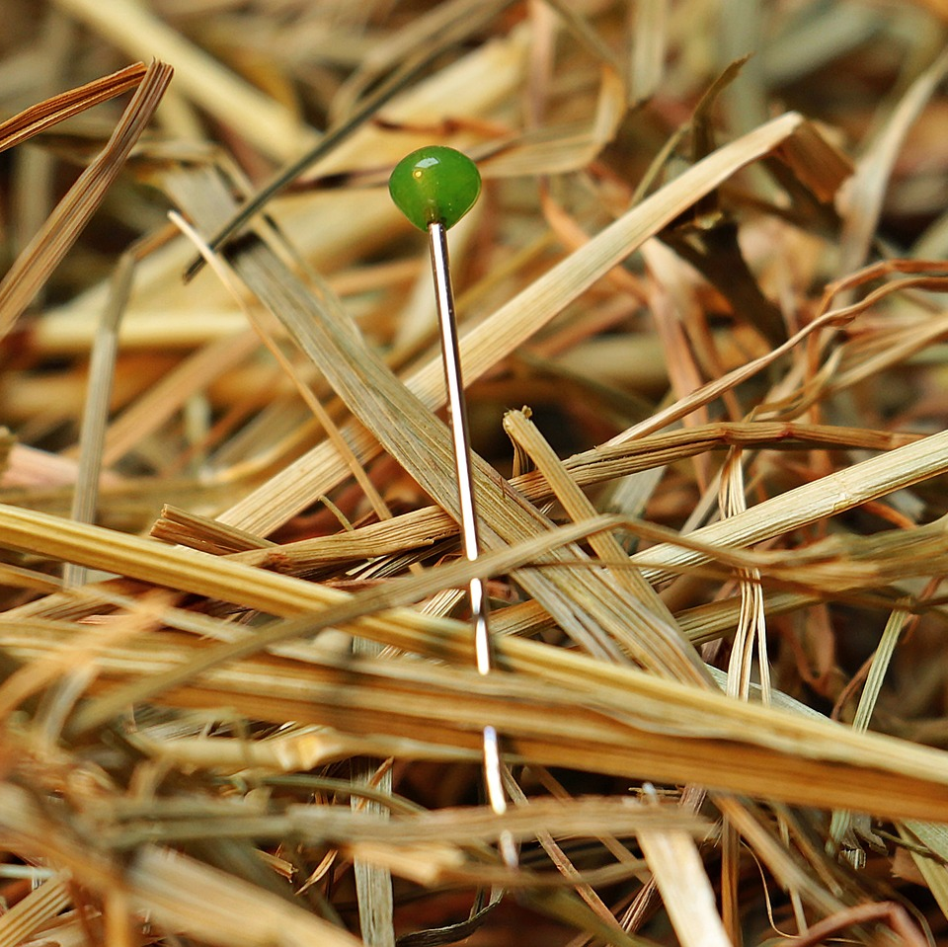
CMSC 28100 Introduction to Complexity Theory Spring 2024 Instructor: William Hoza

Slide 2
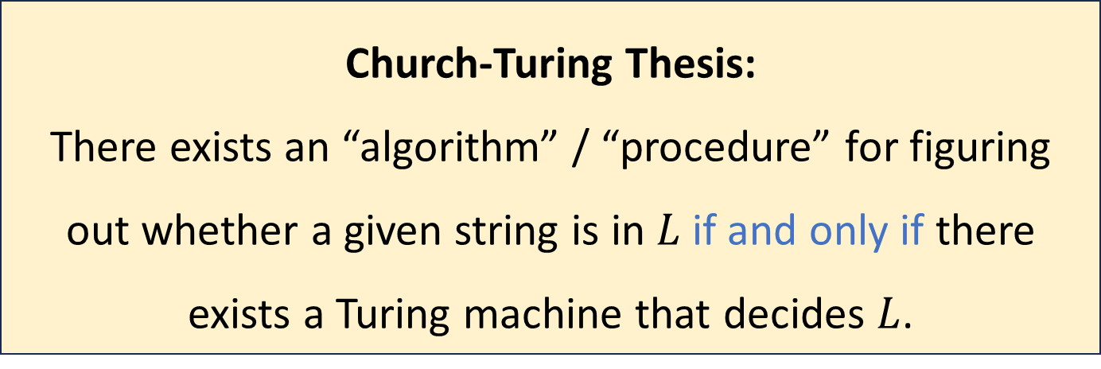
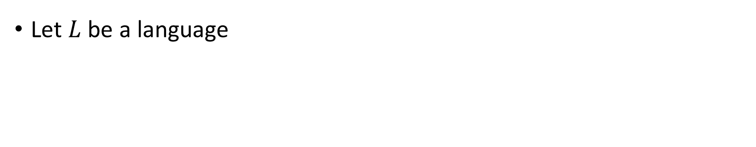
The Church-Turing Thesis
Let $L$ be a language
Church-Turing Thesis:
There exists an “algorithm” / “procedure” for figuring out whether a given string is in $L$ if and only if there exists a Turing machine that decides $L$.
Intuitive notion
Mathematically precise notion

Slide 3
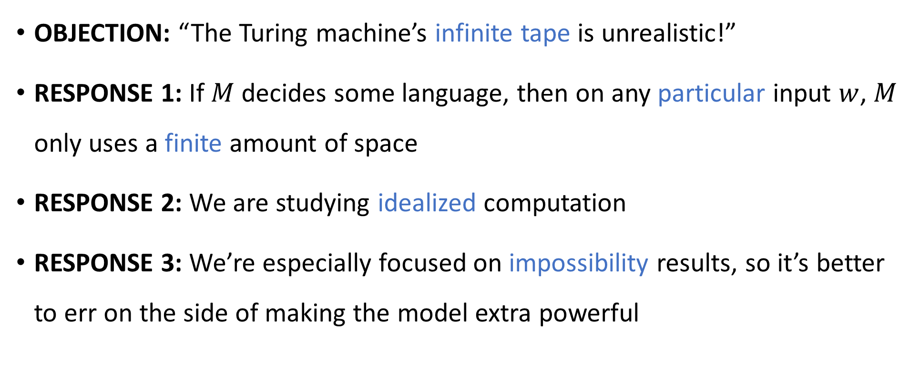
Are Turing machines too powerful?
OBJECTION: “The Turing machine’s infinite tape is unrealistic!”
RESPONSE 1: If $M$ decides some language, then on any particular input $w$, $M$ only uses a finite amount of space
RESPONSE 2: We are studying idealized computation
RESPONSE 3: We’re especially focused on impossibility results, so it’s better to err on the side of making the model extra powerful

Slide 4
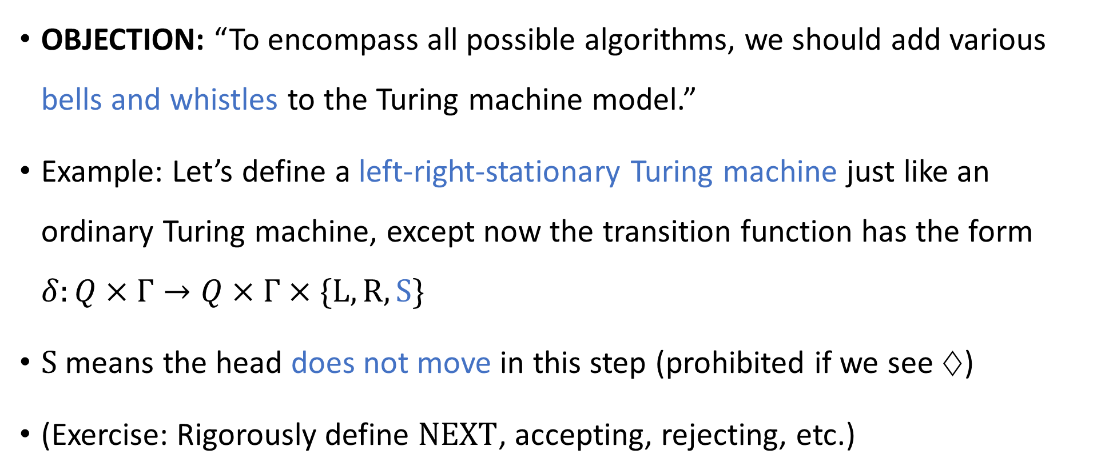
Are Turing machines powerful enough?
OBJECTION: “To encompass all possible algorithms, we should add various bells and whistles to the Turing machine model.”
Example: Let’s define a left-right-stationary Turing machine just like an ordinary Turing machine, except now the transition function has the form $δ:Q×Γ→Q×Γ×\{\text{L},\text{R},\text{S}\}$
$\text{S}$ means the head does not move in this step (prohibited if we see $♢$)
(Exercise: Rigorously define $\text{NEXT}$, accepting, rejecting, etc.)

Slide 5
Left-right-stationary Turing machines
The left-right-stationary Turing machine model poses a challenge to the Church-Turing thesis, because the model is still realistic, even though we added an extra feature
Does the Church-Turing thesis survive this challenge?
Yes, because the left-right-stationary Turing machine model is equivalent to the original Turing machine model, in the following sense:

Slide 6
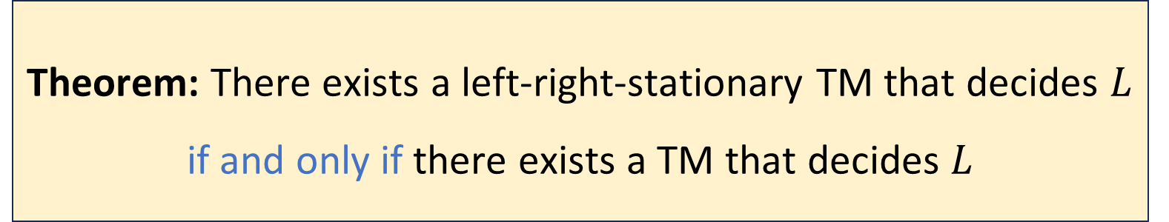

Left-right-stationary Turing machines
Let $L$ be a language
Proof: The $\left(⇐\right)$ direction is trivial, because a TM can be considered a left-right-stationary TM that just happens to never use $\text{S}$
Theorem: There exists a left-right-stationary TM that decides $L$ if and only if there exists a TM that decides $L$

Slide 7
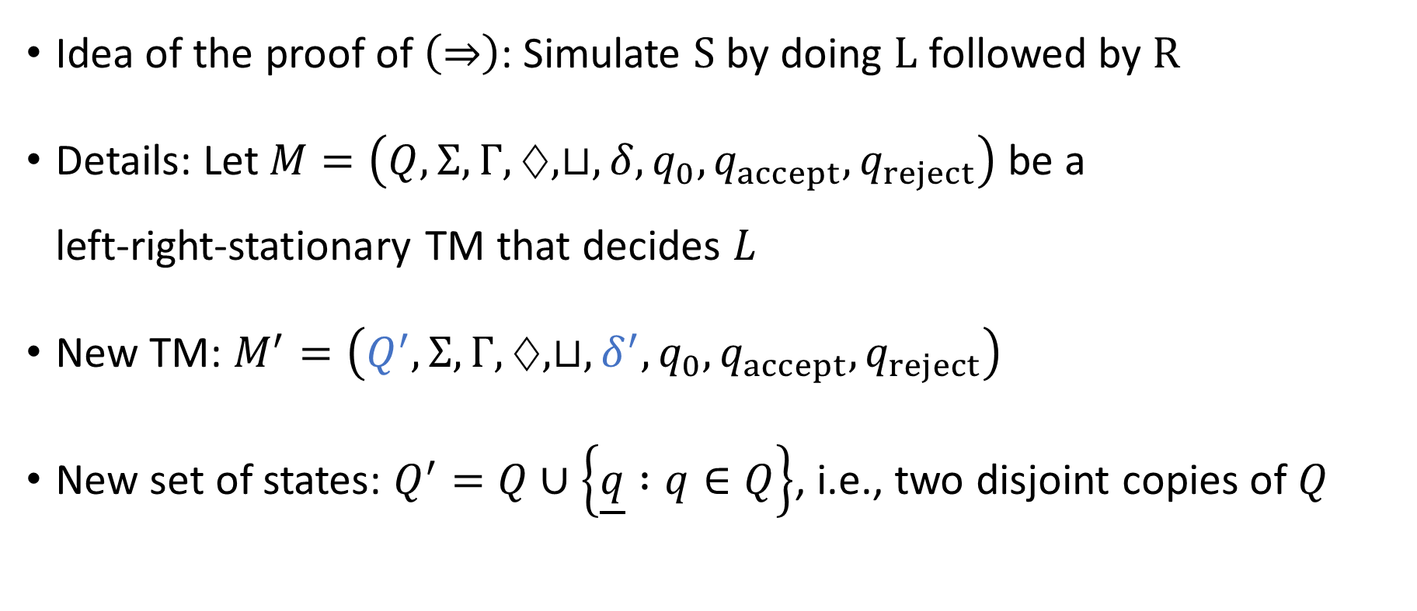
Left-right-stationary Turing machines
Idea of the proof of $\left(⇒\right)$: Simulate $\text{S}$ by doing $\text{L}$ followed by $\text{R}$
Details: Let $M=\left(Q,Σ,Γ,♢,⊔,δ,q_{0},q_{accept},q_{reject}\right)$ be a left‑right‑stationary TM that decides $L$
New TM: $M^{′}=\left(Q^{′}, Σ, Γ, ♢, ⊔, δ^{′},q_{0},q_{accept},q_{reject}\right)$
New set of states: $Q^{′}=Q∪\left\{\underline{q} :q∈Q\right\}$, i.e., two disjoint copies of $Q$

Slide 8
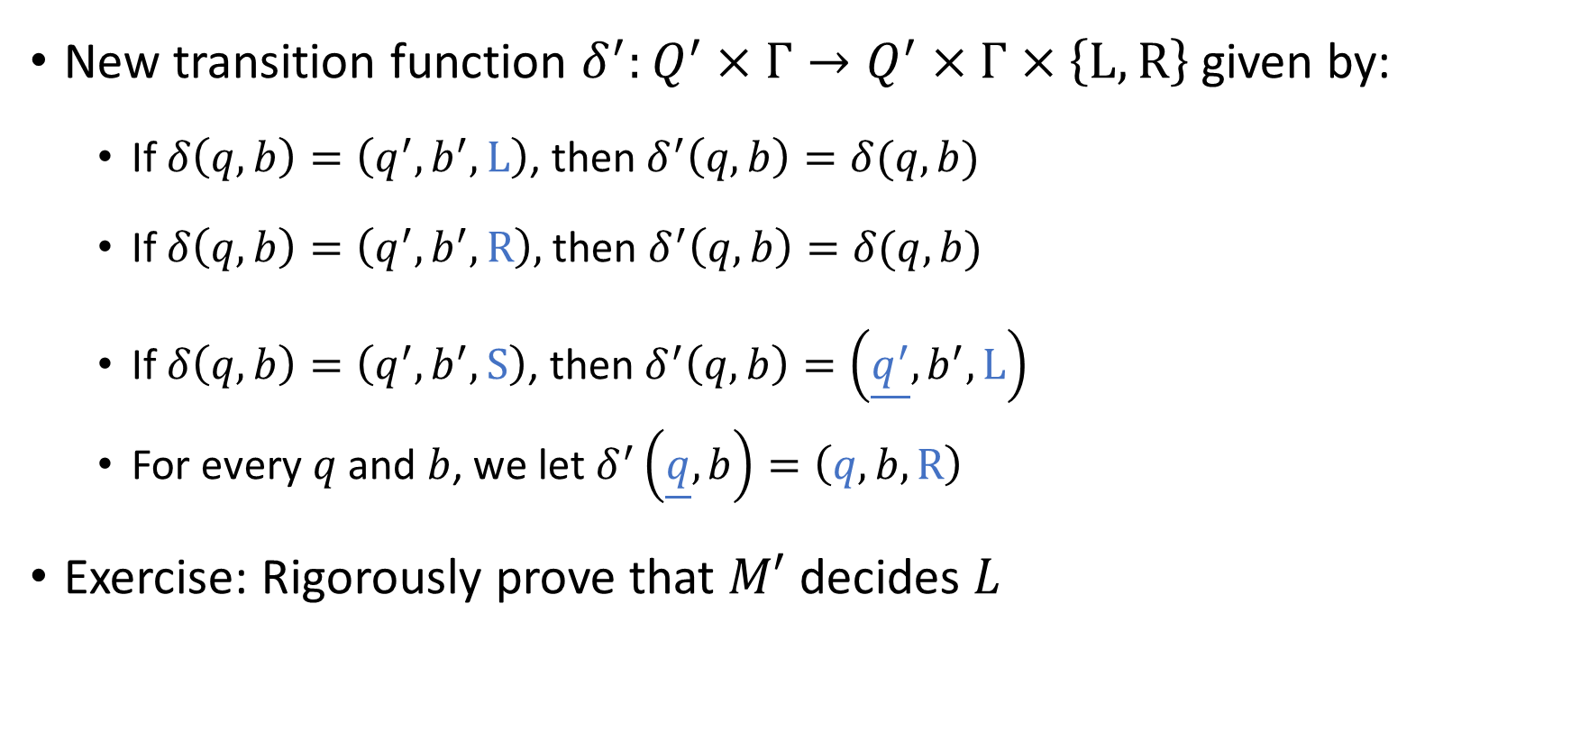
Left-right-stationary Turing machines
New transition function $δ^{′}:Q^{′}×Γ→Q^{′}×Γ×\left\{\text{L},\text{R}\right\}$ given by:
If $δ\left(q, b\right)=\left(q^{′},b^{′},\text{L}\right)$, then $δ^{′}\left(q,b\right)=δ(q, b)$
If $δ\left(q,b\right)=\left(q^{′},b^{′},\text{R}\right),$ then $δ^{′}\left(q,b\right)=δ(q,b)$
If $δ\left(q,b\right)=\left(q^{′},b^{′},\text{S}\right)$, then $δ^{′}\left(q,b\right)=\left(\underline{q^{′}},b^{′},\text{L}\right)$
For every $q$ and $b$, we let $δ^{′}\left(\underline{q},b\right)=\left(q,b,\text{R}\right)$
Exercise: Rigorously prove that $M′$ decides $L$

Slide 9
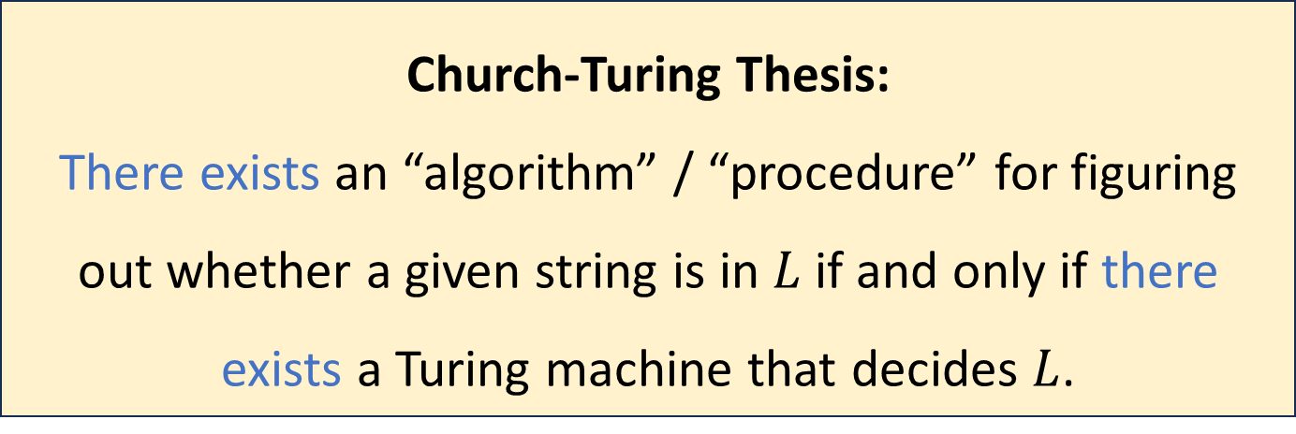
The Church-Turing Thesis
Let $L$ be a language
Church-Turing Thesis:
There exists an “algorithm” / “procedure” for figuring out whether a given string is in $L$ if and only if there exists a Turing machine that decides $L$.
Intuitive notion
Mathematically precise notion

Slide 10



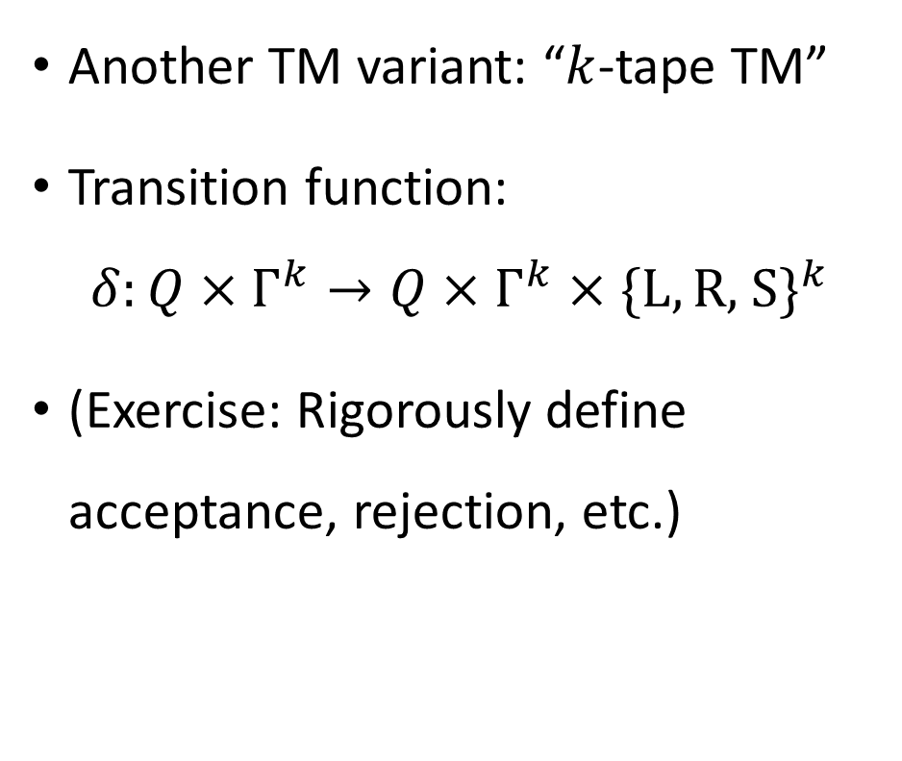



Multi-tape Turing machines
In each step, what determines the actions of head 1?
A: Head 1’s state and the symbol observed by head 1
B: The machine’s state and the symbols observed by all heads
Another TM variant: “$k$-tape TM”
Transition function:
$$δ:Q×Γ^{k}→Q×Γ^{k}×\{\text{L},\text{R}\text{, }\text{S}\}^{k}$$
(Exercise: Rigorously define acceptance, rejection, etc.)
C: Head 1’s state and the symbols observed by all heads
D: The machine’s state and the symbol observed by head 1
Respond at PollEv.com/whoza or text “whoza” to 22333
$$♢$$
1
1
0
$$⊔$$
$$⊔$$
$$♢$$
0
#
1
$
$$⊔$$
$$q$$

Slide 11
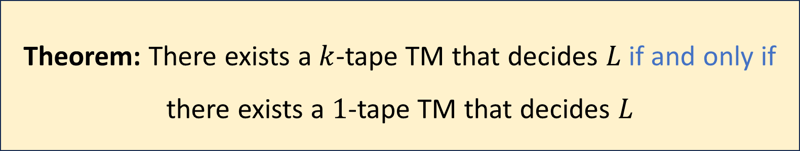

Multi-tape Turing machines
How should we keep track of the locations of the simulated heads?
A: Store the location data in the machine’s state
B: Ensure that the real/simulated heads’ locations are always equal
C: Use special symbols to mark the cells containing simulated heads
D: Store the location data in a single dedicated tape cell
Let $k$ be any positive integer and let $L$ be a language
Respond at PollEv.com/whoza or text “whoza” to 22333
Theorem: There exists a $k$-tape TM that decides $L$ if and only if there exists a $1$-tape TM that decides $L$

Slide 12


Simulating $k$ tapes with $1$ tape
Idea: Pack a bunch of data into each cell
Store “simulated heads” on the tape, along with $k$ “simulated symbols” in each cell
$$♢$$
1
1
0
$$⊔$$
$$⊔$$
$$♢$$
0
#
1
$
$$⊔$$
$$q$$

Slide 13


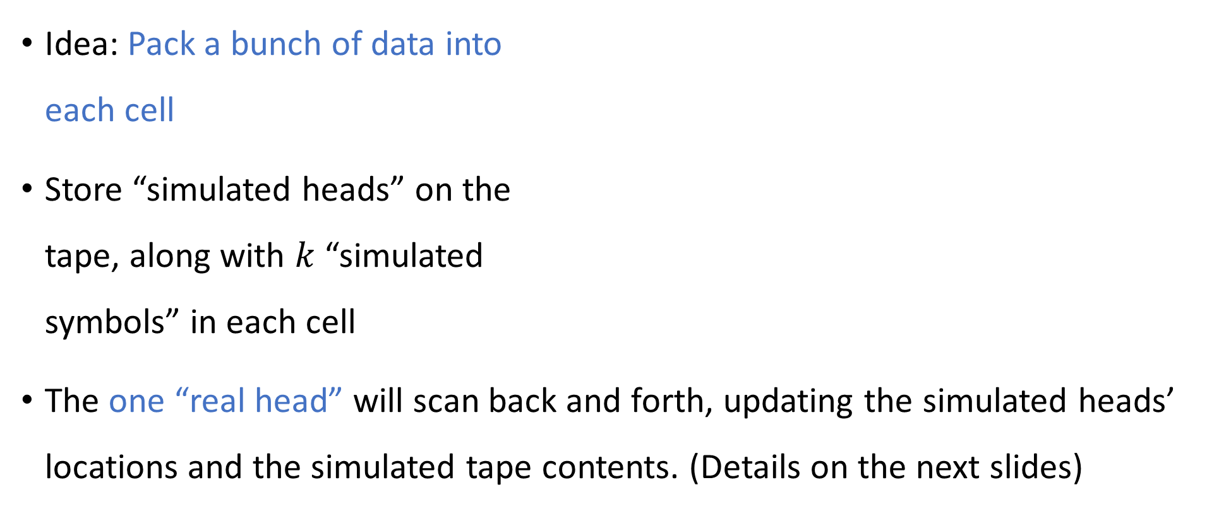

Simulating $k$ tapes with $1$ tape
Idea: Pack a bunch of data into each cell
Store “simulated heads” on the tape, along with $k$ “simulated symbols” in each cell
The one “real head” will scan back and forth, updating the simulated heads’ locations and the simulated tape contents. (Details on the next slides)
0
$$⊔$$
$$♢$$
1
1
0
$$⊔$$
$$⊔$$
$$♢$$
0
#
1
$
$$⊔$$

Slide 14
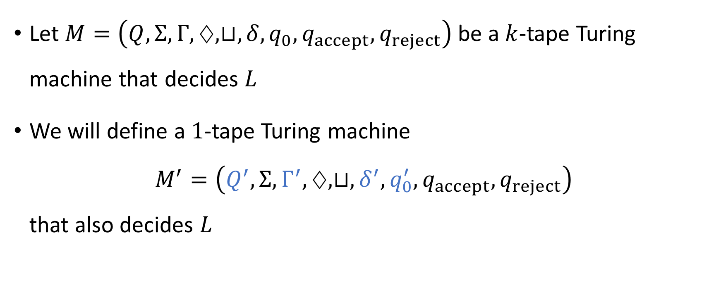
Simulating $k$ tapes with $1$ tape
Let $M=\left(Q,Σ, Γ,♢, ⊔, δ, q_{0},q_{accept},q_{reject}\right)$ be a $k$-tape Turing machine that decides $L$
We will define a $1$-tape Turing machine $M^{′}=\left(Q^{′},Σ, Γ^{′},♢, ⊔, δ^{′},q_{0}^{′},q_{accept},q_{reject}\right)$ that also decides $L$

Slide 15
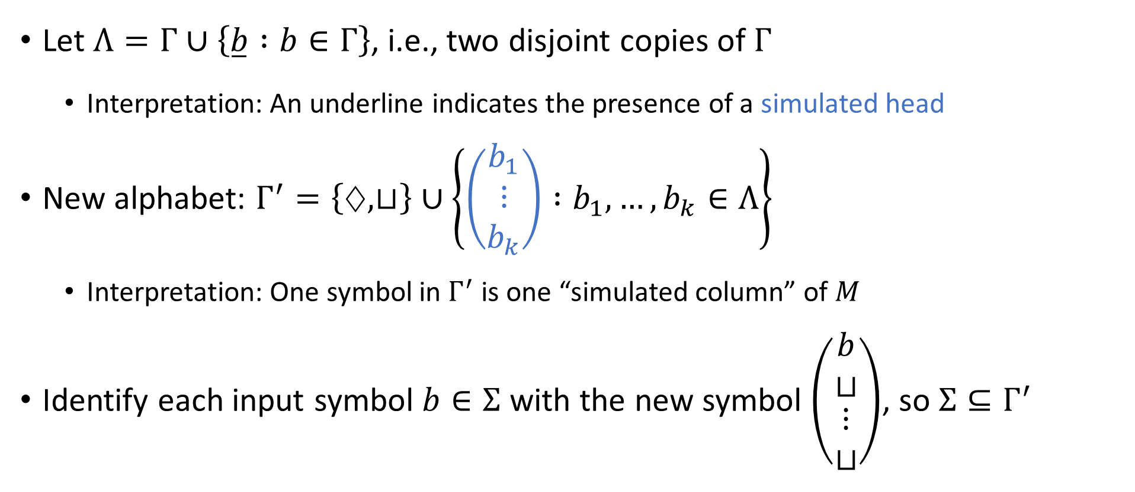
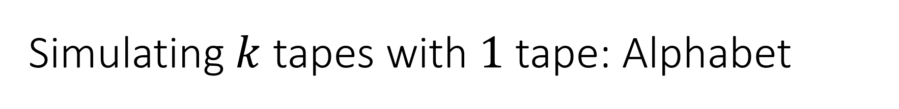
Simulating $k$ tapes with $1$ tape: Alphabet
Let $Λ=Γ∪\left\{\overset{̲}{b} :b∈Γ\right\}$, i.e., two disjoint copies of $Γ$
Interpretation: An underline indicates the presence of a simulated head
New alphabet: $Γ^{′}=\left\{♢, ⊔\right\}∪\left\{\left(\begin{matrix}b_{1} \\ ⋮ \\ b_{k}\end{matrix}\right) :b_{1},…, b_{k}∈Λ\right\}$
Interpretation: One symbol in $Γ^{′}$ is one “simulated column” of $M$
Identify each input symbol $b∈Σ$ with the new symbol $\left(\begin{matrix}b \\ ⊔ \\ \begin{aligned}⋮ \\ ⊔\end{aligned}\end{matrix}\right)$, so $Σ⊆Γ^{′}$

Slide 16
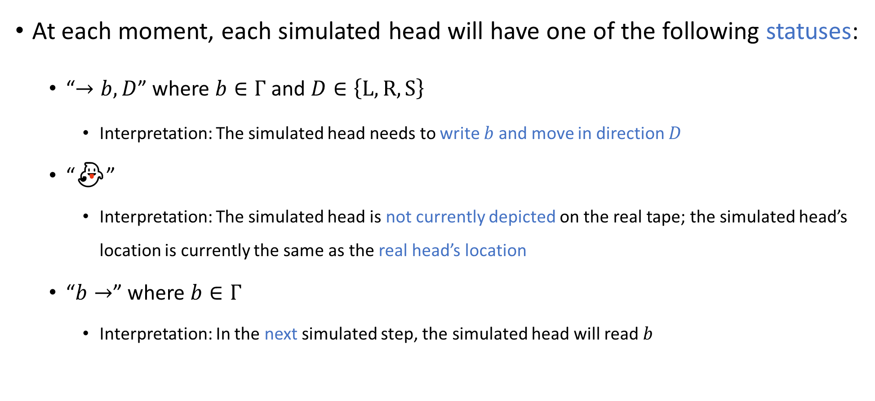

Simulating $k$ tapes with $1$ tape: Head statuses
At each moment, each simulated head will have one of the following statuses:
“$→b,D$” where $b∈Γ$ and $D∈\left\{\text{L},\text{R},\text{S}\right\}$
Interpretation: The simulated head needs to write $b$ and move in direction $D$
“👻”
Interpretation: The simulated head is not currently depicted on the real tape; the simulated head’s location is currently the same as the real head’s location
“$b→$” where $b∈Γ$
Interpretation: In the next simulated step, the simulated head will read $b$

Slide 17


Simulating $k$ tapes with $1$ tape: Head statuses
Let $Ω$ be the set of all possible statuses for a single simulated head:
$$Ω=\left\{“→b,D” :b∈Γ, D∈\left\{\text{L}, \text{R}, \text{S}\right\}\right\} \\ ∪\left\{“\text{👻}”\right\} \\ ∪\left\{“b→” :b∈Γ\right\}$$

Slide 18
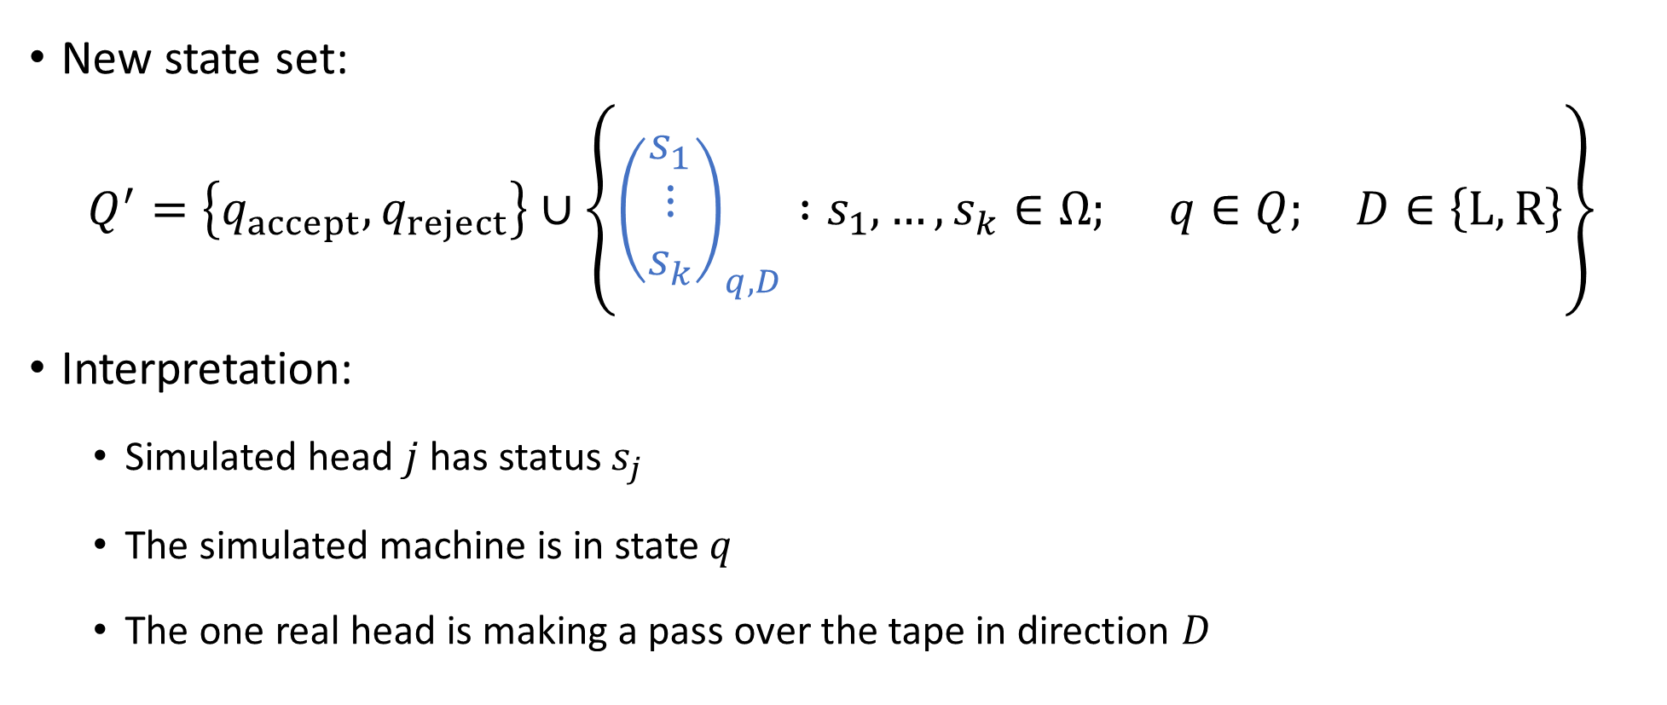

Simulating $k$ tapes with $1$ tape: States
New state set:
$$Q^{′}=\left\{q_{accept},q_{reject}\right\}∪\left\{{\left(\begin{aligned}s_{1} \\ ⋮ \\ s_{k}\end{aligned}\right)}_{q,D} :s_{1},…, s_{k}∈Ω; q∈Q; D∈\left\{\text{L},\text{R}\right\}\right\}$$
Interpretation:
Simulated head $j$ has status $s_{j}$
The simulated machine is in state $q$
The one real head is making a pass over the tape in direction $D$

Slide 19


Simulating $k$ tapes with $1$ tape: Start state
New start state:
$$q_{0}^{′}={\left(\begin{aligned}“\text{👻}” \\ ⋮ \\ “\text{👻}”\end{aligned}\right)}_{q_{0},R}$$

Slide 20


Simulating $k$ tapes with $1$ tape: Transitions
The new transition function will have the form $δ^{′}:Q^{′}×Γ^{′}→Q^{′}×Γ^{′}×\left\{\text{L},\text{R}\right\}$

Slide 21
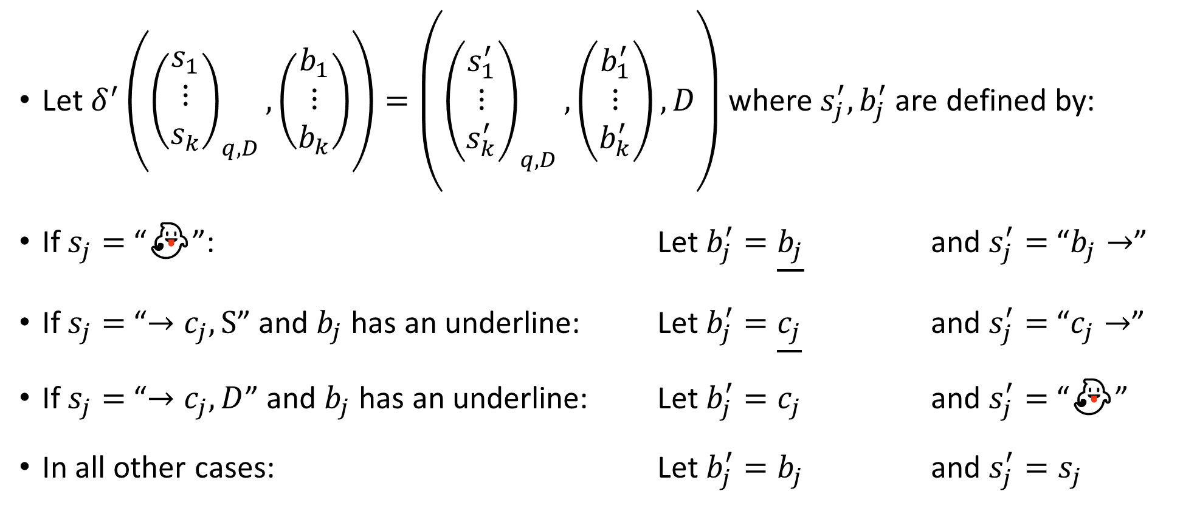

Simulating $k$ tapes with $1$ tape: Transitions
Let $δ^{′}\left({\left(\begin{aligned}s_{1} \\ ⋮ \\ s_{k}\end{aligned}\right)}_{q,D}, \left(\begin{matrix}b_{1} \\ ⋮ \\ b_{k}\end{matrix}\right)\right)=\left({\left(\begin{aligned}s_{1}^{′} \\ ⋮ \\ s_{k}^{′}\end{aligned}\right)}_{q,D},\left(\begin{matrix}b_{1}^{′} \\ ⋮ \\ b_{k}^{′}\end{matrix}\right),D\right)$ where $s_{j}^{′}, b_{j}^{′}$ are defined by:
If $s_{j}=$ “👻”: Let $b_{j}^{′}=\underline{b_{j}}$ and $s_{j}^{′}=$ “$b_{j}→$”
If $s_{j}=$“$→c_{j},\text{S}$” and $b_{j}$ has an underline: Let $b_{j}^{′}=\underline{c_{j}}$ and $s_{j}^{′}=$ “$c_{j}→$”
If $s_{j}=$“$→c_{j}, D$” and $b_{j}$ has an underline: Let $b_{j}^{′}=c_{j}$ and $s_{j}^{′}=$ “👻”
In all other cases: Let $b_{j}^{′}=b_{j}$ and $s_{j}^{′}=s_{j}$

Slide 22

Simulating $k$ tapes with $1$ tape: Transitions
Let $δ^{′}\left({\left(\begin{aligned}s_{1} \\ ⋮ \\ s_{k}\end{aligned}\right)}_{q,R}, ⊔\right)=\left({\left(\begin{aligned}s_{1}^{′} \\ ⋮ \\ s_{k}^{′}\end{aligned}\right)}_{q,L},\left(\begin{matrix}b_{1}^{′} \\ ⋮ \\ b_{k}^{′}\end{matrix}\right),L\right)$ where $s_{j}^{′}, b_{j}^{′}$ are defined by:
If $s_{j}=$ “👻”: Let $b_{j}^{′}= \underline{⊔}$ and $s_{j}^{′}=“⊔ →”$
In all other cases: Let $b_{j}^{′}= ⊔$ and $s_{j}^{′}=s_{j}$

Slide 23
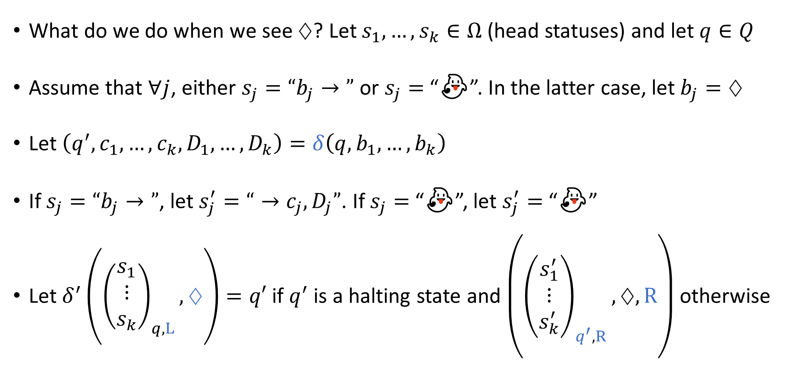

Simulating $k$ tapes with $1$ tape: Transitions
What do we do when we see $♢$? Let $s_{1},…, s_{k}∈Ω$ (head statuses) and let $q∈Q$
Assume that $∀j$, either $s_{j}=“b_{j}→”$ or $s_{j}=$ “👻”. In the latter case, let $b_{j}=♢$
Let $\left(q^{′},c_{1},…, c_{k},D_{1},…, D_{k}\right)=δ\left(q,b_{1},…, b_{k}\right)$
If $s_{j}=“b_{j}→”$, let $s_{j}^{′}=“→c_{j}, D_{j}”$. If $s_{j}=$ “👻”, let $s_{j}^{′}=$ “👻”
Let $δ^{′}\left({\left(\begin{aligned}s_{1} \\ ⋮ \\ s_{k}\end{aligned}\right)}_{q,L}, ♢\right)=q′$ if $q^{′}$ is a halting state and $\left({\left(\begin{aligned}s_{1}^{′} \\ ⋮ \\ s_{k}^{′}\end{aligned}\right)}_{q^{′},R},♢,R\right)$ otherwise

