Slide 1
CMSC 28100 Introduction to Complexity Theory Winter 2024 Instructor: William Hoza
7 |  |  |  |  |  |  | 5 | 3
 |  |  |  |  |  |  |  | 4
 | 4 | 8 |  | 3 |  | 1 | 2
8 |  | 1 | 3 |  |  | 2 | 7 | 5
 | 9 |  | 1 |  |  |  | 4
 | 5 |  |  |  |  | 3
2 |  | 5 |  | 8 | 4
1 | 3 | 4 |  | 5

Slide 2
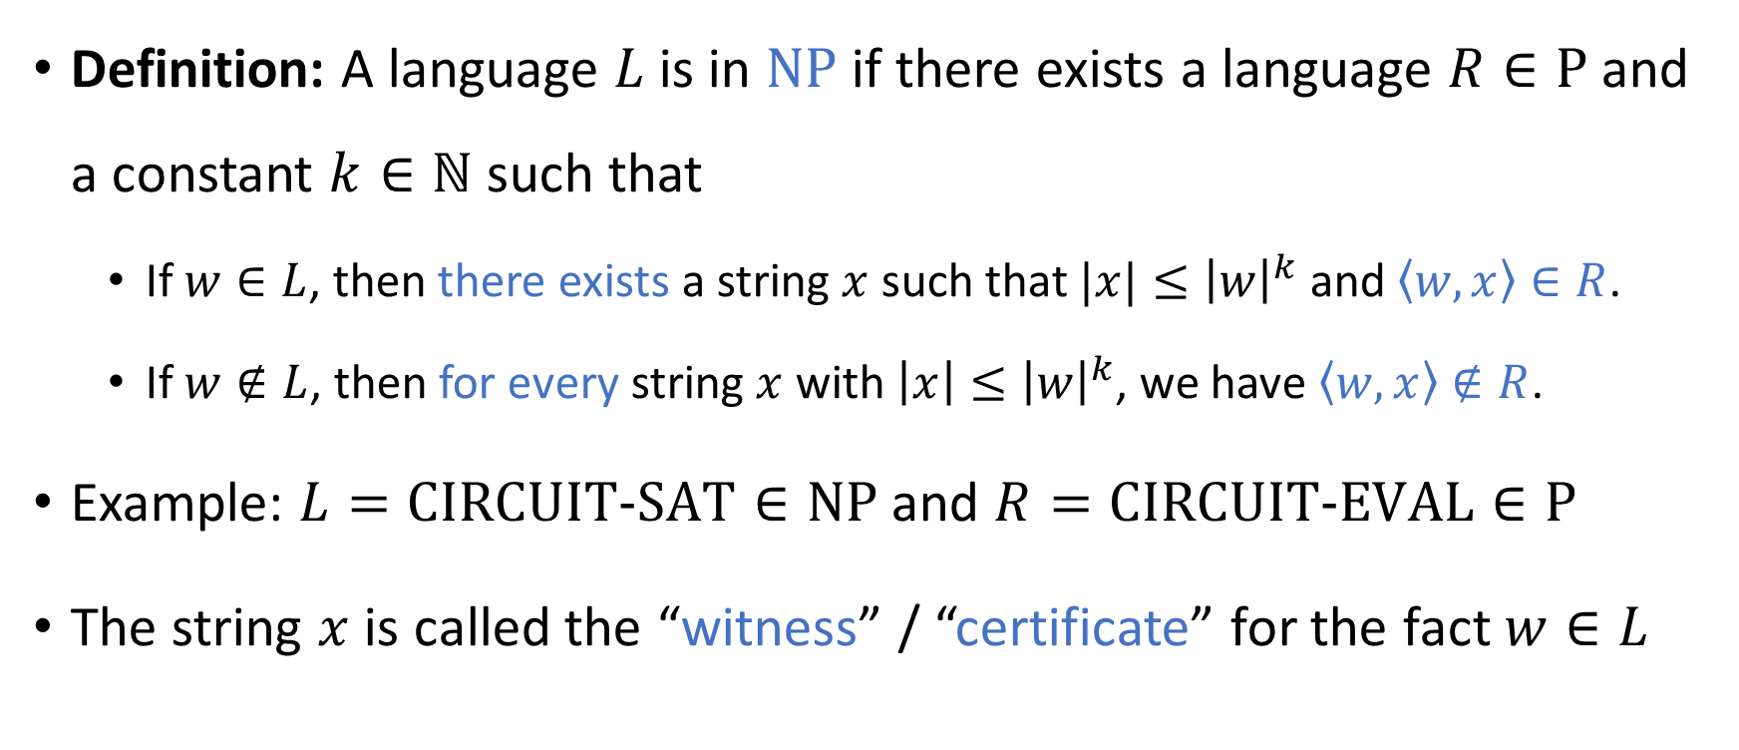

The complexity class $\text{NP}$
Definition: A language $L$ is in $\text{NP}$ if there exists a language $R∈\text{P}$ and a constant $k∈ℕ$ such that
If $w∈L$, then there exists a string $x$ such that $|x|≤{\left|w\right|}^{k}$ and $\left\langle w,x\right\rangle ∈R$.
If $w∉L$, then for every string $x$ with $\left|x\right|≤{\left|w\right|}^{k}$, we have $\left\langle w,x\right\rangle ∉R$.
Example: $L=\text{CIRCUIT}\text{‑}\text{SAT}∈\text{NP}$ and $R=\text{CIRCUIT}\text{‑}\text{EVAL}∈\text{P}$
The string $x$ is called the “witness” / “certificate” for the fact $w∈L$

Slide 3


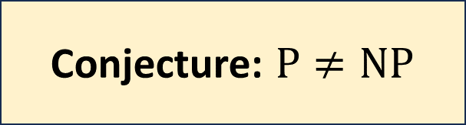
The $\text{P}$ vs. $\text{NP}$ problem
$\text{P}⊆\text{NP}$
Conjecture: $\text{P}≠\text{NP}$

Slide 4
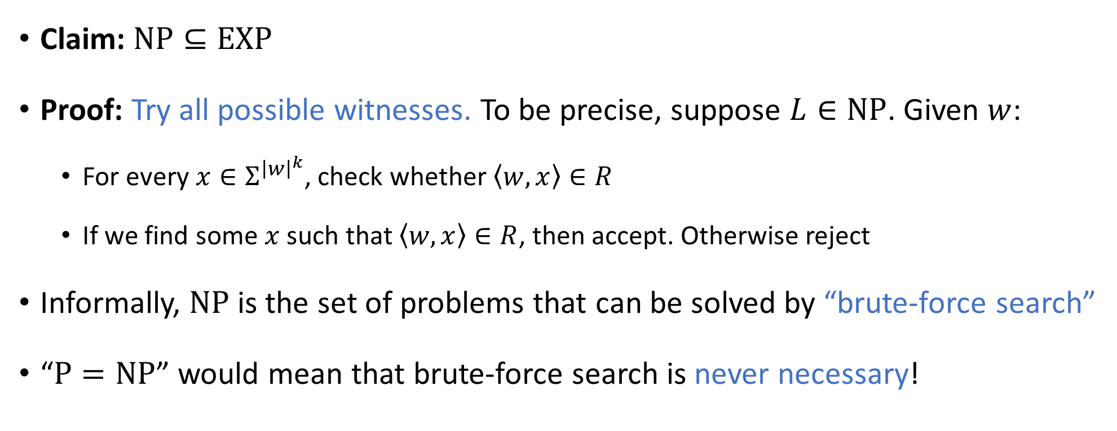
Brute-force search
Claim: $\text{NP}⊆\text{EXP}$
Proof: Try all possible witnesses. To be precise, suppose $L∈\text{NP}$. Given $w$:
For every $x∈Σ^{{\left|w\right|}^{k}}$, check whether $\left\langle w, x\right\rangle ∈R$
If we find some $x$ such that $\left\langle w, x\right\rangle ∈R$, then accept. Otherwise reject
Informally, $\text{NP}$ is the set of problems that can be solved by “brute-force search”
“$\text{P}=\text{NP}$” would mean that brute-force search is never necessary!

Slide 5







P vs. NP vs. EXP: Three possibilities
$$\text{EXP}$$
$$\text{EXP}$$
$$\text{EXP}=\text{NP}$$
$$\text{NP}$$
$$\text{P}$$
$$\text{P}=\text{NP}$$
$$\text{P}$$
What most experts believe
Possible, but unlikely
Possible, but unlikely

Slide 6
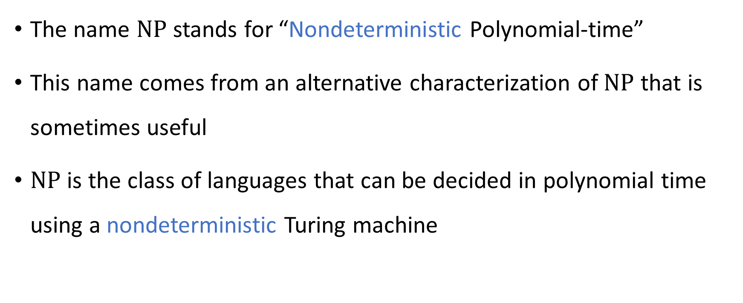
Nondeterminism
The name $\text{NP}$ stands for “Nondeterministic Polynomial-time”
This name comes from an alternative characterization of $\text{NP}$ that is sometimes useful
$\text{NP}$ is the class of languages that can be decided in polynomial time using a nondeterministic Turing machine

Slide 7
Nondeterministic Turing machines
The nondeterministic TM model is an unrealistic model of computation
It is only a conceptual tool that we sometimes use to reason about computation
Idea: At each step of the computation, we have multiple possible transitions
The computation accepts if there is at least one way to reach the accept state

Slide 8
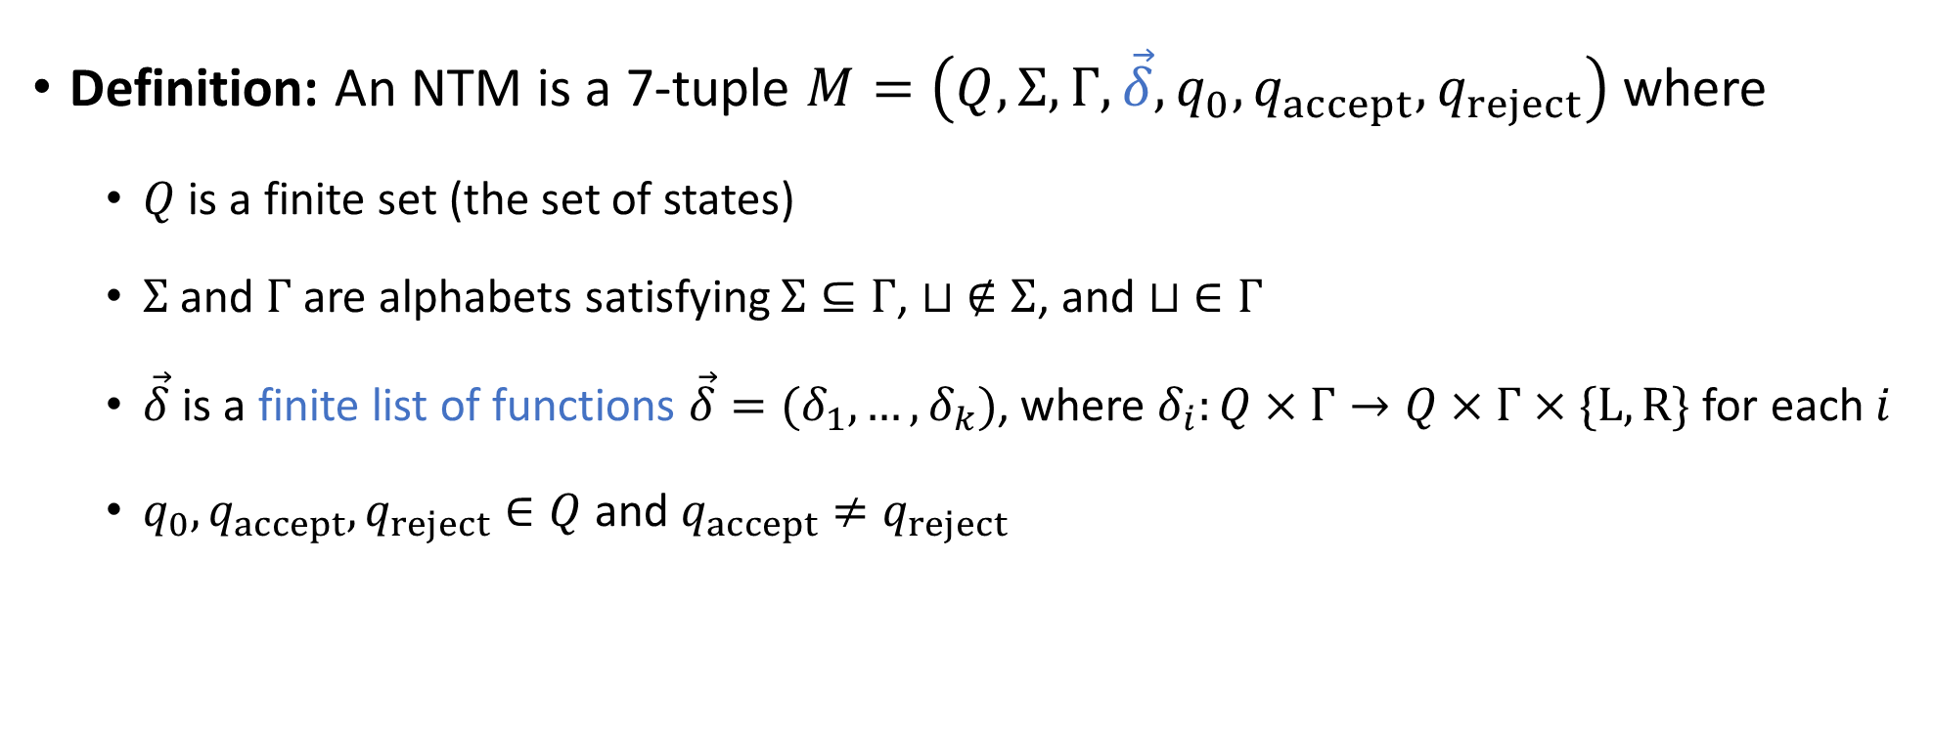
Nondeterministic Turing machines (NTMs)
Definition: An NTM is a 7-tuple $M=\left(Q,Σ, Γ,\vec{δ}, q_{0},q_{accept},q_{reject}\right)$ where
$Q$ is a finite set (the set of states)
$Σ$ and $Γ$ are alphabets satisfying $Σ⊆Γ$, $⊔ ∉Σ$, and $⊔ ∈Γ$
$\vec{δ}$ is a finite list of functions $\vec{δ}=(δ_{1}, …, δ_{k})$, where $δ_{i}:Q×Γ→Q×Γ×\{\text{L},\text{R}\}$ for each $i$
$q_{0},q_{accept},q_{reject}∈Q$ and $q_{accept}≠q_{reject}$

Slide 9
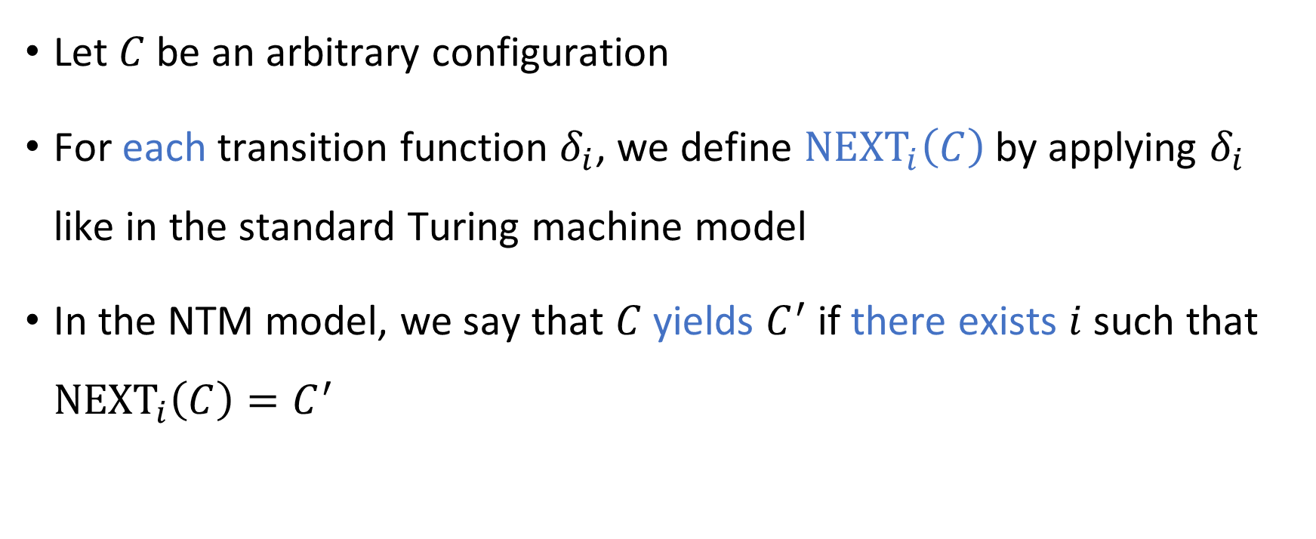
Nondeterministic Turing machines (NTMs)
Let $C$ be an arbitrary configuration
For each transition function $δ_{i}$, we define ${\text{NEXT}}_{i}\left(C\right)$ by applying $δ_{i}$ like in the standard Turing machine model
In the NTM model, we say that $C$ yields $C^{′}$ if there exists $i$ such that ${\text{NEXT}}_{i}\left(C\right)=C^{′}$

Slide 10
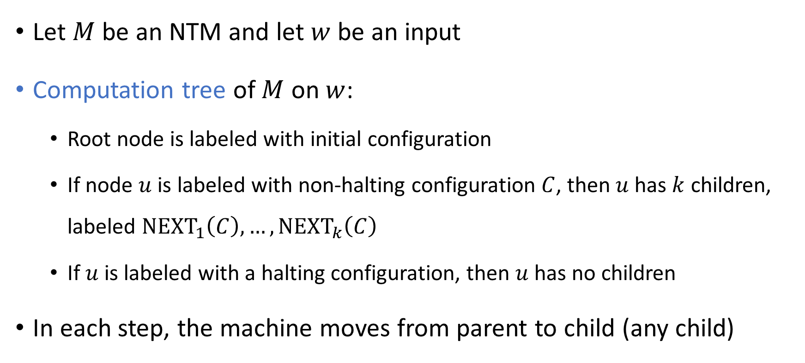
Nodeterministic Turing machines (NTMs)
Let $M$ be an NTM and let $w$ be an input
Computation tree of $M$ on $w$:
Root node is labeled with initial configuration
If node $u$ is labeled with non-halting configuration $C$, then $u$ has $k$ children, labeled ${\text{NEXT}}_{1}\left(C\right),…, {\text{NEXT}}_{k}\left(C\right)$
If $u$ is labeled with a halting configuration, then $u$ has no children
In each step, the machine moves from parent to child (any child)

Slide 11
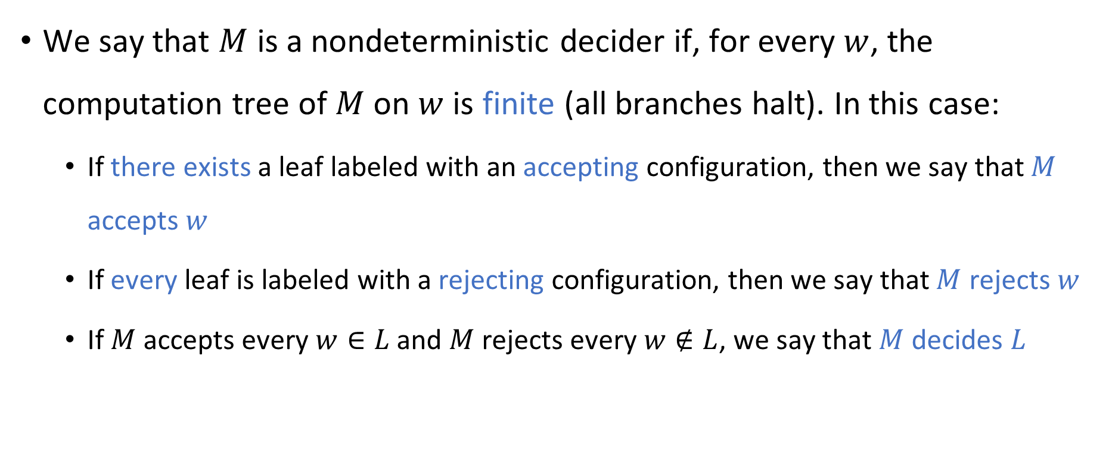
Nondeterministic Turing machines (NTMs)
We say that $M$ is a nondeterministic decider if, for every $w$, the computation tree of $M$ on $w$ is finite (all branches halt). In this case:
If there exists a leaf labeled with an accepting configuration, then we say that $M$ accepts $w$
If every leaf is labeled with a rejecting configuration, then we say that $M$ rejects $w$
If $M$ accepts every $w∈L$ and $M$ rejects every $w∉L$, we say that $M$ decides $L$

Slide 12
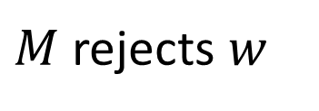
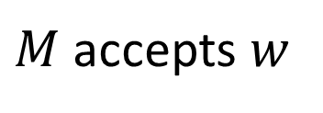
Nondeterministic Turing machines (NTMs)
accept
reject
reject
reject
accept
reject
reject
reject
reject
reject
reject
reject
$M$ accepts $w$
$M$ rejects $w$

Slide 13
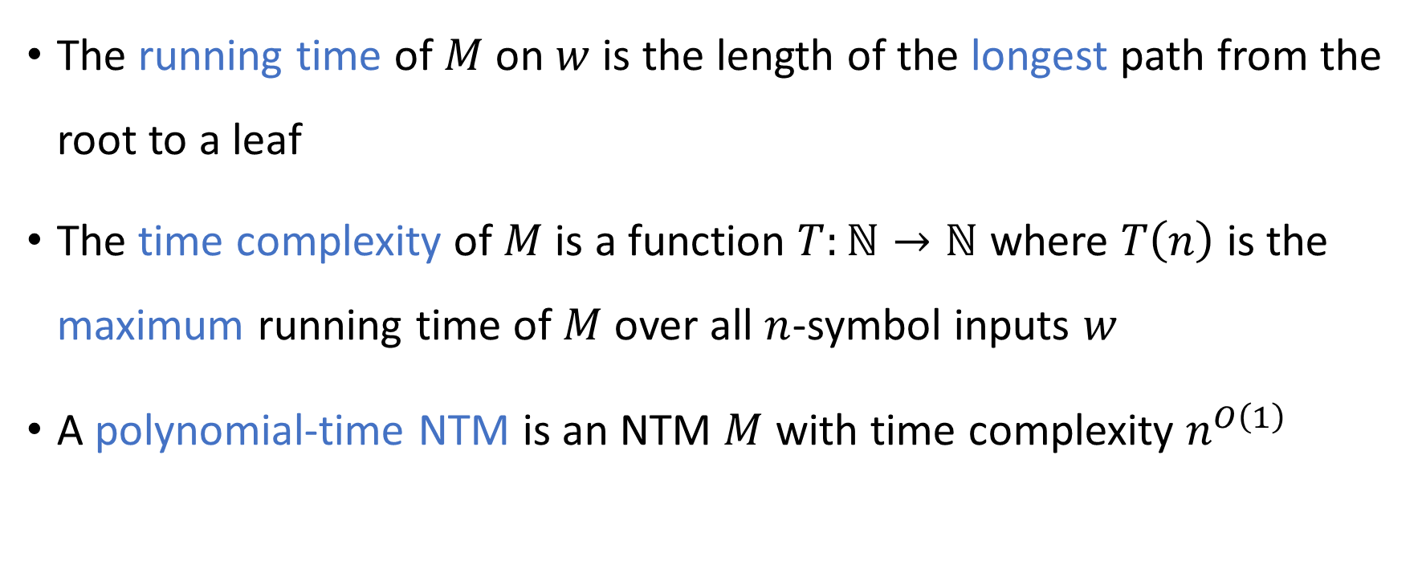
Nondeterministic Turing machines (NTMs)
The running time of $M$ on $w$ is the length of the longest path from the root to a leaf
The time complexity of $M$ is a function $T:ℕ→ℕ$ where $T\left(n\right)$ is the maximum running time of $M$ over all $n$-symbol inputs $w$
A polynomial-time NTM is an NTM $M$ with time complexity $n^{O\left(1\right)}$

Slide 14
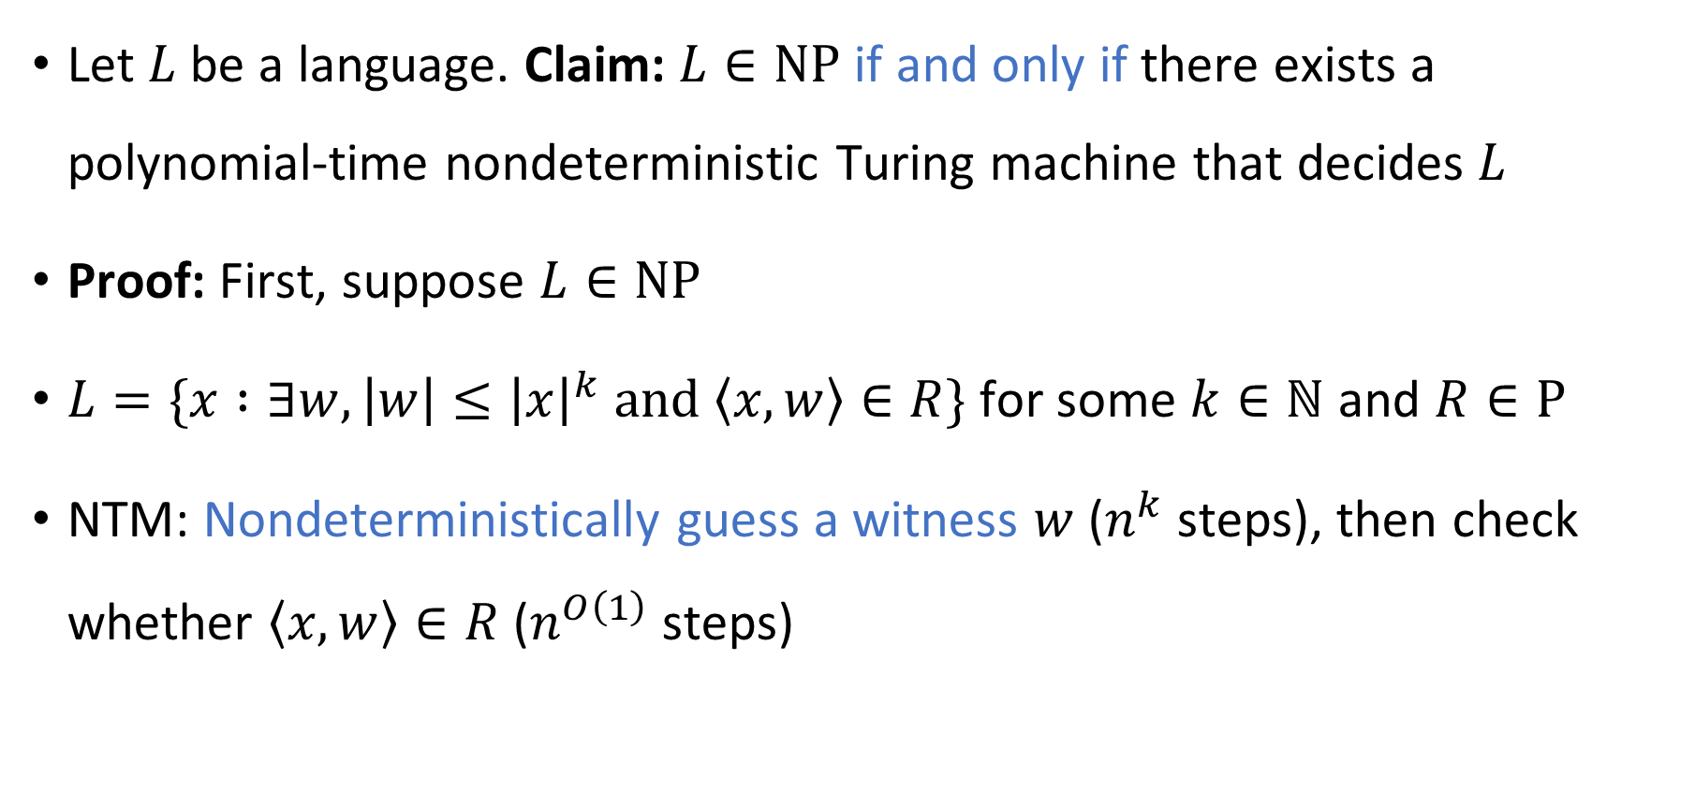

$\text{NP}$ in terms of nodeterministic TMs
Let $L$ be a language. Claim: $L∈\text{NP}$ if and only if there exists a polynomial-time nondeterministic Turing machine that decides $L$
Proof: First, suppose $L∈\text{NP}$
$L=\{x :∃w, \left|w\right|≤{\left|x\right|}^{k} \text{and} \left\langle x,w\right\rangle ∈R\}$ for some $k∈ℕ$ and $R∈\text{P}$
NTM: Nondeterministically guess a witness $w$ ($n^{k}$ steps), then check whether $\left\langle x,w\right\rangle ∈R$ ($n^{O\left(1\right)}$ steps)

Slide 15
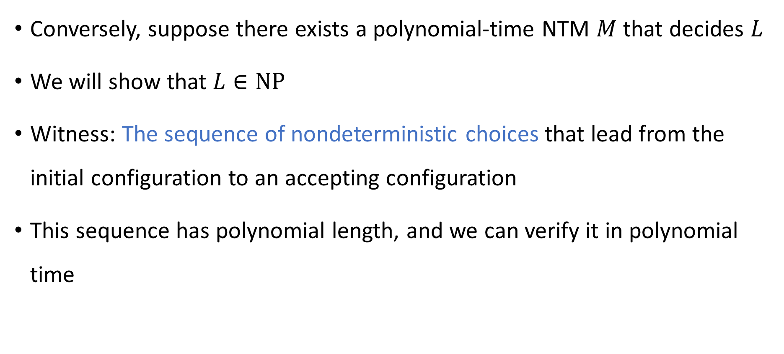

$\text{NP}$ in terms of nodeterministic TMs
Conversely, suppose there exists a polynomial-time NTM $M$ that decides $L$
We will show that $L∈\text{NP}$
Witness: The sequence of nondeterministic choices that lead from the initial configuration to an accepting configuration
This sequence has polynomial length, and we can verify it in polynomial time

Slide 16

Which languages are in $\text{P}$?

Slide 17

Which languages are not in $\text{P}$?

Slide 18
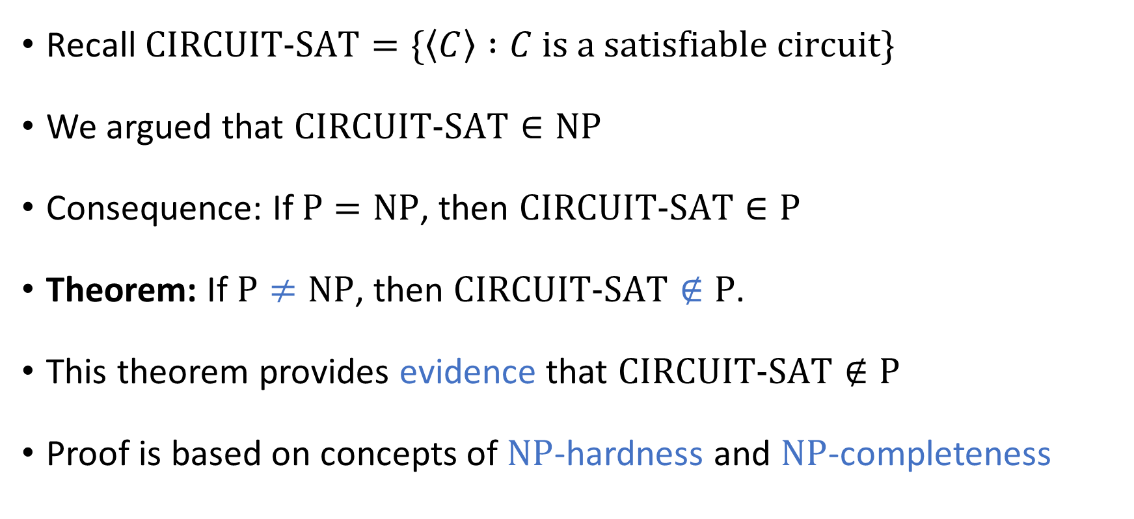

Complexity of $\text{CIRCUIT}\text{‑}\text{SAT}$
Recall $\text{CIRCUIT}\text{‑}\text{SAT}=\{\left\langle C\right\rangle :C \text{is} \text{a} \text{satisfiable} \text{circuit}\}$
We argued that $\text{CIRCUIT}\text{‑}\text{SAT}∈\text{NP}$
Consequence: If $\text{P}=\text{NP}$, then $\text{CIRCUIT}\text{‑}\text{SAT}∈\text{P}$
Theorem: If $\text{P}≠\text{NP}$, then $\text{CIRCUIT}\text{‑}\text{SAT}∉\text{P}$.
This theorem provides evidence that $\text{CIRCUIT}\text{‑}\text{SAT}∉\text{P}$
Proof is based on concepts of $\text{NP}$-hardness and $\text{NP}$-completeness

Slide 19
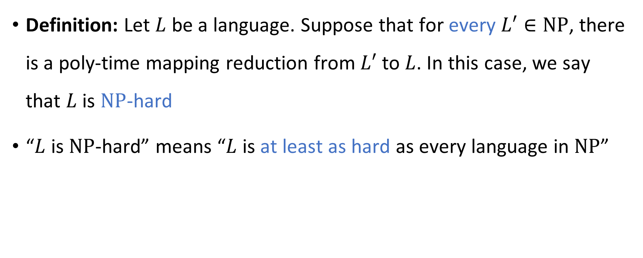
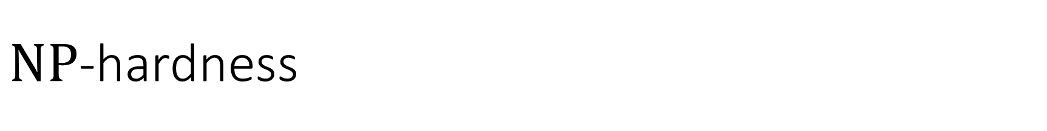
$\text{NP}$-hardness
Definition: Let $L$ be a language. Suppose that for every $L′∈\text{NP}$, there is a poly-time mapping reduction from $L′$ to $L$. In this case, we say that $L$ is $\text{NP}$-hard
“$L$ is $\text{NP}$-hard” means “$L$ is at least as hard as every language in $\text{NP}$”

Slide 20
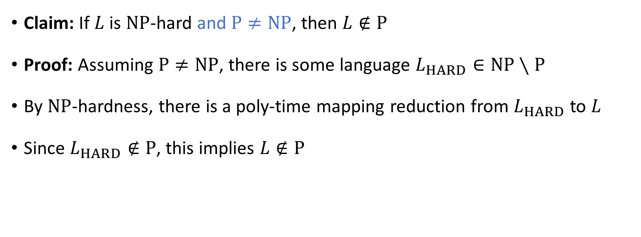
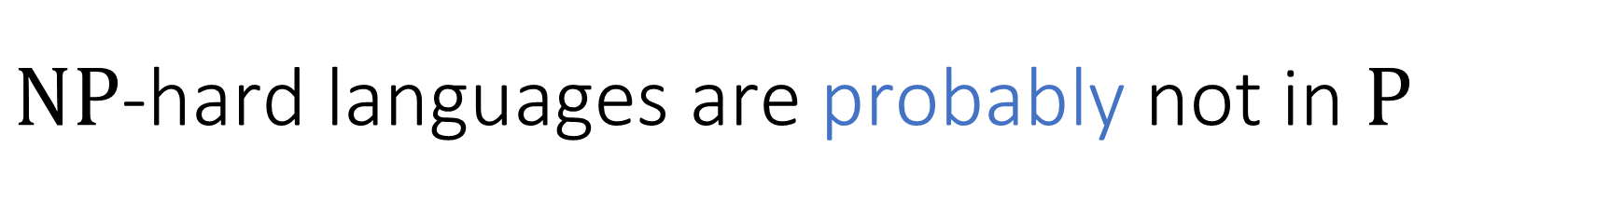
$\text{NP}$-hard languages are probably not in $\text{P}$
Claim: If $L$ is $\text{NP}$-hard and $\text{P}≠\text{NP}$, then $L∉\text{P}$
Proof: Assuming $\text{P}≠\text{NP}$, there is some language $L_{HARD}∈\text{NP}∖\text{P}$
By $\text{NP}$-hardness, there is a poly-time mapping reduction from $L_{HARD}$ to $L$
Since $L_{HARD}∉\text{P}$, this implies $L∉\text{P}$

Slide 21
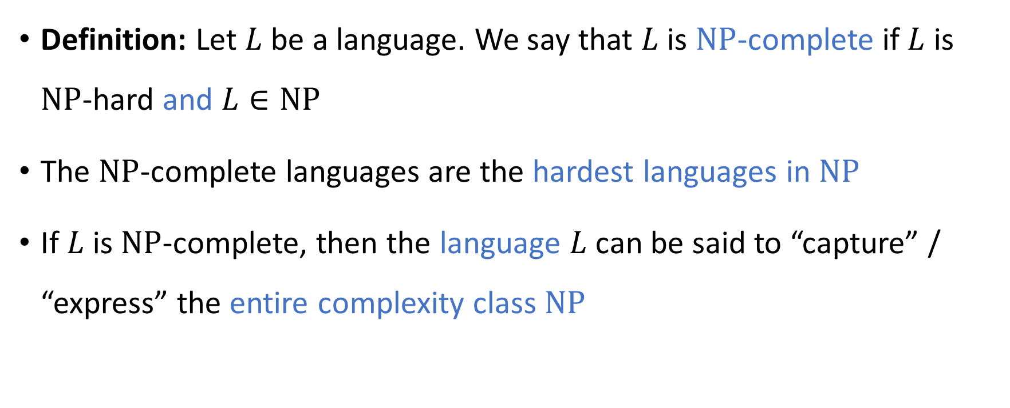
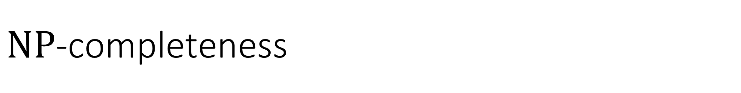
$\text{NP}$-completeness
Definition: Let $L$ be a language. We say that $L$ is $\text{NP}$-complete if $L$ is $\text{NP}$-hard and $L∈\text{NP}$
The $\text{NP}$-complete languages are the hardest languages in $\text{NP}$
If $L$ is $\text{NP}$-complete, then the language $L$ can be said to “capture” / “express” the entire complexity class $\text{NP}$

Slide 22
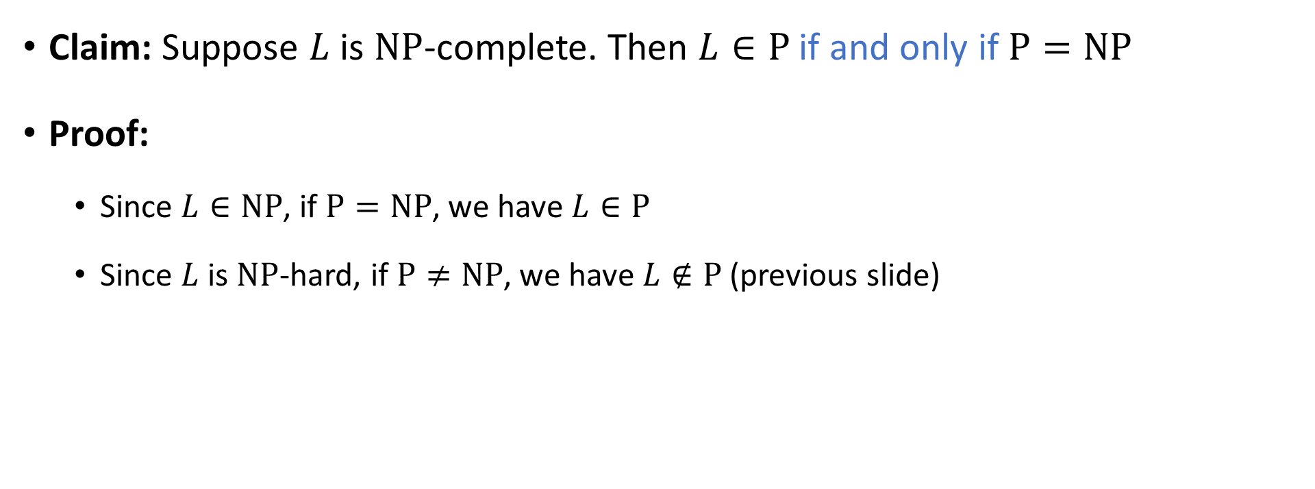
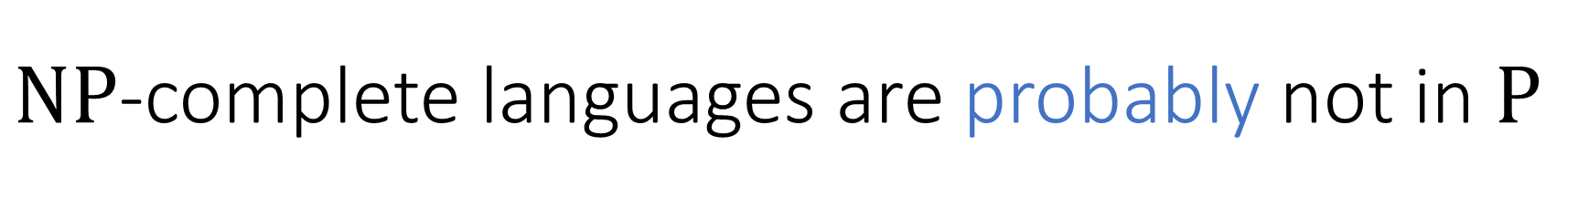
$\text{NP}$-complete languages are probably not in $\text{P}$
Claim: Suppose $L$ is $\text{NP}$-complete. Then $L∈\text{P}$ if and only if $\text{P}=\text{NP}$
Proof:
Since $L∈\text{NP}$, if $\text{P}=\text{NP}$, we have $L∈\text{P}$
Since $L$ is $\text{NP}$-hard, if $\text{P}≠\text{NP}$, we have $L∉\text{P}$ (previous slide)

Slide 23
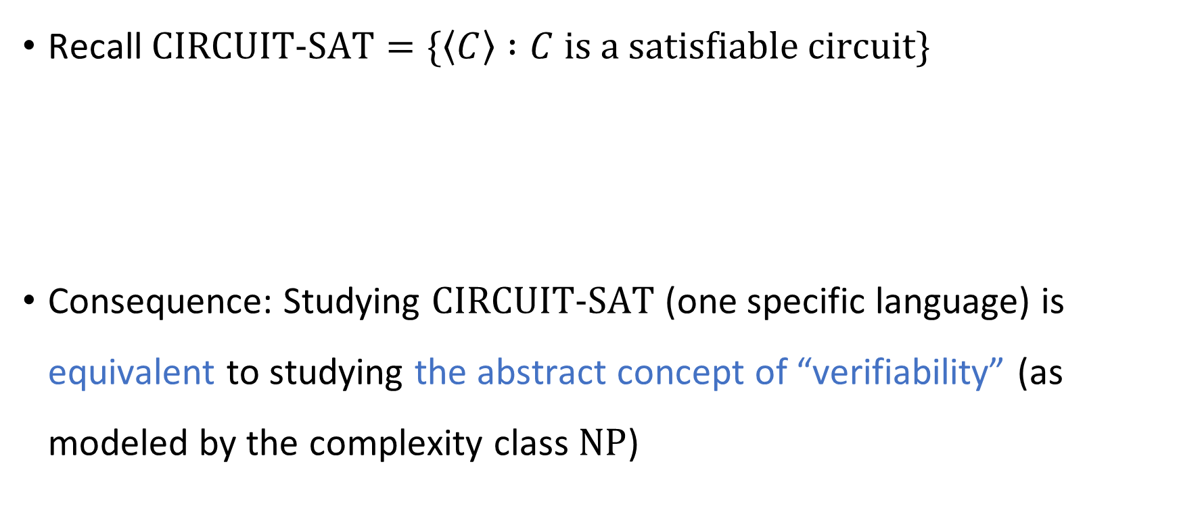


$\text{CIRCUIT}\text{‑}\text{SAT}$ is $\text{NP}$-complete
Recall $\text{CIRCUIT}\text{‑}\text{SAT}=\{\left\langle C\right\rangle :C \text{is} \text{a} \text{satisfiable} \text{circuit}\}$
Consequence: Studying $\text{CIRCUIT}\text{‑}\text{SAT}$ (one specific language) is equivalent to studying the abstract concept of “verifiability” (as modeled by the complexity class $\text{NP}$)
Theorem: $\text{CIRCUIT}\text{‑}\text{SAT}$ is $\text{NP}$-complete.

Slide 24


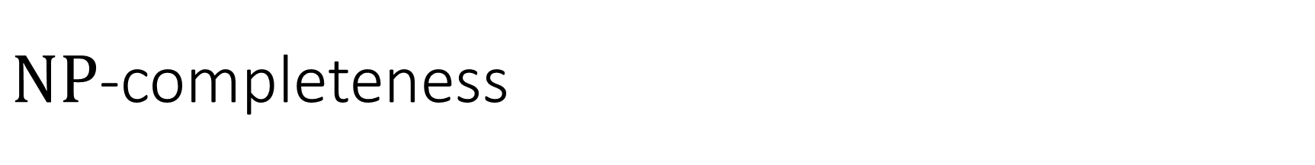



$\text{NP}$-completeness
$\text{NP}$-hard
$$\text{CIRCUIT}\text{‑}\text{SAT}$$
$\text{NP}$-complete
$$\text{NP}$$
$$\text{P}$$

Slide 25


Proof that $\text{CIRCUIT}\text{‑}\text{SAT}$ is $\text{NP}$-complete
We have already shown that $\text{CIRCUIT}\text{‑}\text{SAT}∈\text{NP}$
Remaining job: Prove that $\text{CIRCUIT}\text{‑}\text{SAT}$ is $\text{NP}$-hard
The proof is based on the concept of a uniform circuit family

Slide 26
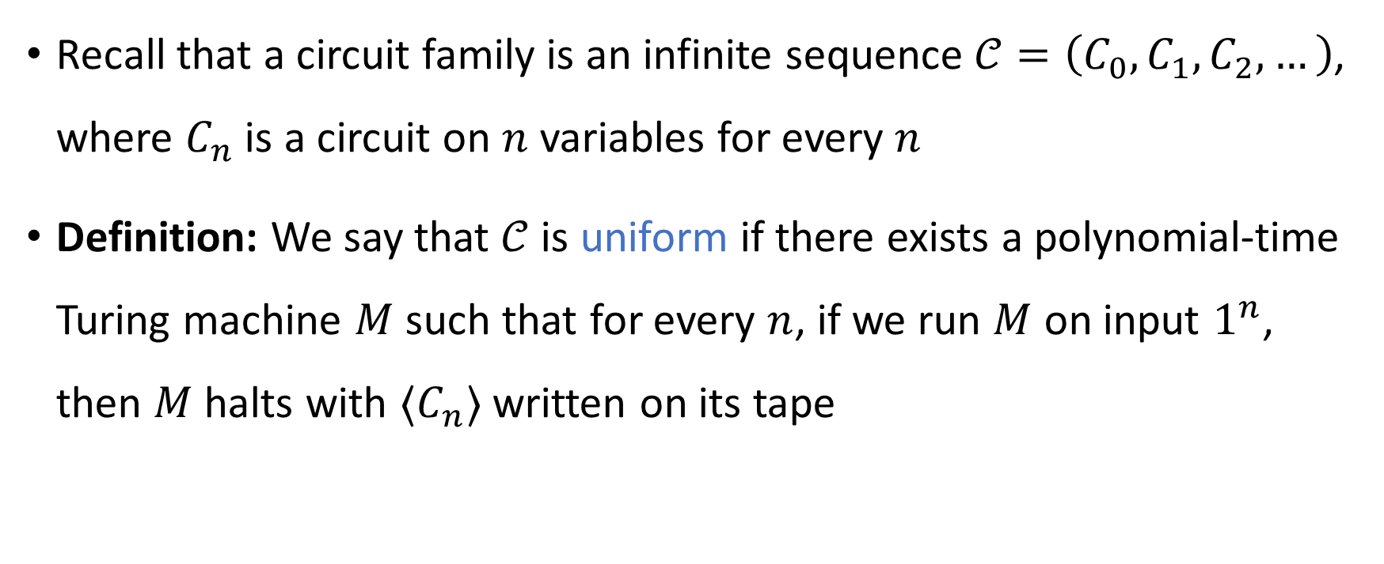
Uniform circuit family
Recall that a circuit family is an infinite sequence $𝒞=\left(C_{0},C_{1},C_{2},…\right)$, where $C_{n}$ is a circuit on $n$ variables for every $n$
Definition: We say that $𝒞$ is uniform if there exists a polynomial-time Turing machine $M$ such that for every $n$, if we run $M$ on input $1^{n}$, then $M$ halts with $⟨C_{n}⟩$ written on its tape

Slide 27
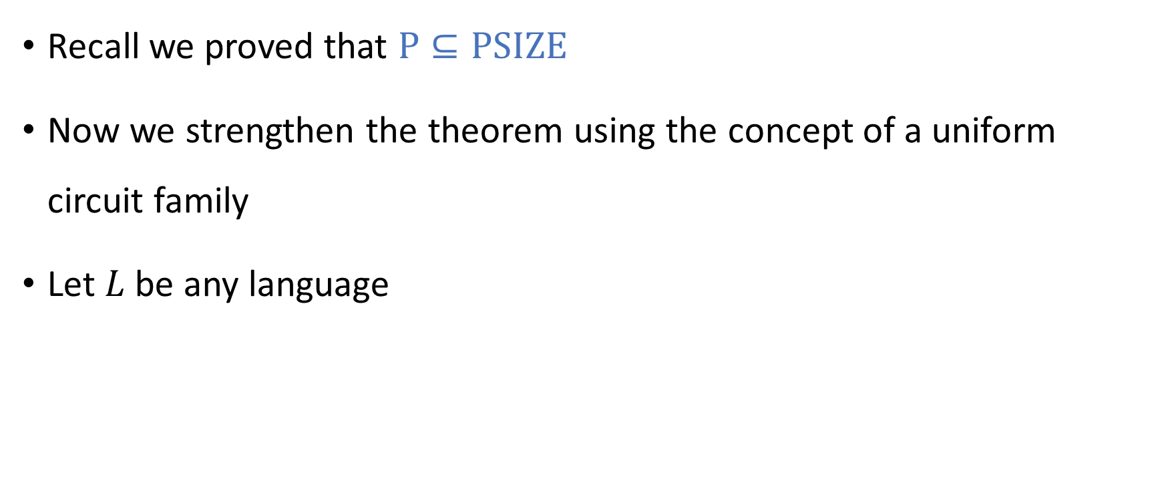
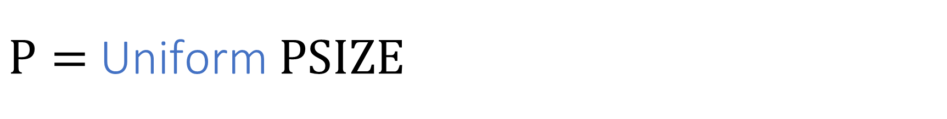
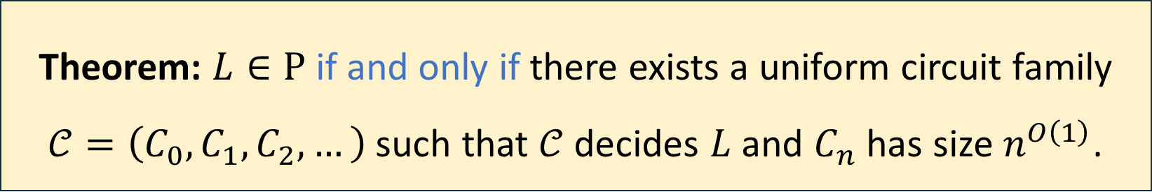
$\text{P}=$ Uniform $\text{PSIZE}$
Recall we proved that $\text{P}⊆\text{PSIZE}$
Now we strengthen the theorem using the concept of a uniform circuit family
Let $L$ be any language
Theorem: $L∈\text{P}$ if and only if there exists a uniform circuit family $𝒞=\left(C_{0},C_{1},C_{2},…\right)$ such that $𝒞$ decides $L$ and $C_{n}$ has size $n^{O\left(1\right)}$.

