Slide 1
CMSC 28100 Introduction to Complexity Theory Winter 2024 Instructor: William Hoza
7 |  |  |  |  |  |  | 5 | 3
 |  |  |  |  |  |  |  | 4
 | 4 | 8 |  | 3 |  | 1 | 2
8 |  | 1 | 3 |  |  | 2 | 7 | 5
 | 9 |  | 1 |  |  |  | 4
 | 5 |  |  |  |  | 3
2 |  | 5 |  | 8 | 4
1 | 3 | 4 |  | 5

Slide 2
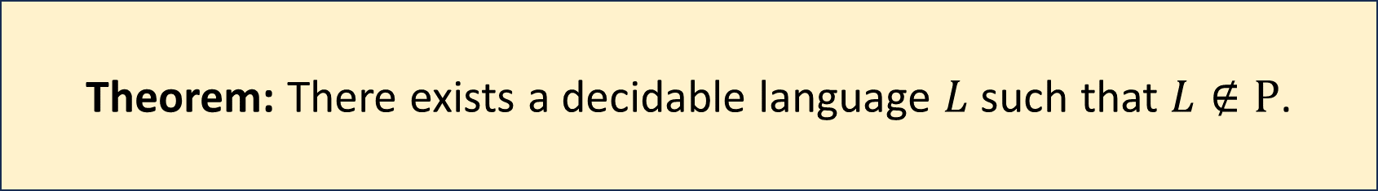
Decidable but intractable
Theorem: There exists a decidable language $L$ such that $L∉\text{P}$.
We will study two distinct proofs of this theorem
Each proof will give us new insights into the nature of efficient computation
Our first proof is based on the “Time Hierarchy Theorem”

Slide 3


The Time Hierarchy Theorem (weaker version)
Let $T:ℕ→ℕ$ be a “reasonable” time complexity bound
Theorem: $\text{TIME}\left(o\left(T\right)\right)≠\text{TIME}\left(T^{3}\right)$

Slide 4


Proof of the Time Hierarchy Theorem
Let $L=\{\left\langle M\right\rangle :M \text{halts} \text{on} 〈M⟩ \text{within} T\left(\left|⟨M⟩\right|\right) \text{steps}\}$
Claim 1: $L∉\text{TIME}\left(o\left(T\right)\right)$.
(We did the proof last class)

Slide 5
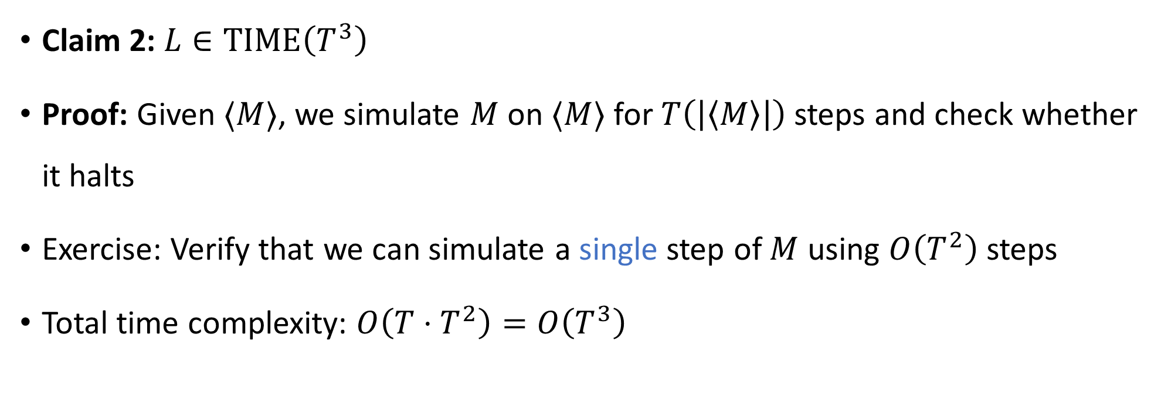

Proof of the Time Hierarchy Theorem
Let $L=\{\left\langle M\right\rangle :M \text{halts} \text{on} 〈M⟩ \text{within} T\left(\left|⟨M⟩\right|\right) \text{steps}\}$
Claim 2: $L∈\text{TIME}\left(T^{3}\right)$
Proof: Given $⟨M⟩$, we simulate $M$ on $⟨M⟩$ for $T\left(\left|\left\langle M\right\rangle \right|\right)$ steps and check whether it halts
Exercise: Verify that we can simulate a single step of $M$ using $O\left(T^{2}\right)$ steps
Total time complexity: $O\left(T⋅T^{2}\right)=O\left(T^{3}\right)$
Subtle point: How do we know when we’re done?

Slide 6
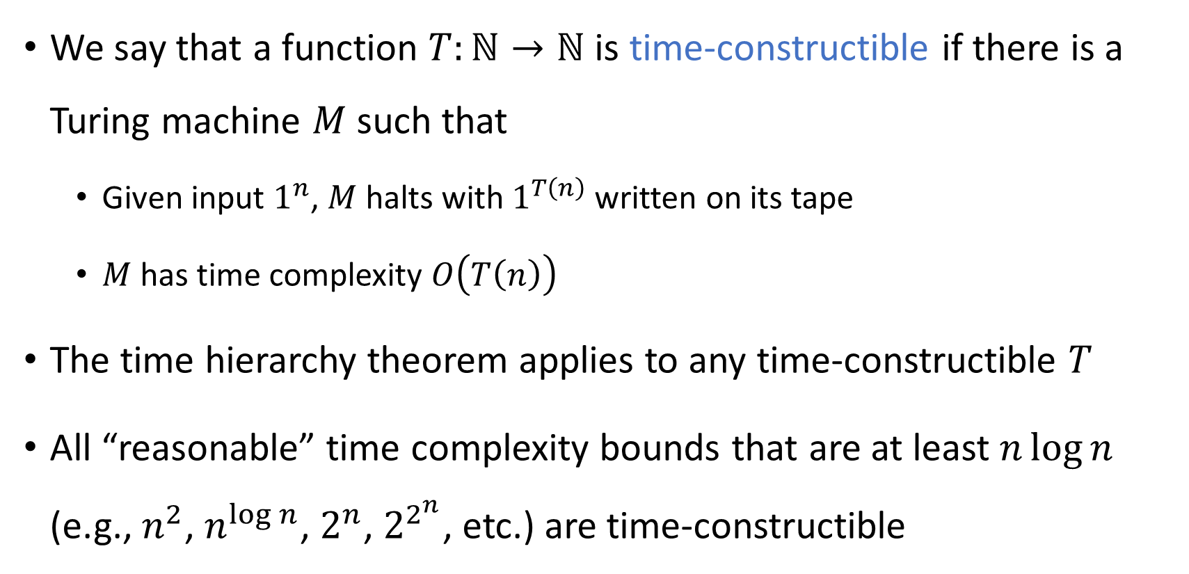
Time-constructible functions
We say that a function $T:ℕ→ℕ$ is time-constructible if there is a Turing machine $M$ such that
Given input $1^{n}$, $M$ halts with $1^{T\left(n\right)}$ written on its tape
$M$ has time complexity $O\left(T\left(n\right)\right)$
The time hierarchy theorem applies to any time-constructible $T$
All “reasonable” time complexity bounds that are at least $n\log{n}$ (e.g., $n^{2}$, $n^{\log{n}}$, $2^{n}$, $2^{2^{n}}$, etc.) are time-constructible

Slide 7




Intractability vs. undecidability
All languages
$$\text{HALT}$$
Decidable languages
$$\{\left\langle M\right\rangle :M \text{halts} \text{on} \left\langle M\right\rangle \text{within} 2^{\left|\left\langle M\right\rangle \right|} \text{steps}\}$$
$$\text{P}$$
$$\text{LIS}$$

Slide 8
Decidable but not tractable
Theorem: There exists a decidable language $L$ such that $L∉\text{P}$.
We have seen one proof of this theorem
Now let’s do another proof, based on the concept of a Boolean circuit

Slide 9




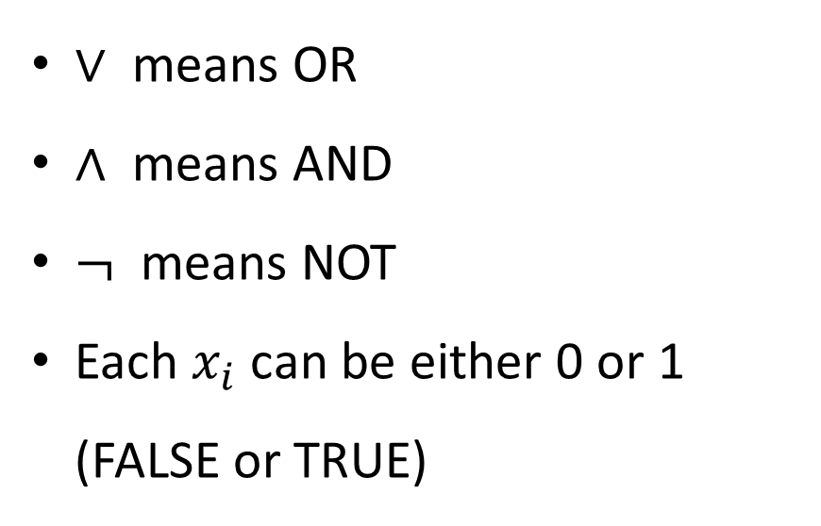















Boolean circuits
For us, a “circuit” is a network of logic gates applied to Boolean variables
1
$$∨$$
$∨$ means OR
$∧$ means AND
$¬$ means NOT
Each $x_{i}$ can be either 0 or 1 (FALSE or TRUE)
1
0
$$∧$$
$$∧$$
0
1
0
1
$$¬$$
$$¬$$
1
0
$$∨$$
$$∨$$
0
1
0
0
$$∧$$
$$∧$$
$$∧$$
$$∧$$
0
1
0
1
1
0
0
1
$$¬$$
$$¬$$
$$¬$$
$$¬$$
0
1
1
1
$$x_{1}$$
$$x_{2}$$
$$x_{3}$$
$$x_{4}$$
0
1
1
1

Slide 10
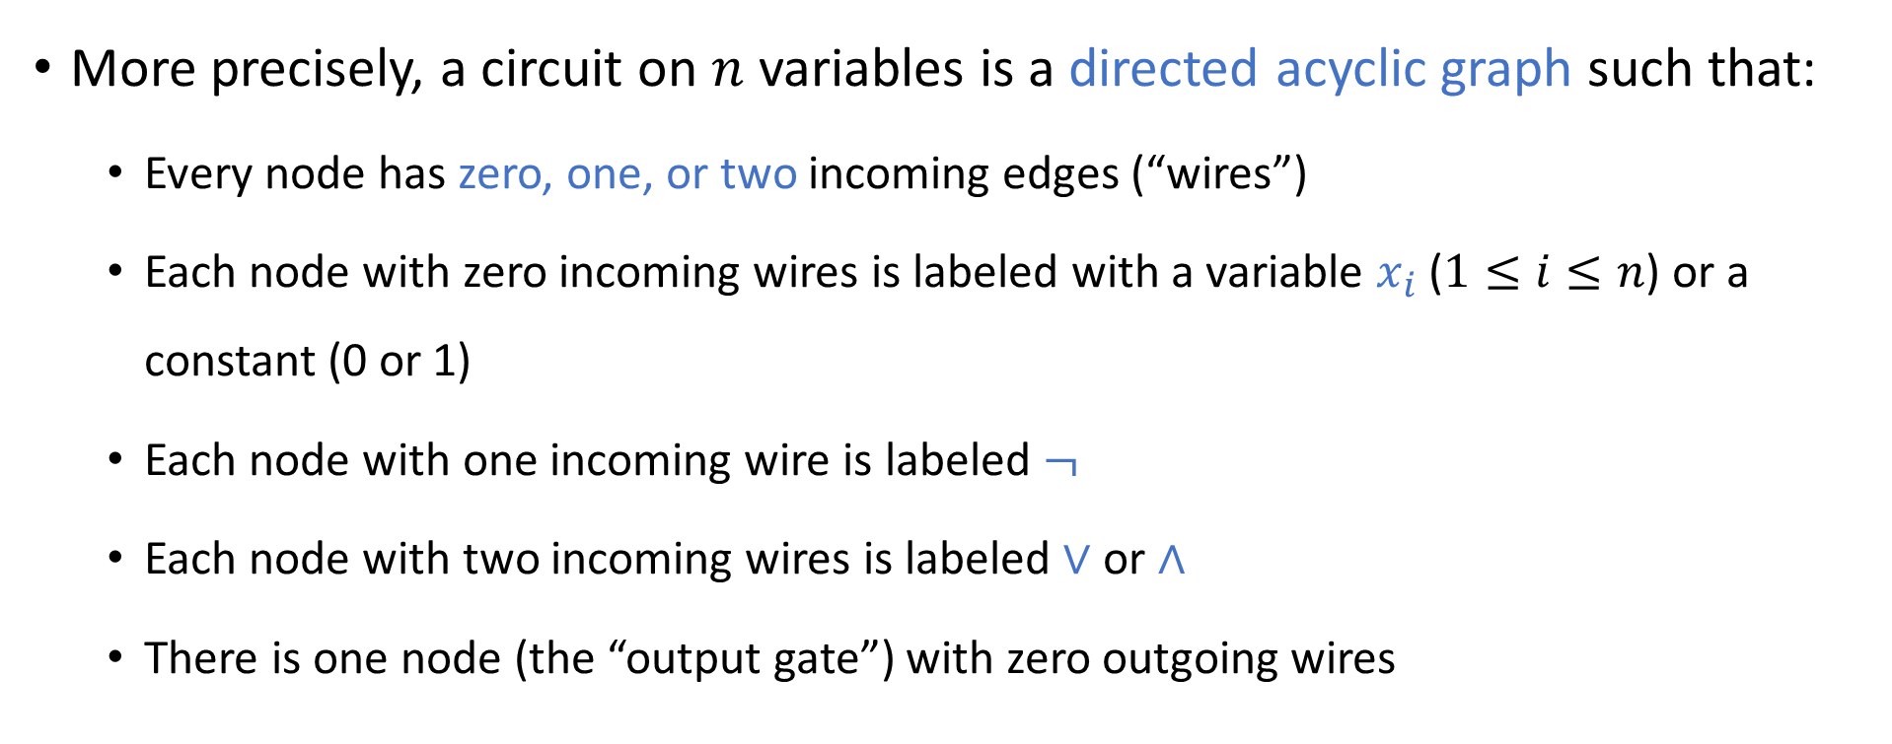
Boolean circuits
More precisely, a circuit on $n$ variables is a directed acyclic graph such that:
Every node has zero, one, or two incoming edges (“wires”)
Each node with zero incoming wires is labeled with a variable $x_{i}$ ($1≤i≤n$) or a constant (0 or 1)
Each node with one incoming wire is labeled $¬$
Each node with two incoming wires is labeled $∨$ or $∧$
There is one node (the “output gate”) with zero outgoing wires

Slide 11
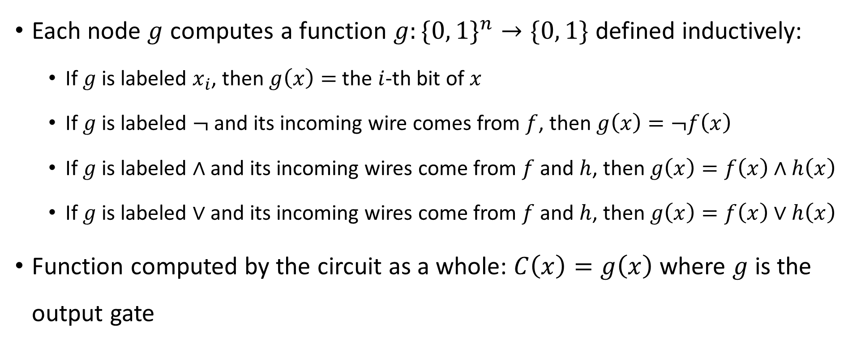
Boolean circuits
Each node $g$ computes a function $g:\{0, 1\}^{n}→\{0, 1\}$ defined inductively:
If $g$ is labeled $x_{i}$, then $g\left(x\right)=$ the $i$-th bit of $x$
If $g$ is labeled $¬$ and its incoming wire comes from $f$, then $g\left(x\right)=¬f\left(x\right)$
If $g$ is labeled $∧$ and its incoming wires come from $f$ and $h$, then $g\left(x\right)=f\left(x\right)∧h\left(x\right)$
If $g$ is labeled $∨$ and its incoming wires come from $f$ and $h$, then $g\left(x\right)=f\left(x\right)∨h\left(x\right)$
Function computed by the circuit as a whole: $C\left(x\right)=g\left(x\right)$ where $g$ is the output gate

Slide 12
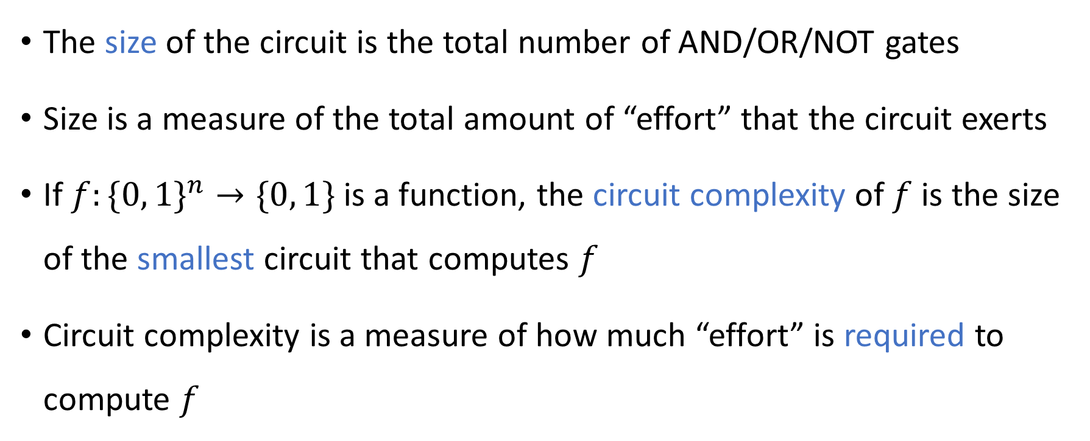
Circuit size
The size of the circuit is the total number of AND/OR/NOT gates
Size is a measure of the total amount of “effort” that the circuit exerts
If $f:\{0, 1\}^{n}→\{0, 1\}$ is a function, the circuit complexity of $f$ is the size of the smallest circuit that computes $f$
Circuit complexity is a measure of how much “effort” is required to compute $f$

Slide 13
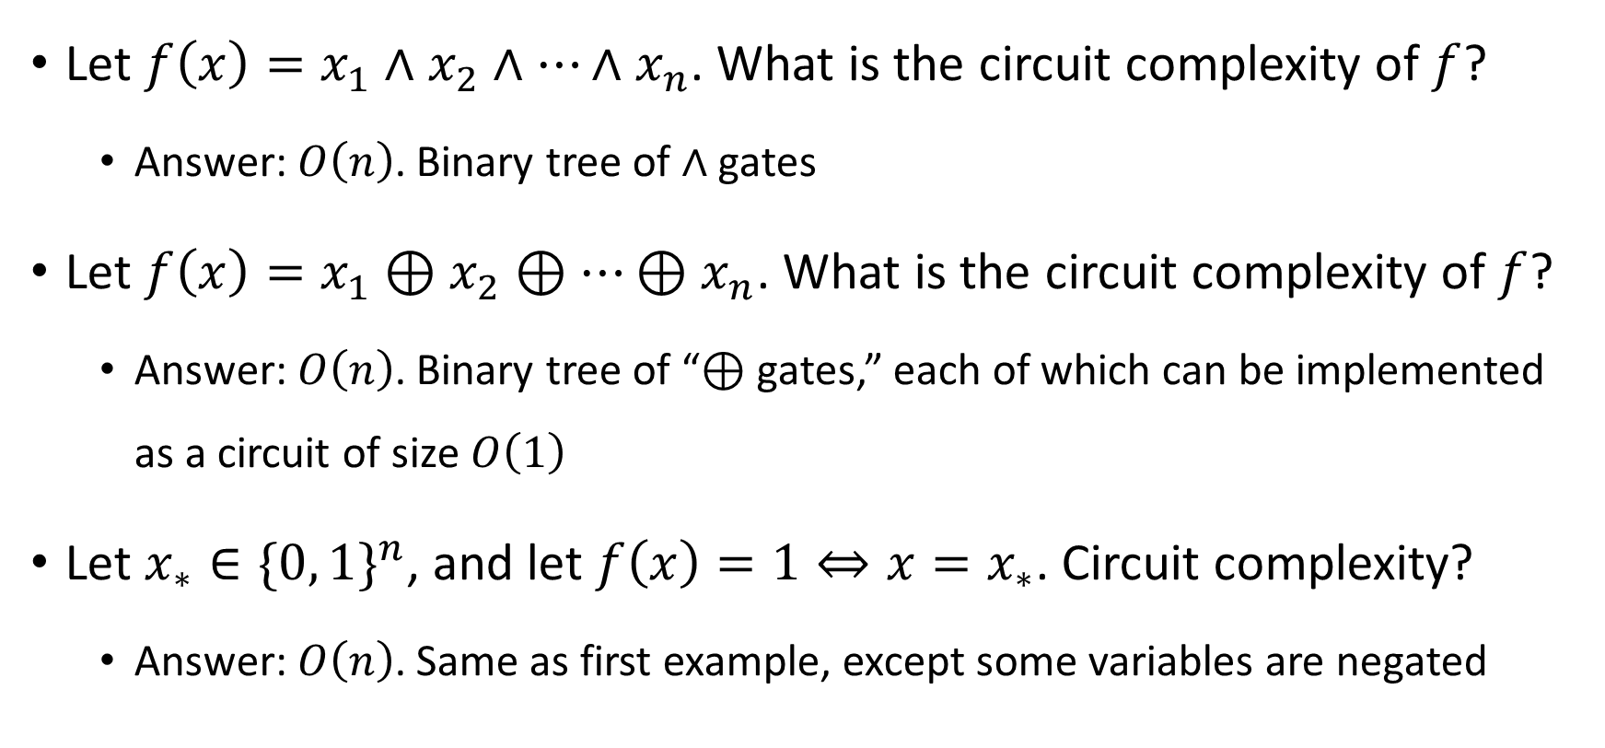
Circuit complexity examples
Let $f\left(x\right)=x_{1}∧x_{2}∧…∧x_{n}$. What is the circuit complexity of $f$?
Answer: $O\left(n\right)$. Binary tree of $∧$ gates
Let $f\left(x\right)=x_{1}⊕x_{2}⊕…⊕x_{n}$. What is the circuit complexity of $f$?
Answer: $O\left(n\right)$. Binary tree of “$⊕$ gates,” each of which can be implemented as a circuit of size $O\left(1\right)$
Let $x_{∗}∈\{0, 1\}^{n}$, and let $f\left(x\right)=1⇔x=x_{∗}$. Circuit complexity?
Answer: $O\left(n\right)$. Same as first example, except some variables are negated

Slide 14
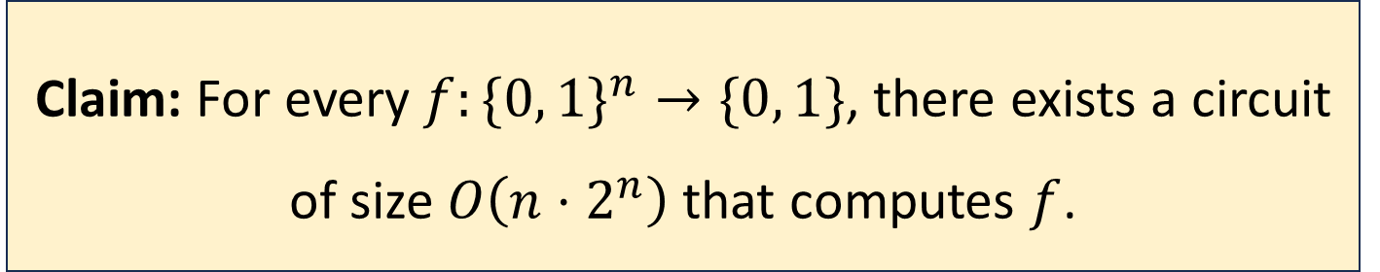
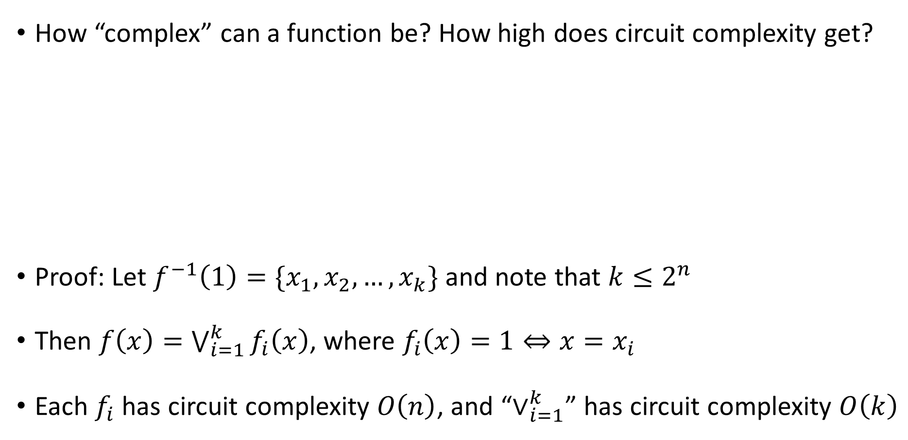
Maximum circuit complexity
How “complex” can a function be? How high does circuit complexity get?
Proof: Let $f^{−1}\left(1\right)=\{x_{1},x_{2},…, x_{k}\}$ and note that $k≤2^{n}$
Then $f\left(x\right)=\bigvee_{i=1}^{k}{f_{i}\left(x\right)}$, where $f_{i}\left(x\right)=1⇔x=x_{i}$
Each $f_{i}$ has circuit complexity $O\left(n\right)$, and “$∨_{i=1}^{k}$” has circuit complexity $O\left(k\right)$
Claim: For every $f:\{0, 1\}^{n}→\{0, 1\}$, there exists a circuit of size $O\left(n⋅2^{n}\right)$ that computes $f$.

Slide 15
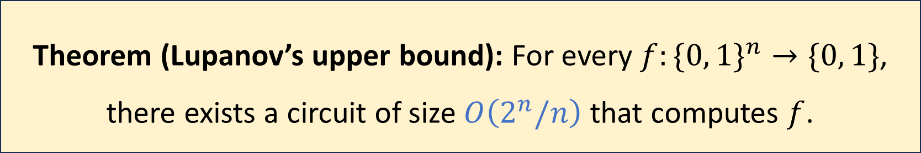
Maximum circuit complexity
Theorem (Lupanov’s upper bound): For every $f:\{0, 1\}^{n}→\{0, 1\}$, there exists a circuit of size $O\left(2^{n}/n\right)$ that computes $f$.
We’ll skip the proof
Is it possible to improve the bound even further?

Slide 16
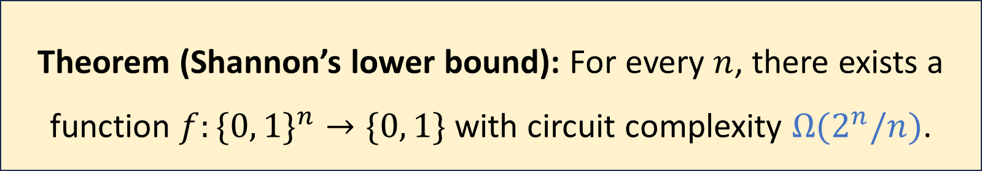
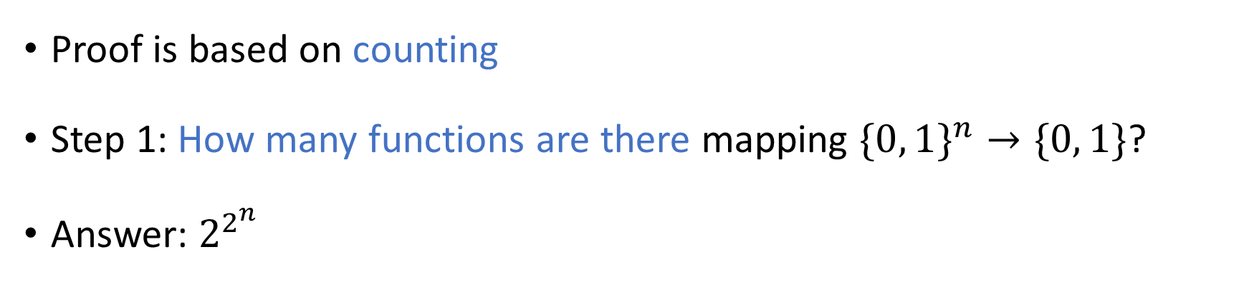
Maximum circuit complexity
Theorem (Shannon’s lower bound): For every $n$, there exists a function $f:\{0, 1\}^{n}→\{0, 1\}$ with circuit complexity $Ω(2^{n}/n)$.
Proof is based on counting
Step 1: How many functions are there mapping $\{0, 1\}^{n}→\{0, 1\}$?
Answer: $2^{2^{n}}$

Slide 17
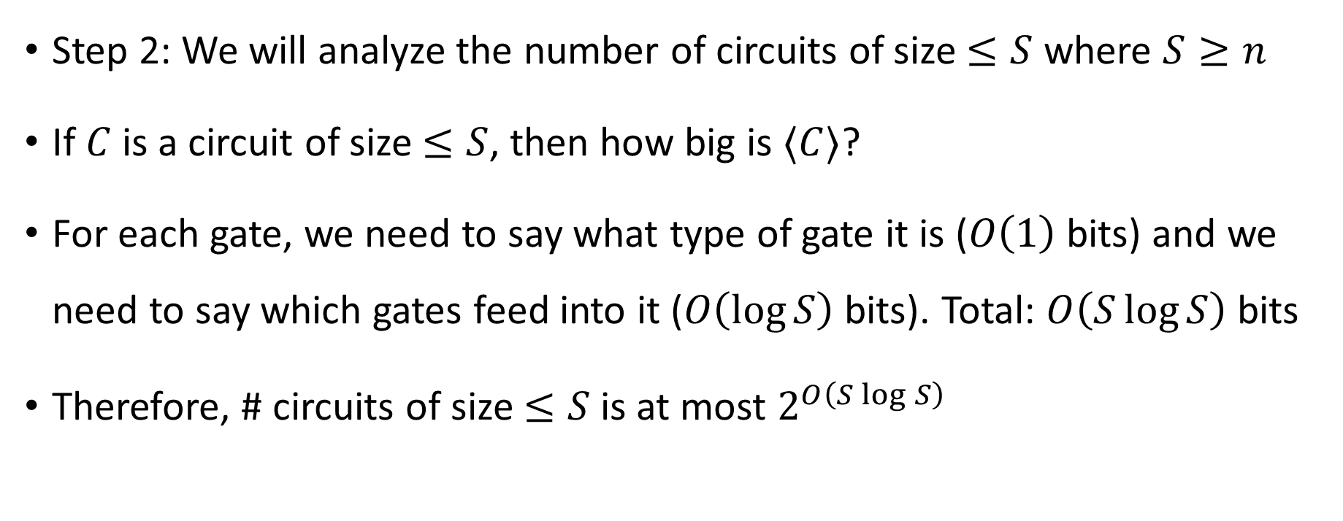
Shannon’s counting argument
Step 2: We will analyze the number of circuits of size $≤S$ where $S≥n$
If $C$ is a circuit of size $≤S$, then how big is $⟨C⟩$?
For each gate, we need to say what type of gate it is ($O\left(1\right)$ bits) and we need to say which gates feed into it ($O\left(\log{S}\right)$ bits). Total: $O\left(S\log{S}\right)$ bits
Therefore, # circuits of size $≤S$ is at most $2^{O\left(S\log{S}\right)}$

Slide 18
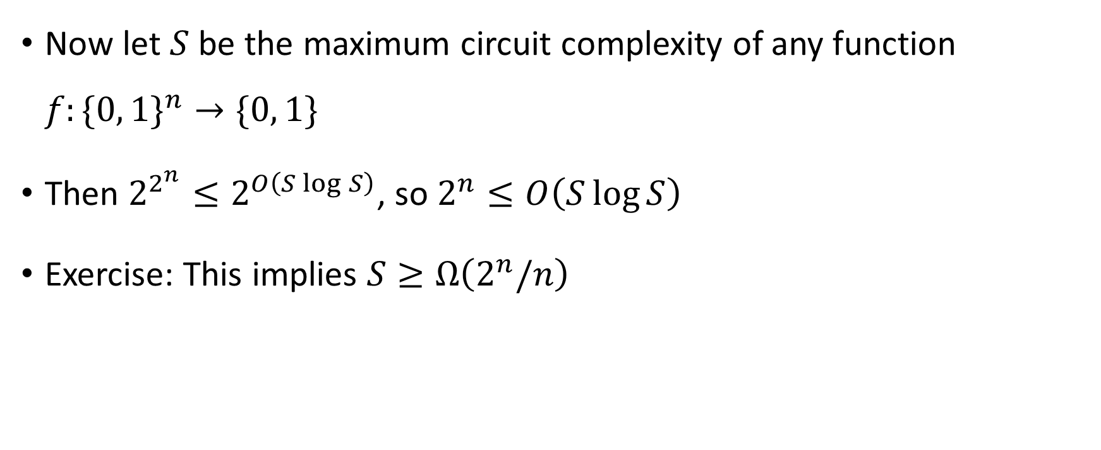
Shannon’s counting argument
Now let $S$ be the maximum circuit complexity of any function $f:\{0, 1\}^{n}→\{0, 1\}$
Then $2^{2^{n}}≤2^{O\left(S\log{S}\right)}$, so $2^{n}≤O\left(S\log{S}\right)$
Exercise: This implies $S≥Ω\left(2^{n}/n\right)$

