Slide 1

CMSC 28100 Introduction to Complexity Theory Spring 2025 Instructor: William Hoza

Slide 2




Sublinear-space computation
Read-only input tape ➡
$$⊔$$
1
1
1
0
$$⊔$$
$$⊔$$
Read-write work tape ➡
$$⊔$$
1
0
#
1
$
0

Slide 3


The complexity class $\text{L}$
$\text{L}$ is the set of languages that can be decided using $O\left(\log{n}\right)$ cells of the work tape

Slide 4





$$\text{EXP}$$
$$\text{PSPACE}$$
$$\text{NP}$$
$$\text{P}$$
$$\text{L}$$

Slide 5
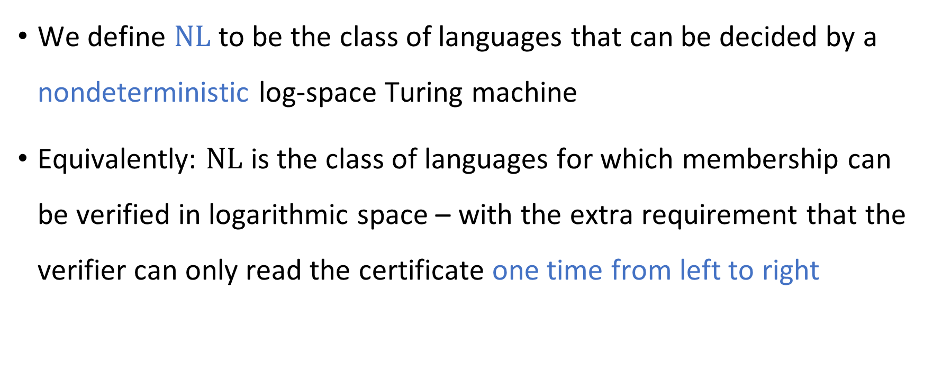
Nondeterministic log space computation
We define $\text{NL}$ to be the class of languages that can be decided by a nondeterministic log-space Turing machine
Equivalently: $\text{NL}$ is the class of languages for which membership can be verified in logarithmic space – with the extra requirement that the verifier can only read the certificate one time from left to right

Slide 6
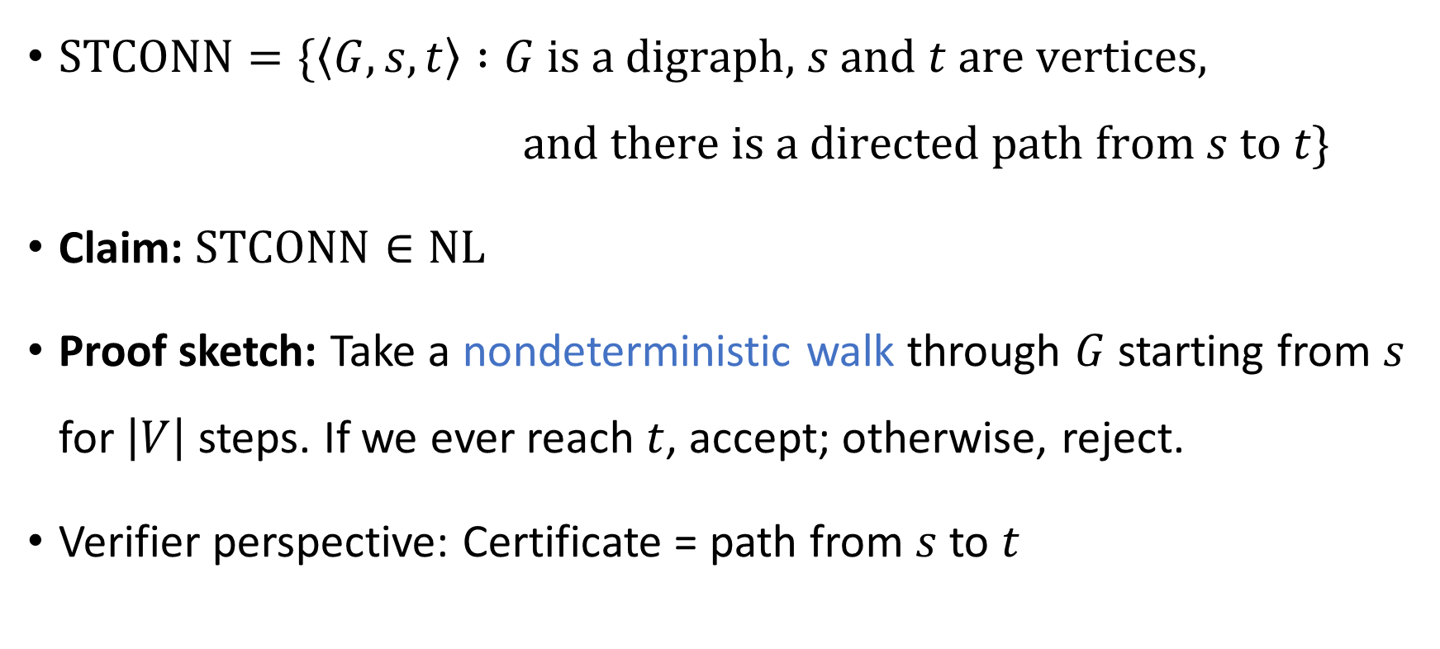

The $s$-$t$ connectivity problem
$\text{STCONN}=\{\left\langle G,s,t\right\rangle :G \text{is} \text{a} \text{digraph}\text{,} s \text{and} t \text{are} \text{vertices}\text{,}$ $\text{and} \text{there} \text{is} \text{a} \text{directed} \text{path} \text{from} s \text{to} t\}$
Claim: $\text{STCONN}∈\text{NL}$
Proof sketch: Take a nondeterministic walk through $G$ starting from $s$ for $\left|V\right|$ steps. If we ever reach $t$, accept; otherwise, reject.
Verifier perspective: Certificate = path from $s$ to $t$

Slide 7



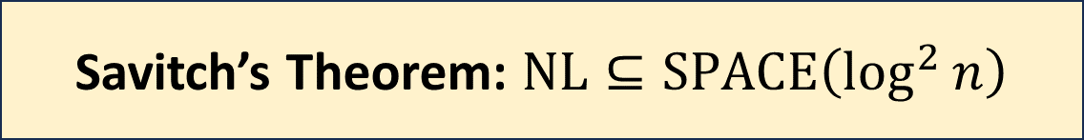
Two surprises about $\text{NL}$
We expect that $\text{P}≠\text{NP}$. However, in the space complexity world…
We expect that $\text{NP}≠\text{coNP}$. However, in the space complexity world…
Savitch’s Theorem: $\text{NL}⊆\text{SPACE}\left(\log^{2}{n}\right)$
Immerman-Szelepcsényi Theorem: $\text{NL}=\text{coNL}$

Slide 8

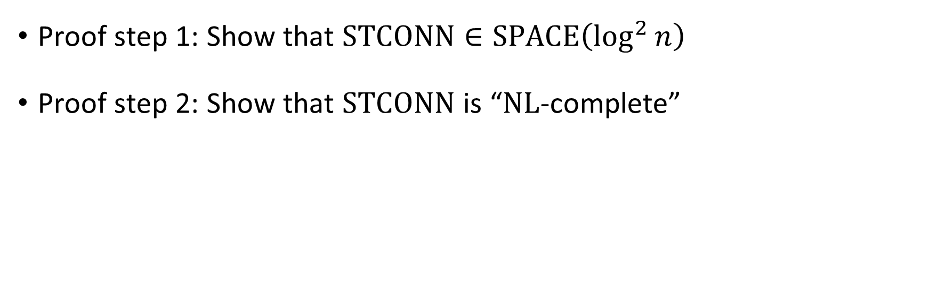
Proof of Savitch’s theorem
Savitch’s Theorem: $\text{NL}⊆\text{SPACE}\left(\log^{2}{n}\right)$
Proof step 1: Show that $\text{STCONN}∈\text{SPACE}\left(\log^{2}{n}\right)$
Proof step 2: Show that $\text{STCONN}$ is “$\text{NL}$-complete”

Slide 9
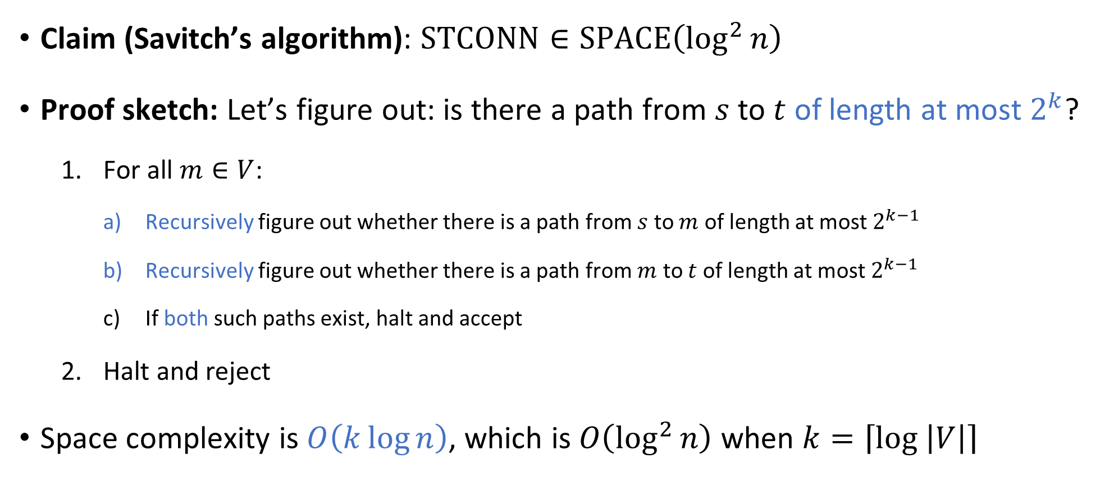
Savitch’s algorithm
Claim (Savitch’s algorithm): $\text{STCONN}∈\text{SPACE}\left(\log^{2}{n}\right)$
Proof sketch: Let’s figure out: is there a path from $s$ to $t$ of length at most $2^{k}$?
For all $m∈V$:
Recursively figure out whether there is a path from $s$ to $m$ of length at most $2^{k−1}$
Recursively figure out whether there is a path from $m$ to $t$ of length at most $2^{k−1}$
If both such paths exist, halt and accept
Halt and reject
Space complexity is $O\left(k\log{n}\right)$, which is $O\left(\log^{2}{n}\right)$ when $k=\left\lceil \log\left|V\right|\right\rceil$

Slide 10
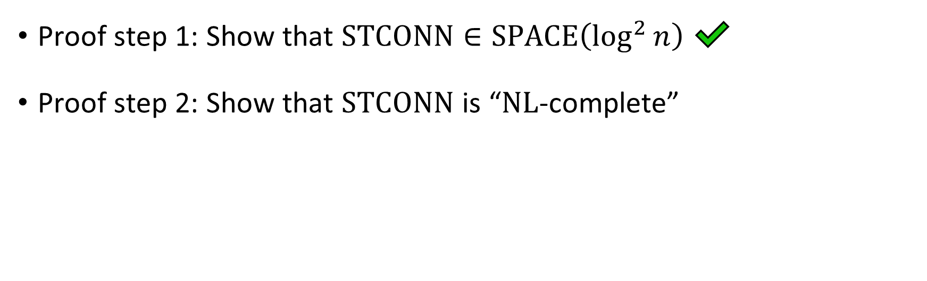
Proof of Savitch’s theorem
Savitch’s Theorem: $\text{NL}⊆\text{SPACE}\left(\log^{2}{n}\right)$
Proof step 1: Show that $\text{STCONN}∈\text{SPACE}\left(\log^{2}{n}\right)$ ✔️
Proof step 2: Show that $\text{STCONN}$ is “$\text{NL}$-complete”

Slide 11
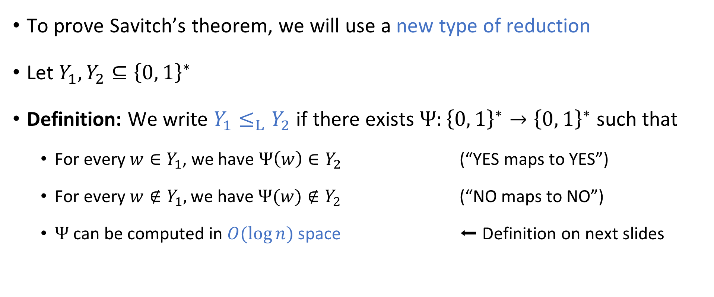
Log-space reductions
To prove Savitch’s theorem, we will use a new type of reduction
Let $Y_{1},Y_{2}⊆{\left\{0, 1\right\}}^{∗}$
Definition: We write $Y_{1}≤_{L}Y_{2}$ if there exists $Ψ:{\left\{0, 1\right\}}^{∗}→{\left\{0, 1\right\}}^{∗}$ such that
For every $w∈Y_{1}$, we have $Ψ\left(w\right)∈Y_{2}$ (“YES maps to YES”)
For every $w∉Y_{1},$ we have $Ψ(w)∉Y_{2}$ (“NO maps to NO”)
$Ψ$ can be computed in $O(\log{n})$ space ⬅ Definition on next slides

Slide 12






Space-bounded “transducer”
Read-only input tape ➡
$$⊔$$
1
1
1
0
$$⊔$$
$$⊔$$
Read-write work tape ➡
$$⊔$$
1
$
1
#
$$⊔$$
$$⊔$$
Write-only output tape ➡
$$⊔$$
1
1
1
0
0
1

Slide 13
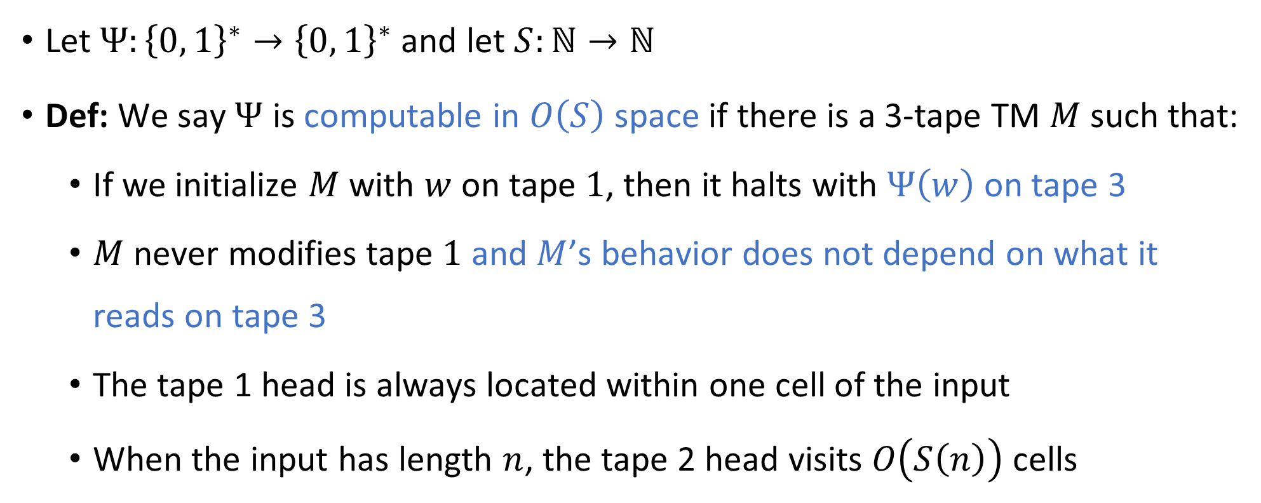
Space complexity for string-valued functions
Let $Ψ:{\left\{0, 1\right\}}^{∗}→{\left\{0, 1\right\}}^{∗}$ and let $S:ℕ→ℕ$
Def: We say $Ψ$ is computable in $O\left(S\right)$ space if there is a 3-tape TM $M$ such that:
If we initialize $M$ with $w$ on tape $1$, then it halts with $Ψ\left(w\right)$ on tape 3
$M$ never modifies tape $1$ and $M$’s behavior does not depend on what it reads on tape 3
The tape 1 head is always located within one cell of the input
When the input has length $n$, the tape 2 head visits $O\left(S\left(n\right)\right)$ cells

Slide 14

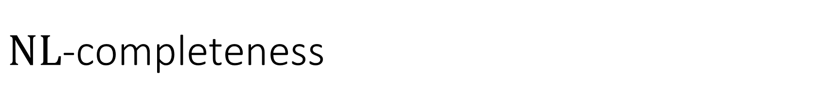
$\text{NL}$-completeness
Let $Y⊆{\left\{0, 1\right\}}^{∗}$
Definition: We say that $Y$ is $\text{NL}$-complete if $Y∈\text{NL}$ and for every $Z∈\text{NL}$, we have $Z≤_{L}Y$

Slide 15
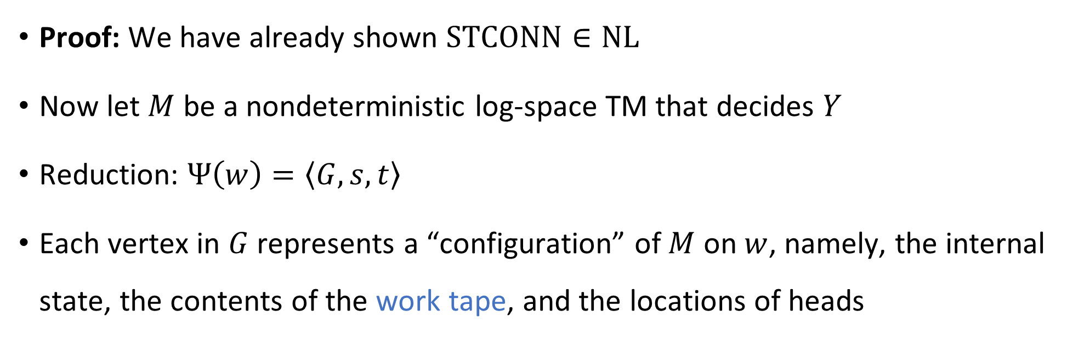


$\text{STCONN}$ is $\text{NL}$-complete
Theorem: $\text{STCONN}$ is $\text{NL}$-complete
Proof: We have already shown $\text{STCONN}∈\text{NL}$
Now let $M$ be a nondeterministic log-space TM that decides $Y$
Reduction: $Ψ\left(w\right)=\left\langle G,s,t\right\rangle$
Each vertex in $G$ represents a “configuration” of $M$ on $w$, namely, the internal state, the contents of the work tape, and the locations of heads

Slide 16
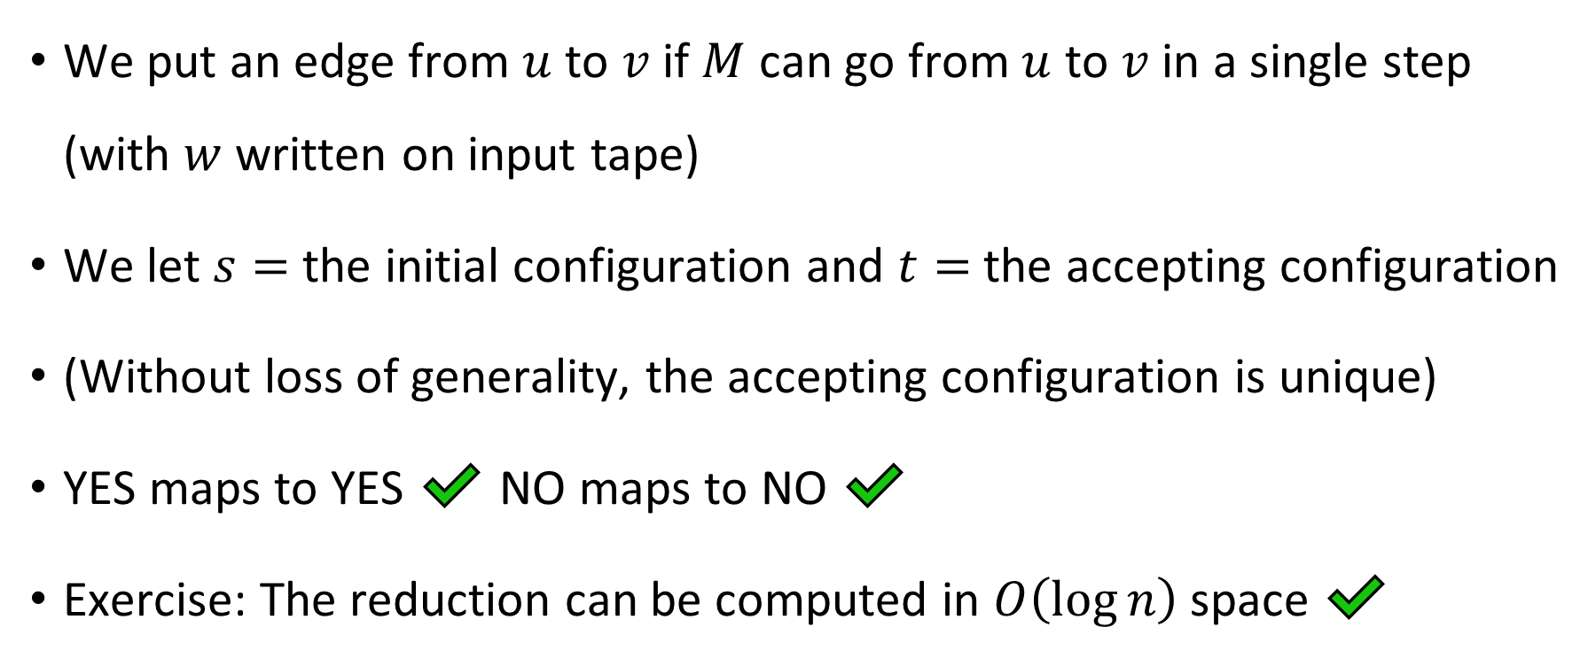

$\text{STCONN}$ is $\text{NL}$-complete
We put an edge from $u$ to $v$ if $M$ can go from $u$ to $v$ in a single step (with $w$ written on input tape)
We let $s=$ the initial configuration and $t=$ the accepting configuration
(Without loss of generality, the accepting configuration is unique)
YES maps to YES ✔️ NO maps to NO ✔️
Exercise: The reduction can be computed in $O\left(\log{n}\right)$ space ✔️

Slide 17
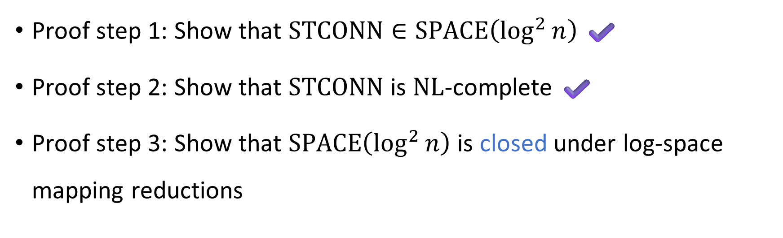
Proof of Savitch’s theorem
Savitch’s Theorem: $\text{NL}⊆\text{SPACE}\left(\log^{2}{n}\right)$
Proof step 1: Show that $\text{STCONN}∈\text{SPACE}\left(\log^{2}{n}\right)$ ✔️
Proof step 2: Show that $\text{STCONN}$ is $\text{NL}$-complete ✔️
Proof step 3: Show that $\text{SPACE}\left(\log^{2}{n}\right)$ is closed under log-space mapping reductions

Slide 18
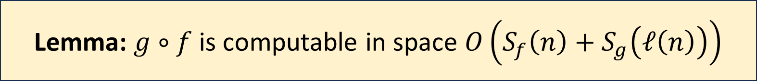
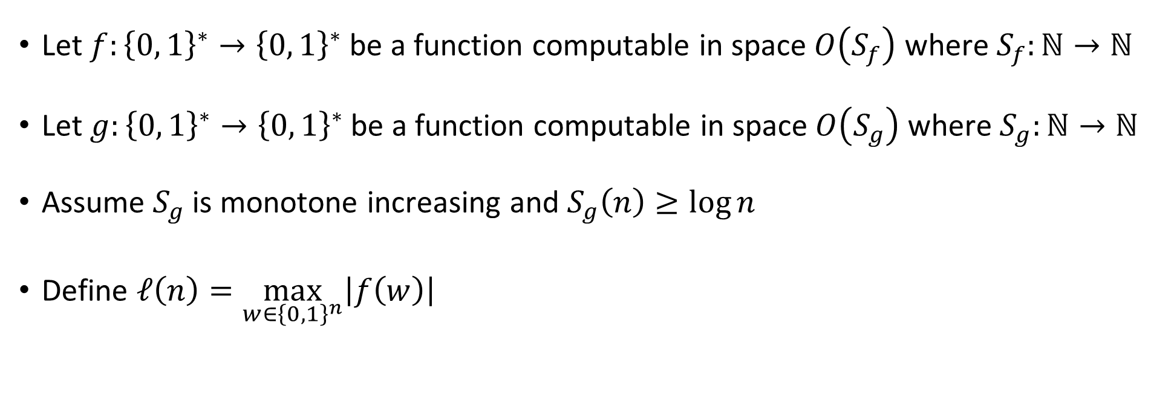
Composing space-bounded algorithms
Let $f:{\left\{0, 1\right\}}^{∗}→{\left\{0, 1\right\}}^{∗}$ be a function computable in space $O\left(S_{f}\right)$ where $S_{f}:ℕ→ℕ$
Let $g:{\left\{0, 1\right\}}^{∗}→{\left\{0, 1\right\}}^{∗}$ be a function computable in space $O\left(S_{g}\right)$ where $S_{g}:ℕ→ℕ$
Assume $S_{g}$ is monotone increasing and $S_{g}\left(n\right)≥\log{n}$
Define $ℓ\left(n\right)=\max_{w∈{\left\{0, 1\right\}}^{n}}\left|f\left(w\right)\right|$
Lemma: $g∘f$ is computable in space $O\left(S_{f}\left(n\right)+S_{g}\left(ℓ\left(n\right)\right)\right)$

Slide 19

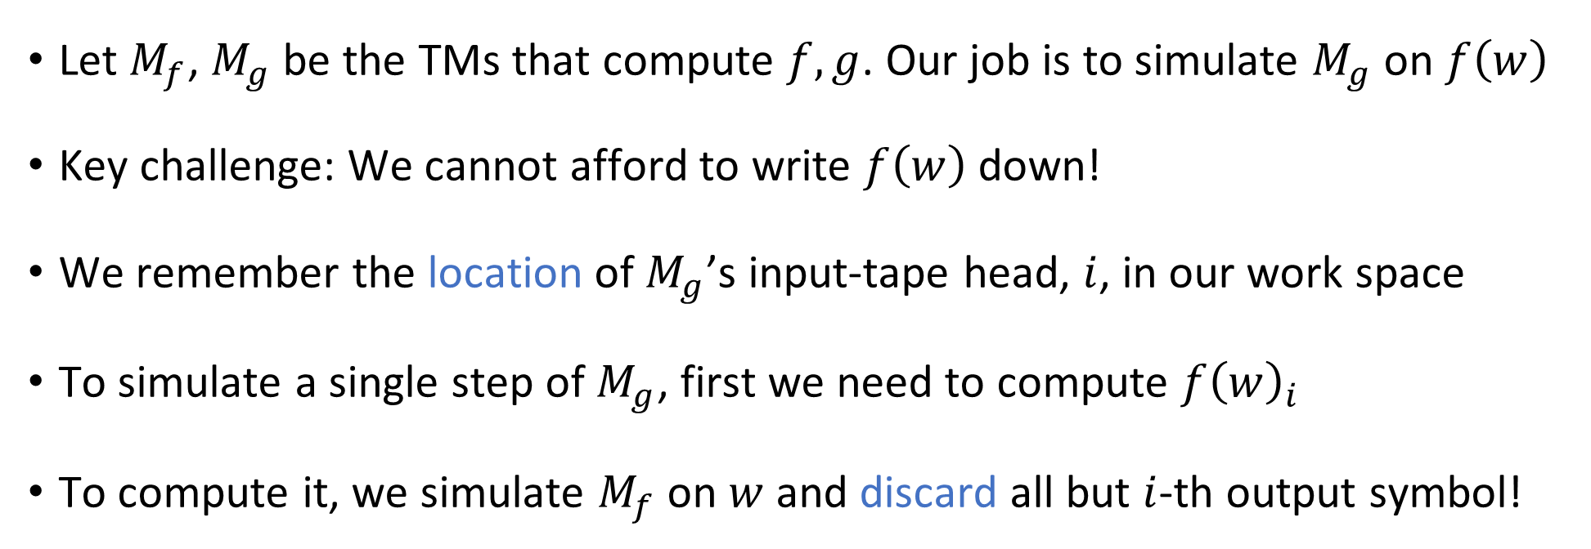
Composing space-bounded algorithms
Lemma: $g∘f$ is computable in space $O\left(S_{f}\left(n\right)+S_{g}\left(ℓ\left(n\right)\right)\right)$
Let $M_{f}$, $M_{g}$ be the TMs that compute $f,g$. Our job is to simulate $M_{g}$ on $f\left(w\right)$
Key challenge: We cannot afford to write $f\left(w\right)$ down!
We remember the location of $M_{g}$’s input-tape head, $i$, in our work space
To simulate a single step of $M_{g}$, first we need to compute $f{\left(w\right)}_{i}$
To compute it, we simulate $M_{f}$ on $w$ and discard all but $i$-th output symbol!

Slide 20
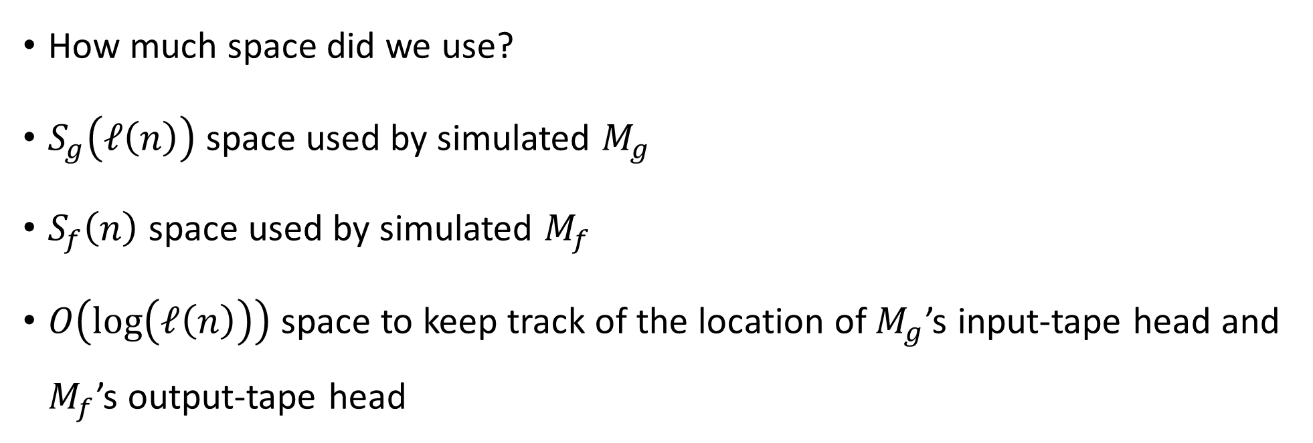
Composing space-bounded algorithms
Lemma: $g∘f$ is computable in space $O\left(S_{f}\left(n\right)+S_{g}\left(ℓ\left(n\right)\right)\right)$
How much space did we use?
$S_{g}\left(ℓ\left(n\right)\right)$ space used by simulated $M_{g}$
$S_{f}\left(n\right)$ space used by simulated $M_{f}$
$O\left(\log\left(ℓ\left(n\right)\right)\right)$ space to keep track of the location of $M_{g}$’s input-tape head and $M_{f}$’s output-tape head

Slide 21
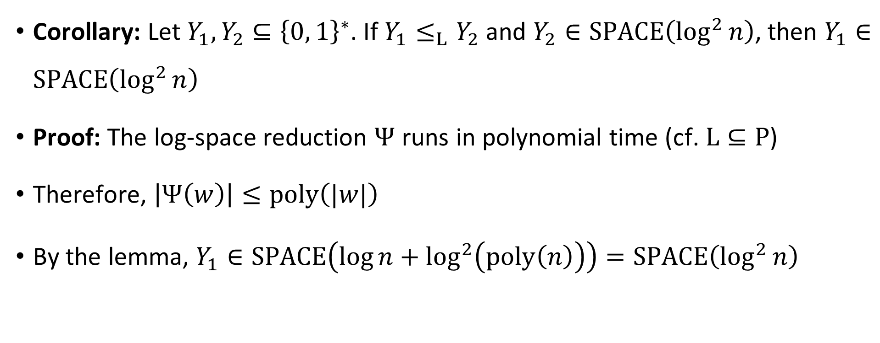
Closure under reductions
Corollary: Let $Y_{1},Y_{2}⊆{\left\{0, 1\right\}}^{∗}$. If $Y_{1}≤_{L}Y_{2}$ and $Y_{2}∈\text{SPACE}\left(\log^{2}{n}\right)$, then $Y_{1}∈\text{SPACE}\left(\log^{2}{n}\right)$
Proof: The log-space reduction $Ψ$ runs in polynomial time (cf. $\text{L}⊆\text{P}$)
Therefore, $\left|Ψ\left(w\right)\right|≤\text{poly}\left(|w|\right)$
By the lemma, $Y_{1}∈\text{SPACE}\left(\log{n}+\log^{2}\left(\text{poly}\left(n\right)\right)\right)=\text{SPACE}\left(\log^{2}{n}\right)$

Slide 22
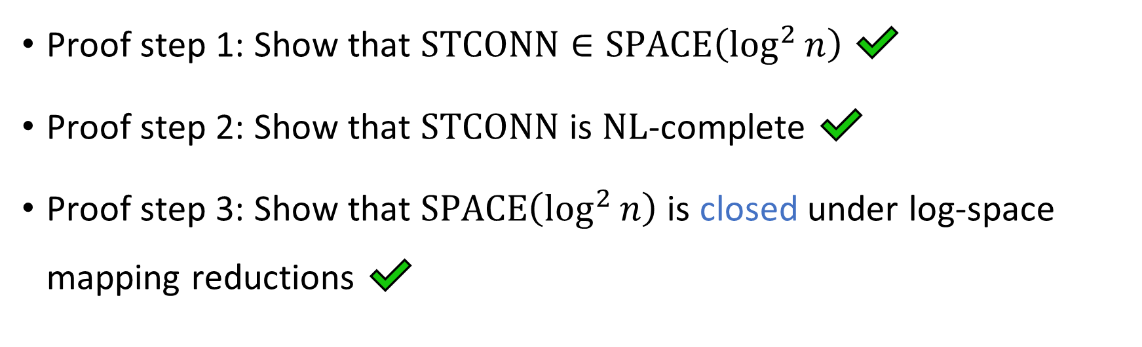
Proof of Savitch’s theorem
Savitch’s Theorem: $\text{NL}⊆\text{SPACE}\left(\log^{2}{n}\right)$
Proof step 1: Show that $\text{STCONN}∈\text{SPACE}\left(\log^{2}{n}\right)$ ✔️
Proof step 2: Show that $\text{STCONN}$ is $\text{NL}$-complete ✔️
Proof step 3: Show that $\text{SPACE}\left(\log^{2}{n}\right)$ is closed under log-space mapping reductions ✔️

