Slide 1
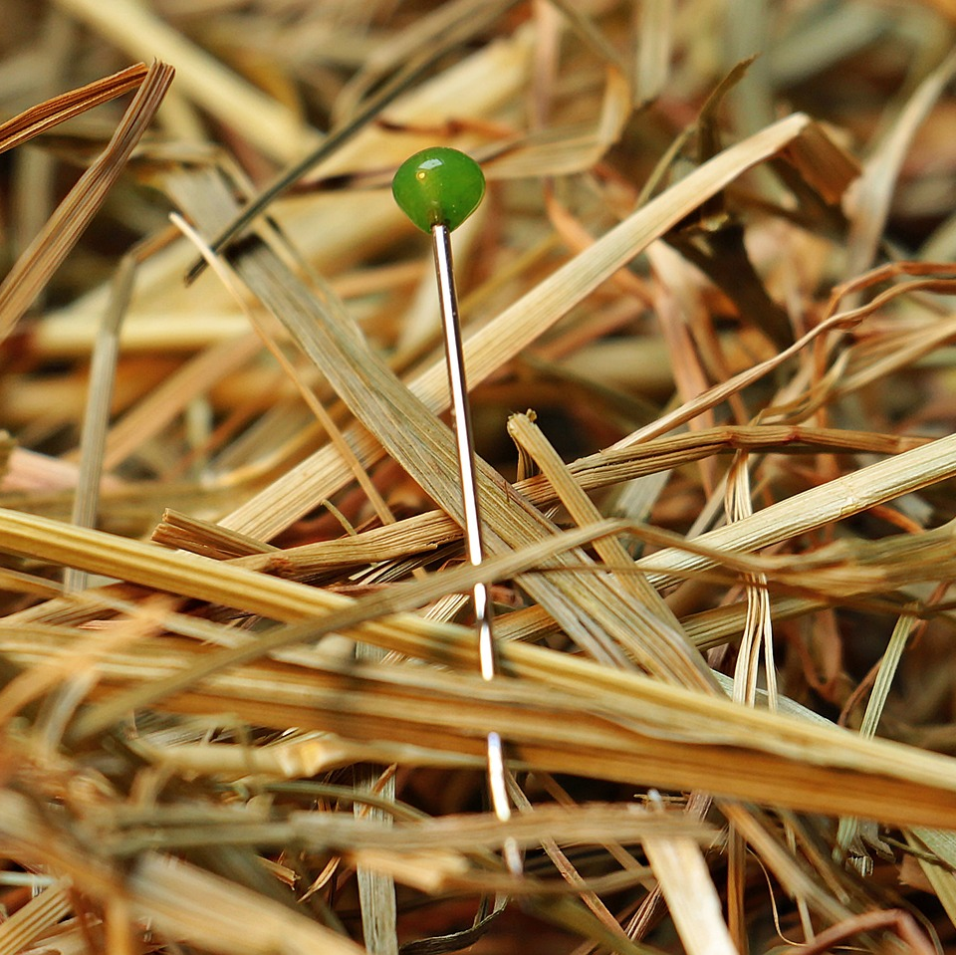
CMSC 28100 Introduction to Complexity Theory Spring 2024 Instructor: William Hoza

Slide 2
Asymptotic analysis

Slide 3
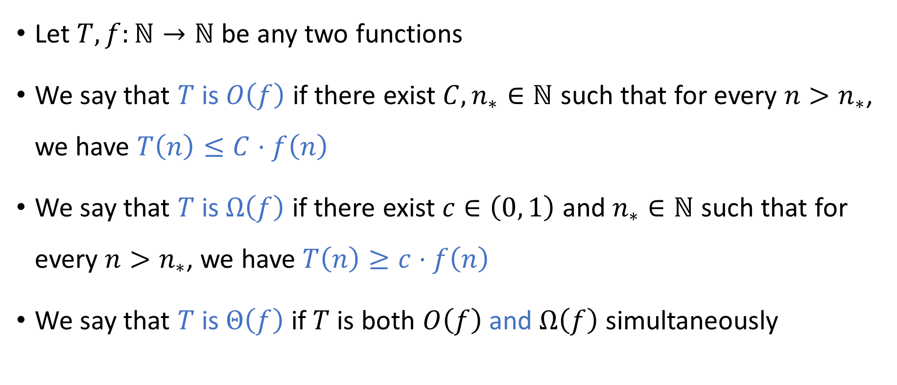
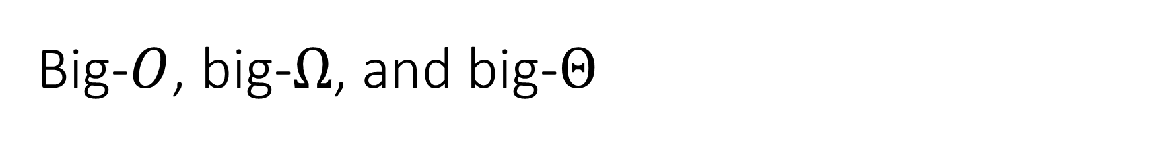
Big-$O$, big-$Ω$, and big-$Θ$
Let $T,f:ℕ→ℕ$ be any two functions
We say that $T$ is $O\left(f\right)$ if there exist ${C,n}_{∗}∈ℕ$ such that for every $n>n_{∗}$, we have $T\left(n\right)≤C⋅f\left(n\right)$
We say that $T$ is $Ω\left(f\right)$ if there exist $c∈\left(0, 1\right)$ and $n_{∗}∈ℕ$ such that for every $n>n_{∗}$, we have $T\left(n\right)≥c⋅f\left(n\right)$
We say that $T$ is $Θ\left(f\right)$ if $T$ is both $O\left(f\right)$ and $Ω\left(f\right)$ simultaneously

Slide 4
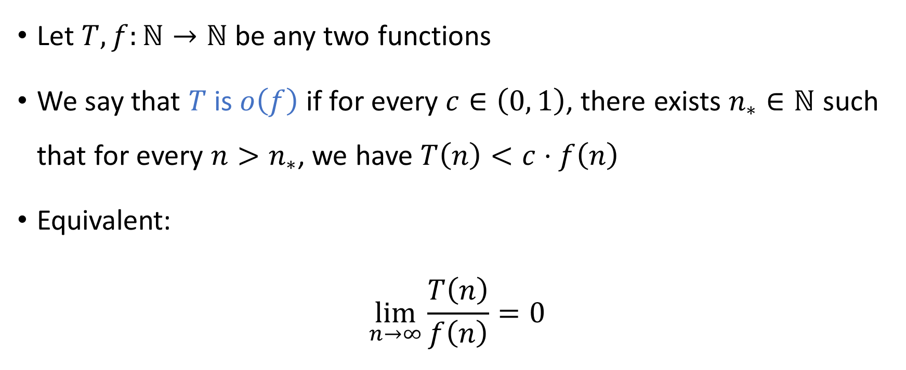

Little-$o$ notation
Let $T,f:ℕ→ℕ$ be any two functions
We say that $T$ is $o\left(f\right)$ if for every $c∈\left(0, 1\right)$, there exists $n_{∗}∈ℕ$ such that for every $n>n_{∗}$, we have $T\left(n\right)<c⋅f\left(n\right)$
Equivalent:
$$\lim_{n→∞}{\frac{T\left(n\right)}{f\left(n\right)}}=0$$

Slide 5
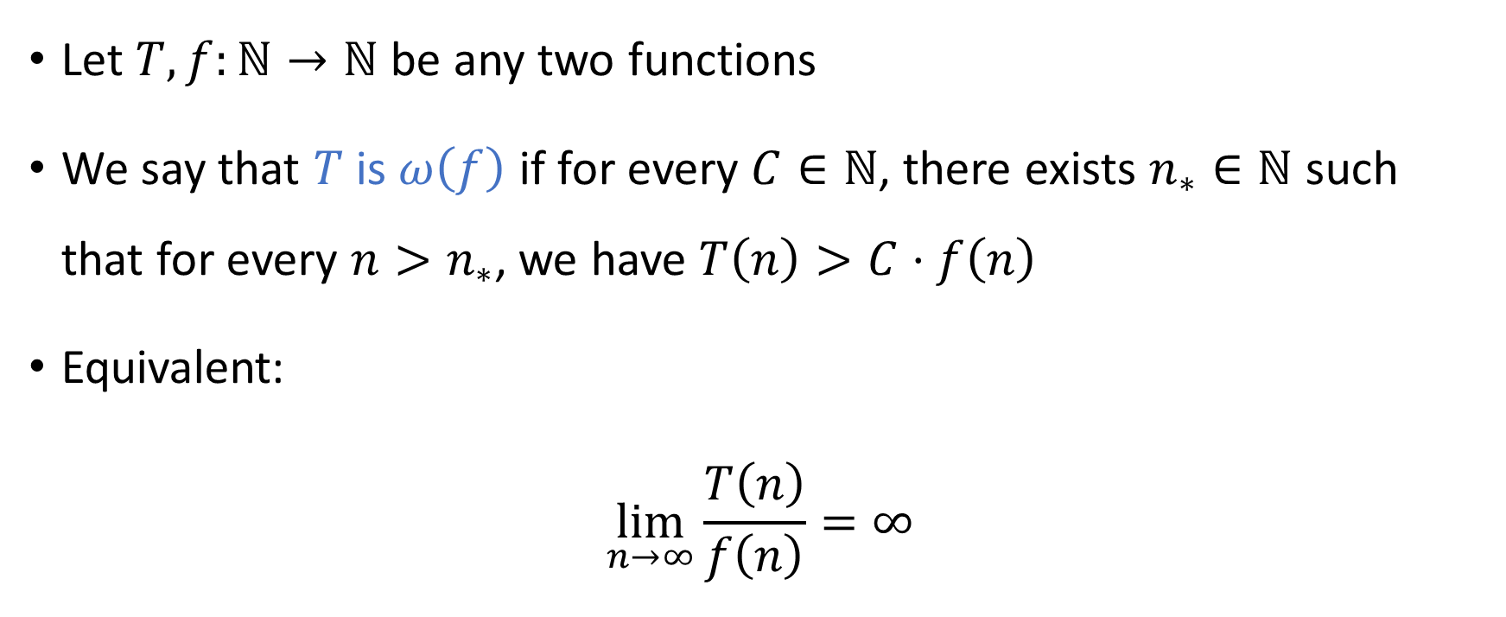

Little-$ω$ notation
Let $T,f:ℕ→ℕ$ be any two functions
We say that $T$ is $ω\left(f\right)$ if for every $C∈ℕ$, there exists $n_{∗}∈ℕ$ such that for every $n>n_{∗}$, we have $T\left(n\right)>C⋅f\left(n\right)$
Equivalent:
$$\lim_{n→∞}{\frac{T\left(n\right)}{f\left(n\right)}}=∞$$

Slide 6
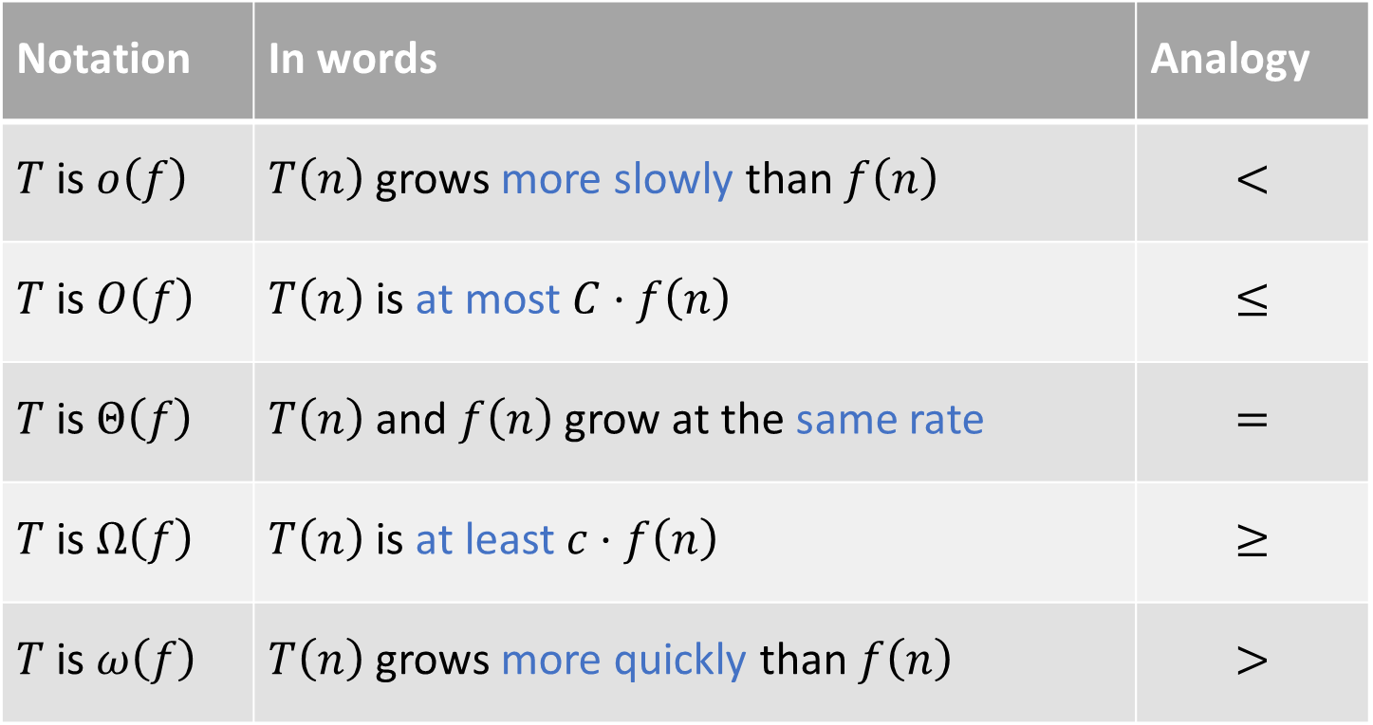
Summary of asymptotic notation
Notation | In words | Analogy
$T$ is $o\left(f\right)$ | $T\left(n\right)$ grows more slowly than $f\left(n\right)$ | $$<$$
$T$ is $O\left(f\right)$ | $T\left(n\right)$ is at most $C⋅f\left(n\right)$ | $$≤$$
$T$ is $Θ\left(f\right)$ | $T\left(n\right)$ and $f\left(n\right)$ grow at the same rate | $$=$$
$T$ is $Ω\left(f\right)$ | $T\left(n\right)$ is at least $c⋅f\left(n\right)$ | $$≥$$
$T$ is $ω\left(f\right)$ | $T\left(n\right)$ grows more quickly than $f\left(n\right)$ | $$>$$

Slide 7
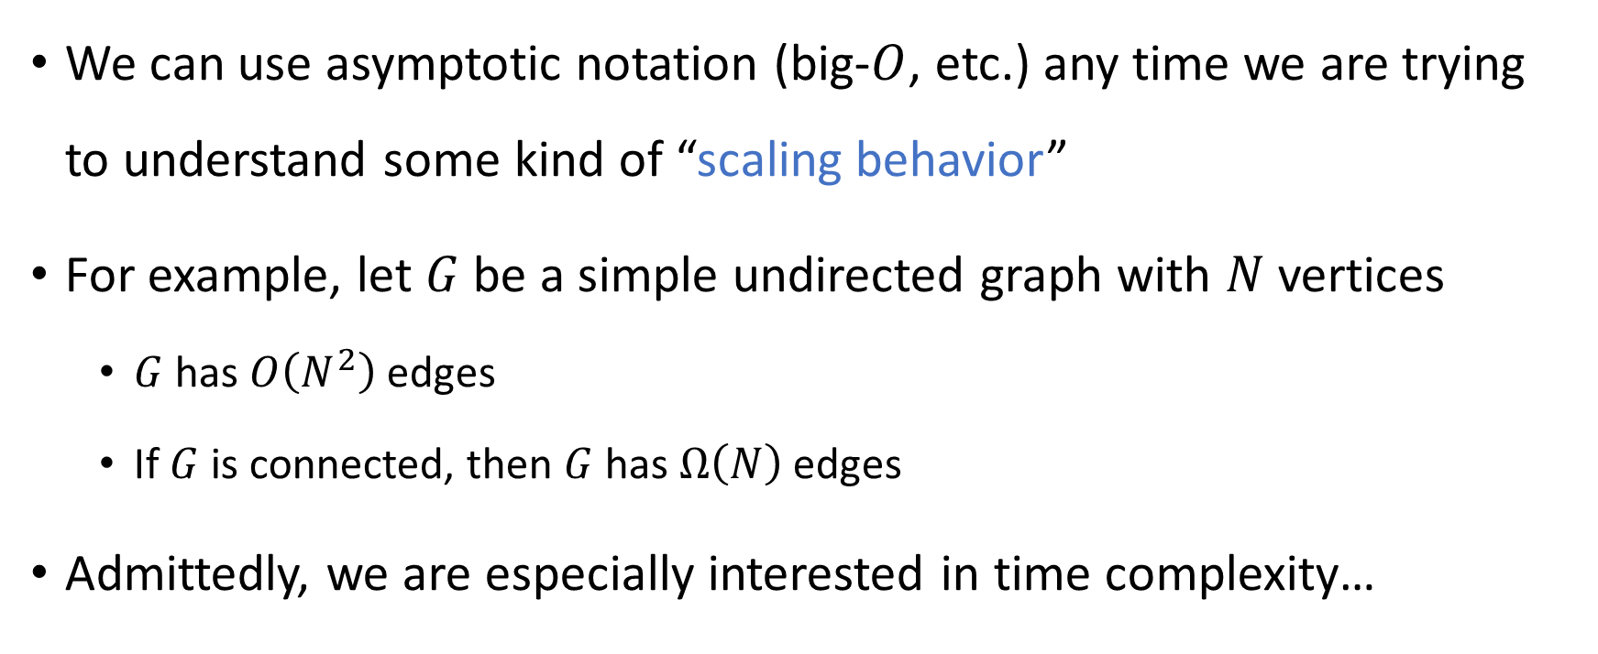
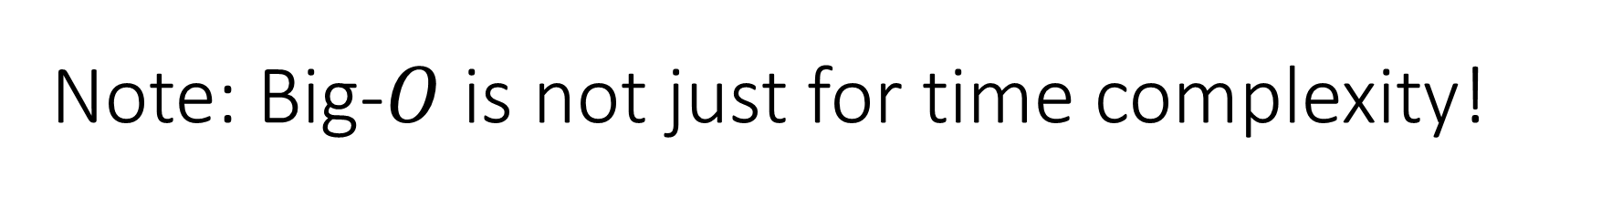
Note: Big-$O$ is not just for time complexity!
We can use asymptotic notation (big-$O$, etc.) any time we are trying to understand some kind of “scaling behavior”
For example, let $G$ be a simple undirected graph with $N$ vertices
$G$ has $O\left(N^{2}\right)$ edges
If $G$ is connected, then $G$ has $Ω\left(N\right)$ edges
Admittedly, we are especially interested in time complexity…

Slide 8
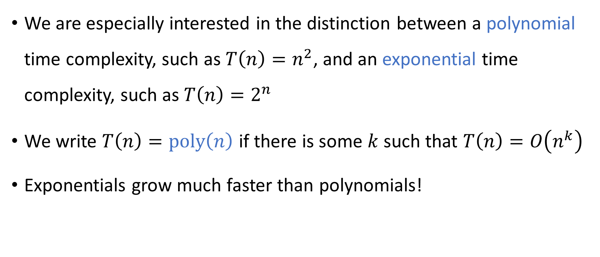
Exponential vs. polynomial
We are especially interested in the distinction between a polynomial time complexity, such as ${T\left(n\right)=n}^{2}$, and an exponential time complexity, such as $T\left(n\right)=2^{n}$
We write $T\left(n\right)=\text{poly}\left(n\right)$ if there is some $k$ such that $T\left(n\right)=O\left(n^{k}\right)$
Exponentials grow much faster than polynomials!

Slide 9
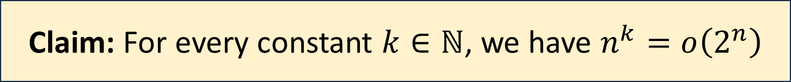
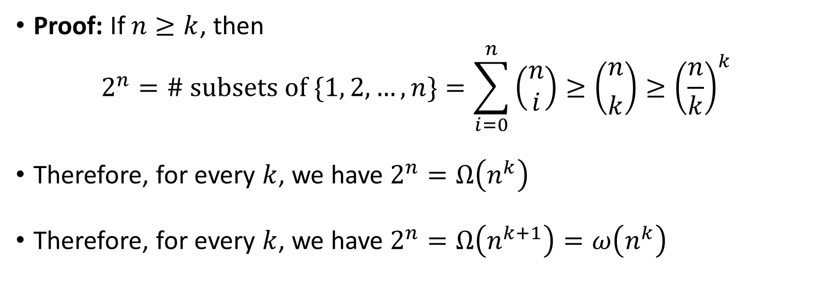
Exponential vs. polynomial
Claim: For every constant $k∈ℕ$, we have $n^{k}=o\left(2^{n}\right)$
Proof: If $n≥k$, then $2^{n}=\# \text{subsets} \text{of} \{1, 2, …, n\}=\sum_{i=0}^{n}{\left(\begin{aligned}n \\ i\end{aligned}\right)}≥\left({n \atop k}\right)≥{\left(\frac{n}{k}\right)}^{k}$
Therefore, for every $k$, we have $2^{n}=Ω\left(n^{k}\right)$
Therefore, for every $k$, we have $2^{n}=Ω\left(n^{k+1}\right)=ω\left(n^{k}\right)$

Slide 10
Which problems can be solved through computation?

Slide 11
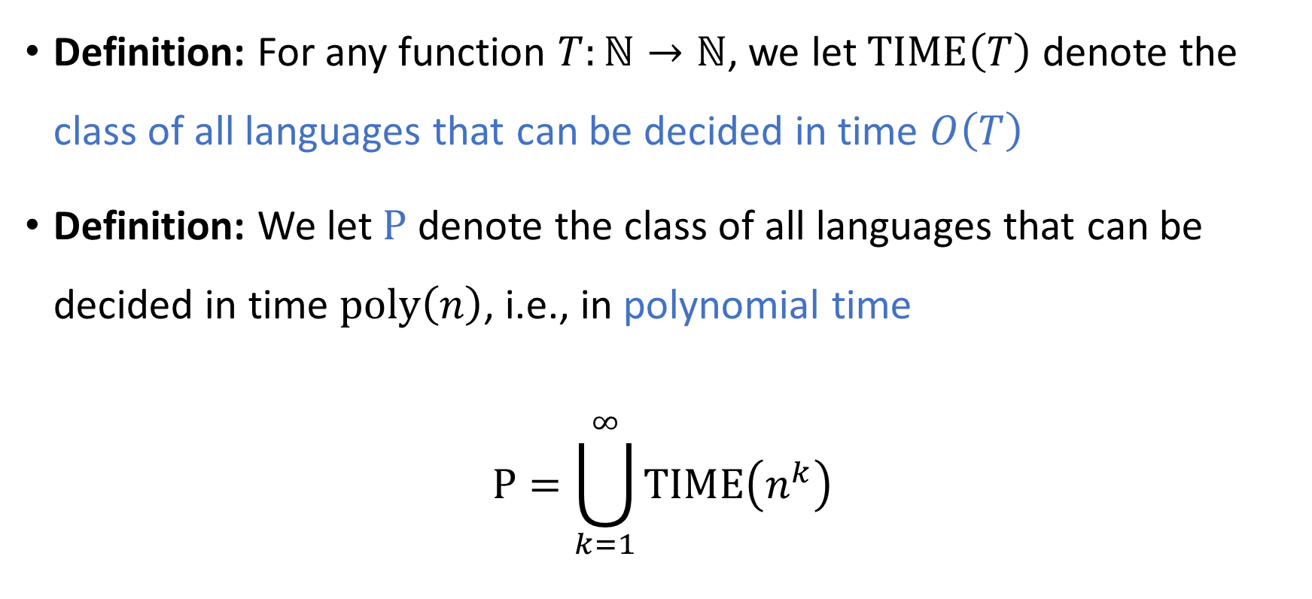

The complexity class $\text{P}$
Definition: For any function $T:ℕ→ℕ$, we let $\text{TIME}\left(T\right)$ denote the class of all languages that can be decided in time $O\left(T\right)$
Definition: We let $\text{P}$ denote the class of all languages that can be decided in time $\text{poly}\left(n\right)$, i.e., in polynomial time
$$\text{P}=\bigcup_{k=1}^{∞}{\text{TIME}\left(n^{k}\right)}$$

Slide 12

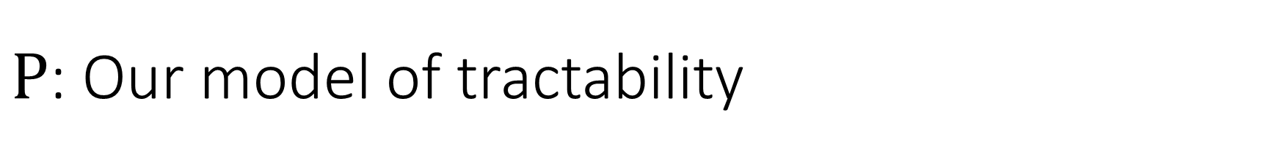
$\text{P}$: Our model of tractability
Let $L$ be a language
If $L∈\text{P}$, then we will consider $L$ “tractable”
If $L∉\text{P}$, then we will consider $L$ “intractable”

Slide 13
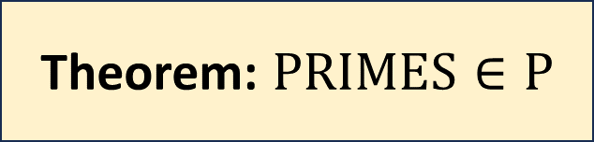
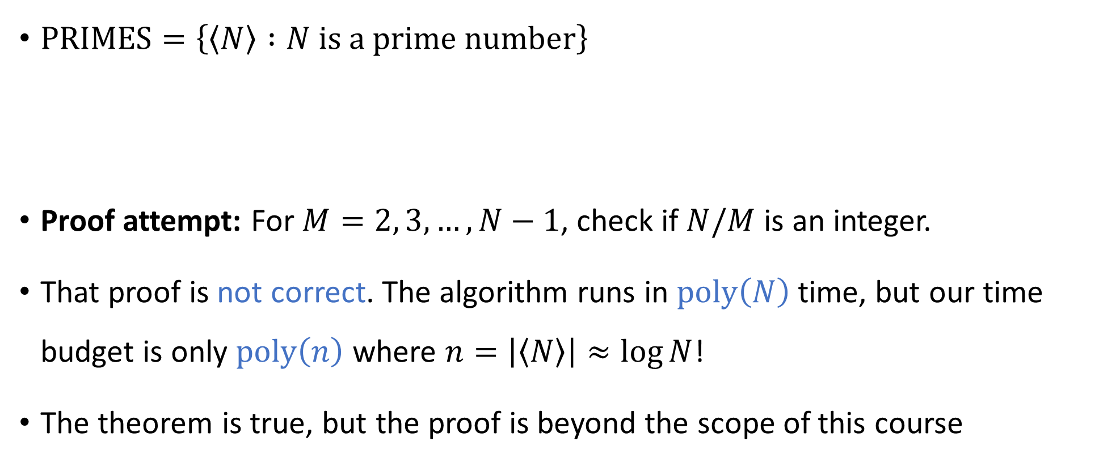
Example: Primality testing
$\text{PRIMES}=\left\{\left\langle N\right\rangle :N \text{is} \text{a} \text{prime} \text{number}\right\}$
Proof attempt: For $M=2, 3, …, N−1$, check if $N/M$ is an integer.
That proof is not correct. The algorithm runs in $\text{poly}\left(N\right)$ time, but our time budget is only $\text{poly}\left(n\right)$ where $n=\left|\left\langle N\right\rangle \right|≈\log{N}$!
The theorem is true, but the proof is beyond the scope of this course
Theorem: $\text{PRIMES}∈\text{P}$

Slide 14
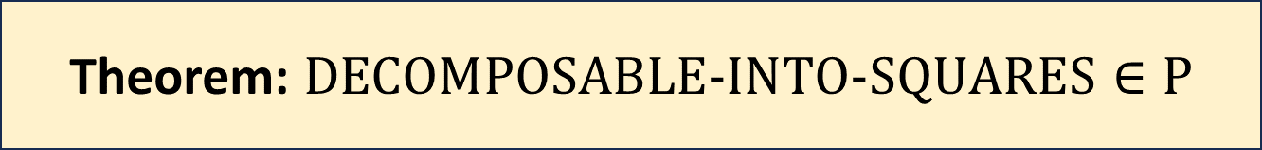

Example: Decompositions into squares
We designed an algorithm that decides $\text{DECOMPOSABLE}\text{‑}\text{INTO}\text{‑}\text{SQUARES}$
That algorithm’s time complexity is $Ω\left(2^{n}\right)$
Can we conclude that $\text{DECOMPOSABLE}\text{‑}\text{INTO}\text{‑}\text{SQUARES}∉\text{P}$?
Theorem: $\text{DECOMPOS}\text{ABLE}\text{‑}\text{INTO}\text{‑}\text{SQUARES}∈\text{P}$

Slide 15
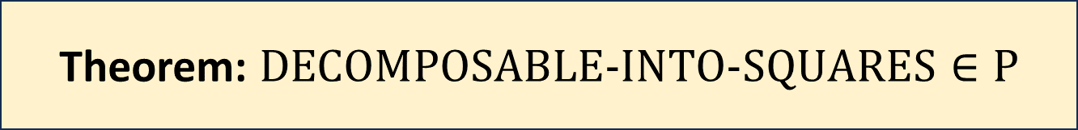
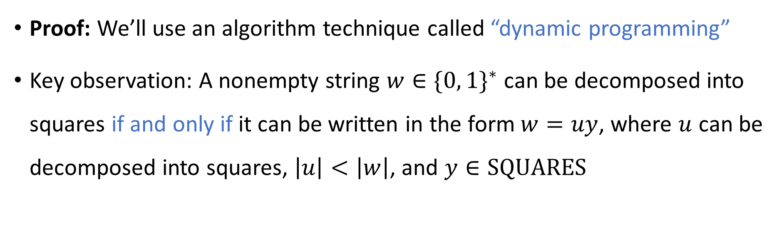
Decomposing into squares in polynomial time
Theorem: $\text{DECOMPOS}\text{ABLE}\text{‑}\text{INTO}\text{‑}\text{SQUARES}∈\text{P}$
Proof: We’ll use an algorithm technique called “dynamic programming”
Key observation: A nonempty string $w∈\{0, 1\}^{∗}$ can be decomposed into squares if and only if it can be written in the form $w=uy$, where $u$ can be decomposed into squares, $\left|u\right|<\left|w\right|$, and $y∈\text{SQUARES}$

Slide 16
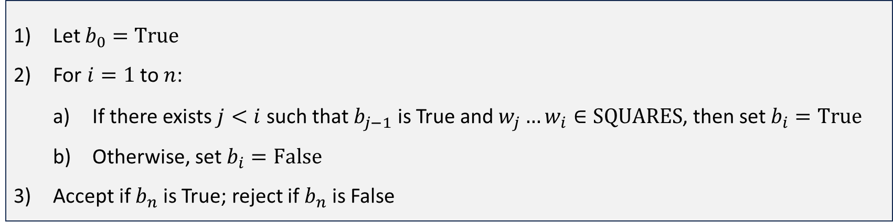

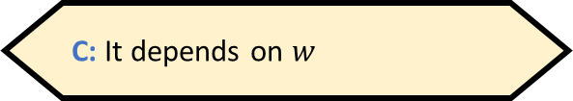
Decomposing into squares in polynomial time
Let $w$ be the input, $w=w_{1}w_{2}…w_{n}$, where $w_{i}∈\{0, 1\}$
Plan: For each $i∈\{0, 1, …, n\}$, we will compute a Boolean value $b_{i}$ that indicates whether $w_{1}w_{2}…w_{i}∈$ $\text{DECOMPOS}\text{ABLE}\text{‑}\text{INTO}\text{‑}\text{SQUARES}$
Let $b_{0}=\text{True}$
For $i=1$ to $n$:
If there exists $j<i$ such that $b_{j−1}$ is True and $w_{j}…w_{i}∈\text{SQUARES}$, then set $b_{i}=\text{True}$
Otherwise, set $b_{i}=\text{False}$
Accept if $b_{n}$ is True; reject if $b_{n}$ is False
What should $b_{0}$ be?
A: True
B: False
C: It depends on $w$
D: It’s not well-defined
Respond at PollEv.com/whoza or text “whoza” to 22333

Slide 17

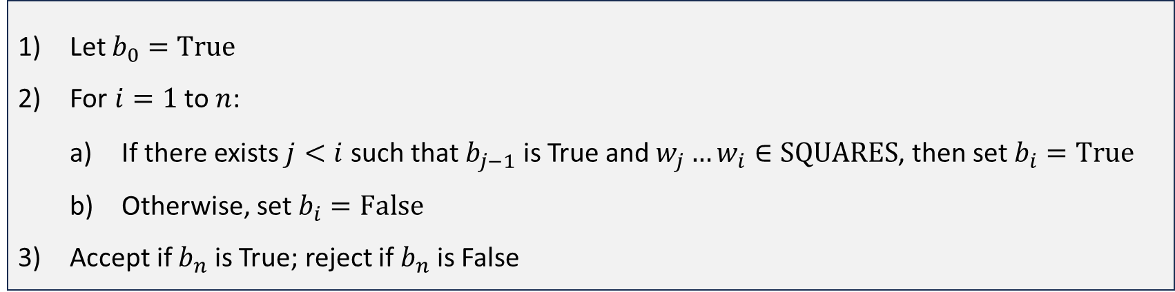


Decomposing into squares in polynomial time
Let $b_{0}=\text{True}$
For $i=1$ to $n$:
If there exists $j<i$ such that $b_{j−1}$ is True and $w_{j}…w_{i}∈\text{SQUARES}$, then set $b_{i}=\text{True}$
Otherwise, set $b_{i}=\text{False}$
Accept if $b_{n}$ is True; reject if $b_{n}$ is False
TM implementation: Store $b_{i}$ in $w_{i}$’s cell, and write # in $w_{j}$’s cell
Current job: Check whether this substring is in $\text{SQUARES}$
#
$$b_{1},…, b_{n}→$$
$$♢$$
F
T
F
F
F
T
F
F
F
F
F
F
F
F
F
0
0
1
0
0
1
0
1
1
1
0
0
1
1
1
0
1
1
0
$$w_{1},…, w_{n}→$$

Slide 18

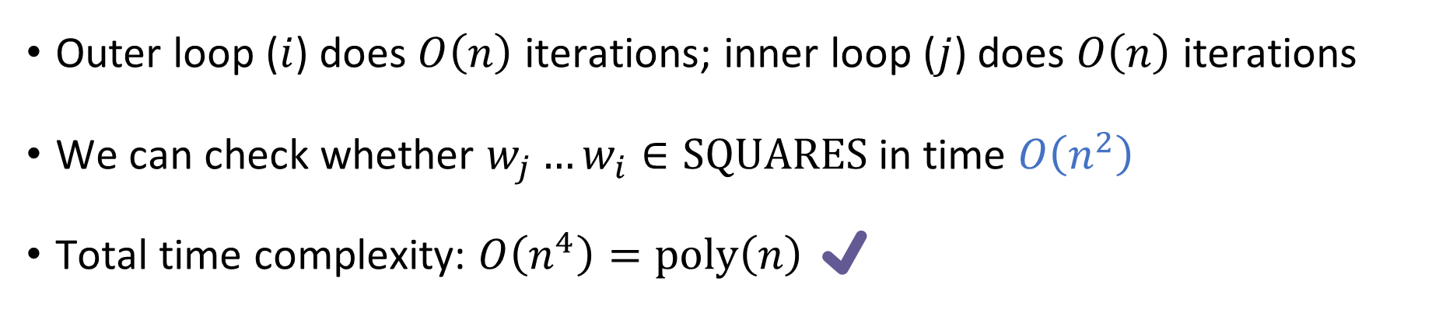
Decomposing into squares in polynomial time
Let $b_{0}=\text{True}$
For $i=1$ to $n$:
If there exists $j<i$ such that $b_{j−1}$ is True and $w_{j}…w_{i}∈\text{SQUARES}$, then set $b_{i}=\text{True}$
Otherwise, set $b_{i}=\text{False}$
Accept if $b_{n}$ is True; reject if $b_{n}$ is False
Outer loop ($i$) does $O\left(n\right)$ iterations; inner loop ($j$) does $O\left(n\right)$ iterations
We can check whether $w_{j}…w_{i}∈\text{SQUARES}$ in time $O\left(n^{2}\right)$
Total time complexity: $O\left(n^{4}\right)=\text{poly}\left(n\right)$ ✔️

Slide 19




Time complexity: Theory vs. practice
OBJECTION: “In an algorithms course, or in the computing industry, we would say that we can decide $\text{SQUARES}$ in time $O\left(n\right)$ rather than $O\left(n^{2}\right)$.”
Is there something wrong with the Turing machine model?
Given an array of bits $y$:
For $i=1$ to $n/2$:
If $y\left[i\right]≠y[i+n/2]$, reject
Accept
$←$ $O\left(n\right)$ iterations
$←$ $O\left(1\right)$ time per iteration “in practice”

Slide 20
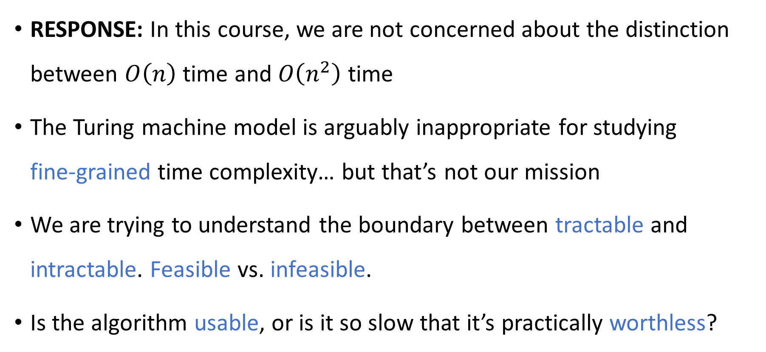
Time complexity: Theory vs. practice
RESPONSE: In this course, we are not concerned about the distinction between $O\left(n\right)$ time and $O\left(n^{2}\right)$ time
The Turing machine model is arguably inappropriate for studying fine‑grained time complexity… but that’s not our mission
We are trying to understand the boundary between tractable and intractable. Feasible vs. infeasible.
Is the algorithm usable, or is it so slow that it’s practically worthless?

Slide 21
Is the Turing machine model a good model?
Switching between two reasonable models of computation can sometimes make the difference between linear time and quadratic time
Could it ever make the difference between polynomial time and exponential time?
For example, what happens if we use a multi-tape Turing machine instead of a single-tape Turing machine?

Slide 22
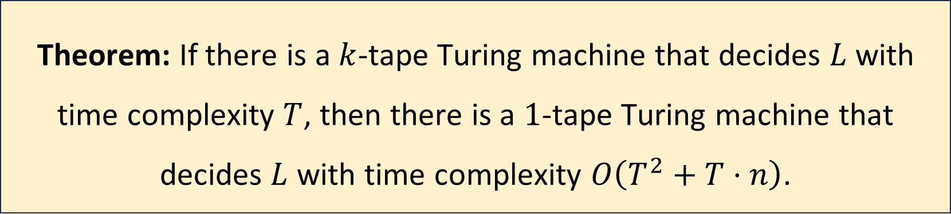

Multi-tape Turing machines, revisited
Let $L$ be a language, let $k$ be a positive integer, and let $T:ℕ→ℕ$
Note: If $T\left(n\right)=O\left(n^{k}\right)$, then $O\left(T^{2}+T⋅n\right)=O\left(n^{2k}\right)=\text{poly}\left(n\right)$
Theorem: If there is a $k$-tape Turing machine that decides $L$ with time complexity $T$, then there is a $1$-tape Turing machine that decides $L$ with time complexity $O\left(T^{2}+T⋅n\right)$.

Slide 23
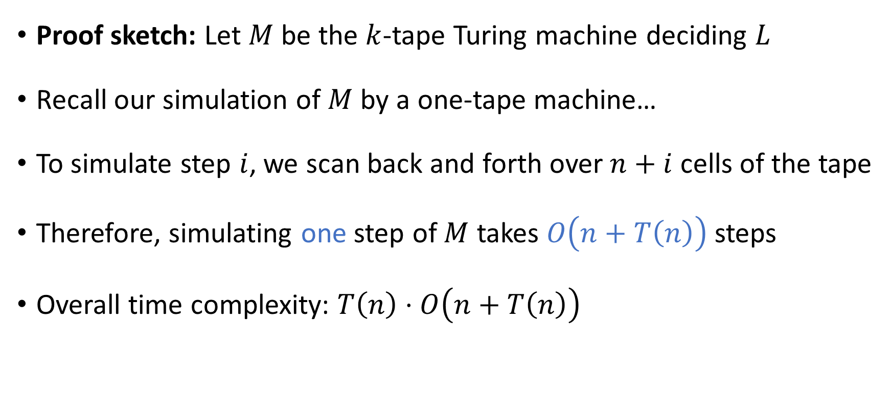
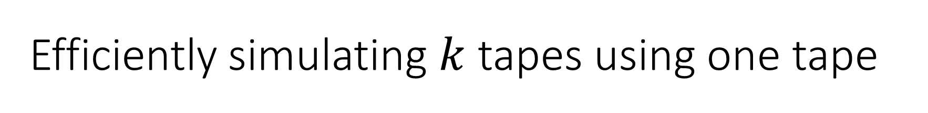
Efficiently simulating $k$ tapes using one tape
Proof sketch: Let $M$ be the $k$-tape Turing machine deciding $L$
Recall our simulation of $M$ by a one-tape machine…
To simulate step $i$, we scan back and forth over $n+i$ cells of the tape
Therefore, simulating one step of $M$ takes $O\left(n+T\left(n\right)\right)$ steps
Overall time complexity: $T\left(n\right)⋅O\left(n+T\left(n\right)\right)$

Slide 24


Robustness of $\text{P}$
Conclusion: We could define $\text{P}$ using one-tape Turing machines or using multi-tape Turing machines
Either way, we get the exact same set of languages

Slide 25
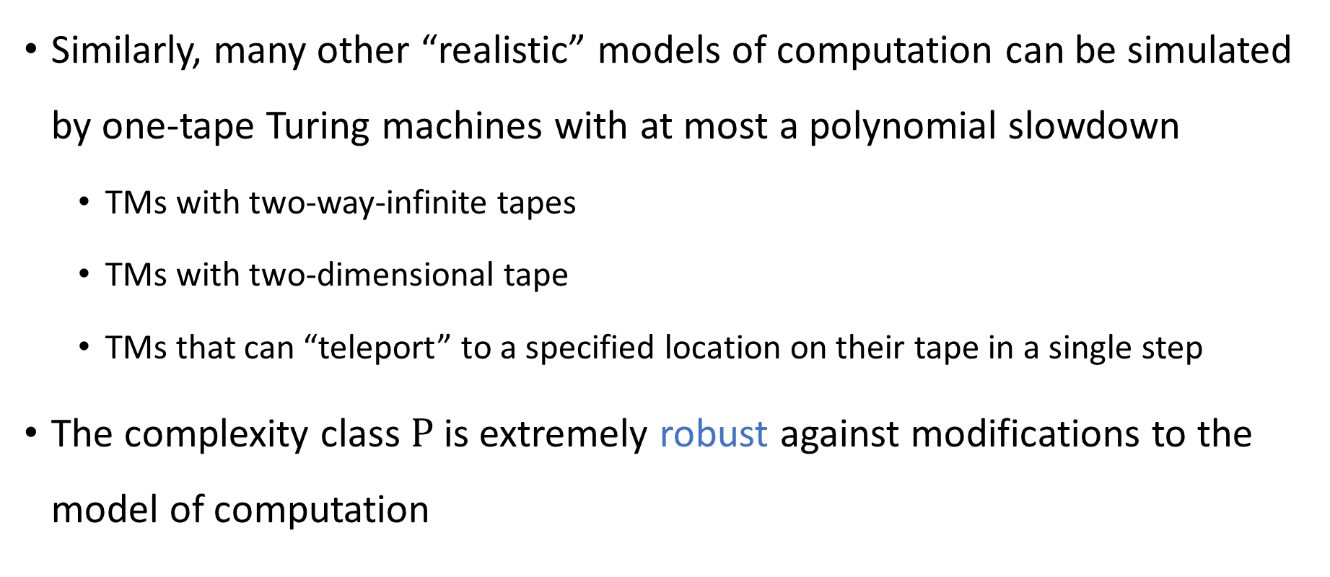

Robustness of $\text{P}$
Similarly, many other “realistic” models of computation can be simulated by one-tape Turing machines with at most a polynomial slowdown
TMs with two-way-infinite tapes
TMs with two-dimensional tape
TMs that can “teleport” to a specified location on their tape in a single step
The complexity class $\text{P}$ is extremely robust against modifications to the model of computation

Slide 26
Note on standards of rigor
Going forward, when we analyze specific algorithms, we will not actually prove that they run in polynomial time… we will just assert it
In each case, one can rigorously prove the time bound by describing a TM implementation and reasoning about the motions of the heads… but this is tedious
Note: We still insist on proofs of correctness, just not efficiency
You should follow this convention on problem set 5 and beyond
Nevertheless, the Turing machine model remains extremely valuable for us, because it tells us what an arbitrary poly-time algorithm looks like!

