Slide 1
CMSC 28100 Introduction to Complexity Theory Autumn 2025 Instructor: William Hoza
⏳

Slide 2
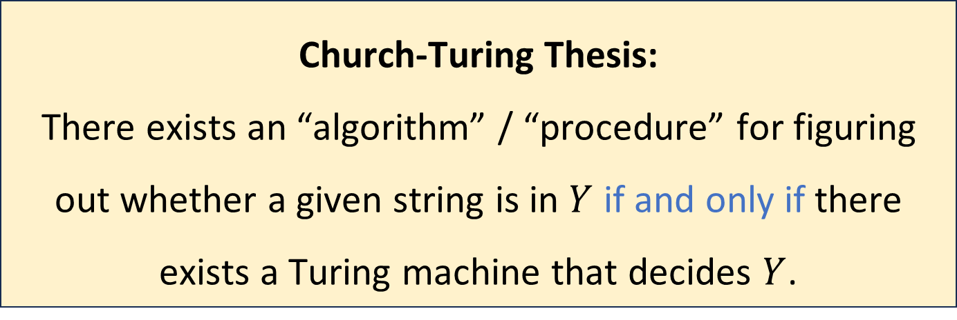
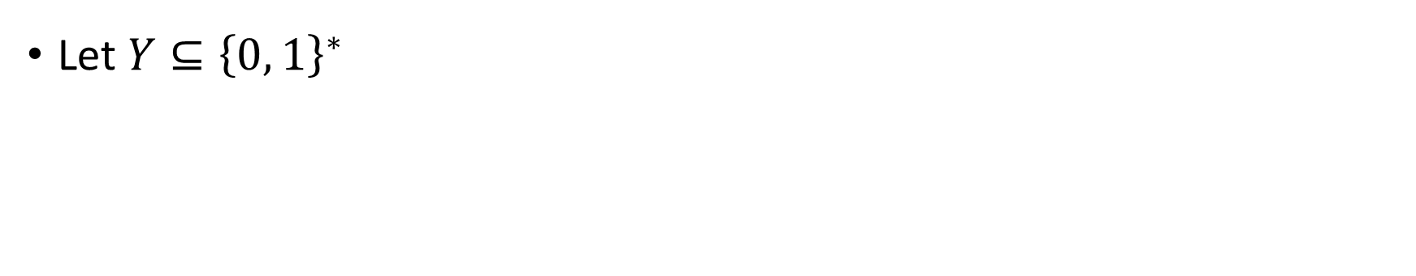
The Church-Turing Thesis
Let $Y⊆{\left\{0, 1\right\}}^{∗}$
Church-Turing Thesis:
There exists an “algorithm” / “procedure” for figuring out whether a given string is in $Y$ if and only if there exists a Turing machine that decides $Y$.
Intuitive notion
Mathematically precise notion

Slide 3
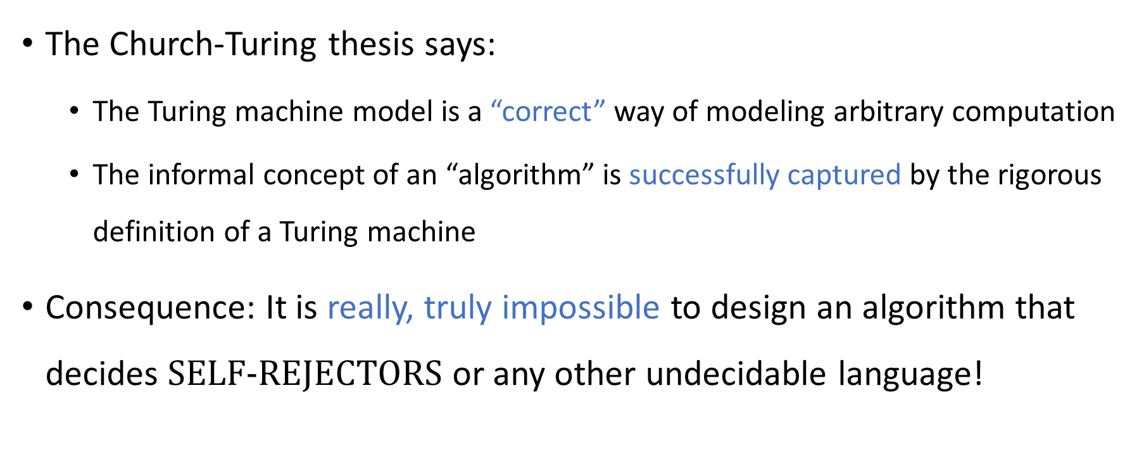
The Church-Turing Thesis
The Church-Turing thesis says:
The Turing machine model is a “correct” way of modeling arbitrary computation
The informal concept of an “algorithm” is successfully captured by the rigorous definition of a Turing machine
Consequence: It is really, truly impossible to design an algorithm that decides $\text{SELF}‑\text{REJECTORS}$ or any other undecidable language!

Slide 4
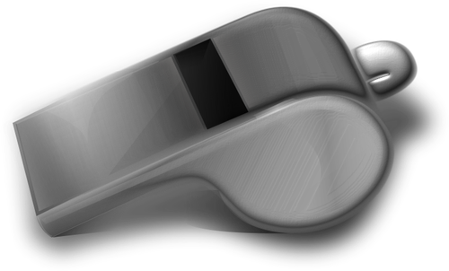
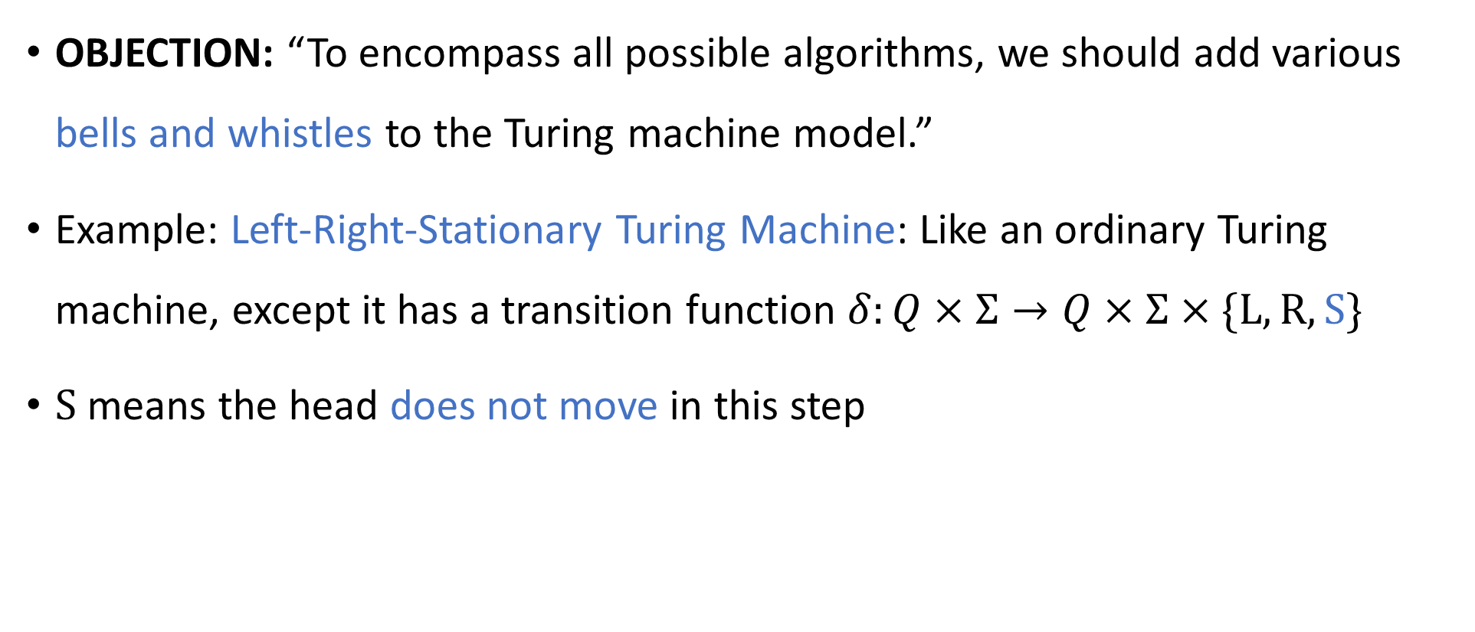
Are Turing machines powerful enough?
🔔
OBJECTION: “To encompass all possible algorithms, we should add various bells and whistles to the Turing machine model.”
Example: Left-Right-Stationary Turing Machine: Like an ordinary Turing machine, except it has a transition function $δ:Q×Σ→Q×Σ×\{\text{L},\text{R},\text{S}\}$
$\text{S}$ means the head does not move in this step

Slide 5
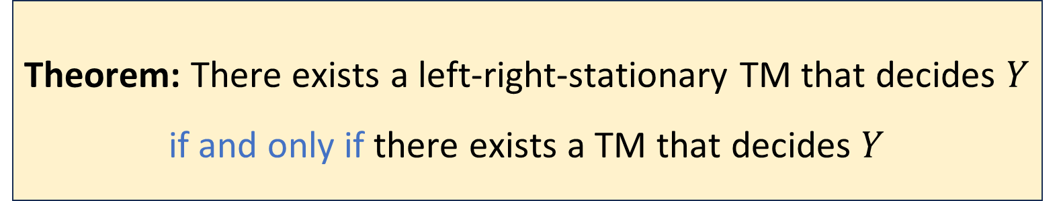

Left-right-stationary Turing machines
🔔
Let $Y$ be a language
We proved:
Theorem: There exists a left-right-stationary TM that decides $Y$ if and only if there exists a TM that decides $Y$

Slide 6

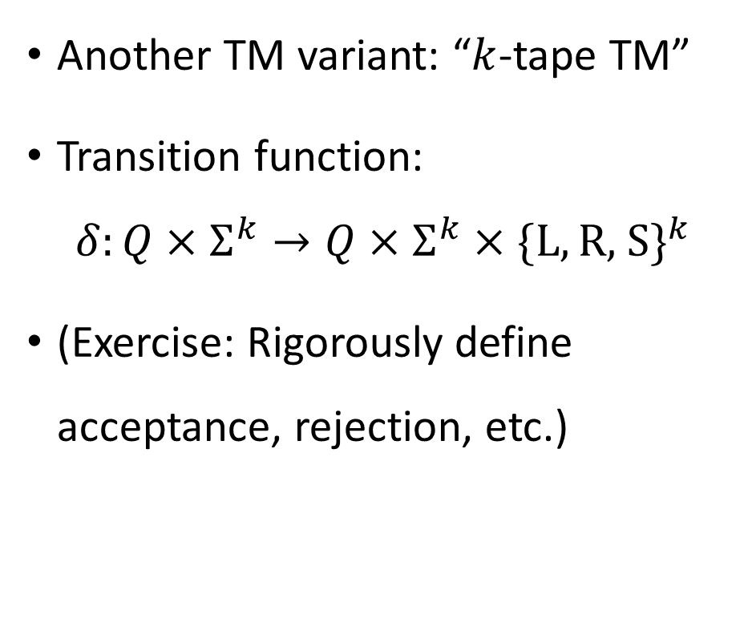





Multi-tape Turing machines
Another TM variant: “$k$-tape TM”
Transition function:
$$δ:Q×Σ^{k}→Q×Σ^{k}×\{\text{L},\text{R}\text{, }\text{S}\}^{k}$$
(Exercise: Rigorously define acceptance, rejection, etc.)
$$⋯$$
1
1
0
$$⊔$$
$$⊔$$
$$⋯$$
0
#
1
$
$$⊔$$
$$q$$

Slide 7
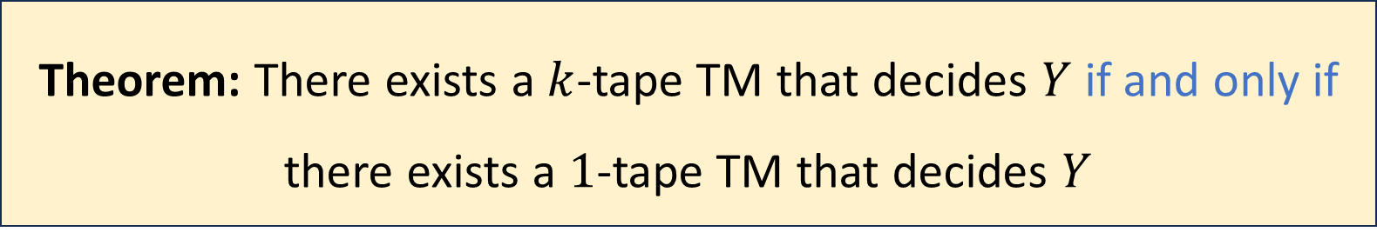

Multi-tape Turing machines
🔔
Let $k$ be any positive integer and let $Y$ be a language
Theorem: There exists a $k$-tape TM that decides $Y$ if and only if there exists a $1$-tape TM that decides $Y$
How should we keep track of the locations of the simulated heads?
A: Store the location data in the machine’s state
B: Ensure that the real/simulated heads’ locations are always equal
Proof on upcoming 12 slides
C: Use special symbols to mark the cells containing simulated heads
D: Store the location data in a single dedicated tape cell
Respond at PollEv.com/whoza or text “whoza” to 22333

Slide 8


Simulating $k$ tapes with $1$ tape
Idea: Pack a bunch of data into each cell
Store “simulated heads” on the tape, along with $k$ “simulated symbols” in each cell
$$⋯$$
1
1
0
$$⊔$$
$$⊔$$
$$⋯$$
0
#
1
$
$$⊔$$
$$q$$

Slide 9


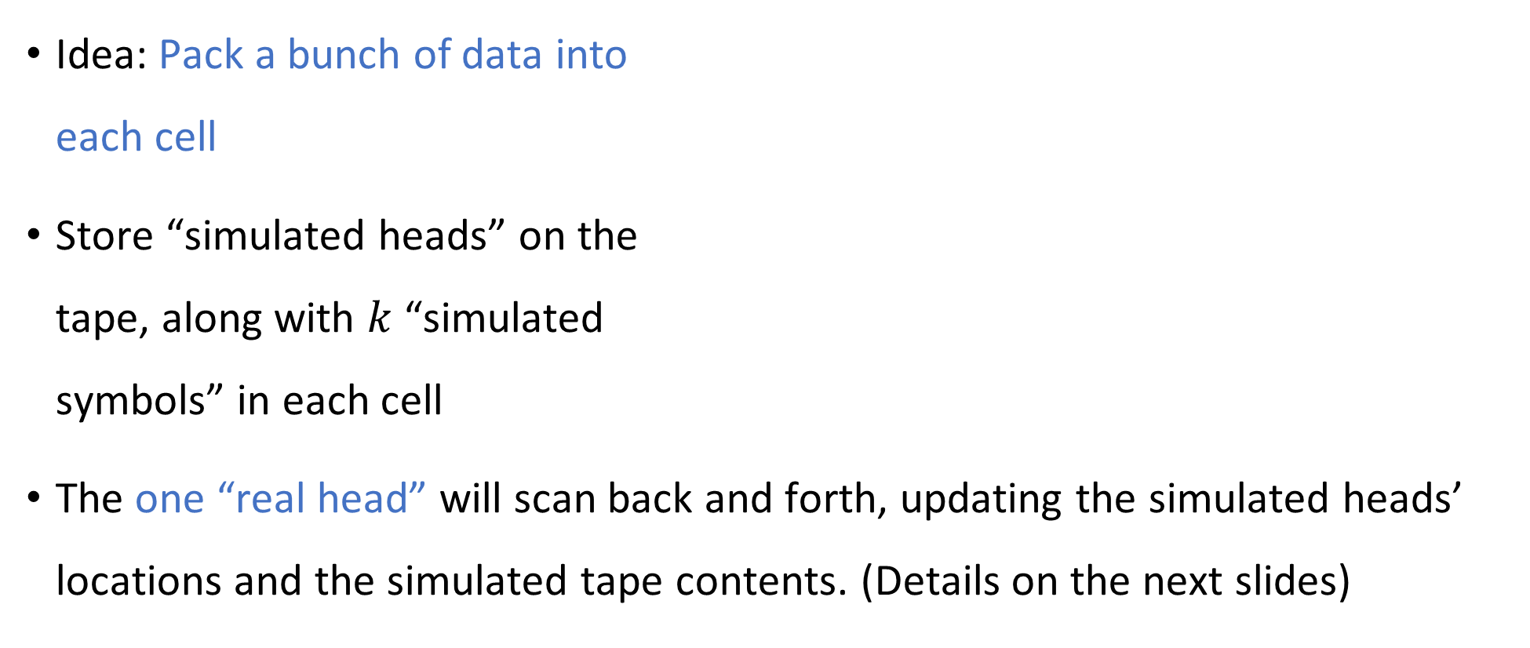

Simulating $k$ tapes with $1$ tape
Idea: Pack a bunch of data into each cell
Store “simulated heads” on the tape, along with $k$ “simulated symbols” in each cell
The one “real head” will scan back and forth, updating the simulated heads’ locations and the simulated tape contents. (Details on the next slides)
0
$$⊔$$
$$⋯$$
1
1
0
$$⊔$$
$$⊔$$
$$⋯$$
0
#
1
$
$$⊔$$

Slide 10
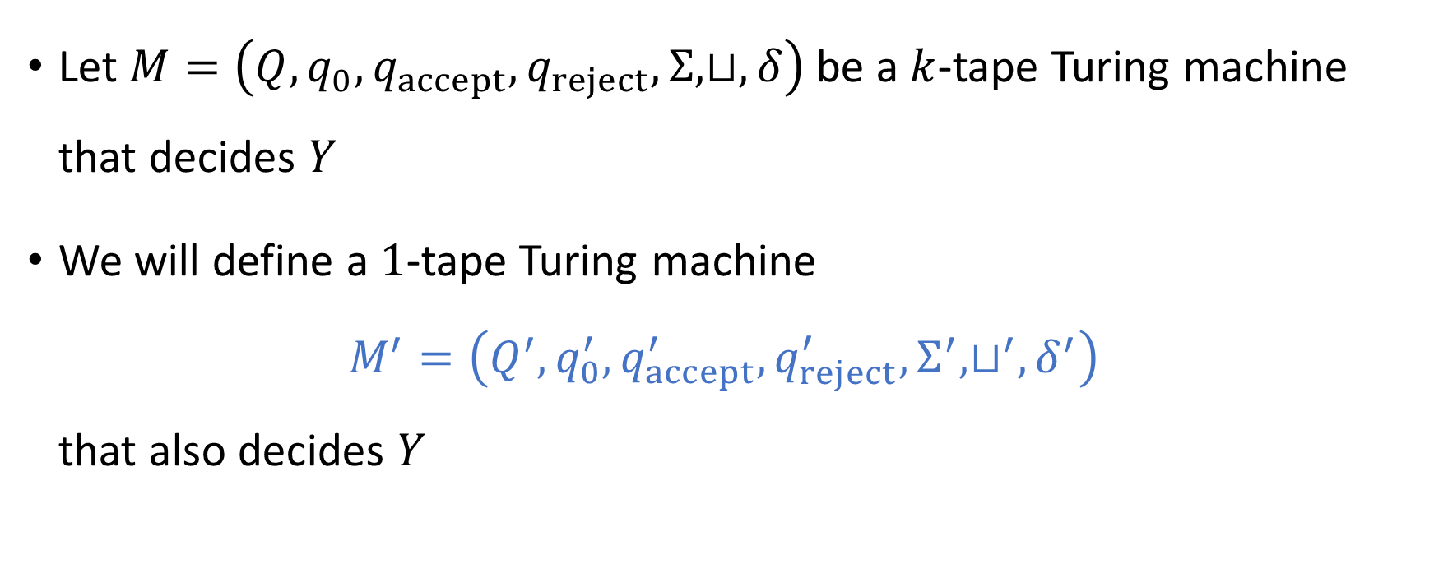
Simulating $k$ tapes with $1$ tape
Let $M=\left(Q, q_{0},q_{accept},q_{reject},Σ,⊔,δ\right)$ be a $k$-tape Turing machine that decides $Y$
We will define a $1$-tape Turing machine $M^{′}=\left(Q^{′}, q_{0}^{′},q_{accept}^{′},q_{reject}^{′},Σ^{′},⊔^{′},δ^{′}\right)$ that also decides $Y$

Slide 11
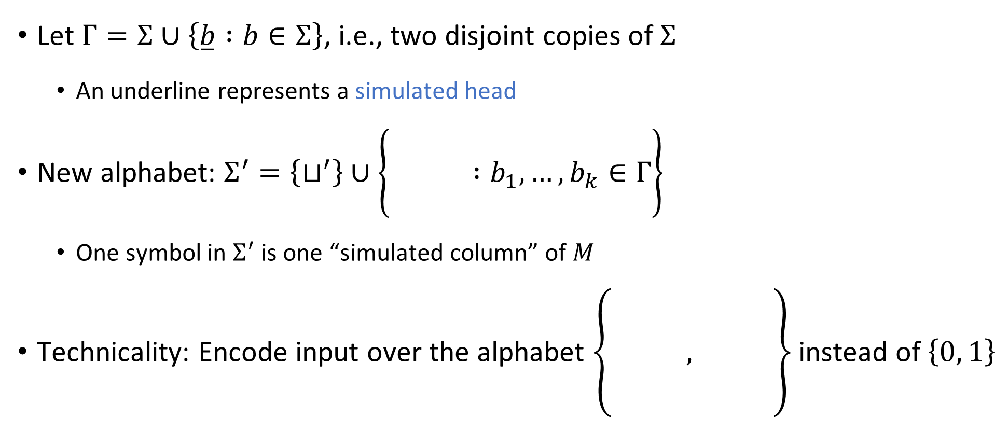
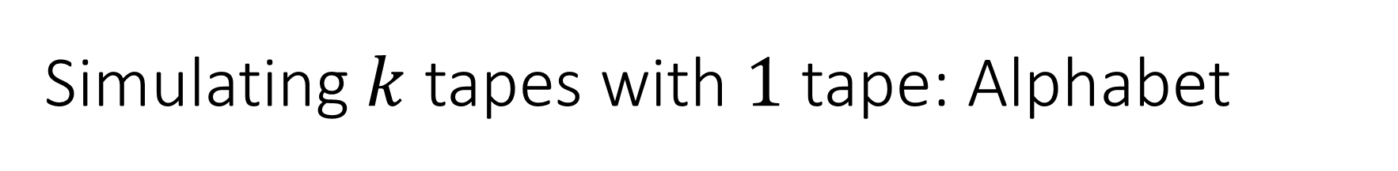
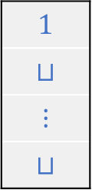
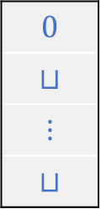
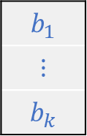
Simulating $k$ tapes with $1$ tape: Alphabet
Let $Γ=Σ∪\left\{\overset{̲}{b} :b∈Σ\right\}$, i.e., two disjoint copies of $Σ$
An underline represents a simulated head
New alphabet: $Σ^{′}=\left\{⊔^{′}\right\}∪\left\{\begin{matrix} \\ \\ \end{matrix} :b_{1},…, b_{k}∈Γ\right\}$
One symbol in $Σ^{′}$ is one “simulated column” of $M$
Technicality: Encode input over the alphabet $\left\{\begin{matrix} \\ \\ \begin{aligned} \\ \end{aligned}\end{matrix} , \right\}$ instead of $\left\{0, 1\right\}$
$$b_{1}$$
$$⋮$$
$$b_{k}$$
$$0$$
$$⊔$$
$$⋮$$
$$⊔$$
$$1$$
$$⊔$$
$$⋮$$
$$⊔$$

Slide 12




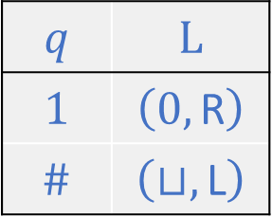
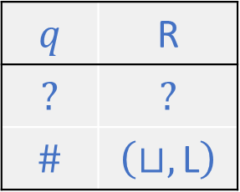



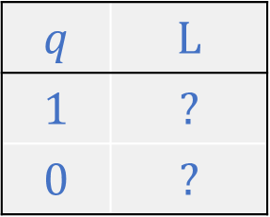



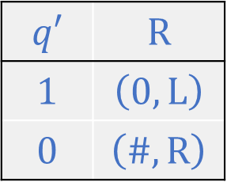


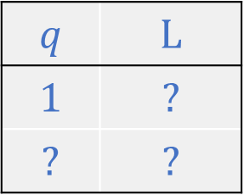


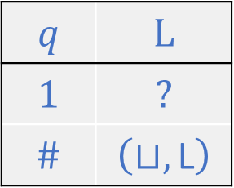




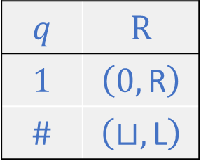


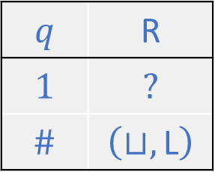


Simulating $2$ tapes with $1$ tape: States
$$⊔$$
$$⊔$$
0
$$⊔$$
#
1
1
0
$$⊔$$
$$⊔^{′}$$
$$⊔^{′}$$
$$⊔^{′}$$
$$⊔^{′}$$
$$⊔^{′}$$
$$⊔^{′}$$
$$⊔$$
$$⊔$$
$$⊔$$
$
0
#
1
$
$$⊔$$
State of $M′$
$$q$$ | $$\text{R}$$
$$?$$ | $$?$$
$$\#$$ | $$\left(⊔,\text{L}\right)$$
$$q$$ | $$\text{R}$$
$$1$$ | $$?$$
$$\#$$ | $$\left(⊔,\text{L}\right)$$
$$q$$ | $$\text{L}$$
$$1$$ | $$?$$
$$\#$$ | $$\left(⊔,\text{L}\right)$$
$$q$$ | $$\text{L}$$
$$1$$ | $$?$$
$$?$$ | $$?$$
$$q$$ | $$\text{L}$$
$$1$$ | $$?$$
$$0$$ | $$?$$
$$q′$$ | $$\text{R}$$
$$1$$ | $$\left(0,\text{L}\right)$$
$$0$$ | $$\left(\#,\text{R}\right)$$
$$q$$ | $$\text{L}$$
$$1$$ | $$\left(0, \text{R}\right)$$
$$\#$$ | $$\left(⊔,\text{L}\right)$$
State of $M→$
$$q$$ | $$\text{R}$$
$$1$$ | $$\left(0, \text{R}\right)$$
$$\#$$ | $$\left(⊔,\text{L}\right)$$
$←$ Direction of $M′$ motion
Head 1 symbol $→$
$←$ Head 1 instruction
Head 2 symbol $→$
$←$ Head 2 instruction

Slide 13


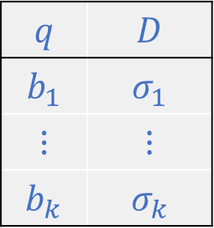
Simulating $k$ tapes with $1$ tape: States
New state set:
$$Q^{′}=\left\{\begin{matrix} \\ \\ \begin{aligned} \\ \\ \\ \end{aligned}\end{matrix} : \begin{matrix}q∈Q \\ D∈\left\{\text{L},\text{R}\right\} \\ \begin{aligned}b_{1},…, b_{k}∈Σ∪\left\{?\right\} \\ σ_{1},…, σ_{k}∈\left(Σ×\left\{\text{L},\text{R},\text{S}\right\}\right)∪\{?\}\end{aligned}\end{matrix} \right\}$$
$$q$$ | $$D$$
$$b_{1}$$ | $$σ_{1}$$
$$⋮$$ | $$⋮$$
$$b_{k}$$ | $$σ_{k}$$

Slide 14


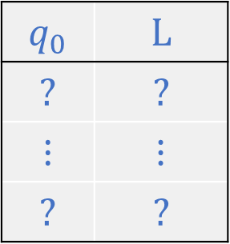
Simulating $k$ tapes with $1$ tape: Start state
New start state:
$$q_{0}^{′}=$$
$$q_{0}$$ | $$\text{L}$$
$$?$$ | $$?$$
$$⋮$$ | $$⋮$$
$$?$$ | $$?$$

Slide 15

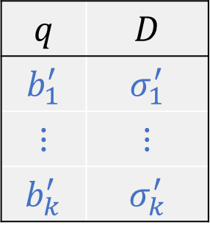

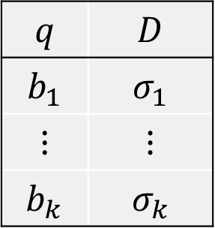
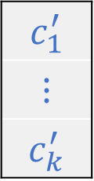
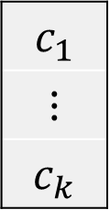
Simulating $k$ tapes with $1$ tape: Transitions
$$δ^{′}\left(\begin{matrix} \\ \\ \begin{aligned} \\ \\ \\ \end{aligned}\end{matrix} , \right)=\left(\begin{matrix} \\ \\ \begin{aligned} \\ \\ \\ \end{aligned}\end{matrix} , , D\right)$$
If $σ_{j}=\left(a,D\right)$ and $c_{j}=\underline{b_{j}}$: Let $b_{j}^{′}=\text{?}$, $σ_{j}^{′}=\text{?}$, $c_{j}^{′}=a$
If $σ_{j}=\left(a,\text{S}\right)$ and $c_{j}=\underline{b_{j}}$: Let $b_{j}^{′}=a$, $σ_{j}^{′}=\text{?}$, $c_{j}^{′}=\underline{a}$
If $σ_{j}=\text{?}$ and $b_{j}=\text{?}$: Let $b_{j}^{′}=c_{j}$, $σ_{j}^{′}=\text{?}$, $c_{j}^{′}=\underline{c_{j}}$
In all other cases: Let $b_{j}^{′}=b_{j}$, $σ_{j}^{′}=σ_{j}$, $c_{j}^{′}=c_{j}$
$$q$$ | $$D$$
$$b_{1}$$ | $$σ_{1}$$
$$⋮$$ | $$⋮$$
$$b_{k}$$ | $$σ_{k}$$
$$q$$ | $$D$$
$$b_{1}^{′}$$ | $$σ_{1}^{′}$$
$$⋮$$ | $$⋮$$
$$b_{k}^{′}$$ | $$σ_{k}^{′}$$
$$c_{1}$$
$$⋮$$
$$c_{k}$$
$$c_{1}^{′}$$
$$⋮$$
$$c_{k}^{′}$$

Slide 16

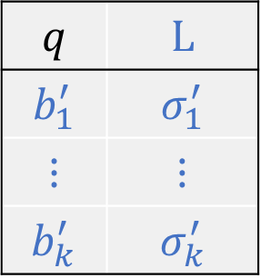
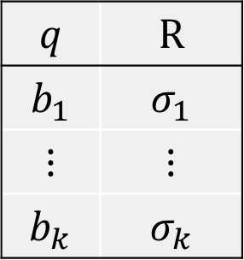
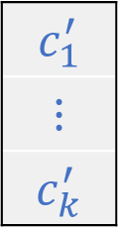
Simulating $k$ tapes with $1$ tape: Transitions
$$δ^{′}\left(\begin{matrix} \\ \\ \begin{aligned} \\ \\ \\ \end{aligned}\end{matrix} , { ⊔}^{′}\right)=\left(\begin{matrix} \\ \\ \begin{aligned} \\ \\ \\ \end{aligned}\end{matrix} , , \text{L}\right)$$
If $σ_{j}= ?$ and $b_{j}= ?$: Let $b_{j}^{′}= ⊔$, $σ_{j}^{′}=\text{?}$, $c_{j}^{′}= \underline{⊔}$
In all other cases: Let $b_{j}^{′}=b_{j}$, $σ_{j}^{′}=σ_{j}$, $c_{j}^{′}= ⊔$
$$q$$ | $$\text{R}$$
$$b_{1}$$ | $$σ_{1}$$
$$⋮$$ | $$⋮$$
$$b_{k}$$ | $$σ_{k}$$
$$q$$ | $$\text{L}$$
$$b_{1}^{′}$$ | $$σ_{1}^{′}$$
$$⋮$$ | $$⋮$$
$$b_{k}^{′}$$ | $$σ_{k}^{′}$$
$$c_{1}^{′}$$
$$⋮$$
$$c_{k}^{′}$$

Slide 17
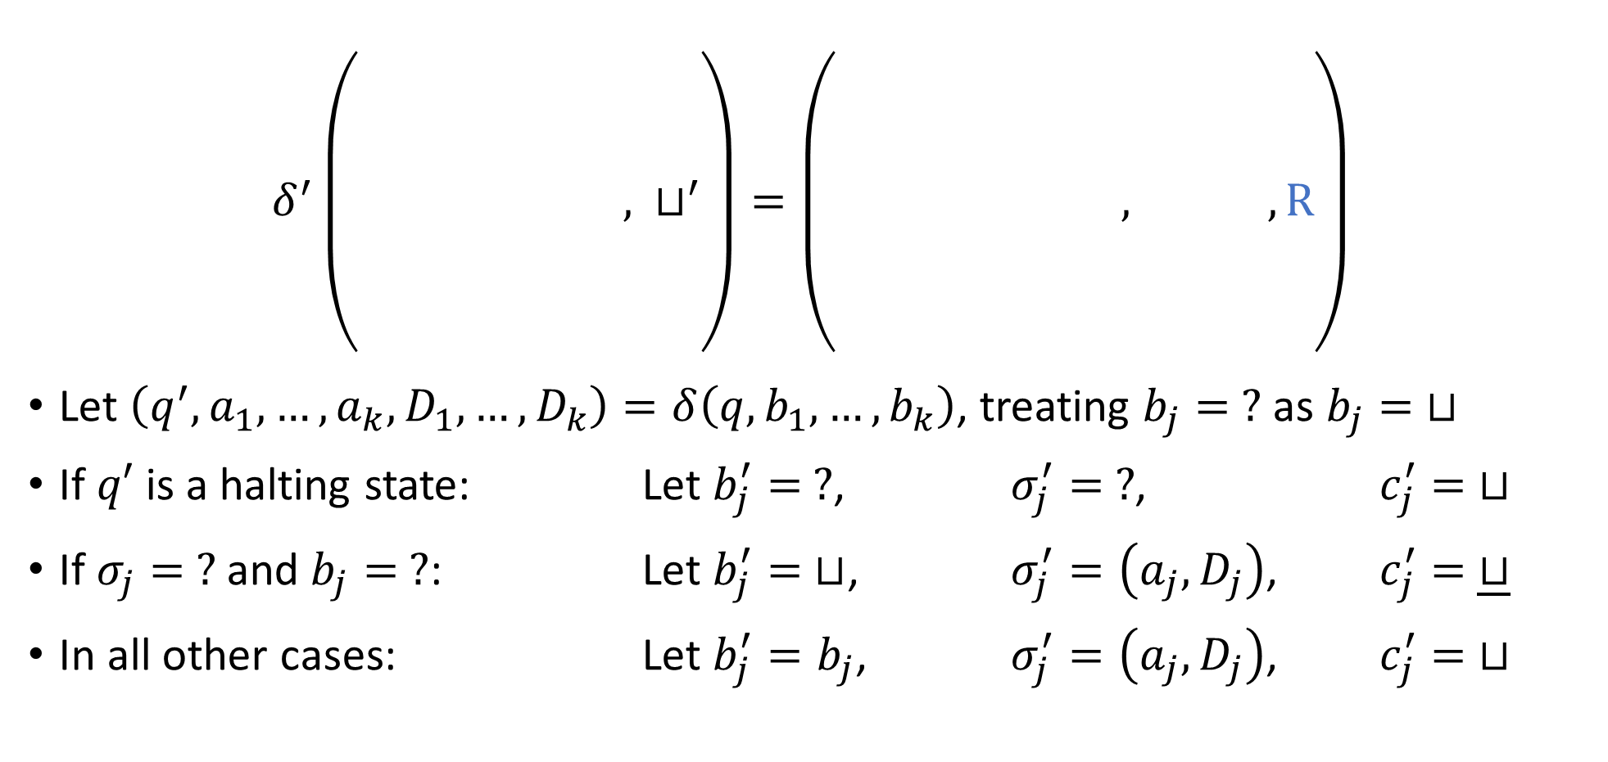
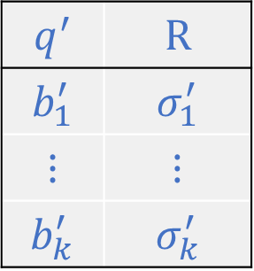
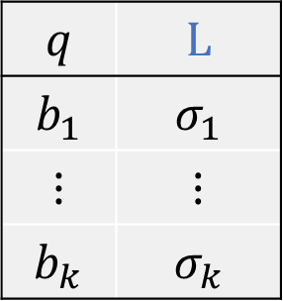
Simulating $k$ tapes with $1$ tape: Transitions
$$δ^{′}\left(\begin{matrix} \\ \\ \begin{aligned} \\ \\ \\ \end{aligned}\end{matrix} , { ⊔}^{′}\right)=\left(\begin{matrix} \\ \\ \begin{aligned} \\ \\ \\ \end{aligned}\end{matrix} , , \text{R}\right)$$
Let $\left(q^{′},a_{1},…, a_{k},D_{1},…, D_{k}\right)=δ\left(q,b_{1},…, b_{k}\right)$, treating $b_{j}= ?$ as $b_{j}= ⊔$
If $q′$ is a halting state: Let $b_{j}^{′}= ?$, $σ_{j}^{′}= ?$, $c_{j}^{′}= ⊔$
If $σ_{j}= ?$ and $b_{j}= ?$: Let $b_{j}^{′}= ⊔$, $σ_{j}^{′}=\left(a_{j},D_{j}\right)$, $c_{j}^{′}= \underline{⊔}$
In all other cases: Let $b_{j}^{′}=b_{j}$, $σ_{j}^{′}=\left(a_{j}, D_{j}\right)$, $c_{j}^{′}= ⊔$
$$q$$ | $$\text{L}$$
$$b_{1}$$ | $$σ_{1}$$
$$⋮$$ | $$⋮$$
$$b_{k}$$ | $$σ_{k}$$
$$q^{′}$$ | $$\text{R}$$
$$b_{1}^{′}$$ | $$σ_{1}^{′}$$
$$⋮$$ | $$⋮$$
$$b_{k}^{′}$$ | $$σ_{k}^{′}$$
$$c_{1}^{′}$$
$$⋮$$
$$c_{k}^{′}$$

Slide 18


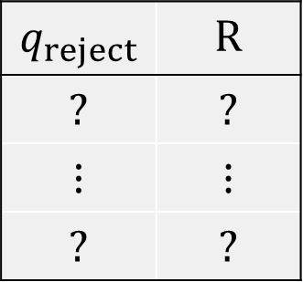
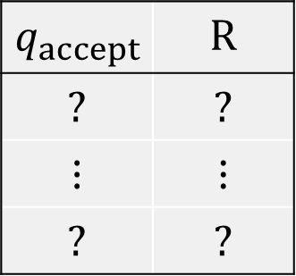
Simulating $k$ tapes with $1$ tape: Halting states
$q_{accept}^{′}=$ $q_{reject}^{′}=$
$$q_{accept}$$ | $$\text{R}$$
$$?$$ | $$?$$
$$⋮$$ | $$⋮$$
$$?$$ | $$?$$
$$q_{reject}$$ | $$\text{R}$$
$$?$$ | $$?$$
$$⋮$$ | $$⋮$$
$$?$$ | $$?$$

Slide 19

Simulating $k$ tapes with $1$ tape
That completes the definition of $M^{′}$
Exercise: Rigorously prove that $M^{′}$ decides the language $Y$

Slide 20
TMs can simulate all “reasonable” machines
We could add various other bells and whistles to the basic TM model
The ability to observe the two neighboring cells
The ability to “teleport” back to the initial cell in a single step
A two-dimensional tape
None of these changes has any effect on the power of the model
🔔

Slide 21

The Church-Turing Thesis
Let $Y⊆{\left\{0, 1\right\}}^{∗}$
Church-Turing Thesis:
There exists an “algorithm” / “procedure” for figuring out whether a given string is in $Y$ if and only if there exists a Turing machine that decides $Y$.
Intuitive notion
Mathematically precise notion

