Slide 1
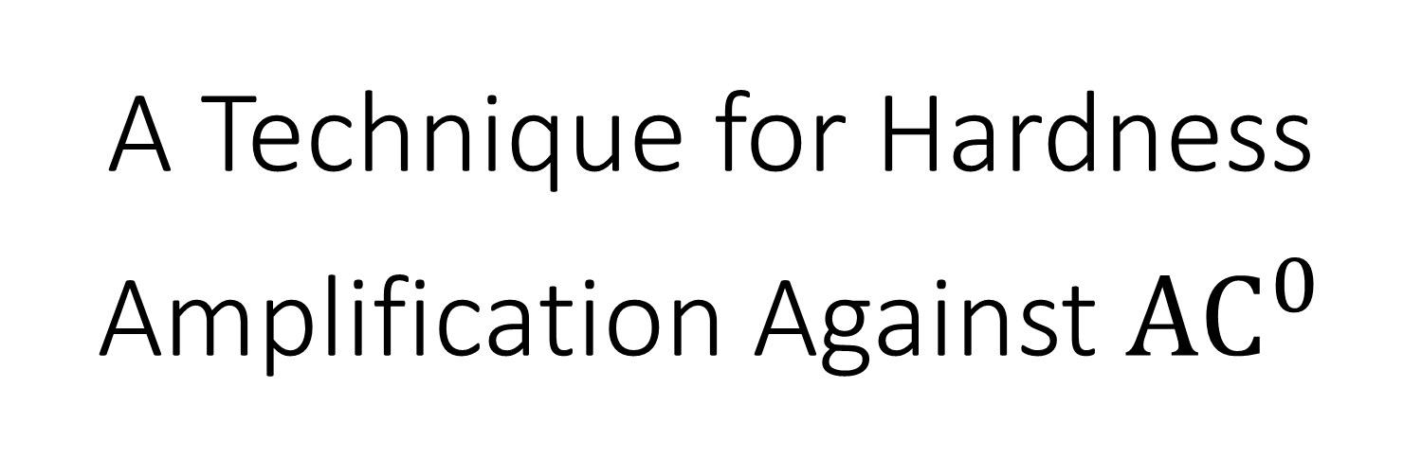
A Technique for Hardness Amplification Against ${\text{AC}}^{0}$
@ Dagstuhl Seminar 24381
September 19, 2024
William M. Hoza¹
The University of Chicago
¹Part of this work was done while the author was visiting the Simons Institute for the Theory of Computing.

Slide 2


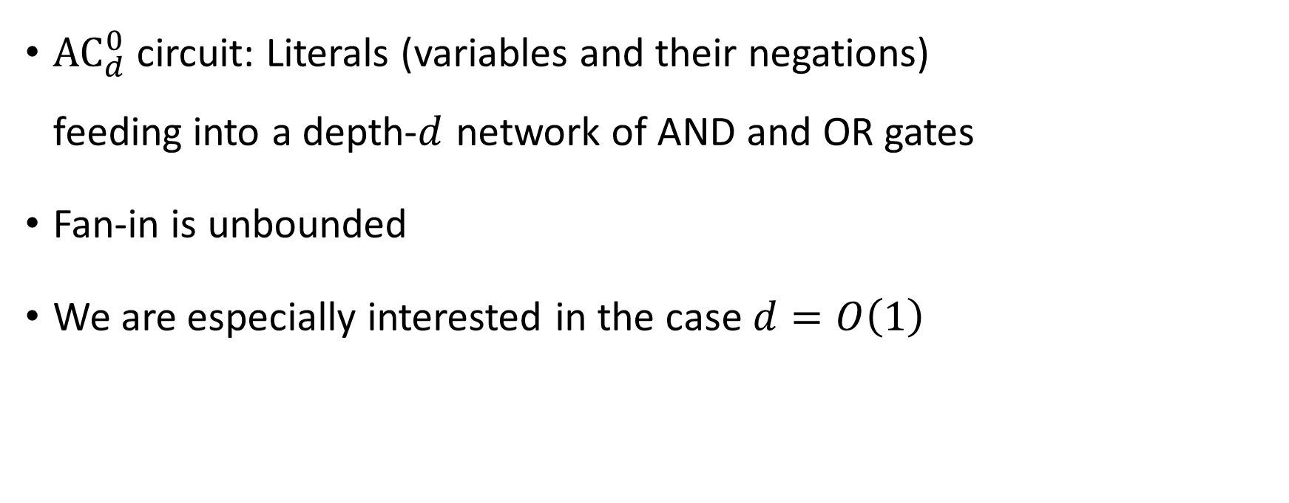


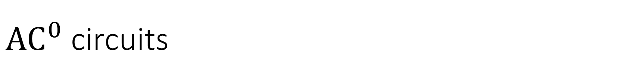









${\text{AC}}^{0}$ circuits
$$∧$$
$$∨$$
$$∨$$
$$∨$$
$$∨$$
$$∧$$
$$∧$$
$$∧$$
${\text{AC}}_{d}^{0}$ circuit: Literals (variables and their negations) feeding into a depth-$d$ network of AND and OR gates
Fan-in is unbounded
We are especially interested in the case $d=O\left(1\right)$
$$x_{1}$$
$$x_{4}$$
$$x_{2}$$
$$¬x_{1}$$
$$x_{3}$$

Slide 3







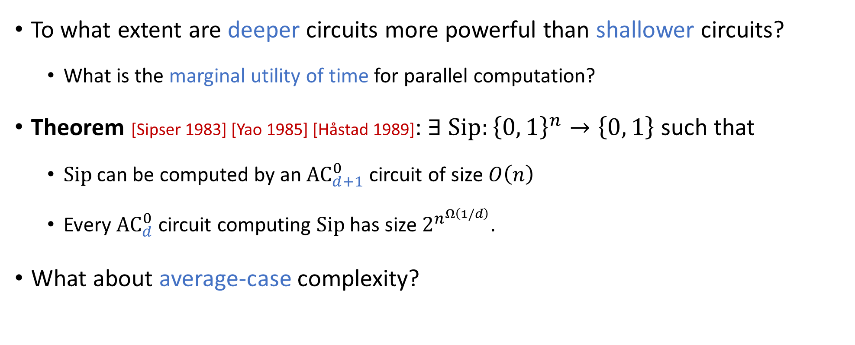









Depth hierarchies
To what extent are deeper circuits more powerful than shallower circuits?
What is the marginal utility of time for parallel computation?
Theorem [Sipser 1983] [Yao 1985] [Håstad 1989]: $∃$ $\text{Sip}:{\left\{0, 1\right\}}^{n}→\left\{0, 1\right\}$ such that
$\text{Sip}$ can be computed by an ${\text{AC}}_{d+1}^{0}$ circuit of size $O\left(n\right)$
Every ${\text{AC}}_{d}^{0}$ circuit computing $\text{Sip}$ has size $2^{n^{Ω\left(1/d\right)}}$.
What about average-case complexity?
$$∧$$
$$⋯$$
$$∨$$
$$⋯$$
$$∨$$
$$⋯$$
$$⋯$$
$$∧$$
$$∧$$
$$⋯$$
$$⋯$$
$$⋯$$
$$x_{1}$$
$$x_{2}$$
$$⋯$$
$$x_{n}$$

Slide 4



The average-case depth hierarchy theorem
Let $n, d∈ℕ$ with $d=o\left(\frac{\log{n}}{\log{\log{n}}}\right)$
Theorem [Håstad, Rossman, Servedio, Tan 2017]: $∃ Sip:\{0, 1\}^{n}→\{0, 1\}$ such that
$\text{Sip}$ can be computed by an ${\text{AC}}_{d+1}^{0}$ circuit of size $O\left(n\right)$
$∀ {\text{AC}}_{d}^{0}$ circuit $g$, either $g$ has size $2^{n^{Ω\left(1/d\right)}}$, or else we have
$$\underset{x∈\{0, 1\}^{n}}{Pr}{[g\left(x\right)=\text{Sip}\left(x\right)]}≤\frac{1}{2}+n^{−Ω\left(1/d\right)}.$$

Slide 5
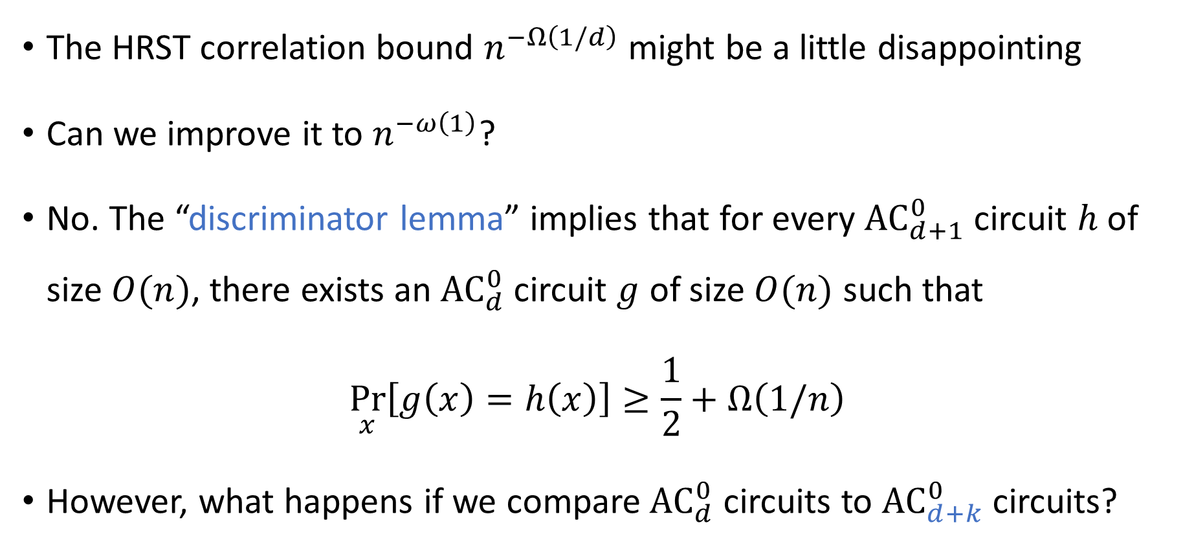
The correlation bound
The HRST correlation bound $n^{−Ω\left(1/d\right)}$ might be a little disappointing
Can we improve it to $n^{−ω\left(1\right)}$?
No. The “discriminator lemma” implies that for every ${\text{AC}}_{d+1}^{0}$ circuit $h$ of size $O(n)$, there exists an ${\text{AC}}_{d}^{0}$ circuit $g$ of size $O(n)$ such that
$$\underset{x}{Pr}\left[g\left(x\right)=h\left(x\right)\right]≥\frac{1}{2}+Ω\left(1/n\right)$$
However, what happens if we compare ${\text{AC}}_{d}^{0}$ circuits to ${\text{AC}}_{d+k}^{0}$ circuits?

Slide 6


Our correlation bound for depth reduction
Let $n,d,k∈ℕ$ with $k≥3$ and $dk=o\left(\frac{\log{n}}{\log{\log{n}}}\right)$
Theorem (this work): $∃ h:\{0, 1\}^{n}→\{0, 1\}$ such that
$h$ can be computed by an ${\text{AC}}_{d+k}^{0}$ circuit of size $O\left(n\right)$
$∀ {\text{AC}}_{d}^{0}$ circuit $g$, either $g$ has size $2^{n^{Ω\left(1/d\right)}}$, or else we have
$$\underset{x∈\{0, 1\}^{n}}{Pr}{[g\left(x\right)=h\left(x\right)]}≤\frac{1}{2}+2^{−Ω{\left(\log{n}\right)}^{k−1}⋅(1/d)}$$

Slide 7
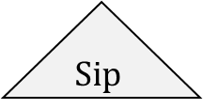


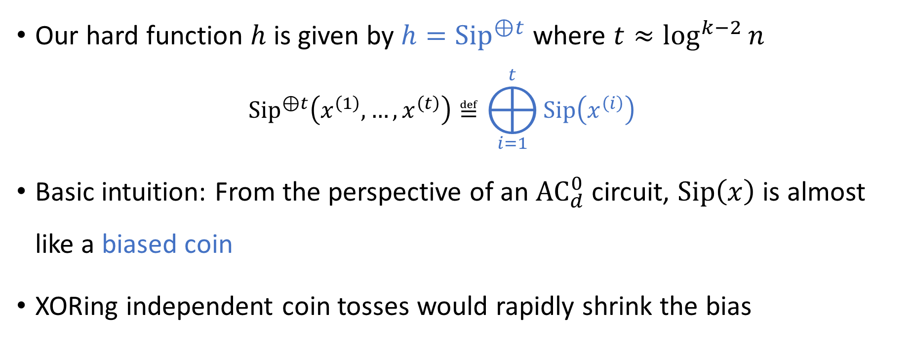



Our hard function
$$⨁$$
$$\text{Sip}$$
$$\text{Sip}$$
$$\text{Sip}$$
$$⋯$$
$$\text{Sip}$$
Our hard function $h$ is given by $h={\text{Sip}}^{⊕t}$ where $t≈\log^{k−2}{n}$
$${\text{Sip}}^{⊕t}\left(x^{\left(1\right)},…, x^{\left(t\right)}\right)≝⨁_{i=1}^{t}{\text{Sip}\left(x^{\left(i\right)}\right)}$$
Basic intuition: From the perspective of an ${\text{AC}}_{d}^{0}$ circuit, $\text{Sip}\left(x\right)$ is almost like a biased coin
XORing independent coin tosses would rapidly shrink the bias

Slide 8
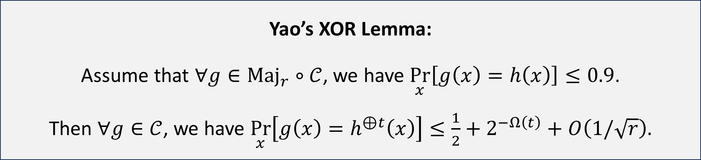

Inspiration: Yao’s XOR Lemma
Let $𝒞$ be any* class of Boolean functions and let $h:{\left\{0, 1\right\}}^{n}→\left\{0, 1\right\}$ be any function
*Assume $𝒞$ is closed under restrictions and complementation
However, proving lower bounds against $\text{Maj}∘{\text{AC}}^{0}$ is much more difficult than proving lower bounds against ${\text{AC}}^{0}$
Yao’s XOR Lemma: Assume that $∀g∈{\text{Maj}}_{r}∘𝒞$, we have $\underset{x}{Pr}\left[g\left(x\right)=h\left(x\right)\right]≤0.9$. Then $∀g∈𝒞$, we have $\underset{x}{Pr}\left[g\left(x\right)=h^{⊕t}\left(x\right)\right]≤\frac{1}{2}+2^{−Ω\left(t\right)}+O\left(1/\sqrt{r}\right).$

Slide 9
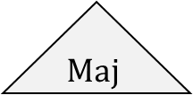
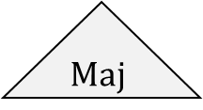

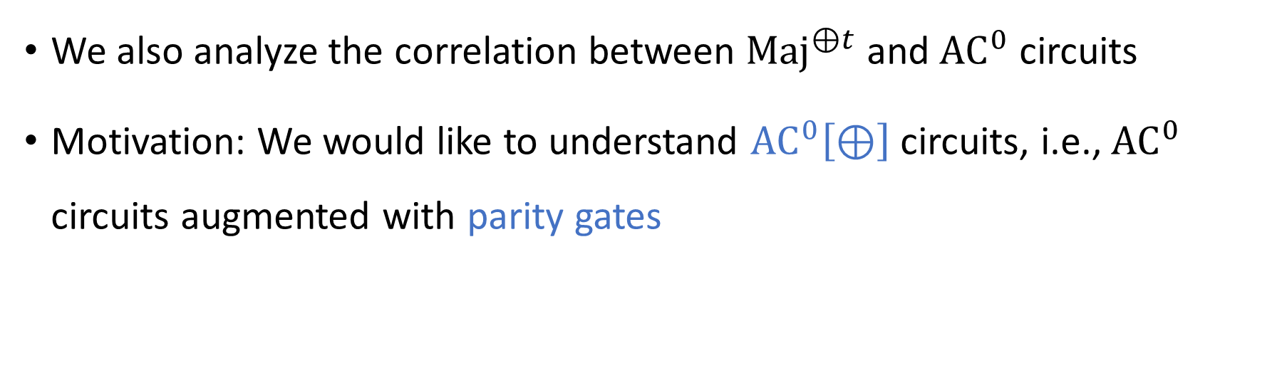



XOR-of-Majority function
$$⨁$$
$$\text{Maj}$$
$$\text{Maj}$$
$$\text{Maj}$$
$$⋯$$
$$\text{Maj}$$
We also analyze the correlation between ${\text{Maj}}^{⊕t}$ and ${\text{AC}}^{0}$ circuits
Motivation: We would like to understand ${\text{AC}}^{0}\left[⊕\right]$ circuits, i.e., ${\text{AC}}^{0}$ circuits augmented with parity gates

Slide 10


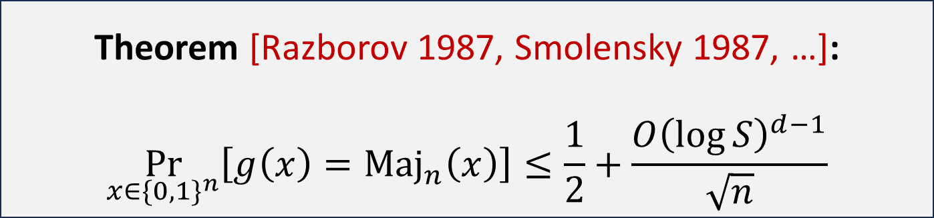
Majority is moderately hard for ${\text{AC}}^{0}\left[⊕\right]$
Let $g:\{0, 1\}^{n}→\{0, 1\}$ be any ${\text{AC}}_{d}^{0}\left[⊕\right]$ circuit of size $S≥n$
Major open problem: Prove $∃h∈\text{NP}$ satisfying a stronger correlation bound
${\text{Maj}}^{⊕t}$ is a good candidate hard function $h$
Theorem [Razborov 1987, Smolensky 1987, …]:
$$\underset{x∈\{0, 1\}^{n}}{Pr}\left[g\left(x\right)={\text{Maj}}_{n}\left(x\right)\right]≤\frac{1}{2}+\frac{O{\left(\log{S}\right)}^{d−1}}{\sqrt{n}}$$

Slide 11


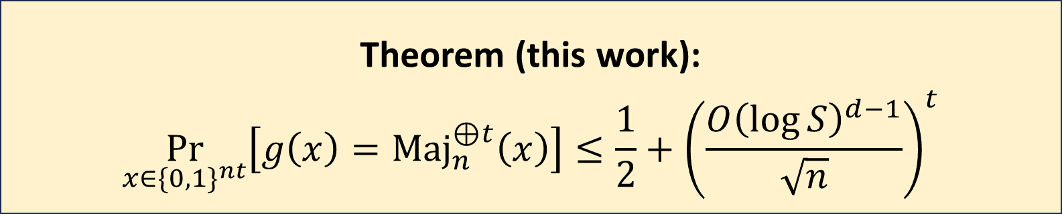
Our correlation bound for ${\text{Maj}}_{n}^{⊕t}$
Let $g:\{0, 1\}^{nt}→\{0, 1\}$ be any ${\text{AC}}_{d}^{0}$ circuit of size $S$
The XOR-of-Majority function is very hard for ${\text{AC}}^{0}$ circuits
Theorem (this work):
$$\underset{x∈\{0, 1\}^{nt}}{Pr}\left[g\left(x\right)={\text{Maj}}_{n}^{⊕t}\left(x\right)\right]≤\frac{1}{2}+{\left(\frac{O{\left(\log{S}\right)}^{d−1}}{\sqrt{n}}\right)}^{t}$$

Slide 12
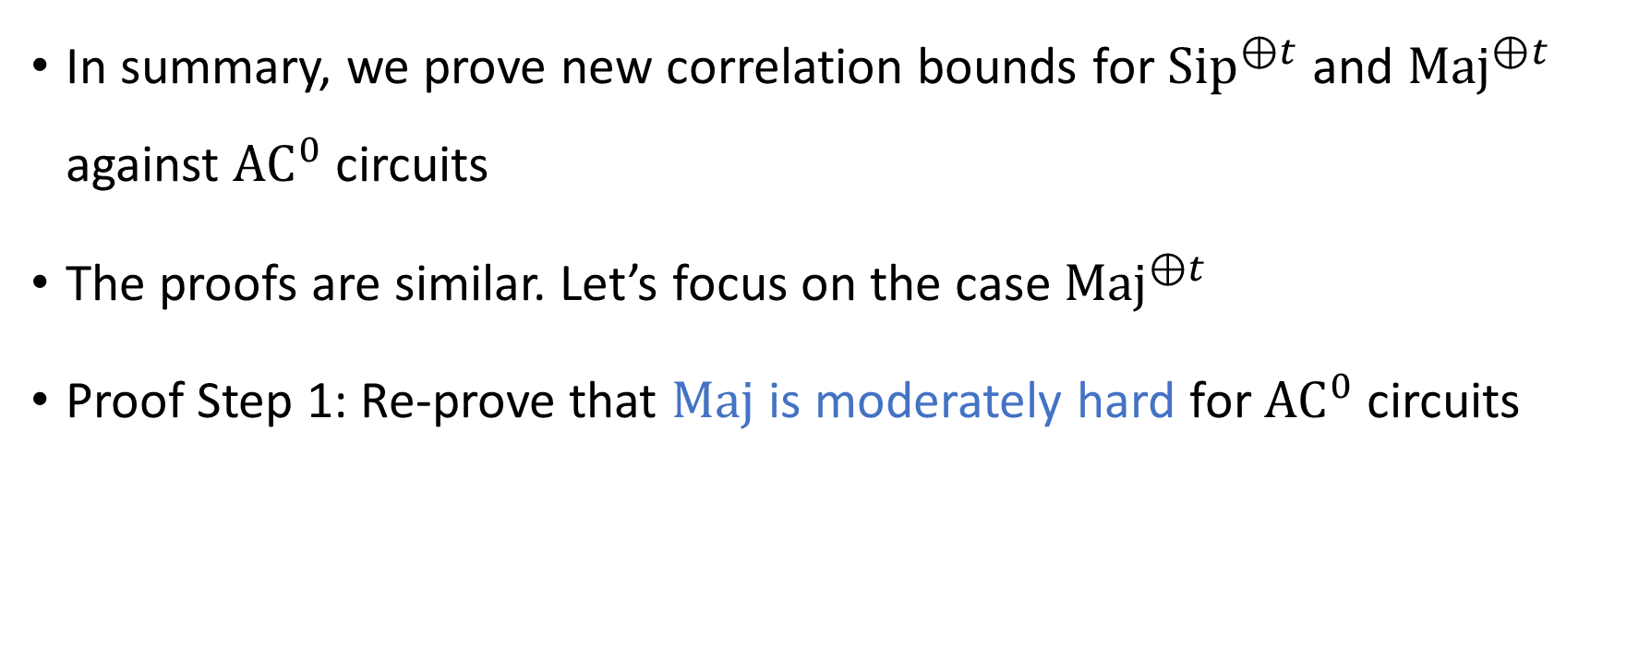
Our technique
In summary, we prove new correlation bounds for ${\text{Sip}}^{⊕t}$ and ${\text{Maj}}^{⊕t}$ against ${\text{AC}}^{0}$ circuits
The proofs are similar. Let’s focus on the case ${\text{Maj}}^{⊕t}$
Proof Step 1: Re-prove that $\text{Maj}$ is moderately hard for ${\text{AC}}^{0}$ circuits

Slide 13








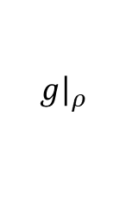
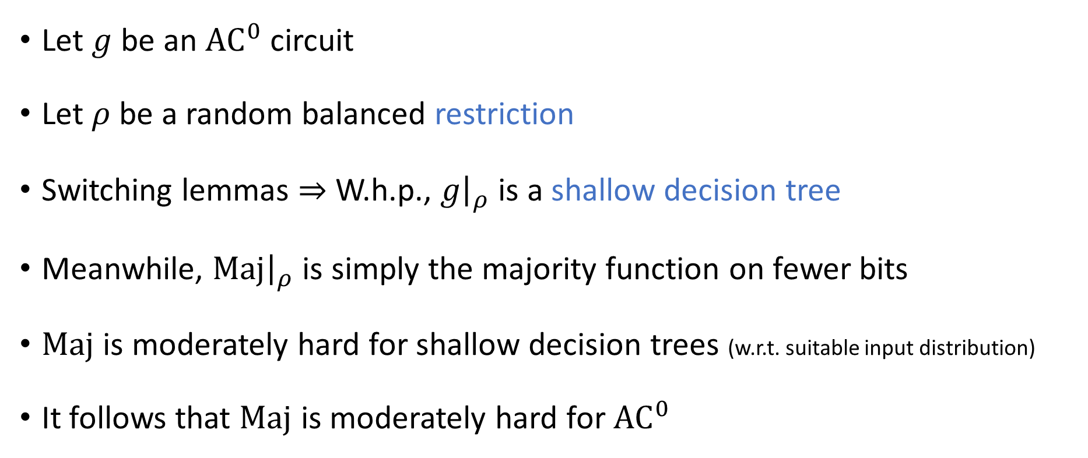
$\text{Maj}$ is moderately hard for ${\text{AC}}^{0}$
$$ρ$$
$$ρ$$
$$g$$
$$\text{Maj}$$
$\text{Maj}$
$g{\left.​\right|}_{ρ}$
Let $g$ be an ${\text{AC}}^{0}$ circuit
Let $ρ$ be a random balanced restriction
Switching lemmas $⇒$ W.h.p., $g{\left.​\right|}_{ρ}$ is a shallow decision tree
Meanwhile, $\text{Maj}{\left.​\right|}_{ρ}$ is simply the majority function on fewer bits
$\text{Maj}$ is moderately hard for shallow decision trees (w.r.t. suitable input distribution)
It follows that $\text{Maj}$ is moderately hard for ${\text{AC}}^{0}$

Slide 14

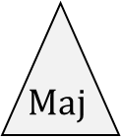
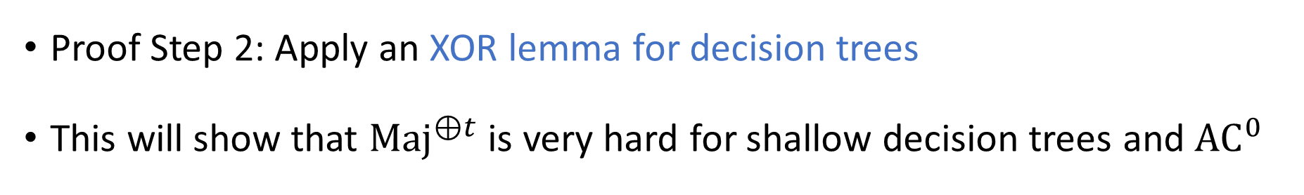







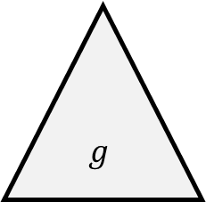


Analyzing ${\text{Maj}}^{⊕t}$ via random restrictions
$$⨁$$
$$g$$
$$\text{Maj}$$
$$\text{Maj}$$
$$\text{Maj}$$
$$\text{Maj}$$
$$\text{Maj}$$
$$\text{Maj}$$
$$\text{Maj}$$
$$⋯$$
$$\text{Maj}$$
Proof Step 2: Apply an XOR lemma for decision trees
This will show that ${\text{Maj}}^{⊕t}$ is very hard for shallow decision trees and ${\text{AC}}^{0}$

Slide 15
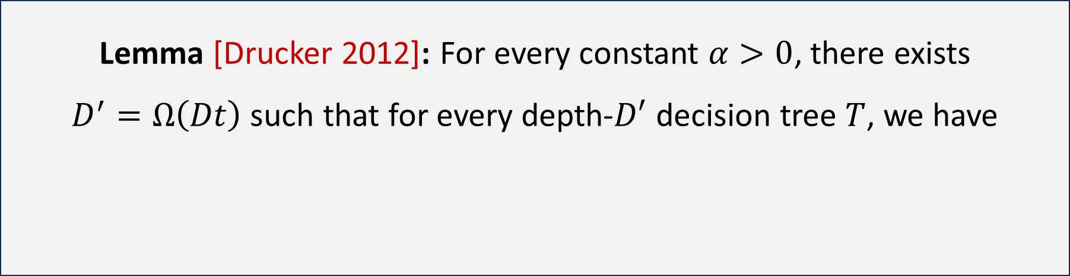


Drucker’s XOR lemma for decision trees
Let $h:\{0, 1\}^{n}→\{0, 1\}$
Assume that $∀$ depth-$D$ decision tree $T$, we have $\underset{x}{Pr}\left[T\left(x\right)=h\left(x\right)\right]≤\frac{1}{2}+ε$
Lemma [Drucker 2012]: For every constant $α>0$, there exists $D^{′}=Ω\left(Dt\right)$ such that for every depth-$D′$ decision tree $T$, we have
$$\underset{x}{Pr}\left[T\left(x\right)=h^{⊕t}\left(x\right)\right]≤\frac{1}{2}+O{\left(ε\right)}^{\left(1−α\right)⋅t}$$

Slide 16
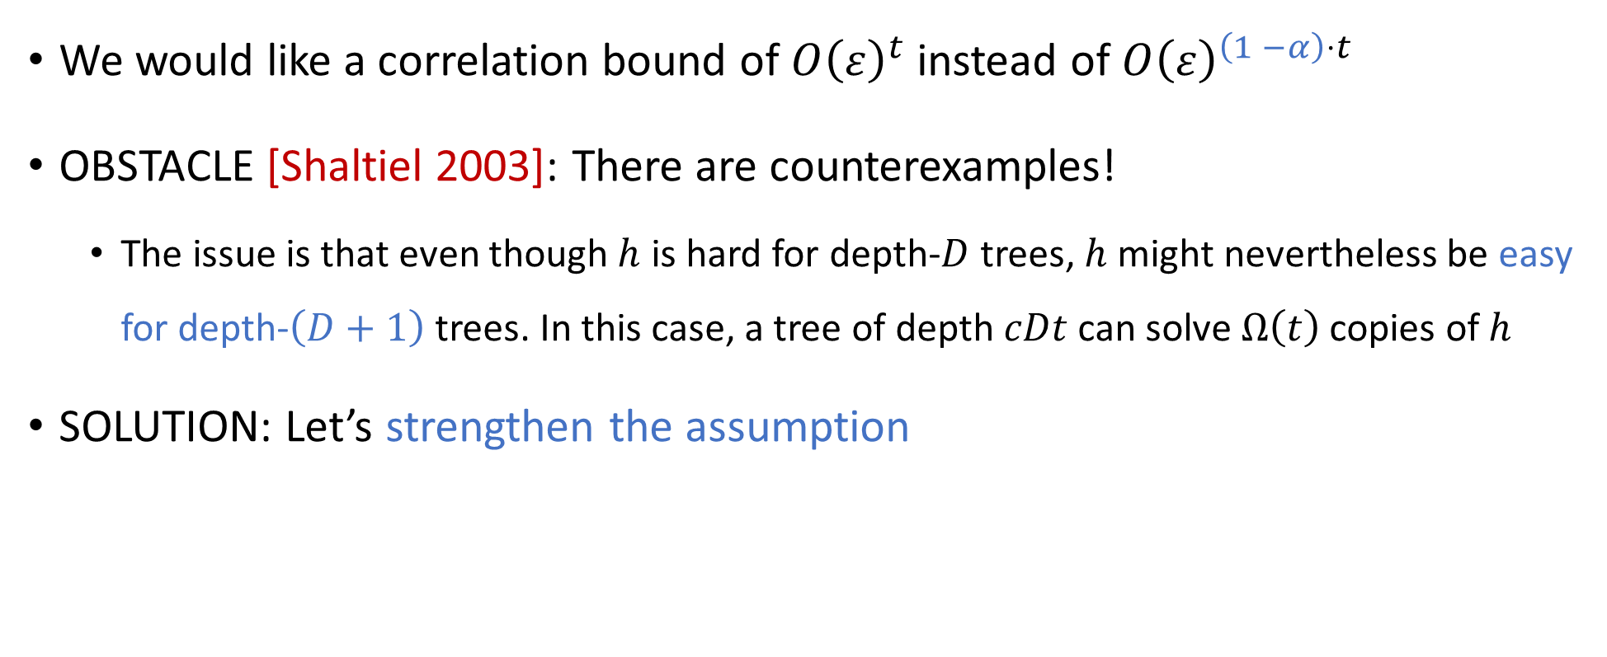
Stronger XOR lemmas for decision trees?
We would like a correlation bound of $O{\left(ε\right)}^{t}$ instead of $O{\left(ε\right)}^{\left(1 −α\right)⋅t}$
OBSTACLE [Shaltiel 2003]: There are counterexamples!
The issue is that even though $h$ is hard for depth-$D$ trees, $h$ might nevertheless be easy for depth-$\left(D+1\right)$ trees. In this case, a tree of depth $cDt$can solve $Ω\left(t\right)$ copies of $h$
SOLUTION: Let’s strengthen the assumption

Slide 17
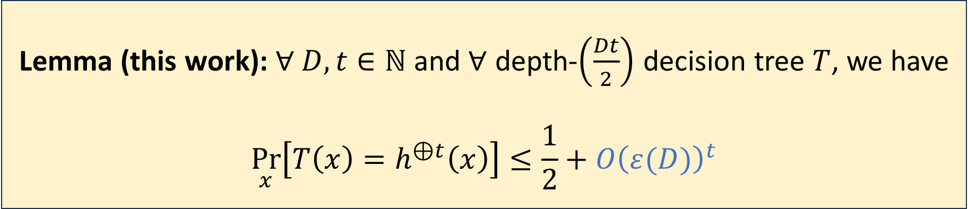

Our new XOR lemma for decision trees
Let $h:\{0, 1\}^{n}→\{0, 1\}$
Assume that for every $D∈ℕ$ and every depth-$D$ decision tree $T$, we have $\underset{x}{Pr}{[T\left(x\right)=h\left(x\right)}]≤\frac{1}{2}+ε\left(D\right)$, where $ε:\left[0, ∞\right)→\left(0, ∞\right)$ is log-concave
Lemma (this work): $∀ D, t∈ℕ$ and $∀$ depth-$\left(\frac{Dt}{2}\right)$ decision tree $T$, we have
$$\underset{x}{Pr}\left[T\left(x\right)=h^{⊕t}\left(x\right)\right]≤\frac{1}{2}+O{\left(ε(D)\right)}^{t}$$

Slide 18
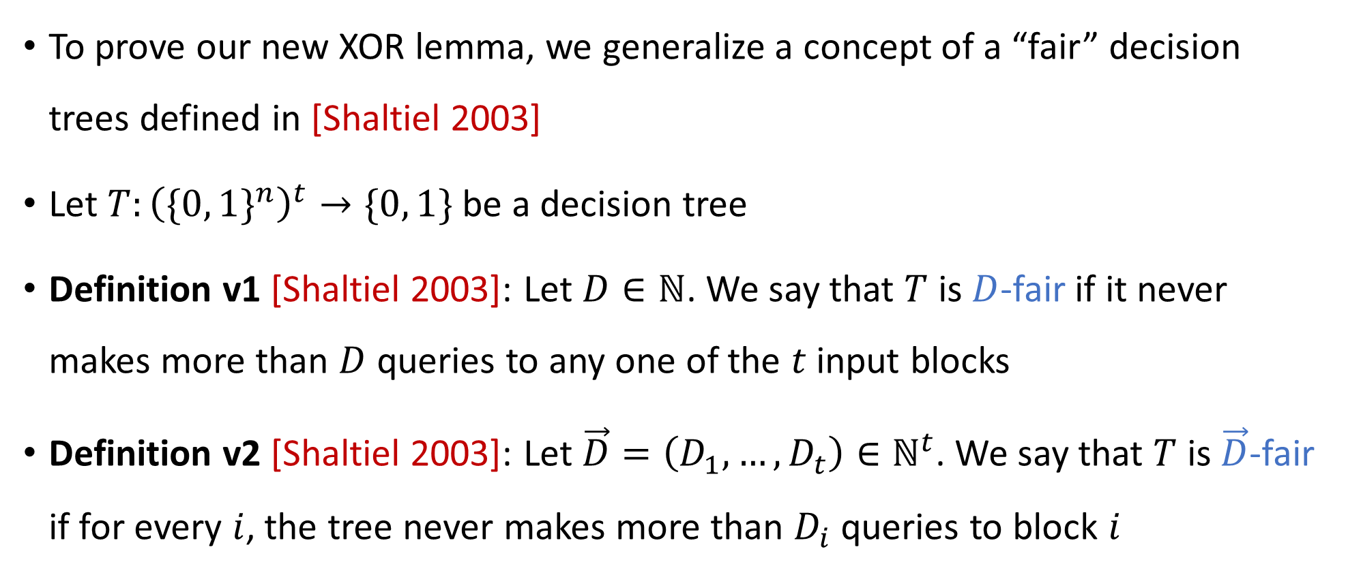
“Fair” decision trees
To prove our new XOR lemma, we generalize a concept of a “fair” decision trees defined in [Shaltiel 2003]
Let $T:{\left(\{0, 1\}^{n}\right)}^{t}→\{0, 1\}$ be a decision tree
Definition v1 [Shaltiel 2003]: Let $D∈ℕ$. We say that $T$ is $D$-fair if it never makes more than $D$ queries to any one of the $t$ input blocks
Definition v2 [Shaltiel 2003]: Let $\vec{D}=\left(D_{1},…, D_{t}\right)∈ℕ^{t}$. We say that $T$ is $\vec{D}$-fair if for every $i$, the tree never makes more than $D_{i}$ queries to block $i$

Slide 19
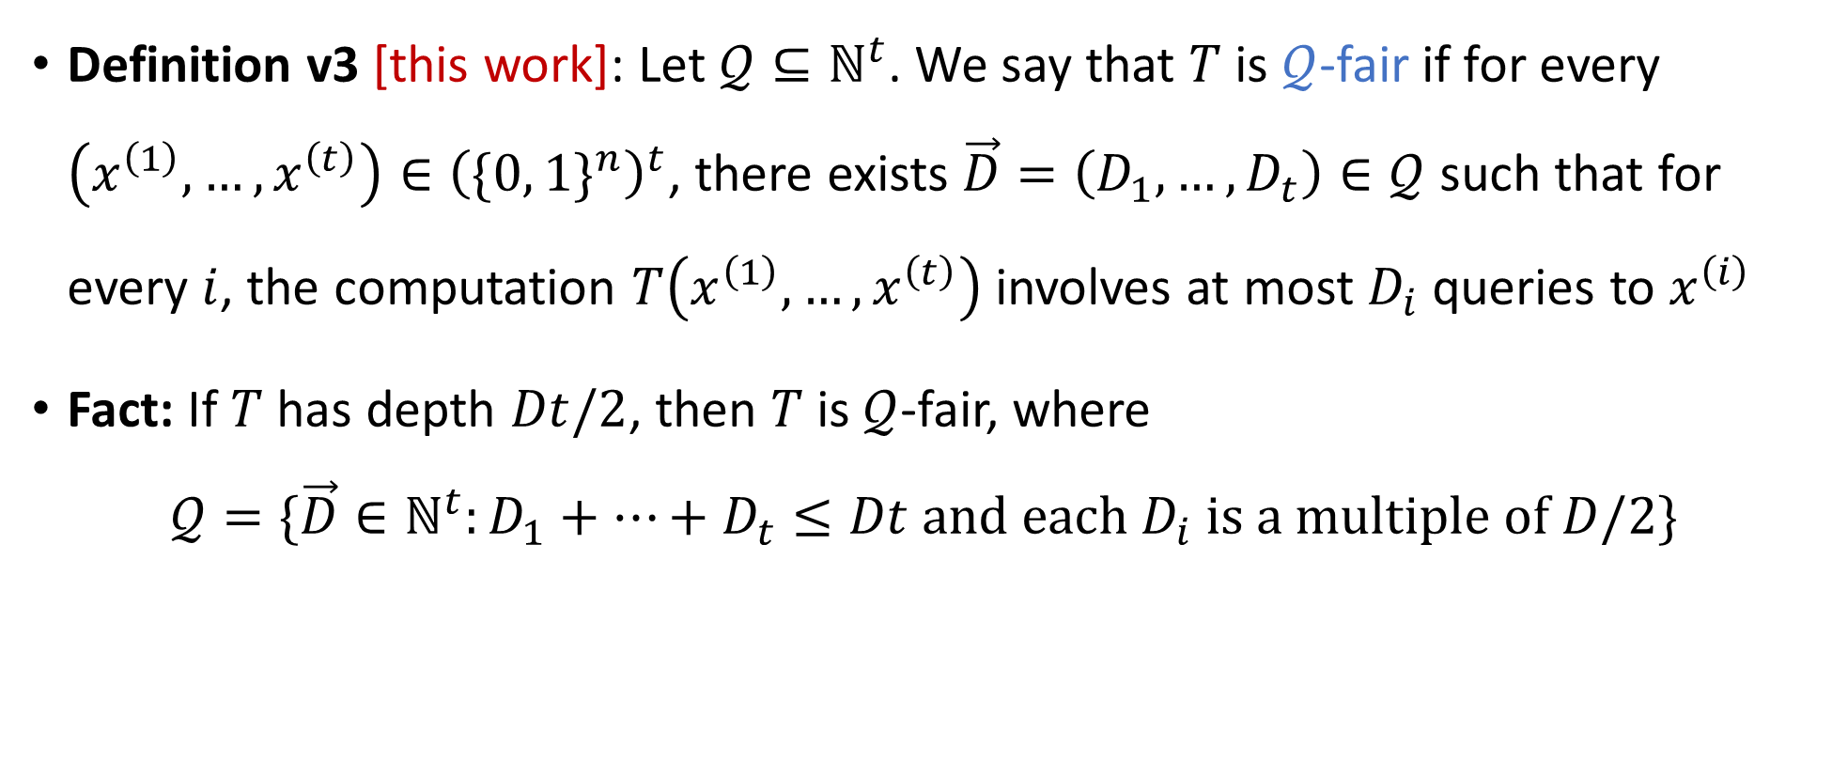
“Fair” decision trees
Definition v3 [this work]: Let $𝒬⊆ℕ^{t}$. We say that $T$ is $𝒬$-fair if for every $\left(x^{\left(1\right)}, …, x^{\left(t\right)}\right)∈{\left(\{0, 1\}^{n}\right)}^{t}$, there exists $\vec{D}=\left(D_{1},…, D_{t}\right)∈𝒬$ such that for every $i$, the computation $T\left(x^{\left(1\right)},…, x^{\left(t\right)}\right)$ involves at most $D_{i}$ queries to $x^{\left(i\right)}$
Fact: If $T$ has depth $Dt/2$, then $T$ is $𝒬$-fair, where
$$𝒬=\{\vec{D}∈ℕ^{t}:D_{1}+…+D_{t}≤Dt \text{and} \text{each} D_{i} \text{is} \text{a} \text{multiple} \text{of} D/2\}$$

Slide 20


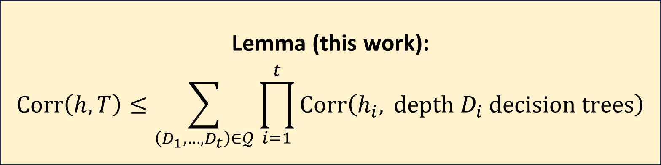
XOR lemma for $𝒬$-fair decision trees
Let $h_{1},…, h_{t}:\{0, 1\}^{n}→\{0, 1\}$ and let $h\left(x^{\left(1\right)},…, x^{\left(t\right)}\right)=⊕_{i=1}^{t}h_{i}\left(x^{\left(i\right)}\right)$
Let $T:{\left(\{0, 1\}^{n}\right)}^{t}→\{0, 1\}$ be a $𝒬$-fair decision tree
Proof is a straightforward induction on depth
Lemma (this work):
$$\text{Corr}\left(h, T\right)≤\sum_{\left(D_{1},…, D_{t}\right)∈𝒬}{\prod_{i=1}^{t}{\text{Corr}\left(h_{i}, \text{depth} D_{i} \text{decision} \text{trees}\right)}}$$

Slide 21
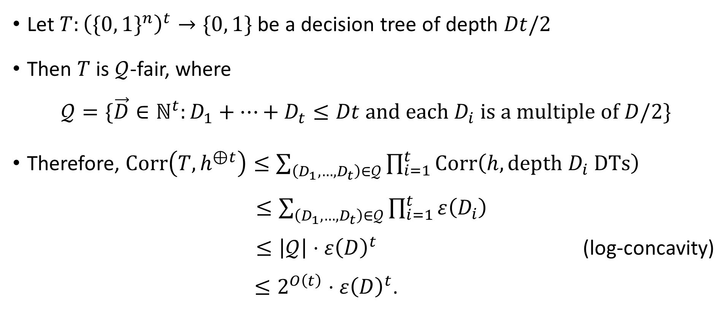
Proof of our main XOR lemma for decision trees
Let $T:{\left(\{0, 1\}^{n}\right)}^{t}→\{0, 1\}$ be a decision tree of depth $Dt/2$
Then $T$ is $𝒬$-fair, where
$$𝒬=\{\vec{D}∈ℕ^{t}:D_{1}+…+D_{t}≤Dt \text{and} \text{each} D_{i} \text{is} \text{a} \text{multiple} \text{of} D/2\}$$
Therefore, $\text{Corr}\left(T,h^{⊕t}\right)≤\sum_{\left(D_{1},…, D_{t}\right)∈𝒬}{\prod_{i=1}^{t}{\text{Corr}\left(h, \text{depth} D_{i} \text{DTs}\right)}}$ $≤\sum_{\left(D_{1},…, D_{t}\right)∈𝒬}{\prod_{i=1}^{t}{ε\left(D_{i}\right)}}$ $≤\left|𝒬\right|⋅ε{\left(D\right)}^{t}$ (log-concavity) $≤2^{O\left(t\right)}⋅ε{\left(D\right)}^{t}$.

Slide 22
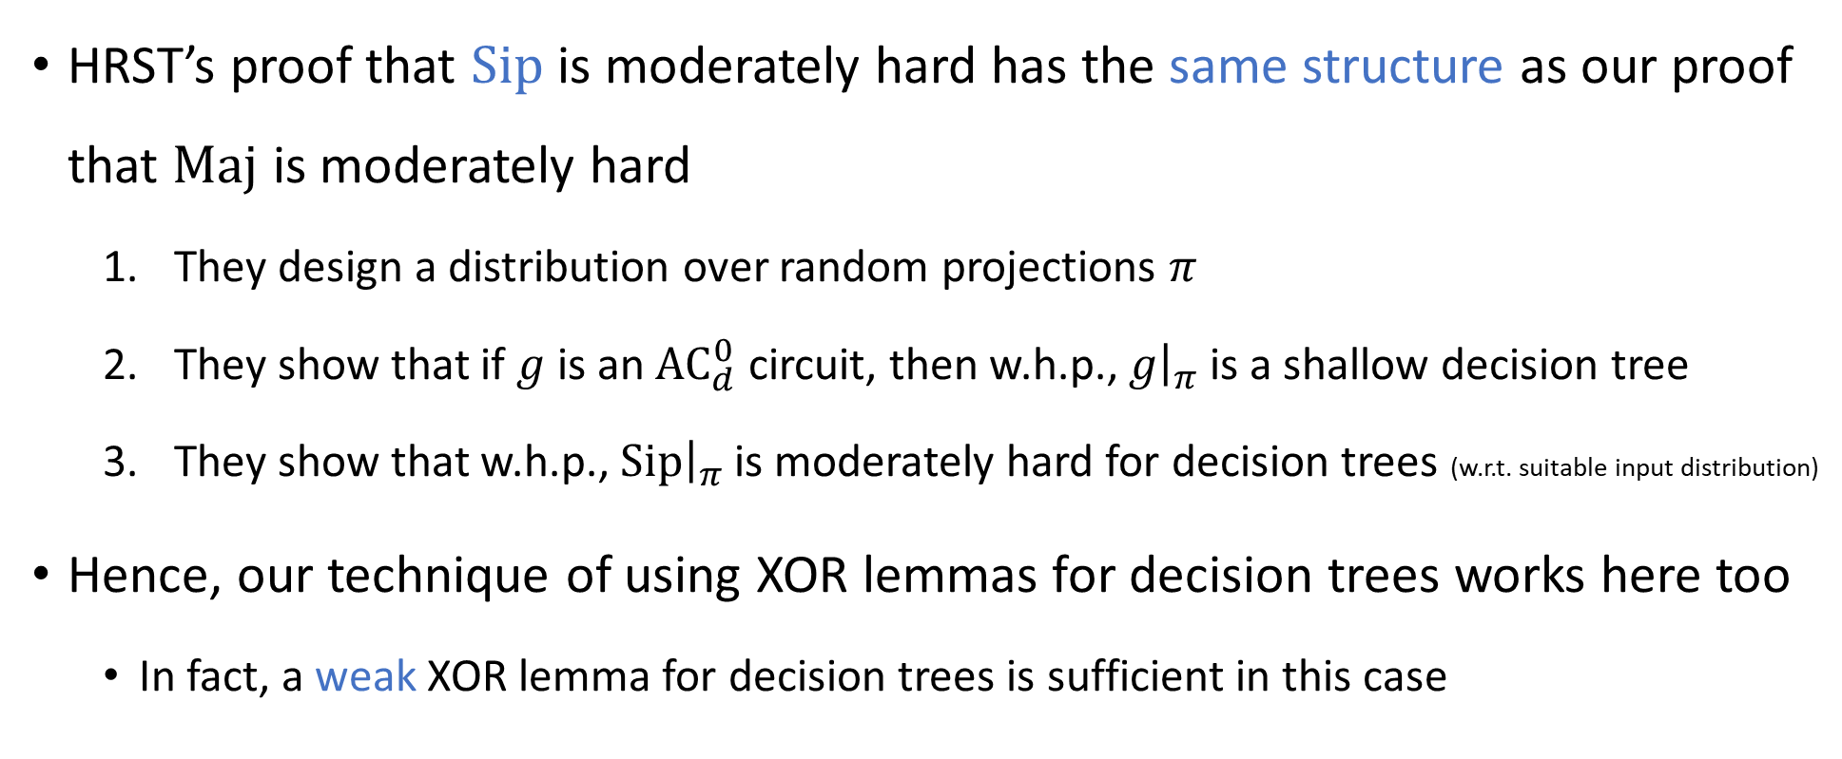

Correlation bound for ${\text{Sip}}^{⊕t}$
HRST’s proof that $\text{Sip}$ is moderately hard has the same structure as our proof that $\text{Maj}$ is moderately hard
They design a distribution over random projections $π$
They show that if $g$ is an ${\text{AC}}_{d}^{0}$ circuit, then w.h.p., $g{\left.​\right|}_{π}$ is a shallow decision tree
They show that w.h.p., $\text{Sip}{\left.​\right|}_{π}$ is moderately hard for decision trees (w.r.t. suitable input distribution)
Hence, our technique of using XOR lemmas for decision trees works here too
In fact, a weak XOR lemma for decision trees is sufficient in this case

Slide 23
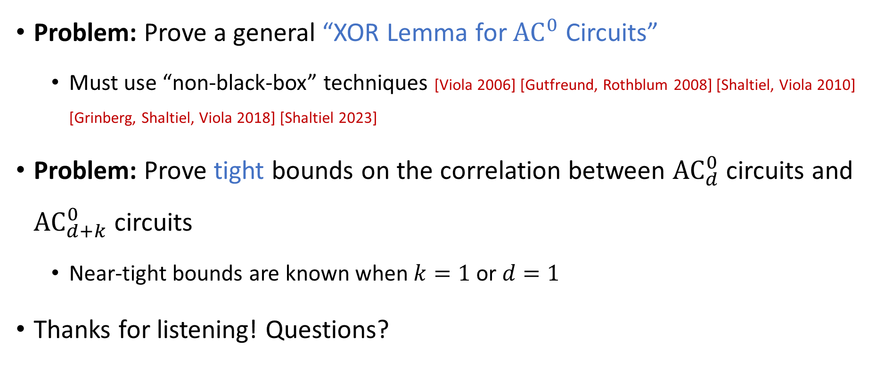
Open problems
Problem: Prove a general “XOR Lemma for ${\text{AC}}^{0}$ Circuits”
Must use “non-black-box” techniques [Viola 2006] [Gutfreund, Rothblum 2008] [Shaltiel, Viola 2010] [Grinberg, Shaltiel, Viola 2018] [Shaltiel 2023]
Problem: Prove tight bounds on the correlation between ${\text{AC}}_{d}^{0}$ circuits and ${\text{AC}}_{d+k}^{0}$ circuits
Near-tight bounds are known when $k=1$ or $d=1$
Thanks for listening! Questions?

