Slide 1
CMSC 28100 Introduction to Complexity Theory Winter 2024 Instructor: William Hoza
7 |  |  |  |  |  |  | 5 | 3
 |  |  |  |  |  |  |  | 4
 | 4 | 8 |  | 3 |  | 1 | 2
8 |  | 1 | 3 |  |  | 2 | 7 | 5
 | 9 |  | 1 |  |  |  | 4
 | 5 |  |  |  |  | 3
2 |  | 5 |  | 8 | 4
1 | 3 | 4 |  | 5

Slide 2
Which problems can be solved through computation?

Slide 3
Which languages are undecidable?

Slide 4

Undecidability beyond analysis of TMs
So far, every undecidable language we have seen has been about analyzing a given Turing machine
What else is undecidable?

Slide 5
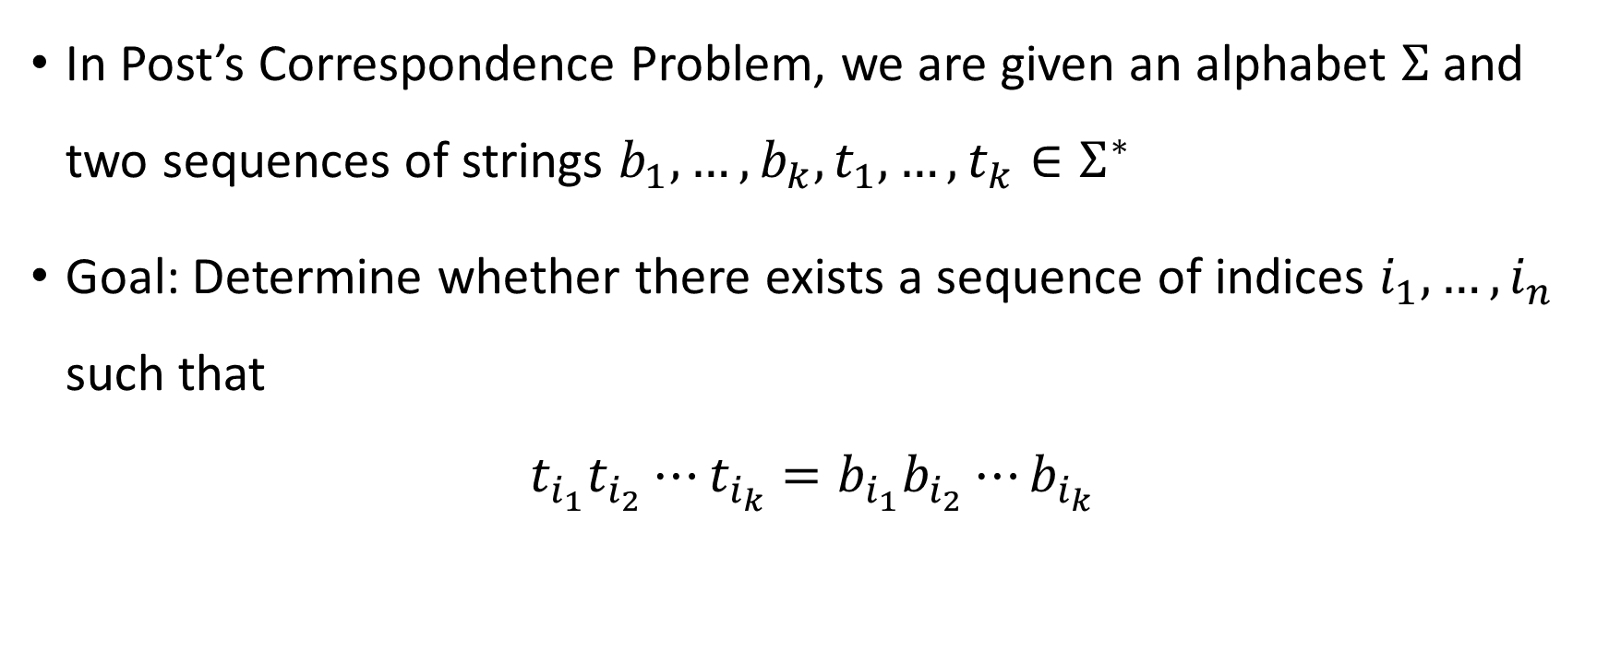
Post’s Correspondence Problem
In Post’s Correspondence Problem, we are given an alphabet $Σ$ and two sequences of strings $b_{1},…, b_{k}, t_{1},…, t_{k}∈Σ^{∗}$
Goal: Determine whether there exists a sequence of indices $i_{1},…, i_{n}$ such that
$$t_{i_{1}}t_{i_{2}}⋯t_{i_{k}}=b_{i_{1}}b_{i_{2}}⋯b_{i_{k}}$$

Slide 6












Post’s Correspondence Problem
Helpful picture: We are given a set of “dominos”
Goal: Determine whether it is possible to generate a “match”
in which the sequence of symbols on top equals the sequence of symbols on the bottom
Using the same domino multiple times is permitted
$$\begin{matrix}t_{1} \\ b_{1}\end{matrix}$$
$$\begin{matrix}t_{2} \\ b_{2}\end{matrix}$$
$$\begin{matrix}t_{3} \\ b_{3}\end{matrix}$$
$$\begin{matrix}t_{k} \\ b_{k}\end{matrix}$$
$$⋯$$
$$\begin{matrix}t_{i_{1}} \\ b_{i_{1}}\end{matrix}$$
$$\begin{matrix}t_{i_{2}} \\ b_{i_{2}}\end{matrix}$$
$$\begin{matrix}t_{i_{3}} \\ b_{i_{3}}\end{matrix}$$
$$\begin{matrix}t_{i_{4}} \\ b_{i_{4}}\end{matrix}$$
$$\begin{matrix}t_{i_{5}} \\ b_{i_{5}}\end{matrix}$$
$$\begin{matrix}t_{i_{n}} \\ b_{i_{n}}\end{matrix}$$
$$⋯$$

Slide 7



















Post’s Correspondence Problem: Example 1
Suppose we are given
This is a YES case because there is a match:
…and another match:
$$\begin{matrix}\text{M}\text{P} \\ \text{OM}\end{matrix}$$
$$\begin{matrix}\text{I}\text{O} \\ \text{T}\end{matrix}$$
$$\begin{matrix}\text{N} \\ \text{ION}\end{matrix}$$
$$\begin{matrix}\text{C}\text{O} \\ \text{C}\end{matrix}$$
$$\begin{matrix}\text{U}\text{T} \\ \text{PU}\end{matrix}$$
$$\begin{matrix}\text{A}\text{T} \\ \text{TA}\end{matrix}$$
$$\begin{matrix}\text{C}\text{O} \\ \text{C}\end{matrix}$$
$$\begin{matrix}\text{M}\text{P} \\ \text{OM}\end{matrix}$$
$$\begin{matrix}\text{U}\text{T} \\ \text{PU}\end{matrix}$$
$$\begin{matrix}\text{A}\text{T} \\ \text{TA}\end{matrix}$$
$$\begin{matrix}\text{I}\text{O} \\ \text{T}\end{matrix}$$
$$\begin{matrix}\text{N} \\ \text{ION}\end{matrix}$$
$←$COMPUTATION
$←$COMPUTATION
$$\begin{matrix}\text{C}\text{O} \\ \text{C}\end{matrix}$$
$$\begin{matrix}\text{M}\text{P} \\ \text{OM}\end{matrix}$$
$$\begin{matrix}\text{U}\text{T} \\ \text{PU}\end{matrix}$$
$$\begin{matrix}\text{I}\text{O} \\ \text{T}\end{matrix}$$
$$\begin{matrix}\text{N} \\ \text{ION}\end{matrix}$$
$←$COMPUTION
$←$COMPUTION

Slide 8




Post’s Correspondence Problem: Example 2
Suppose we are given
This is a NO case. Proof: A match would have to start with
and consequently we will always have more ones on the bottom than on the top
$$\begin{matrix}\text{0} \\ \text{01}\end{matrix}$$
$$\begin{matrix}\text{0}\text{1} \\ \text{10}\end{matrix}$$
$$\begin{matrix}\text{0}\text{1} \\ \text{1}\end{matrix}$$
$$\begin{matrix}\text{0} \\ \text{01}\end{matrix}$$

Slide 9

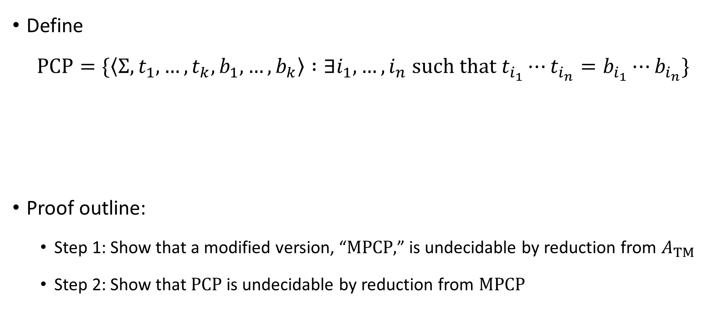
Post’s Correspondence Problem is undecidable
Define
$$\text{PCP}=\{\left\langle Σ, t_{1},…, t_{k}, b_{1},…, b_{k}\right\rangle :∃i_{1},…, i_{n} \text{such} \text{that} t_{i_{1}}⋯t_{i_{n}}=b_{i_{1}}⋯b_{i_{n}}\}$$
Proof outline:
Step 1: Show that a modified version, “$\text{MPCP}\text{,}$” is undecidable by reduction from $A_{TM}$
Step 2: Show that $\text{PCP}$ is undecidable by reduction from $\text{MPCP}$
Theorem: $\text{PCP}$ is undecidable

Slide 10
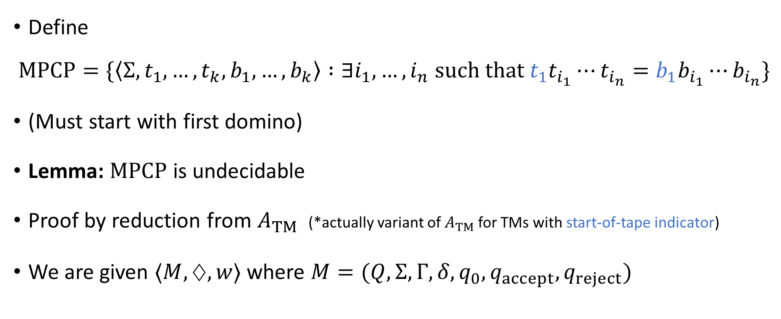
Modified PCP
Define
$$\text{MPCP}=\{\left\langle Σ, t_{1},…, t_{k}, b_{1},…, b_{k}\right\rangle :∃i_{1},…, i_{n} \text{such} \text{that} t_{1}t_{i_{1}}⋯t_{i_{n}}=b_{1}b_{i_{1}}⋯b_{i_{n}}\}$$
(Must start with first domino)
Lemma: $\text{MPCP}$ is undecidable
Proof by reduction from $A_{TM}$ (*actually variant of $A_{TM}$ for TMs with start-of-tape indicator)
We are given $⟨M,♢,w⟩$ where $M=(Q,Σ, Γ,δ,q_{0},q_{accept},q_{reject})$

Slide 11
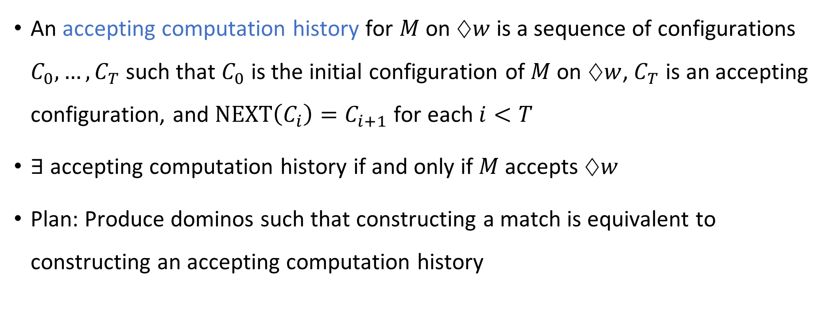
Accepting computation history
An accepting computation history for $M$ on $♢w$ is a sequence of configurations $C_{0},…, C_{T}$ such that $C_{0}$ is the initial configuration of $M$ on $♢w$, $C_{T}$ is an accepting configuration, and $\text{NEXT}\left(C_{i}\right)=C_{i+1}$ for each $i<T$
$∃$ accepting computation history if and only if $M$ accepts $♢w$
Plan: Produce dominos such that constructing a match is equivalent to constructing an accepting computation history

Slide 12


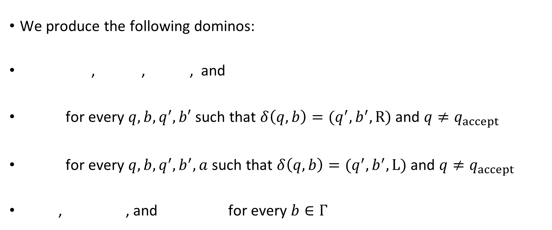








Reduction from $A_{TM}$ to $\text{MPCP}$
We produce the following dominos:
, , , and
for every $q,b,q^{′},b′$ such that $δ\left(q,b\right)=(q^{′},b^{′},\text{R})$ and $q≠q_{accept}$
for every $q,b,q^{′},b^{′},a$ such that $δ\left(q,b\right)=(q^{′},b^{′},\text{L})$ and $q≠q_{accept}$
, , and for every $b∈Γ$
Reduction is computable ✔️
$$\begin{matrix}ε \\ q_{0}♢w⊔\#\end{matrix}$$
$$\begin{matrix}\# \\ \#\end{matrix}$$
$$\begin{matrix}\# \\ ⊔\#\end{matrix}$$
$$\begin{matrix}q_{accept}\# \\ ε\end{matrix}$$
$$\begin{matrix}qb \\ b^{′}q′\end{matrix}$$
$$\begin{matrix}aqb \\ q^{′}ab′\end{matrix}$$
$$\begin{matrix}b \\ b\end{matrix}$$
$$\begin{matrix}bq_{accept} \\ q_{accept}\end{matrix}$$
$$\begin{matrix}q_{accept}b \\ q_{accept}\end{matrix}$$

Slide 13

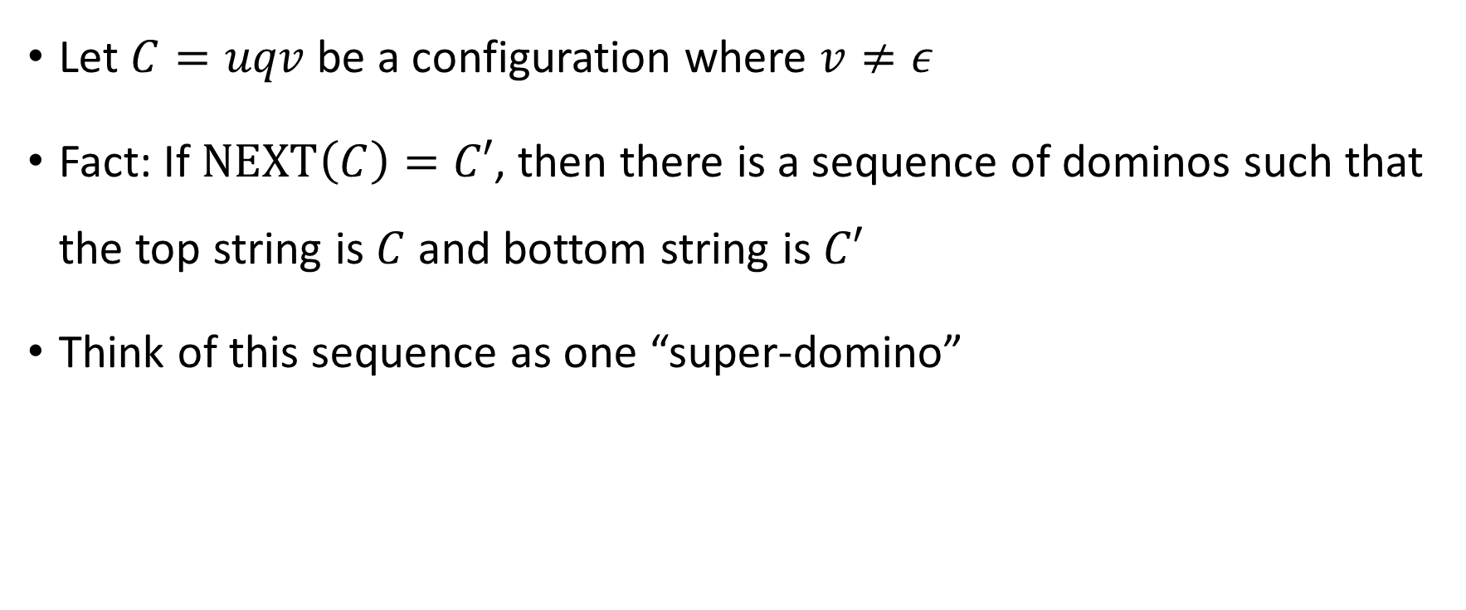
Domino feature 1
Let $C=uqv$ be a configuration where $v≠ε$
Fact: If $\text{NEXT}\left(C\right)=C′$, then there is a sequence of dominos such that the top string is $C$ and bottom string is $C′$
Think of this sequence as one “super-domino”
$$\begin{matrix}C \\ C′\end{matrix}$$

Slide 14



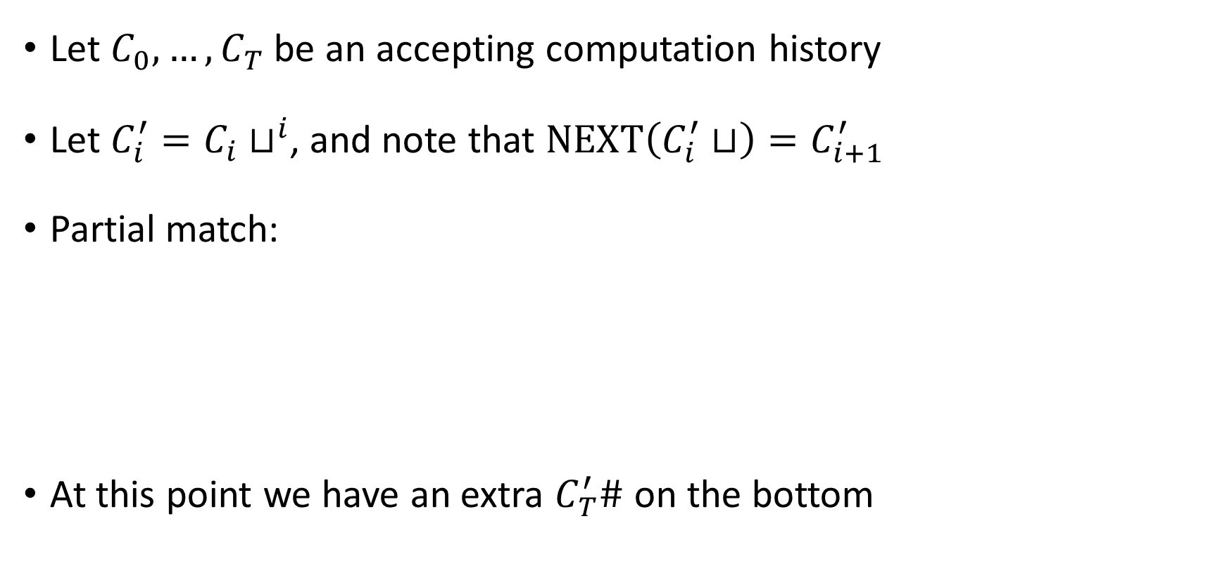






YES maps to YES
Let $C_{0},…, C_{T}$ be an accepting computation history
Let $C_{i}^{′}=C_{i}⊔^{i}$, and note that $\text{NEXT}\left(C_{i}^{′}⊔\right)=C_{i+1}^{′}$
Partial match:
At this point we have an extra $C_{T}^{′}\#$ on the bottom
$$\begin{matrix}ε \\ q_{0}♢w⊔\#\end{matrix}$$
$$\begin{matrix}C_{0}^{′}⊔ \\ C_{1}^{′}\end{matrix}$$
$$\begin{matrix}\# \\ ⊔\#\end{matrix}$$
$$\begin{matrix}C_{1}^{′}⊔ \\ C_{2}^{′}\end{matrix}$$
$$\begin{matrix}\# \\ ⊔\#\end{matrix}$$
$$\begin{matrix}\# \\ ⊔\#\end{matrix}$$
$$\begin{matrix}C_{T−1}^{′}⊔ \\ C_{T}^{′}\end{matrix}$$
$$\begin{matrix}\# \\ \#\end{matrix}$$
$$⋯$$

Slide 15

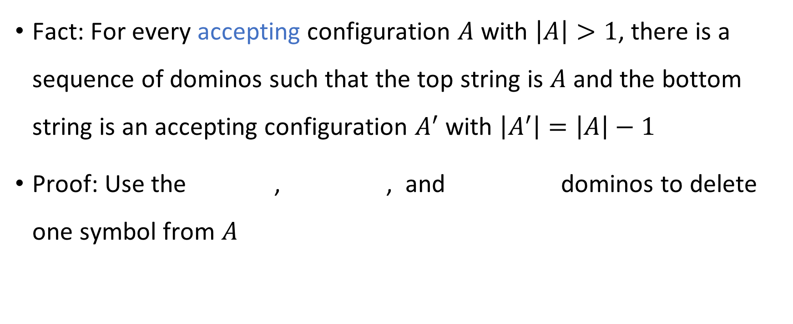



Domino feature 2
Fact: For every accepting configuration $A$ with $\left|A\right|>1$, there is a sequence of dominos such that the top string is $A$ and the bottom string is an accepting configuration $A^{′}$ with $\left|A^{′}\right|=\left|A\right|−1$
Proof: Use the , , and dominos to delete one symbol from $A$
$$\begin{matrix}A \\ A′\end{matrix}$$
$$\begin{matrix}b \\ b\end{matrix}$$
$$\begin{matrix}bq_{accept} \\ q_{accept}\end{matrix}$$
$$\begin{matrix}q_{accept}b \\ q_{accept}\end{matrix}$$

Slide 16








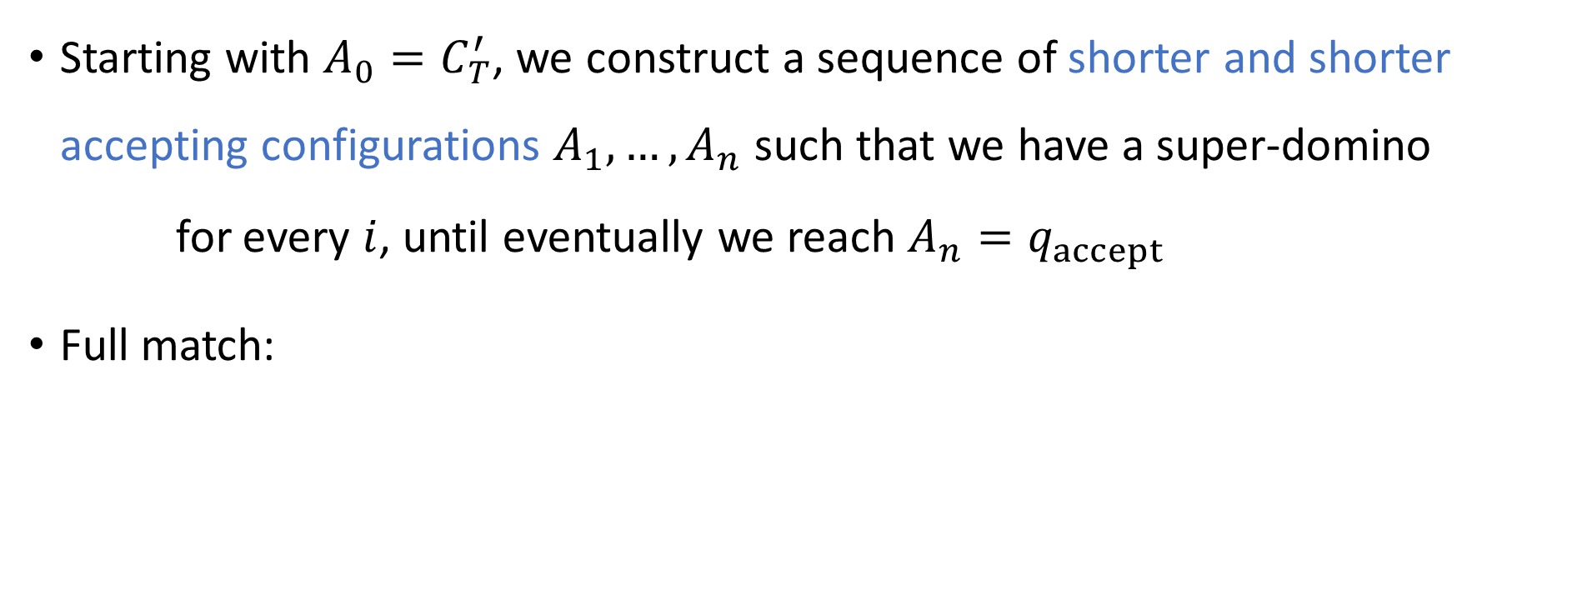











YES maps to YES
Starting with $A_{0}=C_{T}^{′}$, we construct a sequence of shorter and shorter accepting configurations $A_{1},…, A_{n}$ such that we have a super-domino for every $i$, until eventually we reach $A_{n}=q_{accept}$
Full match:
$$\begin{matrix}A_{i−1} \\ A_{i}\end{matrix}$$
$$\begin{matrix}ε \\ q_{0}♢w⊔\#\end{matrix}$$
$$\begin{matrix}C_{0}^{′}⊔ \\ C_{1}^{′}\end{matrix}$$
$$\begin{matrix}\# \\ ⊔\#\end{matrix}$$
$$\begin{matrix}C_{1}^{′}⊔ \\ C_{2}^{′}\end{matrix}$$
$$\begin{matrix}\# \\ ⊔\#\end{matrix}$$
$$\begin{matrix}\# \\ ⊔\#\end{matrix}$$
$$\begin{matrix}C_{T−1}^{′}⊔ \\ C_{T}^{′}\end{matrix}$$
$$\begin{matrix}\# \\ \#\end{matrix}$$
$$\begin{matrix}A_{0} \\ A_{1}\end{matrix}$$
$$\begin{matrix}\# \\ \#\end{matrix}$$
$$\begin{matrix}A_{1} \\ A_{2}\end{matrix}$$
$$\begin{matrix}\# \\ \#\end{matrix}$$
$$\begin{matrix}\# \\ \#\end{matrix}$$
$$\begin{matrix}A_{n−1} \\ A_{n}\end{matrix}$$
$$\begin{matrix}\# \\ \#\end{matrix}$$
$$\begin{matrix}q_{accept}\# \\ ε\end{matrix}$$
$$⋯$$
$$⋯$$

Slide 17

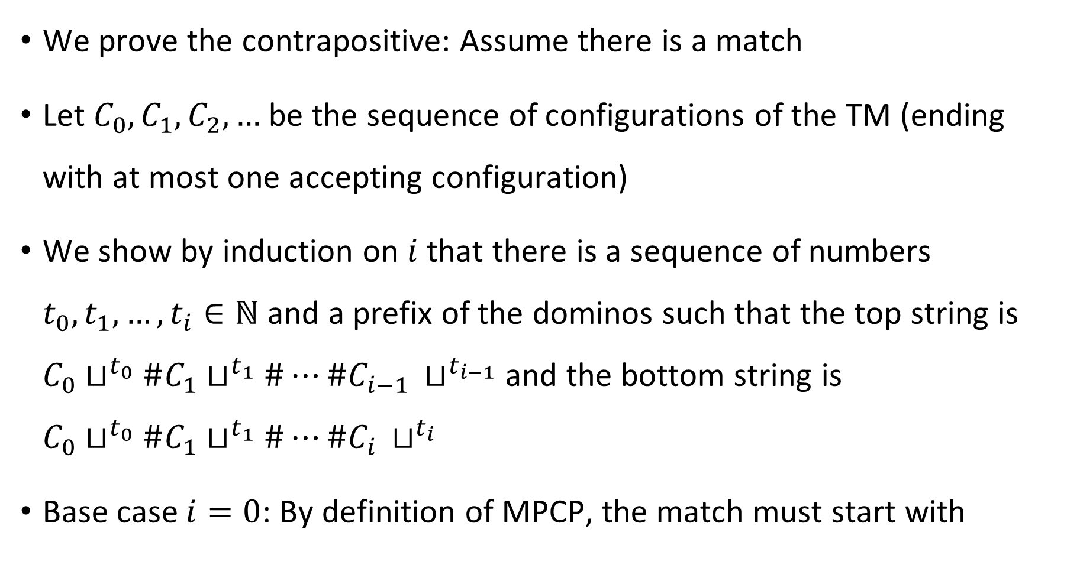
NO maps to NO
We prove the contrapositive: Assume there is a match
Let $C_{0},C_{1},C_{2},…$ be the sequence of configurations of the TM (ending with at most one accepting configuration)
We show by induction on $i$ that there is a sequence of numbers $t_{0},t_{1},…, t_{i}∈ℕ$ and a prefix of the dominos such that the top string is $C_{0}⊔^{t_{0}}\#C_{1}⊔^{t_{1}}\#⋯\#C_{i−1 }⊔^{t_{i−1}}$ and the bottom string is $C_{0}⊔^{t_{0}}\#C_{1}⊔^{t_{1}}\#⋯\#C_{i }⊔^{t_{i}}$
Base case $i=0$: By definition of MPCP, the match must start with
$$\begin{matrix}ε \\ q_{0}♢w⊔\#\end{matrix}$$

Slide 18

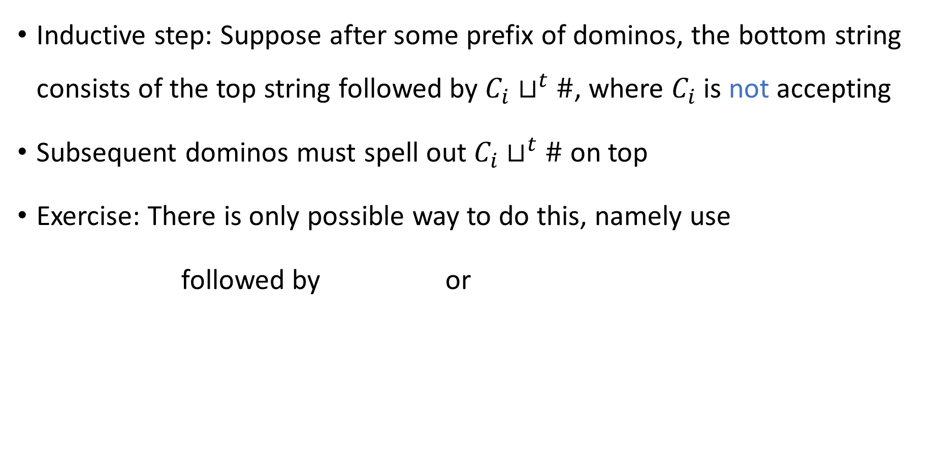


NO maps to NO
Inductive step: Suppose after some prefix of dominos, the bottom string consists of the top string followed by $C_{i}⊔^{t}\#$, where $C_{i}$ is not accepting
Subsequent dominos must spell out $C_{i}⊔^{t}\#$ on top
Exercise: There is only possible way to do this, namely use
followed by or
$$\begin{matrix}C_{i}⊔^{t} \\ C_{i+1}⊔^{t}\end{matrix}$$
$$\begin{matrix}\# \\ \#\end{matrix}$$
$$\begin{matrix}\# \\ ⊔\#\end{matrix}$$

Slide 19


NO maps to NO
Eventually we must use because otherwise there are always more # on bottom than on top
Therefore one of the $C_{i}$ configurations must be accepting
$$\begin{matrix}q_{accept}\# \\ ε\end{matrix}$$

