Slide 1
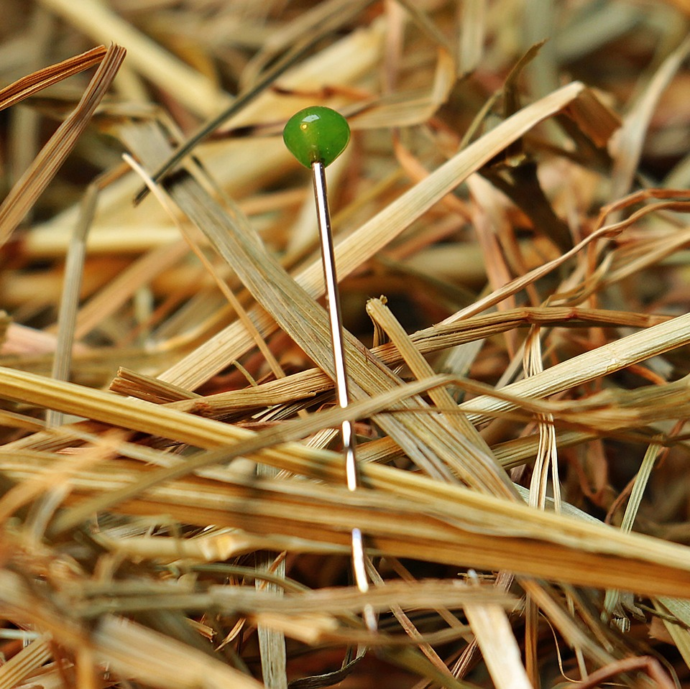
CMSC 28100 Introduction to Complexity Theory Spring 2024 Instructor: William Hoza

Slide 2
Which languages are decidable?

Slide 3


Undecidability
We have seen several examples of undecidable languages
$\text{SELF}‑\text{REJECTORS}$, $\text{HALT}$, $\overline{\text{HALT}}$, ${\text{A}}_{TM}$, ${\text{E}}_{TM}$

Slide 4
Undecidability beyond analysis of TMs
So far, every undecidable problem we have seen has been a problem about analyzing the behavior of a given Turing machine
Does it halt on such-and-such input?
Is there any input it accepts?
Etc.
What else is undecidable?

Slide 5
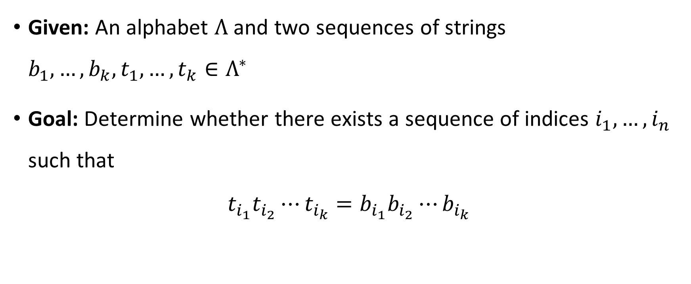
Post’s Correspondence Problem
Given: An alphabet $Λ$ and two sequences of strings $b_{1},…, b_{k}, t_{1},…, t_{k}∈Λ^{∗}$
Goal: Determine whether there exists a sequence of indices $i_{1},…, i_{n}$ such that
$$t_{i_{1}}t_{i_{2}}⋯t_{i_{k}}=b_{i_{1}}b_{i_{2}}⋯b_{i_{k}}$$

Slide 6












Post’s Correspondence Problem
Helpful picture: We are given a set of “dominos”
Goal: Determine whether it is possible to generate a “match”
in which the sequence of symbols on top equals the sequence of symbols on the bottom
Using the same domino multiple times is permitted
$$\begin{matrix}t_{1} \\ b_{1}\end{matrix}$$
$$\begin{matrix}t_{2} \\ b_{2}\end{matrix}$$
$$\begin{matrix}t_{3} \\ b_{3}\end{matrix}$$
$$\begin{matrix}t_{k} \\ b_{k}\end{matrix}$$
$$⋯$$
$$\begin{matrix}t_{i_{1}} \\ b_{i_{1}}\end{matrix}$$
$$\begin{matrix}t_{i_{2}} \\ b_{i_{2}}\end{matrix}$$
$$\begin{matrix}t_{i_{3}} \\ b_{i_{3}}\end{matrix}$$
$$\begin{matrix}t_{i_{4}} \\ b_{i_{4}}\end{matrix}$$
$$\begin{matrix}t_{i_{5}} \\ b_{i_{5}}\end{matrix}$$
$$\begin{matrix}t_{i_{n}} \\ b_{i_{n}}\end{matrix}$$
$$⋯$$

Slide 7






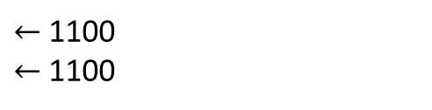


Post’s Correspondence Problem: Example 1
Suppose we are given
This is a YES case. Match:
$$\begin{matrix}\text{0} \\ \text{1}\end{matrix}$$
$$\begin{matrix}\text{1} \\ \text{0}\end{matrix}$$
$$\begin{matrix}\text{1}\text{1} \\ ϵ\end{matrix}$$
$$\begin{matrix}ϵ \\ 00\end{matrix}$$
$$\begin{matrix}\text{1}\text{1} \\ ϵ\end{matrix}$$
$$\begin{matrix}\text{0} \\ \text{1}\end{matrix}$$
$$\begin{matrix}\text{0} \\ \text{1}\end{matrix}$$
$$\begin{matrix}ϵ \\ 00\end{matrix}$$
$←$1100
$←$1100

Slide 8



















Post’s Correspondence Problem: Example 2
Suppose we are given
This is a YES case because there is a match:
…and another match:
$$\begin{matrix}\text{M}\text{P} \\ \text{OM}\end{matrix}$$
$$\begin{matrix}\text{I}\text{O} \\ \text{T}\end{matrix}$$
$$\begin{matrix}\text{N} \\ \text{ION}\end{matrix}$$
$$\begin{matrix}\text{C}\text{O} \\ \text{C}\end{matrix}$$
$$\begin{matrix}\text{U}\text{T} \\ \text{PU}\end{matrix}$$
$$\begin{matrix}\text{A}\text{T} \\ \text{TA}\end{matrix}$$
$$\begin{matrix}\text{C}\text{O} \\ \text{C}\end{matrix}$$
$$\begin{matrix}\text{M}\text{P} \\ \text{OM}\end{matrix}$$
$$\begin{matrix}\text{U}\text{T} \\ \text{PU}\end{matrix}$$
$$\begin{matrix}\text{A}\text{T} \\ \text{TA}\end{matrix}$$
$$\begin{matrix}\text{I}\text{O} \\ \text{T}\end{matrix}$$
$$\begin{matrix}\text{N} \\ \text{ION}\end{matrix}$$
$←$COMPUTATION
$←$COMPUTATION
$$\begin{matrix}\text{C}\text{O} \\ \text{C}\end{matrix}$$
$$\begin{matrix}\text{M}\text{P} \\ \text{OM}\end{matrix}$$
$$\begin{matrix}\text{U}\text{T} \\ \text{PU}\end{matrix}$$
$$\begin{matrix}\text{I}\text{O} \\ \text{T}\end{matrix}$$
$$\begin{matrix}\text{N} \\ \text{ION}\end{matrix}$$
$←$COMPUTION
$←$COMPUTION

Slide 9




Post’s Correspondence Problem: Example 3
Suppose we are given
This is a NO case. Proof: A match would have to start with ,
and consequently, we will always have more ones on the bottom than on the top
$$\begin{matrix}\text{0} \\ \text{01}\end{matrix}$$
$$\begin{matrix}\text{0}\text{10} \\ \text{10}\end{matrix}$$
$$\begin{matrix}\text{1} \\ \text{01}\end{matrix}$$
$$\begin{matrix}\text{0} \\ \text{01}\end{matrix}$$

Slide 10

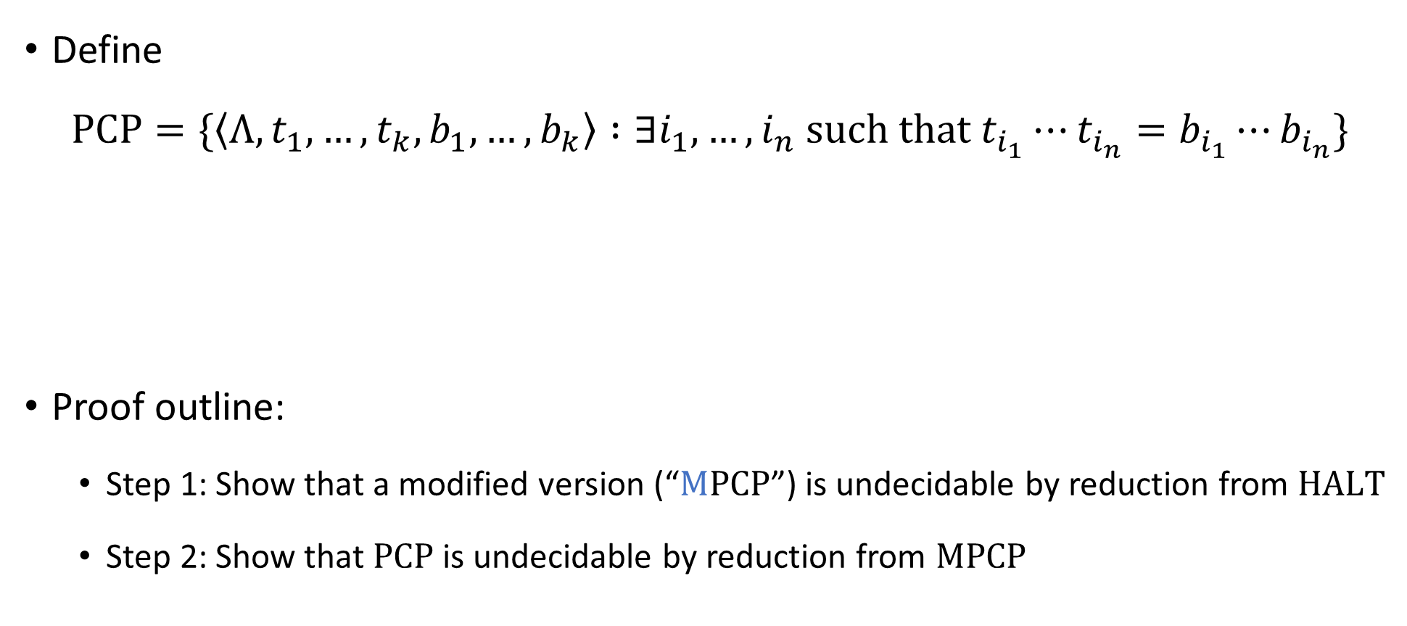
Post’s Correspondence Problem is undecidable
Define
$$\text{PCP}=\{\left\langle Λ, t_{1},…, t_{k}, b_{1},…, b_{k}\right\rangle :∃i_{1},…, i_{n} \text{such} \text{that} t_{i_{1}}⋯t_{i_{n}}=b_{i_{1}}⋯b_{i_{n}}\}$$
Proof outline:
Step 1: Show that a modified version (“$\text{M}\text{PCP}$”) is undecidable by reduction from $\text{HALT}$
Step 2: Show that $\text{PCP}$ is undecidable by reduction from $\text{MPCP}$
Theorem: $\text{PCP}$ is undecidable

Slide 11

Modified PCP
$$\text{MPCP}=\{\left\langle Λ, t_{1},…, t_{k}, b_{1},…, b_{k}\right\rangle :∃i_{1},…, i_{n} \text{such} \text{that} t_{1}t_{i_{1}}⋯t_{i_{n}}=b_{1}b_{i_{1}}⋯b_{i_{n}}\}$$
The difference between $\text{PCP}$ and $\text{MPCP}$: In $\text{MPCP}$, matches must start with the first domino

Slide 12
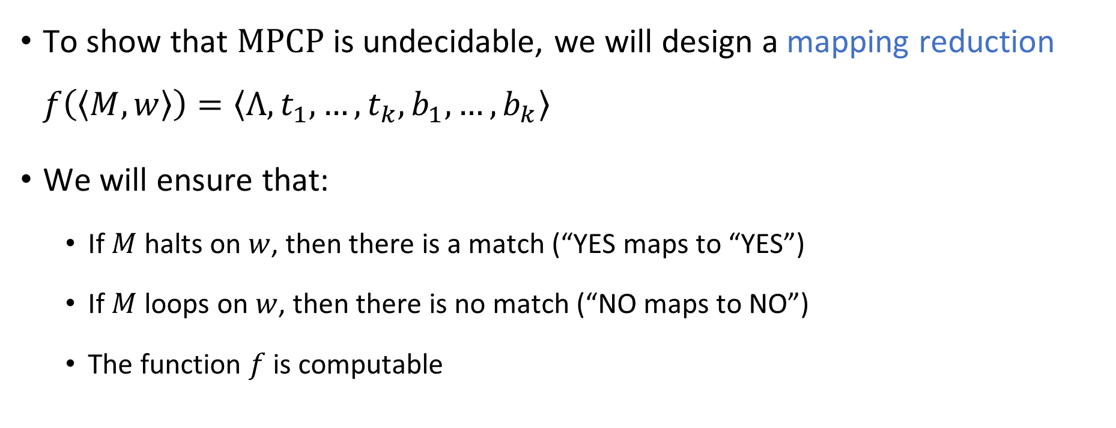

Reduction from $\text{HALT}$ to $\text{MPCP}$
To show that $\text{MPCP}$ is undecidable, we will design a mapping reduction $f\left(\left\langle M,w\right\rangle \right)=\left\langle Λ,t_{1},…, t_{k},b_{1},…, b_{k}\right\rangle$
We will ensure that:
If $M$ halts on $w$, then there is a match (“YES maps to “YES”)
If $M$ loops on $w$, then there is no match (“NO maps to NO”)
The function $f$ is computable

Slide 13
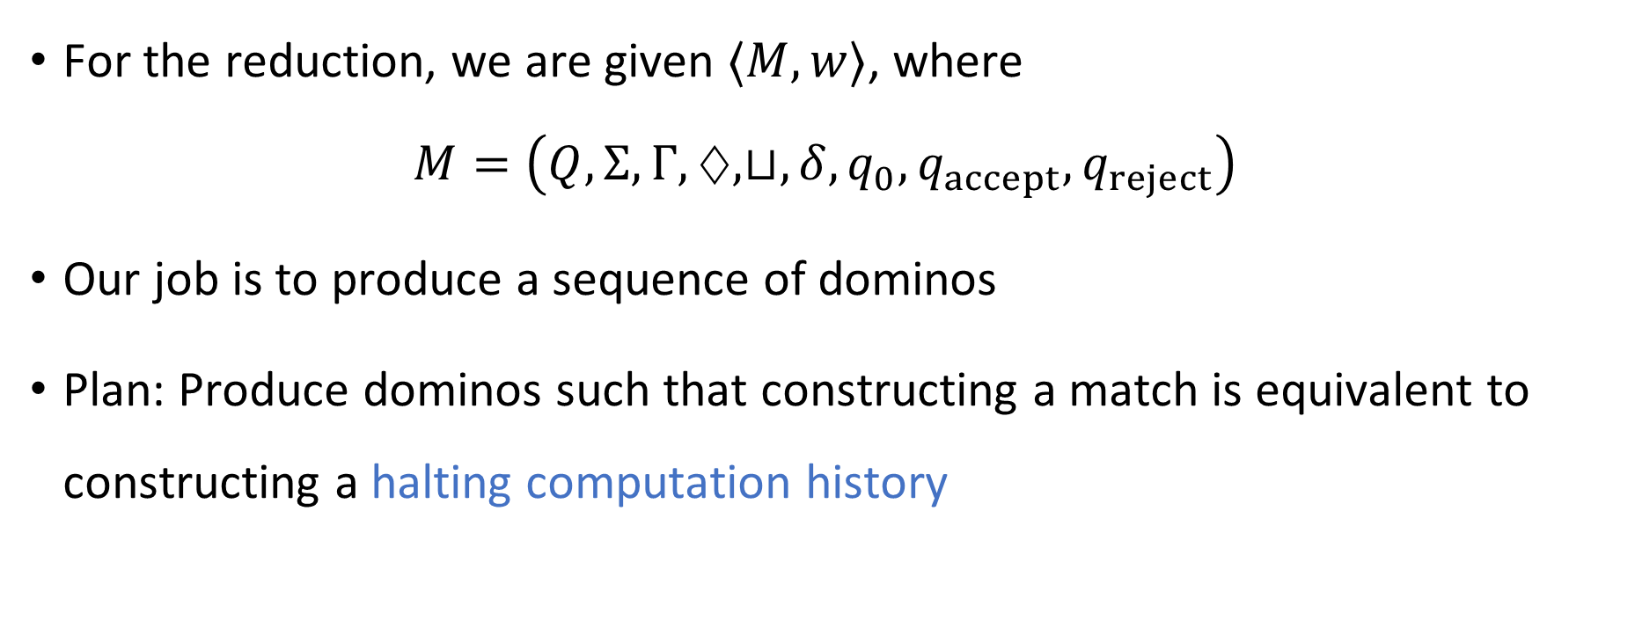

Reduction from $\text{HALT}$ to $\text{MPCP}$
For the reduction, we are given $⟨M,w⟩$, where $M=\left(Q,Σ, Γ,♢,⊔,δ,q_{0},q_{accept},q_{reject}\right)$
Our job is to produce a sequence of dominos
Plan: Produce dominos such that constructing a match is equivalent to constructing a halting computation history

Slide 14


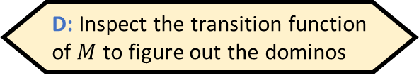



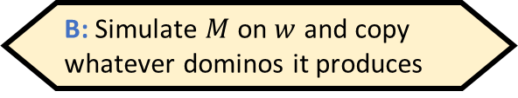
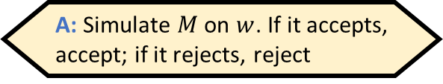



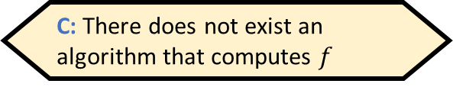



Reduction from $\text{HALT}$ to $\text{MPCP}$
Given $⟨M,w⟩$, how would we compute $f\left(\left\langle M,w\right\rangle \right)$?
A: Simulate $M$ on $w$. If it accepts, accept; if it rejects, reject
B: Simulate $M$ on $w$ and copy whatever dominos it produces
We produce the following dominos:
, , , , and
for every $q,b,q^{′},b′$ such that $δ\left(q,b\right)=(q^{′},b^{′},\text{R})$ and $q∉\left\{q_{accept},q_{reject}\right\}$
for every $q,b,q^{′},b^{′},a$ such that $δ\left(q,b\right)=(q^{′},b^{′},\text{L})$ and $q∉\left\{q_{accept},q_{reject}\right\}$
, , and for every $b∈Γ$ and $q∈\left\{q_{accept},q_{reject}\right\}$
C: There does not exist an algorithm that computes $f$
D: Inspect the transition function of $M$ to figure out the dominos
$$\begin{matrix}\# \\ ⊔\#\end{matrix}$$
$$\begin{matrix}q_{accept}\# \\ ε\end{matrix}$$
$$\begin{matrix}q_{reject}\# \\ ε\end{matrix}$$
$$\begin{matrix}ε \\ ♢q_{0}w⊔\#\end{matrix}$$
$$\begin{matrix}\# \\ \#\end{matrix}$$
Respond at PollEv.com/whoza or text “whoza” to 22333
Reduction is computable ✔️
$$\begin{matrix}qb \\ b^{′}q′\end{matrix}$$
$$\begin{matrix}aqb \\ q^{′}ab′\end{matrix}$$
$$\begin{matrix}b \\ b\end{matrix}$$
$$\begin{matrix}bq \\ q\end{matrix}$$
$$\begin{matrix}qb \\ q\end{matrix}$$

Slide 15

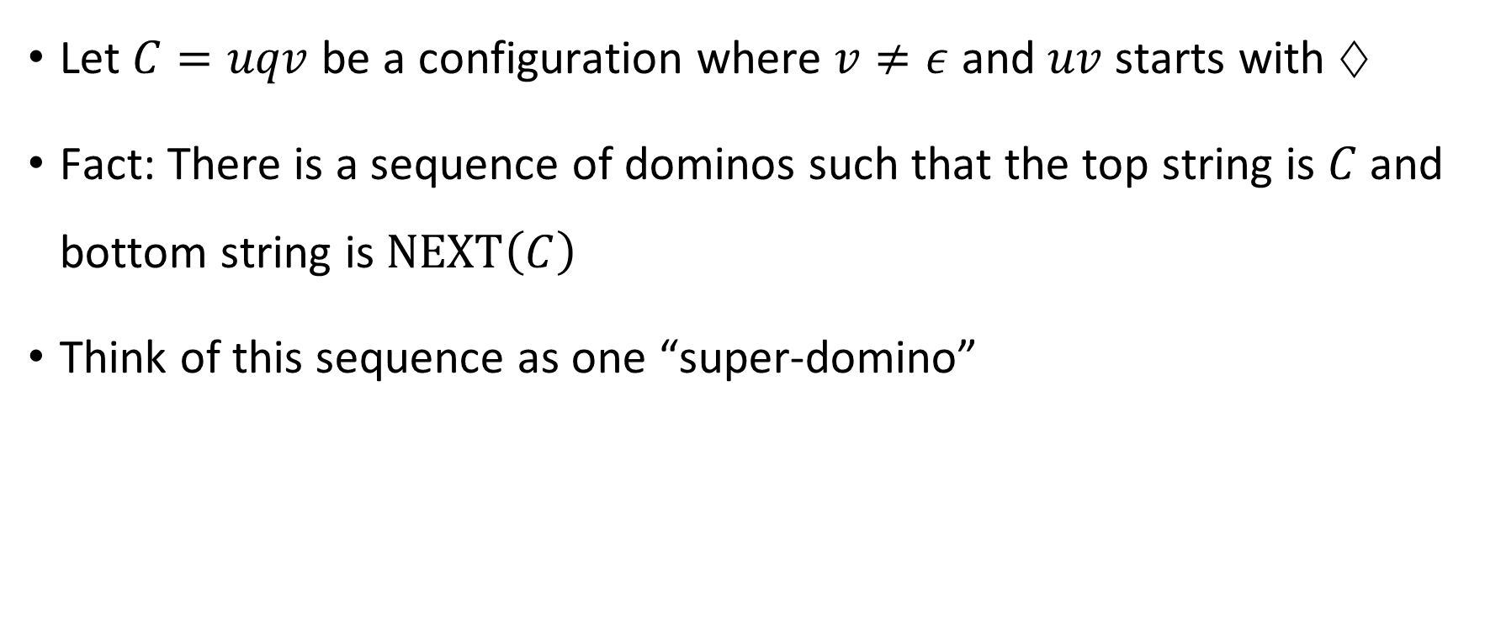
Domino feature 1
Let $C=uqv$ be a configuration where $v≠ε$ and $uv$ starts with $♢$
Fact: There is a sequence of dominos such that the top string is $C$ and bottom string is $\text{NEXT}\left(C\right)$
Think of this sequence as one “super-domino”
$$\begin{matrix}C \\ \text{NEXT}\left(C\right)\end{matrix}$$

Slide 16



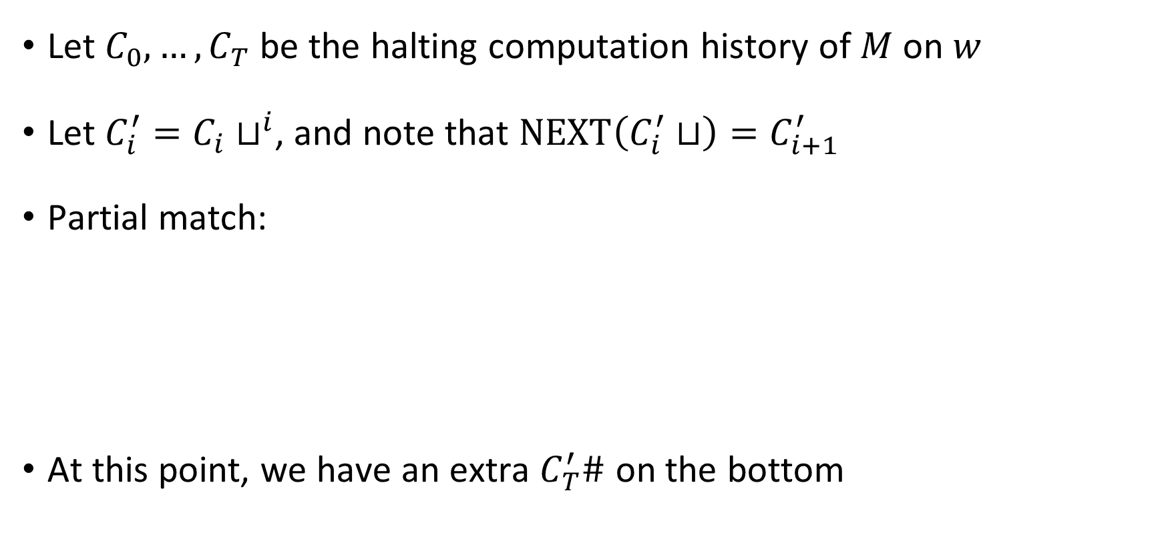






YES maps to YES
Let $C_{0},…, C_{T}$ be the halting computation history of $M$ on $w$
Let $C_{i}^{′}=C_{i}⊔^{i}$, and note that $\text{NEXT}\left(C_{i}^{′}⊔\right)=C_{i+1}^{′}$
Partial match:
At this point, we have an extra $C_{T}^{′}\#$ on the bottom
$$\begin{matrix}ε \\ ♢q_{0}w⊔\#\end{matrix}$$
$$\begin{matrix}C_{0}^{′}⊔ \\ C_{1}^{′}\end{matrix}$$
$$\begin{matrix}\# \\ ⊔\#\end{matrix}$$
$$\begin{matrix}C_{1}^{′}⊔ \\ C_{2}^{′}\end{matrix}$$
$$\begin{matrix}\# \\ ⊔\#\end{matrix}$$
$$\begin{matrix}\# \\ ⊔\#\end{matrix}$$
$$\begin{matrix}C_{T−1}^{′}⊔ \\ C_{T}^{′}\end{matrix}$$
$$\begin{matrix}\# \\ \#\end{matrix}$$
$$⋯$$

Slide 17

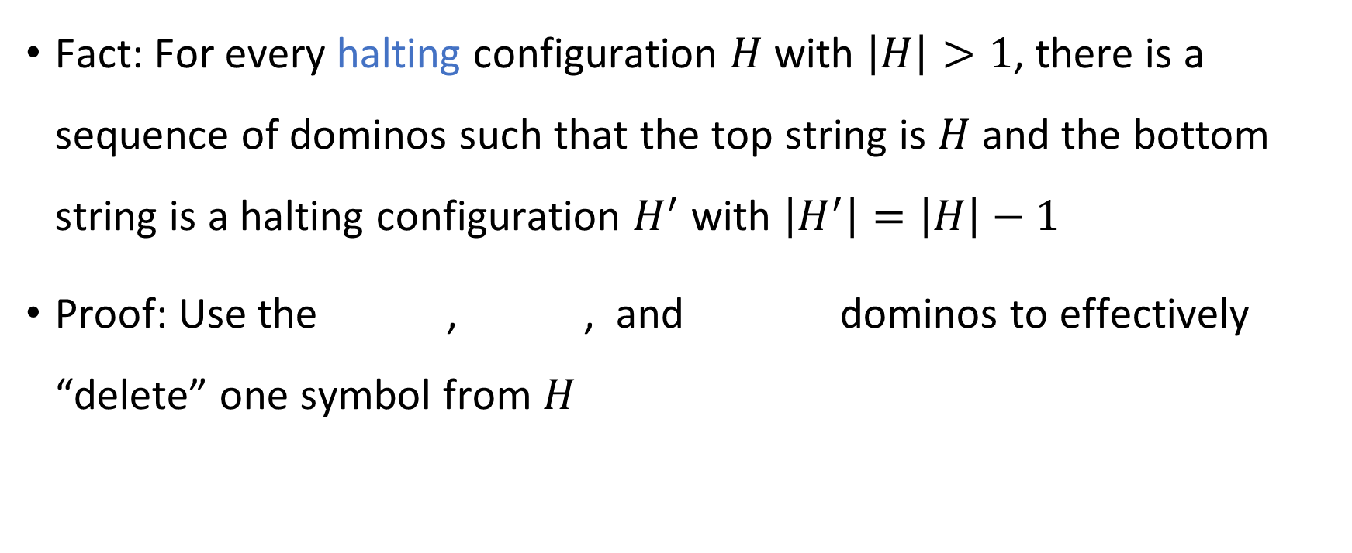



Domino feature 2
Fact: For every halting configuration $H$ with $\left|H\right|>1$, there is a sequence of dominos such that the top string is $H$ and the bottom string is a halting configuration $H^{′}$ with $\left|H^{′}\right|=\left|H\right|−1$
Proof: Use the , , and dominos to effectively “delete” one symbol from $H$
$$\begin{matrix}H \\ H′\end{matrix}$$
$$\begin{matrix}b \\ b\end{matrix}$$
$$\begin{matrix}bq \\ q\end{matrix}$$
$$\begin{matrix}qb \\ q\end{matrix}$$

Slide 18








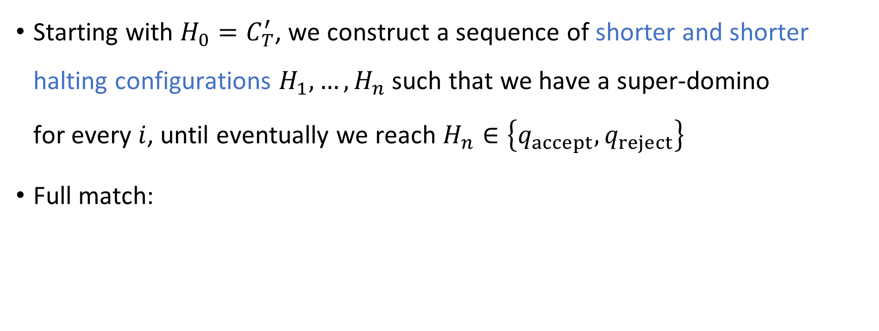











YES maps to YES
Starting with $H_{0}=C_{T}^{′}$, we construct a sequence of shorter and shorter halting configurations $H_{1},…, H_{n}$ such that we have a super-domino for every $i$, until eventually we reach $H_{n}∈\left\{q_{accept},q_{reject}\right\}$
Full match:
$$\begin{matrix}H_{i−1} \\ H_{i}\end{matrix}$$
$$\begin{matrix}ε \\ ♢q_{0}w⊔\#\end{matrix}$$
$$\begin{matrix}C_{0}^{′}⊔ \\ C_{1}^{′}\end{matrix}$$
$$\begin{matrix}\# \\ ⊔\#\end{matrix}$$
$$\begin{matrix}C_{1}^{′}⊔ \\ C_{2}^{′}\end{matrix}$$
$$\begin{matrix}\# \\ ⊔\#\end{matrix}$$
$$\begin{matrix}\# \\ ⊔\#\end{matrix}$$
$$\begin{matrix}C_{T−1}^{′}⊔ \\ C_{T}^{′}\end{matrix}$$
$$\begin{matrix}\# \\ \#\end{matrix}$$
$$\begin{matrix}H_{0} \\ H_{1}\end{matrix}$$
$$\begin{matrix}\# \\ \#\end{matrix}$$
$$\begin{matrix}H_{1} \\ H_{2}\end{matrix}$$
$$\begin{matrix}\# \\ \#\end{matrix}$$
$$\begin{matrix}\# \\ \#\end{matrix}$$
$$\begin{matrix}H_{n−1} \\ H_{n}\end{matrix}$$
$$\begin{matrix}\# \\ \#\end{matrix}$$
$$\begin{matrix}H_{n}\# \\ ε\end{matrix}$$
$$⋯$$
$$⋯$$

Slide 19

NO maps to NO
Suppose $M$ loops on $w$. Let $C_{0},C_{1},C_{2},…$ be the computation history of $M$ on $w$ (an infinite sequence of configurations)
Assume, for the sake of contradiction, that there is a match

